Slide 1
Catheter Rotation Measuring Device
Madison Burke | Savannah Buro | Amari Deleon | Christopher Hayot
Alberto Villacrez | Jake Anthony Vickers
Notes:
Customize your title slide to be appealing to the audience. This is the first thing they see apply some graphic design elements that may summarize your presentation.

Slide 2
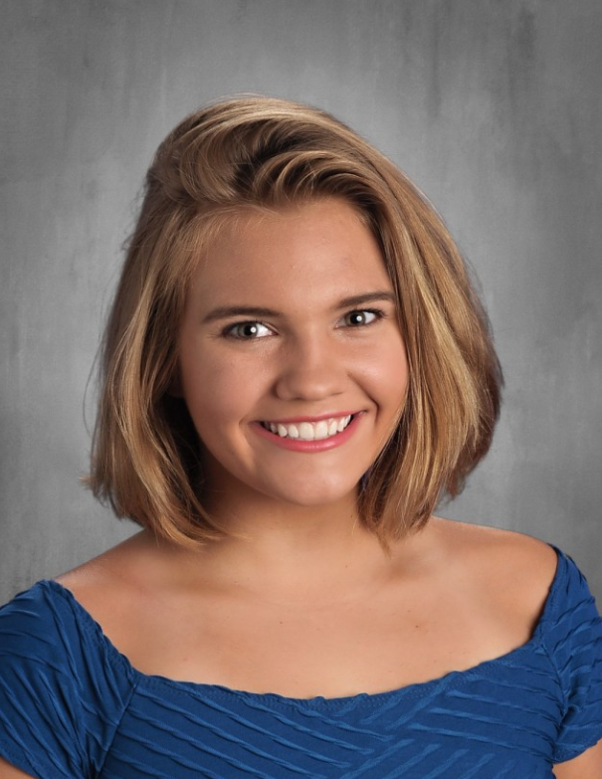
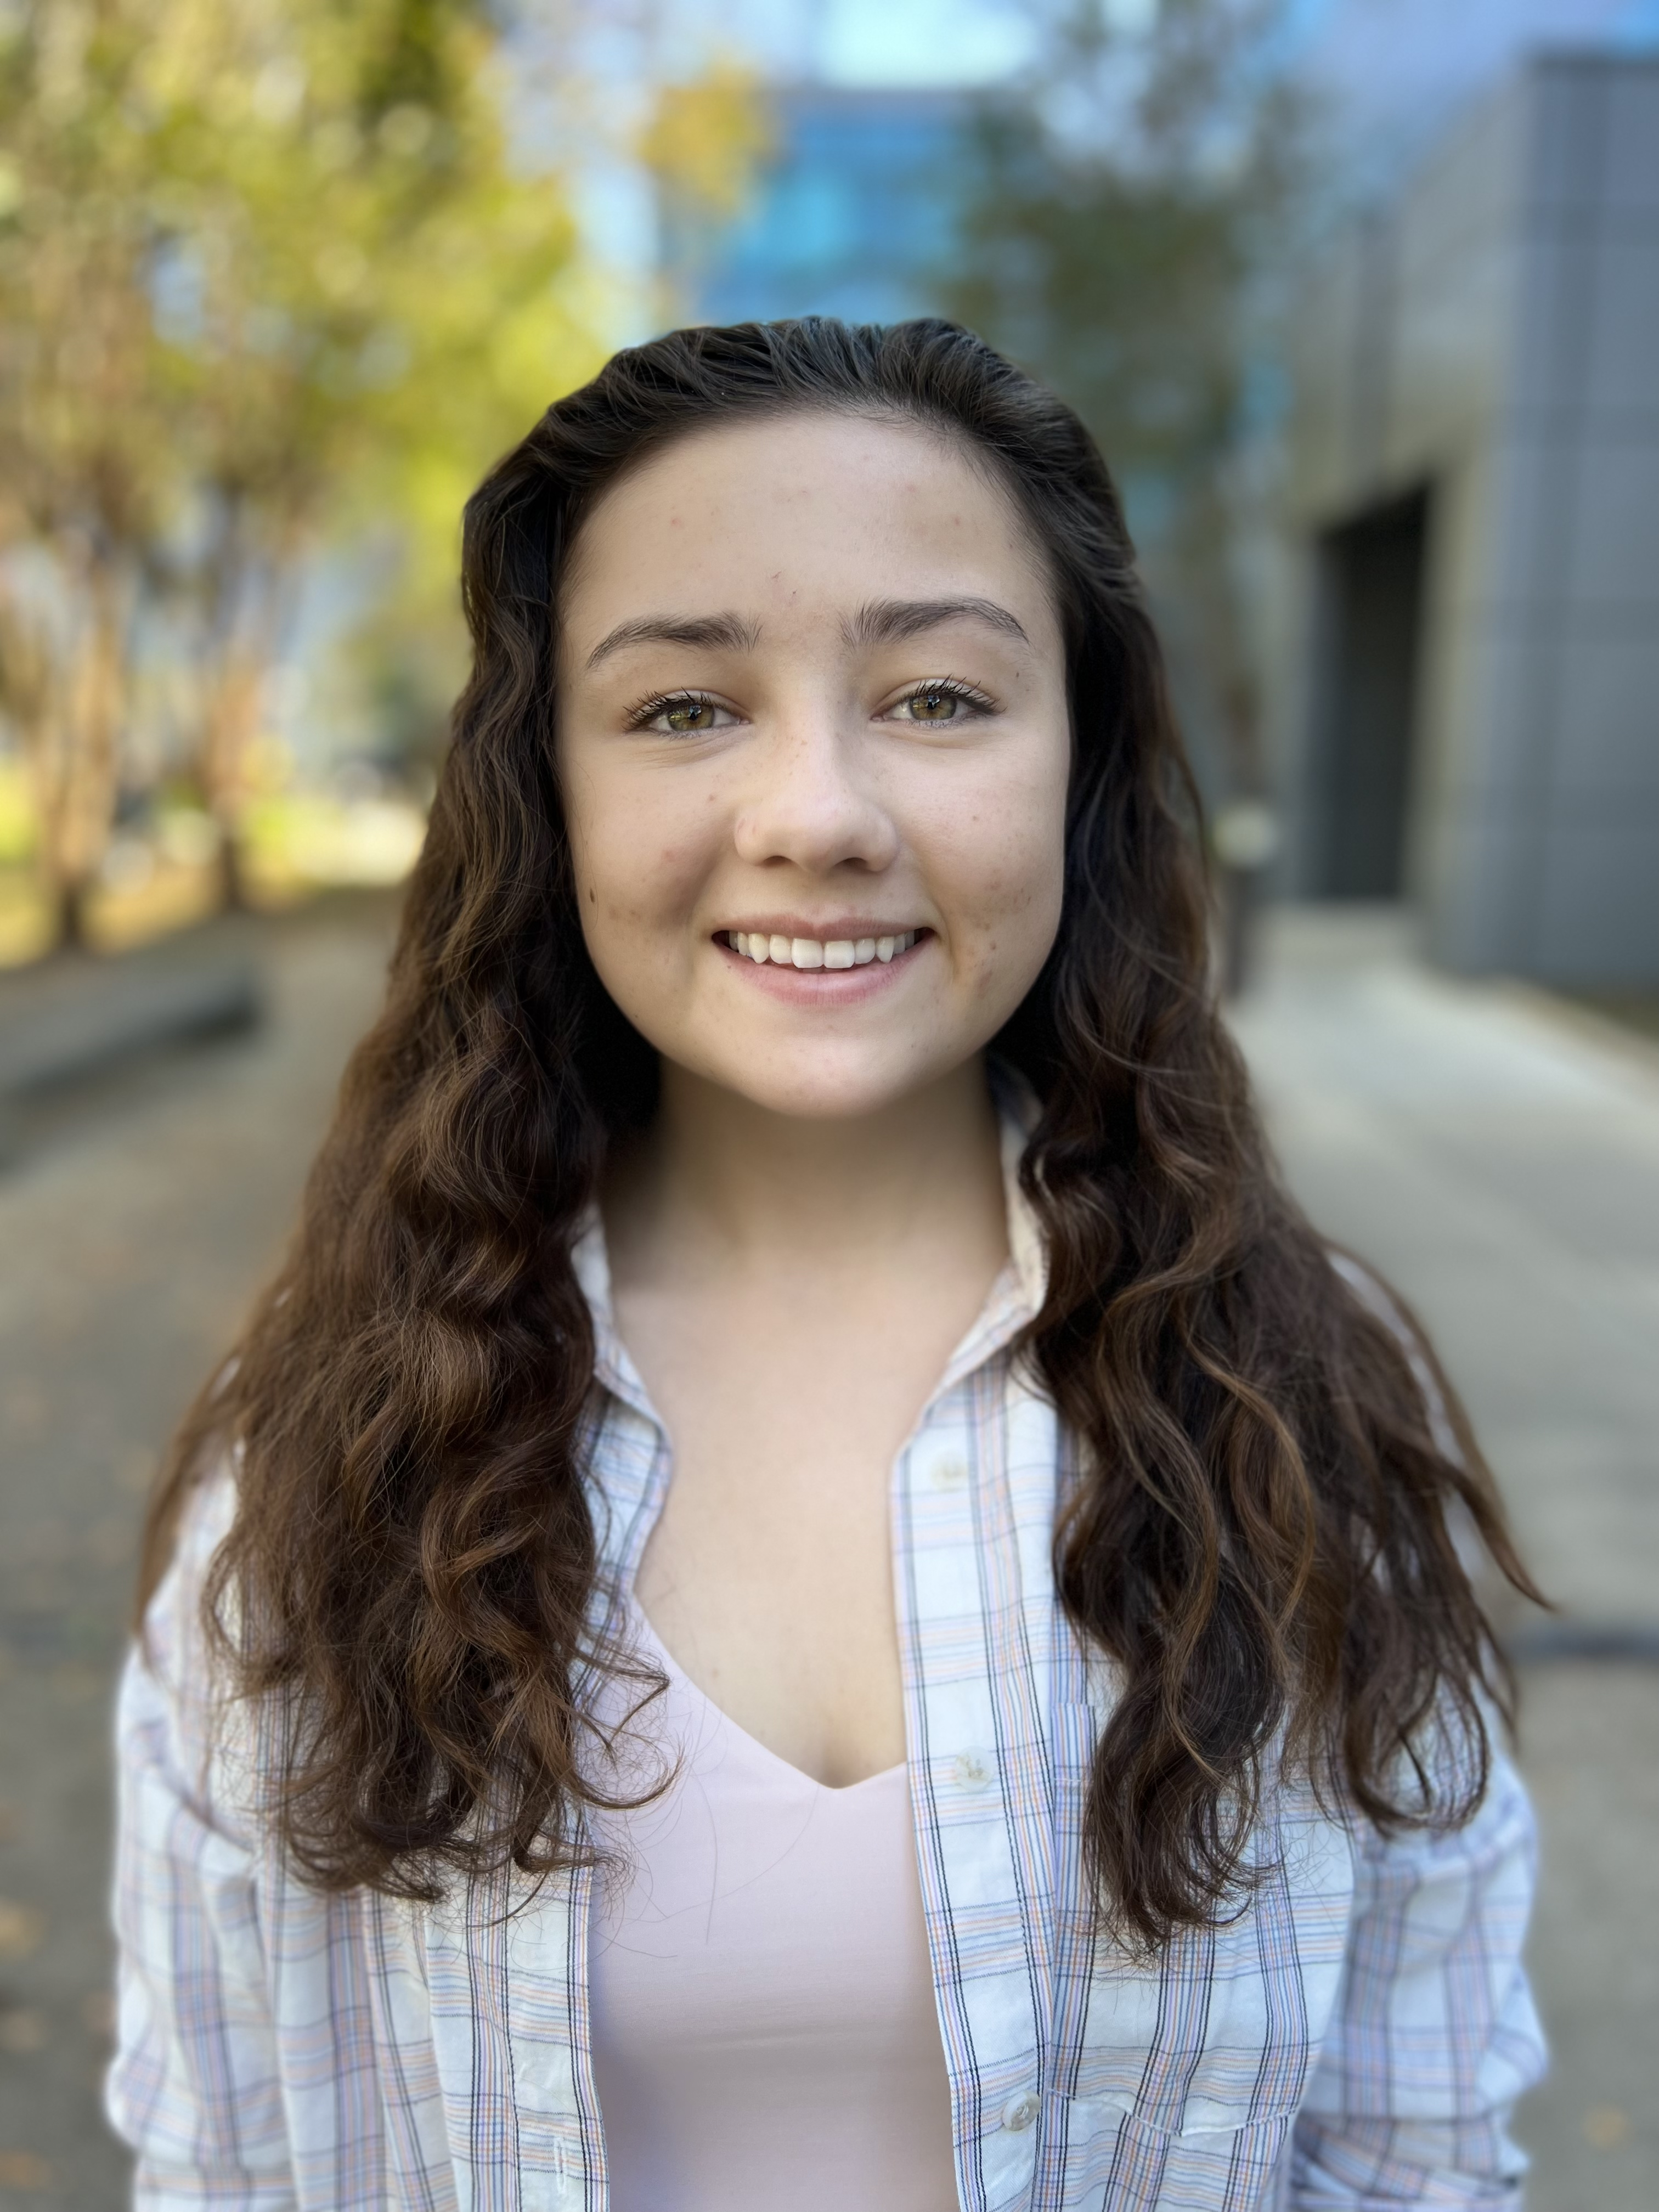
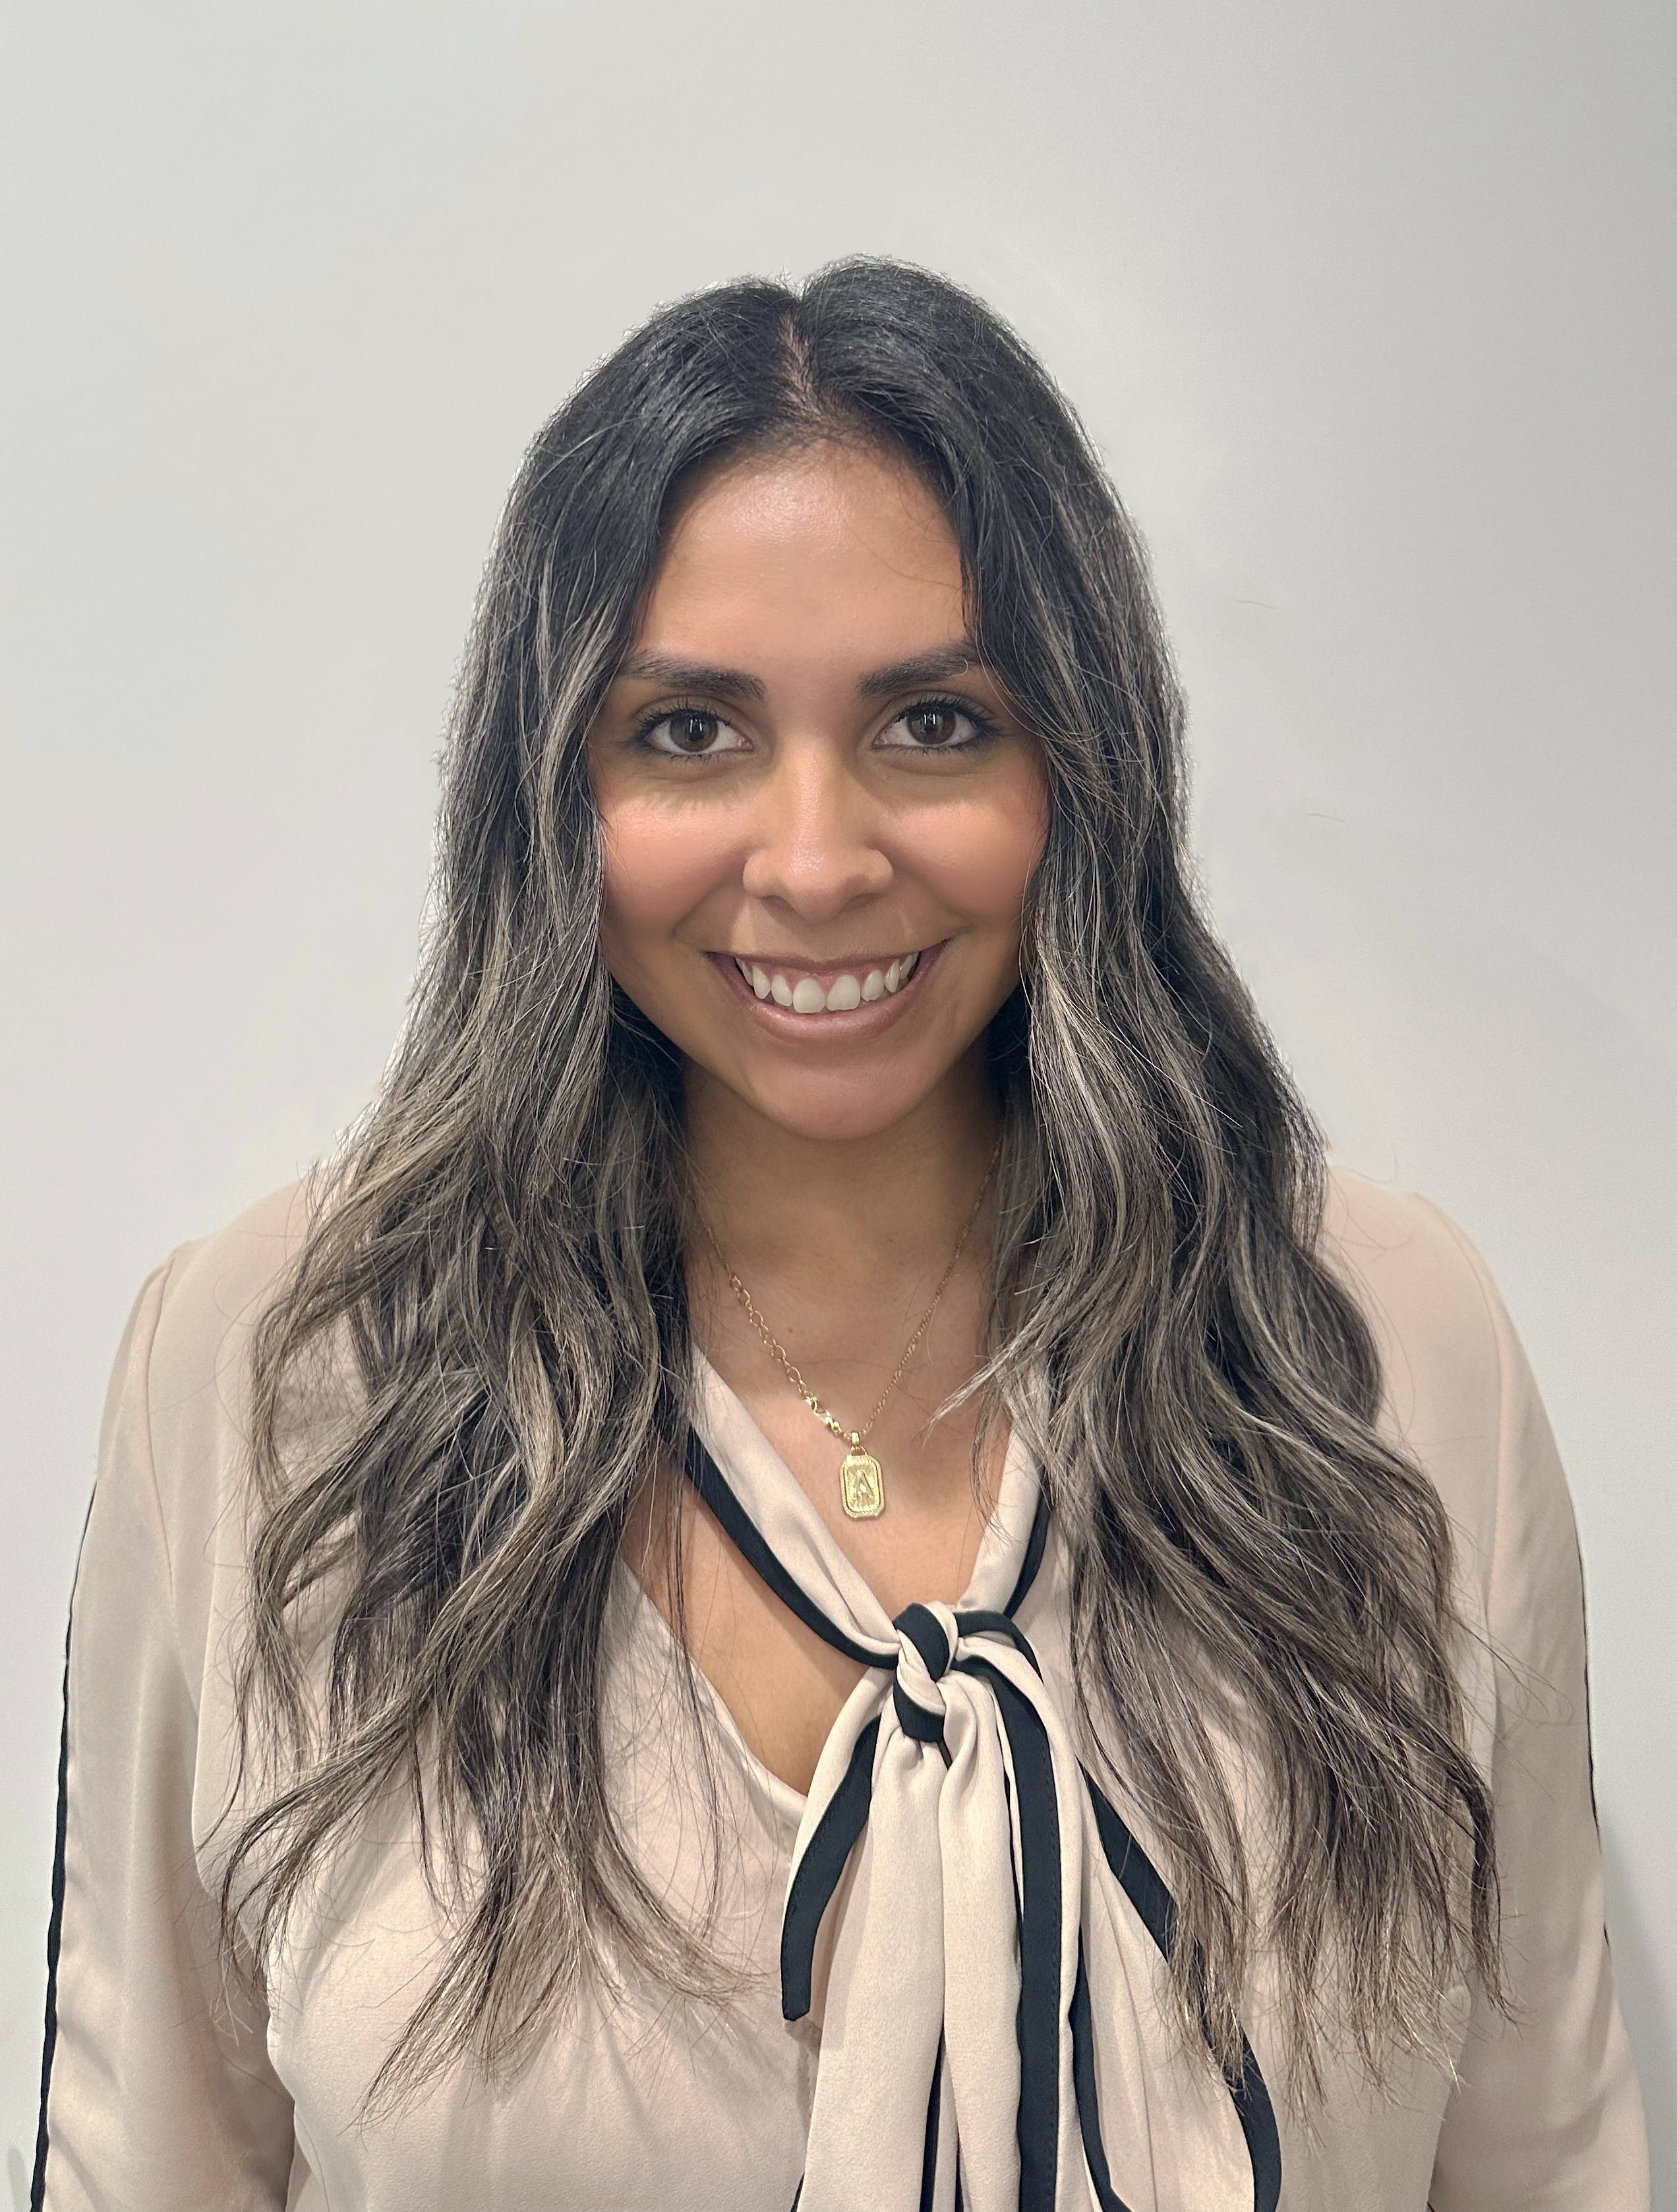
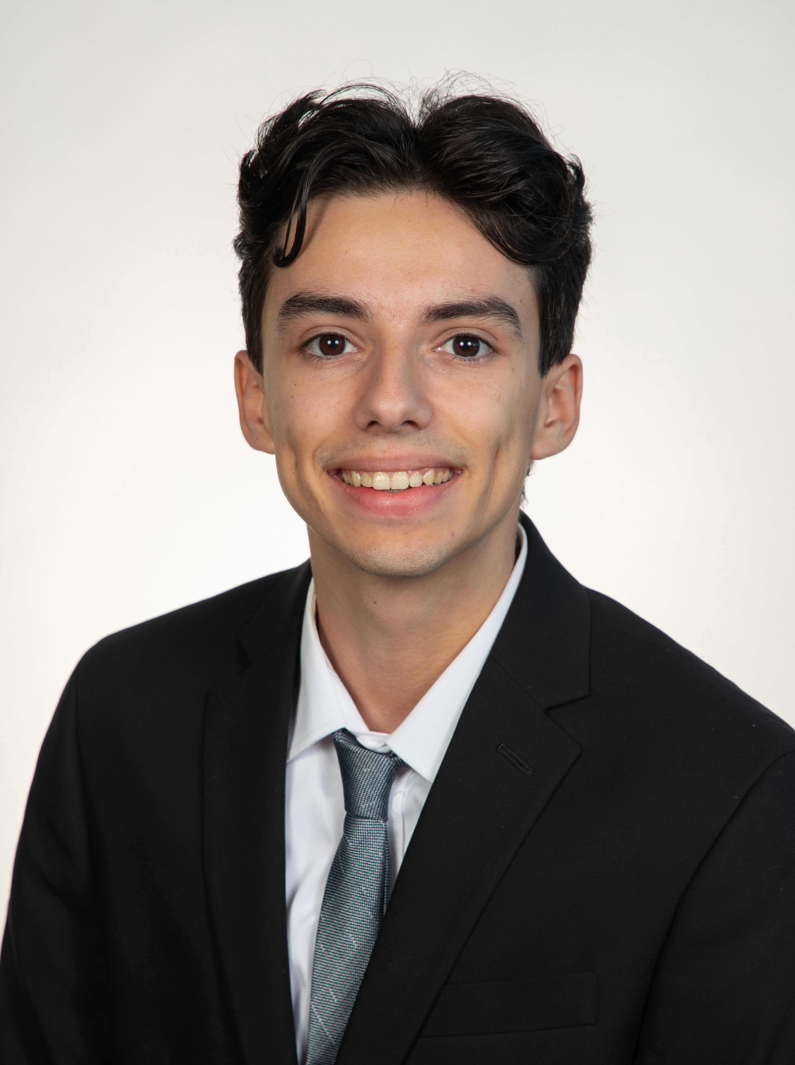
Team Members
Madison Burke
Savannah Buro
Amari Deleon
Christopher Hayot
Alberto Villacrez
Jake Vickers
Software & Quality Engineer
(BME)
Biomaterials & Testing Engineer
(BME)
Biomaterials & Quality Engineer
(BME)
Software & Design Engineer
(BME)
Bioinstrumentation Engineer
(BME)
Systems & Testing Engineer
(ME)
Departments of Mechanical & Biomedical Engineering

Slide 3
Sponsors & Advisors
Chuck Lindholm
Biosense Webster
Amar Patel
Biosense Webster
Dharani
Balakumar
Biosense Webster
Dr. Stephen Arce
FAMU-FSU
Dept. of CBE
Departments of Mechanical & Biomedical Engineering
Notes:
SOMEBODY WHO SPEND MONEY AND TIME

Slide 4
Project Description
To design and construct a measuring device that confirms the rotational relationship between a cardiac catheter’s handle and tip, allowing design engineers and physicians increased control precision.
Handle
(Proximal End)
Tip
(Distal End)
Departments of Mechanical & Biomedical Engineering

Slide 5
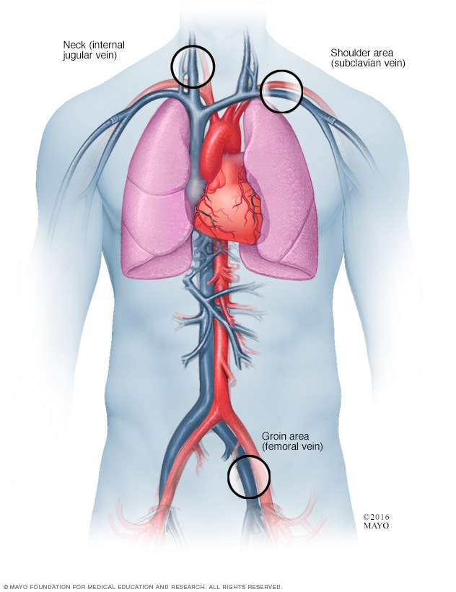
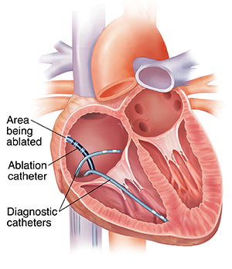
Cardiac Catheter Background
Catheter Insertion Sites
Departments of Mechanical & Biomedical Engineering
Notes:
Uses for Cardiac Catheter and why our device is need.
Where does is go, what does it do, how does it work, why we need . Copper wire anaolgy

Slide 6
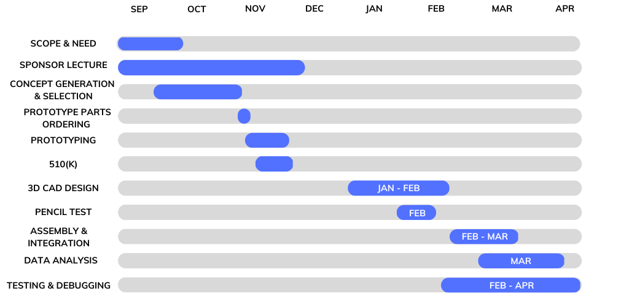
Progress
Departments of Mechanical & Biomedical Engineering

Slide 7
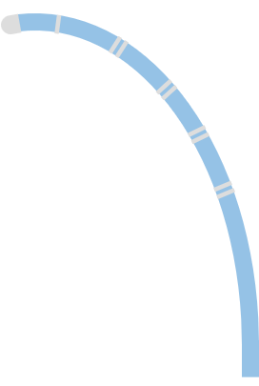
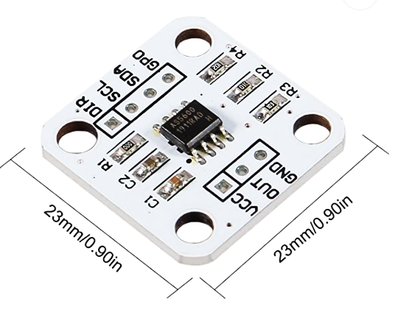
Initial Design
Baseboard
LCD Display
Magnetic Encoder Module
MASACath
Handle Angle: 65.1 deg
Tip Angle: 43.2 deg
Arduino
Magnet Tube
Arduino
Magnet
Guiding Tube
IMU Module
Rigid Track
AS5600
Departments of Mechanical & Biomedical Engineering

Slide 8
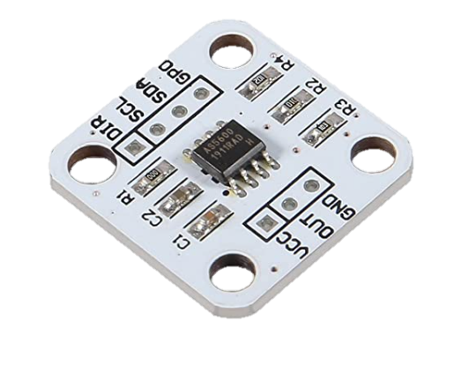
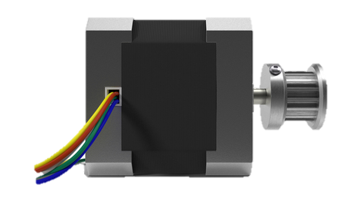
UI Display
Plexiglass Cover
Peg Holes
Wood Baseboard
Arduino
IMU
Guiding Tube
Sheath
Motor
Tip
Handle
Clamps
Rigid Supports
Departments of Mechanical & Biomedical Engineering

Slide 9
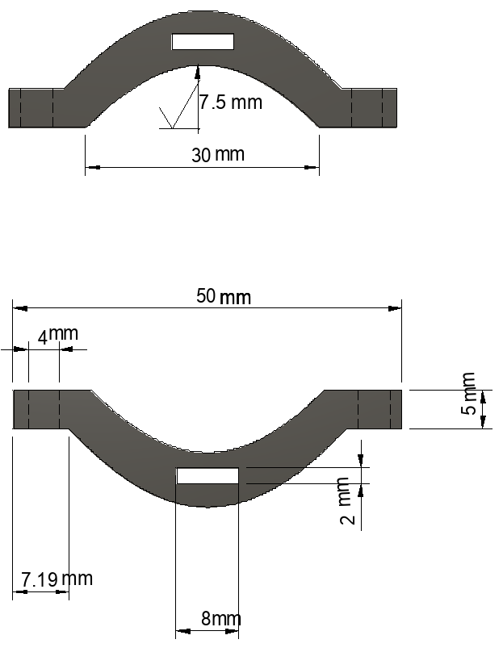
Handle Module
IMU (Internal Measurement Unit)
Measures input rotation from stepper motor
Motor
NEMA 17 Stepper Motor
Reads & outputs rotation, defined by operator
Clamps
Connects motor shaft, IMU, and handle as rigid body
Two points of contact with handle
M3 screws & washers
Slots hold stepper motor attachment
IMU mounted on top
IMU
Stepper Motor
Handle
Departments of Mechanical & Biomedical Engineering

Slide 10
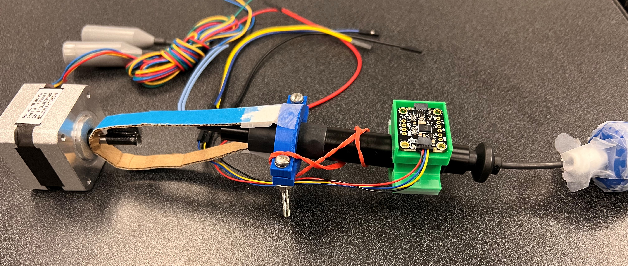
Handle Module
Purpose: To provide a set input rotation to use as a reference for measured tip rotation.
IMU
Motor
Clamps
Departments of Mechanical & Biomedical Engineering

Slide 11
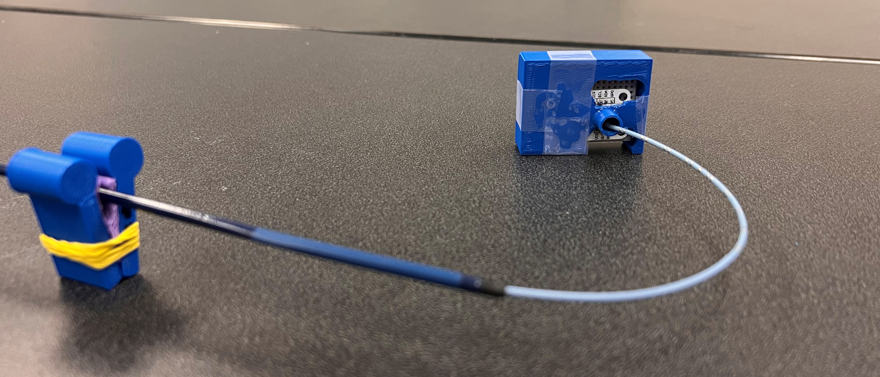
Tip Module
Magnetic Encoder
Measures rotation translated from the handle
Locking mechanism to prevent catheter from slipping out
Magnet Tube
Guiding Tube
Magnet
Magnet Tube
Magnet
Guiding Tube
Locking
Mechanism
Tight Fit
Magnetic
Encoder
Departments of Mechanical & Biomedical Engineering

Slide 12
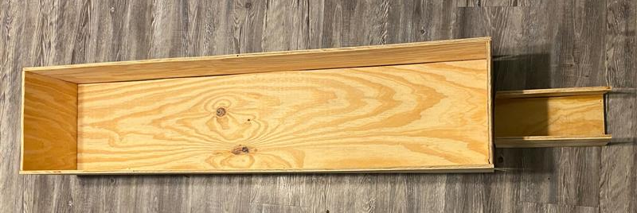
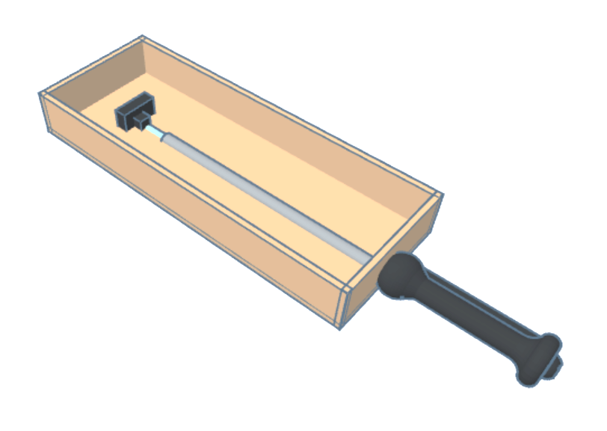
Environment Module
Test Enclosure
Rigid box with sliding plexiglass lid
Enclosure for environmental control
Baseboard has peg holes for easy setup between different orientations
Current Enclosure Build
Departments of Mechanical & Biomedical Engineering

Slide 13
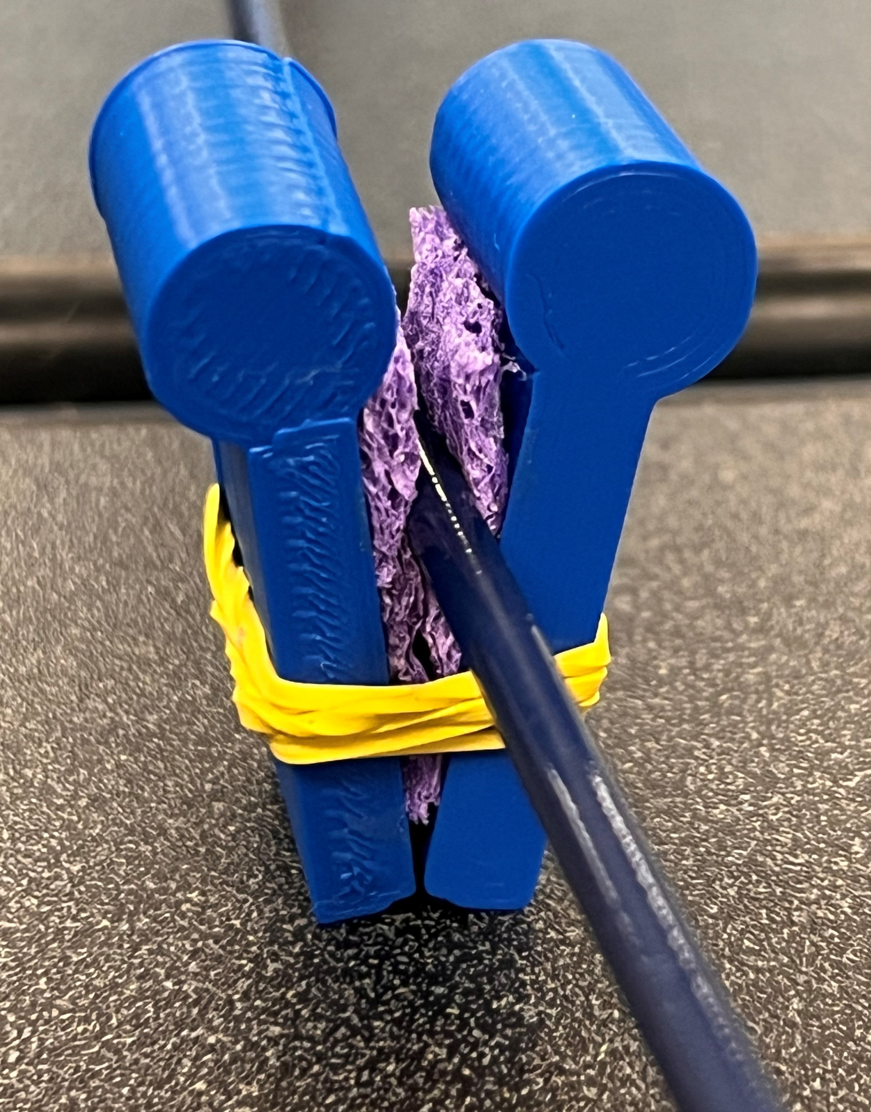
Environment Module
Component Interfaces
Catheter guided through the sheath, with tip free to move at end.
Sheath is guided through rigid frame attached to baseboard.
Sheath
Sheath
Catheter
Catheter
“Vein”
“Vein”
Peg Hole
Peg Hole
Side View of Interface Connection
Cross-Section of V mount
Cross-Section of Tube Shaft
Departments of Mechanical & Biomedical Engineering

Slide 14
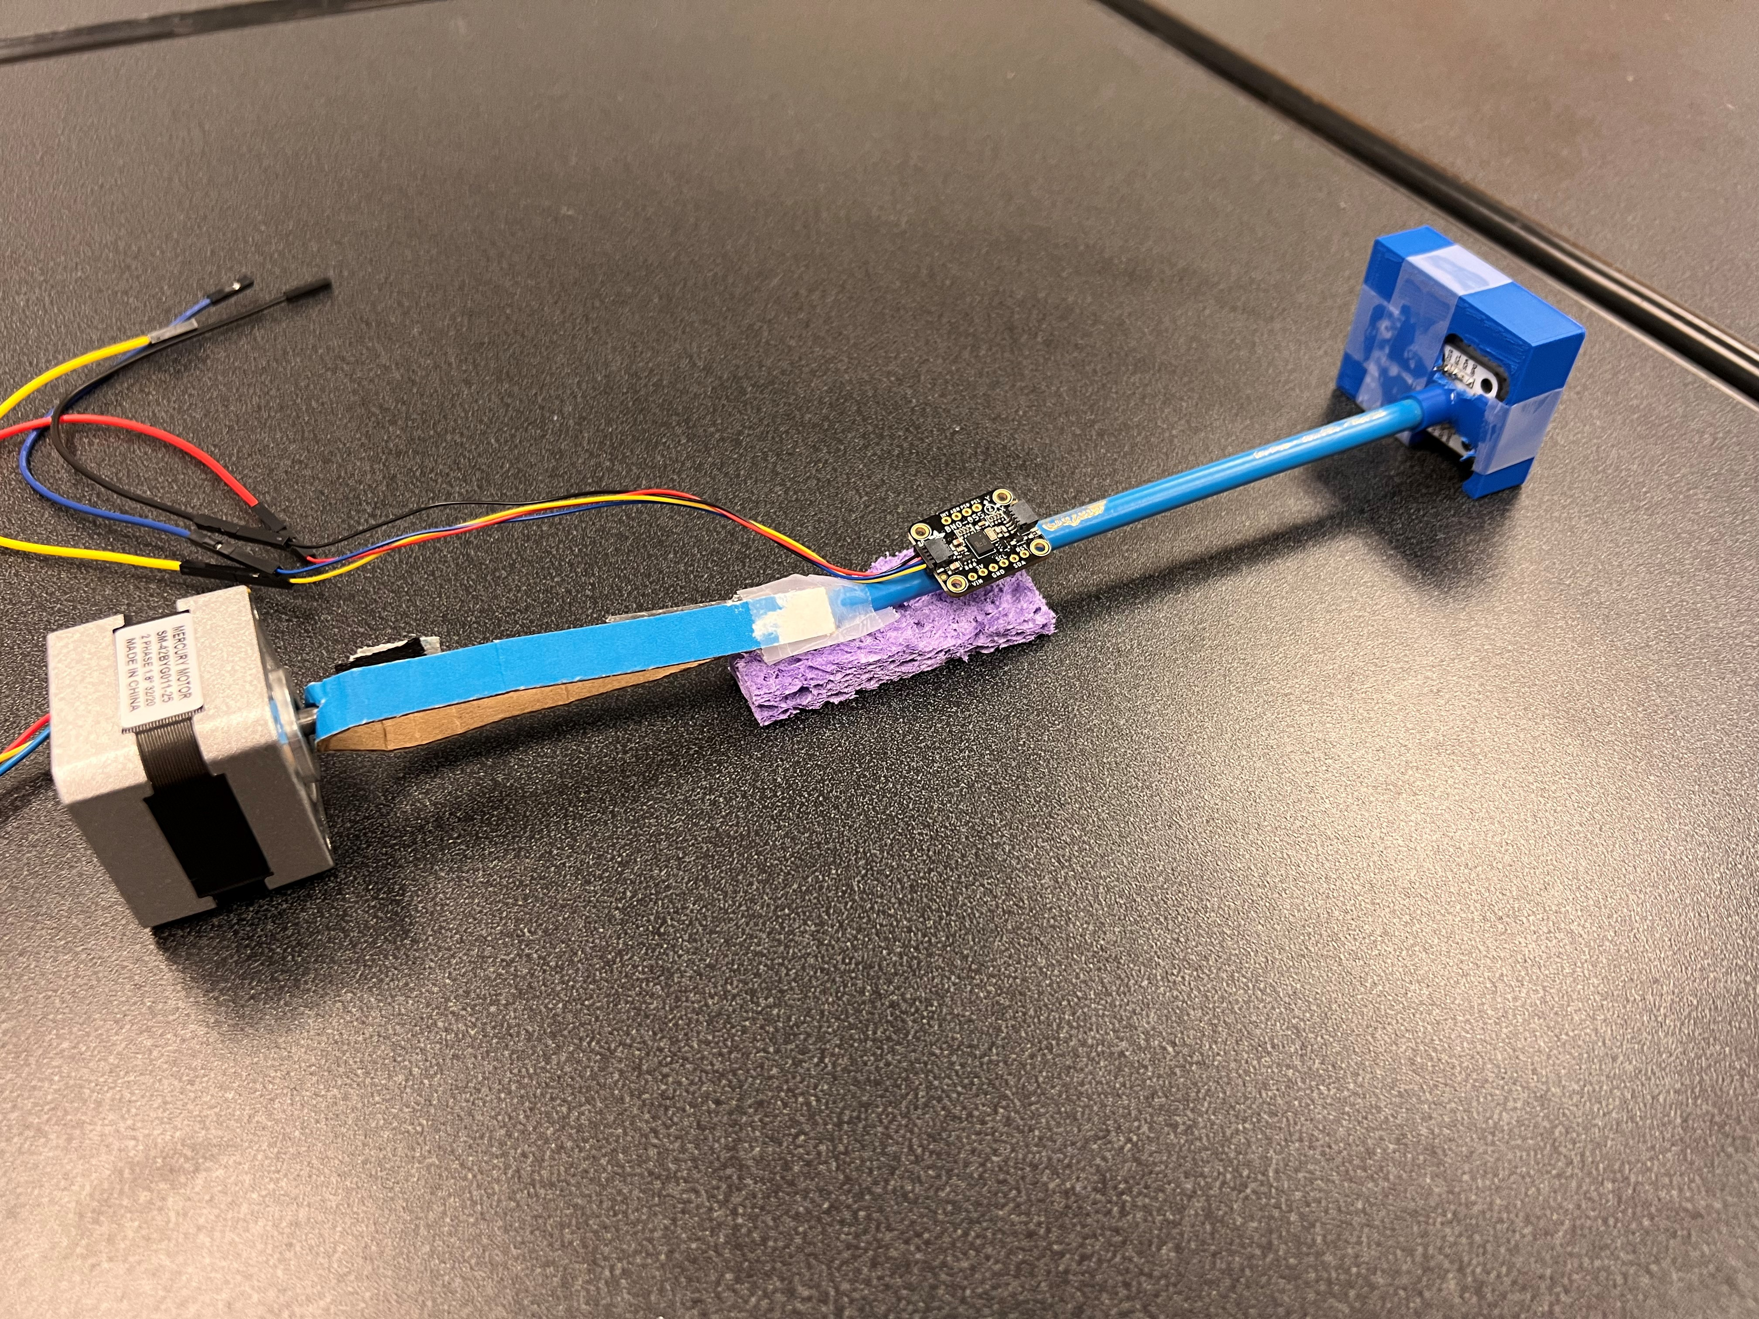
Benchmark Testing Schedule
Pencil Test
Purpose:
Verify handle & tip sensors are properly calibrated
Method:
Treat catheter as a rigid body
Perform 5+ measurements
Expected Result:
1:1 rotation translation between two ends
Departments of Mechanical & Biomedical Engineering

Slide 15
Benchmark Testing Schedule
Computer Vision Validation
Purpose:
Validate tip sensor design choice
Method:
Perform “Pencil Test” but with computer vision MATLAB analysis at tip end
Using “PENTAWAY” catheter, mark each tip with a different color for observation
Expected Results:
Accuracy of: MATLAB angle reading ≤ magnetic encoder
Gage R&R Study
Purpose:
Validate repeatability and reproducibility
Test setup constraints & measurement system are accurate and precise
Method: “Crossed GR&R Study”
3 operators, 1 catheter
5+ orientation measurements
Expected Results:
<10% variation of measured angle between operators & orientations
Departments of Mechanical & Biomedical Engineering

Slide 16
Current Work & Issues
Testing Design
CAD Design
Environment Simulation
Construction of Pencil Test setup
Benchmarks of successful test
Computer vision programming
Handle & motor clamps
Tip & UI module housings
“Vein” structure
Enclosure & Pegboard Modeling
Enclosure Temperature control
Vein/sheath pressure simulation
Addition of fluid between sheath and vein structure
Departments of Mechanical & Biomedical Engineering

Slide 17
Project Description
To design and construct a measuring device to confirm the rotational relationship between cardiac catheters’ handle and tip ends, allowing physicians and design engineers to increase control precision.
Handle
Tip
Electrodes
Departments of Mechanical & Biomedical Engineering

Slide 18
Background
Project Scope
510(k) Proposal
Functional Decomp & Targets
Aug-Sep
Oct
Nov-Dec
Customer Needs
Concept Generation & Selection
Prototyping & Validation Testing
Departments of Mechanical & Biomedical Engineering

Slide 19
Progress
Departments of Mechanical & Biomedical Engineering

Slide 20
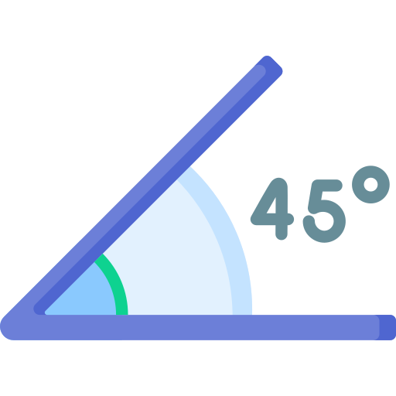
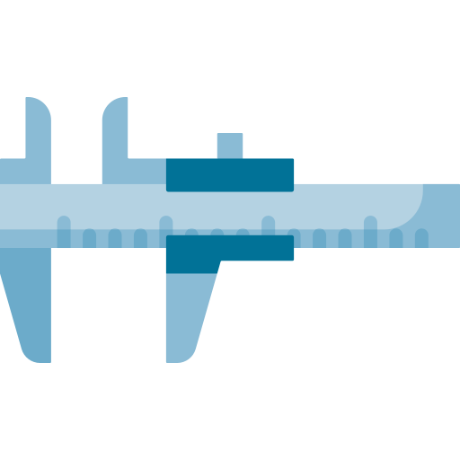
Customer Needs
Raw Data Gathering
Need Statements
1
2
Surgeons Designers
3
4
Need Interpretation
Reflection on
Results & Process
Angle Accuracy Analysis
Departments of Mechanical & Biomedical Engineering
Notes:
What is the current problem for the catheter?
What do you expect the device to do?
Dynamic process of identifying customer need
Raw Data Gathering
Weekly lectures
Cardiac ablation lab
Surgery Shadowing
Need statement
Doctors: It bothers me that when I rotate the catheter handle, the tip doesn’t rotate the same amount. I want to know the angle of rotations.
Designers: We want to have a device to measure the rotational angle of the catheter tip/handle so that we could determine why the current translation is not direct and use it in the development process of catheters.
Controls are precise
Results are reliable
Easy to install and use
Interpret needs
The device measures rotation angles of the catheter tip/handle.
The device can be used for testing purpose.
The device can be used to explore relationships between catheter tip and handle rotations.
The device can produce reliable results and can be precisely controlled.
TO know the rotation angle, to have accuracy, and to analyze the relationship

Slide 21
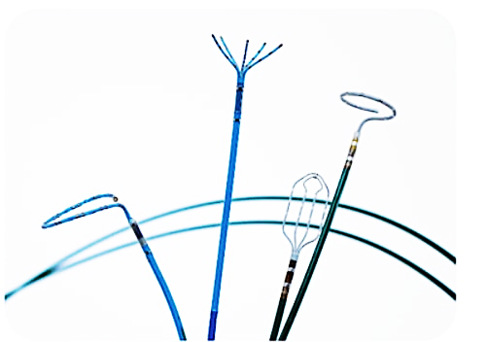
Key Goals
Quantifiable measuring
system
Accurate
± 1 degree
minimum accuracy
Repeatable
Withstands
multiple uses
Translatable across different types of catheters and operators
Departments of Mechanical & Biomedical Engineering

Slide 22
Assumptions
1
Biosense
Webster
Device is suitable for only one catheter at a time.
Catheters are assumed to be manufactured by Biosense Webster.
Device not used inside human body
Departments of Mechanical & Biomedical Engineering

Slide 23
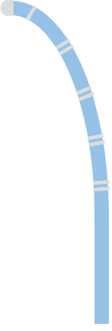
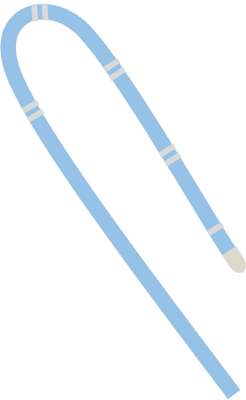
Catheter Motion
Tip Deflection
Tip Deflection
Body Rotation
Body Rotation
Linear Translation
Linear Translation
Departments of Mechanical & Biomedical Engineering
Notes:
Before we introduce functional decomp, let’s take a look at how catheter works

Slide 24
Functional Decomposition
Ease of Use
Measurement
User
System
Sensors
Controls
21.CFR.820
Departments of Mechanical & Biomedical Engineering

Slide 25
Critical Targets
Ease of Use
User
System
Simple Test Procedure
< 10 minutes to completion
Automatic Data Processing
~2 minutes
Interactable User Interface
Digital Display
Formatted Results
Easily Accessible
Length doesn’t exceed longest catheter by > 5 inches
Mounted on top of common surface
Compatible with varying Catheter Models
< 5 setup steps needed to change between models
Measurement
Departments of Mechanical & Biomedical Engineering

Slide 26
Critical Targets
Ease of Use
Sensors
Controls
21.CFR.820
Measure Tip Deflection
resolution w/in ± 1mm
Measure Shaft Rotation & Bend
resolution w/in ± 1 degree
Separates Proximal & Distal Ends
2 Sensor Systems
Compare Proximal & Distal End Data
Microcontroller
Error Analysis
Noise Controller
Simulates In Vitro Environment
Sheath Diameter < 1 mm + Vein Diameter
Quality Schedule
Re-Calibration: > 6 months
Sterilization: after every use
Measurement
Departments of Mechanical & Biomedical Engineering

Slide 27
Concept Generation
Catheter Measuring Device
Physical Quantity Input
Signal Output
Angle
Torque
External Search
Internal Search
Engineer Experts
Catheter Patents
Benchmarking
Individual Brainstorming
Team collaboration
Departments of Mechanical & Biomedical Engineering

Slide 28
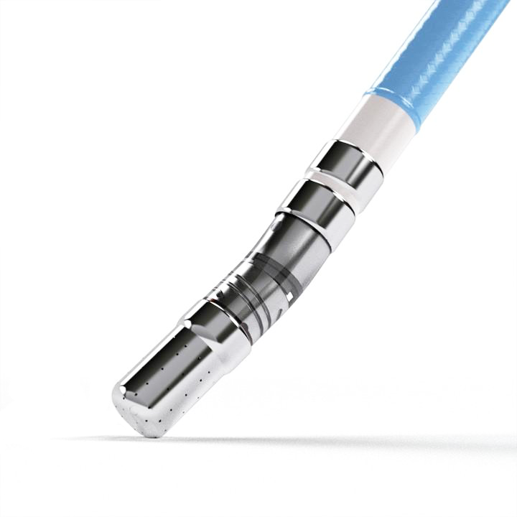
High Fidelity
Departments of Mechanical & Biomedical Engineering

Slide 29
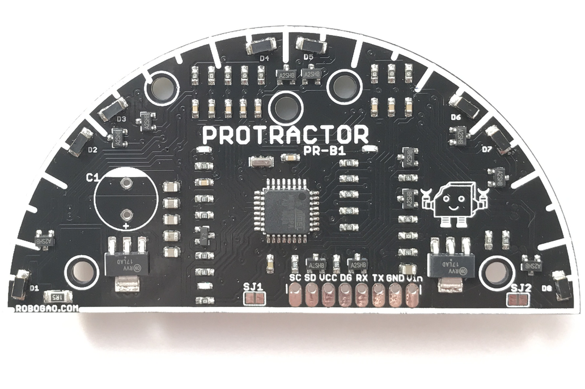
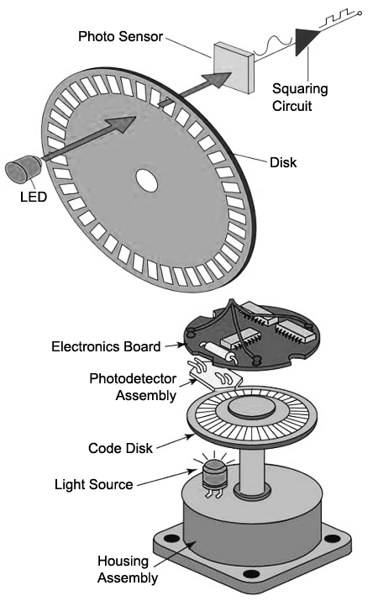
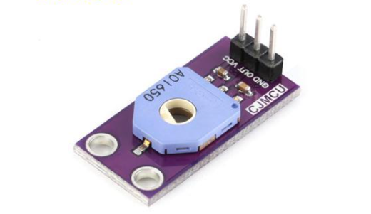
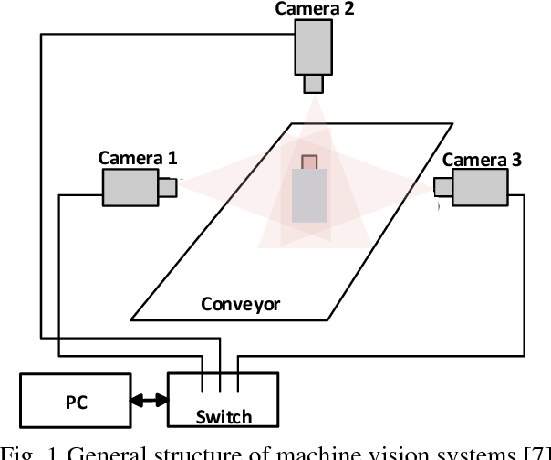
Rotary Angle Sensor
Proximity Sensor
Computer Vision
Optical Encoder
Departments of Mechanical & Biomedical Engineering

Slide 30
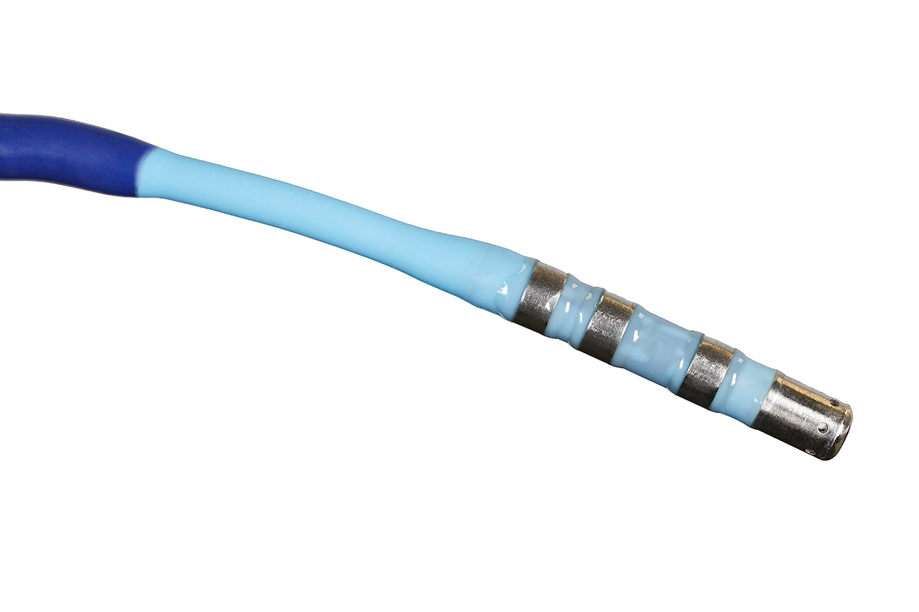
Medium Fidelity
Departments of Mechanical & Biomedical Engineering

Slide 31
CATHerine
Servo
Motor
Torque
Meter
Rigid Track
Custom Connector
Arduino
Polyurethane
Sheath
Departments of Mechanical & Biomedical Engineering

Slide 32
Sauron
LCD Display
MASACath
Handle Angle: 65.1 deg
Tip Angle: 43.2 deg
Magnetic Encoder Module
Arduino
Arduino
IMU Module
Departments of Mechanical & Biomedical Engineering

Slide 33
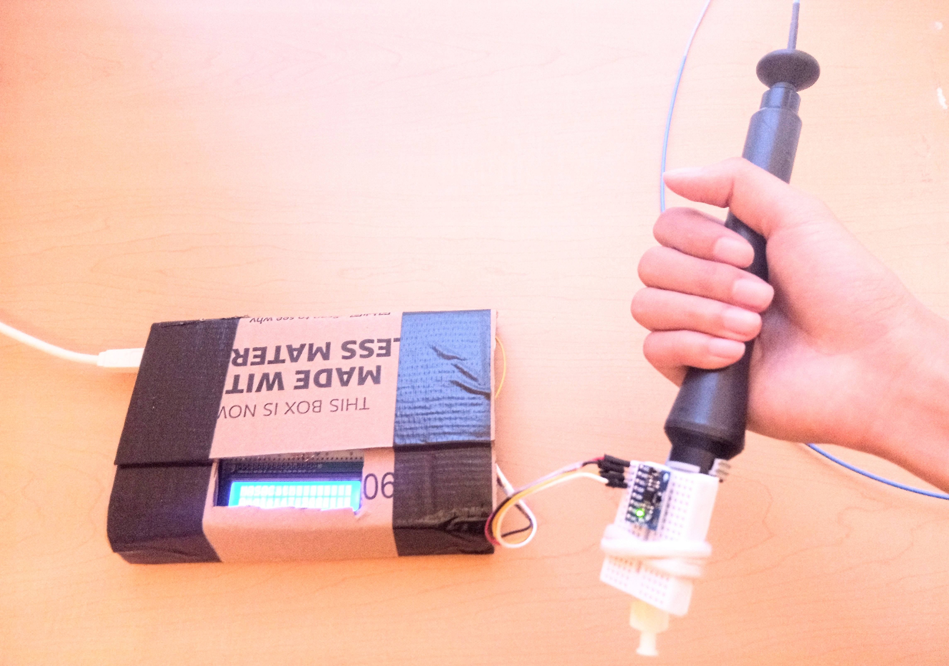
Handle Measurement
Departments of Mechanical & Biomedical Engineering

Slide 34
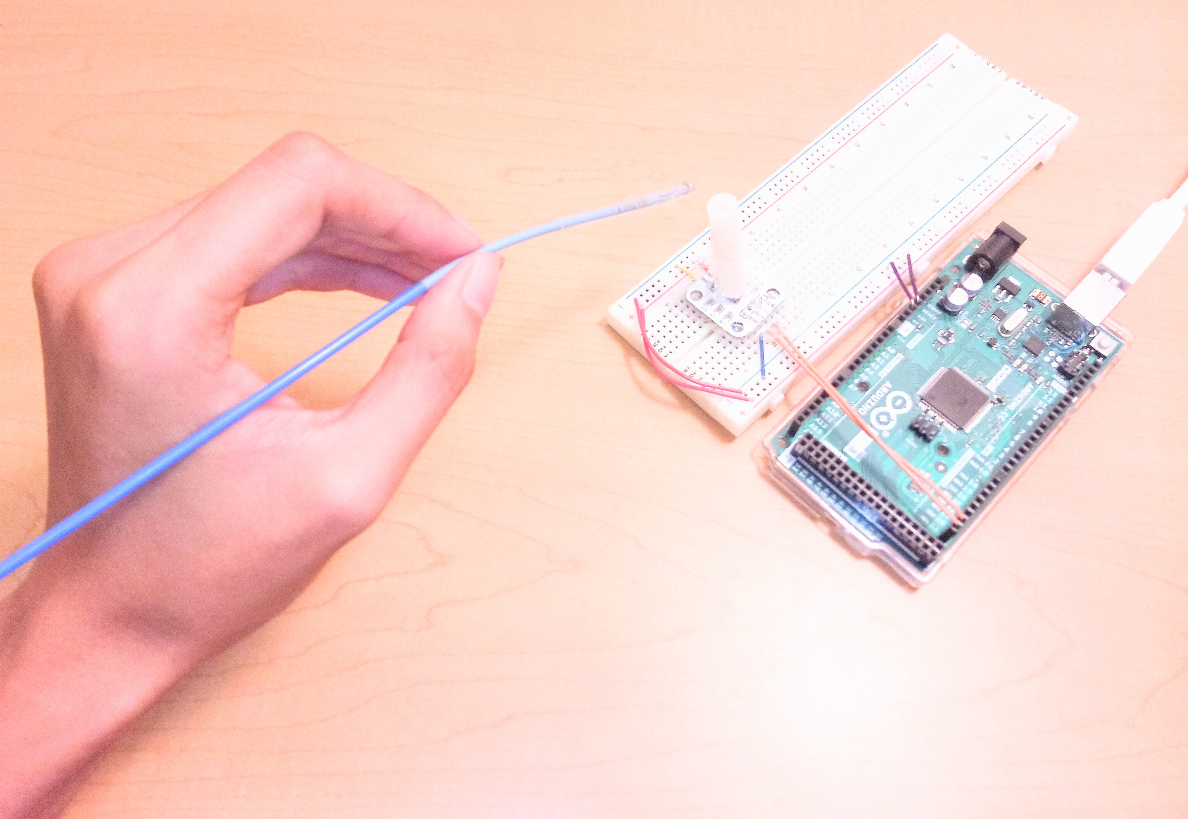
Tip Measurement
Magnet Tube
Magnet
Guiding Tube
AS5600
Departments of Mechanical & Biomedical Engineering

Slide 35
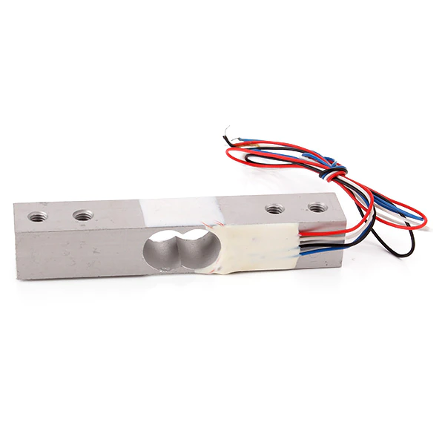
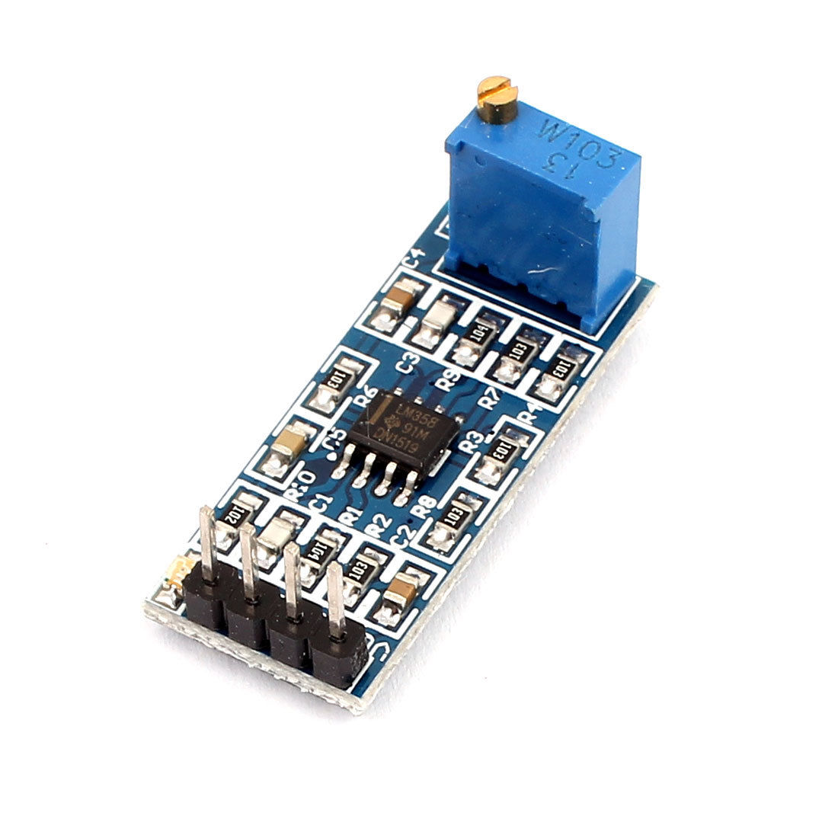
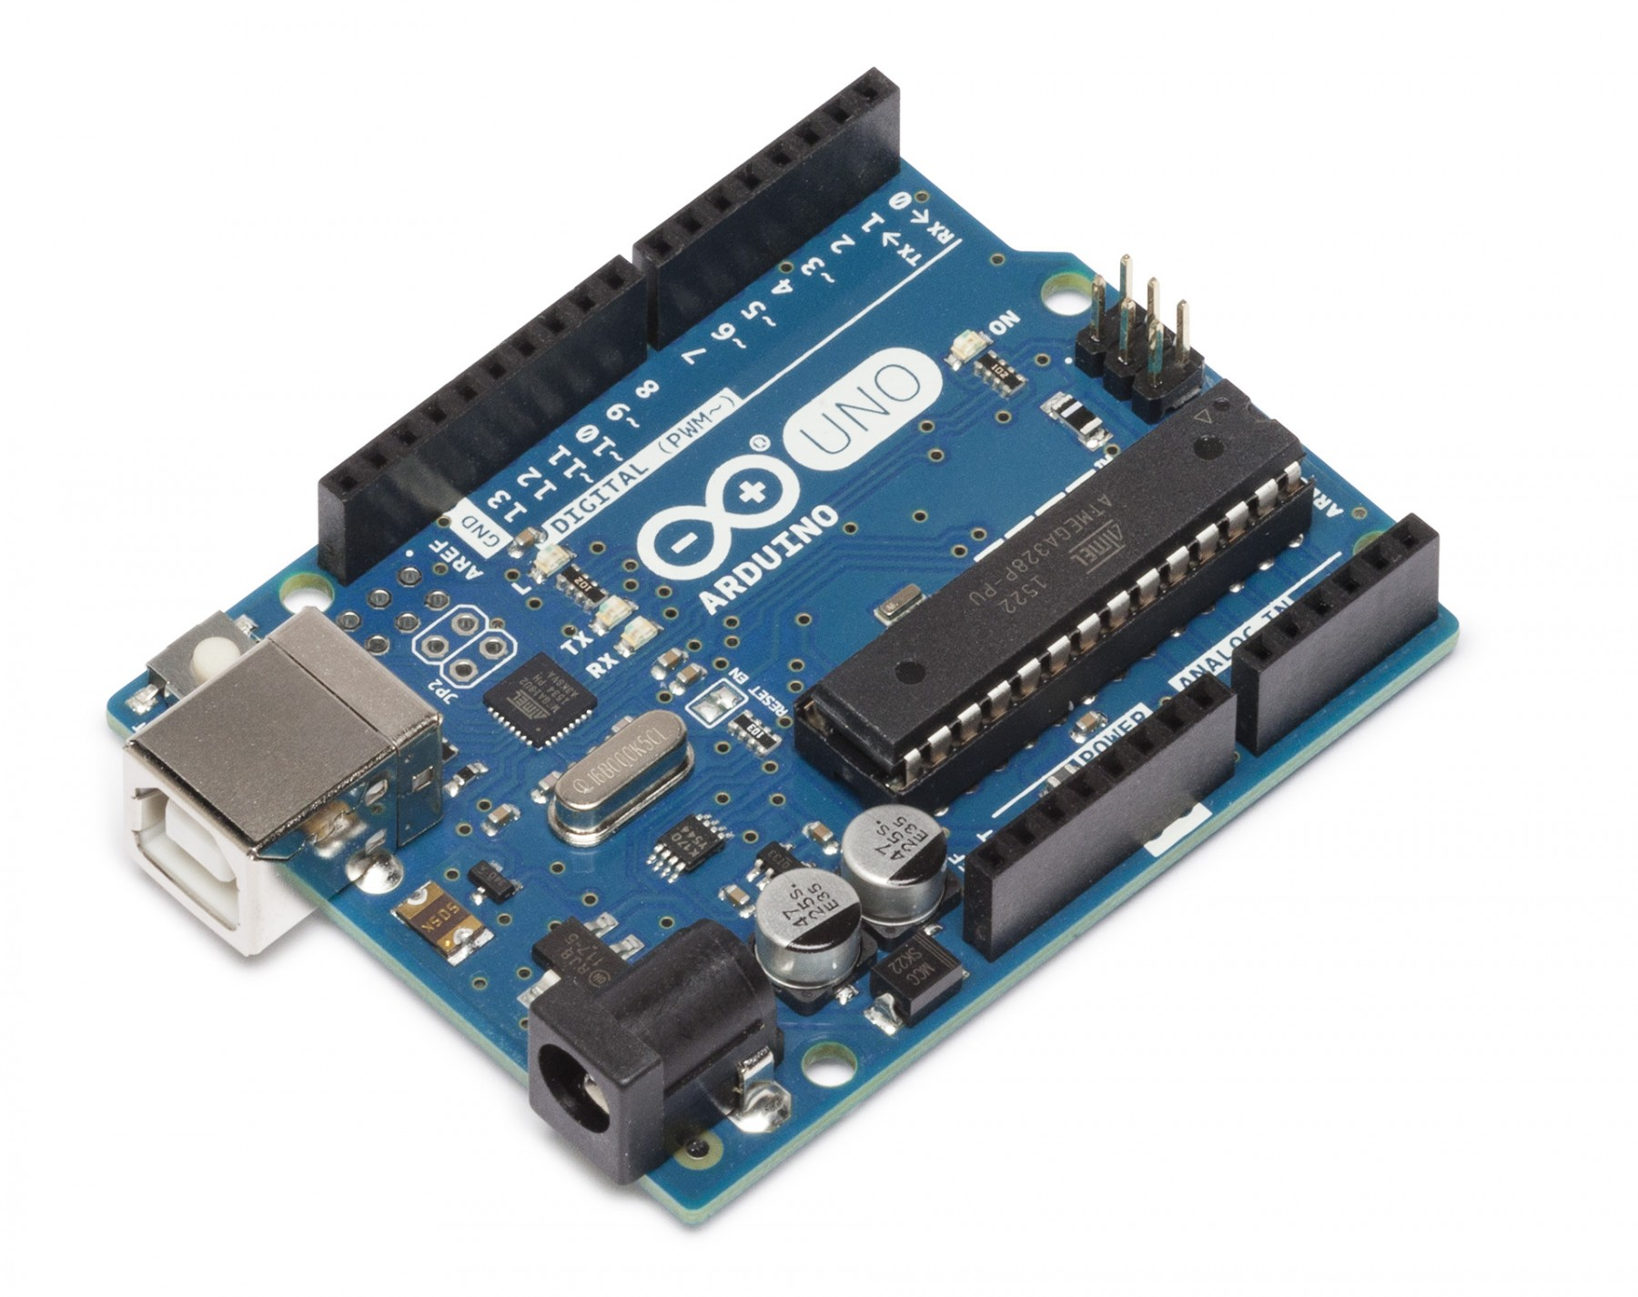
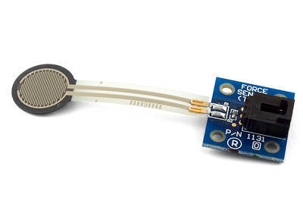
Strain Gauge
Signal Amplifier
Measures dynamic torque
Magnet Tube
Magnet
Guiding Tube
Measures angle
AS5600
Departments of Mechanical & Biomedical Engineering

Slide 36
Future Work
Prototype
Evaluation &
Environment
Building
Final Design
Material
Purchasing
Detailed Design
&
Data Analysis
Verification & Validation Testing
Departments of Mechanical & Biomedical Engineering

Slide 37
Future Work
Prototype
Evaluation &
Environment
Building
Final Design
Material
Purchasing
Detailed Design
&
Data Analysis
Verification & Validation Testing
Departments of Mechanical & Biomedical Engineering

Slide 38
References
Mayo Foundation for Medical Education and Research. (n.d.). Catheter insertion points for cardiac ablation. Mayo Clinic. Retrieved January 25, 2023, from https://www.mayoclinic.org/tests-procedures/atrial-fibrillation-ablation/multimedia/img-20302581
Mayo Foundation for Medical Education and Research. (2022, April 30). Atrial fibrillation ablation. Mayo Clinic. Retrieved January 25, 2023, from https://www.mayoclinic.org/tests-procedures/atrial-fibrillation-ablation/about/pac-20384969#:~:text=During%20cardiac%20ablation%2C%20catheters%20are,the%20groin%2C%20shoulder%20or%20neck
Departments of Mechanical & Biomedical Engineering

Slide 39
Backup Slides
Departments of Mechanical & Biomedical Engineering

Slide 40
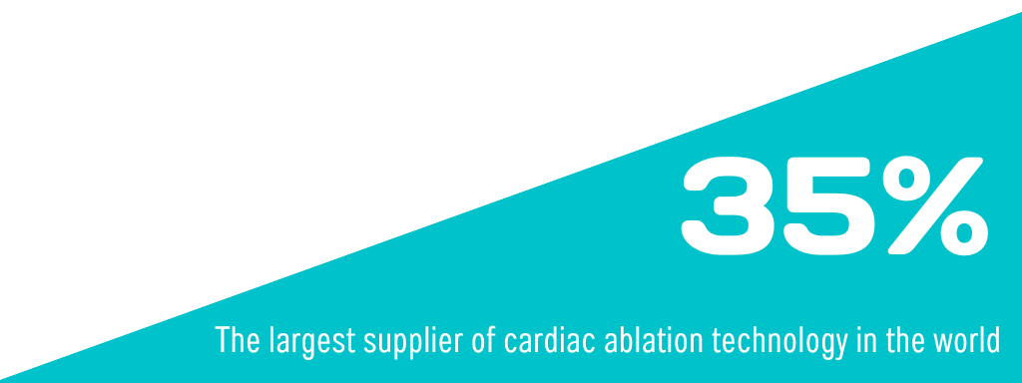
Primary Market
& Biomedical Engineering

Slide 41
Secondary Markets
Research Labs
&
Institutions
Catheter Manufacturers
Medical
Schools

Slide 42
LCD Display
Magnetic Encoder Module
Polyurethane
Sheath
MASACath
Handle Angle: 52.2º
Tip Angle: 38.4º
Arduino
Arduino
IMU Module
Departments of Mechanical & Biomedical Engineering

Slide 43
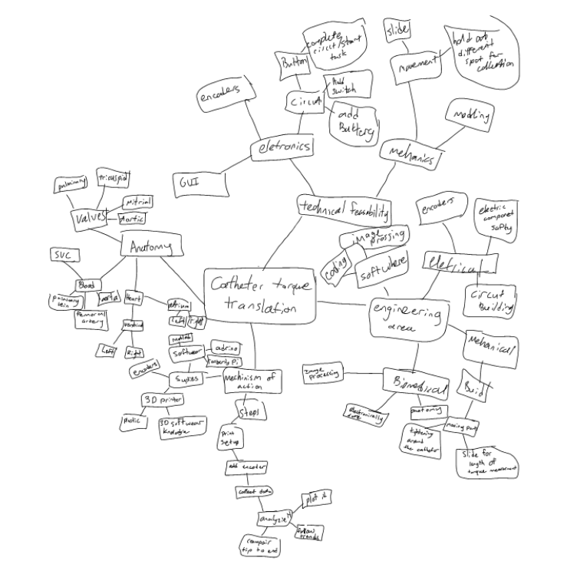
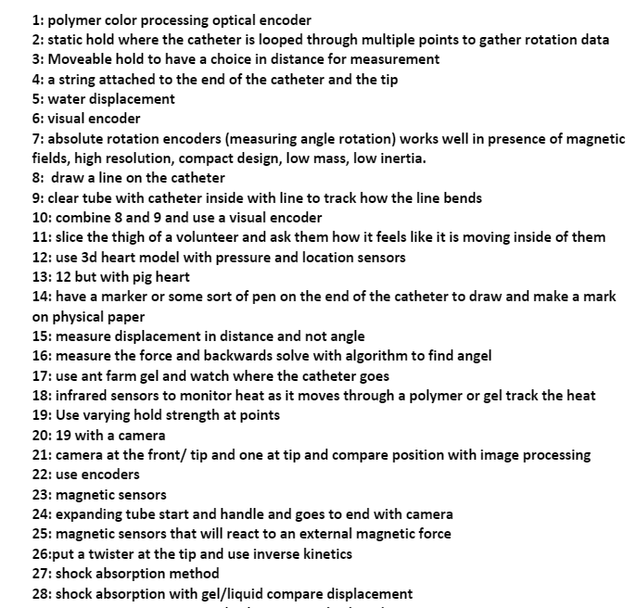
Concept Classification Tree

Slide 44
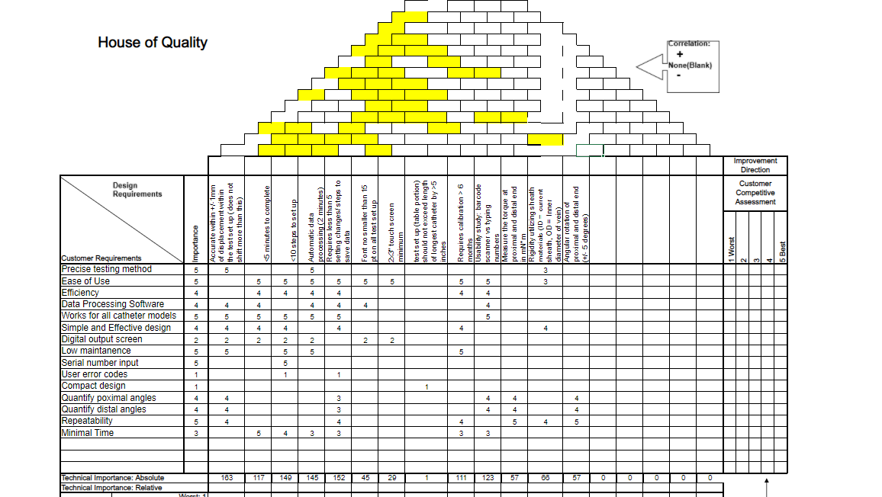
House of Quality
Departments of Mechanical & Biomedical Engineering

Slide 45
Concept Selection
House of Quality
Pugh Chart
Selected Concept
Prototyping
Learning
Testing & Evaluation
Selected Concept
Rapid Prototyping
House of Quality
Pugh Chart
Customer Need Development
Departments of Mechanical & Biomedical Engineering

Slide 46
Surgical Environment
Notes:
Show if ppl ask during question section

Slide 47
Sauron Software System
Item 2
Sub System 1
IMU
Module
Item 1
LCD
Module
Microcontroller
Module
Item 3
Magnetic
Encoder
Module
Departments of Mechanical & Biomedical Engineering

Slide 48
Functional Decomp
Repeatability
Sensors
Data Processing
Identifies locations of translation drop-offs
Distinguishes Proximal/Distal Ends
Varying Test Setups
Automatic Data Processing
Compatible with different catheter models
Measure Angles of Bending & Twist
Compact Design
Measure Tip Displacement
Accounts for varying positional set-ups

Slide 49
Functional Decomposition
Ease of Use
Measurement
Regulatory
User
System
Sensors
Controls
21.CFR.820
Compact Design
Repeatable
Tip Rotation & Displacement
Signal Transducing & Processing
Quality & Calibration Schedule
Digital Display
Adjustable System Parameters
Rotation of Handle
Distinct Proximal/Distal End Containers
Sterilized Environment
Departments of Mechanical & Biomedical Engineering

Slide 50
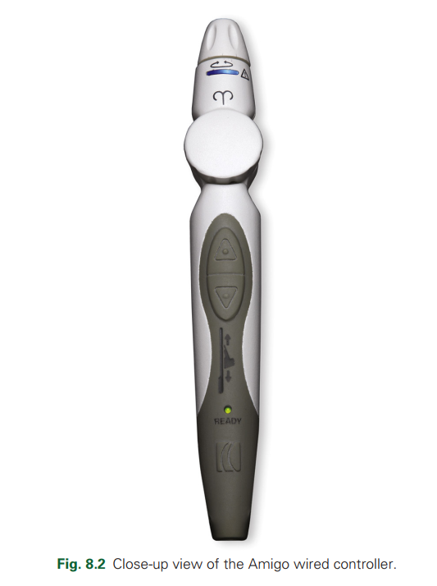
IMU for Catheter Handle
9-axis IMU ( 3-axis gyro + acc + mag) + Arduino Mega 2560
Noise Filter (Kalman VS Complementary Filter) Programming
Vpython 3D Modeling, real-time visualization
Why IMU?
Freedom for handle movement
Future modification (Remote Catheter System,
Catheter Robotics, Gesture machine learning)
& Biomedical Engineering

