Slide 1
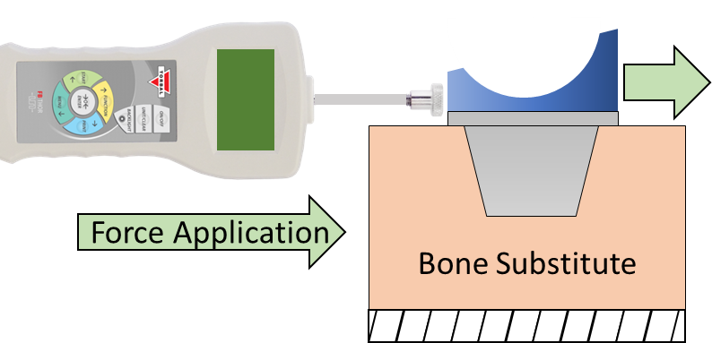
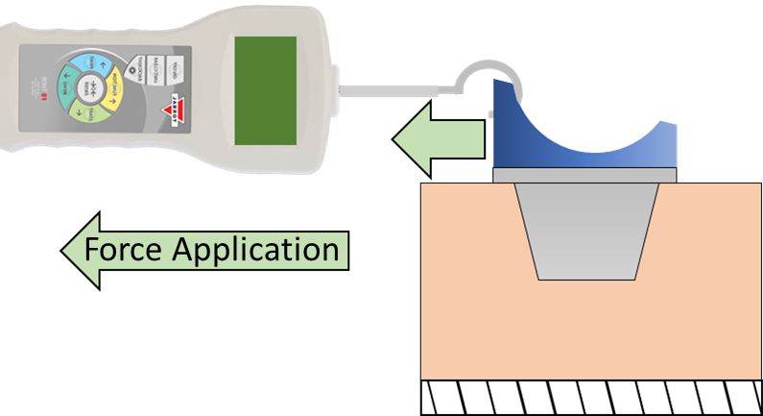
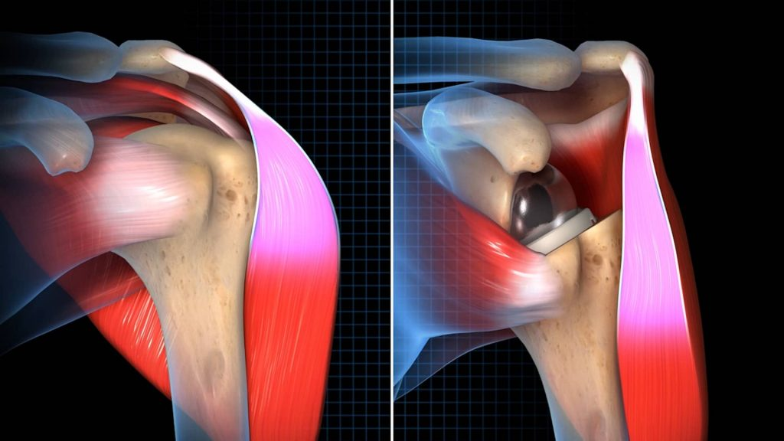
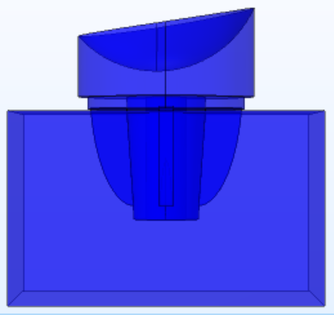
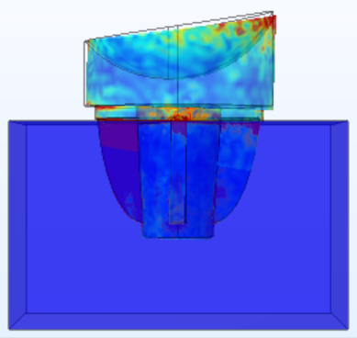
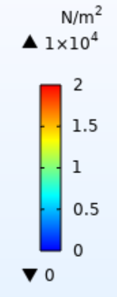
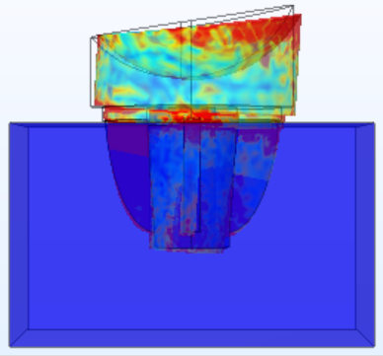
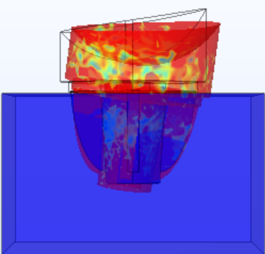
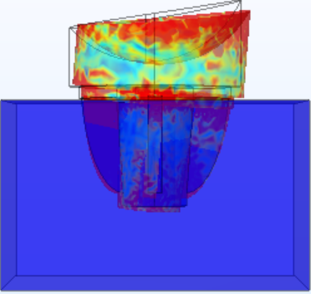
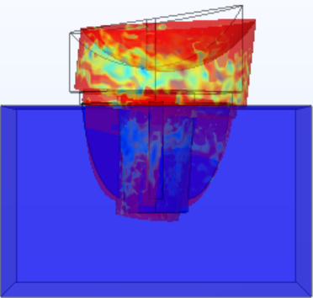
Stemless Reverse Shoulder Arthroplasty
Valeria Aguilera, Ethan Corey, William Crittenden, Alex Nowzamani, Matthew Mohammed, Nickolas Wolniewicz
Objective
Mechanical Testing
Results
Discussion
Design a reverse stemless shoulder implant to improve range of motion, strength in the shoulder and reduce overall pain. Create testing procedures to ensure the implant would not fail.
Testing was split into two sections:
(1) Measuring force with a 10 kg Force Meter​ on Extruded Polystyrene Insulation
(2) Measuring force with a Digital Force Gauge and 10 and 15 PCF Bone Blocks.
Applying a compressive force to walls of the bone block increased the peak force values the implants could withstand before failure.
The 15 PCF bone blocks were more susceptible to fractures forming during the implantation process as opposed to the softer 10 PCF bone blocks.
When the fins were orientated perpendicular to the applied force, the peak force performance was higher
When a fin was oriented in the rotational path of the cage, the force was lower
Limited by the number of bone blocks
Shear
Background
Bone Substitute
(1)
About 50,000 people undergo shoulder replacement surgery annually.
There are over 800,000 people in the U.S. with a shoulder implant.
Reverse Stemless implants may reduce bone loss, protect rotator cuff, and lower fracture risk.
Testing variables like fin count can help develop future implant designs.
Lever Out
Bone Substitute
Future Plans
COMSOL Model
Improving COMSOL models
Improving tests to make them more robust by adding metal plates to the bone block walls
Realistic prototyping
Materials: Titanium and Cobalt Chrome alloy, HDPE
Machinery: SLS
Testing Mechanisms: Instron
Force Applied
Shear Stress (N/m²)
*Low = fins offset 30° from original
High = fins offset starting at 12 o clock position
100 N
(2)
0 N
100 N
Rotator Cuff
Deltoid
0 N
Prototyping
Acknowledgements
200 N
300 N
200 N
Advisor: Tom Vanasse​
Instructors: Stephen Arce, Ph.D. Shayne McConomy, Ph.D.​
Equipment Use: FAMU-FSU College of Engineering, Formlabs, Emily Hubiki
*Low = fins offset 30° from original
High = fins offset starting at 12 o clock position
400 N
500 N
400 N
500 N

