Slide 1
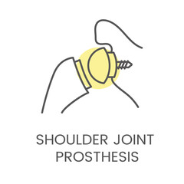
Team 114
Notes:
Customize your title slide to be appealing to the audience. This is the first thing they see apply some graphic design elements that may summarize your presentation.

Slide 2
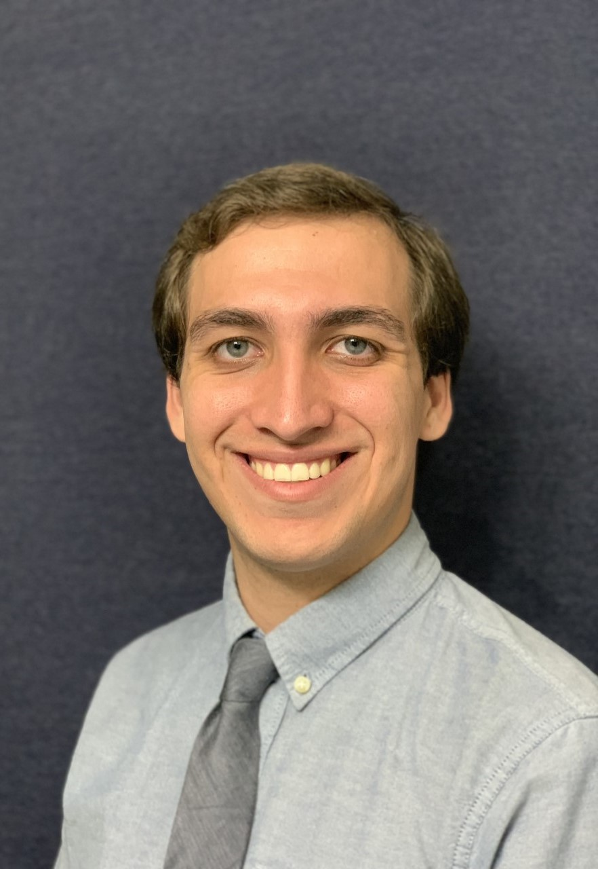
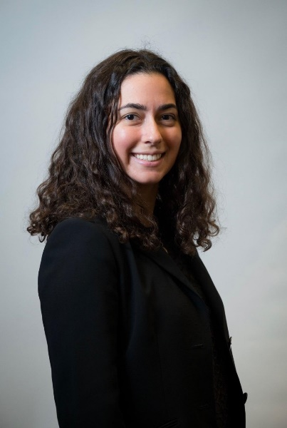
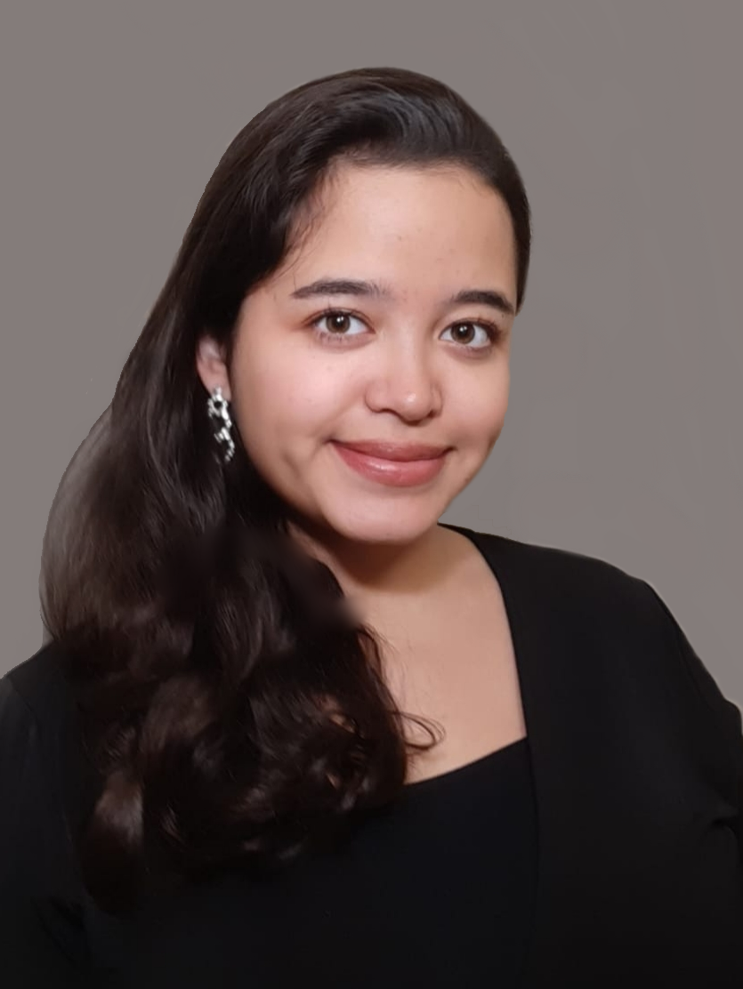
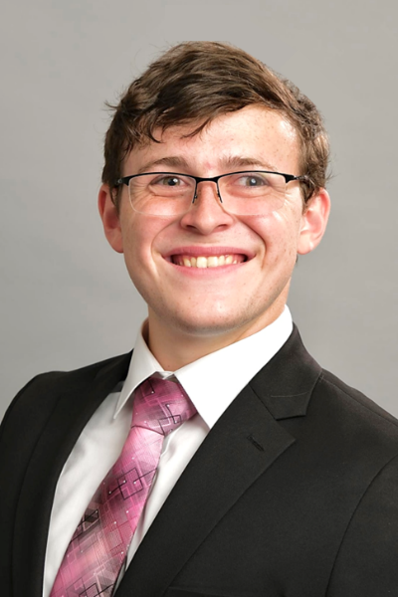


Team Members
Valeria Aguilera
William Crittenden
Alexandra Nowzamani
Ethan Corey
Matthew Mohammed
Nickolas Wolniewicz

Slide 3

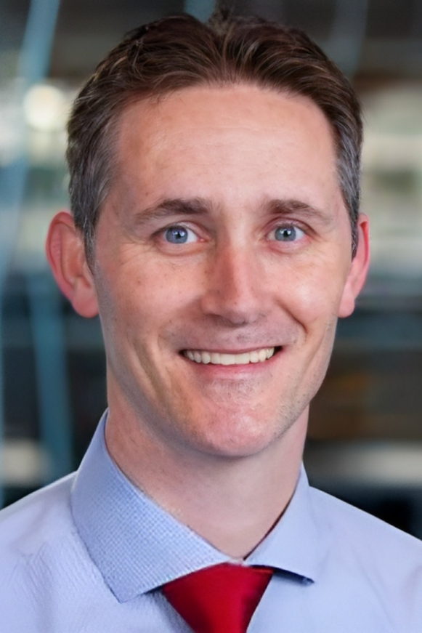
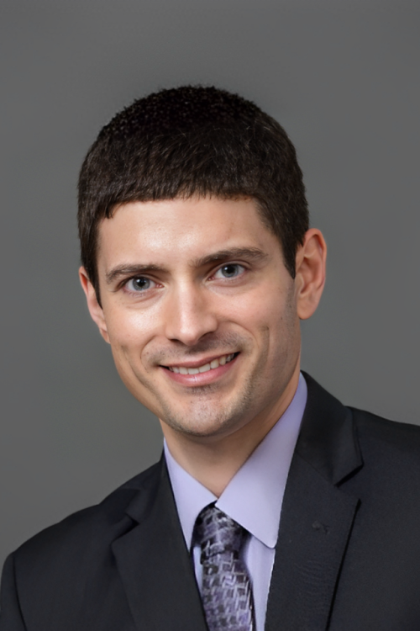
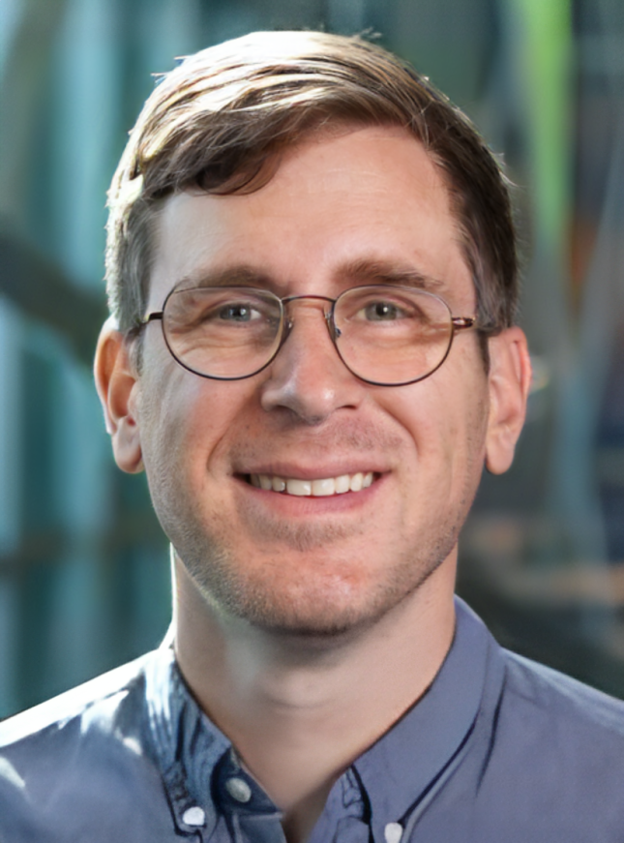
Sponsor and Advisors
Academic Advisor
Shayne McConomy, Ph.D.
Professor, FAMU – FSU Engineering
Project Sponsor
Tom Vanasse,
Director of Engineering, Exactech
Academic Advisor
Stephen Arce, Ph.D.
Professor, FAMU – FSU Engineering

Slide 4


Project Objective
The objective of this project is to design a stemless reverse shoulder prosthetic to prevent levering out, ease surgical revisions, and formulate a series of tests to appropriately evaluate the design.

Slide 5
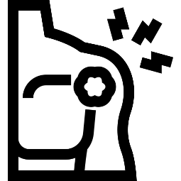
Total Shoulder Replacement
Purpose:
To provide ample fixation, restore range of motion, and ease surgical revisions by replacing portions of the shoulder joint with an artificial implant.

Slide 6

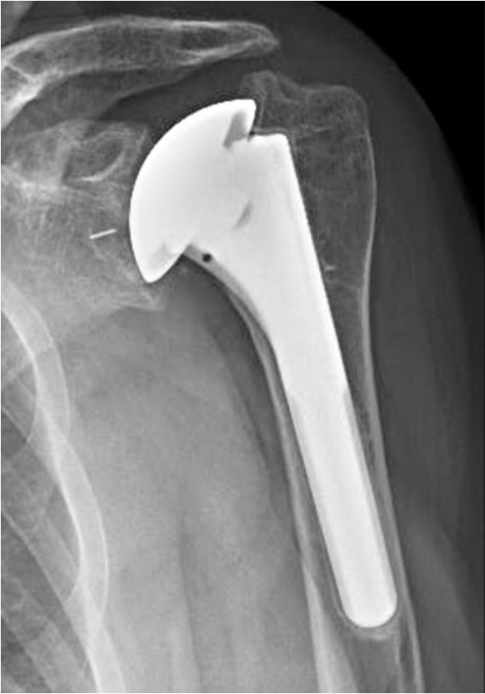
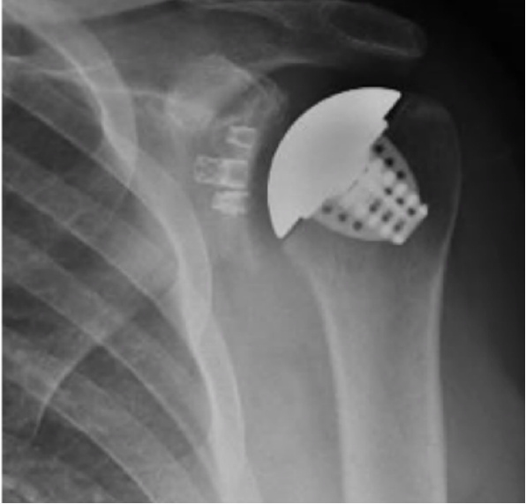
Types of Implants
Stemmed Implant
Stemless Implant

Slide 7
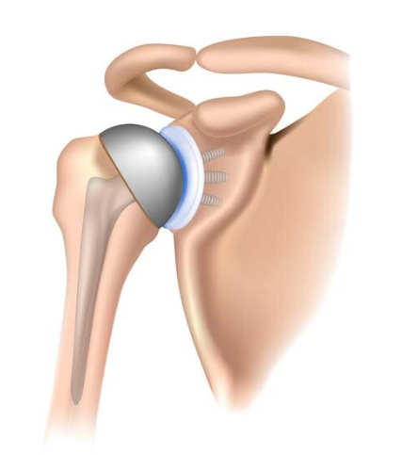
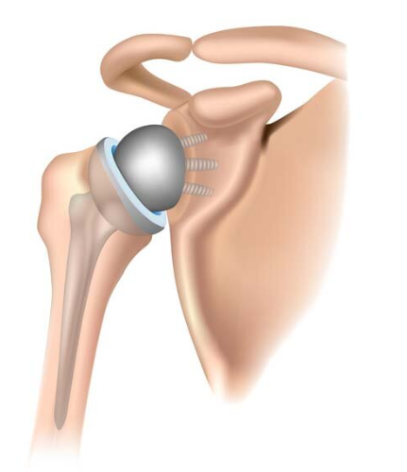
Anatomical vs. Reverse
Anatomical (aTSA)
Reverse (rTSA)

Slide 8

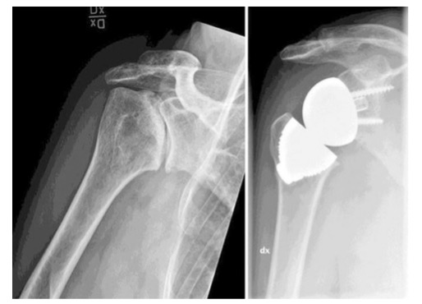
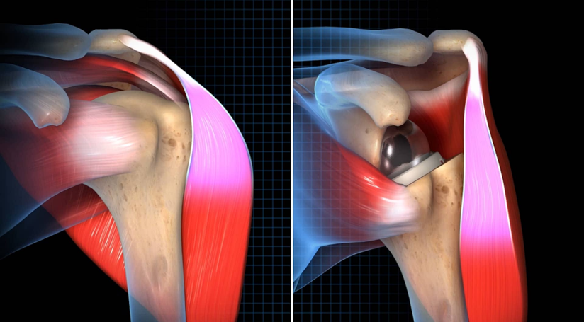

Reverse Stemless Shoulder Implant
Potential Benefits:
Prevents rotator cuff damage.
Better joint stabilization.
Easier revisions.
Decrease of fractures.
Preservation of bone.
Shifts emphasis to deltoid muscle.

Slide 9

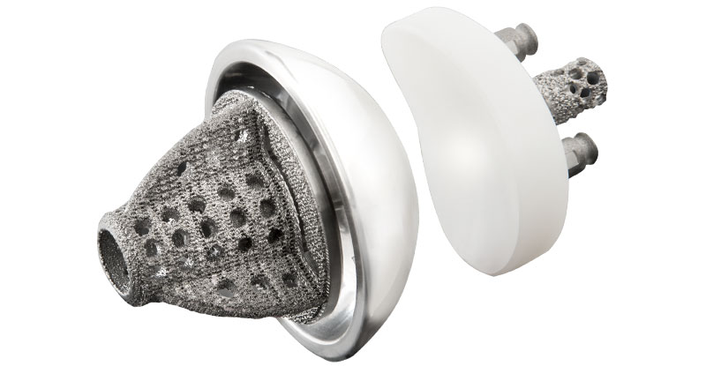
Current Exactech Design

Slide 10

Concept Selection
Generated
Concepts
Revise Concepts
House of Quality
Pugh Chart

Slide 11

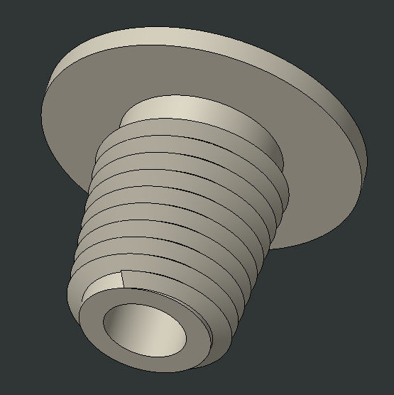
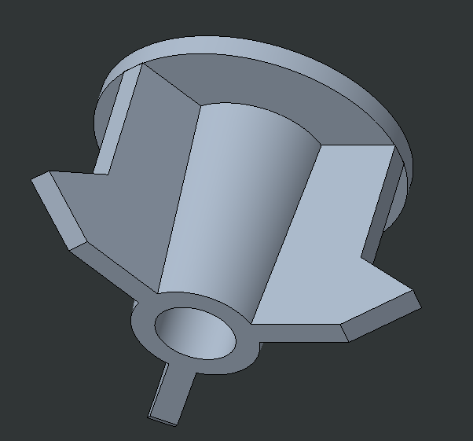
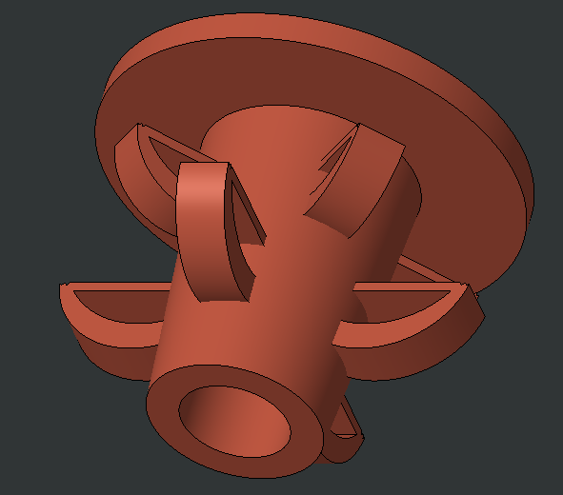
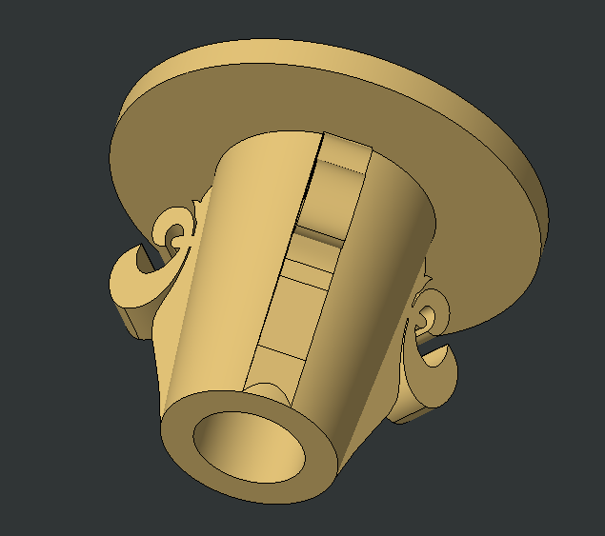
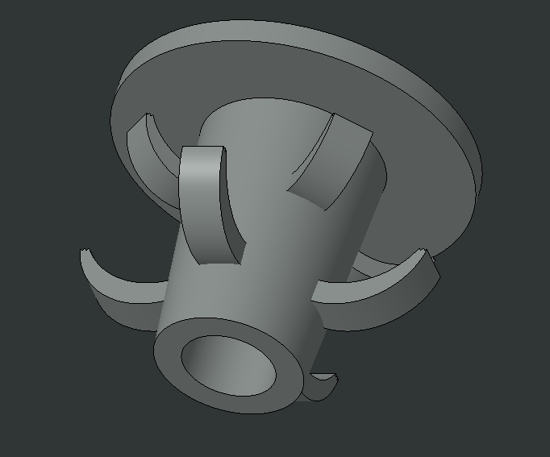
Concepts
Pugh Chart
Concept 1
Concept 2
Concept 3
Concept 4
Concept 5

Slide 12

Customer Needs
Prevents lever out
Prevents micromotion (< 150 μm)
No device failure
No bone fracture
Easy revision
Immune response
Ease of implantation
Biologic fixation over time (6-8 weeks post-op)

Slide 13

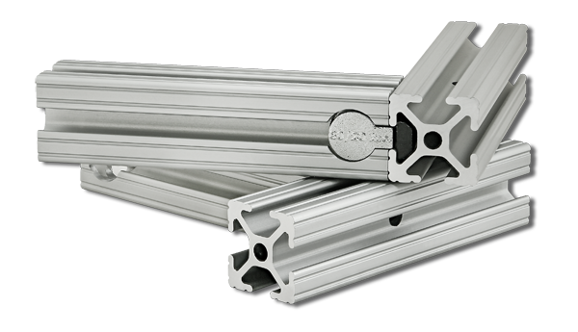

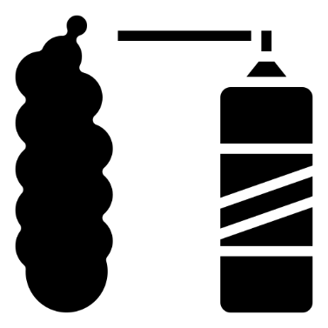
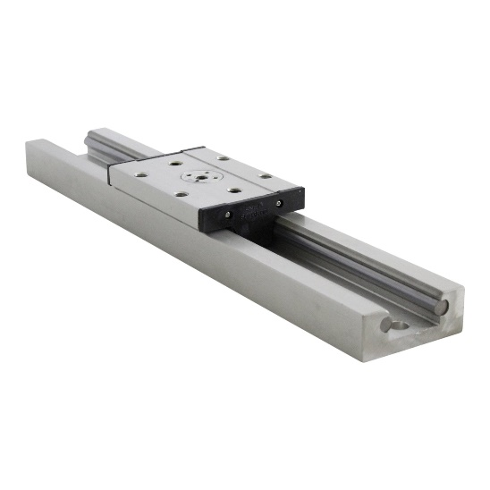

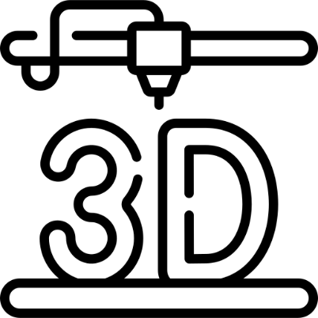
Testing Apparatus

Slide 14
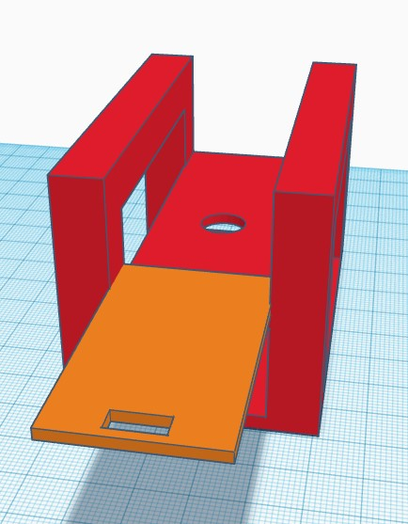
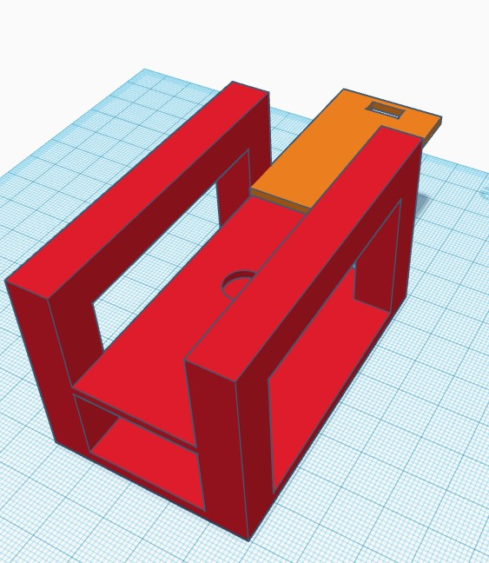
Testing Apparatus cont'd

Slide 15
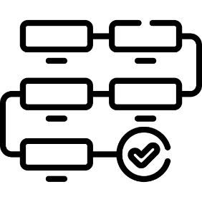
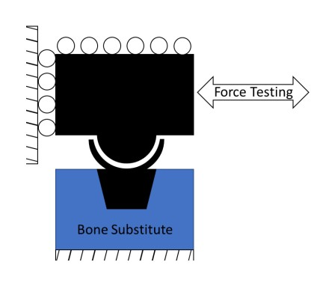
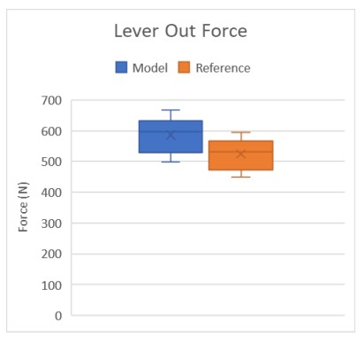
Testing Apparatus Procedure
Place implant that is coated in foam on to the designated slot.
Push slider bar against the implant.
Measure force taken to lever out the implant.

Slide 16

FDA Strategy
There are currently no anatomic stemless reverse implants in the U.S.
Therefore, there is no FDA classification code.
De Novo request.
Use Exactech current design as a predicate device.

Slide 17

Biocompatibility
Biocompatibility is a large part of getting FDA approval.
Through the De Novo request a clinical study is required along with a 510k submission to receive FDA approval.
Tests for biocompatibility includes areas such as sensitization, cytotoxicity, hemocompatibility, and carcinogenicity.

Slide 18
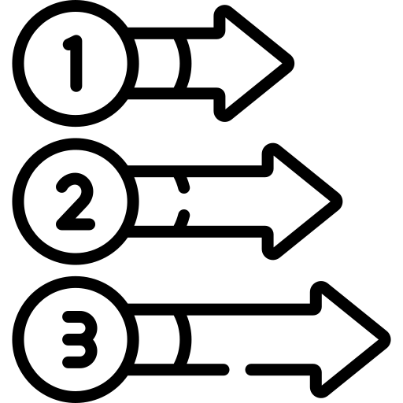
Next Steps
Finish 3D printing all the concepts.
Complete building/setup of testing apparatus.
Test and record data.
Choose design to modify for better revisions.
Test using Sawbone.
Print the final design using the SLS machine at Exactech.

