Slide 1
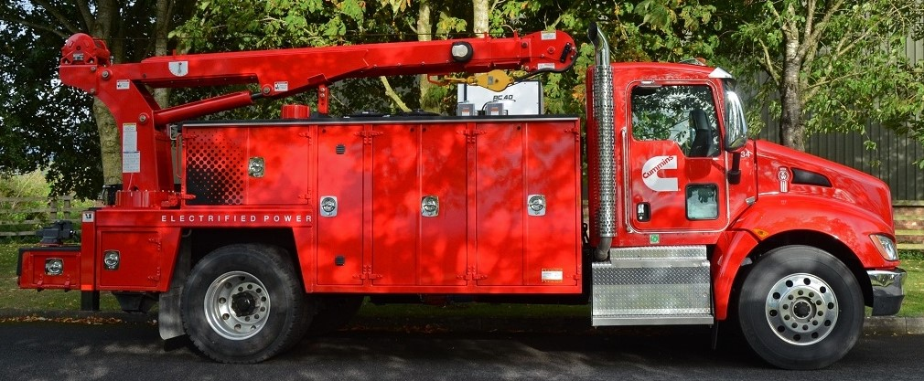
Hybrid Vehicle Battery Cooling
Team 507: Anthony Vicary | Chris Carley | Clayton Carlson | Corey Kelley | Jacob Owens
Notes:
Customize your title slide to be appealing to the audience. This is the first thing they see apply some graphic design elements that may summarize your presentation.

Slide 2
TEAM 507
Corey Kelley
Systems
Engineer
Clayton Carlson
Thermal Fluid Engineer
Chris Carley
Materials Engineer
Anthony Vicary
Heat Transfer
Engineer
Jacob Owens
Design Engineer

Slide 3
Sponsor and Advisor
Dr. Michael Hayes
Cummins, Inc
Material Engineer
Dr. Juan Ordonez
FAMU-FSU College of Engineering

Slide 4
Background
27% of CO2 emissions come from transportation
26% of those emissions come from heavy-duty Class 8 trucks
Increased emissions standards and improvements in Lithium-Ion Batteries
Lead to development of hybrid and electric trucks

Slide 5
Background
Hybrid have highest rate of vehicle fires
Lithium-Ion Battery fires are extremely dangerous
Exposure to high temperatures degrades Lithium-Ion Batteries
Exposure to low temperatures increases internal resistance within battery

Slide 6
Background
Acceleration requires large amounts of power
Large current is produced within the battery and large amount of heat are produced
Cooling methods must keep up with thermal loads

Slide 7
Project Objective
The objective of this project is to develop a cooling method for a hybrid vehicle battery pack that is at least 5% more effective than current industry standards.
The cooling method should focus on improvements within battery modules.

Slide 8
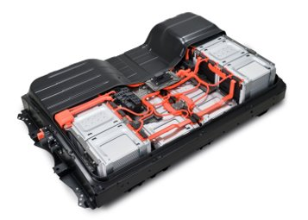
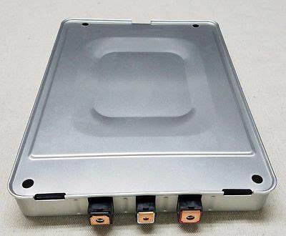
Battery Pack Components
Battery Pack
Module
Cells

Slide 9
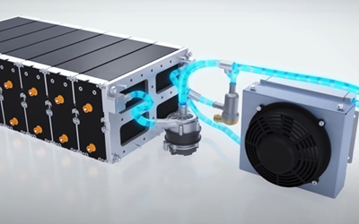
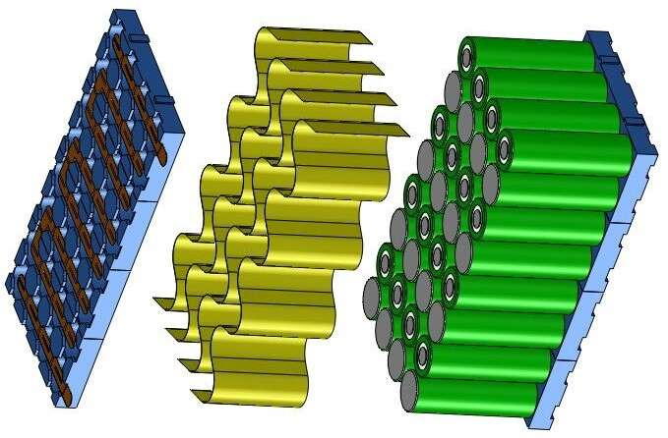
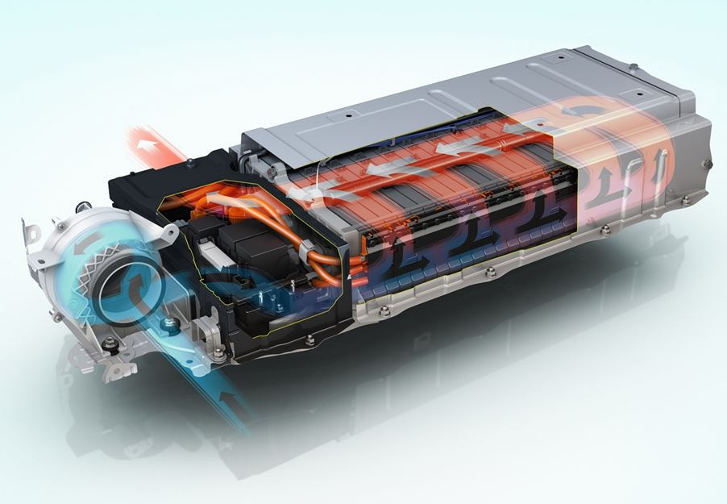
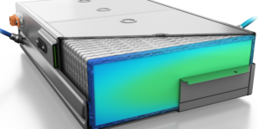
Current Cooling Methods
Liquid Cooled
Conductive Material Cooling
Air Cooled
Fluid Submersive Cooling

Slide 10
Key Goals
Improve battery cooling 5% over industry benchmark
Design focuses on innovation at module level
Keep cost of ownership down
Develop a safe method to test our design
Keep battery within efficient operating temperature

Slide 11
Assumptions
Design will be based on a 10 kWh battery pack
Domain of project will be within battery enclosure
Battery will be subjected to a variety of operating conditions
Not able to physically open a battery module
Notes:
Mention that design will be implemented with 10 kWh battery pack in mind but will be scalable for larger battery packs

Slide 12
Markets
Primary Markets
Hybrid Vehicle Developers
Battery Pack Manufacturers
Secondary Markets
Electric Vehicle Developers
Environmental Organizations
Automotive Industry
Electronics Industry

Slide 13
Customer Needs
Components other than the cell are less than 20% of the weight of the module.
Has the ability to withstand high heat transfer rates.
Performs effectively in extreme temperatures that would cause damage to the battery.
Cooling design has ability to be implemented inside of the battery module.
Design prevents puncture of pouch cells.
Lower the risk of thermal runaway
Design has ability to be integrated with BMS.
Design has ability to be implemented into Class 8 hybrid vehicle packs.

Slide 14
Major Functions
Battery Cooling Method
Heat Transfer
Safety
Efficiency
Control

Slide 15
Heat Transfer: Functions
Heat Transfer
Cools Battery
Heats Battery
Dissipates Excess Heat

Slide 16
Safety: Functions
Safety
Avoids Puncture
Reduces Thermal Runaway
Withstands Thermal Cycling
Withstands Shock and Vibrations

Slide 17
Efficiency: Functions
Efficiency
Minimize Weight
Minimize Energy Loss
Minimize Total Cost of Ownership

Slide 18
Controls: Functions
Control
Senses Temperature
Regulates Temperature

Slide 19
References
Statista. (2022, June 21). Breakdown of transportation GHG emissions in the U.S. 2020, by source. Retrieved October 10, 2022, from https://www.statista.com/statistics/922655/us-transportation-greenhouse-gas-emissions-by-source/
Cummins zero emissions road map. (2022, March 23). Cummins Inc. Retrieved October 10, 2022, from https://www.cummins.com/news/2022/03/23/cummins-zero-emissions-road-map
Pachpute, S. (2022b, August 9). Battery Cooling Techniques in Electric Vehicle ·. CFD Flow Engineering. Retrieved October 10, 2022, from https://cfdflowengineering.com/battery-cooling-techniques-in-electric-vehicle/

Slide 20
Future Work
Targets and Metrics
Concept Generation
Concept Selection
Risk Assessment
Bill of Materials
Testing
Final Product

Slide 22
Backup Slides

Slide 23
Battery Cooling Method
Heat Transfer
Safety
Efficiency
Minimize Weight
Minimize Energy loss
Minimize TCO
Avoids Puncture
Reduce thermal runaway
Withstand thermal cycling
Withstand shock and vibrations
Cools battery
Steady
Transient
Heats battery
Dissipates excess heat
Controls
Sense Temperature
Regulate Temperature

Slide 24
 | Heat Transfer | Safety | Efficiency | Controls
Cools Battery | X |  |  | X
Heats Battery | X |  |  | X
Dissipates Excess Heat | X |  | X
Avoids Puncture | X | X
Withstand Thermal Cycling | X | X | X
Withstand Shock and Vibrations |  | X
Minimize Weight | X | X | X
Minimize Energy Loss | X |  | X
Minimize Total Cost of Ownership | X |  | X
Regulate Temperature | X |  | X | X
Sense Temperature |  |  | X | X

Slide 25
Background
Class 8 vehicles would put significant thermal stress on battery packs
Current battery cooling concepts cannot effectively handle this high level of heat generation
Improvements must be made to battery cooling systems to be more compatible with heavy duty vehicles
Notes:
Class 8 vehicles are 33,000lbs and up

Slide 26
Background
Hybrids have highest rate of vehicle fires
Electrical fires are extremely hard to put out
Exposure to high temperatures degrades Lithium-Ion Batteries
Exposure to very cold temperatures reduces battery range

Slide 27
College of Engineering Color Palette
2299 C
Color Values:
RGB 164 210 51
Hex/HTML #A4D233
CMYK 41 0 84 0
1788 C
Color Values:
RGB 238 39 55
Hex/HTML #EE2737
CMYK 0 88 82 0
75% Black
Color Values:
RGB 64 64 64
Hex/HTML #404040
CMYK 0 0 0 75
Pantone
2299 C
Pantone
1788 C
CoE Dk Gray
2239 C
Color Values:
RGB 0 207 180
Hex/HTML #00CFB4
CMYK 59 0 39 0
647 C
Color Values:
RGB 35 97 146
Hex/HTML #236192
CMYK 96 54 5 27
50% Black
Color Values:
RGB 128 128 128
Hex/HTML #808080
CMYK 0 0 0 50
Pantone
2239 C
Pantone
647 C
CoE Md Gray
2199 C
Color Values:
RGB 0 187 220
Hex/HTML #00BBDC
CMYK 77 0 16 0
7535 C
Color Values:
RGB 183 176 156
Hex/HTML #B7B09C
CMYK 10 11 23 19
25% Black
Color Values:
RGB 191 191 191
Hex/HTML #bfbfbf
CMYK 0 0 0 25
Pantone
2199 C
Pantone
7535 C
CoE Lt Gray
Notes:
Theses are the official color palettes of the college of engineering.

Slide 28
PowerPoint Color Theme
Accent1
647 C
Color Values:
RGB 35 97 146
Hex/HTML #236192
CMYK 96 54 5 27
Accent4
2239 C
Color Values:
RGB 0 207 180
Hex/HTML #00CFB4
CMYK 59 0 39 0
Light 1
White
Color Values:
RGB 255 255 255
Hex/HTML #FFFFFF
CMYK 0 0 0 0
Dark 1
100% Black
Color Values:
RGB 0 0 0
Hex/HTML #000000
CMYK 0 0 0 100
Pantone
647 C
Pantone
2239 C
White
Black
Accent 2
2199 C
Color Values:
RGB 0 187 220
Hex/HTML #00BBDC
CMYK 77 0 16 0
Accent5
7535 C
Color Values:
RGB 183 176 156
Hex/HTML #B7B09C
CMYK 10 11 23 19
Light 2
25% Black
Color Values:
RGB 191 191 191
Hex/HTML #bfbfbf
CMYK 0 0 0 25
Dark 2
75 % Black
Color Values:
RGB 64 64 64
Hex/HTML #404040
CMYK 0 0 0 75
Pantone
2199 C
Pantone
7535 C
CoE Lt Gray
CoE Dk Gray
Accent3
1788 C
Color Values:
RGB 238 39 55
Hex/HTML #EE2737
CMYK 0 88 82 0
Accent6
2299 C
Color Values:
RGB 164 210 51
Hex/HTML #A4D233
CMYK 41 0 84 0
Pantone
1788 C
Pantone
2299 C
Notes:
These are the college colors as prioritized within this PowerPoint Template

Slide 29
Notes:
This slide has the rule of third layout tool. The rule thirds layout helps with the sizing of elements.

Slide 30
Notes:
This slide has the rule of third layout tool. The rule thirds layout helps with the sizing of elements.

