Slide 1
Reversible Stemless Shoulder Implant
Team 112
04/04/24

Slide 2
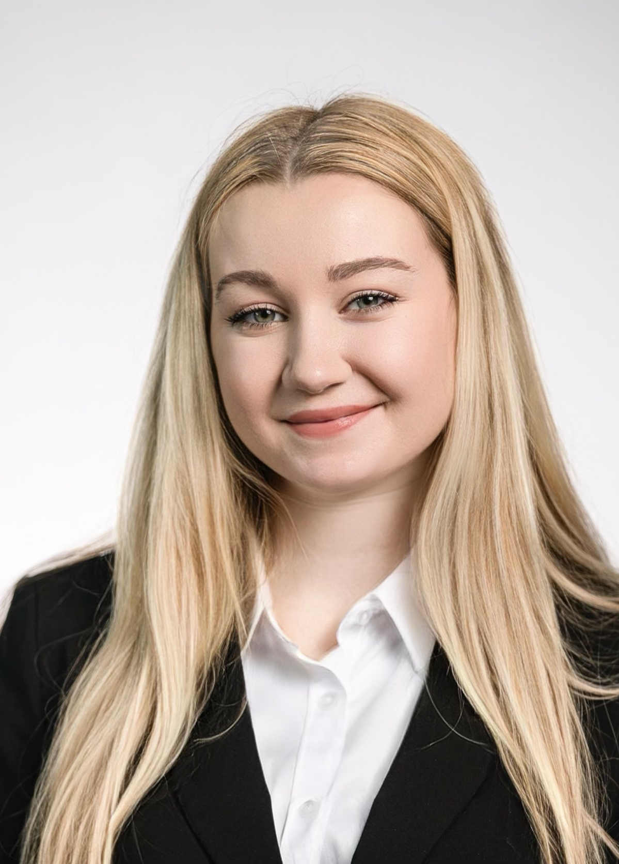
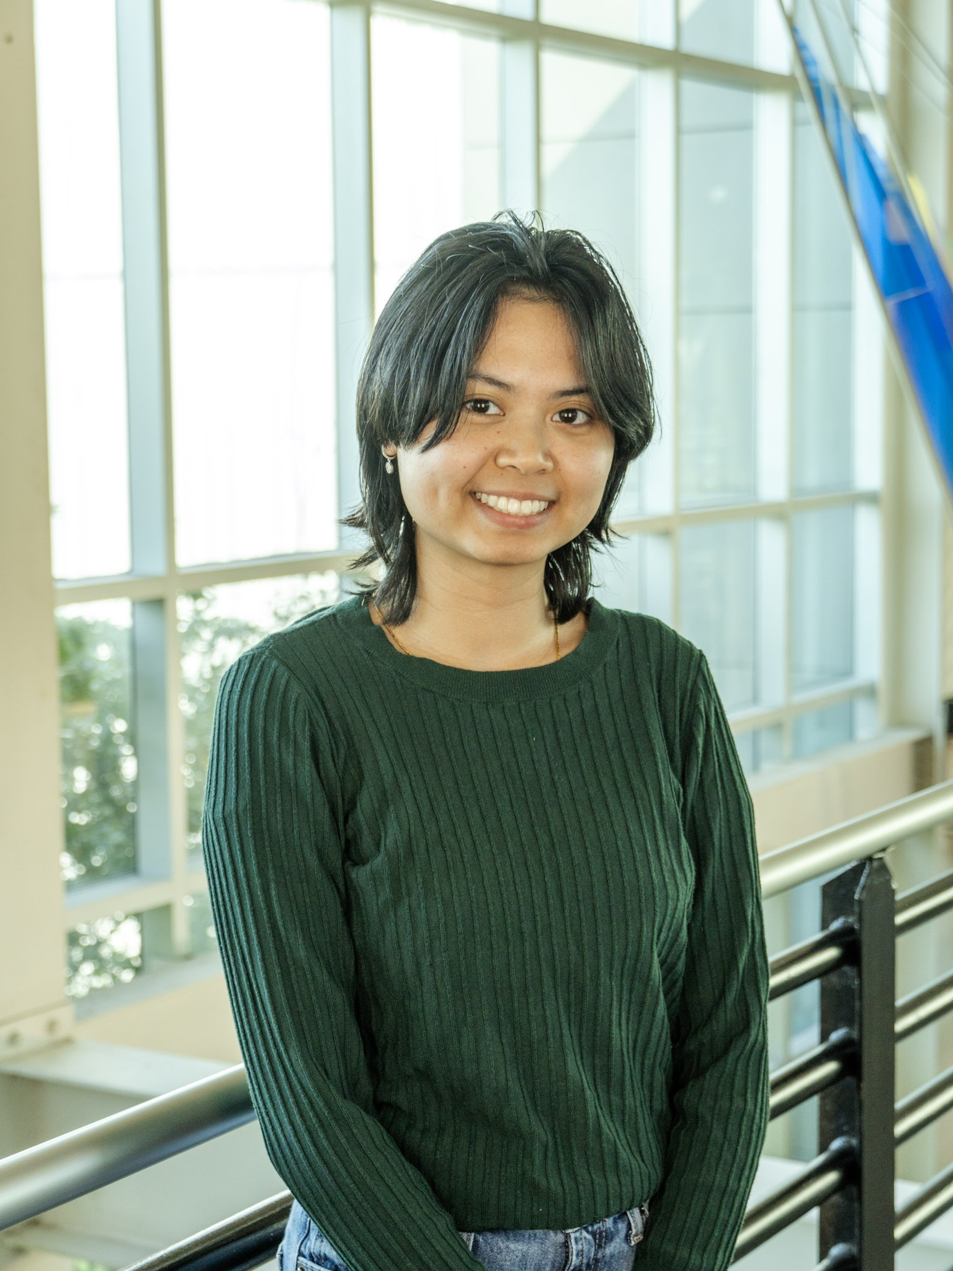
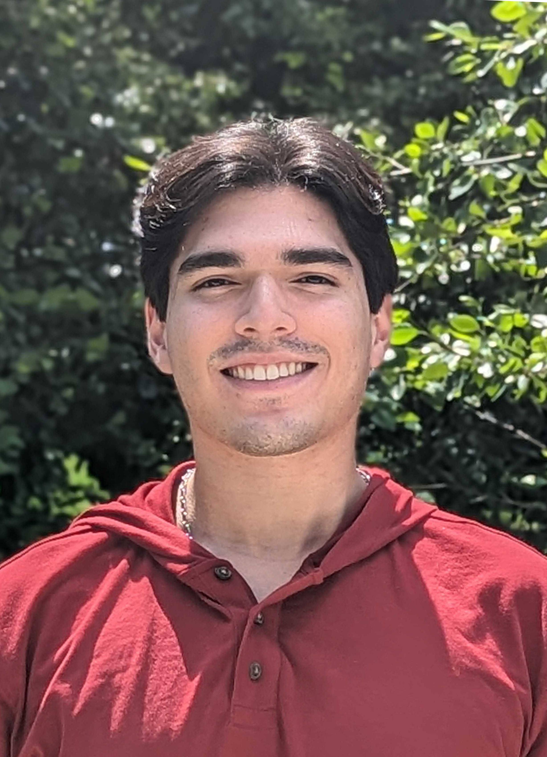


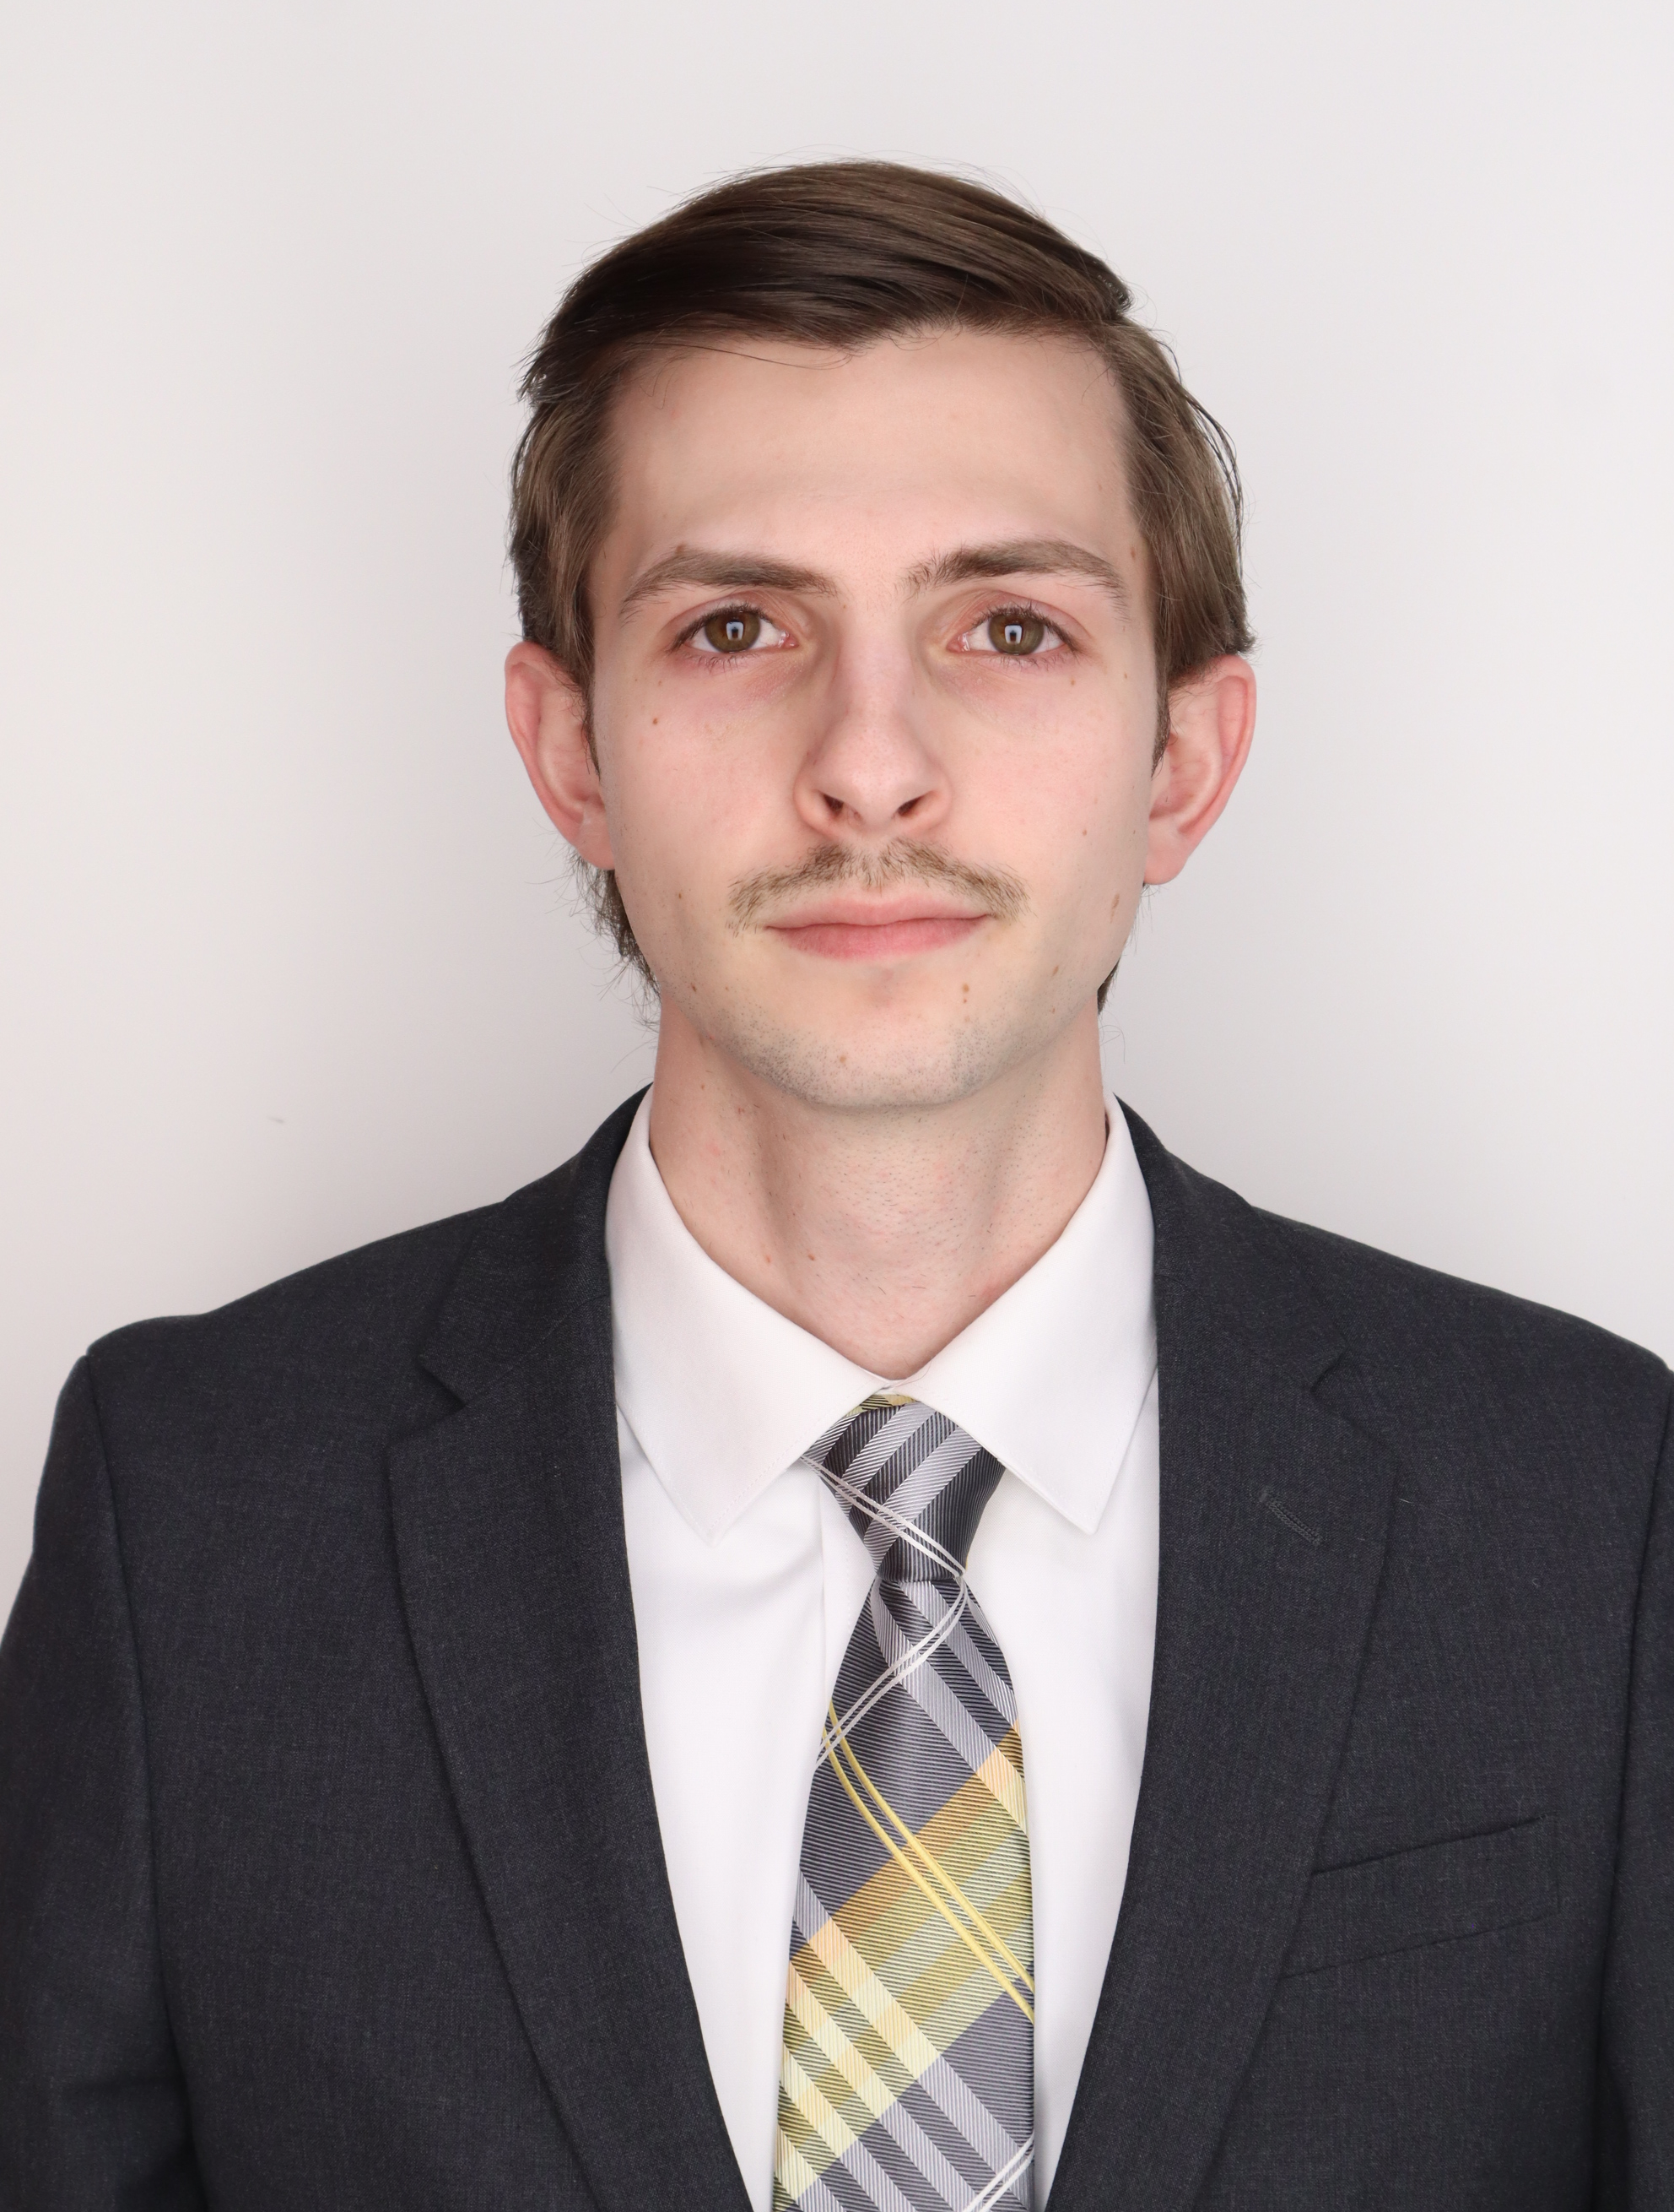

Team Introductions
Kiersten Cady
Kiersten Cady
Mechanical Engineer
Angelina Lanh
Biomedical Engineer
Santiago Lazarte
Biomedical Engineer
John Sorensen
Biomedical Engineer
Taylor Vanderlinden
Biomedical Engineer
William Wartman
Mechanical Engineer
Exactech Team
Notes:
Hello everyone, this is team 1x2 working with Exactech

Slide 3
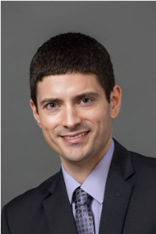
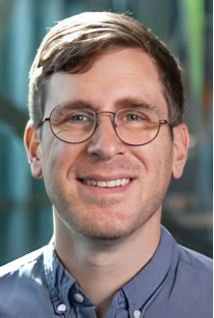
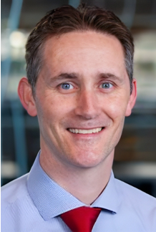
Sponsor and Advisors
Kiersten Cady
Engineering Mentor
Tom Vanasse
Liaison Engineer at Exactech
Academic Advisor
Stephen Arce, Ph.D.
Teaching Faculty III
Academic Advisor
Shayne McConomy, Ph.D.
Teaching Faculty II

Slide 4
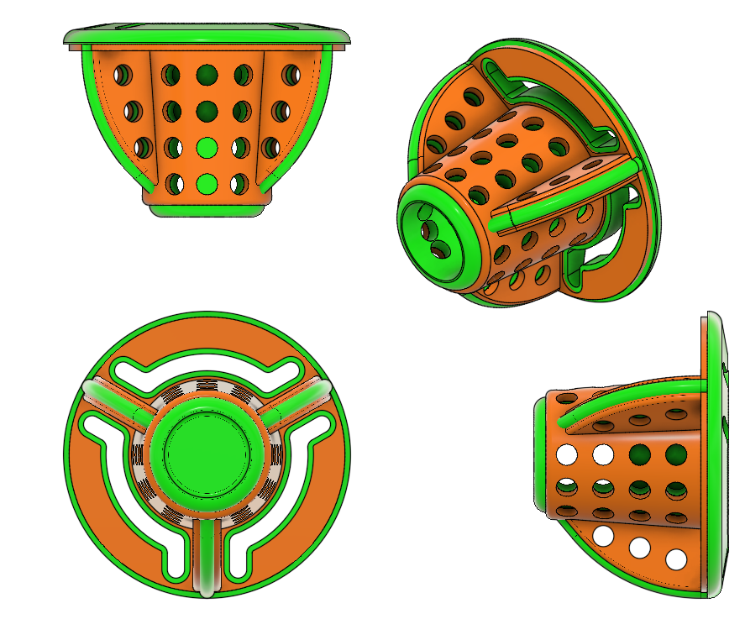
Objective
Kiersten Cady
The objective of this project is to improve upon Exactech’s current stemless shoulder implant, the Equinoxe, to achieve:
Increased fixation and stability
Use in a reverse shoulder configuration
Notes:
The objective of this project is to improve upon Exactech's current reversible stemless shoulder implant, the Equinox. So, what is Equinox and how did I improve it? Before I can answer this question, some background information is needed.

Slide 5

Motivation
Angelina Lanh
Osteoarthritis (OA) is the most common form of arthritis and it affects 70% of people over the age of sixty-five [2]
Because natural cartilage repair is limited, individuals can undergo years of excruciating pain and limited mobility
Processes such as shoulder replacement surgeries provide a viable long-term solution for patients
[1]
Notes:
So for our motivation, osteoarthritis or OA is the most common form of arthritis, which causes the cartilage between the bones at the joint to wear down, and affects about 70% of the U.S. population above the age of 65. Because natural cartilage repair is very limited, individuals with OA and other joint diseases or injuries may deal with years of excruciating pain and severely limited mobility. For them, shoulder replacement surgeries may be a viable long-term solution.

Slide 6
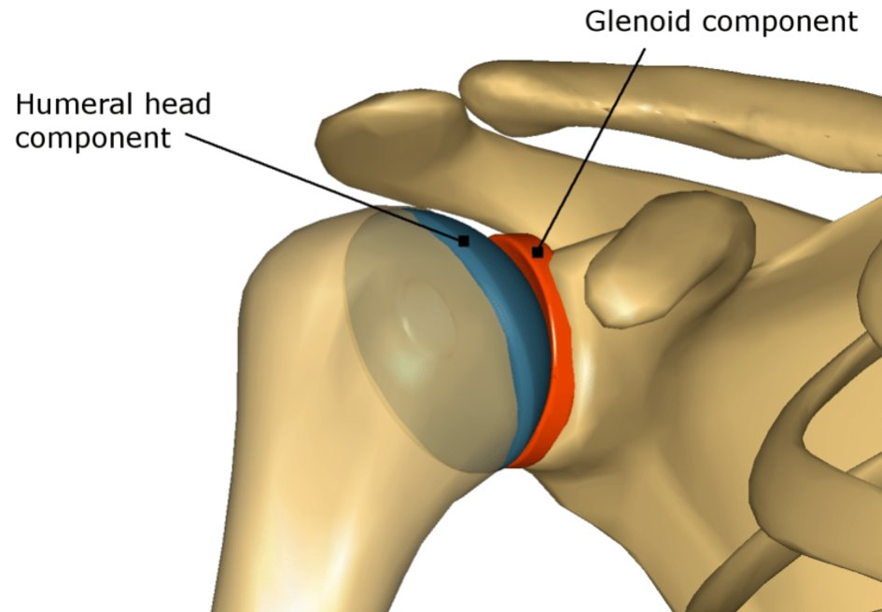
Existing Solutions
Angelina Lanh
Shoulder Implantation Designs
  Stemmed vs. Stemless
  Anatomical vs. Reverse
[3]
Notes:
Existing shoulder implant models include the combination of a stemmed vs stemless and anatomical vs reverse design . Currently the anatomical stemmed, anatomical stemless, and reverse stemmed designs are available on the market, however the reverse stemless design has not received full FDA approval and is the chosen design by Exactech and for our project.
The image on the right shows the shoulder joint, also known as the ball and socket joint due to the shaping of the arm and shoulder bones wehre they connect in blue and red.

Slide 7
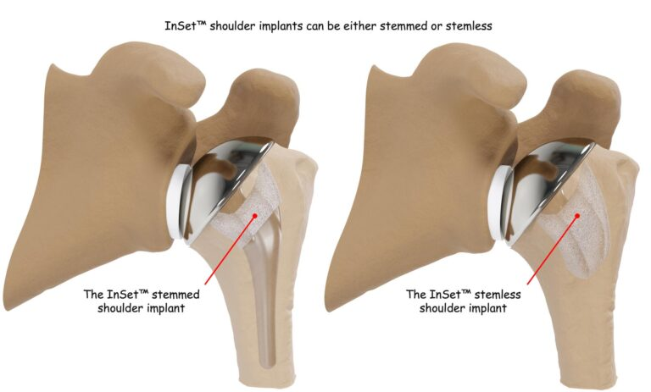
Stemmed vs Stemless
Angelina Lanh
Shoulder
Shoulder
Stemmed shoulder implant
Stemless shoulder implant
Arm
Arm

Slide 8
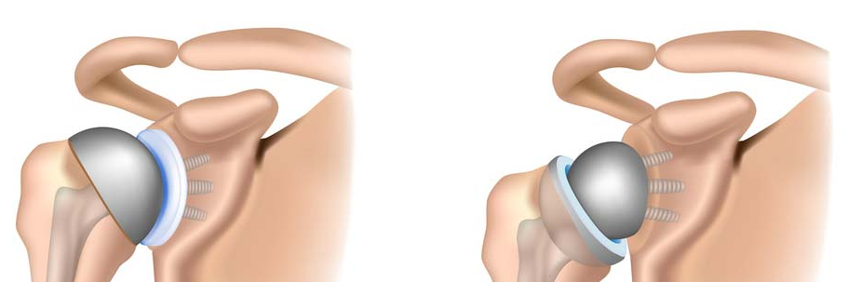
Anatomical vs Reverse
Taylor Vanderlinden
Lazarte
Arm
Arm
Shoulder
Shoulder
Anatomical
Reverse
Notes:
The anatomical design for the shoulder implantation, as shown on the left, mimics how the actual shoulder joint is shaped. Therefore, it adopts the "ball and socket" configuration where the end of the component in the individual's arm has a ball-like rounded end that fits into the cup-like socket of the component attached to an individual's shoulder. In the reverse design, as shown on the right, the anatomical design is flipped so that the "socket" is now on the component attached to an individual's arm, and the "ball" is on the component attached to an individual's shoulder. The purpose of the reverse design is to preserve more of an individual's natural tissue.

Slide 9
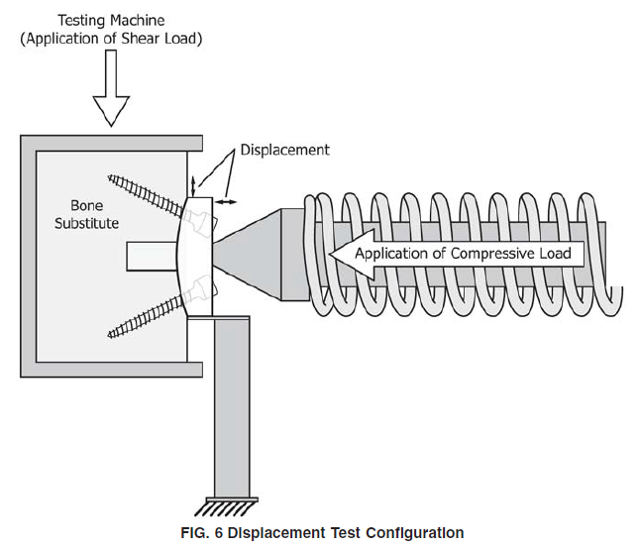
Current Standard – F2028-17 (ASTM)
Santiago Lazarte
Results are dependent on bone mimicking material
Influence of implant geometry and alignment
Test variations (e.g. drilling vs pressing, density of block material)
Improved Standards and testing methods (glenoid/shoulder specific)
Governed by deformation mechanics

Slide 10
Requirements
Kiersten Cady
Customer Needs
  Increase the strength of the interface between bone and implant
  Designs can be rigorously tested so that they exceed the current design in short and long-term fixation and resistance to forces and moments
Stability
  Resist Forces – 10% improvement from base model
Ergonomics
  Ease of Implantation
Adaptability
  Variable Implant Sizes

Slide 11
Concepts
Kiersten Cady
Concept Generation and Selection
  3 fin design (7.334 in^2) – Equinoxe Equivalent
  5 fin design (8.369 in^2)
  7 fin design (9.530 in^2)
Increase in surface area interaction makes for a stronger interface
  Adding more fins requires additional bone loss
  Finding a balance between fixation and amount of bone removed

Slide 12
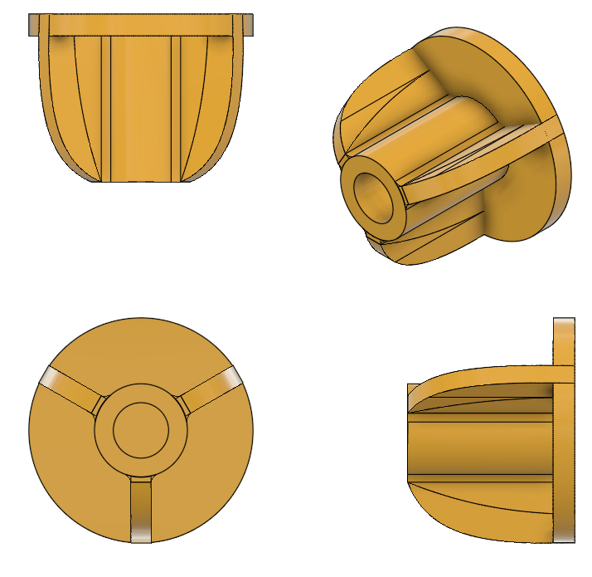
3 Fin Design
William Wartman
Notes:
My first design was the equinoxe equivalent.

Slide 13
Differences Between Designs
William Wartman
Equinoxe
3 Fin Design
Socket Attachment Point
Holes
Notes:
The 3 Fin design is the equinoxe equivalent. This design will be used as a datum point to reference the improvements or disimprovements of the alternative designs. The lack of perforations or holes is due to the manner of simulation. These holes serve to promote bone ingrowth to help long-term fixation. This is impossible to replicate in artificial bone and is removed in the equivalent design. Additionally, the Socket Attachment Point is where a secondary part is attached which encompasses the socket for the ball and socket joint. This is also eliminated as the methodology of applying the force to the implant is modified. The orange coating is plasma spray on the material to roughen the surface and give better interfacial contact.

Slide 14
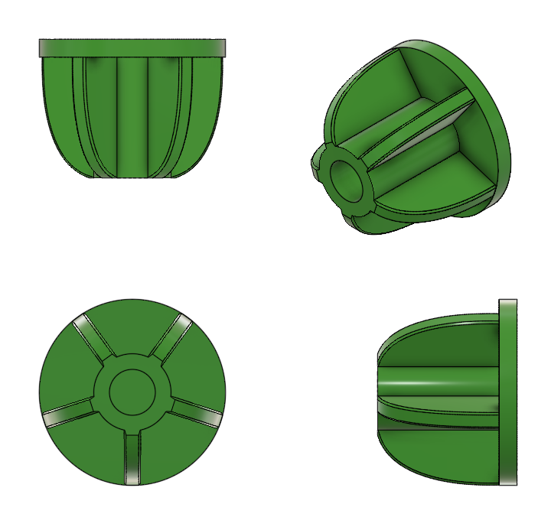
5 Fin Design
William Wartman
Notes:
The concept we approached with was that of increasing bearing surface area in the contact region. This can be done in a multitude of different ways but ultimately, I decided to keep it simple and increase the number of fins on the equinoxe model.

Slide 15
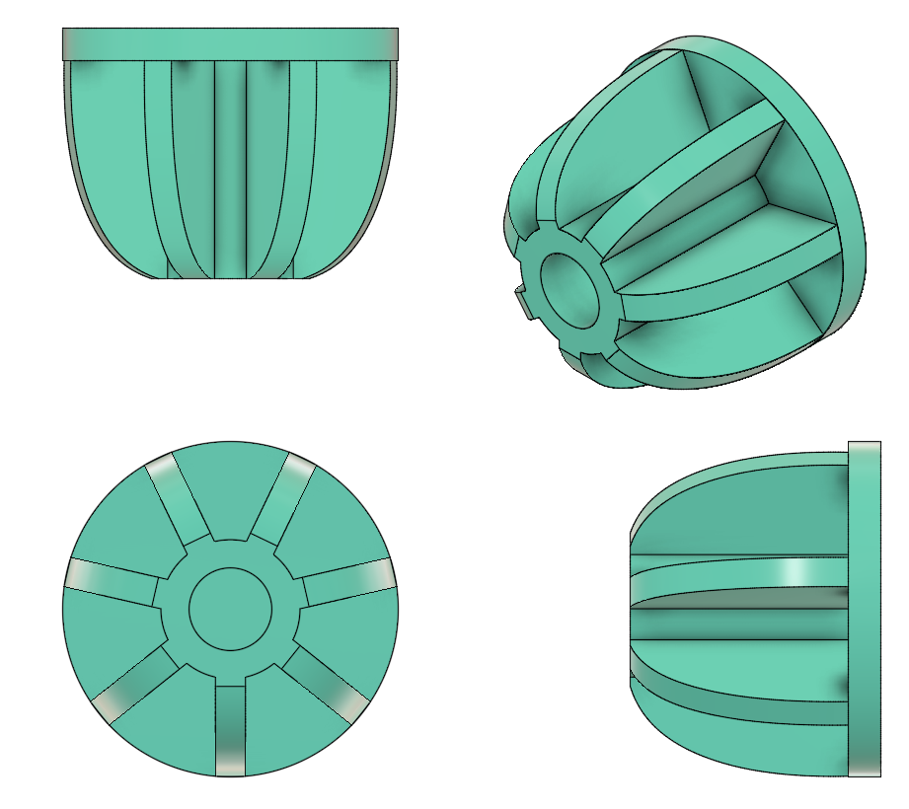
7 Fin Design
William Wartman

Slide 16
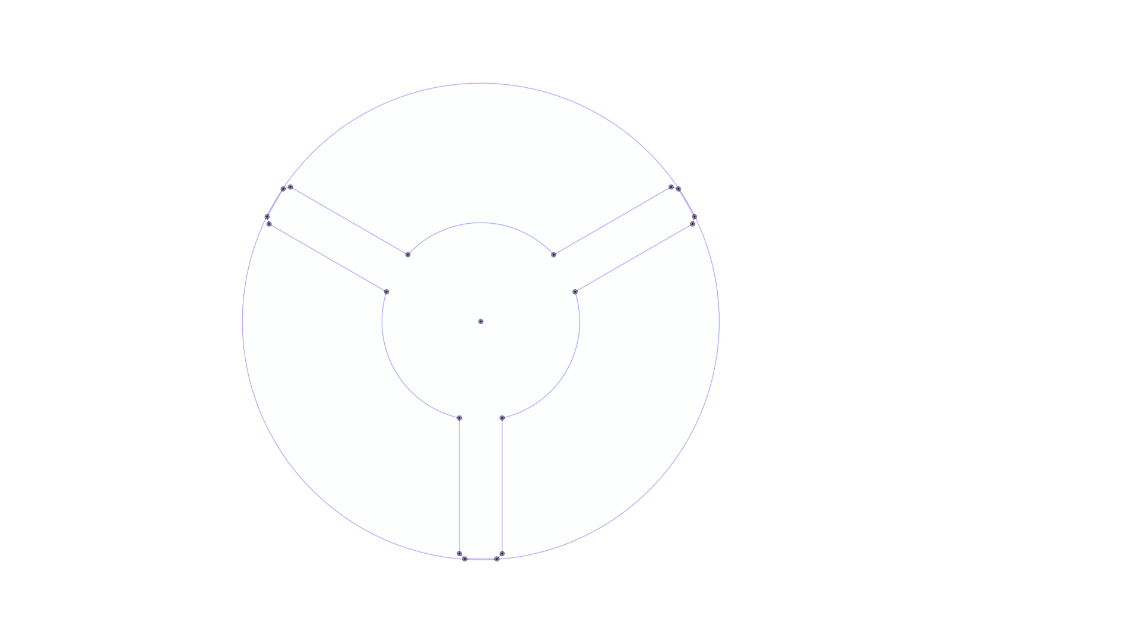
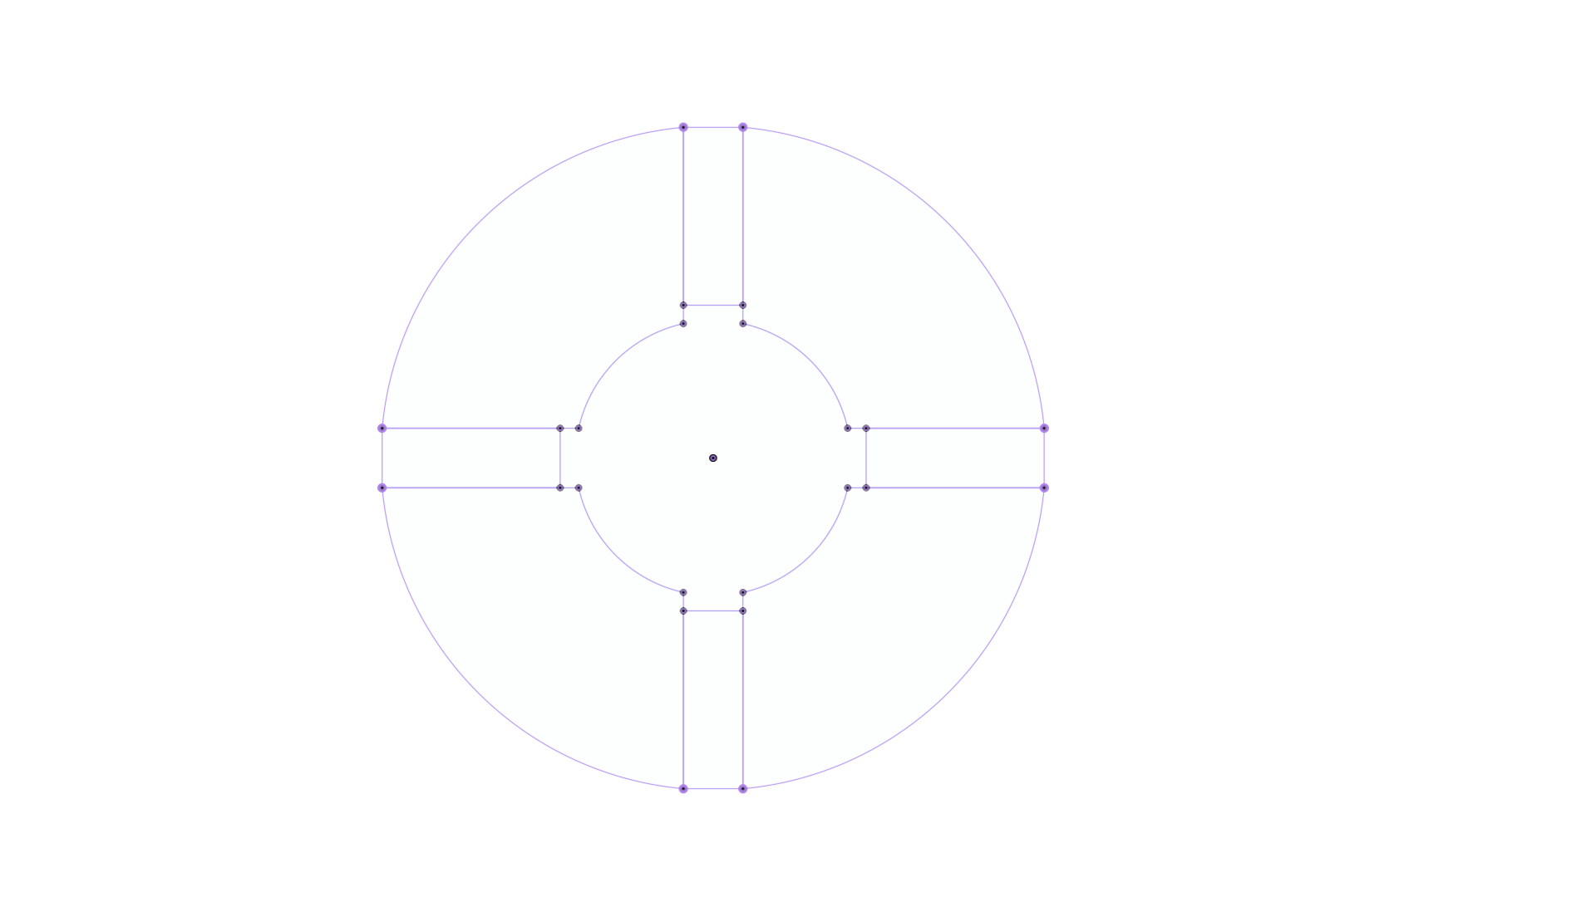
Odd vs Even #Fins
Taylor Vanderlinden
Force
Force
Notes:
2D Sketch Projection of the 3 fin model
As William just stated, we have a 3 fin, 5 fin, and 7 fin design for the shoulder implantation...
If you notice, all of the designs have an odd number of fins. We chose an odd number of fins because when the applied force falls in line with one of the fins it causes any of the fins that align with that force to be diminished causing them to fail in assisting the stability of the implant.
For the odd number of fins, only one force would be diminished versus for the even number of fins, two fins would be diminished.

Slide 17
In Line vs Not in Line
Taylor Vanderlinden
Force
Force
Notes:
To perform our testing, we orientated the shoulder implant so that we could conduct tests both in line and out of line of the implant's fins to simulate the best and worst case scenarios where a force could be applied.

Slide 18
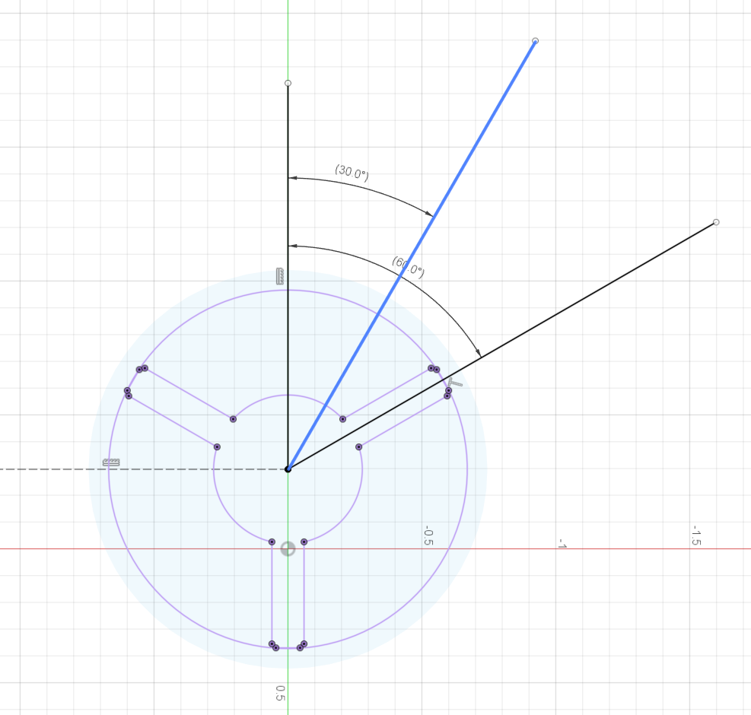
In Line vs Not in Line
Taylor Vanderlinden
3 Fin not inline 30 deg
5 Fin not inline 18 deg
7 Fin not inline 12.9 deg
Notes:
For the not in-line testing, we had to reorientate the implants so that no fins fall in line with the applied force. Therefore, we rotated the 3 fin implant 30 degrees, the 5 fin implant 18 degree, and the 7 fin implant 12.9 degrees.

Slide 19
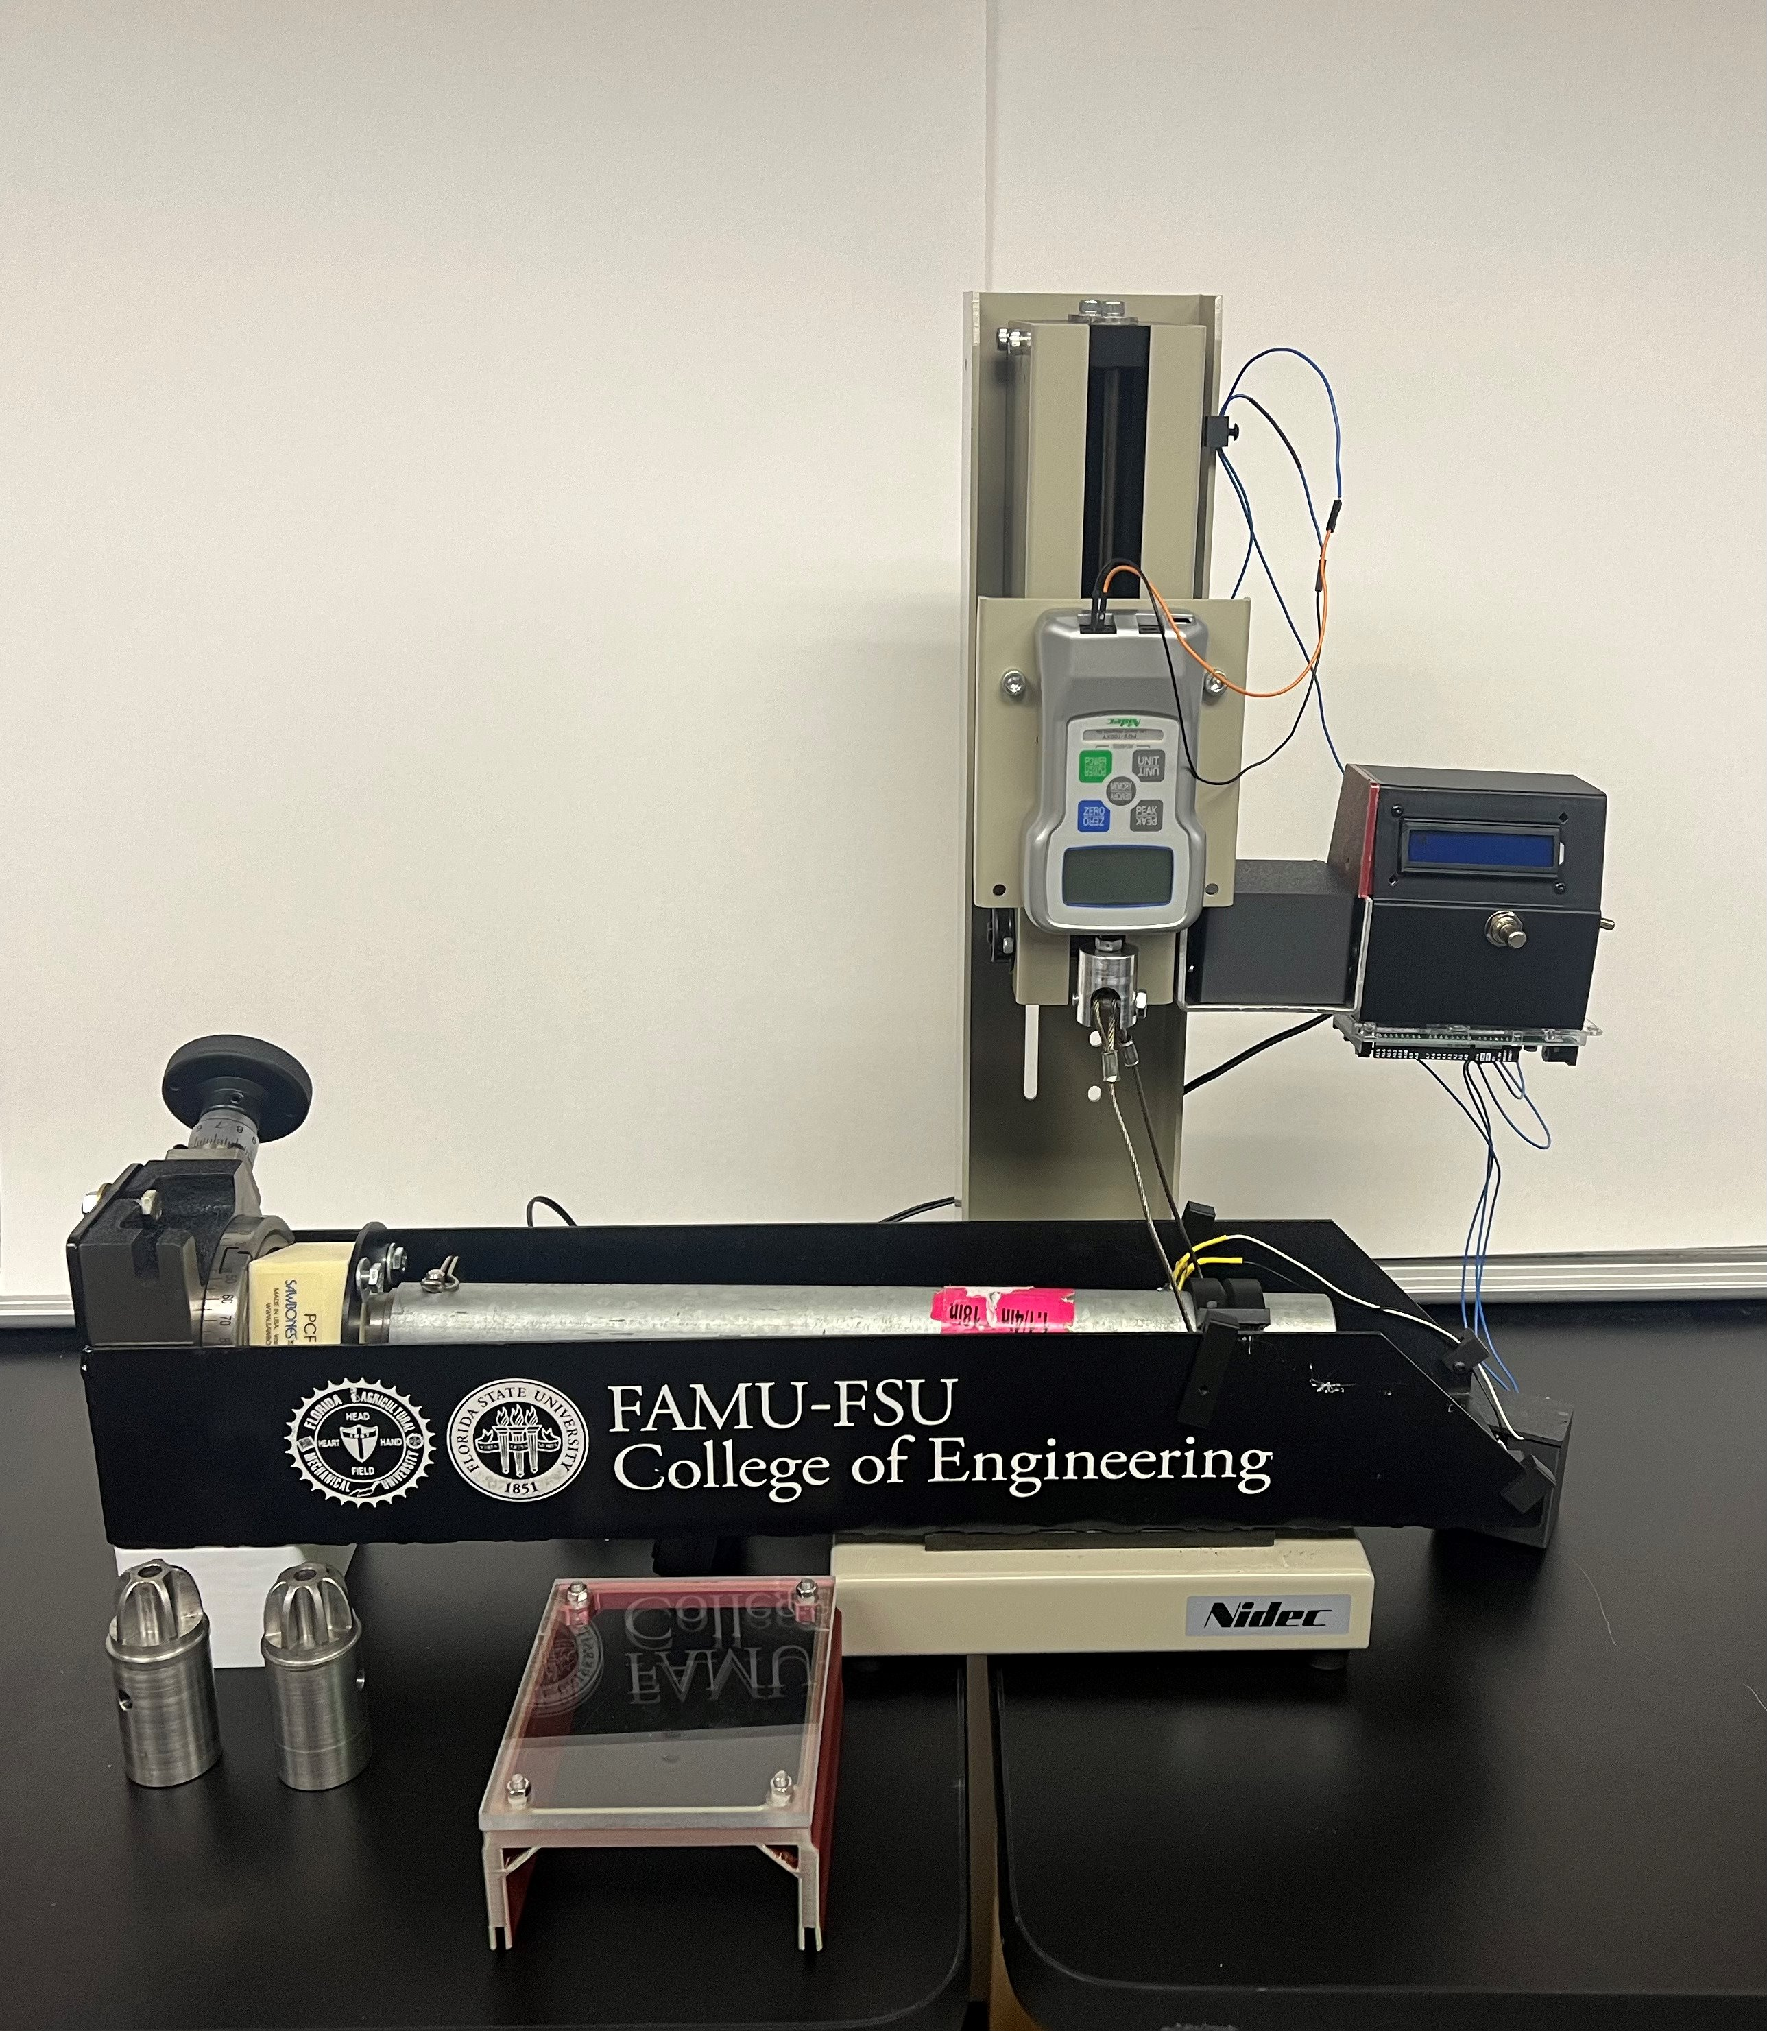
Test Stand
William Wartman
Bone Block
Force Gauge
Implant

Slide 20
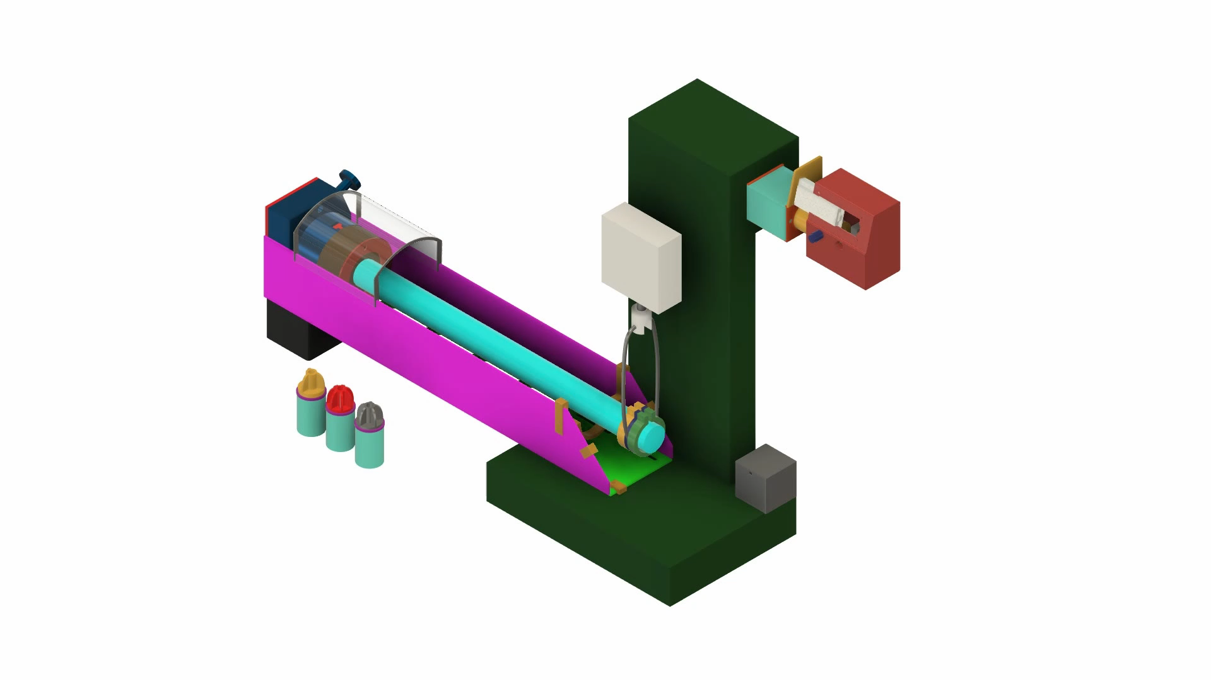
Test Stand Exploded View
William Wartman

Slide 21
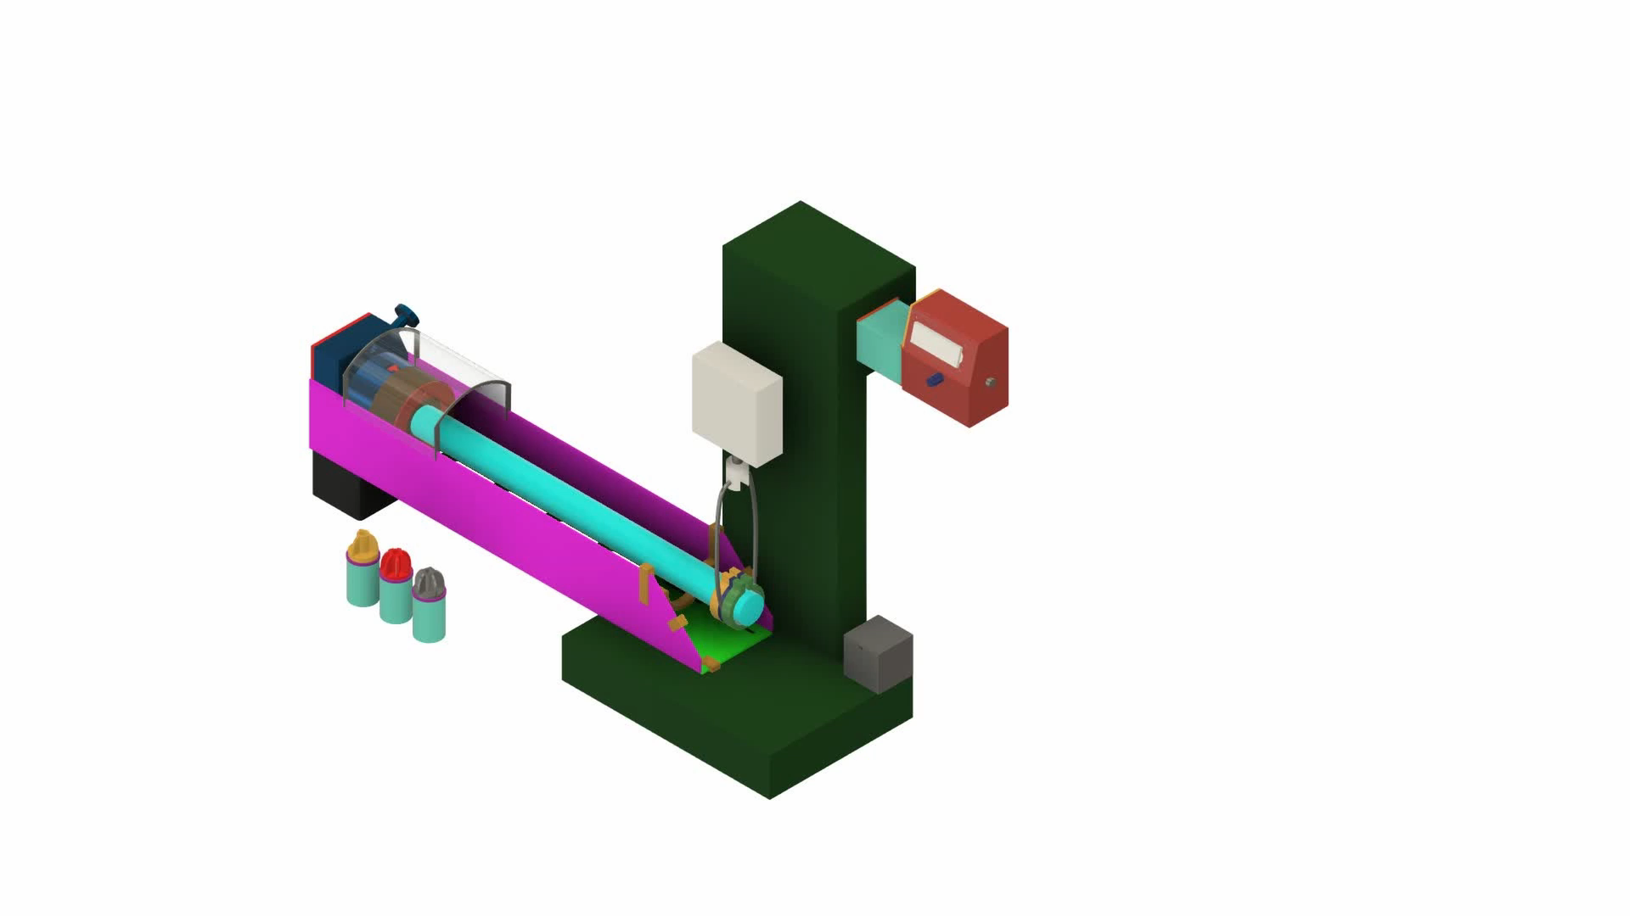
Test Stand Operation
William Wartman

Slide 22
Variables
John Sorensen
3 Fins
5 Fins
10 PCF
15 PCF
20 PCF
Poor/diseased bone quality
Healthy bone quality
In Line
Not In Line

Slide 23
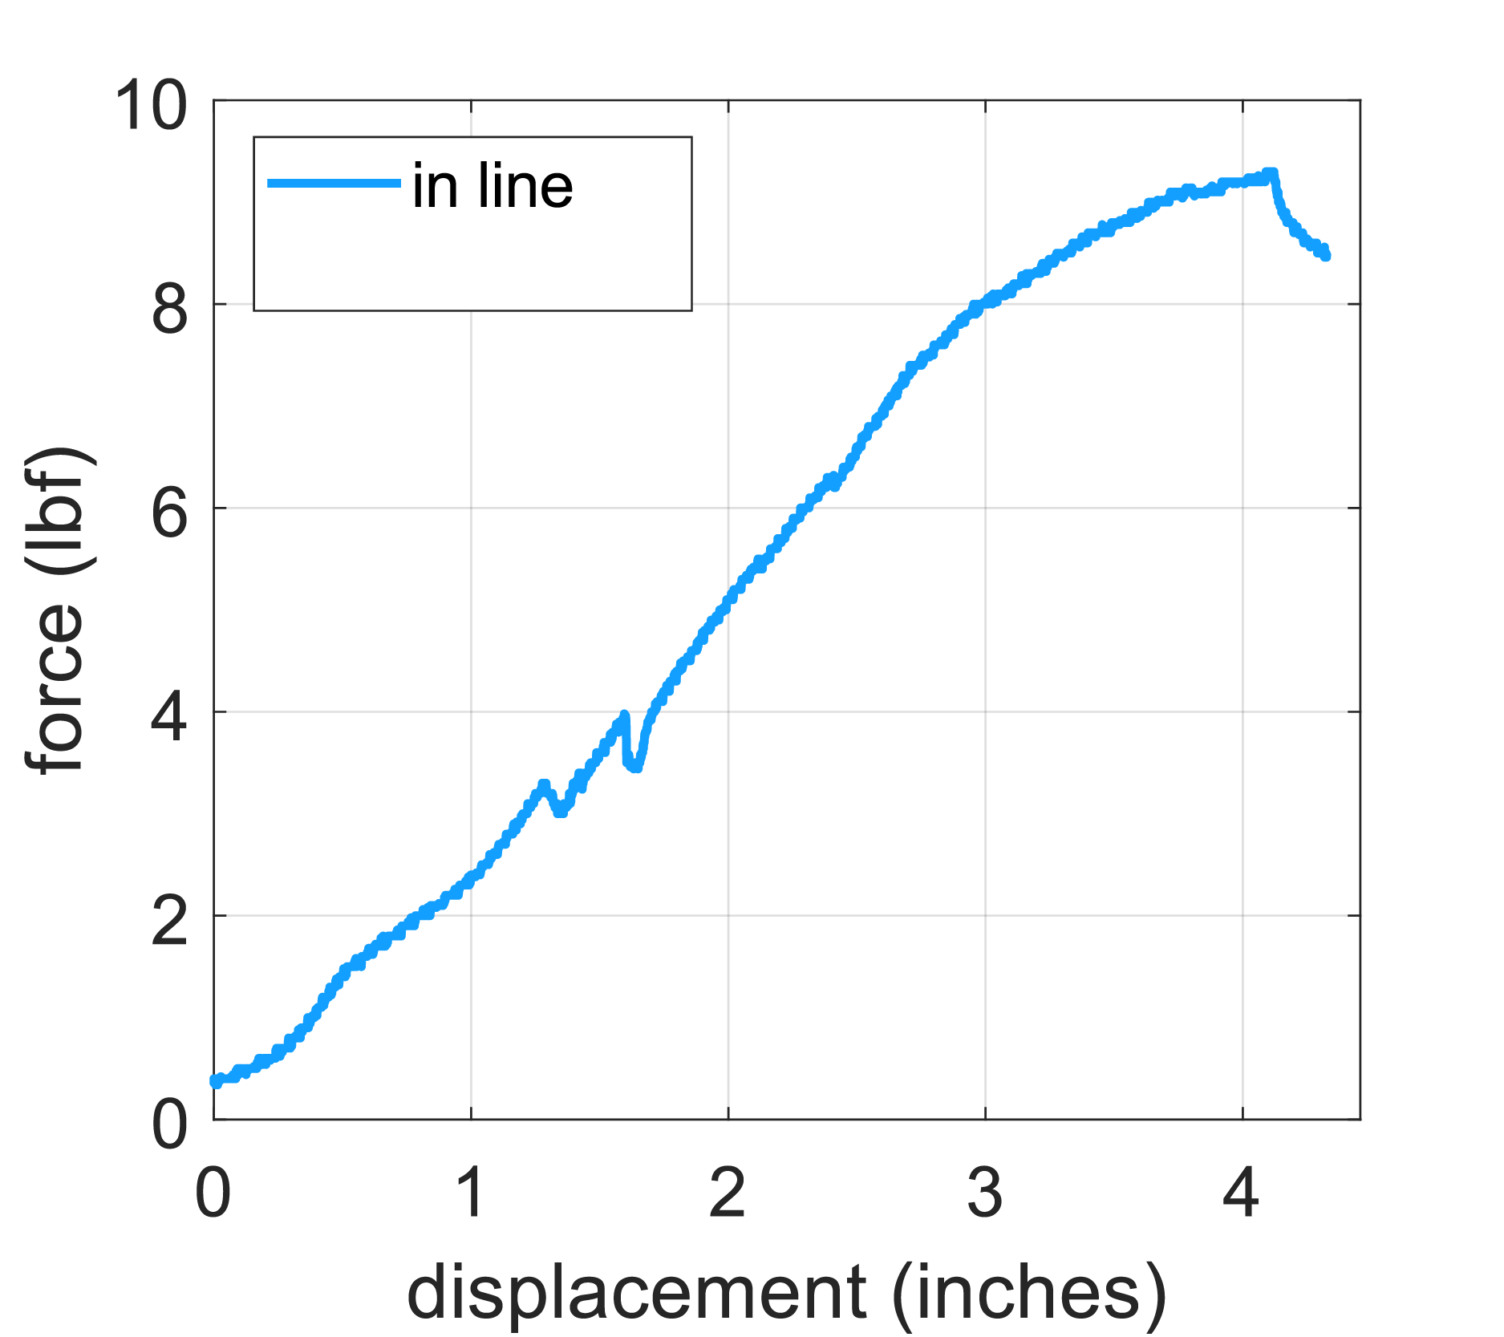
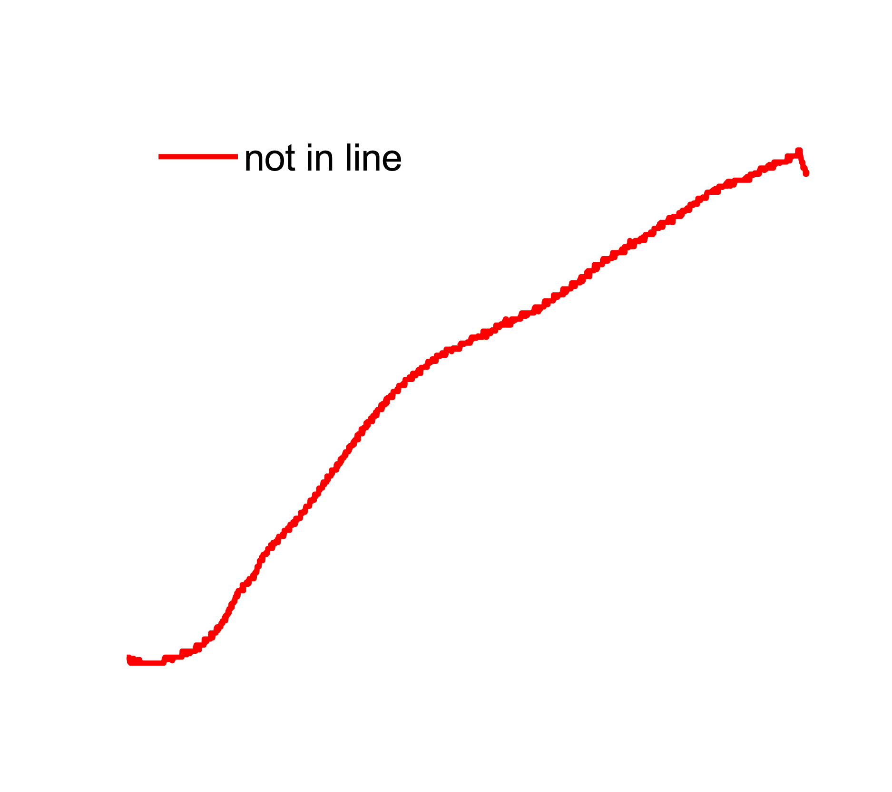
3 Fin 10 PCF
John Sorensen
In Line
  The maximum force was determined to be 9.2 Ibf and 4.1 inches
  Withstood a larger force and failed at a smaller displacement point
  Early signs of failure or experimental error
Max Force

Slide 24
3 Fin 10 PCF
John Sorensen
Not In Line
  The maximum force was determined to be 8.5 Ibf and 4.4 inches
  Withstood a smaller force and failed at a larger displacement point
  Further testing to verify results
Max Force

Slide 25
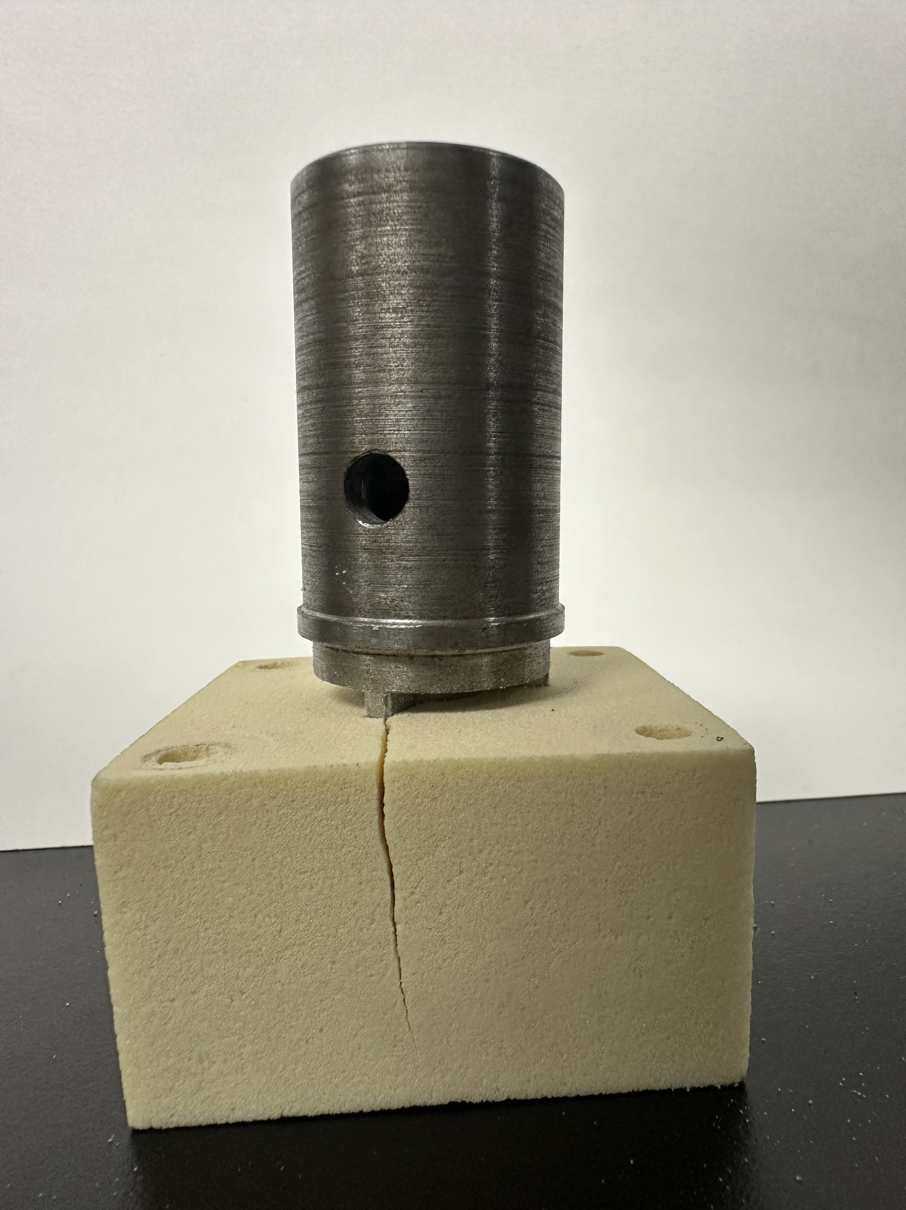
John Sorensen

Slide 26
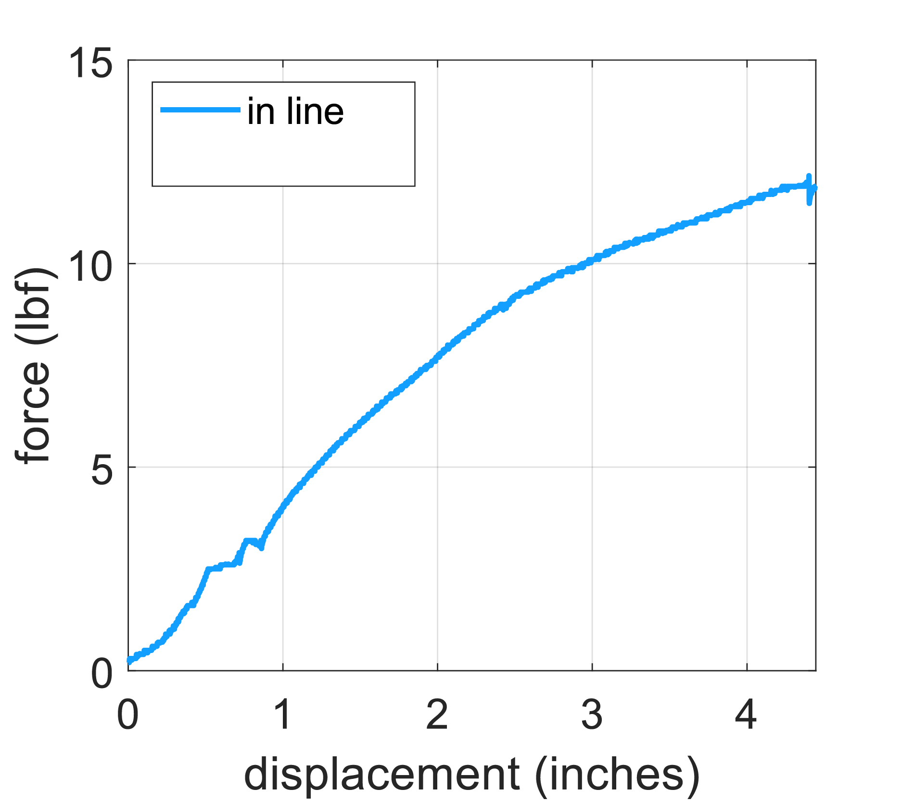
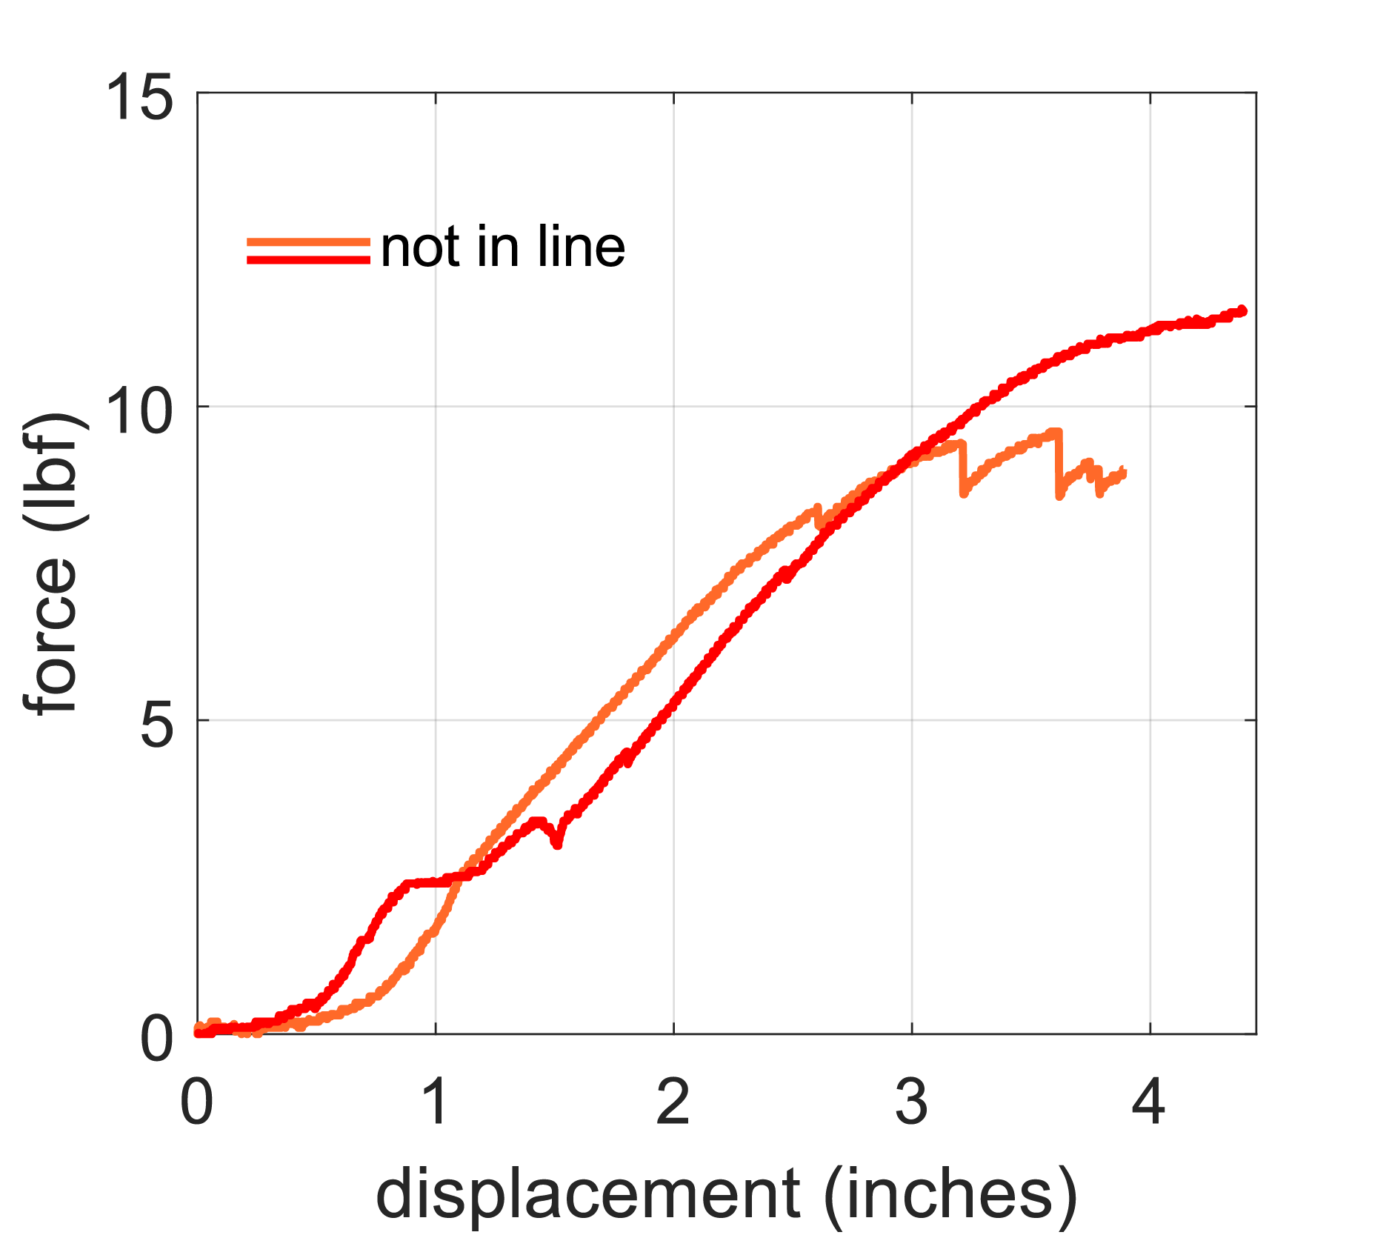
5 fin 10 PCF
Santiago
Lazarte
Decrease in force
without aligned fins

Slide 27
3 fins vs 5 fins
Santiago
Lazarte
5 fins displaces more material in the bone block

Slide 28
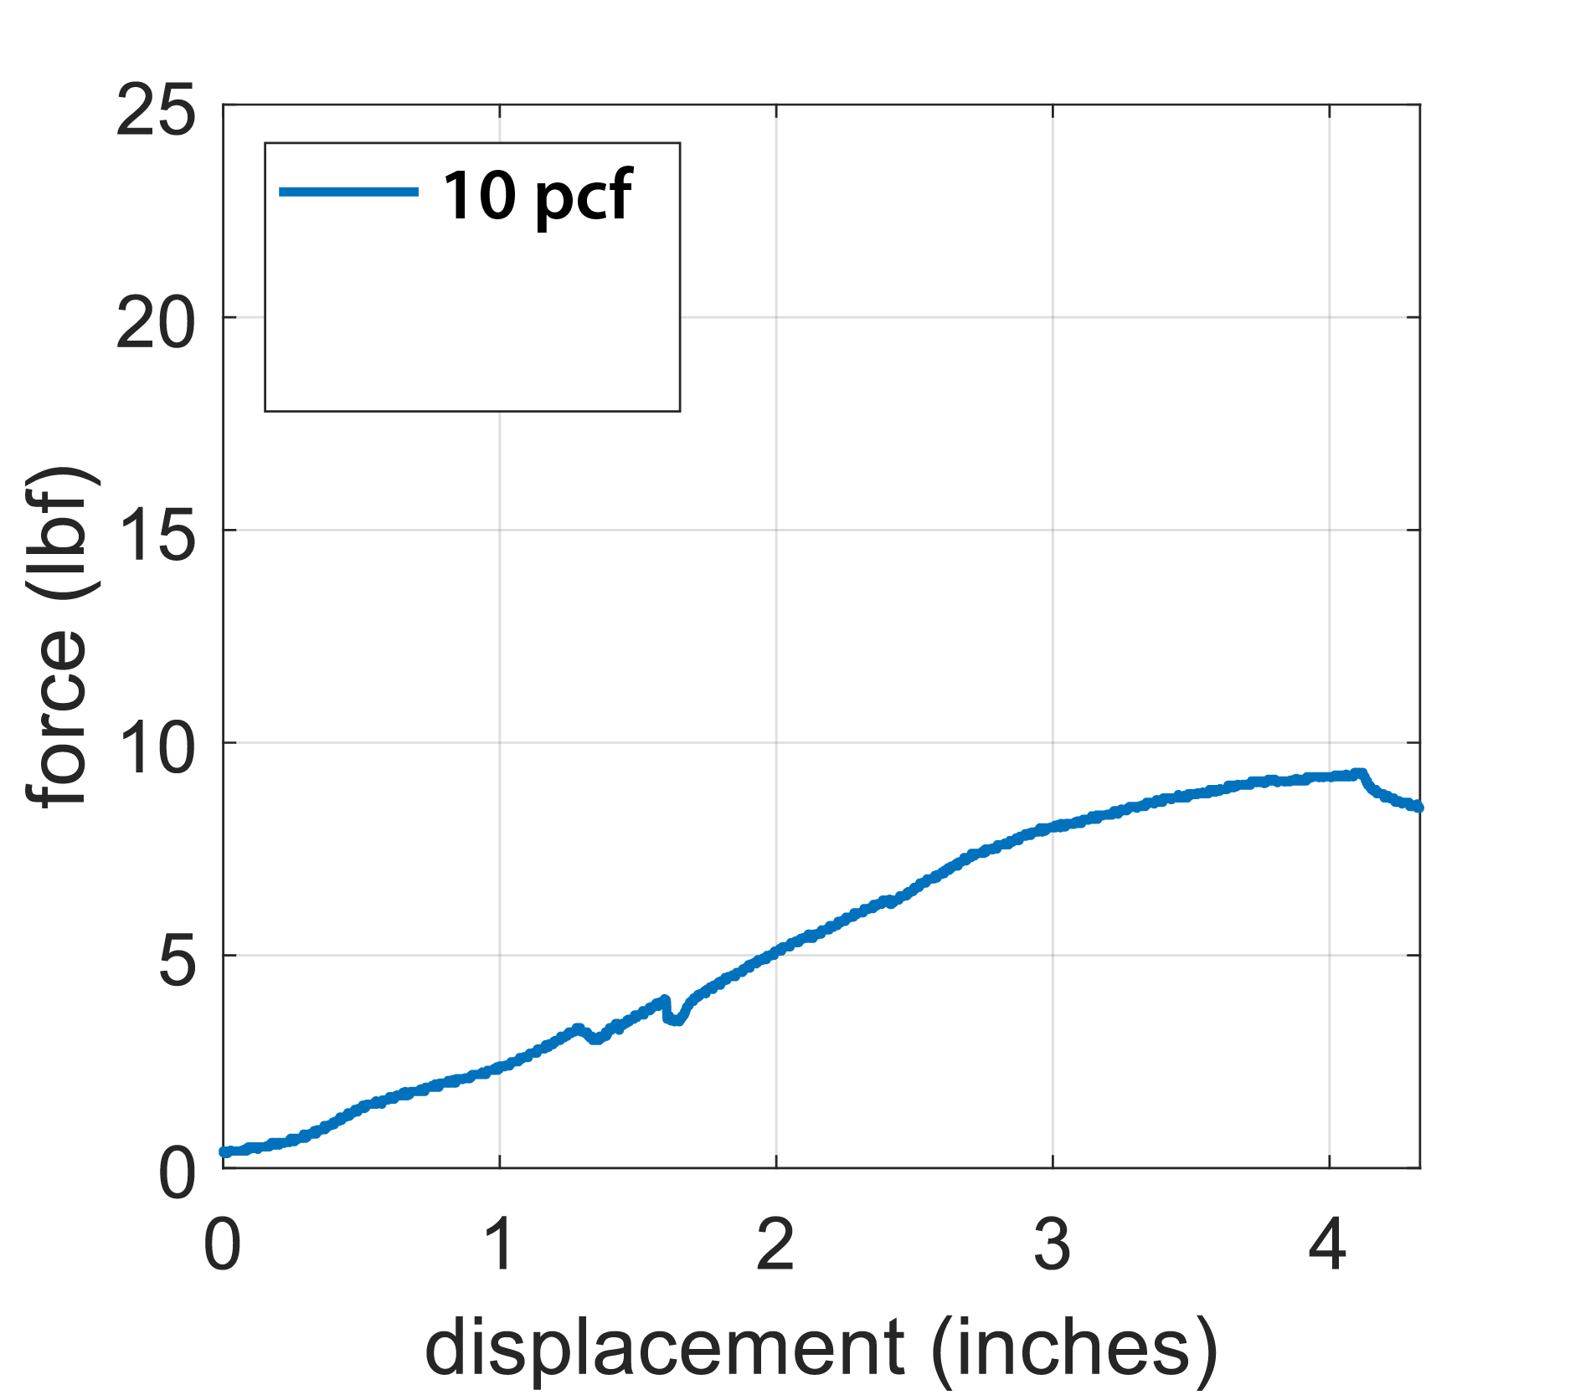
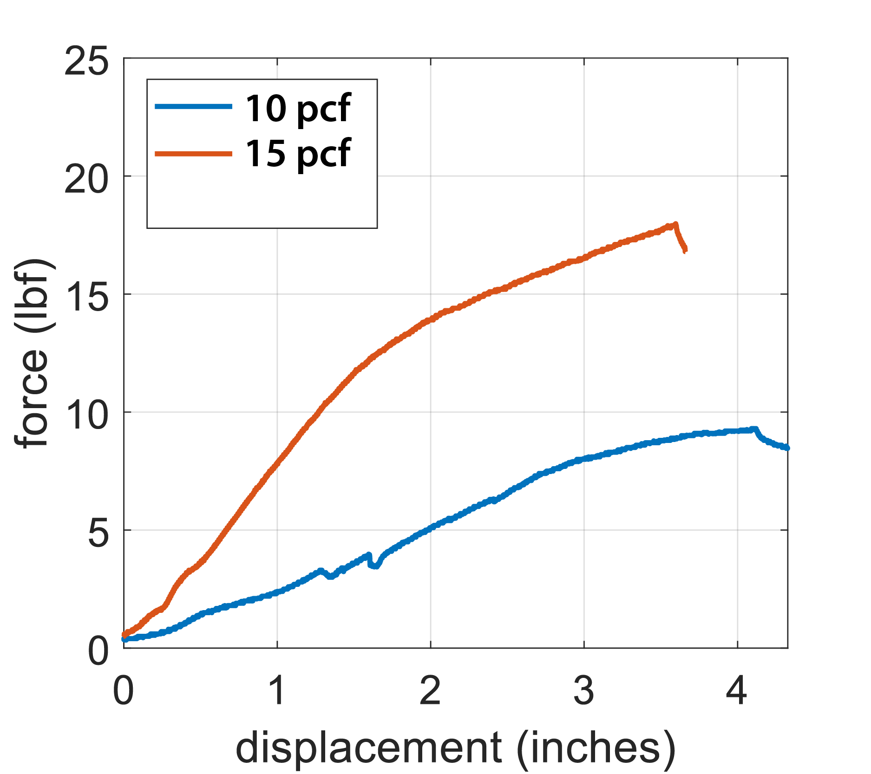
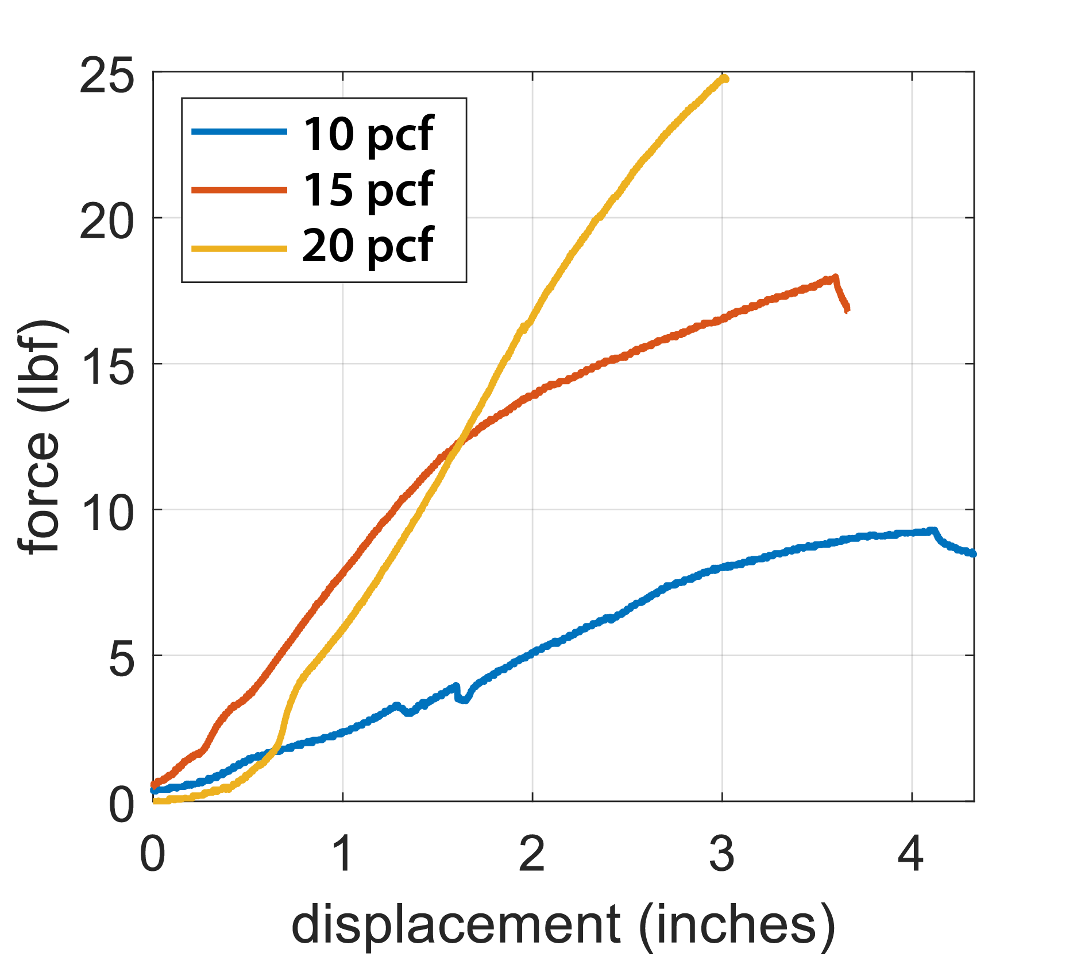
Density – 3 fin (In Line)
Santiago
Lazarte
Expected result: more material, more resistance

Slide 29
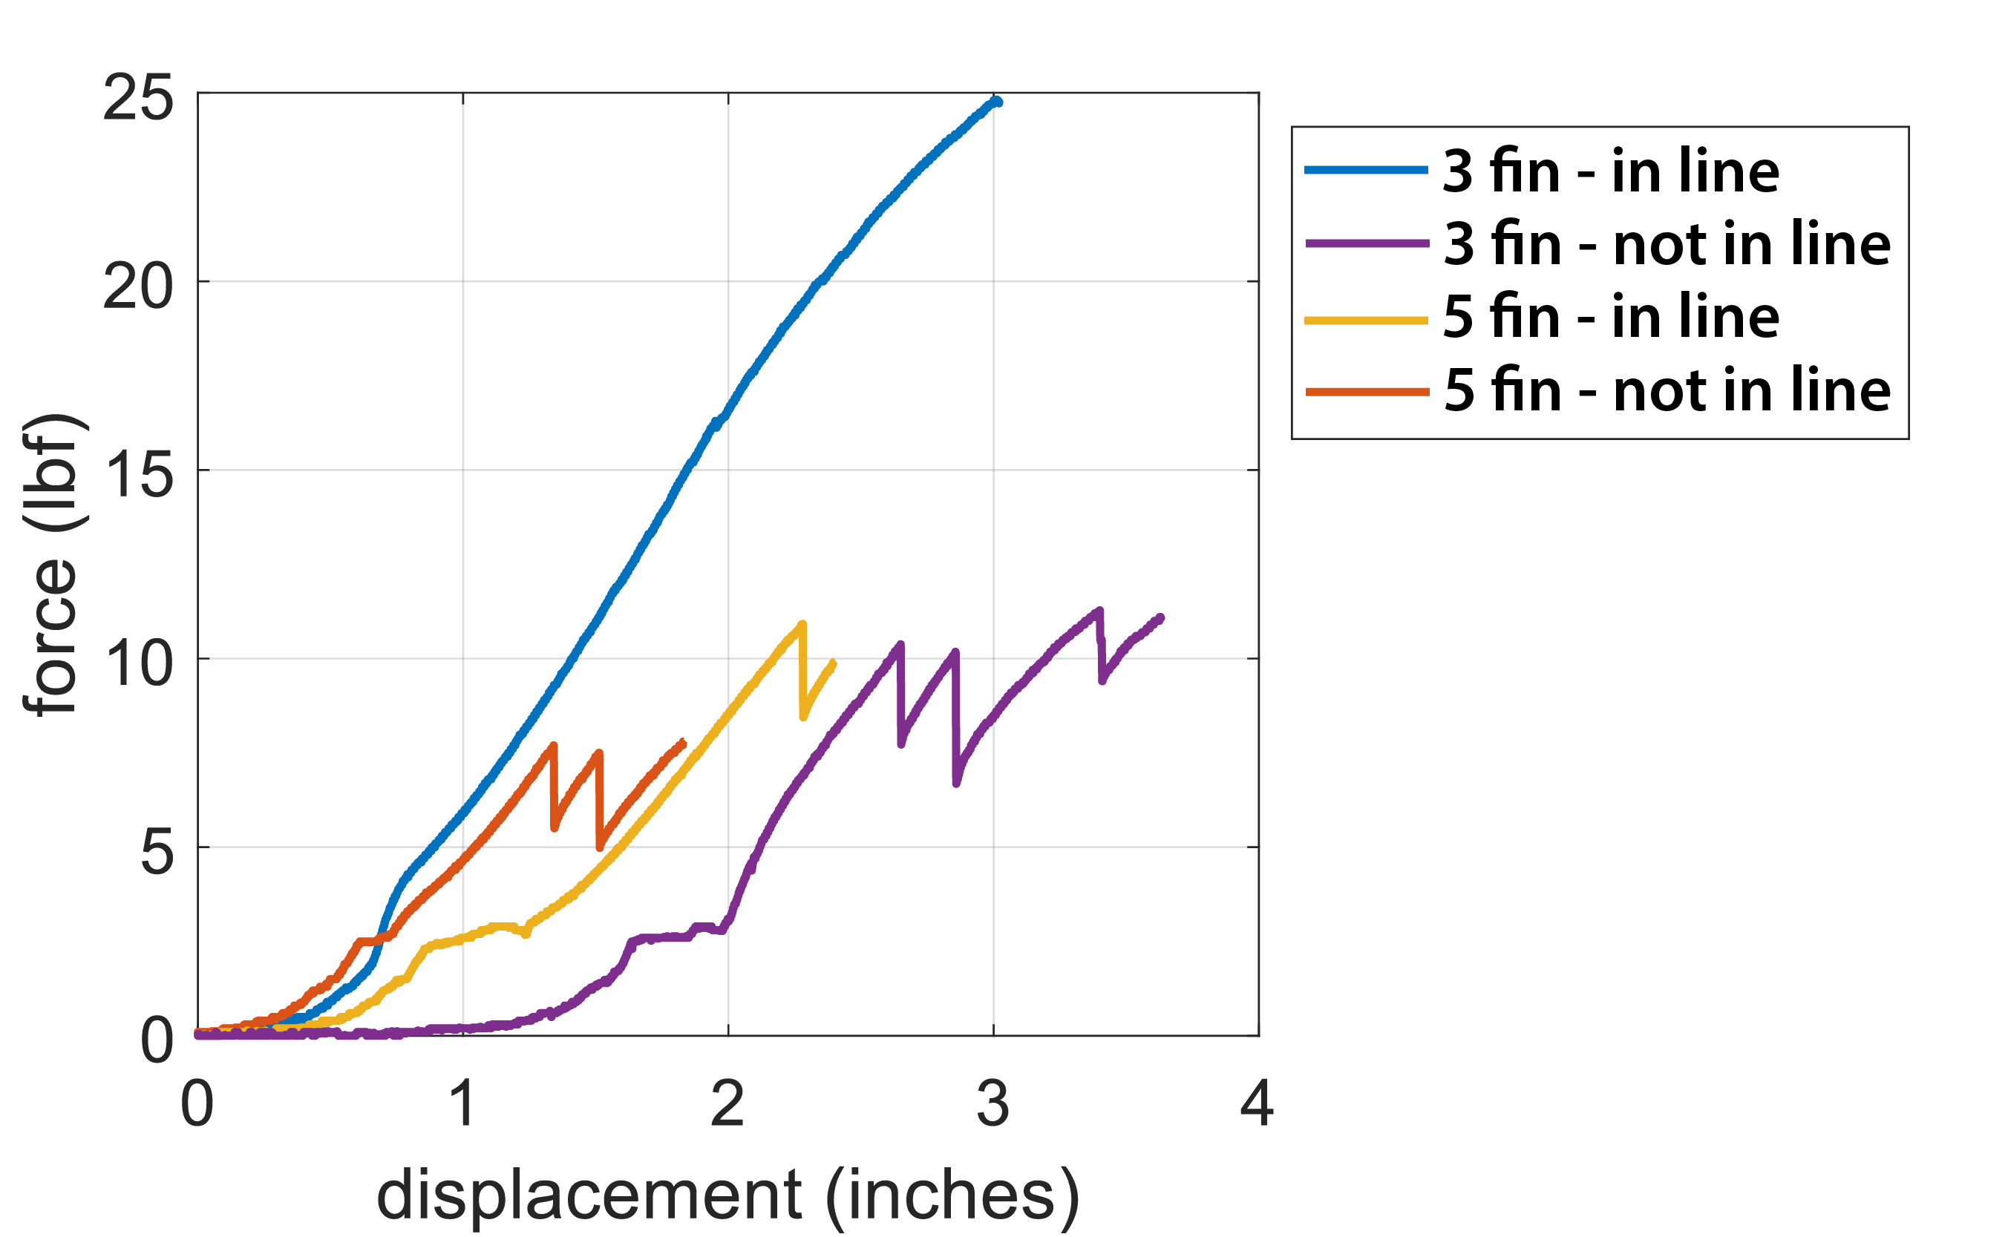
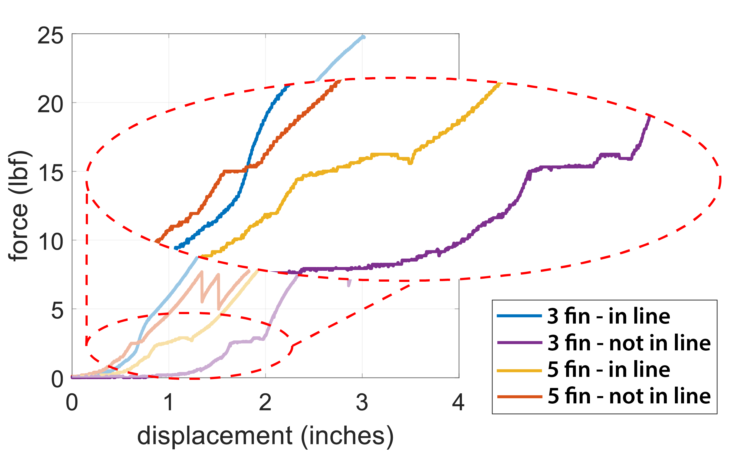
20 PCF
Santiago
Lazarte
Denser material. Strained a lot during set up. We believe the blocks are “weakened”, leading to early failure
Notes:
Standard 2028-17 suggests somewhere between 17-20 pcf

Slide 30
3-5 Fins 10 pcf
Santiago
Lazarte
Alignment | 3 Fin (Ibf) | 5 Fin (Ibf) | Percent Improvement
Inline | 9.2 | 11.1 | 20.6
Not Inline | 8.5 | 9.6 | 12.9

Slide 31
Statistical Analysis
John Sorensen
Without >30 tests in each category the results are inconclusive
Point towards a verifiable outcome
Statistics needed to show types of error and quantity
ANOVA (analysis of variance)

Slide 32
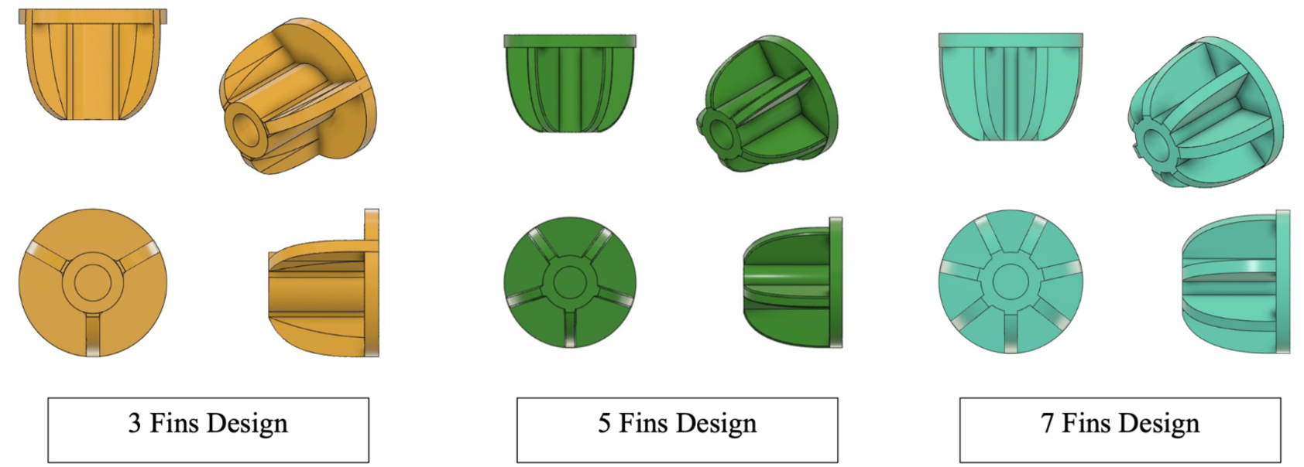
Future Testing
Angelina Lanh
Additional 3 and 5 fin tests
7 Fin Testing
Fatigue testing
  Same initial setup as max force testing with Arduino code will be written for automatic cyclic testing at 80% of max force for both orientations
Fixation/micromotion testing for adequate initial fixation for bone in-growth
Notes:
For future testing, we want to do additional max force tests for the 3 and 5 fin models for both in line and out of line, as well as begin testing the 7 fin model which we unfortunately did not get to this year. We also wanted to perform fatigue testing for all 3 models with the same initial set up but with an Arduino program that would apply torque at 80% of the max force for that model and fin orientation cyclically until failure. Another test that may be interesting to pursue is fixation or micromotion testing to prove adequate initial bone-implant fixation for ideal bone growth.

Slide 33

Thank You!
Team 112

Slide 34
References
William Wartman
[1] “5 Reasons Your Shoulder Hurts or Feels Weak,” Munson Healthcare, https://www.munsonhealthcare.org/blog/5-reasons-your-shoulder-may-hurt-or-feel-weak (accessed Mar. 5, 2024).
[2] L. Kock, C. C. van Donkelaar, and K. Ito, “Tissue engineering of functional articular cartilage: The current status,” Cell and Tissue Research, vol. 347, no. 3, pp. 613–627, Oct. 2011. doi:10.1007/s00441-011-1243-1
[3] "2 Representation of the two components (humeral head and glenoid) placed in the shoulder model,” Research Gate, https://www.researchgate.net/figure/The-variation-of-humeral-head-circular-diameter-glenoid-radius-of-curvature-Gl-RoC_fig5_322877099 (accessed Mar. 6, 2024).
[4] Equinoxe reverse system. www.exac.com. (2022, July 6).
https://www.exac.com/extremities/equinoxe-reverse-system/
[5] Total shoulder replacement surgery. Shoulder Innovations. (2022, October 31). https://shoulderinnovations.com/total-shoulder-replacement-surgery/
[6] McClintock, Dr. K. (2023, August 2). Pros and cons of reverse shoulder replacement surgery. Kyle McClintock, DO | Orthopedic Surgeon Roseville, CA. https://drmcclintock.com/pros-and-cons-of-reverse-shoulder-replacement-surgery/
[7] Shoulder bones. Joint Preservation Center. (2013, April
5). http://josephbermanmd.com/anatomy-of-the-shoulder/shoulder-bones/

Slide 35
Lessons Learned
William Wartman
Biomedical Engineering
  Shoulder anatomy
  Joint mechanics
  Implantation design
Mechanical Engineering
  Embedded programming
  Fundamental forces in the shoulder
ASTM F-1839-08 standard for ortho foam blocks
ASTM F-2028-17 standard for dynamic evaluation of glenoid loosening or disassociation
Notes:
“Standard Specification for Rigid Polyurethane Foam for Use as a Standard Material for Testing Orthopaedic Devices and Instruments”

Slide 36
Update
Kiersten Cady
Testing Apparatus
Implant Testing
  15 Tests Conducted
Data Processing
Matlab Code
Unusable Data
  Testing Rig Malfunctions
  Data Storage Issues
  Bone Block Cracking

Slide 37

Goal Result
Angelina Lanh
Patients with a stemless shoulder replacement to have increased stability at the joint with the option for a reverse stemless design
Notes:
The overall goal result is for the patient with a stemless to have increased joint stability and decreased pain at the joint with the new option to have a reverse stemless design. And to tie it back to our example in the beginning, after a stemless reverse shoulder replacement, Linda can now see her grandchildren more often due to a significant reduction in pain and increased mobility, and no longer requires her strong prescription painkillers.

Slide 38
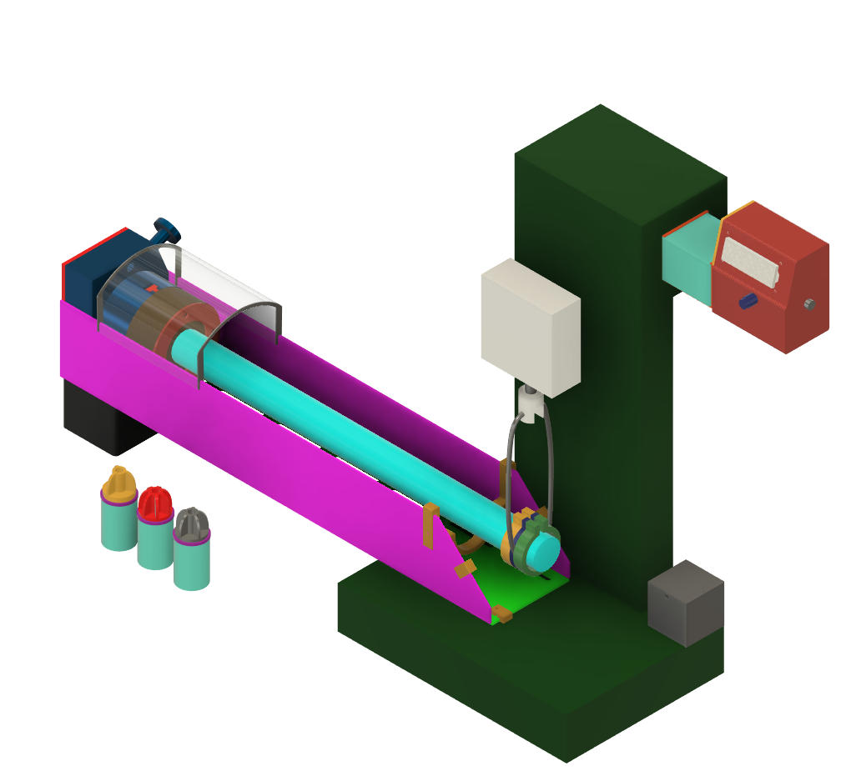
Test Stand Assembly
William Wartman

Slide 39
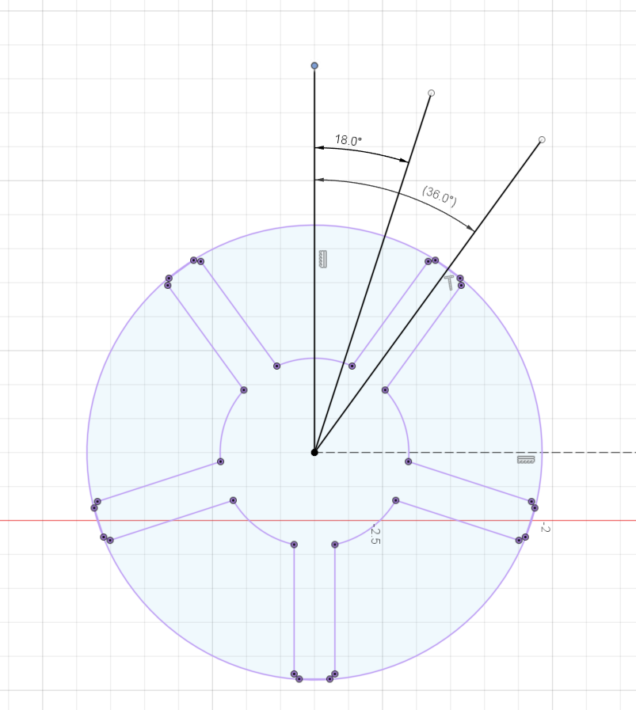
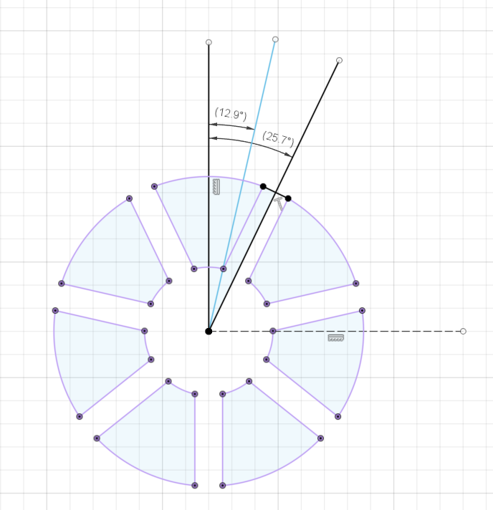
William Wartman

Slide 40
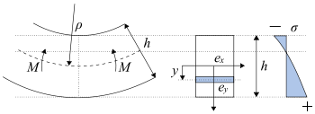
Bending Stress
William Wartman
Notes:
We don’t care about bending stress in the beam (tube) we only care about bending stress at the interface

Slide 41
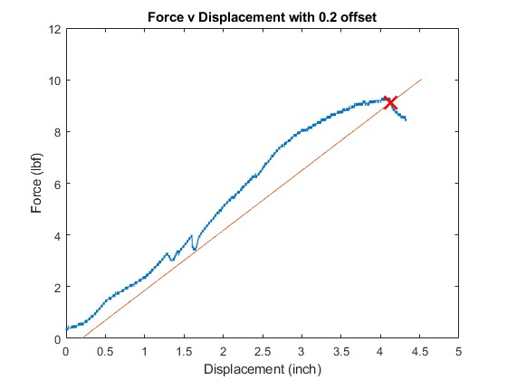
Furthering Failure Criterion
William Wartman
Similar to 0.2% offset in stress-strain graph
1st order linear fit with 0.2 displacement offset from the origin
Small dips likely due to accidentally contact with the shutoff switch during testing
Notes:
Graph is of 10 PCF bone block using the 3 FIN model Block 8

Slide 42
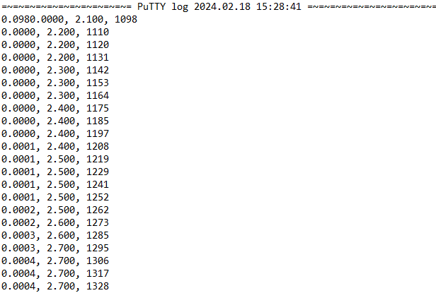
PuTTY Serial Output
William Wartman
Displacement (in)
Time (milliseconds)
Force (lbf)

Slide 43
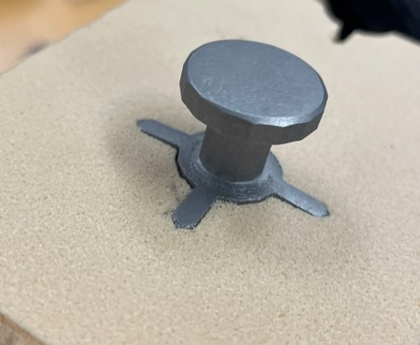
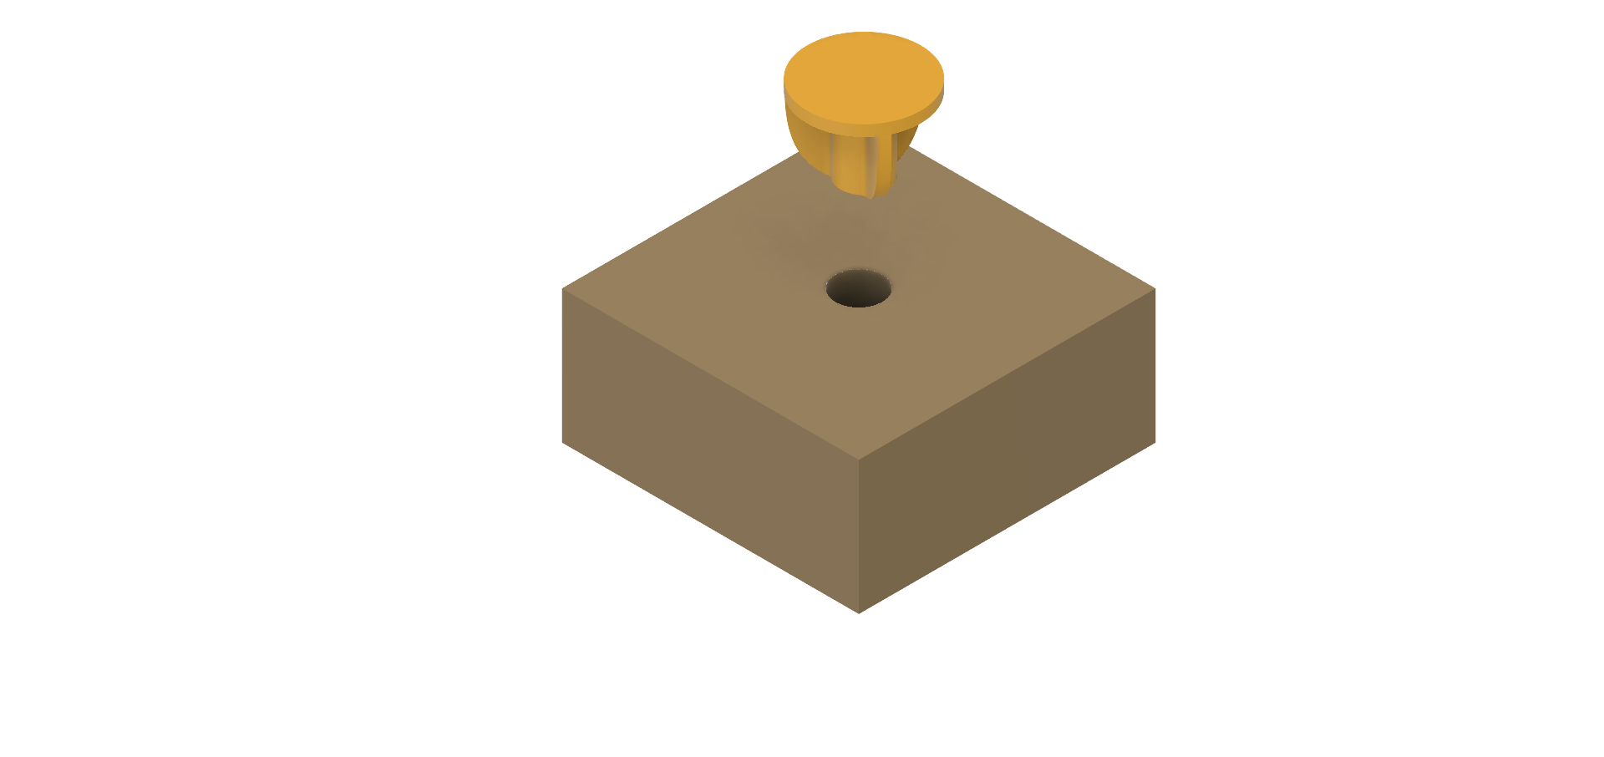
Testing Implantation Methods
William Wartman
Pressing Force
2
Bone Block

Slide 44
Equinox
William Wartman

Slide 45
Backup Slides

Slide 46
Functional Decomposition
Kiersten Cady
Reversible Stemless Shoulder Implant
Stability
Ergonomics
Adaptable

Slide 47
Even vs Odd #Fins
Taylor Vanderlinden
Force
Notes:
2D Sketch Projection of the 3 fin model
Versus when looking at the even number of fin design in the case where an applied force aligns with one of the fins, then it will actually cause two of the fins to fail in assisting the stability of the shoulder implant.

Slide 48
Functional Decomposition
Kiersten Cady
Stability
Hold shoulder
Resist Shear Forces
Resist Rocking Moments
Resist Torque
Ergonomics
Easier to Implant
Adaptable
Variable Sized Implants

Slide 49
Future Testing
Angelina Lanh

Slide 50
Targets and Metrics
Kiersten Cady
Preventing premature implant failure
Resist shear, torque, or rocking moments
Improvements the ease installation

Slide 51
Targets and Metrics
Kiersten Cady
Targets
Resists rocking moments at least 10% better than Equinox
Resists torque at least 10% better than Equinox
Resists shear forces at least 10% better than Equinox
Implantation is at least 10% better than Equinox

Slide 52
Targets and Metrics
Kiersten Cady
Resist Rocking Moments
Moment (Newton-meter)
Resist Shear
Stress (Newton per square meter)
Resist Torque
Easier to Implant
Physical Exertion
Time
Steps
Torque (Newton-meter)

Slide 53
Targets and Metrics
Kiersten Cady
Lifespan
Cost of Manufacturing
Recyclability
90% recyclable
Material composition and overall part density
10-20 years with minimal surgical revisions

Slide 54
Concept Generation
Kiersten Cady
Anti-Problem
Battle of Perspectives
Biomimicry
Material Composition
Fixation Methods
Cylinder Geometry
Fin Geometry

Slide 55
Concept Generation
Kiersten Cady
Medium Fidelity Concepts
Large diameter hollow cylinder with internal fins
Large diameter hollow cylinder with internal cylinder
Small diameter hollow cylinder with four external fins
Small diameter hollow cylinder with five external fins
Small diameter hollow cylinder with internal fins and external fins

Slide 56
Customer Needs
Question | Customer Statement | Interpreted Need
What are the current design’s causes of failure? | Rocking and shear stress. | Increase strength of the interface between bone and implant.
What do you want us to do? | Improve upon the current Exactech’s design. | Development of designs that can be rigorously tested such that they exceed the current design in longevity and resistance to certain forces and moments.
Would fasteners work to secure the implant to the bone? | No, due to the density of bone fasteners would not work. | Other methods of attaching are needed to prevent bone fragmentation.
How should be align implants for testing? | Last year's team made 3D printed punches, you will need something similar. | Design and implement punches to properly align implants with the substitutive bone surface.

Slide 57
Customer Needs continued...
Question | Customer Statement | Interpreted Need
Does a current method of testing, these designs exist? | Last year's team focused on testing their designs using their own methods, you will need to do something similar. | We will need to develop a solid method of testing designs for max shear and bending moment.
What are some ways to imitate bone for implant testing? | Bone block or bone foam. | Bone block or bone foam.
Which factors are important besides the implant bone interface? | Mobility and preventing scapular notching are both important factors. | Our design must consider these two phenomena when designing.
What different configurations are currently available for these implants? | Both inlay and onlay, I would like to see you test both. | Investigate both and compare the results.

Slide 58
Customer Needs continued...
Question | Customer Statement | Interpreted Need
Can cement or epoxy be used to secure the implant to the bone? | No due to revision surgeries. The cement and implant can't always be removed. | No due to revision surgeries. The cement and implant can't always be removed.

Slide 59
Functional Decomposition
Function​ | Stability​ | Ergonomics​ | Adaptable​
Resist Rocking moments​ | X​ | ​ | X​
Resist Shear forces​ | X​ | ​ | X​
Resist Torque​ | X​ | ​ | X​
Easier to Implant​ | ​ | X​ | ​
Variable Sized Implants​ | ​ | X​ | X​

Slide 60
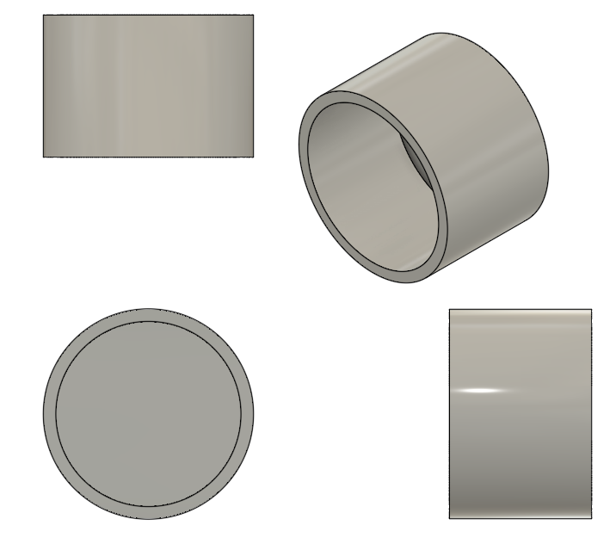
Cup Design
William Wartman

Slide 61
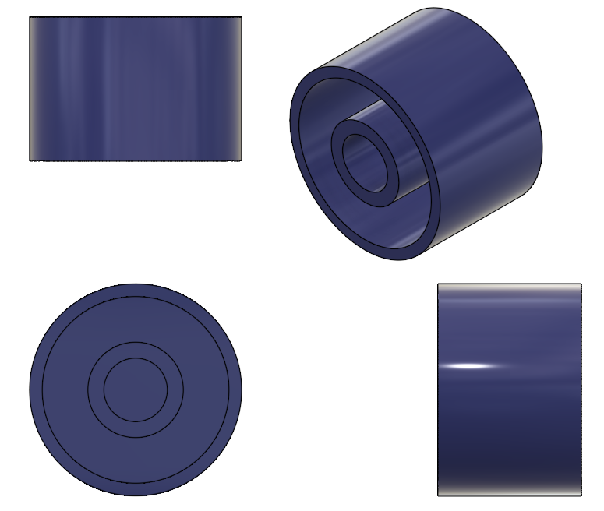
Cup Internal Cylinder Design
William Wartman

Slide 62
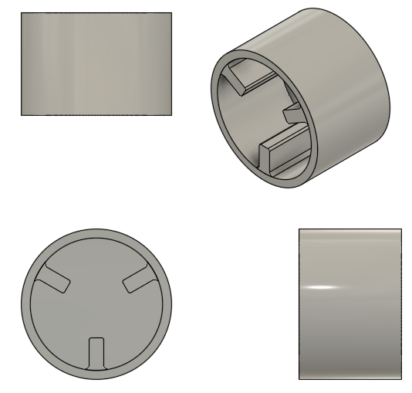
Cup Internal 3 Fin Design
William Wartman

Slide 63
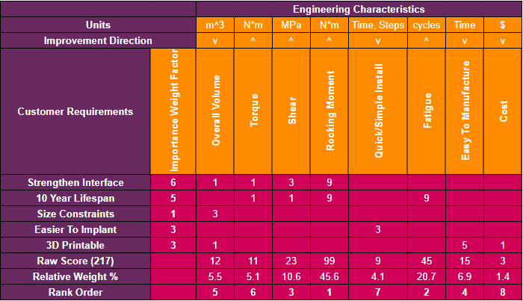
HOQ
William Wartman

Slide 64
Top Five Most Important Engineering Characteristics
William Wartman
Rank Order | 1 | 2 | 3 | 4 | 5
Engineering Characteristic | Rocking Moment | Fatigue | Shear | Easy to Manufacture | Overall Volume

Slide 65
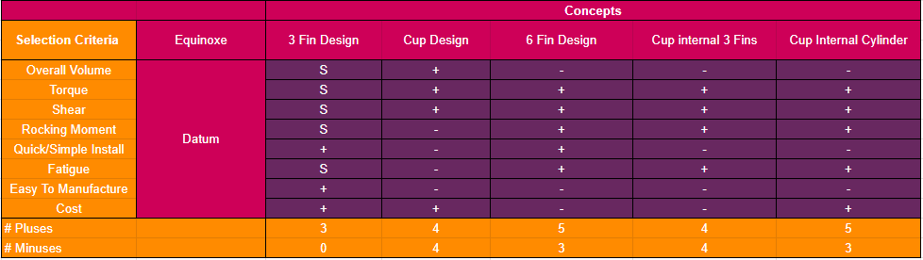
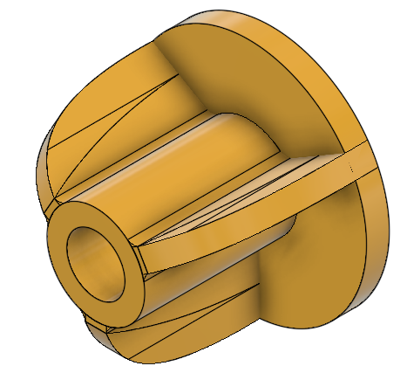
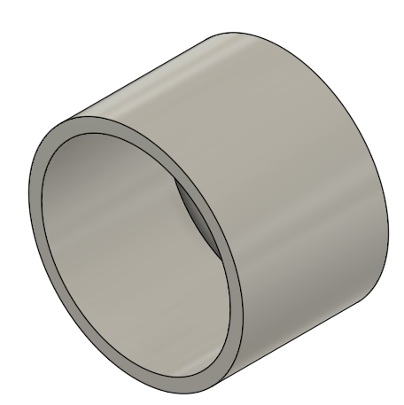
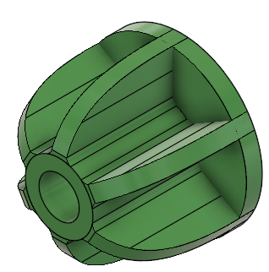
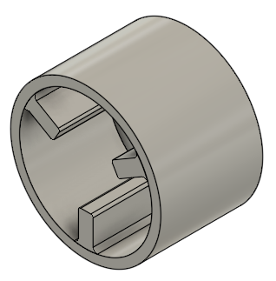
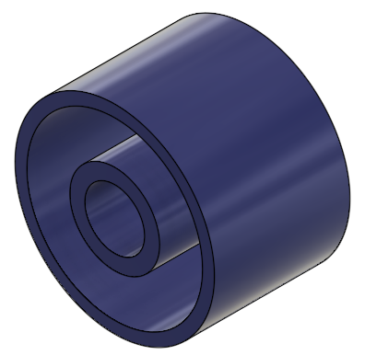
Pugh Chart
William Wartman

Slide 66

Pugh Chart Continued
William Wartman

Slide 67




Final Rating Matrix
William Wartman
Cup
6 Fin
Cup Internal Cylinder

Slide 68

Inlay vs Onlay

Slide 69
College of Engineering Color Palette
1 2 3 4
Pantone: PMS 195 C
RGB: 120, 47, 64
Hex: #782F40
CMYK:19, 90, 50, 55
1 2 3 4
Pantone: Black C
RGB: 0, 0, 0
Hex: #000000
CMYK:0, 0, 0, 100
Garnet
Black
1 2 3 4
RGB: 238, 118, 36
Hex: #EE7624
CMYK:2, 66, 99, 0
1 2 3 4
Pantone: PMS 000C
RGB: 255, 255, 255
Hex: #FFFFFF
CMYK: 0, 0, 0, 0
Fang
Orange
White
Notes:
Avoid 75% Black in B135

Slide 70
Accent Color Palette
1 2 3 4
RGB: 0, 59, 111
Hex: #003B6F
CMYK:
1 2 3 4
RGB: 0, 59, 111
Hex: #003B6F
CMYK:
1 2 3 4
RGB: 251, 236, 93
Hex: #FBEC5D
CMYK:
1 2 3 4
RGB: 219, 215, 210
Hex: #DBD7D2
CMYK:
1 2 3 4
RGB: 251, 236, 93
Hex: #FBEC5D
CMYK:
1 2 3 4
RGB: 219, 215, 210
Hex: #DBD7D2
CMYK:
Tardis Blue
Tardis Blue
Corn
Timberwolf
Corn
Timberwolf
1 2 3 4
RGB: 206, 0, 88
Hex: #CE0058
CMYK: 0, 100, 43, 12
1 2 3 4
RGB: 206, 0, 88
Hex: #CE0058
CMYK: 0, 100, 43, 12
1 2 3 4
RGB: 104, 40, 96
Hex: #682860
CMYK:
1 2 3 4
RGB: 220, 220, 220
Hex: #DCDCDC
CMYK:
Rubine Red
Rubine Red
Imperial
Gainsboro
1 2 3 4
RGB: 72, 146, 155
Hex: #48929b
CMYK:
1 2 3 4
RGB: 64, 224, 208
Hex: #40E0D0
CMYK:
1 2 3 4
RGB: 255, 139, 0
Hex: #FF8B00
CMYK:
Asagi-iro
Turquoise
American Orange
Notes:
Remove American orange add hyperlink grey
Make corn the last for b135
All work in 134 imperial move later
Tardis doesn’t work in b136

Slide 71
F7AB19
D67F15
EE7624
D64615
F73119
Analogous
https://color.adobe.com/create/color-wheel
6E3610
F0A16C
EE7624
6E4931
BASB1C
Monochromatic
A14508
4BED3B
EE7624
250CED
2010A1
Triad
A1470C
FF8C40
EE7624
0098A1
24E2ED
Complementary
28A164
2FED8D
EE7624
0848A1
1871ED
Split Complementary
EDAC2F
3BED93
EE7624
0C6AED
ED2F18
Double Split Complementary
ED660C
C7ED3B
EE7624
0CE1ED
A418ED
Square
BA7E09
87724A
EE7624
60EFCF
09BA61
Compound
AD551A
6E3610
EE7624
FA7625
D46820
Shades
Notes:
These are the variants that work well with Fang Orange. The bolded items show well on the projectors.

Slide 72
85412D
8F3831
782f40
8F3176
792D85
Analogous
https://color.adobe.com/create/color-wheel
C44D69
8E626D
782F40
C48796
451B25
Monochromatic
C43959
78743B
782F40
236178
43A2C4
Triad
C43959
C46078
782F40
25C43D
2F783A
Complementary
93C460
577835
782F40
39C49D
297861
Split Complementary
784435
5A783B
782F40
237860
6E2978
Double Split Complementary
782337
78683b
782F40
237830
293978
Square
AB4D32
DEBAAF
782F40
5D8555
70AB32
Compound
38161E
C44D69
782F40
853447
5E2532
Shades

Slide 73
A105
A105
B135 Stage Left
B135 Stage Right
B136
B134, A105
B135

