Slide 1

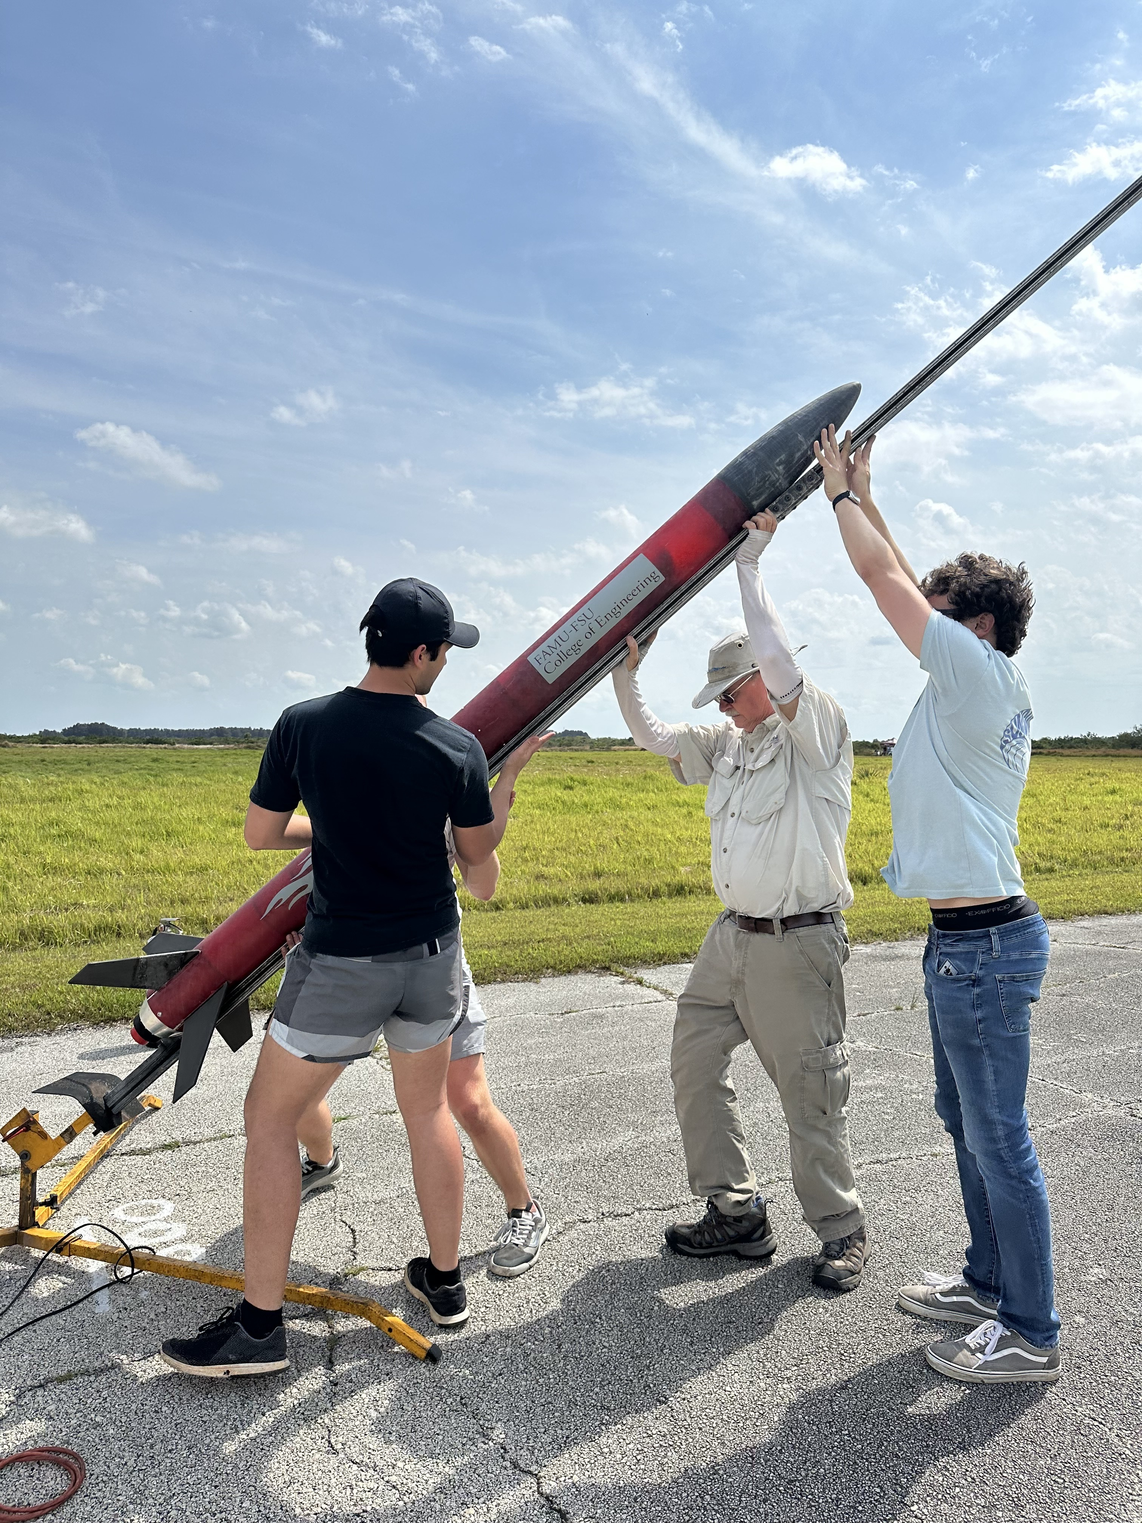
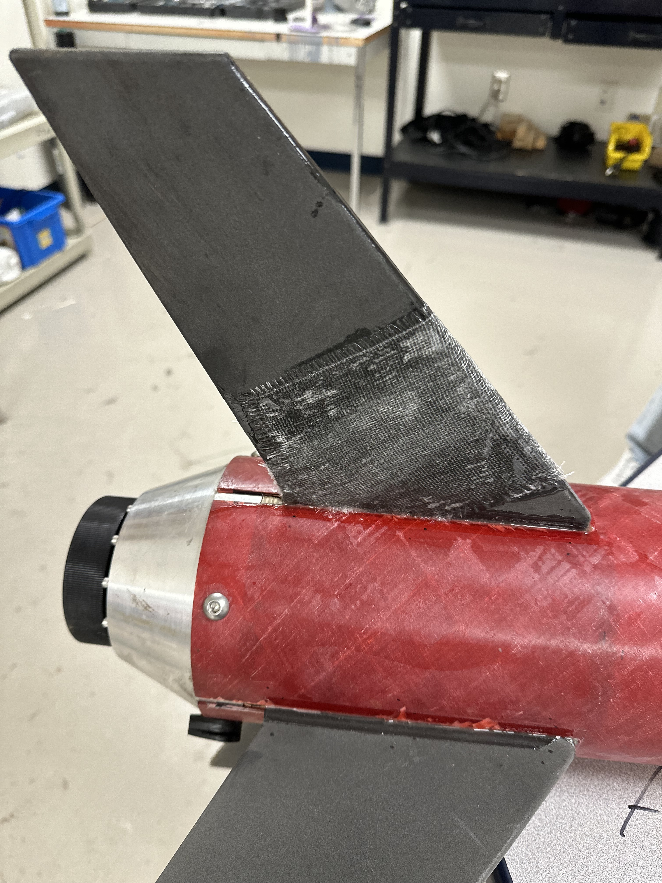
Full-Scale Flight 3
Atzimba Avellaneda
Launched again on March 9th.
Epoxied broken fin from last flight.
Parachute lines resized.

Slide 2
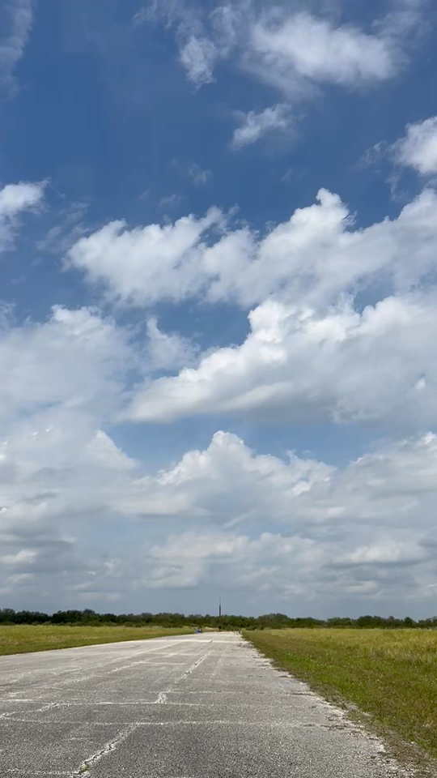
Flight 3 – Launch
Atzimba Avellaneda
Stable flight profile.
Launch angle: 5˚.
Wind speed: 16-mph.
Burn time: 2.27-s.
Notes:
This is a convience slide, I broke the video into takeoff, drogue deploy, main deploy, and landing

Slide 3
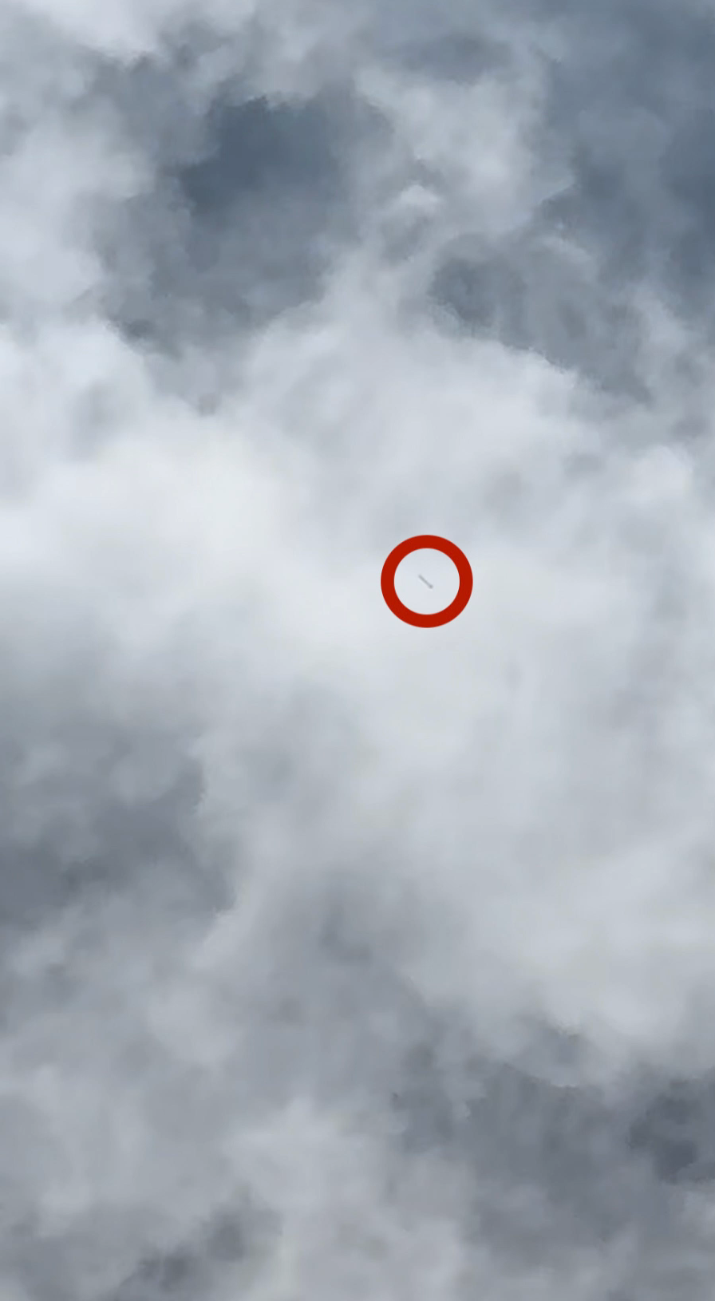
Flight 3 – Drogue Chute Deployment
Atzimba Avellaneda
Drogue parachute deployed at apogee.
Descent rate: 85-ft/s.
  Predicted rate: 97-ft/s.
Notes:
This is a convience slide, I broke the video into takeoff, drogue deploy, main deploy, and landing

Slide 4
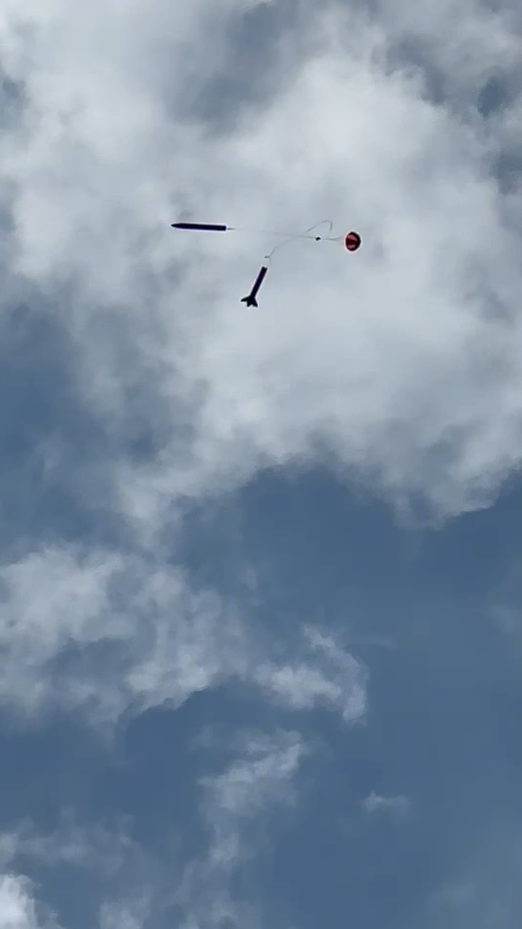
Flight 3 – Main Chute Deployment
Atzimba Avellaneda
Main parachute deployed above 500-ft.
Descent rate: 11-ft/s.
  Predicted rate: 13-ft/s.
Notes:
This is a convenience slide, I broke the video into takeoff, drogue deploy, main deploy, and landing

Slide 5
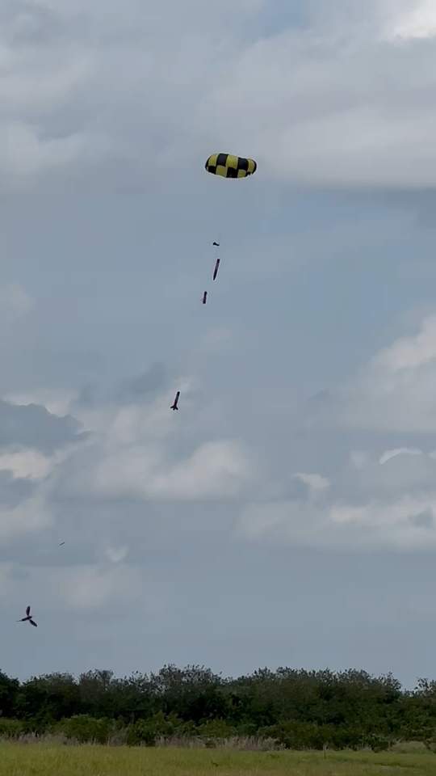
Flight 3 – Landing
Atzimba Avellaneda
Landed softly in tall grass. Kinetic energy of 45 ft-lbf.
No damage to launch vehicle or parachutes.
Notes:
This is a convience slide, I broke the video into takeoff, drogue deploy, main deploy, and landing

Slide 6
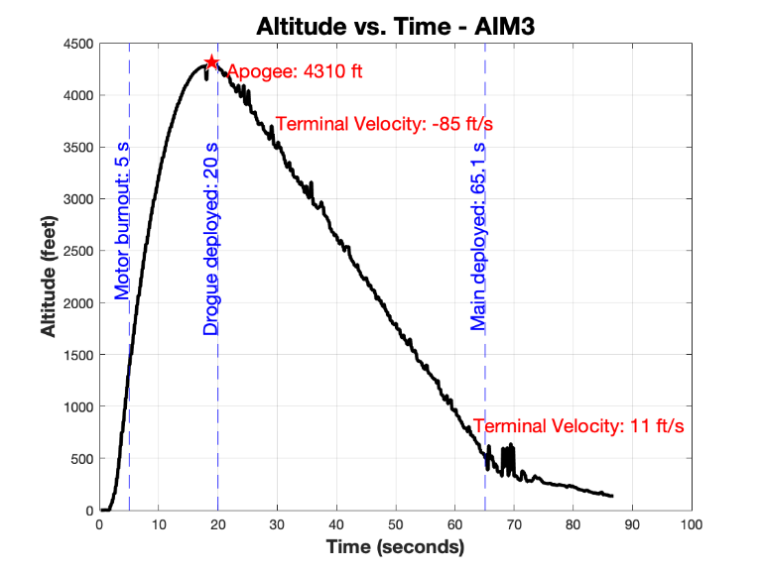
Full Scale Flight 3 - Analysis
Atzimba Avellaneda
Solved the parachute packing problem.
Fixed Cord length.
Flight was complete success.

