Slide 1
Powder Removal in Microgravity Environments (PRIME)
Team 518
October 13th, 2023

Slide 2
Team Introductions
Kyle Evans
Thermal Fluids Engineer
Alexander Fryer
Project and Test Engineer
Tripp Lappalainen
Manufacturing and Design Engineer

Slide 3
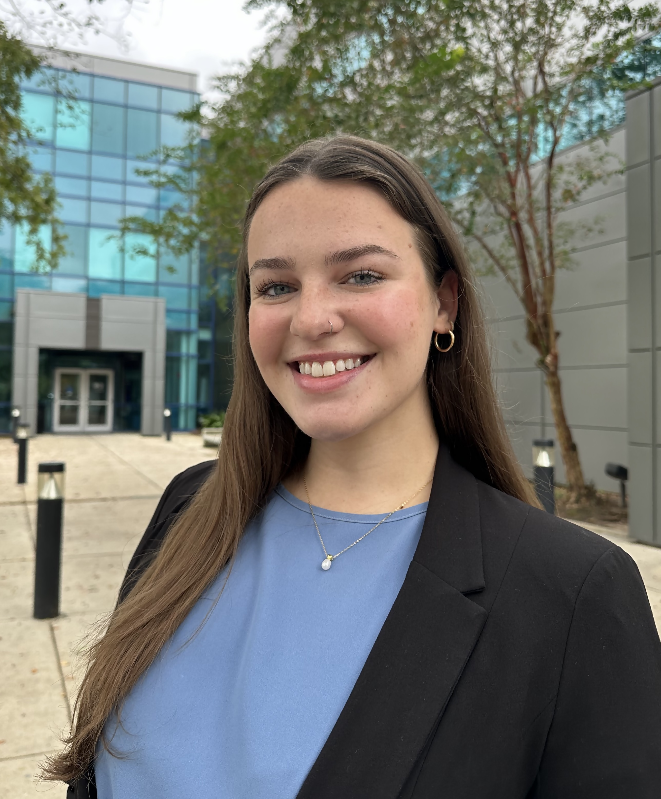
Team Introductions
Lauren McNealy
Systems Engineer
Cole Daly
Mechatronics
Engineer
Chelsea Kiselewski
Quality and Design Engineer

Slide 4
Sponsor and Advisor
Engineering Mentor
Justin McEldery
Materials Engineer -
NASA Marshall Space Flight Center
Academic Advisor
McConomy, Shane Ph.D.
Full Professor

Slide 5
Project Scope
Presented By: Kyle Evans, Tripp Lappalainen ,Alexander Fryer

Slide 6
Objective
The objective of this project is to develop a method for removing powder residue from additive manufactured parts in microgravity environments.

Slide 7
Key Goals
Clean Internal Features
Clean Multiple Parts
Functions in Microgravity
Automatic Operation
Physical Prototype

Slide 8
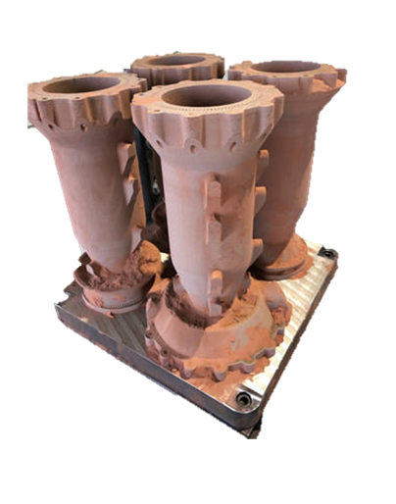
Project Background
Limited experience & knowledge
Contamination of hazardous metal particles
Combustion & unhealthy air
Contaminated printed parts from NASA
Notes:
In recent years, NASA has explored metal powder printing in space. Printing on ground is well understood and researched; however, there are some roadblocks with printing in space so far:
Limited experience/ knowledge of power printing in space
Contamination by trapped powder in parts leads to hazardous metal particles floating in microgravity
Unclean parts can lead to combustion and unhealthy air

Slide 9
Markets
Primary Markets
Secondary Market​
Aerospace Industry
Government Space Agency
Manufacturing Industry
Research Programs

Slide 10
Stakeholders
Primary Stakeholder
NASA
Secondary Stakeholder
FAMU-FSU College of Engineering Teaching Staff
Notes:
Our primary stakeholder is NASA because NASA is the project sponsor and main customer.
The senior design teaching staff are stakeholders because of their advisory role for the team.
Our academic advisor would also act as a stakeholder because they will provide guidance and contribute advice towards our project.

Slide 11
Assumptions
p = 1 atm
120V, 15A outlet
6 x 6 x 6
No supports

Slide 12
Customer Needs
Question
Sponsor Response
Customer need
Are there mass constraints for the design?
What materials are the parts to be cleaned made of?
Is there a limited amount of solvent available?
25lbs for the ground prototype.
Aluminum, copper, possibly iron, Inconel, and titanium.
Over a gallon of solvent per part would be excessive.
The device will be light
The device can clean different types of metal.
The device will use little solvent.

Slide 13
Functional Decomposition
PRIME

Slide 14
Functional Decomposition
PRIME
User Interface
Safety
Cleaning
Transportation

Slide 15
Functional Decomposition
User Interface
Smart Communications
Shows Part
Loading
Receives Signal
User Communications
Smart Timer

Slide 16
Functional Decomposition
Cleaning
Cleans external features of part
Cleans internal features of part
Moves debris away from part

Slide 17
Functional Decomposition
Safety
Cleans external features of part
Cleans internal features of part
Moves debris away from part

Slide 18
Functional Decomposition
Transportation
Modular
Moves with user input

Slide 19
Future Work
Targets & Metrics
Concept Generation & Selection
Risk Assessment

Slide 20
Questions

Slide 21
Reference
Justin McElderry, J.E. (2023, September 22). Intro to PRIME. NASA Marshall Space Flight Center

Slide 22
PRIME
User interface
Loading
Transportation
Safety
Cleaning
Smart communication
Shows part while cleaning
Loads part
Unloads part
Receives signal to start cleaning by user
Comminates to user when part is clean
Communicates to user part cleaning time
Cleans external features of part
Moves debris away from part
Cleans internal features of part
Structurally sound
Maintain orientation
Prevents leaks
Modular
Moves with user input

Slide 23
This is 10-point
This is 15–point Times
This is 20–point
This is 25–point
This is 30–point
This is 35–point
This is 40–point
This is 50–point
This is 60–point
This is 72–point
Notes:
Use at least 20-point font in Room A105, B134, and B136
Use at least 25-point font in Room B135

Slide 24
College of Engineering Color Palette
1 2 3 4
Pantone: PMS 195 C
RGB: 120, 47, 64
Hex: #782F40
CMYK:19, 90, 50, 55
1 2 3 4
Pantone: Black C
RGB: 0, 0, 0
Hex: #000000
CMYK:0, 0, 0, 100
Garnet
Black
1 2 3 4
RGB: 238, 118, 36
Hex: #EE7624
CMYK:2, 66, 99, 0
1 2 3 4
Pantone: PMS 000C
RGB: 255, 255, 255
Hex: #FFFFFF
CMYK: 0, 0, 0, 0
Fang
Orange
White
Notes:
Avoid 75% Black in B135

Slide 25
Accent Color Palette
1 2 3 4
RGB: 0, 59, 111
Hex: #003B6F
CMYK:
1 2 3 4
RGB: 0, 59, 111
Hex: #003B6F
CMYK:
1 2 3 4
RGB: 251, 236, 93
Hex: #FBEC5D
CMYK:
1 2 3 4
RGB: 219, 215, 210
Hex: #DBD7D2
CMYK:
1 2 3 4
RGB: 251, 236, 93
Hex: #FBEC5D
CMYK:
1 2 3 4
RGB: 219, 215, 210
Hex: #DBD7D2
CMYK:
Tardis Blue
Tardis Blue
Corn
Timberwolf
Corn
Timberwolf
1 2 3 4
RGB: 206, 0, 88
Hex: #CE0058
CMYK: 0, 100, 43, 12
1 2 3 4
RGB: 206, 0, 88
Hex: #CE0058
CMYK: 0, 100, 43, 12
1 2 3 4
RGB: 104, 40, 96
Hex: #682860
CMYK:
1 2 3 4
RGB: 220, 220, 220
Hex: #DCDCDC
CMYK:
Rubine Red
Rubine Red
Imperial
Gainsboro
1 2 3 4
RGB: 72, 146, 155
Hex: #48929b
CMYK:
1 2 3 4
RGB: 64, 224, 208
Hex: #40E0D0
CMYK:
1 2 3 4
RGB: 255, 139, 0
Hex: #FF8B00
CMYK:
Asagi-iro
Turquoise
American Orange
Notes:
Remove American orange add hyperlink grey
Make corn the last for b135
All work in 134 imperial move later
Tardis doesn’t work in b136

Slide 26
F7AB19
D67F15
EE7624
F73119
D64615
Analogous
https://color.adobe.com/create/color-wheel
ED660C
6E3610
F0A16C
EE7624
6E4931
BASB1C
Monochromatic
A14508
4BED3B
EE7624
250CED
2010A1
Triad
BA7E09
A1470C
FF8C40
EE7624
0098A1
24E2ED
Complementary
28A164
2FED8D
EE7624
0848A1
1871ED
09BA61
Split Complementary
EDAC2F
3BED93
EE7624
0C6AED
ED2F18
Double Split Complementary
C7ED3B
EE7624
0CE1ED
A418ED
Square
87724A
EE7624
60EFCF
Compound
AD551A
6E3610
EE7624
FA7625
D46820
Shades
Notes:
These are the variants that work well with Fang Orange. The bolded items show well on the projectors.

Slide 27
https://color.adobe.com/create/color-wheel
85412D
8F3831
782f40
8F3176
792D85
Analogous
C44D69
8E626D
782F40
C48796
451B25
Monochromatic
C43959
78743B
782F40
236178
43A2C4
Triad
C43959
C46078
782F40
25C43D
2F783A
Complementary
93C460
577835
782F40
39C49D
297861
Split Complementary
784435
5A783B
782F40
237860
6E2978
Double Split Complementary
782337
78683b
782F40
237830
293978
Square
AB4D32
DEBAAF
782F40
5D8555
70AB32
Compound
38161E
C44D69
782F40
853447
5E2532
Shades

Slide 28
A105
A105
B135 Stage Left
B135 Stage Right
B136
B134, A105
B135

