Slide 1
Team 520: Actively Sealed Cryogenic Coupler
Virtual Design Review 1
Jason Goldstein, Lauren Roche, Sean Rodney,
Valerie Rodriguez, Nicolas Sgammato

Slide 2


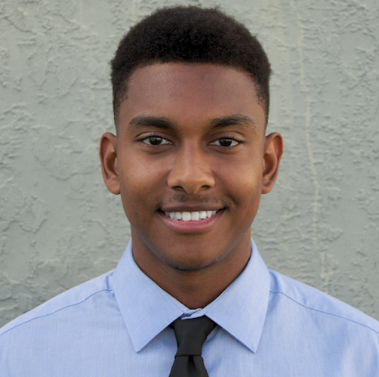
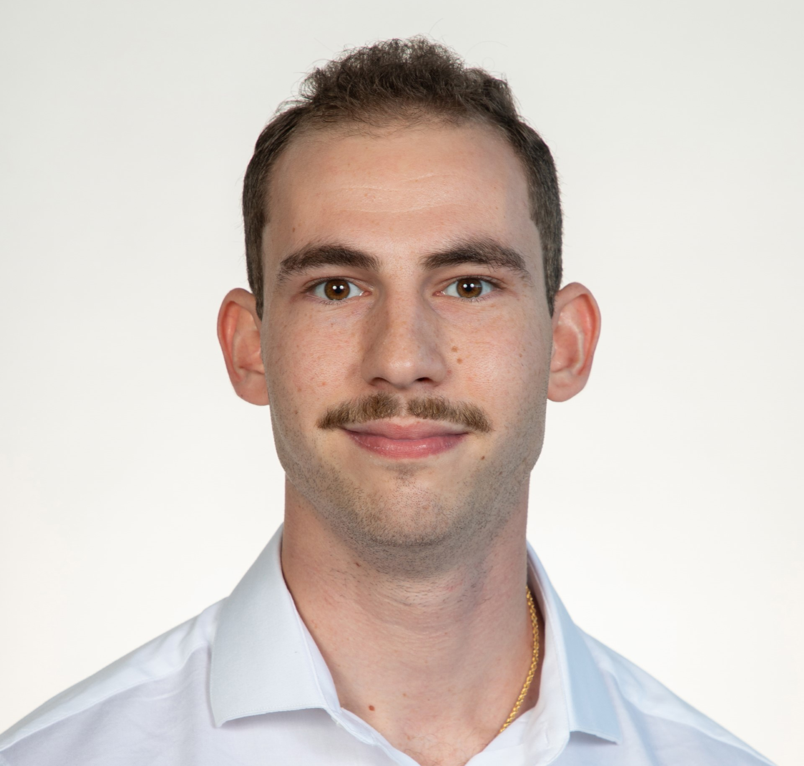

Team 520
Sean Rodney
Jason Goldstein
Materials Engineer
Lauren Roche
Cryogenics Engineer
Sean Rodney
Test Engineer
Valerie Rodriguez
Thermal-Fluids Engineer
Nicolas Sgammato
Design Engineer

Slide 3


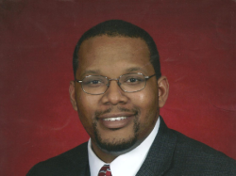
Sponsors
Sean Rodney
James C. Buzzell
Propulsion Systems Engineer,
NASA MSFC
Marvin W. Barnes
Advanced Propulsion Research and Development,
NASA MSFC

Slide 4

Objective
Sean Rodney
The objective of this project is to design,
build, and test an actively sealed coupler
that prevents the leakage of cryogenic fuel
during the transfer from depot to vessel for future
deep space NASA missions.

Slide 5


Background
Sean Rodney
Cryogenic Fuel Transfer
Deep Space Mission
Lunar Base Fuel Depot

Slide 6
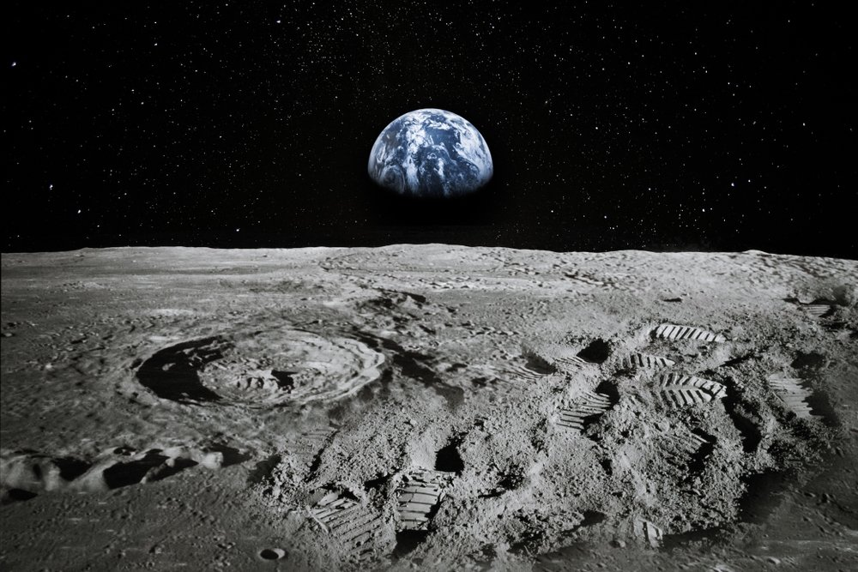
Key Goals
Sean Rodney
Protect from Contamination and Heat
Prevent and Monitor
Leaks
Survive
90-Day Lunar Mission

Slide 7

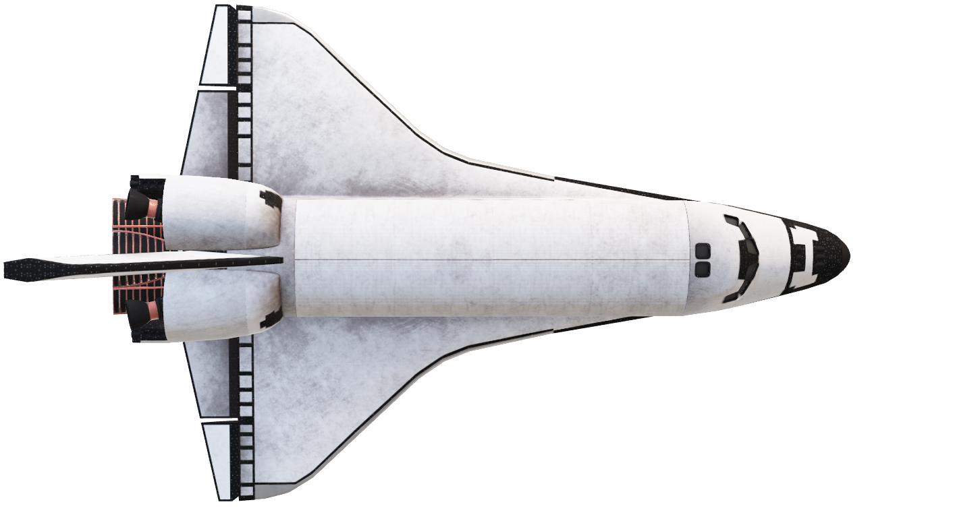
Primary Markets
Sean Rodney
Marshall Space
Flight Center

Slide 8
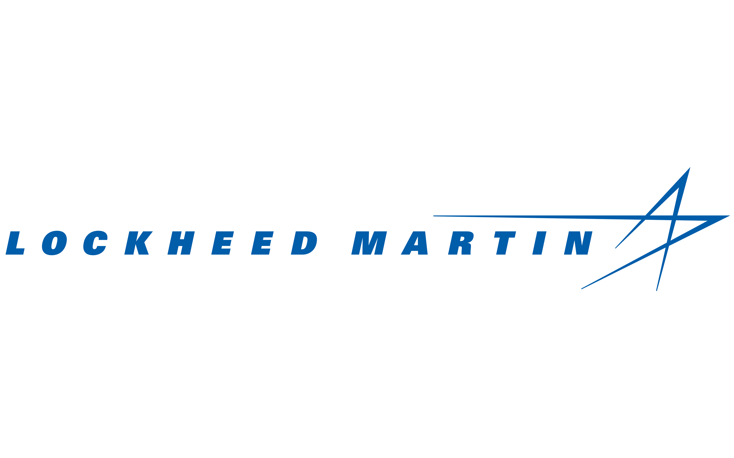


Secondary Market
Sean Rodney

Slide 9

Customer Needs
Valerie Rodriguez
Extend the life of the cryogenic fuel storage in space
Minimize the leakage rate of fuels during the transfer process
Seal activation upon contact of coupler halves
Limit boil-off of fuel due to heat transfer
Protect system from foreign particulate matter

Slide 10
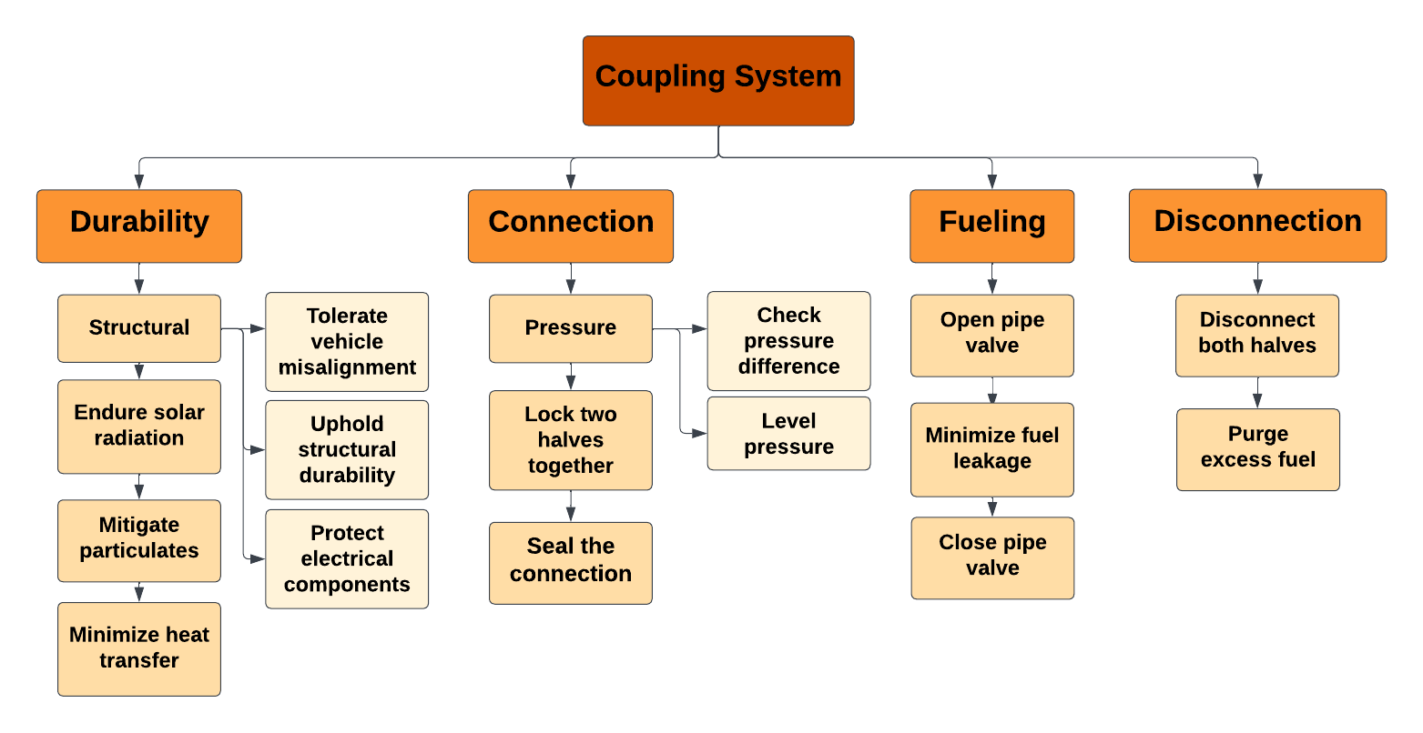
Function Decomposition – An overview
Valerie Rodriguez

Slide 11
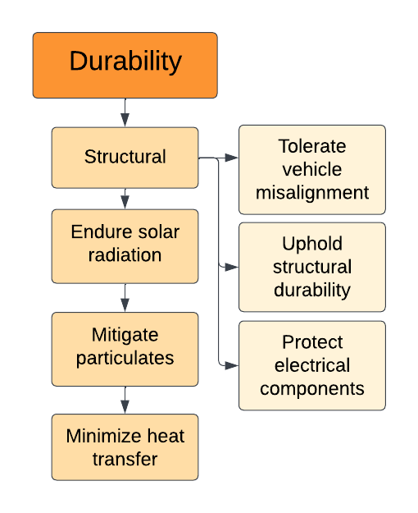
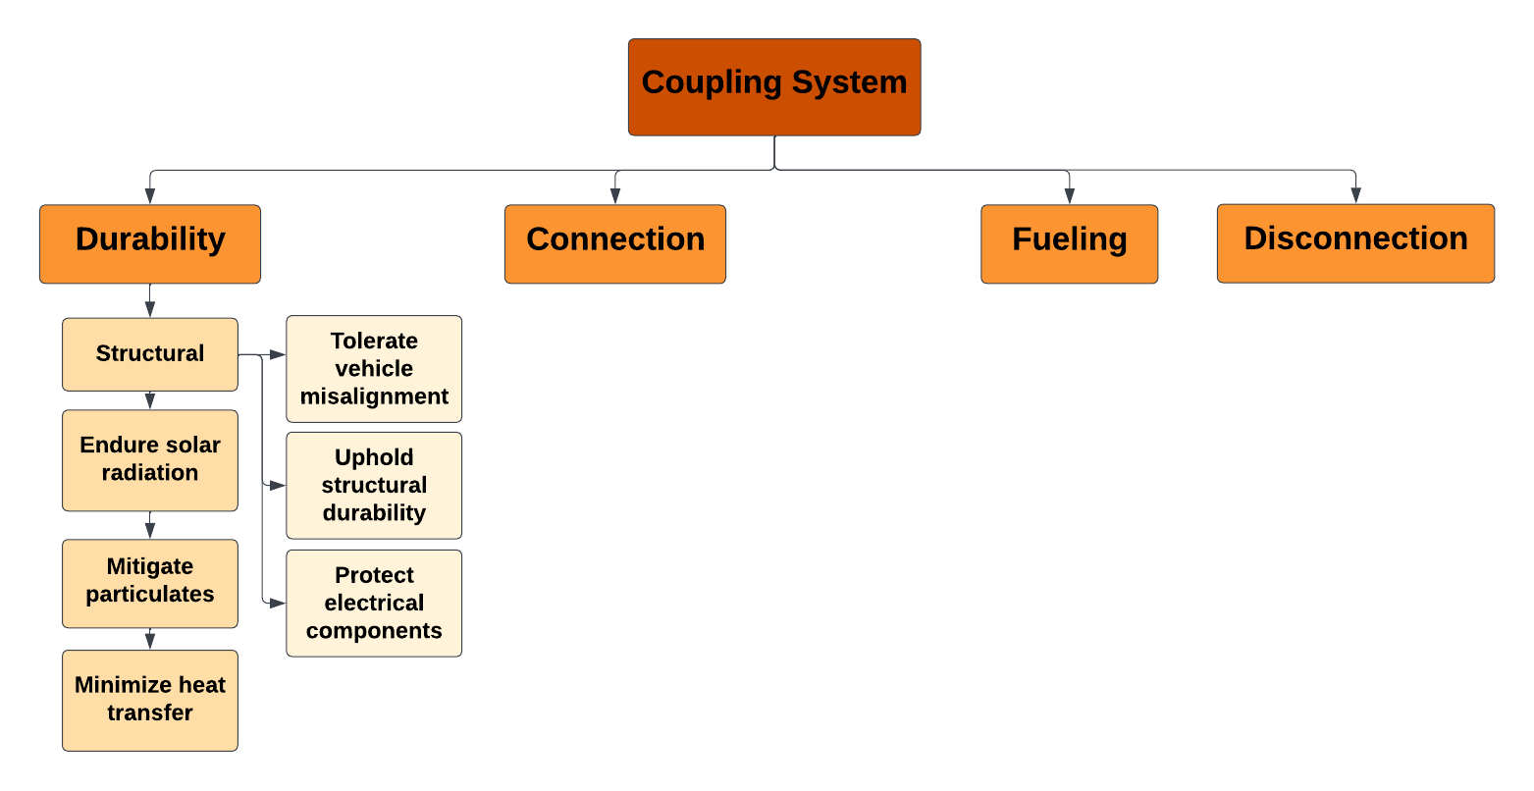
Valerie Rodriguez

Slide 12
Valerie Rodriguez

Slide 13
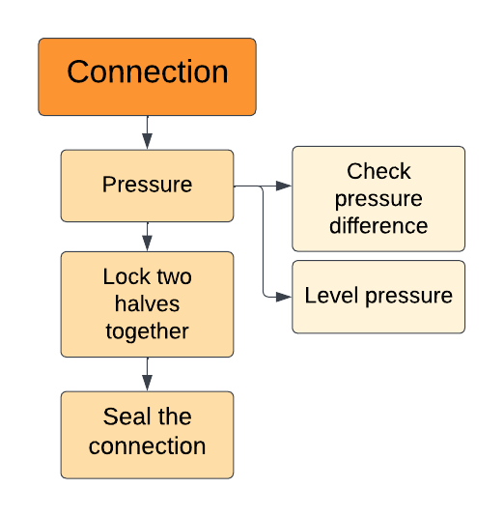
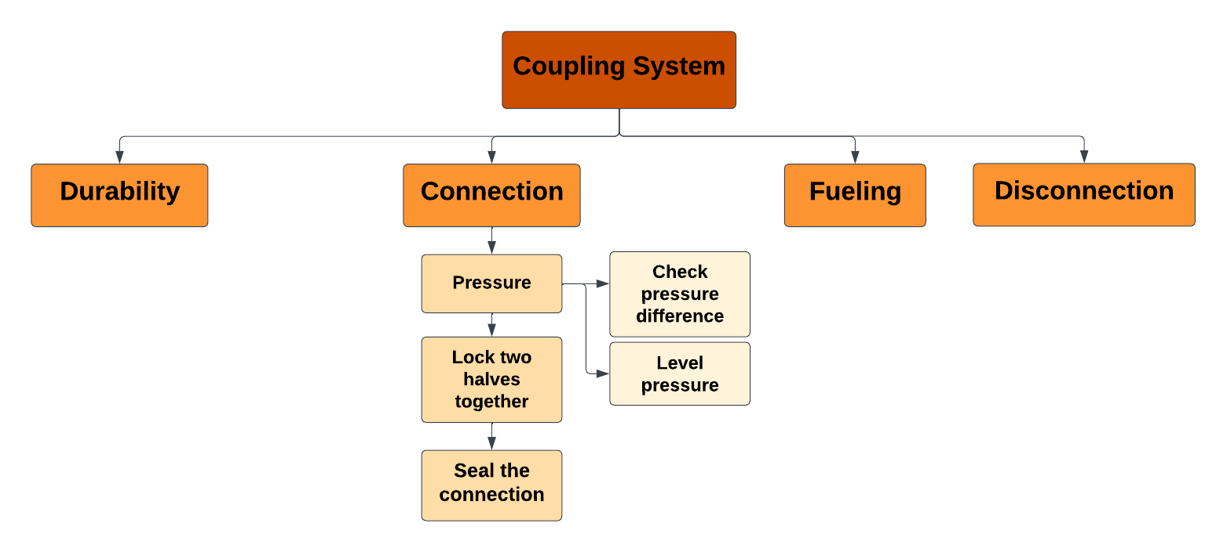
Valerie Rodriguez

Slide 14
Valerie Rodriguez

Slide 15
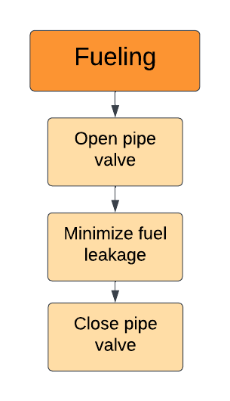
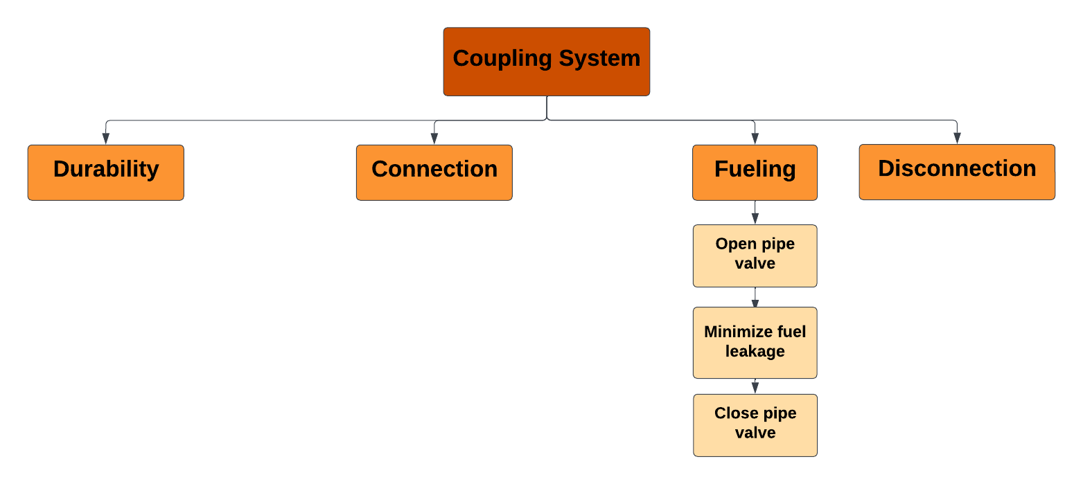
Valerie Rodriguez

Slide 16
Valerie Rodriguez

Slide 17
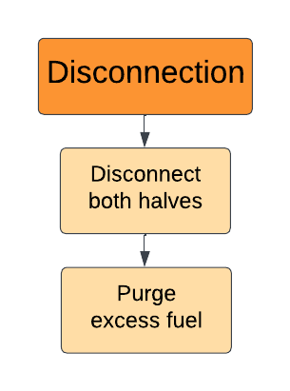
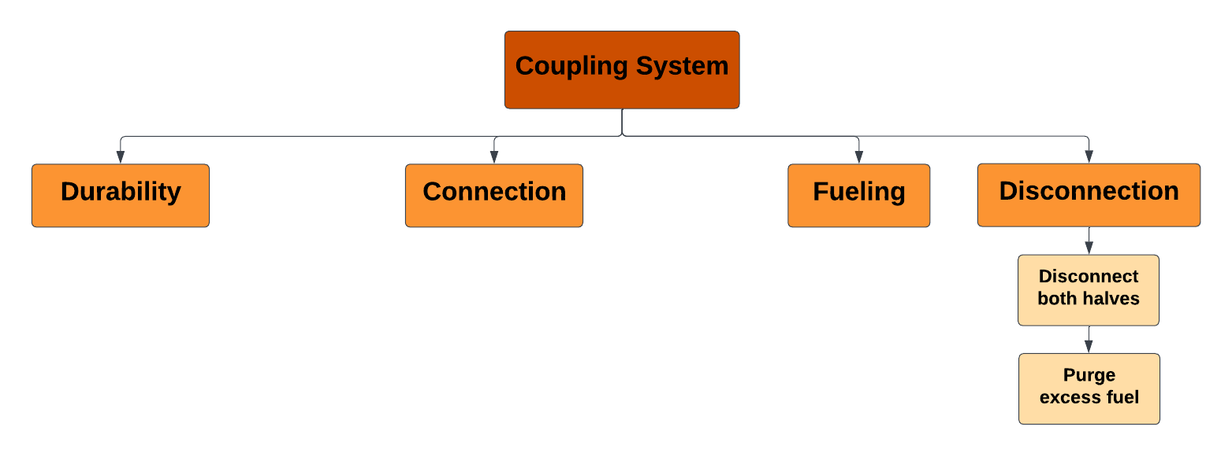
Valerie Rodriguez

Slide 18
Thank You
Questions?

