Slide 1
Team 520: NASA-MSFC Actively Sealed Cryogenic Coupler
Virtual Design Review 2
Jason Goldstein, Lauren Roche, Sean Rodney,
Valerie Rodriguez, Nicolas Sgammato

Slide 2







Team 520
Jason Goldstein
Jason Goldstein
Materials Engineer
Lauren Roche
Cryogenics Engineer
Sean Rodney
Test Engineer
Valerie Rodriguez
Thermal-Fluids Engineer
Nicolas Sgammato
Design Engineer
Department of Mechanical Engineering
2

Slide 3



Sponsors
Jason Goldstien
James C. Buzzell
Propulsion Systems Engineer,
NASA MSFC
Marvin W. Barnes
Advanced Propulsion Research and Development,
NASA MSFC
Department of Mechanical Engineering
3

Slide 4

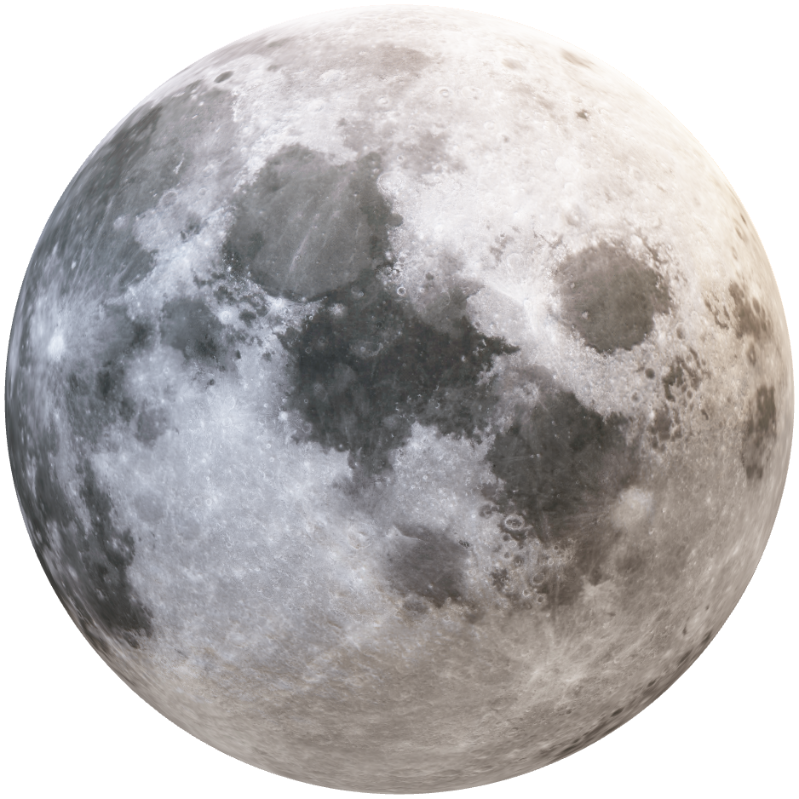
Objective
Jason Goldstein
The objective of this project is to design,
build, and test an actively sealed coupler
that prevents the leakage of cryogenic fuel
during the transfer from depot to vessel for future
deep space NASA missions.
Department of Mechanical Engineering
4

Slide 5
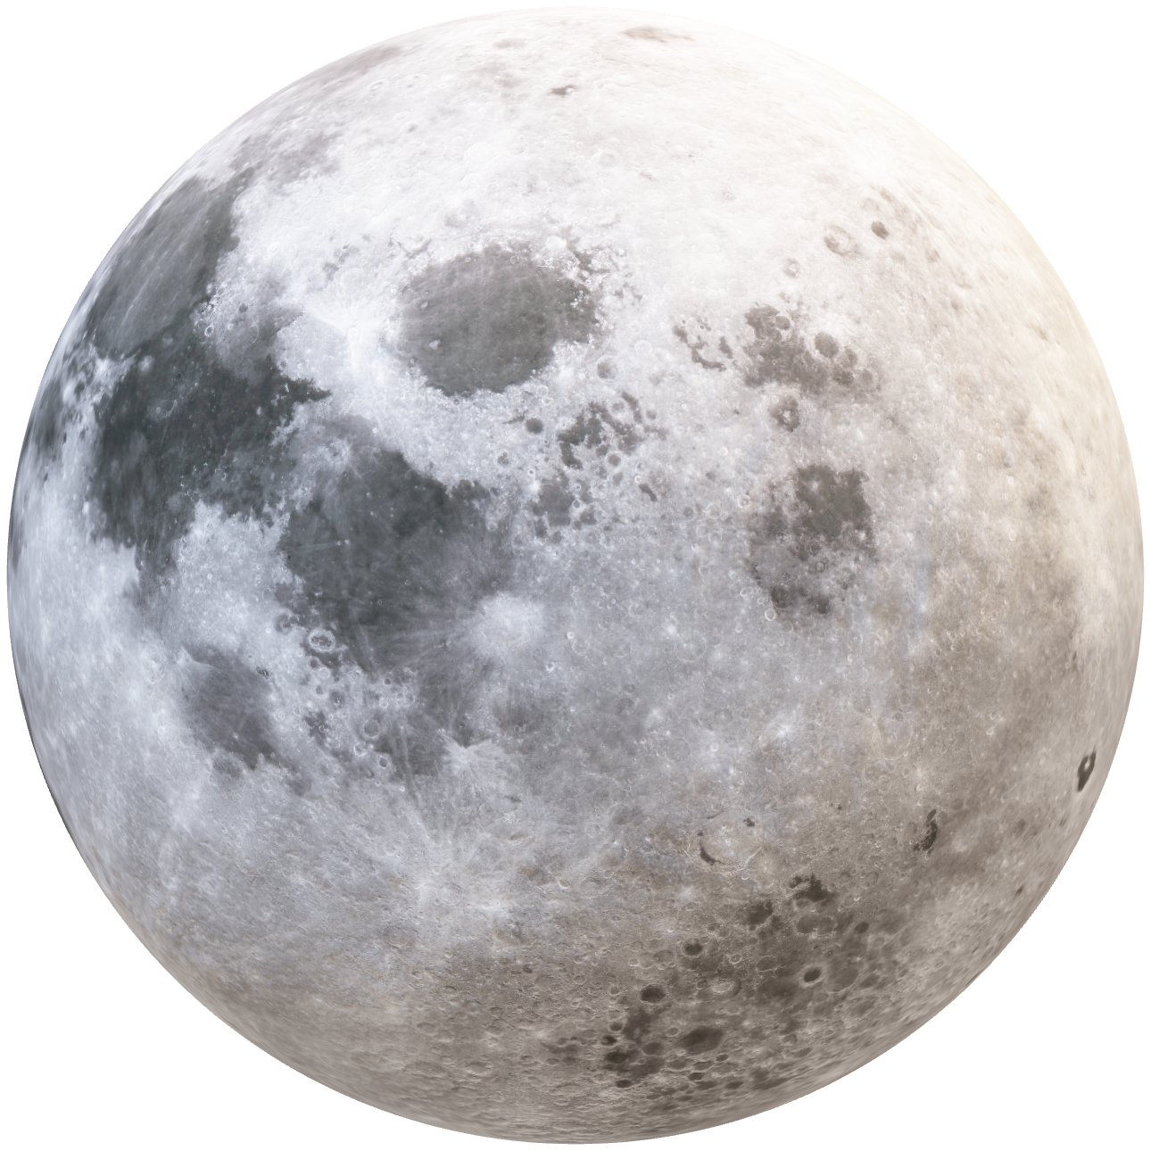
Background
Lauren Roche
Cryogenic Fuel Transfer
Deep Space Mission
Lunar Base Fuel Depot
Department of Mechanical Engineering
5

Slide 6
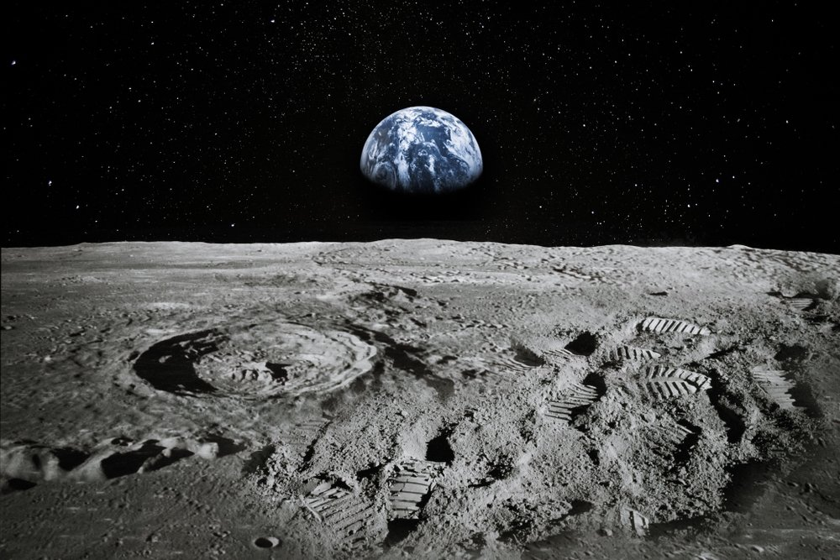
Key Goals
Lauren Roche
Protect from Contamination and Heat
Prevent and Monitor
Leaks
Survive
90-Day Lunar Mission
Department of Mechanical Engineering
6

Slide 7


Nicolas Sgammato
Targets and Metrics
Fuel Leakage Heat Transfer Coupler Connection Structure Integrity
Fuel Leakage Rate from Flowmeter
Interior Temperature from Thermocouple
Connection Force from Transducer
Material Yielding from Tensile Test
Department of Mechanical Engineering
7

Slide 8
Nicolas Sgammato
Fuel Leakage
Measured Using Venturi Flowmeter at the National High Magnetic Field Laboratory (NHMFL)
Target From Critical Targets Table Provided by Sponsor
For Internal Leakage:
≤ 500 SCIM LN2 at 15 and 50 PSID While De-mated
For External Leakage:
≤ 50 SCIM LN2 at 5 and 50 PSIG Internal Pressure
Department of Mechanical Engineering
8

Slide 9


Nicolas Sgammato
Heat Transfer
Measured Using a Thermocouple in Coupler Interior
Target Derived From Boiling Point of Liquid Nitrogen
Coupler Interior Temperature
≤ 80 K
Department of Mechanical Engineering
9

Slide 10
Jason Goldstein
Coupler Connection
Measured using a Force Transducer Attached to One Half of Coupler
Target Derived From Previous NASA Coupler
Connection/
Disconnection Force:
≤ 250 LBF
Department of Mechanical Engineering
10

Slide 11

Jason Goldstein
Structural Integrity
Measured using Tensile Testing on Selected Material
Safe Range was Chosen Due to Material Not Yet Being Selected
Plastic Deformation of Chosen Material:
≤ 5%
Department of Mechanical Engineering
11

Slide 12


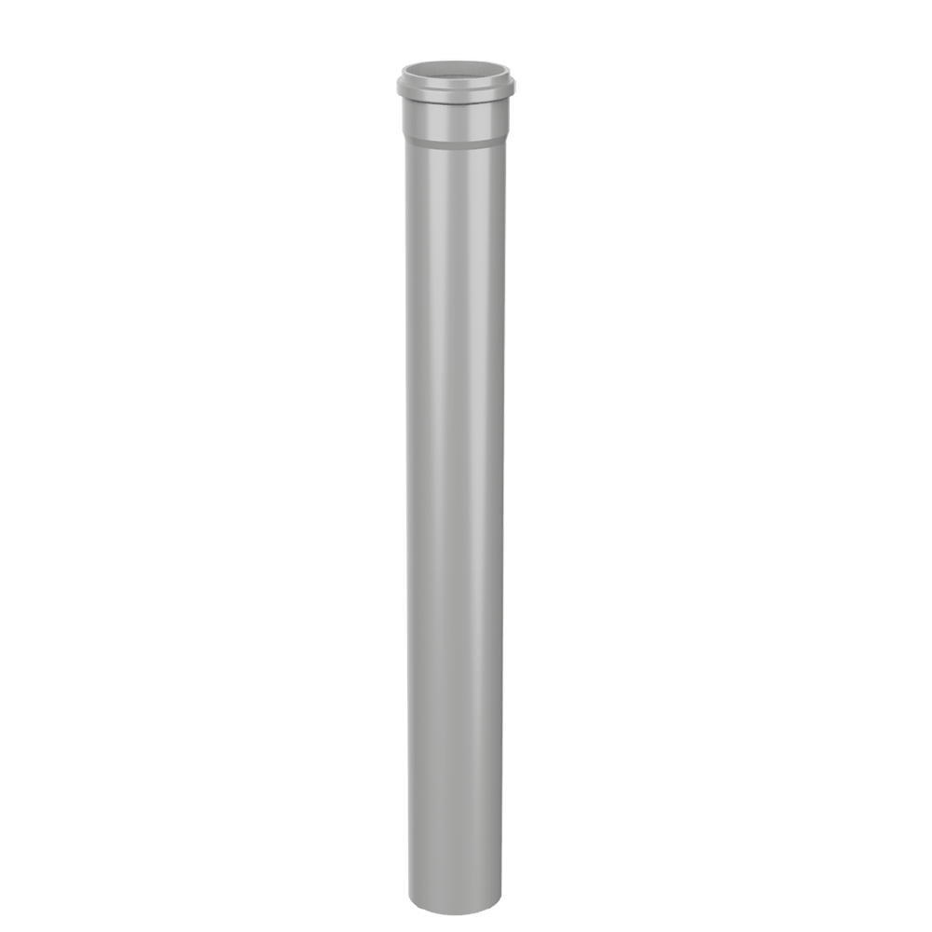
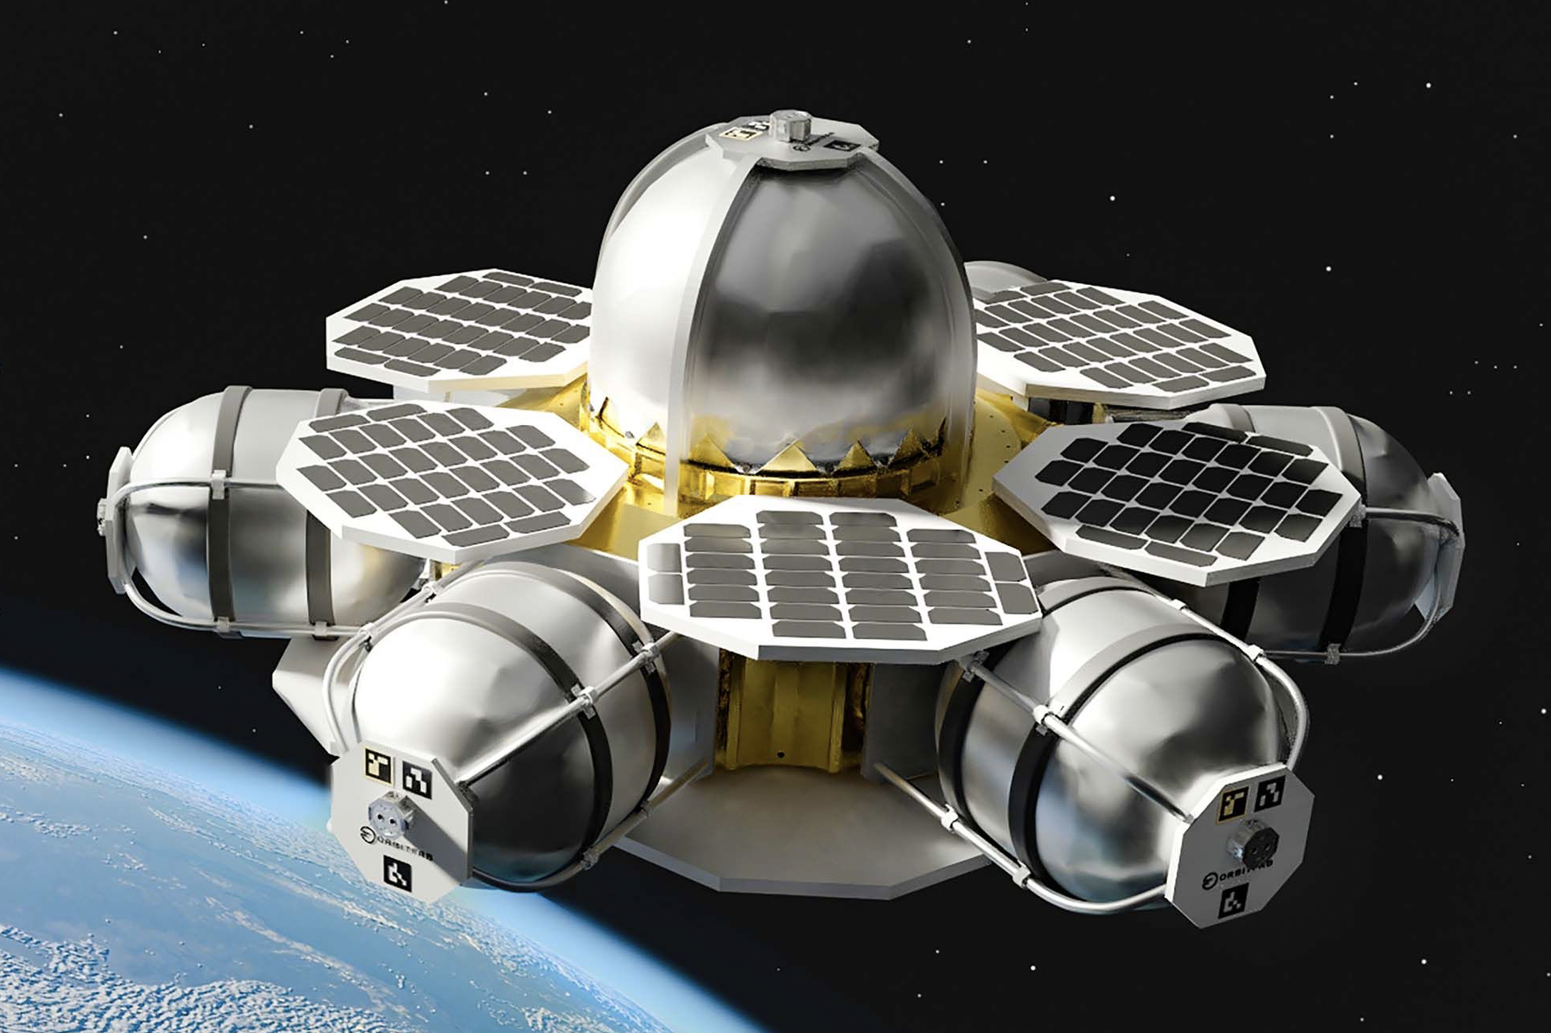
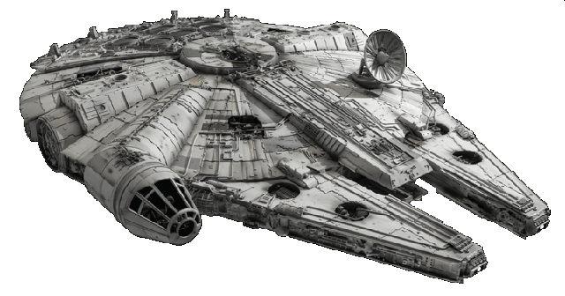
Jason Goldstein
Concept Generation Tactics
Biomimicry
Crap Shoot
Morphological Chart
1
A
A
B
C
1
1
1
2
B
2
2
2
3
C
3
3
3
4
D
5
E
Department of Mechanical Engineering
12

Slide 13
Lauren Roche
Terminology
Seals​
Insulation
MLI
SOFI
Double vacuum wall
Encapsulated O-ring
Teflon Seal
Locks
Valves
Force held
Collet Lock
Double poppet valve
Department of Mechanical Engineering
13

Slide 14
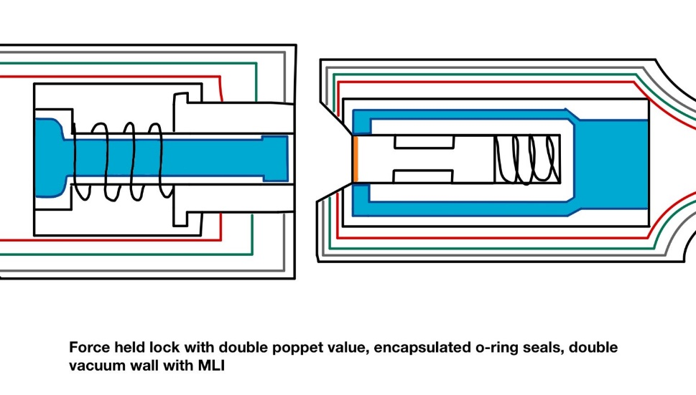
Lauren Roche
High Fidelity Concepts
Concept #33
Force held double poppet actuator, sealed with encapsulated O-rings, insulated by a double vacuum wall structure and Multi-Layered Insulation
Department of Mechanical Engineering
14

Slide 15
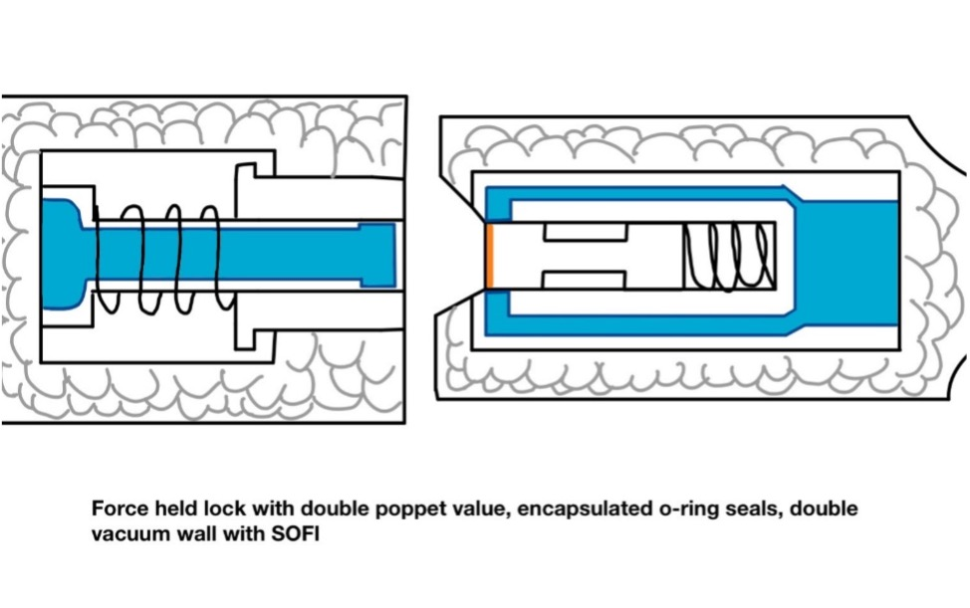
Lauren Roche
High Fidelity Concepts
Concept #98
Force held double poppet actuator, sealed with encapsulated O-rings, insulated by a double vacuum wall structure and Spray-On Foam Insulation (SOFI)
Department of Mechanical Engineering
15

Slide 16
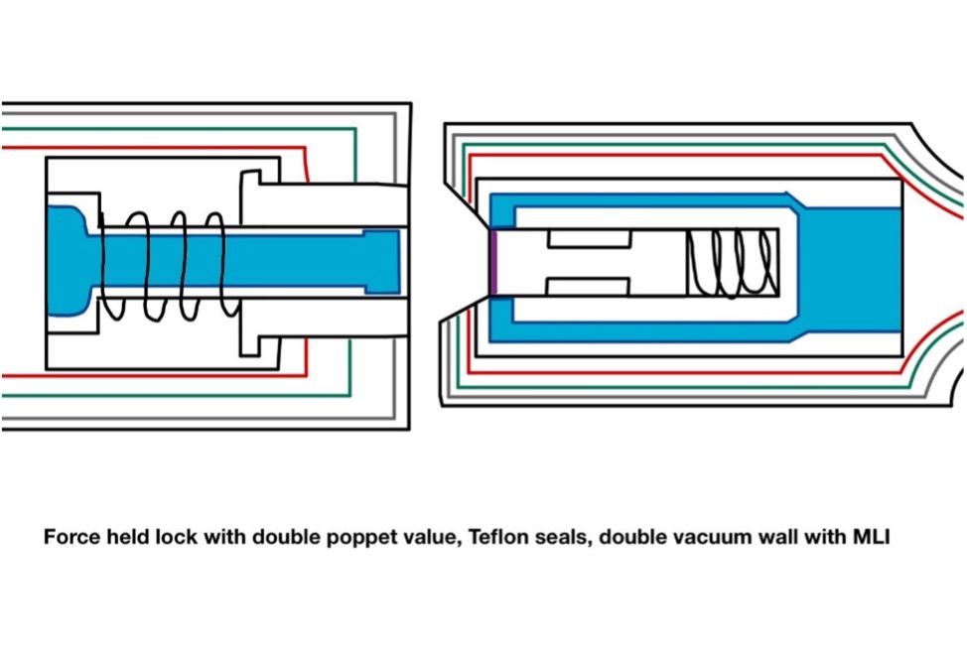
Nicolas Sgammato
High Fidelity Concepts
Concept #100
Force held double poppet actuator, sealed with Teflon, insulated by a double vacuum wall structure and Multi-Layered Insulation (MLI)
Department of Mechanical Engineering
16

Slide 17
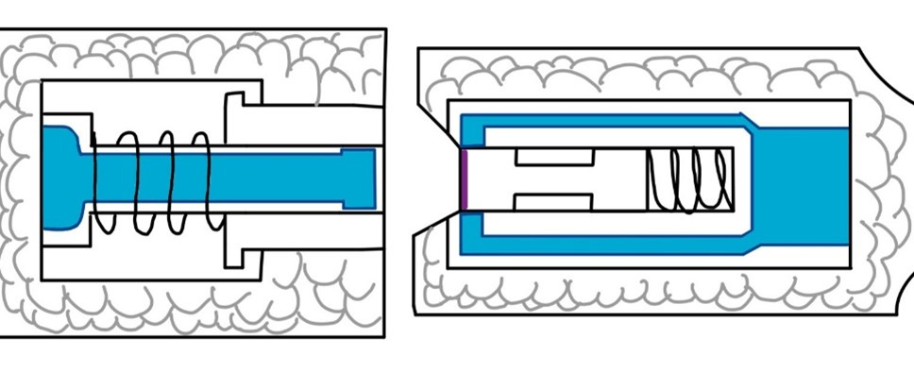
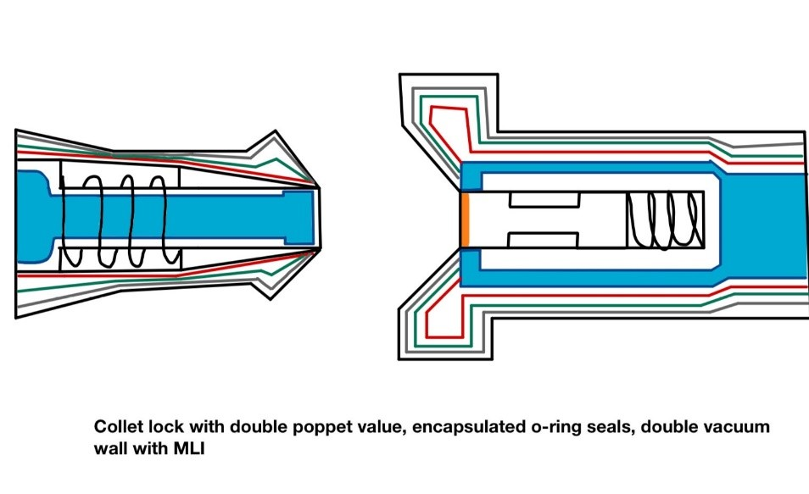
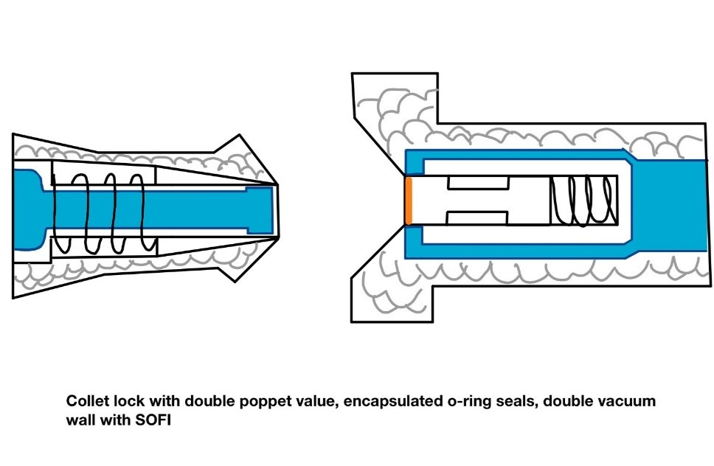
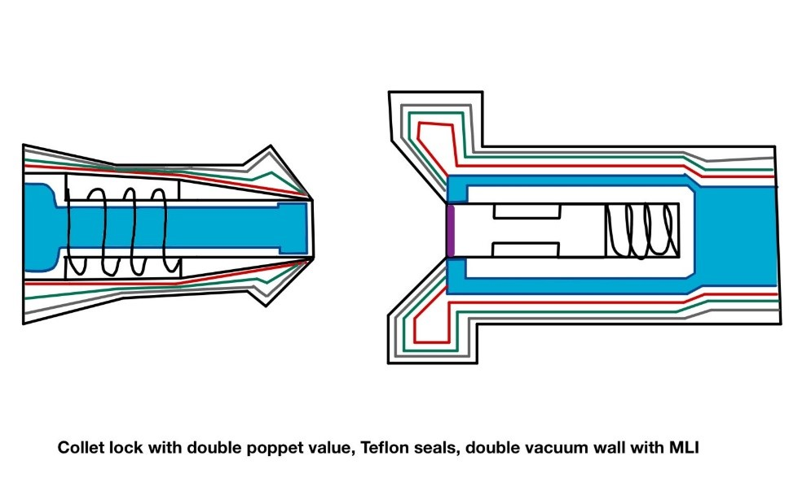
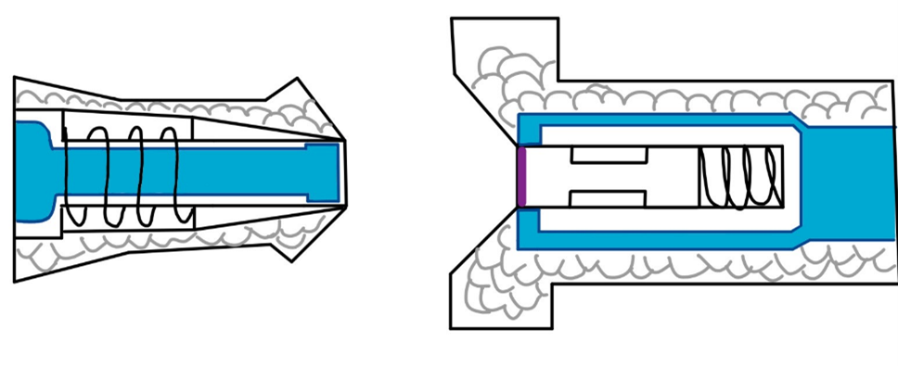
Nicolas Sgammato
Medium Fidelity Concepts
#99
#82
#81
#80
#79
Department of Mechanical Engineering
17

Slide 18

Nicolas Sgammato
Medium Fidelity Concepts
Force held lock
Double vacuum & SOFI
#99
Double Poppet
Teflon Seals
Department of Mechanical Engineering
18

Slide 19
Jason Goldstein
Medium Fidelity Concepts
Double vacuum & MLI
#82
Double Poppet
Collet lock
Encapsulated Seals
Department of Mechanical Engineering
19

Slide 20
Jason Goldstein
Medium Fidelity Concepts
Double vacuum & SOFI
#81
Double Poppet
Collet Lock
Encapsulated Seals
Department of Mechanical Engineering
20

Slide 21
Jason Goldstein
Medium Fidelity Concepts
Double vacuum & MLI
#80
Double Poppet
Collet Lock
Teflon Seals
Department of Mechanical Engineering
21

Slide 22
Lauren Roche
Medium Fidelity Concepts
Double vacuum & SOFI
#79
Double Poppet
Collet Lock
Teflon Seals
Department of Mechanical Engineering
22

Slide 23
Lauren Roche
Concept Selection
Binary Pairwise Comparison
House of Quality
Pugh Charts
Analytical Hierarchy Process
Final Selection
Department of Mechanical Engineering
23

Slide 24
Lauren Roche
Binary Pairwise Comparison
Compares Customer Needs to Each Other to Determine Relative Importance
Customer Needs | Score
Fluid Loss Prevention | 6
Active Seal | 6
Maintains Pressure | 6
Effective Coupling | 6
Heat Transfer Protection | 5
Particulate Mitigation | 4
Life-Span | 3
Cost | 3
Sizing Parameters | 3
Material Resilience | 2
Reusability | 1
Department of Mechanical Engineering
24

Slide 25
Nicolas Sgammato
House of Quality
Customer Requirements
Life-span
Fluid Loss
Active Seal
Material Resilience
Reusability
Maintains Pressure
Effective Coupling
Heat Transfer
Particulate Mitigation
Channel Sizing Parameters
Cost
Ranked Engineering Characteristics
1. Fuel Leakage
2. Seal
3. Heat Transfer
4. Durability
5. Weight
6. Cost
Department of Mechanical Engineering
25

Slide 26
Nicolas Sgammato
Pugh Charts- First Iteration
Selection Criteria
Leakage
Lifetime
Seal
Resilience
Size
Cost
#82
#81
#80
#33
#98
#100
#99
-2
-2
-2
1
1
1
1
Datum: NASA Low Separation Force Quick Disconnect
Department of Mechanical Engineering
26

Slide 27
Nicolas Sgammato
Pugh Charts- Second Iteration
Selection Criteria
Leakage
Lifetime
Seal
Resilience
Size
Cost
S
-
S
-
+
+
Concept #98
Force held double poppet actuator, sealed with encapsulated O-rings, insulated by a double vacuum wall structure and Spray-On Foam Insulation (SOFI)
Datum: Concept #33
Department of Mechanical Engineering
27

Slide 28
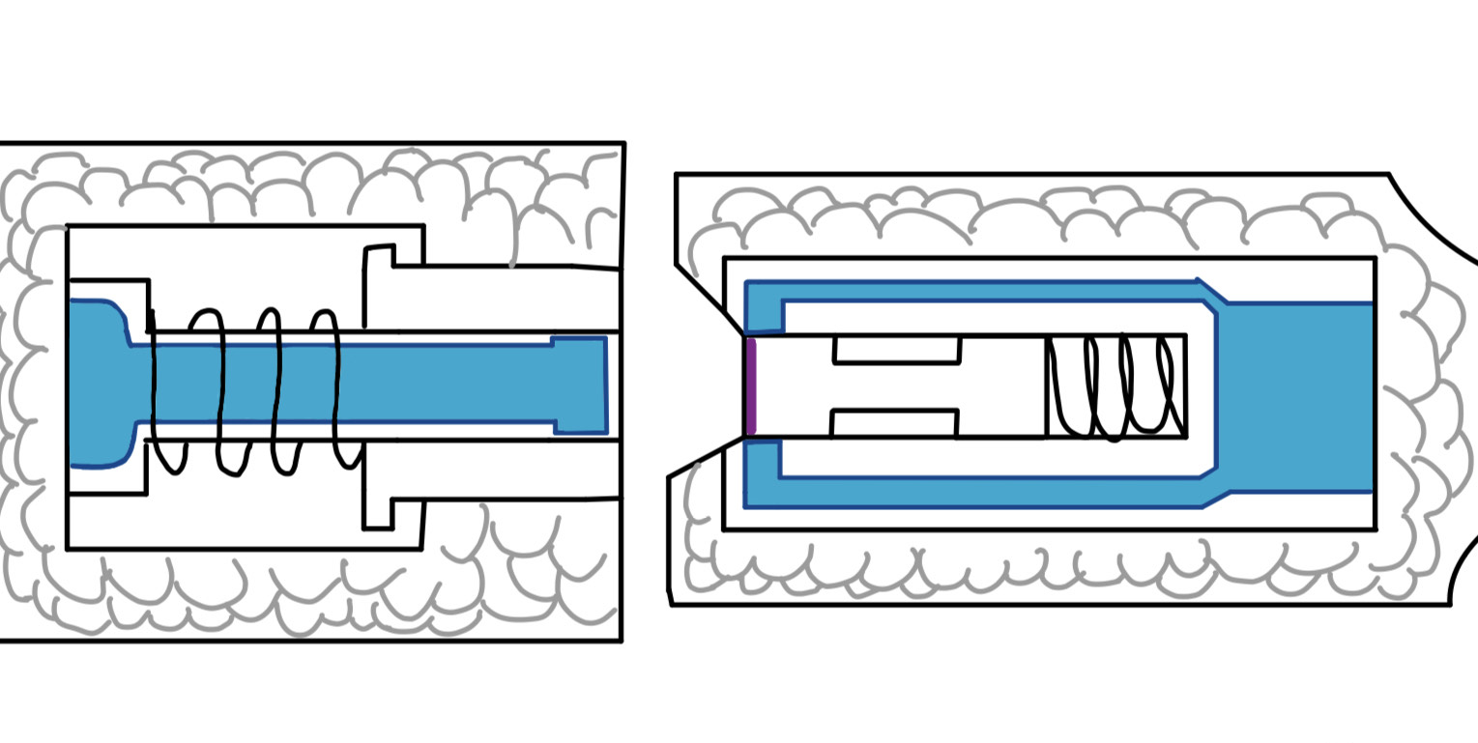
Jason Goldstein
Pugh Charts- Second Iteration
Selection Criteria
Leakage
Lifetime
Seal
Resilience
Size
Cost
-
-
-
-
+
+
Concept #99
Force held double poppet actuator, sealed with Teflon, double vacuum wall structure and Spray-On Foam Insulation (SOFI)
Datum: Concept #33
Department of Mechanical Engineering
28

Slide 29
Jason Goldstein
Pugh Charts- Second Iteration
Selection Criteria
Leakage
Lifetime
Seal
Resilience
Size
Cost
-
S
-
-
S
+
Concept #100
Force held double poppet actuator, sealed with Teflon, insulated by a double vacuum wall structure and Multi-Layered Insulation (MLI)
Datum: Concept #33
Department of Mechanical Engineering
29

Slide 30
Jason Goldstein
Analytical Hierarchy Process
Concept #33
Alternative Value:
1.032
Concept #98
Alternative Value:
0.466
Concept #100
Alternative Value:
0.632
Department of Mechanical Engineering
30

Slide 31
Lauren Roche
Final Concept Selection
Concept #33: Double poppet actuator and force held lock, seal with encapsulated seals, insulated by double vacuum wall and Multi-Layer Insulation (MLI) blanket
Department of Mechanical Engineering
31

Slide 32
Lauren Roche
Concept #33-
Department of Mechanical Engineering
32

Slide 33
Lauren Roche
Concept #33
Department of Mechanical Engineering
33

Slide 34




Nicolas Sgammato
Future Work
Manufacture final design at machine shop
Create detailed model of
selected design
Conduct cryogenic
testing at MagLab
Order parts, build prototype and refine design
Department of Mechanical Engineering
34

Slide 35
Thank You.
520: NASA Actively sealed Cryogenic Coupler
Jason Goldstein, Lauren Roche, Sean Rodney,
Valerie Rodriguez, Nicolas Sgammato

