Slide 1
Team 520: NASA-MSFC Actively Sealed Cryogenic Coupler
Virtual Design Review 4
Jason Goldstein, Lauren Roche, Sean Rodney,
Valerie Rodriguez, Nicolas Sgammato

Slide 2
Team 520
Valerie Rodriguez
Jason Goldstein
Materials Engineer
Lauren Roche
Cryogenics Engineer
Sean Rodney
Test Engineer
Valerie Rodriguez
Thermal-Fluids Engineer
Nicolas Sgammato
Design Engineer
Department of Mechanical Engineering
2

Slide 3
Sponsors
Valerie Rodriguez
James C. Buzzell
Propulsion Systems Engineer,
NASA MSFC
Marvin W. Barnes
Advanced Propulsion Research and Development,
NASA MSFC
Department of Mechanical Engineering
3

Slide 4
Objective
Valerie Rodriguez
The objective of this project is to design,
build, and test an actively sealed coupler
that prevents the leakage of cryogenic fuel
during the transfer from depot to vessel for future
deep space NASA missions.
Department of Mechanical Engineering
4

Slide 5
Background
Sean Rodney
Cryogenic Fuel Transfer
Mechanical Connection
Force Held
Department of Mechanical Engineering
5

Slide 6
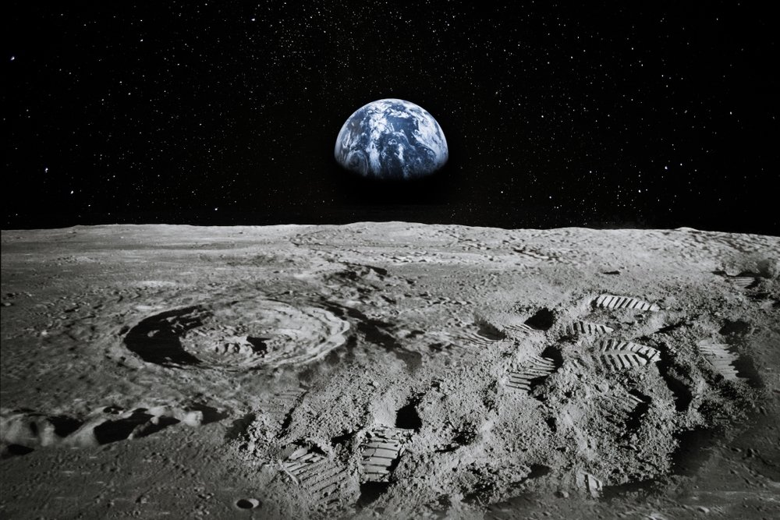
Key Goals
Sean Rodney
Effective Sealing
Prevent and Monitor
Leaks
90-Day Lunar Mission
Department of Mechanical Engineering
6

Slide 7
Sponsor Updates:
Sean Rodney
Insulation negligible for testing
SOFI: Smooth Exterior for future implementation
Flow rate should be low enough during fueling for pressure drop to be negligible.
Lubricant: Dry-film lube
Assume pressure in tanks is equalized.
Department of Mechanical Engineering
7

Slide 8
Fall Design
Valerie Rodriguez
Double-poppet actuator​
Force-held
lock
F
Encapsulated seals
Department of Mechanical Engineering
8

Slide 9
Valerie Rodriguez
Initial Concept
Department of Mechanical Engineering
9

Slide 10
Valerie Rodriguez
Initial Concept
Department of Mechanical Engineering
10

Slide 11
Initial Design Flaws
Valerie Rodriguez
Department of Mechanical Engineering
11

Slide 12
Valerie Rodriguez
Flow Channel Misalignment and Size
Insertion Relief Port
Difficult Seal Location and Manufacturing
Department of Mechanical Engineering
12

Slide 13
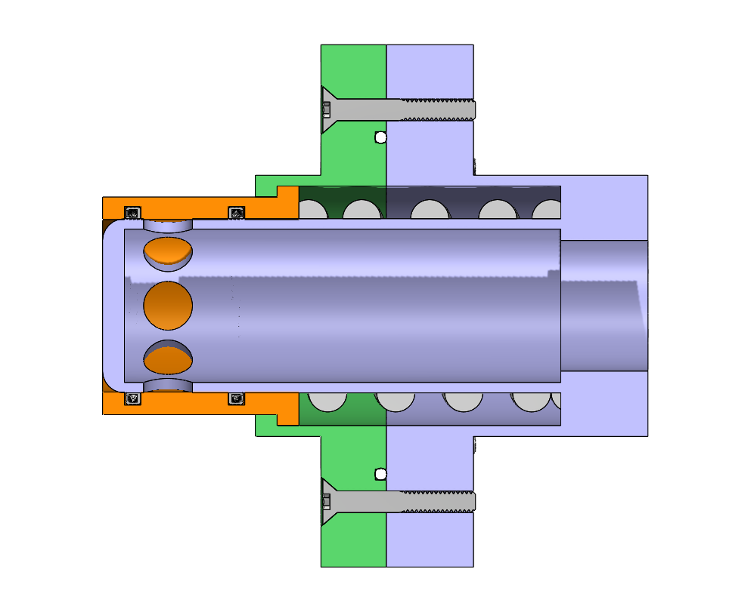
Updated Design
Sean Rodney
Probe
Receiver
Department of Mechanical Engineering
13

Slide 14
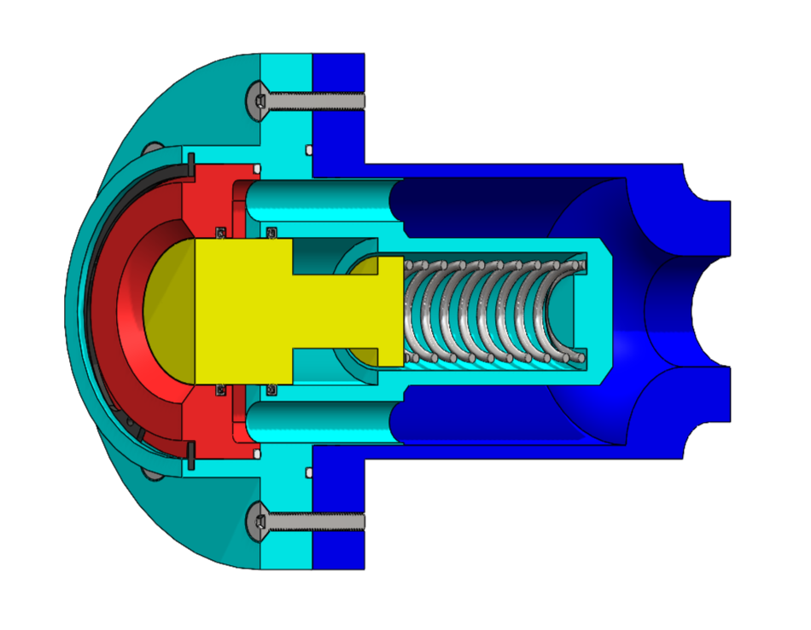
Receiving Half
Sean Rodney
Static PTFE O-Rings
Stainless Steel Spring
Actuator
Spring-Energized PTFE Seals
Department of Mechanical Engineering
14

Slide 15
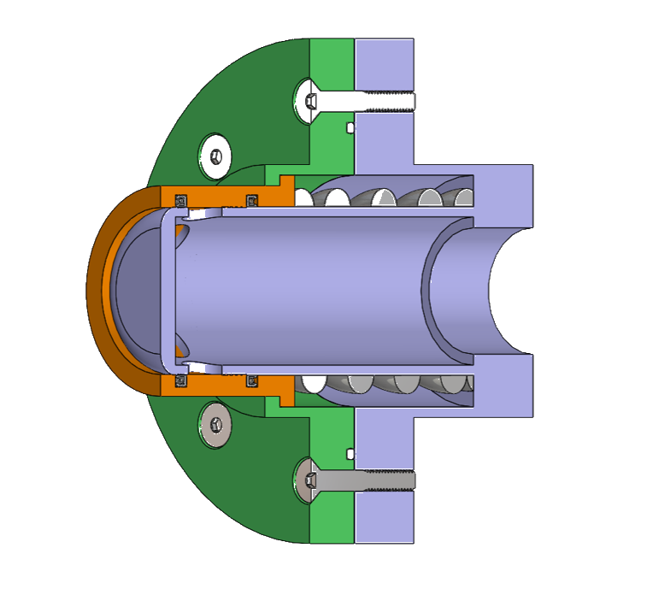
Probe Half
Sean Rodney
Static PTFE O-Rings
Actuator
Spring-Energized PTFE Seals
Stainless Steel Spring
Department of Mechanical Engineering
15

Slide 16
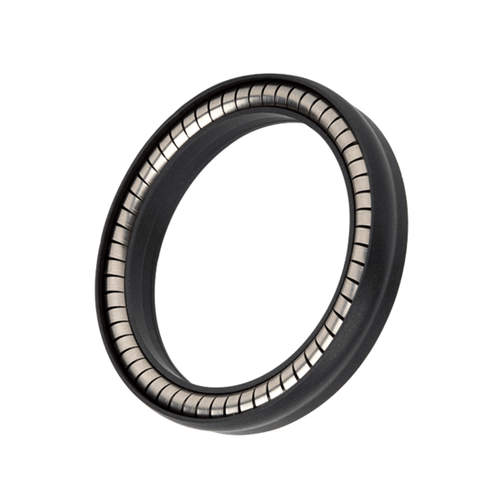
Updated Sealing
Sean Rodney
Spring-energized seal
Implements a circular spring to exert outward pressure
Encapsulated by PTFE (Teflon) due to excellent performance in cryogenic applications
Seals translating cylindrical bodies
Static and low speed applications
103A Omniseal​®
Note: Image for illustrative purposes only: The depicted seal is for stylization and a similar seal from McMaster-Carr will be implemented.
Department of Mechanical Engineering
16

Slide 17
Manufacturing
Sean Rodney
Main components of probe and receiver will be CNC machined by the FAMU-FSU COE machine shop
Springs and seals will be ready to install from the manufacturer
Assembly of the coupler will be completed by the design team
Department of Mechanical Engineering
17

Slide 18
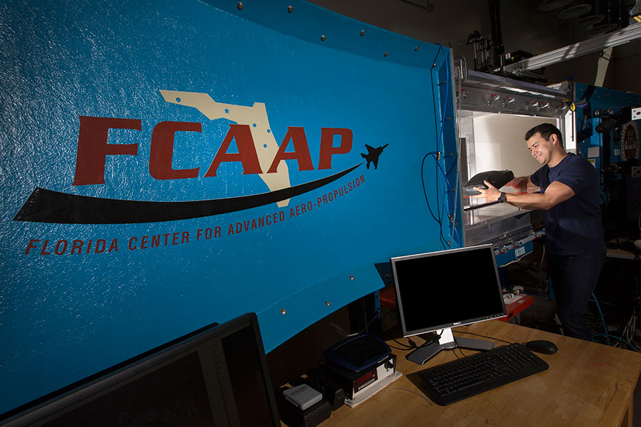
Sean Rodney
Testing
Cryogenic
Flow Rate
Leakage
Durability
Status:
In Progress
Status:
Approved
Status:
Pending Approval
Status:
Approved
Department of Mechanical Engineering
18

Slide 19
Leakage Testing
Sean Rodney
Identify design conflicts/areas of improvement
Calculate leakage rates and use Nasa environment correction factors to obtain target rates
Apply calculated rates and developed solutions to improve design before cryogenic testing
Department of Mechanical Engineering
19

Slide 20
Cryogenic Testing
Sean Rodney
Initiation of NHMFL
on-boarding and training
KF fitting for compatibility with NHMFL equipment
Material-safety check with Dr. Wei Guo
Department of Mechanical Engineering
20

Slide 21
Flow Rate Testing
Valerie Rodriguez
PIV testing will be conducted at the Florida Center For Advanced Aero-Propulsions
(FCAAP)
Particle Imaging Velocimetry will be used to analyze the flow inside the coupler
The design is to be sliced and placed in the low-speed wind tunnel to test flow rates
Department of Mechanical Engineering
21

Slide 22
Durability Testing
Valerie Rodriguez
Durability must be tested to identify any possible vulnerabilities in the design
The parts will be brushed with paint and tested at different forces
Leakage test will be preformed again to check for cracks and if design is reusable
The paint will chip away exposing areas experiencing the most force
Department of Mechanical Engineering
22

Slide 23
Testing Validation
Valerie Rodriguez
External leakage: Less than 50 SCIM liquid nitrogen at 5 and 50 psig internal pressure
Leakage
Cryogenic
Internal leakage: Less than 500 SCIM liquid nitrogen at 15 and 50 psid while demated
Stainless steel springs can endure at least 10 N of force to keep tightly sealed connection
The valve can endure minimum 80 K temperatures
Flow Rate
Less than 5% plastic deformation
Durability
Department of Mechanical Engineering
23

Slide 24
Testing Validation
Valerie Rodriguez
External leakage: Less than 50 SCIM liquid nitrogen at 5 and 50 psig internal pressure
Leakage
Cryogenic
Internal leakage: Less than 500 SCIM liquid nitrogen at 15 and 50 psid while demated
Stainless steel springs can endure at least 10 N of force to keep tightly sealed connection
The valve can endure minimum 80 K temperatures
Flow Rate
Less than 5% plastic deformation
Durability
Department of Mechanical Engineering
24

Slide 25
Valerie Rodriguez
Future Work
Conduct all
testing methods
Finish calculations, order parts, build prototype and refine design
Analyze and Interpret
data from testing
Manufacture final design at machine shop
Department of Mechanical Engineering
25

Slide 26
Thank You.
520: NASA Actively sealed Cryogenic Coupler
Jason Goldstein, Lauren Roche, Sean Rodney,
Valerie Rodriguez, Nicolas Sgammato

Slide 27
Backup Slides

Slide 28
Flow Rate Testing
Valerie Rodriguez
In the case testing at the FCAAP lab is denied, fluid dynamics will be simulated in COMSOL.
Testing using PIV would be ideal but main concerns can still be analyzed using this software.
Department of Mechanical Engineering
28

Slide 29
Lunar Refueling Depot
Reduced Cost
Increased Safety
Extended Mission Capabilities

Slide 30
Problems with Current Designs
Sealing and Leakage
Thermal Radiation
Contamination

Slide 31
Actively Sealed Coupler
Seals when the two halves make contact

Slide 32
Background
Lauren Roche
Cryogenic Fuel Transfer
Deep Space Mission
Lunar Base Fuel Depot
Department of Mechanical Engineering
32

Slide 33
Customer Needs
Valerie Rodriguez
Extend the life of the cryogenic fuel storage in space
Minimize the leakage rate of fuels during the transfer process
Seal activation upon contact of coupler halves
Limit boil-off of fuel due to heat transfer
Protect system from foreign particulate matter

Slide 34
Customer Needs
Valerie Rodriguez
Extend life of the cryogenic fuel
Minimize the leakage rate
Seal activation upon contact of coupler halves
Limit Boil Off
System Protection

Slide 35
Customer Needs
Valerie Rodriguez
Extend life of the cryogenic fuel
Minimize the leakage rate
Seal activation upon contact of coupler halves
Limit boil off
System protection

Slide 36
Functional Decomposition
Valerie Rodriguez
Coupling System
Durability
Connection
Fueling
Disconnection

Slide 37
Functional Decomposition
Valerie Rodriguez
Coupling System
Durability
Connection
Fueling
Disconnection
Major Function
Endure Solar Radiation
Mitigate Particulates
Minimize Heat Transfer
Tolerate Vehicle Misalignment
Uphold Structural Durability
Protect Electrical Components
Minor Function

Slide 38
Functional Decomposition
Valerie Rodriguez
Coupling System
Durability
Connection
Fueling
Disconnection
Major Function
Check Pressure Difference
Level Pressure
Lock two Halves Together
Seal the Connection
Minor Function

Slide 39
Functional Decomposition
Valerie Rodriguez
Coupling System
Durability
Connection
Fueling
Disconnection
Major Function
Open Pipe Valve
Minimize Fuel Leakage
Close Pipe Valve
Minor Function

Slide 40
Functional Decomposition
Valerie Rodriguez
Coupling System
Durability
Connection
Fueling
Disconnection
Major Function
Disconnect Both Halves
Purge Excess Fuel
Minor Function

Slide 41
Name
Status Update
Research on materials, locks, insulation, existing designs
Wrapping up concept generation and concept selection
Contact sponsor to get feedback on our top designs
Department of Mechanical Engineering
41

Slide 42
Nicolas Sgammato
Fuel Leakage
Measured Using Venturi Flowmeter at the National High Magnetic Field Laboratory (NHMFL)
Target From Critical Targets Table Provided by Sponsor
For Internal Leakage:
≤ 500 SCIM LN2 at 15 and 50 PSID While De-mated
For External Leakage:
≤ 50 SCIM LN2 at 5 and 50 PSIG Internal Pressure
Department of Mechanical Engineering
42

Slide 43
Nicolas Sgammato
Heat Transfer
Measured Using a Thermocouple in Coupler Interior
Target Derived From Boiling Point of Liquid Nitrogen
Coupler Interior Temperature
≤ 80 K
Department of Mechanical Engineering
43

Slide 44
Jason Goldstein
Coupler Connection
Measured using a Force Transducer Attached to One Half of Coupler
Target Derived From Previous NASA Coupler
Connection/
Disconnection Force:
≤ 250 LBF
Department of Mechanical Engineering
44

Slide 45
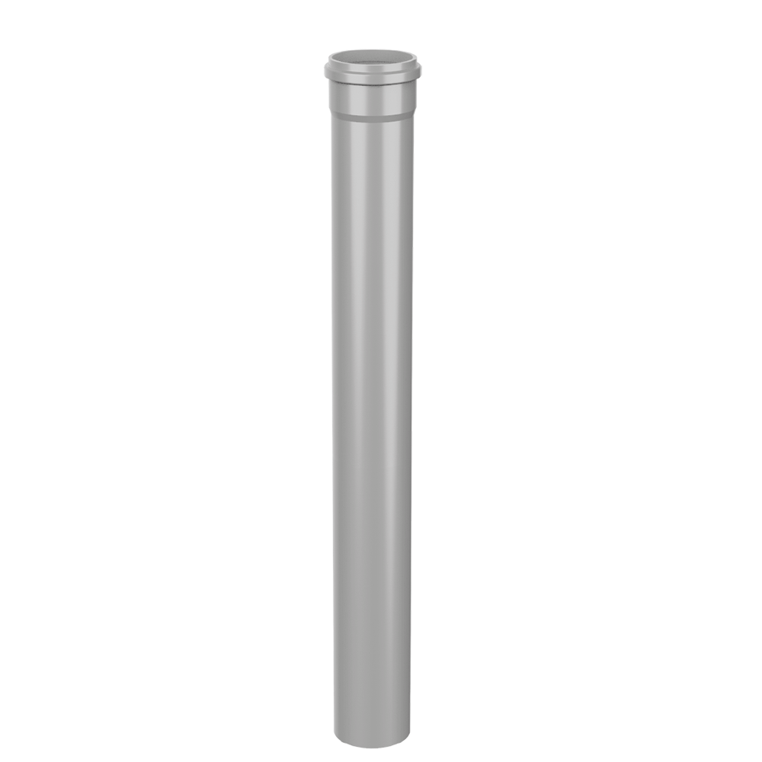
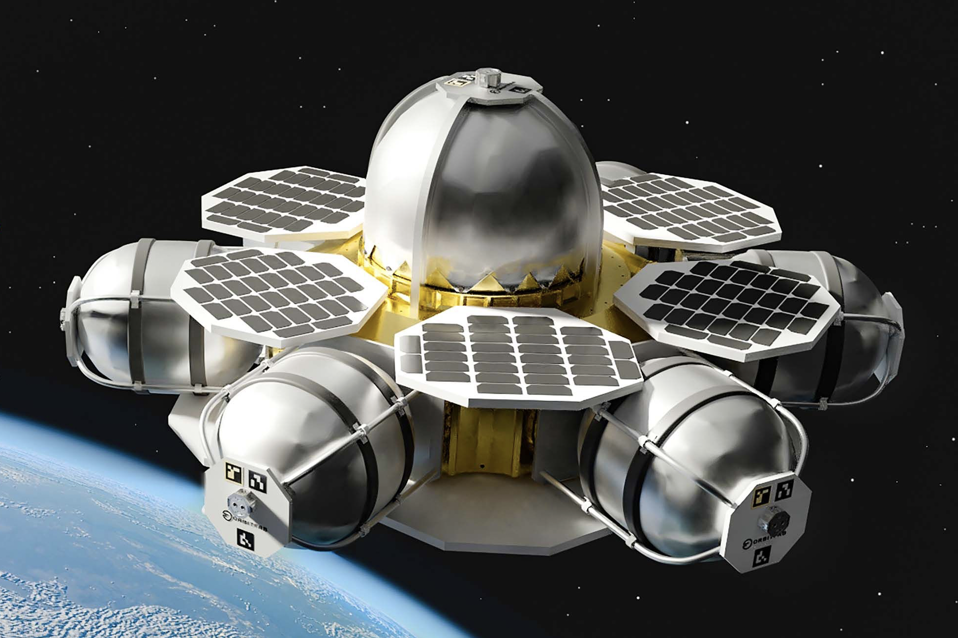
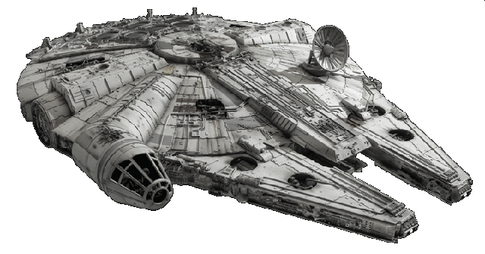
Jason Goldstein
Concept Generation Tactics
Biomimicry
Crap Shoot
Morphological Chart
1
A
A
B
C
1
1
1
2
B
2
2
2
3
C
3
3
3
4
D
5
E
Department of Mechanical Engineering
45

Slide 46
Lauren Roche
Terminology
Seals​
Insulation
MLI
SOFI
Double vacuum wall
Encapsulated O-ring
Teflon Seal
Locks
Valves
Force held
Collet Lock
Double poppet valve
Department of Mechanical Engineering
46

Slide 47
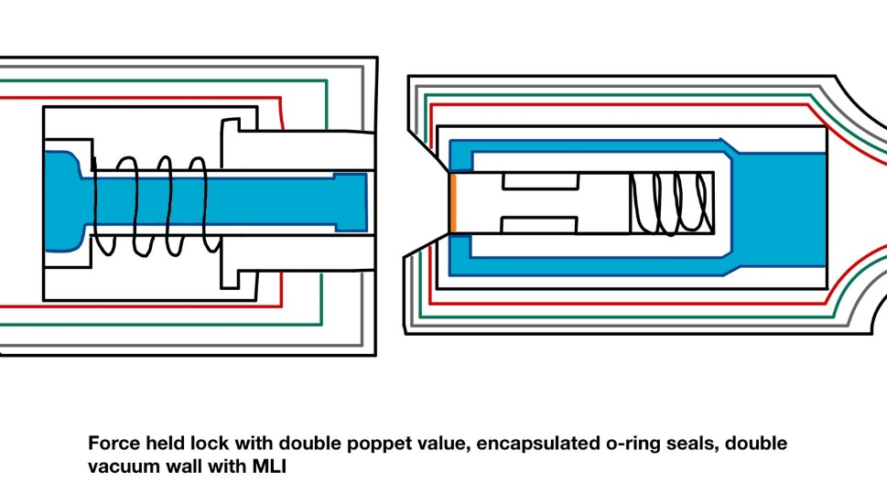
Lauren Roche
High Fidelity Concepts
Concept #33
Force held double poppet actuator, sealed with encapsulated O-rings, insulated by a double vacuum wall structure and Multi-Layered Insulation
Department of Mechanical Engineering
47

Slide 48
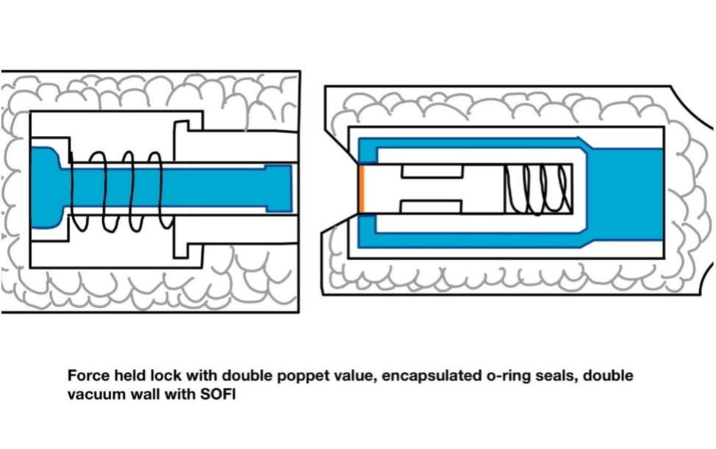
Lauren Roche
High Fidelity Concepts
Concept #98
Force held double poppet actuator, sealed with encapsulated O-rings, insulated by a double vacuum wall structure and Spray-On Foam Insulation (SOFI)
Department of Mechanical Engineering
48

Slide 49
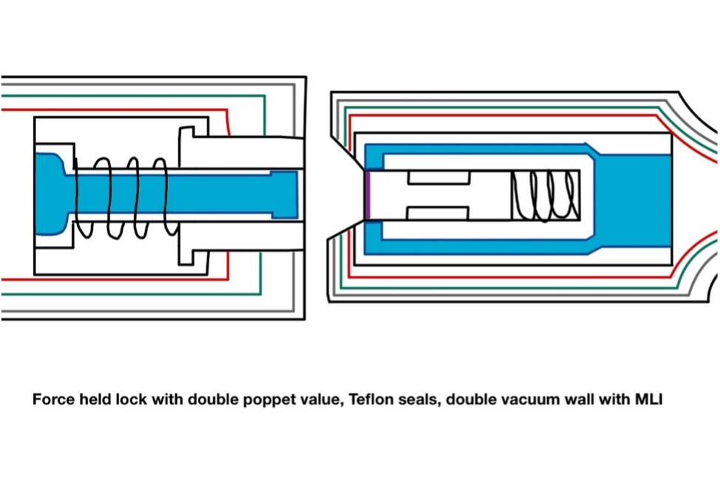
Nicolas Sgammato
High Fidelity Concepts
Concept #100
Force held double poppet actuator, sealed with Teflon, insulated by a double vacuum wall structure and Multi-Layered Insulation (MLI)
Department of Mechanical Engineering
49

Slide 50
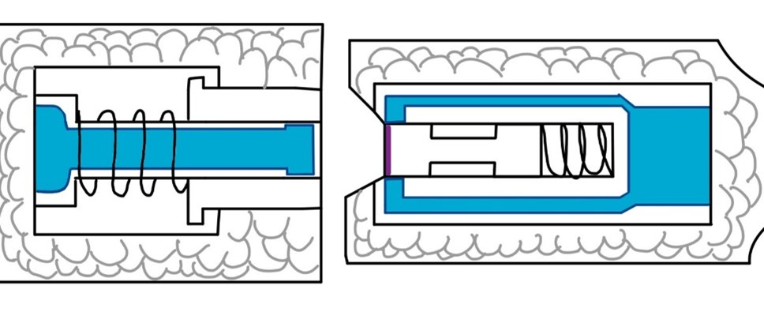
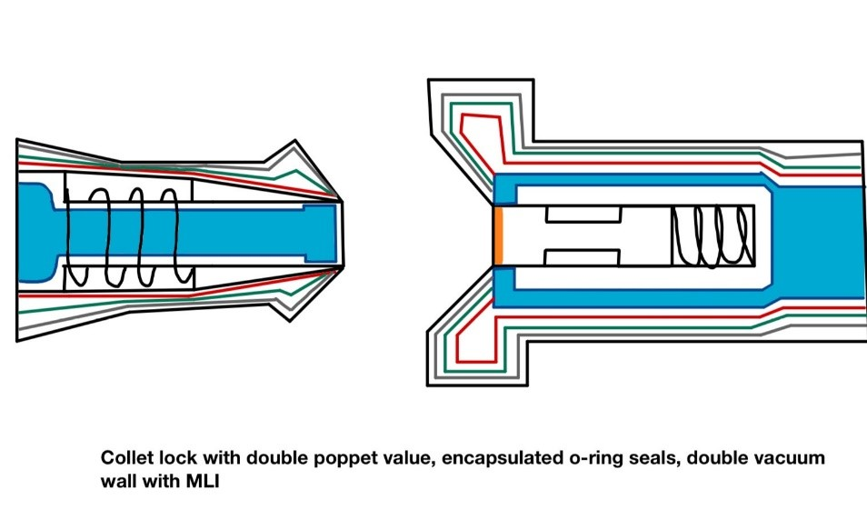
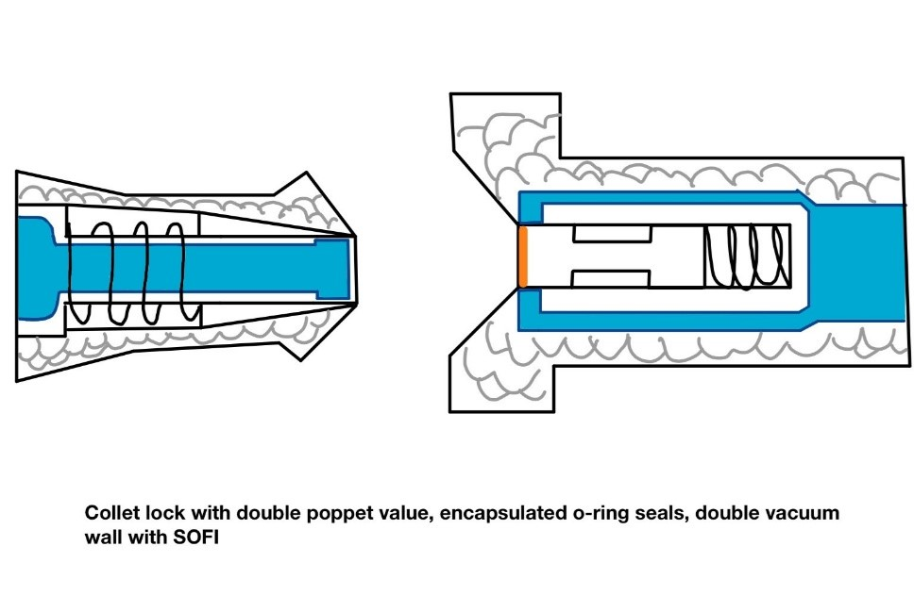
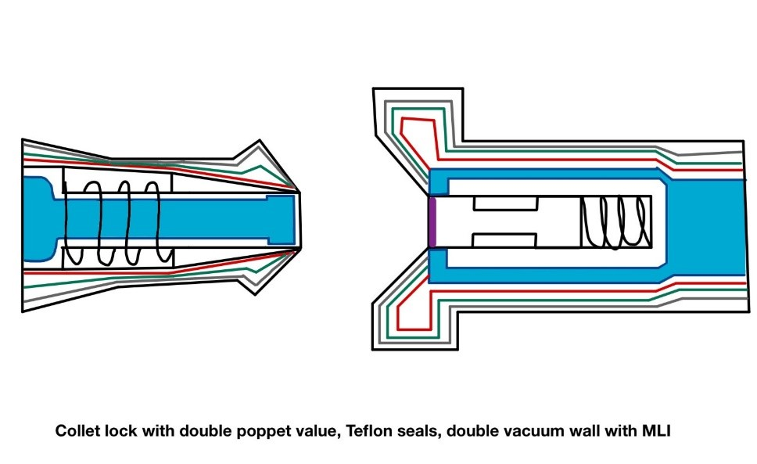
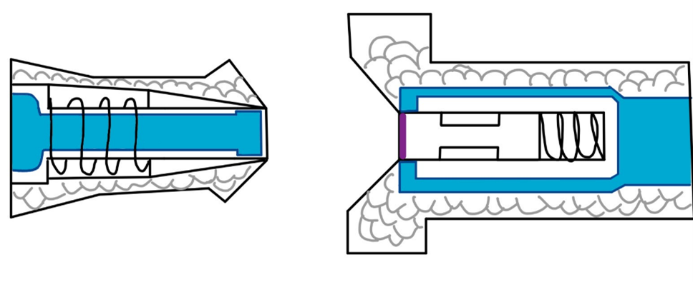
Nicolas Sgammato
Medium Fidelity Concepts
#99
#82
#81
#80
#79
Department of Mechanical Engineering
50

Slide 51
Nicolas Sgammato
Medium Fidelity Concepts
Force held lock
Double vacuum & SOFI
#99
Double Poppet
Teflon Seals
Department of Mechanical Engineering
51

Slide 52
Jason Goldstein
Medium Fidelity Concepts
Double vacuum & MLI
#82
Double Poppet
Collet lock
Encapsulated Seals
Department of Mechanical Engineering
52

Slide 53
Jason Goldstein
Medium Fidelity Concepts
Double vacuum & SOFI
#81
Double Poppet
Collet Lock
Encapsulated Seals
Department of Mechanical Engineering
53

Slide 54
Jason Goldstein
Pugh Charts- Second Iteration
Selection Criteria
Leakage
Lifetime
Seal
Resilience
Size
Cost
-
S
-
-
S
+
Concept #100
Force held double poppet actuator, sealed with Teflon, insulated by a double vacuum wall structure and Multi-Layered Insulation (MLI)
Datum: Concept #33
Department of Mechanical Engineering
54

Slide 55
Terminology
Seals​
Encapsulated O-ring seal​
Teflon Seal
Insulation
MLI
SOFI
Double vacuum wall
Locks
Force held
Collet Lock
Valves
Double poppet valve
Department of Mechanical Engineering
55

Slide 56
Name
Top Concepts
Force held lock with double poppet valve, encapsulated seals, double vacuum and MLI (multi-layered insulation)
Force held lock with double poppet valve, encapsulated seals, double vacuum and SOFI (spray-on foam insulation)
Collet lock with double poppet valve, encapsulated seals, double vacuum and MLI
Collet lock with double poppet valve, encapsulated seal, double vacuum and SOFI
Department of Mechanical Engineering
56

Slide 57
Nicolas Sgammato
Pugh Charts- Second Iteration
Selection Criteria
Leakage
Lifetime
Seal
Resilience
Size
Cost
S
-
S
-
+
+
Concept #98
Force held double poppet actuator, sealed with encapsulated O-rings, insulated by a double vacuum wall structure and Spray-On Foam Insulation (SOFI)
Datum: Concept #33
Department of Mechanical Engineering
57

Slide 58
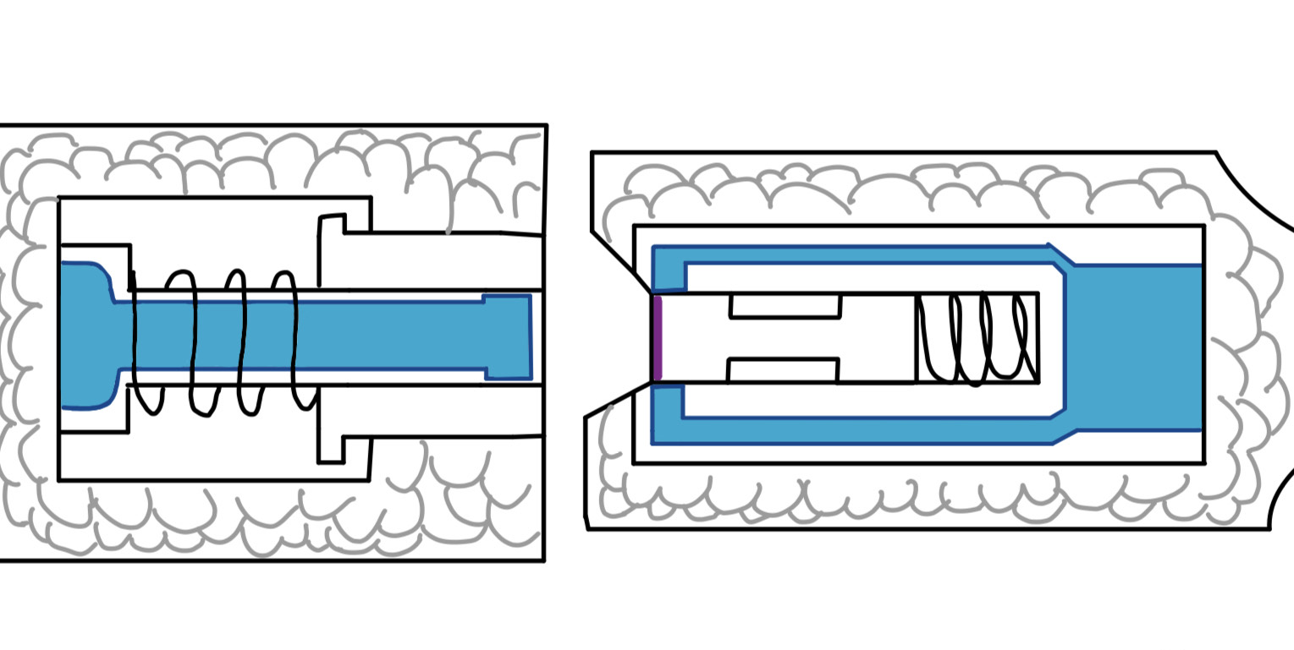
Jason Goldstein
Pugh Charts- Second Iteration
Selection Criteria
Leakage
Lifetime
Seal
Resilience
Size
Cost
-
-
-
-
+
+
Concept #99
Force held double poppet actuator, sealed with Teflon, double vacuum wall structure and Spray-On Foam Insulation (SOFI)
Datum: Concept #33
Department of Mechanical Engineering
58

Slide 59
Jason Goldstein
Analytical Hierarchy Process
Concept #33
Alternative Value:
1.032
Concept #98
Alternative Value:
0.466
Concept #100
Alternative Value:
0.632
Department of Mechanical Engineering
59

Slide 60
Nicolas Sgammato
Targets and Metrics
Fuel Leakage Heat Transfer Coupler Connection Structure Integrity
Fuel Leakage Rate from Flowmeter
Interior Temperature from Thermocouple
Connection Force from Transducer
Material Yielding from Tensile Test
Department of Mechanical Engineering
60

Slide 61
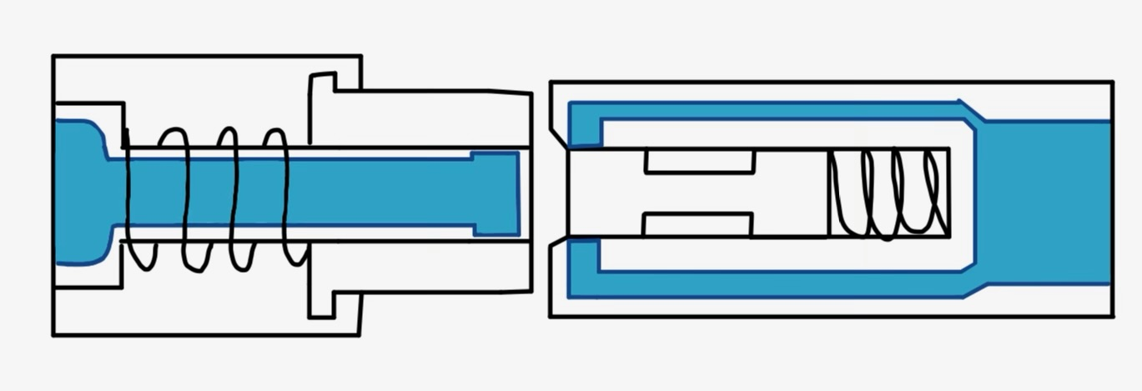
#33:
Encapsulated
O-ring seals and MLI
High Fidelity Concepts
#48:
Force held double – poppet actuator with double vacuum wall insulation structure paired with:
#50
Department of Mechanical Engineering
61

Slide 62
Jason Goldstein
Medium Fidelity Concepts
Double-poppet valve and double vacuum wall
#49 | Force-held lock Teflon seals SOFI
#32 | Collet lock encapsulated O-ring seals MLI
#31 | Collet lock encapsulated O-ring seals SOFI
#30 | Collet lock Teflon seals MLI
Department of Mechanical Engineering
62

Slide 63
Jason Goldstein
Medium Fidelity Concepts
Double vacuum & MLI
#80
Double Poppet
Collet Lock
Teflon Seals
Department of Mechanical Engineering
63

Slide 64
Lauren Roche
Medium Fidelity Concepts
Double vacuum & SOFI
#79
Double Poppet
Collet Lock
Teflon Seals
Department of Mechanical Engineering
64

Slide 65
Lauren Roche
Concept Selection
Binary Pairwise Comparison
House of Quality
Pugh Charts
Analytical Hierarchy Process
Final Selection
Department of Mechanical Engineering
65

Slide 66
Lauren Roche
Binary Pairwise Comparison
Compares Customer Needs to Each Other to Determine Relative Importance
Customer Needs | Score
Fluid Loss Prevention | 6
Active Seal | 6
Maintains Pressure | 6
Effective Coupling | 6
Heat Transfer Protection | 5
Particulate Mitigation | 4
Life-Span | 3
Cost | 3
Sizing Parameters | 3
Material Resilience | 2
Reusability | 1
Department of Mechanical Engineering
66

Slide 67
Jason Goldstein
Structural Integrity
Measured using Tensile Testing on Selected Material
Safe Range was Chosen Due to Material Not Yet Being Selected
Plastic Deformation of Chosen Material:
≤ 5%
Department of Mechanical Engineering
67

Slide 68
Nicolas Sgammato
House of Quality
Customer Requirements
Life-span
Fluid Loss
Active Seal
Material Resilience
Reusability
Maintains Pressure
Effective Coupling
Heat Transfer
Particulate Mitigation
Channel Sizing Parameters
Cost
Ranked Engineering Characteristics
1. Fuel Leakage
2. Seal
3. Heat Transfer
4. Durability
5. Weight
6. Cost
Department of Mechanical Engineering
68

Slide 69
Nicolas Sgammato
Pugh Charts- First Iteration
Selection Criteria
Leakage
Lifetime
Seal
Resilience
Size
Cost
#82
#81
#80
#33
#98
#100
#99
-2
-2
-2
1
1
1
1
Datum: NASA Low Separation Force Quick Disconnect
Department of Mechanical Engineering
69

Slide 70
Nicolas Sgammato
Medium Fidelity Concepts
#49
Force held double poppet actuator, sealed with Teflon, double vacuum wall structure and Spray-On Foam Insulation (SOFI)
Department of Mechanical Engineering
70

Slide 71
Nicolas Sgammato
Medium Fidelity Concepts
#32
Double poppet actuator with collet lock, sealed with encapsulated O-rings, double vacuum wall structure and Multi-Layer Insulation (MLI)
Department of Mechanical Engineering
71

Slide 72
Jason Goldstein
Medium Fidelity Concepts
#31
Collet locked double poppet actuator, sealed with encapsulated O-rings, double vacuum wall structure and Spray-On Foam Insulation
Department of Mechanical Engineering
72

Slide 73
Jason Goldstein
Medium Fidelity Concepts
#30
Double poppet-actuator with collet lock, Teflon seals, double vacuum wall structure and Multi-Layer Insulation
Department of Mechanical Engineering
73

Slide 74
Jason Goldstein
Medium Fidelity Concepts
#29
Double poppet-actuator with collet lock, Teflon seals, double vacuum wall structure and Spray on Foam Insulation
Department of Mechanical Engineering
74

Slide 75
High Fidelity Concepts
Concept #33
Concept #48
Concept #50
Department of Mechanical Engineering
75

Slide 76
Lauren Roche
High Fidelity Concepts
Force-held lock with double-poppet valve
and double vacuum wall
#33 | Encapsulated O-ring seals MLI
#48 | Encapsulated O-ring seals SOFI
#50 | Teflon seals MLI
Department of Mechanical Engineering
76

Slide 77
Nicolas Sgammato
Final Concept Selection
Force-held lock with double-poppet valve
and double vacuum wall
#33 | encapsulated O-ring seals MLI
Department of Mechanical Engineering
77

Slide 78
Fall Design
Double poppet actuator and force held lock, seal with encapsulated seals, insulated by double vacuum wall and Multi-Layer Insulation (MLI) blanket

Slide 79
Lauren Roche
Final Concept Selection
Concept #33: Double poppet actuator and force held lock, seal with encapsulated seals, insulated by double vacuum wall and Multi-Layer Insulation (MLI) blanket
Department of Mechanical Engineering
79

Slide 80
Lauren Roche
Concept #33
Department of Mechanical Engineering
80

Slide 81
Lauren Roche
Concept #33
Department of Mechanical Engineering
81

Slide 82
Lauren Roche
Concept #33
Department of Mechanical Engineering
82

Slide 83
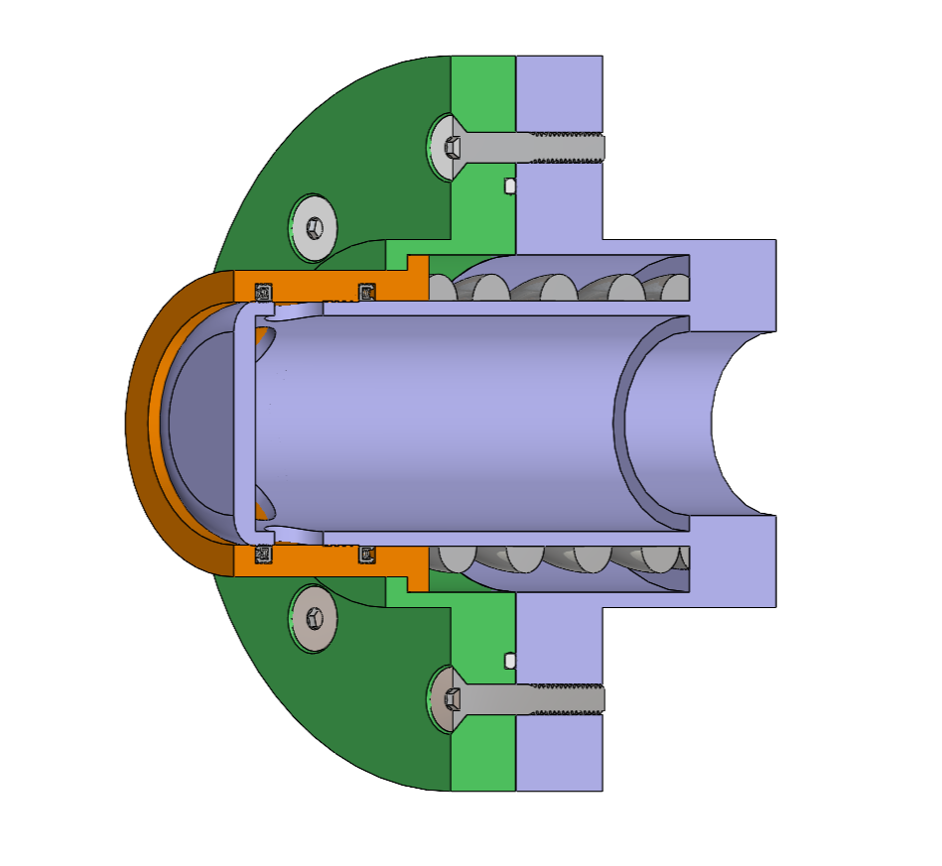
Probe Half
Sean Rodney
Static PTFE O-Rings
Actuator
Spring-Energized PTFE Seals
Stainless Steel Spring
Department of Mechanical Engineering
83

Slide 84
This is 10-point
This is 15–point Times
This is 20–point
This is 25–point
This is 30–point
This is 35–point
This is 40–point
This is 50–point
This is 60–point
This is 72–point
Notes:
Use at least 20-point font in Room A105, B134, and B136
Use at least 25-point font in Room B135

Slide 85
College of Engineering Color Palette
1 2 3 4
Pantone: PMS 195 C
RGB: 120, 47, 64
Hex: #782F40
CMYK:19, 90, 50, 55
1 2 3 4
Pantone: Black C
RGB: 0, 0, 0
Hex: #000000
CMYK:0, 0, 0, 100
Garnet
Black
1 2 3 4
RGB: 238, 118, 36
Hex: #EE7624
CMYK:2, 66, 99, 0
1 2 3 4
Pantone: PMS 000C
RGB: 255, 255, 255
Hex: #FFFFFF
CMYK: 0, 0, 0, 0
Fang
Orange
White
Notes:
Avoid 75% Black in B135

Slide 86
Accent Color Palette
1 2 3 4
RGB: 0, 59, 111
Hex: #003B6F
CMYK:
1 2 3 4
RGB: 0, 59, 111
Hex: #003B6F
CMYK:
1 2 3 4
RGB: 251, 236, 93
Hex: #FBEC5D
CMYK:
1 2 3 4
RGB: 219, 215, 210
Hex: #DBD7D2
CMYK:
1 2 3 4
RGB: 251, 236, 93
Hex: #FBEC5D
CMYK:
1 2 3 4
RGB: 219, 215, 210
Hex: #DBD7D2
CMYK:
Tardis Blue
Tardis Blue
Corn
Timberwolf
Corn
Timberwolf
1 2 3 4
RGB: 206, 0, 88
Hex: #CE0058
CMYK: 0, 100, 43, 12
1 2 3 4
RGB: 206, 0, 88
Hex: #CE0058
CMYK: 0, 100, 43, 12
1 2 3 4
RGB: 104, 40, 96
Hex: #682860
CMYK:
1 2 3 4
RGB: 220, 220, 220
Hex: #DCDCDC
CMYK:
Rubine Red
Rubine Red
Imperial
Gainsboro
1 2 3 4
RGB: 72, 146, 155
Hex: #48929b
CMYK:
1 2 3 4
RGB: 64, 224, 208
Hex: #40E0D0
CMYK:
1 2 3 4
RGB: 255, 139, 0
Hex: #FF8B00
CMYK:
Asagi-iro
Turquoise
American Orange
Notes:
Remove American orange add hyperlink grey
Make corn the last for b135
All work in 134 imperial move later
Tardis doesn’t work in b136

Slide 87
F7AB19
D67F15
EE7624
D64615
F73119
Analogous
https://color.adobe.com/create/color-wheel
6E3610
F0A16C
EE7624
6E4931
BASB1C
Monochromatic
A14508
4BED3B
EE7624
250CED
2010A1
Triad
A1470C
FF8C40
EE7624
0098A1
24E2ED
Complementary
28A164
2FED8D
EE7624
0848A1
1871ED
Split Complementary
EDAC2F
3BED93
EE7624
0C6AED
ED2F18
Double Split Complementary
ED660C
C7ED3B
EE7624
0CE1ED
A418ED
Square
BA7E09
87724A
EE7624
60EFCF
09BA61
Compound
AD551A
6E3610
EE7624
FA7625
D46820
Shades
Notes:
These are the variants that work well with Fang Orange. The bolded items show well on the projectors.

Slide 88
85412D
8F3831
782f40
8F3176
792D85
Analogous
https://color.adobe.com/create/color-wheel
C44D69
8E626D
782F40
C48796
451B25
Monochromatic
C43959
78743B
782F40
236178
43A2C4
Triad
C43959
C46078
782F40
25C43D
2F783A
Complementary
93C460
577835
782F40
39C49D
297861
Split Complementary
784435
5A783B
782F40
237860
6E2978
Double Split Complementary
782337
78683b
782F40
237830
293978
Square
AB4D32
DEBAAF
782F40
5D8555
70AB32
Compound
38161E
C44D69
782F40
853447
5E2532
Shades

Slide 89
A105
A105
B135 Stage Left
B135 Stage Right
B136
B134, A105
B135

