Slide 1
Team 520
NASA Marshall Space Flight Center:
Actively Sealed Cryogenic Coupler (ASCC)
Jason Goldstein, Lauren Roche, Sean Rodney,
Valerie Rodriguez, Nicolas Sgammato
Design Review 6

Slide 2

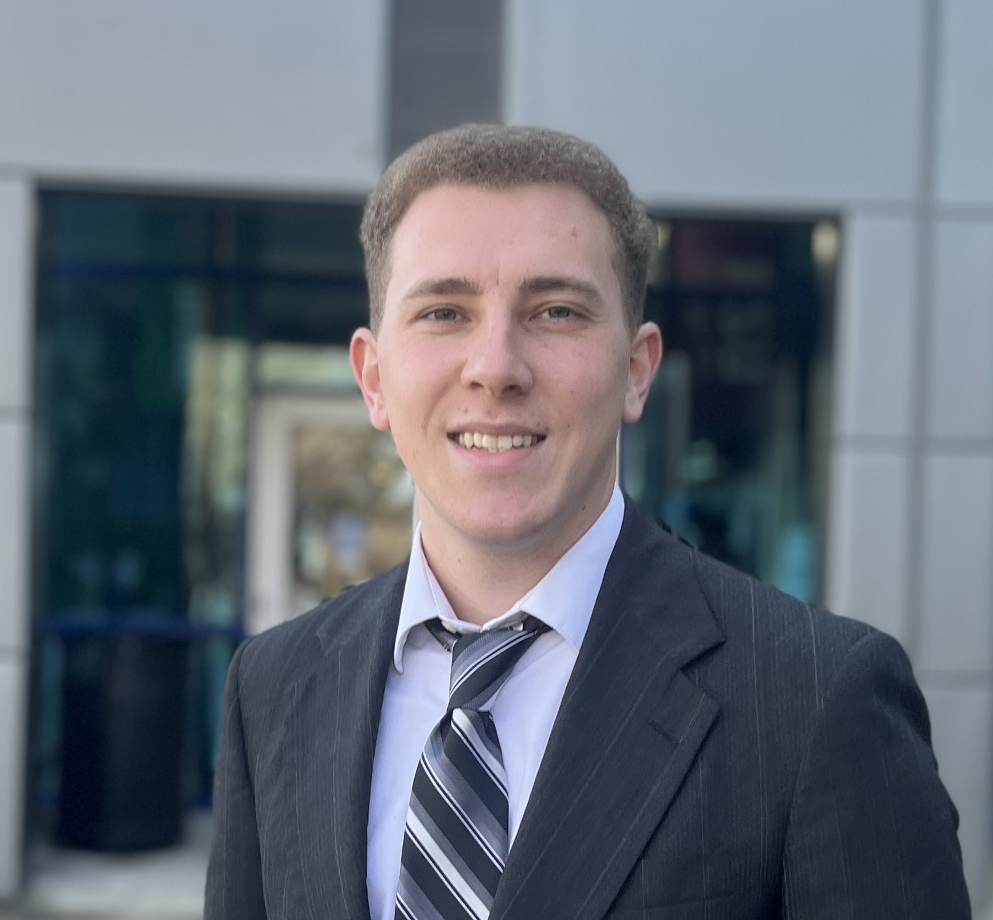

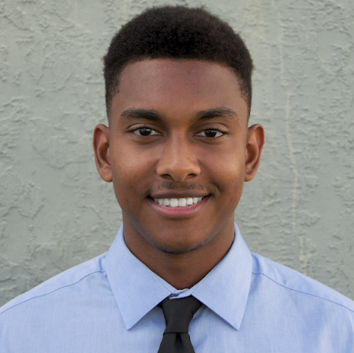
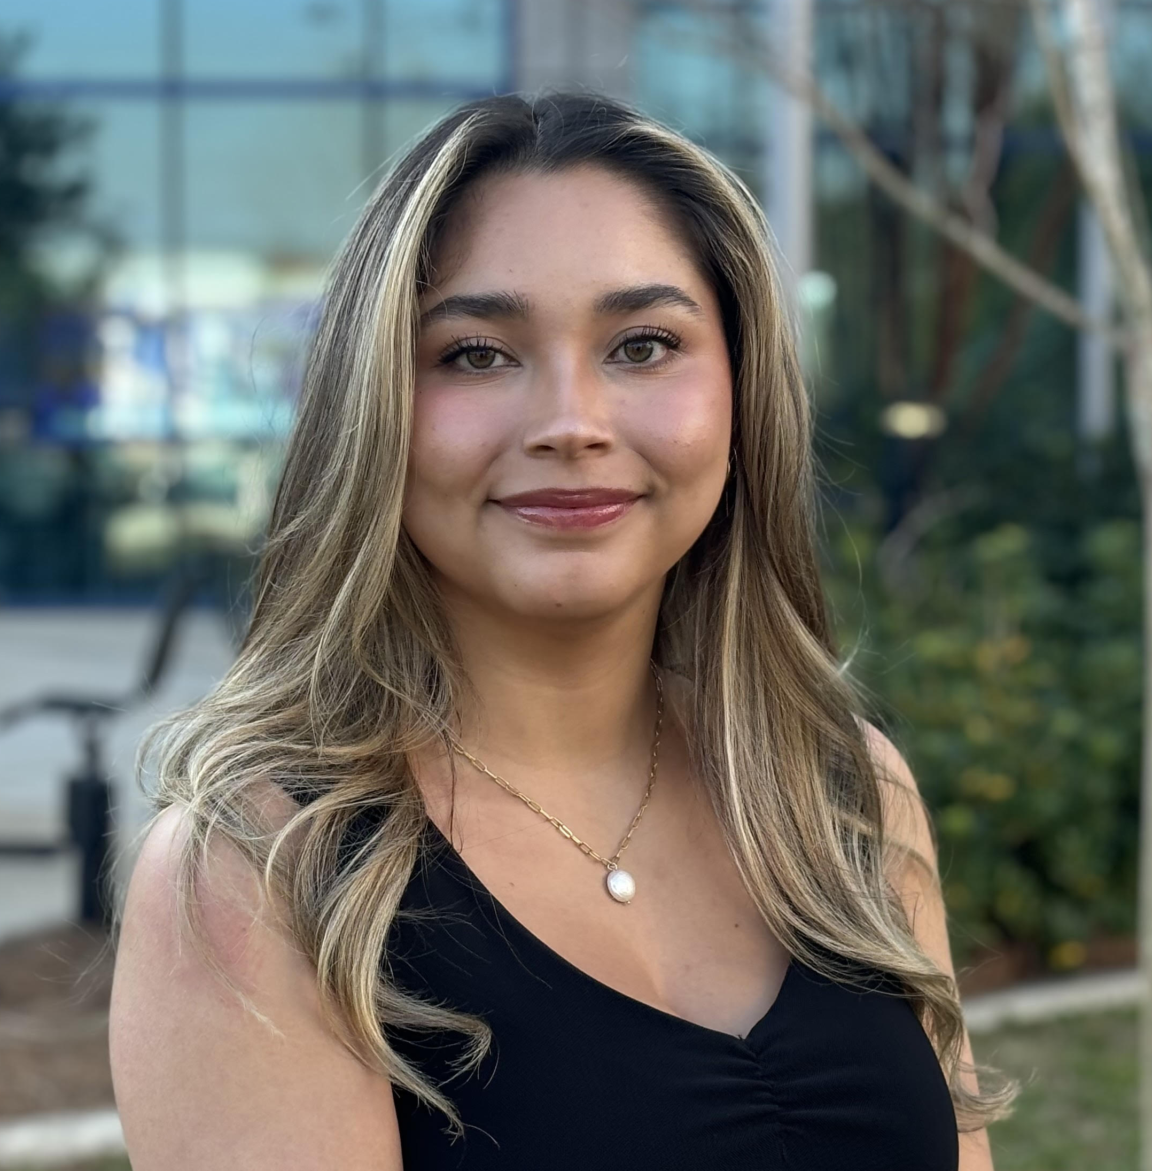


Meet The Team
Valerie Rodriguez
Jason Goldstein
Materials Engineer
Lauren
Roche
Cryogenics Engineer
Sean Rodney
Test
Engineer
Valerie Rodriguez
Thermal-Fluids Engineer
Nicolas Sgammato
Design
Engineer

Slide 3


Sponsors
Valerie Rodriguez
James C. Buzzell
Propulsion Systems Engineer,
NASA MSFC
Marvin Barnes
Propulsion Systems Engineer,
NASA MSFC

Slide 4

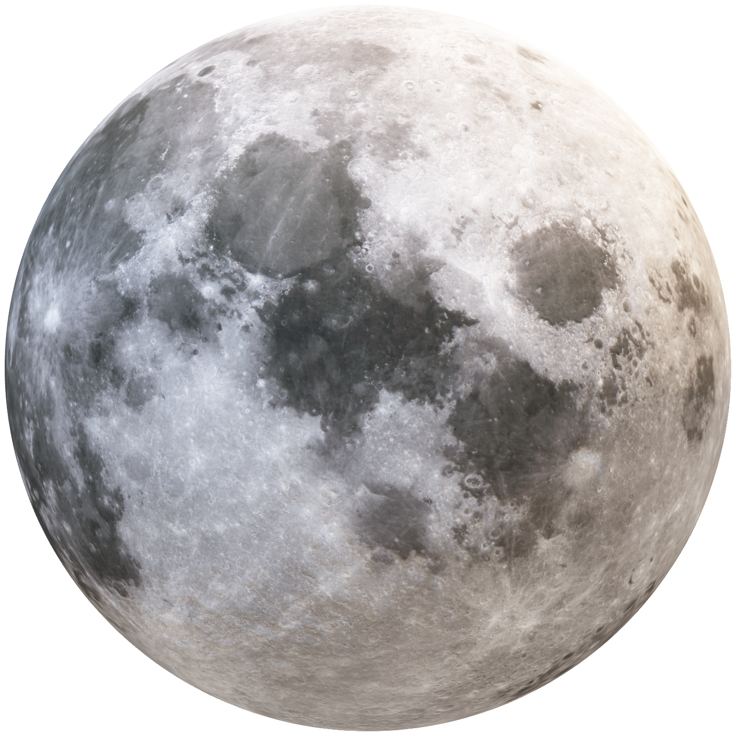
Objective
Valerie Rodriguez
The objective of this project is to design, build, and test an actively sealed coupler that prevents the leakage of cryogenic fuel during the transfer from depot to vessel for future NASA missions.

Slide 5
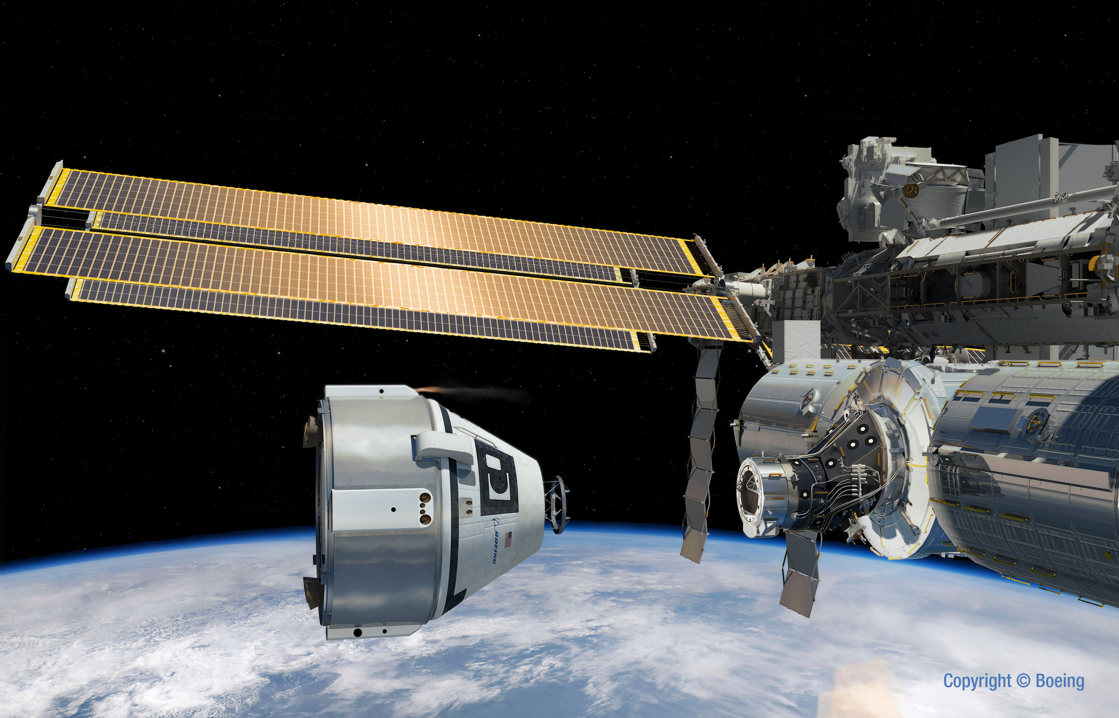
Background
Valerie Rodriguez
Cryogenic couplers allow for extended duration of space missions.
Their purpose is to make a sealed and secure connection between the space craft and the fuel source.

Slide 6
Background
Valerie Rodriguez
The coupler is to be used for future NASA lunar missions.
The navigation system from the spacecraft guides the receiving half of the coupler to mate with the probe half, mounted on the tanker ship.
Previous designs required human intervention to lock and initiate fuel transfer.

Slide 7


Active Sealing
Valerie Rodriguez
The actively sealed portion of the design requires the system to seal purely based on the mechanical connection of the two halves.
This avoids from using electronic components in cryogenic conditions and allows for quick connection and disconnection.
Department of Mechanical Engineering
Notes:
Yassify

Slide 8



Key Goals
Valerie Rodriguez
Effective Sealing
Minimize Leakage
90 Day Lunar Mission

Slide 9

Assumptions
Valerie Rodriguez
Flow rate and tank pressures will be controlled externally by space craft operators.
Heat load is negligible due to insulation and through flow time.
Misalignment tolerance will not exceed 0.25” total non-concentricity. Vehicle will have capture feature for gross misalignment.
Department of Mechanical Engineering
9

Slide 10




Markets
Sean Rodney
Marshall Space Flight Center

Slide 11

Customer Needs
Sean Rodney
Extend the life of the cryogenic fuel storage in space
Minimize the leakage rate of fuels during the transfer process
Seal activation upon contact of coupler halves
Limit boil-off of fuel due to heat transfer
Protect system from foreign particulate matter

Slide 12
Functional Decomposition
Sean Rodney
Connection
Thermal Management
Durability
Fueling
Disconnection

Slide 13


Sean Rodney
Connection
Lock two halves together and allow for flow channel alignment
Maintain sealed connection during fuel transfer

Slide 14


Sean Rodney
Durability
Uphold structural durability
Minimize stresses to system components

Slide 15
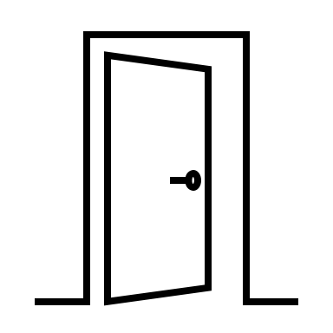

Sean Rodney
Fueling
Open and close flow channels
Minimize fuel leakage

Slide 16


Sean Rodney
Endure solar radiation
Thermal Management
Minimize heat from conduction, convection, and radiation

Slide 17


Sean Rodney
Disconnect both halves
Maintain sealed connection for excess fuel
Disconnection

Slide 18
Concept Generation
Lauren Roche
Biomimicry
100 Concepts
Concept Selection
3 High Fidelity
Crap Shoot
5 Med. Fidelity
Morphological Chart

Slide 19
Concept Selection
Lauren Roche
Binary Pairwise Comparison
House of Quality
Analytical Hierarchy Process
Pugh Charts
Final Selection
Notes:
BPC: which customer needs are most important to us
HoQ: used the weight of importance for each need to find the engineering characteristics to focus on
Pugh: comparing high and medium fidelity concepts to the market datum and each other
AHP: numerically determine which concept is best for our needs

Slide 20
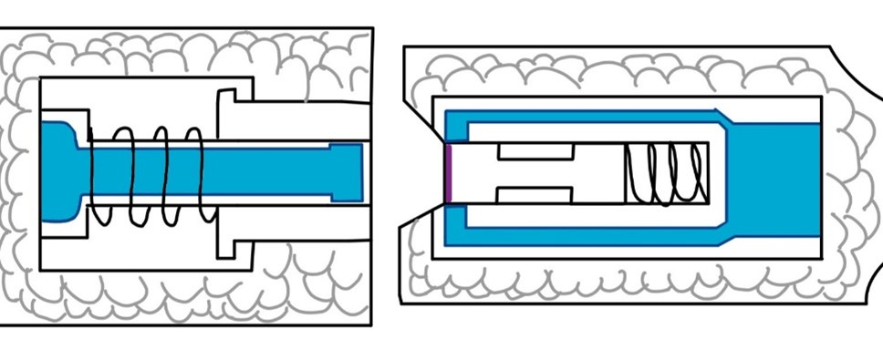
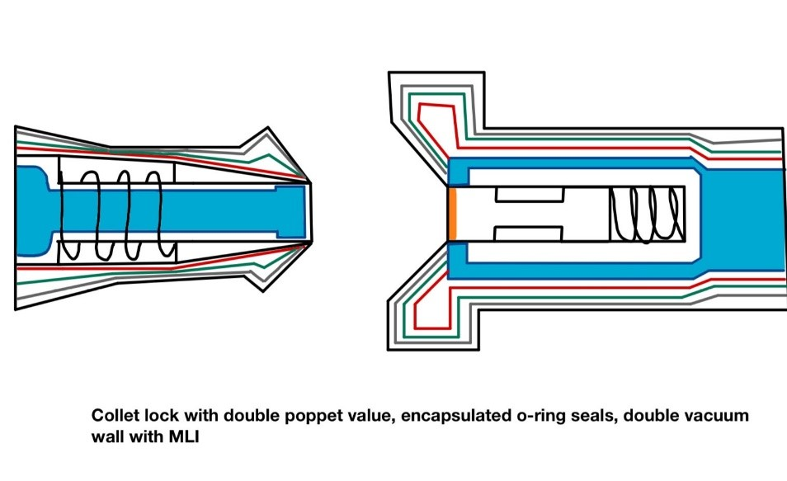
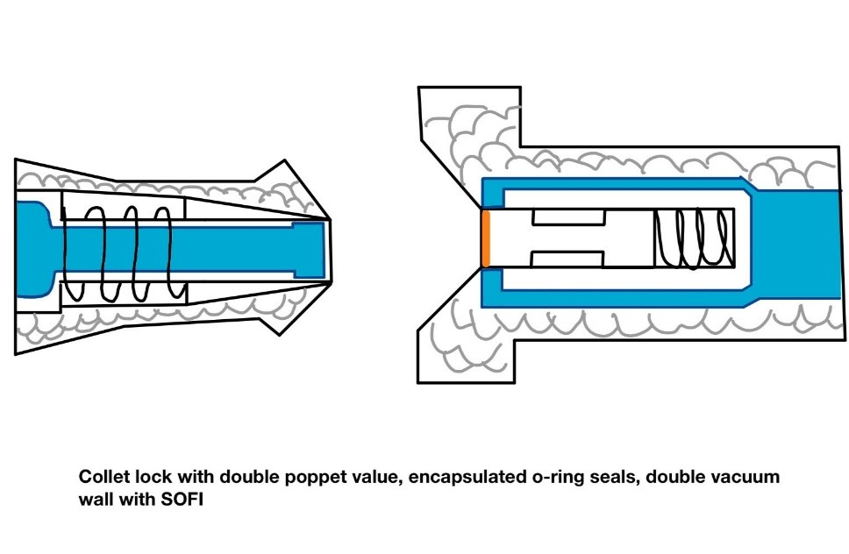
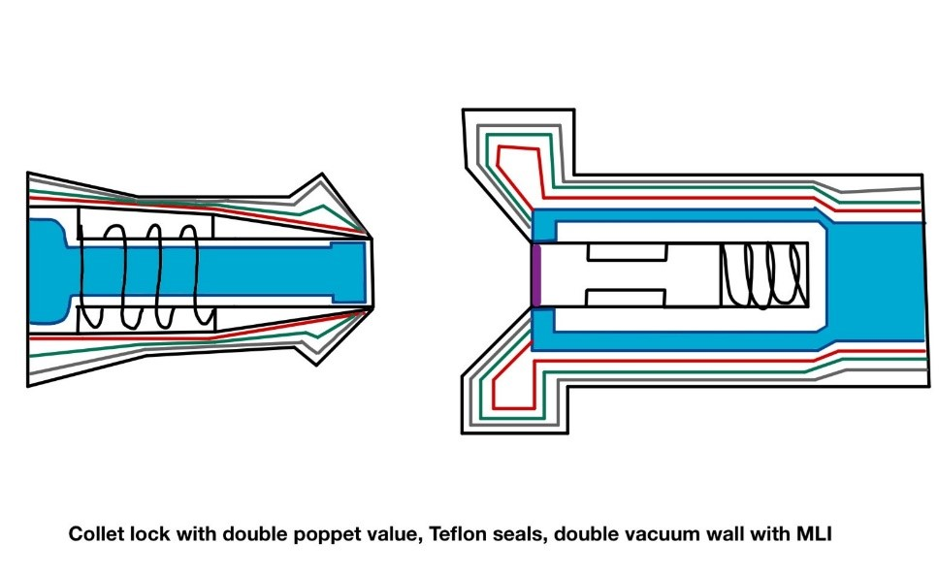
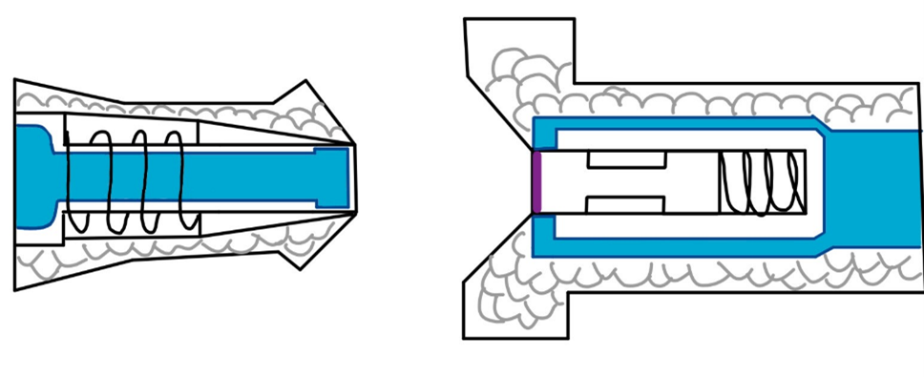
Medium Fidelity Concepts
Lauren Roche
#99
#82
#81
#80
#79
Department of Mechanical Engineering
20
Notes:
5 medium fidelity concepts
Solid confidence that these designs would work for our application
99 is a force held lock
The rest are collet locks – both halves would snap together

Slide 21
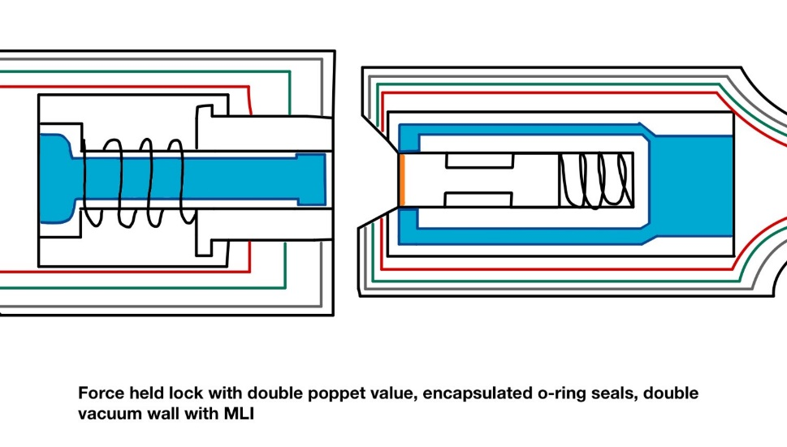
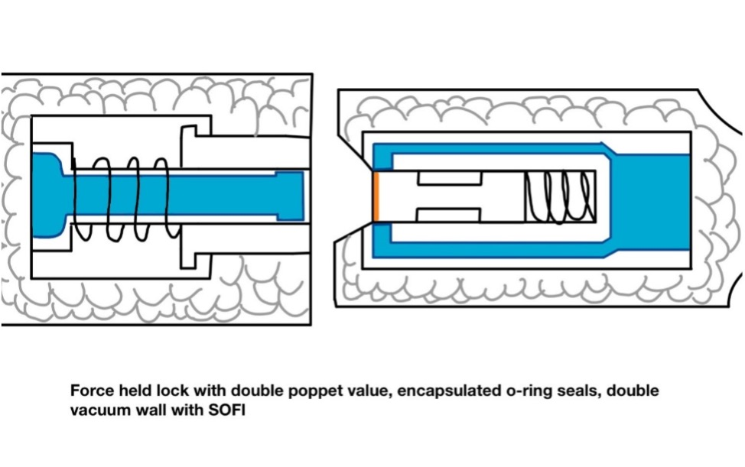
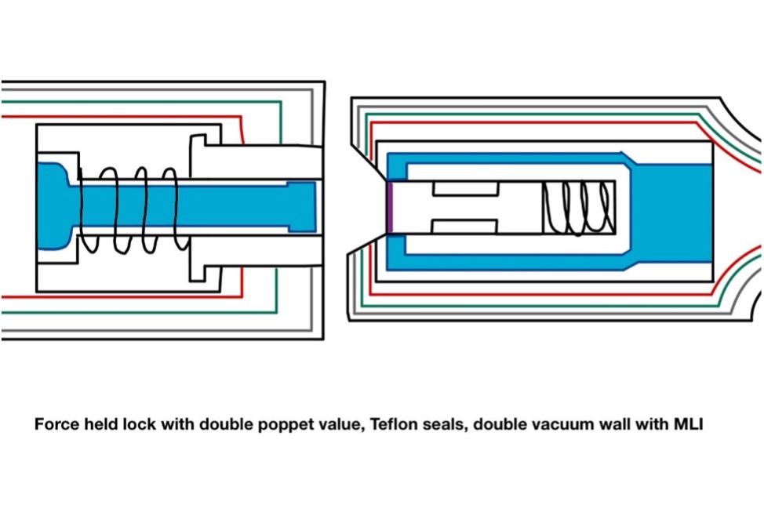
High Fidelity Concepts
Lauren Roche
Force held + double poppet actuator + double vacuum wall with:
Encapsulated O-rings
Multi-Layered Insulation (MLI)
#33
Encapsulated O-rings
Spray-On Foam Insulation (SOFI)
#98
Teflon Seals
Multi-Layered Insulation (MLI)
#100
Notes:
3 high fidelity concepts, we had the most confidence that these would be successful.
All three designs feature a force-held double poppet actuator and a double vacuum wall
Variations of sealing and insulating

Slide 22
Analytical Hierarchy Process
Lauren Roche
Concept #33
Alternative Value:
0.473
Concept #98
Alternative Value:
0.322
Concept #100
Alternative Value:
0.205
Notes:
3 high fidelity concepts were evaluated, and we produced a numerical value for which one would be best
Highest value, meaning it’s the

Slide 23
Final Selection
Lauren Roche
#33
Force held double poppet actuator, sealed with encapsulated O-rings, insulated by a double vacuum wall structure and Multi-Layered Insulation (MLI)
Notes:
Gave us a basic design to move forward with. Based on research and feedback from our sponsor, we implemented many upgrades to get to our current model

Slide 24
Coupler Operation
Lauren Roche
Notes:
Pilot drives the receiver half to mate with the probe half and this connection is held by force
The springs on either side compress, allowing fluid to flow from the depot to the spacecraft

Slide 25
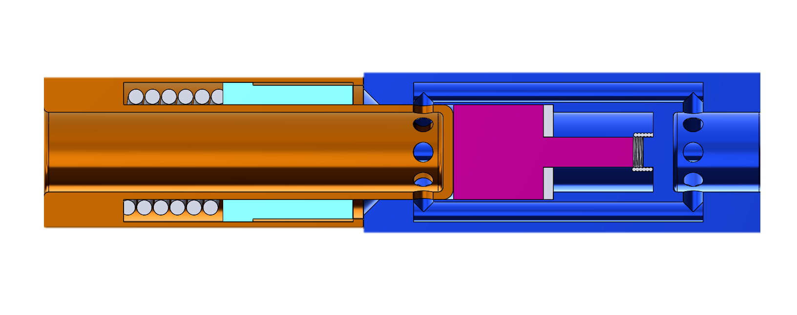
Initial Concept
Nicolas Sgammato
Receiver
Probe

Slide 26
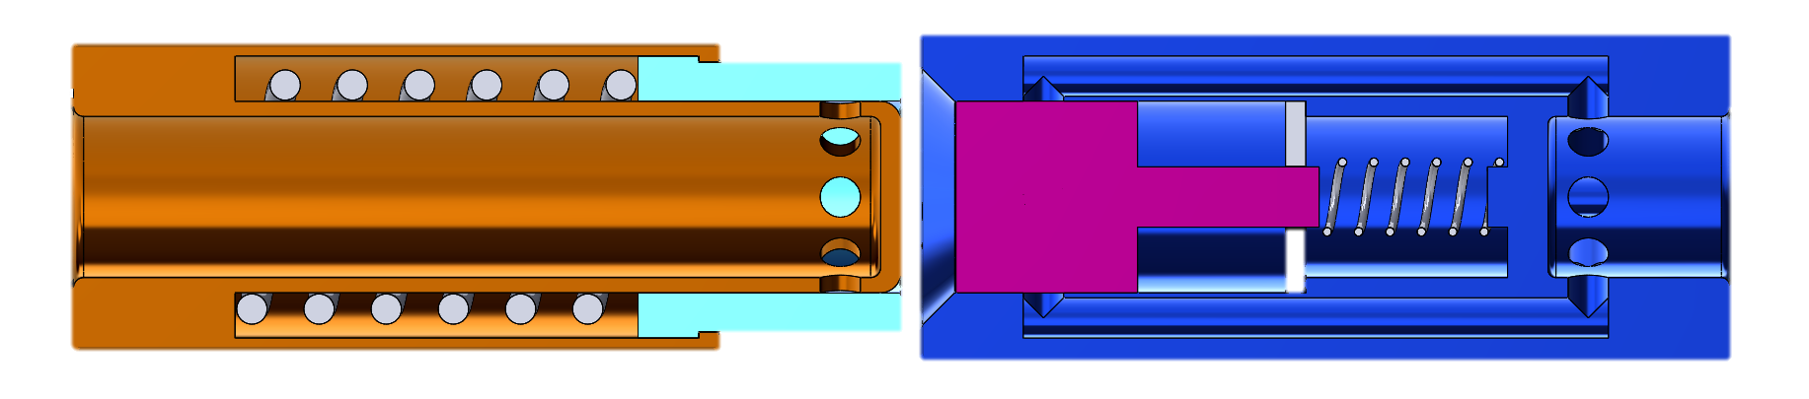
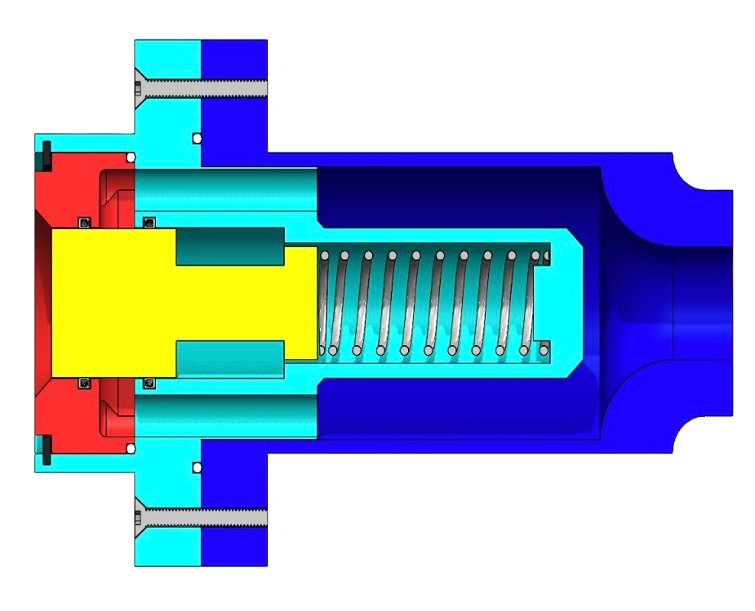
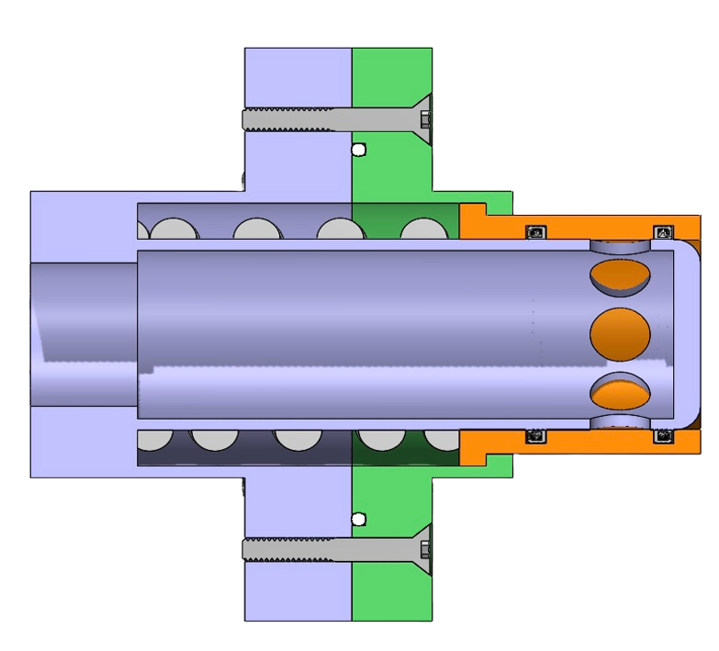
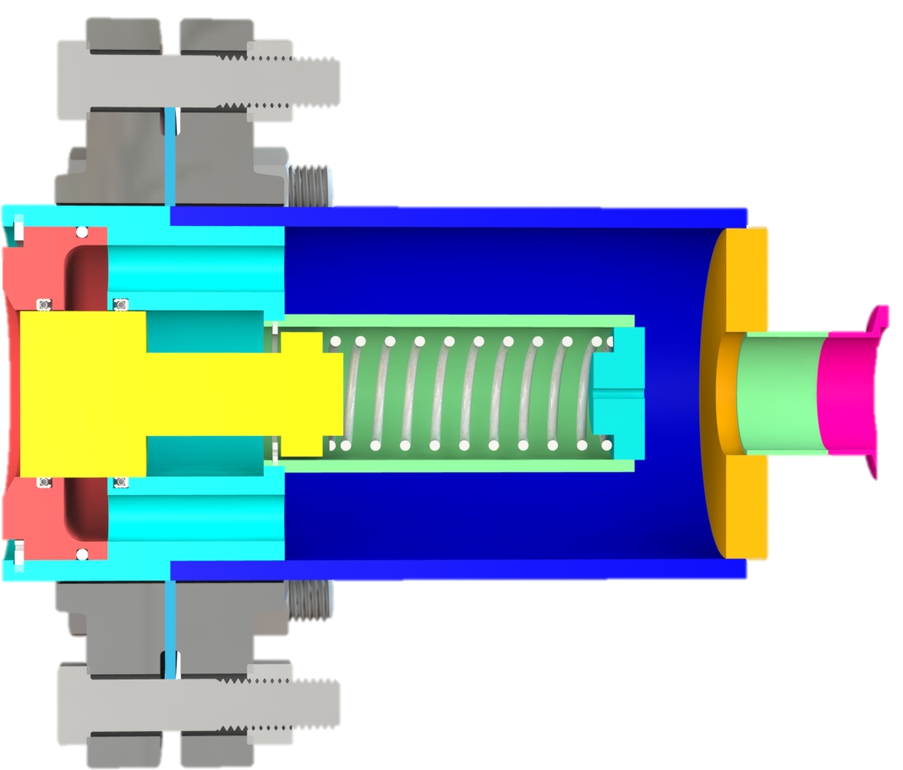
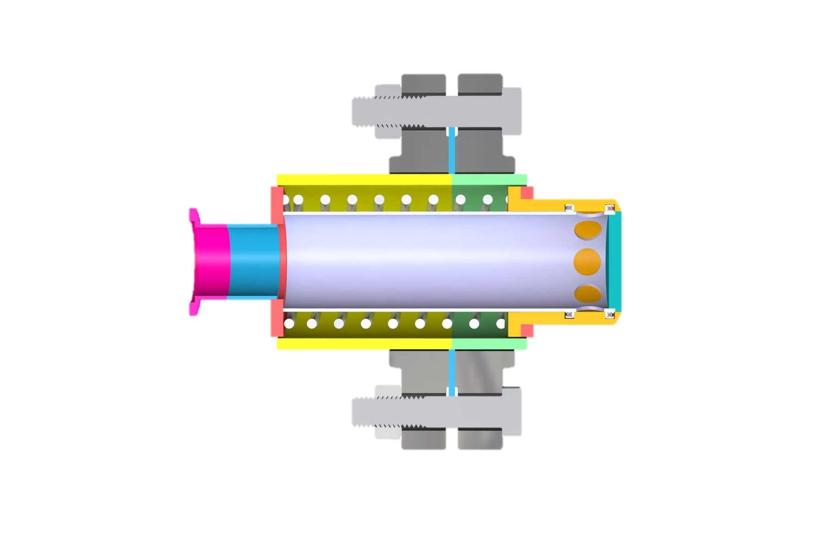
Design Evolution
Nicolas Sgammato
Version 1
Version 2
Version 3

Slide 27
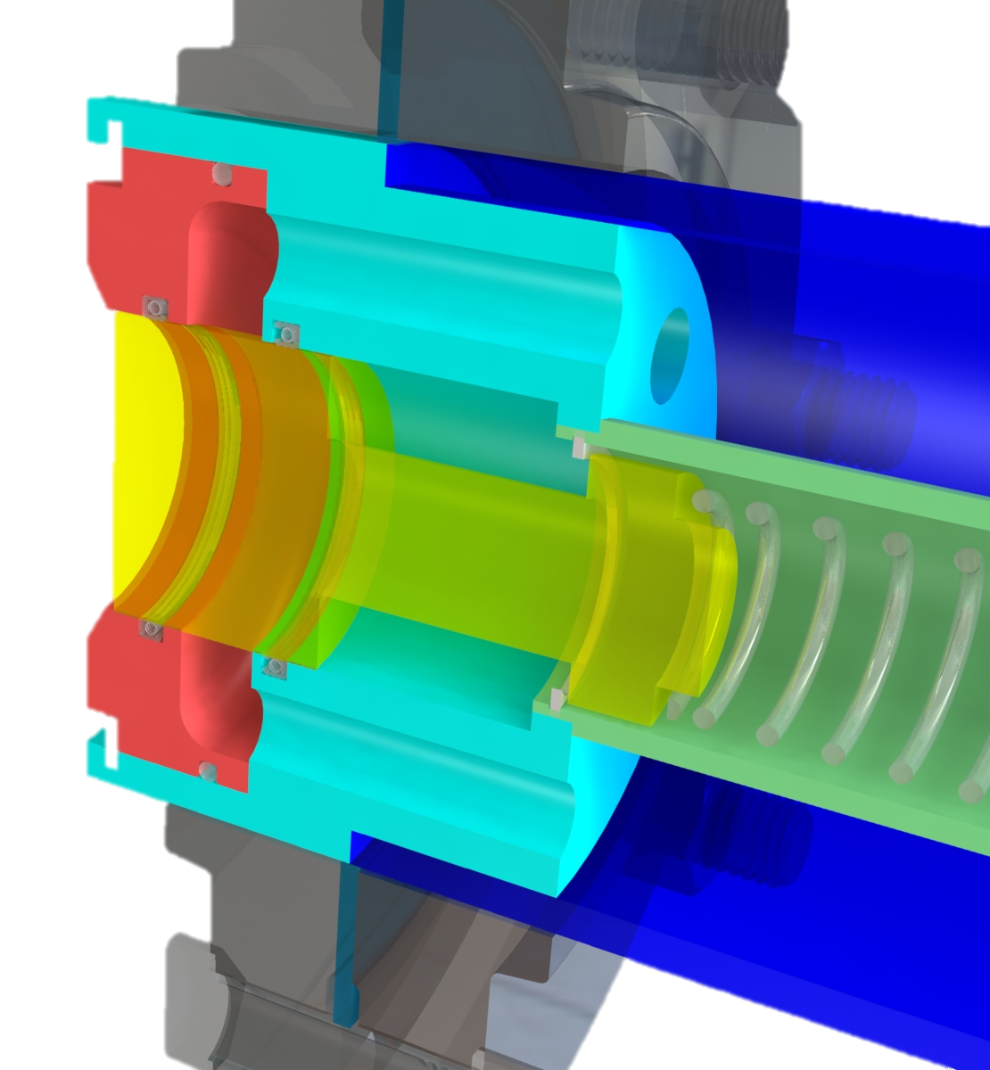
Major Changes
Nicolas Sgammato
Multiple flow channels on both halves
Single 360-degree flow channel on the receiver half

Slide 28
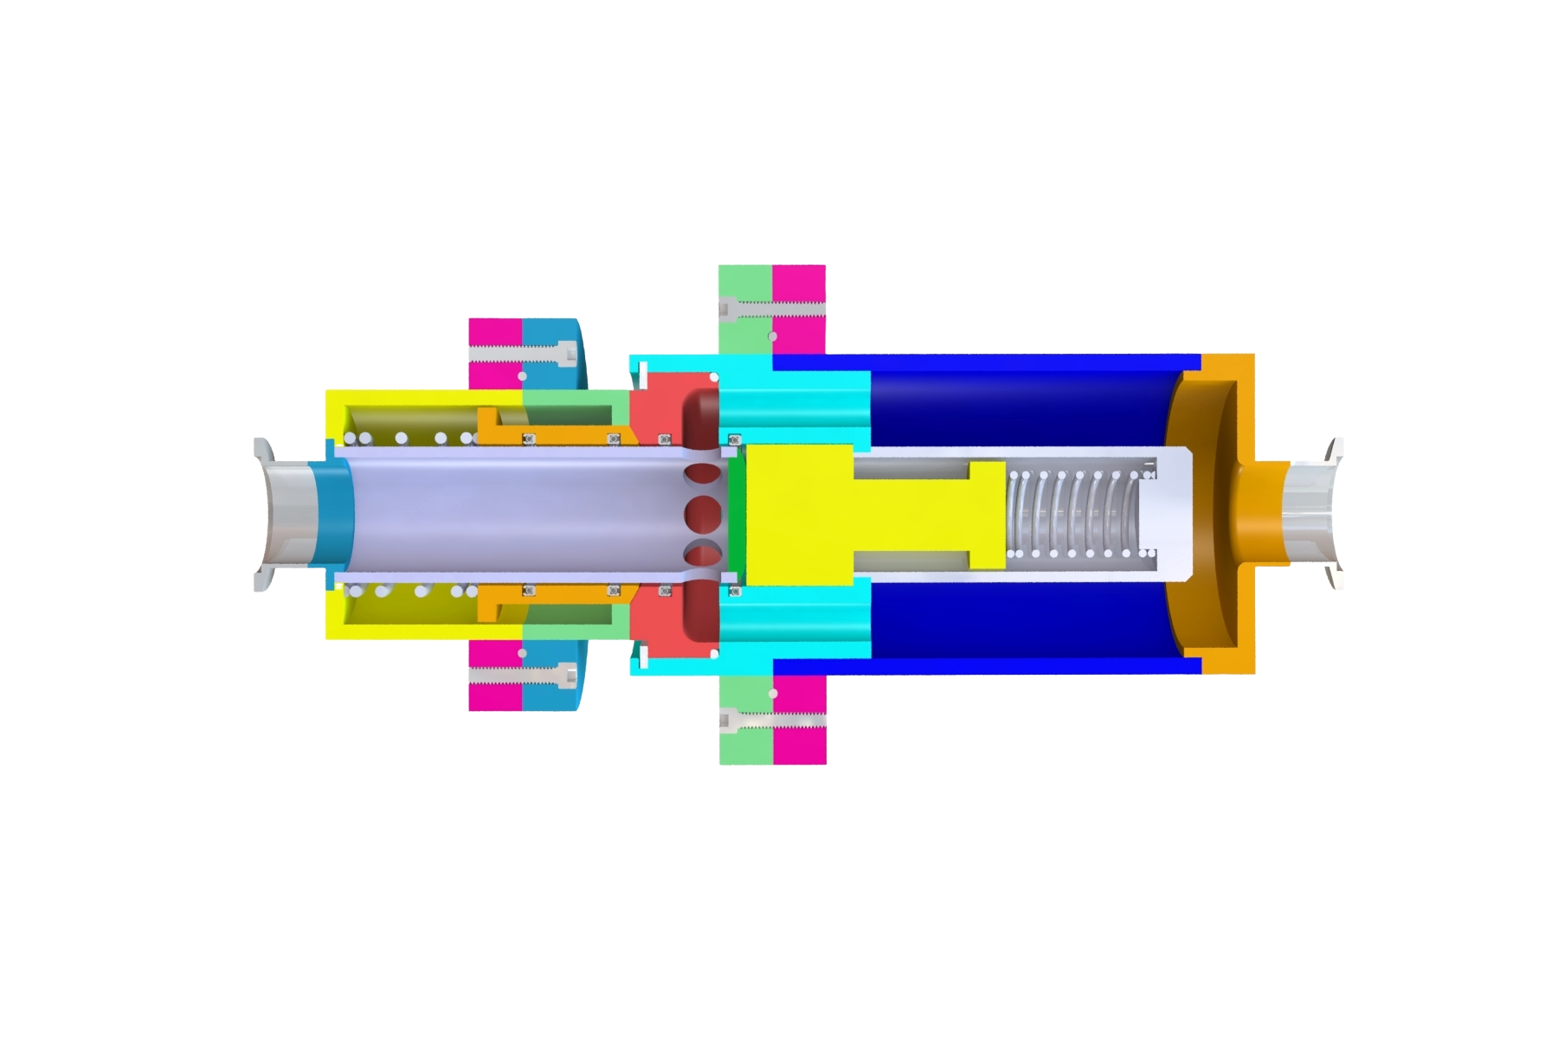
Major Changes
Nicolas Sgammato
Large and complex components
Components split into multiple pieces

Slide 29
Major Changes
Nicolas Sgammato
Based on arbitrary dimensions
Adjusted to match standard pipe sizes

Slide 30
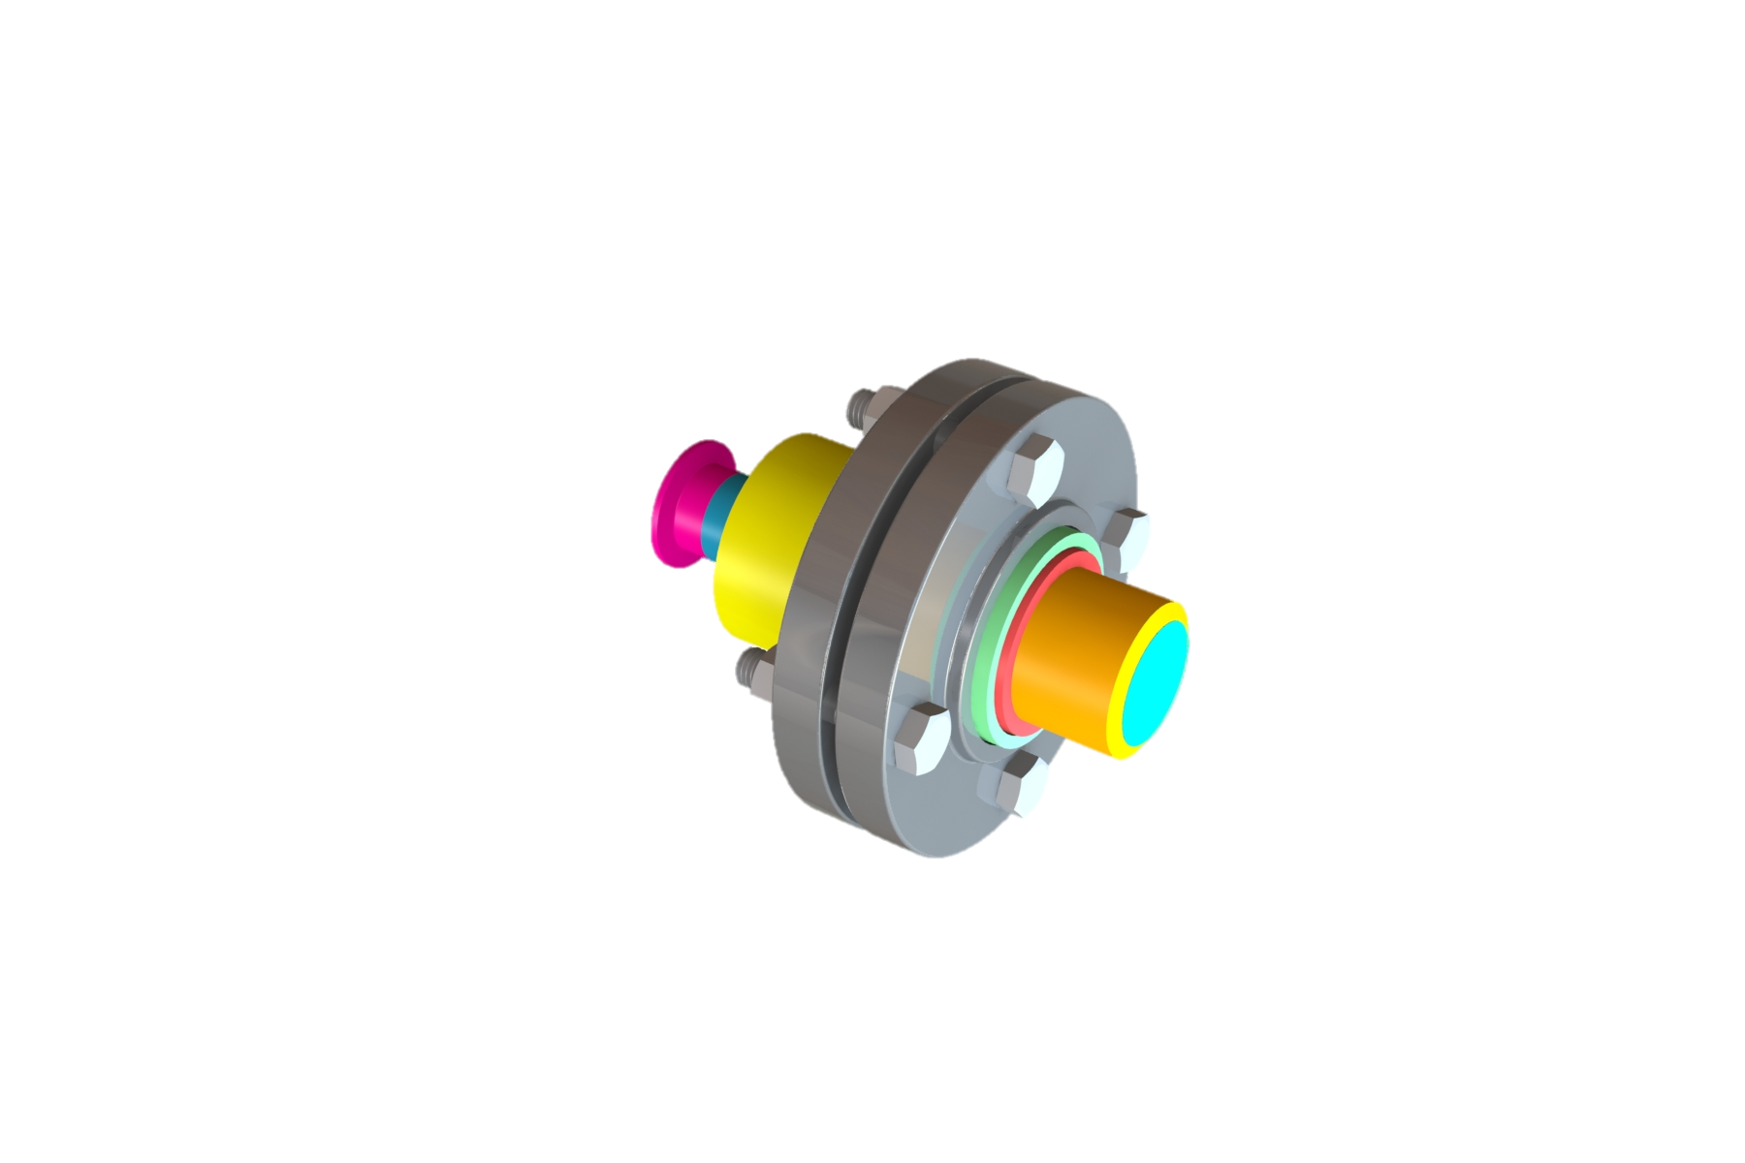
Final Concept
Nicolas Sgammato
Probe Half

Slide 31
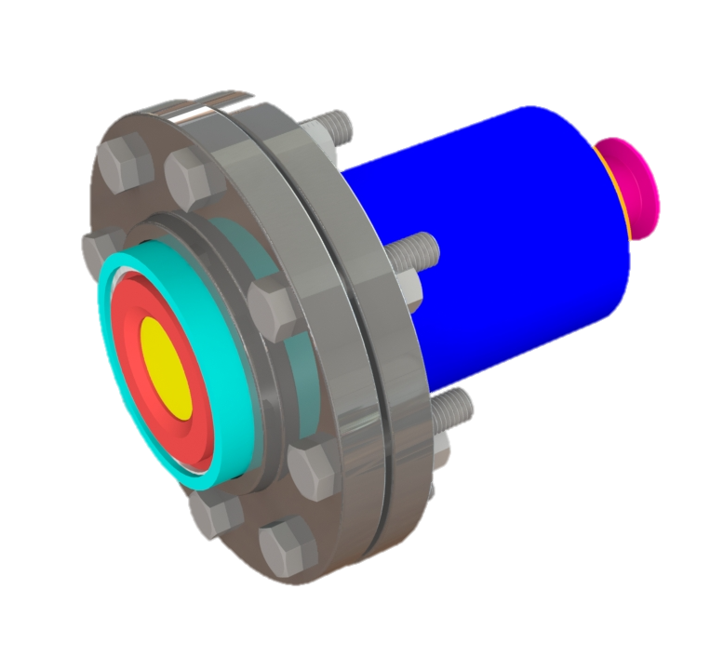
Final Concept
Nicolas Sgammato
Receiver Half

Slide 32
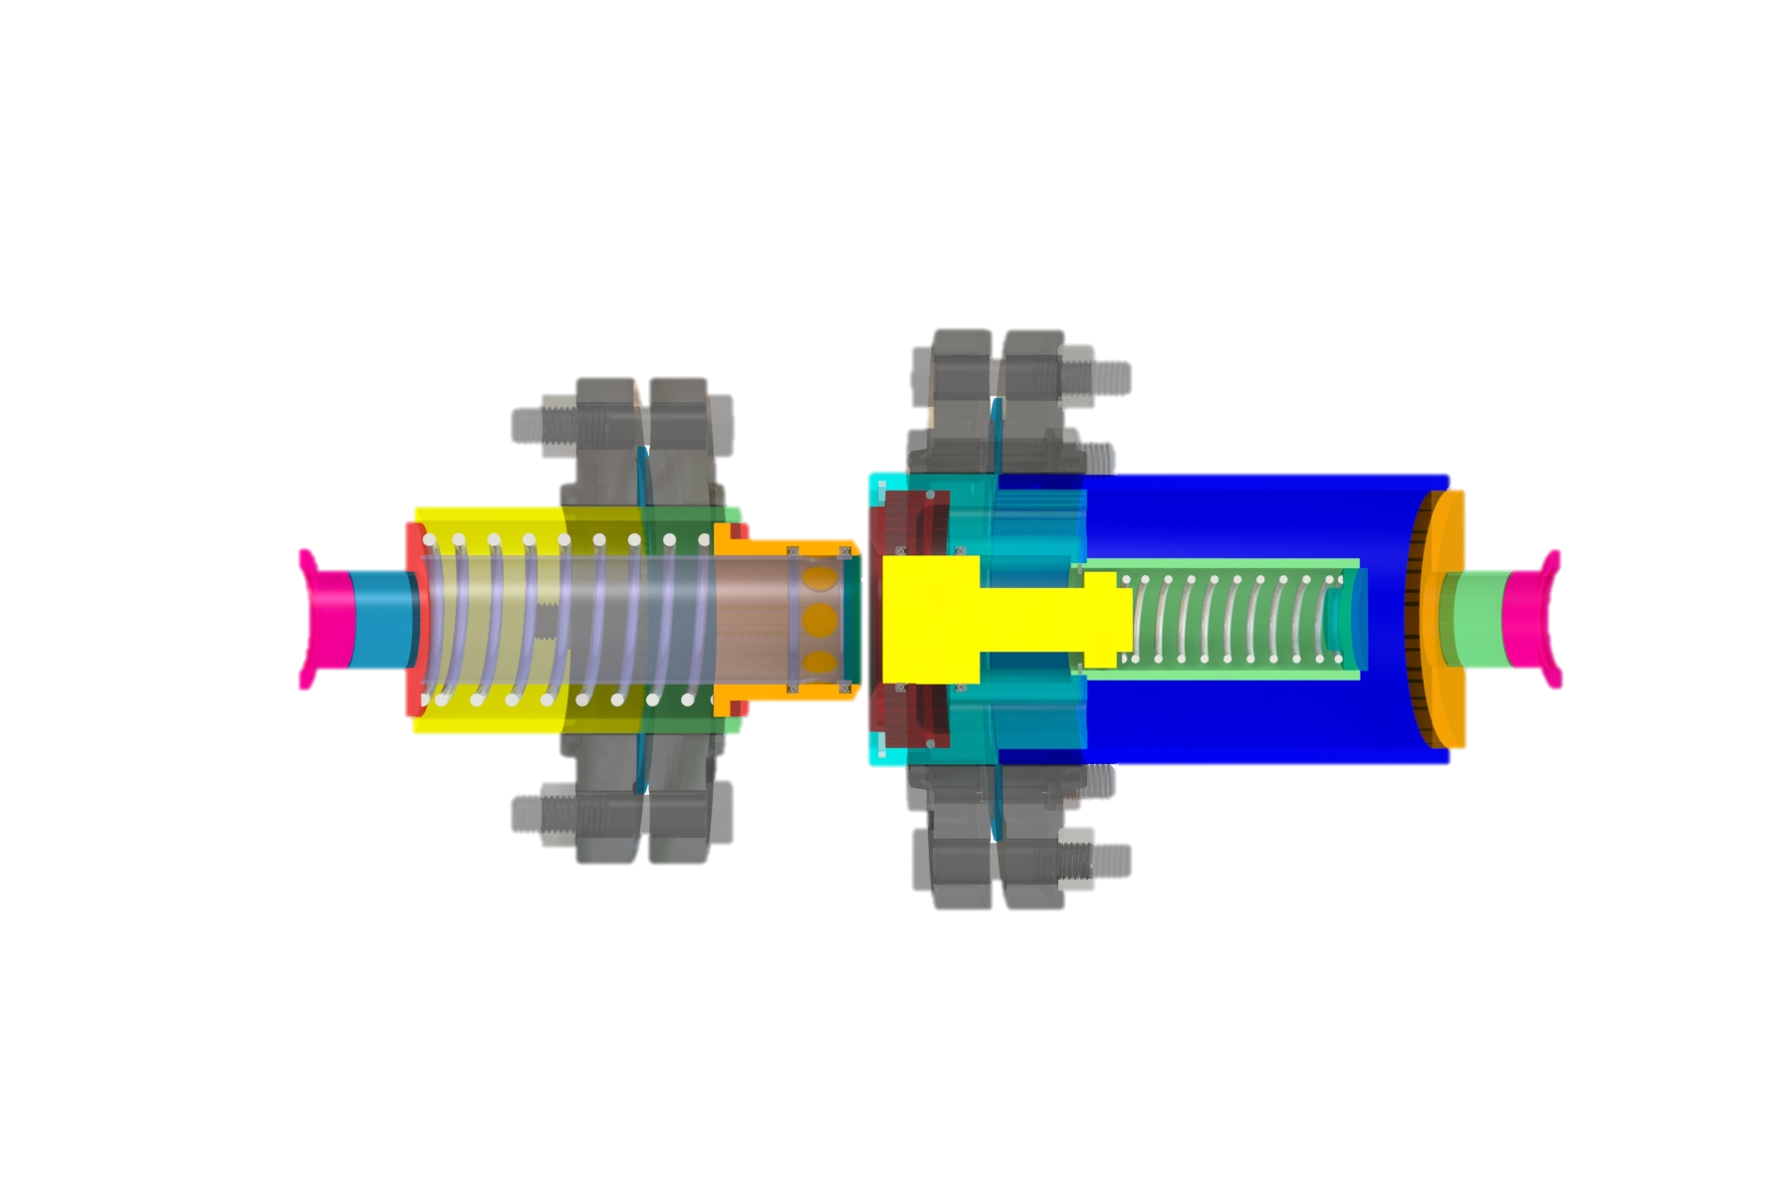
Components
Nicolas Sgammato
Stainless Steel Springs
Spring-Loaded Actuators

Slide 33
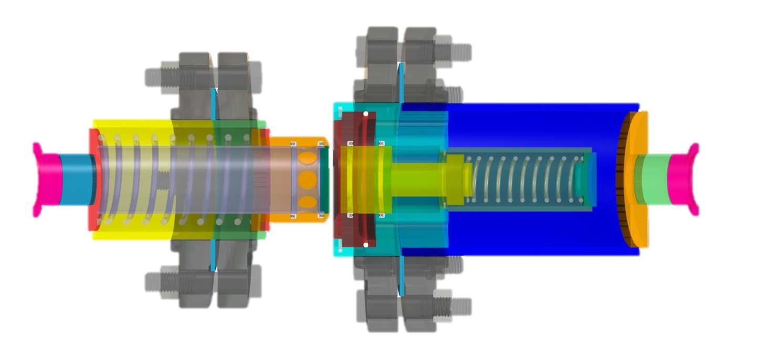
Components
Nicolas Sgammato
PTFE Gaskets
Spring-Energized PTFE Seals
PTFE O-Ring

Slide 34
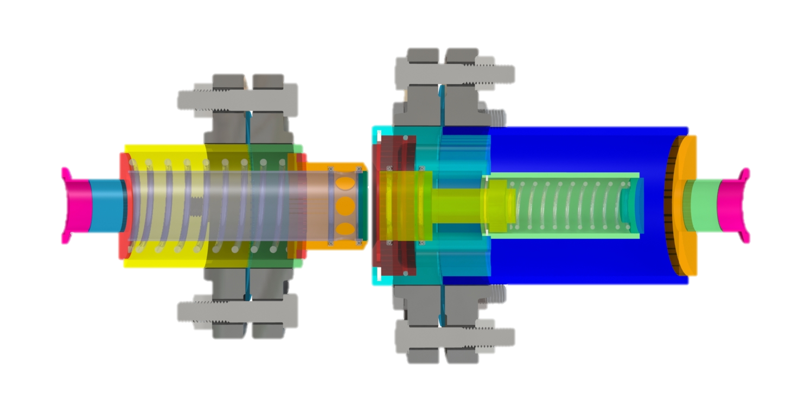
Components
Nicolas Sgammato
Flanges and Hardware
Retaining Rings
KF Fittings

Slide 35
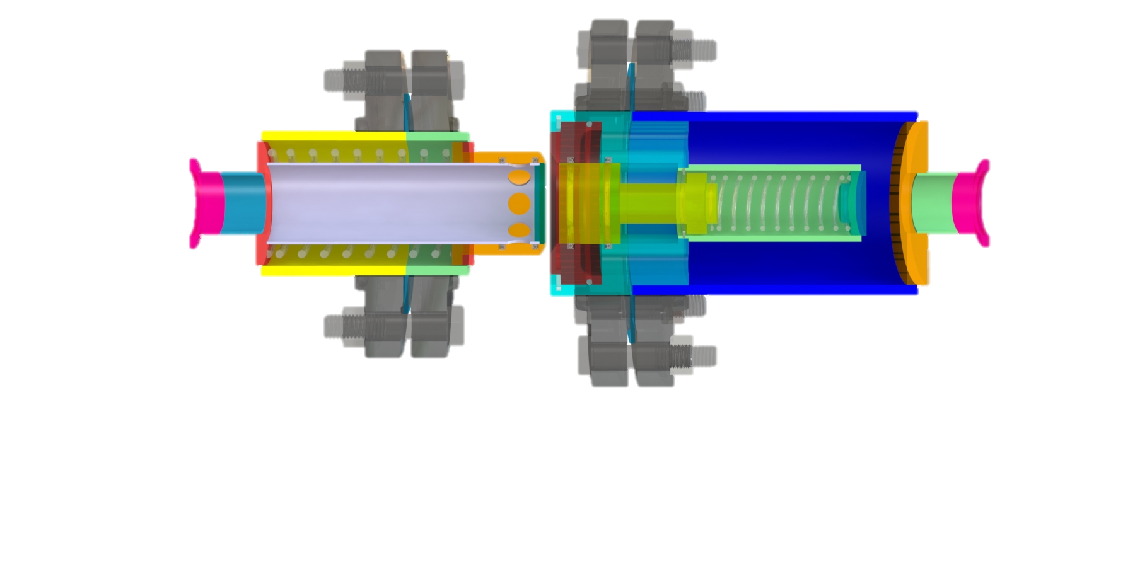
Manufacturing
Nicolas Sgammato
304 Stainless Steel Pipe

Slide 36
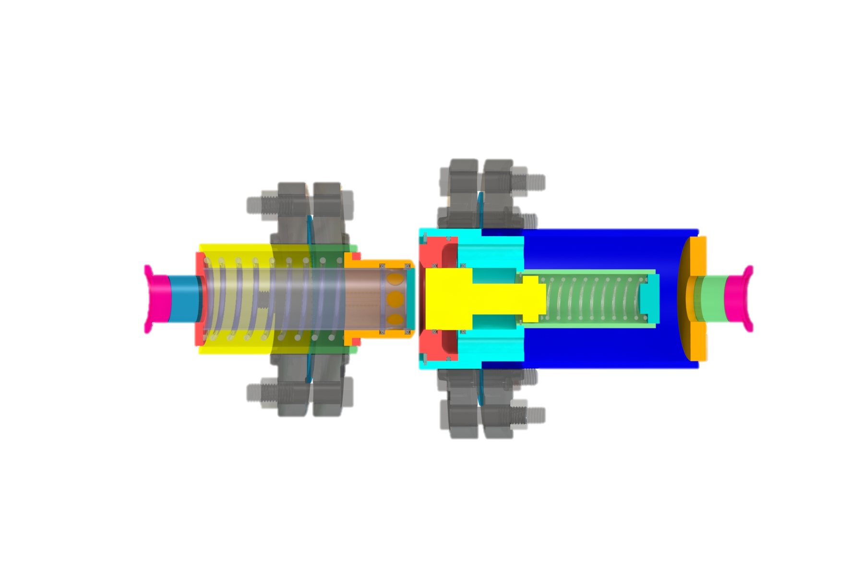
Manufacturing
Nicolas Sgammato
Machined Components

Slide 37
Vacuum Leak Testing
Jason Goldstein
Pull vacuum on inner chamber
Analyze pressure of 24-hour period
Determine air leakage
Estimate leakage of cryogenic fuels
Status:
Training Complete

Slide 38

Liquid Nitrogen Flow Testing
Jason Goldstein
Connect coupler to a liquid nitrogen tank
Control and observe flow through the coupler
Verify normal operation and determine any points of failure
Status:
Training Complete
Evaluate efficacy of design under cryogenic conditions

Slide 39
Budget Breakdown
Jason Goldstein
Remaining Budget
$221.40
Spent: $1778.60
Allocated: $2000
Raw Materials
$1,248.72

Slide 40
Lessons Learned
Jason Goldstein
Communicate with manufacturers early and often
Continuously reevaluate priorities
The project is dynamic and not static
There is some value in every idea

Slide 41


Suggestions for Improvement
Jason Goldstein
Implement spray-on foam insulation to external surfaces
Evaluate thermal performance of coupler
Perform more thorough leak testing (helium gas testing)

Slide 42




Summary
Jason Goldstein

Slide 43
Summary
Jason Goldstein
Objective: create an actively sealed coupler that limits leakage during cryogenic fuel transfer for space missions

Slide 44
Summary
Jason Goldstein
Our team analyzed the constraints and developed a design that met our goals

Slide 45
Summary
Jason Goldstein
We have finalized our design and began manufacturing and assembly.

Slide 46
Summary
Jason Goldstein
We will begin testing following the completion of assembly and safety verification

Slide 47
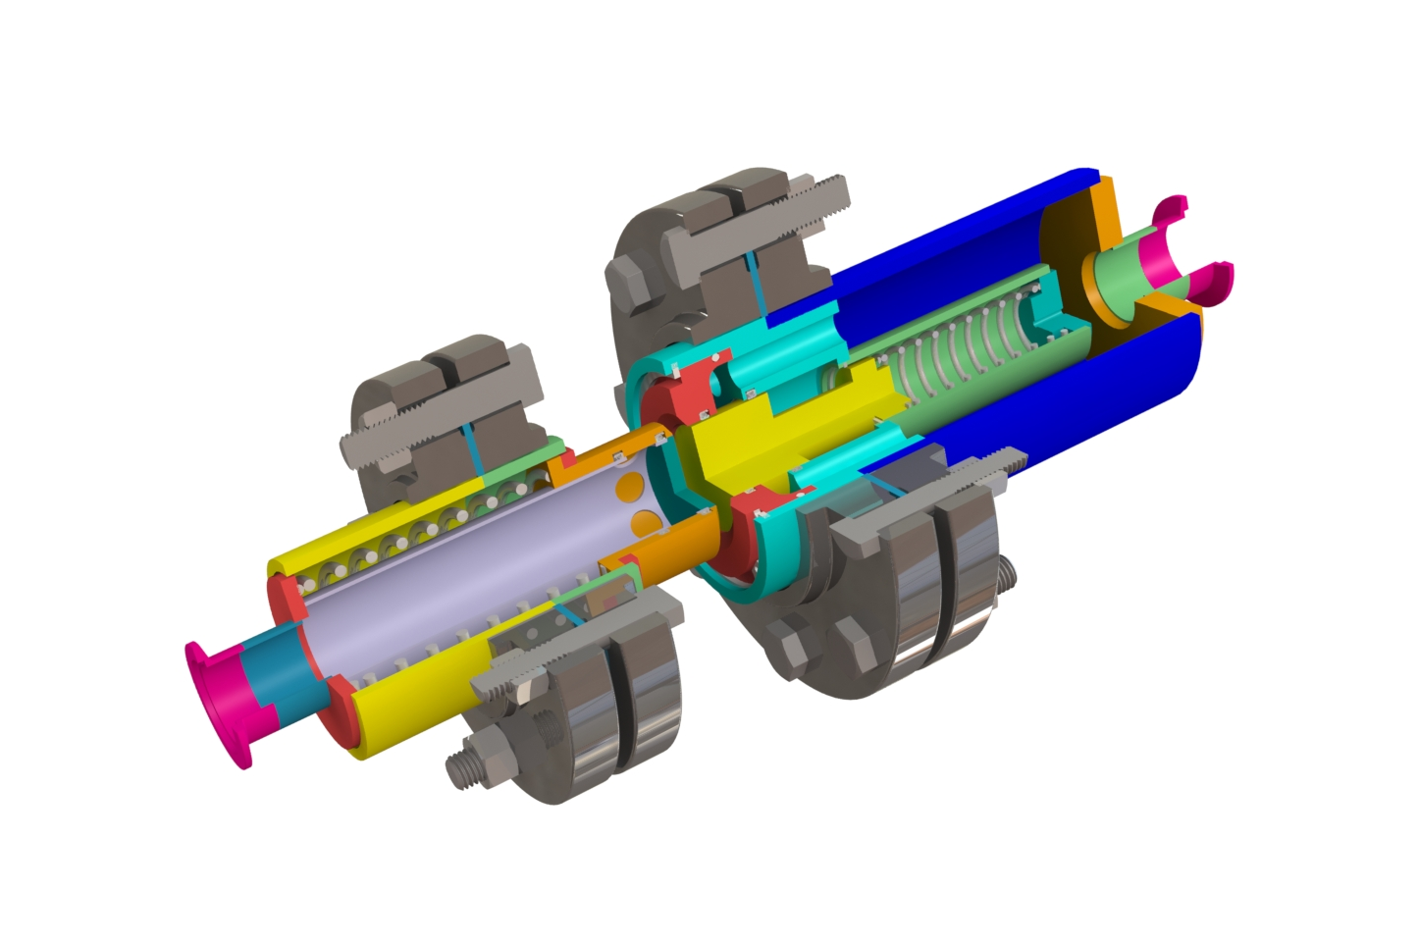
Conclusion
Nicolas Sgammato
Over the past two academic semesters, our team collaborated to create a cryogenic coupler that actively seals and limits fuel leakage for a 90-day mission period

Slide 48
Nicolas Sgammato
Thank You
James Buzzell and NASA MSFC, Jeremy Phillips and FAMU-FSU CoE Machine Shop, Dr. Wei Guo and Makai Hulse at the National MagLab, and Dr. Shayne McConomy

Slide 49





Nicolas Sgammato
Connect with Us

Slide 50
Backup Slides

Slide 51
Name
References
NASA Low Force Quick Disconnect Coupler – Kennedy Space Center
NASA-STD-5012
NASA-STD-5020
AIAA-S-080
Omni-Seal book/manual that Buzz provided us

Slide 52




Current Priorities
Name
Conduct water leakage test with 3D-printed model of design
Analyze and interpret data from testing to improve the design
Order necessary materials/parts to begin manufacturing and assembly of coupler
Complete cryogenic testing at the National High Magnetic Field Laboratory (NHMFL)
Department of Mechanical Engineering
21
Notes:
Previous version is in back up slides. Add or make any changes.

Slide 53



Future Work
Name
Perform fluid flow simulations using SolidWorks
Conduct durability tests on the final coupler design
Implement spray on foam insulation (SOFI) to outer surface
Department of Mechanical Engineering
22
Notes:
Previous version is in back up slides. Add or make any changes.

Slide 54
Thank You.
520: NASA Actively Sealed Cryogenic Coupler
Jason Goldstein, Lauren Roche, Sean Rodney,
Valerie Rodriguez, Nicolas Sgammato

Slide 55
Questions?
Not exactly sure If this should be separate from the thank you slide or combined with it. Also not sure exactly how it should look :/
Jason Goldstein, Lauren Roche, Sean Rodney,
Valerie Rodriguez, Nicolas Sgammato

Slide 56

Flow Rate Testing
Valerie Rodriguez
In the case testing at the FCAAP lab is denied, fluid dynamics will be simulated in COMSOL.
Testing using PIV would be ideal but main concerns can still be analyzed using this software.
Department of Mechanical Engineering
56

Slide 57
Meet The Team
Name
Jason Goldstein
Materials Engineer
Lauren Roche
Cryogenics Engineer
Sean Rodney
Test Engineer
Valerie Rodriguez
Thermal-Fluids Engineer
Nicolas Sgammato
Design Engineer
Department of Mechanical Engineering
57

Slide 58
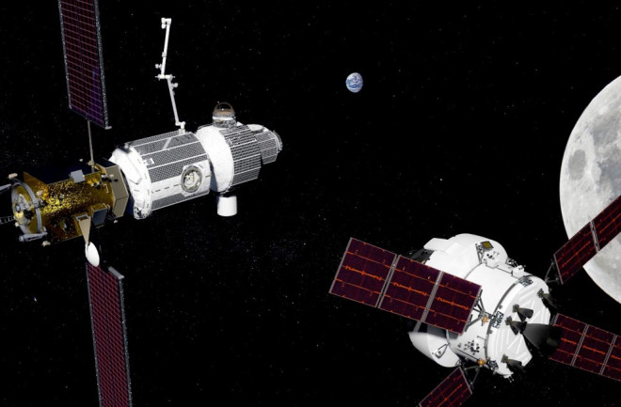
Lunar Refueling Depot
Reduced Cost
Increased Safety
Extended Mission Capabilities

Slide 59
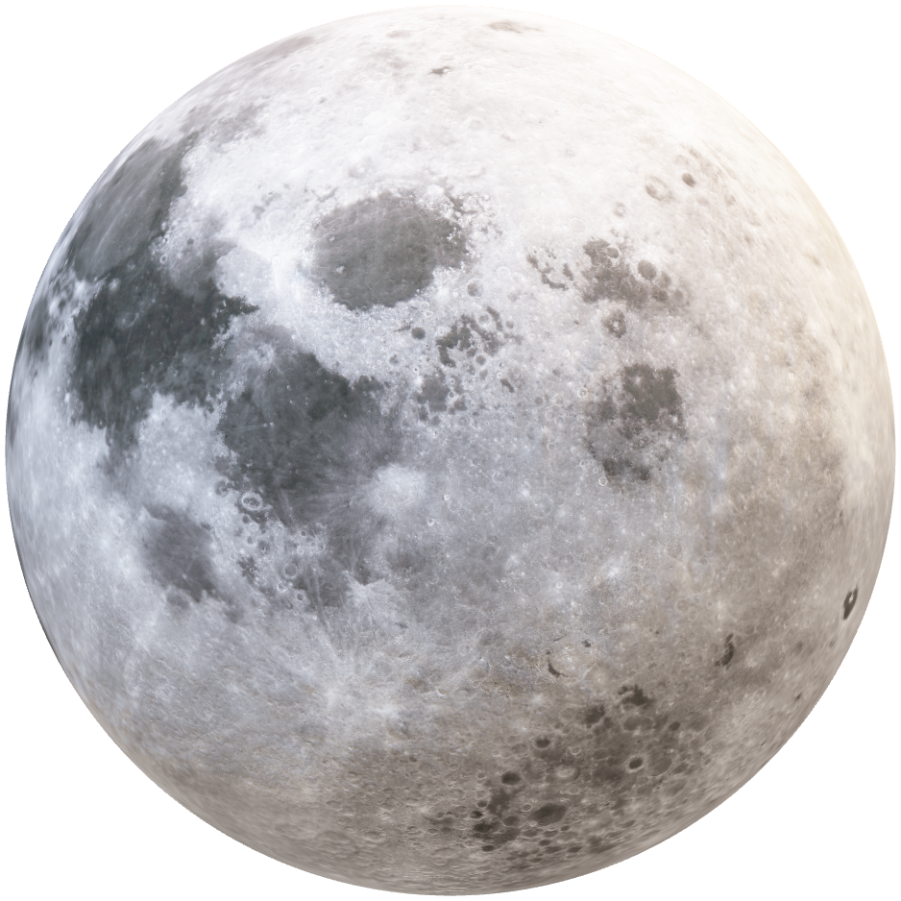
Problems with Current Designs
Sealing and Leakage
Thermal Radiation
Contamination

Slide 60
Actively Sealed Coupler
Seals when the two halves make contact

Slide 61
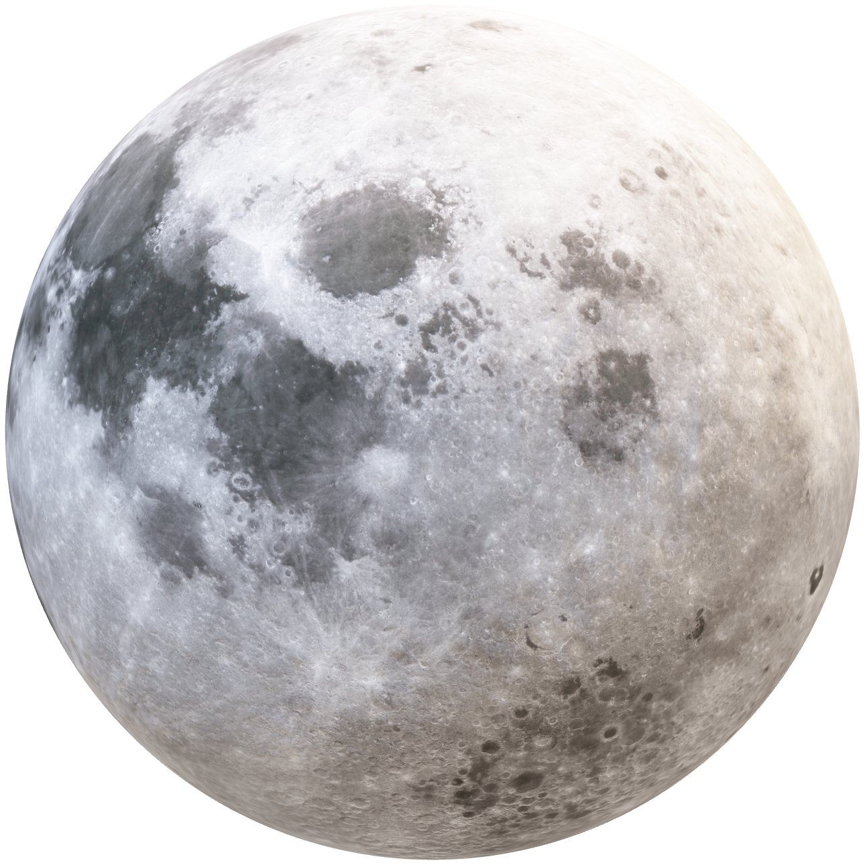
Background
Lauren Roche
Cryogenic Fuel Transfer
Deep Space Mission
Lunar Base Fuel Depot
Department of Mechanical Engineering
61

Slide 62
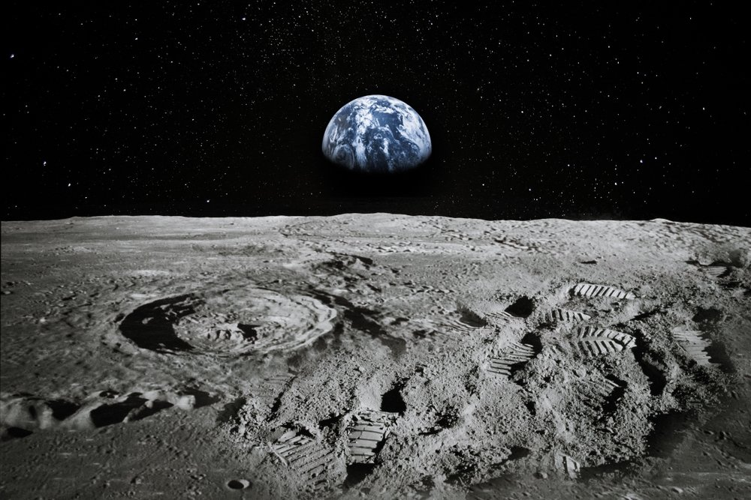
Key Goals
Name
Effective Sealing
Minimize
Leakage
90-Day Lunar Mission
Department of Mechanical Engineering
62
Notes:
Highkey what we agreed wed change this to
- Changed to “minimize leakage”

Slide 63

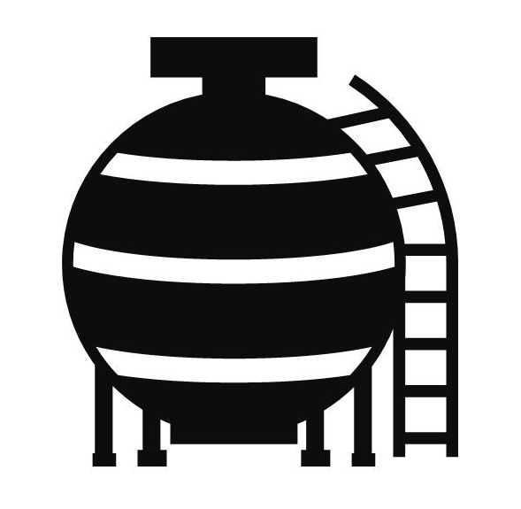




Customer Needs
Valerie Rodriguez
Extend life of the cryogenic fuel
Minimize the leakage rate
Seal activation upon contact of coupler halves
Limit Boil Off
System Protection

Slide 64
Customer Needs
Valerie Rodriguez
Extend life of the cryogenic fuel
Minimize the leakage rate
Seal activation upon contact of coupler halves
Limit boil off
System protection

Slide 65
Functional Decomposition
Valerie Rodriguez
Coupling System
Durability
Connection
Fueling
Disconnection

Slide 66
Functional Decomposition
Valerie Rodriguez
Coupling System
Durability
Connection
Fueling
Disconnection
Major Function
Endure Solar Radiation
Mitigate Particulates
Minimize Heat Transfer
Tolerate Vehicle Misalignment
Uphold Structural Durability
Protect Electrical Components
Minor Function

Slide 67
Functional Decomposition
Valerie Rodriguez
Coupling System
Durability
Connection
Fueling
Disconnection
Major Function
Check Pressure Difference
Level Pressure
Lock two Halves Together
Seal the Connection
Minor Function

Slide 68
Functional Decomposition
Valerie Rodriguez
Coupling System
Durability
Connection
Fueling
Disconnection
Major Function
Open Pipe Valve
Minimize Fuel Leakage
Close Pipe Valve
Minor Function

Slide 69
Functional Decomposition
Valerie Rodriguez
Coupling System
Durability
Connection
Fueling
Disconnection
Major Function
Disconnect Both Halves
Purge Excess Fuel
Minor Function

Slide 70
Name
Status Update
Research on materials, locks, insulation, existing designs
Wrapping up concept generation and concept selection
Contact sponsor to get feedback on our top designs
Department of Mechanical Engineering
70

Slide 71


Nicolas Sgammato
Fuel Leakage
Measured Using Venturi Flowmeter at the National High Magnetic Field Laboratory (NHMFL)
Target From Critical Targets Table Provided by Sponsor
For Internal Leakage:
≤ 500 SCIM LN2 at 15 and 50 PSID While De-mated
For External Leakage:
≤ 50 SCIM LN2 at 5 and 50 PSIG Internal Pressure
Department of Mechanical Engineering
71

Slide 72


Nicolas Sgammato
Heat Transfer
Measured Using a Thermocouple in Coupler Interior
Target Derived From Boiling Point of Liquid Nitrogen
Coupler Interior Temperature
≤ 80 K
Department of Mechanical Engineering
72

Slide 73
Jason Goldstein
Coupler Connection
Measured using a Force Transducer Attached to One Half of Coupler
Target Derived From Previous NASA Coupler
Connection/
Disconnection Force:
≤ 250 LBF
Department of Mechanical Engineering
73

Slide 74


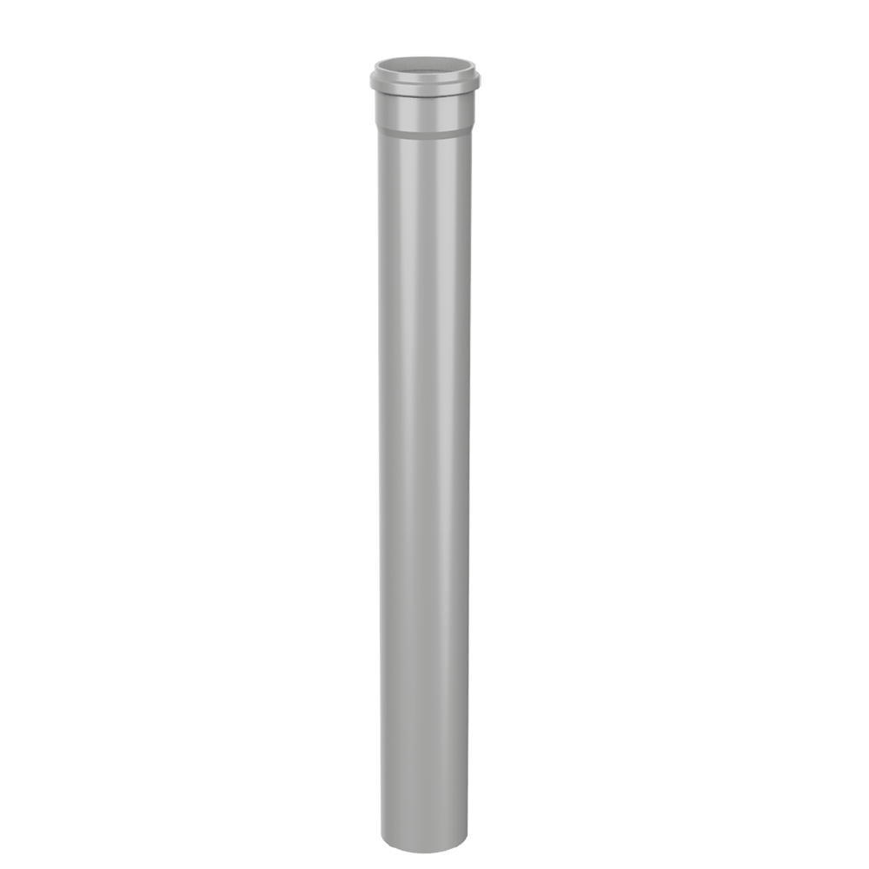
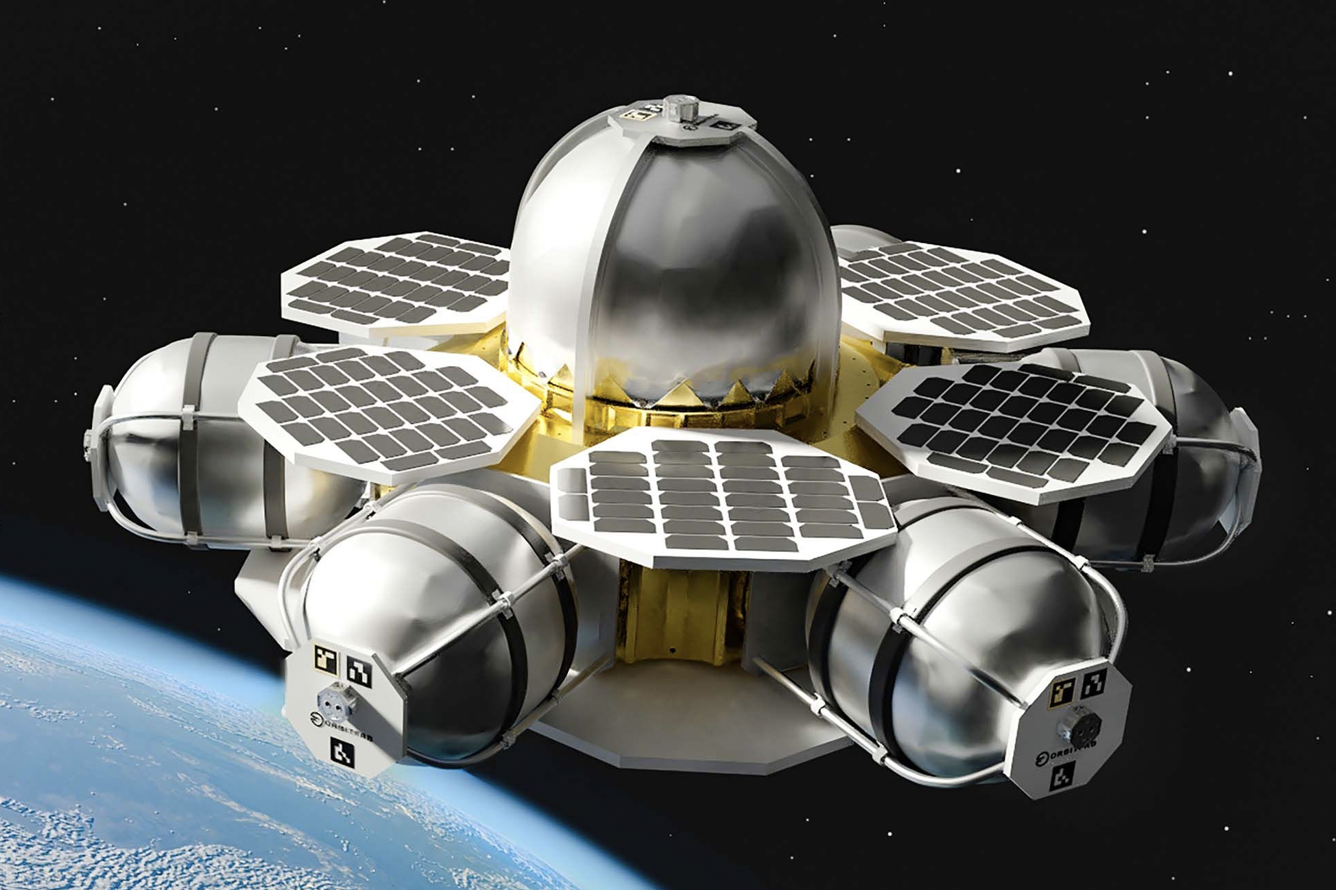
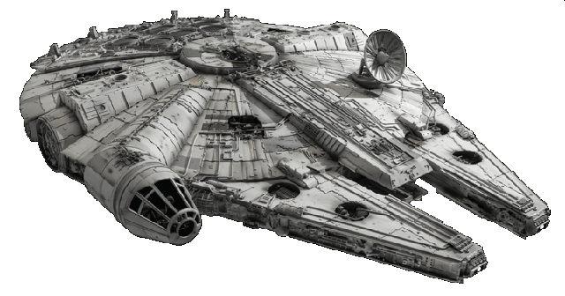
Jason Goldstein
Concept Generation Tactics
Biomimicry
Crap Shoot
Morphological Chart
1
A
A
B
C
1
1
1
2
B
2
2
2
3
C
3
3
3
4
D
5
E
Department of Mechanical Engineering
74

Slide 75
Lauren Roche
Terminology
Seals​
Insulation
MLI
SOFI
Double vacuum wall
Encapsulated O-ring
Teflon Seal
Locks
Valves
Force held
Collet Lock
Double poppet valve
Department of Mechanical Engineering
75

Slide 76
Lauren Roche
High Fidelity Concepts
Concept #33
Force held double poppet actuator, sealed with encapsulated O-rings, insulated by a double vacuum wall structure and Multi-Layered Insulation
Department of Mechanical Engineering
76

Slide 77
Lauren Roche
High Fidelity Concepts
Concept #98
Force held double poppet actuator, sealed with encapsulated O-rings, insulated by a double vacuum wall structure and Spray-On Foam Insulation (SOFI)
Department of Mechanical Engineering
77

Slide 78
Nicolas Sgammato
High Fidelity Concepts
Concept #100
Force held double poppet actuator, sealed with Teflon, insulated by a double vacuum wall structure and Multi-Layered Insulation (MLI)
Department of Mechanical Engineering
78

Slide 79
Coupler Operation
Name
Department of Mechanical Engineering
28

Slide 80
Nicolas Sgammato
Medium Fidelity Concepts
#99
#82
#81
#80
#79
Department of Mechanical Engineering
80

Slide 81

Nicolas Sgammato
Medium Fidelity Concepts
Force held lock
Double vacuum & SOFI
#99
Double Poppet
Teflon Seals
Department of Mechanical Engineering
81

Slide 82
Jason Goldstein
Medium Fidelity Concepts
Double vacuum & MLI
#82
Double Poppet
Collet lock
Encapsulated Seals
Department of Mechanical Engineering
82

Slide 83
Jason Goldstein
Medium Fidelity Concepts
Double vacuum & SOFI
#81
Double Poppet
Collet Lock
Encapsulated Seals
Department of Mechanical Engineering
83

Slide 84
Jason Goldstein
Pugh Charts- Second Iteration
Selection Criteria
Leakage
Lifetime
Seal
Resilience
Size
Cost
-
S
-
-
S
+
Concept #100
Force held double poppet actuator, sealed with Teflon, insulated by a double vacuum wall structure and Multi-Layered Insulation (MLI)
Datum: Concept #33
Department of Mechanical Engineering
84

Slide 85
Terminology
Seals​
Encapsulated O-ring seal​
Teflon Seal
Insulation
MLI
SOFI
Double vacuum wall
Locks
Force held
Collet Lock
Valves
Double poppet valve
Department of Mechanical Engineering
85

Slide 86
Name
Top Concepts
Force held lock with double poppet valve, encapsulated seals, double vacuum and MLI (multi-layered insulation)
Force held lock with double poppet valve, encapsulated seals, double vacuum and SOFI (spray-on foam insulation)
Collet lock with double poppet valve, encapsulated seals, double vacuum and MLI
Collet lock with double poppet valve, encapsulated seal, double vacuum and SOFI
Department of Mechanical Engineering
86

Slide 87
Nicolas Sgammato
Pugh Charts- Second Iteration
Selection Criteria
Leakage
Lifetime
Seal
Resilience
Size
Cost
S
-
S
-
+
+
Concept #98
Force held double poppet actuator, sealed with encapsulated O-rings, insulated by a double vacuum wall structure and Spray-On Foam Insulation (SOFI)
Datum: Concept #33
Department of Mechanical Engineering
87

Slide 88
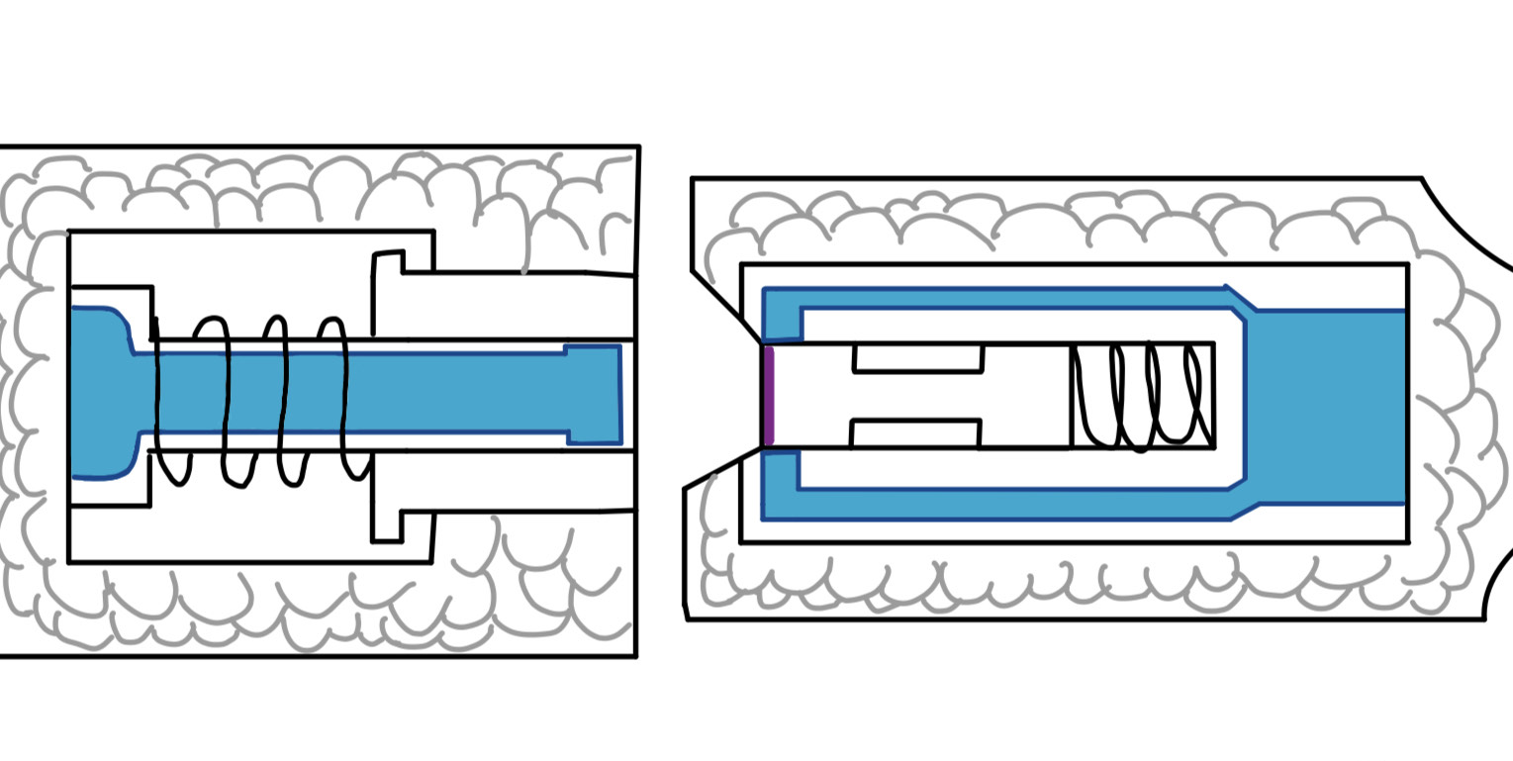
Jason Goldstein
Pugh Charts- Second Iteration
Selection Criteria
Leakage
Lifetime
Seal
Resilience
Size
Cost
-
-
-
-
+
+
Concept #99
Force held double poppet actuator, sealed with Teflon, double vacuum wall structure and Spray-On Foam Insulation (SOFI)
Datum: Concept #33
Department of Mechanical Engineering
88

Slide 89
High Fidelity Concepts
#33
Force held double poppet actuator, sealed with encapsulated O-rings, insulated by a double vacuum wall structure and Multi-Layered Insulation (MLI)
#98
Force held double poppet actuator, sealed with encapsulated O-rings, insulated by a double vacuum wall structure and Spray-On Foam Insulation (SOFI)
#100
Force held double poppet actuator, sealed with Teflon, insulated by a double vacuum wall structure and Multi-Layered Insulation (MLI)
Notes:
Title text looks weird only because of the animation.
- Theres so much going on with the orange and photos… change?

Slide 90
Jason Goldstein
Analytical Hierarchy Process
Concept #33
Alternative Value:
1.032
Concept #98
Alternative Value:
0.466
Concept #100
Alternative Value:
0.632
Department of Mechanical Engineering
90

Slide 91
Nicolas Sgammato
Targets and Metrics
Fuel Leakage Heat Transfer Coupler Connection Structure Integrity
Fuel Leakage Rate from Flowmeter
Interior Temperature from Thermocouple
Connection Force from Transducer
Material Yielding from Tensile Test
Department of Mechanical Engineering
91

Slide 92
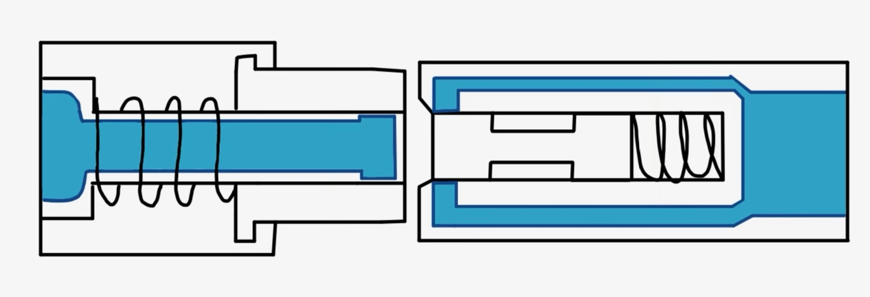
#33:
Encapsulated
O-ring seals and MLI
High Fidelity Concepts
#48:
Force held double – poppet actuator with double vacuum wall insulation structure paired with:
#50
Department of Mechanical Engineering
92

Slide 93
Jason Goldstein
Medium Fidelity Concepts
Double-poppet valve and double vacuum wall
#49 | Force-held lock Teflon seals SOFI
#32 | Collet lock encapsulated O-ring seals MLI
#31 | Collet lock encapsulated O-ring seals SOFI
#30 | Collet lock Teflon seals MLI
Department of Mechanical Engineering
93

Slide 94
Jason Goldstein
Medium Fidelity Concepts
Double vacuum & MLI
#80
Double Poppet
Collet Lock
Teflon Seals
Department of Mechanical Engineering
94

Slide 95
Lauren Roche
Medium Fidelity Concepts
Double vacuum & SOFI
#79
Double Poppet
Collet Lock
Teflon Seals
Department of Mechanical Engineering
95

Slide 96
Lauren Roche
Concept Selection
Binary Pairwise Comparison
House of Quality
Pugh Charts
Analytical Hierarchy Process
Final Selection
Department of Mechanical Engineering
96

Slide 97
Lauren Roche
Binary Pairwise Comparison
Compares Customer Needs to Each Other to Determine Relative Importance
Customer Needs | Score
Fluid Loss Prevention | 6
Active Seal | 6
Maintains Pressure | 6
Effective Coupling | 6
Heat Transfer Protection | 5
Particulate Mitigation | 4
Life-Span | 3
Cost | 3
Sizing Parameters | 3
Material Resilience | 2
Reusability | 1
Department of Mechanical Engineering
97

Slide 98

Jason Goldstein
Structural Integrity
Measured using Tensile Testing on Selected Material
Safe Range was Chosen Due to Material Not Yet Being Selected
Plastic Deformation of Chosen Material:
≤ 5%
Department of Mechanical Engineering
98

Slide 99
Nicolas Sgammato
House of Quality
Customer Requirements
Life-span
Fluid Loss
Active Seal
Material Resilience
Reusability
Maintains Pressure
Effective Coupling
Heat Transfer
Particulate Mitigation
Channel Sizing Parameters
Cost
Ranked Engineering Characteristics
1. Fuel Leakage
2. Seal
3. Heat Transfer
4. Durability
5. Weight
6. Cost
Department of Mechanical Engineering
99

Slide 100
Nicolas Sgammato
Pugh Charts- First Iteration
Selection Criteria
Leakage
Lifetime
Seal
Resilience
Size
Cost
#82
#81
#80
#33
#98
#100
#99
-2
-2
-2
1
1
1
1
Datum: NASA Low Separation Force Quick Disconnect
Department of Mechanical Engineering
100

Slide 101
Nicolas Sgammato
Medium Fidelity Concepts
#49
Force held double poppet actuator, sealed with Teflon, double vacuum wall structure and Spray-On Foam Insulation (SOFI)
Department of Mechanical Engineering
101

Slide 102
Nicolas Sgammato
Medium Fidelity Concepts
#32
Double poppet actuator with collet lock, sealed with encapsulated O-rings, double vacuum wall structure and Multi-Layer Insulation (MLI)
Department of Mechanical Engineering
102

Slide 103
Jason Goldstein
Medium Fidelity Concepts
#31
Collet locked double poppet actuator, sealed with encapsulated O-rings, double vacuum wall structure and Spray-On Foam Insulation
Department of Mechanical Engineering
103

Slide 104
Jason Goldstein
Medium Fidelity Concepts
#30
Double poppet-actuator with collet lock, Teflon seals, double vacuum wall structure and Multi-Layer Insulation
Department of Mechanical Engineering
104

Slide 105
Jason Goldstein
Medium Fidelity Concepts
#29
Double poppet-actuator with collet lock, Teflon seals, double vacuum wall structure and Spray on Foam Insulation
Department of Mechanical Engineering
105

Slide 106
High Fidelity Concepts
Concept #33
Concept #48
Concept #50
Department of Mechanical Engineering
106

Slide 107
Lauren Roche
High Fidelity Concepts
Force-held lock with double-poppet valve
and double vacuum wall
#33 | Encapsulated O-ring seals MLI
#48 | Encapsulated O-ring seals SOFI
#50 | Teflon seals MLI
Department of Mechanical Engineering
107

Slide 108
Nicolas Sgammato
Final Concept Selection
Force-held lock with double-poppet valve
and double vacuum wall
#33 | encapsulated O-ring seals MLI
Department of Mechanical Engineering
108

Slide 109
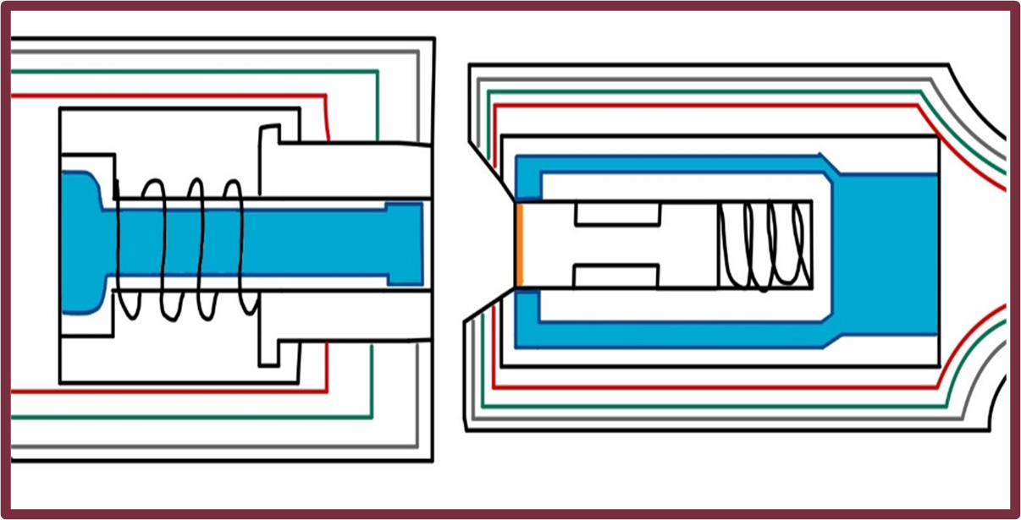
Fall Design
Double poppet actuator and force held lock, seal with encapsulated seals, insulated by double vacuum wall and Multi-Layer Insulation (MLI) blanket

Slide 110
Lauren Roche
Final Concept Selection
Concept #33: Double poppet actuator and force held lock, seal with encapsulated seals, insulated by double vacuum wall and Multi-Layer Insulation (MLI) blanket
Department of Mechanical Engineering
110

Slide 111
Coupler Operation
Name
*We should fix this animation so that the receiver end (right piece) comes into frame while the probe end (left piece) is stationary
Department of Mechanical Engineering
Notes:
Make this sexier and flip the direction

Slide 112
Lauren Roche
Concept #33
Department of Mechanical Engineering
112

Slide 113
Lauren Roche
Concept #33
Department of Mechanical Engineering
113

Slide 114
Lauren Roche
Concept #33
Department of Mechanical Engineering
114

Slide 115
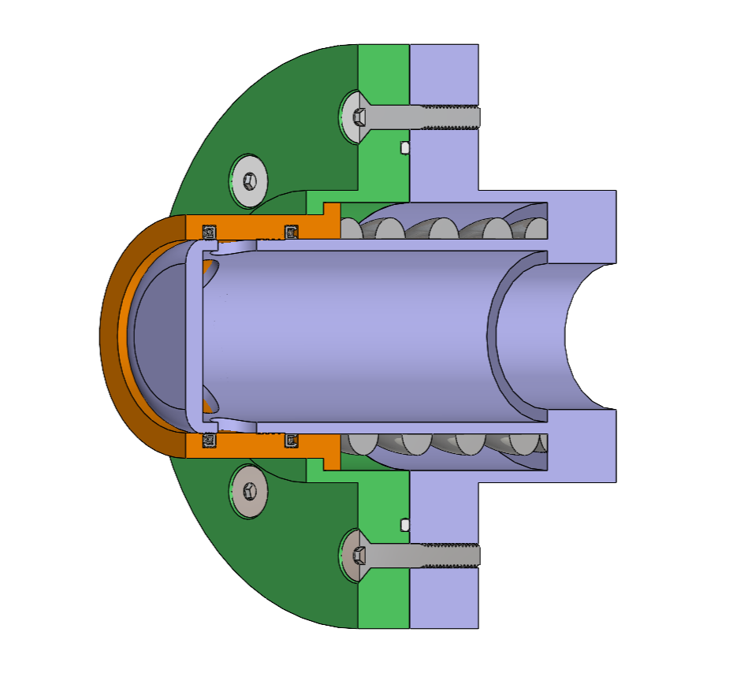
Probe Half
Sean Rodney
Static PTFE O-Rings
Actuator
Spring-Energized PTFE Seals
Stainless Steel Spring
Department of Mechanical Engineering
115

Slide 116
Sponsor Updates:
Sean Rodney
Insulation negligible for testing
SOFI: Smooth Exterior for future implementation
Flow rate should be low enough during fueling for pressure drop to be negligible.
Lubricant: Dry-film lube
Assume pressure in tanks is equalized.
Department of Mechanical Engineering
116

Slide 117
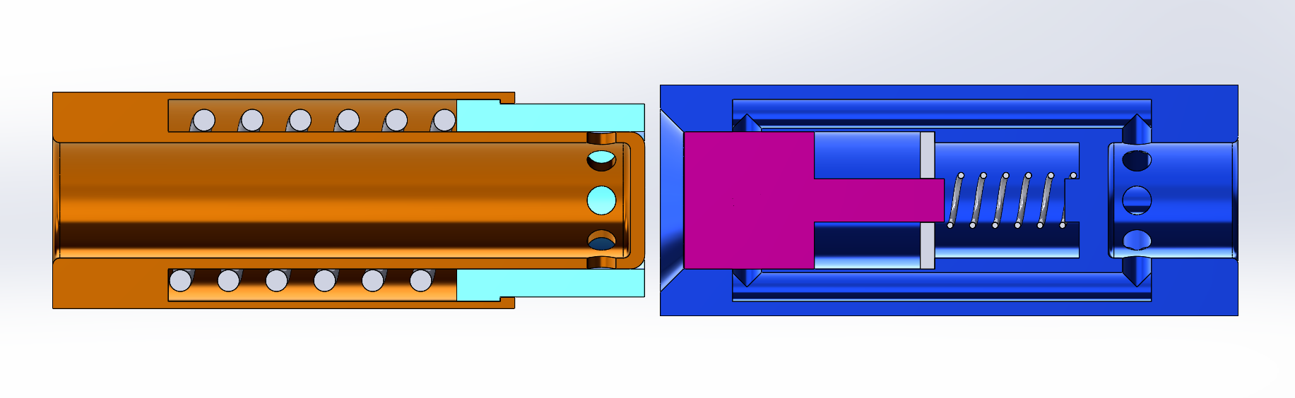
Fall Design
Valerie Rodriguez
Double-poppet actuator​
Force-held
lock
F
Encapsulated seals
Department of Mechanical Engineering
117

Slide 118
Initial Design Flaws
Valerie Rodriguez
Department of Mechanical Engineering
118

Slide 119
Valerie Rodriguez
Flow Channel Misalignment and Size
Insertion Relief Port
Difficult Seal Location and Manufacturing
Department of Mechanical Engineering
119

Slide 120
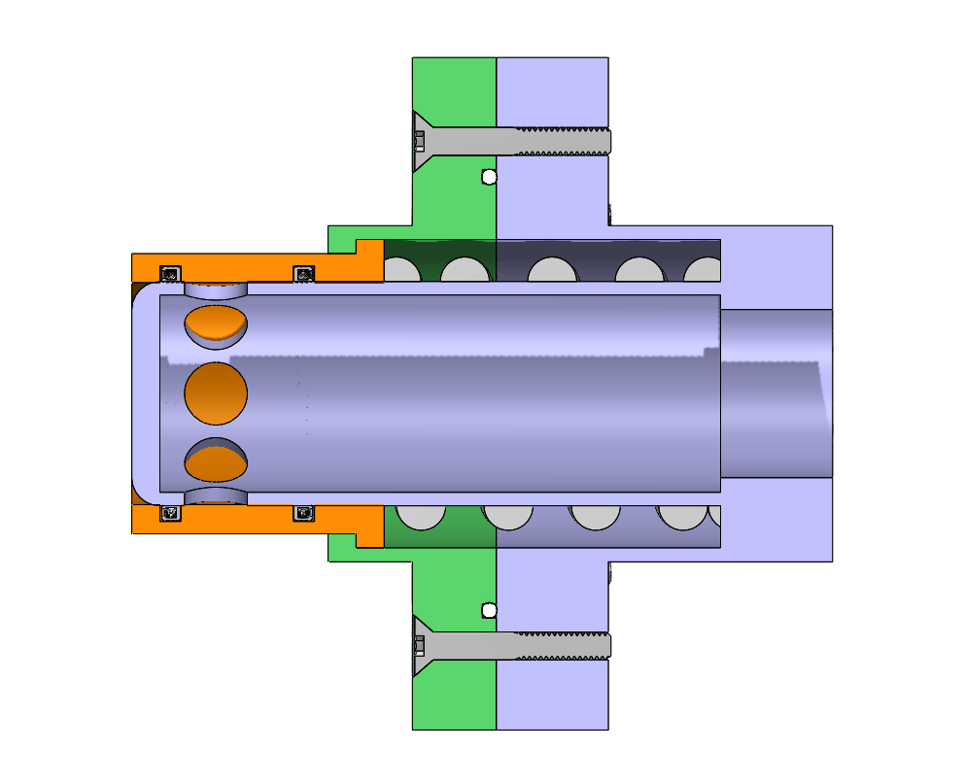
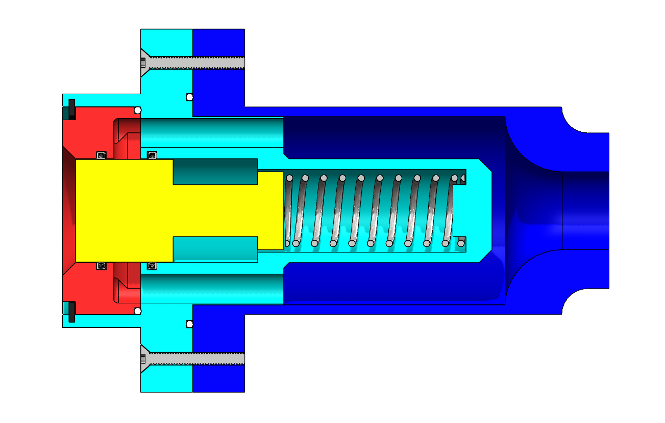
Updated Design
Sean Rodney
Department of Mechanical Engineering
120

Slide 121
ASCC MK2
Name
Department of Mechanical Engineering
10

Slide 122
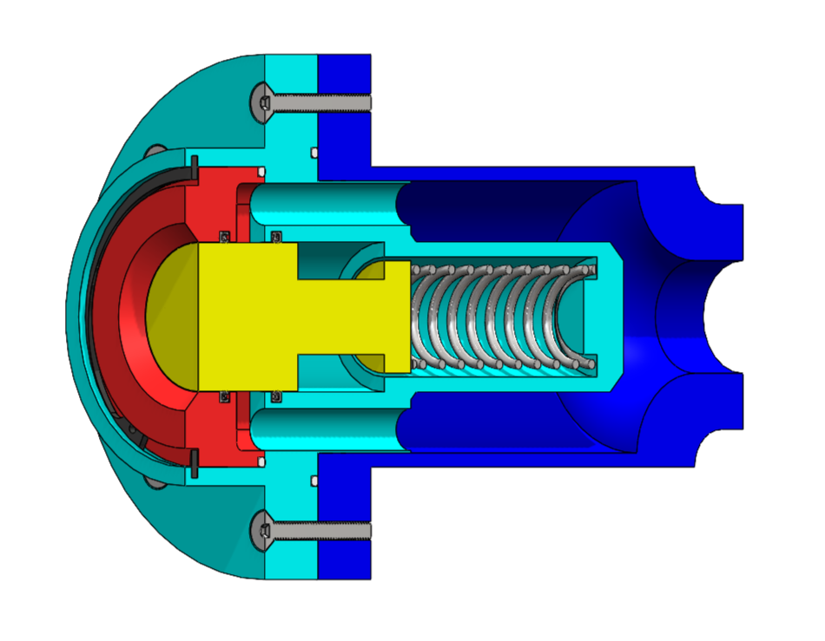
Receiving Half
Sean Rodney
Static PTFE O-Rings
Stainless Steel Spring
Actuator
Spring-Energized PTFE Seals
Department of Mechanical Engineering
122

Slide 123
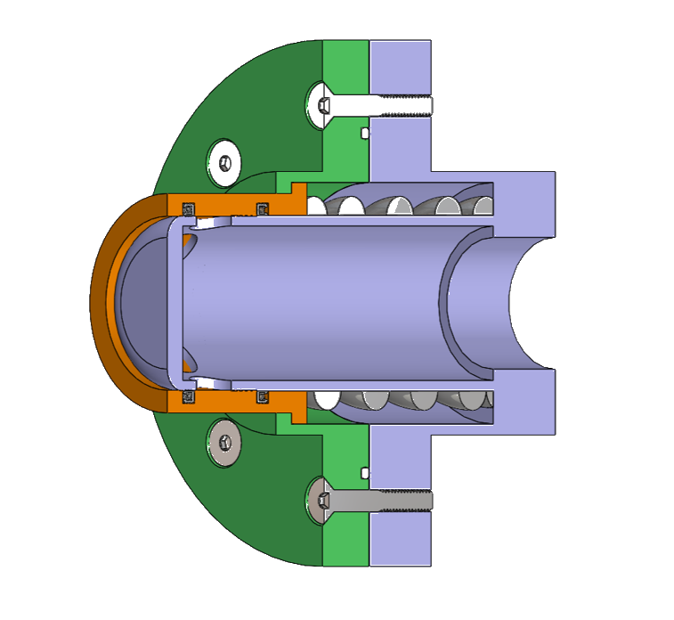
Sean Rodney
Static PTFE O-Rings
Actuator
Spring-Energized PTFE Seals
Stainless Steel Spring
Department of Mechanical Engineering
123

Slide 124
Design Revisions
Nicolas Sgammato
Single flow channel on receiver side
Arbitrary dimensions based on previous design
Multiple flow channels on receiver required alignment
Dimensions adjusted to match standard pipe sizes
Flange diameters and thicknesses decreased
Probe end fixed to outer surface
Oversized flange dimensions
Probe split from outer surface and cap feature added
Department of Mechanical Engineering
12

Slide 125
Design Revisions Continued
Name
Flange seals located primarily within one flange half
Flange seal location moved to between flange surfaces
Large and complex components created manufacturing difficulties
Components split up into multiple pieces
Gap formed between probe actuator and receiver cap upon mating
Chamfer added to outer edge of probe actuator
Cryogenic testing inhibited by open ends
Adapters added to connect KF fittings for testing
Department of Mechanical Engineering
13

Slide 126
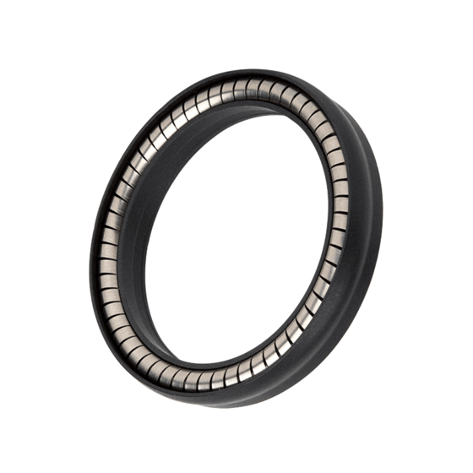
Updated Sealing
Sean Rodney
Spring-energized seal
Implements a circular spring to exert outward pressure
Encapsulated by PTFE (Teflon) due to excellent performance in cryogenic applications
Seals translating cylindrical bodies
Static and low speed applications
103A Omniseal​®
Note: Image for illustrative purposes only: The depicted seal is for stylization and a similar seal from McMaster-Carr will be implemented.
Department of Mechanical Engineering
126

Slide 127
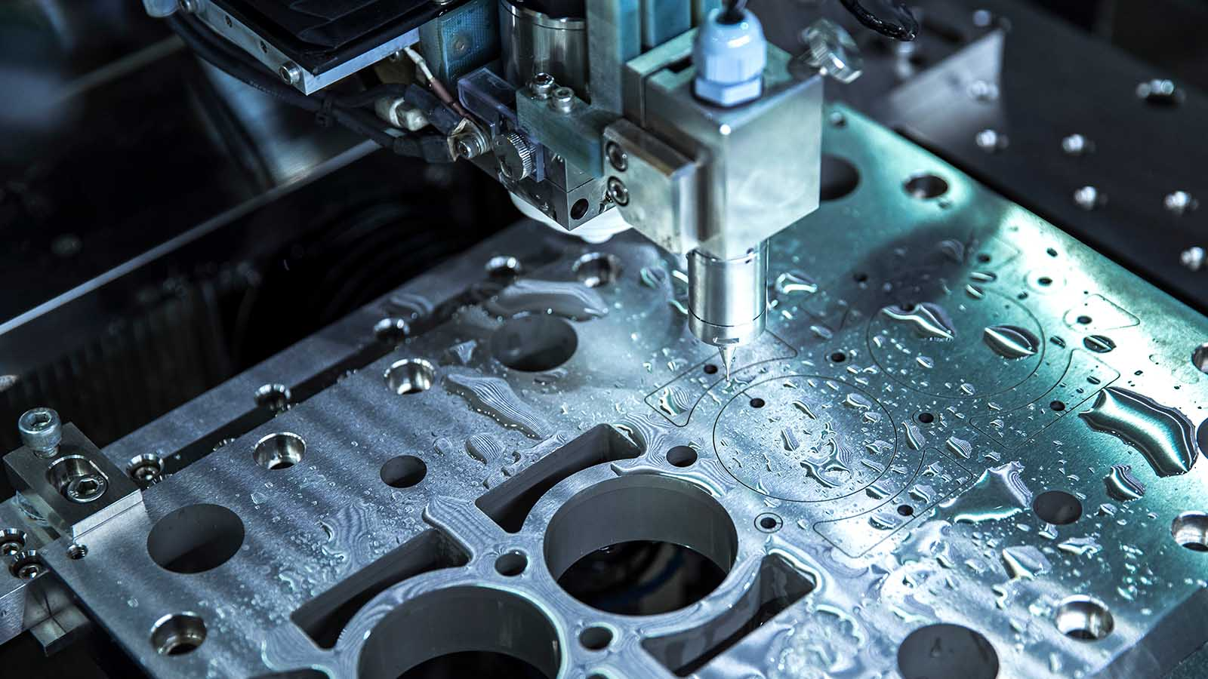
Manufacturing
Sean Rodney
Main components of probe and receiver will be CNC machined by the FAMU-FSU COE machine shop
Springs and seals will be ready to install from the manufacturer
Assembly of the coupler will be completed by the design team
Department of Mechanical Engineering
127

Slide 128
Anticipated Challenges + Solutions
Name
Order materials as soon as possible to allow time for re-order in case of a manufacturer issue
Material Issues
Design for less required machining and budget for extra materials in the event of irreparable fabrication errors
Machining Errors
Flow Channel Interference With Seals
If scraping of the seals by the flow channel holes is observed, a feature may need to be added to prevent significant seal damage
Department of Mechanical Engineering
15
Notes:
- Make this look nicer, update with new challenges

Slide 129
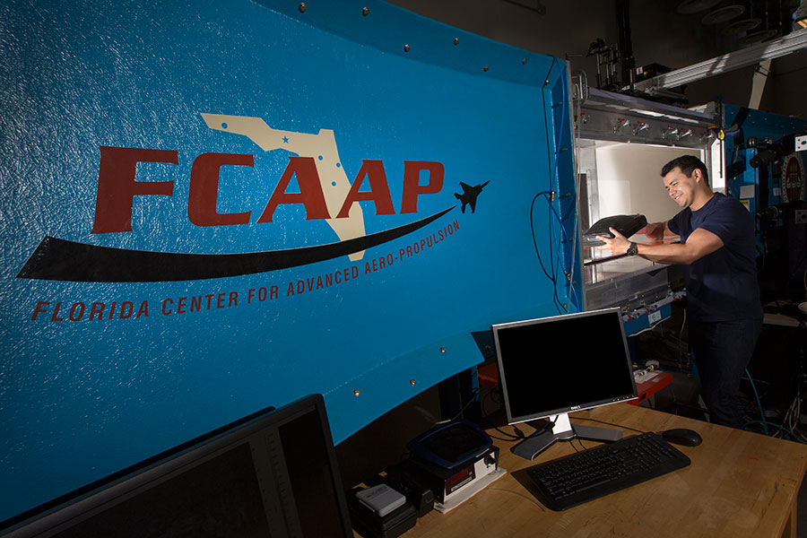
Sean Rodney
Testing
Cryogenic
Flow Rate
Leakage
Durability
Status:
In Progress
Status:
Approved
Status:
Pending Approval
Status:
Approved
Department of Mechanical Engineering
129

Slide 130



Leakage Testing
Sean Rodney
Identify design conflicts/areas of improvement
Calculate leakage rates and use Nasa environment correction factors to obtain target rates
Apply calculated rates and developed solutions to improve design before cryogenic testing
Department of Mechanical Engineering
130

Slide 131

Cryogenic Testing
Sean Rodney
Initiation of NHMFL
on-boarding and training
KF fitting for compatibility with NHMFL equipment
Material-safety check with Dr. Wei Guo
Department of Mechanical Engineering
131

Slide 132
Flow Rate Testing
Valerie Rodriguez
PIV testing will be conducted at the Florida Center For Advanced Aero-Propulsions
(FCAAP)
Particle Imaging Velocimetry will be used to analyze the flow inside the coupler
The design is to be sliced and placed in the low-speed wind tunnel to test flow rates
Department of Mechanical Engineering
132

Slide 133
Durability Testing
Valerie Rodriguez
Durability must be tested to identify any possible vulnerabilities in the design
The parts will be brushed with paint and tested at different forces
Leakage test will be preformed again to check for cracks and if design is reusable
The paint will chip away exposing areas experiencing the most force
Department of Mechanical Engineering
133

Slide 134
Testing
Validation
Valerie Rodriguez
External leakage: Less than 50 SCIM liquid nitrogen at 5 and 50 psig internal pressure
Leakage
Cryogenic
Internal leakage: Less than 500 SCIM liquid nitrogen at 15 and 50 psid while demated
Stainless steel springs can endure at least 10 N of force to keep tightly sealed connection
The valve can endure minimum 80 K temperatures
Flow Rate
Less than 5% plastic deformation
Durability
Department of Mechanical Engineering
134

Slide 135
Testing
Validation
Valerie Rodriguez
External leakage: Less than 50 SCIM liquid nitrogen at 5 and 50 psig internal pressure
Leakage
Cryogenic
Internal leakage: Less than 500 SCIM liquid nitrogen at 15 and 50 psid while demated
Stainless steel springs can endure at least 10 N of force to keep tightly sealed connection
The valve can endure minimum 80 K temperatures
Flow Rate
Less than 5% plastic deformation
Durability
Department of Mechanical Engineering
135

Slide 136
Budget Breakdown
Name
Raw Materials - $1248.72
Seals - $380.00
Springs - $41.14
Miscellaneous - $66.36
Remaining Budget - $263.78
Total Budget - $2000.00
Department of Mechanical Engineering
16

Slide 137
Summary
Jason Goldstein
The objective of this project was to create an actively sealed coupler that limits leakage during cryogenic fuel transfer for deep space missions.
42
137

Slide 138
Summary
Jason Goldstein

Slide 139
Summary
Jason Goldstein
Through discussions with our sponsor and machine shop, our team analyzed the constraints and developed a design that met our operation goals
42
139

Slide 140



Current Priorities
Jason Goldstein
Conduct testing at MagLab
Complete manufacturing
Analyze and present data
Assemble coupler

Slide 141
This is 10-point
This is 15–point Times
This is 20–point
This is 25–point
This is 30–point
This is 35–point
This is 40–point
This is 50–point
This is 60–point
This is 72–point
Notes:
Use at least 20-point font in Room A105, B134, and B136
Use at least 25-point font in Room B135

Slide 142
College of Engineering Color Palette
1 2 3 4
Pantone: PMS 195 C
RGB: 120, 47, 64
Hex: #782F40
CMYK:19, 90, 50, 55
1 2 3 4
Pantone: Black C
RGB: 0, 0, 0
Hex: #000000
CMYK:0, 0, 0, 100
Garnet
Black
1 2 3 4
RGB: 238, 118, 36
Hex: #EE7624
CMYK:2, 66, 99, 0
1 2 3 4
Pantone: PMS 000C
RGB: 255, 255, 255
Hex: #FFFFFF
CMYK: 0, 0, 0, 0
Fang
Orange
White
Notes:
Avoid 75% Black in B135

Slide 143
Accent Color Palette
1 2 3 4
RGB: 0, 59, 111
Hex: #003B6F
CMYK:
1 2 3 4
RGB: 0, 59, 111
Hex: #003B6F
CMYK:
1 2 3 4
RGB: 251, 236, 93
Hex: #FBEC5D
CMYK:
1 2 3 4
RGB: 219, 215, 210
Hex: #DBD7D2
CMYK:
1 2 3 4
RGB: 251, 236, 93
Hex: #FBEC5D
CMYK:
1 2 3 4
RGB: 219, 215, 210
Hex: #DBD7D2
CMYK:
Tardis Blue
Tardis Blue
Corn
Timberwolf
Corn
Timberwolf
1 2 3 4
RGB: 206, 0, 88
Hex: #CE0058
CMYK: 0, 100, 43, 12
1 2 3 4
RGB: 206, 0, 88
Hex: #CE0058
CMYK: 0, 100, 43, 12
1 2 3 4
RGB: 104, 40, 96
Hex: #682860
CMYK:
1 2 3 4
RGB: 220, 220, 220
Hex: #DCDCDC
CMYK:
Rubine Red
Rubine Red
Imperial
Gainsboro
1 2 3 4
RGB: 72, 146, 155
Hex: #48929b
CMYK:
1 2 3 4
RGB: 64, 224, 208
Hex: #40E0D0
CMYK:
1 2 3 4
RGB: 255, 139, 0
Hex: #FF8B00
CMYK:
Asagi-iro
Turquoise
American Orange
Notes:
Remove American orange add hyperlink grey
Make corn the last for b135
All work in 134 imperial move later
Tardis doesn’t work in b136

Slide 144
F7AB19
D67F15
EE7624
D64615
F73119
Analogous
https://color.adobe.com/create/color-wheel
6E3610
F0A16C
EE7624
6E4931
BASB1C
Monochromatic
A14508
4BED3B
EE7624
250CED
2010A1
Triad
A1470C
FF8C40
EE7624
0098A1
24E2ED
Complementary
28A164
2FED8D
EE7624
0848A1
1871ED
Split Complementary
EDAC2F
3BED93
EE7624
0C6AED
ED2F18
Double Split Complementary
ED660C
C7ED3B
EE7624
0CE1ED
A418ED
Square
BA7E09
87724A
EE7624
60EFCF
09BA61
Compound
AD551A
6E3610
EE7624
FA7625
D46820
Shades
Notes:
These are the variants that work well with Fang Orange. The bolded items show well on the projectors.

Slide 145
85412D
8F3831
782f40
8F3176
792D85
Analogous
https://color.adobe.com/create/color-wheel
C44D69
8E626D
782F40
C48796
451B25
Monochromatic
C43959
78743B
782F40
236178
43A2C4
Triad
C43959
C46078
782F40
25C43D
2F783A
Complementary
93C460
577835
782F40
39C49D
297861
Split Complementary
784435
5A783B
782F40
237860
6E2978
Double Split Complementary
782337
78683b
782F40
237830
293978
Square
AB4D32
DEBAAF
782F40
5D8555
70AB32
Compound
38161E
C44D69
782F40
853447
5E2532
Shades

Slide 146
A105
A105
B135 Stage Left
B135 Stage Right
B136
B134, A105
B135

Slide 152
Team 520: NASA-MSFC Actively Sealed Cryogenic Coupler
Virtual Design Review 4
Jason Goldstein, Lauren Roche, Sean Rodney,
Valerie Rodriguez, Nicolas Sgammato

