Slide 1
Team 522 – Rockwell Automation Manufacturing Device for Students
Luis Garcia, Caleb Mears, Chloe Keiran, Maria Rojas, Caden Schwartz

Slide 2





Team Introductions
Luis Garcia
Systems/
Dynamics
Engineer
Caleb Mears
Manufacturing
Engineer
Maria Rojas
Test Engineer
Chloe Keiran
Design
Engineer
Caden Schwartz
Electrical Systems Engineer

Slide 3





Sponsor and Advisor
Industry Sponsor
Tajaey Young
Rockwell Automation
Industry Sponsor
Amanda Eason
Rockwell Automation
Academic Advisor
Shayne McConomy, Ph.D.
Professor/Advisor

Slide 4
Objective
The objective of this project is to create a system that can demonstrate the automated manufacturing process and create an educational item.

Slide 5


Key Goals & Targets
Key Goals
Showcase automated manufacturing process
Provide educational experience
Create
tangible product

Slide 6

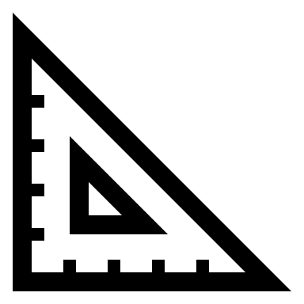


Key Goals & Targets
Key Goals
Showcase automated manufacturing process
Provide educational experience
Create
tangible product
Targets

Slide 7
Key Goals & Targets
Key Goals
Showcase automated manufacturing process
Provide educational experience
Create
tangible product
Targets
Latency:
5 ms

Slide 8
Key Goals & Targets
Key Goals
Showcase automated manufacturing process
Provide educational experience
Create
tangible product
Targets
Latency:
5 ms
Load Cap:
30 lb

Slide 9
Key Goals & Targets
Key Goals
Showcase automated manufacturing process
Provide educational experience
Create
tangible product
Targets
Latency:
5 ms
Load Cap:
30 lb
Cycle Time: <5 min

Slide 10
Key Goals & Targets
Key Goals
Showcase automated manufacturing process
Provide educational experience
Create
tangible product
Targets
Latency:
5 ms
Load Cap:
30 lb
Cycle Time: <5 min
Survey Percentage:
>70%
Notes:
Main reason for Rockwell to do this project, spark interest in the manufacturing industry and the advantages of having an automated process to make any products. How it turns raw material into a finished product
We're showing this to kids K-12 and we want them to get interested in the subject and learn about this process.
That the viewers can take home with them.
Response time for our sensor, we wanted a smooth process while the product is being built with quick responses from the sensors at each station.
Structure will be being moved from place to place to be showcased and we want it to be easily transported and moved around by 1-2 people.
Time it takes to run through a full assembly and make one full product. we don t want a slow process that makes it boring for the viewers since they might have a shorter attention span. So we want the process to be engaging and keep the viewers interested in what is happening in the system as well as being able to identify what is happening at each stage of the manufacturing line.
This is kind of a survey where we ask the viewers how interesting it was and if they feel they learned something to measure the success of the demonstration and they grade it from 1-10, and we want that score to be greater than 70%.

Slide 11





Concept Selection
Concept Generation
House of Quality
Analytical Hierarchy Process
Final Selection

Slide 12
Final Selection
Metal Pin
Highest alternative value
Most achievable within given timeline
Satisfies all customer requirements
Final Selection

Slide 13

Design Updates
OLD DESIGN
NEW DESIGN
Fully automated physical
Fully automated Emulate3D
PLC
Arduino/breadboard control
Integrated assembly line
ON/OFF stepper motors

Slide 14
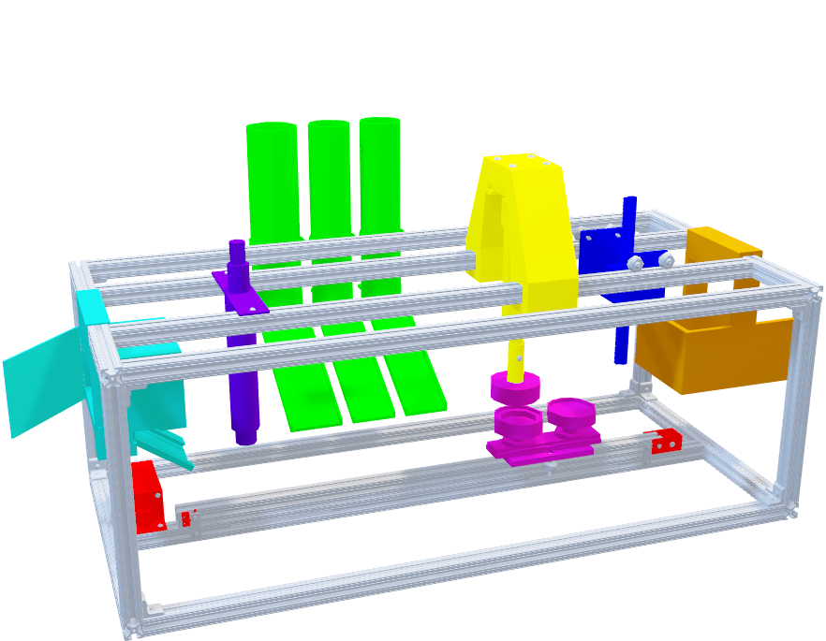
System Design
Insert design
Pin top
Orient design
Mylar plastic
Pin bottom
Press pin
Eject pin

Slide 15
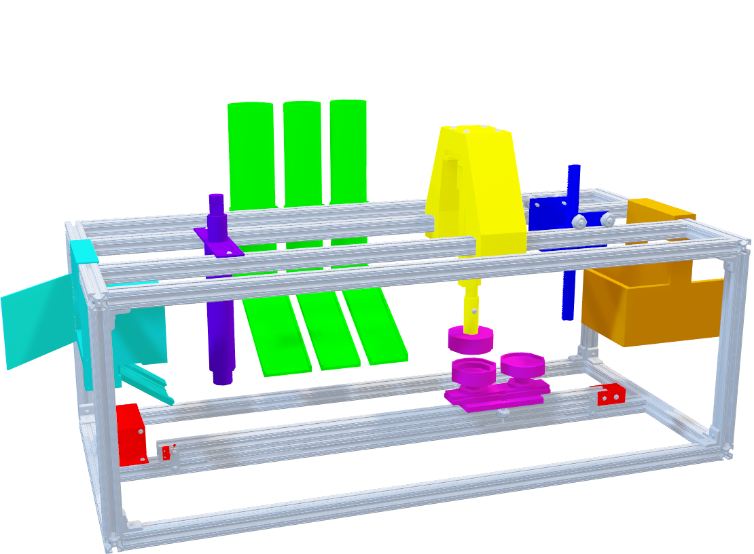
System Design
Framing
Aluminum extrusion rods
Machine shop
M6 Bolts and Corner Brackets
1.5 ft (x4)
1.0 ft (x4)
3.0 ft (x7)
2.5 ft (x1)

Slide 16
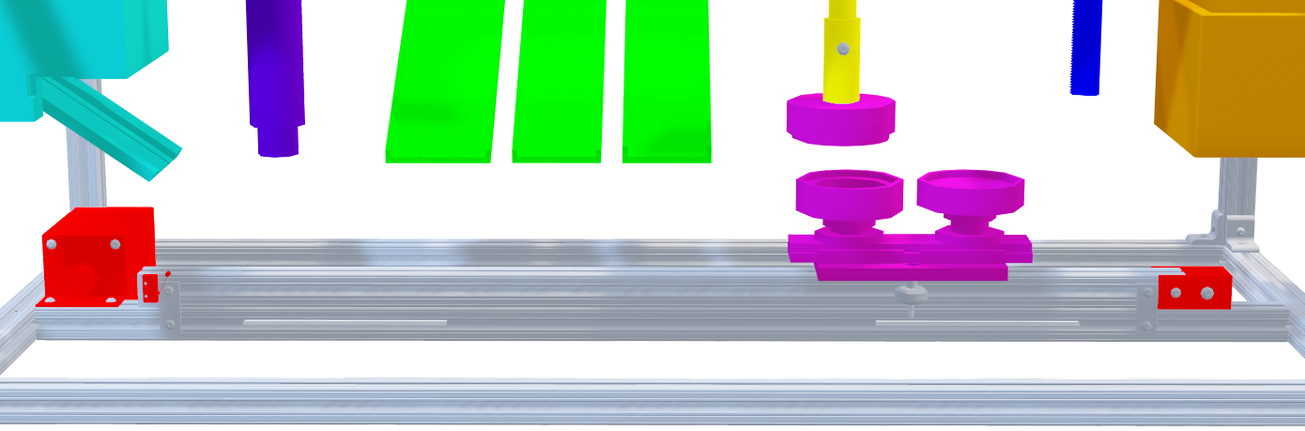
System Design
Conveyor
Analogous to 3D Printer track
Tension Housing
Gantry
Analogous to 3D Printer gantry
Die Mold subject

Slide 17
System Design
Insert design
Pin top
Orient design
Mylar plastic
Pin bottom
Press pin
Eject pin

Slide 18
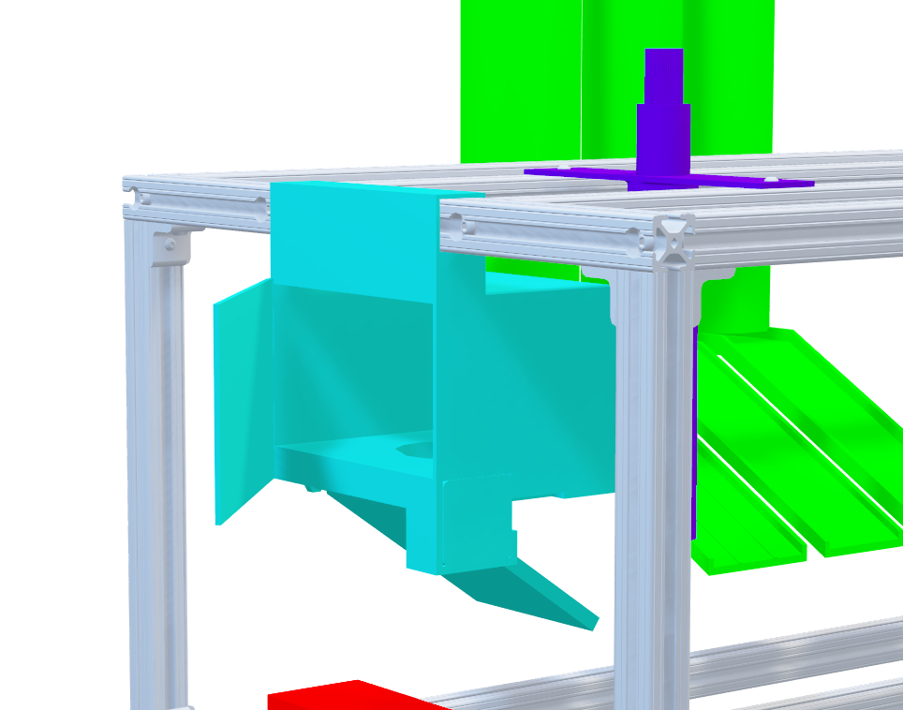
System Design
Insert design
Entry Gate
Manual Insert
Ramp
Stepper motor

Slide 19
System Design
Insert design
Pin top
Orient design
Mylar plastic
Pin bottom
Press pin
Eject pin

Slide 20
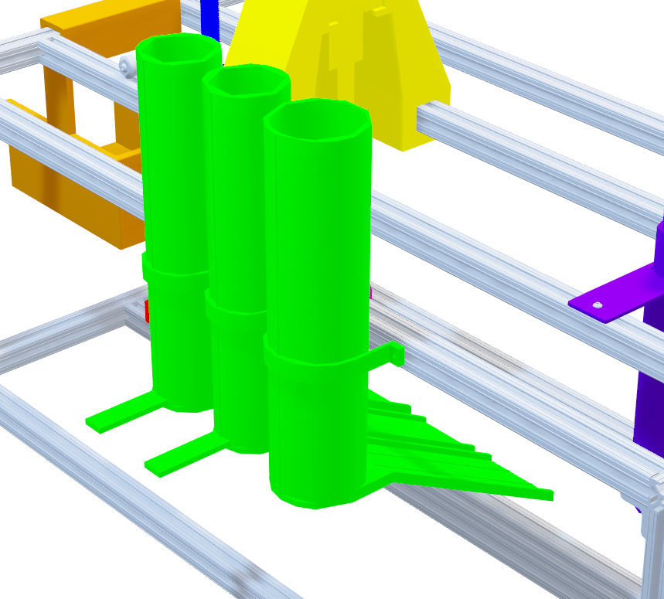
System Design
Pin top
Pin bottom
Mylar plastic
Storage Silos
Manual piston
Linear actuators

Slide 21
System Design
Insert design
Pin top
Orient design
Mylar plastic
Pin bottom
Press pin
Eject pin

Slide 22
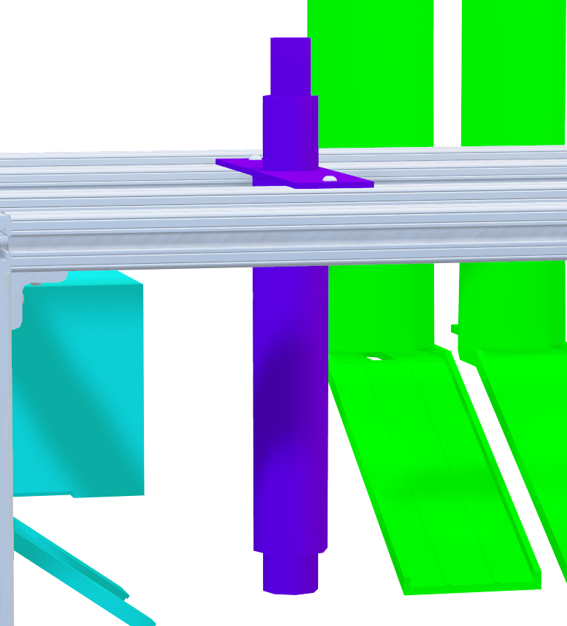
System Design
Orient design
Orientation Arm
Manual Raise/Lower
Track System
Linear Actuator Rotating

Slide 23
System Design
Insert design
Pin top
Orient design
Mylar plastic
Pin bottom
Press pin
Eject pin

Slide 24
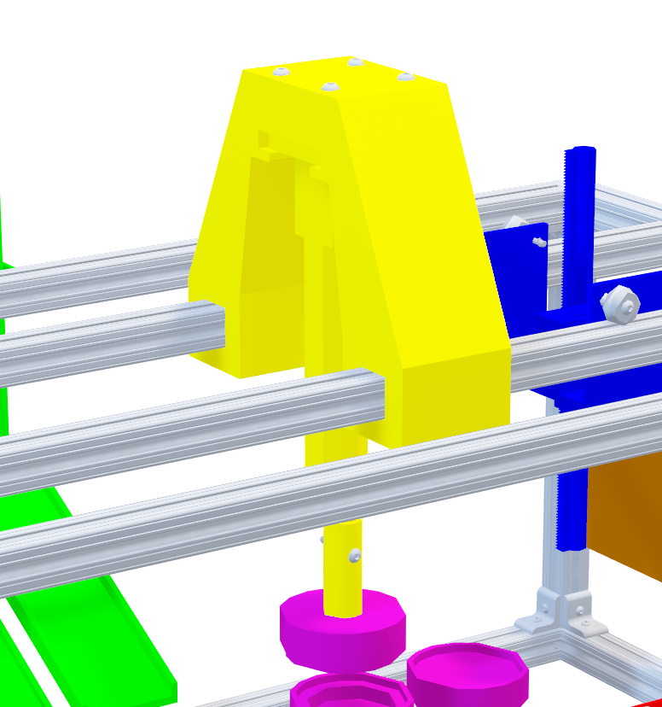
System Design
Press pin
Press
Strong linear actuator
~150lbs force required
Detachable die

Slide 25
System Design
Insert design
Pin top
Orient design
Mylar plastic
Pin bottom
Press pin
Eject pin

Slide 26
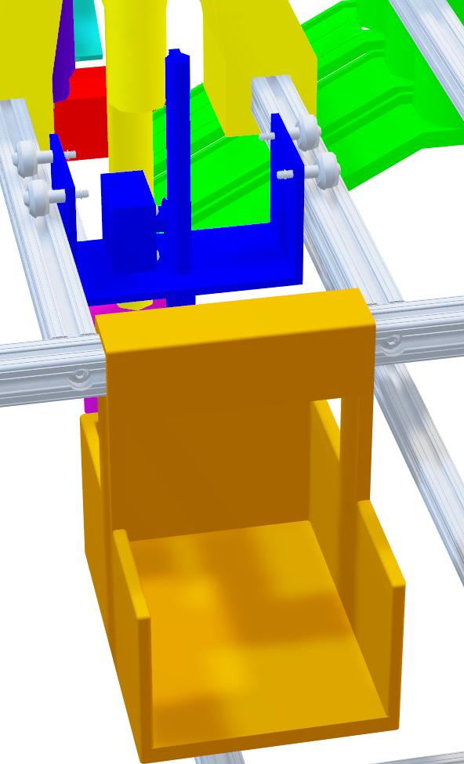
System Design
Eject pin
Ejection
Stepper motor w/
Rack and pinion
Manual horizontal movement

Slide 27
Initial Electrical System Design
Key Points
Power Supply:
+24V DC
+5V USB connection
One Arduino controls all systems
Three pushbuttons and three limit switches
Linear actuator optical sensor is wired to Arduino
Two power supplies
Microcontroller: Arduino UNO3
All buttons
DM442, DM542 motor drivers
Stepper motor 1, 2, 3
Power supply: +12V DC
IBT-2 Motor Driver
Firgelli Linear Actuator

Slide 28
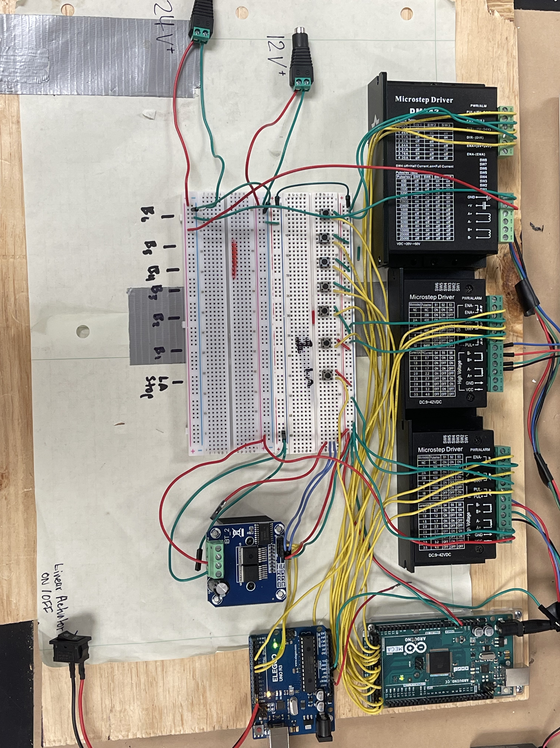
Final Electrical System Design
Key Points
Two Arduinos:
Stepper motors and linear actuator are separate systems
7 pushbuttons and 1 limit switch
Linear actuator optical sensor is not used

Slide 29
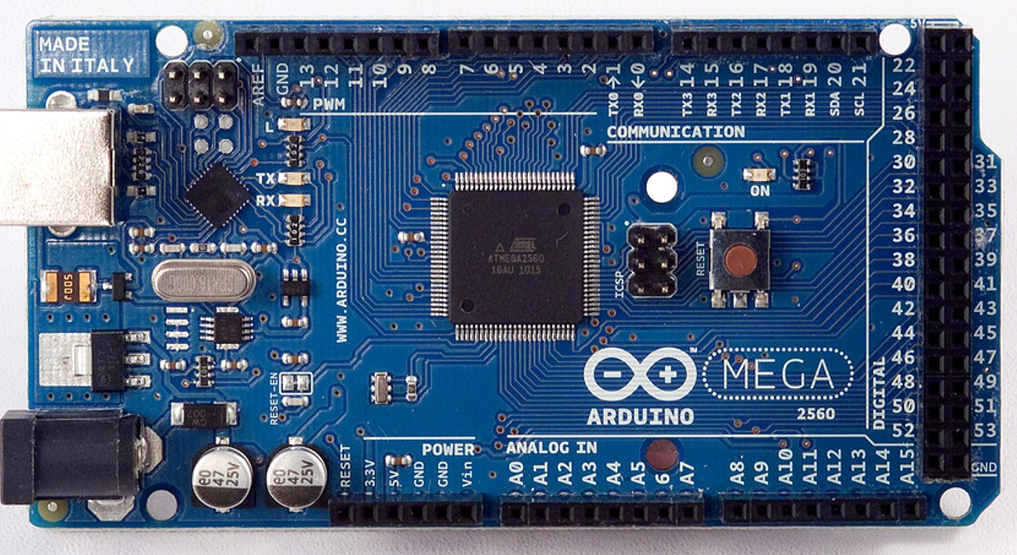
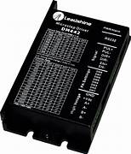
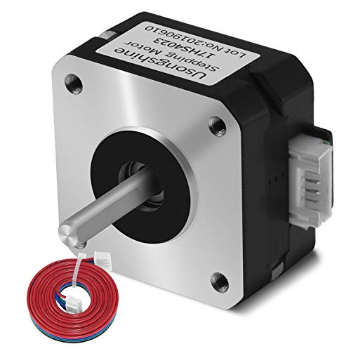
Stepper Motor Motion Control
Microcontroller
Arduino MEGA
Motor Driver
DM442
Stepper Motor
17HS4023
Note: Arduino MEGA powered by 5V USB connection
DM442 powered by 12V power supply

Slide 30
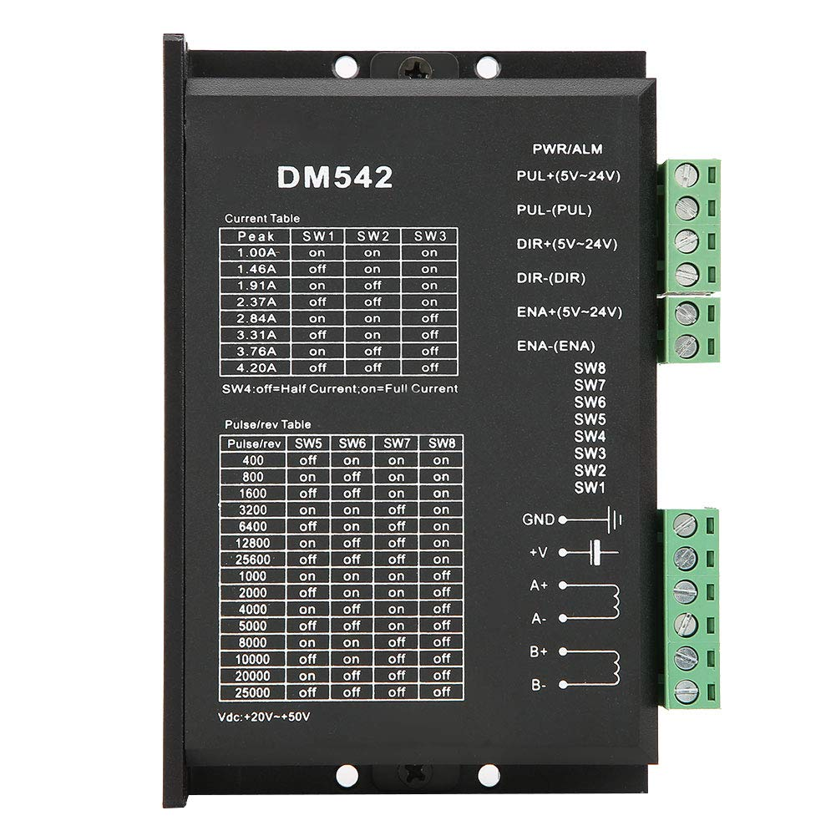
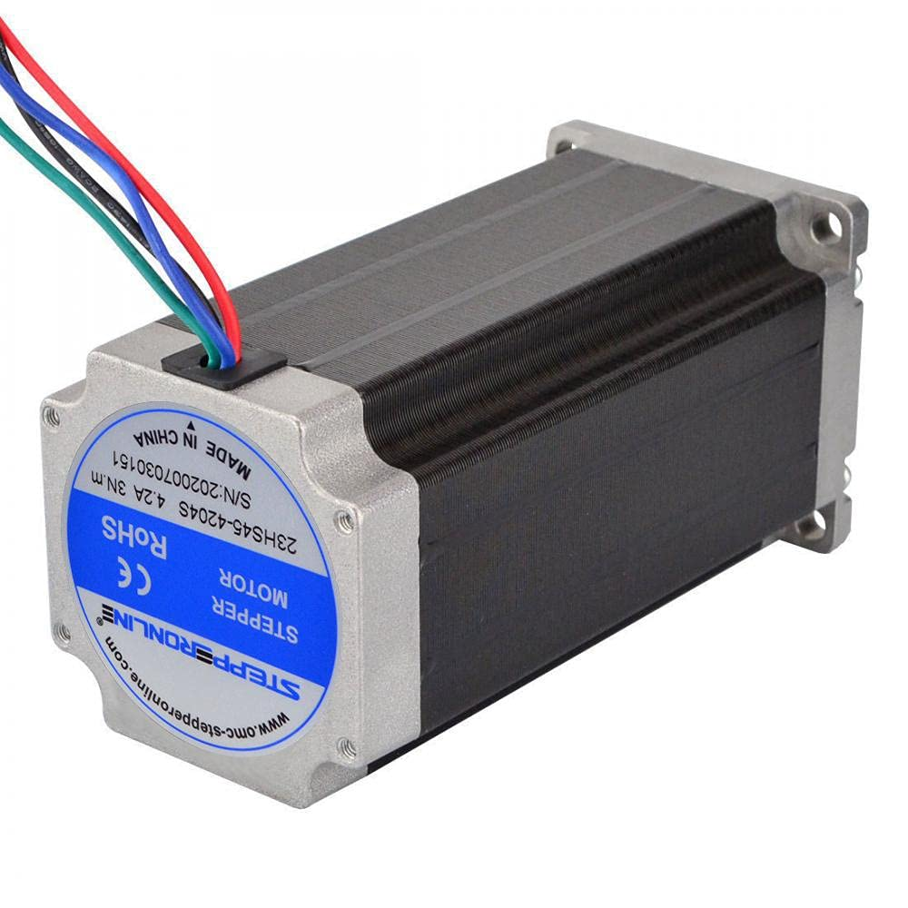
Stepper Motor Motion Control
Motor Driver
DM542
Stepper Motor
23HS45-4204S
Note: DM542 powered by 24V power supply
Logic from Arduino MEGA powered by 5V USB connection

Slide 31
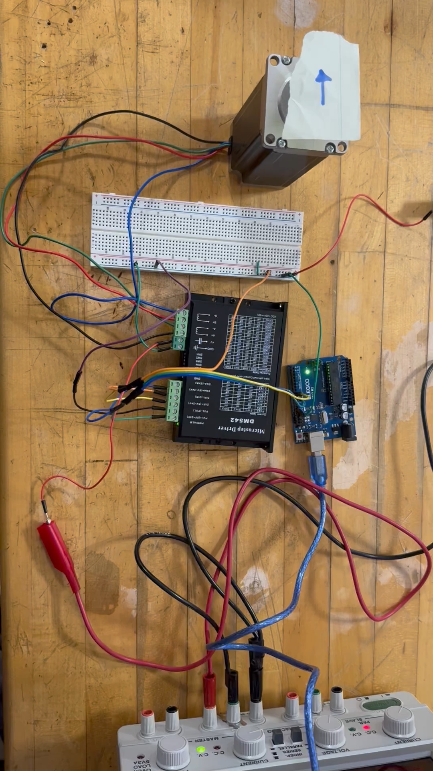
Stepper Motor Motion Control
COMPONENTS
Motor control using micro-stepping
Power Supply:
+24V DC
+5V USB connection
Microcontroller: Arduino UNO3
Buttons 1 & 2
Motor Driver:
DM542 micro stepper
Stepper Motor: 23HS45-4204S

Slide 32
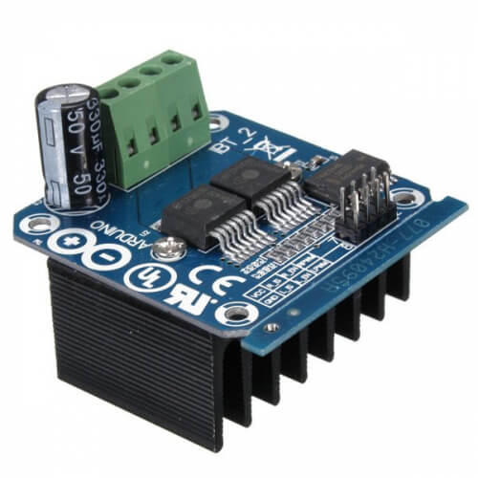
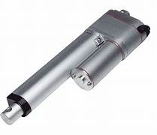
Linear Actuator Motion Control
IBT-2 High Power Motor Driver
Firgelli Linear Actuator 250lbs press
Note: IBT-2 powered by 12V power supply
Logic from Arduino UNO3 powered by 5V USB connection

Slide 33
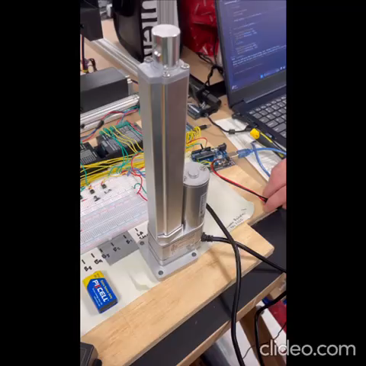
Linear Actuator Motion Control
Components
Power supply: +12V DC
+5V USB connection
Microcontroller: Arduino UNO3
Switch1 & Button 0
IBT-2 Motor Driver
Firgelli Linear Actuator

Slide 34
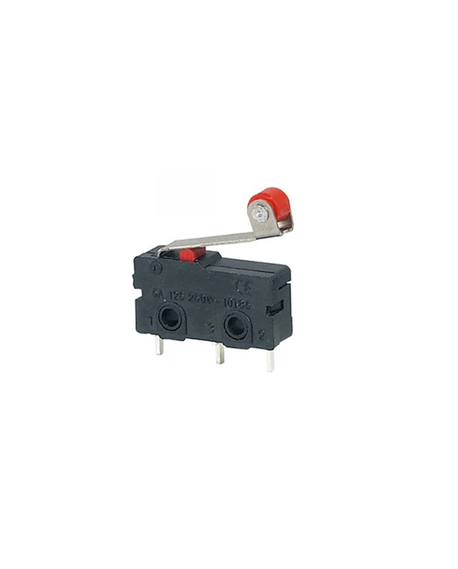
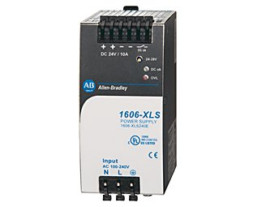
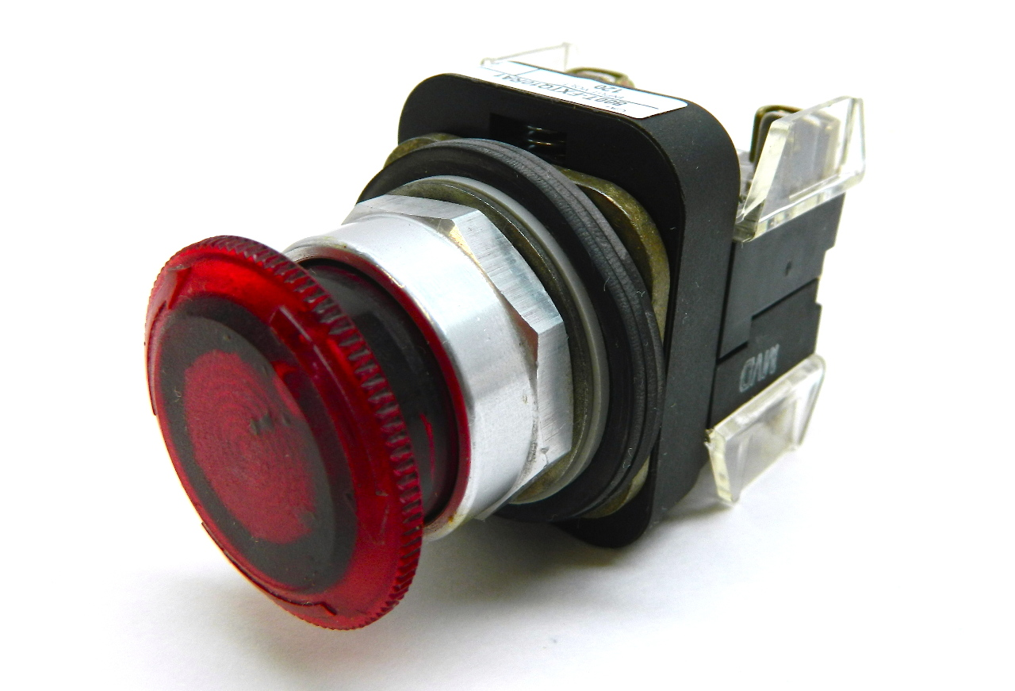
Electrical Updates
SOFTWARE
HARDWARE
Fine tune precision motor control code for assembly.
Limit switches and push buttons used as inputs to direct motor position.
Rockwell power supply and illuminated pushbuttons unavailable.
System designed for ease of changing parts from generic to Rockwell.

Slide 35






Electrical Updates
Electronic Enclosure
Ensures easy access for maintenance
Allows for external connectivity
Accommodates driver's heat dissipation
Electrical Assembly
Wiring and soldering of components
Calibrate motion control for accuracy
Documentation of electrical systems

Slide 36

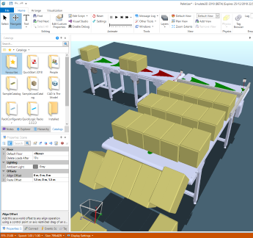
Emulate3D
Software developed by Rockwell
Simulates industrial automation systems
Instrumental for testing
Predict future performance & simulation

Slide 37
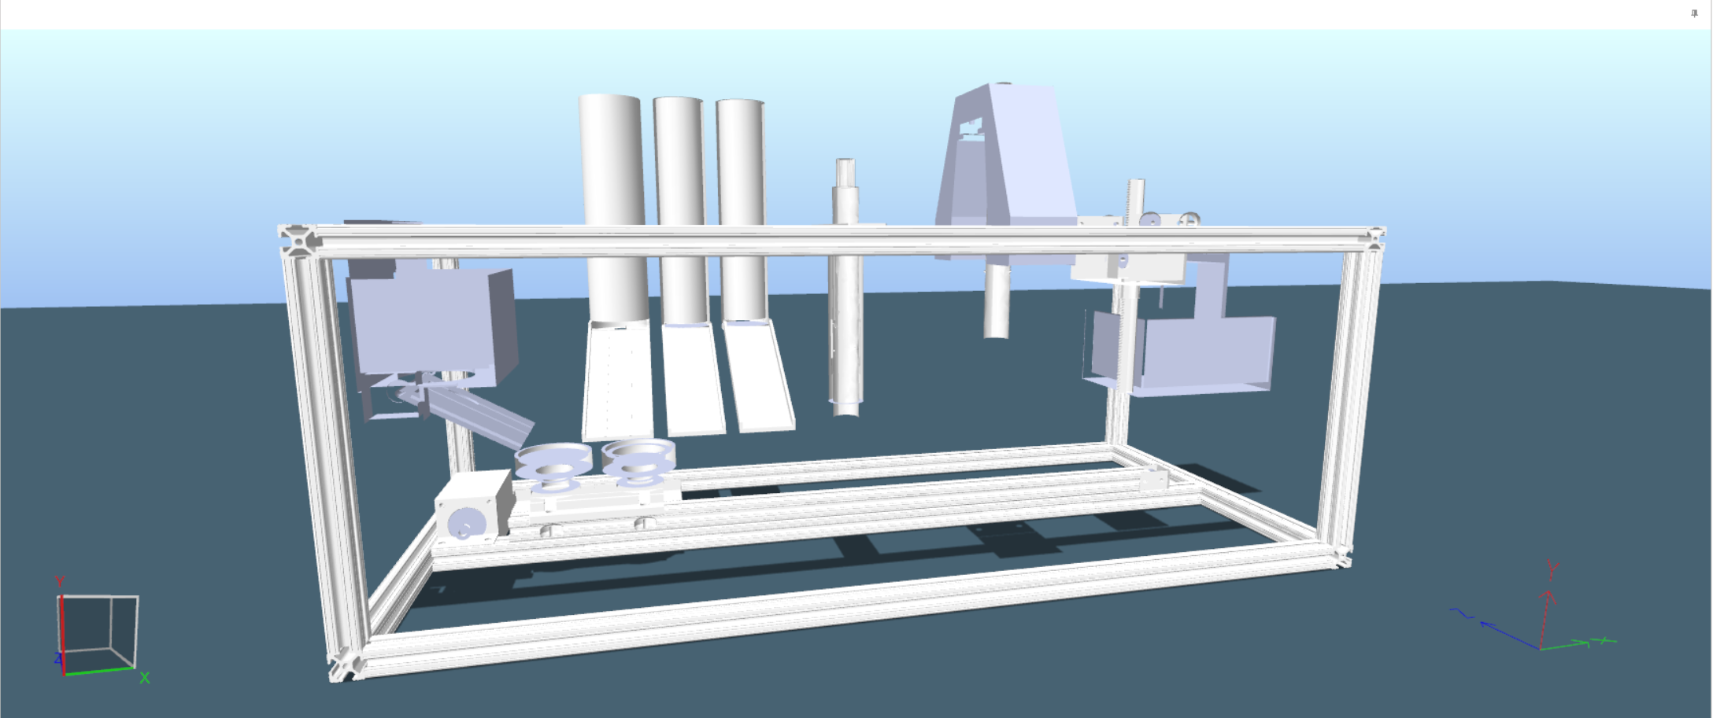
Emulate3D Model

Slide 38
Emulate3D vs. Physical Model
Kinematic joints to constraint motion
Motors and position controllers

Slide 39
Emulate3D vs. Physical Model
Kinematic joints to constraint motion
Motors and position controllers
Automated cycle controlled using QuickLogic (can be used for PLCs)

Slide 40
Emulate3D – Joint Control
Gantry
Ejection
Press
Kinematic Prismatic Joint
Kinematic Cylindrical Joint
Orientation System

Slide 41
Emulate3D – Joint Control
Gantry
Ejection
Press
Kinematic Prismatic Joint
Kinematic Cylindrical Joint
Orientation System
1 DOF

Slide 42
Emulate3D – Joint Control
Gantry
Ejection
Press
Kinematic Prismatic Joint
Kinematic Cylindrical Joint
Orientation System
1 DOF
2 DOF

Slide 43
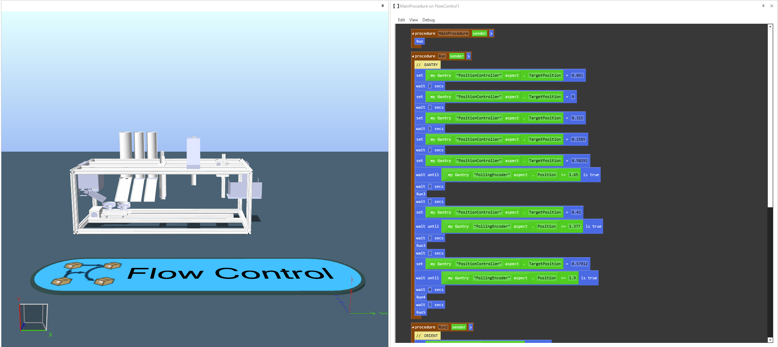
Emulate3D – QuickLogic

Slide 44
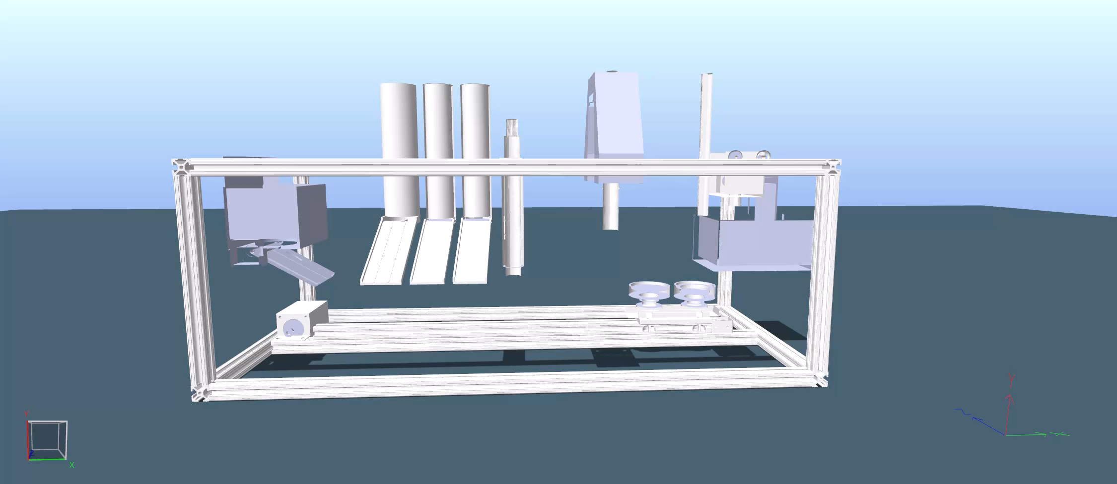
Emulate3D Simulation

Slide 45


Emulate3D Issues
QuickLogic:
Getting the code to work per part using the same controller
Software:
Understanding commands and functions to achieve a goal

Slide 46
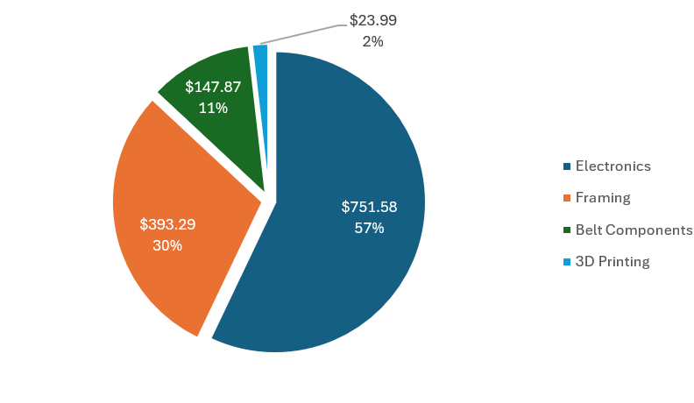
Budget Update
Total Spent: $1,316.73
Amount Remaining:
$683.27

Slide 47
Incomplete Work
Before Design Day
After Design Day
Complete Emulate3D simulation and load creator
Add remaining 3D parts and fine tune the physical model
One Arduino
Consult with Sponsors about future design changes
Incorporating survey
Automated system

Slide 48
Lessons Learned
Planning
Communication
Troubleshooting

Slide 49
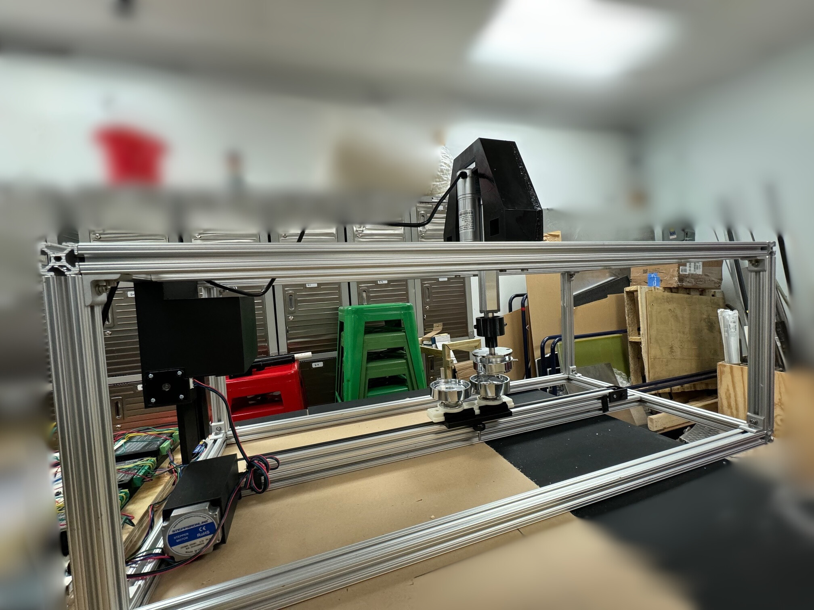
Summary
Objective: Create a manufacturing device for students
Goals: Showcase the manufacturing process that creates a metal pin for students
Design: Physical model with both manual and automated parts
Outcome: 90% complete physical and virtual build

Slide 50
Future Work
Fine Tune
Physical & Virtual
Model
Engineering Design Day
Consult With Sponsors About Future Design Changes
Further Testing & Risk Analysis

Slide 51
Questions?
When you invest in Team 522 solutions, you invest in the future of educational manufacturing.

Slide 52
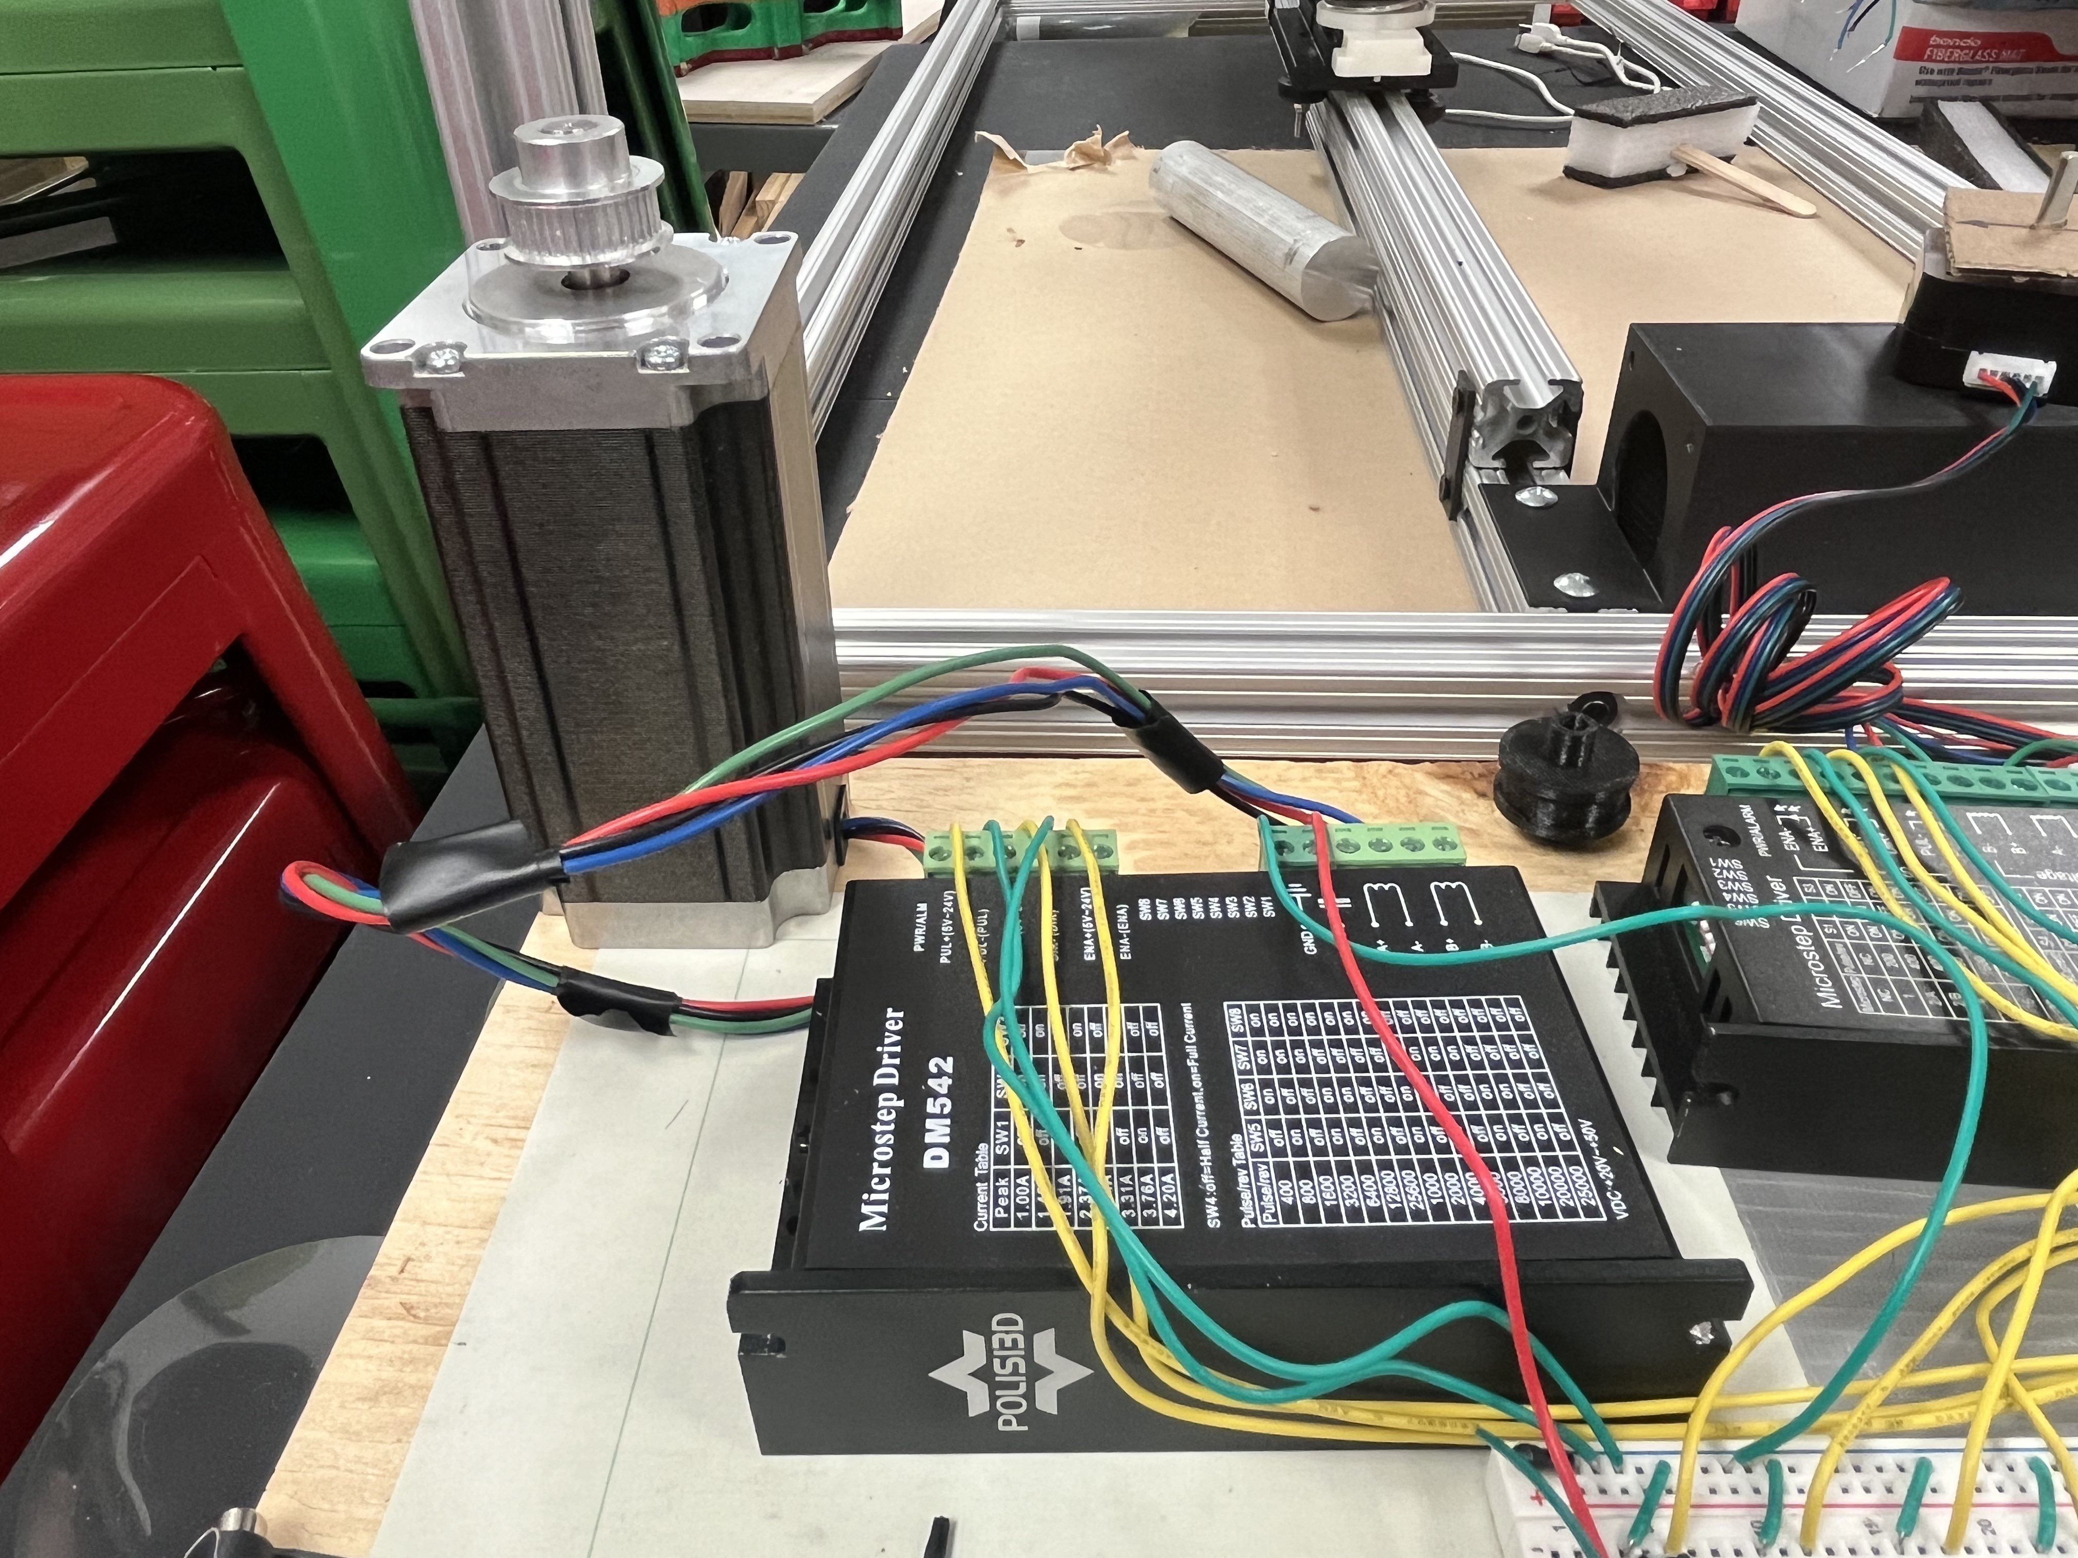
Motion Control
Motor Driver
DM542
Stepper Motor
23HS45-4204S

Slide 53
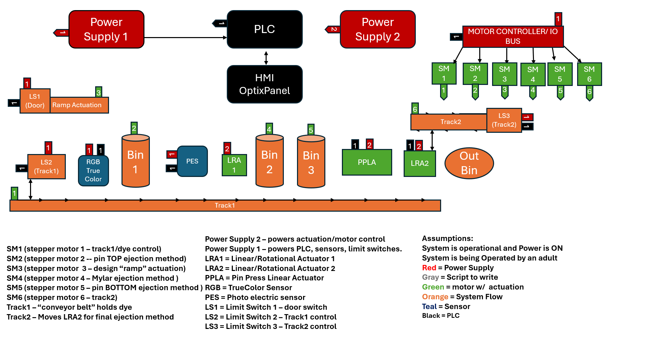
System Design

Slide 54
This is 10-point
This is 15–point Times
This is 20–point
This is 25–point
This is 30–point
This is 35–point
This is 40–point
This is 50–point
This is 60–point
This is 72–point
Notes:
Use at least 20-point font in Room A105, B134, and B136
Use at least 25-point font in Room B135

Slide 55
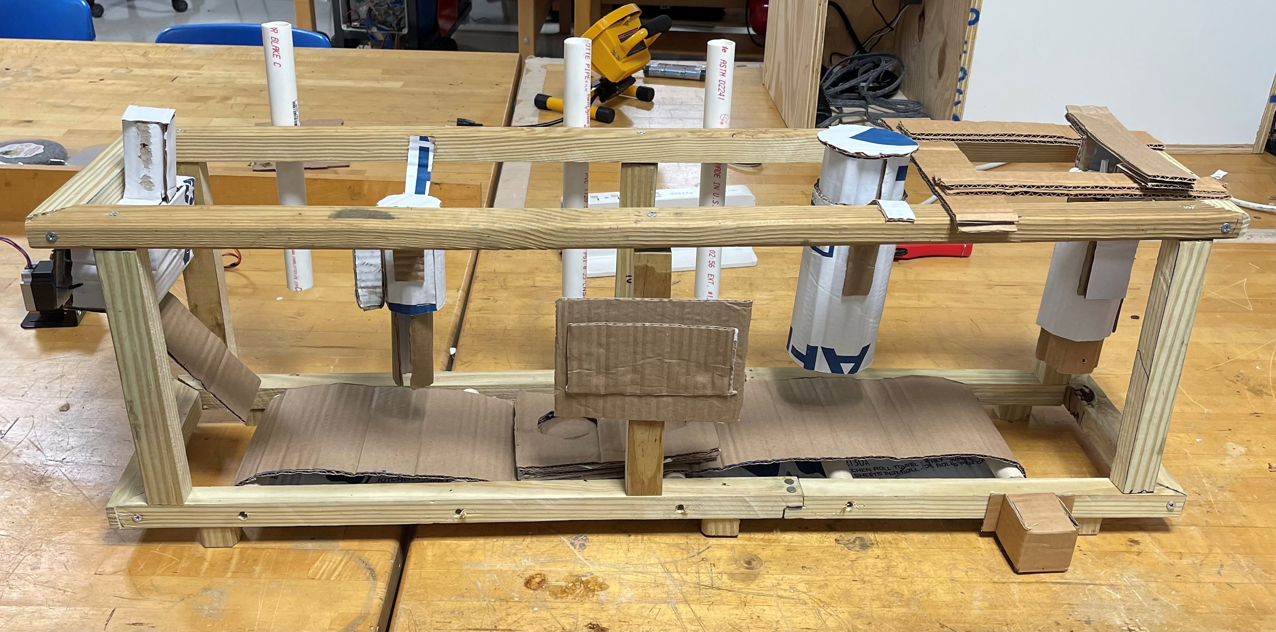
Initial System Design
Insert design
Pin top
Orient design
Mylar plastic
Pin bottom
Press pin
Eject pin

Slide 56
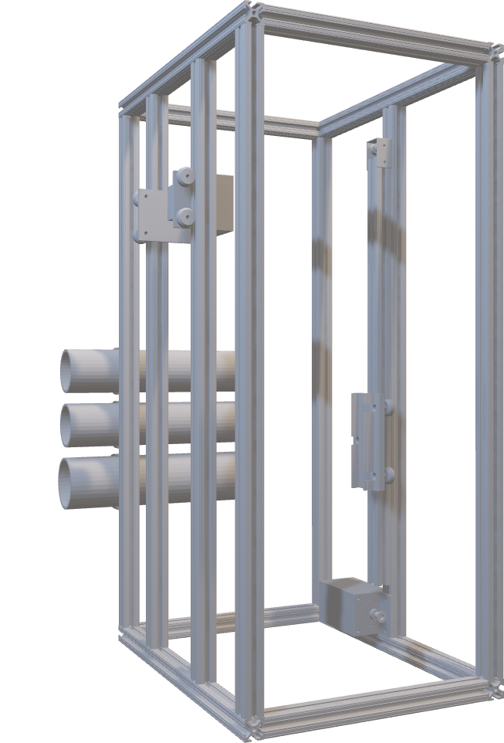
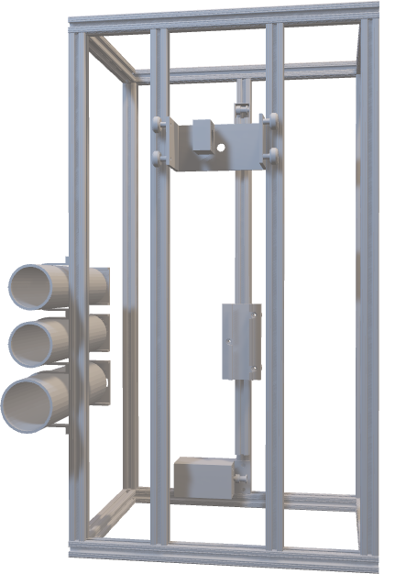
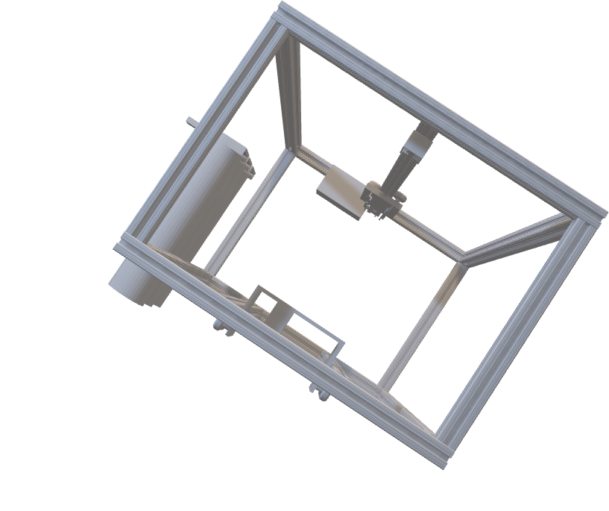
CAD Model

Slide 57
Project Updates
Simulate Emulate model
Complete frame build****
Optimized code

Slide 58
Electrical Components
Power Supply 1
Arduino
Power Supply 2
1
1
2
Motor Controllers
SM1
SM 2
SM 3
1
1
Push Button w/ LED
LS1 (Door)
3
1
2
3
1
Ramp Actuation
1
2
4
5
1
1
Bin1
Bin2
Bin3
Manual Pin Press
Out Bin
LS3 (Eject)
LS2 (Track1)
1
1
1
TRACK 1

Slide 59
Electrical Components
Power Supply 1
Arduino
1
1
1
LS1 (Door)
3
1
Ramp Actuation
2
4
5
1
1
Bin1
Bin2
Bin3
Manual Pin Press
Out Bin
LS3 (Eject)
LS2 (Track1)
1
1
1
TRACK 1

Slide 60
Power Supply 1
1
MCU
Power Supply 2
1
2
MOTOR CONTOLLERS
Push Button w/ LED
SM1
SM2
SM3
1
1
1
2
3
LS1 (Door)
3
1
Ramp Actuation
1
2
4
5
Bin1
Bin2
Bin3
Out Bin
1
1
LS2 (Track1)
Manual Pin Press
LS3 (Eject)
1
1
1
Track1
SIMPLIFIED DESIGN
Power Supply 2 – powers actuation/motor control
Power Supply 1 – powers PLC, LED, limit switches.
LS1 = Limit Switch 1 – door switch
LS2 = Limit Switch 2 – Track1 control
LS3 = Limit Switch 3 – Track2 control
PUSHBUTTON = ROCKWELL LED PB
SM1 (stepper motor 1 – track1/dye control)
SM2 (stepper motor 2 -- pin TOP ejection method)
SM3 (stepper motor 3 – design “ramp” actuation)
SM4 (stepper motor 4 – Mylar ejection method )
SM5 (stepper motor 5 – pin BOTTOM ejection method )
Track1 – “conveyor belt” holds dye

Slide 61
College of Engineering Color Palette
1 2 3 4
Pantone: PMS 195 C
RGB: 120, 47, 64
Hex: #782F40
CMYK:19, 90, 50, 55
1 2 3 4
Pantone: Black C
RGB: 0, 0, 0
Hex: #000000
CMYK:0, 0, 0, 100
Garnet
Black
1 2 3 4
RGB: 238, 118, 36
Hex: #EE7624
CMYK:2, 66, 99, 0
1 2 3 4
Pantone: PMS 000C
RGB: 255, 255, 255
Hex: #FFFFFF
CMYK: 0, 0, 0, 0
Fang
Orange
White
Notes:
Avoid 75% Black in B135

Slide 62
Accent Color Palette
1 2 3 4
RGB: 0, 59, 111
Hex: #003B6F
CMYK:
1 2 3 4
RGB: 0, 59, 111
Hex: #003B6F
CMYK:
1 2 3 4
RGB: 251, 236, 93
Hex: #FBEC5D
CMYK:
1 2 3 4
RGB: 219, 215, 210
Hex: #DBD7D2
CMYK:
1 2 3 4
RGB: 251, 236, 93
Hex: #FBEC5D
CMYK:
1 2 3 4
RGB: 219, 215, 210
Hex: #DBD7D2
CMYK:
Tardis Blue
Tardis Blue
Corn
Timberwolf
Corn
Timberwolf
1 2 3 4
RGB: 206, 0, 88
Hex: #CE0058
CMYK: 0, 100, 43, 12
1 2 3 4
RGB: 206, 0, 88
Hex: #CE0058
CMYK: 0, 100, 43, 12
1 2 3 4
RGB: 104, 40, 96
Hex: #682860
CMYK:
1 2 3 4
RGB: 220, 220, 220
Hex: #DCDCDC
CMYK:
Rubine Red
Rubine Red
Imperial
Gainsboro
1 2 3 4
RGB: 72, 146, 155
Hex: #48929b
CMYK:
1 2 3 4
RGB: 64, 224, 208
Hex: #40E0D0
CMYK:
1 2 3 4
RGB: 255, 139, 0
Hex: #FF8B00
CMYK:
Asagi-iro
Turquoise
American Orange
Notes:
Remove American orange add hyperlink grey
Make corn the last for b135
All work in 134 imperial move later
Tardis doesn’t work in b136

Slide 63
F7AB19
D67F15
EE7624
D64615
F73119
Analogous
https://color.adobe.com/create/color-wheel
6E3610
F0A16C
EE7624
6E4931
BASB1C
Monochromatic
A14508
4BED3B
EE7624
250CED
2010A1
Triad
A1470C
FF8C40
EE7624
0098A1
24E2ED
Complementary
28A164
2FED8D
EE7624
0848A1
1871ED
Split Complementary
EDAC2F
3BED93
EE7624
0C6AED
ED2F18
Double Split Complementary
ED660C
C7ED3B
EE7624
0CE1ED
A418ED
Square
BA7E09
87724A
EE7624
60EFCF
09BA61
Compound
AD551A
6E3610
EE7624
FA7625
D46820
Shades
Notes:
These are the variants that work well with Fang Orange. The bolded items show well on the projectors.

Slide 64
85412D
8F3831
782f40
8F3176
792D85
Analogous
https://color.adobe.com/create/color-wheel
C44D69
8E626D
782F40
C48796
451B25
Monochromatic
C43959
78743B
782F40
236178
43A2C4
Triad
C43959
C46078
782F40
25C43D
2F783A
Complementary
93C460
577835
782F40
39C49D
297861
Split Complementary
784435
5A783B
782F40
237860
6E2978
Double Split Complementary
782337
78683b
782F40
237830
293978
Square
AB4D32
DEBAAF
782F40
5D8555
70AB32
Compound
38161E
C44D69
782F40
853447
5E2532
Shades

Slide 65
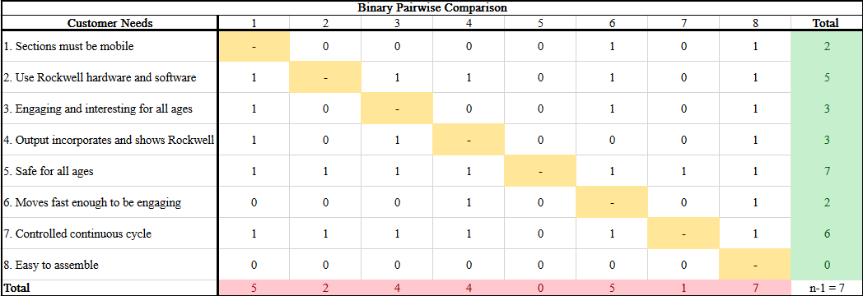
Binary Pairwise Comparison

Slide 66
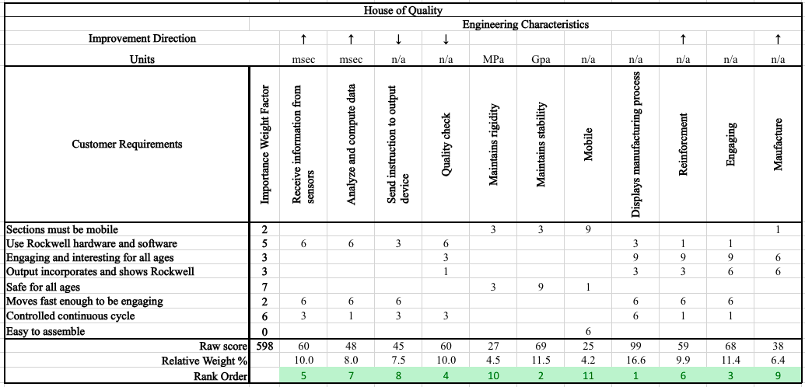
HOQ

Slide 67
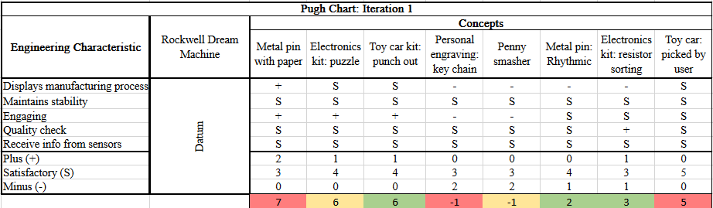
Pugh Chart iteration #1

Slide 68
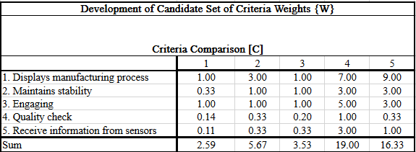
AHP

Slide 69
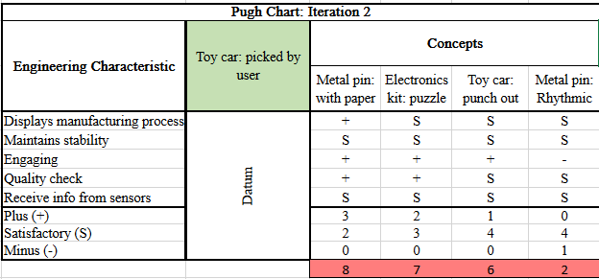
Pugh Chart Iteration #2

Slide 70
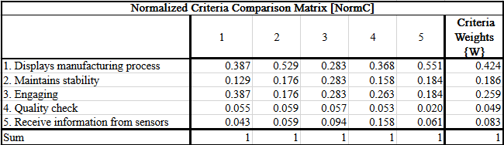
Normalized AHP

Slide 71
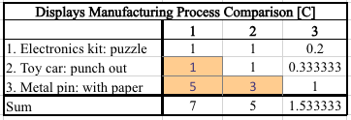
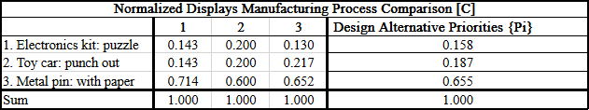
AHP DESIGN ALTERNATIVE - "Displays Manufacturing Process"

Slide 72


AHP DESIGN ALTERNATIVE - "Displays Manufacturing Process"

Slide 73
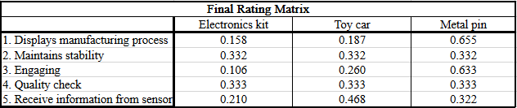
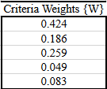
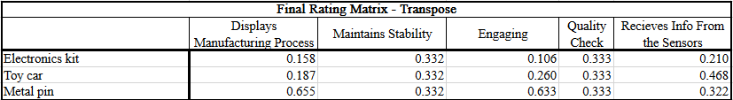

Final Rating Matrix

Slide 74
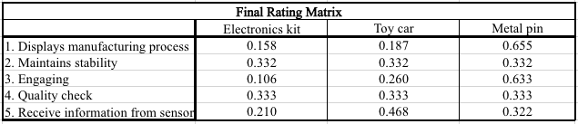

Final Selection

Slide 75
A105
A105
B135 Stage Left
B135 Stage Right
B136
B134, A105
B135

