Slide 1


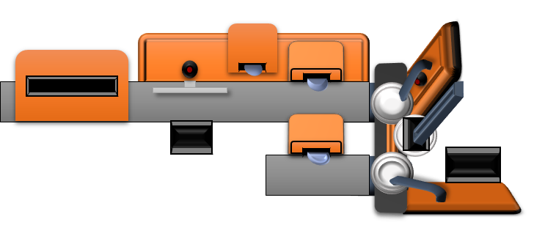



Team 522: Rockwell Automation Manufacturing Device for Students
Luis Garcia, Chloe Keiran, Caleb Mears, Maria Rojas, Caden Schwartz
The objective of this project is to create a system that can demonstrate the automated manufacturing process and create an educational item
Key Goals
Concept Selected
Metal pin with Rockwell branding and personalization
Functional Decomposition
Display the manufacturing process
Provide an educational experience
Distribution of a tangible educational product
ROCKWELL AUTOMATED LEARNING TOOL
CONTROL
SUPPORT
EDUCATE
MANUFACTURE
PIN TOP
PIN BOTTOM
CUSTOM DESIGN
System Design
Customer Needs
Future Work
Under 30 pounds
Use Rockwell hardware/software
Engage all ages
Safe
Product with Rockwell branding
Design Prototype/
System Modeling
Testing Hardware & Software
Final Prototype/ Risk Analysis

Slide 2
