Slide 1

Submersible Vehicle Kit
Team 310
Naval Surface Warfare Center (NSWC) Panama City

Slide 2
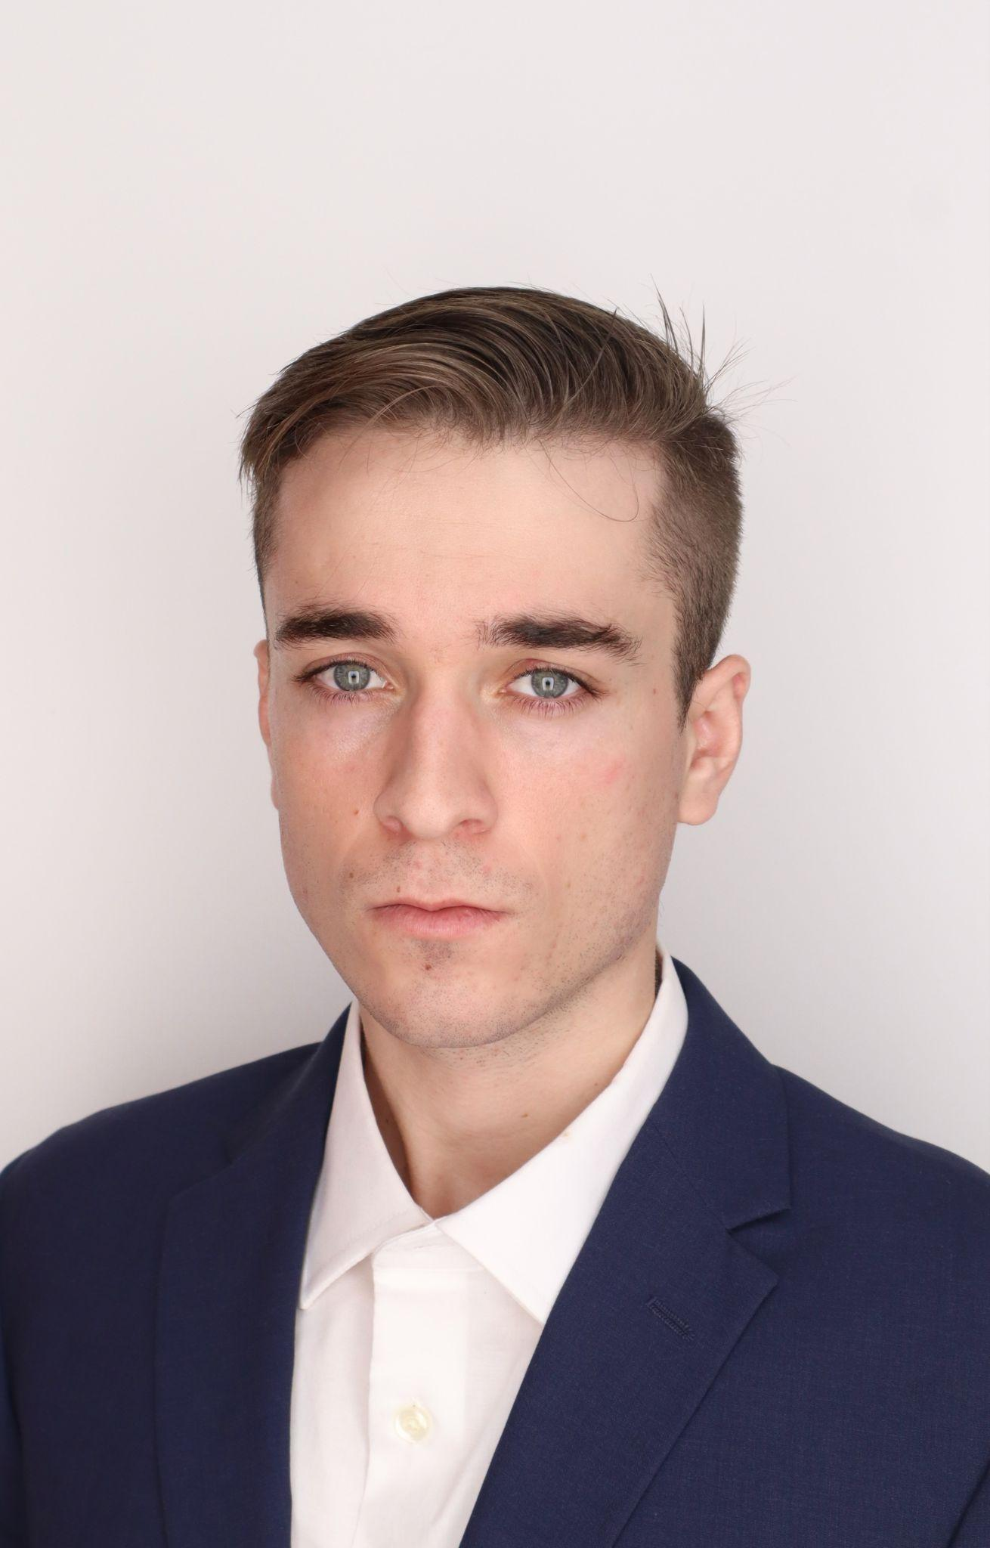
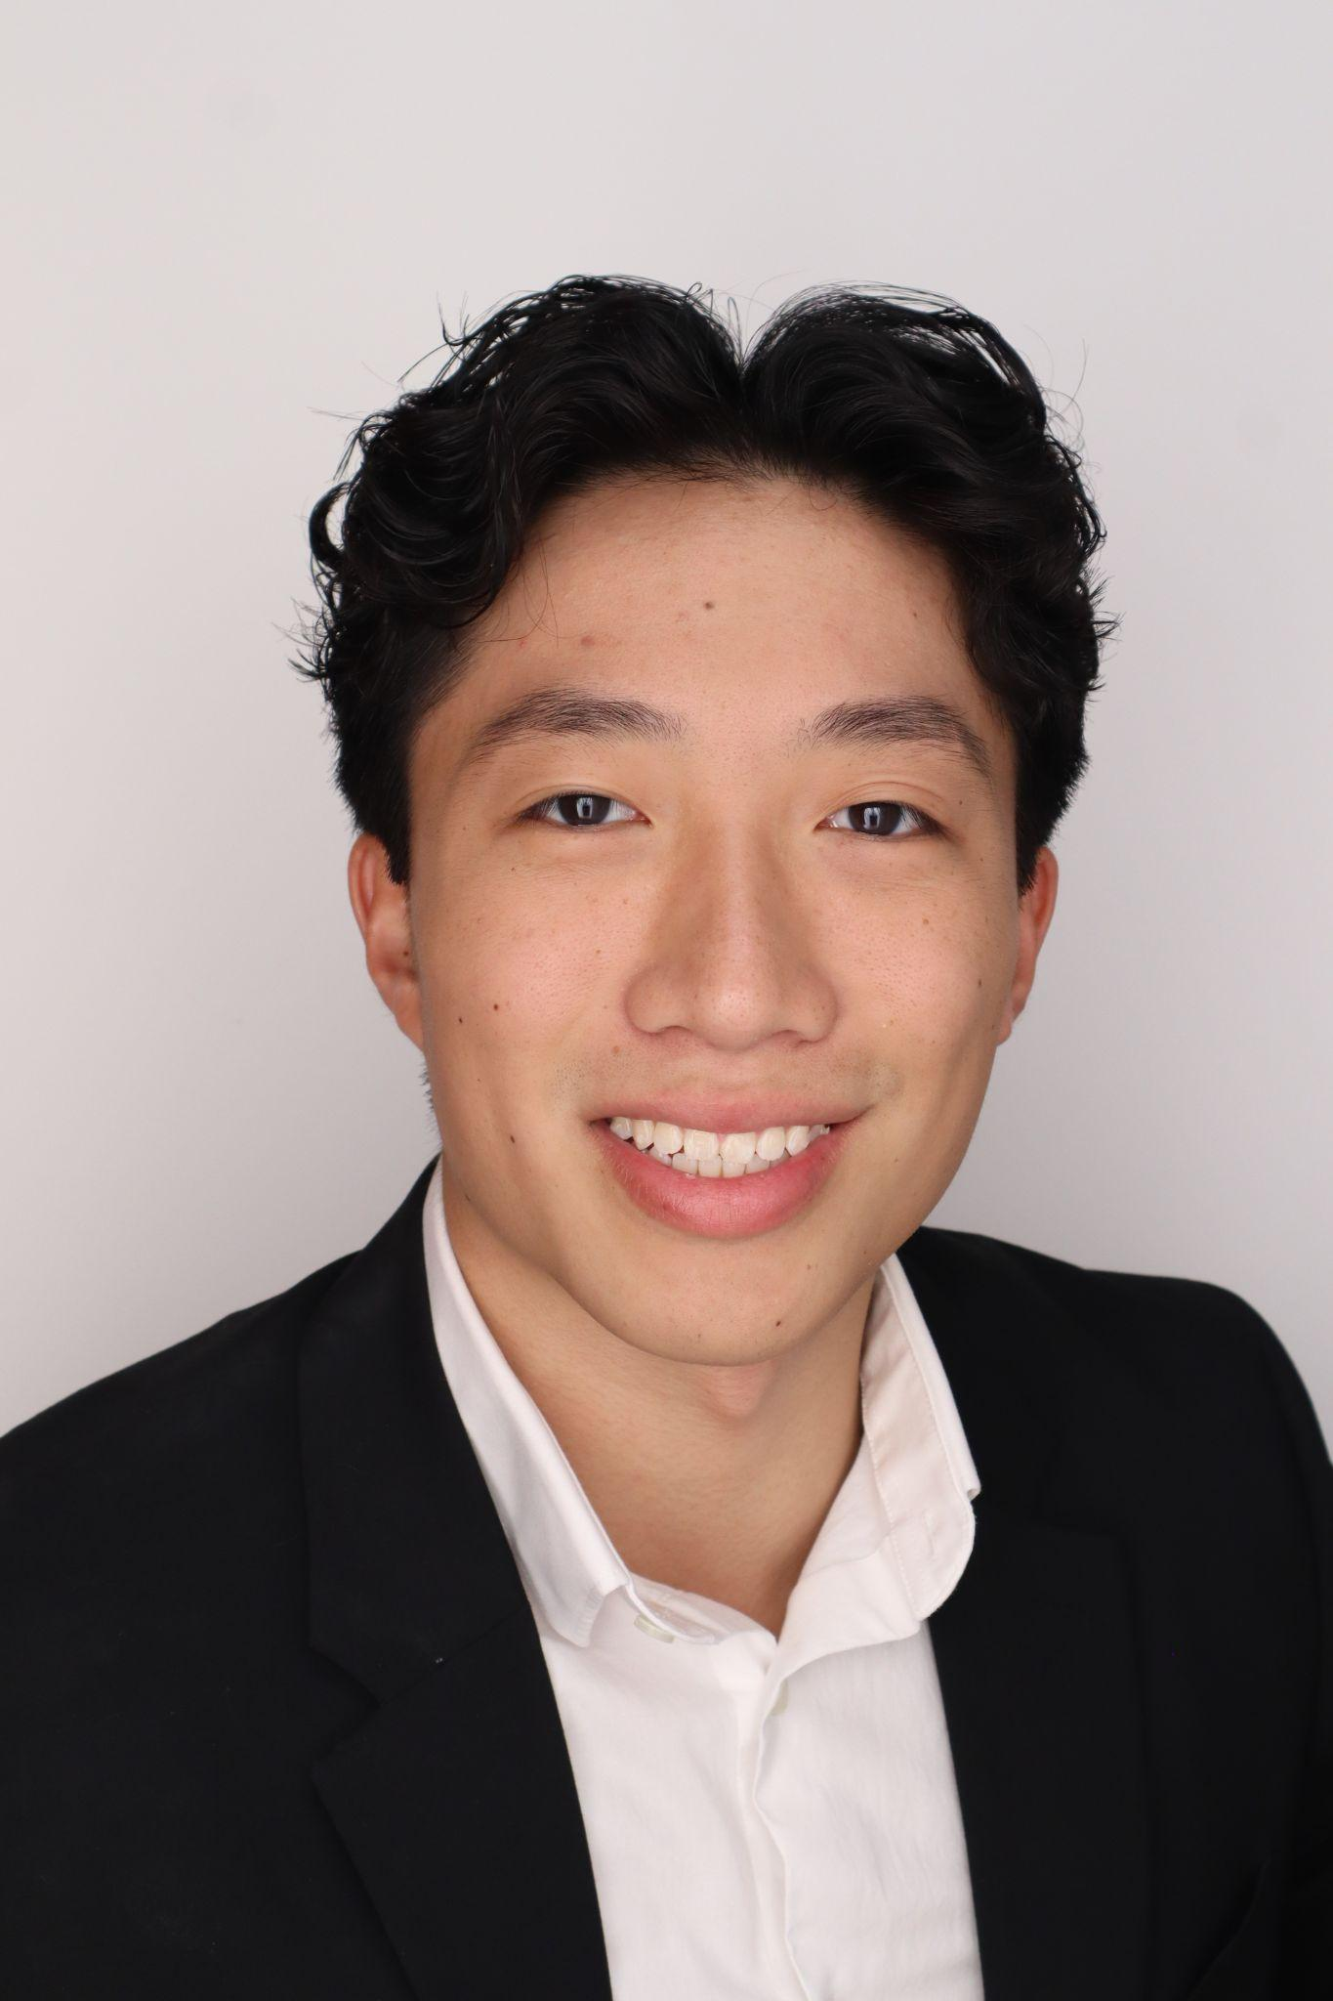
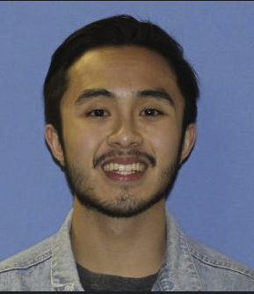
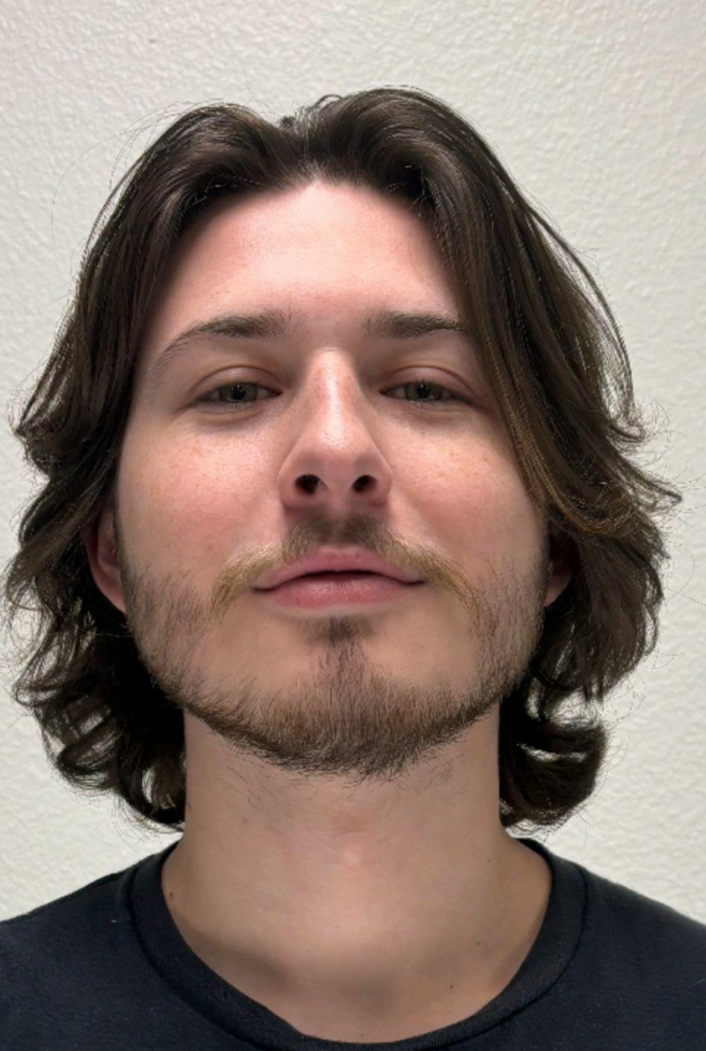

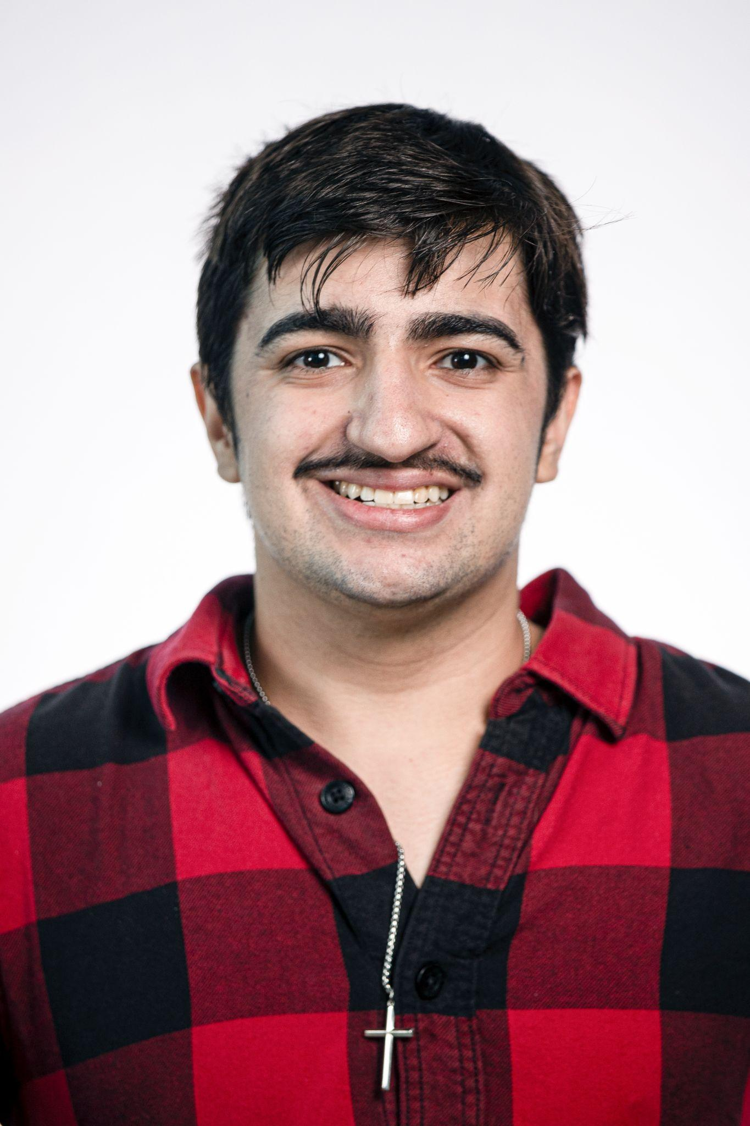
Team Introductions
Riley Lessard
Team Leader
Yili Liu
Lead ME
Kenny Le
Floater #1
Parker Nuzum
Lead ECE
Scott Garner
Floater #2
Justin Llerena
Lead Finance

Slide 3
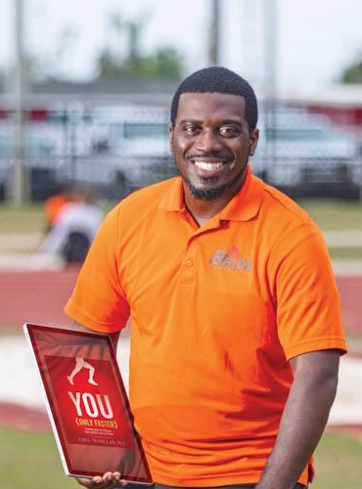
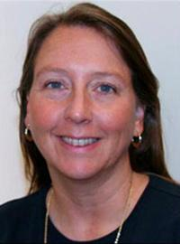
Sponsor and Advisor
Dr. Damion Dunlap
Sponsor, NSWC
Dr. Linda DeBrunner
Advisor, FAMU-FSU COE

Slide 4
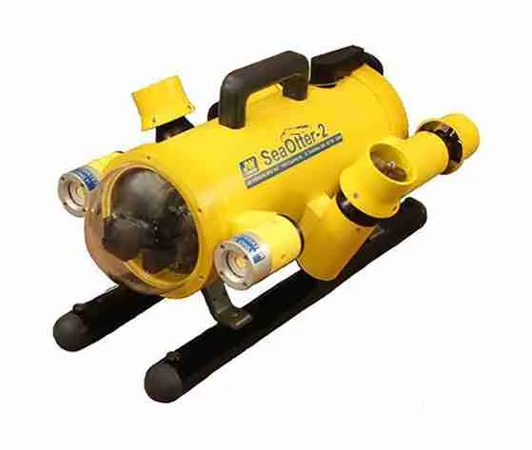
Project Summary
Team 310 has been tasked to design and build a tethered submersible vehicle kit in partnership with NSWC Panama City, Sparkfun Electronics and Experiential Robotics for the purpose of STEM education and outreach, primarily targeting middle and high schoolers.
The design will emphasize affordability and accessibility.
The vehicle is intended to operate in a pool with students will control the vehicle from a top-side control station with a live camera feed from the vehicle assisting in operation and navigation.

Slide 5
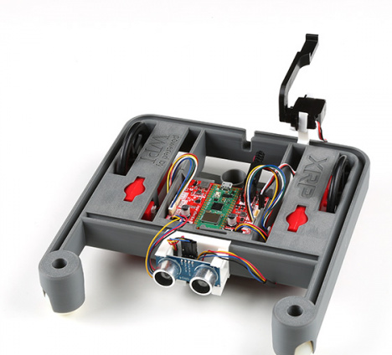
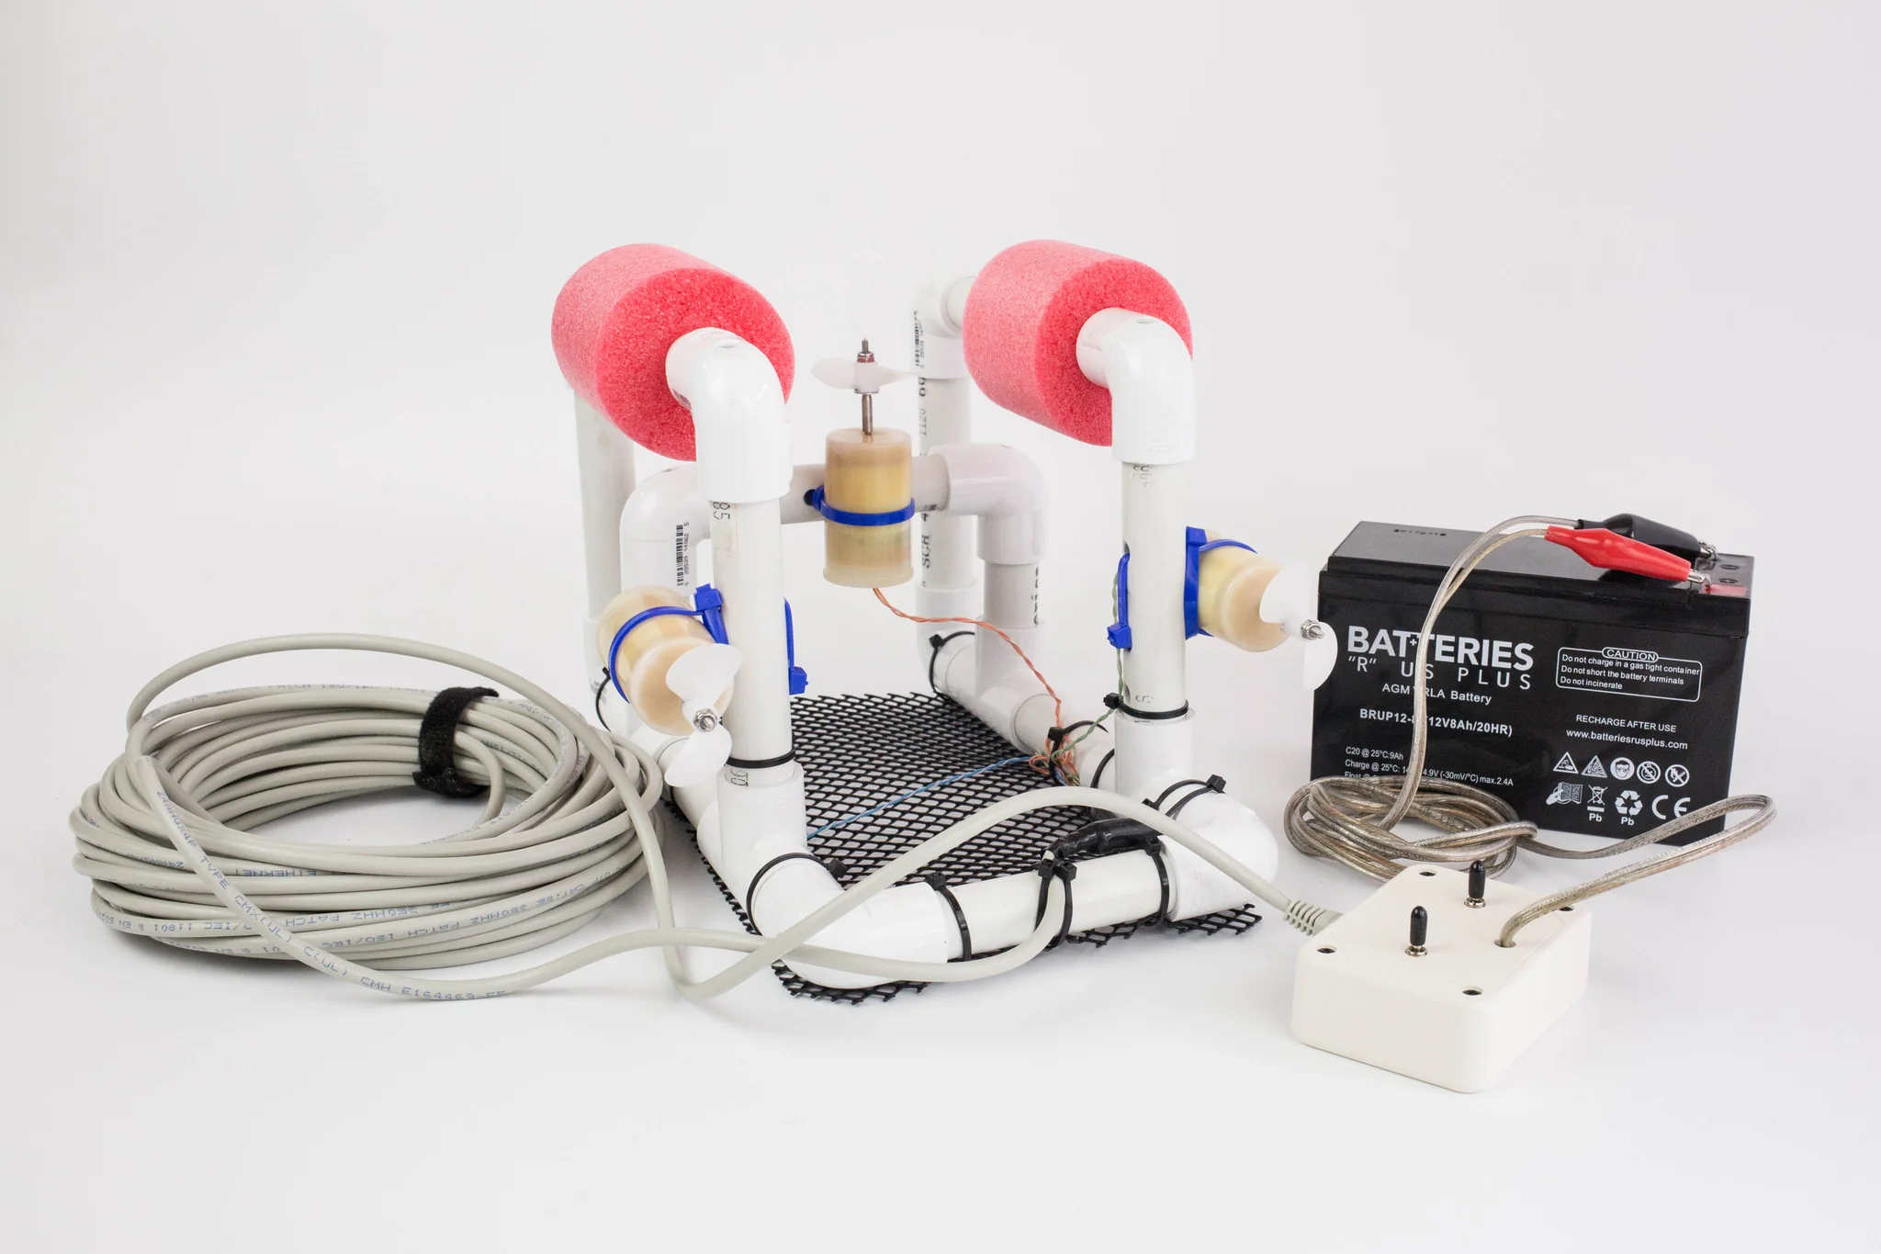
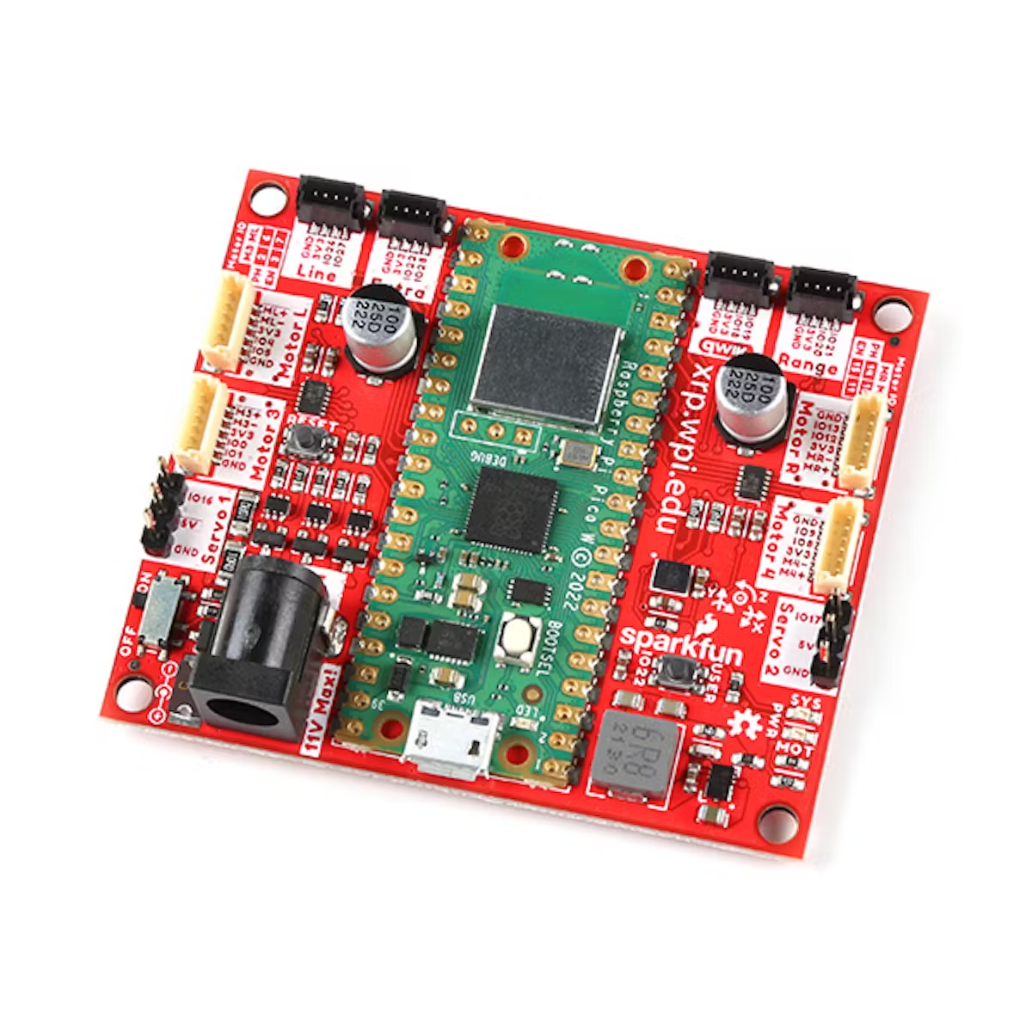
Background
SeaPerch Kit - RoboNation
XRP Kit - Sparkfun Electronics

Slide 6
Project Scope

Slide 7



Assumptions
Primary User Level:
Middle to High School
(6-12th Grade)
Submersible will be operated in freshwater environments.
Submersible will be tethered for power/control signal and retrieval.

Slide 8

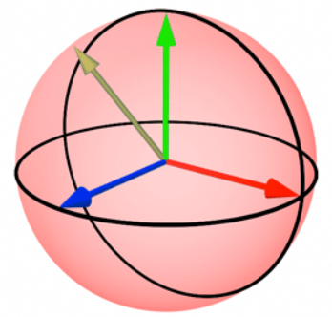



Key Goals
Maintain structural integrity and fully operational at depth of 20 feet.
Depth and heading control, signal supplied through a game controller.
Affordable to students and educational programs.
Cost < $500
Live video feed to control station.

Slide 9
Customer Needs
Affordability & Usability
Affordable Design: Target cost of $500 for middle/high school students.
Ease of Assembly: Designed for simple assembly and tinkering.
Accessible Control Interface: Intuitive control via a game controller.
1
Educational Features
Feedback Control System: Teaches heading and depth stability.
Live Camera Feed: Provides real-time video for navigation.
Tethered Power & Control: Ensures consistent power and control.
XRP Controller Board: Compatible with existing robotics tools.
2
Performance & Durability
Depth Durability: Operates at 20 feet, designed for pool environments.
Speed & Performance: Matches/exceeds SeaPerch kits.
Versatile Design: Adaptable to various pool conditions for effective performance in educational settings.
3
3

Slide 10
Requirements/Needs
Requirements
Interpreted Needs
01
Feedback control System
The submersible shall have feedback control systems for heading and depth stability
02
Live Camera Feed
Shall provide live and HD visual feedback so that users can clearly observe their surroundings underwater
03
Affordable
The kit shall be equal to or under $500
04
Tether Power/Control
The tether shall supply power and control signals
Length shall be at least 50 feet, so it can provide plenty range for underwater exploration
05
Depth Durability
The submersible shall maintain structural integrity within water depths of 20 feet

Slide 11
Targets
Function
Target
01
Thrust Power
Thrusters shall provide quick acceleration and deceleration to allow submersible to reach target speed rapidly
02
Battery/Power
Target of running time to at least 20 minutes, it provides students enough time for their demonstrations
Optimize energy
03
Maintain Center of Mass
When submerged, the submersible shall not roll, pitch, or yaw by more than 5 degrees
This ensure the submersible remains stable and easy to control
04
Maintain Neutral Buoyancy
With a neutral buoyancy it ensures the submersible can hover without any significant vertical drift

Slide 12
Functional Decomposition
Breaks down the submersible vehicle kit into core components and sub-functions.
Clarifies how each part supports overall project goals.

Slide 13
Functional Decomposition
Submersible
Vehicle kit
Provide Power
Control Vehicle
Movement
Capture Live
Camera Feed
Ensure
Durability
User
Interface
Buoyancy

Slide 14
Functional Decomposition
Provide Power
Control Vehicle
Movement
Capture Live
Camera Feed
Manage Batteries
Control
Thrusters
Capture
Video
Transmit to
Control Station
Distribute Power
Regulate
Heading
Regulate
Depth

Slide 15
Functional Decomposition
Ensure
Durability
User
Interface
Buoyancy
Maintain
Watertight
Hull
Map
Controller
Input
Maintain
Neutral
Buoyancy
Withstand Water Pressure
Display
System
Status
Maintain
Center of
Mass

Slide 16
Future Plans
Motor Type
Battery Type
Battery Placement
Housing Type
Tether Type

Slide 17
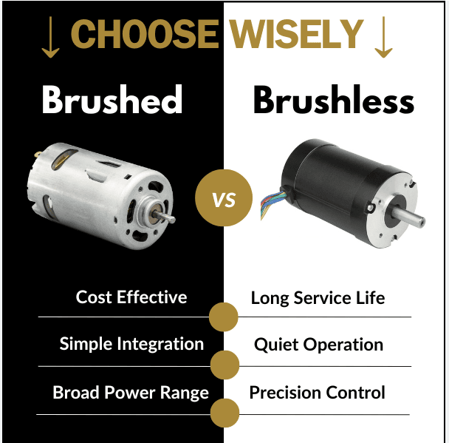
Motor

Slide 18
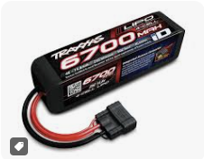
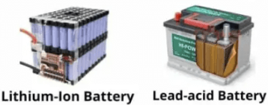
Battery
On board
On Land

Slide 19
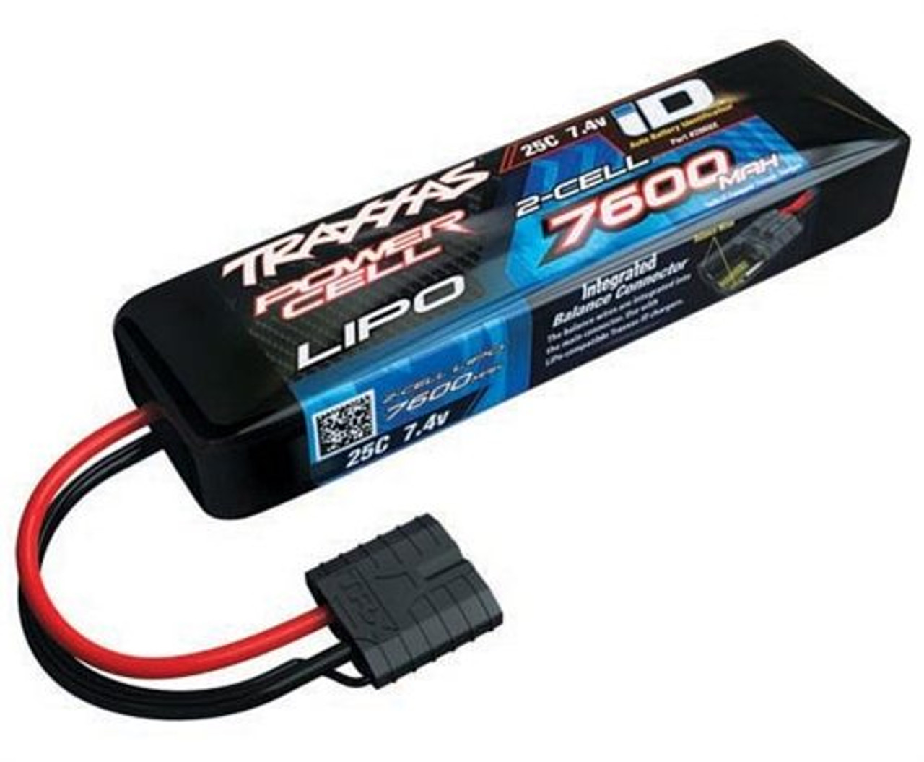
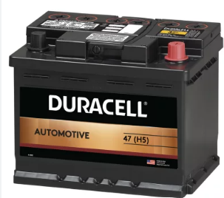
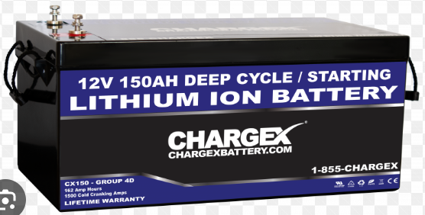
Battery
On board
On Land

Slide 20
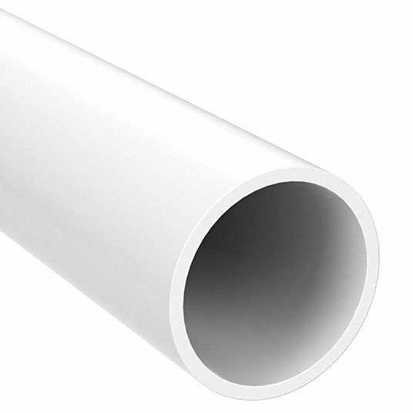

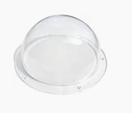
Housing
PVC
Acrylic

Slide 21
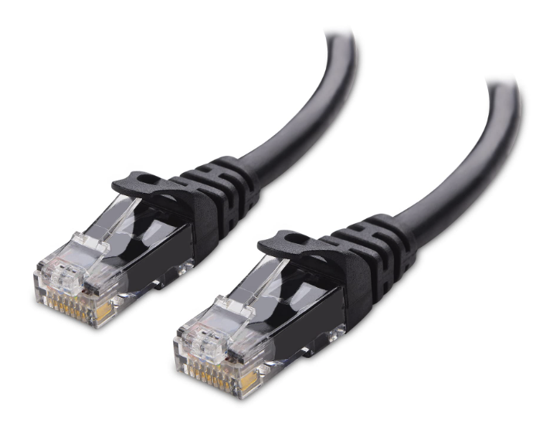
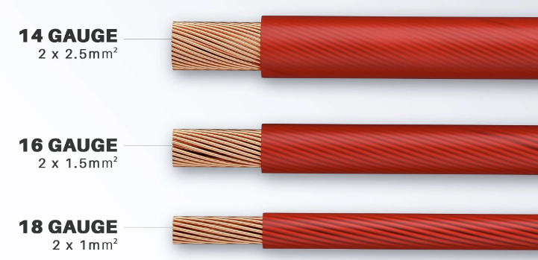
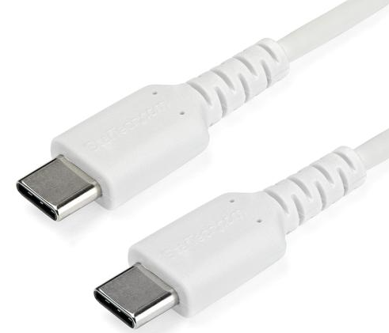
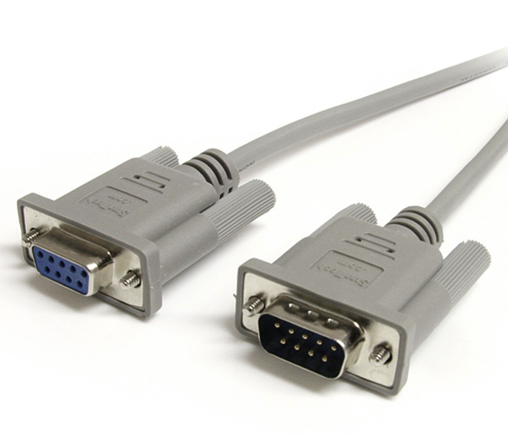
Tether
Ethernet
Power
USB Type-C
Serial

Slide 22
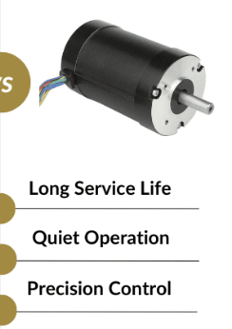
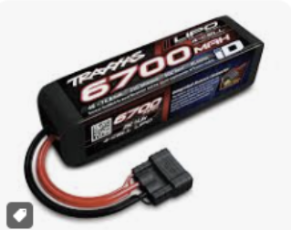
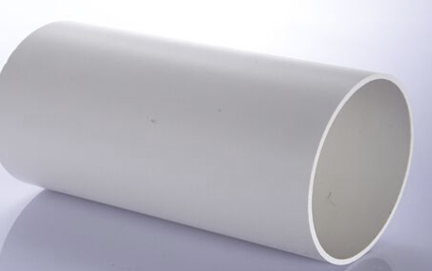
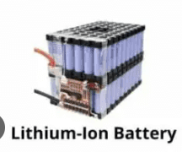
Primary directives
1. Brushless, On Board, LiPo, PVC, Ethernet
2. Brushless, On Land, Lithium Ion, PVC, Ethernet, 14 Gauge Wire

Slide 23
Summary
We covered our key goals, customer needs, requirements, targets, functional decomposition, as well as our future plans. By combining all of our scattered information into this one presentation we have gained a new found understanding as well as confidence in of our senior design objective.

Slide 24
Questions?

Slide 25
Functional Decomposition
Submersible
Vehicle kit
Provide Power
Control Vehicle
Movement
Capture Live
Camera Feed
Ensure
Durability
User
Interface
Buoyancy
Manage Batteries
Control
Thrusters
Capture
Video
Maintain
Watertight
Hull
Map
Controller
Input
Maintain
Neutral
Buoyancy
Distribute Power
Transmit to
Control Station
Withstand Water Pressure
Display
System
Status
Maintain
Center of
Mass
Regulate
Heading
Regulate
Depth

