Slide 1

Submersible Vehicle Kit
Team 310
Naval Surface Warfare Center (NSWC) Panama City

Slide 2


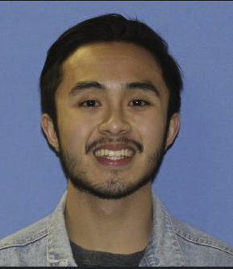
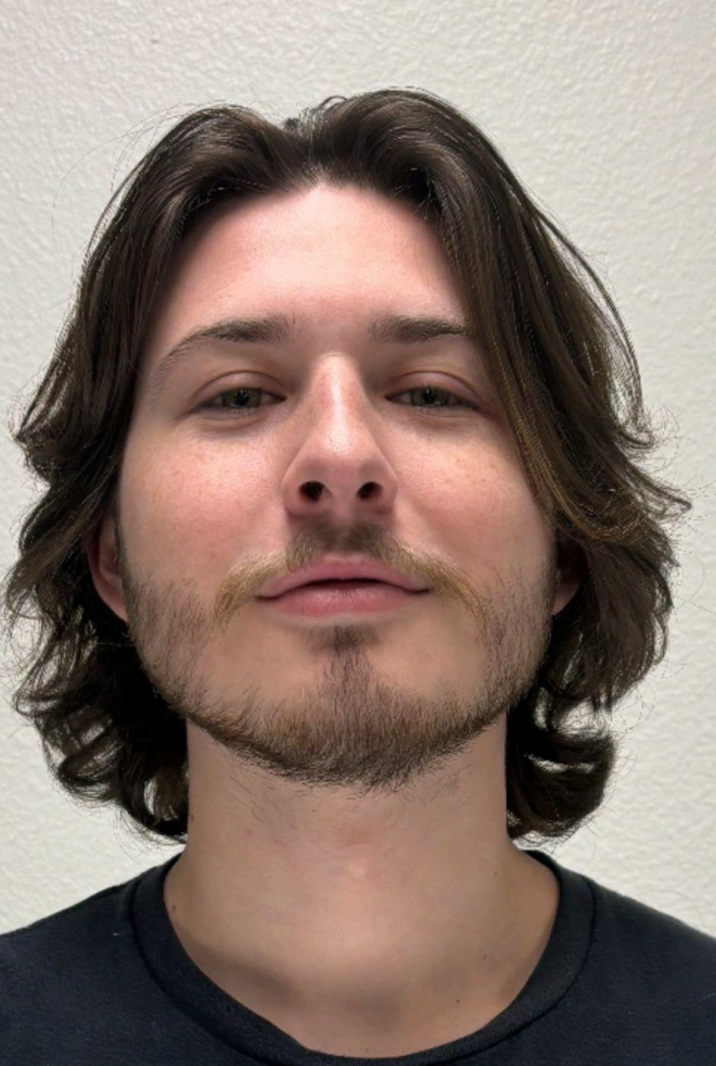


Team Introductions
Riley Lessard
Team Leader
Yili Liu
Lead ME
Kenny Le
Floater #1
Parker Nuzum
Lead ECE
Scott Garner
Floater #2
Justin Llerena
Lead Finance

Slide 3

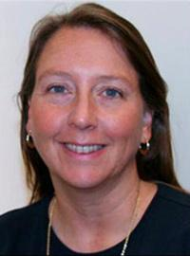
Sponsor and Advisor
Dr. Damion Dunlap
Sponsor, NSWC
Dr. Linda DeBrunner
Advisor, FAMU-FSU COE

Slide 4

Problem Statement
Develop an accessible and affordable submersible vehicle kit for middle and high school students.
Provide a hands-on learning experience focused on underwater robotics.
Demonstrate core principles such as:
Buoyancy control
Stability
Propulsion
Highlight real-world applications in STEM education.
Operate in controlled freshwater environments.
Function effectively at depths up to 20 feet.

Slide 5



Assumptions
Primary User Level:
Middle to High School
(6-12th Grade)
Submersible will be operated in pool environments.
Submersible will be tethered for power/control signal and retrieval.

Slide 6

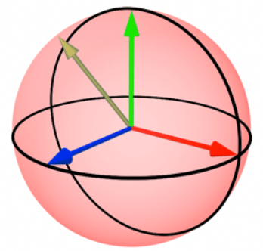



Key Goals
Maintain structural integrity and be fully operational at depth of 20 feet.
Depth and heading control, signal supplied through a game controller.
Affordable to students and educational programs.
Cost < $500
Live video feed to control station.

Slide 7
Customer Needs
Lowest Priority
Chlorine Resistant Materials: Materials must be chlorine proof.
Modular Assembly: Submersible kit must be modular, allowing easy adjustment of buoyancy and center of gravity
Feedback Control System: Teaches heading and depth stability.
1
Medium Priority
Affordable Design: Target cost of $500 for middle/high school students.
Accessible Control Interface: Intuitive on land control station. Accessible via a game controller.
Tethered Power & Control: Ensures consistent power and control.
XRP Controller Board: Compatible with existing robotics tools.
2
Highest Priority
Depth Durability: Operates at 20 feet, designed for pool environments.
Speed & Performance: Matches/exceeds SeaPerch kits.
Live Camera Feed: Provides real-time video in 1080p for navigation
3
3

Slide 8
Concept Generation
Three High Fidelity Concepts
100 Concepts
100 Concepts
Five Medium Fidelity Concepts
Scott Garner ‹#›

Slide 9
Medium Fidelity
Tetra-Prop Drive
Cylindrical Hull
4 Propellers mounted at 45 degree angles from longitudinal center axis.
Modular Hull
Two piece hull, one for camera and one for propulsion.
4 Propellers, two rearward facing and two upright.
Trimaran-Style
Central hull with two small outriggers for stability.
Outriggers have propellers mounted rearward.
Central hull has upright propellers for depth control.
Fish Propeller
Fish shaped hull.
Oscillating fin for propulsion.
Control surfaces for heading control.
Vertical propellers for depth control.
Dual-Chamber
Cube shaped hull divided into two compartments.
One for electronics and propulsion.
One for buoyancy control through ballast tanks.
Standard propellor setup.

Slide 10
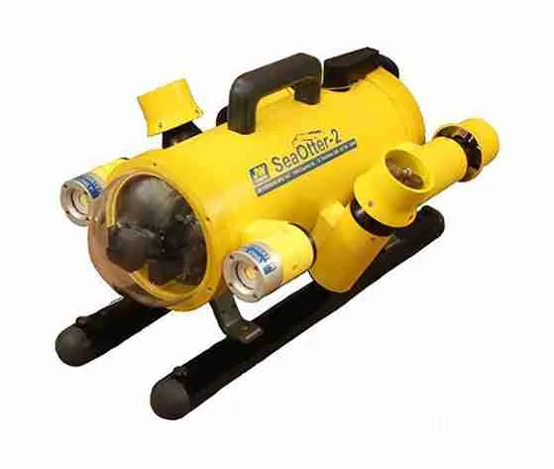
Design One (PVC Hull)
PVC pipe for hull.
Sealed acrylic dome at front.
Camera inside providing live feed.
Two weighted cylinders on the left and right.
balancing + buoyancy control.
Two rearward facing thrusters on left and right.
forwards and backwards movement along with rotation.
Two thrusters facing downward at 45 degree angle from center axis.
Ascent and descent motion control.
50 ft tether going through the rear of the body.
Threaded cap.
Epoxy for waterproofing.
Controller board inside body.
Control propellers.
Communication through tether.

Slide 11
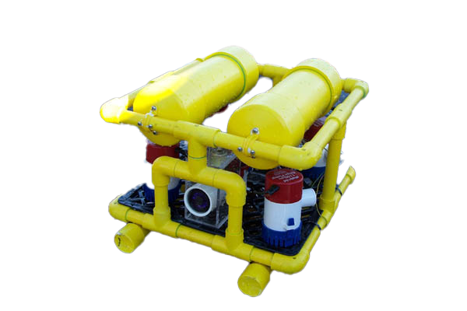
Design Two (PVC Frame)
Cube shaped PVC frame.
Floats on top.
Weights on bottom.
Components mounted externally.
Waterproof ROV thrusters.
Mounted vertically on the four corners.
Movement - (Typical quadcopter drone).
Components mounted internally.
Waterproof camera mount.
Live feed.
Controller board in a small watertight box.
50 ft tether.
Attached to the microcontroller box.
Power - (14 AWG speaker wire)(Lead acid-battery)
Communication - (ethernet)(Pc)
Game controller
Input.

Slide 12
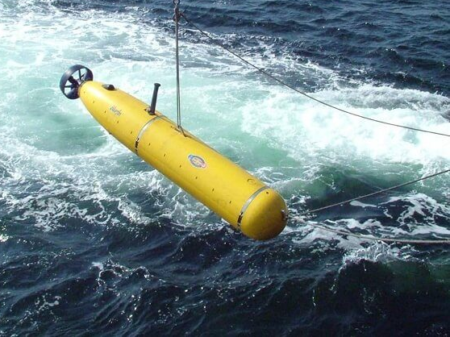
Design Three (Submarine Style)
PVC pipe for hull.
Sealed acrylic dome at front.
Camera inside providing live feed.
Single motor and propeller mounted at the rear.
Forward and backwards movement.
Internal weights.
Slight positive buoyancy.
Bow planes/Diving planes.
Heading and depth control.
Requires forward motion.
Actuated using servos within the body.
Sealed LiPo battery.
Onboard and accessible through watertight hatch.
Microcontroller mounted inside watertight hull.
100 ft tether.
Communication (Ethernet).

Slide 13
Concept Selection

Slide 14
Concept Selection (HOQ)
Customer Need | Functional Requirement | Relative Weight
Speed and Performance | Exceed performance of Sea Perch Kit | 12.9
Depth Durability | Sustained operational ability at 20 feet. | 12.1
Live Camera Feed | HD camera providing feedback. | 11.4
Accessible Control Interface | On land control station with intuitive user interface and game controller for input. | 11.1
Tethered Power and Control | Tether with power and control signal from control station to submersible. | 9.8

Slide 15
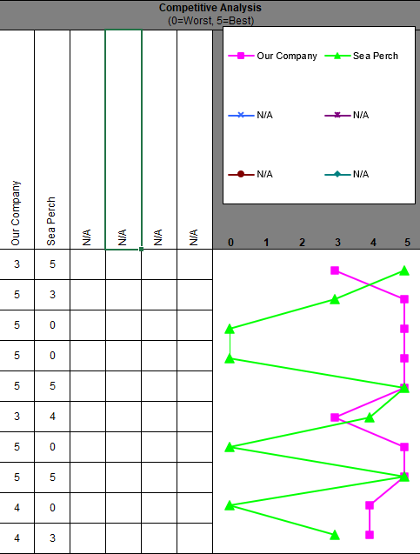
House of Quality Results
Order of importance: 10 - 2 - 4 - 9 - 5 - 7 - 1 - 8 - 3 - 6
Based on calculated technical weight/importance.

Slide 16
Pairwise Comparison
 | Cost | Durability | Ease of Assembly | Weight | Performance | Buoyancy
Cost | 1 | 0.778 | 1 | 2.333 | 0.778 | 1
Durability | 1.286 | 1 | 1.286 | 3 | 1 | 1.286
Ease of Assembly | 1 | 0.778 | 1 | 2.333 | 0.778 | 1
Weight | 0.429 | 0.333 | 0.429 | 1 | 0.333 | 0.429
Performance | 1.286 | 1 | 1.286 | 3 | 1 | 1.286
Buoyancy Control | 1 | 0.778 | 1 | 2.333 | 0.778 | 1
Using the following comparison: 1 = equally important, 3 =
moderate, 5 = strong, 7 = very strong, and 9 = extreme.
Reciprocal values (1/3, 1/5, etc.) are used when the second criterion is more important than the first.

Slide 17
Pairwise Comparison
Criteria | Weight
Cost | 0.1667
Durability | 0.2143
Ease of Assembly | 0.1667
Weight | 0.0714
Performance | 0.2143
Buoyancy Control | 0.1667

Slide 18
Analytical Hierarchy Process
 | Cost | Durability | Ease of Assembly | Weight | Performance | Buoyancy
PVC Hull | 0.6369 | 0.7306 | 0.6369 | 0.1104 | 0.6491 | 0.6369
PVC Frame | 0.2582 | 0.1883 | 0.2582 | 0.5665 | 0.2789 | 0.2582
Submarine Style | 0.1047 | 0.0809 | 0.1047 | 0.3229 | 0.0719 | 0.1047
Criteria Weight | 0.1667 | 0.2143 | 0.1667 | 0.0714 | 0.2143 | 0.1667
Concept | Alternative Value
PVC Hull | 0.420
PVC Frame | 0.340
Submarine Style | 0.240

Slide 19
Preliminary Design

Slide 20
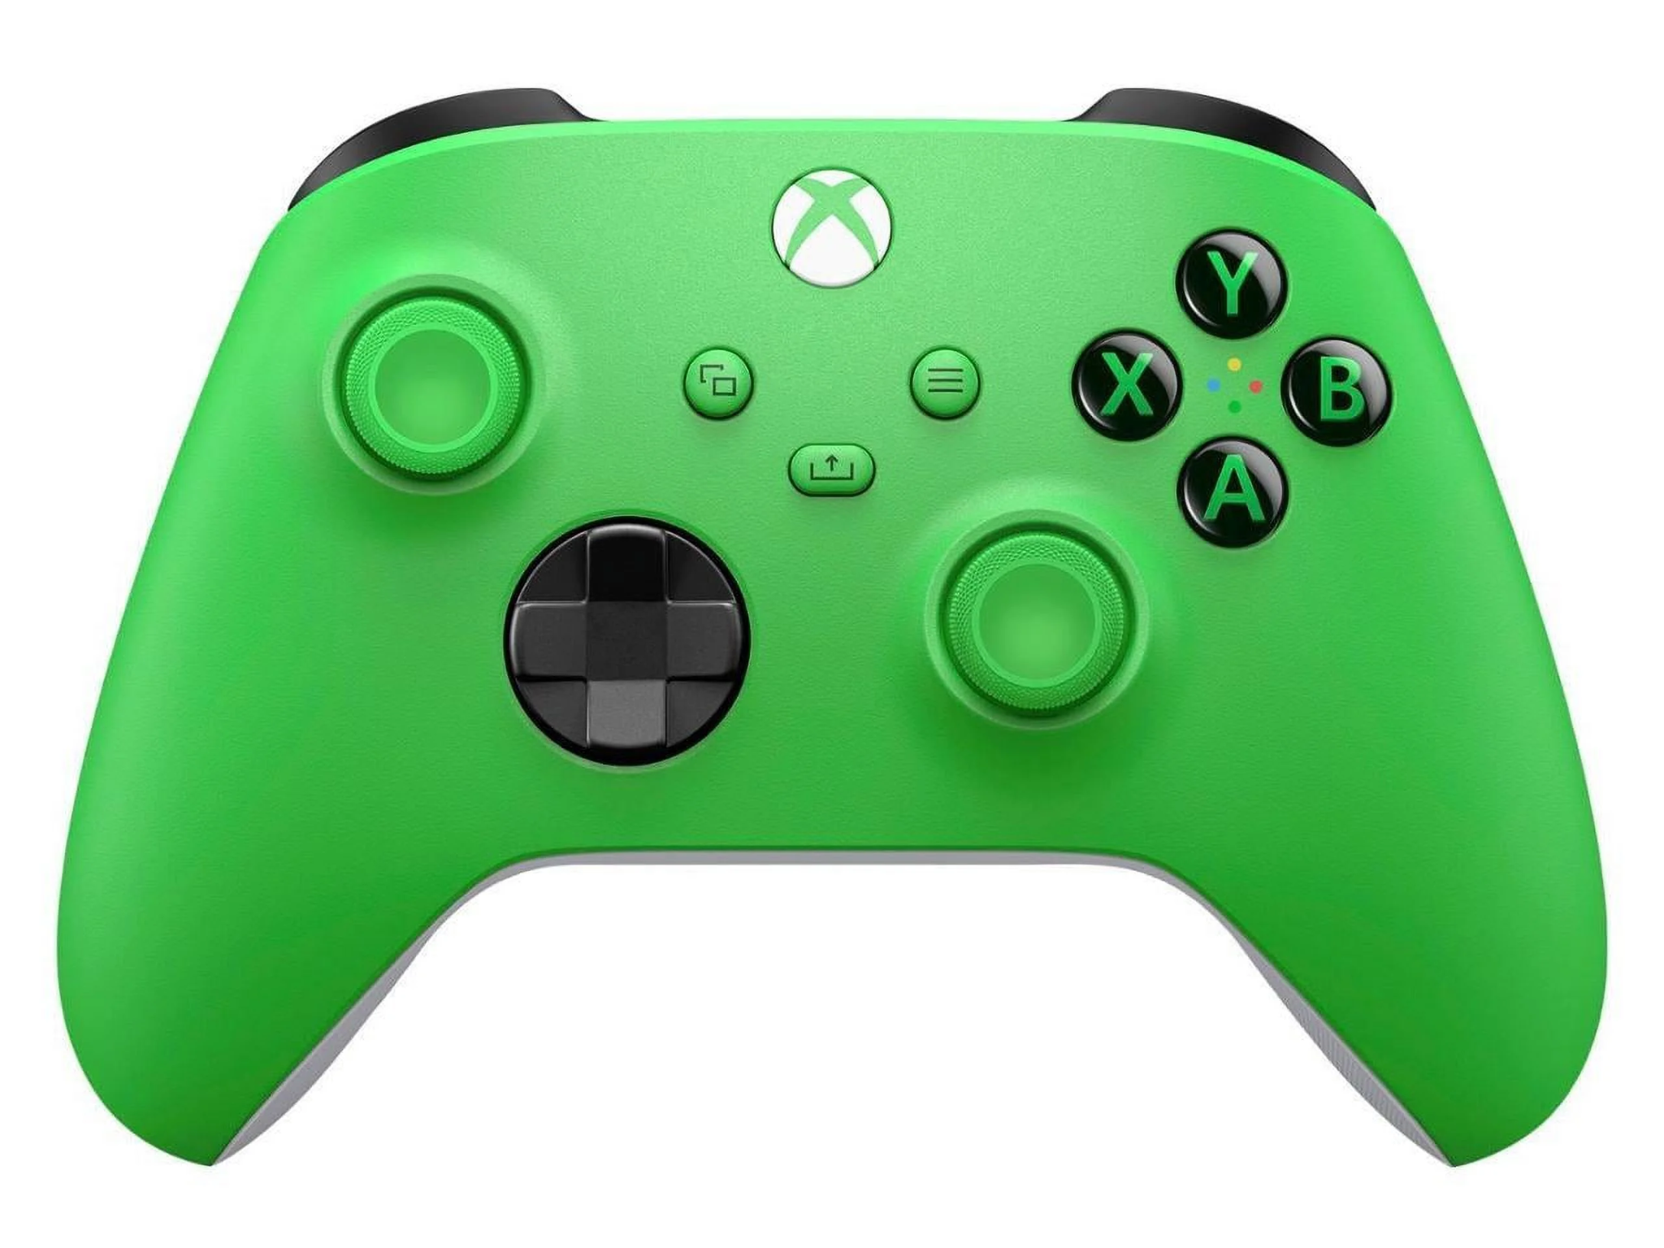
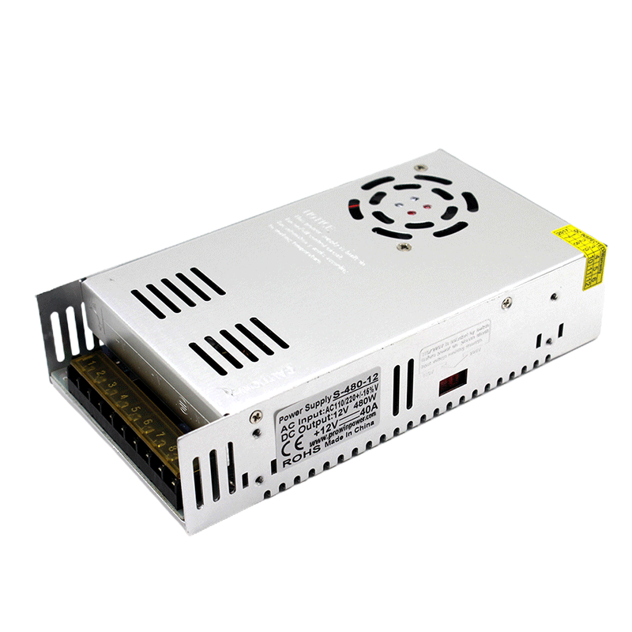
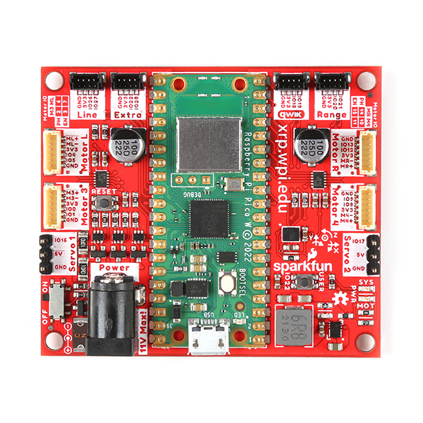
Component List
Game Controller - Xbox One Controller
PC - Windows Laptop
DC Power Supply - 24V 33A 880 Watts
Tether - 40 ft, 14/2 Romex & CAT 6 Ethernet
XRP Controller Board - SparkFun

Slide 21
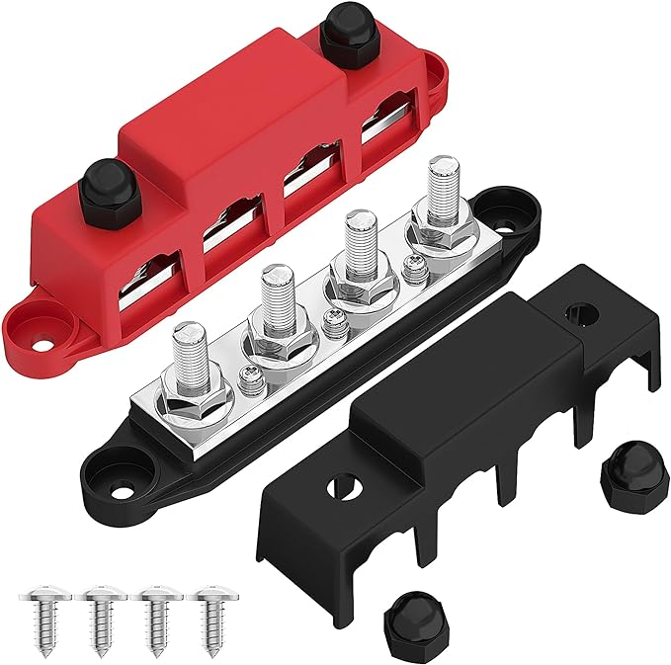
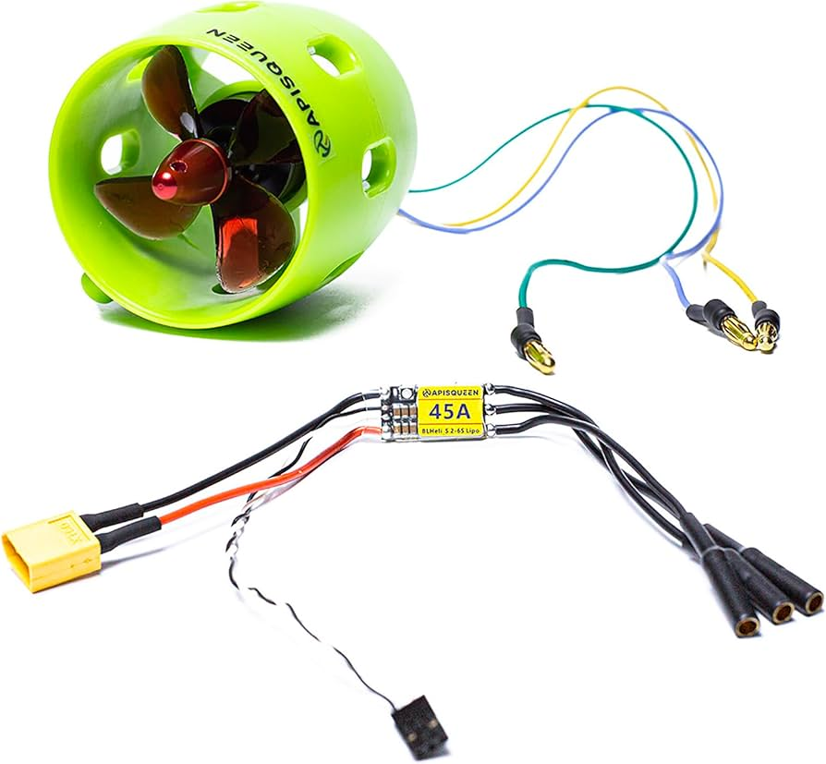
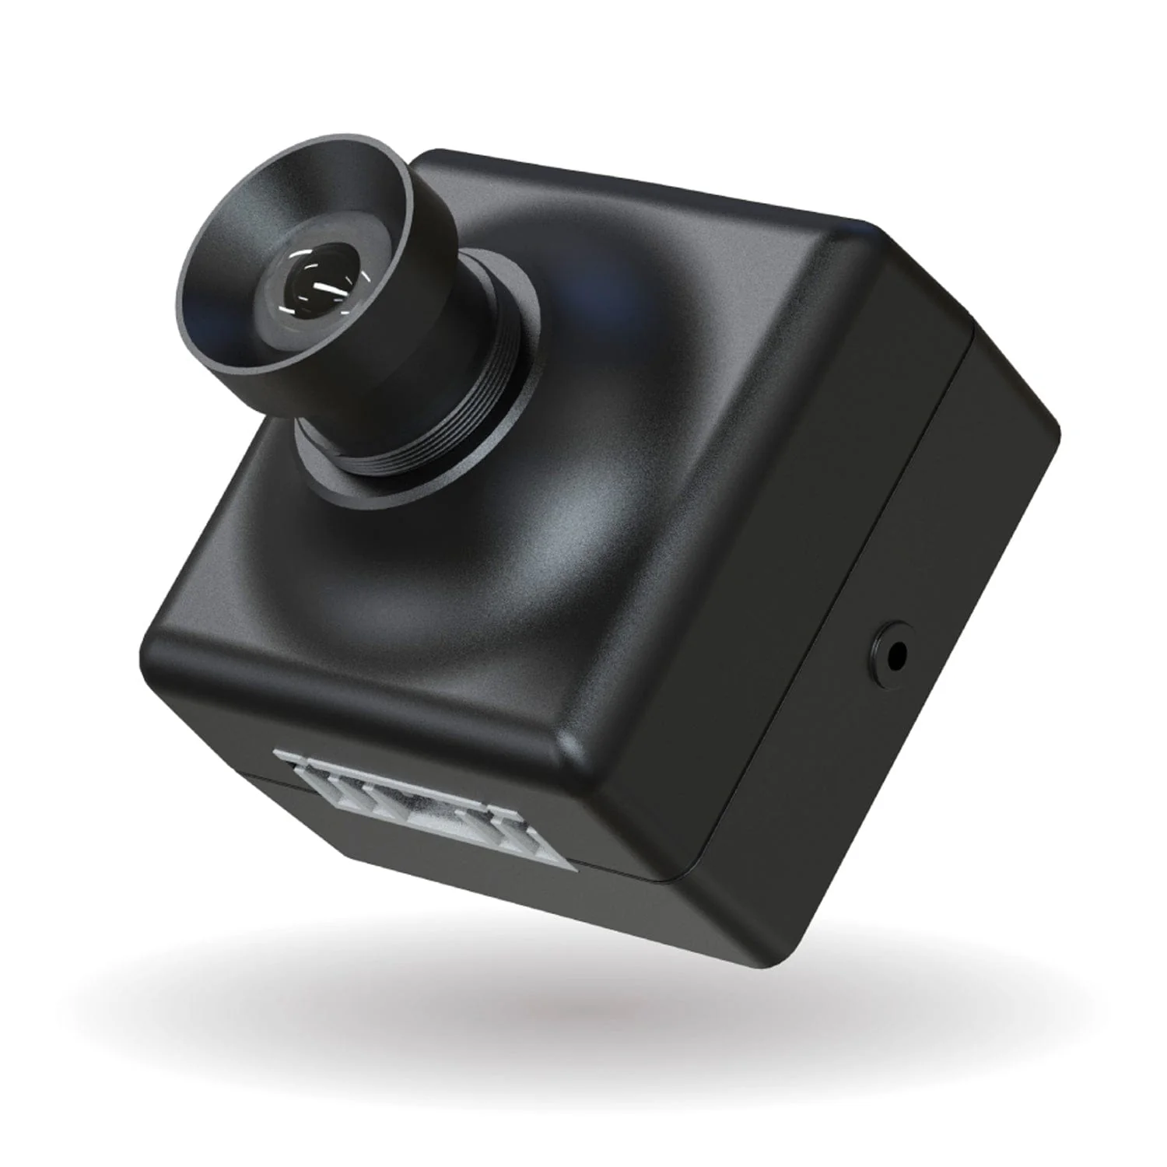
Component List (Continued)
Power Distribution Block / Rectifier.
LED Lights
Thrusters x4 - Apisqueen U01 Brushless Thrusters & ESCs
PVC Body / Ballast Skids
Camera - SPI Camera

Slide 22
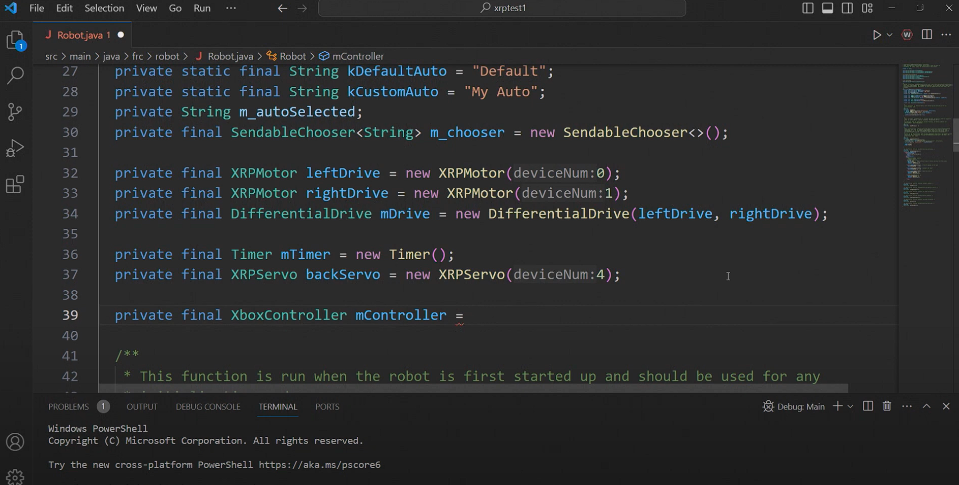
Software
WPI Visual Studio Code Overview:
Integrated Development Environment
Supports C++ and Java
Includes WPILib extension for robotics programming

Slide 23
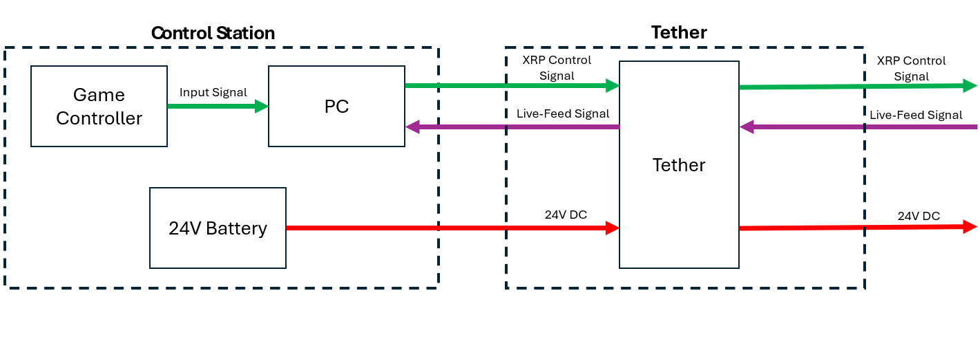
Preliminary Design

Slide 24
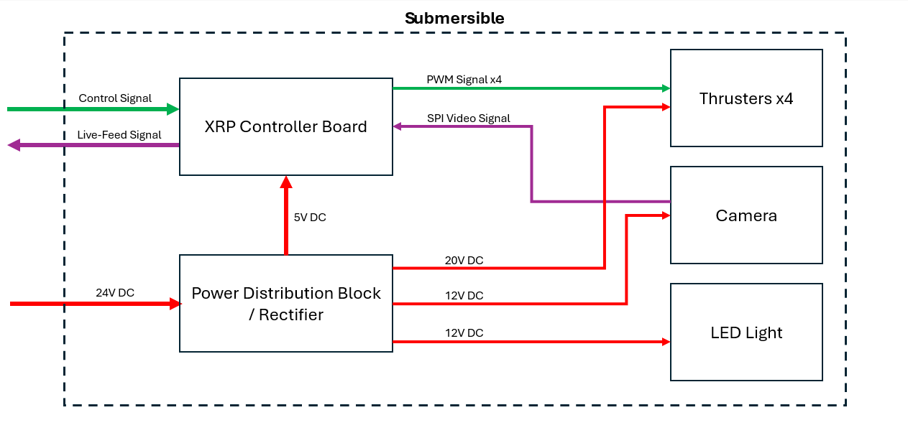
Preliminary Design

Slide 25
Preliminary Design
The block diagram above shows the interactions of each component in the submersible vehicle system. Each box represents an individual component with the arrows connecting them representing inputs and outputs of each component. The block diagram closely mirrors our functional decomposition but focuses on component interaction rather than functions. One change from our functional decomposition is the addition of an LED light to be used for illumination while the vehicle is submerged.

Slide 26





Future Works
Create bill of materials.
Meet with Advisor and Sponer.
Create working test bench.
Begin prototyping.
Create spring semester plan.

Slide 27
Questions?

Slide 28
Component List
Game Controller - Xbox One Controller.
Input: User.
Output: Serial Signal.
PC - Windows Laptop.
Input: Serial Signal From Game Controller, Video-Feed Signal.
Output: XRP Control Signal.
24 Volt DC Battery - Lead-Acid Marine Battery (60Ah).
Output: 24V DC.
Tether - 100 ft, 12 Gauge Speaker Wire / CAT 5.
Input: 24V DC Power, XRP Control Signal, Video-Feed Signal.
Output: 24V DC Power, XRP Control Signal, Video-Feed Signal.
XRP Controller Board
Input: XRP Control Signal, SPI Video Signal.
Output: PWM Signal x4, USB 1.1 (Video-Feed Signal).

Slide 29
Component List (Continued)
Power Distribution Block / Rectifier.
Input: 24V DC Power.
Output: 20V, 12V, and 5V DC Power.
Thrusters x4 - Apisqueen U01 Brushless Thruster & ESC.
Input: 20V DC Power, PWM Signal.
Output: Thrust.
Camera - SPI Camera.
Input: 12V DC Power.
Output: SPI Video Signal.
LED Light.
Input: 12V DC Power.
Output: Light.

Slide 30
Project Summary
Team 310 has been tasked to design and build a tethered submersible vehicle kit in partnership with NSWC Panama City, Sparkfun Electronics and Experiential Robotics for the purpose of STEM education and outreach, primarily targeting middle and high schoolers.
The design will emphasize affordability and accessibility.
The vehicle is intended to operate in a pool with students will control the vehicle from a top-side control station with a live camera feed from the vehicle assisting in operation and navigation.

Slide 31
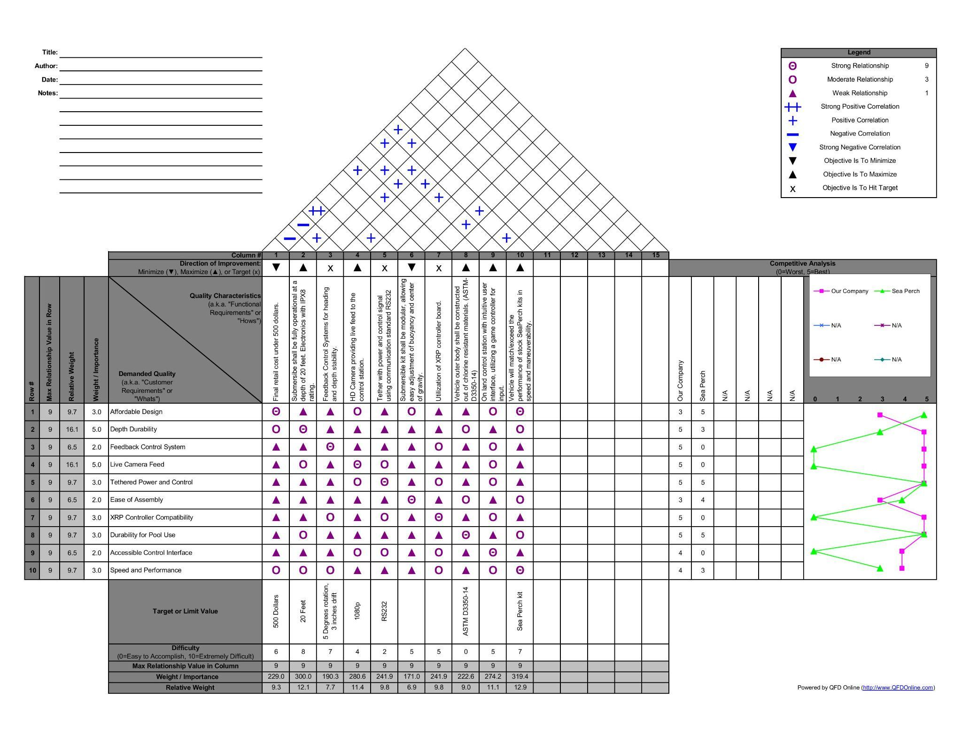
Concept Selection (HOQ)

Slide 32
Pairwise Comparison
Criteria | Cost | Durability | Ease of Assembly | Weight | Performance | Buoyancy Control
Cost | 0.200 | 0.167 | 0.200 | 0.156 | 0.167 | 0.200
Durability | 0.257 | 0.214 | 0.257 | 0.200 | 0.214 | 0.257
Ease of Assembly | 0.200 | 0.167 | 0.200 | 0.156 | 0.167 | 0.200
Weight | 0.086 | 0.071 | 0.086 | 0.067 | 0.071 | 0.086
Performance | 0.257 | 0.214 | 0.257 | 0.200 | 0.214 | 0.257
Buoyancy Control | 0.200 | 0.167 | 0.200 | 0.156 | 0.167 | 0.200

