Slide 1
Fluid Power Vehicle Challenge – T506
Design Review 1
Ethan Mercado and Gabriel Vazquez
October 17th, 2024

Slide 2
Team 506: Introductions
Gabriel Vazquez
Adonay Almanza- Enriquez
Controls Engineer
Daniel Garmendia
Quality Engineer
Gabriel Vazquez
Design Engineer
Trace Flowers Modeling & Simulation Engineer
Ethan Mercado
Systems Engineer

Slide 3
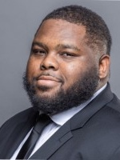
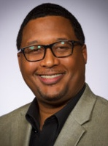
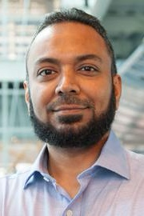
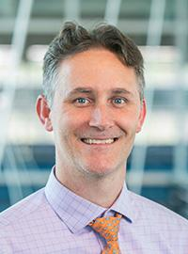
Sponsors and Advisors
Gabriel Vazquez
Hakeem Rhodes
Dow Sponsor
Marcus Rideaux
Dow Sponsor
Mohd Yousuf Ali, Ph.D. FAMU-FSU College of Engineering Advisor
Dr. Shayne McConomy
FAMU-FSU College of Engineering Advisor

Slide 4
Objective
Gabriel Vazquez
The objective of the project is to design a fluid-powered vehicle with the aim of competing in the competition organized by the NFPA (National Fluid power Association)

Slide 5
Markets
Gabriel Vazquez
National Fluid Power Association
Education
Retail

Slide 6
Key Goals
Gabriel Vazquez
Meet the requirements and safety guidelines of the challenge
Complete all the races and place first in at least one award category
Produce comprehensive documentation for future team’s success

Slide 7
Challenges
Gabriel Vazquez
Sprint Race
Endurance Race
Efficiency Race

Slide 8
Assumptions
Gabriel Vazquez
Hydraulic Fluid Provided
Favorable Weather
Optimal Environment
Able-Bodied Operator
Designed For Competition Only

Slide 9
Vehicle Requirements
Gabriel Vazquez
Use of Hydraulics
Energy Storage Device
Two Pressure Indicators
Regenerative Braking
Maximum weight of 210 pounds

Slide 10
Disqualifications
Ethan Mercado
Insufficient Braking
Lack of Stability
Poor Visibility
Dangerous Protrusions & Design Features
Zero Tolerance for Active Leaks
Unsportsmanlike Conduct

Slide 11
Scoring
Ethan Mercado
Midway Review & Final Presentation
Regenerative Braking
FPVC Mentorship
15
4
15
3
Sprint Race
1st - 3 pts
2nd - 2 pts
3rd - 1 pt
Efficiency Race
1st - 3 pts
2nd - 2 pts
3rd - 1 pt
Endurance Race
1st - 3 pts
2nd - 2 pts
3rd - 1 pt
3
3
3
3

Slide 12
Functional Hierarchy Chart
Ethan Mercado
Vehicle
Frame
Fasten components
Stability
Human Packaging
Power
Hydraulic
Regenerative Braking
Human
Foot Pedaling
Pumping
Motion
Accelerate
Brake
Turn
Mechatronics
User interface
Display Information
User Inputs
User Independent
Receive Inputs
Interpret Data
Prepare Data
Transmit Data
Perform Action
Storing Pressure
Energy Storage
Power Electronics
Suspension

Slide 13
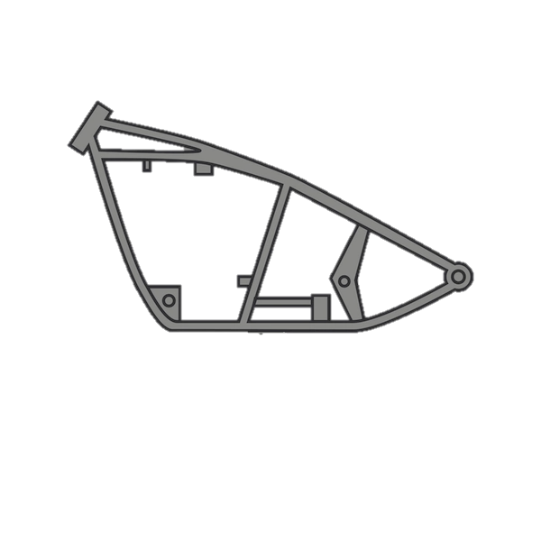
Subsystems
Ethan Mercado
Frame
Motion
Power
Mechatronics

Slide 14
Frame and Motion Functions
Ethan Mercado
Frame
Motion
Fasten components
Stabilization
Human Packaging
Brake
Turn
Accelerate

Slide 15
Power Functions
Ethan Mercado
Power
Hydraulic
Human
Regenerative Braking
Storing Pressure
Pumping
Foot Pedaling

Slide 16
Mechatronics Functions
Ethan Mercado
Mechatronics
Energy Storage
User interface
User Independent
Receive Inputs
Power Electronics
User Inputs
Display Information
Prepare Data
Interpret Data
Transmit Data
Perform Action

Slide 17
Future Work
Ethan Mercado
Simulations and Calculations
Order Parts
Present
12/1
Design Selection
Parts Selection

Slide 18
References
Ethan Mercado
​OpenAI. (2024). ChatGPT (October 2024 version). Retrieved from [Large language model]: https://chat.openai.com/
Oquendo_Chandler, M., Luken, D., Von Hoene, J., Kohli, B., Stathis, E., & King, C. (2018). University of Cincinnatic NFPA Fluid Power Vehicle Challenge Project Report. Retrieved from Scholar@UC: https://scholar.uc.edu/downloads/j6731412w?locale=en
Pluta, M., Geragthy, S., Kaas, J., & McCarthy, J. (2024). 2025 NFPA Fluid Power Vehicle Challenge: Overview, Rules, and Awards. National Fluid Power Association. Retrieved from NFPA Foundation: https://nfpafoundation.org/wp-content/uploads/2024/08/2025-FPVC-Overview- Rules-and-Awards-v.4.pdf
Torrey, J., Trujillo, A., Londono, K., & Chan, B. (2019). Fluid Power Vehicle Challenge: Final Design Review. California Polytechnic State University. Retrieved from Digital Commons Cal Poly: https://digitalcommons.calpoly.edu/cgi/viewcontent.cgi?article=1597&context=mesp
Widmann, J., Gray, M., D'amour, R., Lopez, A. A., Ferrandino, C., & Dietz, J. (2024). Cal Poly Fluid Power Vehicle Challenge Final Design Review. California Polytechnic State University. Retrieved from Digital Commons Cal Poly: https://digitalcommons.calpoly.edu/cgi/viewcontent.cgi?article=1853&context=mesp

Slide 19
Inspiring Quote
Ethan Mercado
“Just as hydraulics transforms pressure into power, so too can we harness our challenges to elevate ourselves beyond the limits of possibility”
-ChatGPT

