Slide 1
Fluid Power Vehicle Challenge – T506
Design Review 2
November 21st, 2024

Slide 2
Team 506: Introductions
Daniel Garmendia
Adonay Almanza- Enriquez
Controls Engineer
Daniel Garmendia
Quality Engineer
Gabriel Vazquez
Design Engineer
Trace Flowers Modeling & Simulation Engineer
Presenter
Ethan Mercado
Systems Engineer
Presenter
Presenter

Slide 3
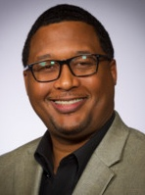
Sponsors and Advisors
Daniel Garmendia
Hakeem Rhodes
Dow Sponsor
Marcus Rideaux
Dow Sponsor
Mohd Yousuf Ali, Ph.D. FAMU-FSU College of Engineering Advisor
Dr. Shayne McConomy
FAMU-FSU College of Engineering Advisor

Slide 4
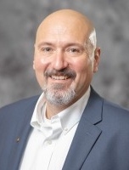
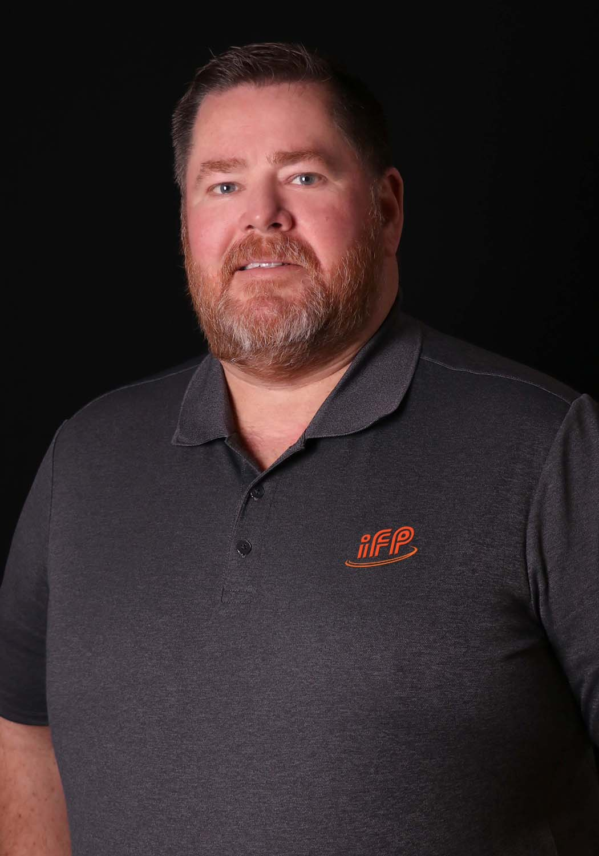
Competition Mentors
Daniel Garmendia
Cory Fisher
Sun Hydraulics
Dean EberHardt
IFP Motion Solutions

Slide 5
Objective
Daniel Garmendia
The objective of the project is to design a fluid-powered vehicle with the aim of competing in the competition organized by the NFPA (National Fluid power Association)

Slide 6
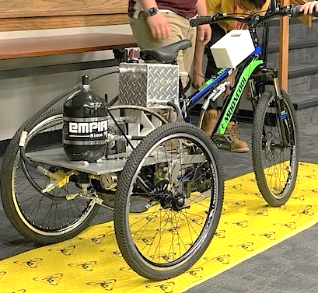
Background
Daniel Garmendia
Brakes
Single-Rider
Reservoir
Accumulator
Pressure Gauge
Arizona State University

Slide 7
Scoring and Awards
Daniel Garmendia
Midway Review & Final Presentation
Sprint Race
Efficiency Race
Endurance Race
FPVC Mentorship
Regenerative Braking
15
9
7
12 Award Categories
Total Cash Prizes: $12500

Slide 8
Breakdown of Awards
Daniel Garmendia
Pneumatics: $1000
Design: $1000
Electronics: $1000
Races: $4500
Workmanship: $1000
Presentations: $2000
Teamwork: $1000
Safety: $1000
Notes:
Pnuematics: $1000
Electronics: $1000
Judges Choice: design: $1000
Judges Choice: Safety $1000
Judges Choice: Workmanship: $1000
Judges Choice: Teamwork: $1000
Midway/Final review: 1000$ each
Each Race: 1st $750 2nd $500 3rd $250

Slide 9
Functional Hierarchy Chart
Daniel Garmendia
Vehicle
Frame
Fasten components
Stability
Human Packaging
Power
Hydraulic
Regenerative Braking
Human
Foot Pedaling
Pumping
Motion
Accelerate
Brake
Turn
Mechatronics
User interface
Display Information
User Inputs
User Independent
Receive Inputs
Interpret Data
Prepare Data
Transmit Data
Perform Action
Storing Pressure
Energy Storage
Power Electronics
Suspension

Slide 10
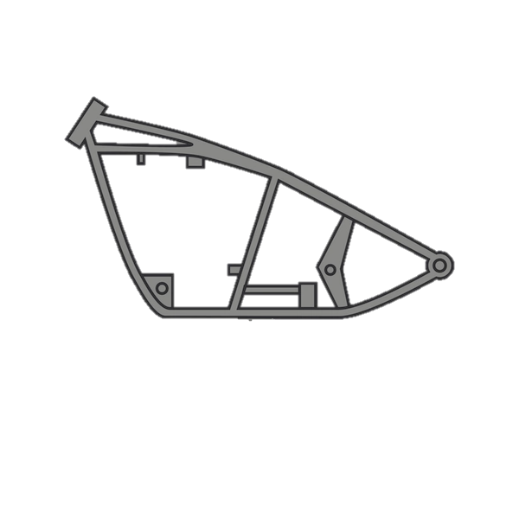
Functional Decomposition
Daniel Garmendia
Frame
Motion
Power
Mechatronics

Slide 11
Power Functions
Daniel Garmendia
Power
Hydraulic
Human
Regenerative Braking
Storing Pressure
Pumping
Foot Pedaling

Slide 12
Hydraulic Diagrams
Trace Flowers
Pump
Gauge
Motor
Normally Open Solenoid Valve
Check Valve
Accumulator
Test Point
Flow Control Valve
Normally Closed Solenoid Valve
Pressure Relief Valve
Reservoir

Slide 13
Trace Flowers
Direct Drive
Pump
Check Valve
Control Valve (N.O)
Motor

Slide 14
Trace Flowers
Stationary Charging Mode
Pump
Check Valve
Control Valve (N.C.)
Accumulator

Slide 15
Trace Flowers
Discharge Mode
Accumulator
Control Valve (N.C.)
Control Valve (N.O)
Motor

Slide 16
Trace Flowers
Discharge Mode Boost
Accumulator
Check Valve
Control Valve (N.C.)
Motor

Slide 17
Check Valve
Trace Flowers
Regenerative Breaking
Check Valve
Motor
Control Valve (N.C.)
Accumulator

Slide 18
Trace Flowers
Pressure Release
Accumulator
Flow Control Valve

Slide 19
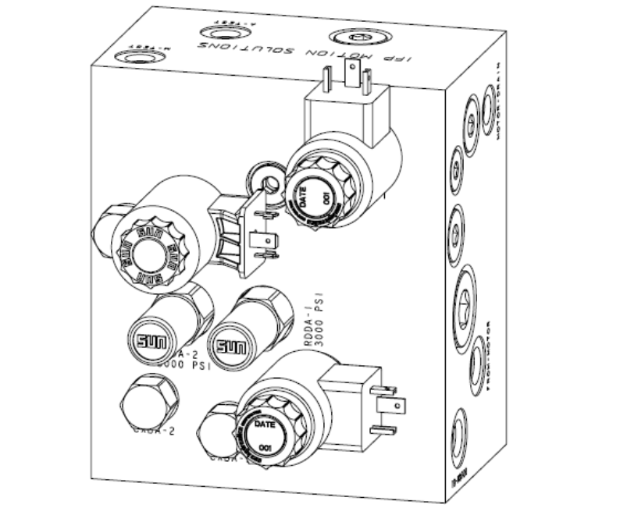
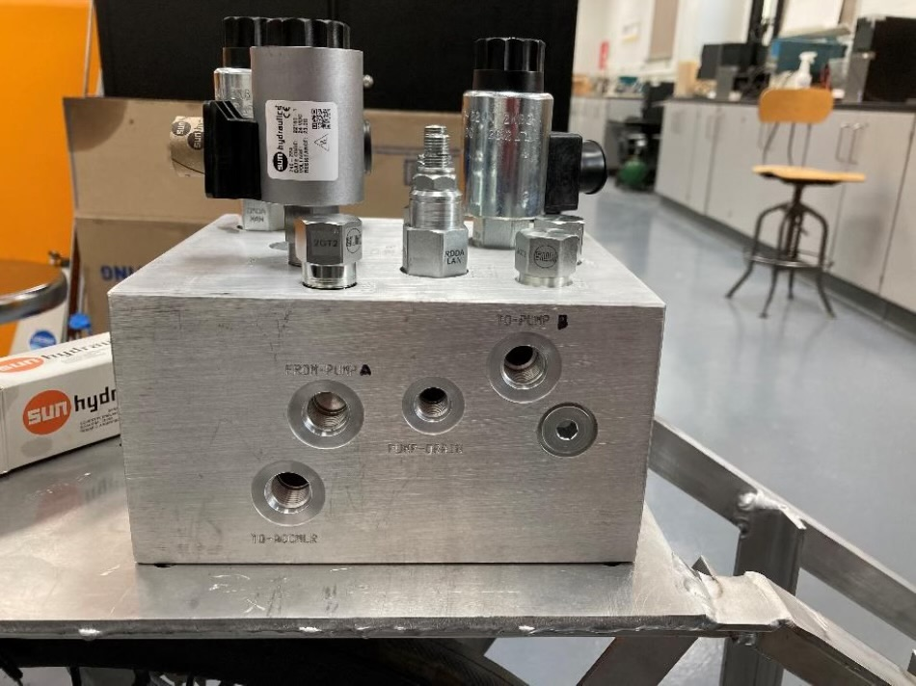
Trace Flowers
Manifold

Slide 20
Race Targets and Metrics
Adonay Almanza
Sprint Race
Endurance Race
Efficiency Race
Time < 30 [Seconds]
Distance > 2000 [Feet]
Efficiency > 20 [%]

Slide 21
Critical Targets and Metrics
Adonay Almanza
Storing Pressure
Acceleration
Vehicle Weight
Pressure > 2750 [psi]
Time < 13.5 [Seconds]
Weight < 150 [lbs]

Slide 22
Concept Generation
Adonay Almanza
Morphological Chart
Brainstorming
Crap-Shoot
100 Concepts

Slide 23
Concept Selection
Adonay Almanza
Binary Pairwise Matrix
House of Quality
Pugh Chart
Analytical Hierarchy
Process

Slide 24
Final Concepts
Adonay Almanza
Make a Custom Frame
Use a Three-Speed Transmission
Purchase a Frame

Slide 25
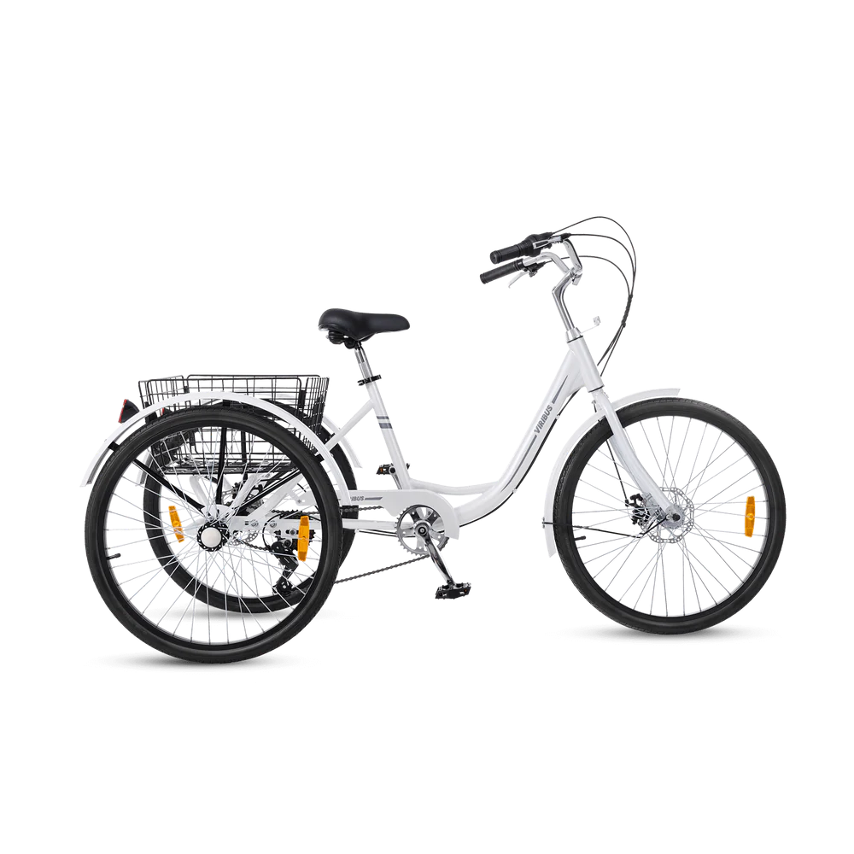
Final Selection
Adonay Almanza
Saves Time
Purchased Frame
Stable Foundation
Ample Room

Slide 26
Future Work
Adonay Almanza
Part Selection
Travel to Sun Hydraulics in Sarasota
Present
12/1
1/9
1/31
Calculations and Simulations for Design
Order Parts
FPVC
Midway Review

Slide 27
Questions
Adonay Almanza
Adonay Almanza
Trace Flowers
Daniel Garmendia
Ethan Mercado
Gabriel Vazquez

Slide 28
References
Adonay Almanza
​Andrews, E., Moore, C., Sobel, A., Towne,B. (2023). Akron, Ohio, Capstone Projects Final Report.
OpenAI. (2024). ChatGPT (October 2024 version). Retrieved from [Large language model]: https://chat.openai.com/
Oquendo Chandler, M., Luken, D., Von Hoene, J., Kohli, B., Stathis, E., & King, C. (2018). University of Cincinnatic NFPA Fluid Power Vehicle Challenge Project Report. Retrieved from Scholar@UC: https://scholar.uc.edu/downloads/j6731412w?locale=en
Pluta, M., Geragthy, S., Kaas, J., & McCarthy, J. (2024). 2025 NFPA Fluid Power Vehicle Challenge: Overview, Rules, and Awards. National Fluid Power Association. Retrieved from NFPA Foundation: https://nfpafoundation.org/wp-content/uploads/2024/08/2025-FPVC-Overview- Rules-and-Awards-v.4.pdf
Torrey, J., Trujillo, A., Londono, K., & Chan, B. (2019). Fluid Power Vehicle Challenge: Final Design Review. California Polytechnic State University. Retrieved from Digital Commons Cal Poly: https://digitalcommons.calpoly.edu/cgi/viewcontent.cgi?article=1597&context=mesp
Widmann, J., Gray, M., D'amour, R., Lopez, A. A., Ferrandino, C., & Dietz, J. (2024). Cal Poly Fluid Power Vehicle Challenge Final Design Review. California Polytechnic State University. Retrieved from Digital Commons Cal Poly: https://digitalcommons.calpoly.edu/cgi/viewcontent.cgi?article=1853&context=mesp

Slide 29
Back Up Slides

Slide 30
Slide Headline
Try to keep text at 16 pt minimum.
Try to put as few words as possible on the slide if you’re using for a presentation.
Mix and match the backgrounds as shown in this template or just use one throughout.
You can put department/unit logos in slide master at Horizontal 0.89” Vertical 6.44” From top left corner

Slide 31
Font Check
This is 10-point
This is 15–point Times
This is 20–point
This is 25–point
This is 30–point
This is 35–point
This is 40–point
This is 50–point
This is 60–point
This is 72–point
Notes:
Use at least 20-point font in Room A105, B134, and B136
Use at least 25-point font in Room B135

Slide 32
College of Engineering Color Palette
1 2 3 4
Pantone: PMS 195 C
RGB: 120, 47, 64
Hex: #782F40
CMYK:19, 90, 50, 55
1 2 3 4
Pantone: Black C
RGB: 0, 0, 0
Hex: #000000
CMYK:0, 0, 0, 100
Garnet
Black
1 2 3 4
RGB: 238, 118, 36
Hex: #EE7624
CMYK:2, 66, 99, 0
1 2 3 4
Pantone: PMS 000C
RGB: 255, 255, 255
Hex: #FFFFFF
CMYK: 0, 0, 0, 0
Fang
Orange
White
Notes:
Avoid 75% Black in B135

Slide 33
Accent Color Palette
1 2 3 4
RGB: 0, 59, 111
Hex: #003B6F
CMYK:
1 2 3 4
RGB: 0, 59, 111
Hex: #003B6F
CMYK:
1 2 3 4
RGB: 251, 236, 93
Hex: #FBEC5D
CMYK:
1 2 3 4
RGB: 219, 215, 210
Hex: #DBD7D2
CMYK:
1 2 3 4
RGB: 251, 236, 93
Hex: #FBEC5D
CMYK:
1 2 3 4
RGB: 219, 215, 210
Hex: #DBD7D2
CMYK:
Tardis Blue
Tardis Blue
Corn
Timberwolf
Corn
Timberwolf
1 2 3 4
RGB: 206, 0, 88
Hex: #CE0058
CMYK: 0, 100, 43, 12
1 2 3 4
RGB: 206, 0, 88
Hex: #CE0058
CMYK: 0, 100, 43, 12
1 2 3 4
RGB: 104, 40, 96
Hex: #682860
CMYK:
1 2 3 4
RGB: 220, 220, 220
Hex: #DCDCDC
CMYK:
Rubine Red
Rubine Red
Imperial
Gainsboro
1 2 3 4
RGB: 72, 146, 155
Hex: #48929b
CMYK:
1 2 3 4
RGB: 64, 224, 208
Hex: #40E0D0
CMYK:
1 2 3 4
RGB: 255, 139, 0
Hex: #FF8B00
CMYK:
Asagi-iro
Turquoise
American Orange
Notes:
Remove American orange add hyperlink grey
Make corn the last for b135
All work in 134 imperial move later
Tardis doesn’t work in b136

Slide 34
F7AB19
D67F15
EE7624
D64615
F73119
Analogous
6E3610
F0A16C
EE7624
6E4931
BASB1C
Monochromatic
A14508
4BED3B
EE7624
250CED
2010A1
Triad
A1470C
FF8C40
EE7624
0098A1
24E2ED
Complementary
28A164
2FED8D
EE7624
0848A1
1871ED
Split Complementary
EDAC2F
3BED93
EE7624
0C6AED
ED2F18
Double Split Complementary
ED660C
C7ED3B
EE7624
0CE1ED
A418ED
Square
BA7E09
87724A
EE7624
60EFCF
09BA61
Compound
https://color.adobe.com/create/color-wheel
AD551A
6E3610
EE7624
FA7625
D46820
Shades
Notes:
These are the variants that work well with Fang Orange. The bolded items show well on the projectors.

Slide 35
85412D
8F3831
782f40
8F3176
792D85
Analogous
C44D69
8E626D
782F40
C48796
451B25
Monochromatic
C43959
78743B
782F40
236178
43A2C4
Triad
C43959
C46078
782F40
25C43D
2F783A
Complementary
93C460
577835
782F40
39C49D
297861
Split Complementary
784435
5A783B
782F40
237860
6E2978
Double Split Complementary
782337
78683b
782F40
237830
293978
Square
AB4D32
DEBAAF
782F40
5D8555
70AB32
Compound
https://color.adobe.com/create/color-wheel
38161E
C44D69
782F40
853447
5E2532
Shades

Slide 36
A105
A105
B135 Stage Left
B135 Stage Right
B136
B134, A105
B135

Slide 37
Border Line
Border Line
Border Line
Center of White Space
Center of Slide
Middle of Slide
Middle of White Space
Edge of Branding
Border Line
Notes:
Vertical lines from top down.
Borderline and top of title. (0.5 inch)
Center of Slide (0 inch y-direction for the entire slide)
Center of Design Content (0 inch y-direction considering the title, footer, and negative space)
Bottom of Design Content (0.25 in gap to the footer. 0.75 to the bottom of the screen)
Horizontal lines from left to right
Borderline (0.5 inch)
Center of design content.
Center of slide (0 inch y-direction for the entire slide)
Borderline (0.125 inch all around)

