Slide 1
Fluid Power Vehicle Challenge – T506
Design Review 4
January 21st, 2025

Slide 2
Team 506: Introductions
Gabriel Vazquez
Adonay Almanza- Enriquez
Controls Engineer
Daniel Garmendia
Quality Engineer
Gabriel Vazquez
Design Engineer
Trace Flowers Modeling & Simulation Engineer
Ethan Mercado
Systems Engineer
Presenter
Presenter

Slide 3
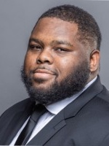
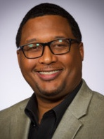
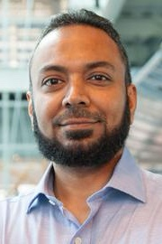
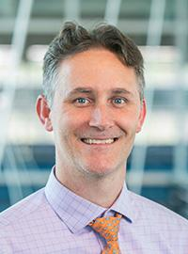
Sponsors and Advisors
Gabriel Vazquez
Hakeem Rhodes
Dow Sponsor
Marcus Rideaux
Dow Sponsor
Mohd Yousuf Ali, Ph.D. FAMU-FSU College of Engineering Advisor
Dr. Shayne McConomy
FAMU-FSU College of Engineering Advisor

Slide 4
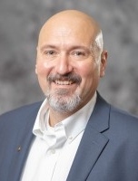
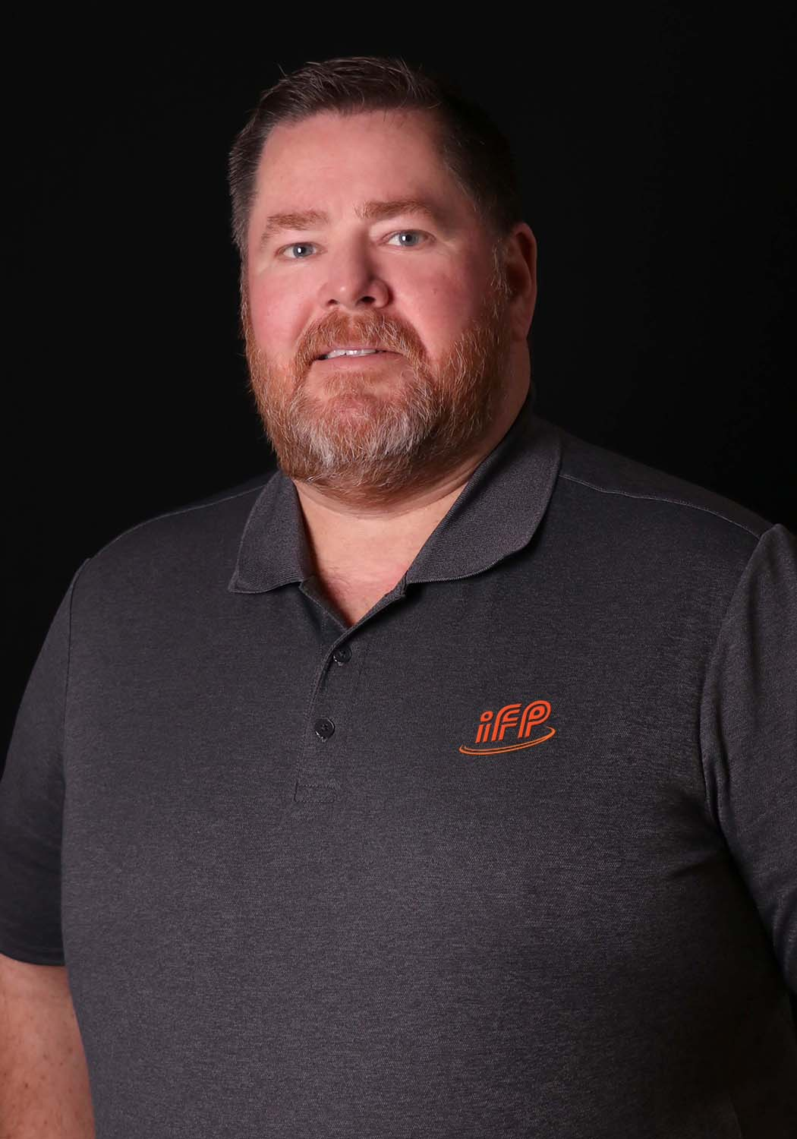
Competition Mentors
Gabriel Vazquez
Cory Fisher
Sun Hydraulics
Dean EberHardt
IFP Motion Solutions

Slide 5
Objective
Gabriel Vazquez
The objective of the project is to design a fluid-powered vehicle with the aim of competing in the competition organized by the NFPA (National Fluid power Association)

Slide 6
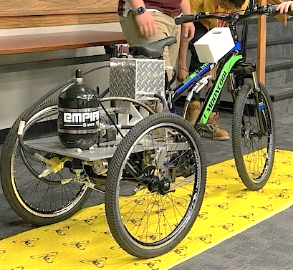
Background
Gabriel Vazquez
Brakes
Single-Rider
Reservoir
Accumulator
Pressure Gauge
Arizona State University

Slide 7
Challenges
Gabriel Vazquez
Sprint Race
Endurance Race
Efficiency Race
Time < 30 [Seconds]
Distance > 2000 [Feet]
Efficiency > 20 [%]

Slide 8
Scoring and Awards
Gabriel Vazquez
Midway Review & Final Presentation
Sprint Race
Efficiency Race
Endurance Race
FPVC Mentorship
Regenerative Braking
15
9
7
12 Award Categories
Total Cash Prizes: $12500

Slide 9
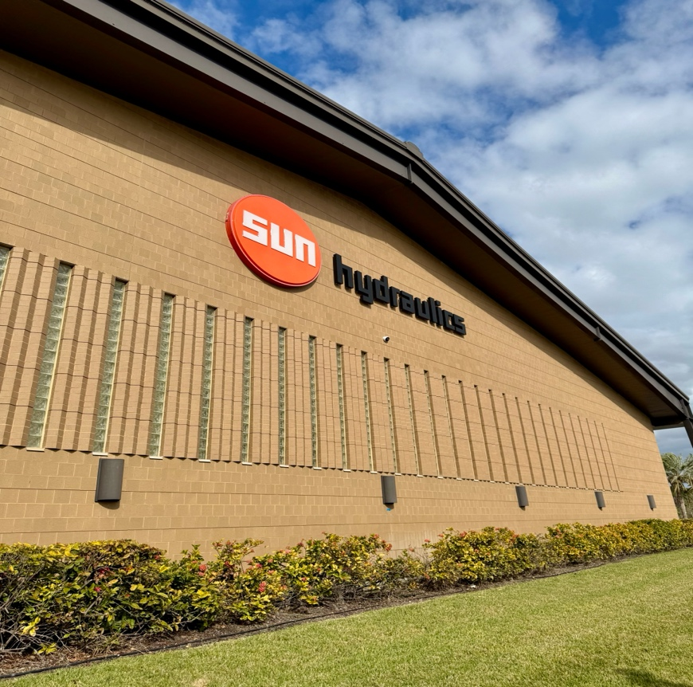
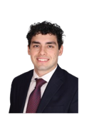
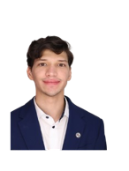
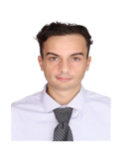
Midway Review Practice
Gabriel Vazquez
Midway Review
7

Slide 10
Breakdown of Awards
Gabriel Vazquez
Pneumatics: $1000
Design: $1000
Electronics: $1000
Races: $4500
Workmanship: $1000
Presentations: $2000
Teamwork: $1000
Safety: $1000
Notes:
Pnuematics: $1000
Electronics: $1000
Judges Choice: design: $1000
Judges Choice: Safety $1000
Judges Choice: Workmanship: $1000
Judges Choice: Teamwork: $1000
Midway/Final review: 1000$ each
Each Race: 1st $750 2nd $500 3rd $250

Slide 11
Key Goals
Gabriel Vazquez
Meet the requirements and safety guidelines of the challenge
Complete all the races and place first in at least one award category
Produce comprehensive documentation for future team’s success

Slide 12
Functional Hierarchy Chart
Gabriel Vazquez
Vehicle
Frame
Fasten components
Stability
Human Packaging
Power
Hydraulic
Regenerative Braking
Human
Foot Pedaling
Pumping
Motion
Accelerate
Brake
Turn
Mechatronics
User interface
Display Information
User Inputs
User Independent
Receive Inputs
Interpret Data
Prepare Data
Transmit Data
Perform Action
Storing Pressure
Energy Storage
Power Electronics
Suspension

Slide 13
Power Functions
Gabriel Vazquez
Power
Hydraulic
Human
Regenerative Braking
Storing Pressure
Pumping
Foot Pedaling

Slide 14
Hydraulic Diagrams
Gabriel Vazquez
Pump
Gauge
Motor
Normally Open Solenoid Valve
Check Valve
Accumulator
Test Point
Flow Control Valve
Normally Closed Solenoid Valve
Pressure Relief Valve
Reservoir

Slide 15
Gabriel Vazquez
Direct Drive
Pump
Check Valve
Control Valve (N.O)
Motor

Slide 16
Ethan Mercado
Stationary Charging Mode
Pump
Check Valve
Control Valve (N.C.)
Accumulator

Slide 17
Ethan Mercado
Discharge Mode
Accumulator
Control Valve (N.C.)
Control Valve (N.O)
Motor

Slide 18
Ethan Mercado
Discharge Mode Boost
Accumulator
Check Valve
Control Valve (N.C.)
Motor

Slide 19
Check Valve
Ethan Mercado
Regenerative Breaking
Check Valve
Motor
Control Valve (N.C.)
Accumulator

Slide 20
Ethan Mercado
Pressure Release
Accumulator
Flow Control Valve

Slide 21
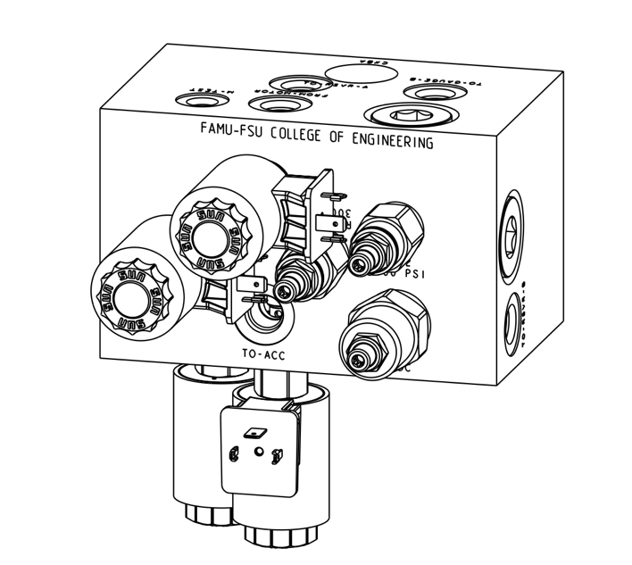
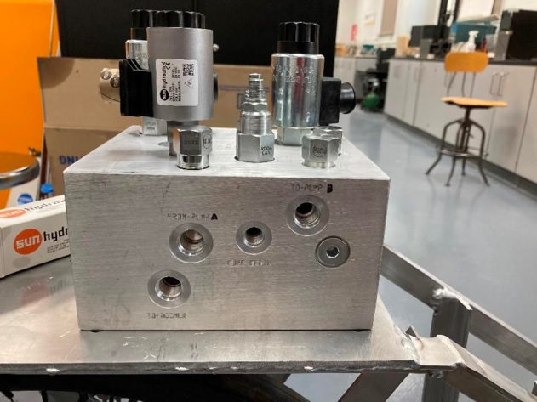
Ethan Mercado
Manifold

Slide 22
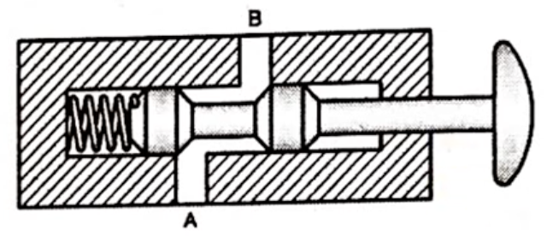
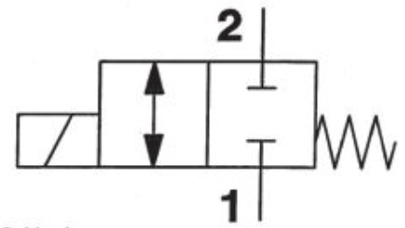
Valve Selection – Spool Valve
Ethan Mercado

Slide 23
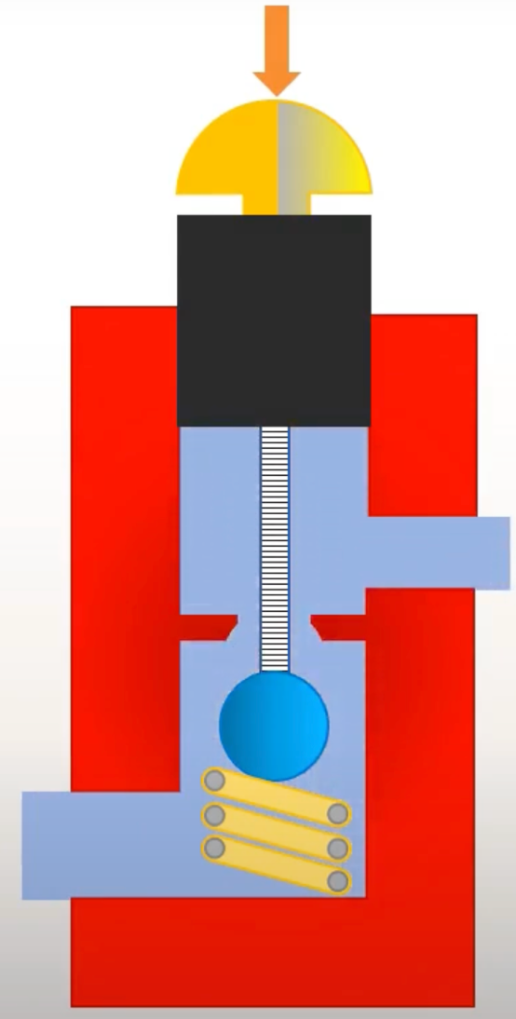
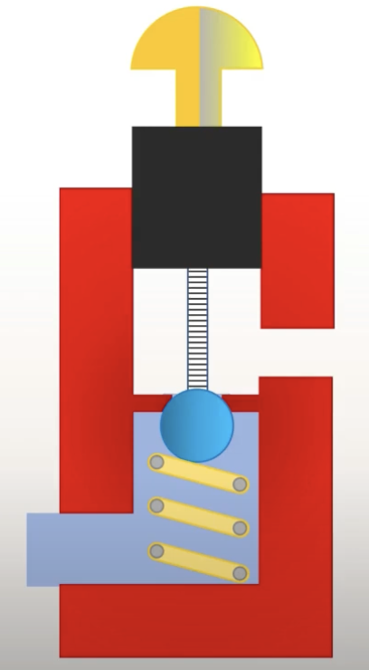
Valve Selection – Poppet Valve
Ethan Mercado

Slide 24
Mechatronics Functions
Ethan Mercado
Mechatronics
Energy Storage
User interface
User Independent
Receive Inputs
Power Electronics
User Inputs
Display Information
Prepare Data
Interpret Data
Transmit Data
Perform Action

Slide 25
Display
Ethan Mercado
Direct Drive
Pressure Readings
Direct Drive
Regenerative Breaking
Regenerative Breaking
1st Gauge
2nd Gauge
573 psi
375 psi
Discharge Mode
Stationary Charging
Speed
Discharge Mode
Stationary Charging
6.7e8 mph

Slide 26
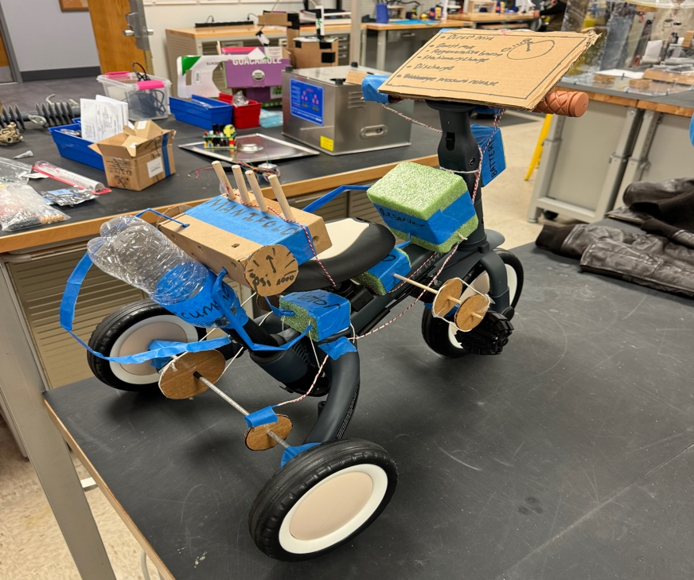
Prototype
Ethan Mercado
Display
Solenoid Valve
Manifold
Controller
12V Battery
Accumulator
Reservoir
Hose
Pump
Wire
Pressure Gauge
Motor

Slide 27
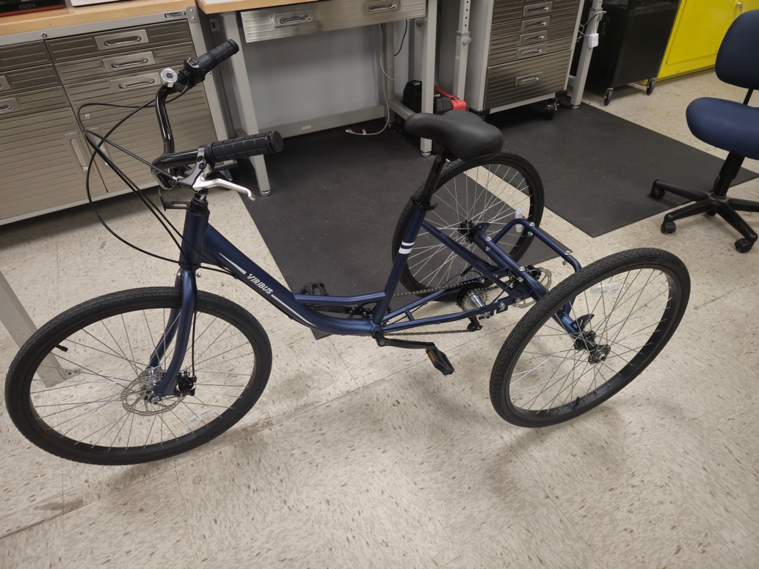
Developments and Challenges
Ethan Mercado
Frame Assembled
Microcontroller (PLC)
Hydraulic Fluid
Frame Modifications
New Brakes
Proper Hose Routing
Stronger Chain
Simulating (Simscape)

Slide 28
Future Work
Ethan Mercado
FPVC
Midway Review
Testing and Fine Tuning
Present
1/31
4/23
Finish Ordering Parts
Assembly Hydraulics and Electronics
Competition

Slide 29
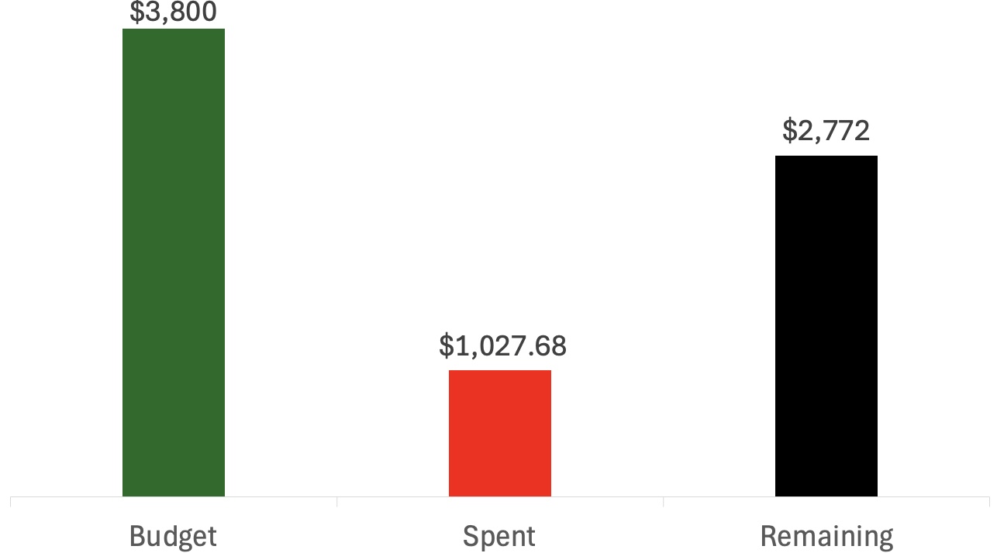
Budget
Ethan Mercado
Expenses: $1027.68
Bike: $213.93
Hotel: $461.04
Travel & Meals: $352.71

Slide 30
Questions
Ethan Mercado
Adonay Almanza
Trace Flowers
Daniel Garmendia
Ethan Mercado
Gabriel Vazquez

Slide 31
References
Ethan Mercado
​Andrews, E., Moore, C., Sobel, A., Towne,B. (2023). Akron, Ohio, Capstone Projects Final Report.
BEST MECHANICAL ENGINEERING. “2/2 Direction Control Valves - 2/2 DCV.” YouTube, YouTube, 27 Dec. 2020, www.youtube.com/watch?v=-NBmWa7vKo4.
OpenAI. (2024). ChatGPT (October 2024 version). Retrieved from [Large language model]: https://chat.openai.com/
Oquendo Chandler, M., Luken, D., Von Hoene, J., Kohli, B., Stathis, E., & King, C. (2018). University of Cincinnati NFPA Fluid Power Vehicle Challenge Project Report. Retrieved from Scholar@UC: https://scholar.uc.edu/downloads/j6731412w?locale=en
Pluta, M., Geragthy, S., Kaas, J., & McCarthy, J. (2024). 2025 NFPA Fluid Power Vehicle Challenge: Overview, Rules, and Awards. National Fluid Power Association. Retrieved from NFPA Foundation: https://nfpafoundation.org/wp-content/uploads/2024/08/2025-FPVC-Overview- Rules-and-Awards-v.4.pdf
Simplify Mechanical. “Ball Seat Poppet Valve Working Explained with Animation.” YouTube, YouTube, 7 May 2021, www.youtube.com/watch?v=QESe6rDrfX8.
Torrey, J., Trujillo, A., Londono, K., & Chan, B. (2019). Fluid Power Vehicle Challenge: Final Design Review. California Polytechnic State University. Retrieved from Digital Commons Cal Poly: https://digitalcommons.calpoly.edu/cgi/viewcontent.cgi?article=1597&context=mesp
Widmann, J., Gray, M., D'amour, R., Lopez, A. A., Ferrandino, C., & Dietz, J. (2024). Cal Poly Fluid Power Vehicle Challenge Final Design Review. California Polytechnic State University. Retrieved from Digital Commons Cal Poly: https://digitalcommons.calpoly.edu/cgi/viewcontent.cgi?article=1853&context=mesp

