Slide 1
Fluid Power Vehicle Challenge – T506
Design Review 5
February 18th, 2025

Slide 2
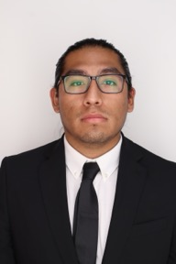
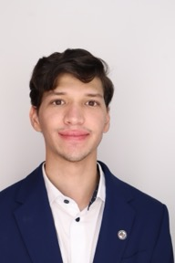
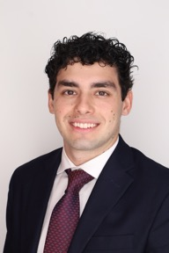
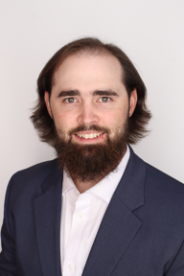
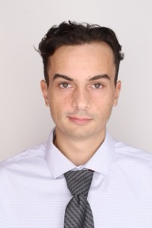
Team 506: Introductions
Daniel Garmendia
Adonay Almanza- Enriquez
Controls Engineer
Daniel Garmendia
Quality Engineer
Gabriel Vazquez
Design Engineer
Trace Flowers Modeling & Simulation Engineer
Presenter
Ethan Mercado
Systems Engineer
Presenter
Presenter

Slide 3
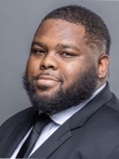
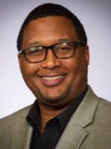
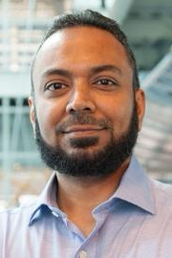
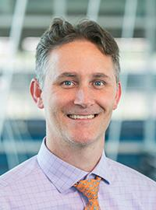
Sponsors and Advisors
Daniel Garmendia
Hakeem Rhodes
Dow Sponsor
Marcus Rideaux
Dow Sponsor
Mohd Yousuf Ali, Ph.D. FAMU-FSU College of Engineering Advisor
Dr. Shayne McConomy
FAMU-FSU College of Engineering Advisor

Slide 4
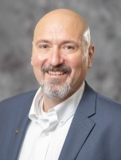

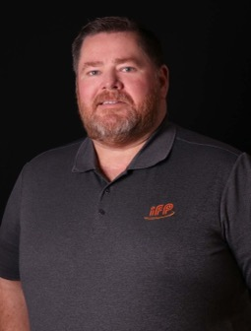
Competition Mentors
Daniel Garmendia
Cory Fisher
Sun Hydraulics
Dean EberHardt
IFP Motion Solutions

Slide 5

Objective
Daniel Garmendia
The objective of the project is to design a fluid-powered vehicle with the aim of competing in the competition organized by the NFPA (National Fluid power Association)

Slide 6
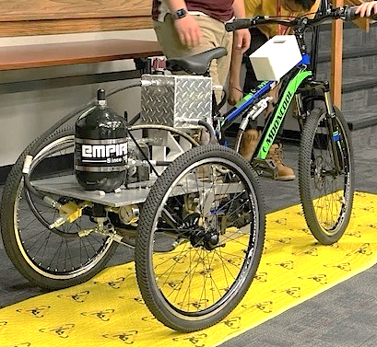
Background
Daniel Garmendia
Brakes
Single-Rider
Reservoir
Accumulator
Pressure Gauge
Arizona State University

Slide 7



Challenges
Daniel Garmendia
Sprint Race
Endurance Race
Efficiency Race
Time < 30 [Seconds]
Distance > 2000 [Feet]
Efficiency > 20 [%]

Slide 8



Key Goals
Daniel Garmendia
Meet the requirements and safety guidelines of the challenge
Complete all the races and place first in at least one award category
Produce comprehensive documentation for future team’s success

Slide 9


Scoring and Awards
Daniel Garmendia
Midway Review & Final Presentation
Sprint Race
Efficiency Race
Endurance Race
FPVC Mentorship
Regenerative Braking
15
9
7
12 Award Categories
Total Cash Prizes: $12500

Slide 10


Breakdown of Awards
Daniel Garmendia
Pneumatics: $1000
Design: $1000
Electronics: $1000
Races: $4500
Workmanship: $1000
Presentations: $2000
Teamwork: $1000
Safety: $1000
Notes:
Pnuematics: $1000
Electronics: $1000
Judges Choice: design: $1000
Judges Choice: Safety $1000
Judges Choice: Workmanship: $1000
Judges Choice: Teamwork: $1000
Midway/Final review: 1000$ each
Each Race: 1st $750 2nd $500 3rd $250

Slide 11
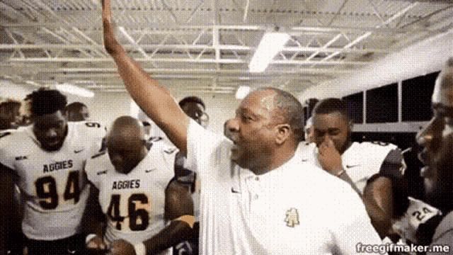
Results and Critiques
Daniel Garmendia
Scoring
Critique
Praise
Midway Review: 3.82/5
Calculation: Incline was not steep enough to be competitive in sprint race
Overall quality and depth of the presentation
$1000

Slide 12
Functional Hierarchy Chart
Daniel Garmendia
Vehicle
Frame
Fasten components
Stability
Human Packaging
Power
Hydraulic
Regenerative Braking
Human
Foot Pedaling
Pumping
Motion
Accelerate
Brake
Turn
Mechatronics
User interface
Display Information
User Inputs
User Independent
Receive Inputs
Interpret Data
Prepare Data
Transmit Data
Perform Action
Storing Pressure
Energy Storage
Power Electronics
Suspension

Slide 13
Power Functions
Daniel Garmendia
Power
Hydraulic
Human
Regenerative Braking
Storing Pressure
Pumping
Foot Pedaling

Slide 14
Hydraulic Diagrams
Trace Flowers
Pump
Gauge
Motor
Normally Open Solenoid Valve
Check Valve
Accumulator
Test Point
Flow Control Valve
Normally Closed Solenoid Valve
Pressure Relief Valve
Reservoir

Slide 15
Trace Flowers
Direct Drive
Pump
Check Valve
Control Valve (N.O)
  Motor

Slide 16
Trace Flowers
Stationary Charging Mode
Pump
Check Valve
Control Valve (N.C.)
Accumulator

Slide 17
Trace Flowers
Discharge Mode
Accumulator
Control Valve (N.C.)
Control Valve (N.O)
Motor

Slide 18
Trace Flowers
Discharge Mode Boost
Accumulator
Check Valve
Control Valve (N.C.)
  Motor

Slide 19
Check Valve
Trace Flowers
Regenerative Braking
Check Valve
Motor
Control Valve (N.C.)
  Accumulator
Notes:
No need for control valve is going to be switch out for check valve

Slide 20
Trace Flowers
Pressure Release
Accumulator
Flow Control Valve

Slide 21
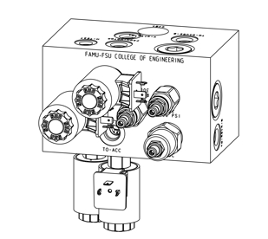
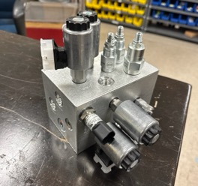
Trace Flowers
Manifold

Slide 22


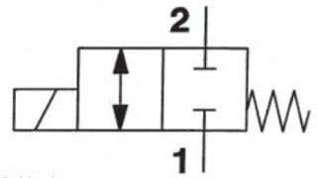
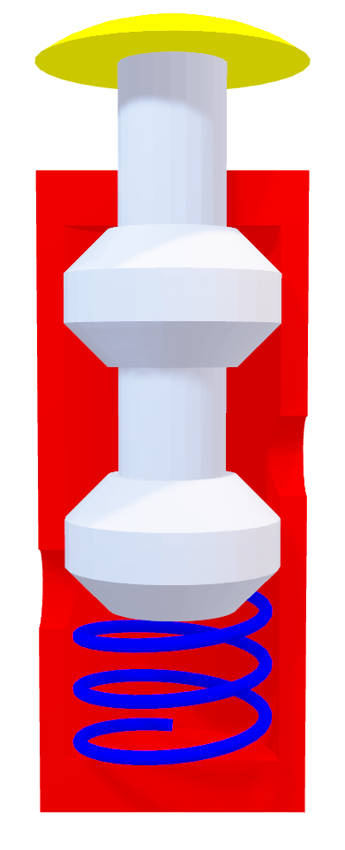
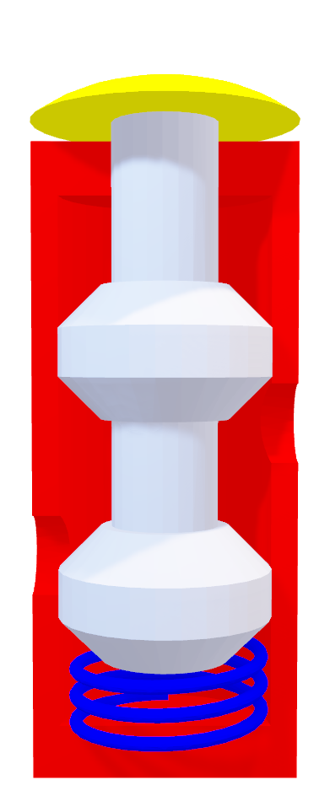
Valve Selection – Spool Valve
Trace Flowers

Slide 23


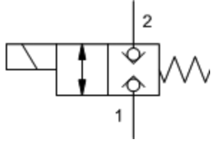
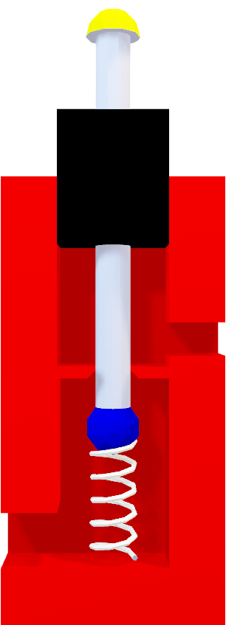
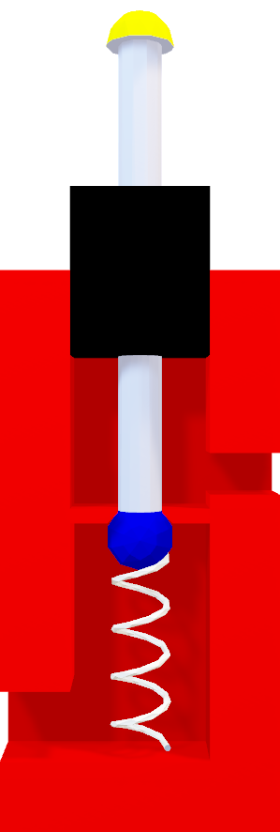
Valve Selection – Poppet Valve
Trace Flowers

Slide 24
Mechatronics Functions
Adonay Almanza
Mechatronics
Energy Storage
User interface
User Independent
Receive Inputs
Power Electronics
User Inputs
Display Information
Prepare Data
Interpret Data
Transmit Data
Perform Action

Slide 25
Display
Adonay Almanza
Direct Drive
Pressure Readings
Direct Drive
Regenerative Breaking
Regenerative Breaking
1st Gauge
2nd Gauge
573 psi
375 psi
Discharge Mode
Stationary Charging
Speed
Discharge Mode
Stationary Charging
6.7e8 mph

Slide 26
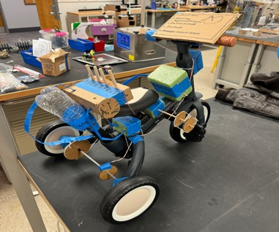
Prototype
Adonay Almanza
Display
Solenoid Valve
Manifold
Controller
12V Battery
Accumulator
Reservoir
Hose
Pump
Wire
Pressure Gauge
Motor

Slide 27
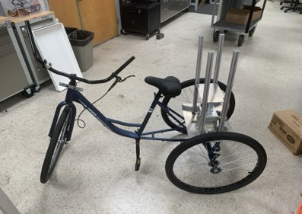
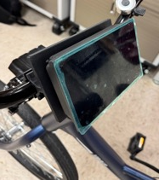
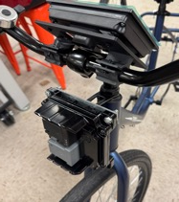
Developments & Challenges
Adonay Almanza
Mount Motor & Pump
Simulating in Animation Studio
Purchasing Hosing
Microcontroller (PLC)
Mount Manifold
Build Reservoir
Mount Accumulator
Frame Modifications

Slide 28





Final Competition
Adonay Almanza
1:24 PM
2:00 PM
4:00 PM
8:00 AM
10:00 AM
12:00 PM
6:00 PM
8:30 AM
1:00 PM
4:30 PM
10:00 AM
12:00 PM
2:00 PM
Tuesday – April 22
Fly into Des Moines from Panama City
Rent Car & Drive to Cedar Rapids
Check into Hotel
Wednesday – April 23
Tour IFP Motion Solutions
Drive to Ames
Assemble bike, complete pre-race inspection
Welcome Reception
Thursday – April 24
Final Presentation & Design Review
Races and Regenerative Braking Demonstration
Networking Dinner
Friday – April 25
Disassemble bike
Award Ceremony
Drive to Des Moines Airport

Slide 29
Future Work
Adonay Almanza
Assembly Hydraulics and Electronics
Competition
Present
4/23
Finish Ordering Minor Parts
Testing and Fine Tuning

Slide 30
Budget
Adonay Almanza
Expenses: $3183.54
Bike: $213.93
Brakes: $54.99
Chain: $51.60
Hotel: $461.04
Travel & Meals: $462.71
IFP Components: $1745.27
SunSource Components: $194

Slide 31





Questions
Adonay Almanza
Adonay Almanza
Trace Flowers
Daniel Garmendia
Ethan Mercado
Gabriel Vazquez

Slide 32
References
Adonay Almanza
​Andrews, E., Moore, C., Sobel, A., Towne,B. (2023). Akron, Ohio, Capstone Projects Final Report.
BEST MECHANICAL ENGINEERING. “2/2 Direction Control Valves - 2/2 DCV.” YouTube, YouTube, 27 Dec. 2020, www.youtube.com/watch?v=-NBmWa7vKo4.
OpenAI. (2024). ChatGPT (October 2024 version). Retrieved from [Large language model]: https://chat.openai.com/
Oquendo Chandler, M., Luken, D., Von Hoene, J., Kohli, B., Stathis, E., & King, C. (2018). University of Cincinnati NFPA Fluid Power Vehicle Challenge Project Report. Retrieved from Scholar@UC: https://scholar.uc.edu/downloads/j6731412w?locale=en
Pluta, M., Geragthy, S., Kaas, J., & McCarthy, J. (2024). 2025 NFPA Fluid Power Vehicle Challenge: Overview, Rules, and Awards. National Fluid Power Association. Retrieved from NFPA Foundation: https://nfpafoundation.org/wp-content/uploads/2024/08/2025-FPVC-Overview- Rules-and-Awards-v.4.pdf
Simplify Mechanical. “Ball Seat Poppet Valve Working Explained with Animation.” YouTube, YouTube, 7 May 2021, www.youtube.com/watch?v=QESe6rDrfX8.
Torrey, J., Trujillo, A., Londono, K., & Chan, B. (2019). Fluid Power Vehicle Challenge: Final Design Review. California Polytechnic State University. Retrieved from Digital Commons Cal Poly: https://digitalcommons.calpoly.edu/cgi/viewcontent.cgi?article=1597&context=mesp
Widmann, J., Gray, M., D'amour, R., Lopez, A. A., Ferrandino, C., & Dietz, J. (2024). Cal Poly Fluid Power Vehicle Challenge Final Design Review. California Polytechnic State University. Retrieved from Digital Commons Cal Poly: https://digitalcommons.calpoly.edu/cgi/viewcontent.cgi?article=1853&context=mesp

