Slide 1
Fluid Power Vehicle Challenge – T506
Design Review 6
April 1st, 2025

Slide 2
Team 506: Introductions
Gabriel Vazquez
Adonay Almanza- Enriquez
Controls Engineer
Daniel Garmendia
Quality Engineer
Gabriel Vazquez
Design Engineer
Trace Flowers Modeling & Simulation Engineer
Ethan Mercado
Systems Engineer

Slide 3
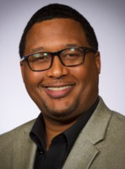
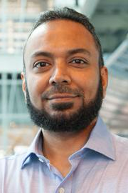
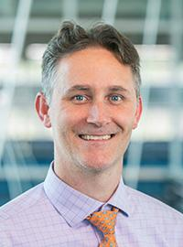
Sponsors and Advisors
Gabriel Vazquez
Hakeem Rhodes
Dow Sponsor
Marcus Rideaux
Dow Sponsor
Mohd Yousuf Ali, Ph.D. FAMU-FSU College of Engineering Advisor
Dr. Shayne McConomy
FAMU-FSU College of Engineering Advisor

Slide 4
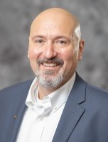
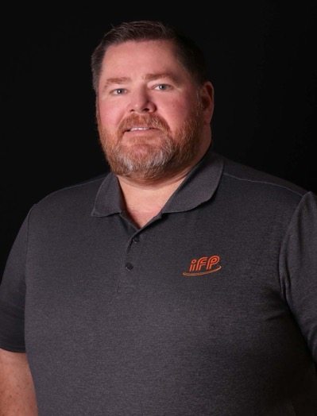
Competition Mentors
Gabriel Vazquez
Cory Fisher
Sun Hydraulics
Dean Eberhardt
IFP Motion Solutions

Slide 5
Objective
Gabriel Vazquez
The objective of the project is to design a fluid-powered vehicle with the aim of competing in the competition organized by the NFPA (National Fluid power Association).

Slide 6
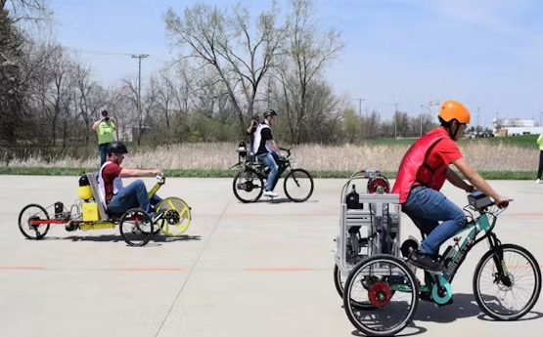
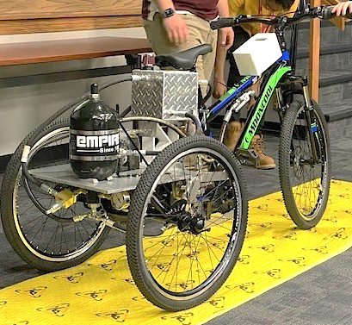
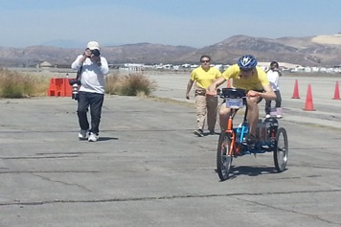
Background (cont.)
Gabriel Vazquez
Brakes
Single Rider
Reservoir
Accumulator
Electronics
Hosing
Pressure Guage
Arizona State University

Slide 7
Challenges
Gabriel Vazquez
Sprint Race
Endurance Race
Efficiency Race
Time < 30 [Seconds]
Distance > 2000 [Feet]
Efficiency > 20 [%]

Slide 8
Key Goals
Gabriel Vazquez
Meet the requirements and safety guidelines of the challenge
Complete all the races and place first in at least one award category
Produce comprehensive documentation for future team’s success

Slide 9
Scoring and Awards
Gabriel Vazquez
Midway Review & Final Presentation
Sprint Race
Efficiency Race
Endurance Race
FPVC Mentorship
Regenerative Braking
15
9
7
12 Award Categories
Total Cash Prizes: $12500

Slide 10
Breakdown of Awards
Gabriel Vazquez
Pneumatics: $1000
Design: $1000
Electronics: $1000
Races: $4500
Workmanship: $1000
Safety: $1000
Teamwork: $1000
Presentations: $2000
Notes:
Pnuematics: $1000
Electronics: $1000
Judges Choice: design: $1000
Judges Choice: Safety $1000
Judges Choice: Workmanship: $1000
Judges Choice: Teamwork: $1000
Midway/Final review: 1000$ each
Each Race: 1st $750 2nd $500 3rd $250

Slide 11
Functional Hierarchy Chart
Daniel Garmendia
Vehicle
Frame
Fasten components
Stability
Human Packaging
Power
Hydraulic
Regenerative Braking
Human
Foot Pedaling
Pumping
Motion
Accelerate
Brake
Turn
Mechatronics
User interface
Display Information
User Inputs
User Independent
Receive Inputs
Interpret Data
Prepare Data
Transmit Data
Perform Action
Storing Pressure
Energy Storage
Power Electronics
Suspension

Slide 12
Power Functions
Daniel Garmendia
Power
Hydraulic
Human
Regenerative Braking
Storing Pressure
Pumping
Foot Pedaling

Slide 13
Hydraulic Diagrams
Daniel Garmendia
Pump
Motor
Gauge
Motor
Normally Open Solenoid Valve
Check Valve
Accumulator
Test Point
Flow Control Valve
Normally Closed Solenoid Valve
Pressure Relief Valve
Pump
Reservoir

Slide 14
Daniel Garmendia
Direct Drive
Motor
Pump
Check Valve
Control Valve (N.O)
Motor
Pump
Reservoir

Slide 15
Daniel Garmendia
Stationary Charging Mode
Motor
Pump
Check Valve
Control Valve (N.C.)
Pump
Accumulator
Reservoir

Slide 16
Daniel Garmendia
Discharge Mode
Motor
Accumulator
Control Valve (N.C.)
Control Valve (N.O)
Motor
Pump
Reservoir

Slide 17
Ethan Mercado
Discharge Mode Boost
Motor
Accumulator
Check Valve
Control Valve (N.C.)
Motor
Pump
Reservoir

Slide 18
Ethan Mercado
Regenerative Braking
Motor
Check Valve
Motor
Control Valve (N.C.)
Accumulator
Pump
Reservoir
Notes:
No need for control valve is going to be switch out for check valve

Slide 19
Ethan Mercado
Pressure Release
Motor
Accumulator
Flow Control Valve
Pump
Reservoir

Slide 20
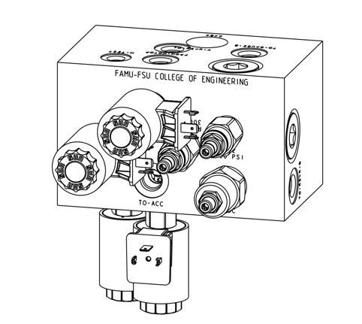
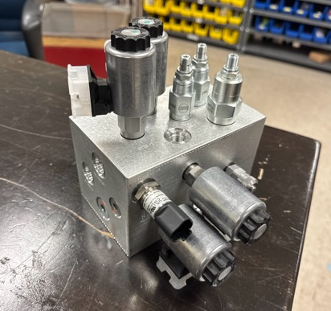
Ethan Mercado
Manifold
Motor
Pump
Reservoir

Slide 21
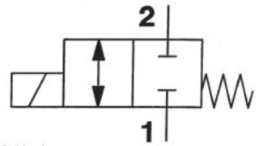
Valve Selection – Spool Valve
Ethan Mercado

Slide 22
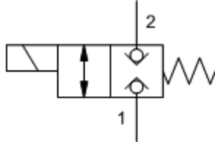
Valve Selection – Poppet Valve
Ethan Mercado

Slide 23
Mechatronics Functions
Adonay Almanza
Mechatronics
Energy Storage
User interface
User Independent
Receive Inputs
Power Electronics
User Inputs
Display Information
Prepare Data
Interpret Data
Transmit Data
Perform Action

Slide 24
Display page 1
Adonay Almanza
Direct Drive
Direct Drive
Direct Drive
Regenerative Braking
Regenerative Braking
Regenerative Braking
Off
On
Discharge Mode
Stationary Charging
Discharge Mode
Stationary Charging
Discharge Mode
Stationary Charging
PRESSURE READINGS
PRESSURE READINGS

Slide 25
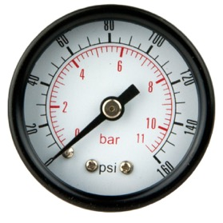
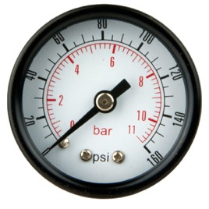
Display page 2
Adonay Almanza
Pressure Readings
Location 1
Location 2
0 psi
0 psi
Main Menu

Slide 26
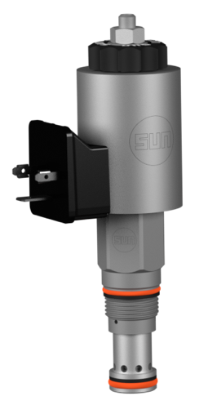
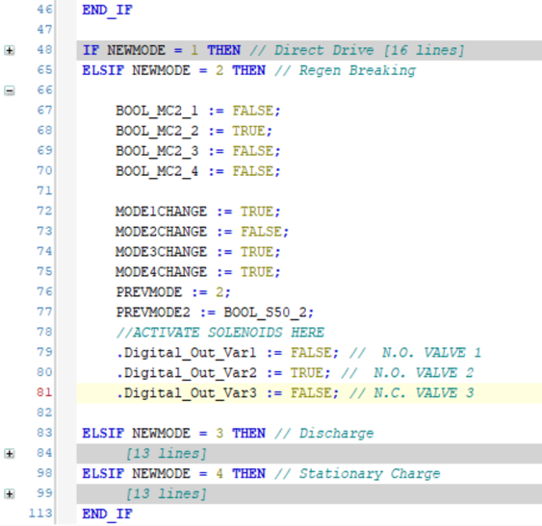
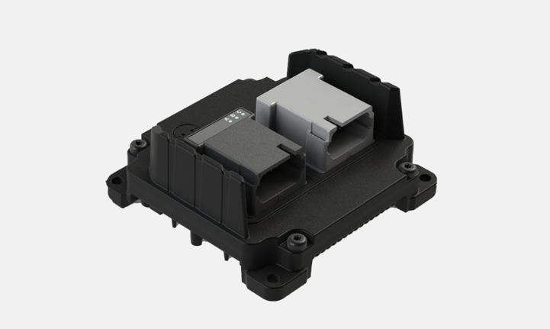
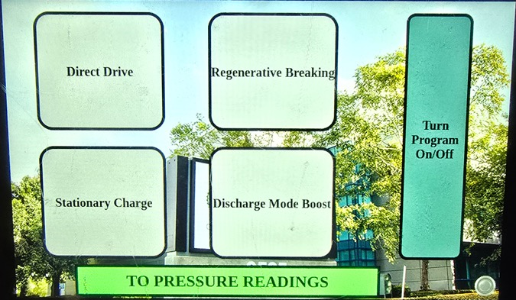
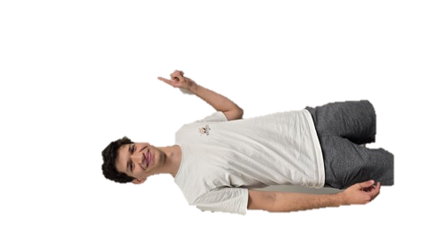
How it Works
Adonay Almanza
PLC
Motor
Solenoid
Display
Direct Drive
Direct Drive
Regenerative Braking
Regenerative Braking
Off
On
Discharge Mode
Stationary Charging
PRESSURE READINGS
Pump
Reservoir

Slide 27
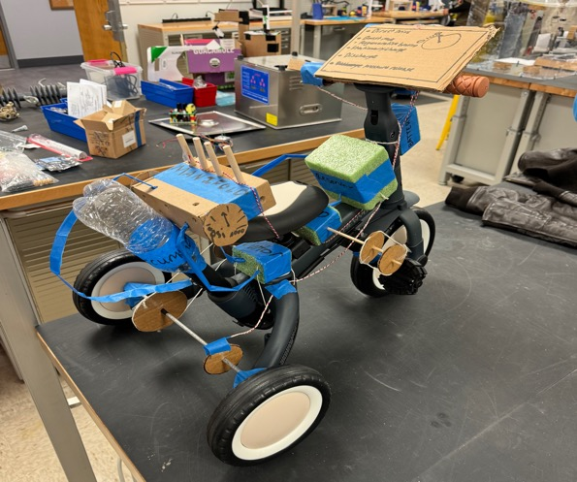
Prototype
Adonay Almanza
Solenoid Valve
Display
Manifold
Controller
Accumulator
12V Battery
Hose
Reservoir
Pressure Gauge
Pump
Motor
Wire

Slide 28
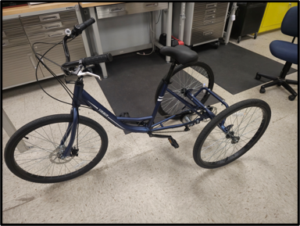
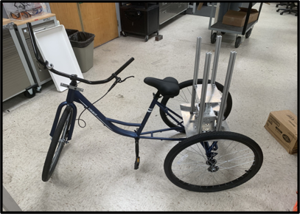
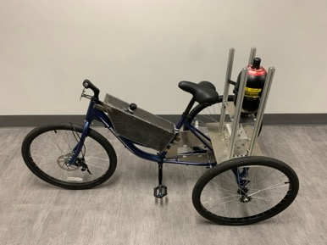
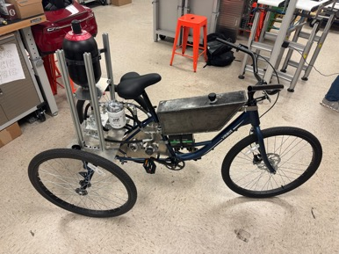
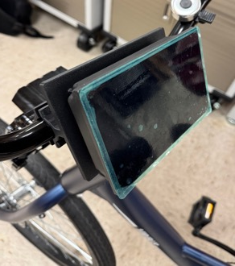
Development of Vehicle
Trace Flowers
Mount Accumulator
Mount Motor & Pump
Mount Battery
Build Reservoir
Mount Manifold
Assemble Hosing
Mount PLC and Display
Microcontroller (PLC)

Slide 29
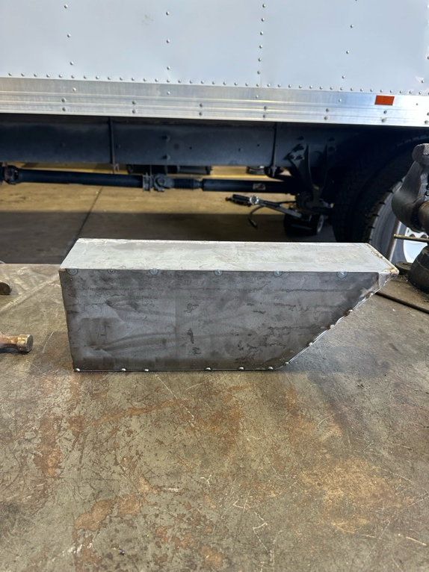
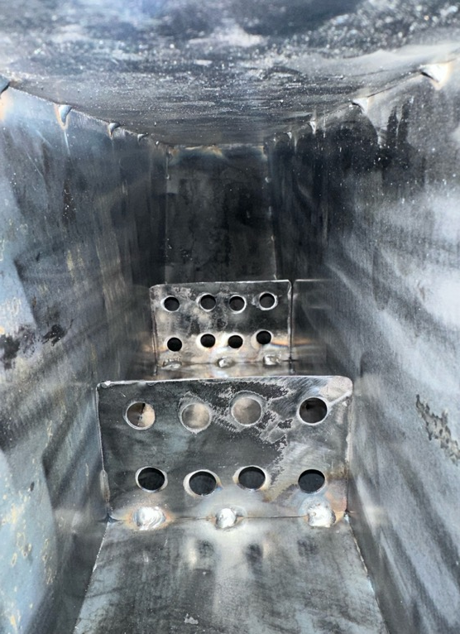
Developments: Reservoir
Trace Flowers

Slide 30
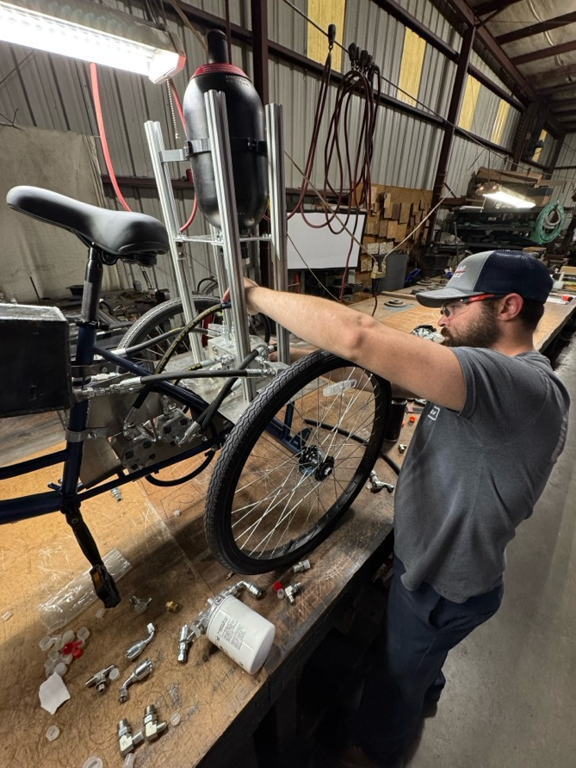
Developments: Capital Rubber
Trace Flowers

Slide 31
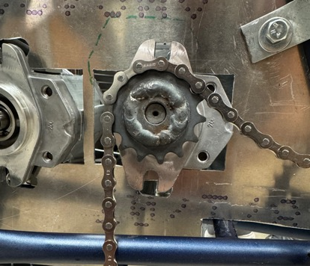
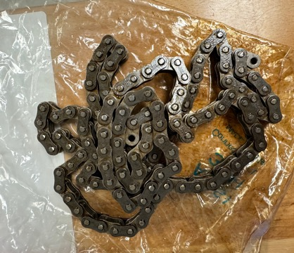
Final Challenges and Steps
Trace Flowers
Wiring
Gears and sprockets
Alignment
Safety
Testing
3/8-inch pitch
1/2-inch pitch
Workmanship
The Great Bicycle
Shop

Slide 32
Final Competition
Trace Flowers
1:24 PM
2:00 PM
4:00 PM
8:00 AM
10:00 AM
12:00 PM
6:00 PM
8:30 AM
1:00 PM
4:30 PM
10:00 AM
12:00 PM
2:00 PM
Tuesday – April 22
Fly into Des Moines from Panama City
Rent Car & Drive to Cedar Rapids
Check into Hotel
Wednesday – April 23
Tour IFP Motion Solutions
Drive to Ames
Assemble bike, complete pre-race inspection
Welcome Reception
Thursday – April 24
Final Presentation & Design Review
Races and Regenerative Braking Demonstration
Networking Dinner
Friday – April 25
Disassemble bike
Award Ceremony
Drive to Des Moines Airport

Slide 33
Future Work
Trace Flowers
Testing and Fine Tuning
Competition
and Final Review
Present
4/11
4/23
Final Assembly
Ship Vehicle

Slide 34
Budget
Trace Flowers
Total Expenses: $3,469.04
DOW and Stipend: $1,529.77
Hotel: $461.04
Travel & Meals: $462.71
Overall Components: $606.02
New Components: $285.50
NFPA: $1,939.27
IFP Components: $1745.27
SunSource Components: $194

Slide 35
Questions
Trace Flowers
Adonay Almanza
Trace Flowers
Daniel Garmendia
Motor
Ethan Mercado
Gabriel Vazquez
Pump
Reservoir

Slide 36
References
Trace Flowers
​Andrews, E., Moore, C., Sobel, A., Towne,B. (2023). Akron, Ohio, Capstone Projects Final Report.
BEST MECHANICAL ENGINEERING. “2/2 Direction Control Valves - 2/2 DCV.” YouTube, YouTube, 27 Dec. 2020, www.youtube.com/watch?v=-NBmWa7vKo4.
OpenAI. (2024). ChatGPT (October 2024 version). Retrieved from [Large language model]: https://chat.openai.com/
Oquendo Chandler, M., Luken, D., Von Hoene, J., Kohli, B., Stathis, E., & King, C. (2018). University of Cincinnati NFPA Fluid Power Vehicle Challenge Project Report. Retrieved from Scholar@UC: https://scholar.uc.edu/downloads/j6731412w?locale=en
Pluta, M., Geragthy, S., Kaas, J., & McCarthy, J. (2024). 2025 NFPA Fluid Power Vehicle Challenge: Overview, Rules, and Awards. National Fluid Power Association. Retrieved from NFPA Foundation: https://nfpafoundation.org/wp-content/uploads/2024/08/2025-FPVC-Overview- Rules-and-Awards-v.4.pdf
Simplify Mechanical. “Ball Seat Poppet Valve Working Explained with Animation.” YouTube, YouTube, 7 May 2021, www.youtube.com/watch?v=QESe6rDrfX8.
Torrey, J., Trujillo, A., Londono, K., & Chan, B. (2019). Fluid Power Vehicle Challenge: Final Design Review. California Polytechnic State University. Retrieved from Digital Commons Cal Poly: https://digitalcommons.calpoly.edu/cgi/viewcontent.cgi?article=1597&context=mesp
Widmann, J., Gray, M., D'amour, R., Lopez, A. A., Ferrandino, C., & Dietz, J. (2024). Cal Poly Fluid Power Vehicle Challenge Final Design Review. California Polytechnic State University. Retrieved from Digital Commons Cal Poly: https://digitalcommons.calpoly.edu/cgi/viewcontent.cgi?article=1853&context=mesp

