Slide 1
Team 507: Southeast Con
VDR 1
Kelsey Gross, Ian Lemler, Luiz Santos, Eric Strawn

Slide 2


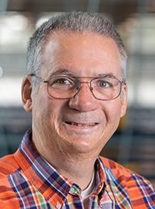

Sponsors and Advisors
Kelsey Gross
Dr. Oscar Chuy
Dr. Bruce Harvey
Dr. Johnathan Clark

Slide 3

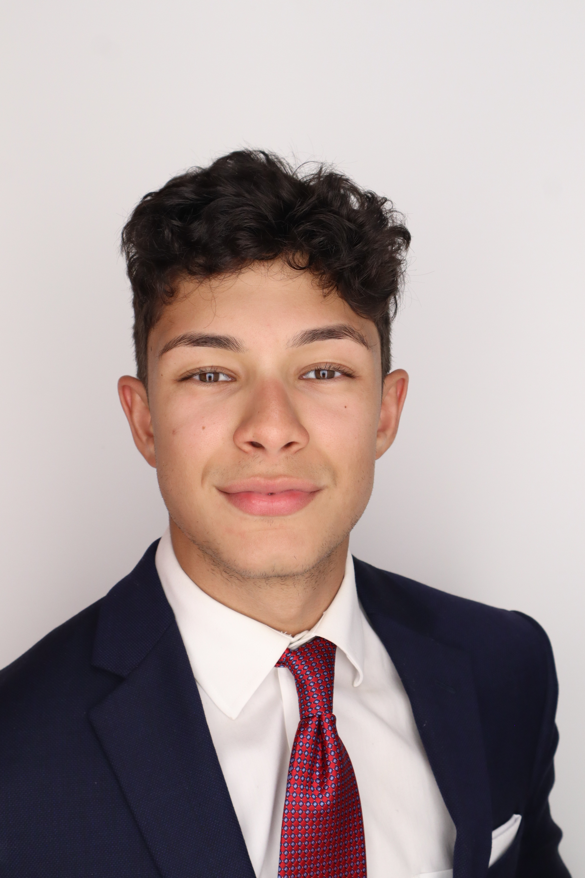
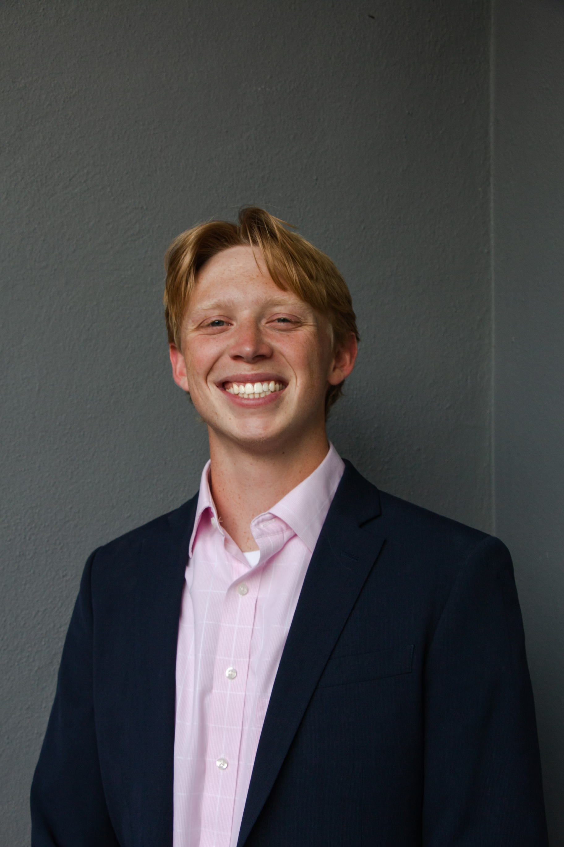
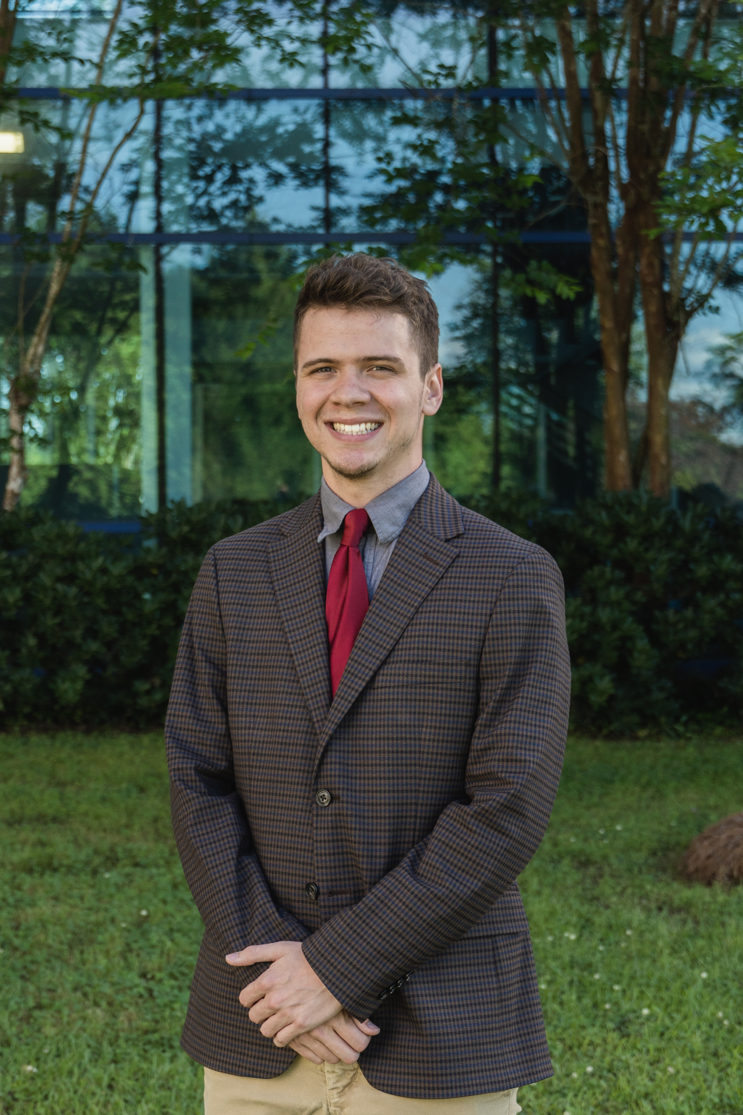
Meet the Team
Kelsey Gross
Kelsey Gross
Luiz Santos
Fabrication Engineer
Ian Lemler
Eric Strawn

Slide 4
Objective
Kelsey Gross
The objective of this project is to design, develop, and compete with a working robot that allows for the collection of different types of astral materials and optimizes point scoring.

Slide 5
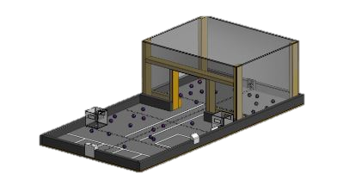
Project Description
Kelsey Gross
Regional Competition for the Southeast States
Design, build, test, and program a fully autonomous robot
3 Minutes to complete all tasks
Collect astral materials and store them
Work with ECE departments team

Slide 6
Key Goals
Eric Strawn
Create a fully autonomous robot whose functions optimize point scoring.
Design a mechanism to pick up the astral materials and store them into a container.
Design the robot to fit in a 12x12x12 inch cube.
Design and build a team beacon for high point scoring via its placement.

Slide 7
Markets
Eric Strawn
1. ECE Department at FAMU-FSU College of Engineering
2. Future SoutheastCon Competitors
3. Potential Employer that may have interest in the outcome of the competition

Slide 8
Assumptions
Eric Strawn
The batteries are sensitive and require that the team handle them with care.
There will be a power source available at the competition.
The astral materials are made of PLA.
The robot will be operating in a 4’x8’ field identical to the one provided by Dr. Harvey.
The robot has 3 minutes to complete its tasks.
The astral materials will be scattered randomly on the play field.
The containers for depositing astral materials are 6in cubes.
The game manual is up to date.

Slide 9
Assumptions
Eric Strawn
Some of the astral materials will be magnetic (Geodinium), and some will be nonmagnetic (Nebulite).
There will be a dark area and a naturally lit area on the game field. There will be an infrared camera in the cave which impedes certain sensors.
The astral materials will have the following dimensions: 40mm (about 1.58in) in diameter.
The ECE team will be tasked with handling the software components of the robot.
Points will be earned according to the game manual scoring summary.

Slide 10
Stakeholders
Eric Strawn
Dr. Jonathan Clark
Dr. Shayne McConomy
Dr. Bruce Harvey
Dr. Oscar Chuy
Level of Interest
Level of Influence

Slide 11
Customer Needs
Ian Lemler
Who is the customer?
IEEE SoutheastCon Hardware Competition
Mining Mayhem - Game Manual

Slide 12
Customer Needs
Ian Lemler
Functional Needs
Physical Design Specifications
Game Rules

Slide 13
Physical Design Specifications
Luiz Santos
Robot fits in a 12" cube
Robot weighs less than 12 Kg
List of prohibited materials in the game manual

Slide 14
Functional Needs
Luiz Santos
Robot starts when LED bulb is lit
Robot collects and sorts materials
Robot views and reads April tags
Robot moves shipping containers

Slide 15
Following Game Rules
Luiz Santos
Robot completes tasks inside 3-minute timeframe
Earn points based on the Scoring Summary table in the game manual
Robot avoids penalties by following safety rules in section 3.5 of game manual

Slide 16
Functional Decomposition
Luiz Santos
Robot
Collecting Mechanism
Sorting Mechanism
Bin Relocation
Navigation
Powertrain
Sensors
Program
Motors
Chassis

Slide 17
Future Work
Luiz Santos
Research past designs that worked for other teams
Coordinate with ECE team and concept generation and selection
Build first prototype with cardboard

Slide 18
Back Up Slides

Slide 19
Assumptions
Eric Strawn
Some of the astral materials will be magnetic (Geodinium), and some will be nonmagnetic (Nebulite).
There will be a dark area and a naturally lit area on the game field. There will be an infrared camera in the cave which impedes certain sensors.
The astral materials will have the following dimensions: 40mm (about 1.58in) in diameter.
The ECE team will be tasked with handling the software components of the robot.
Points will be earned according to the game manual scoring summary.

Slide 20
Assumptions
Eric Strawn
The batteries are sensitive and require that the team handle them with care.
There will be a power source available at the competition.
The astral materials are made of PLA.
The robot will be operating in a 4’x8’ field identical to the one provided by Dr. Harvey.
The robot has 3 minutes to complete its tasks.
The astral materials will be scattered randomly on the play field.
The containers for depositing astral materials are 6in cubes.
The game manual is up to date.

Slide 21





Slide Headline
Try to keep text at 16 pt minimum.
Try to put as few words as possible on the slide if you’re using for a presentation.
Mix and match the backgrounds as shown in this template or just use one throughout.
You can put department/unit logos in slide master at Horizontal 0.89” Vertical 6.44” From top left corner

Slide 22
Font Check
This is 10-point
This is 15–point Times
This is 20–point
This is 25–point
This is 30–point
This is 35–point
This is 40–point
This is 50–point
This is 60–point
This is 72–point
Notes:
Use at least 20-point font in Room A105, B134, and B136
Use at least 25-point font in Room B135

Slide 23
College of Engineering Color Palette
1 2 3 4
Pantone: PMS 195 C
RGB: 120, 47, 64
Hex: #782F40
CMYK:19, 90, 50, 55
1 2 3 4
Pantone: Black C
RGB: 0, 0, 0
Hex: #000000
CMYK:0, 0, 0, 100
Garnet
Black
1 2 3 4
RGB: 238, 118, 36
Hex: #EE7624
CMYK:2, 66, 99, 0
1 2 3 4
Pantone: PMS 000C
RGB: 255, 255, 255
Hex: #FFFFFF
CMYK: 0, 0, 0, 0
Fang
Orange
White
Notes:
Avoid 75% Black in B135

Slide 24
Accent Color Palette
1 2 3 4
RGB: 0, 59, 111
Hex: #003B6F
CMYK:
1 2 3 4
RGB: 0, 59, 111
Hex: #003B6F
CMYK:
1 2 3 4
RGB: 251, 236, 93
Hex: #FBEC5D
CMYK:
1 2 3 4
RGB: 219, 215, 210
Hex: #DBD7D2
CMYK:
1 2 3 4
RGB: 251, 236, 93
Hex: #FBEC5D
CMYK:
1 2 3 4
RGB: 219, 215, 210
Hex: #DBD7D2
CMYK:
Tardis Blue
Tardis Blue
Corn
Timberwolf
Corn
Timberwolf
1 2 3 4
RGB: 206, 0, 88
Hex: #CE0058
CMYK: 0, 100, 43, 12
1 2 3 4
RGB: 206, 0, 88
Hex: #CE0058
CMYK: 0, 100, 43, 12
1 2 3 4
RGB: 104, 40, 96
Hex: #682860
CMYK:
1 2 3 4
RGB: 220, 220, 220
Hex: #DCDCDC
CMYK:
Rubine Red
Rubine Red
Imperial
Gainsboro
1 2 3 4
RGB: 72, 146, 155
Hex: #48929b
CMYK:
1 2 3 4
RGB: 64, 224, 208
Hex: #40E0D0
CMYK:
1 2 3 4
RGB: 255, 139, 0
Hex: #FF8B00
CMYK:
Asagi-iro
Turquoise
American Orange
Notes:
Remove American orange add hyperlink grey
Make corn the last for b135
All work in 134 imperial move later
Tardis doesn’t work in b136

Slide 25
F7AB19
D67F15
EE7624
D64615
F73119
Analogous
6E3610
F0A16C
EE7624
6E4931
BASB1C
Monochromatic
A14508
4BED3B
EE7624
250CED
2010A1
Triad
A1470C
FF8C40
EE7624
0098A1
24E2ED
Complementary
28A164
2FED8D
EE7624
0848A1
1871ED
Split Complementary
EDAC2F
3BED93
EE7624
0C6AED
ED2F18
Double Split Complementary
ED660C
C7ED3B
EE7624
0CE1ED
A418ED
Square
BA7E09
87724A
EE7624
60EFCF
09BA61
Compound
https://color.adobe.com/create/color-wheel
AD551A
6E3610
EE7624
FA7625
D46820
Shades
Notes:
These are the variants that work well with Fang Orange. The bolded items show well on the projectors.

Slide 26
85412D
8F3831
782f40
8F3176
792D85
Analogous
C44D69
8E626D
782F40
C48796
451B25
Monochromatic
C43959
78743B
782F40
236178
43A2C4
Triad
C43959
C46078
782F40
25C43D
2F783A
Complementary
93C460
577835
782F40
39C49D
297861
Split Complementary
784435
5A783B
782F40
237860
6E2978
Double Split Complementary
782337
78683b
782F40
237830
293978
Square
AB4D32
DEBAAF
782F40
5D8555
70AB32
Compound
https://color.adobe.com/create/color-wheel
38161E
C44D69
782F40
853447
5E2532
Shades

Slide 27
A105
A105
B135 Stage Left
B135 Stage Right
B136
B134, A105
B135

Slide 28
Border Line
Border Line
Border Line
Center of White Space
Center of Slide
Middle of Slide
Middle of White Space
Edge of Branding
Border Line
Notes:
Vertical lines from top down.
Borderline and top of title. (0.5 inch)
Center of Slide (0 inch y-direction for the entire slide)
Center of Design Content (0 inch y-direction considering the title, footer, and negative space)
Bottom of Design Content (0.25 in gap to the footer. 0.75 to the bottom of the screen)
Horizontal lines from left to right
Borderline (0.5 inch)
Center of design content.
Center of slide (0 inch y-direction for the entire slide)
Borderline (0.125 inch all around)

