Slide 1
Team 507: Southeast Con
VDR 2
Kelsey Gross, Ian Lemler, Luiz Santos, Eric Strawn
11/14/2024

Slide 2
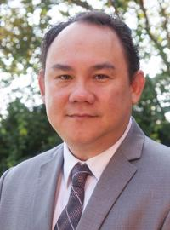
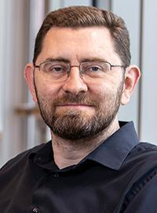
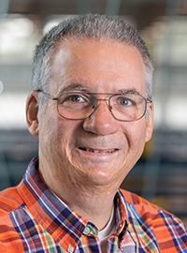
Sponsors and Advisors
Ian Lemler
Dr. Oscar Chuy
Dr. Johnathan Clark
Dr. Bruce Harvey

Slide 3
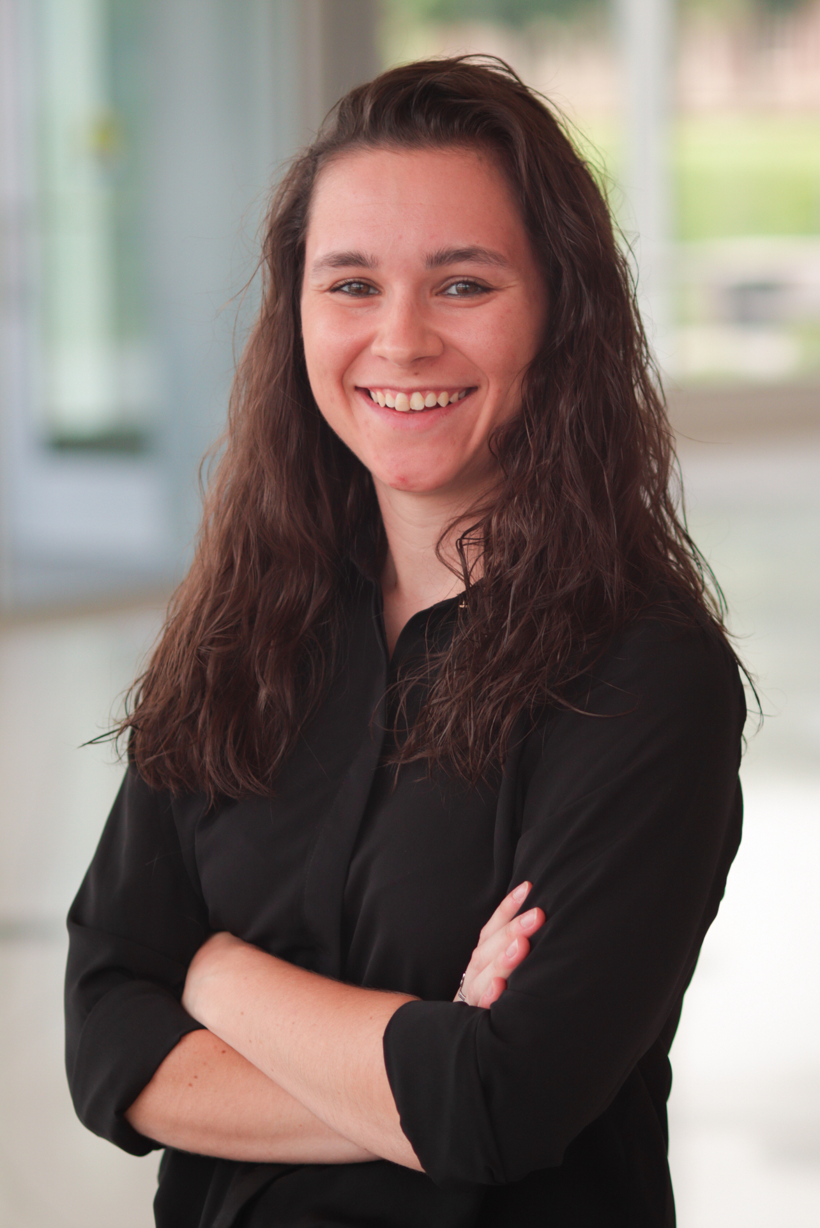
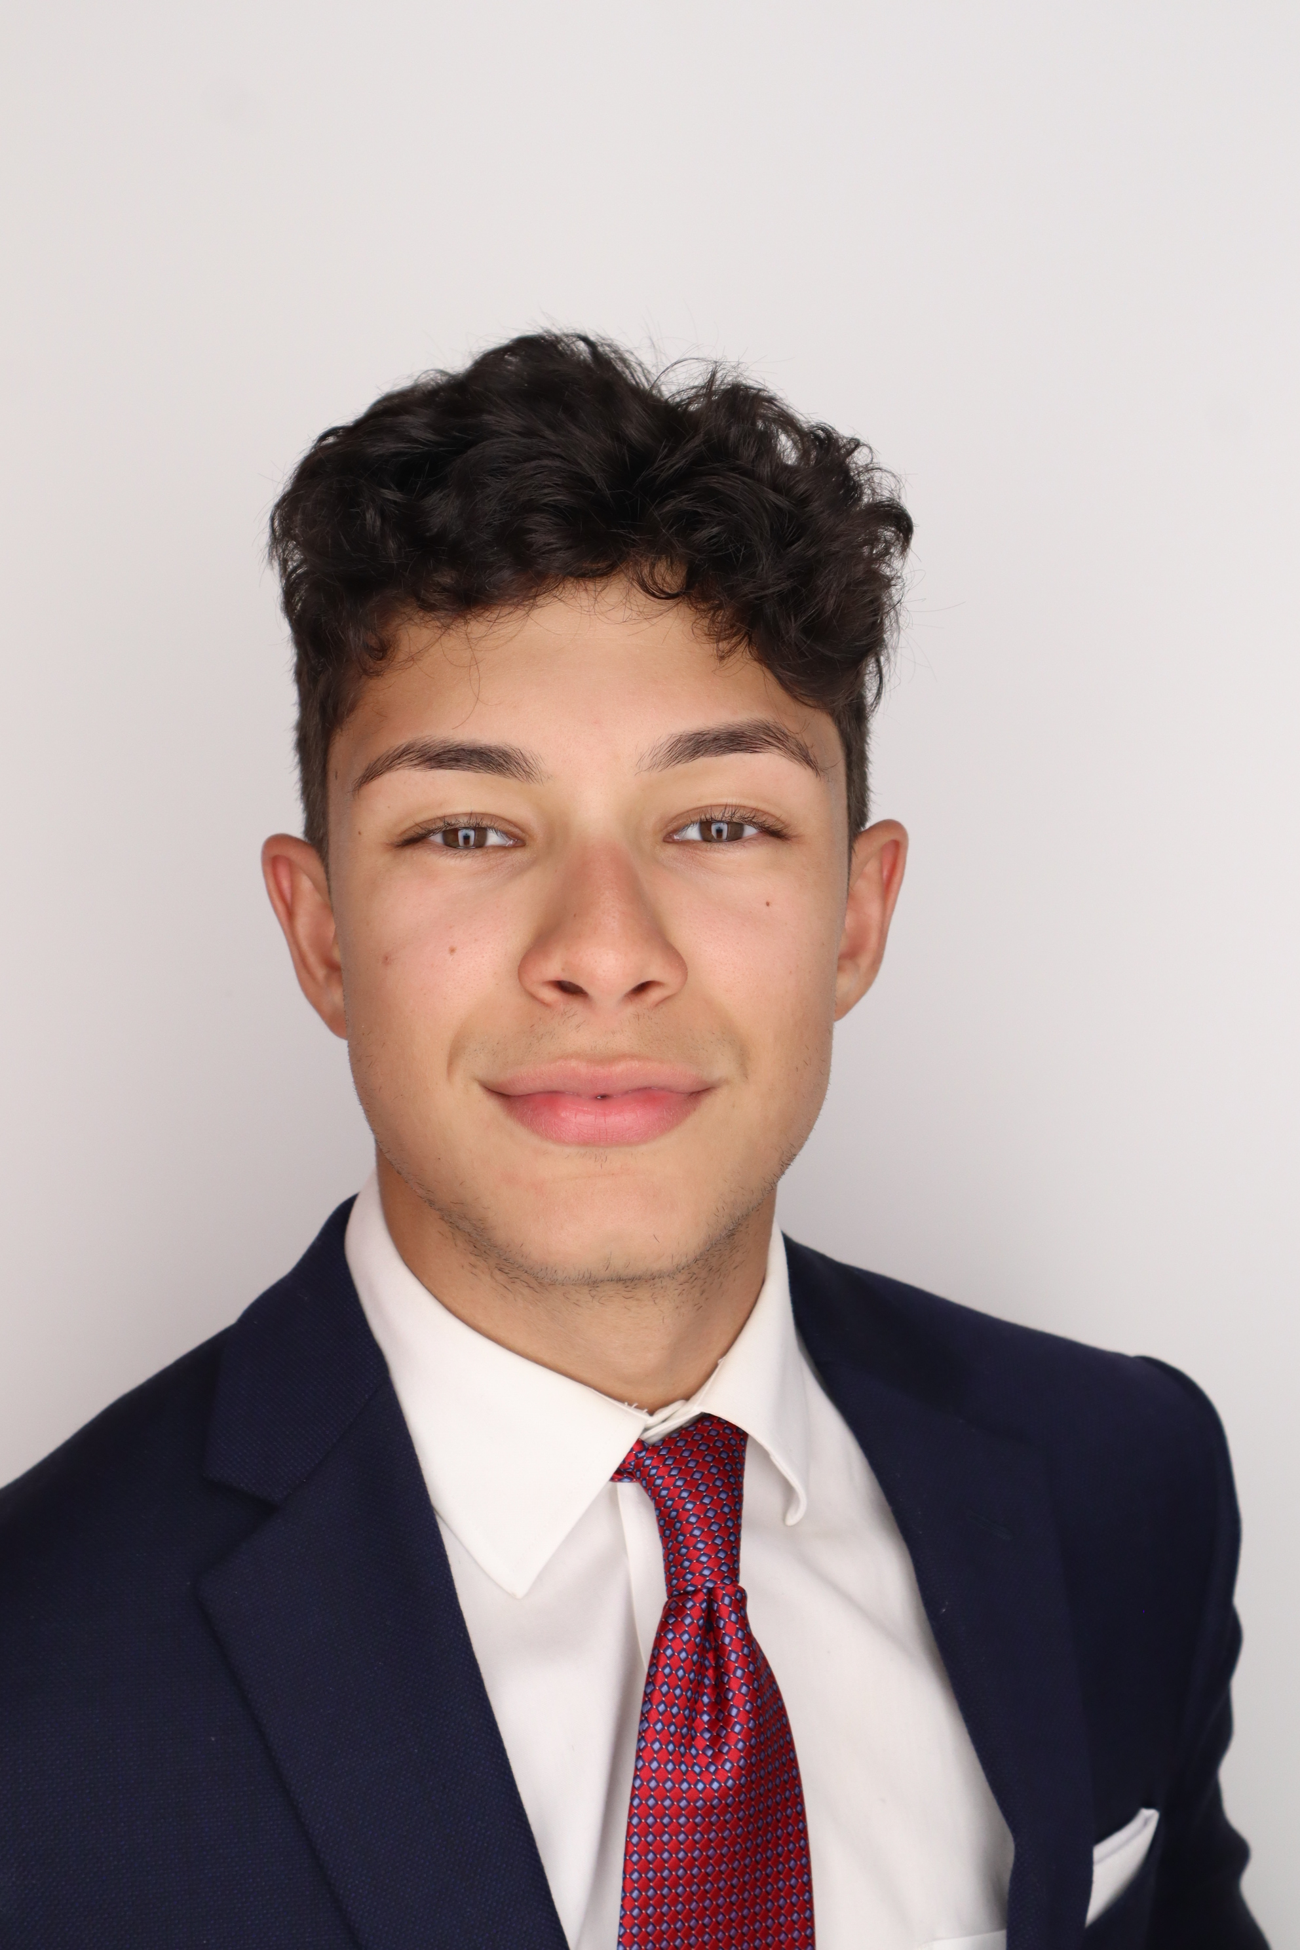
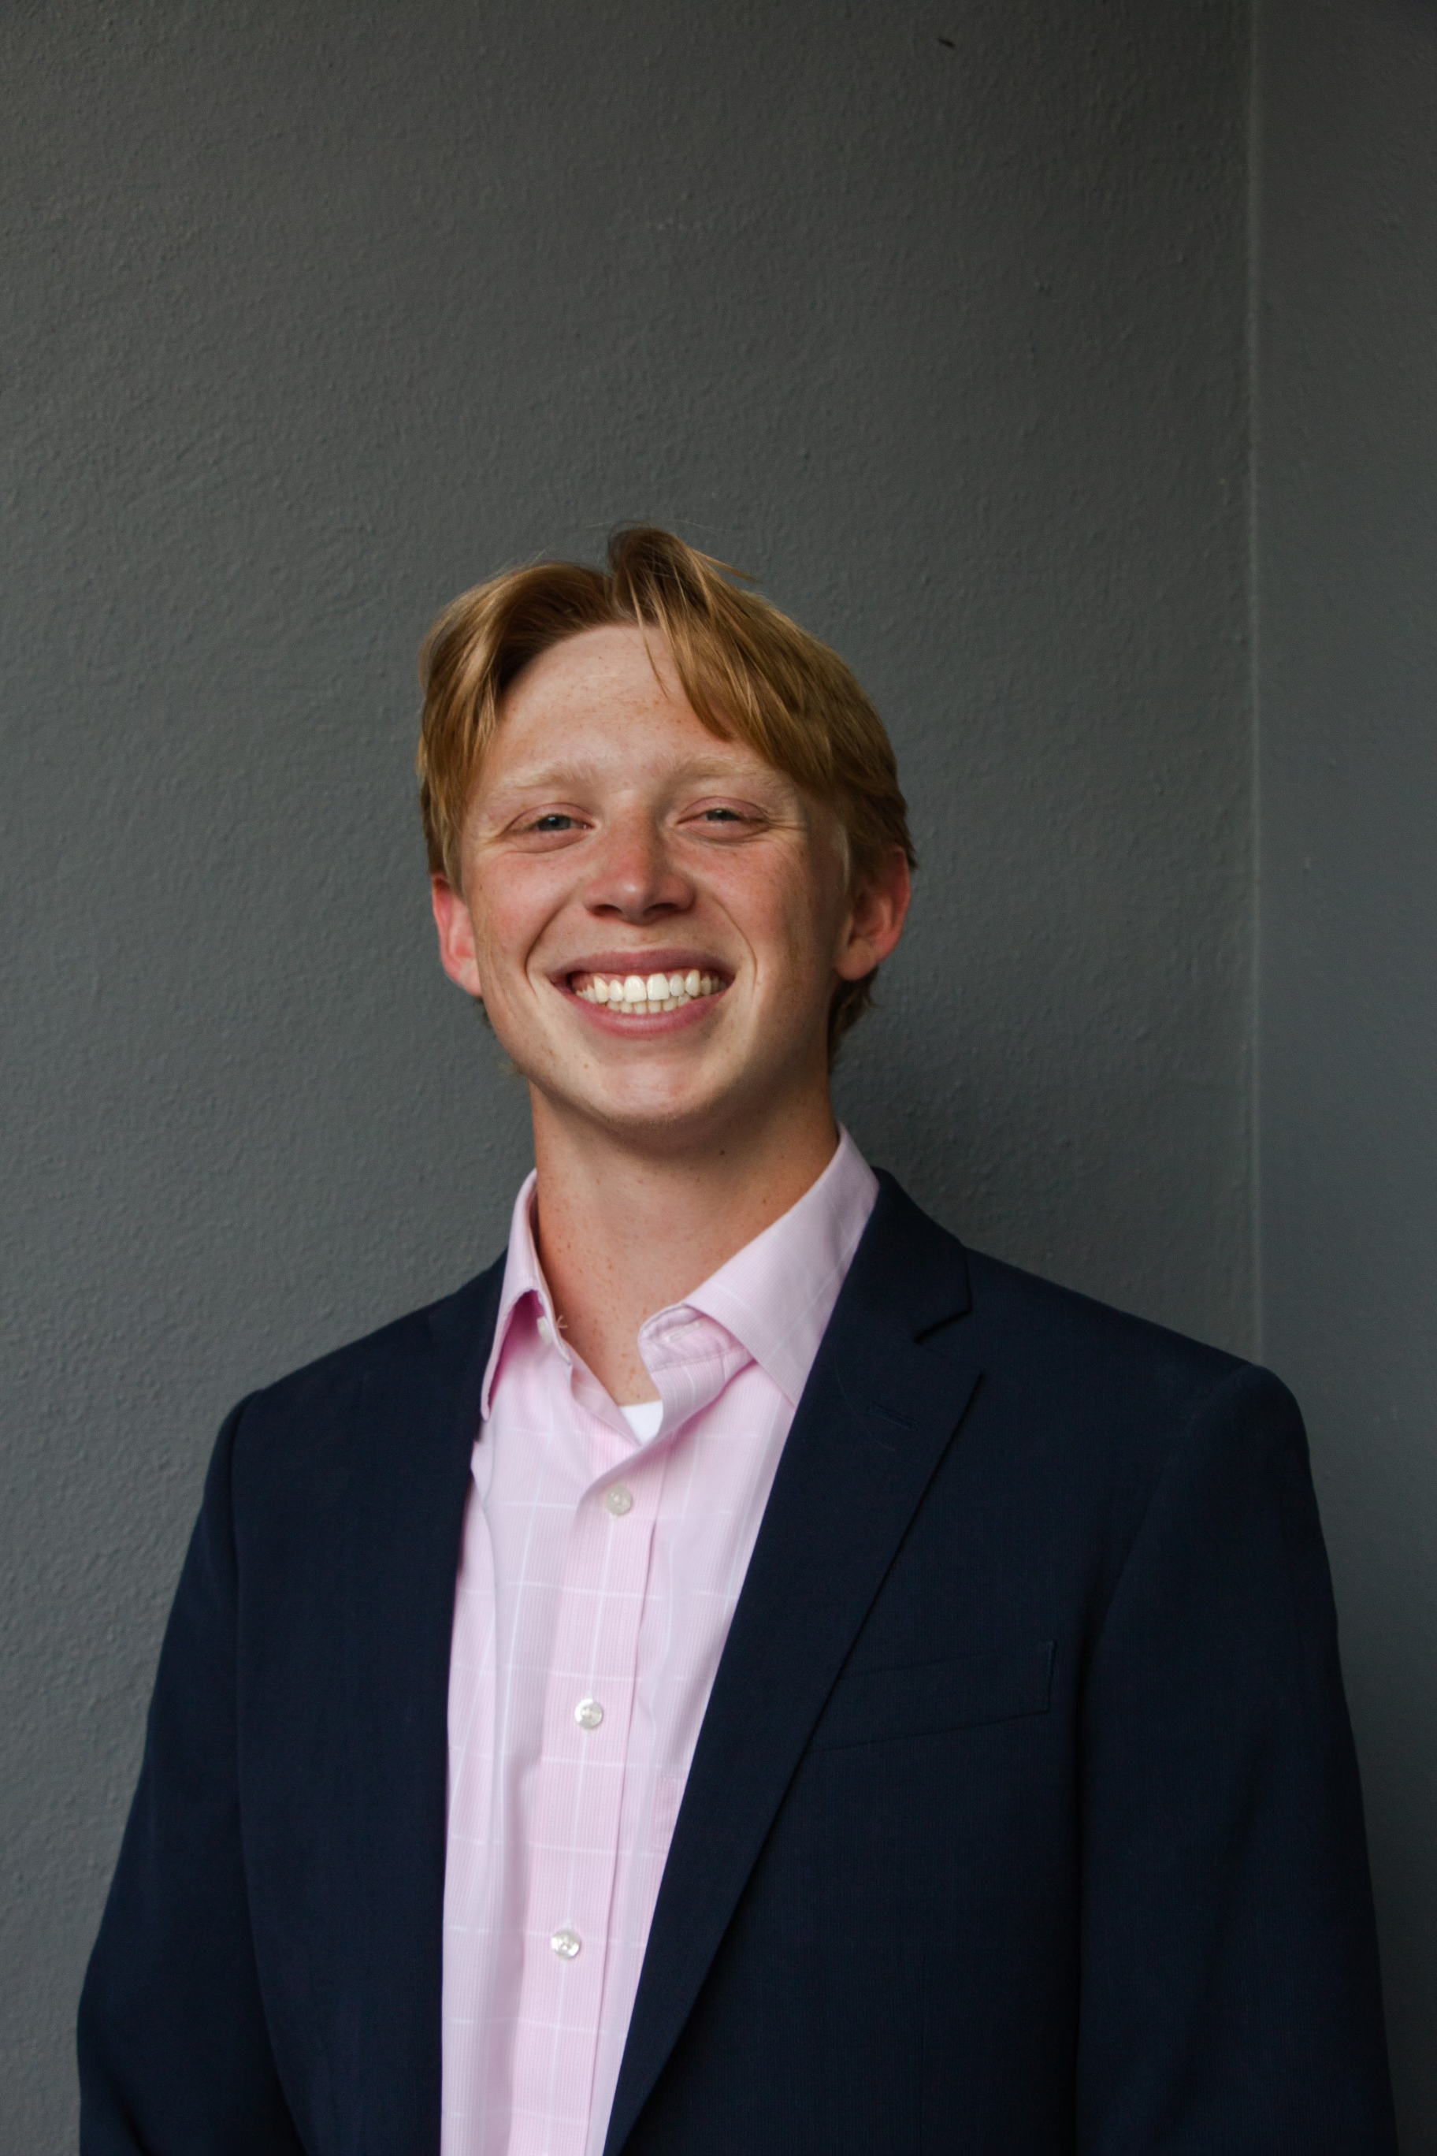
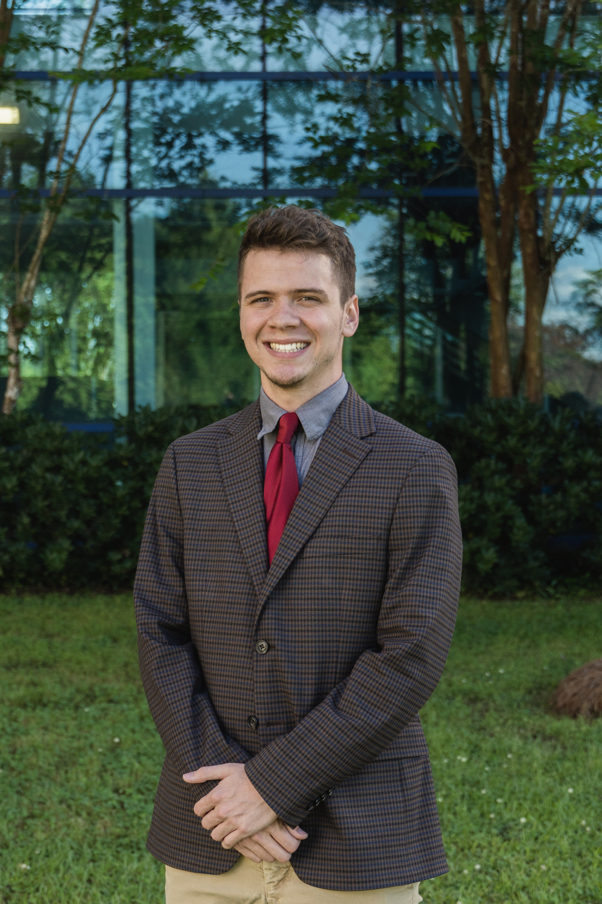
Meet the Team
Ian Lemler
Kelsey Gross
Luiz Santos
Ian Lemler
Eric Strawn

Slide 4
Objective
Ian Lemler
The objective of this project is to design, develop, and compete with a working robot that allows for the collection of different types of astral materials and optimizes point scoring.

Slide 5
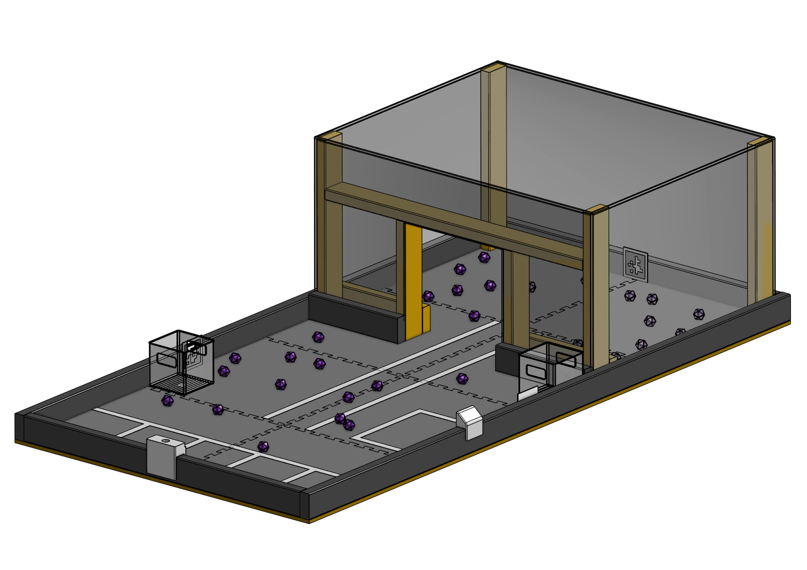
Project Description
Ian Lemler
Regional Competition for the Southeast States
Design, build, test, and program a fully autonomous robot
3 Minutes to complete all tasks
Collect astral materials and store them
Work with ECE departments team

Slide 6
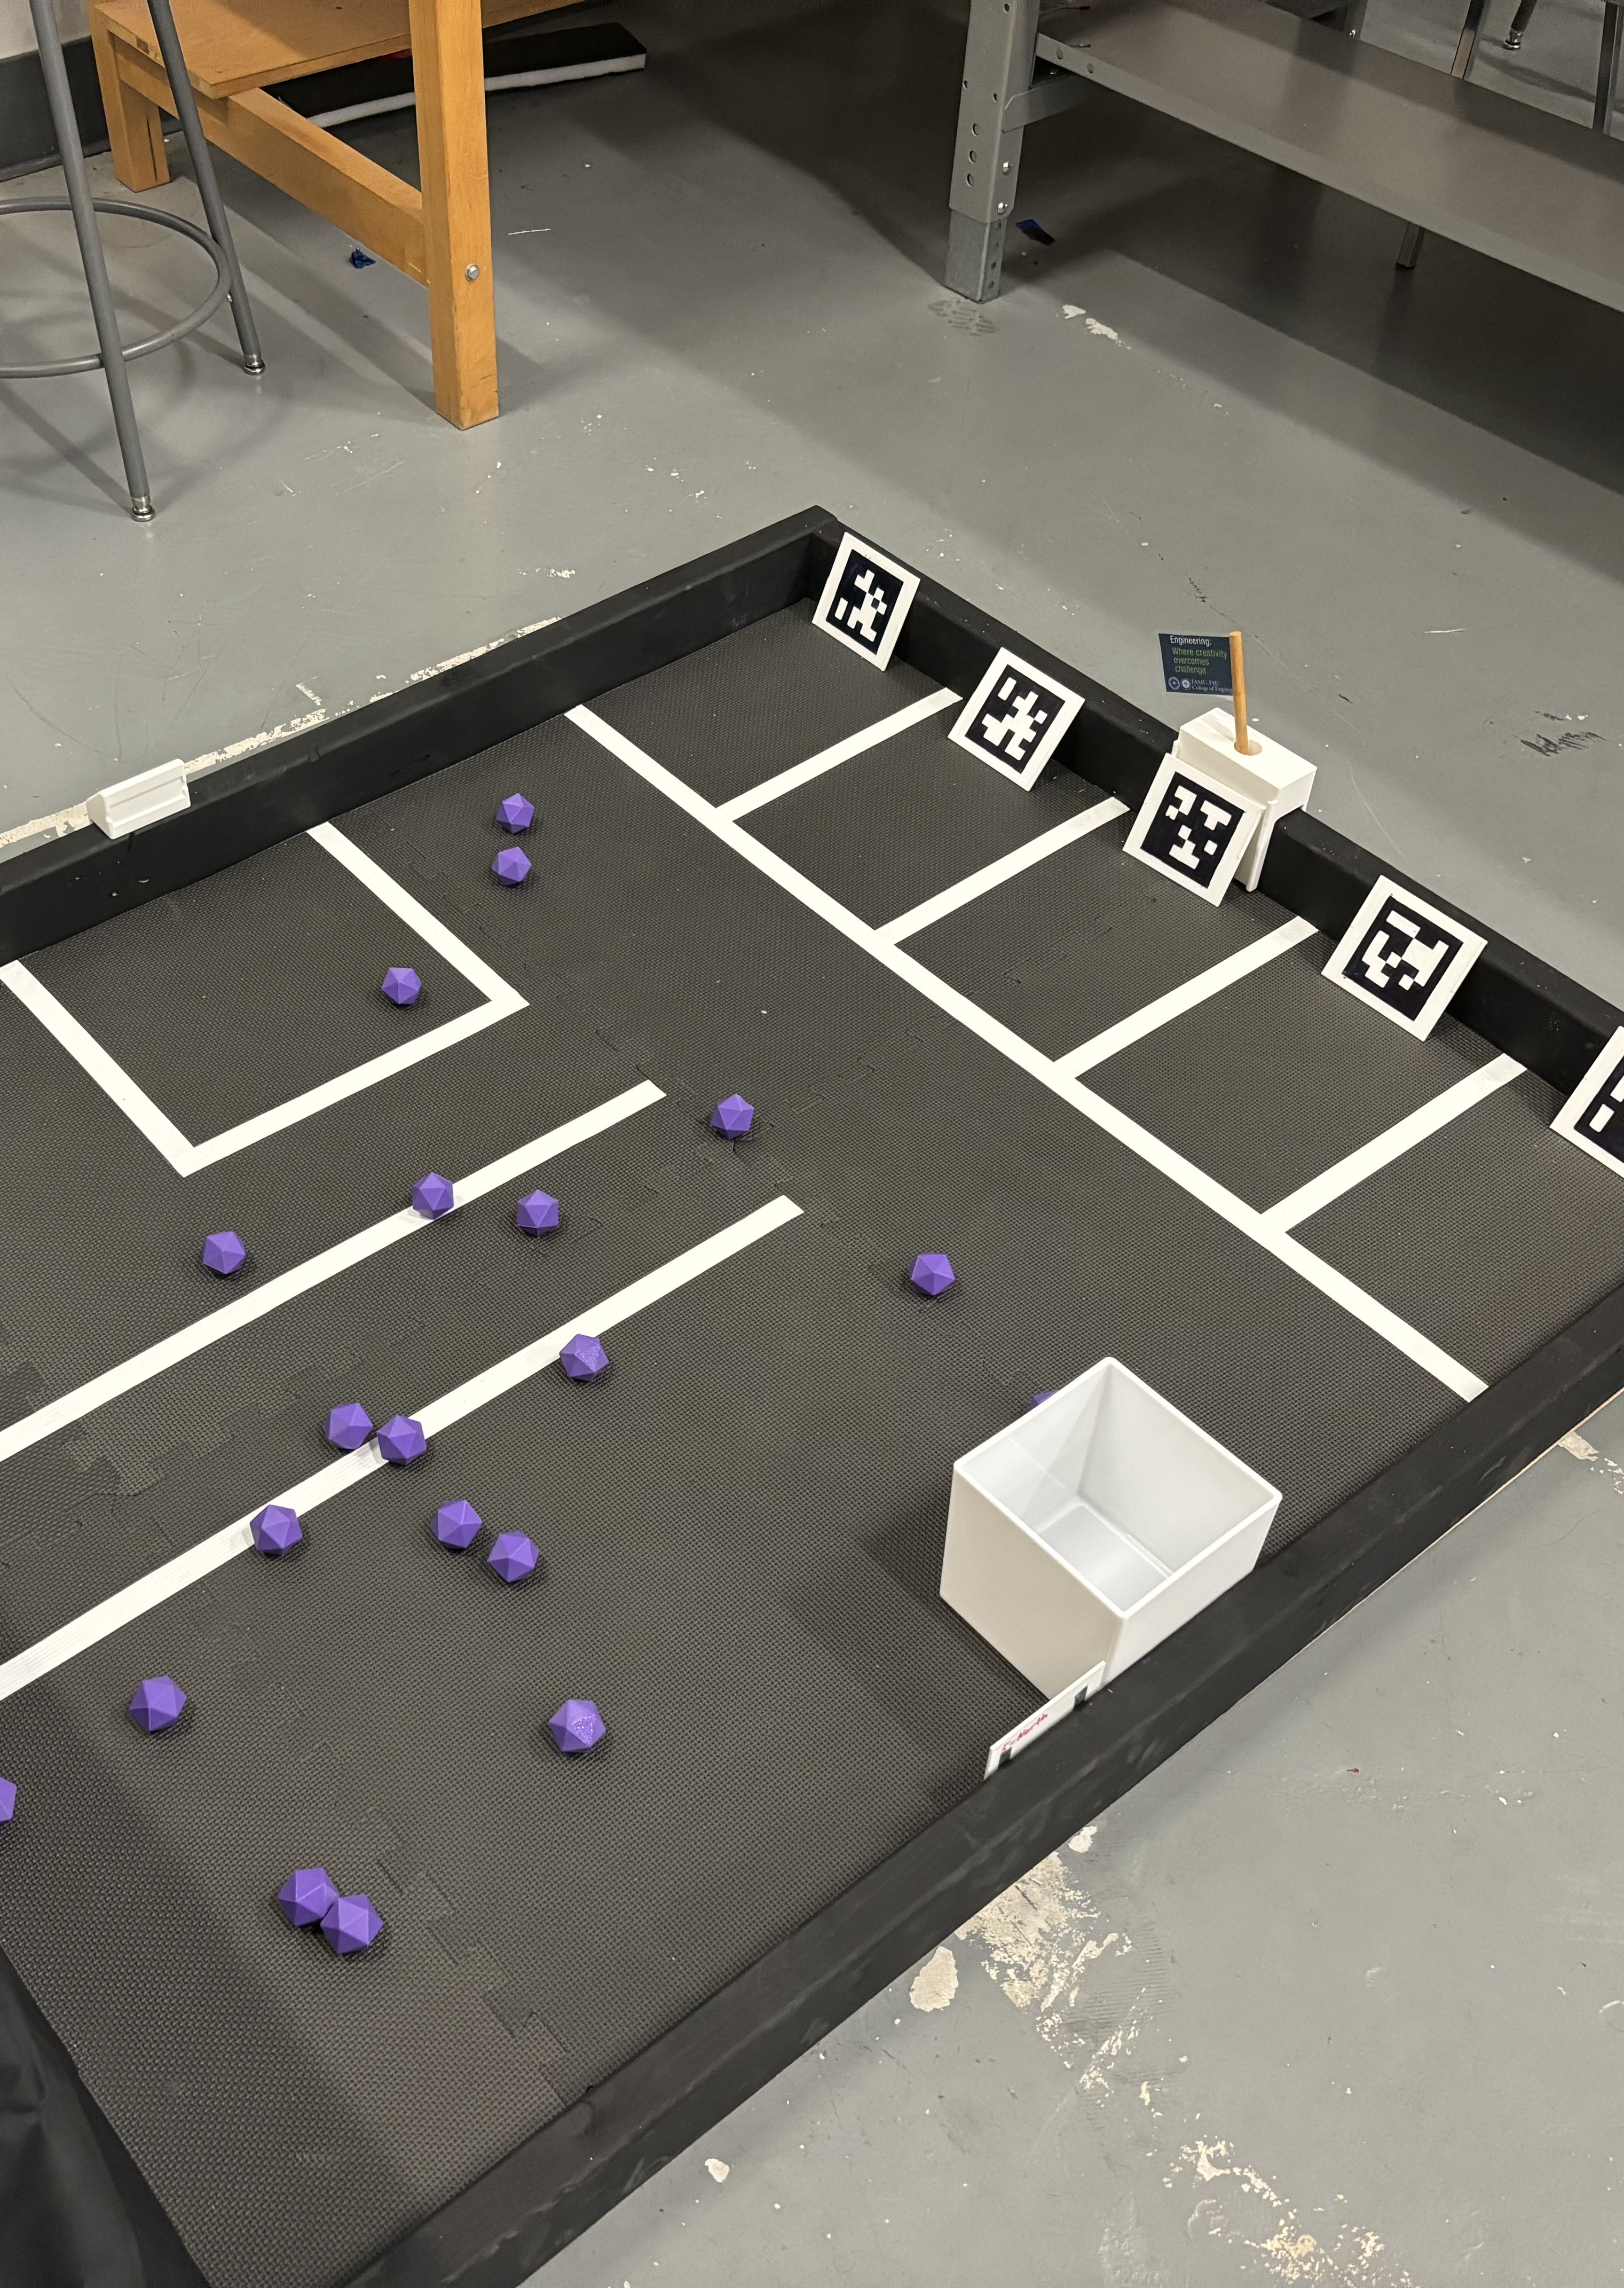
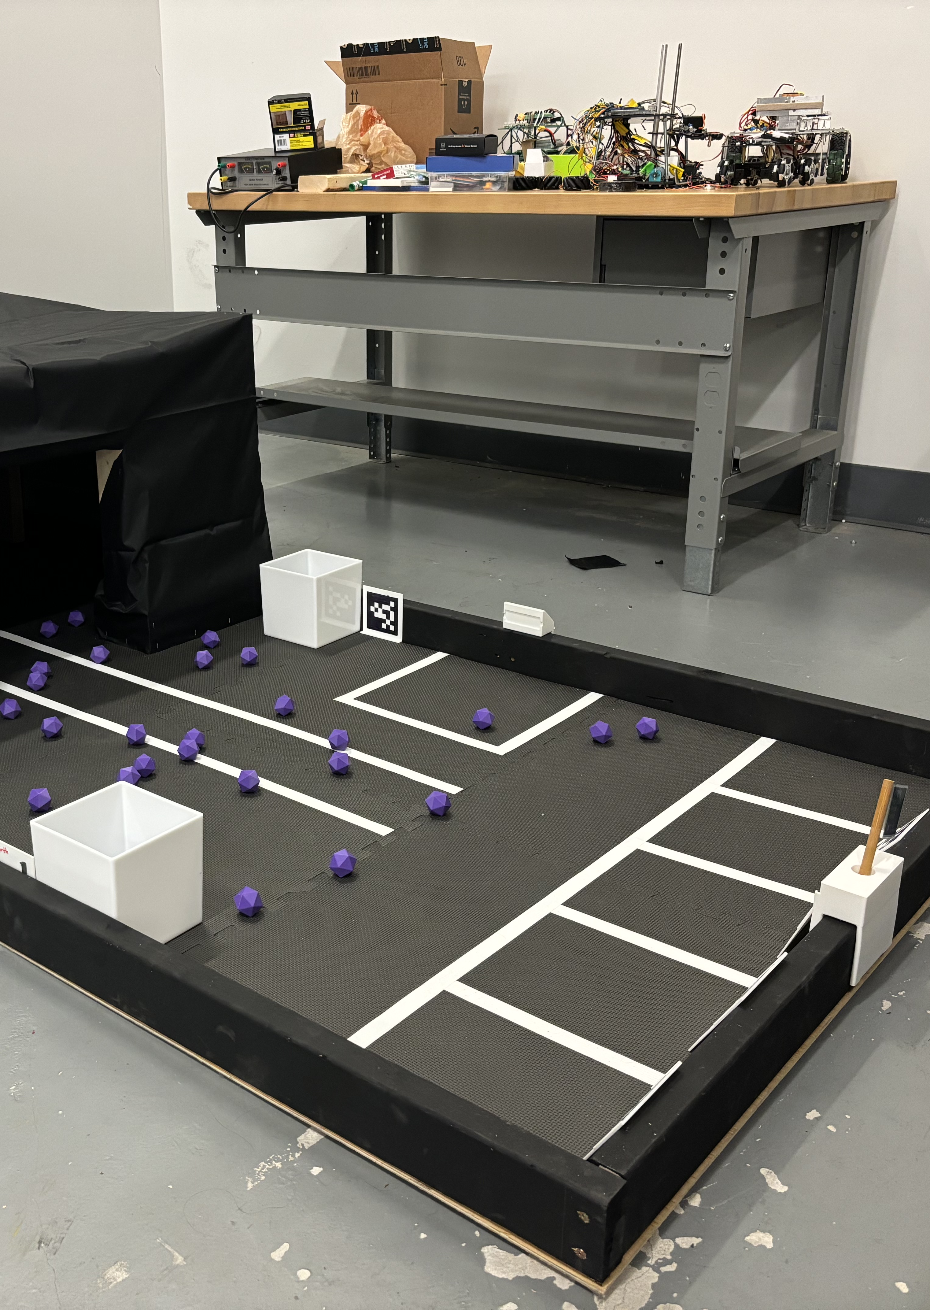
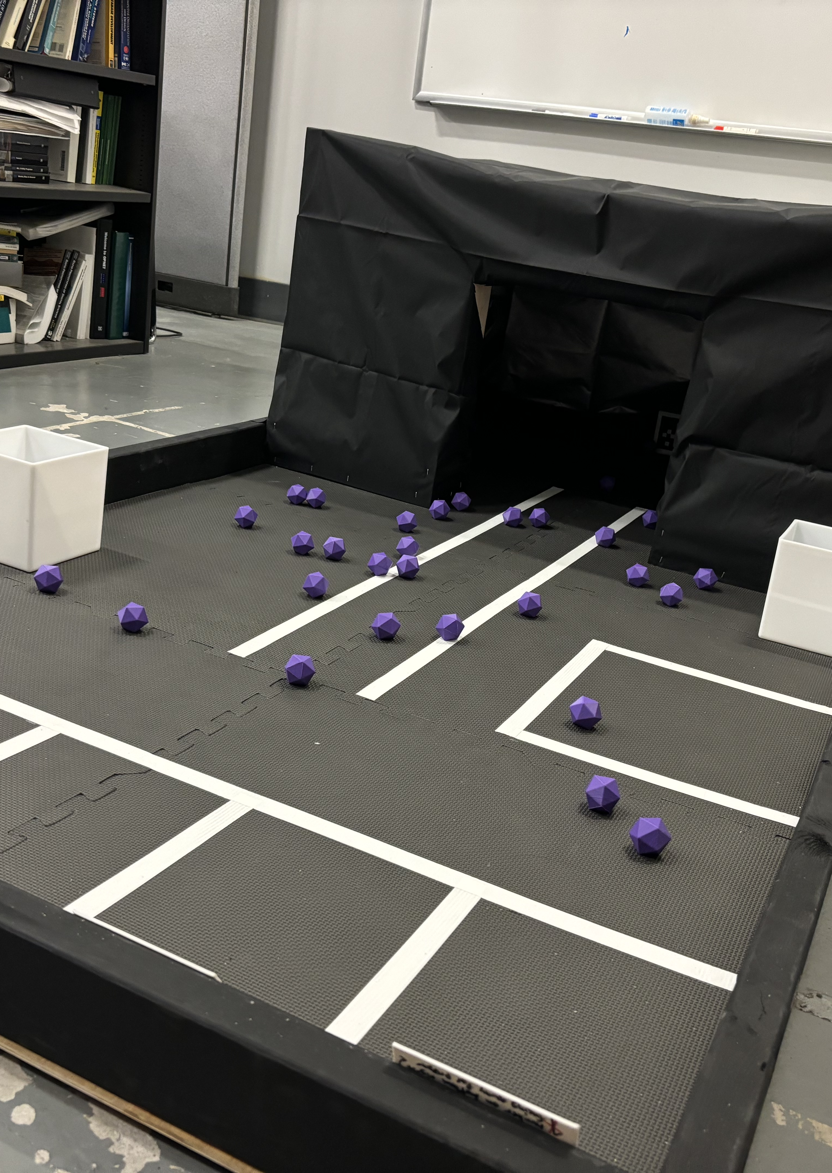
The Game Field
Ian Lemler

Slide 7
Targets and Metrics
Ian Lemler

Slide 8
Targets – Collection Mechanism
Ian Lemler
Function | Target | Metric
Detect Objects | Materials are detected within a 20 cm radius with 95% accuracy | % of materials detected
Grip Objects | 90% collection success rate | % of materials supported
Detection and Collection Integration | Less than 2 seconds between material detection and collection start | Tested in software portion of robot (time between code portions)

Slide 9
Targets – Sorting Mechanism
Ian Lemler
Function | Target | Metric
Differentiate Materials | Able to differentiate between materials with a 90% accuracy | Field test to determine accuracy (percentage)
Separation | Separates different materials with 75% accuracy | Field test to determine accuracy (percentage)

Slide 10
Targets –Navigation
Ian Lemler
Function | Target | Metric
Work in Cave | Operate at 85% efficiency of robot outside the cave | Compare to all targets outside of the cave
Autonomous | Operate autonomously for 3 minutes before being turned off | Timer to measure operation time (minutes)
Detect LED | Robot moves within 2 seconds of LED light being turned on | Timer to measure start time after LED (seconds)

Slide 11
Targets – Structure, Power, and User Interaction
Ian Lemler
Function | Target | Metric
Meets Weight Requirement | Less than 12 kg | Weight scale
Emergency Stop capabilities | Power to 0V | Voltmeter
Support Weight | Support up to 15 kg and operate normally | Weight scale
Generate Power | 5-24V for at least 4 minutes | Timer to measure how long the battery can support all functions of the robot

Slide 12
Critical Targets
Ian Lemler
Weigh less than 12 kg and support up to 15 kg
All power goes to 0V upon activation of emergency stop
Battery generates enough power to support necessary systems for the duration of the game (3-4 minutes)
Robot collects and supports objects with a 90% success rate
Robot detects LED light within 2 seconds to ensure optimal start speed

Slide 13
Point Potential
Kelsey Gross
Task | Points
Out of the Landing Site | 5
Out of the Landing Site within 3 Seconds | 5
In the Cave (First Time) | 15
Cosmic Shipping Container in Non-Telemetry Rendezvous Pad | 15
Cosmic Shipping Container in Telemetry Rendezvous Pad | 30
Astral Material supported by the Robot Unit (each) | 1
Astral Material in wrong Shipping Container (each) | 2
Nebulite in Nebulite Cosmic Shipping Container | 5
Geodinium in the Geodinium Cosmic Shipping Container | 6
Team Beacon has at least some portion in the Beacon Mast | 40

Slide 14
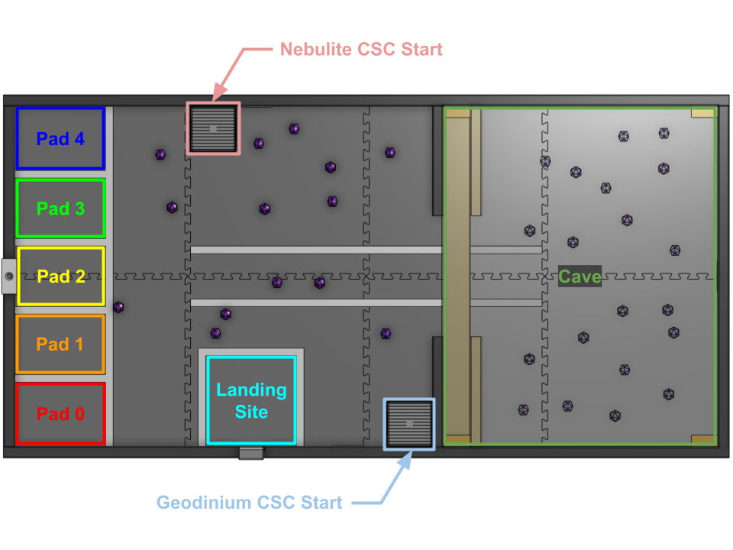
Point Optimization
Kelsey Gross
Ideal Plan | Points
Out of the Landing Site | 5
Out of the Landing Site within 3 Seconds | 5
In the Cave (First Time) | 15
Cosmic Shipping Container in Telemetry Rendezvous Pad | 30
Geodinium in the Geodinium Cosmic Shipping Container
Team Beacon has at least some portion in the Beacon Mast | 40
In the Cave Points Gained | 52
Out of the Cave Points Gained | 88
Total: | 235
Notes:
283 MAX vs 235 PLANNED

Slide 15
Concept Generation
Kelsey Gross

Slide 16
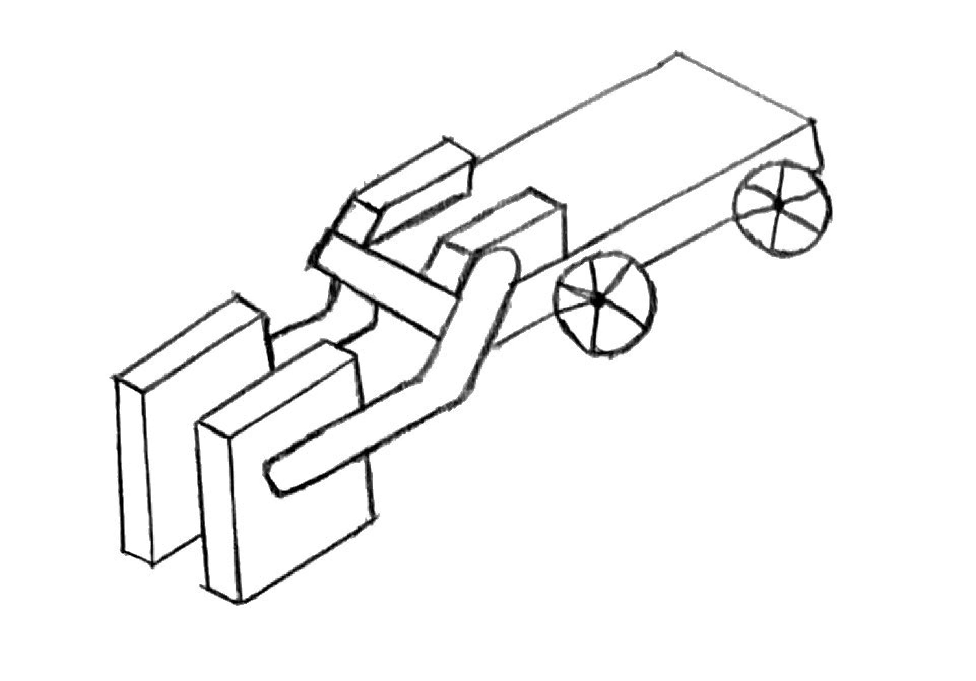
Compactor
Kelsey Gross

Slide 17
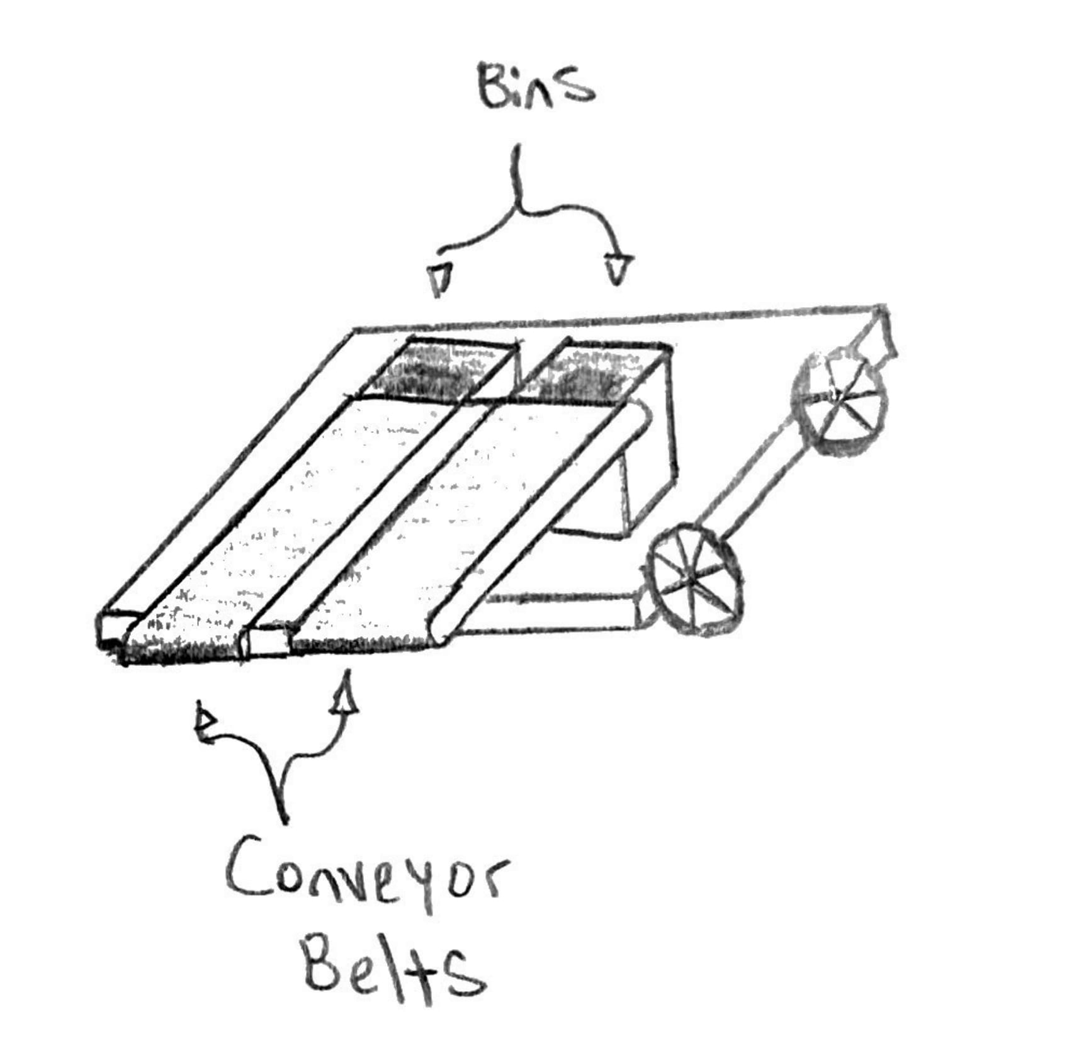
Multi Conveyer
Kelsey Gross

Slide 18
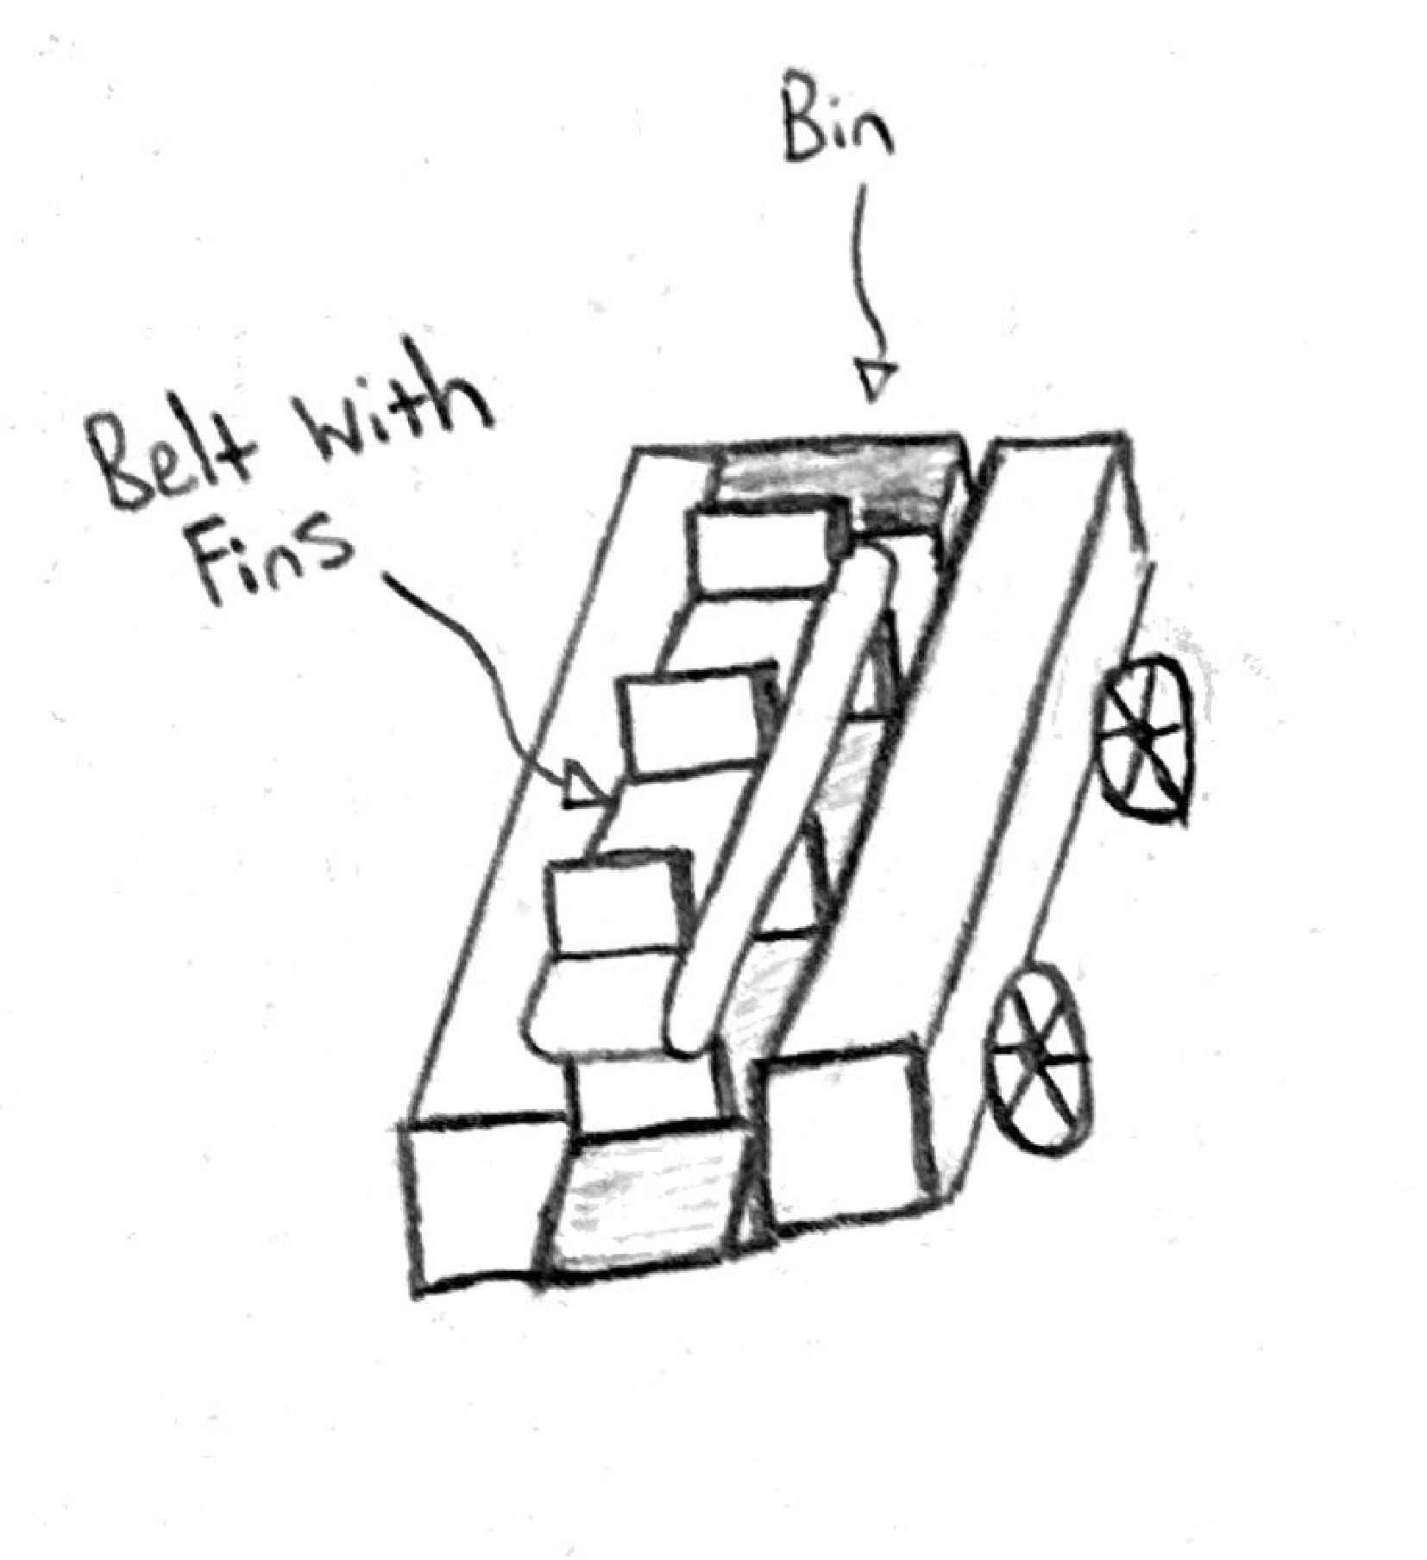
Lazy Hercules
Kelsey Gross

Slide 19
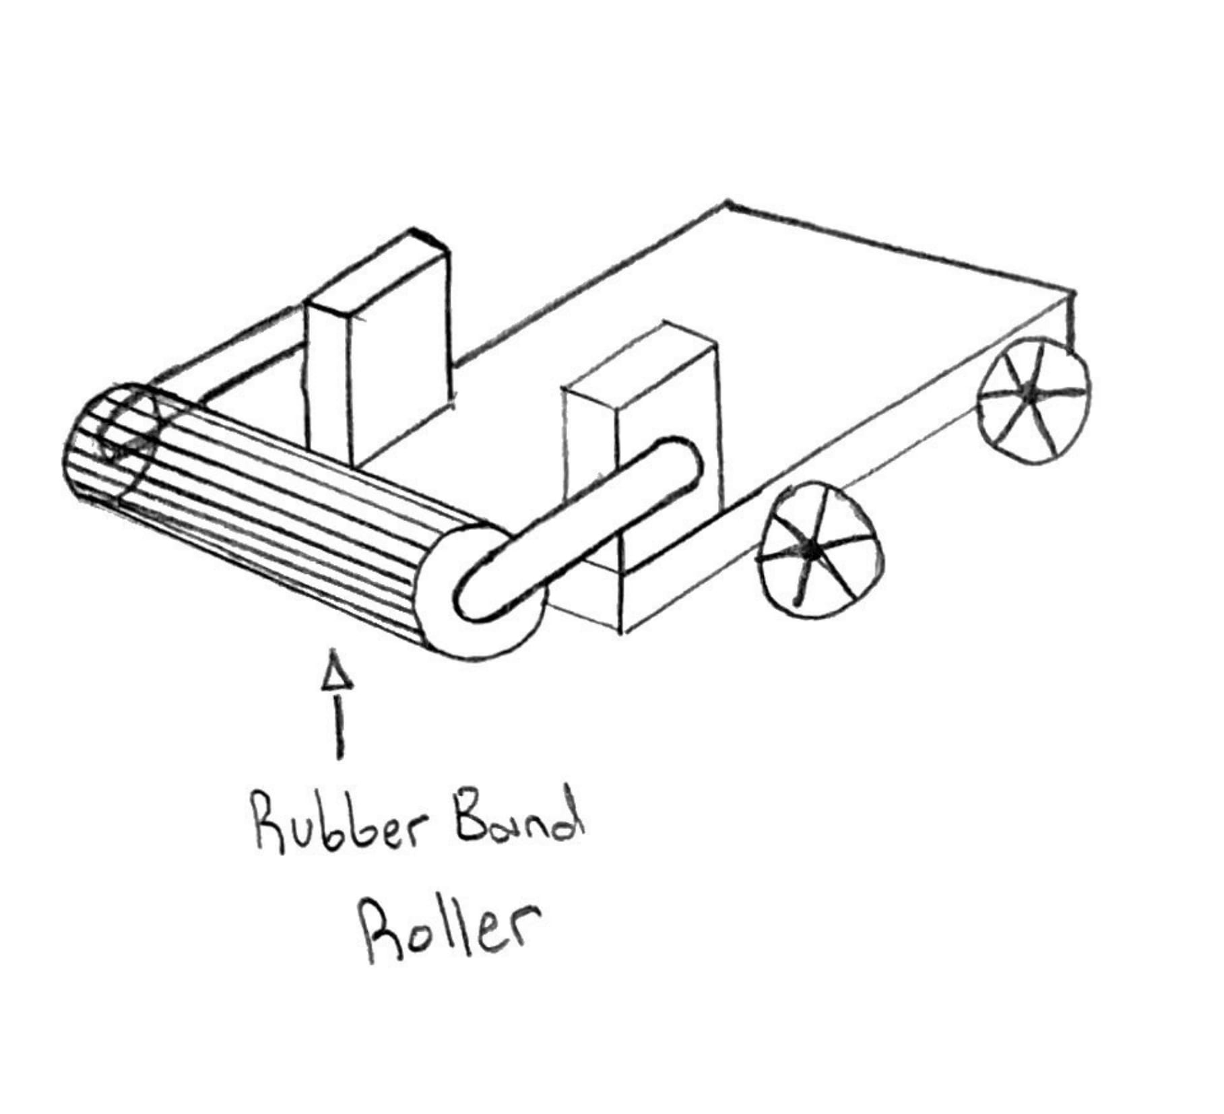
Band Box Bot
Kelsey Gross

Slide 20
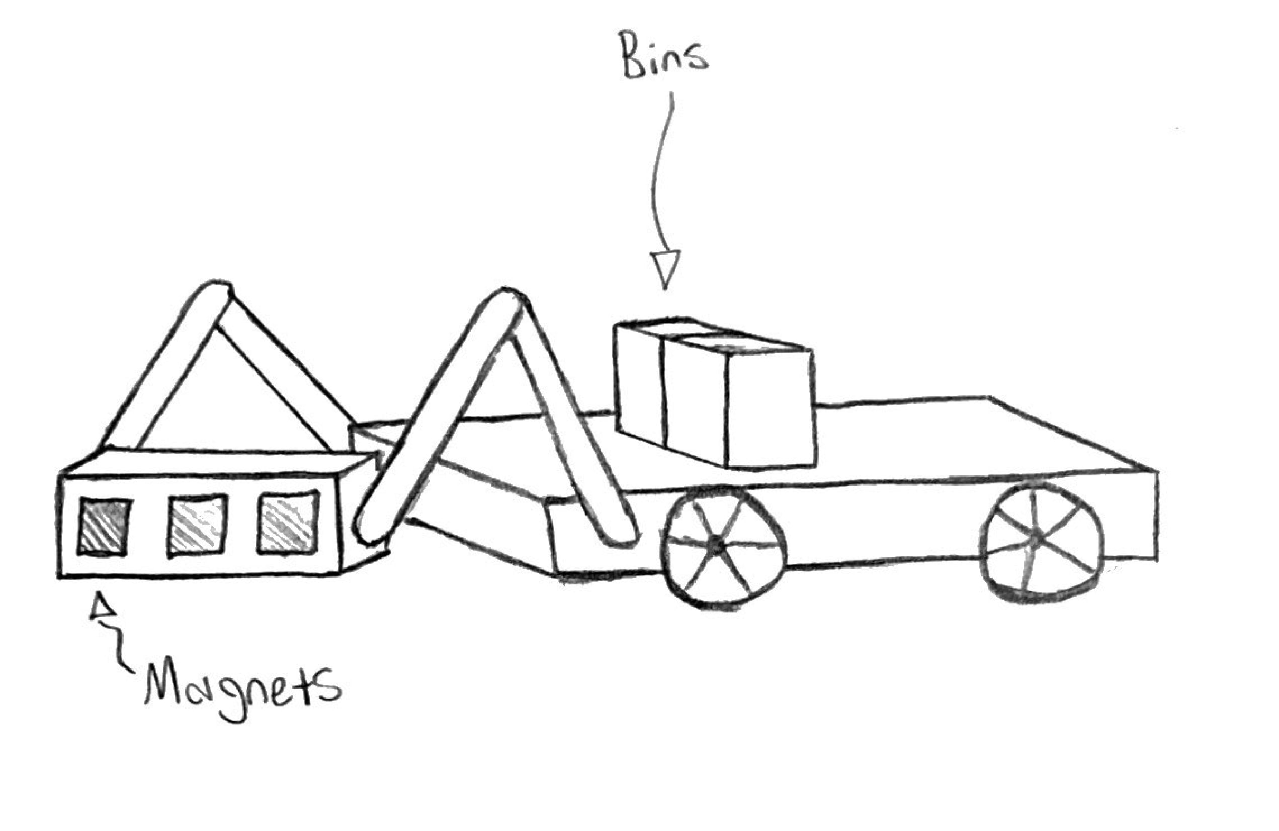
Magnetic Bulldozer
Kelsey Gross

Slide 21
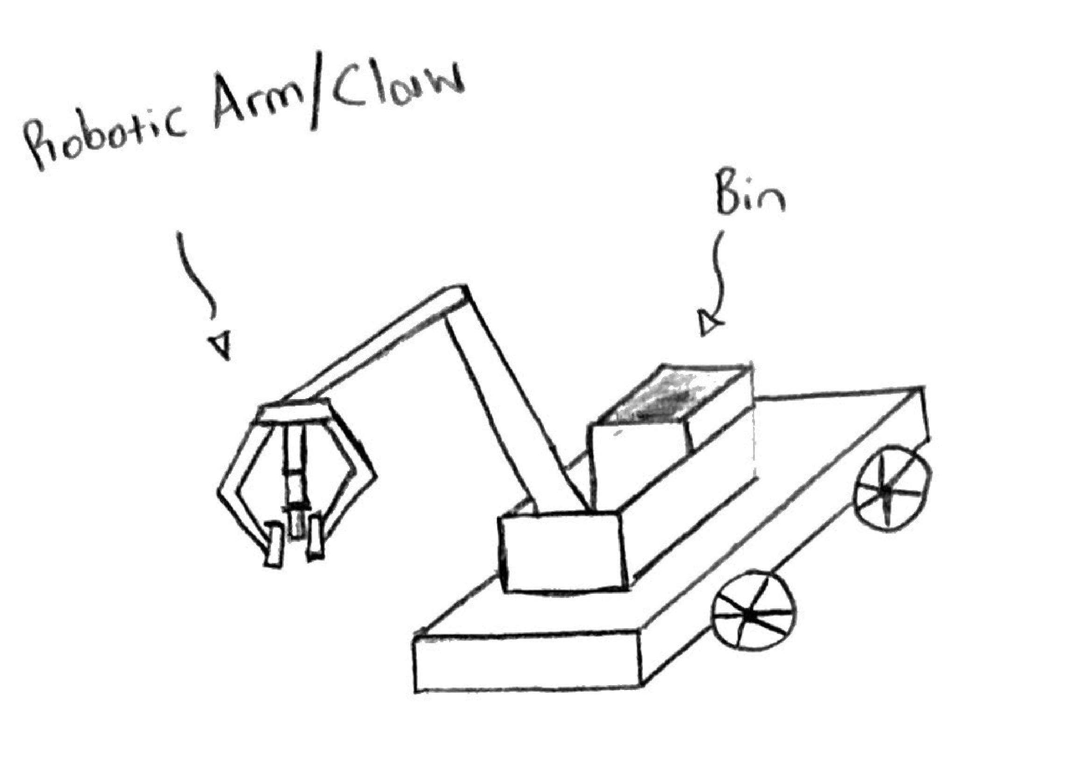
Robotic Claw
Kelsey Gross

Slide 22
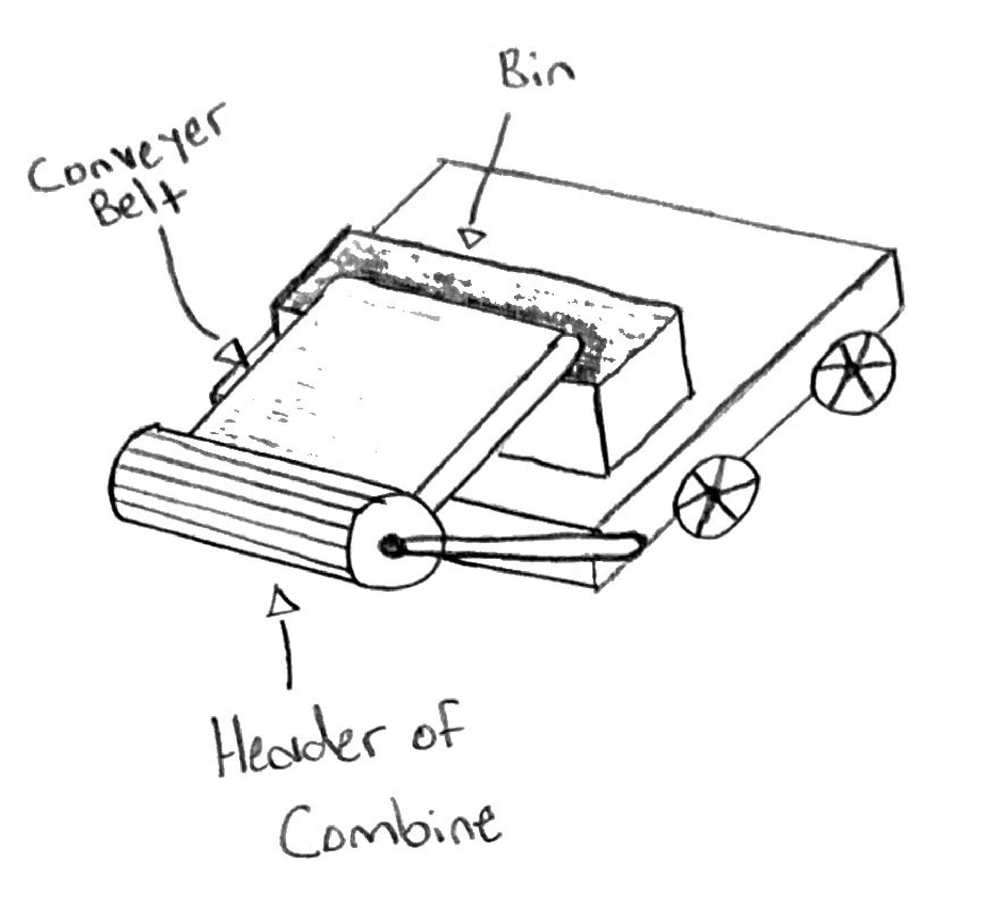
Frank
Kelsey Gross

Slide 23
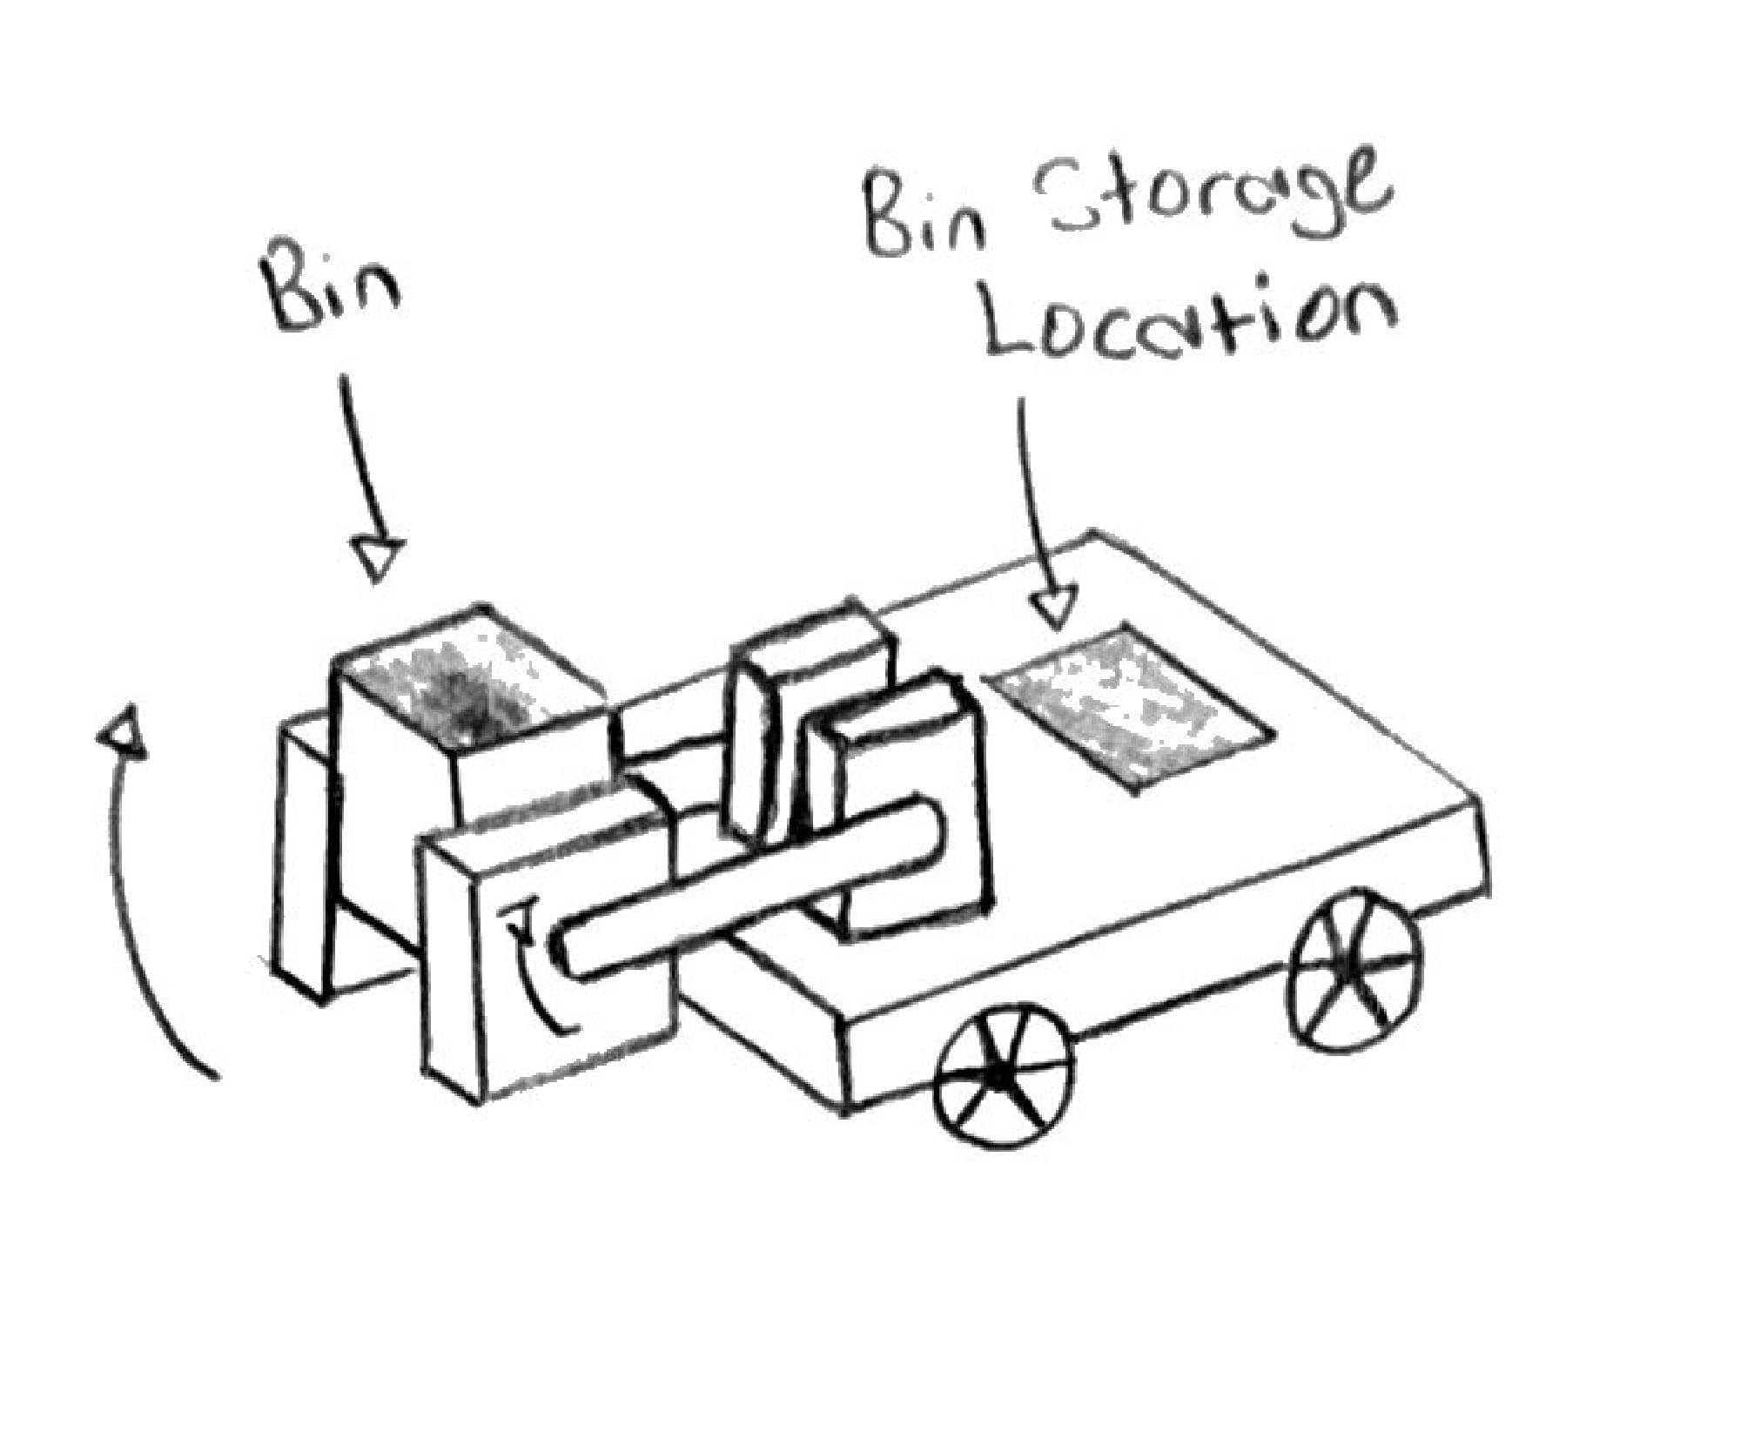
Clamp and Lift
Kelsey Gross

Slide 24
Concept Selection
Ian Lemler

Slide 25
Binary Pairwise Comparison
Ian Lemler
Customer Requirement | IWF
Under 12 kg | 4
Starts with LED | 7
Size Constraint Followed | 4
Battery Powers Robot | 8
IR Camera works in Cave | 1
Intakes Material | 7
Reads April Tag | 4
Feedback System | 6
Autonomous | 9
Detect Materials | 4
Sort Materials | 1

Slide 26
House of Quality
Ian Lemler
Engineering Characteristic | Raw Score | Rank Order
Weight | 72 | 7
Voltage From Power Supply | 722 | 7
Stability | 59 | 10
Time to Move | 63 | 9
Time to Complete Collection | 76 | 6
Volume | 126 | 3
Time to Place Beacon | 160 | 2
Time to Place Bins | 55 | 11
Sensors | 201 | 1
Speed of Shutoff | 54 | 12
Mobility | 94 | 4
Wheel Torque | 93 | 5

Slide 27
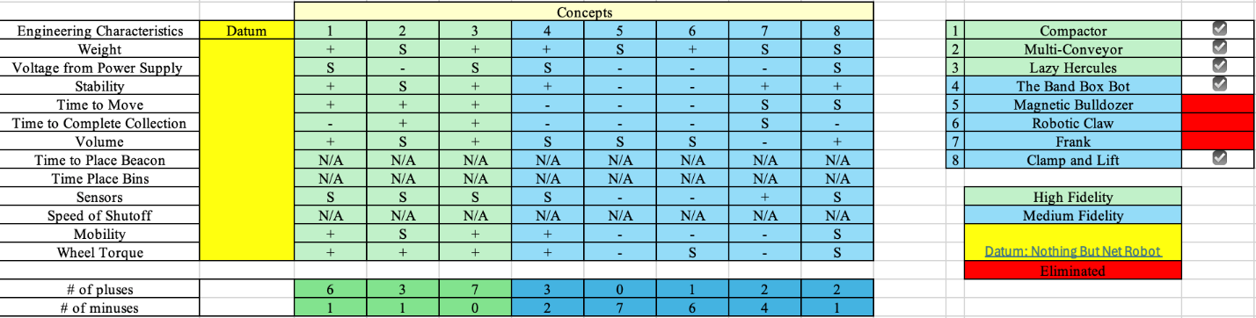
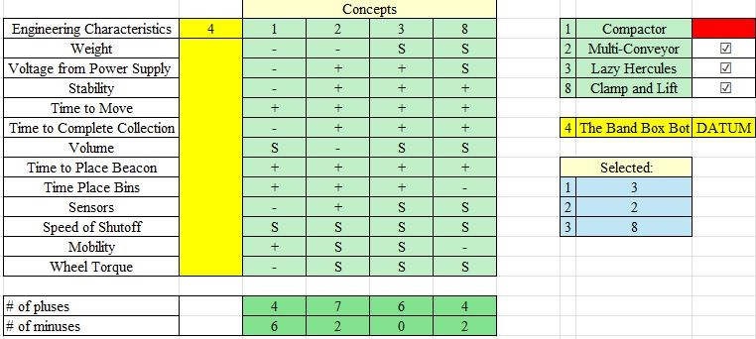
Pugh Charts
Ian Lemler

Slide 28
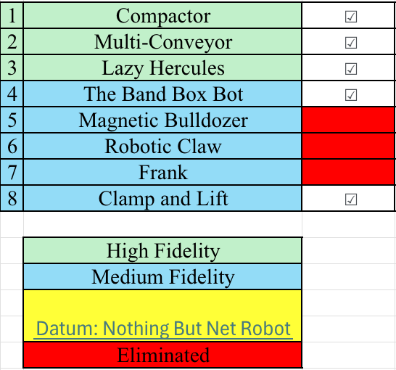
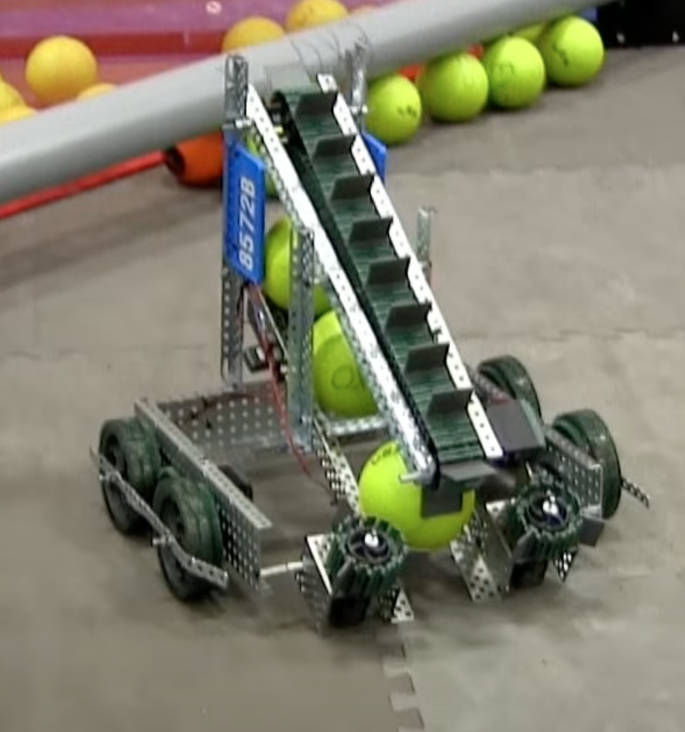
Pugh Chart 1 - Results
Ian Lemler

Slide 29
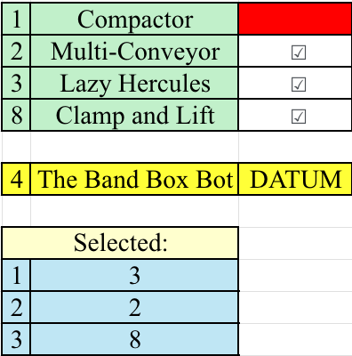
Pugh Chart 2 - Results
Ian Lemler

Slide 30
AHP
Ian Lemler
Criteria | Sum | Normalized
Weight | 60.03 | 0.215
Voltage from power supply | 60.53 | 0.159
Stability | 45.68 | 0.111
Time to move | 5.03 | 0.019
Time to complete collection | 24.34 | 0.060
Volume | 58.00 | 0.194
Time to place beacon | 7.30 | 0.021
Time to place bins | 9.70 | 0.026
Sensors | 30.77 | 0.073
Speed of shutoff | 15.58 | 0.038
Mobility | 16.42 | 0.040
Wheel torque | 18.42 | 0.044

Slide 31
Testing
Kelsey Gross

Slide 32
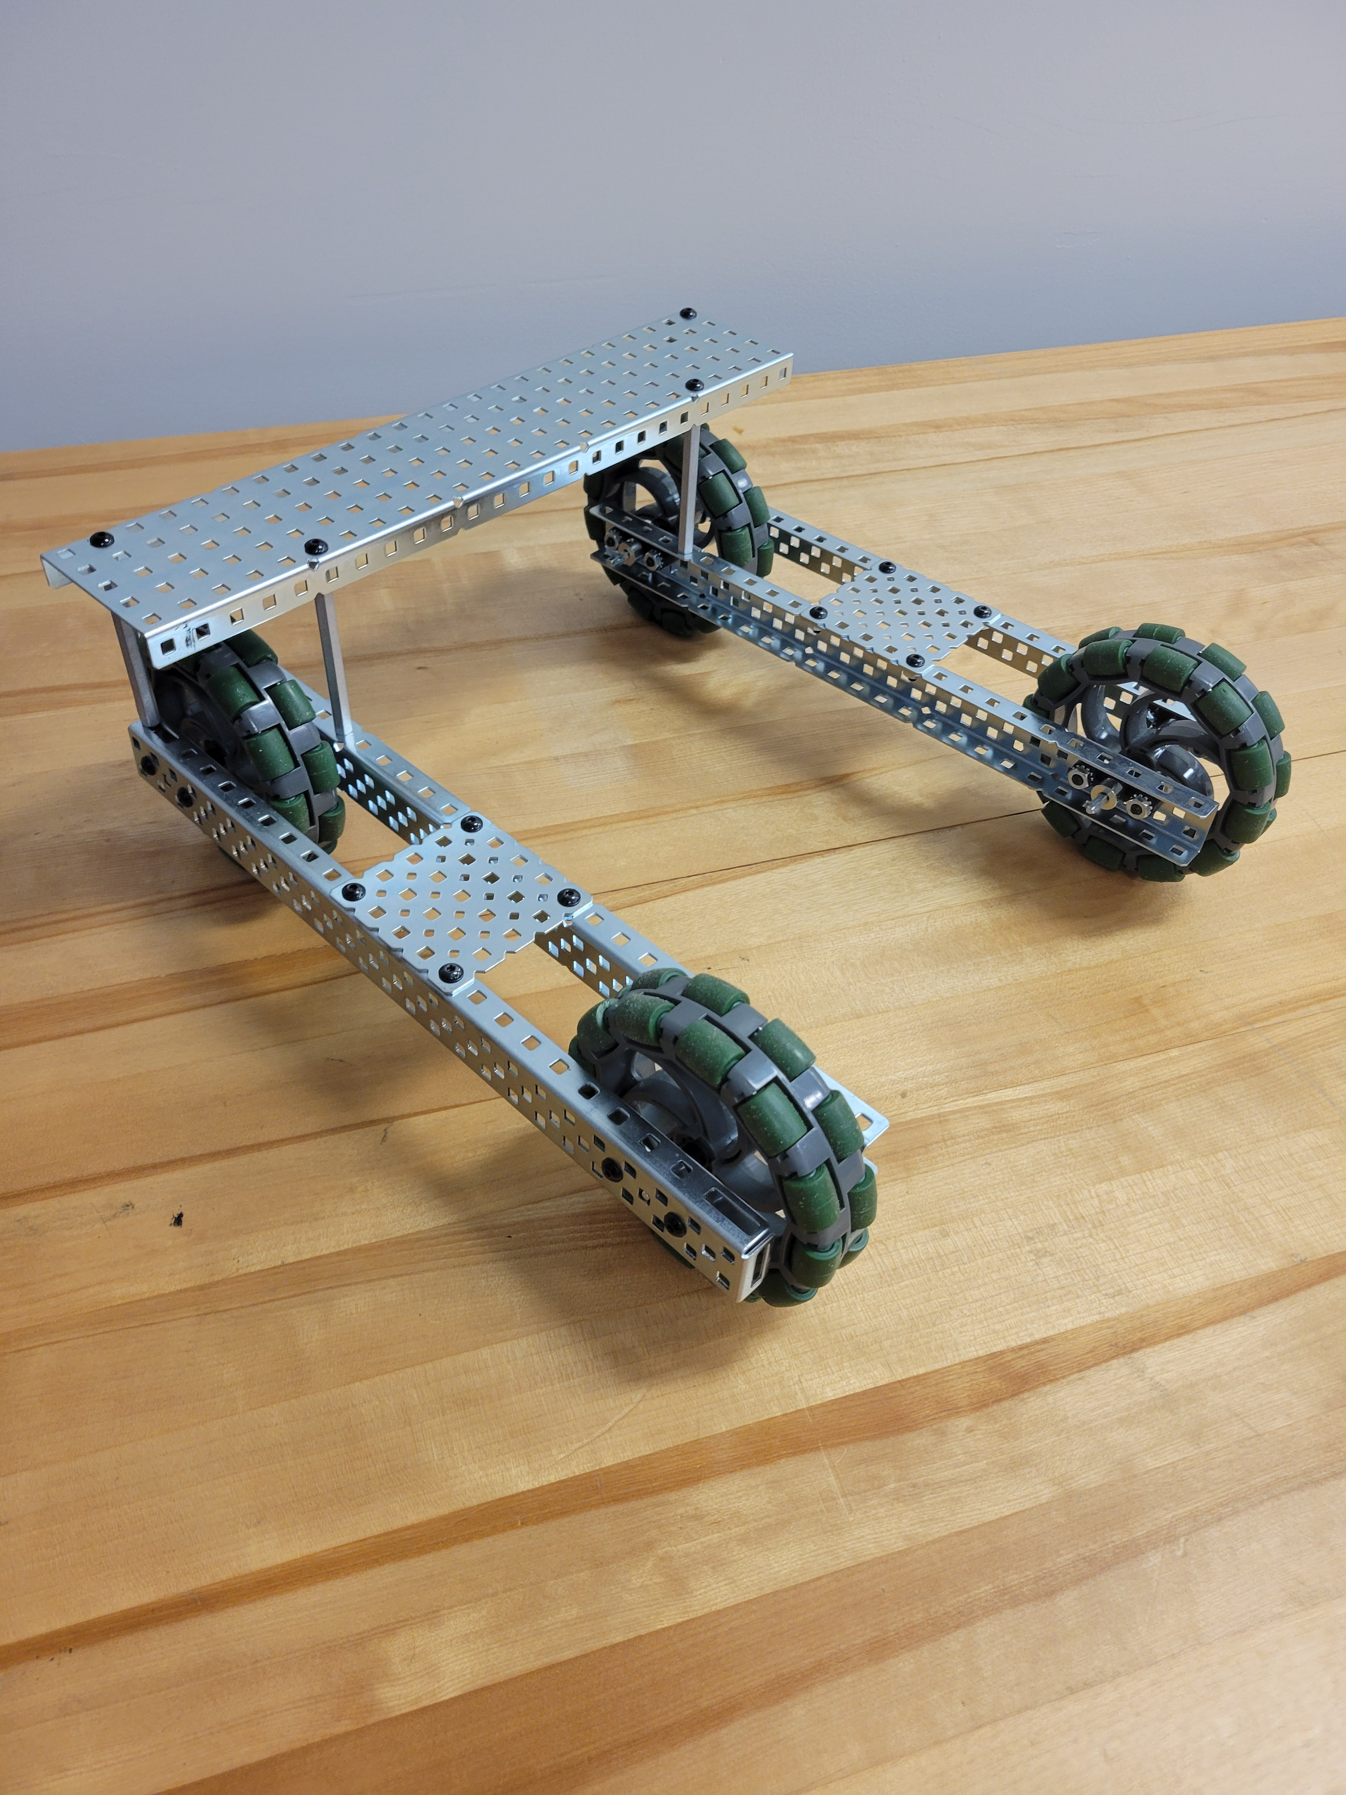
Concept 1
Kelsey Gross
Proof of drive train concept
Give a visual representation of start size constraint in the X and Y axis
12 in.
12 in.

Slide 33
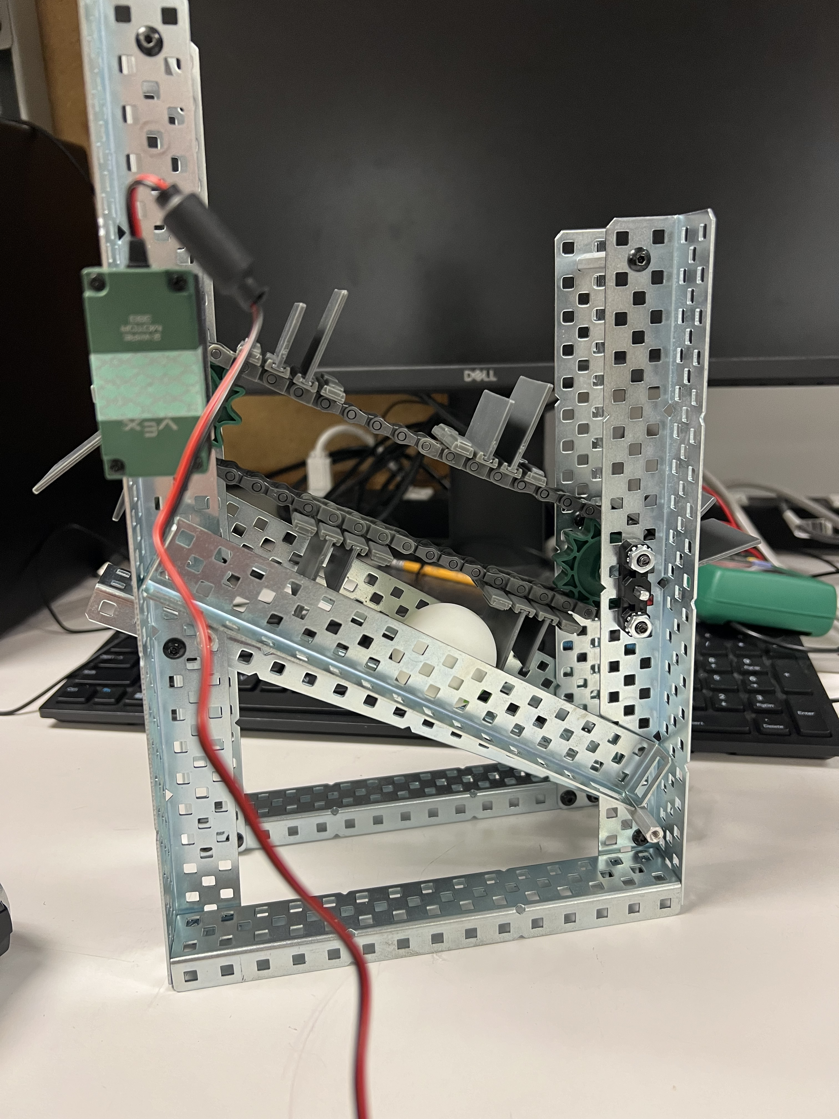
Concept 2
Kelsey Gross
Validate Lazy Hercules intake methodology
Test whether the magnets in the Geodinium was strong enough to stick to steel
Allow for spec-ing of motors for the conveyor belt to be done and validated

Slide 34
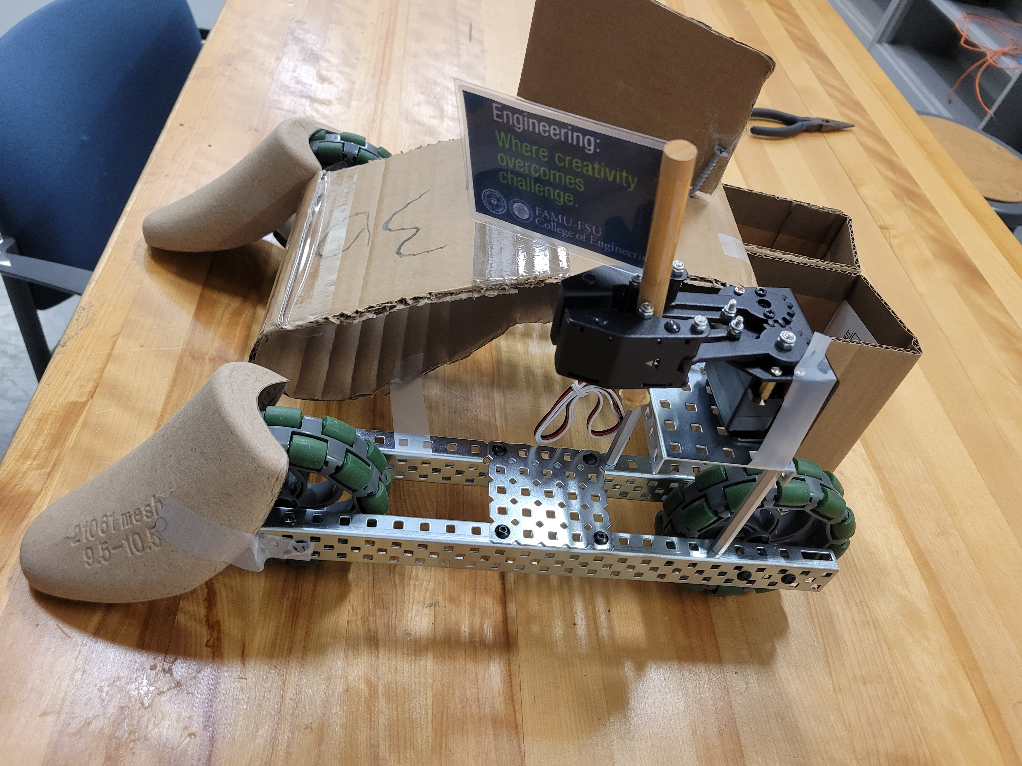
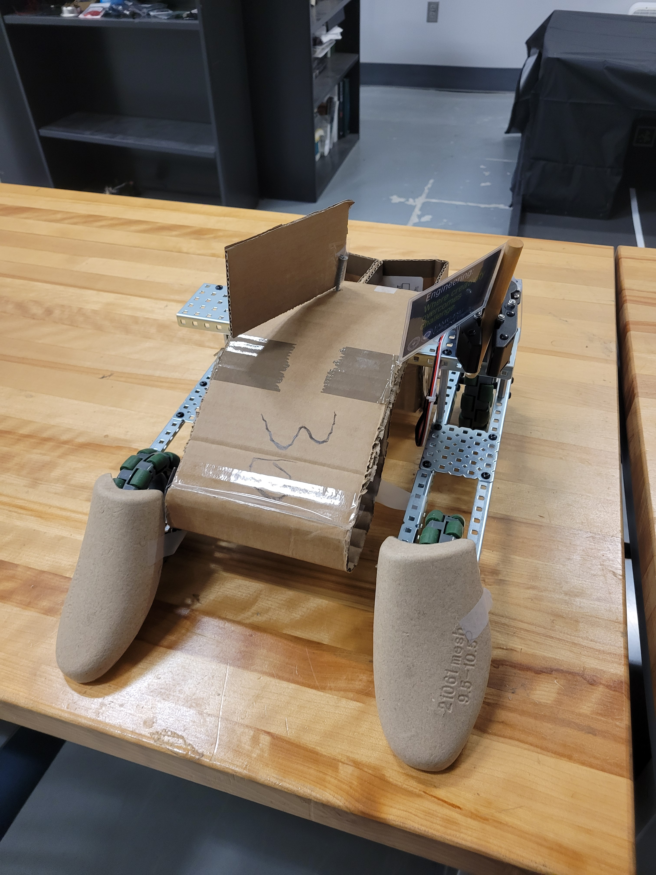
Prototype 1
Kelsey Gross

Slide 35
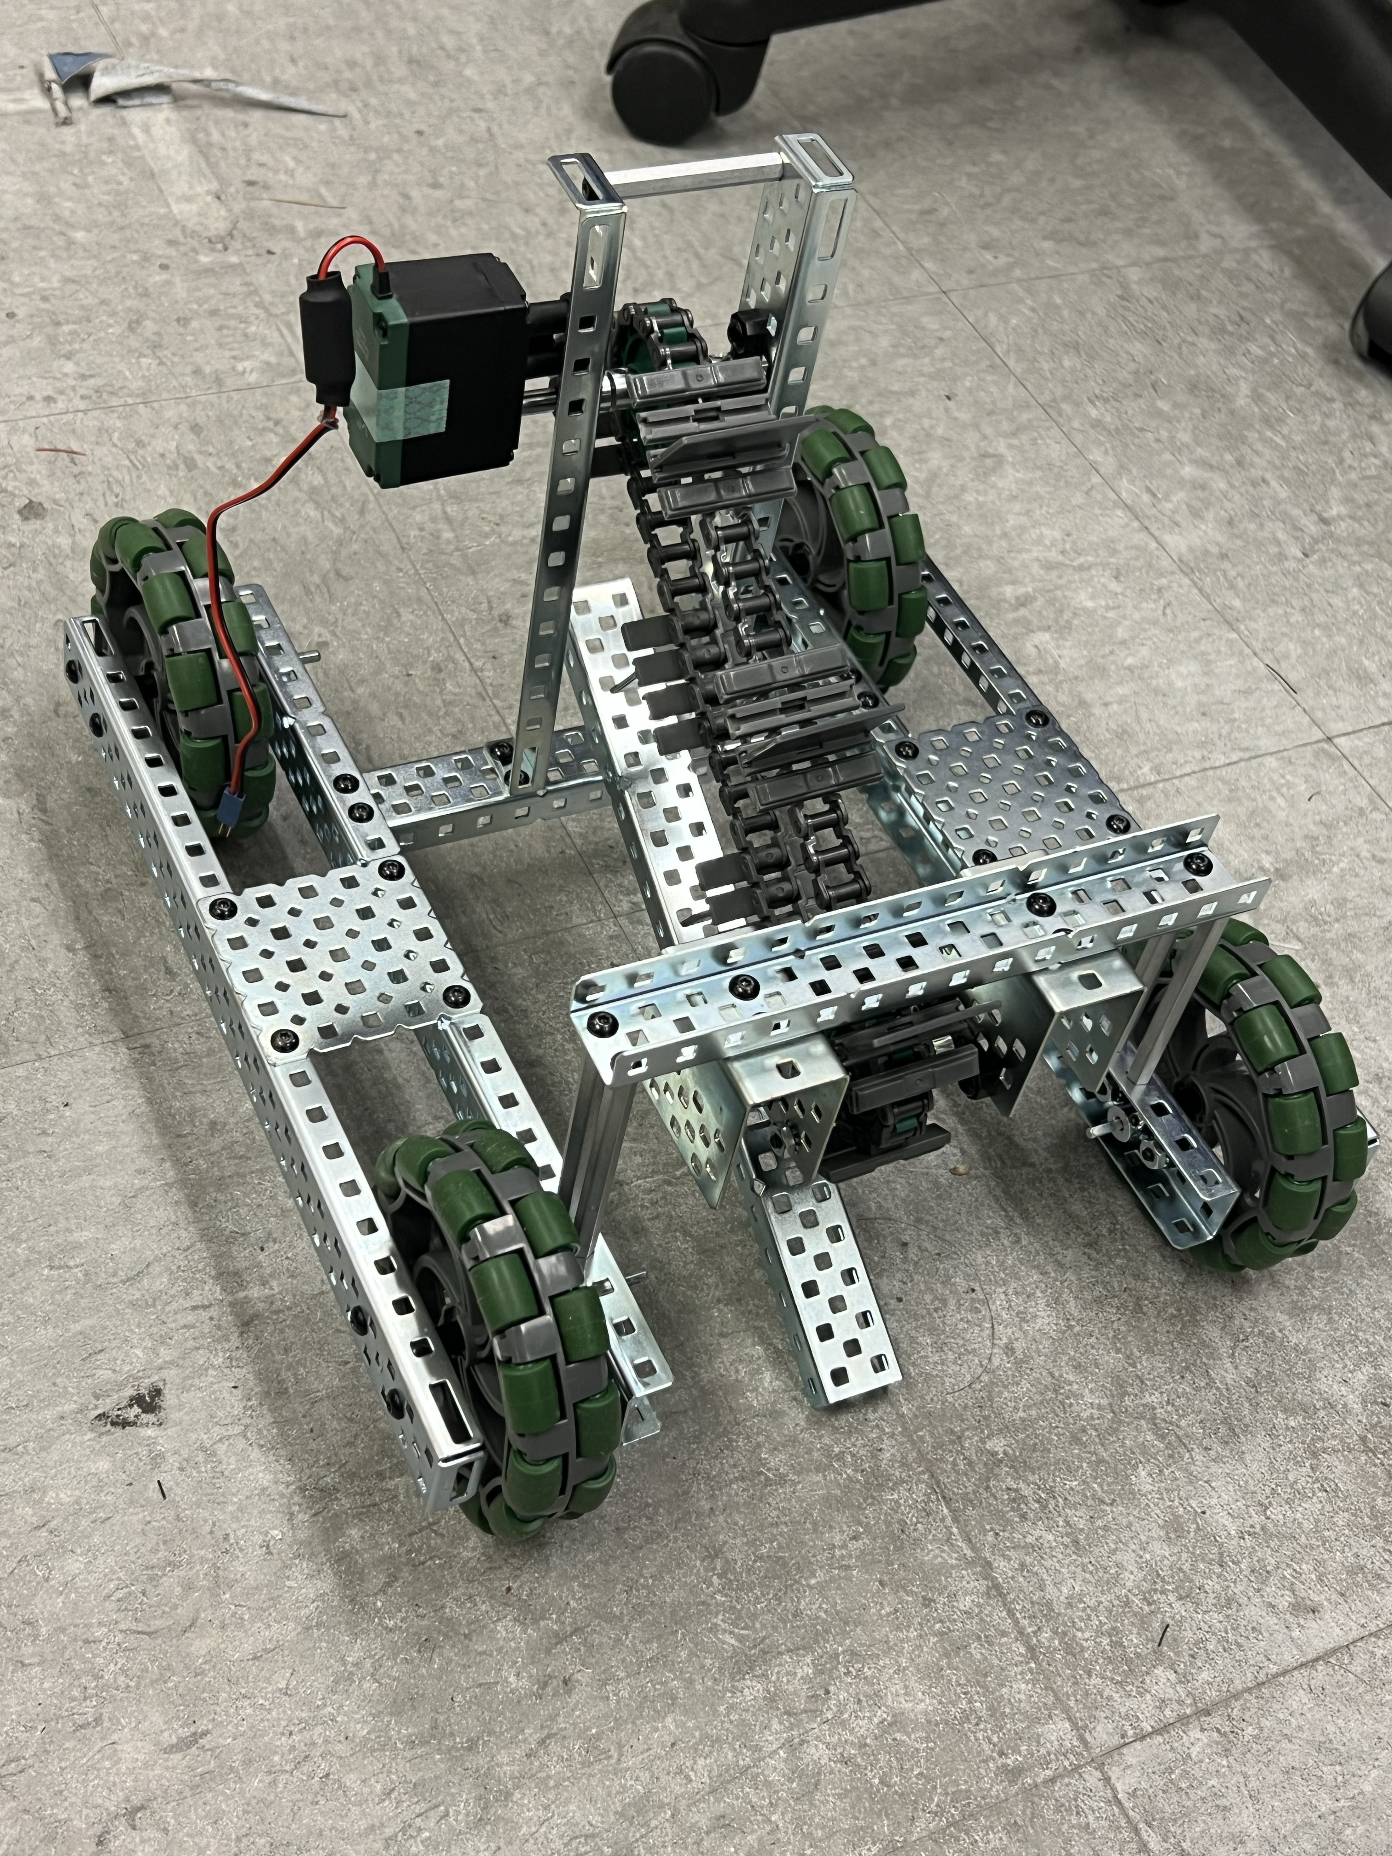
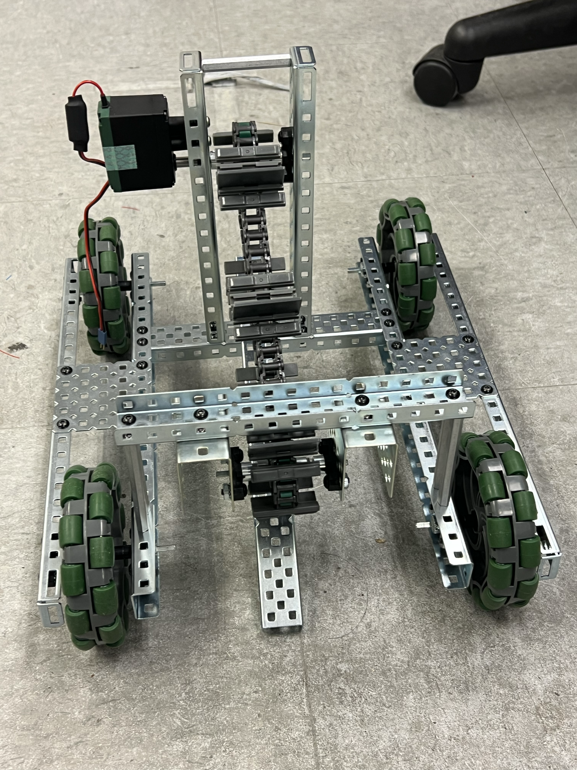
Prototype 2
Kelsey Gross

Slide 36
Completed Work
Ian Lemler
Research past designs that worked for other teams
Finish concept generation and selection
Build first prototype with cardboard

Slide 37
Future Work
Kelsey Gross
Create fully functional prototype by end of semester
Iterate on functional prototype

Slide 38





Slide Headline
Try to keep text at 16 pt minimum.
Try to put as few words as possible on the slide if you’re using for a presentation.
Mix and match the backgrounds as shown in this template or just use one throughout.
You can put department/unit logos in slide master at Horizontal 0.89” Vertical 6.44” From top left corner

Slide 39
Font Check
This is 10-point
This is 15–point Times
This is 20–point
This is 25–point
This is 30–point
This is 35–point
This is 40–point
This is 50–point
This is 60–point
This is 72–point
Notes:
Use at least 20-point font in Room A105, B134, and B136
Use at least 25-point font in Room B135

Slide 40
College of Engineering Color Palette
1 2 3 4
Pantone: PMS 195 C
RGB: 120, 47, 64
Hex: #782F40
CMYK:19, 90, 50, 55
1 2 3 4
Pantone: Black C
RGB: 0, 0, 0
Hex: #000000
CMYK:0, 0, 0, 100
Garnet
Black
1 2 3 4
RGB: 238, 118, 36
Hex: #EE7624
CMYK:2, 66, 99, 0
1 2 3 4
Pantone: PMS 000C
RGB: 255, 255, 255
Hex: #FFFFFF
CMYK: 0, 0, 0, 0
Fang
Orange
White
Notes:
Avoid 75% Black in B135

Slide 41
Accent Color Palette
1 2 3 4
RGB: 0, 59, 111
Hex: #003B6F
CMYK:
1 2 3 4
RGB: 0, 59, 111
Hex: #003B6F
CMYK:
1 2 3 4
RGB: 251, 236, 93
Hex: #FBEC5D
CMYK:
1 2 3 4
RGB: 219, 215, 210
Hex: #DBD7D2
CMYK:
1 2 3 4
RGB: 251, 236, 93
Hex: #FBEC5D
CMYK:
1 2 3 4
RGB: 219, 215, 210
Hex: #DBD7D2
CMYK:
Tardis Blue
Tardis Blue
Corn
Timberwolf
Corn
Timberwolf
1 2 3 4
RGB: 206, 0, 88
Hex: #CE0058
CMYK: 0, 100, 43, 12
1 2 3 4
RGB: 206, 0, 88
Hex: #CE0058
CMYK: 0, 100, 43, 12
1 2 3 4
RGB: 104, 40, 96
Hex: #682860
CMYK:
1 2 3 4
RGB: 220, 220, 220
Hex: #DCDCDC
CMYK:
Rubine Red
Rubine Red
Imperial
Gainsboro
1 2 3 4
RGB: 72, 146, 155
Hex: #48929b
CMYK:
1 2 3 4
RGB: 64, 224, 208
Hex: #40E0D0
CMYK:
1 2 3 4
RGB: 255, 139, 0
Hex: #FF8B00
CMYK:
Asagi-iro
Turquoise
American Orange
Notes:
Remove American orange add hyperlink grey
Make corn the last for b135
All work in 134 imperial move later
Tardis doesn’t work in b136

Slide 42
F7AB19
D67F15
EE7624
D64615
F73119
Analogous
6E3610
F0A16C
EE7624
6E4931
BASB1C
Monochromatic
A14508
4BED3B
EE7624
250CED
2010A1
Triad
A1470C
FF8C40
EE7624
0098A1
24E2ED
Complementary
28A164
2FED8D
EE7624
0848A1
1871ED
Split Complementary
EDAC2F
3BED93
EE7624
0C6AED
ED2F18
Double Split Complementary
ED660C
C7ED3B
EE7624
0CE1ED
A418ED
Square
BA7E09
87724A
EE7624
60EFCF
09BA61
Compound
https://color.adobe.com/create/color-wheel
AD551A
6E3610
EE7624
FA7625
D46820
Shades
Notes:
These are the variants that work well with Fang Orange. The bolded items show well on the projectors.

Slide 43
85412D
8F3831
782f40
8F3176
792D85
Analogous
C44D69
8E626D
782F40
C48796
451B25
Monochromatic
C43959
78743B
782F40
236178
43A2C4
Triad
C43959
C46078
782F40
25C43D
2F783A
Complementary
93C460
577835
782F40
39C49D
297861
Split Complementary
784435
5A783B
782F40
237860
6E2978
Double Split Complementary
782337
78683b
782F40
237830
293978
Square
AB4D32
DEBAAF
782F40
5D8555
70AB32
Compound
https://color.adobe.com/create/color-wheel
38161E
C44D69
782F40
853447
5E2532
Shades

Slide 44
A105
A105
B135 Stage Left
B135 Stage Right
B136
B134, A105
B135

Slide 45
Border Line
Border Line
Border Line
Center of White Space
Center of Slide
Middle of Slide
Middle of White Space
Edge of Branding
Border Line
Notes:
Vertical lines from top down.
Borderline and top of title. (0.5 inch)
Center of Slide (0 inch y-direction for the entire slide)
Center of Design Content (0 inch y-direction considering the title, footer, and negative space)
Bottom of Design Content (0.25 in gap to the footer. 0.75 to the bottom of the screen)
Horizontal lines from left to right
Borderline (0.5 inch)
Center of design content.
Center of slide (0 inch y-direction for the entire slide)
Borderline (0.125 inch all around)

