Slide 1

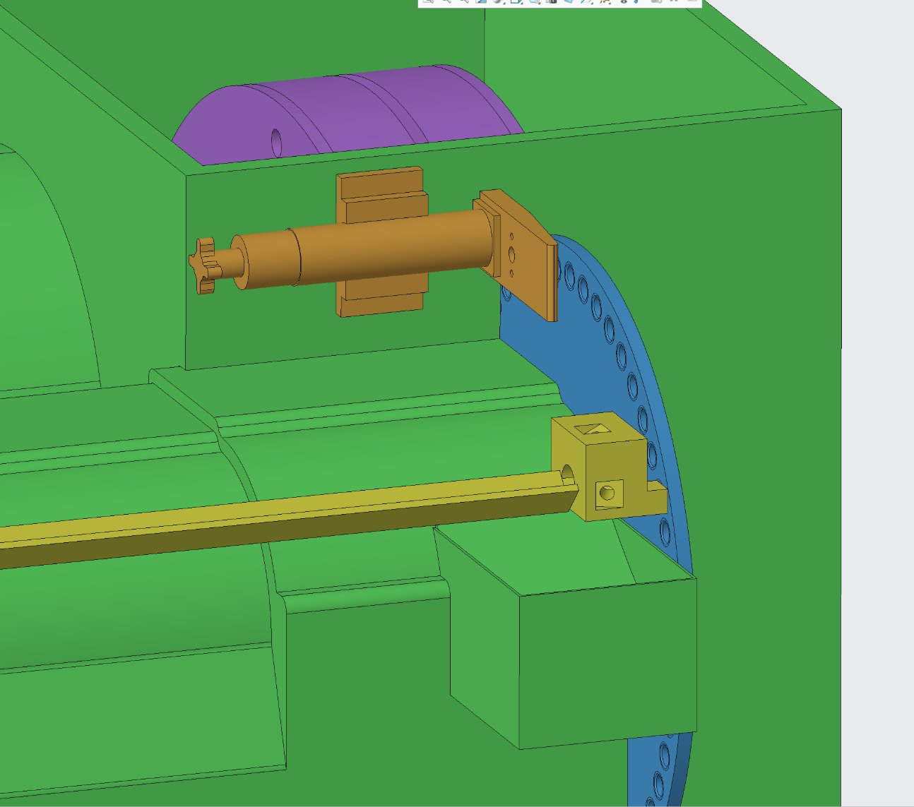
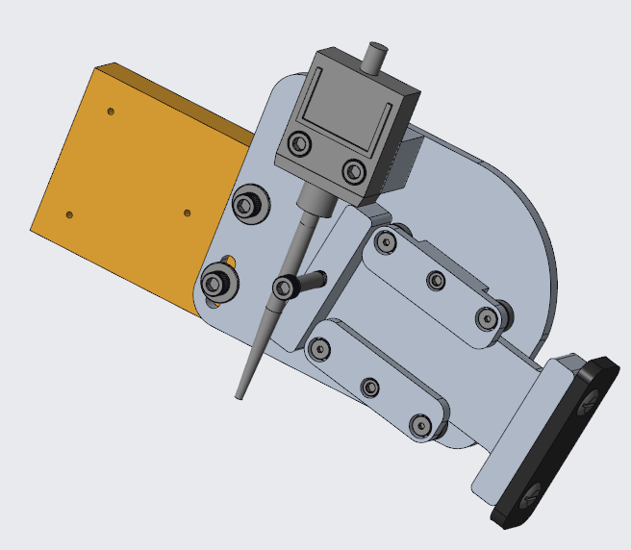
Team 511: JTEKT Grinder Safeguard
H. Bice | A. Garcia | N. Molitor | L. Salcedo | J. Telusmond
Sponsor: Anthony Camarda
Advisor: Keith Larson
Objective
Design Considerations
To design machine safeguarding for a 1967 Besly dual-disk grinder that improves operator safety without lowering output efficiency.
Safe
  No injuries by design when triggering it
Impassable
  The safeguard cannot be bypassed.
Resilient
  Able to withstand incidental impacts
Dependable
  Maintains proper motor controls , despite dust and coolant accumulation
Corrosion-Resistant
  Remains free from rust over time
ω
Background
Safety in manufacturing environments is of chief importance
  3 operators have been seriously injured
The Besly dual-disk grinder is a critical machine in JTEKT's production line for short/odd part runs
As such, increasing safety without decreasing efficiency is paramount
  ⬤ 30-inch dual grinding disks
  ⬤ 23-inch dial
  ⬤ Outer casing
  ⬤ Pneumatic actuator
  ⬤ Dial adjustment: this is our mounting point
  ⬤ Dangerous areas
Future Work
Perform design modifications to align with project specifications
Design and configure circuits for seamless integration into existing machinery
Integrate new design wiring with existing JTEKT models
Visit the JTEKT facility to install and test the prototype within the existing wiring
Observe effects of integration of design long term
Challenges
Ensuring no more pinch points or other hazards are introduced
Not impeding machine use or maintenance
  For hand/auto loading
  Allow full access to all controls/adjusters
Ensuring switch doesn't produce false stops
Making sure that the switch stops as soon as it is activated
Prevent circumvention of design
Thank You!
Please ask any questions, comments, or concerns you have for us!

