Slide 1
SAFE CNC MACHINE
Virtual Design Review I
Samuel Byers, Amanda Garcia-Menocal, Shelby Gerlt, Malik Grant, Carlton Walker
October 15, 2024

Slide 2
Team 514
Amanda
Garcia-Menocal
Samuel Byers
Amanda Garcia-Menocal
Shelby Gerlt
Malik Grant
Carlton Walker
Mech Engineer
Structural Engineer
Software Engineer
Materials Engineer
Systems Engineer

Slide 3
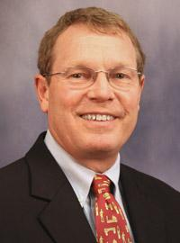
Guidance and Sponsorship
Amanda
Garcia-Menocal
Dr. Shayne McConomy
Sponsor
Dr. Eric Hellstrom
Advisor

Slide 4
Stakeholders
Amanda
Garcia-Menocal
FAMU-FSU COE
FAMU-FSU COE
Elias Haase
Jacob Schmitt
Tripp Lappalainen

Slide 5
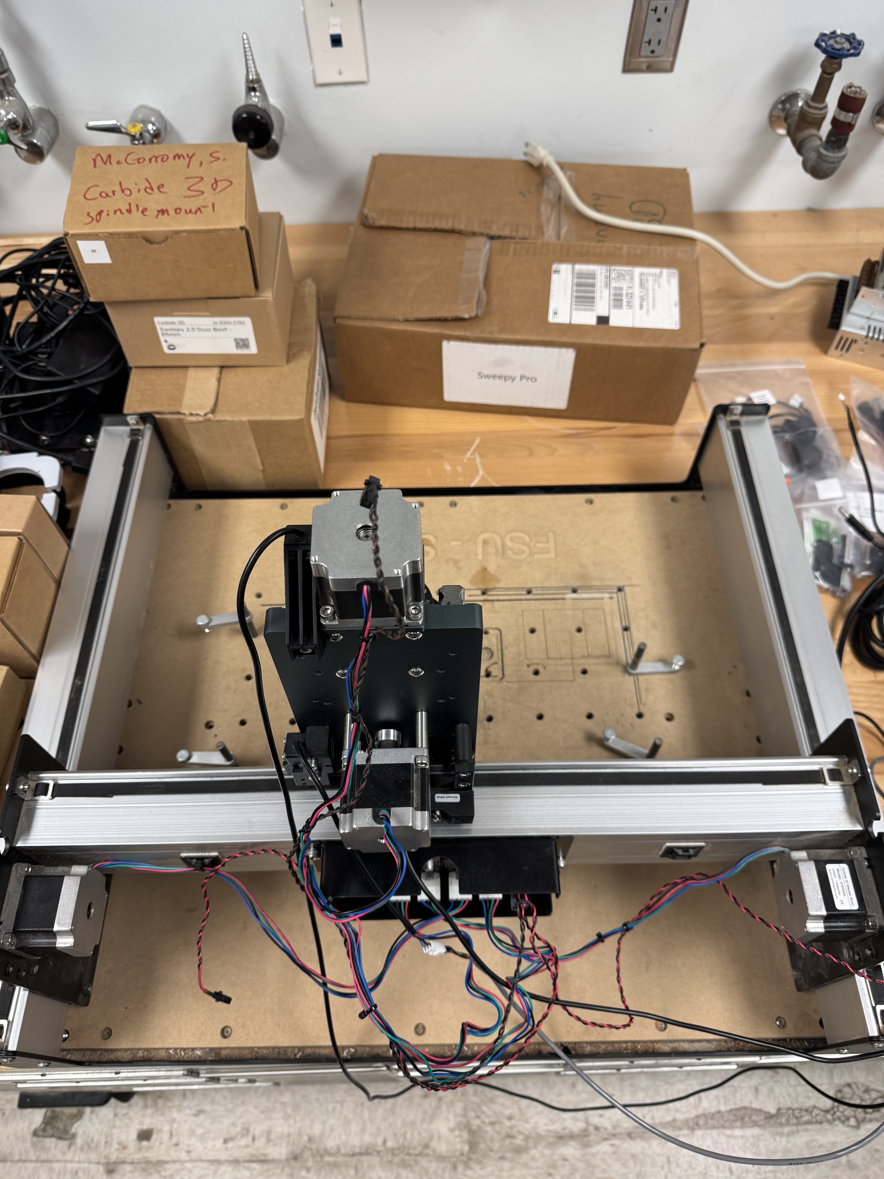
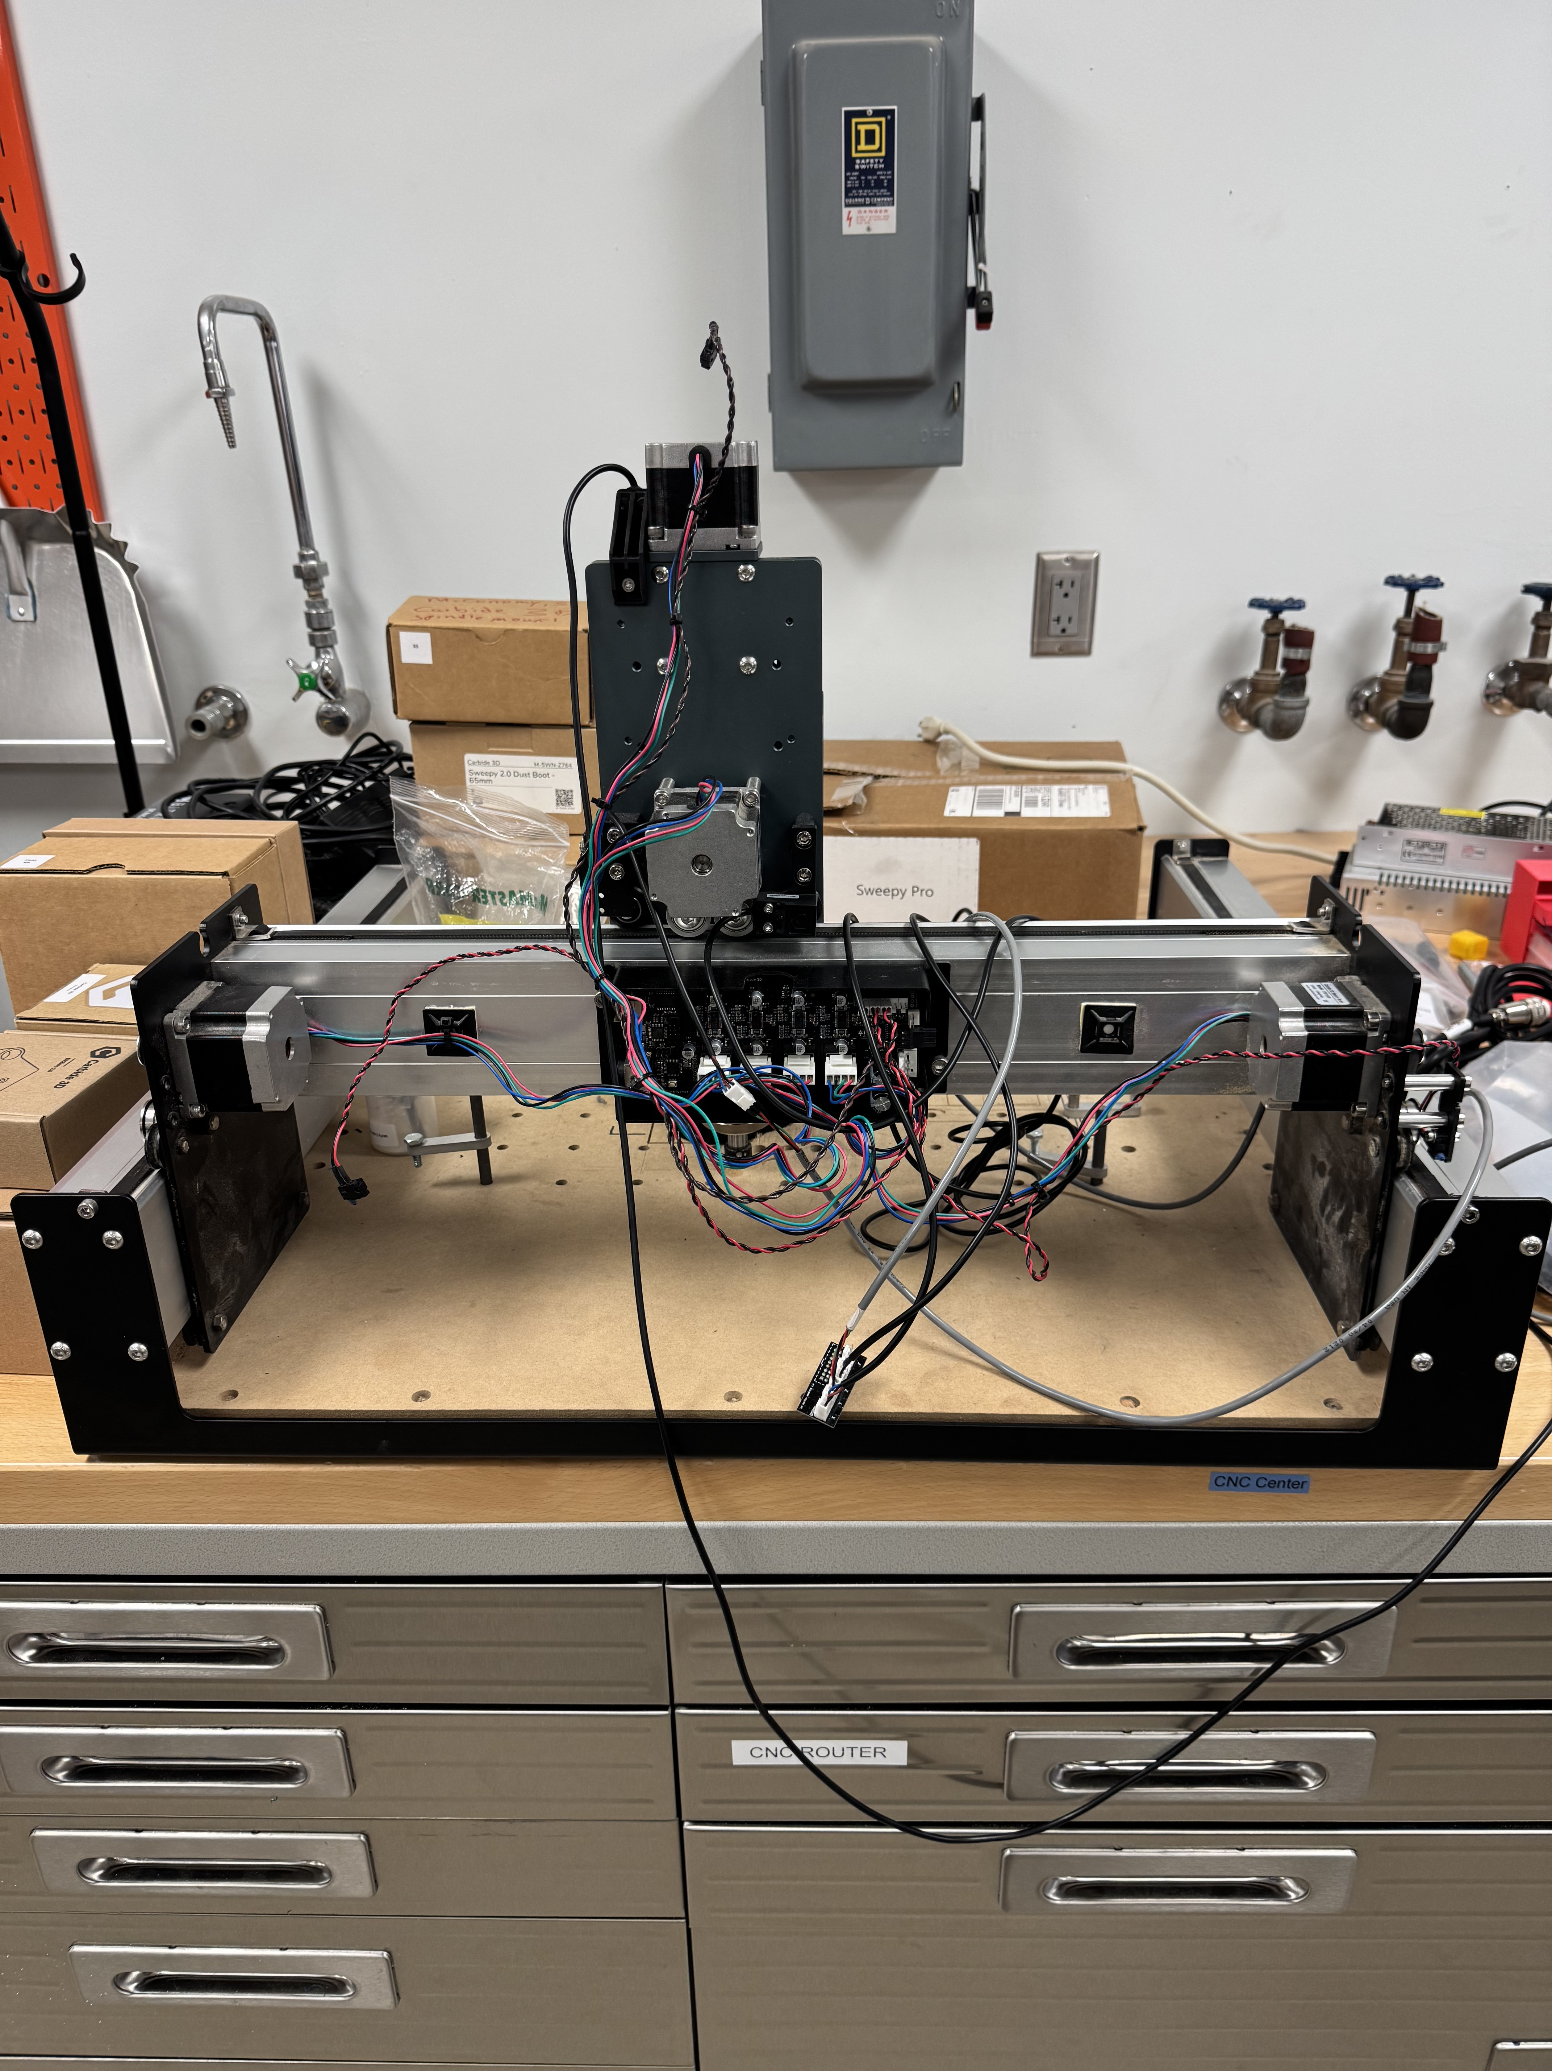
Project Brief and Initial State
Shelby Gerlt
CNC Machine – Computer Numerical Control Machine
Notes:
The objective of this project is to make the Senior Design Labs CNC router safe for student use without requiring additional supervision. This will be achieved by developing machine safeguards that eliminate the need for Personal Protective Equipment (PPE) in the room while the machine is in operation.

Slide 6
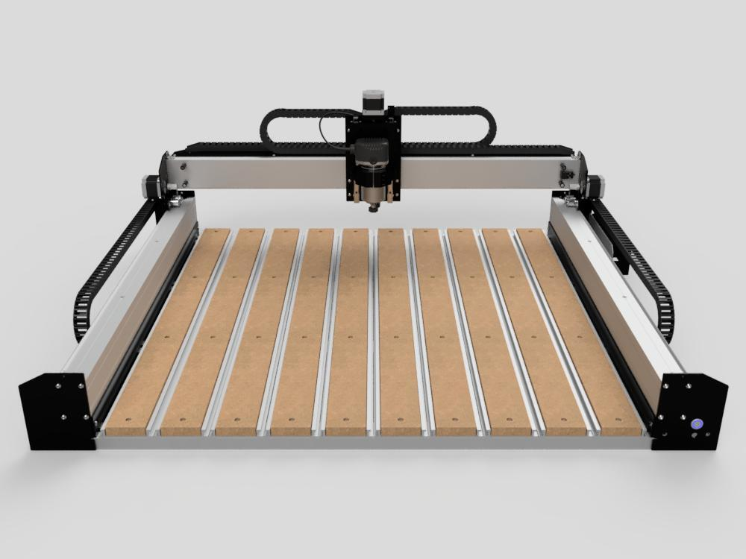
Introduction to Hazards
Shelby Gerlt
Notes:
Computer Numerical Control (CNC) is an automated machining device
CNC Router moves router bits along stationary material

Slide 7
Key Goals
Amanda
Garcia-Menocal
Safe operating conditions
Protection from hazards
Intuitive user interface
SAFE CNC

Slide 8
Markets for Design Benchmarking
Amanda
Garcia-Menocal
Hobbyists
Machine Shops
College and universities
Manufacturers
CUSTOMERS

Slide 9
Assumptions to Guide the Design
Amanda
Garcia-Menocal
The user will understand proper CNC use
The machine will be properly maintained
PPE will not be used/worn by the user
Only compatible materials will be used

Slide 10
Primary Customer Needs
Shelby Gerlt
Intuitive integration of safety tools and processes.
Safety additions do not hinder use of CNC machine.​
No PPE!

Slide 11
Interpretation of Needs
Shelby Gerlt
No administrative controls or PPE
Intuitive safeguards
Ease of access to machine
Easily maintainable/ replaceable parts
Safeguards will not affect normal processes

Slide 12
Customer Requested Controls
Shelby Gerlt
Elimination
Substitution
Engineering Controls
Administrative Controls
PPE
Physically remove hazard
Isolate people from the hazard
Outside of project scope

Slide 13
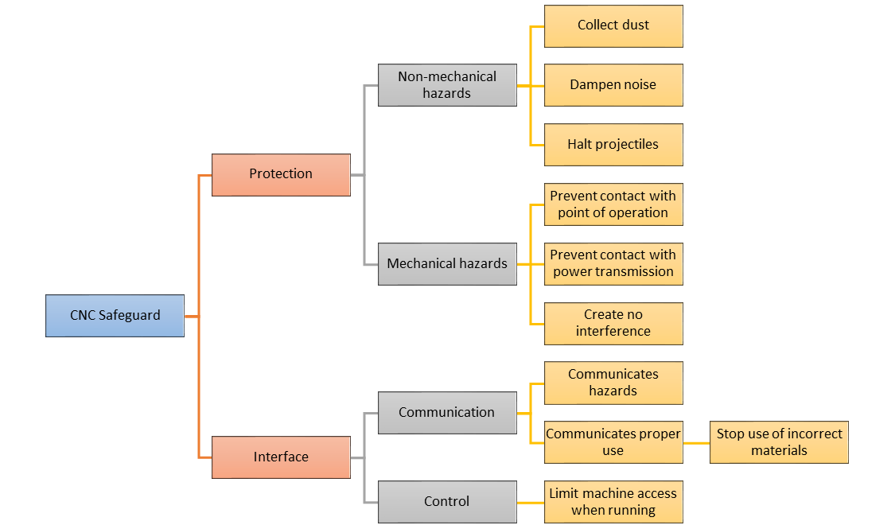
Hierarchy of Functions: Overview
Amanda
Garcia-Menocal

Slide 14
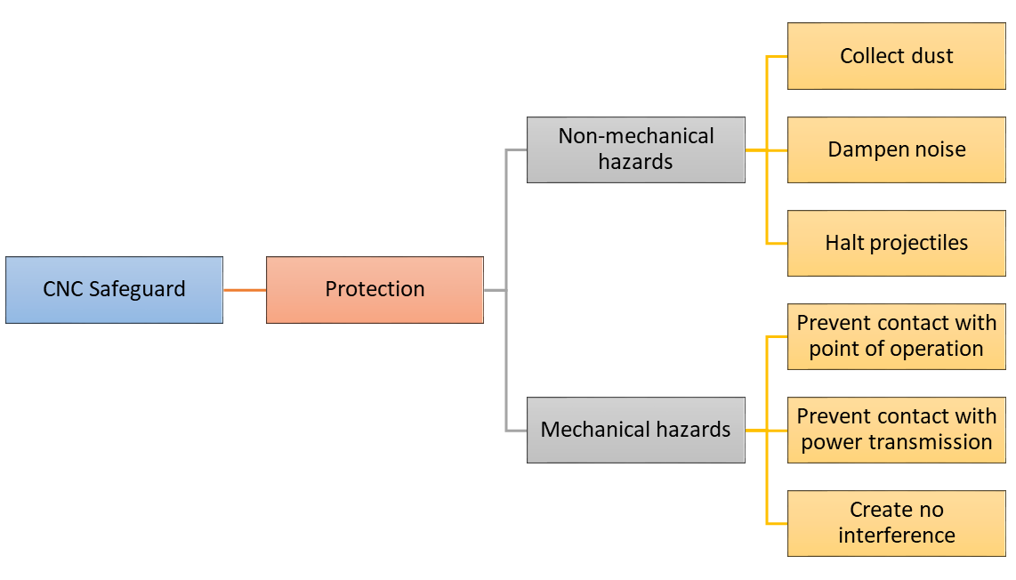
Hierarchy of Functions: Protection
Amanda
Garcia-Menocal
Notes:
Point of op: bit
Pwr trans: belts

Slide 15
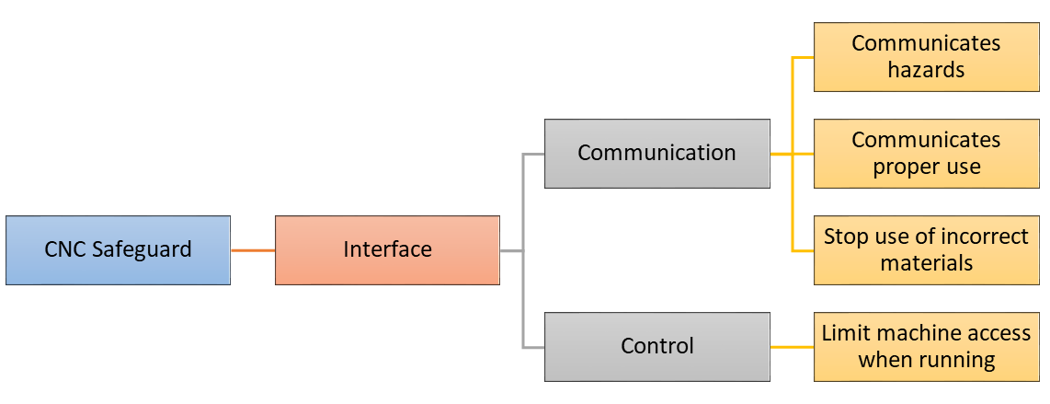
Hierarchy of Functions: Interface
Amanda
Garcia-Menocal

Slide 16
Future Work
Shelby Gerlt
Industry Research
Concept Selection
Initial Prototyping and Development
Design Review 1
Design Review 2
Project Decomposition

