Slide 1
SAFE CNC MACHINE
Virtual Design Review II
Samuel Byers, Amanda Garcia-Menocal, Shelby Gerlt, Malik Grant, Carlton Walker
November 21, 2024

Slide 2
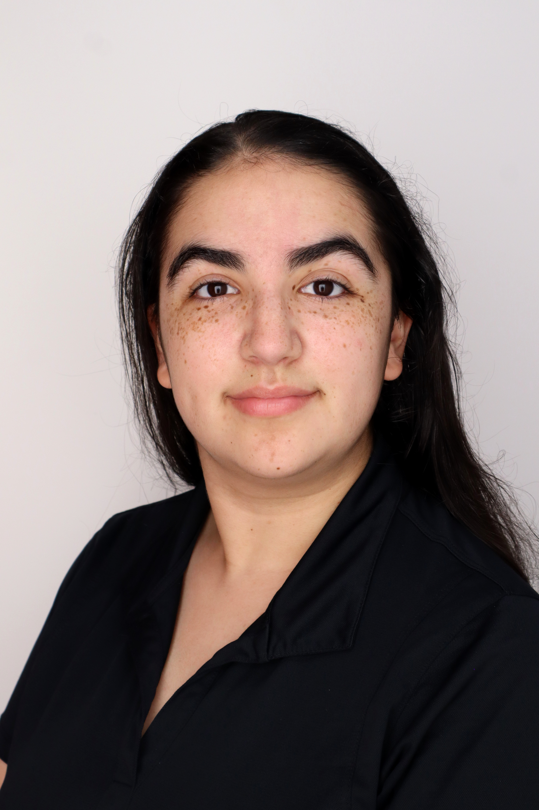
Team 514
Malik Grant
Samuel Byers
Amanda Garcia-Menocal
Shelby Gerlt
Malik Grant
Carlton Walker
Mech Engineer
Structural Engineer
Software Engineer
Materials Engineer
Systems Engineer

Slide 3
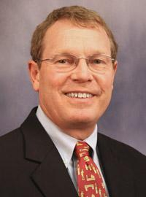
Guidance and Sponsorship
Malik Grant
Dr. Shayne McConomy
Sponsor
Dr. Eric Hellstrom
Advisor

Slide 4
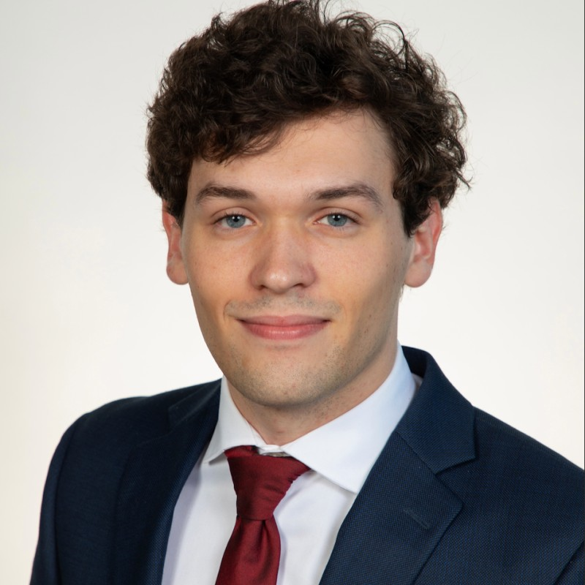
Stakeholders
Malik Grant
FAMU-FSU COE
FAMU-FSU COE
Elias Haase
Jacob Schmitt
Tripp Lappalainen

Slide 5
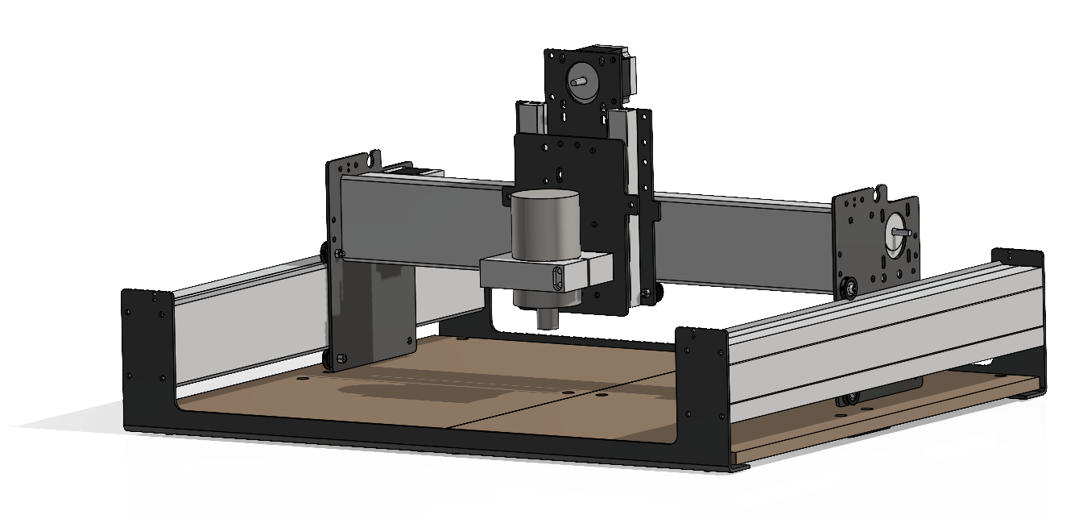
Project Objective
Carlton Walker
Shapeoko 3 CNC Router
Implement safeguards for the CNC router to:
Protect users from hazards
Eliminate the need for PPE
Notes:
The objective of this project is to make the Senior Design Labs CNC router safe for student use without requiring additional supervision. This will be achieved by developing machine safeguards that eliminate the need for Personal Protective Equipment (PPE) in the room while the machine is in operation.

Slide 6
Hazards
Carlton Walker
Notes:
For this project we wanted to consider major hazards that the CNC router machine can cause while in use for our users.

Slide 7
Hazards
Carlton Walker
Moving Parts
Notes:
The first hazard is the moving parts such as the belts and z axis translation of the

Slide 8
Hazards
Carlton Walker
Moving Parts
Projectiles
Notes:
The objective of this project is to make the Senior Design Labs CNC router safe for student use without requiring additional supervision. This will be achieved by developing machine safeguards that eliminate the need for Personal Protective Equipment (PPE) in the room while the machine is in operation.

Slide 9
Hazards
Carlton Walker
Moving Parts
Projectiles
Impalement
Notes:
The objective of this project is to make the Senior Design Labs CNC router safe for student use without requiring additional supervision. This will be achieved by developing machine safeguards that eliminate the need for Personal Protective Equipment (PPE) in the room while the machine is in operation.

Slide 10
Hazards
Carlton Walker
Moving Parts
Projectiles
Impalement
Particles
Notes:
The objective of this project is to make the Senior Design Labs CNC router safe for student use without requiring additional supervision. This will be achieved by developing machine safeguards that eliminate the need for Personal Protective Equipment (PPE) in the room while the machine is in operation.

Slide 11
Assumptions to Guide the Design
Samuel Byers
The user will understand how to use the machine

Slide 12
Assumptions to Guide the Design
Samuel Byers
The user will understand how to use the machine
The machine will be properly maintained

Slide 13
Assumptions to Guide the Design
Samuel Byers
The user will understand how to use the machine
The machine will be properly maintained
The user will not be using PPE

Slide 14
Assumptions to Guide the Design
Samuel Byers
The user will understand how to use the machine
The machine will be properly maintained
The user will not be using PPE
Only compatible materials will be used in the machine

Slide 15
Hierarchy of Functions
Malik Grant
CNC Safeguard
Protection
Non-mechanical hazards
Mechanical hazards
Interface
Communication
Control
Collect dust
Dampen noise
Halt projectiles
Prevent contact with point of operation
Prevent contact with power transmission
Create no interference
Communicates hazards
Communicates proper use
Stops use of incorrect materials
Limit machine access when running

Slide 16
Hierarchy of Functions
Malik Grant
CNC
Protection
Non hazards
M hazards
Interface
Comm
Control
Collect
Dampen
Halt
Prevent
Prevent
Create
Comm
Comm
Stops
Limit
Non-mechanical hazards
Mechanical hazards
Collect dust
Dampen noise
Halt projectiles
Prevent contact with point of operation
Prevent contact with power transmission
Create no interference
Protection
CNC Safeguard

Slide 17
Hierarchy of Functions
Malik Grant
CNC
Protection
Non hazards
M hazards
Interface
Comm
Control
Collect
Dampen
Halt
Prevent
Prevent
Create
Comm
Comm
Stops
Limit
Interface
Communication
Control
Communicates hazards
Communicates proper use
Stops use of incorrect materials
Limit machine access when running
CNC Safeguard

Slide 18
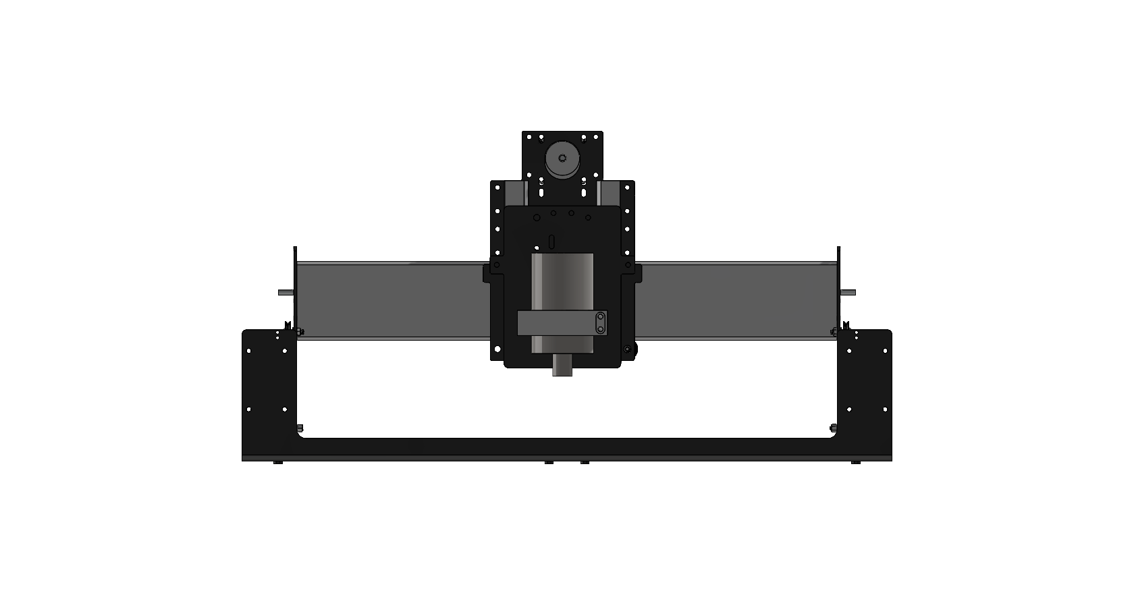
Critical Target: Halt Projectiles
Carlton Walker
Target | 3000 N
Metric | Impact force
Testing | Impact test

Slide 19
Critical Target: Create No Interference
Carlton Walker
Target | Pass
Metric | Pass/Fail
Testing | Observation

Slide 20
Critical Target: Limit Access When On
Carlton Walker
Target | True
Metric | Boolean
Testing | Observation

Slide 21
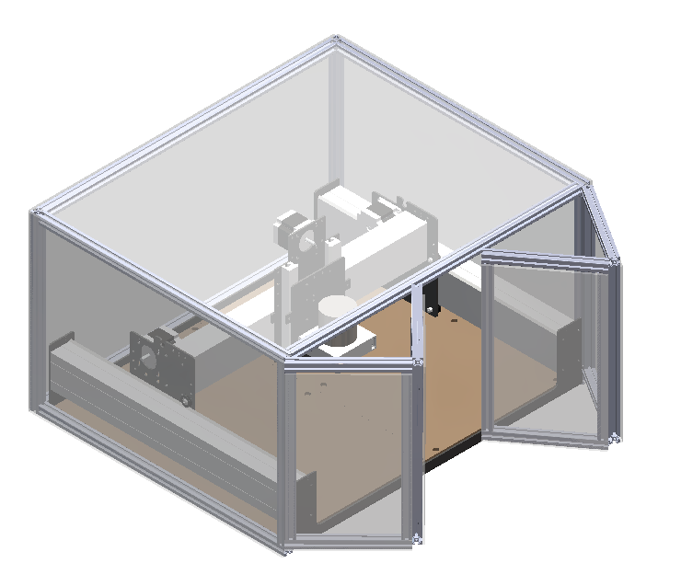
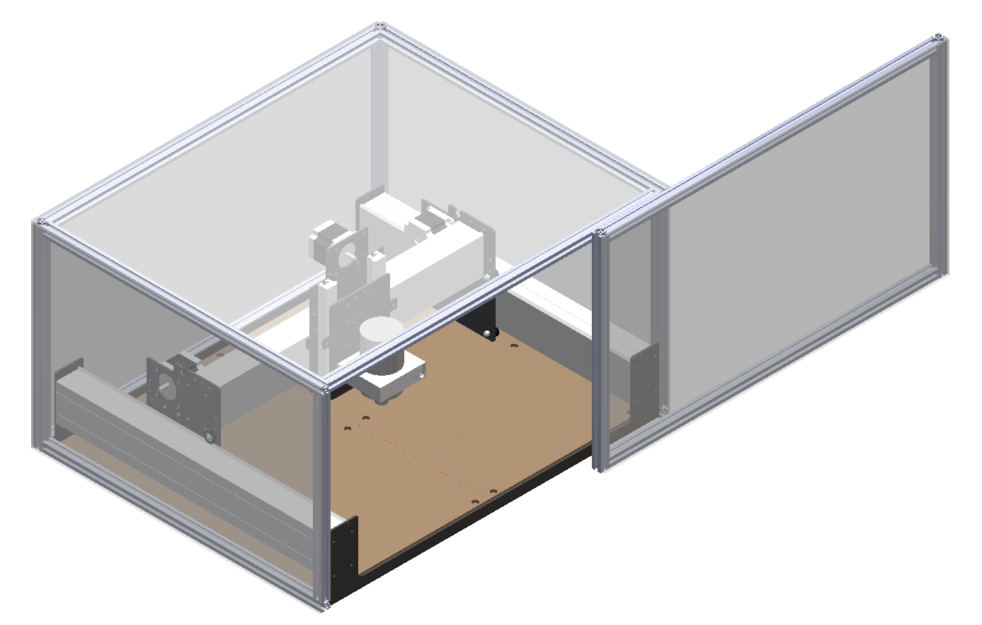
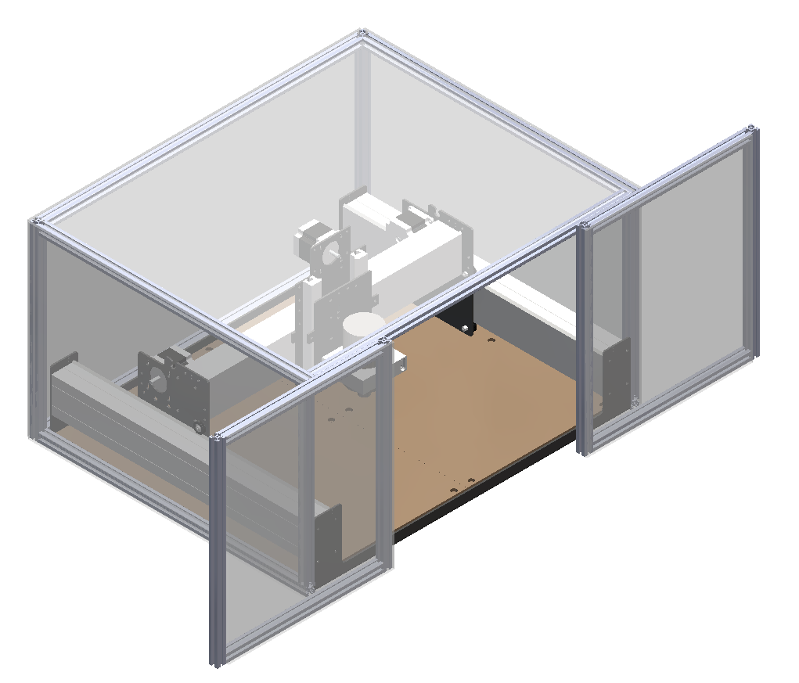
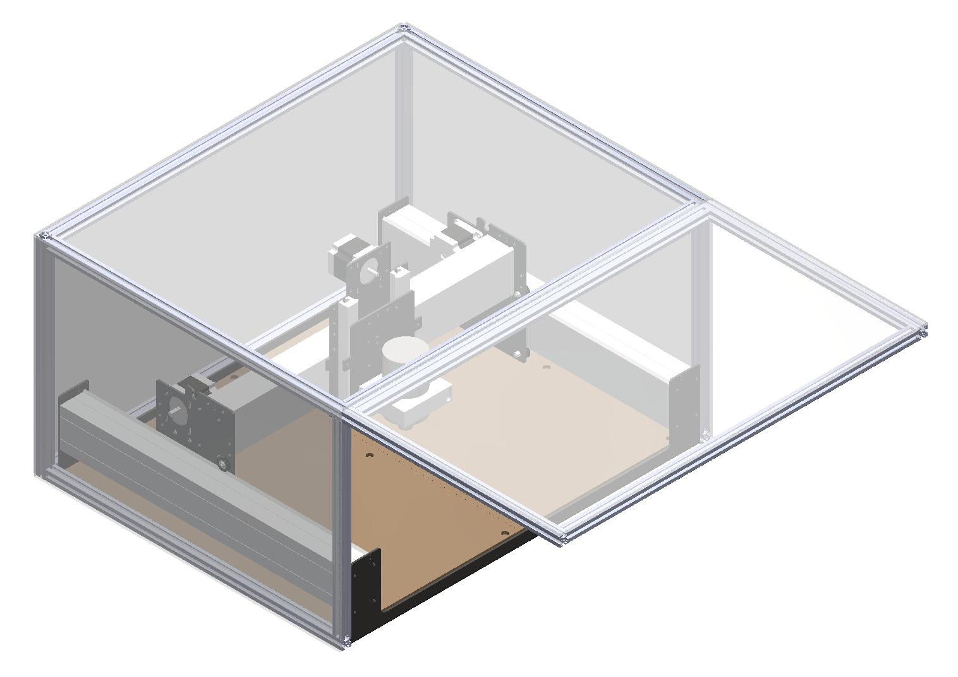
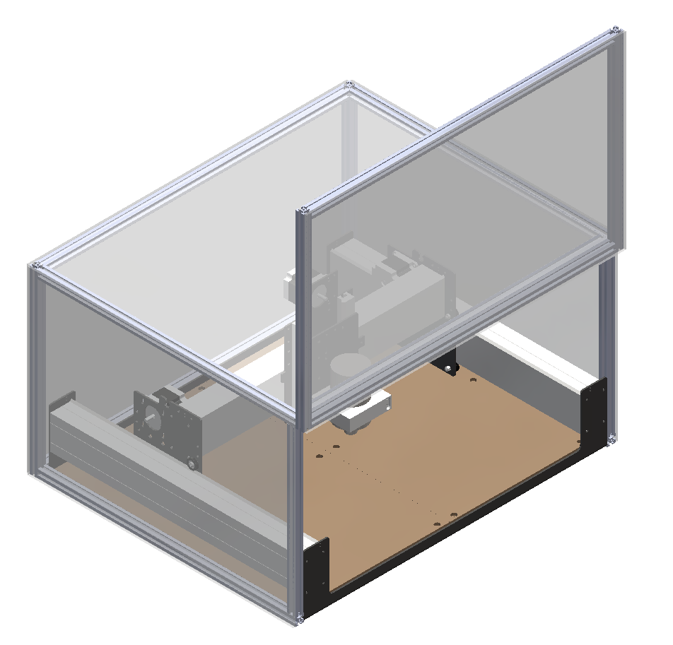
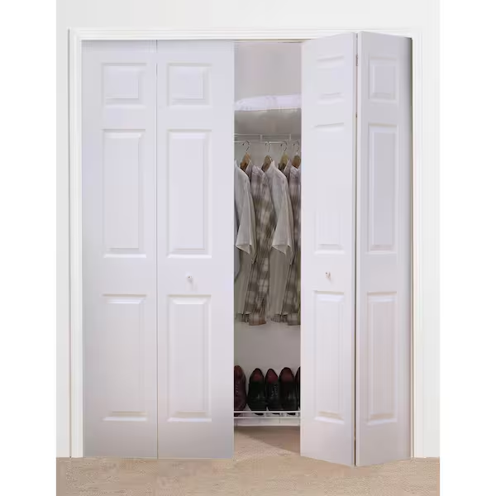
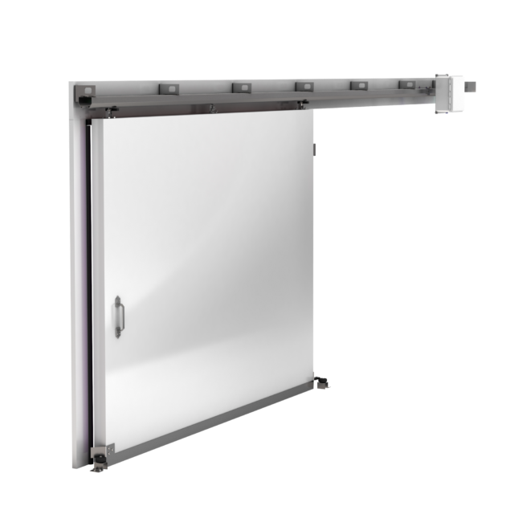
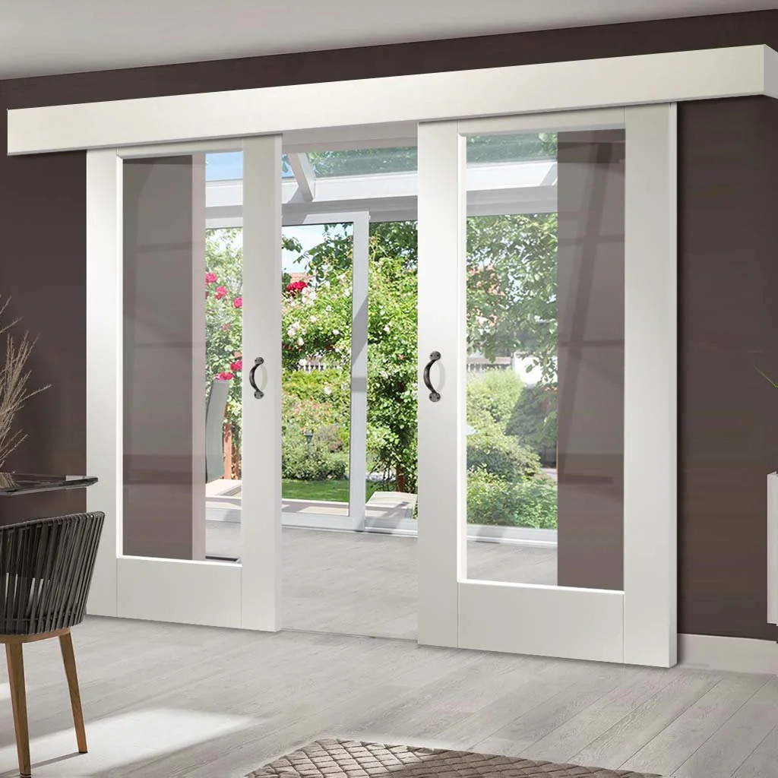
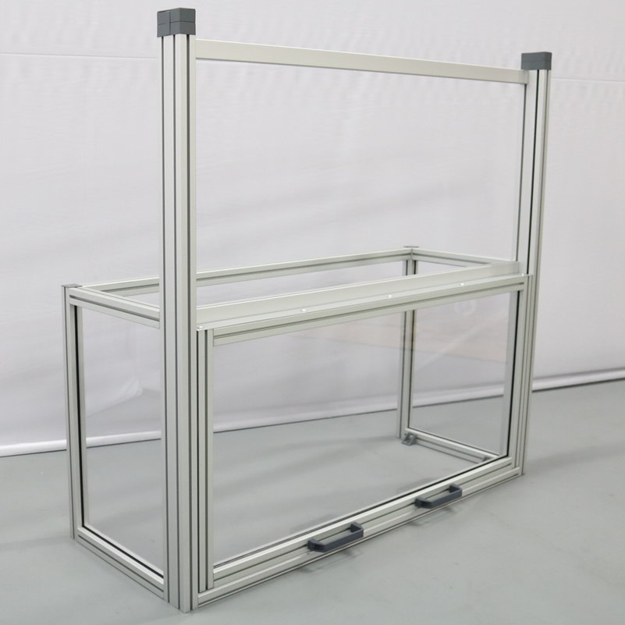
Medium Fidelity Concepts
Malik Grant
Bifold door
Horizontal sliding door
Double sliding door
Top-hinge door
Vertical sliding door

Slide 22
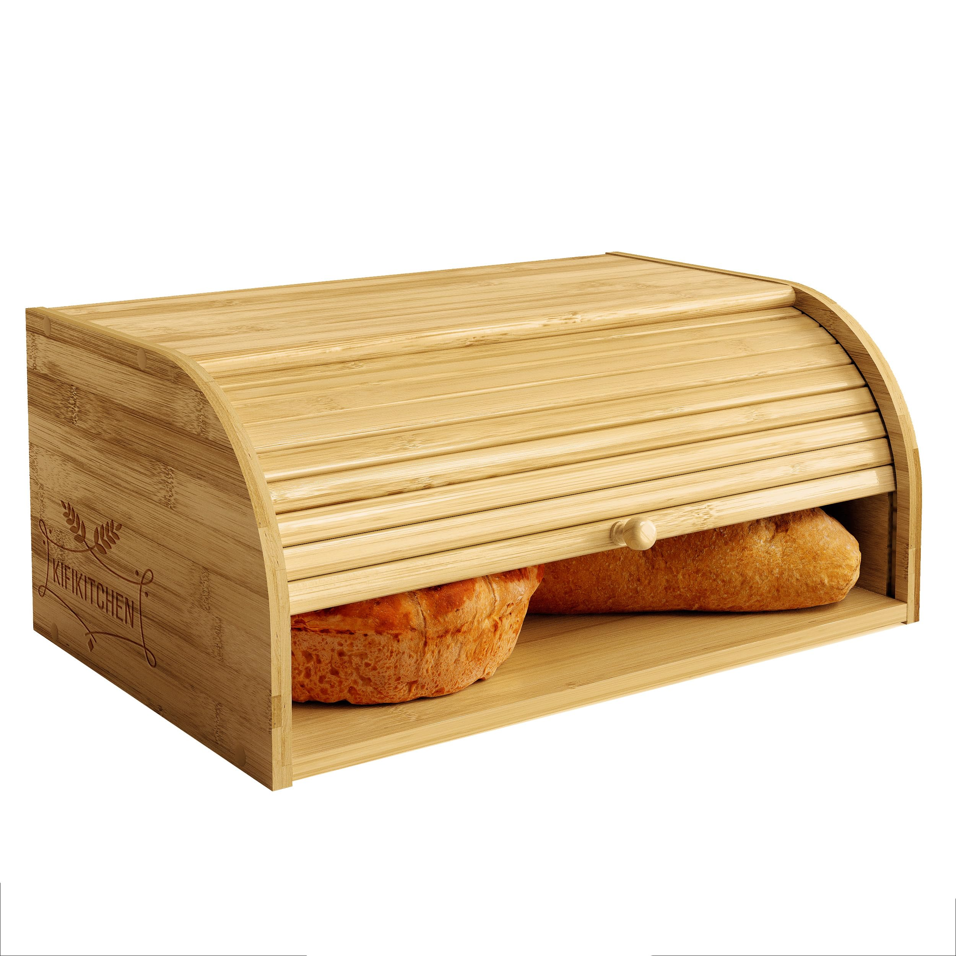
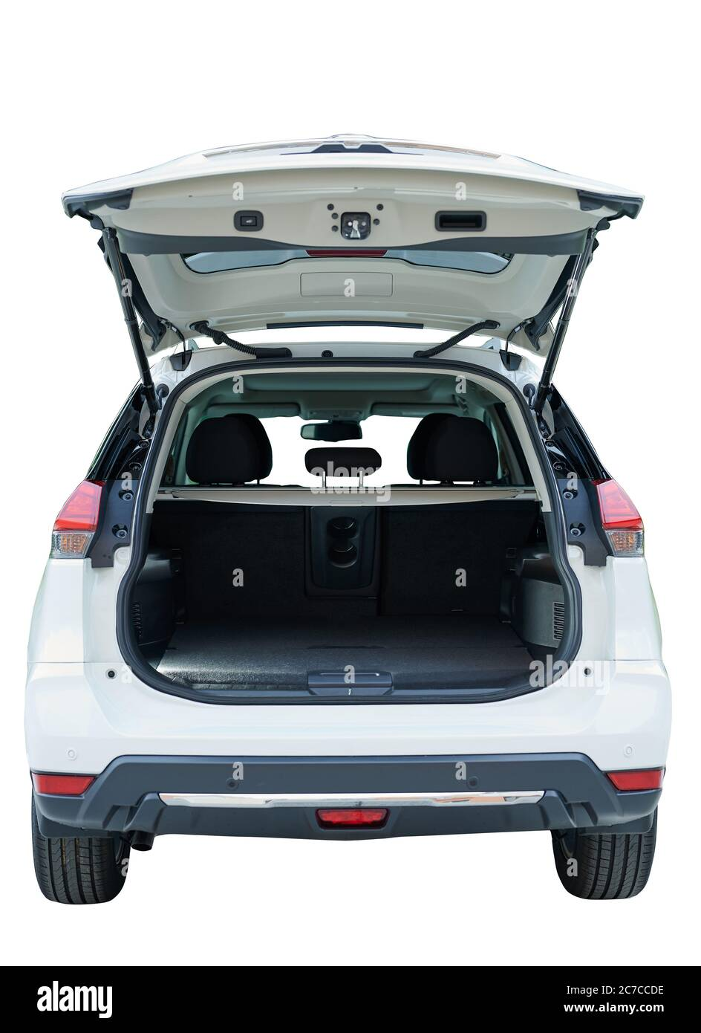
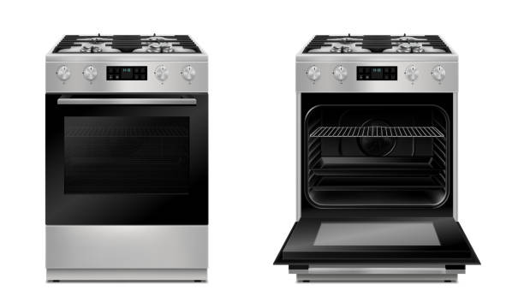
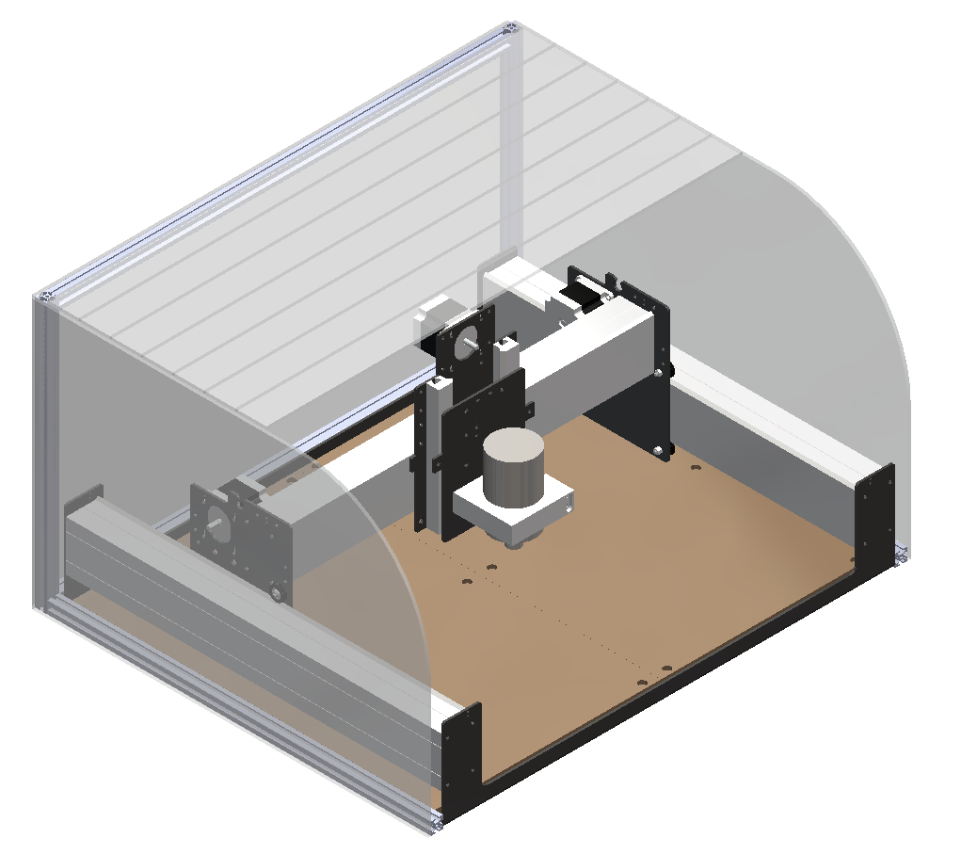
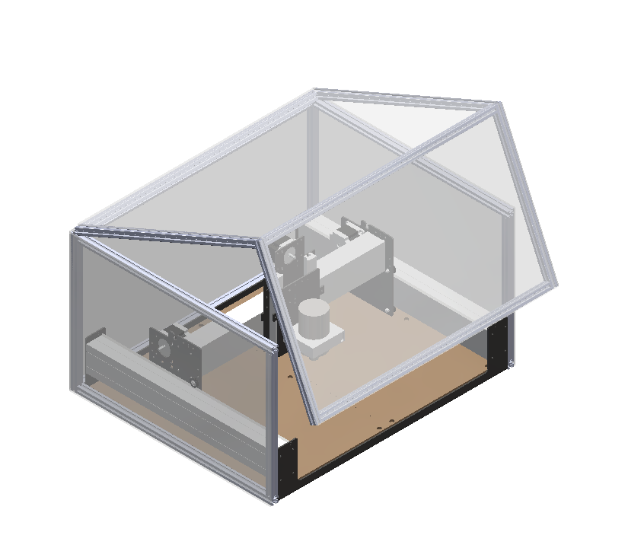
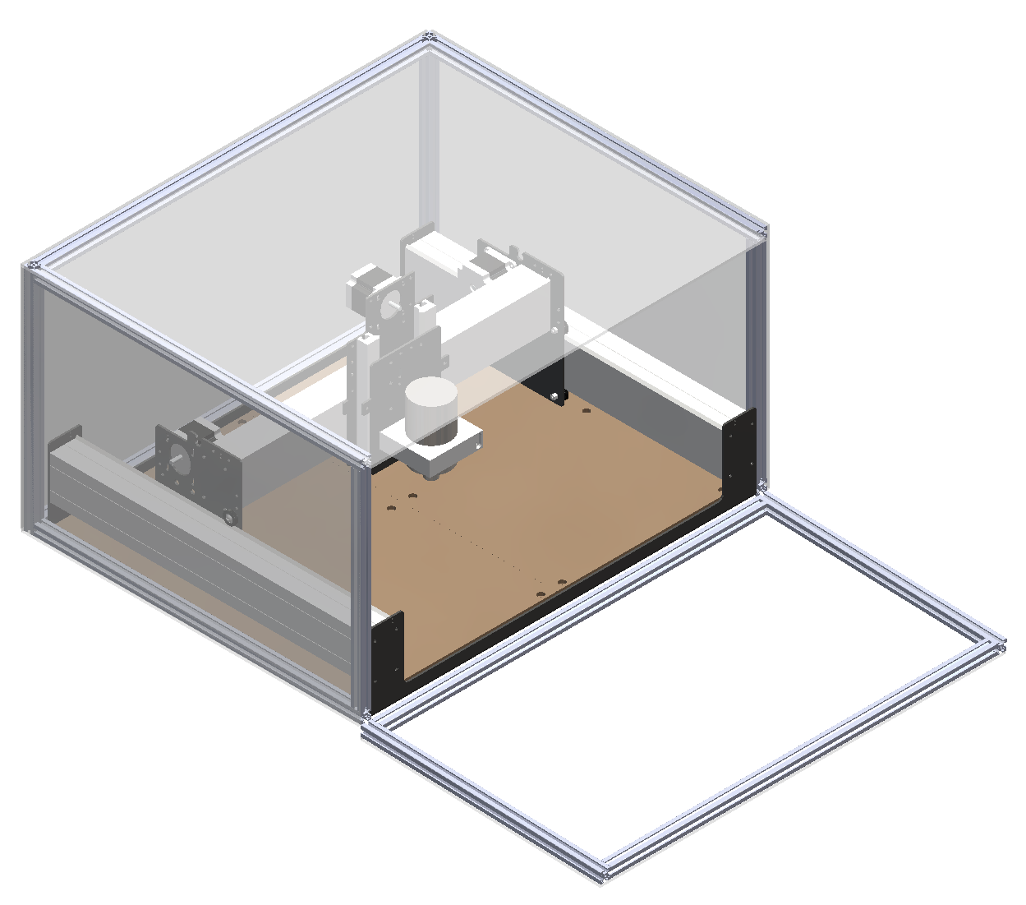
High Fidelity Concepts
Malik Grant
Roll cover
Hatch
Oven door

Slide 23
Concept Selection
Samuel Byers
Concepts

Slide 24
Concept Selection
Samuel Byers
Concepts
Characteristics
Impact force
Clearance
Limited access
Disassembly time
Displacement due to vibration

Slide 25
Concept Selection
Samuel Byers
Concepts
Characteristics
Impact force
Clearance
Limited access
Disassembly time
Displacement due to vibration
Selection

Slide 26
Final Selection
Samuel Byers
Bifold door
Horizontal sliding door
Double sliding door
Top-hinge door
Vertical sliding door

Slide 27
Final Selection
Samuel Byers
Bifold door
Horizontal sliding door
Double sliding door
Top-hinge door
Vertical sliding door

Slide 28
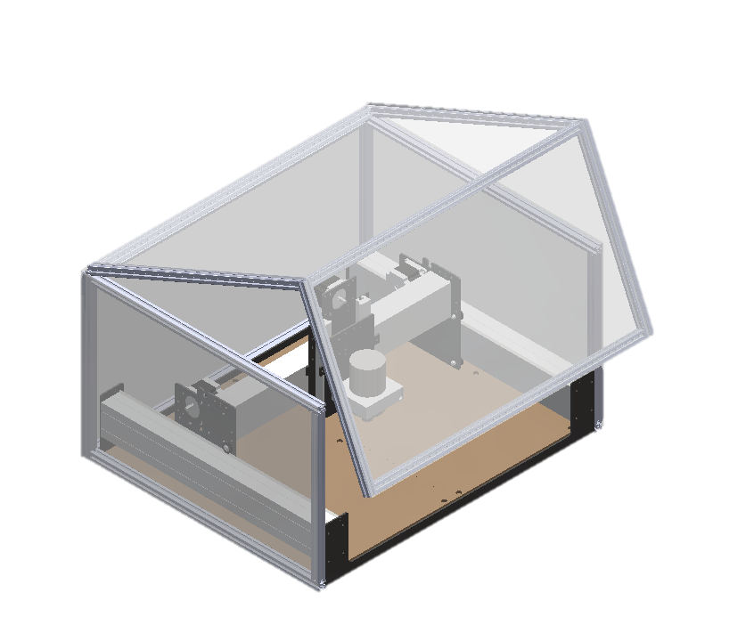
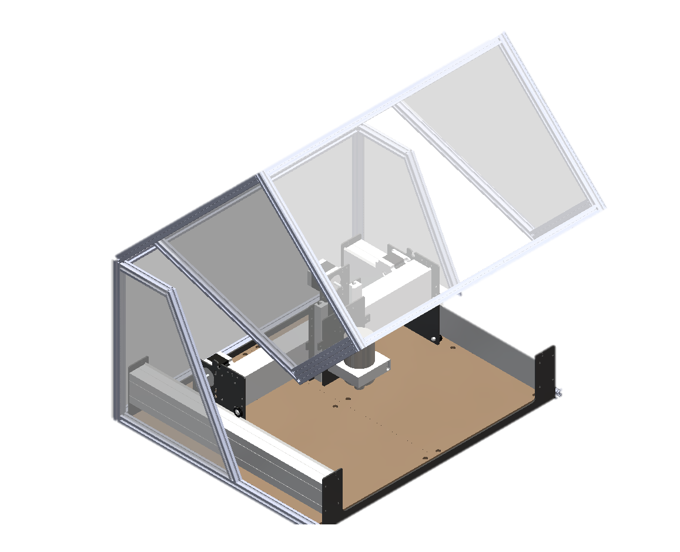
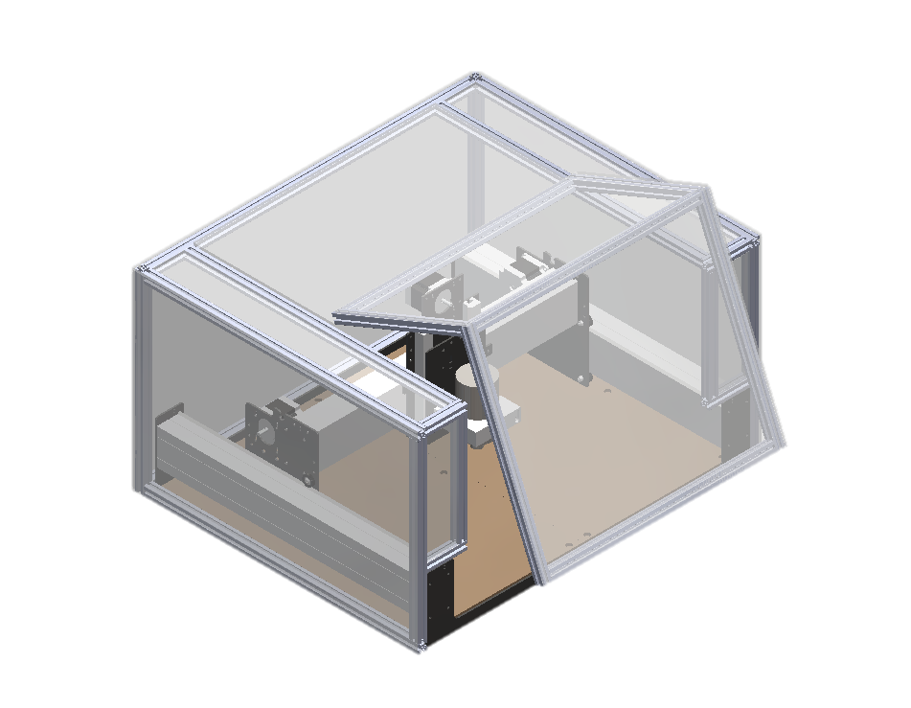
Current Concept Prototypes
Carlton Walker
Hatch
Hinge
Shell

Slide 29
Current Concept Prototypes
Carlton Walker
Hatch
Hinge
Shell

Slide 30
Current Concept Prototypes
Carlton Walker
Hatch
Hinge
Shell

Slide 31
Future Work
Malik Grant
Design Review 2
Material Selection
Refining Prototype
Design Ideation and Selection
Design Review 3
Targets and Validation

Slide 32
Targets: Mechanical
Samuel Byers
Function | Target | Metric
Prevent contact w/ point of operation | Particle levels < 5 mg/m³ | Clearance
Prevent contact w/ power transmission | Noise levels < 85 dB | Clearance

Slide 33
Targets: Non-Mechanical
Samuel Byers
Function | Target | Metric
Collect Dust | Particle levels < 5 mg/m³ | Particulates
Dampen Noise | Noise levels < 85 dB | Decibel

Slide 34
Targets: Interface
Samuel Byers
Function | Target | Metric
Prevent use of incorrect materials | Customer uses proper materials | User opinion

Slide 35
Targets: Beyond the Functions
Samuel Byers
Function | Target | Metric
Manage Cables | Visibility of wires/aesthetics | Sponsor opinion
Disassemble Quickly | < 1 day | Time
Limit Vibrations | 5 ± 0.5 mm | Displacement

