Slide 1

SAFE CNC MACHINE
Design Review IV
Samuel Byers, Amanda Garcia-Menocal, Shelby Gerlt, Malik Grant, Carlton Walker
January 24, 2025

Slide 2





Team 514
Shelby Gerlt
Samuel Byers
Amanda Garcia-Menocal
Shelby Gerlt
Malik Grant
Carlton Walker
Supply Chain Engineer
Structural Engineer
Test Engineer
Electrical Engineer
Design Engineer

Slide 3


Guidance and Sponsorship
Shelby Gerlt
Dr. Shayne McConomy
Sponsor
Dr. Eric Hellstrom
Advisor

Slide 4




Stakeholders
Shelby Gerlt
FAMU-FSU COE
FAMU-FSU COE
Elias Haase
Jacob Schmitt
Tripp Lappalainen

Slide 5
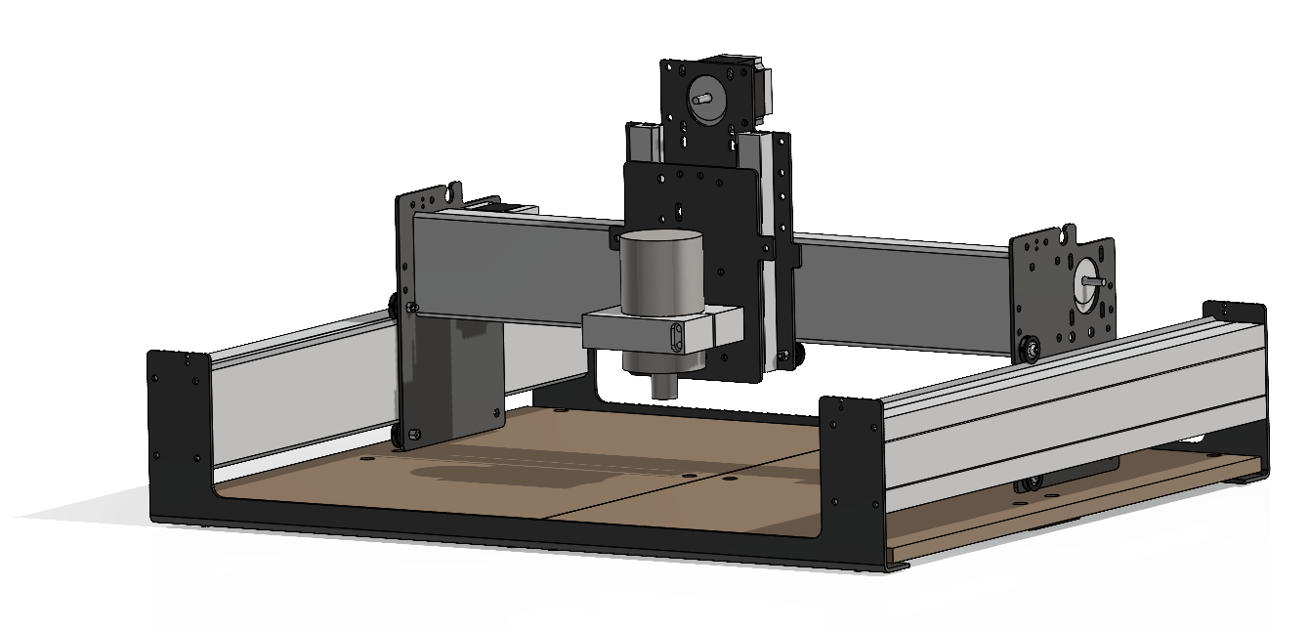
Project Objective
Shelby Gerlt
Shapeoko 3 CNC Router
Implement safeguards for the CNC router to:
Manage hazards
Mitigate the need for PPE
Protect user from safety concerns
Notes:
The objective of this project is to make the Senior Design Labs CNC router safe for student use without requiring additional supervision. This will be achieved by developing machine safeguards that limit the need for Personal Protective Equipment (PPE) in the room while the machine is in operation.

Slide 6
FALL REVIEW HERE
Shelby Gerlt
Defined project scope & customer needs
Outlined goals & set targets
Revised selected design concept
Material selection
Finalized & presented CAD design
Design Review 4
Notes:
Going to begin with a recap of work done last semester and up to this point, then talk about our current design, and finally plans for this semester as we come to design review 5

Slide 7




Hazards
Shelby Gerlt
Notes:
For this project we wanted to consider major hazards that the CNC router machine can cause while in use for our users.

Slide 8


Hazards
Shelby Gerlt
Moving Parts
Notes:
The first hazard is the moving parts such as the belts and z axis translation of the

Slide 9

Hazards
Shelby Gerlt
Moving Parts
Projectiles
Notes:
The objective of this project is to make the Senior Design Labs CNC router safe for student use without requiring additional supervision. This will be achieved by developing machine safeguards that eliminate the need for Personal Protective Equipment (PPE) in the room while the machine is in operation.

Slide 10


Hazards
Shelby Gerlt
Moving Parts
Projectiles
Impalement
Notes:
The objective of this project is to make the Senior Design Labs CNC router safe for student use without requiring additional supervision. This will be achieved by developing machine safeguards that eliminate the need for Personal Protective Equipment (PPE) in the room while the machine is in operation.

Slide 11

Hazards
Shelby Gerlt
Moving Parts
Projectiles
Impalement
Particles
Notes:
The objective of this project is to make the Senior Design Labs CNC router safe for student use without requiring additional supervision. This will be achieved by developing machine safeguards that eliminate the need for Personal Protective Equipment (PPE) in the room while the machine is in operation.

Slide 12
Critical Targets and Metrics
Shelby Gerlt
Function
Halt Projectiles
Limit access while running
Target
≥ 4,000 N
Fully Operable
Metric
Impact Force
Clearance
Create no interference
2 ± 0.2mm
User observation

Slide 13
Implemented Safety Measures
Shelby Gerlt
Moving Parts
Projectiles
Impalement
Particles
Notes:
The objective of this project is to make the Senior Design Labs CNC router safe for student use without requiring additional supervision. This will be achieved by developing machine safeguards that eliminate the need for Personal Protective Equipment (PPE) in the room while the machine is in operation.

Slide 14
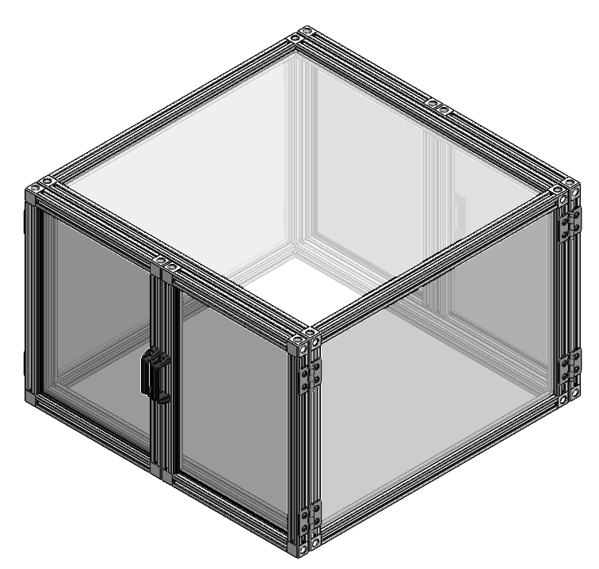
Implemented Safety Measures
Shelby Gerlt
Moving Parts
Enclosure
Projectiles
Emergency Shutoff
Impalement
Automatic Shutoff
Particles
Notes:
The objective of this project is to make the Senior Design Labs CNC router safe for student use without requiring additional supervision. This will be achieved by developing machine safeguards that eliminate the need for Personal Protective Equipment (PPE) in the room while the machine is in operation.

Slide 15
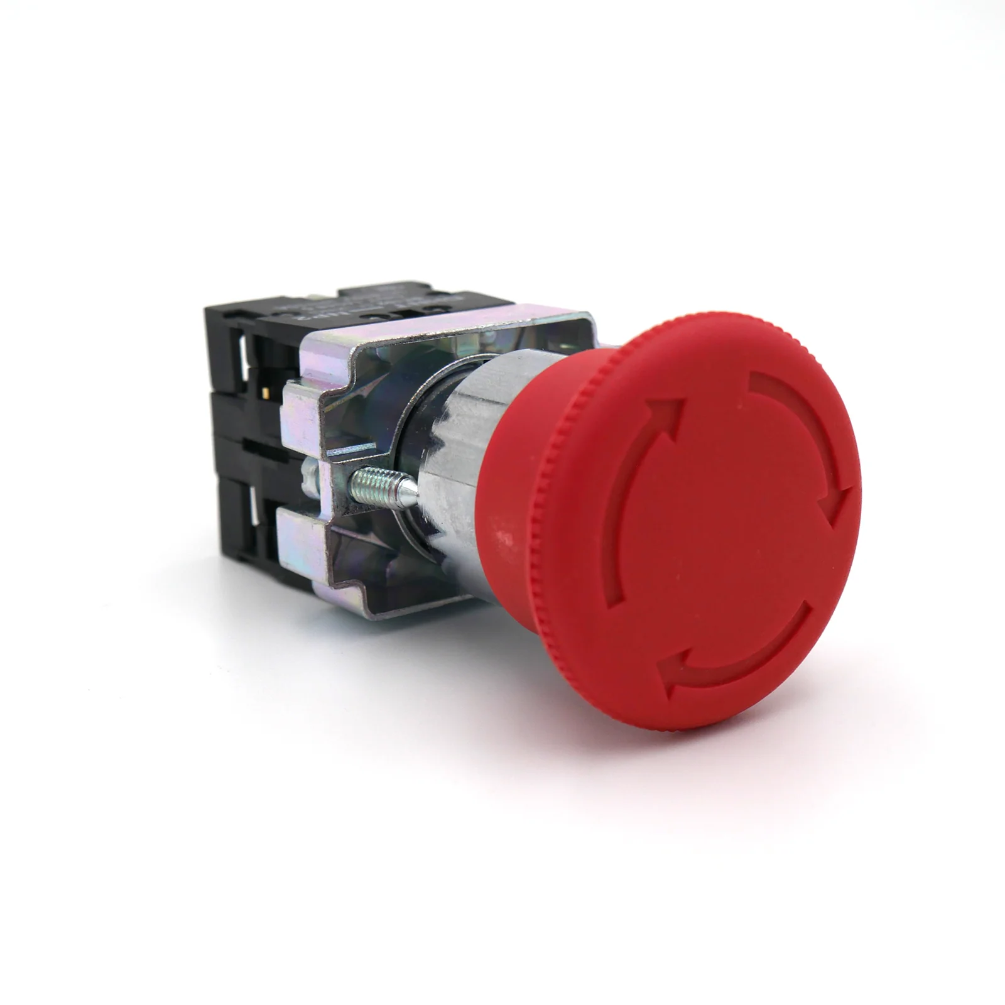
Implemented Safety Measures
Shelby Gerlt
Moving Parts
Enclosure
Projectiles
Emergency Shutoff
Impalement
Automatic Shutoff
Particles
Notes:
The objective of this project is to make the Senior Design Labs CNC router safe for student use without requiring additional supervision. This will be achieved by developing machine safeguards that eliminate the need for Personal Protective Equipment (PPE) in the room while the machine is in operation.

Slide 16
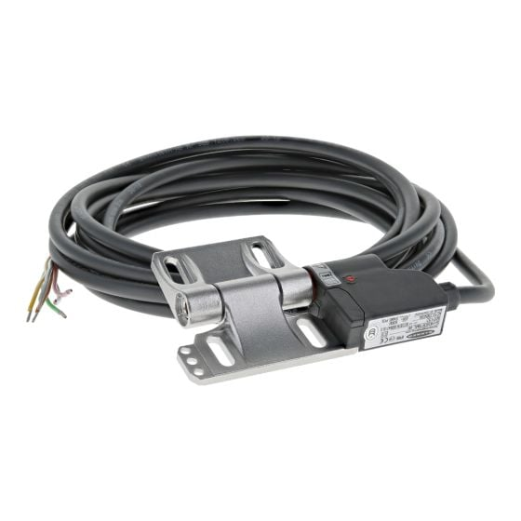
Implemented Safety Measures
Shelby Gerlt
Moving Parts
Enclosure
Projectiles
Emergency Shutoff
Impalement
Automatic Shutoff
Particles
Notes:
The objective of this project is to make the Senior Design Labs CNC router safe for student use without requiring additional supervision. This will be achieved by developing machine safeguards that eliminate the need for Personal Protective Equipment (PPE) in the room while the machine is in operation.

Slide 17
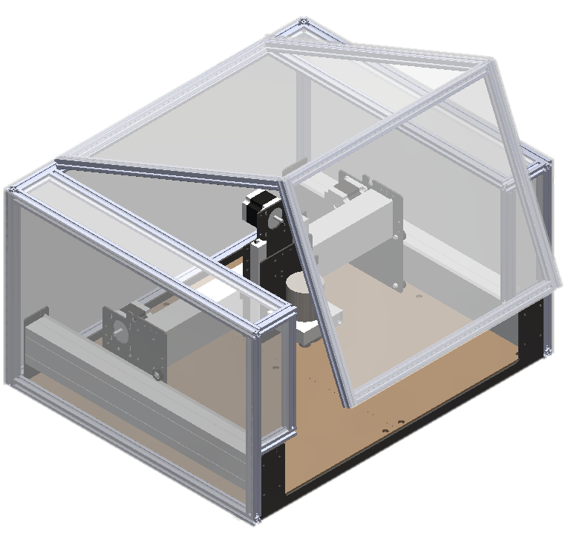
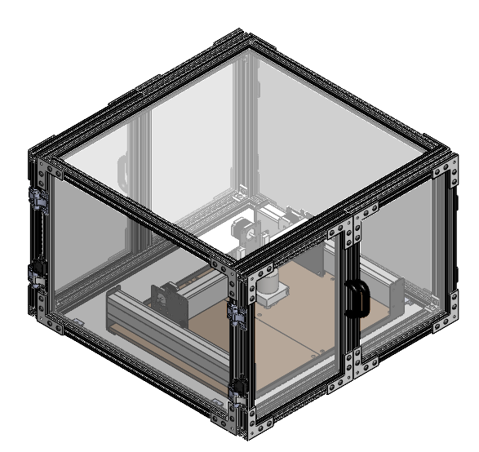

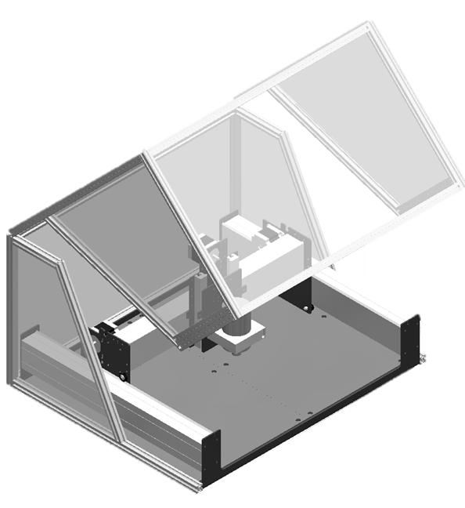
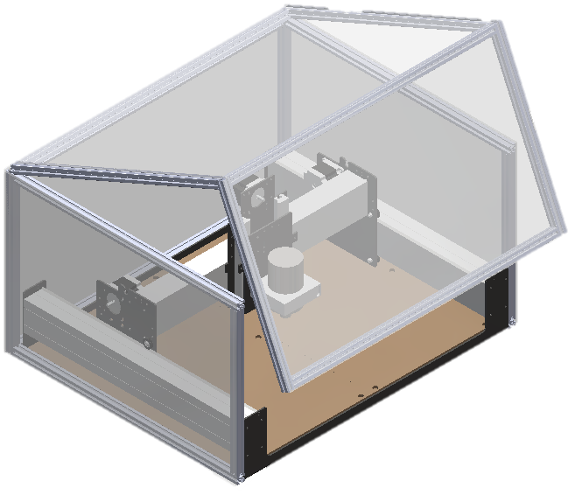
Changes from Initial Concepts
Carlton Walker
Preliminary Designs CAD
Updated Design
Front Opening Doors
Auto-Off Hinge
Back Door

Slide 18
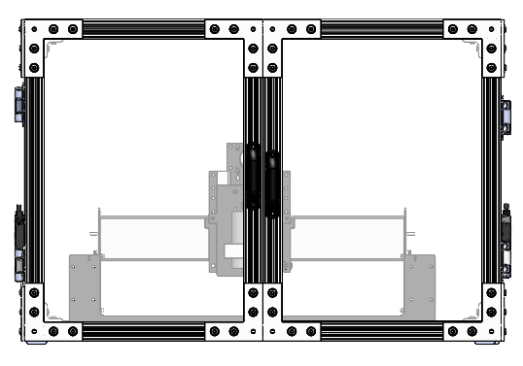
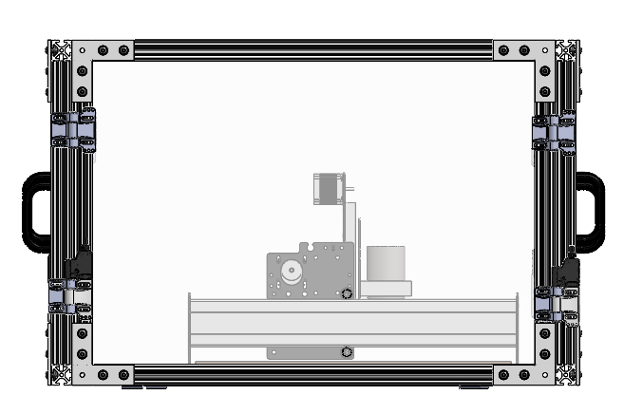
Current Design
Carlton Walker

Slide 19
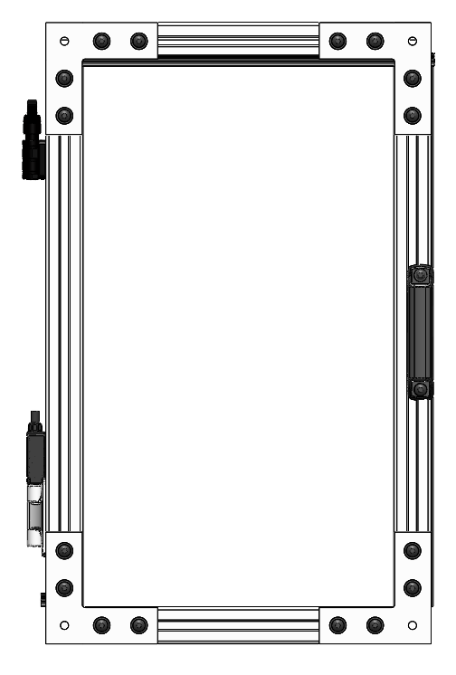
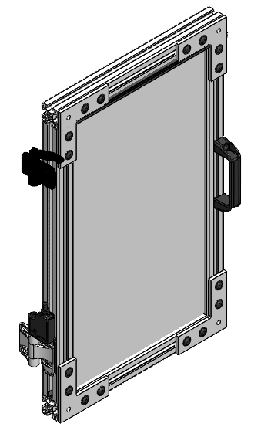
Current Design
Carlton Walker

Slide 20
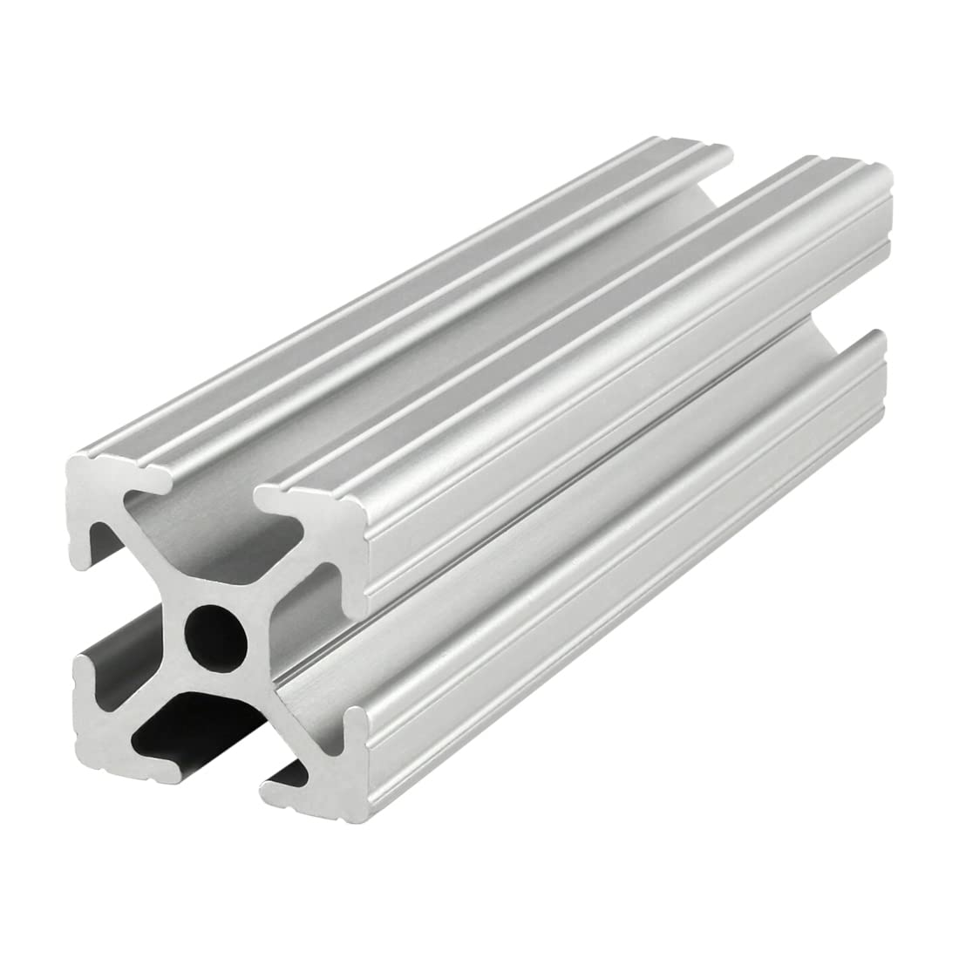
Material Selection – Pros of Aluminum Extrusion
Carlton Walker
Modular/Future additions and changes
Strength-to-weight ratio
Long-term solution
Simple assembly
Corrosion resistant
Notes:
Strength-to-weight ratio: 80/20 aluminum is strong but lightweight, making it ideal for applications that need high strength support while reducing weight
Corrosion resistance: Aluminum's natural oxide film protects it from corrosion, so it doesn't need additional anti-corrosion treatment
Modular design: 80/20 aluminum is easy to set up and take down, and you can add or remove parts without complex tools
Electromagnetic shielding: 80/20 aluminum can provide electromagnetic shielding, which is useful for electronic devices
Easy to customize: 80/20 aluminum can be cut, drilled, and tapped to meet specific needs
Non-toxic: Aluminum is non-toxic, unlike wood alternatives that can be a fire hazard
Reusable: 80/20 aluminum can be reused

Slide 21
Projected Costs
Carlton Walker
Projected costs have taken into account:
Taxes
Shipping
Cutting & Assembly
Notes:
Can talk about use of software

Slide 22



Cost Breakdown
Carlton Walker
Materials
Electrical
Base

Slide 23
Budget Allocation
Carlton Walker
3%
4%
$1,698.73 Materials
$117.00
Electrical
91%
$57.31
Base

Slide 24
Future Work
Carlton Walker
Material Procurement
Design Review 4
Assemble Initial Prototype
Test Full Assembly
Make necessary changes
Test Second Prototype
Install In Final Location
Notes:
Figure out how to add attachements
Modify base platform (vibration)
Emergency shut off (figure out)
Verify parts and suppliers

Slide 25
Spring Plan
Carlton Walker
Infrastructure
Modify base platform to accommodate for attachments
Suppliers
Verify all parts are compatible with the software
Electronics
Emergency shutoff, wires, power source

Slide 26
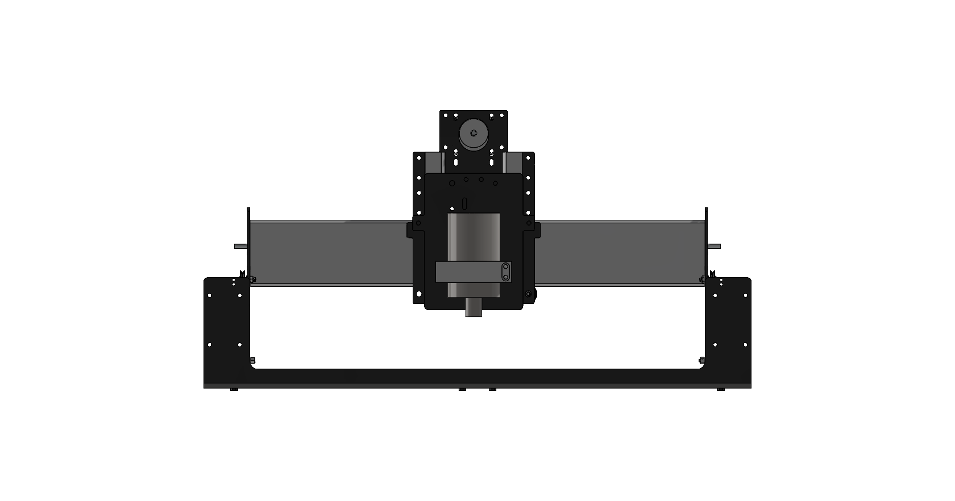
Critical Target: Halt Projectiles
Shelby Gerlt
Target | 3000 N
Metric | Impact force
Testing | Impact test
Notes:
To test the ability of a selected barrier to halt projectiles, an impact test will be performed.

Slide 27
Critical Target: Create No Interference
Shelby Gerlt
Target | Pass
Metric | Pass/Fail
Testing | Observation
Notes:
To test whether the design creates no interference, the machine will be tested with the safeguards in place to check that it can successfully complete a cycle.

Slide 28
Critical Target: Limit Access When On
Shelby Gerlt
Target | True
Metric | Pass/Fail
Testing | Observation
Notes:
To test whether the machine prevents the user from accessing it, the machine will be turned on and a subject will attempt to access it. In the case that the access is overridden, the machine will have a limit switch to shut it down.

Slide 29
Hierarchy of Functions
Shelby Gerlt
CNC Safeguard
Protection
Non-mechanical hazards
Mechanical hazards
Interface
Communication
Control
Collect dust
Dampen noise
Halt projectiles
Prevent contact with point of operation
Prevent contact with power transmission
Create no interference
Communicates hazards
Communicates proper use
Stops use of incorrect materials
Limit machine access when running
Notes:
Hierarchy of functions outlines the goals we have for our design. The primary functions are to halt projectiles, create no interference, and limit machine access while running

Slide 30
Hierarchy of Functions
Shelby Gerlt
CNC
Protection
Non hazards
M hazards
Interface
Comm
Control
Collect
Dampen
Halt
Prevent
Prevent
Create
Comm
Comm
Stops
Limit
Non-mechanical hazards
Mechanical hazards
Collect dust
Dampen noise
Halt projectiles
Prevent contact with point of operation
Prevent contact with power transmission
Create no interference
Protection
CNC Safeguard
Notes:
One of the main hazards is projectiles, in case of this our design has to be able to counter or stop projectiles from hitting anyone near the machine.
The safeguard design must also not prevent the machine from functioning as intended.

Slide 31
Hierarchy of Functions
Shelby Gerlt
CNC
Protection
Non hazards
M hazards
Interface
Comm
Control
Collect
Dampen
Halt
Prevent
Prevent
Create
Comm
Comm
Stops
Limit
Interface
Communication
Control
Communicates hazards
Communicates proper use
Stops use of incorrect materials
Limit machine access when running
CNC Safeguard
Notes:
Final critical target, the design will prevent anyone from accessing the router while it is on. This means the user will not be able to come into contact with the machine at all while it is running.

Slide 32
Targets: Mechanical
Samuel Byers
Function | Target | Metric
Prevent contact w/ point of operation | Particle levels < 5 mg/m³ | Clearance
Prevent contact w/ power transmission | Noise levels < 85 dB | Clearance

Slide 33
Targets: Non-Mechanical
Samuel Byers
Function | Target | Metric
Collect Dust | Particle levels < 5 mg/m³ | Particulates
Dampen Noise | Noise levels < 85 dB | Decibel

Slide 34
Targets: Interface
Samuel Byers
Function | Target | Metric
Prevent use of incorrect materials | Customer uses proper materials | User opinion

Slide 35
Targets: Beyond the Functions
Samuel Byers
Function | Target | Metric
Manage Cables | Visibility of wires/aesthetics | Sponsor opinion
Disassemble Quickly | < 1 day | Time
Limit Vibrations | 5 ± 0.5 mm | Displacement

Slide 36
Assumptions to Guide the Design
Samuel Byers
The user will understand how to use the machine

Slide 37
Assumptions to Guide the Design
Samuel Byers
The user will understand how to use the machine
The machine will be properly maintained

Slide 38
Assumptions to Guide the Design
Samuel Byers
The user will understand how to use the machine
The machine will be properly maintained
The user will not be using PPE

Slide 39
Assumptions to Guide the Design
Samuel Byers
The user will understand how to use the machine
The machine will be properly maintained
The user will not be using PPE
Only compatible materials will be used in the machine

Slide 40
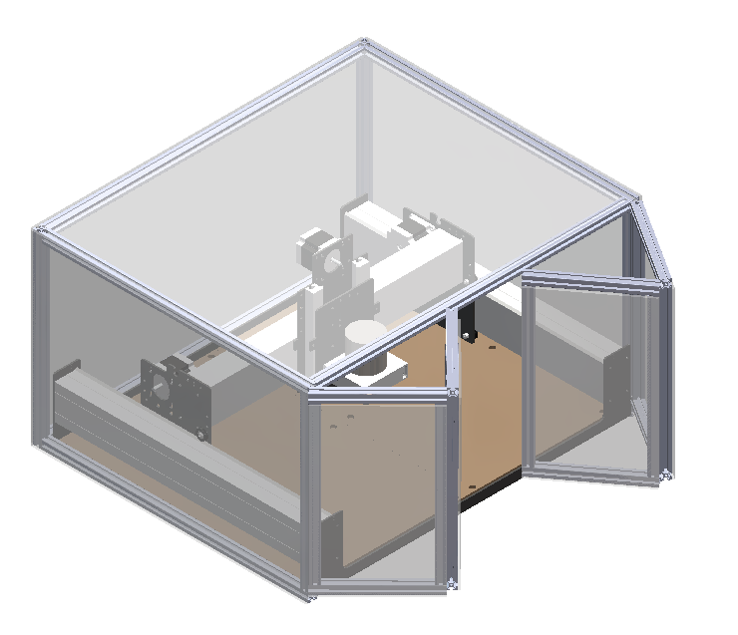
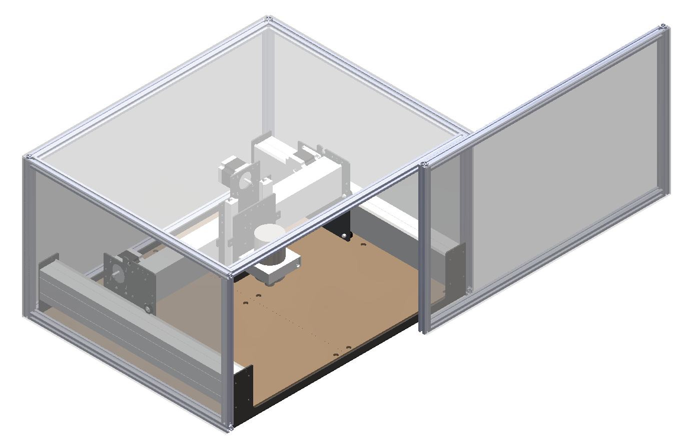
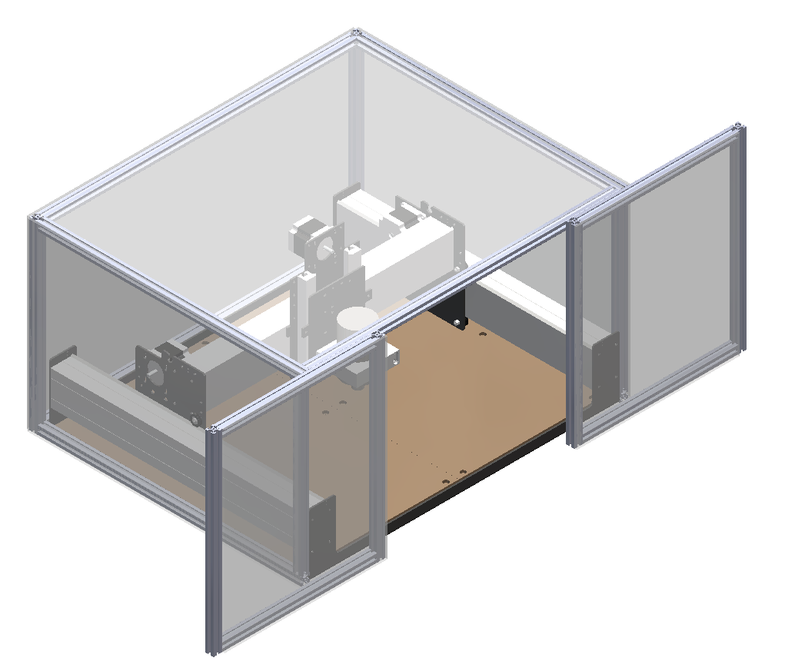
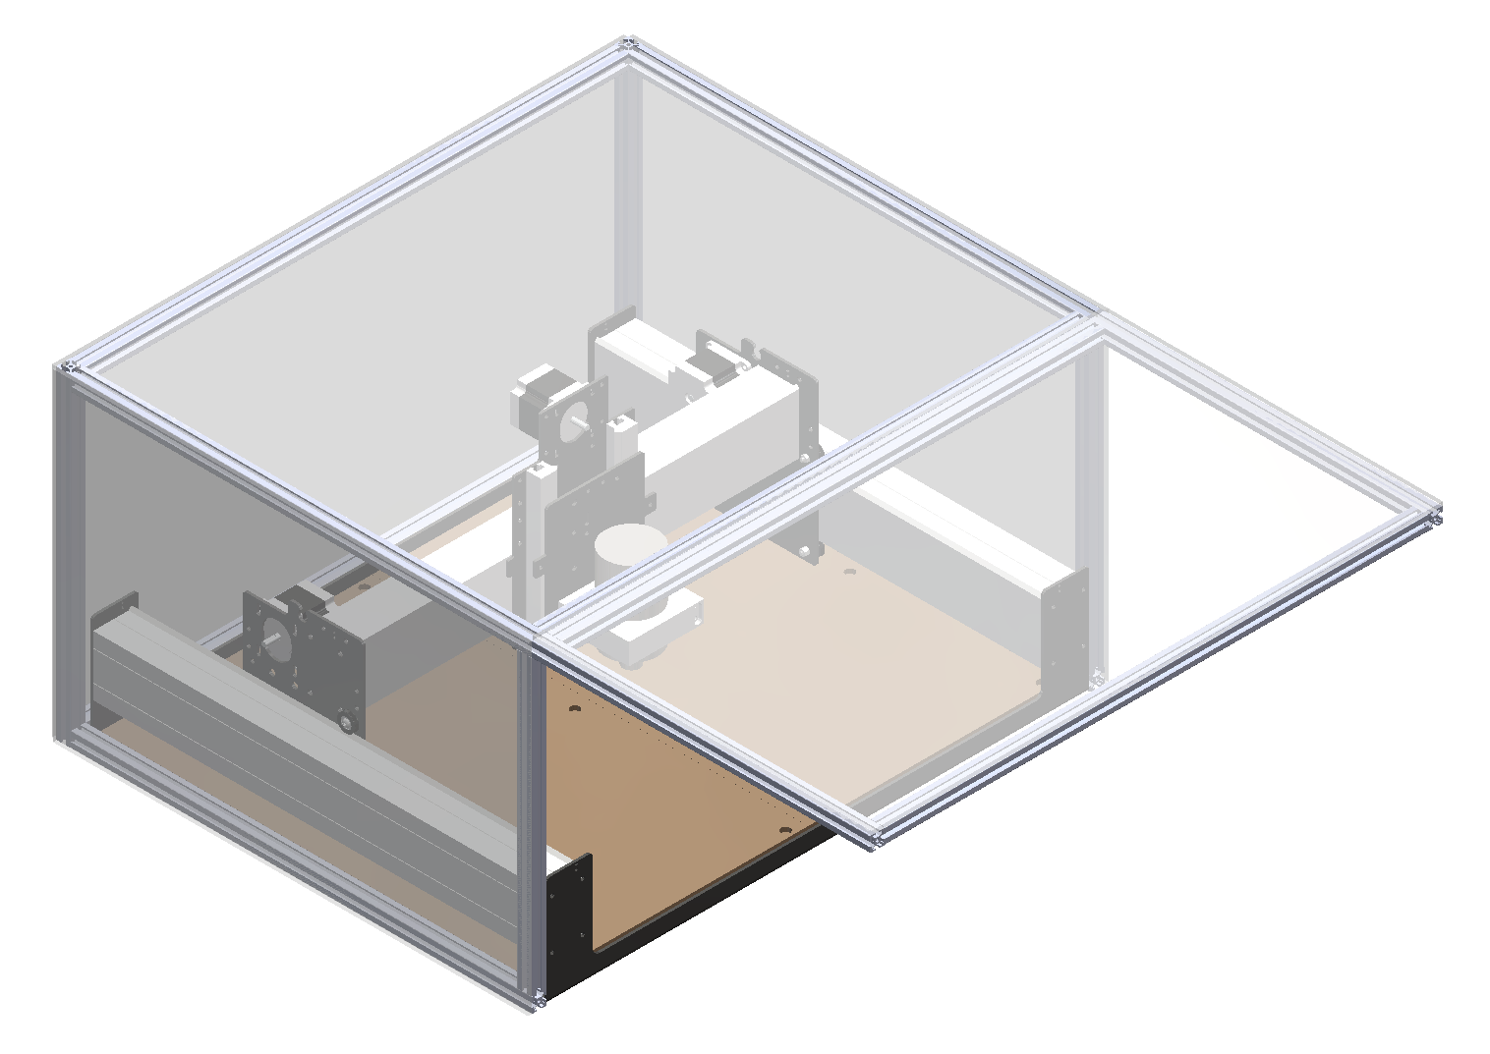
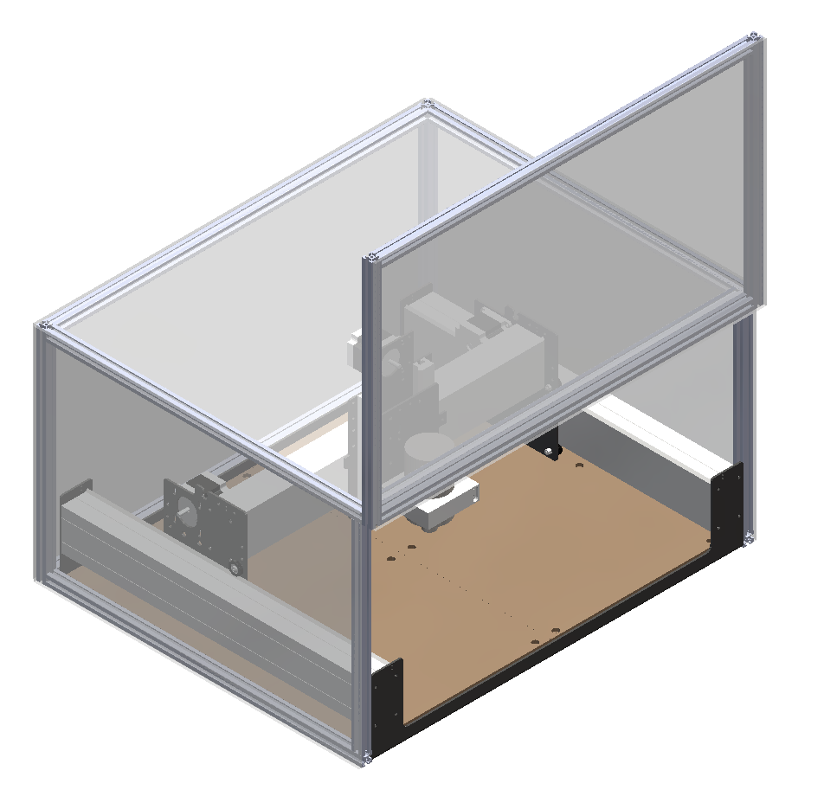
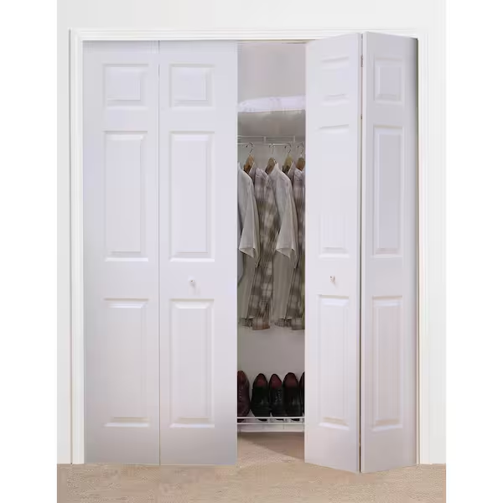
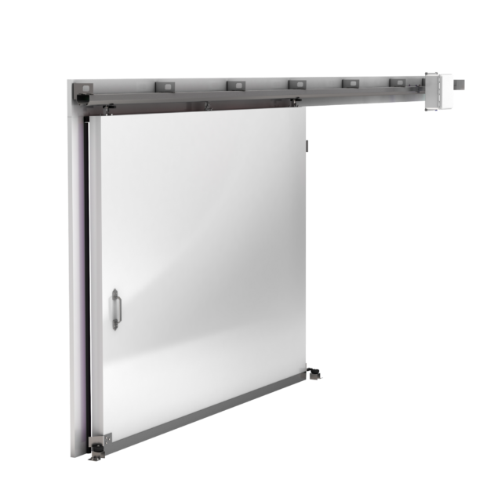

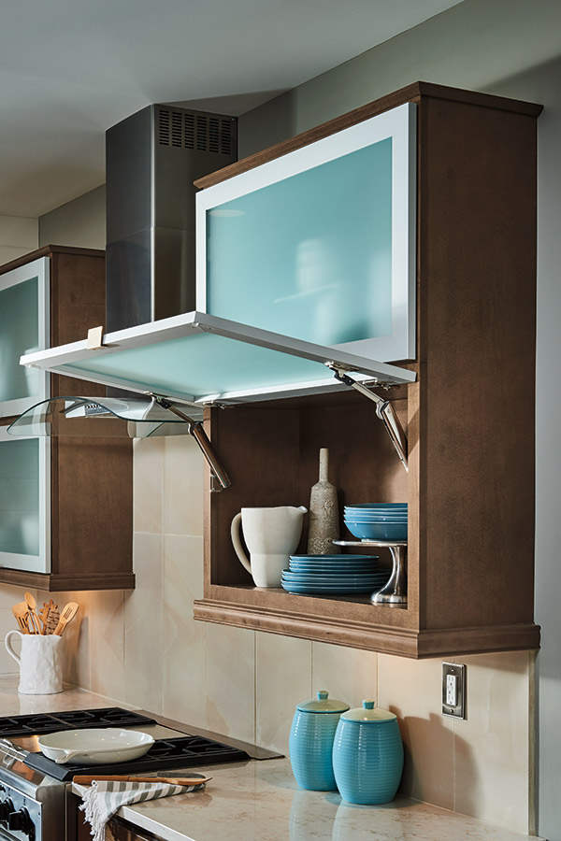
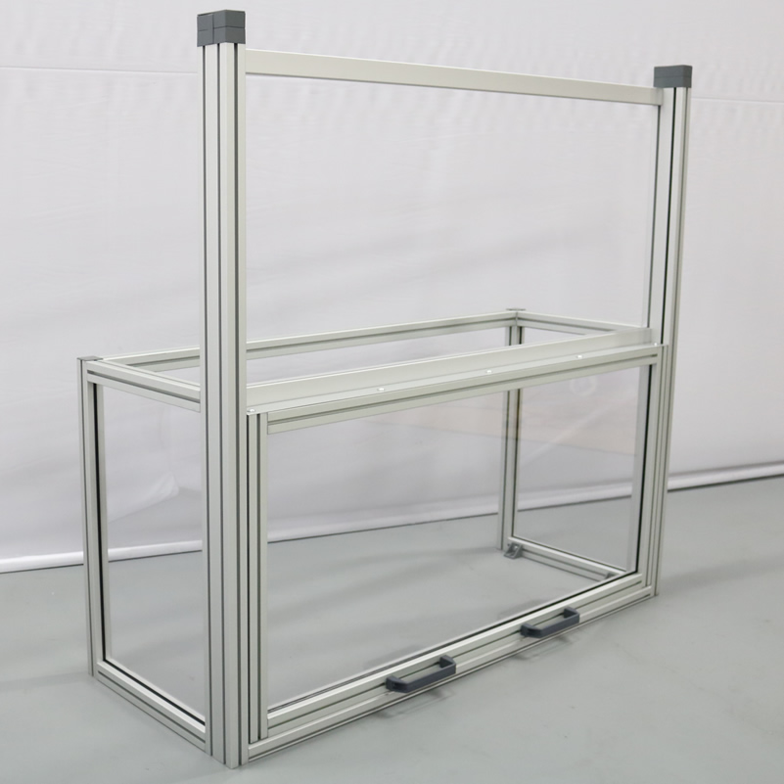
Medium Fidelity Concepts
Malik Grant
Bifold door
Horizontal sliding door
Double sliding door
Top-hinge door
Vertical sliding door
Notes:
For our concept selection, we first started with generating 100 different ideas centered around our critical targets. After developing these ideas from each member of the team we came together to narrow down our concepts to 5 medium fidelity concepts and 3 high fidelity concepts. We used different processes to rank these concepts. For our 5 medium fidelity concepts, we were able to get real life comparisons and were able to pull different features that would be best for our prototype.

Slide 41

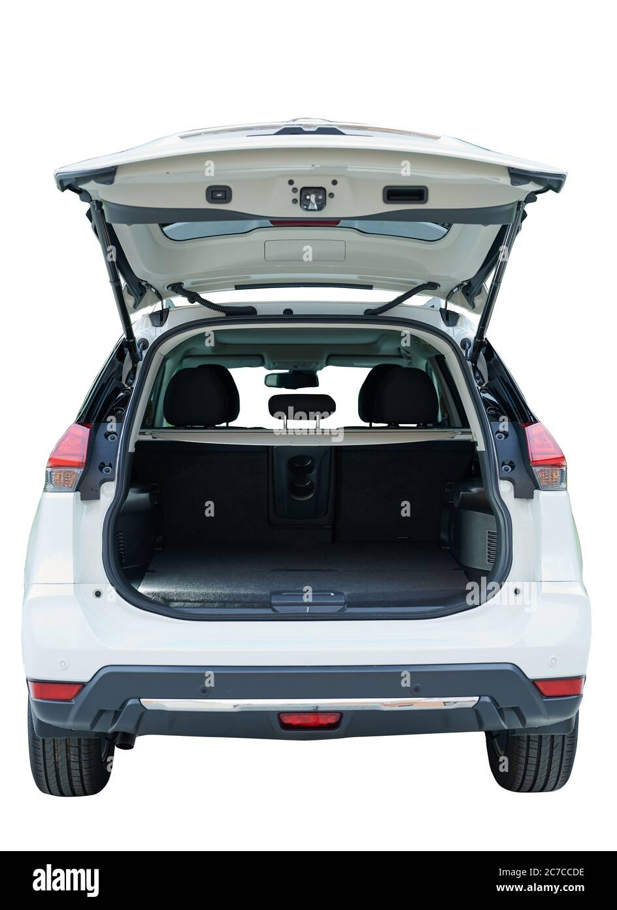
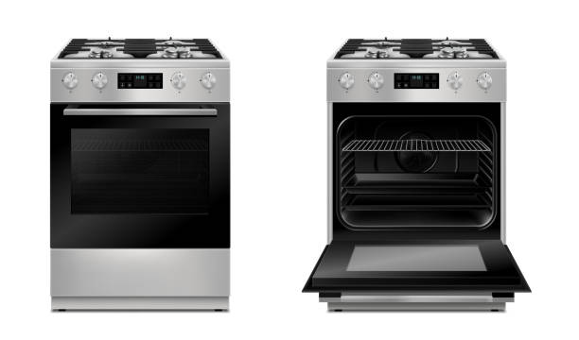
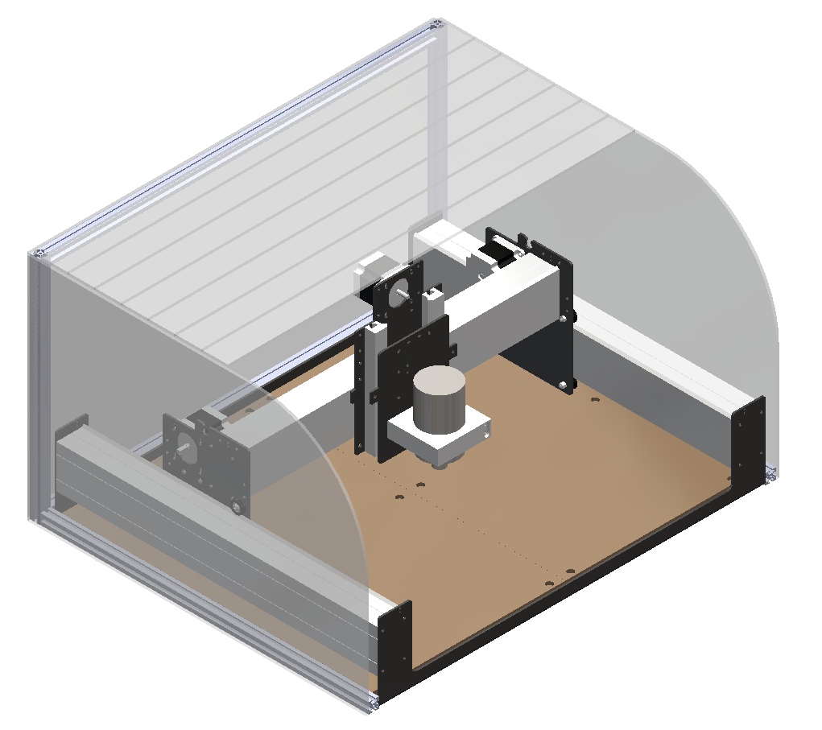
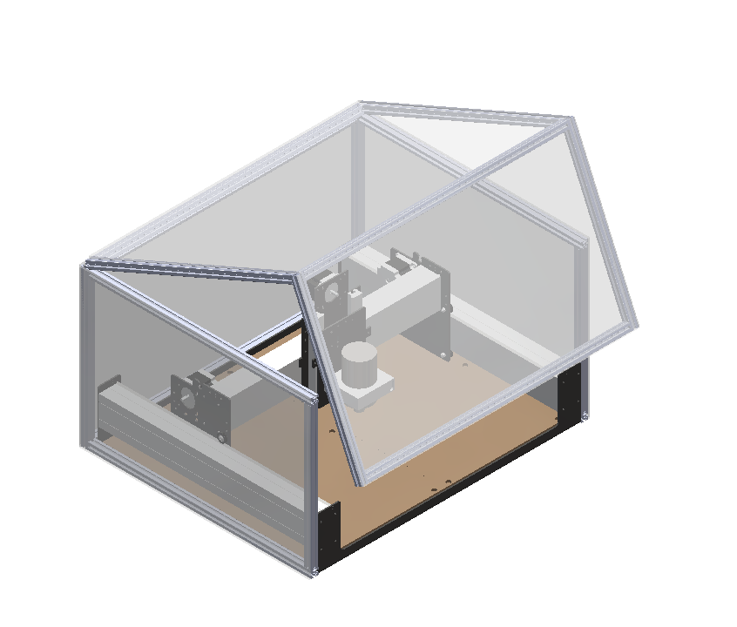
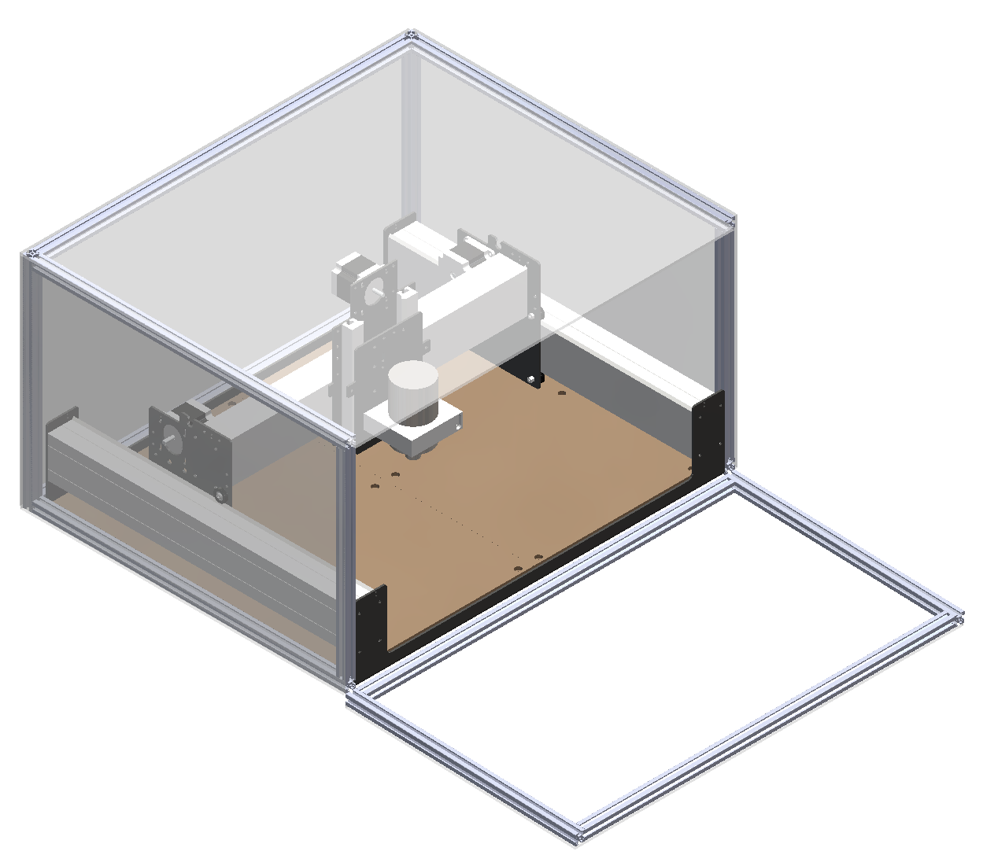
High Fidelity Concepts
Malik Grant
Roll cover
Hatch
Oven door
Notes:
Here is our 3 high fidelity concepts,

Slide 42
Concept Selection
Samuel Byers
Concepts

Slide 43
Concept Selection
Samuel Byers
Concepts
Characteristics
Impact force
Clearance
Limited access
Disassembly time
Displacement due to vibration

Slide 44
Concept Selection
Samuel Byers
Concepts
Characteristics
Impact force
Clearance
Limited access
Disassembly time
Displacement due to vibration
Selection

Slide 45
Final Selection
Samuel Byers
Bifold door
Horizontal sliding door
Double sliding door
Top-hinge door
Vertical sliding door

Slide 46
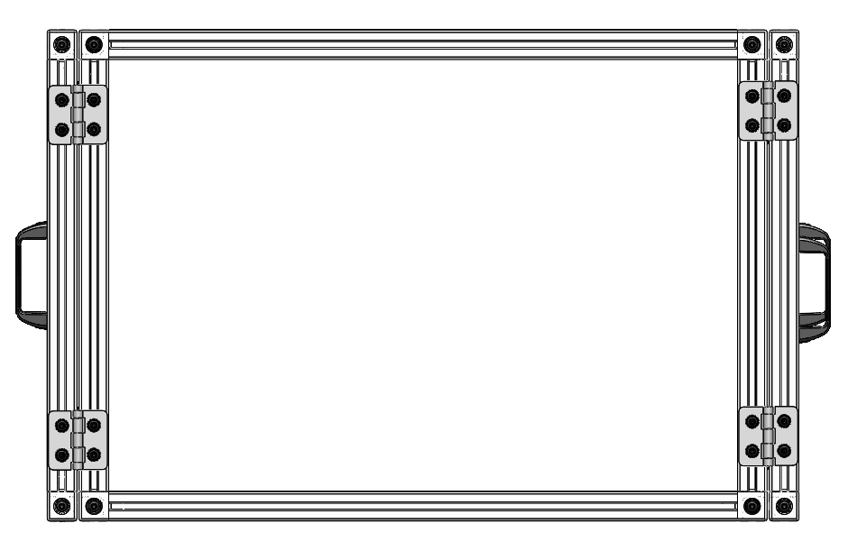
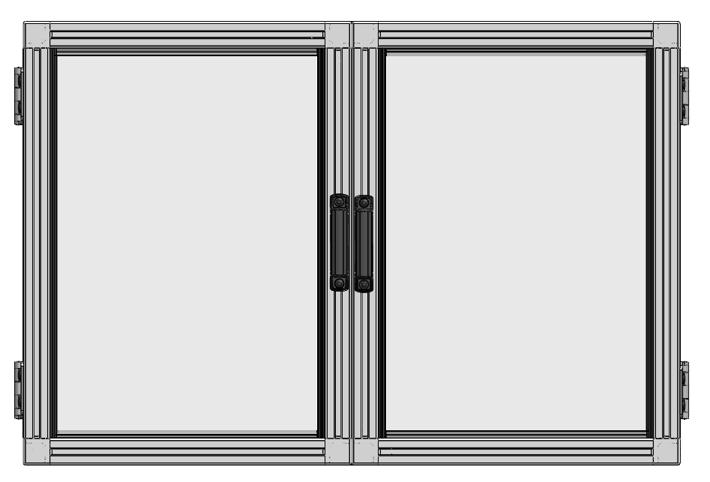
Current Design
Carlton Walker

Slide 47
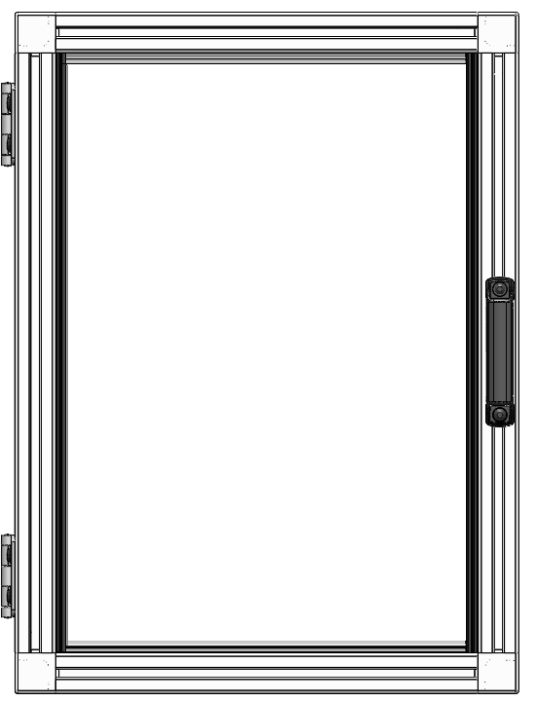
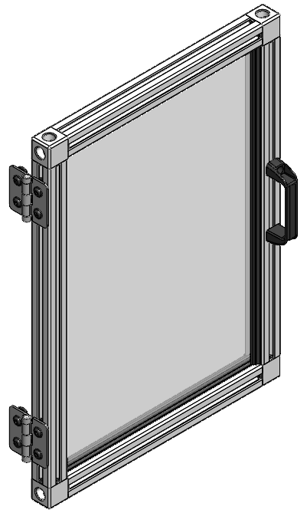
Current Design
Carlton Walker

