Slide 1
SAFE CNC MACHINE
Design Review V
Samuel Byers, Amanda Garcia-Menocal, Shelby Gerlt, Malik Grant, Carlton Walker
February 18, 2025

Slide 2
Team 514
Malik Grant
Samuel Byers
Amanda Garcia-Menocal
Shelby Gerlt
Malik Grant
Carlton Walker
Supply Chain Engineer
Structural Engineer
Test Engineer
Electrical Engineer
Design Engineer

Slide 3
Guidance and Sponsorship
Malik Grant
Dr. Shayne McConomy
Sponsor
Dr. Eric Hellstrom
Advisor

Slide 4
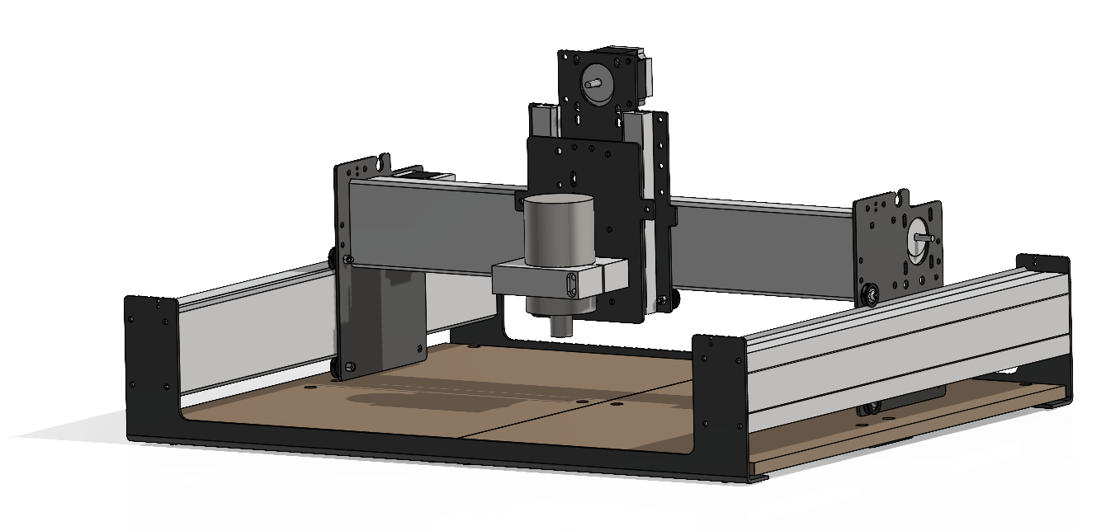
Project Objective
Malik Grant
The objective of this project is to design safeguards for the Senior Design Lab’s CNC router to protect students and staff from hazards and mitigate the need for PPE.
Shapeoko 3 CNC Router
Notes:
The objective of this project is to make the Senior Design Labs CNC router safe for student use without requiring additional supervision. This will be achieved by developing machine safeguards that limit the need for Personal Protective Equipment (PPE) in the room while the machine is in operation.

Slide 5
Previous Work
Malik Grant
Identified hazards in current condition
Designed risk reduction safety features
Completed CAD model
Finalized design and material selection
Selected suppliers for materials
Design Review 5
Notes:
Going to begin with a recap of work done last semester and up to this point, then talk about our current design, and finally plans for this semester as we come to design review 5

Slide 6
Hazards
Malik Grant
Moving Parts
Projectiles
Impalement
Particles
Notes:
The objective of this project is to make the Senior Design Labs CNC router safe for student use without requiring additional supervision. This will be achieved by developing machine safeguards that eliminate the need for Personal Protective Equipment (PPE) in the room while the machine is in operation.

Slide 7
Critical Targets and Metrics
Malik Grant
Function
Halt Projectiles
Limit access while running
Create no interference
Target
<= 4,000 N
Fully Operable
2 ± 0.2mm
Metric
Impact Force
Clearance
User observation

Slide 8
Assessed Hazards
Amanda Garcia-Menocal
Moving Parts
Projectiles
Impalement
Particles
Notes:
The objective of this project is to make the Senior Design Labs CNC router safe for student use without requiring additional supervision. This will be achieved by developing machine safeguards that eliminate the need for Personal Protective Equipment (PPE) in the room while the machine is in operation.

Slide 9
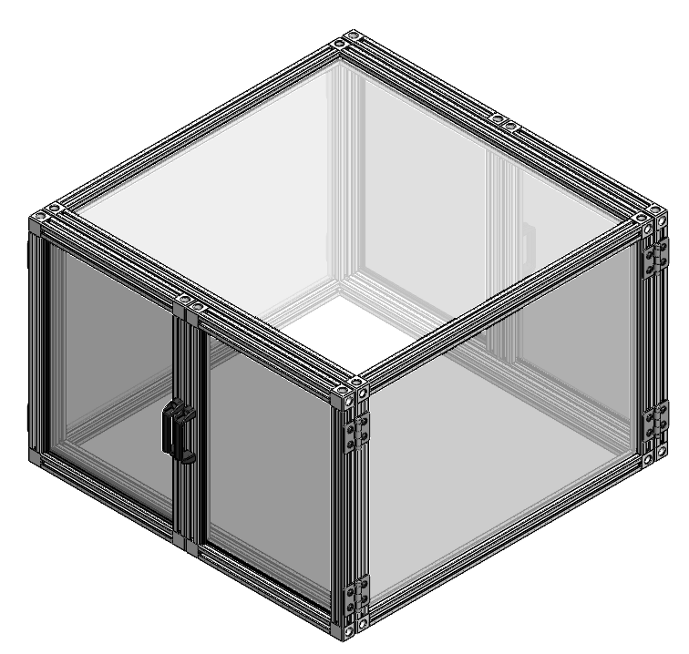
Implemented Safety Functions
Amanda Garcia-Menocal
Moving Parts
Enclosure
Projectiles
Impalement
Particles
Notes:
The objective of this project is to make the Senior Design Labs CNC router safe for student use without requiring additional supervision. This will be achieved by developing machine safeguards that eliminate the need for Personal Protective Equipment (PPE) in the room while the machine is in operation.

Slide 10
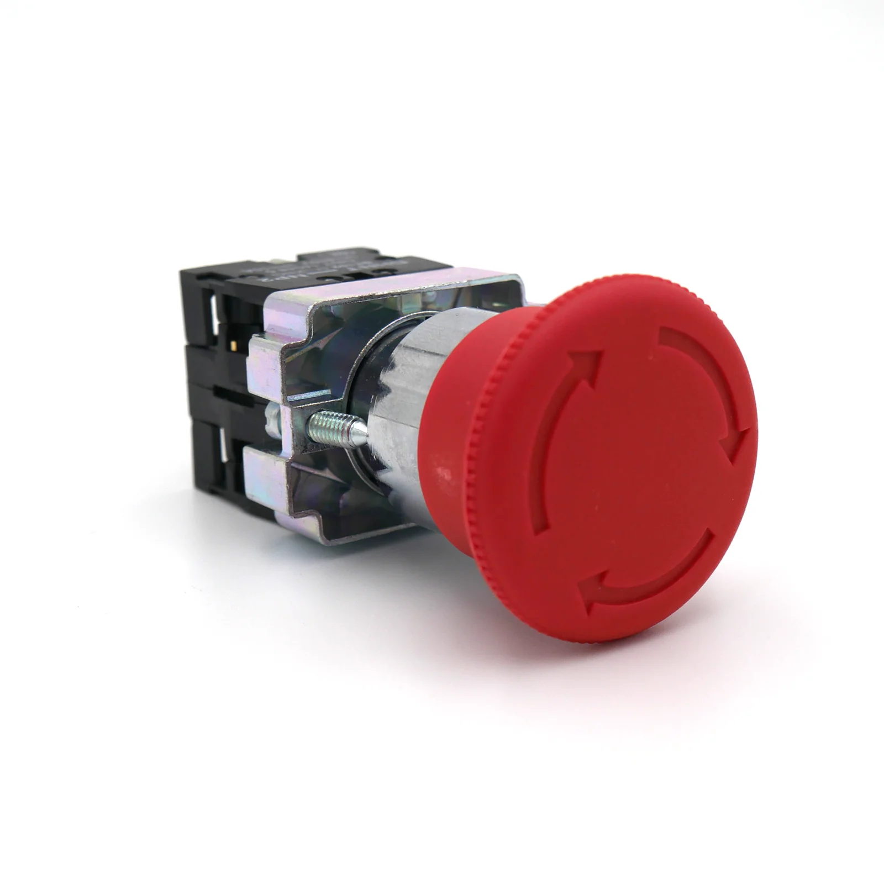
Implemented Safety Functions
Amanda Garcia-Menocal
Moving Parts
Enclosure
Projectiles
Emergency Shutoff
Impalement
Automatic Shutoff
Particles
Notes:
The objective of this project is to make the Senior Design Labs CNC router safe for student use without requiring additional supervision. This will be achieved by developing machine safeguards that eliminate the need for Personal Protective Equipment (PPE) in the room while the machine is in operation.

Slide 11
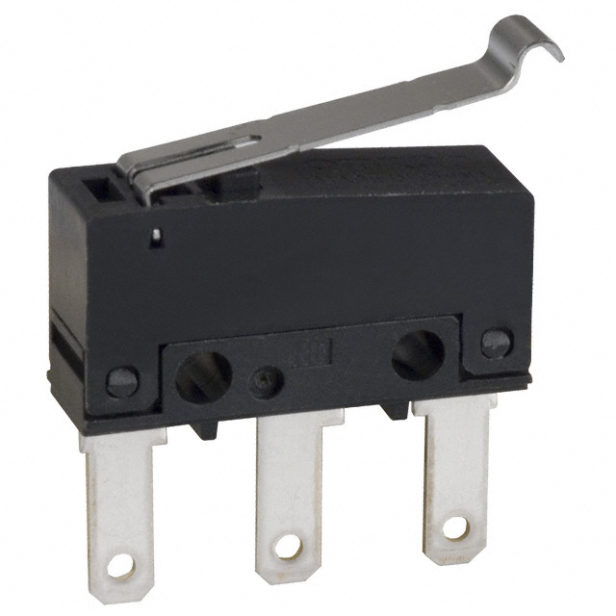
Implemented Safety Functions
Amanda Garcia-Menocal
Moving Parts
Enclosure
Projectiles
Emergency Shutoff
Impalement
Automatic Shutoff
Particles
Notes:
The objective of this project is to make the Senior Design Labs CNC router safe for student use without requiring additional supervision. This will be achieved by developing machine safeguards that eliminate the need for Personal Protective Equipment (PPE) in the room while the machine is in operation.

Slide 12
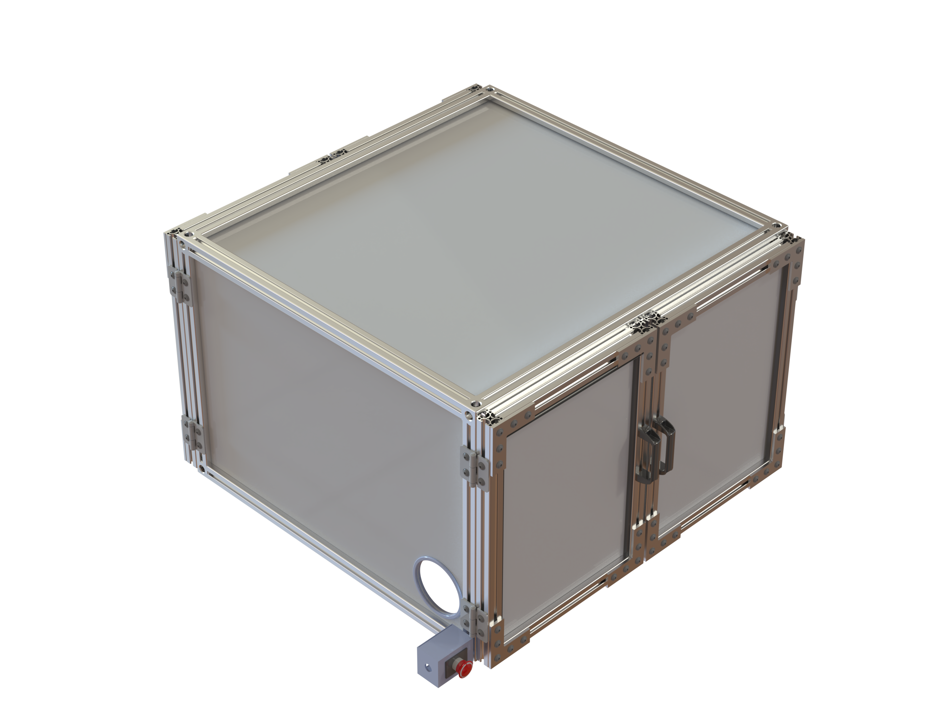
Enclosure Design
Amanda Garcia-Menocal

Slide 13
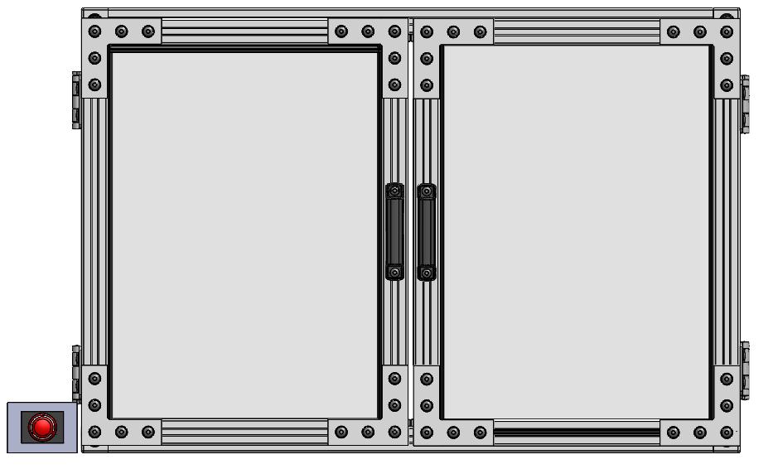
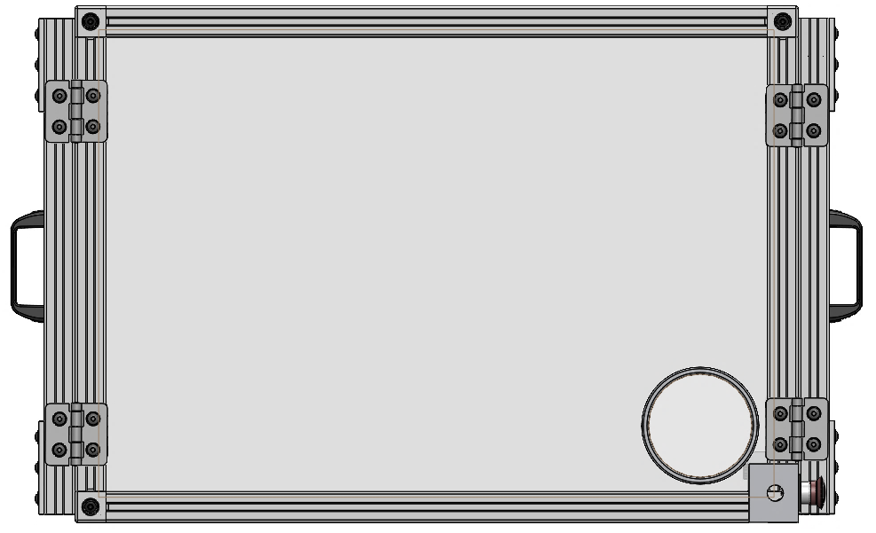
Enclosure Design
Amanda Garcia-Menocal
Front view:
Side view:

Slide 14
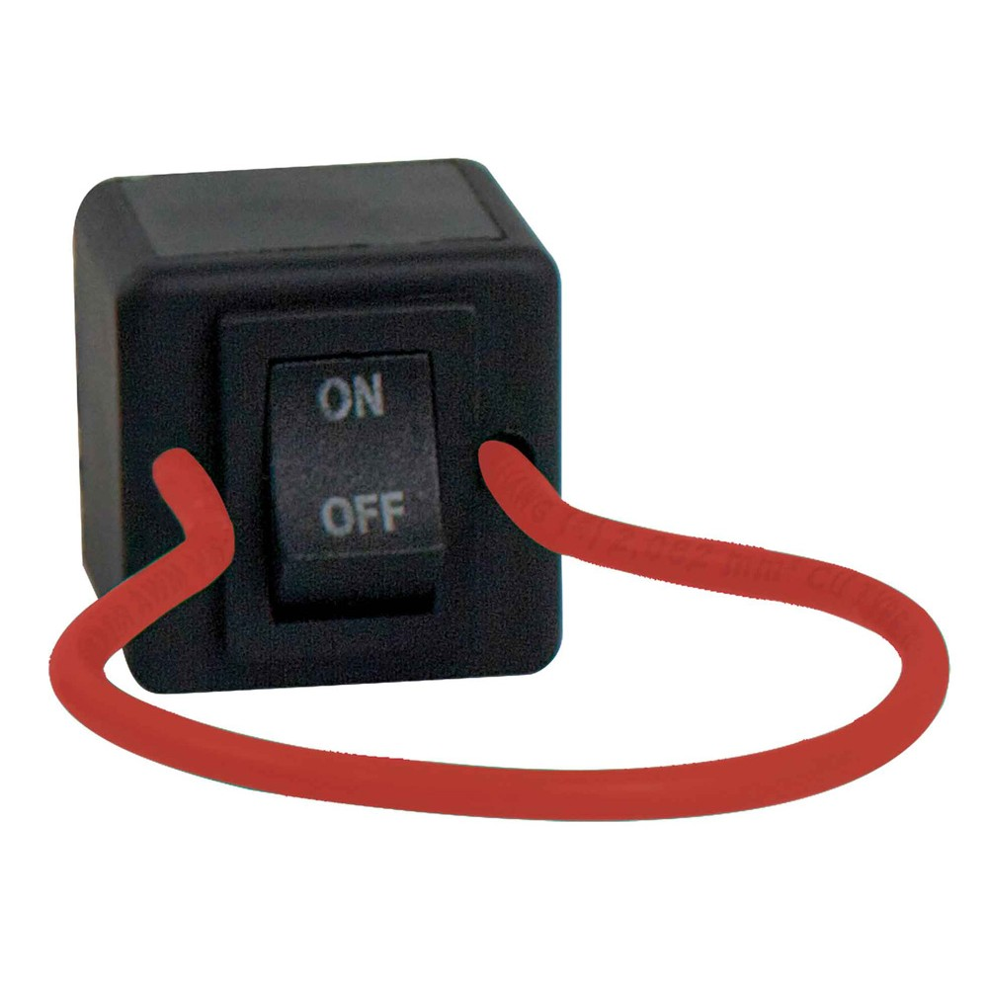
Electrical Design
Amanda Garcia-Menocal
Power Source
Breaks Series
Breaks Series
Notes:
The way the system would be powered is displayed in this diagram with the essential parts including limit switches on the doors, power source relay on/off switch, and emergency shut off button. The doors will have two limit switches on each side of the door to ensure for contact with the frame. The limit switches will be powered directly from the power source of the machine which is being powered from the room outlet. If the door is not fully in tack then the machine will not be powered. But now if the machine wants to be in use while the doors are open that is when you would use the power source relay on/off button to send the current directly to the machine. And finally, the emergency stop button will cut all power through the series of wire for the whole machine. We are using 12 gauge wiring to feed the current throughout the system

Slide 15
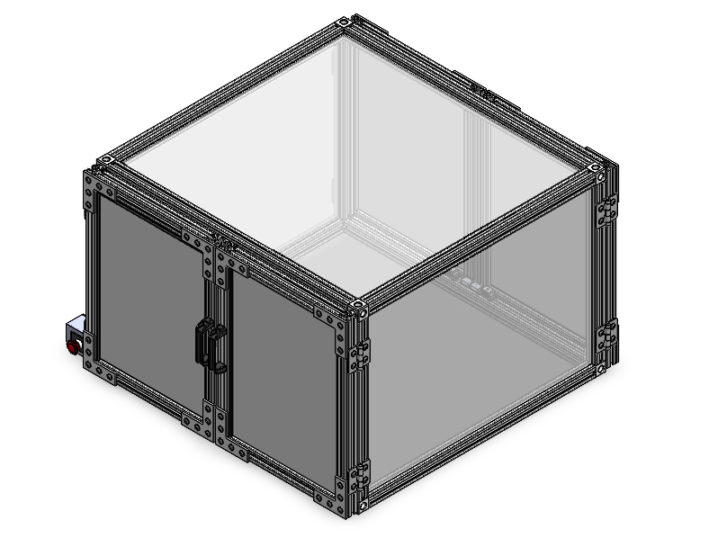
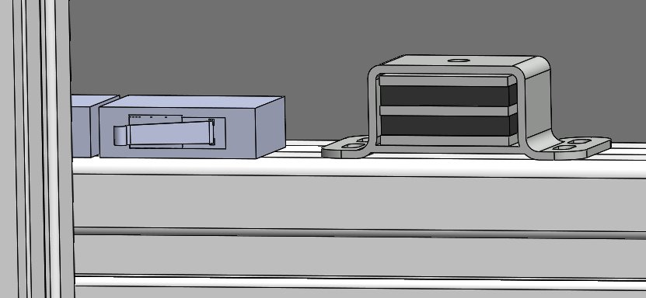
Door Design
Amanda Garcia-Menocal

Slide 16
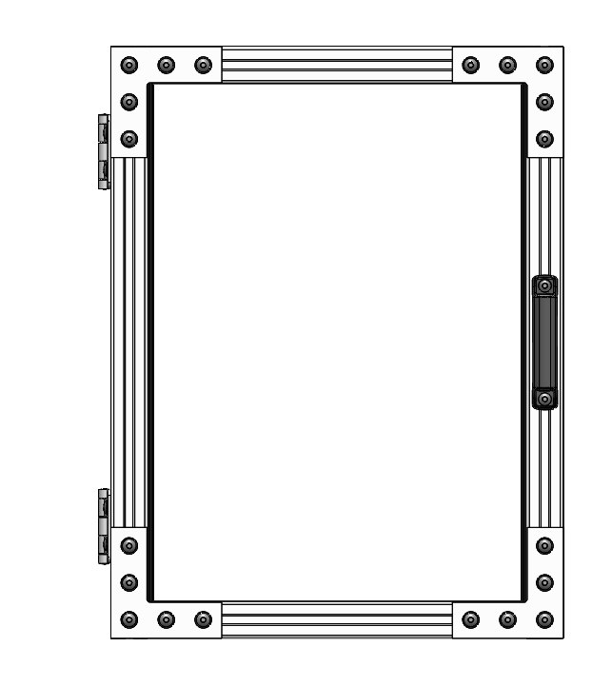
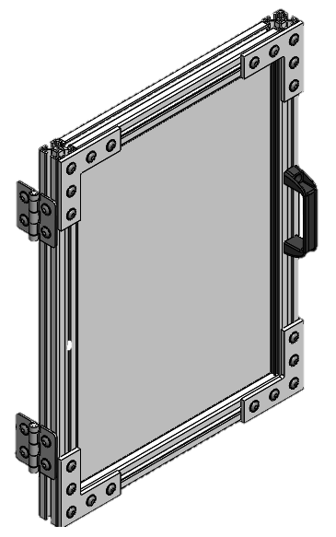
Door Design
Amanda Garcia-Menocal

Slide 17
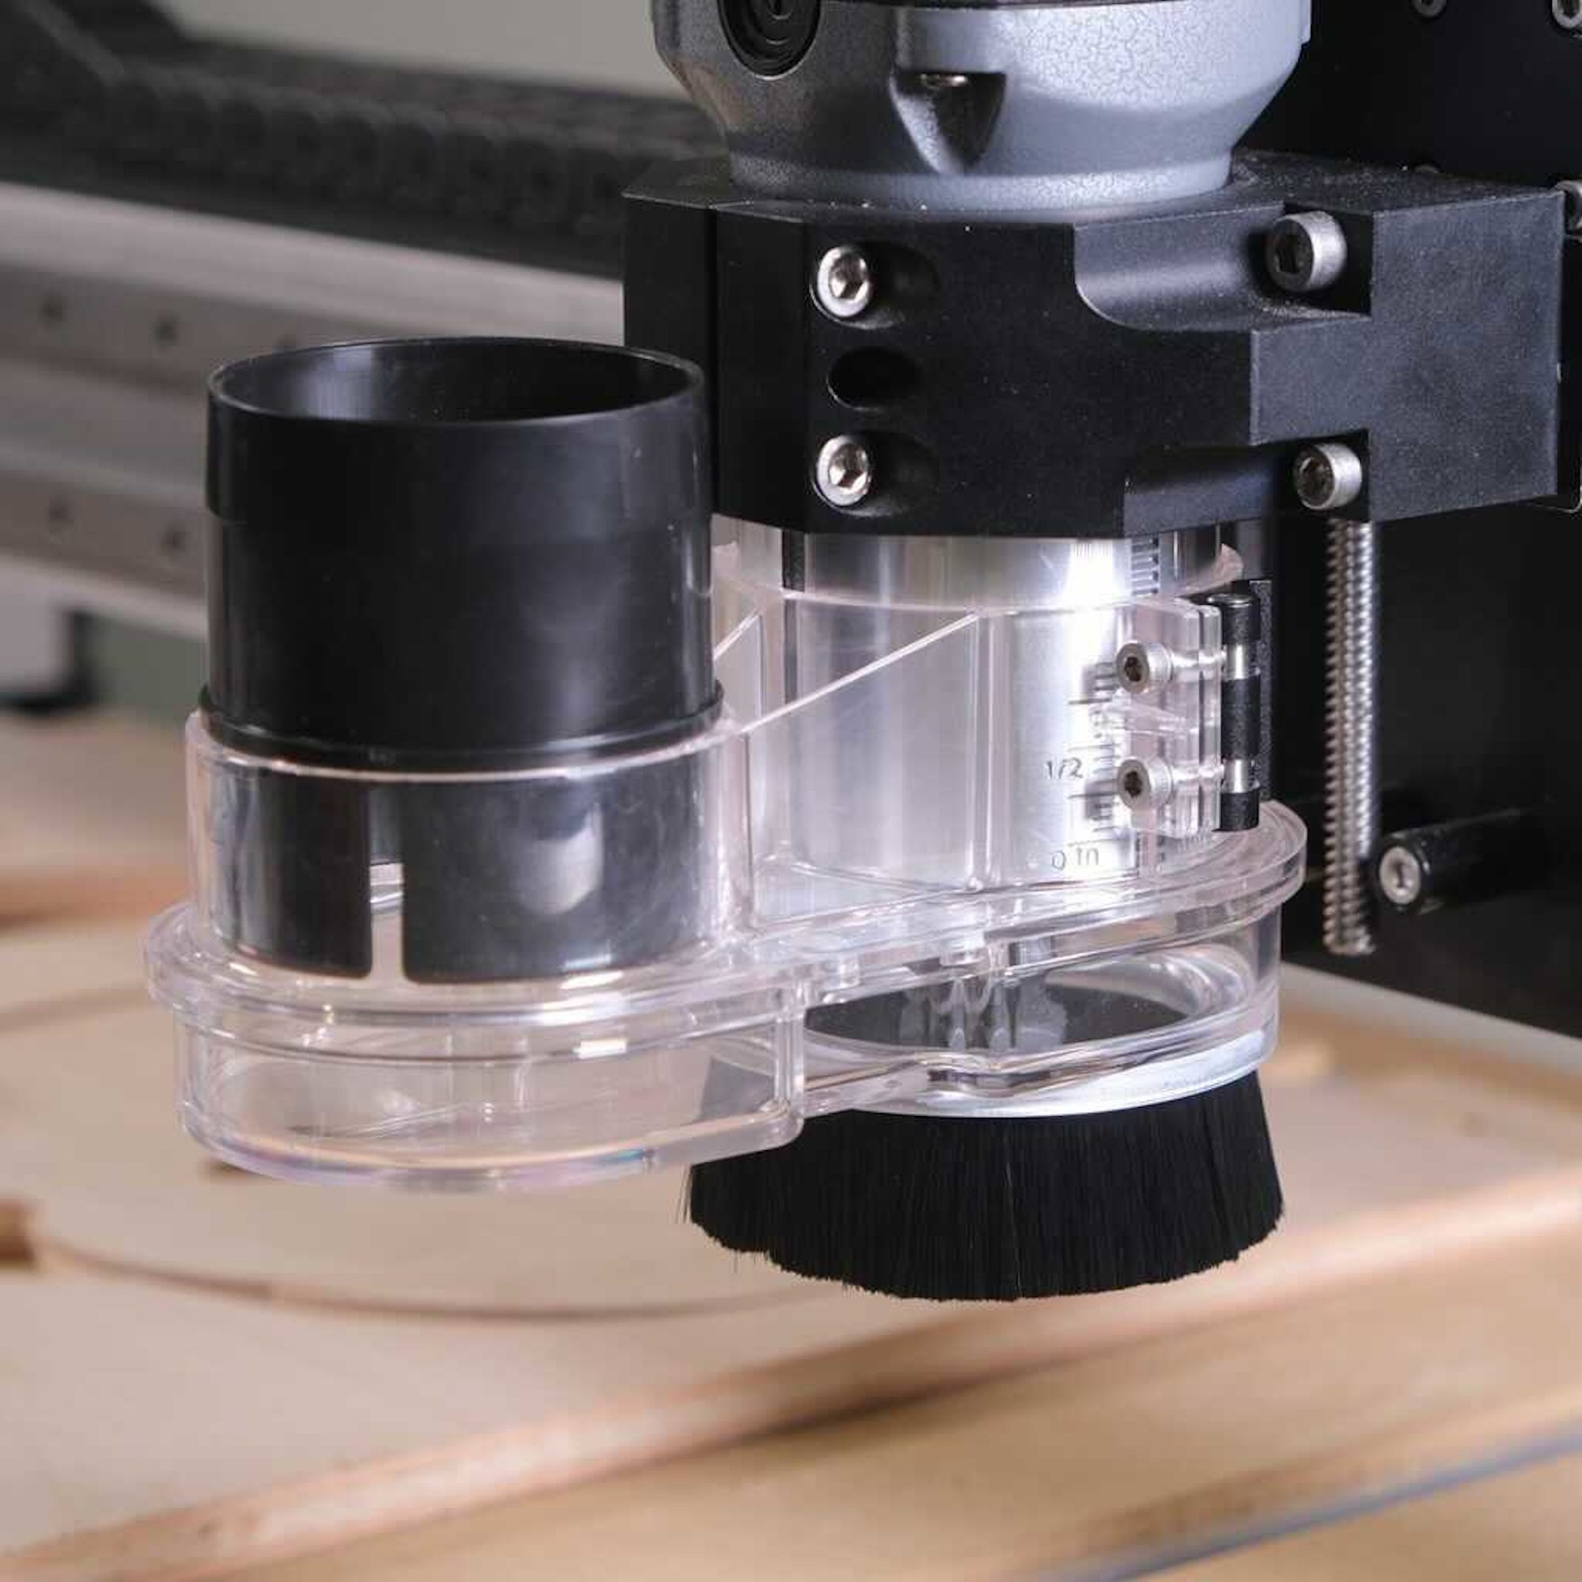
Vacuum Collection Design
Amanda Garcia-Menocal
Dust Sweep Attachment
Dust Separator
Dust Collector

Slide 18
Vacuum Collection Design
Amanda Garcia-Menocal
Dust Sweep Attachment
Dust Separator
Dust Collector

Slide 19
Vacuum Collection Design
Amanda Garcia-Menocal
Dust Sweep Attachment
Dust Separator
Dust Collector
Particles
Dust

Slide 20
Projected Costs
Samuel Byers
Projected costs have considered:
Taxes
Shipping
Cutting & Assembly
Notes:
Can talk about use of software

Slide 21
Materials Budget Breakdown
Samuel Byers
3%
Electrical
$60.00
4%
Base
$59.04
Polycarbonate
$428.23
Metal
$700.27
Miscellaneous
$437.24

Slide 22
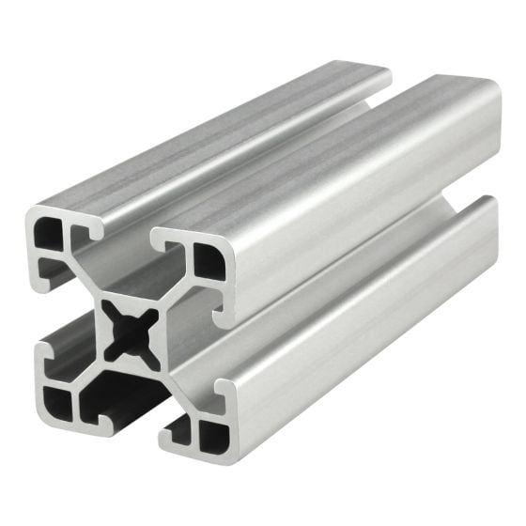
Aluminum Extrusion Material Selection
Samuel Byers
Modular
Good strength-to-weight ratio
Long-term solution
Simple assembly
Corrosion resistant
1.50”
1.50”

Slide 23
Polycarbonate Material Selection
Samuel Byers
Pros
Impact resistance
Durability
Heat tolerance

Slide 24
Polycarbonate Material Selection
Samuel Byers
Pros
Impact resistance
Durability
Heat tolerance
Cons
Scratch sensitivity
UV degradation
Chemical sensitivity

Slide 25
Future Work
Samuel Byers
Finish ordering all materials
Design Review 5
Assemble enclosure
Install and level enclosure
Install vacuum hose
Complete electrical wiring
Test design and verify risk reduction
Notes:
Figure out how to add attachements
Modify base platform (vibration)
Emergency shut off (figure out)
Verify parts and suppliers

Slide 26
Project Objective
Shelby Gerlt
Shapeoko 3 CNC Router
Implement safeguards for the CNC router to:
Mitigate the need for PPE
Protect students and staff from hazards
Notes:
The objective of this project is to make the Senior Design Labs CNC router safe for student use without requiring additional supervision. This will be achieved by developing machine safeguards that limit the need for Personal Protective Equipment (PPE) in the room while the machine is in operation.

Slide 27
Stakeholders
Shelby Gerlt
FAMU-FSU COE
FAMU-FSU COE
Elias Haase
Jacob Schmitt
Tripp Lappalainen

Slide 28
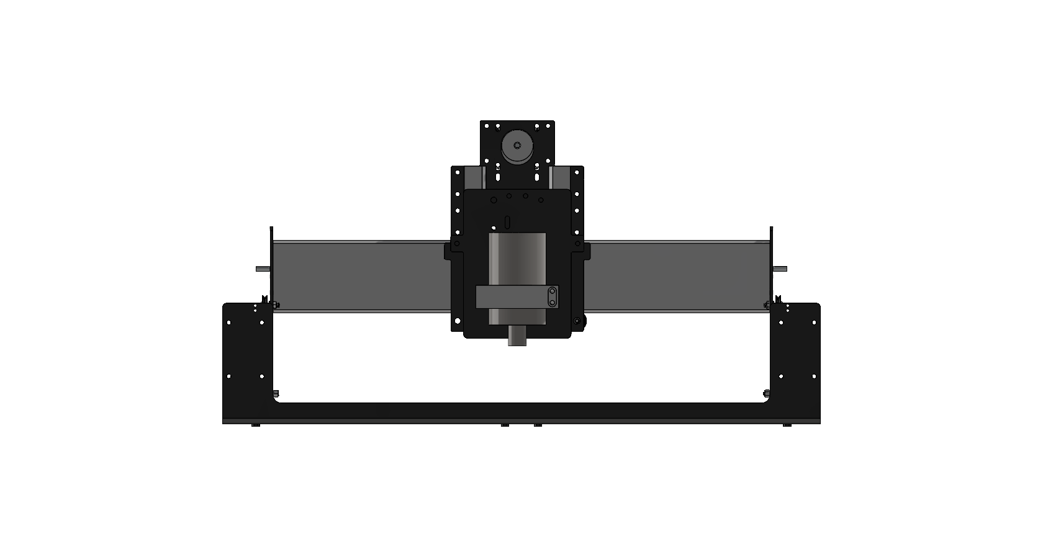
Critical Target: Halt Projectiles
Shelby Gerlt
Target | 3000 N
Metric | Impact force
Testing | Impact test
Notes:
To test the ability of a selected barrier to halt projectiles, an impact test will be performed.

Slide 29
Critical Target: Create No Interference
Shelby Gerlt
Target | Pass
Metric | Pass/Fail
Testing | Observation
Notes:
To test whether the design creates no interference, the machine will be tested with the safeguards in place to check that it can successfully complete a cycle.

Slide 30
Critical Target: Limit Access When On
Shelby Gerlt
Target | True
Metric | Pass/Fail
Testing | Observation
Notes:
To test whether the machine prevents the user from accessing it, the machine will be turned on and a subject will attempt to access it. In the case that the access is overridden, the machine will have a limit switch to shut it down.

Slide 31
Hierarchy of Functions
Shelby Gerlt
CNC Safeguard
Protection
Non-mechanical hazards
Mechanical hazards
Interface
Communication
Control
Collect dust
Dampen noise
Halt projectiles
Prevent contact with point of operation
Prevent contact with power transmission
Create no interference
Communicates hazards
Communicates proper use
Stops use of incorrect materials
Limit machine access when running
Notes:
Hierarchy of functions outlines the goals we have for our design. The primary functions are to halt projectiles, create no interference, and limit machine access while running

Slide 32
Hierarchy of Functions
Shelby Gerlt
CNC
Protection
Non hazards
M hazards
Interface
Comm
Control
Collect
Dampen
Halt
Prevent
Prevent
Create
Comm
Comm
Stops
Limit
Non-mechanical hazards
Mechanical hazards
Collect dust
Dampen noise
Halt projectiles
Prevent contact with point of operation
Prevent contact with power transmission
Create no interference
Protection
CNC Safeguard
Notes:
One of the main hazards is projectiles, in case of this our design has to be able to counter or stop projectiles from hitting anyone near the machine.
The safeguard design must also not prevent the machine from functioning as intended.

Slide 33
Hierarchy of Functions
Shelby Gerlt
CNC
Protection
Non hazards
M hazards
Interface
Comm
Control
Collect
Dampen
Halt
Prevent
Prevent
Create
Comm
Comm
Stops
Limit
Interface
Communication
Control
Communicates hazards
Communicates proper use
Stops use of incorrect materials
Limit machine access when running
CNC Safeguard
Notes:
Final critical target, the design will prevent anyone from accessing the router while it is on. This means the user will not be able to come into contact with the machine at all while it is running.

Slide 34
Targets: Mechanical
Samuel Byers
Function | Target | Metric
Prevent contact w/ point of operation | Particle levels < 5 mg/m³ | Clearance
Prevent contact w/ power transmission | Noise levels < 85 dB | Clearance

Slide 35
Targets: Non-Mechanical
Samuel Byers
Function | Target | Metric
Collect Dust | Particle levels < 5 mg/m³ | Particulates
Dampen Noise | Noise levels < 85 dB | Decibel

Slide 36
Targets: Interface
Samuel Byers
Function | Target | Metric
Prevent use of incorrect materials | Customer uses proper materials | User opinion

Slide 37
Targets: Beyond the Functions
Samuel Byers
Function | Target | Metric
Manage Cables | Visibility of wires/aesthetics | Sponsor opinion
Disassemble Quickly | < 1 day | Time
Limit Vibrations | 5 ± 0.5 mm | Displacement

Slide 38
Assumptions to Guide the Design
Samuel Byers
The user will understand how to use the machine
The machine will be properly maintained
The user will not be using PPE
Only compatible materials will be used in the machine

Slide 39
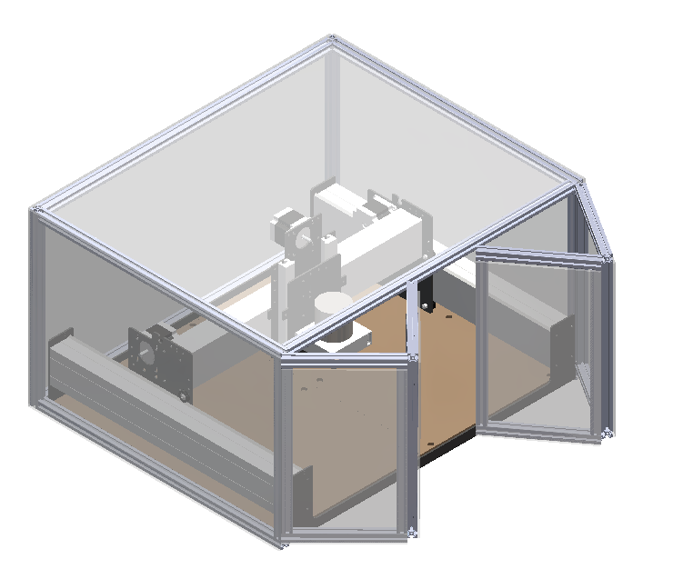
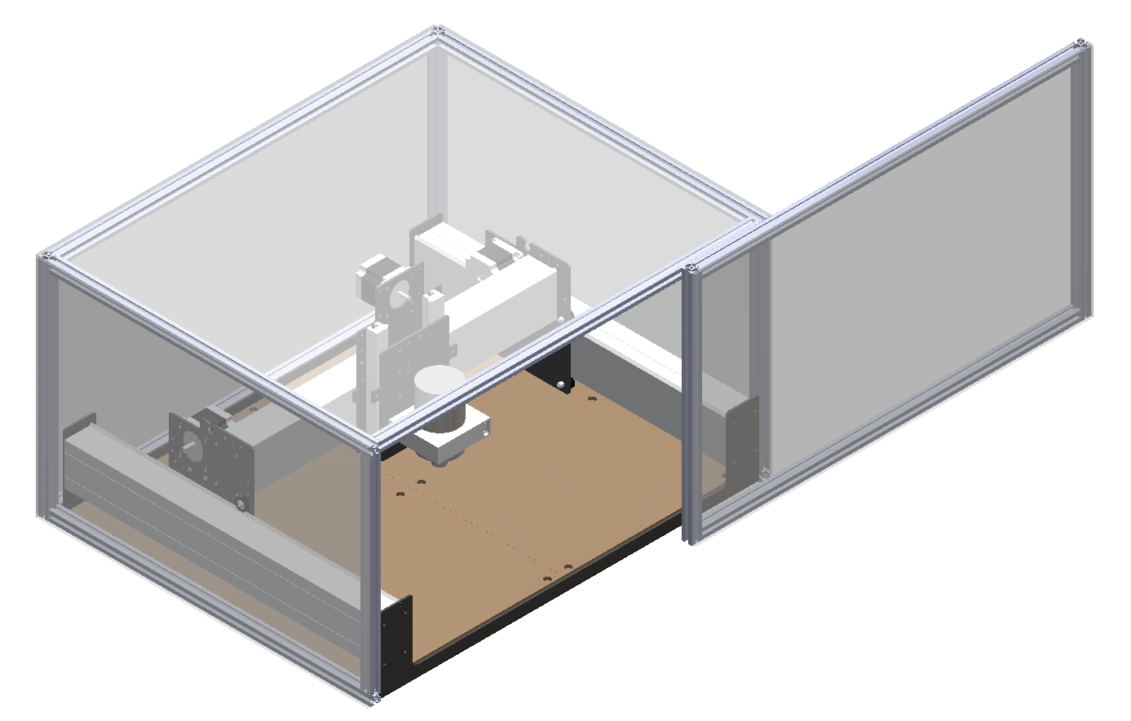
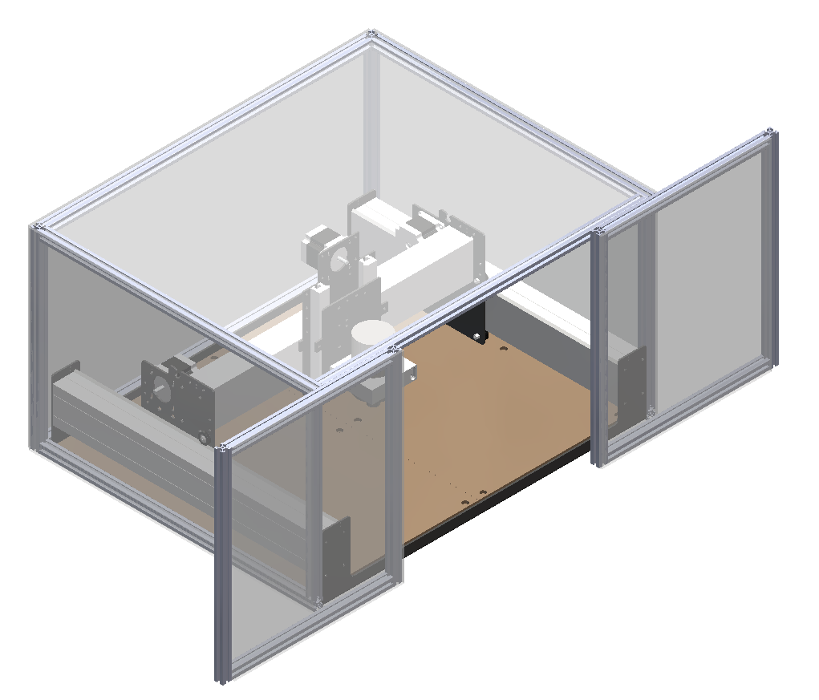
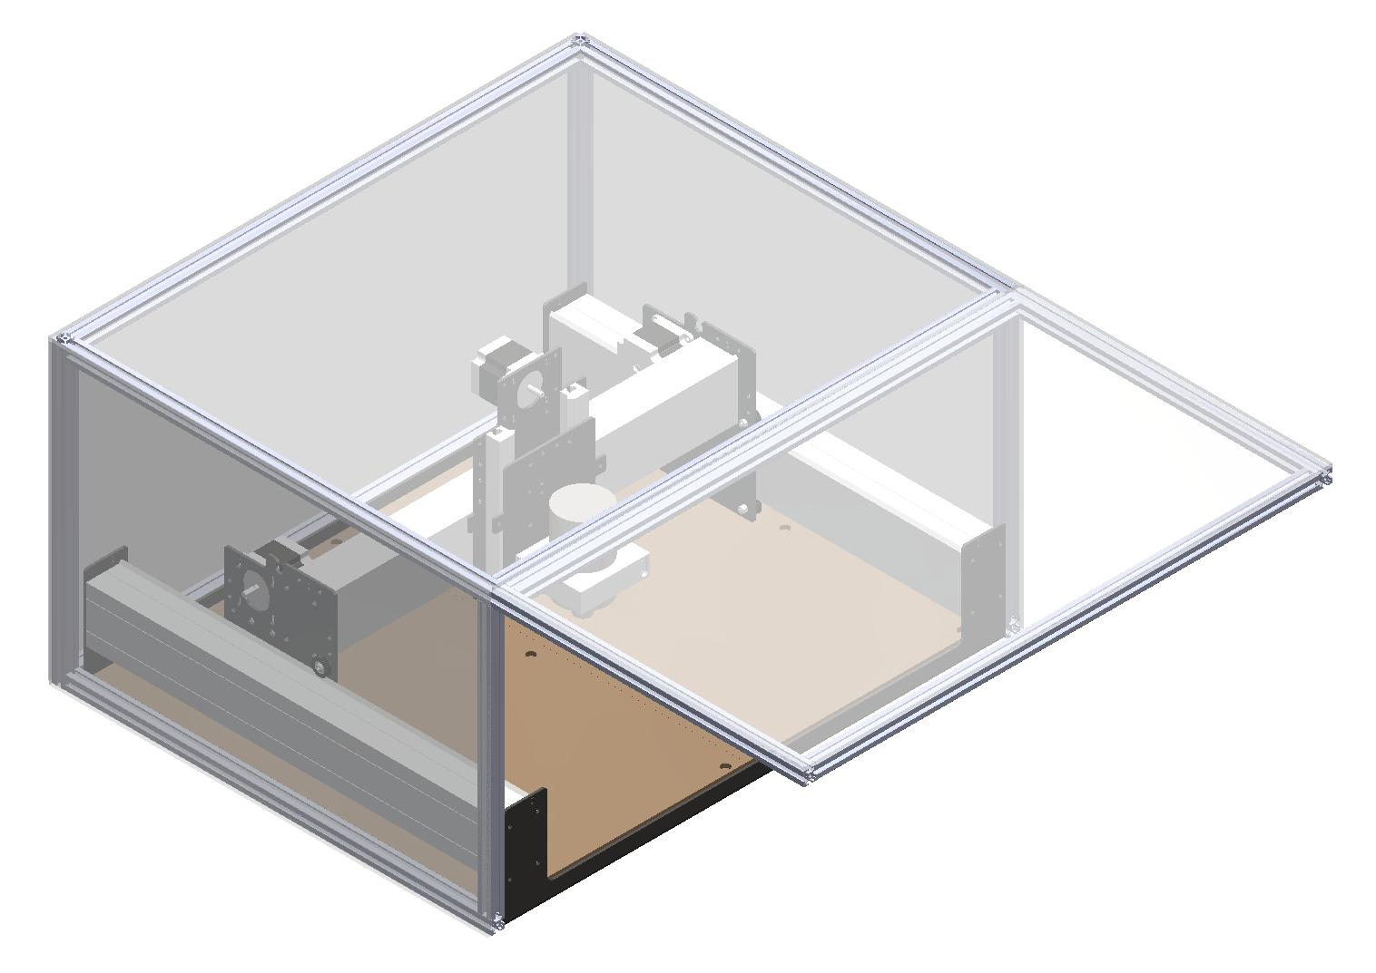
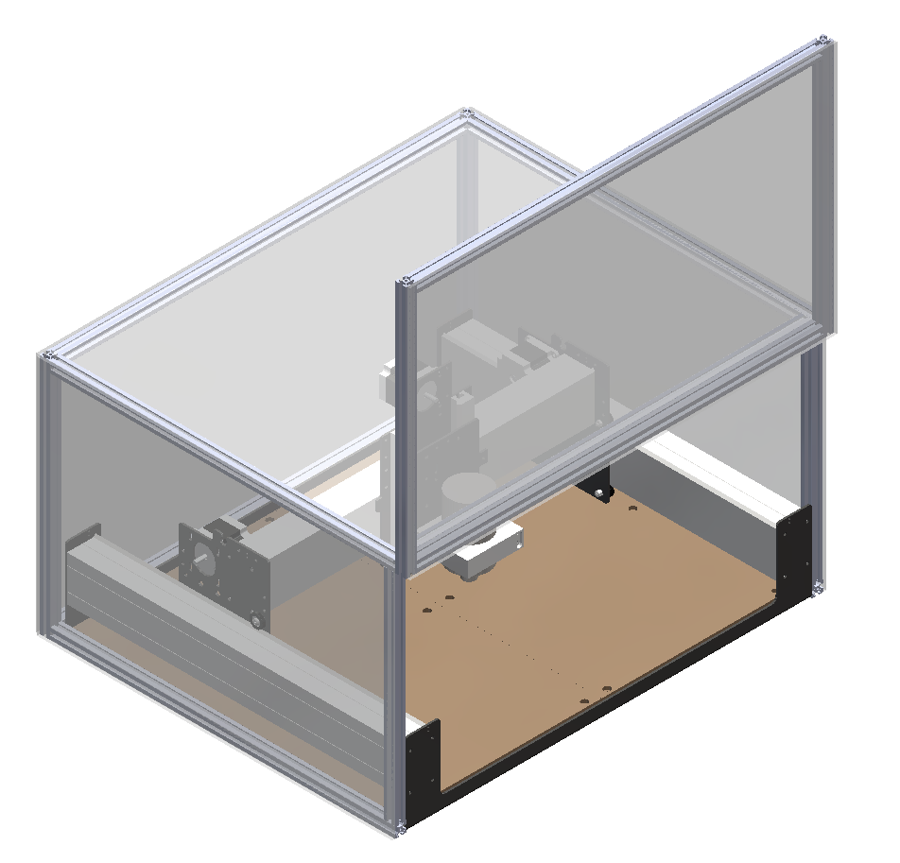
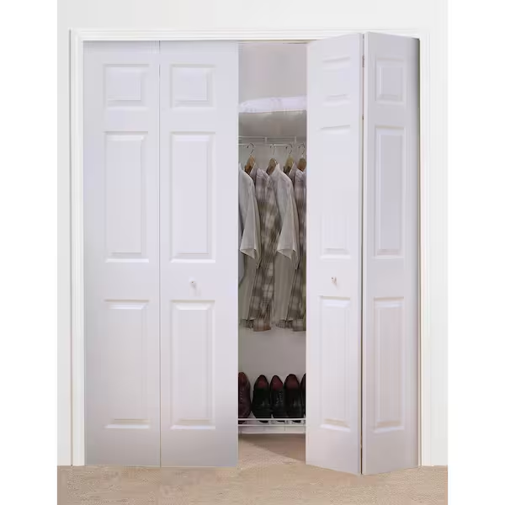
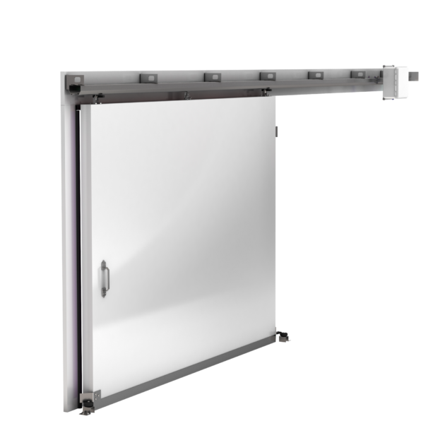
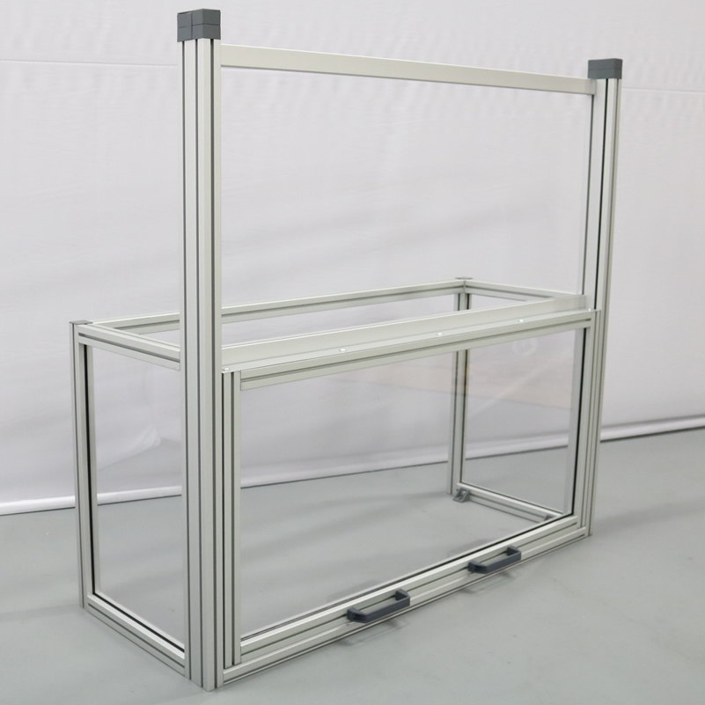
Medium Fidelity Concepts
Malik Grant
Bifold door
Horizontal sliding door
Double sliding door
Top-hinge door
Vertical sliding door
Notes:
For our concept selection, we first started with generating 100 different ideas centered around our critical targets. After developing these ideas from each member of the team we came together to narrow down our concepts to 5 medium fidelity concepts and 3 high fidelity concepts. We used different processes to rank these concepts. For our 5 medium fidelity concepts, we were able to get real life comparisons and were able to pull different features that would be best for our prototype.

Slide 40
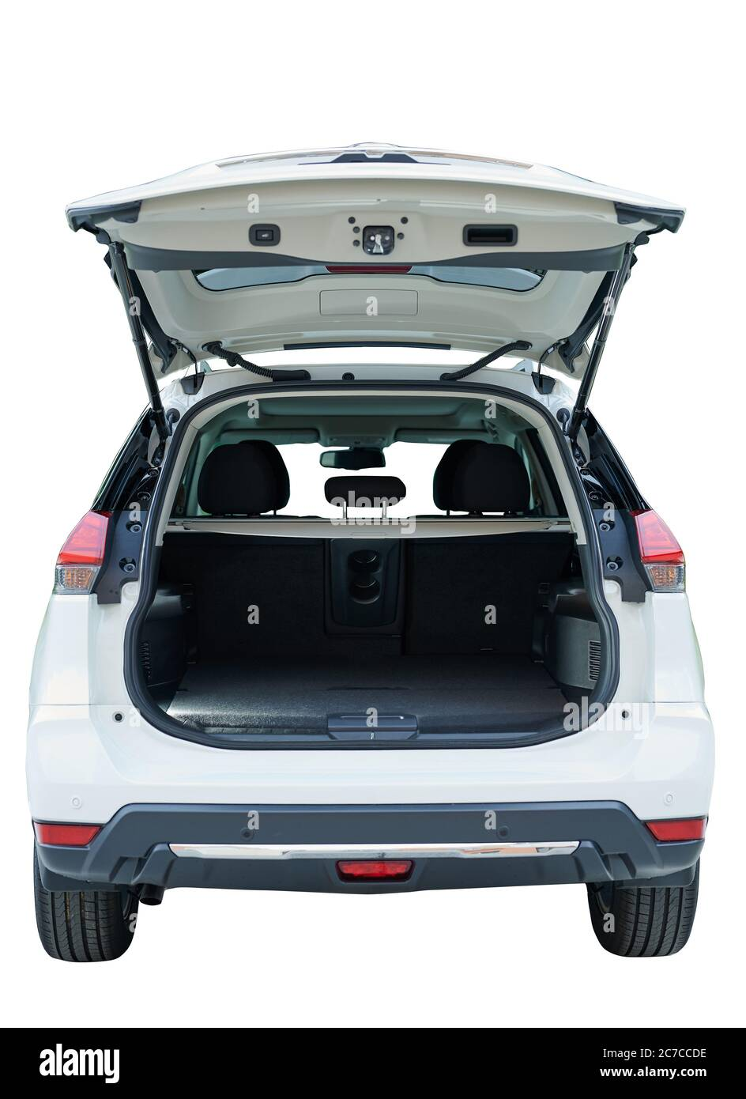
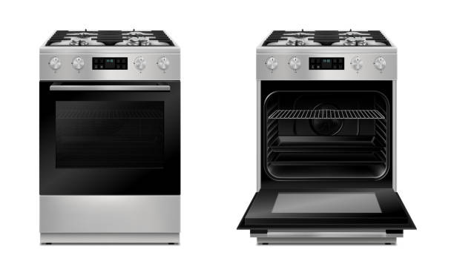
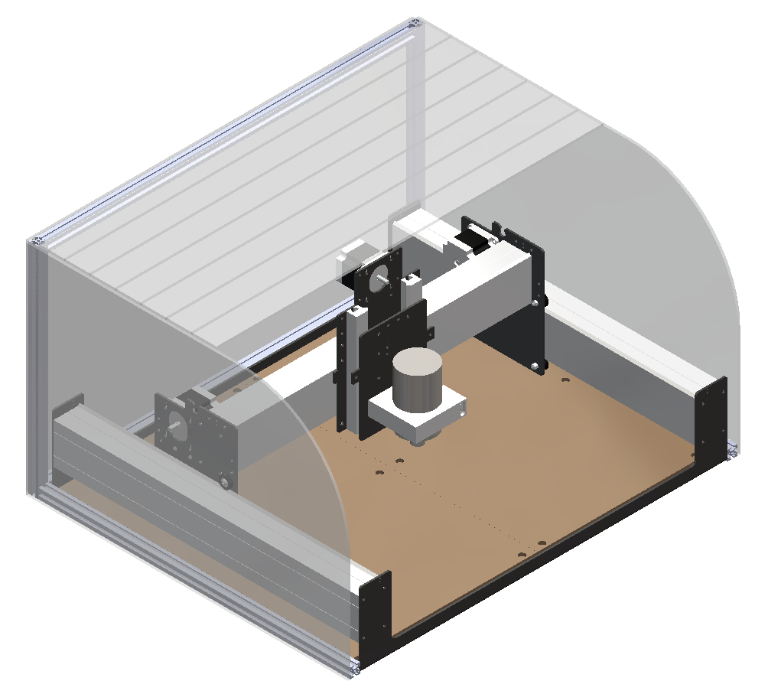
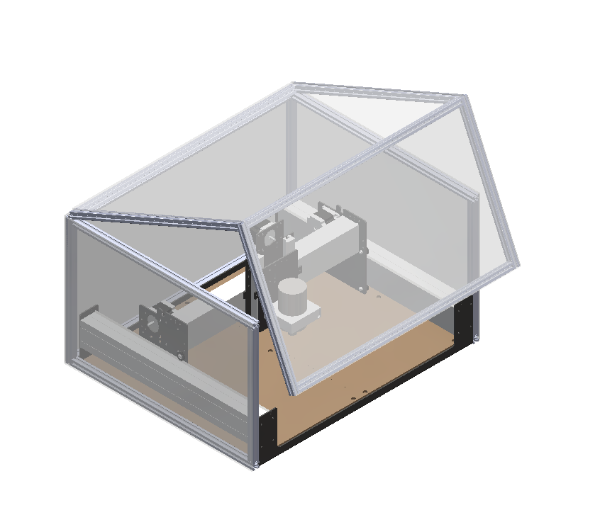
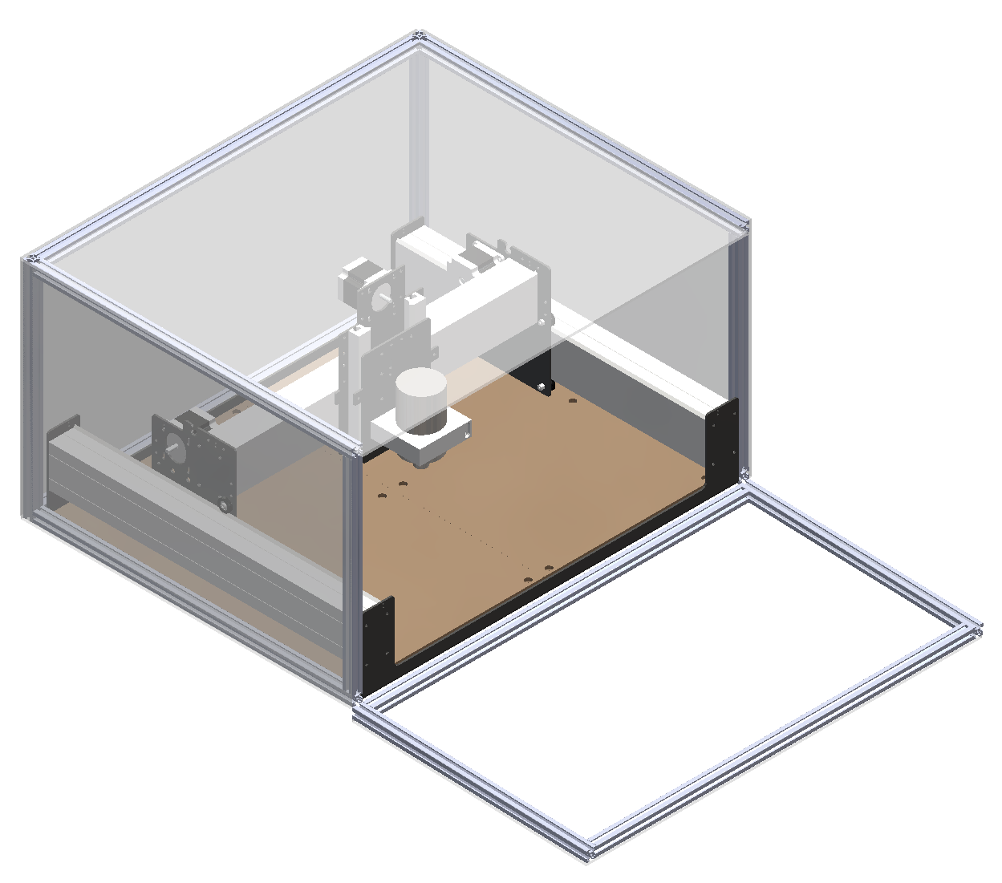
High Fidelity Concepts
Malik Grant
Roll cover
Hatch
Oven door
Notes:
Here is our 3 high fidelity concepts,

Slide 41
Concept Selection
Samuel Byers
Concepts

Slide 42
Concept Selection
Samuel Byers
Concepts
Characteristics
Impact force
Clearance
Limited access
Disassembly time
Displacement due to vibration

Slide 43
Concept Selection
Samuel Byers
Concepts
Characteristics
Impact force
Clearance
Limited access
Disassembly time
Displacement due to vibration
Selection

Slide 44
Final Selection
Samuel Byers
Bifold door
Horizontal sliding door
Double sliding door
Top-hinge door
Vertical sliding door

Slide 45
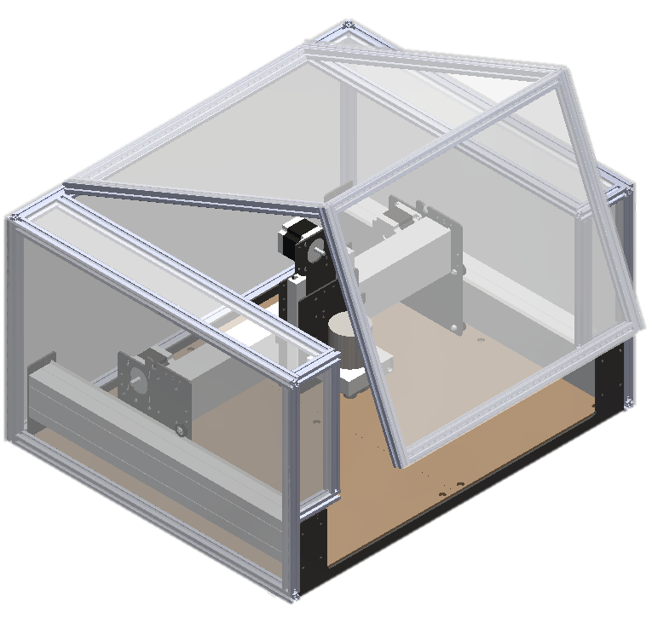
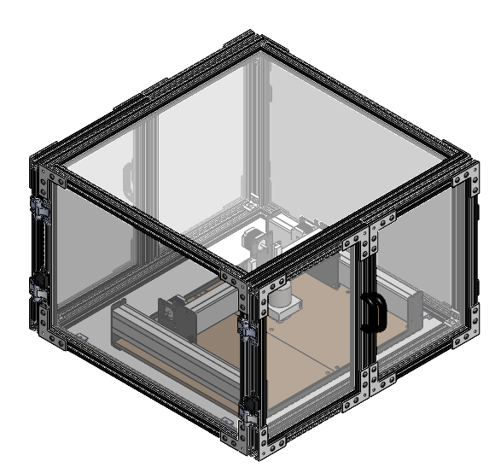
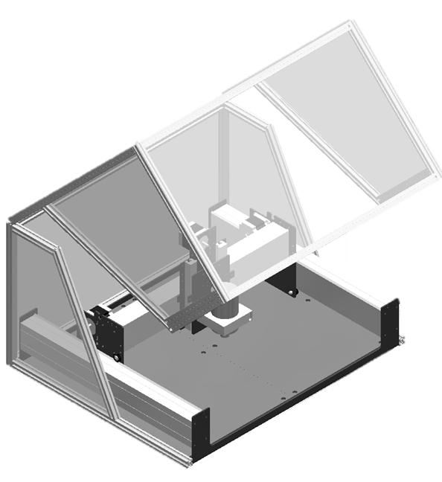
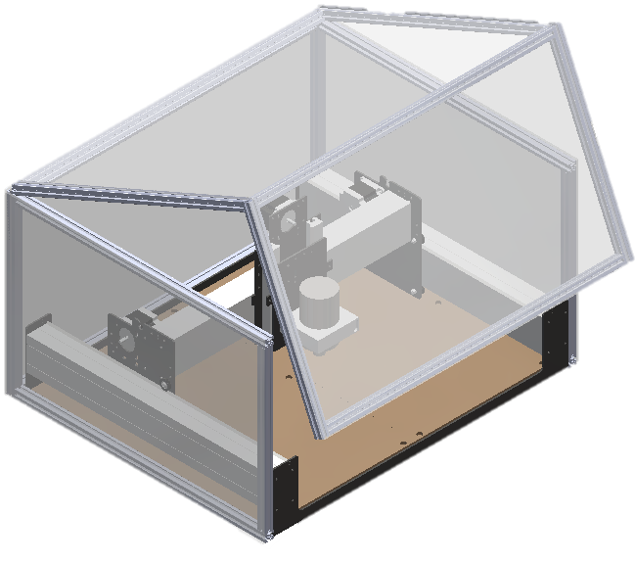
Changes from Initial Concepts
Carlton Walker
Preliminary Designs CAD
Updated Design
Front Opening Doors
Auto-Off Hinge
Back Door

