Slide 1

SAFE CNC MACHINE
Design Review VI
Team 514: Samuel Byers, Amanda Garcia-Menocal, Shelby Gerlt, Malik Grant, Carlton Walker
April 1, 2025
Notes:
Good evening, this is Team 514 presenting our design review 5 for the safeguard for the cnc router machine

Slide 2





Team 514
Malik Grant
Samuel Byers
Amanda Garcia-Menocal
Shelby Gerlt
Malik Grant
Carlton Walker
Supply Chain Engineer
Structural Engineer
Test Engineer
Electrical Engineer
Design Engineer
Notes:
Here displayed is Team 514 you have Sam, Amanada, Shelby, Myself, and Carlton

Slide 3


Guidance and Sponsorship
Malik Grant
Dr. Shayne McConomy
Sponsor
Dr. Eric Hellstrom
Advisor
Notes:
For this project we are being sponsored by Dr. McConomy and we are being advised by faculty Dr. Hellstorm

Slide 4
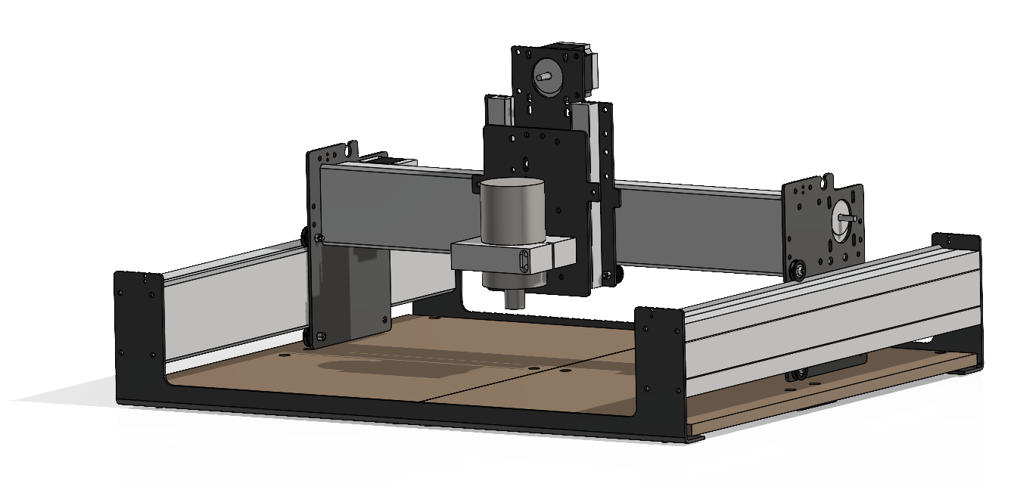
Project Objective
Malik Grant
The objective of this project is to design safeguards for the Senior Design Lab’s CNC router to protect students and staff from hazards and mitigate the need for PPE.
Shapeoko 3 CNC Router
Notes:
The objective of this project is to make the Senior Design Labs CNC router safe for student use without requiring additional supervision. This will be achieved by developing machine safeguards that limit the need for Personal Protective Equipment (PPE) in the room while the machine is in operation.

Slide 5










Hazards
Amanda Garcia-Menocal
Moving Parts
Projectiles
Impalement
Particles
Notes:
To start brainstorming ideas wanted to first start establishing our main hazards our users could encounter. First, the CNC machine has multiple moving parts that could cause pinch hazards or potential clothing or hair being pulled into the machine. Next we have the projectiles, Sharp objects have potential to to harm our users so we want to ensure our enclusire prevents materials like plastics, aluminum, or wood to not be able to harm anyone. Next, the CNC has a drill bit that can cut off someones finger if it interacts with the machine. That is major hazard and we want to prioritize no acess to the machine at anytime it is running. Finally, we want to control the amount of particles that could be produced in the air. The enclusre will be sealed just enough to ensure no partilces like dust will escape into the air.

Slide 6
Critical Targets and Metrics
Amanda Garcia-Menocal
Function
Halt projectiles
Limit access while running
Create no interference
Target
≤ 4,000 N
Fully operable
2 ± 0.2mm
Metric
Impact force
Clearance
User observation
Notes:
Based on our central hazards we wanted to address regarding the objective, we developed our critical targets and metrics based on these hazards. First we want our safeguard to halt projectiles from our users. The enclosure will able to withstand a projectile that is equal to or more than 4000 N. Next, our enclosure will create no interference with the cnc machine as it is running. We will be basing this off user observation and the machine being fully operable. And finally our last target we want to limit any access to the machine. For our target of plus or minus 2.02 mm we want it to be sealed but not fully sealed for pressure issues while using the vaccum attachment.

Slide 7
Assessed Hazards
Amanda Garcia-Menocal
Moving Parts
Projectiles
Impalement
Particles
Notes:
The objective of this project is to make the Senior Design Labs CNC router safe for student use without requiring additional supervision. This will be achieved by developing machine safeguards that eliminate the need for Personal Protective Equipment (PPE) in the room while the machine is in operation.

Slide 8
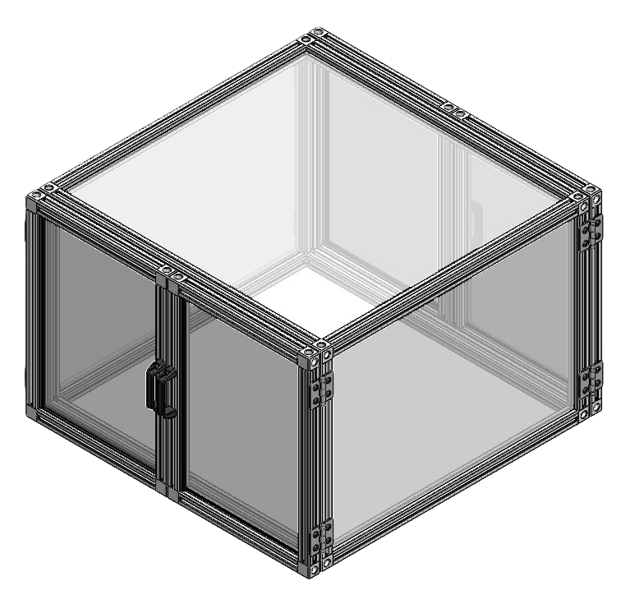
Implemented Safety Functions
Amanda Garcia-Menocal
Moving Parts
Enclosure
Projectiles
Impalement
Particles
Notes:
The objective of this project is to make the Senior Design Labs CNC router safe for student use without requiring additional supervision. This will be achieved by developing machine safeguards that eliminate the need for Personal Protective Equipment (PPE) in the room while the machine is in operation.

Slide 9
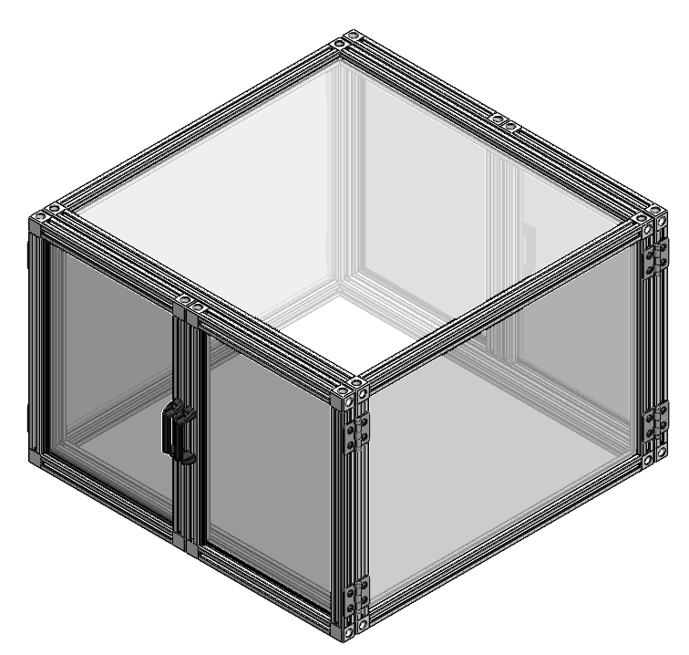
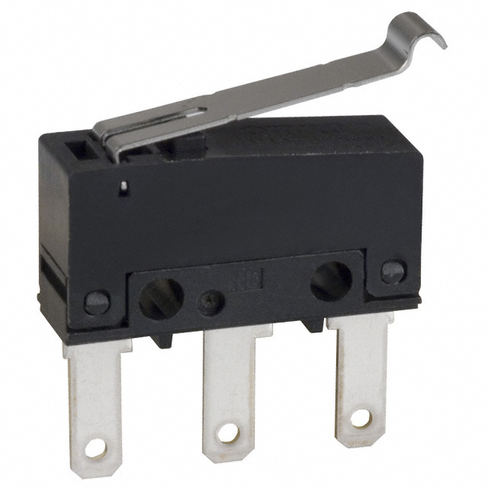
Implemented Safety Functions
Amanda Garcia-Menocal
Moving Parts
Enclosure
Projectiles
Automatic Shutoff
Impalement
Automatic Shutoff
Particles
Notes:
The objective of this project is to make the Senior Design Labs CNC router safe for student use without requiring additional supervision. This will be achieved by developing machine safeguards that eliminate the need for Personal Protective Equipment (PPE) in the room while the machine is in operation.

Slide 10
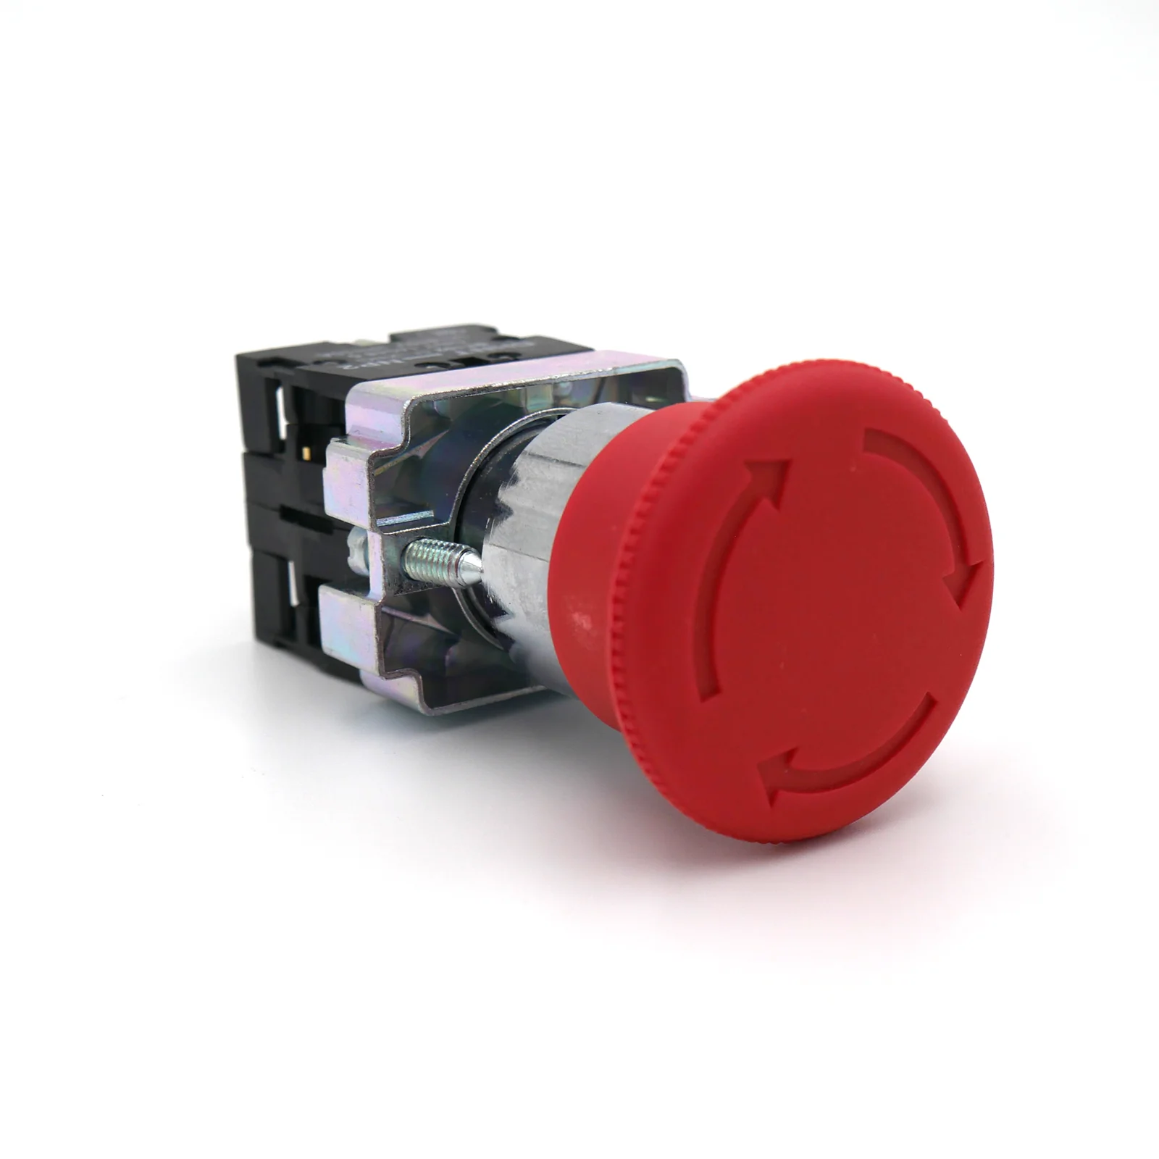
Implemented Safety Functions
Amanda Garcia-Menocal
Moving Parts
Enclosure
Projectiles
Automatic Shutoff
Impalement
Emergency Shutoff
Particles
Notes:
The objective of this project is to make the Senior Design Labs CNC router safe for student use without requiring additional supervision. This will be achieved by developing machine safeguards that eliminate the need for Personal Protective Equipment (PPE) in the room while the machine is in operation.

Slide 11
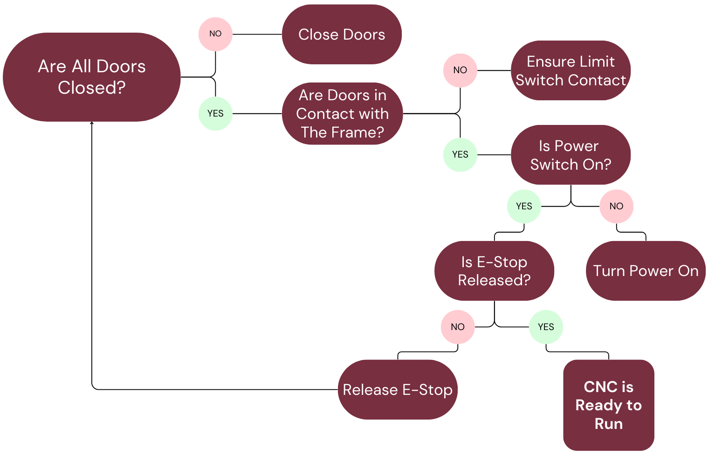
Safety Logic
Amanda Garcia-Menocal

Slide 12
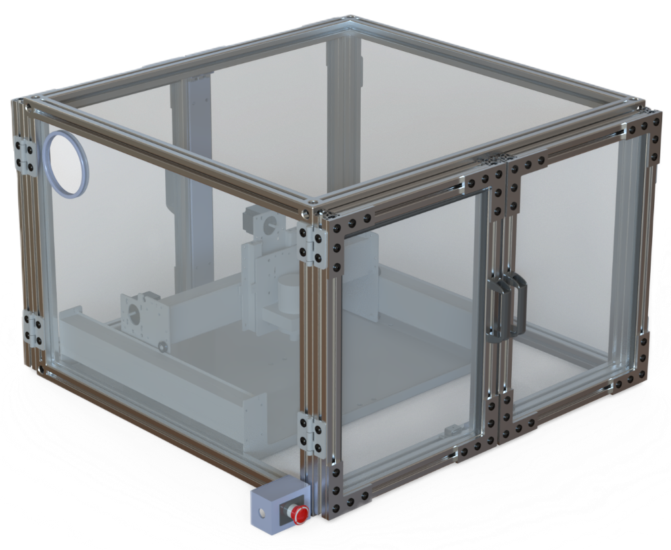
Enclosure Design
Carlton Walker
38 in
25 in
37 in

Slide 13
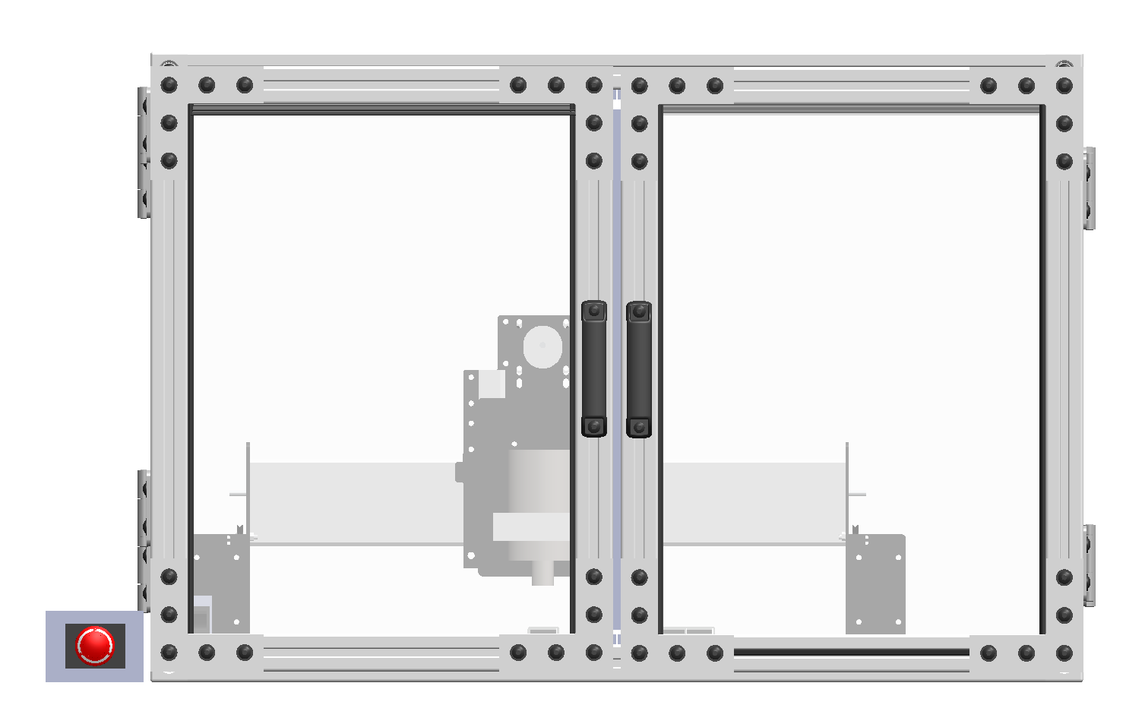
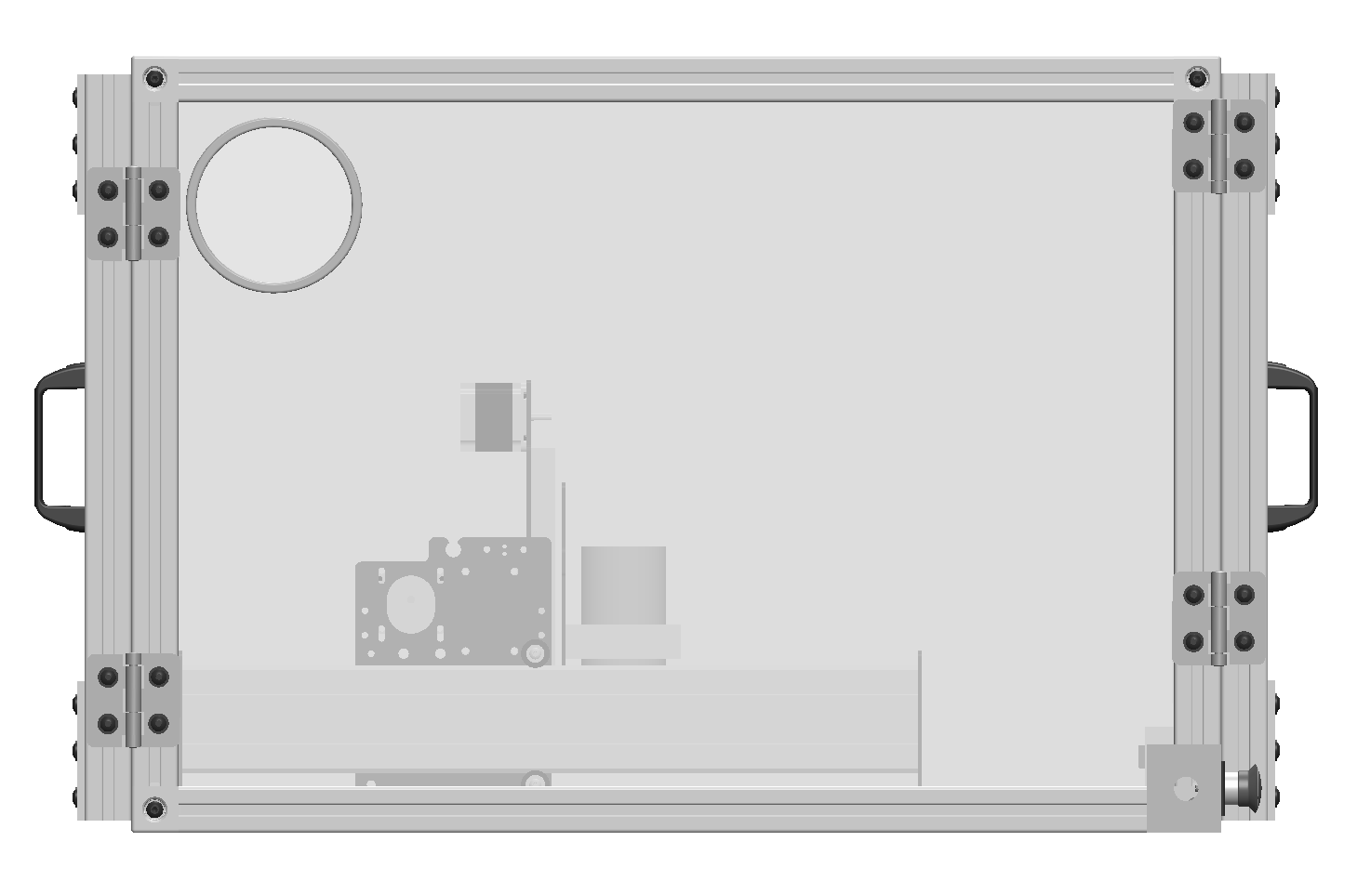
Enclosure Design
Carlton Walker
Front view:
Side view:

Slide 14
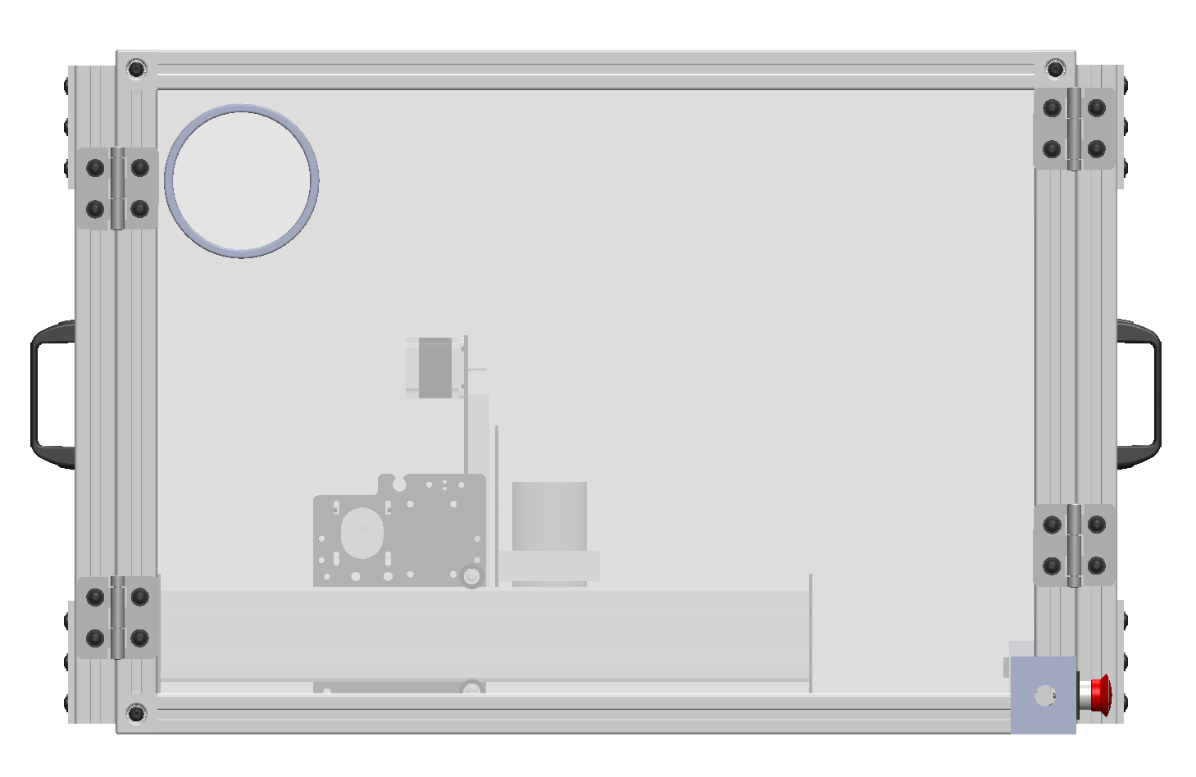
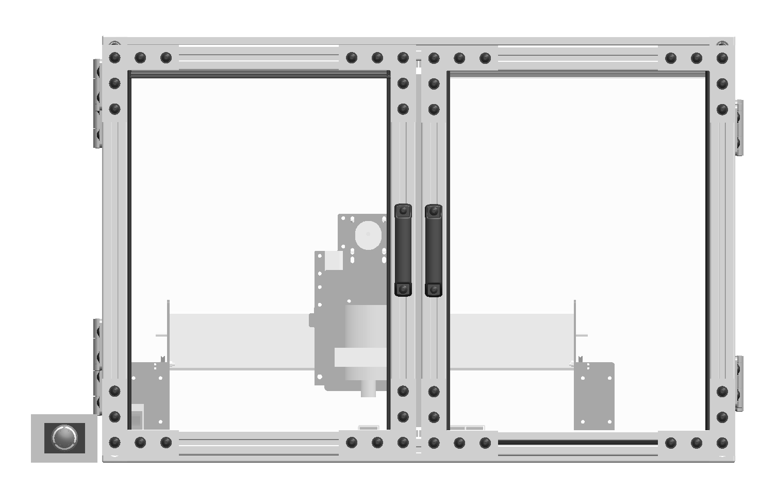
Enclosure Design
Carlton Walker
Front view:
Side view:

Slide 15
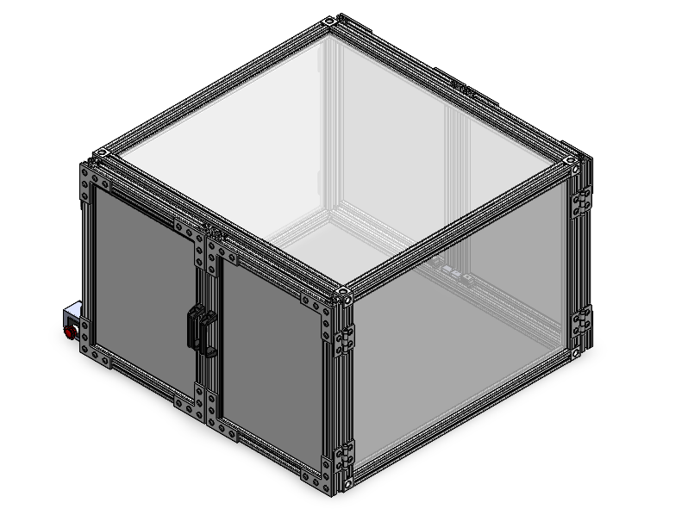
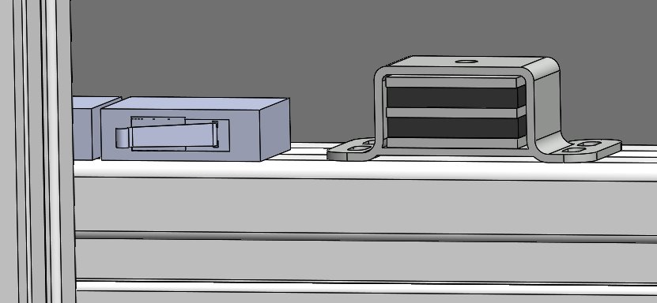
Door Catch
Carlton Walker

Slide 16
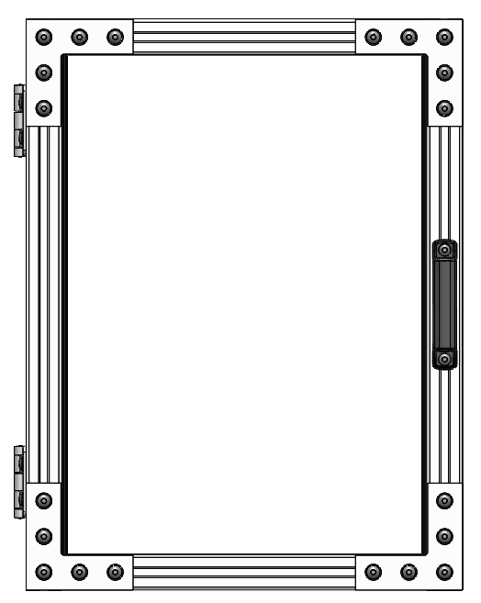
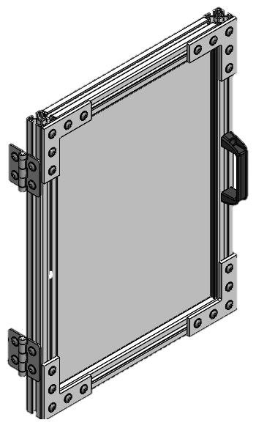
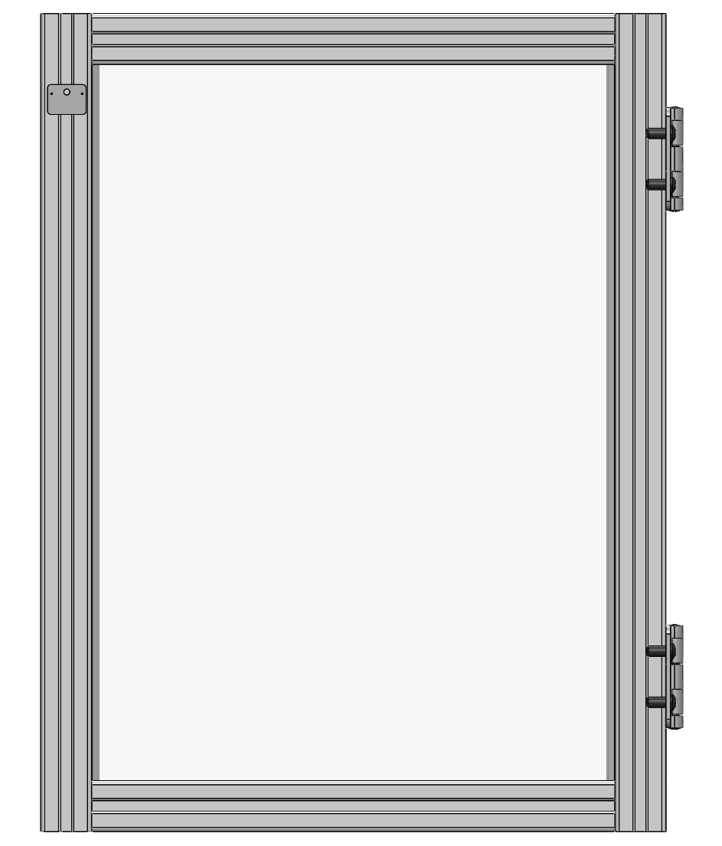
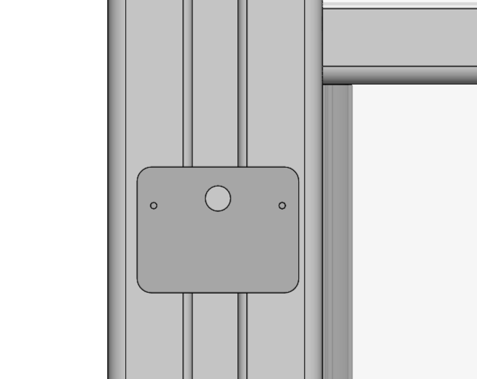
Door Design
Carlton Walker
24in
18.35 in

Slide 17
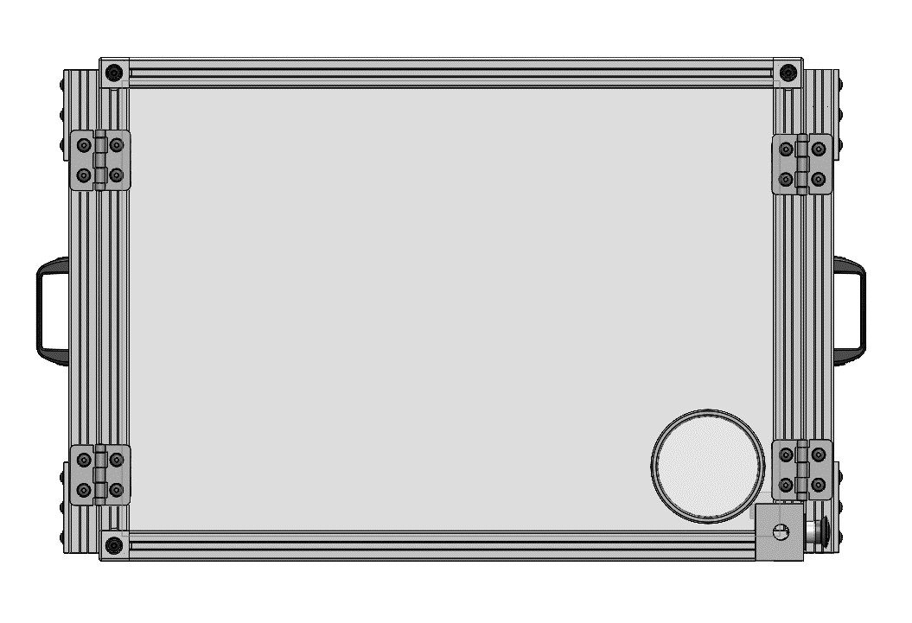
Door Design
Carlton Walker
Symmetrical
Table clearance

Slide 18
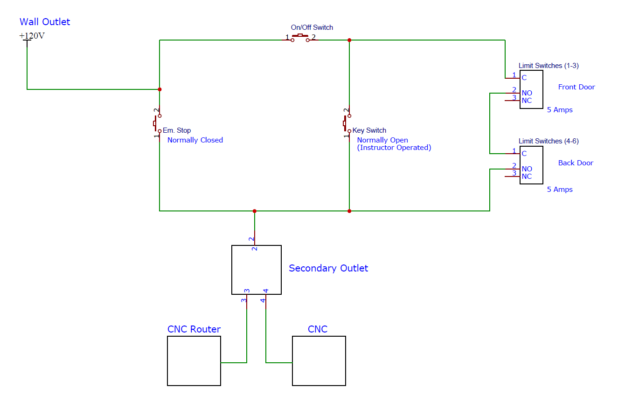
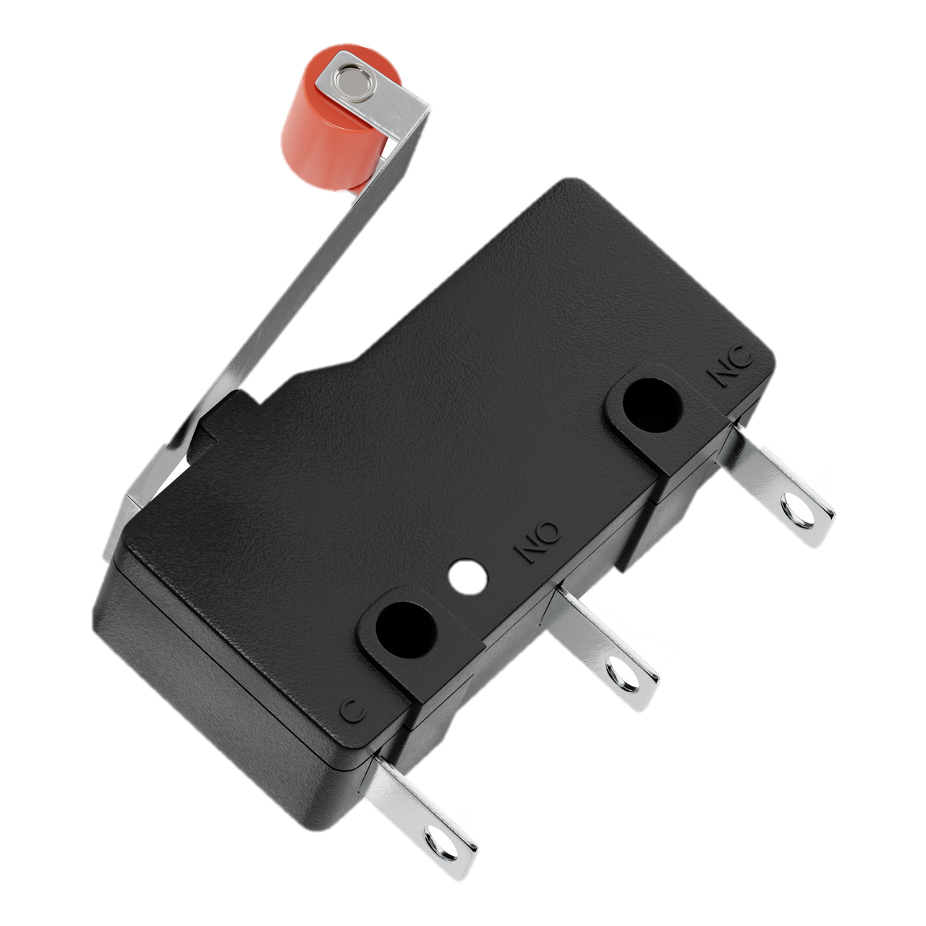
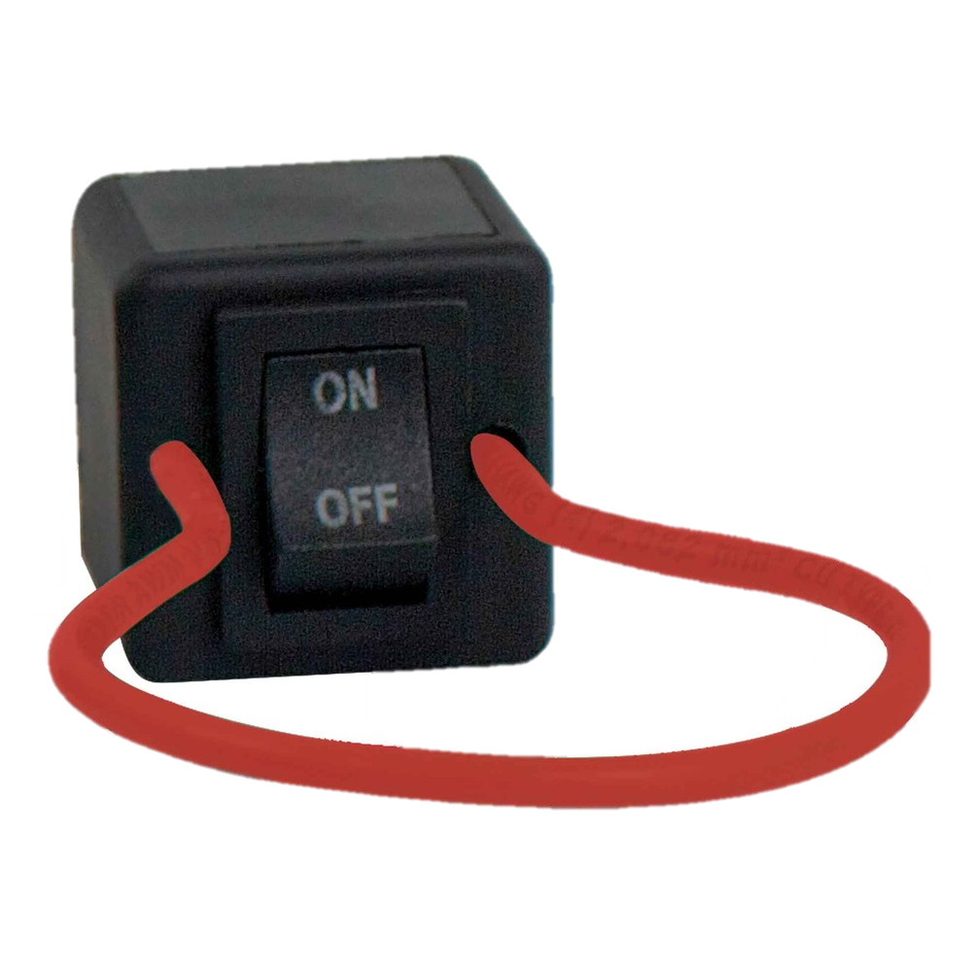
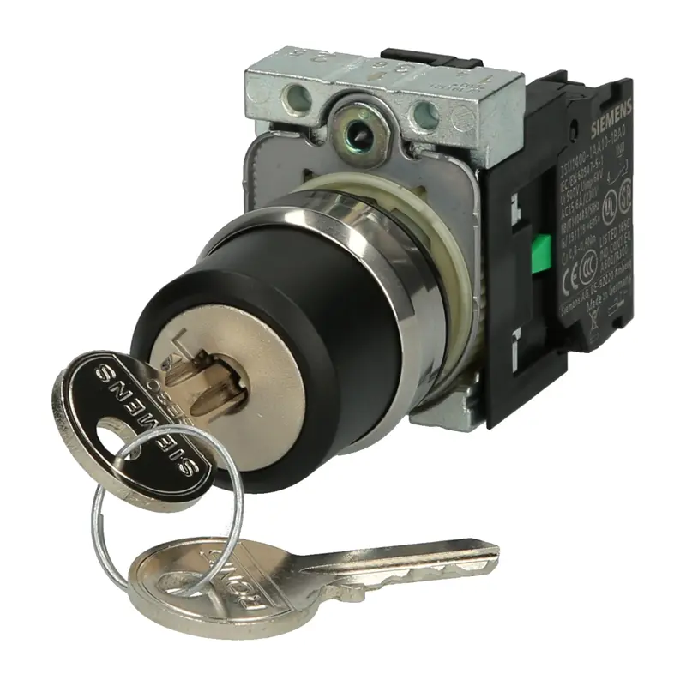
Electrical Design – Components
Shelby Gerlt
E-Stop and Power Switch always active
Limit Switches in parallel with Key Switch
Notes:
The way the system would be powered is displayed in this diagram with the essential parts including limit switches on the doors, power source relay on/off switch, and emergency shut off button. The doors will have two limit switches on each side of the door to ensure for contact with the frame. The limit switches will be powered directly from the power source of the machine which is being powered from the room outlet. If the door is not fully in tack then the machine will not be powered. But now if the machine wants to be in use while the doors are open that is when you would use the power source relay on/off button to send the current directly to the machine. And finally, the emergency stop button will cut all power through the series of wire for the whole machine. We are using 12 gauge wiring to feed the current throughout the system

Slide 19
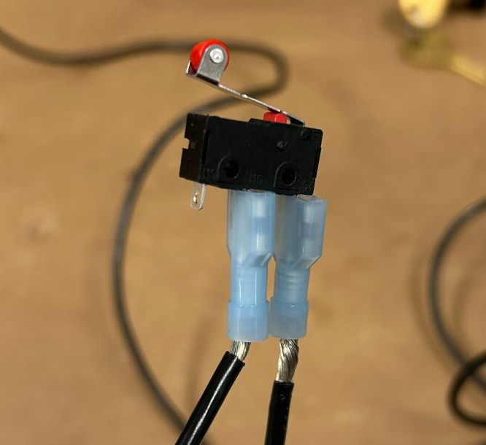
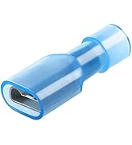
Electrical Design – Limit Switches
Terminal Diagram
1: Common
2: Normally Open
3: Normally Closed
1
2
3
Cable Lug Adapters

Slide 20
Electrical Design – Placement
Shelby Gerlt
Wiring to components runs through 80/20 frame
Secondary outlet inside of enclosure
Notes:
The way the system would be powered is displayed in this diagram with the essential parts including limit switches on the doors, power source relay on/off switch, and emergency shut off button. The doors will have two limit switches on each side of the door to ensure for contact with the frame. The limit switches will be powered directly from the power source of the machine which is being powered from the room outlet. If the door is not fully in tack then the machine will not be powered. But now if the machine wants to be in use while the doors are open that is when you would use the power source relay on/off button to send the current directly to the machine. And finally, the emergency stop button will cut all power through the series of wire for the whole machine. We are using 12 gauge wiring to feed the current throughout the system

Slide 21
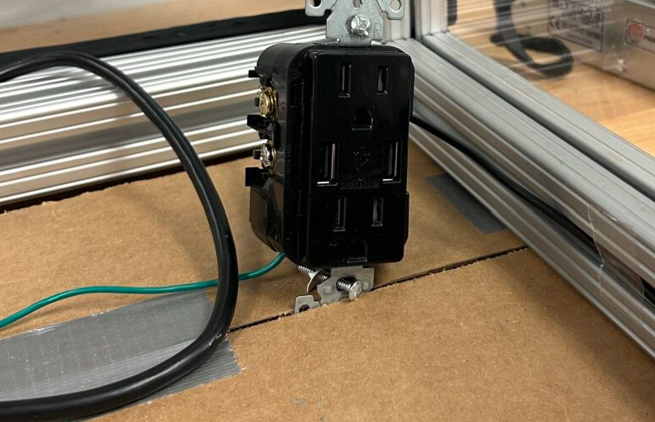
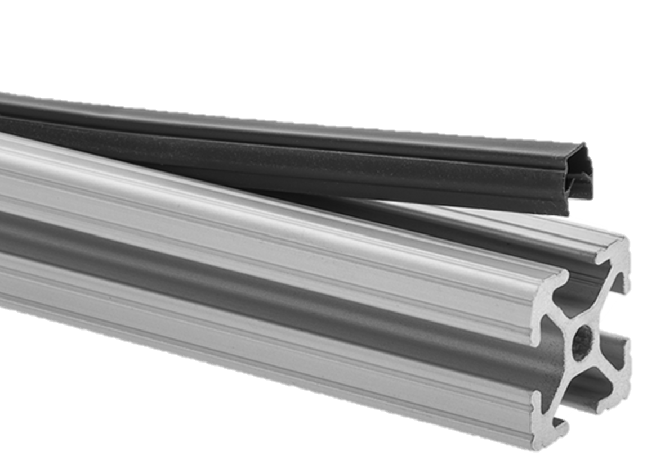
Cable Management
Shelby Gerlt
CNC plugs directly into the secondary outlet
Dust cover to hide wiring

Slide 22
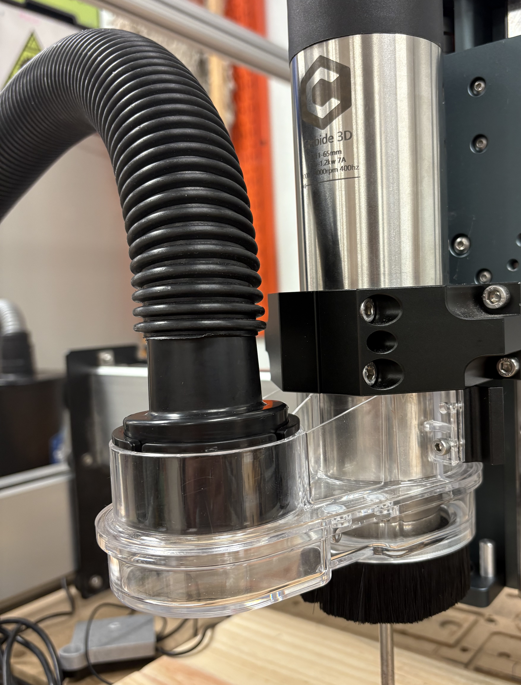

Vacuum Collection Design
Samuel Byers
Dust Separator
Festool Shop-vac
Dust Sweeper

Slide 23
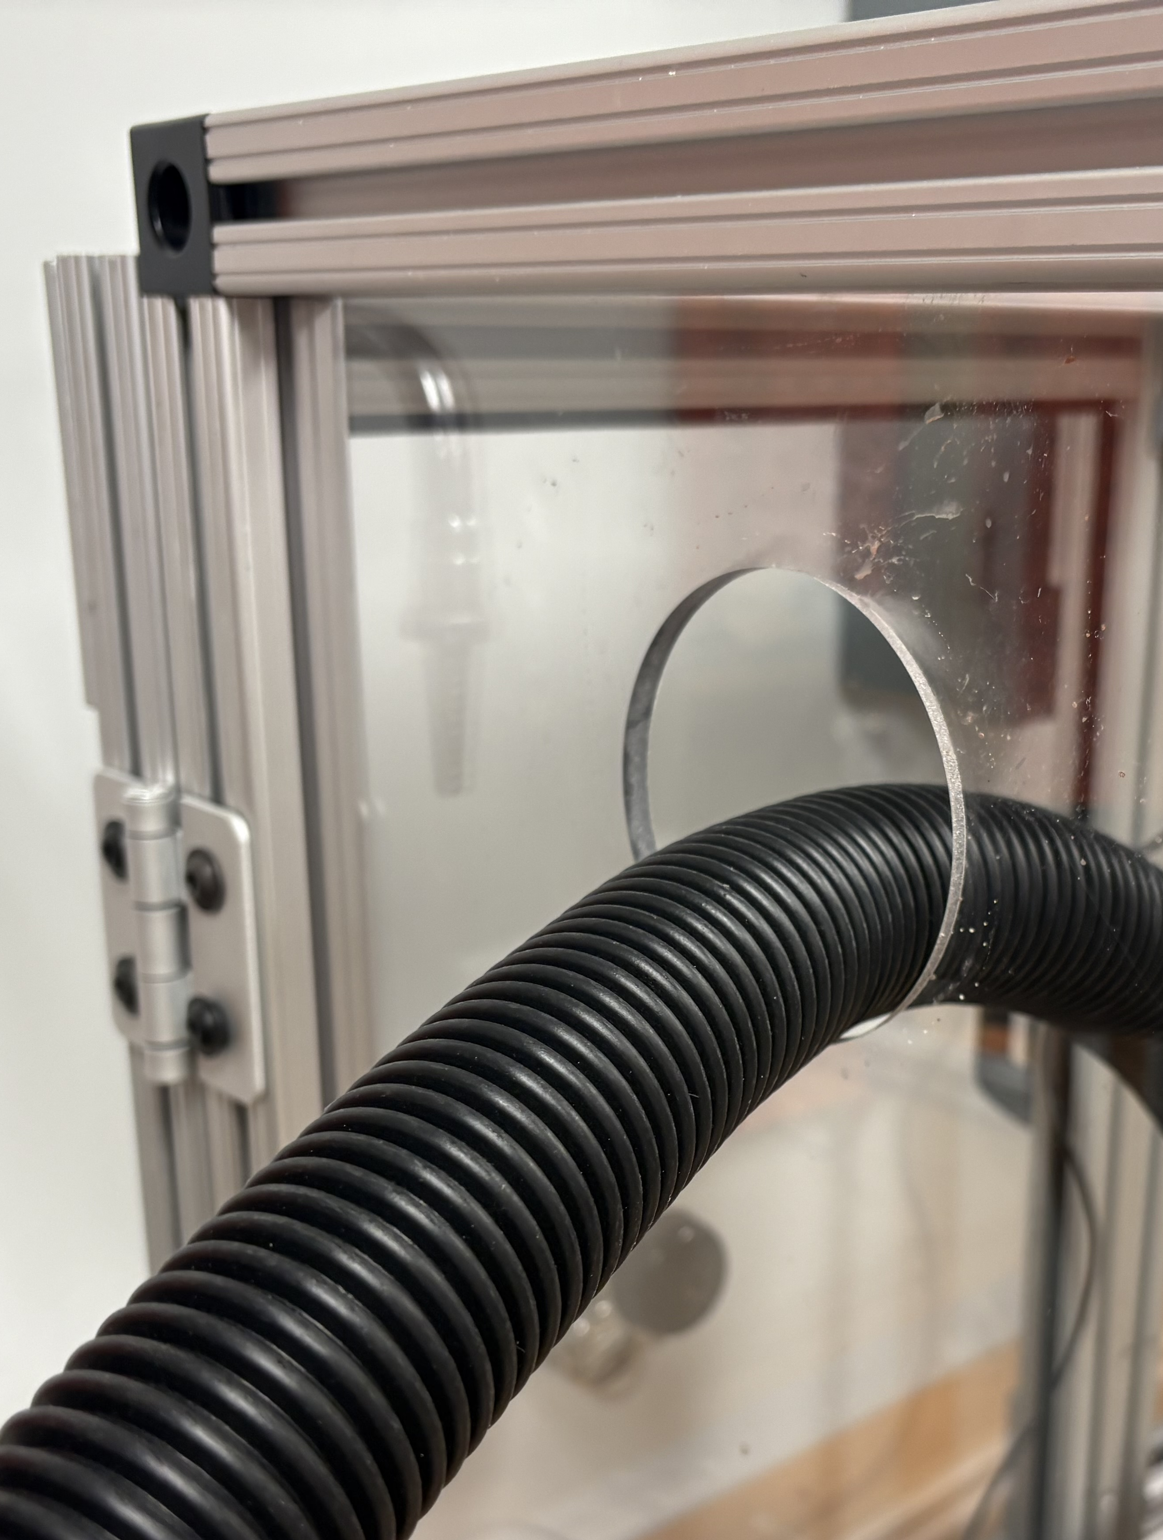
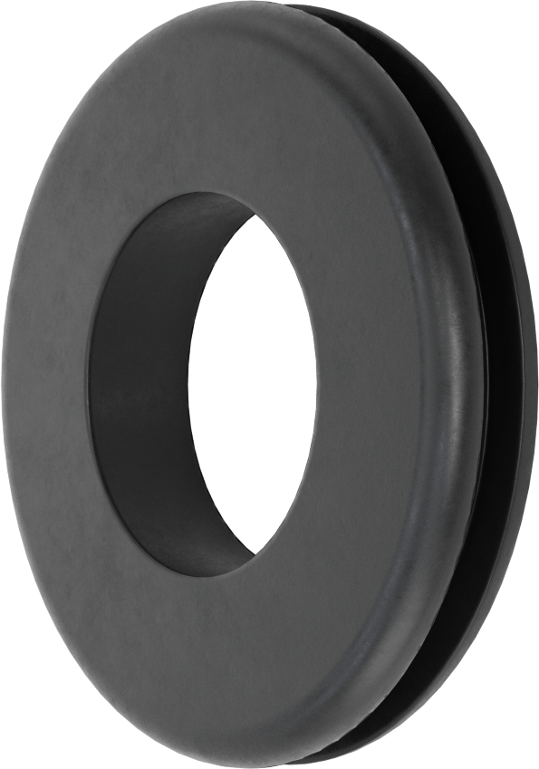
Vacuum Hose Design
Samuel Byers
2.0”

Slide 24
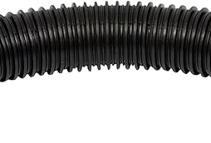
Vacuum Hose Design
Samuel Byers
1.8”
2.0”

Slide 25





Project Cost Breakdown
Samuel Byers
Metal
$700
Base
$59
Hardware
$437
Electrical
$60
Polycarbonate
$428
Notes:
The next item is the budget for this project. We have a budget of $2,000. The total projected cost listed here is $1600. However, due to a very recent change in suppliers, the total projected cost is closer to $1500.
We are using two different suppliers. The first supplier is Grainger because they offer an academic discount to FSU. Whatever we could source from Grainger, we are ordering from McMaster-Carr.
We also took inventory of the materials available in the senior design lab. Whatever materials we could use, we set aside and this has been taken into account for our projected costs.
Projected costs have also taken into account taxes, shipping, and any cutting and assembly fees.

Slide 26
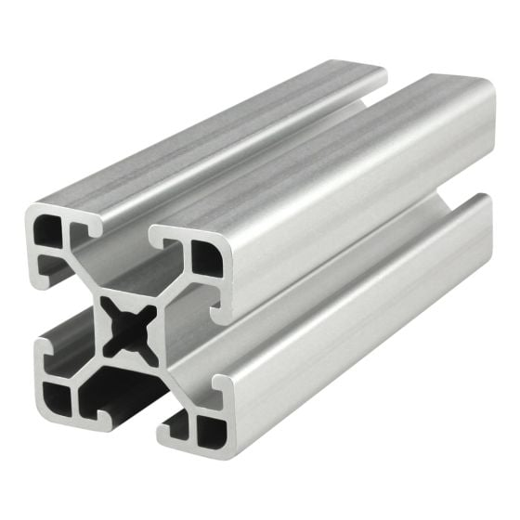
Aluminum Extrusion Material Selection
Samuel Byers
Modular
Good strength-to-weight ratio
Long-term solution
Simple assembly
Corrosion resistant
1.50”
1.50”
Notes:
Next, we want to go into more detail about why we chose the materials that we did.
For the frame, we will be using aluminum extrusions, 1.5” by 1.5”, hollow interior, ultra-lightweight, and smooth-sided.
Compared to other materials we considered, such as wood, aluminum extrusion has a number of pros.
It is modular, allowing us to easily make changes as we go along. It also allows the professor, TAs, and even future teams to easily change or make additions to the enclosure.
It has great strength-to-weight ratio, especially compared to wood, and is a long-term solution.
It is also very easy to assemble. It has T-slots on each side allowing for items to easily slide in and out.
And it is corrosion resistant.

Slide 27
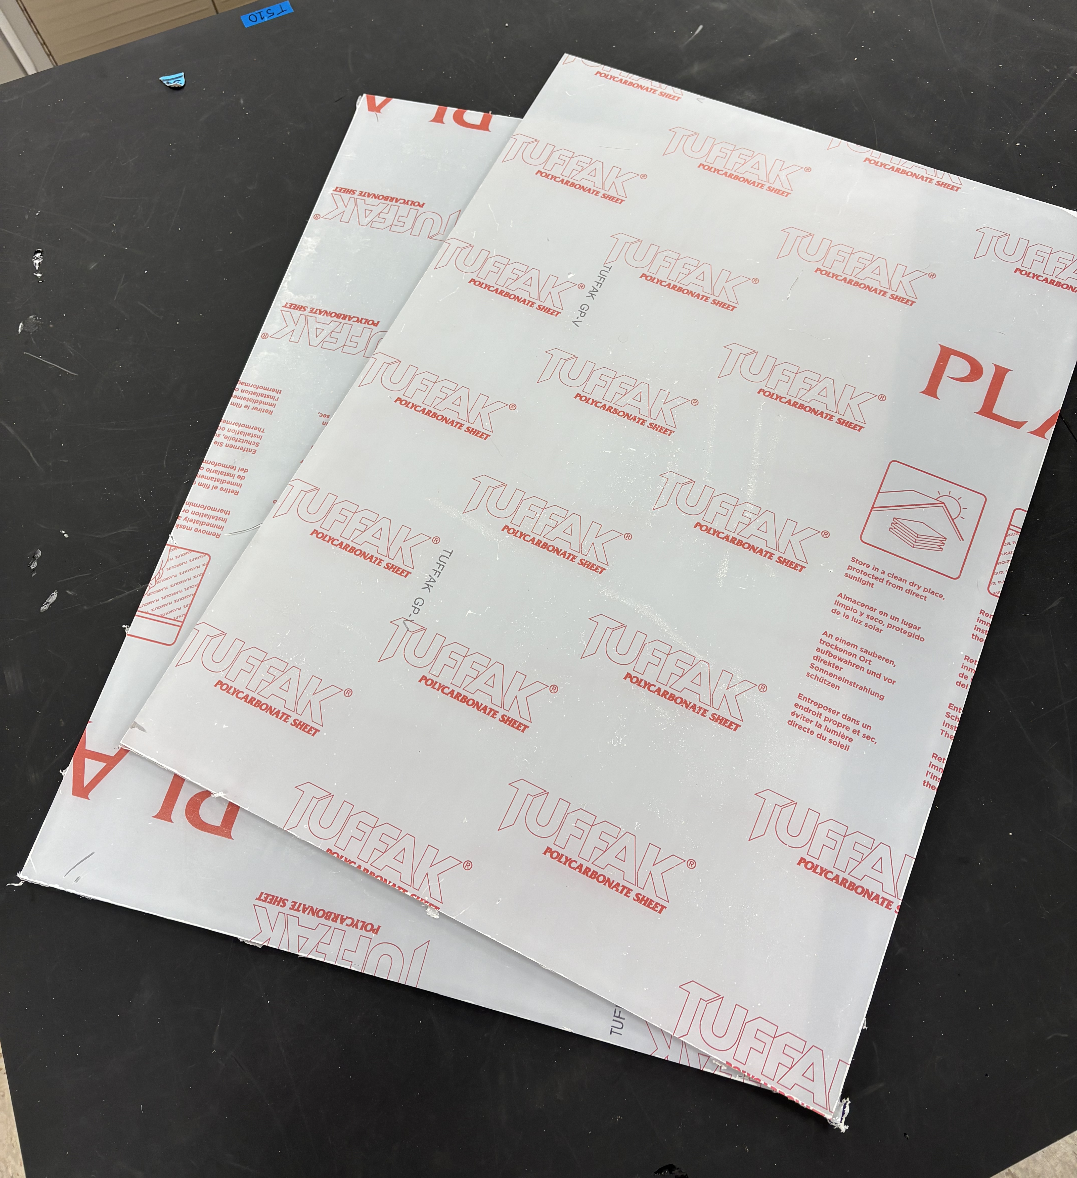
Polycarbonate Material Selection
Samuel Byers
Pros
Impact resistance
Durability
Heat tolerance
Notes:
For the siding, we will be using polycarbonate, a quarter of an inch sheets.
Compared to other materials we considered, such as acrylic, polycarbonate has a number of pros.
It is much more impact resistant and durable than acrylic. And is heat tolerant for any heat that might be generated by the machine.

Slide 28
Polycarbonate Material Selection
Samuel Byers
Pros
Impact resistance
Durability
Heat tolerance
Cons
Scratch sensitivity
UV degradation
Chemical sensitivity
Notes:
However, polycarbonate does have some cons.
Polycarbonate is scratch sensitive. To mitigate this, we want to potentially test using a clear coating over the polycarbonate, similar to what they use on polycarbonate safety goggle lenses.
Polycarbonate is also prone to UV degradation. However, because the enclosure is located in a room with no windows and only artificial lighting, this will not be an issue.
And finally, polycarbonate is sensitive to certain chemicals. To clean the siding, you can use mild dish detergent soap diluted with water.
But you cannot use solvents (such as acetone), strong acids or bases, ammonia-based cleaners, or abrasive cleaners.
To mitigate this, we plan to include this in the operation manual and potentially include a sticker on the side of the enclosure with a warning.

Slide 29
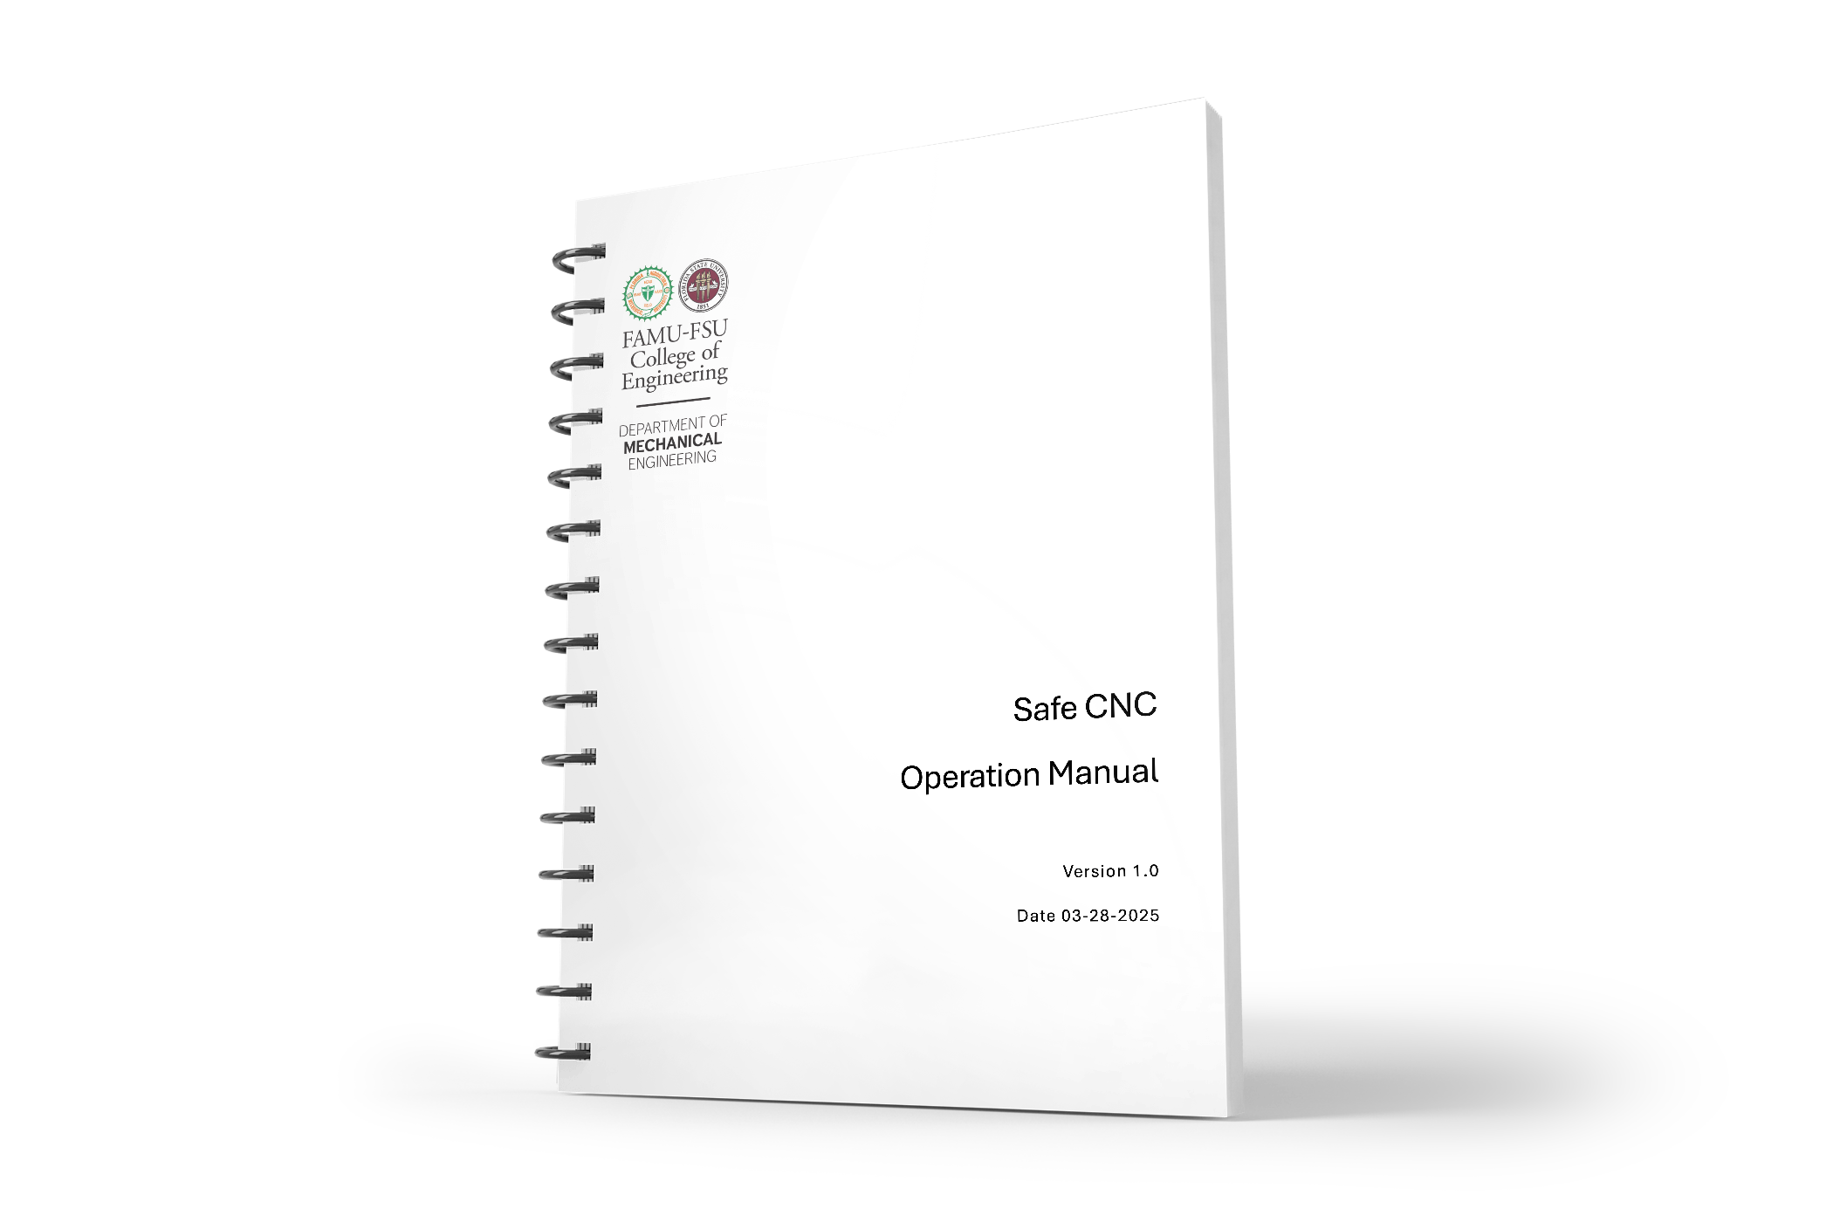
Hazard Communication
Samuel Byers
Operation Manual
Subsystem descriptions
Operation of safety system
Troubleshooting
Maintenance Guidelines

Slide 30
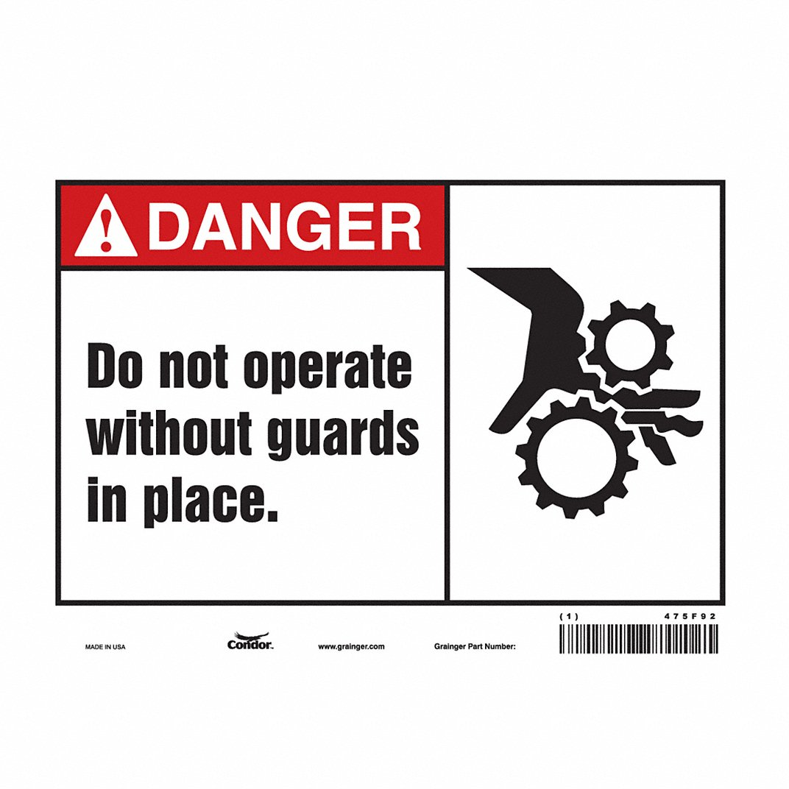
Hazard Communication
Samuel Byers
Operation Manual
Machine Hazard Signage

Slide 31
Future Work
Samuel Byers
Design Review 6
Finish installing electrical parts and mounts
Print final version of operation manual
Test all safety functions
Install and level base
Notes:
For future work, we will finish ordering all materials. At this point, we have ordered almost everything except for the base and electrical components.
Once the materials come in, we will begin to assemble the enclosure hopefully right after spring break.
From there, we can install and level the enclosure in its designated location in the senior design lab, install the vacuum hose, and complete the electrical wiring.
Finally, we will test the design and verify risk reduction to make sure the safety functions are working properly.
Thank you, this concludes our presentation. And we will open it now up to any questions.

Slide 32
Lessons Learned
Samuel Byers
Trust but verify
Document, document, document (and organize)
Make parts as easy to replace as possible
Hold people accountable to the timeline
Communicate, communicate, communicate
Notes:
For future work, we will finish ordering all materials. At this point, we have ordered almost everything except for the base and electrical components.
Once the materials come in, we will begin to assemble the enclosure hopefully right after spring break.
From there, we can install and level the enclosure in its designated location in the senior design lab, install the vacuum hose, and complete the electrical wiring.
Finally, we will test the design and verify risk reduction to make sure the safety functions are working properly.
Thank you, this concludes our presentation. And we will open it now up to any questions.

Slide 33
Project Objective
Shelby Gerlt
Shapeoko 3 CNC Router
Implement safeguards for the CNC router to:
Mitigate the need for PPE
Protect students and staff from hazards
Notes:
The objective of this project is to make the Senior Design Labs CNC router safe for student use without requiring additional supervision. This will be achieved by developing machine safeguards that limit the need for Personal Protective Equipment (PPE) in the room while the machine is in operation.

Slide 34




Stakeholders
Shelby Gerlt
FAMU-FSU COE
FAMU-FSU COE
Elias Haase
Jacob Schmitt
Tripp Lappalainen

Slide 35
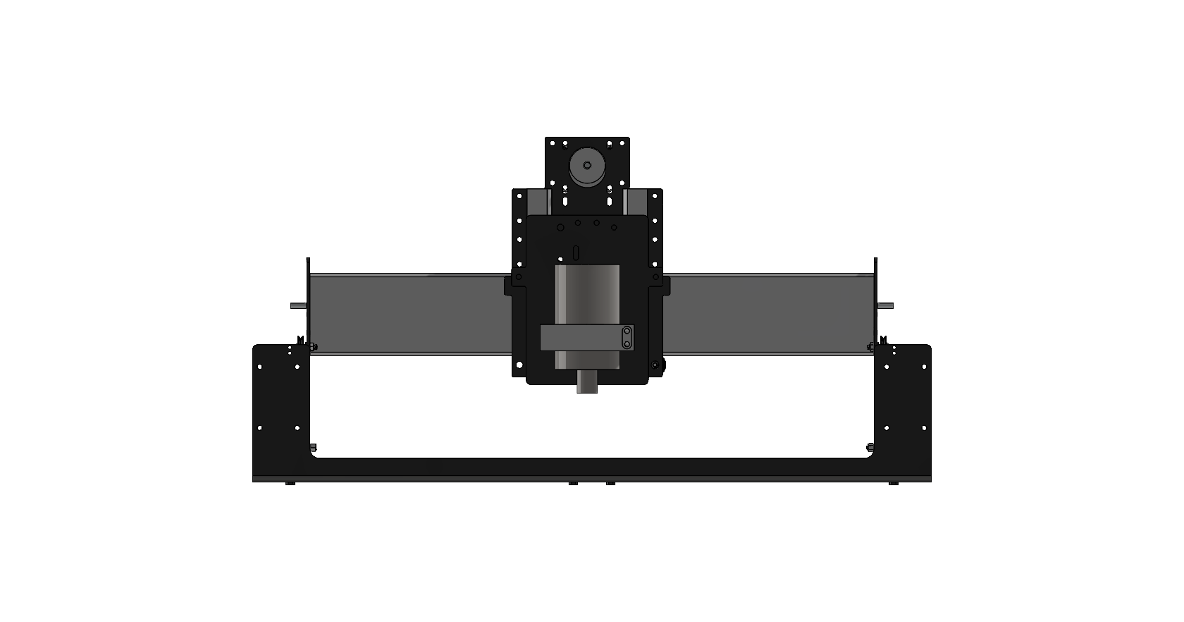
Critical Target: Halt Projectiles
Shelby Gerlt
Target | 3000 N
Metric | Impact force
Testing | Impact test
Notes:
To test the ability of a selected barrier to halt projectiles, an impact test will be performed.

Slide 36
Critical Target: Create No Interference
Shelby Gerlt
Target | Pass
Metric | Pass/Fail
Testing | Observation
Notes:
To test whether the design creates no interference, the machine will be tested with the safeguards in place to check that it can successfully complete a cycle.

Slide 37
Critical Target: Limit Access When On
Shelby Gerlt
Target | True
Metric | Pass/Fail
Testing | Observation
Notes:
To test whether the machine prevents the user from accessing it, the machine will be turned on and a subject will attempt to access it. In the case that the access is overridden, the machine will have a limit switch to shut it down.

Slide 38
Hierarchy of Functions
Shelby Gerlt
CNC Safeguard
Protection
Non-mechanical hazards
Mechanical hazards
Interface
Communication
Control
Collect dust
Dampen noise
Halt projectiles
Prevent contact with point of operation
Prevent contact with power transmission
Create no interference
Communicates hazards
Communicates proper use
Stops use of incorrect materials
Limit machine access when running
Notes:
Hierarchy of functions outlines the goals we have for our design. The primary functions are to halt projectiles, create no interference, and limit machine access while running

Slide 39
Hierarchy of Functions
Shelby Gerlt
CNC
Protection
Non hazards
M hazards
Interface
Comm
Control
Collect
Dampen
Halt
Prevent
Prevent
Create
Comm
Comm
Stops
Limit
Non-mechanical hazards
Mechanical hazards
Collect dust
Dampen noise
Halt projectiles
Prevent contact with point of operation
Prevent contact with power transmission
Create no interference
Protection
CNC Safeguard
Notes:
One of the main hazards is projectiles, in case of this our design has to be able to counter or stop projectiles from hitting anyone near the machine.
The safeguard design must also not prevent the machine from functioning as intended.

Slide 40
Hierarchy of Functions
Shelby Gerlt
CNC
Protection
Non hazards
M hazards
Interface
Comm
Control
Collect
Dampen
Halt
Prevent
Prevent
Create
Comm
Comm
Stops
Limit
Interface
Communication
Control
Communicates hazards
Communicates proper use
Stops use of incorrect materials
Limit machine access when running
CNC Safeguard
Notes:
Final critical target, the design will prevent anyone from accessing the router while it is on. This means the user will not be able to come into contact with the machine at all while it is running.

Slide 41
Targets: Mechanical
Samuel Byers
Function | Target | Metric
Prevent contact w/ point of operation | Particle levels < 5 mg/m³ | Clearance
Prevent contact w/ power transmission | Noise levels < 85 dB | Clearance

Slide 42
Targets: Non-Mechanical
Samuel Byers
Function | Target | Metric
Collect Dust | Particle levels < 5 mg/m³ | Particulates
Dampen Noise | Noise levels < 85 dB | Decibel

Slide 43
Targets: Interface
Samuel Byers
Function | Target | Metric
Prevent use of incorrect materials | Customer uses proper materials | User opinion

Slide 44
Targets: Beyond the Functions
Samuel Byers
Function | Target | Metric
Manage Cables | Visibility of wires/aesthetics | Sponsor opinion
Disassemble Quickly | < 1 day | Time
Limit Vibrations | 5 ± 0.5 mm | Displacement

Slide 45
Assumptions to Guide the Design
Samuel Byers
The user will understand how to use the machine
The machine will be properly maintained
The user will not be using PPE
Only compatible materials will be used in the machine

Slide 46
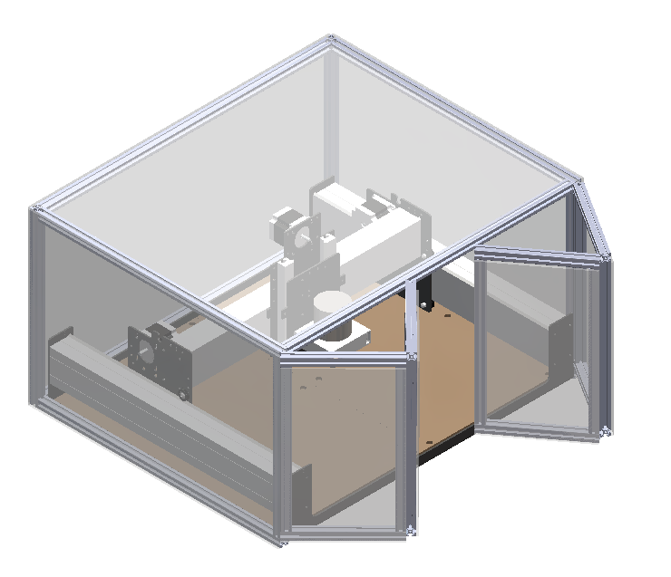
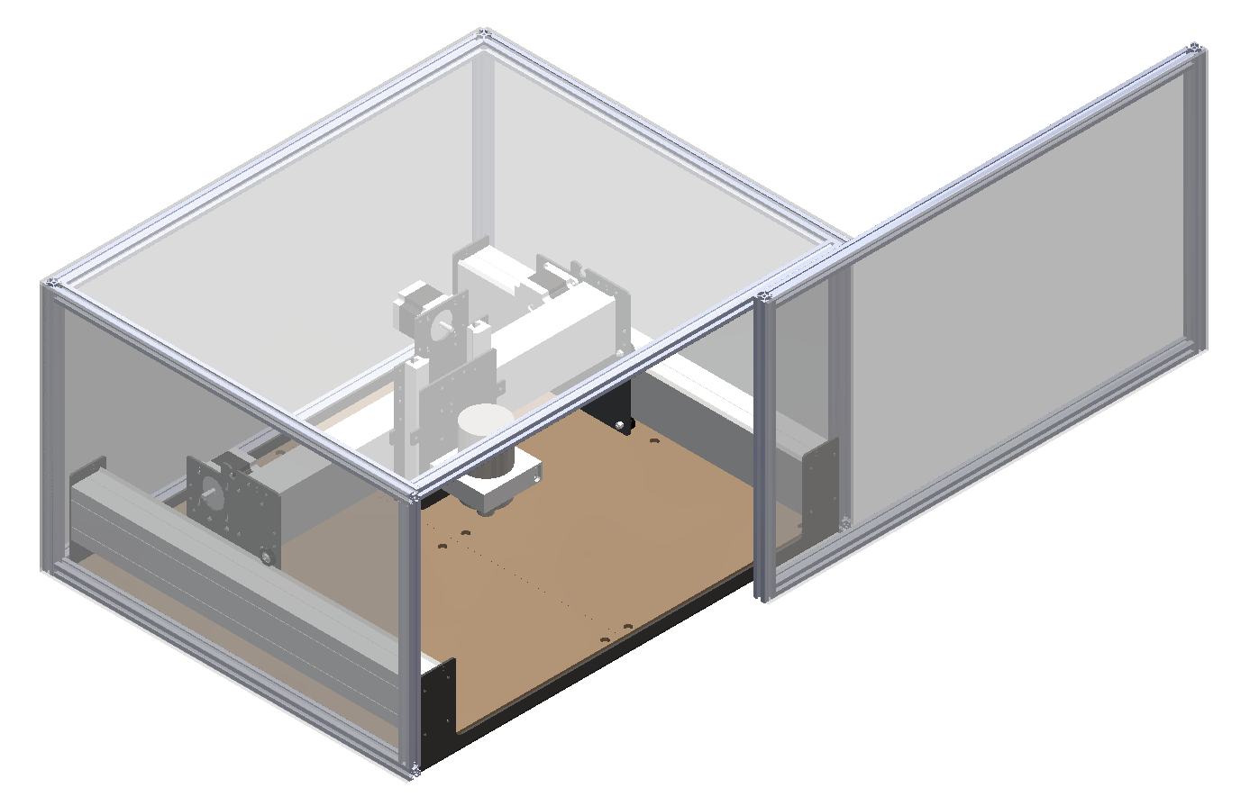
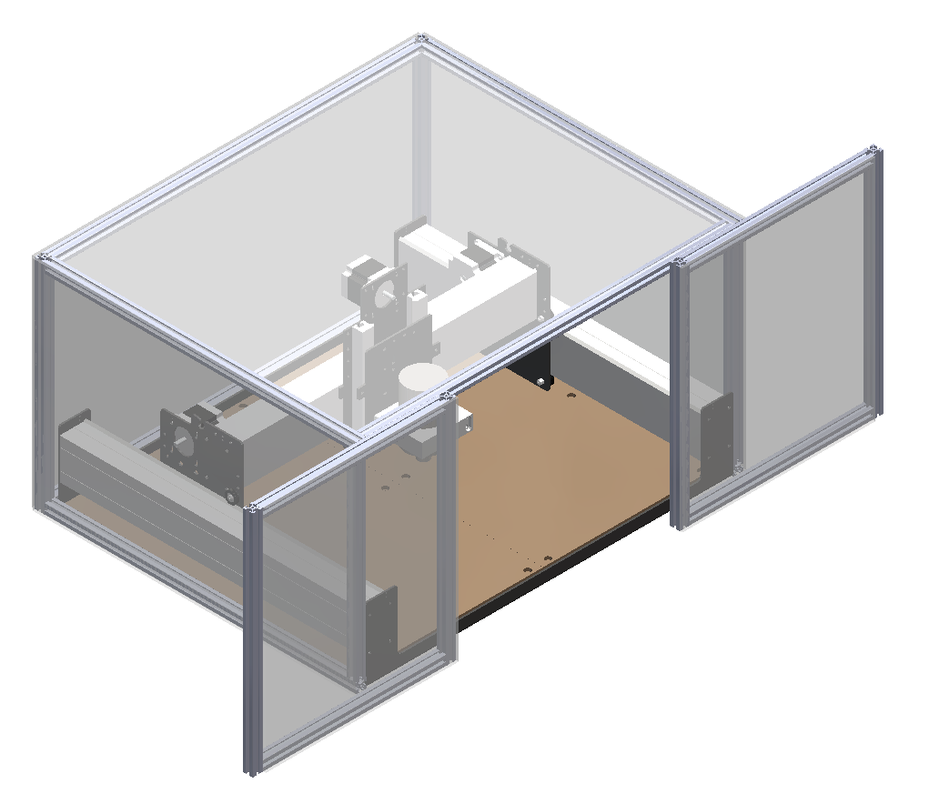
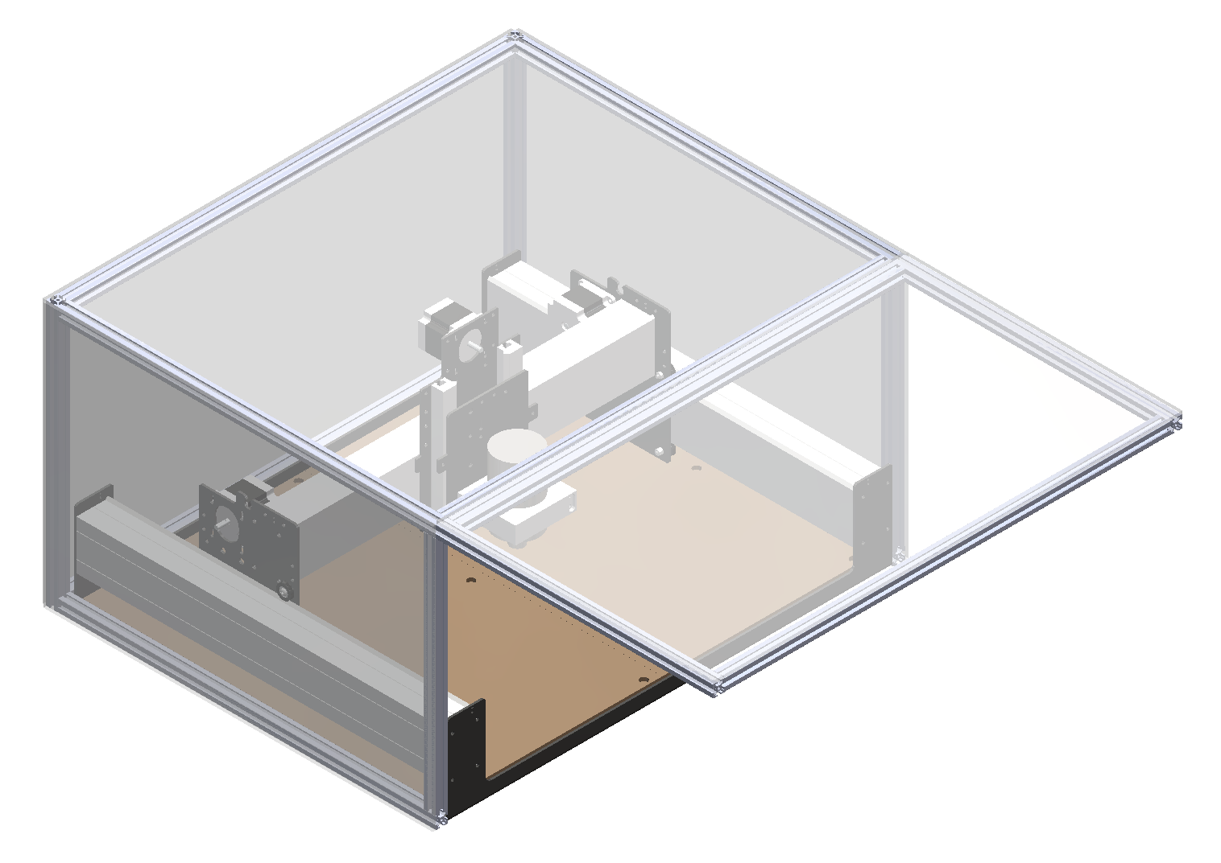
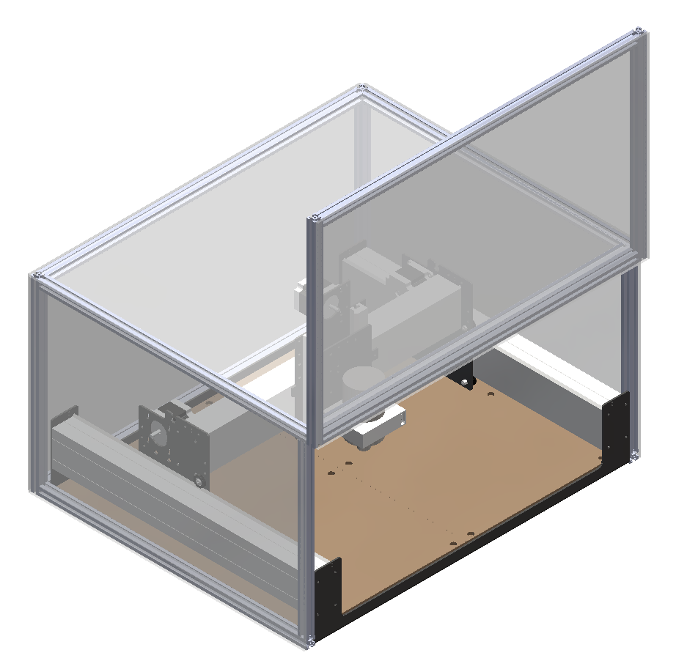
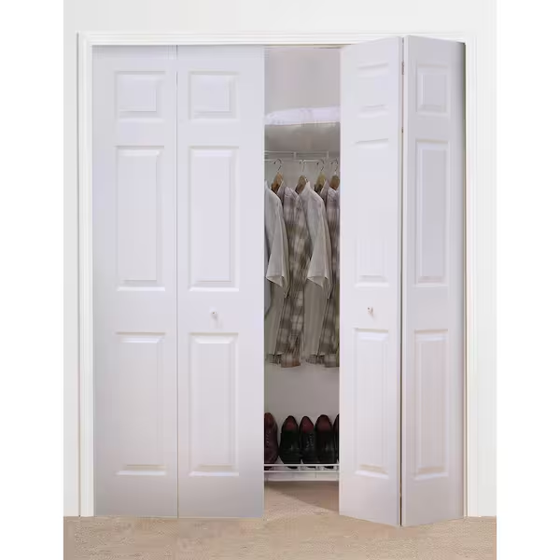
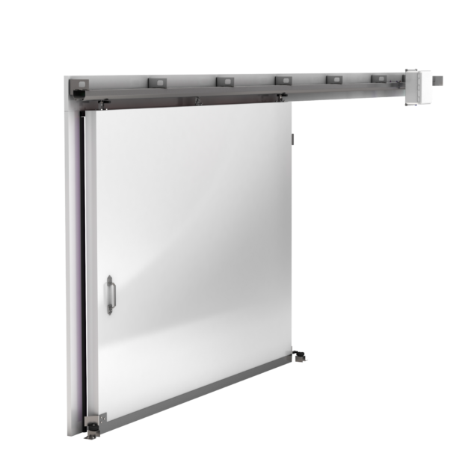
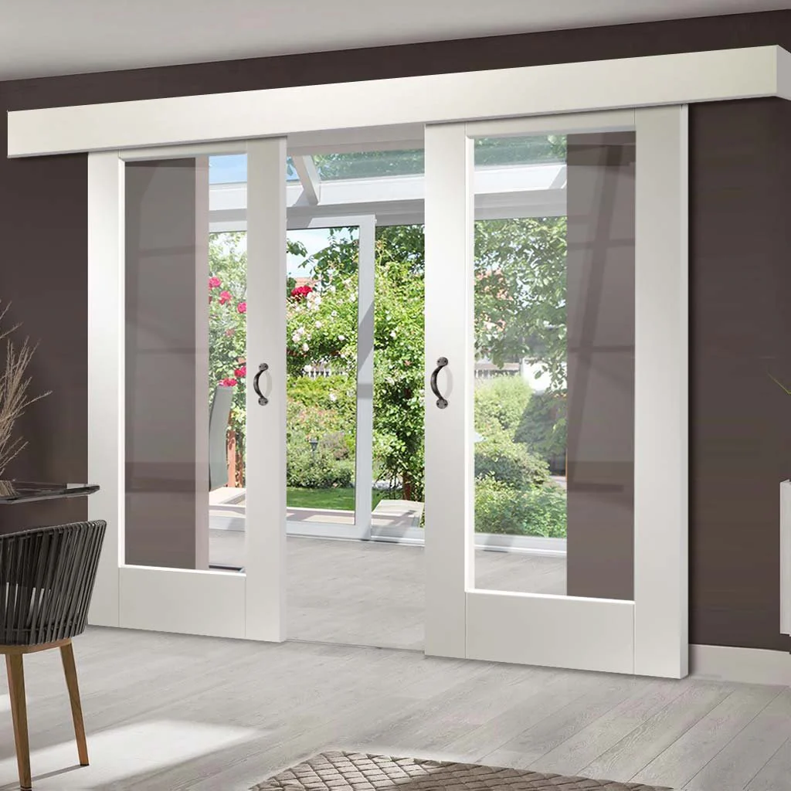
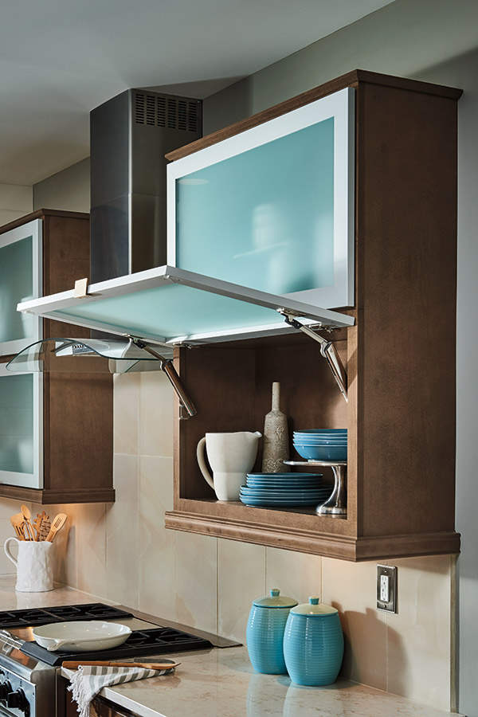
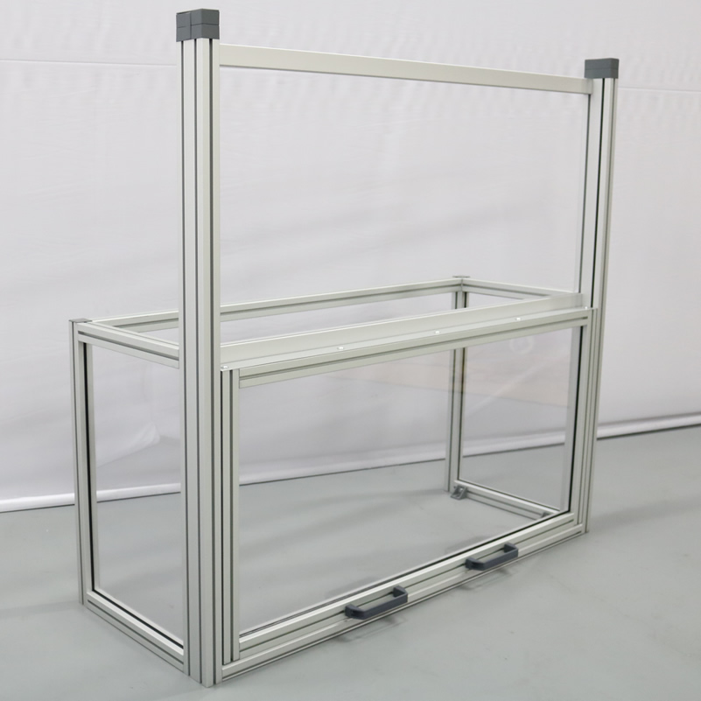
Medium Fidelity Concepts
Malik Grant
Bifold door
Horizontal sliding door
Double sliding door
Top-hinge door
Vertical sliding door
Notes:
For our concept selection, we first started with generating 100 different ideas centered around our critical targets. After developing these ideas from each member of the team we came together to narrow down our concepts to 5 medium fidelity concepts and 3 high fidelity concepts. We used different processes to rank these concepts. For our 5 medium fidelity concepts, we were able to get real life comparisons and were able to pull different features that would be best for our prototype.

Slide 47

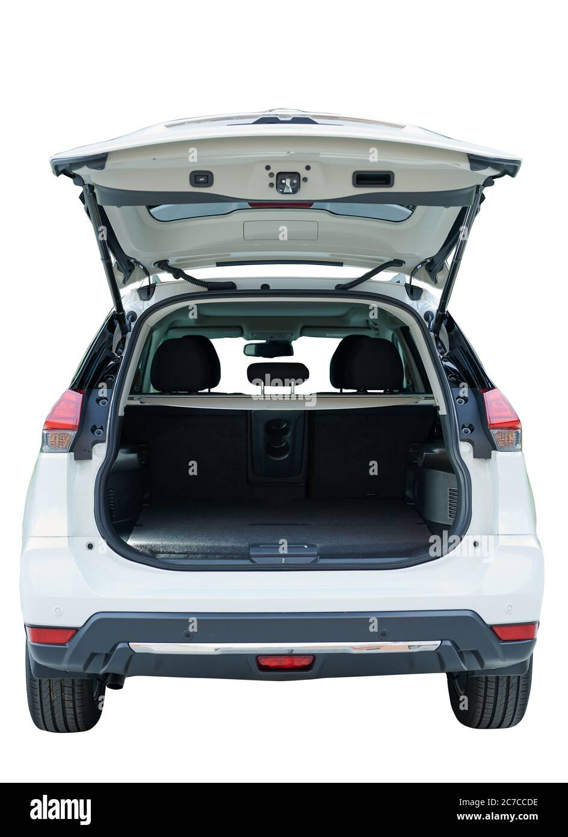
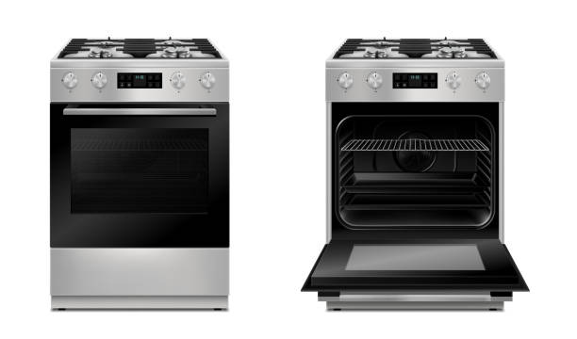
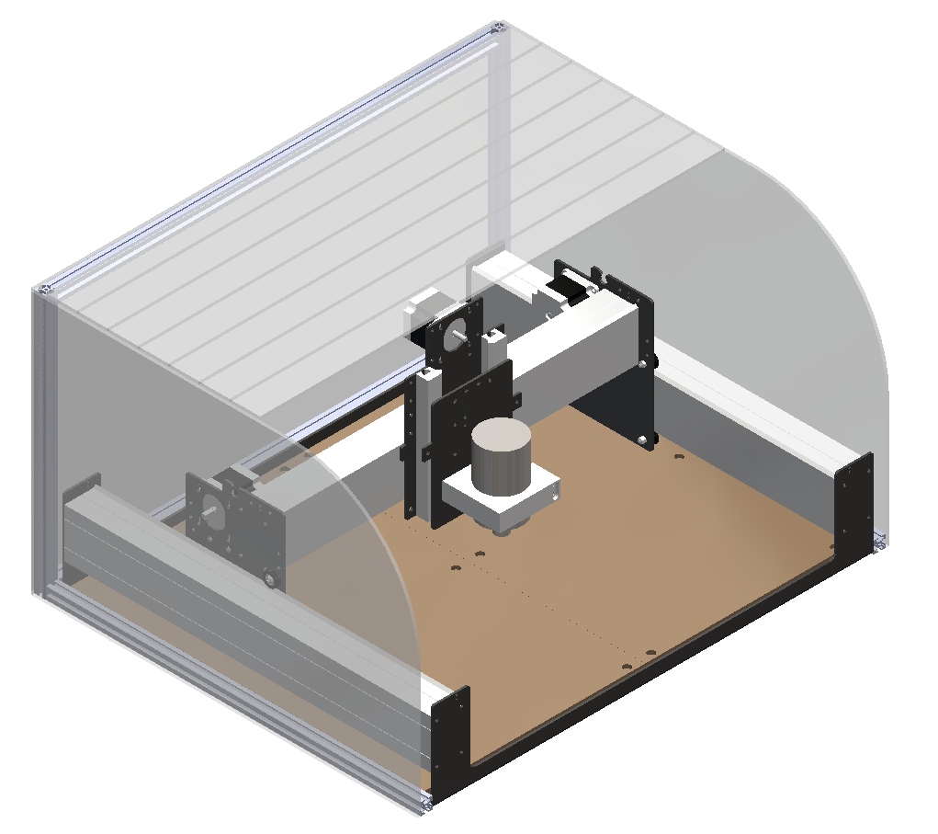
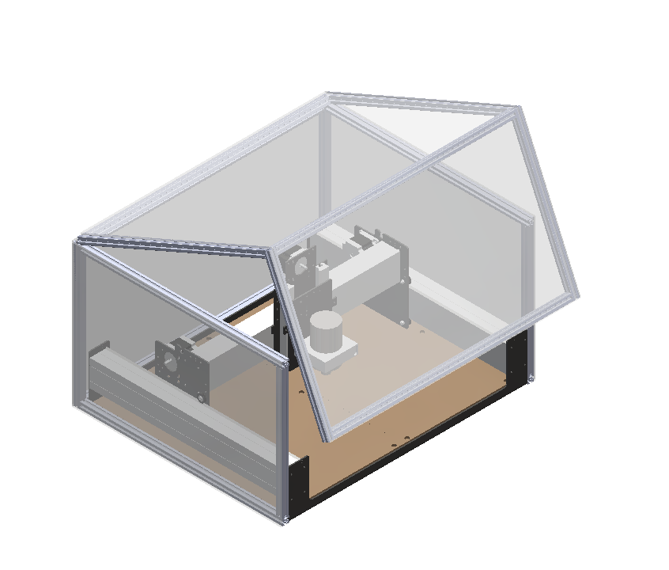
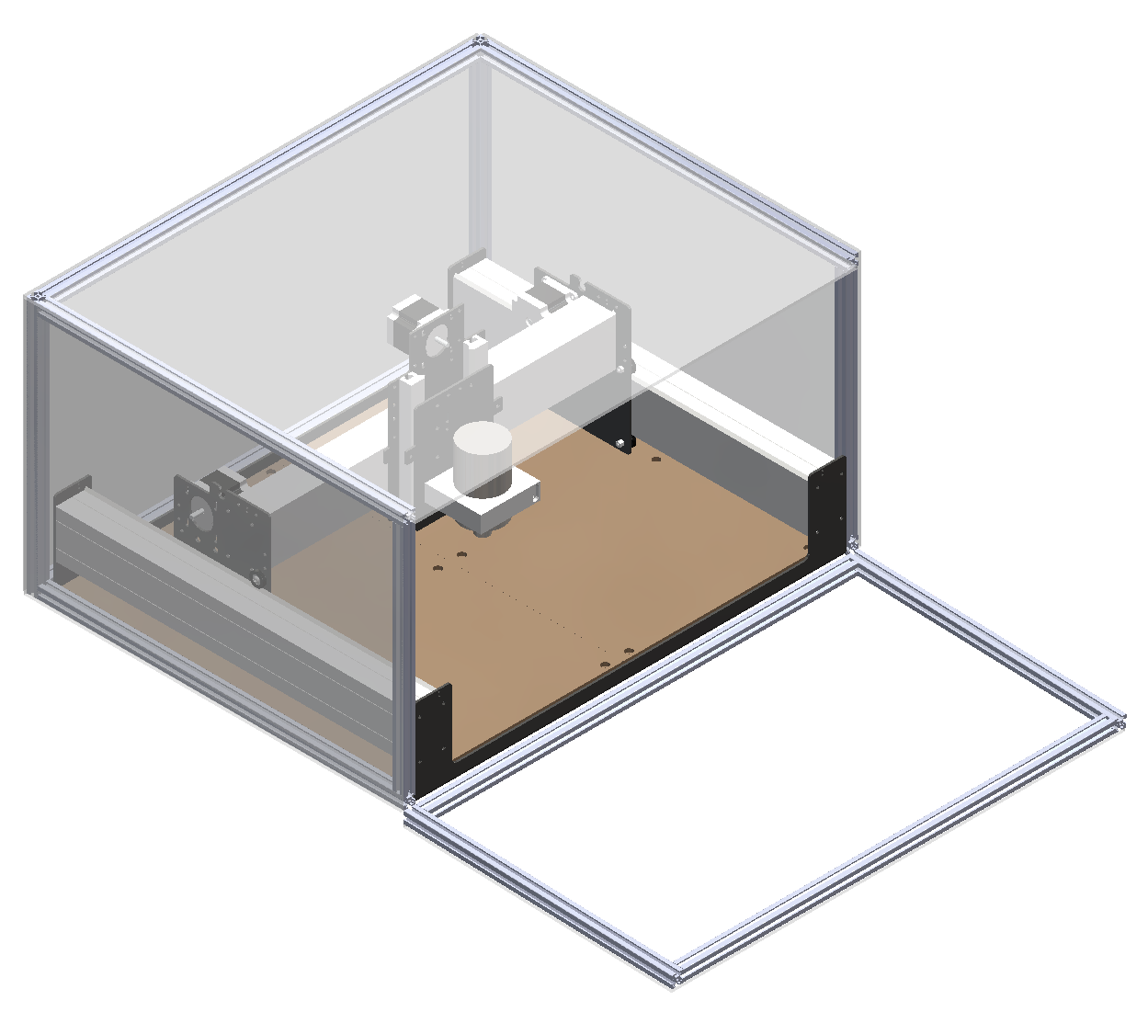
High Fidelity Concepts
Malik Grant
Roll cover
Hatch
Oven door
Notes:
Here is our 3 high fidelity concepts,

Slide 48
Concept Selection
Samuel Byers
Concepts

Slide 49
Concept Selection
Samuel Byers
Concepts
Characteristics
Impact force
Clearance
Limited access
Disassembly time
Displacement due to vibration

Slide 50
Concept Selection
Samuel Byers
Concepts
Characteristics
Impact force
Clearance
Limited access
Disassembly time
Displacement due to vibration
Selection

Slide 51
Final Selection
Samuel Byers
Bifold door
Horizontal sliding door
Double sliding door
Top-hinge door
Vertical sliding door

Slide 52





Changes from Initial Concepts
Carlton Walker
Preliminary Designs CAD
Updated Design
Front Opening Doors
Auto-Off Hinge
Back Door

Slide 53


Electrical Design
Amanda Garcia-Menocal
Power Source
Breaks Series
Breaks Series
Notes:
The way the system would be powered is displayed in this diagram with the essential parts including limit switches on the doors, power source relay on/off switch, and emergency shut off button. The doors will have two limit switches on each side of the door to ensure for contact with the frame. The limit switches will be powered directly from the power source of the machine which is being powered from the room outlet. If the door is not fully in tack then the machine will not be powered. But now if the machine wants to be in use while the doors are open that is when you would use the power source relay on/off button to send the current directly to the machine. And finally, the emergency stop button will cut all power through the series of wire for the whole machine. We are using 12 gauge wiring to feed the current throughout the system

