Slide 1
Smart Phone Barometric Map
Members:
Dayreal Brown Xuanchen Xiang
Robert Minter Ziheng Zhang

Slide 2
The Problem

Slide 3
The Problem

Slide 4
Potential

Slide 5
The Problem

Slide 6
Our Solution

Slide 7
Engineering Background
Xuanchen Xiang

Slide 8
Air Pressure Map
The air pressure maps show the air pressure for various locations over the world.
http://www.usairnet.com/weather/maps/current/barometric-pressure/

Slide 9
Basic Relation Between Wind Data & Pressure
P_{larger}
Unit Area
P_{smaller}
F
Rough equation:
MpH=√(PSF/0.00256)
- using Bernoulli Theorem

Slide 10
Problems to be solved
Required Accuracy: ±1 hPa/mb
The accuracy of GPS is poor and unstable.
The sensor measurements can vary severely.
The relationship between wind and pressure is complicated, we also need to know the other factors.
Required Updated speed: every 10 min
The meteorological station updates data every several hours.
Required Resolution: 1 sensor/kilometer
GPS doesn't work in indoor environments.
Hard to gather data where is uninhabited.

Slide 11
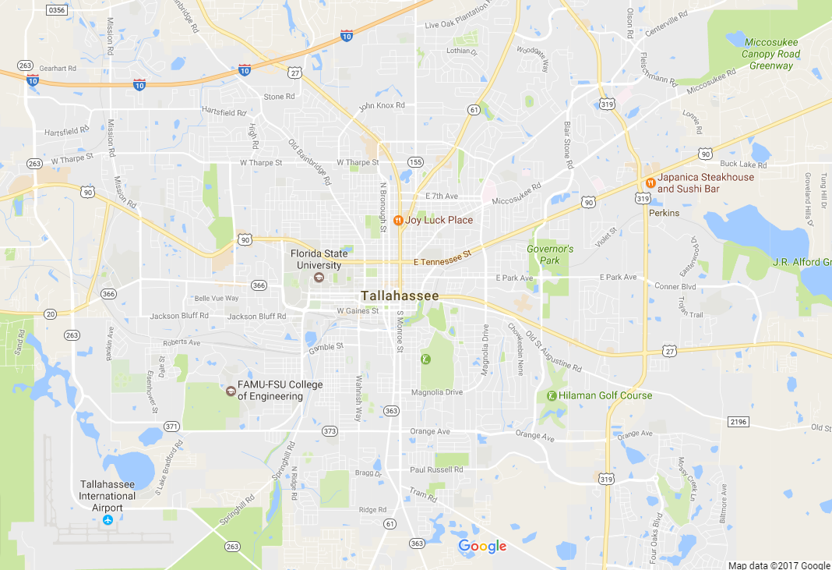
Testing Points
Florida State University:
Latitude: 30.441878N
Longitude: 84.298489W
Altitude: 24.052m/78.911ft

Slide 12
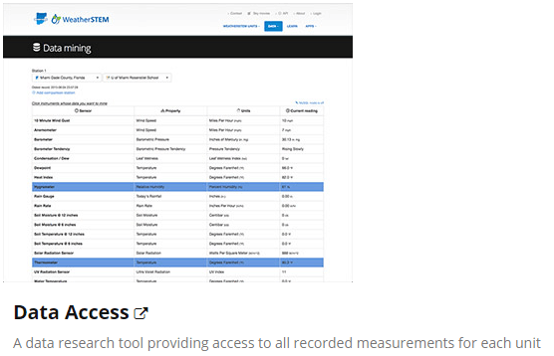
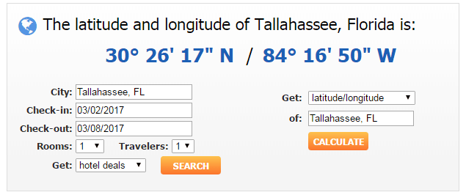
Sample Data

Slide 13
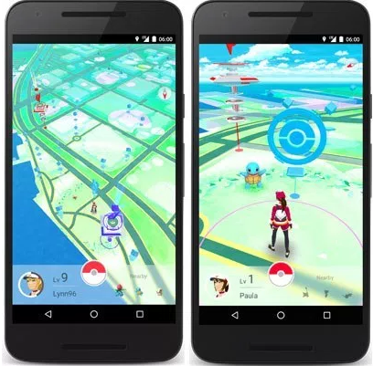
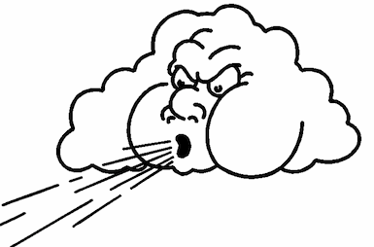
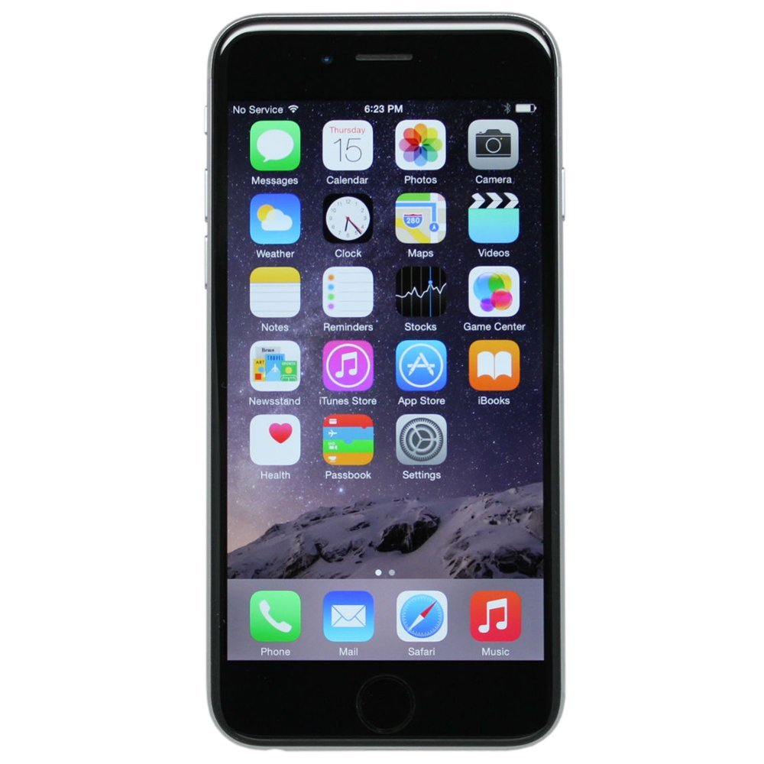
Overall Frame
GPS
Weather stations
Smartphone sensor
Wind Data

Slide 14
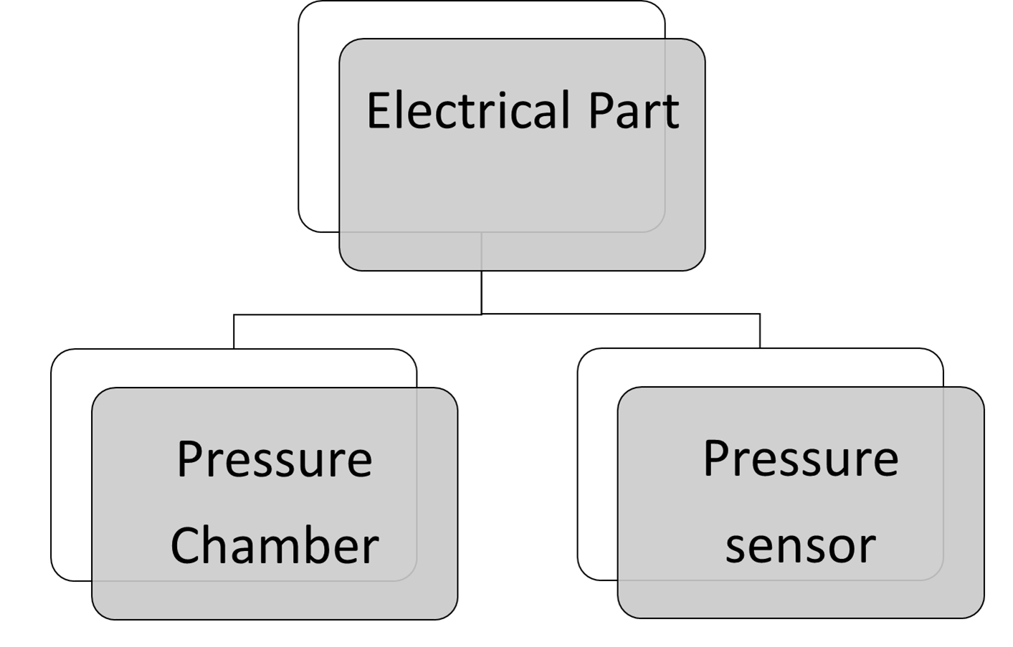
Stage 1

Slide 15
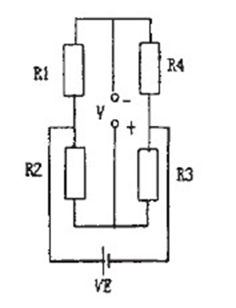
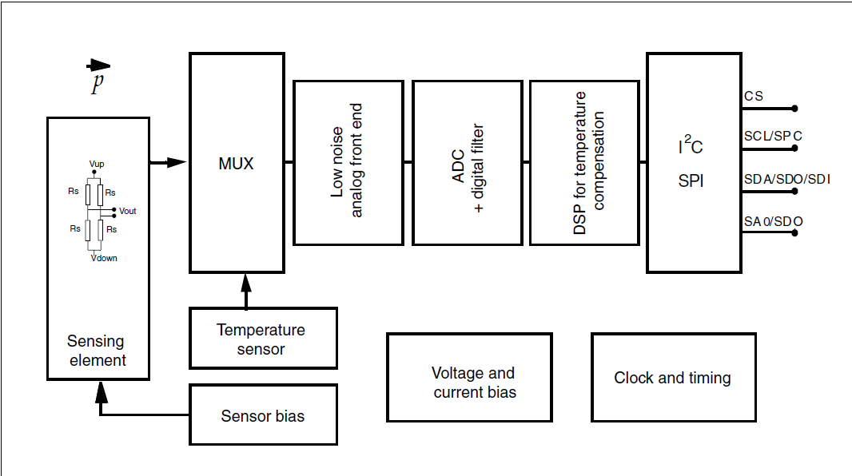
Stage 1
When there is pressure on the sensor, it will cause the shape change, which leads to the change of impedance and it will bring about a change in the output of electrical s.
By examining and calculating the output, we could get the pressure value.
Use the balanced bridge to convert the pressure signal into the electric signal.
Then, use the circuit above to amplify the outputs.

Slide 16
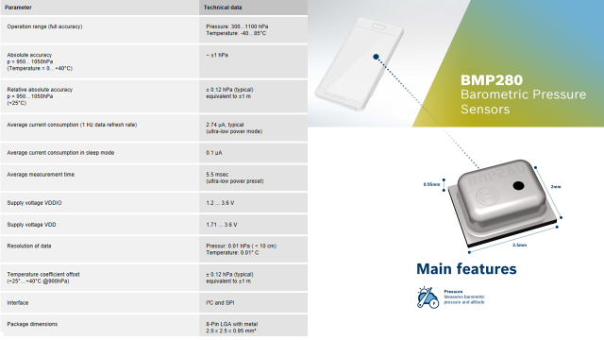
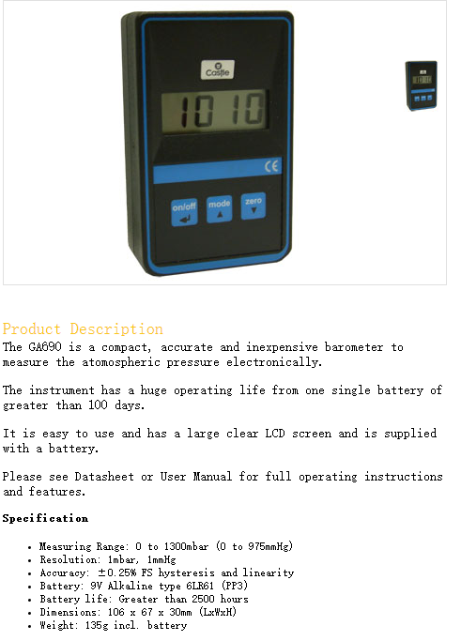
Stage 1

Slide 17
Stage 2
What do we want to make?
Pressure map
What do we need?
Data
What should data be like?
Data should be updated every 10 min and pressure error should be within 1 mb

Slide 18
Stage 2

Slide 19
Stage 2
Laplace pressure formula
a=1/273
T: temperature
P:Pressure
Z:Height
Only for ideal condition

Slide 20
Stage 2
Atmospheric short-term state change is not big, we can consider it quasi static and adiabatic
the first thermodynamic law
state equation
We got
When
Do the calculation

Slide 21
Example 02/19/2017 21:53
Tallahassee：
Height：62m（constant）
Pressure：1019.6 mb
(we are in Tally
we can know the pressure at any time
By using pressure meter)
Temperature: 17.2 degree C
Jacksonville
Height：4.9m（constant）
Pressure：？Mb（1018.6）
Temperature: 18.9 degree C
P=1018.8 MB
Error :0.2 mb

Slide 22
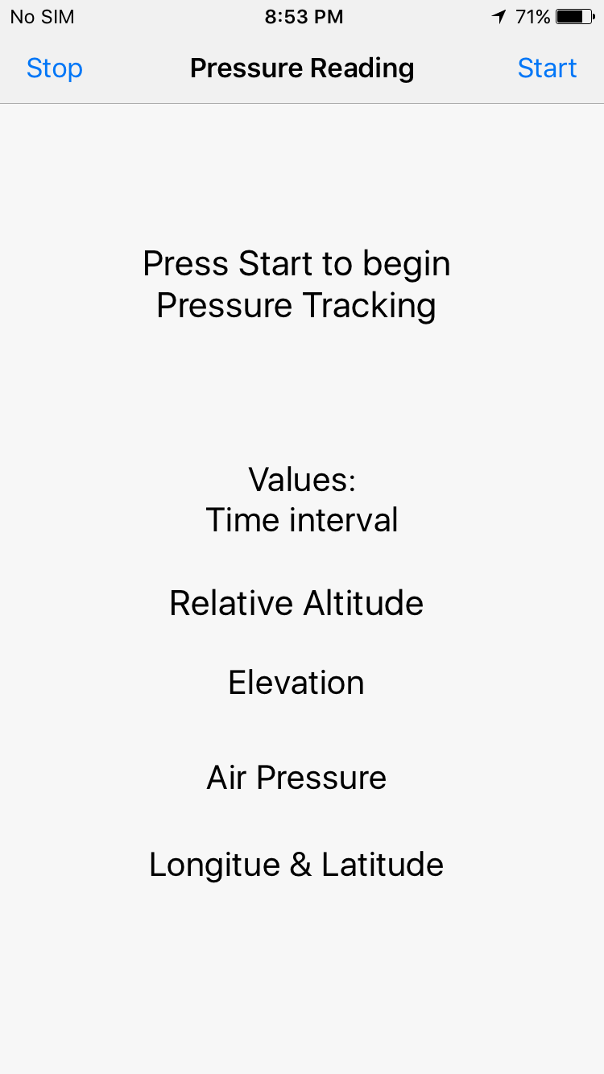
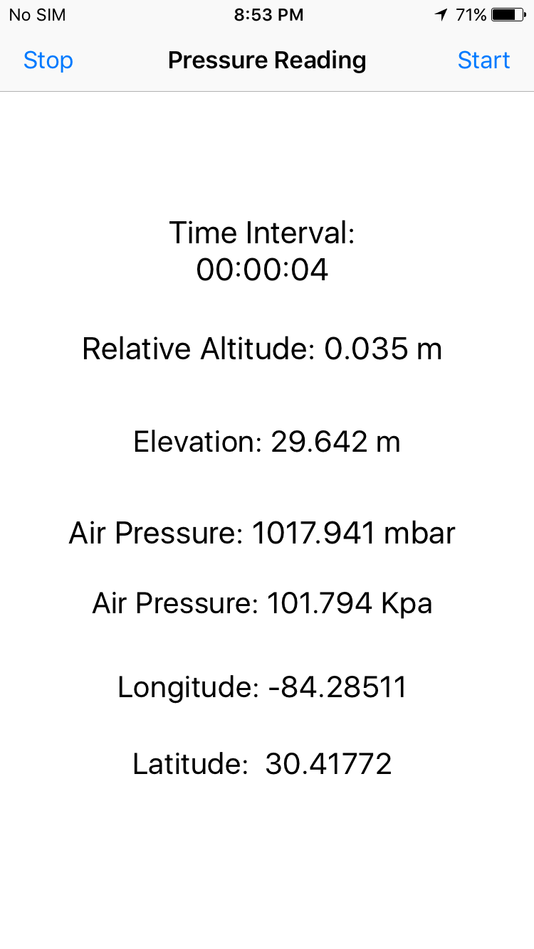
App Development
Xcode was used to design the application for iOS.
The app would be able to give the user their pressure in millibars and in kilopascals at their location.
Also their longitude, latitude, relative altitude and elevation.
The data would then be sent to a online database for record keeping.

Slide 23
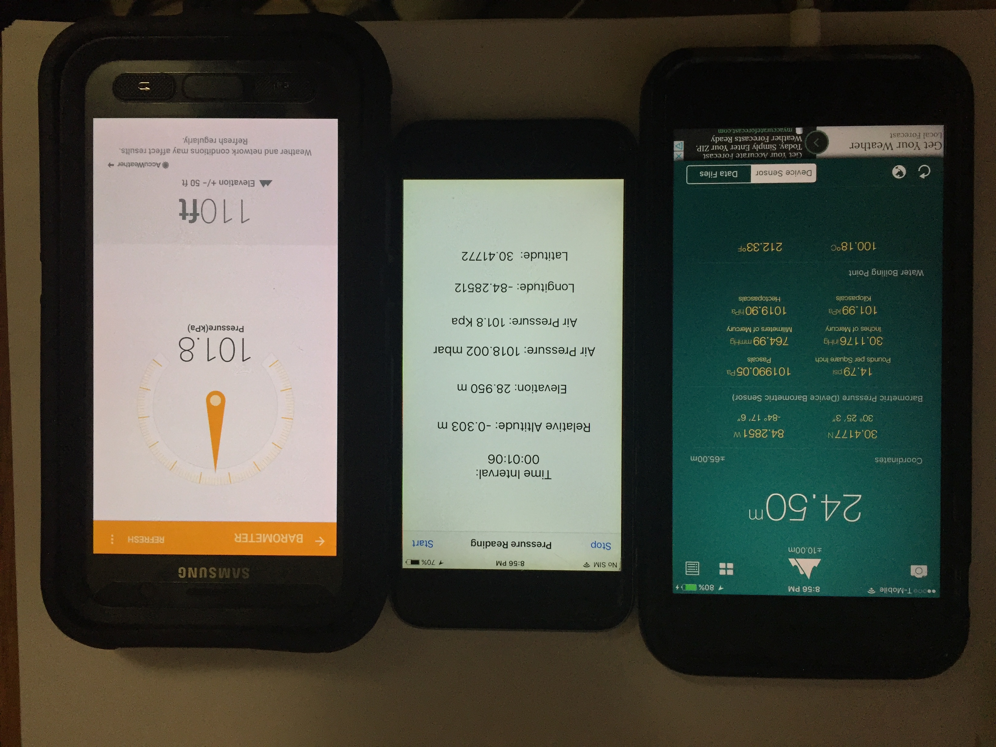
Sensor Accuracy
The accuracy of the GPS
$±$0.002 for Latitude & $±$0.003 for Longitude
The accuracy of the barometer
$±$1 millibars & $±$0.1 Kilopascals
The accuracy of the elevation
Varies between $±$ 0.5 to $±$6 meter
Wi-Fi or data coverage must be enabled to upload data readings.

Slide 24
Web Server
XAMPP was used as it provides a free webserver and database access.
The information from the application would be sent to the database.
A table of the values sent from the app would be kept and available for inspection or query.
A PHP connection links the
app and a MySQL database.

Slide 25
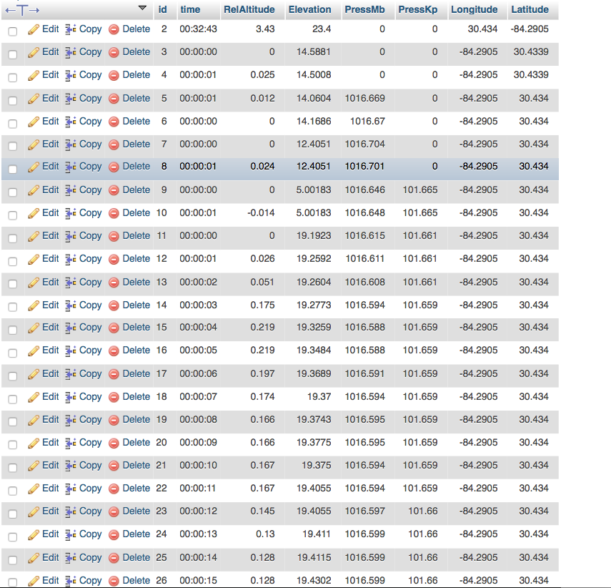
Database
The database has 8 fields:
Id – Primary Key
Time – current time during operation
Relative Altitude – distance moved vertically since beginning data gathering
Elevation – distance about mean sea level
Pressure
In millibars & kilopascals
Longitude and Latitude – 2D coordinates giving position on Earth’s surface

Slide 26
Risk/Hazards
Since the project is entirely software related, there virtually no physical risks/hazards associated with our project.
The application contains no malicious software

Slide 27
Future Work
Mapping a user’s location based on their long/lat coordinates to a map
Possibly showing the distance covered during the duration of operation of the app
Editing Time reading to be a timestamp along with the date
For logging purposes

Slide 28
Questions?

