Slide 1
Smart Phone Barometer Map
Members:
Dayreal Brown Xuanchen Xiang
Robert Minter Ziheng Zhang

Slide 2
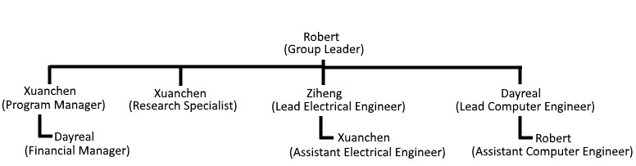
Group Breakdown:

Slide 3
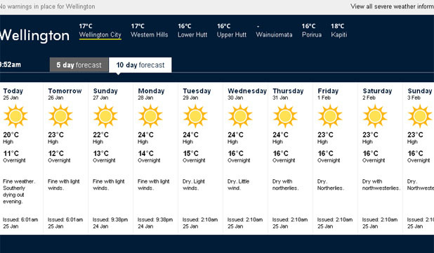
Problem:

Slide 4
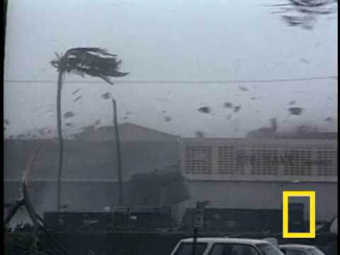
Problem:

Slide 5
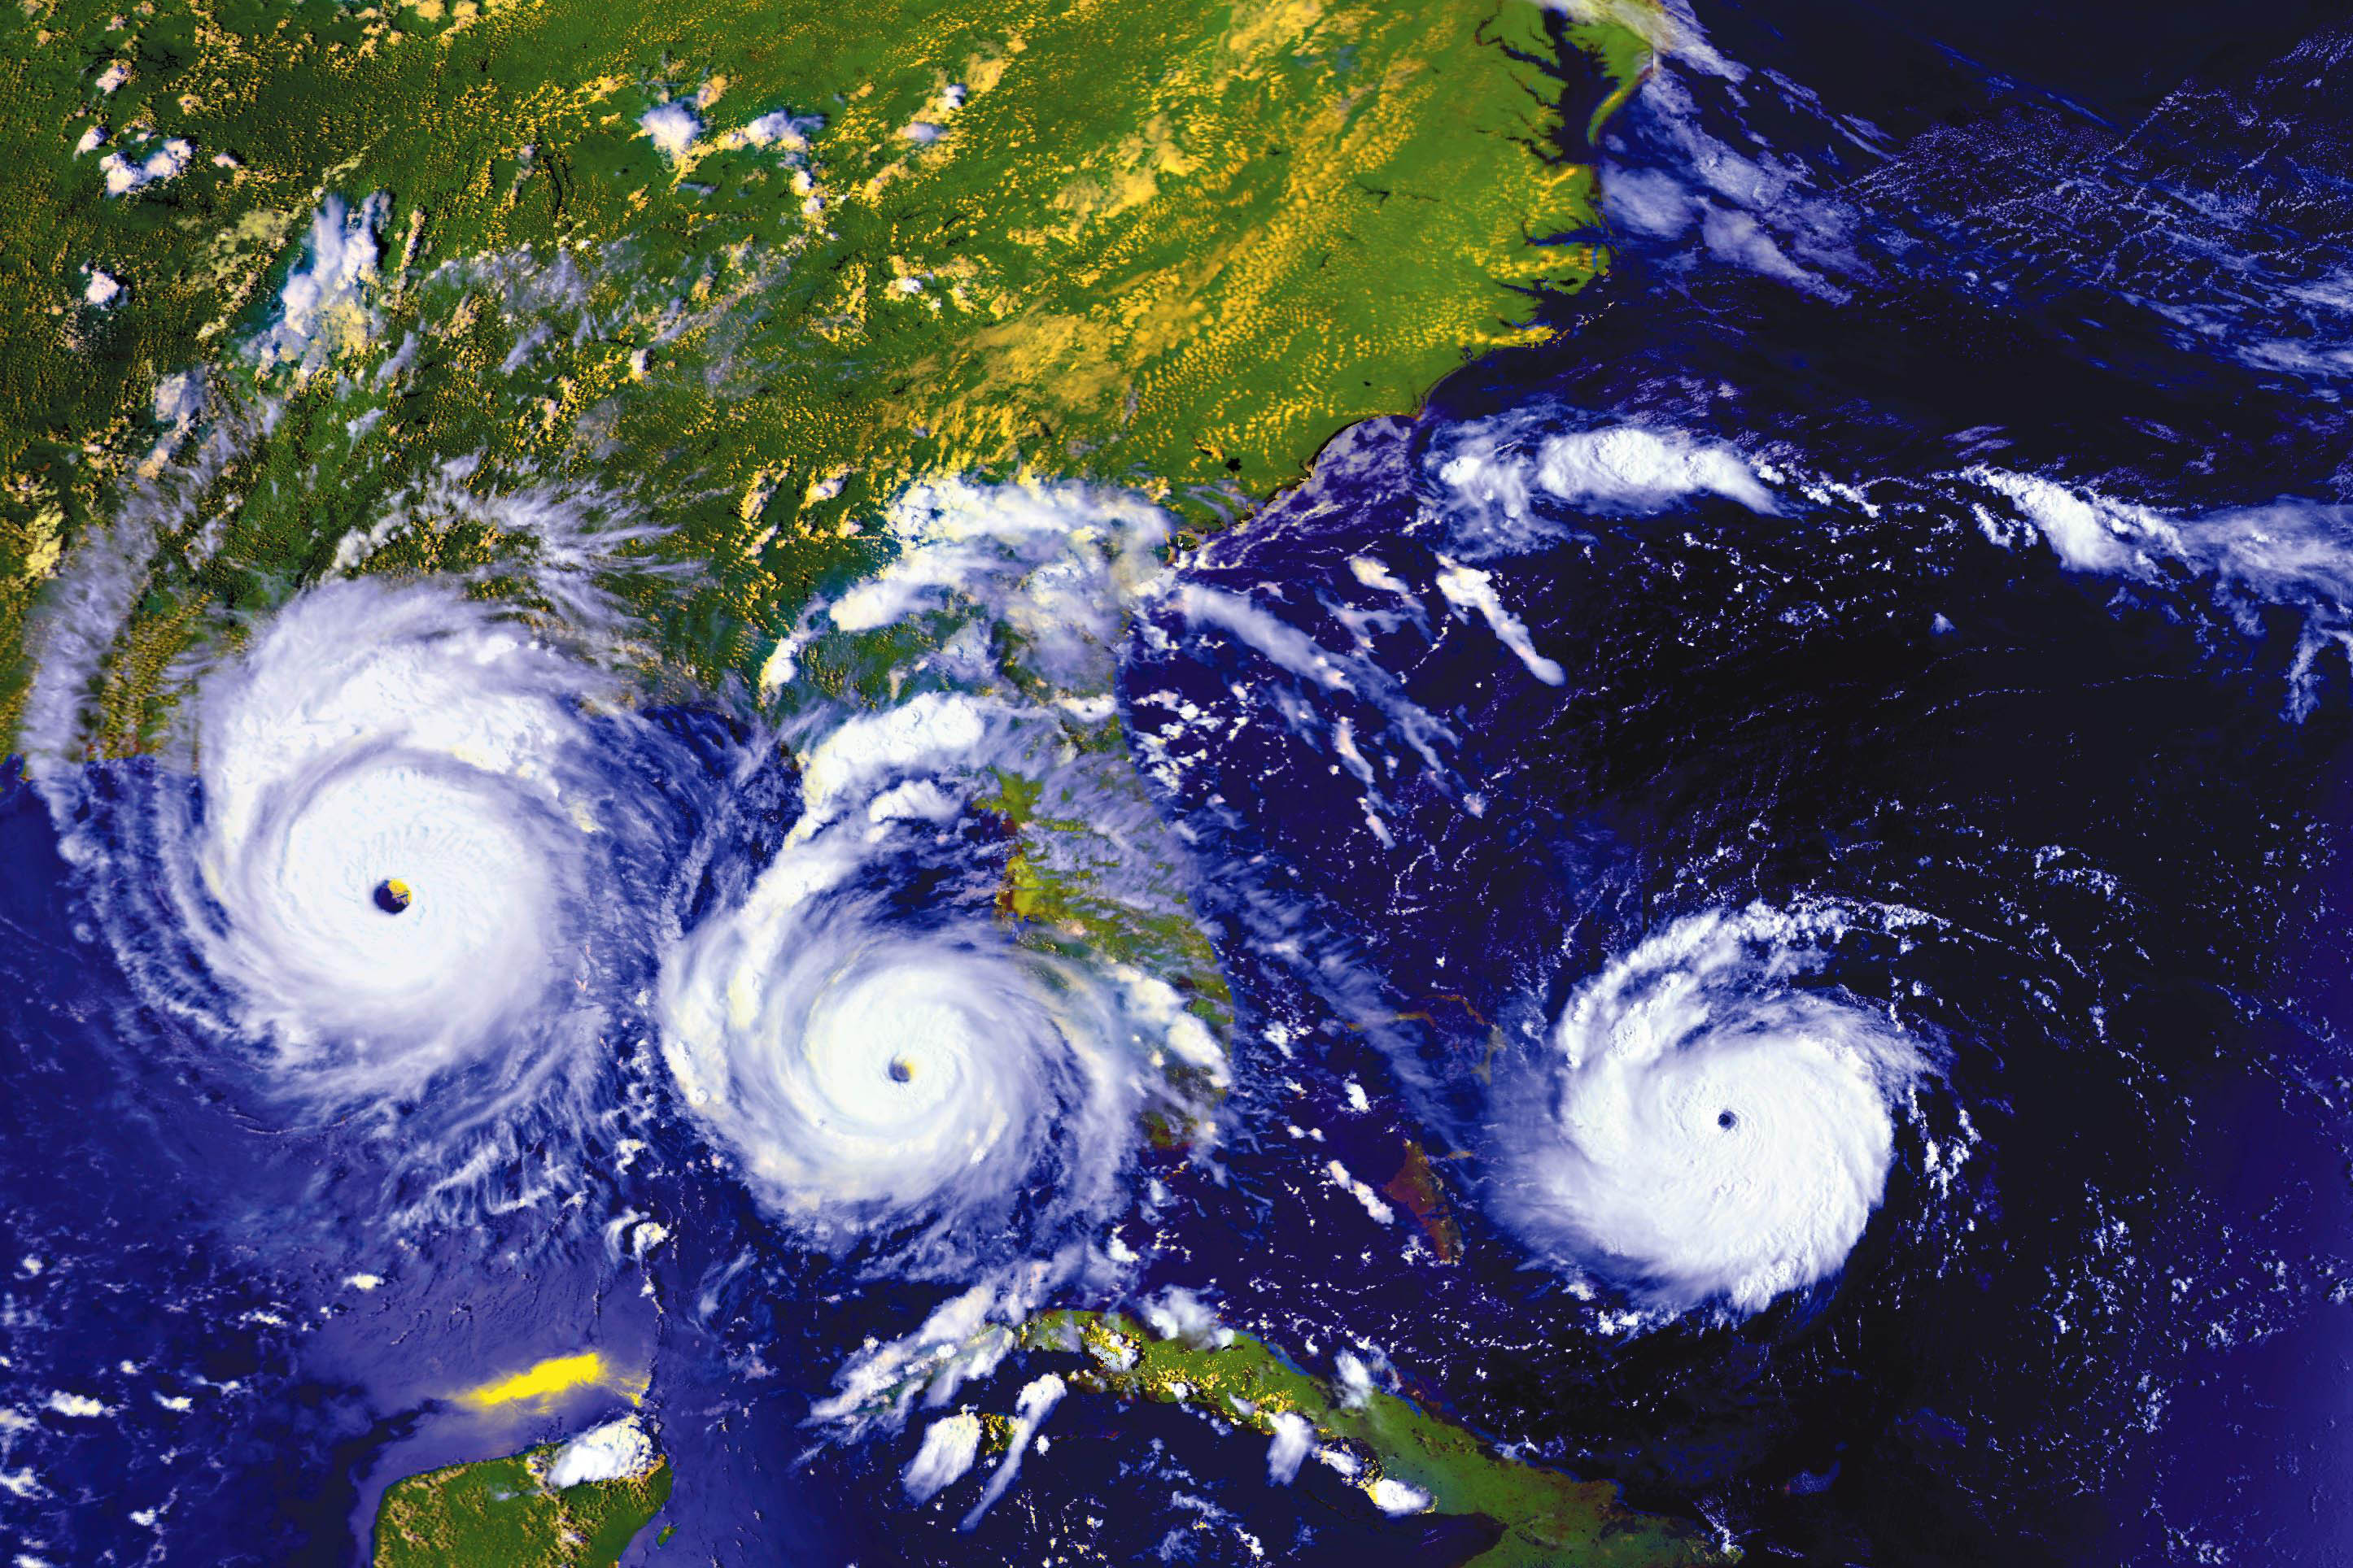
Problem:

Slide 6
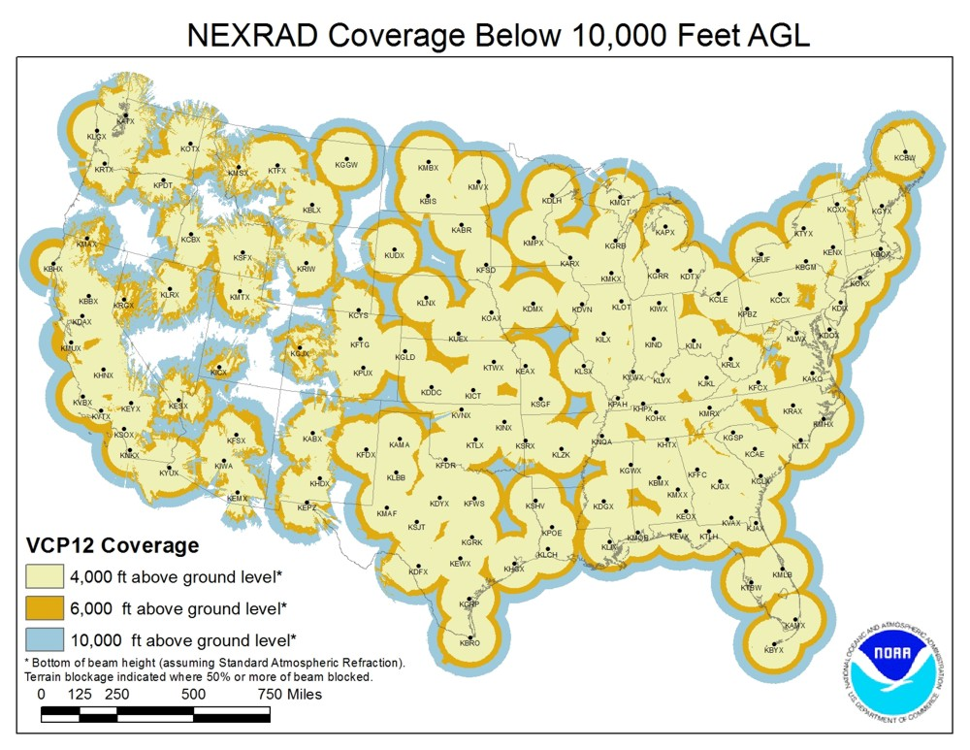
Problem:

Slide 7
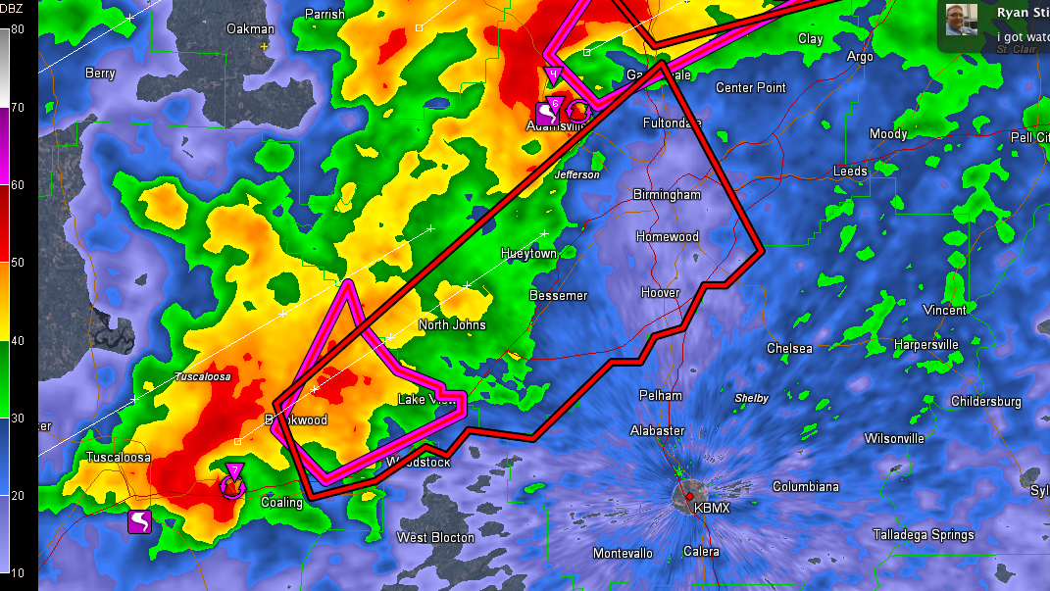
Potential:

Slide 8
Smartphone Barometric Mapping
Engineering Background
Charlotte Xiang

Slide 9
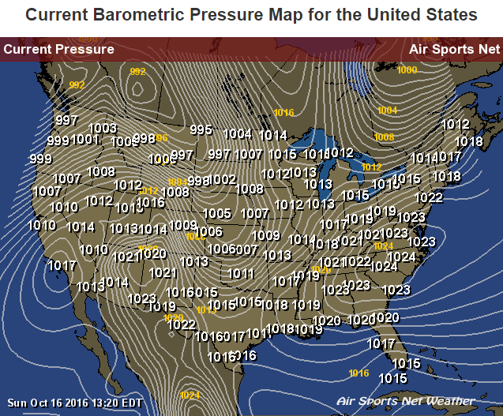
What is the air pressure map?
The air pressure maps show the air pressure for various locations over the world.
http://www.usairnet.com/weather/maps/current/barometric-pressure/

Slide 10
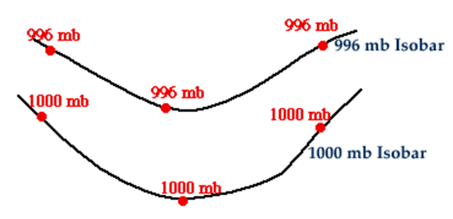
How to read isobars?
isobar: an imaginary line or a line on a map or chart connecting or marking places of equal barometric pressure
http://ww2010.atmos.uiuc.edu/(Gh)/guides/mtr/prs/isb.rxml
isobars close = strong winds
isobars far apart = weak winds

Slide 11
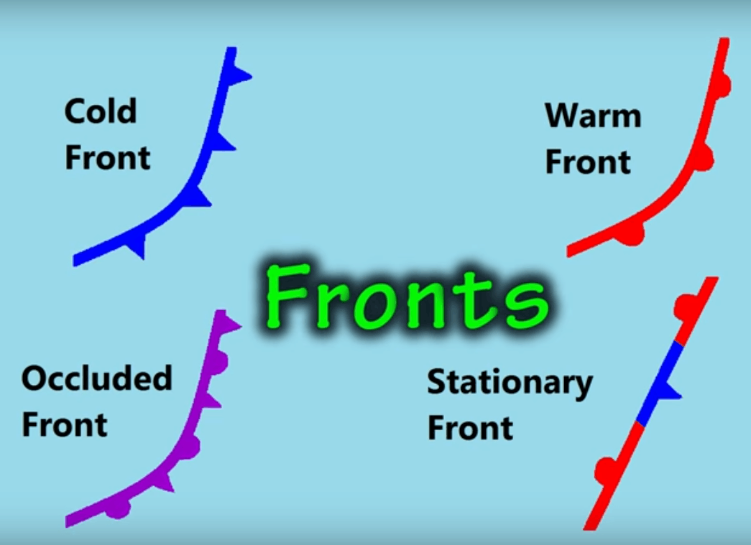
Warm Front: warm air slides over departing cold air- large bands of precipitation form.
Cold Front: Cold air pushes under a warm air mass. Warm air rises quickly=narrow bands of violent storms form.
Occluded Front: 2 air masses merge and force warm air between them to rise quickly. Strong winds and heavy precipitation will occur.
Stationary Front: Warm or cold front stops moving. Light wind and precipitation may occur across the front boundary.
https://www.youtube.com/watch?v=bd7DcVnrSL8

Slide 12
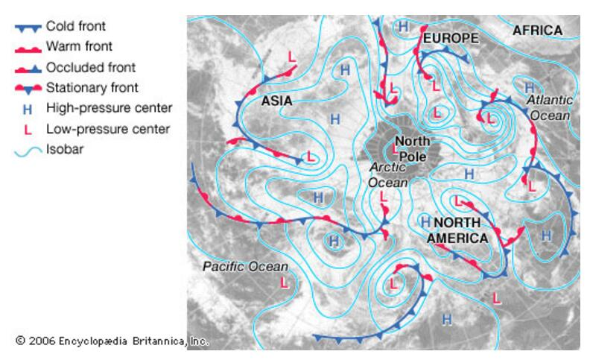
https://www.britannica.com/science/isobar-cartography

Slide 13
How to draw barometric maps?
Barometric
Mapping
Location
Air
Pressure
GPS
weather
station
smart-phone
sensor

Slide 14
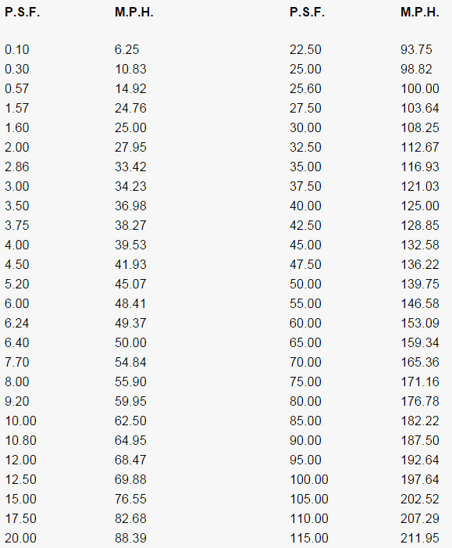
How wind relates to air pressure?
P_{larger}
Unit Area
P_{smaller}
F
Rough equation:
MpH=√(PSF/0.00256)
- using Bernoulli Theorem
http://bristolite.com/interfaces/psi_wind.aspx

Slide 15
Problems to be solved:
Required Accuracy: ±1 hPa/mb
The accuracy of GPS is poor and unstable.
The sensor measurements can vary severely.
The relationship between wind and pressure is complicated, we also need to know the other factors such as humidity.
Required Updated speed: every 10 min
The meteorological station updates data every several hours.

Slide 16
Problems to be solved:
Required Resolution: 1 sensor/kilometer
GPS doesn't work in indoor environments.
Hard to gather data where is uninhabited.

Slide 17
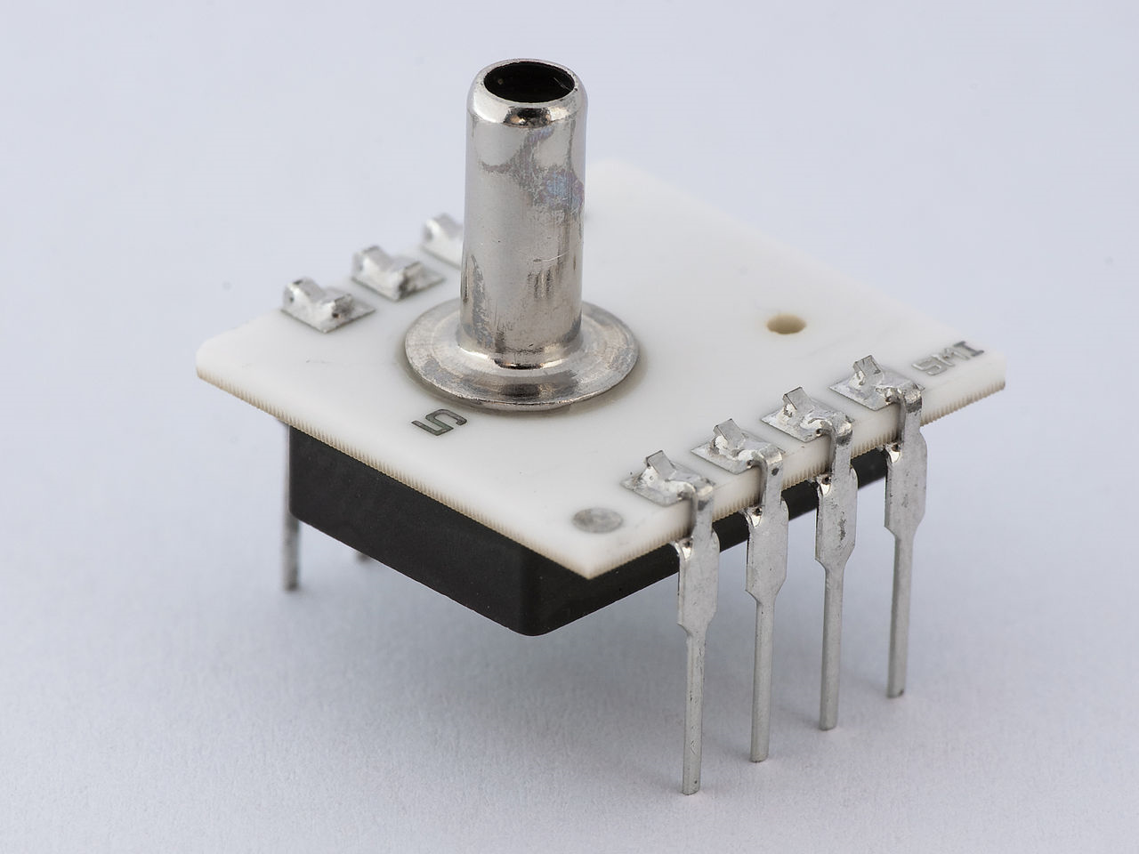
pressure sensor
A pressure sensor measures pressure, typically of gases or liquids. Pressure is an expression of the force required to stop a fluid from expanding, and is usually stated in terms of force per unit area. A pressure sensor usually acts as a transducer; it generates a signal as a function of the pressure imposed. For the purposes of this article, such a signal is electrical.
Pressure sensors are used for control and monitoring in thousands of everyday applications. Pressure sensors can also be used to indirectly measure other variables such as fluid/gas flow, speed, water level, and altitude. Pressure sensors can alternatively be called pressure transducers, pressure transmitters, pressure senders, pressure indicators, piezometers and manometers, among other names.
Pressure sensors can vary drastically in technology, design, performance, application suitability and cost. A conservative estimate would be that there may be over 50 technologies and at least 300 companies making pressure sensors worldwide.

Slide 18
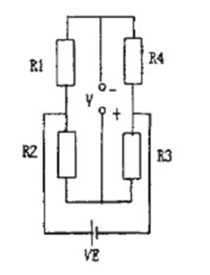
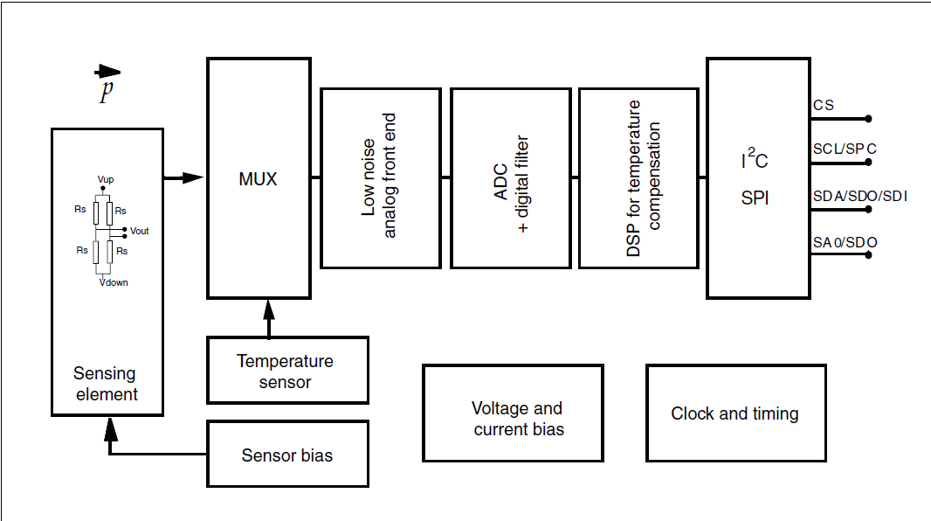
When there is pressure on the sensor, it will cause the shape change, which leads to the change of impedance and it will bring about a change in the output of electrical s.
By examining and calculating the output, we could get the pressure value.
Use the balanced bridge to convert the pressure signal into the electric signal.
Then, use the circuit above to amplify the outputs.

Slide 19
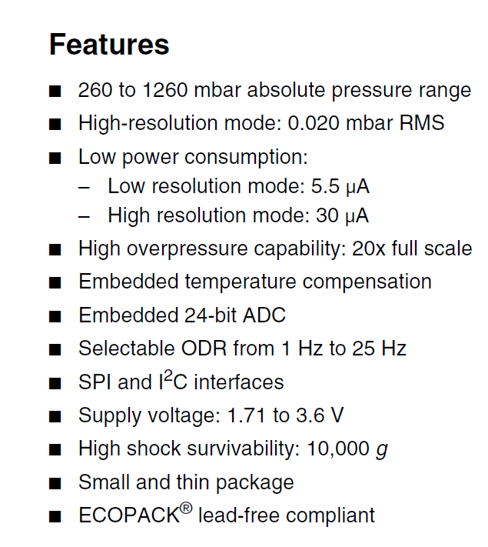
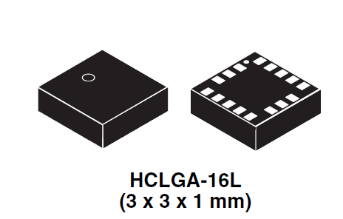
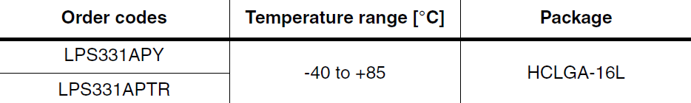

Slide 21
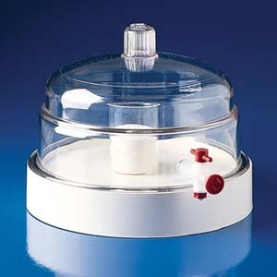
Pressure Chamber
---------To test the accuracy of pressure sensors in the smart phone
Means to test the accuracy:
Put an accurate pressure sensor and the smart phone in the chamber at the same time. Compare the value of pressure get from the two.
Accuracy
RMS Request：1 mb

Slide 22
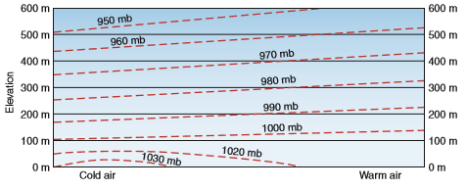
Pressure range in the chamber:
The normal range of the Earth's air pressure is from 980 millibars (mb) to 1050 mb.
The highest barometric pressure on record was 1083.8 millibars (adjusted to sea level), measured in Agata, Siberia on December 31, 1968. The lowest pressure ever measured was 870 millibars from an October 12th typhoon in the western Pacific Ocean.
-------------World Meteorological Organization
Pressure range in our experiment:
Highest:1100mb
Lowest:10mb(the lowest pressure is 0.5% of that at sea level)

Slide 23
Design Approach
Design an application to use barometer sensor in smartphones to capture pressure readings
Gather pressure readings, either through free-of-charge archives or purchasing a from company

Slide 24

Application Development
Collect data from multiple users
  Can gather across widespread area
Sponsor prefers app made for iOS
Display readings to user
  Pressure – Barometer
  Location – GPS
  Elevation – GPS, Barometer
Notes:
Each user = a node.
Improved map resolution
Originally going to design for Android

Slide 25
Application Development
Pros
  Dispersal of smart phones
  Simple Interface, set up refresh rate
  Cover gaps in weather station radars
Cons
  Publishing on app store(s)
    Distribution
  Phones w/o sensor
  Varying degree of accuracy between phones
Notes:
Samsung Galaxy SIII
Iphone 6S
Accuracy of sensor
Windows phone (forgot name)

Slide 26

Archive Data/Purchasing
  Data Archive
    National Oceanic and Atmospheric Administration (NOAA )
  Company
    Open Signal
Pros
  No cost for physical development of product
  Data storage
Cons
  Cost of purchase
  Need for real-time data
  Reliance on secondary source

Slide 27
Sensor Fusion
Takes in multiple readings to provide better measurements and estimates.
Mainly used for 3D location positioning/orientation
  Gyroscope, accelerometers, GPS
Necessary Sensors
  Barometer and GPS

Slide 28
Preferred Approach
The App Development option would be more beneficial to chose as students
  Proposes designing, experimenting, testing
Archive data option would result in simply a research assignment rather than an actual design project.

Slide 29
Division of Work
Group Composition: 2 Electrical, 2 Computer
CpE:
  Design functionality of app to collect readings from phone sensors
  Write code for algorithms to normalize data
EE: Testing of accuracy of sensors

Slide 30
THANK YOU!
Questions?

