Slide 1
Rescue Drone:
Increasing Autonomy and Implementing Computer Vision
Team 4

Slide 2
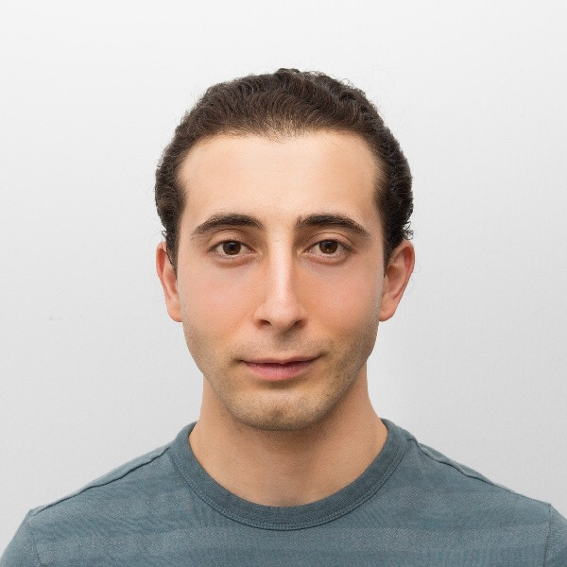
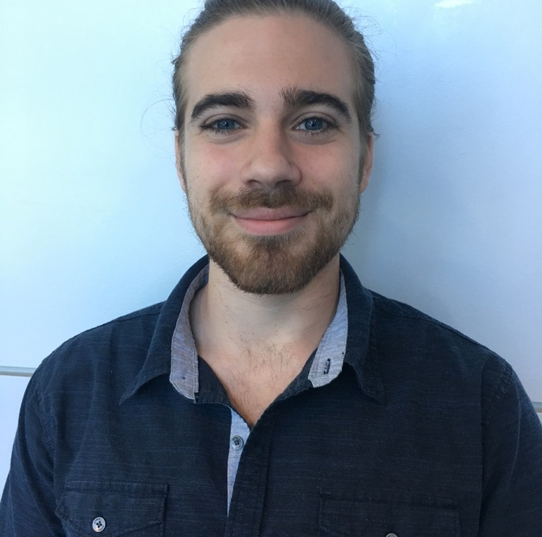
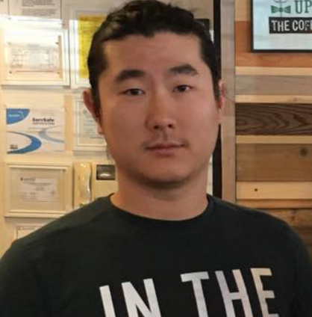
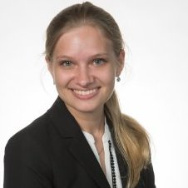

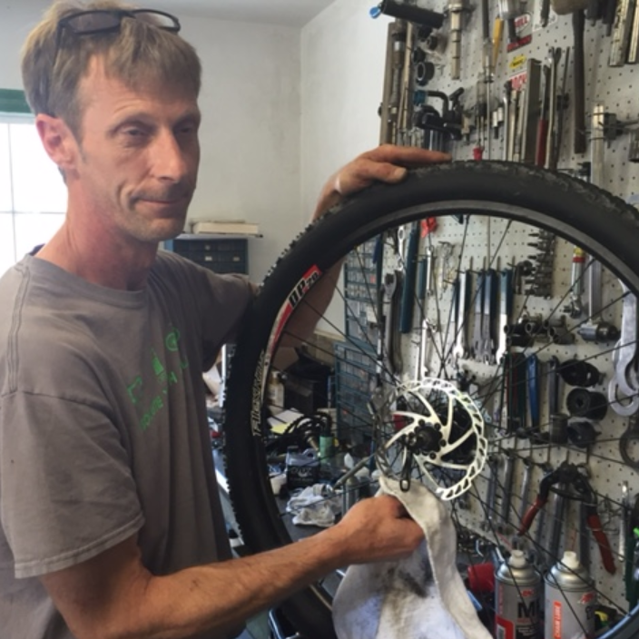
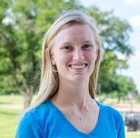
Halil Yonter
Team Leader
FlytOS
Cody Campbell
Hardware Engineering
Processors
Shawn Cho
Software Engineering
WiFi/USNG
Alexandra Borgesen
Computer Engineering
Object Detection
Peter Burchell
Mechanical Engineer
Propeller Testing
Sarah Hood
Dynamic Systems Engineer
Calculations

Slide 3
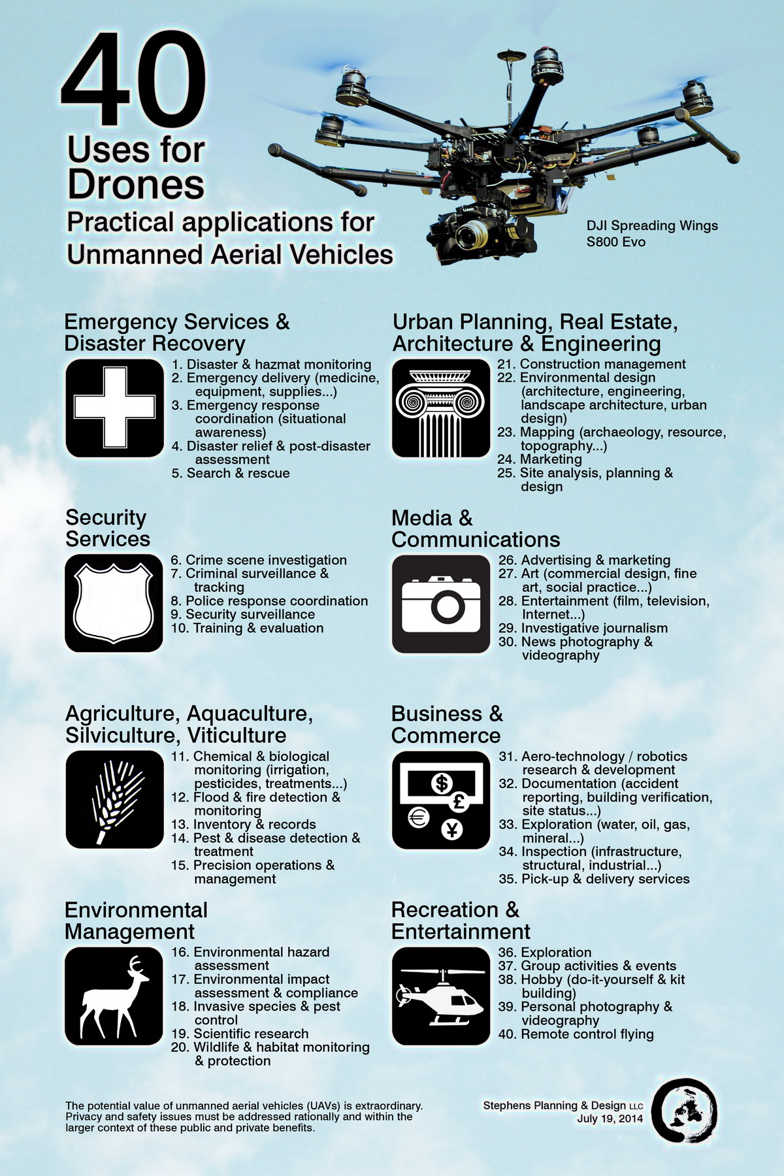
Recap → Flight Control → Processor → Object Detection → WiFi / USNG → Propeller Testing
 | Transportation and Delivery | Wildlife and Habitat Monitoring
 | Inspection and Exploration | Emergency Search and Rescue

Slide 4
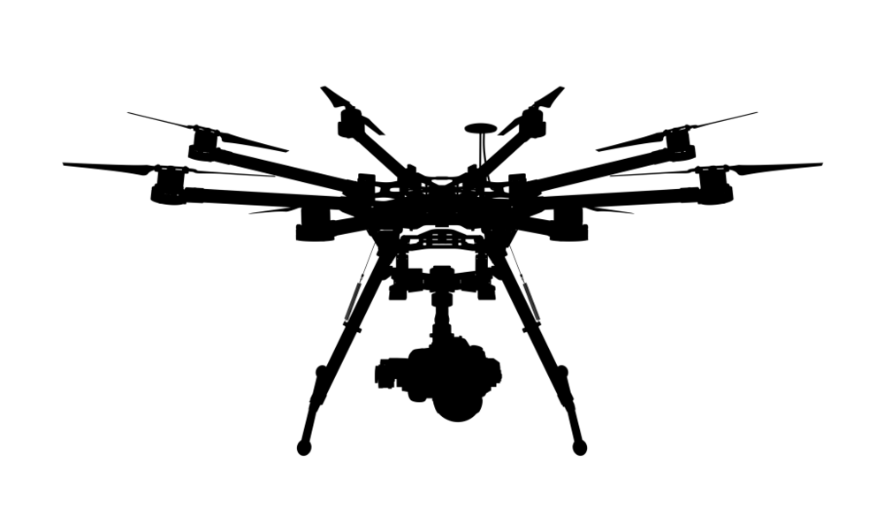

Recap → Flight Control → Processor → Object Detection → WiFi / USNG → Propeller Testing
Flight Control
Communication
On-board Computer
Propeller Testing
Object Detection
Efficiency Comparison

Slide 5


Recap → Flight Control → Processor → Object Detection → WiFi / USNG → Propeller Testing
Built on ROS | High-Level APIs | Wifi Compatible | Serial Communication

Slide 6

Recap → Flight Control → Processor → Object Detection → WiFi / USNG → Propeller Testing
Autonomous Flight | Sensor Package | Auto Takeoff / Landing

Slide 7
On-board Processor
Cody Campbell

Slide 8


Recap → Flight Control → Processor → Object Detection → WiFi / USNG → Propeller Testing
Hardware Comparison
Powerful development board
Low power consumption
Designed specifically for
  Video Processing
  Image Recognition
  Deep Learning
FlytOS - Classified Release
Fast
Light
Low profile
FlytOS - Public Release
Notes:
ODROID allows focus on new processing techniques rather than redeveloping a communication system with user interface.

Slide 9
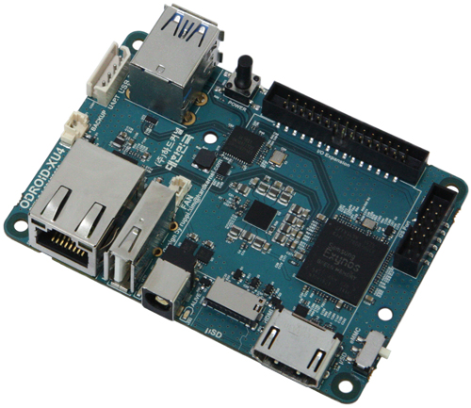
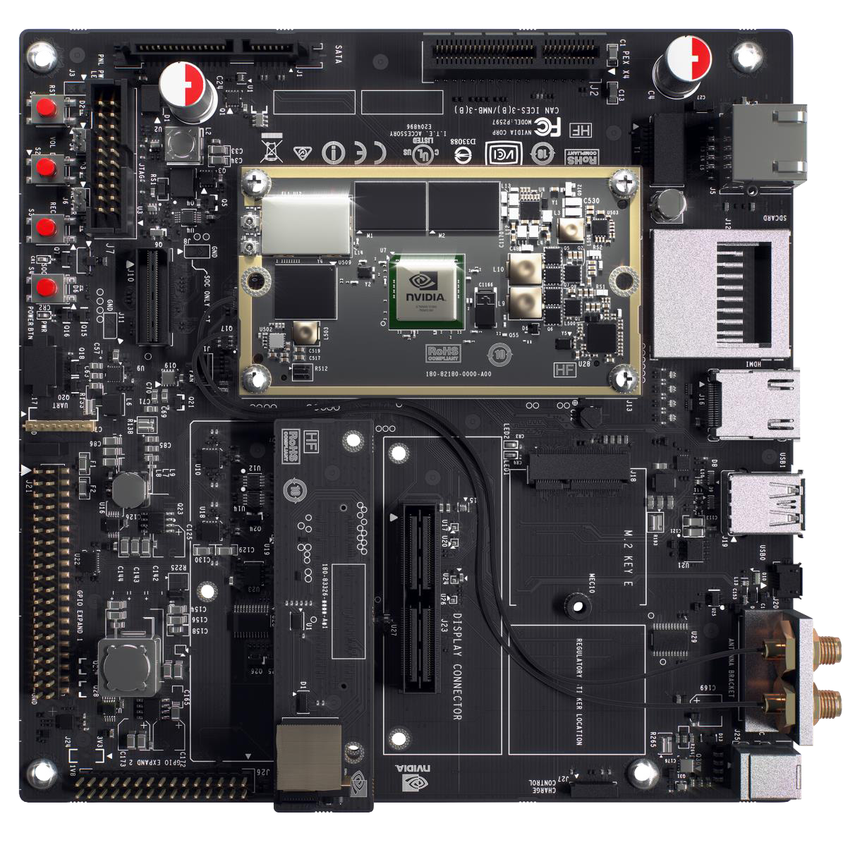
Recap → Flight Control → Processor → Object Detection → WiFi / USNG → Propeller Testing
The Hardware: NVIDIA TX1
Highlights:
Cuda
Machine Learning
Low Power Consumption
Specifications:
64-bit ARM A57 CPUs
4 GB LPDDR4 Memory
WiFi and Bluetooth Compatible
Notes:
~10Watts → max 15 Watts

Slide 10
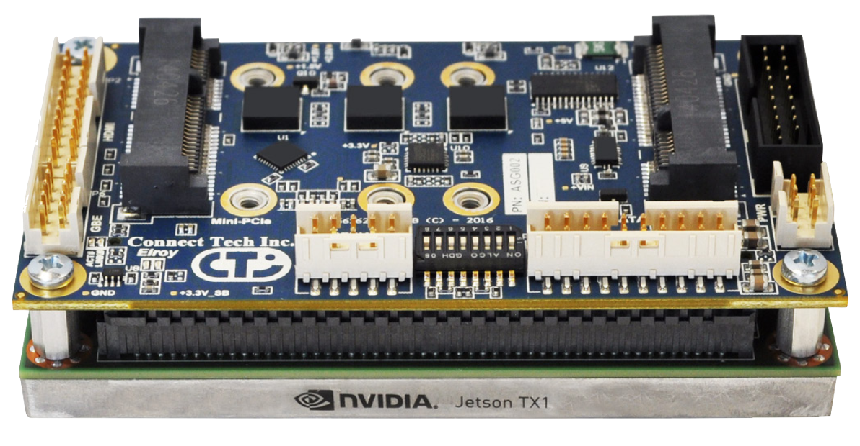
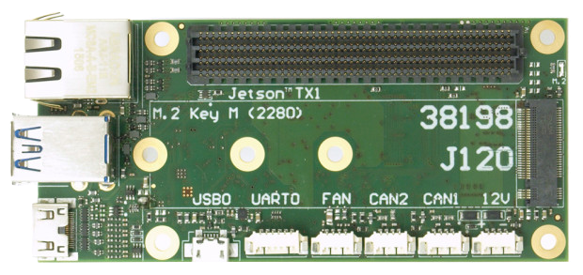
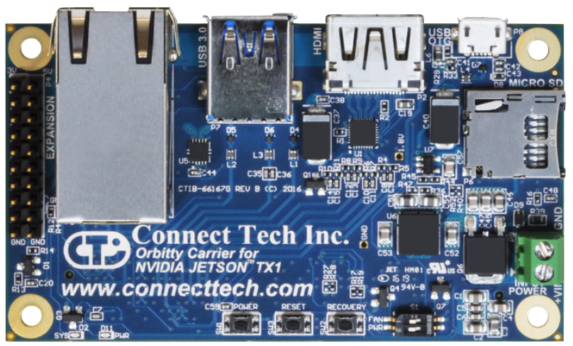
Recap → Flight Control → Processor → Object Detection → WiFi / USNG → Propeller Testing
The Hardware: NVIDIA TX1
Development board alternates

Slide 11
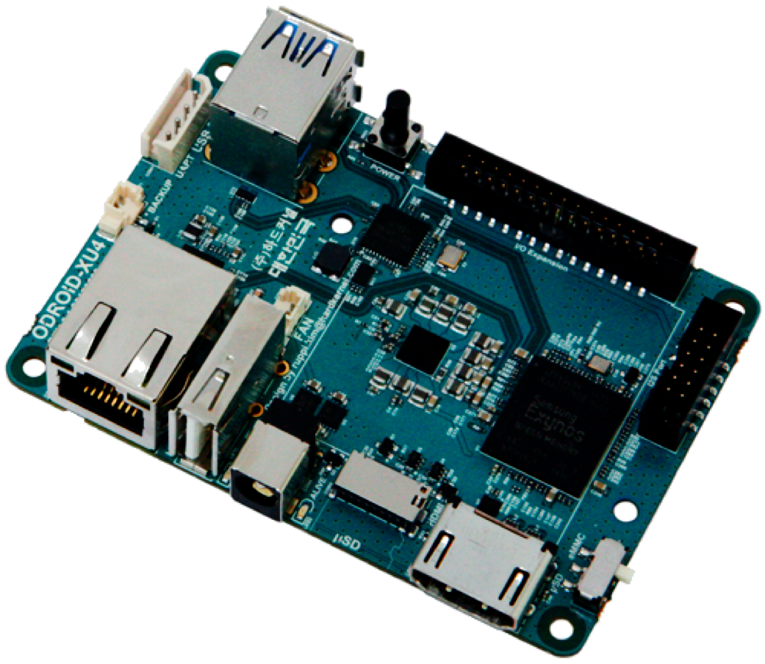
Recap → Flight Control → Processor → Object Detection → WiFi / USNG → Propeller Testing
The Hardware: ODROID XU4
Specifications:
Size : 82 x 58 x 22 mm
2 x USB 3.0 Host, 1 x USB 2.0 Host
2 Gb LPDDR3 RAM PoP stacked
Samsung Exynos5422 Cortex™-A15 2 Ghz and Cortex™-A7 Octa core CPUs

Slide 12
Computer Vision Software
Alexandra Borgesen

Slide 13


Recap → Flight Control → Processor → Object Detection → WiFi / USNG → Propeller Testing
Object Detection
OpenCV
  Commonly used for advanced robotics
  Utilizes Cuda cores
Python
  Slower than C++
  … but also easily extended with C++!
OpenCV-Python
  Color filtering
  Segmentation and Elimination

Slide 14
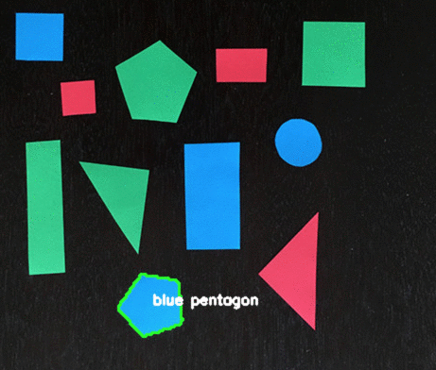
Recap → Flight Control → Processor → Object Detection → WiFi / USNG → Propeller Testing
Color Filtering
Limitations
  Lighting Conditions
  Hues
  Saturation
Color can take on many different appearances in less controlled environments
Also considered thermal sensing and facial recognition.

Slide 15

Recap → Flight Control → Processor → Object Detection → WiFi / USNG → Propeller Testing
Segmentation and Elimination
P = Unique Objects
Q = Environment
P = 1 - Q
The process of dividing an image into multiple segments – sets of pixels
Frequently used to locate objects in satellite images (roads, forests, crops, etc.)
Rather than looking for unique objects, we aim to eliminate the known environment

Slide 16
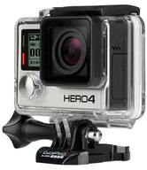
Recap → Flight Control → Processor → Object Detection → WiFi / USNG → Propeller Testing
Camera
Need a reliable HD Camera
At our sponsor’s request: GoPro 3 or GoPro 4
  Compared with Polaroid Cube and Kodak Pixpro
 | GoPro Hero3+ | GoPro Hero4 | Polaroid Cube+ | Kodak Pixpro S360
Weight | 74 g | 88 g | 45 g | 103 g
HD Recording | 1080p (60 fps) | 1080p (120 fps) | 1080p (60 fps) | 1080p (30 fps)
Still Photo Resolutions | 12 MP | 12 MP | 6 MP | 10 MP

Slide 17
Communication and Location
Shawn Cho

Slide 18


Recap → Flight Control → Processor → Object Detection → WiFi / USNG → Propeller Testing
Objective
Streamline flight procedure by…
Utilizing Internet Protocol (IP) based LAN
Convert Lat./Long. to USNG system

Slide 19

Recap → Flight Control → Processor → Object Detection → WiFi / USNG → Propeller Testing
Why IP-Based Network?
Easy adaptation and application with WiFi
Fast data transfer rate
(up to 1.3 Gbps @ 5 Ghz)
FlytOS supports WiFi

Slide 20
Recap → Flight Control → Processor → Object Detection → WiFi / USNG → Propeller Testing
Implementation Options
Laptop as the Host
Use Ad Hoc mode
Create WLAN
B. Drone as the Host
Enable Host mode on FlytOS

Slide 21
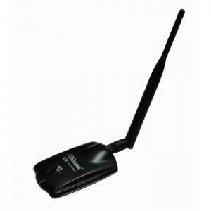
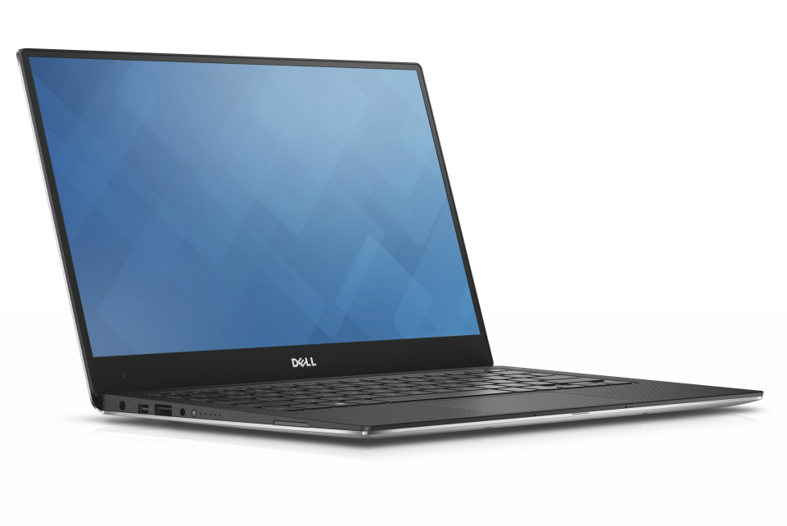
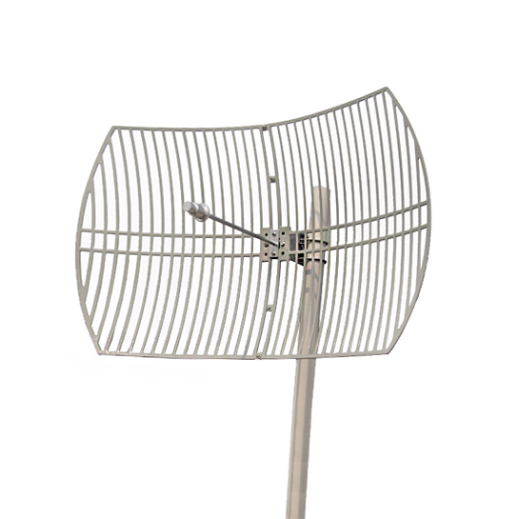
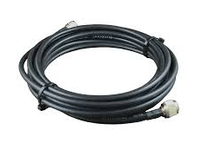
Recap → Flight Control → Processor → Object Detection → WiFi / USNG → Propeller Testing
Option A
Required equipment,
Laptop
USB WiFi Adapter
Directional Patch Antenna

Slide 22
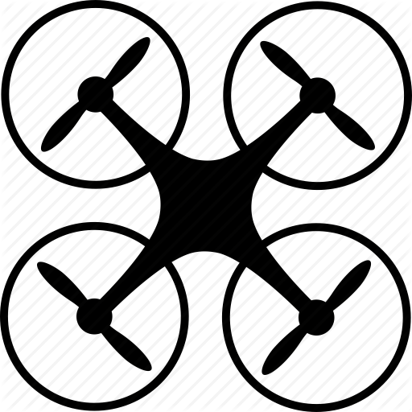



Recap → Flight Control → Processor → Object Detection → WiFi / USNG → Propeller Testing
Implementation

Slide 23
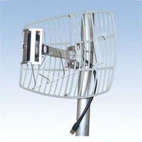
Recap → Flight Control → Processor → Object Detection → WiFi / USNG → Propeller Testing
21 dBi Directional Parabolic Grid Antenna
Range ≤ 5 Miles
+ 21 dBi of Gain
13 degree wide signal cone
N-Female connector fits common cable assemblies

Slide 24
Recap → Flight Control → Processor → Object Detection → WiFi / USNG → Propeller Testing
USNG System vs Lat/Lon System
United States National Grid (USNG)
Developed by Federal Geographic Data Committee (FGDC)
Resembles Military Grid Reference System (MGRS)
"Read right and then up"; East and North in linear increments
Coordinates are easily translated to distance
Latitude/Longitude System
Uses degrees, minutes, and seconds
Determining physical distance between two coordinates take time
Complex behavior near the poles
Discontinuity at the meridian ± 180° longitude

Slide 25
Propeller Testing
Peter Burchell

Slide 26
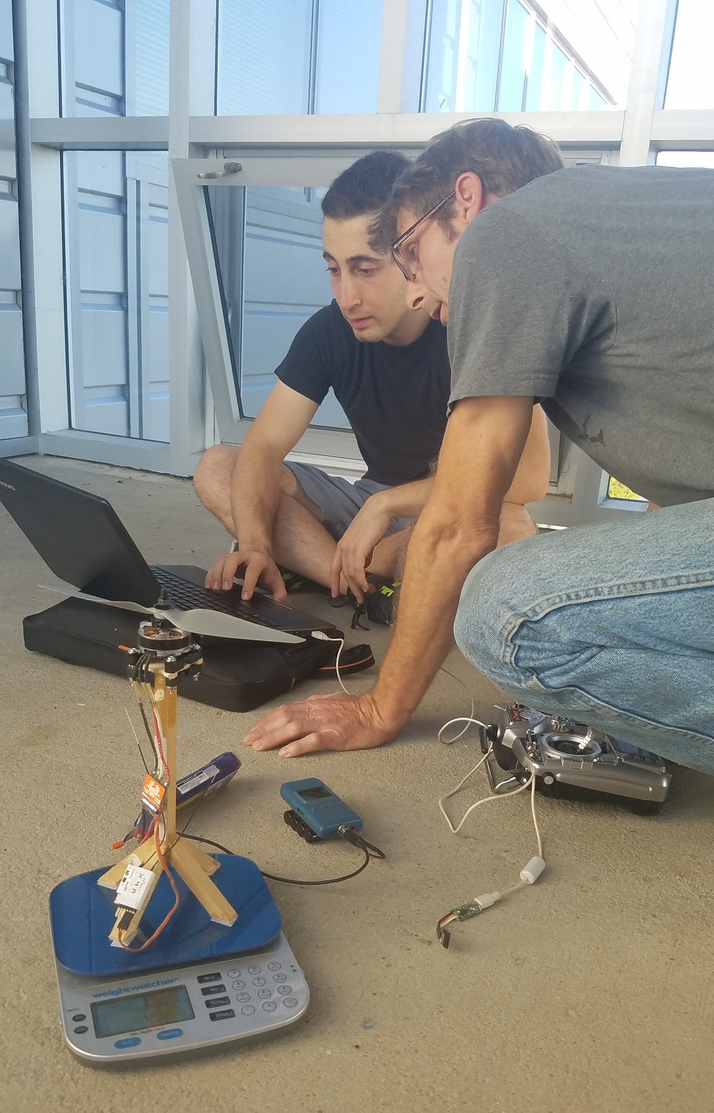
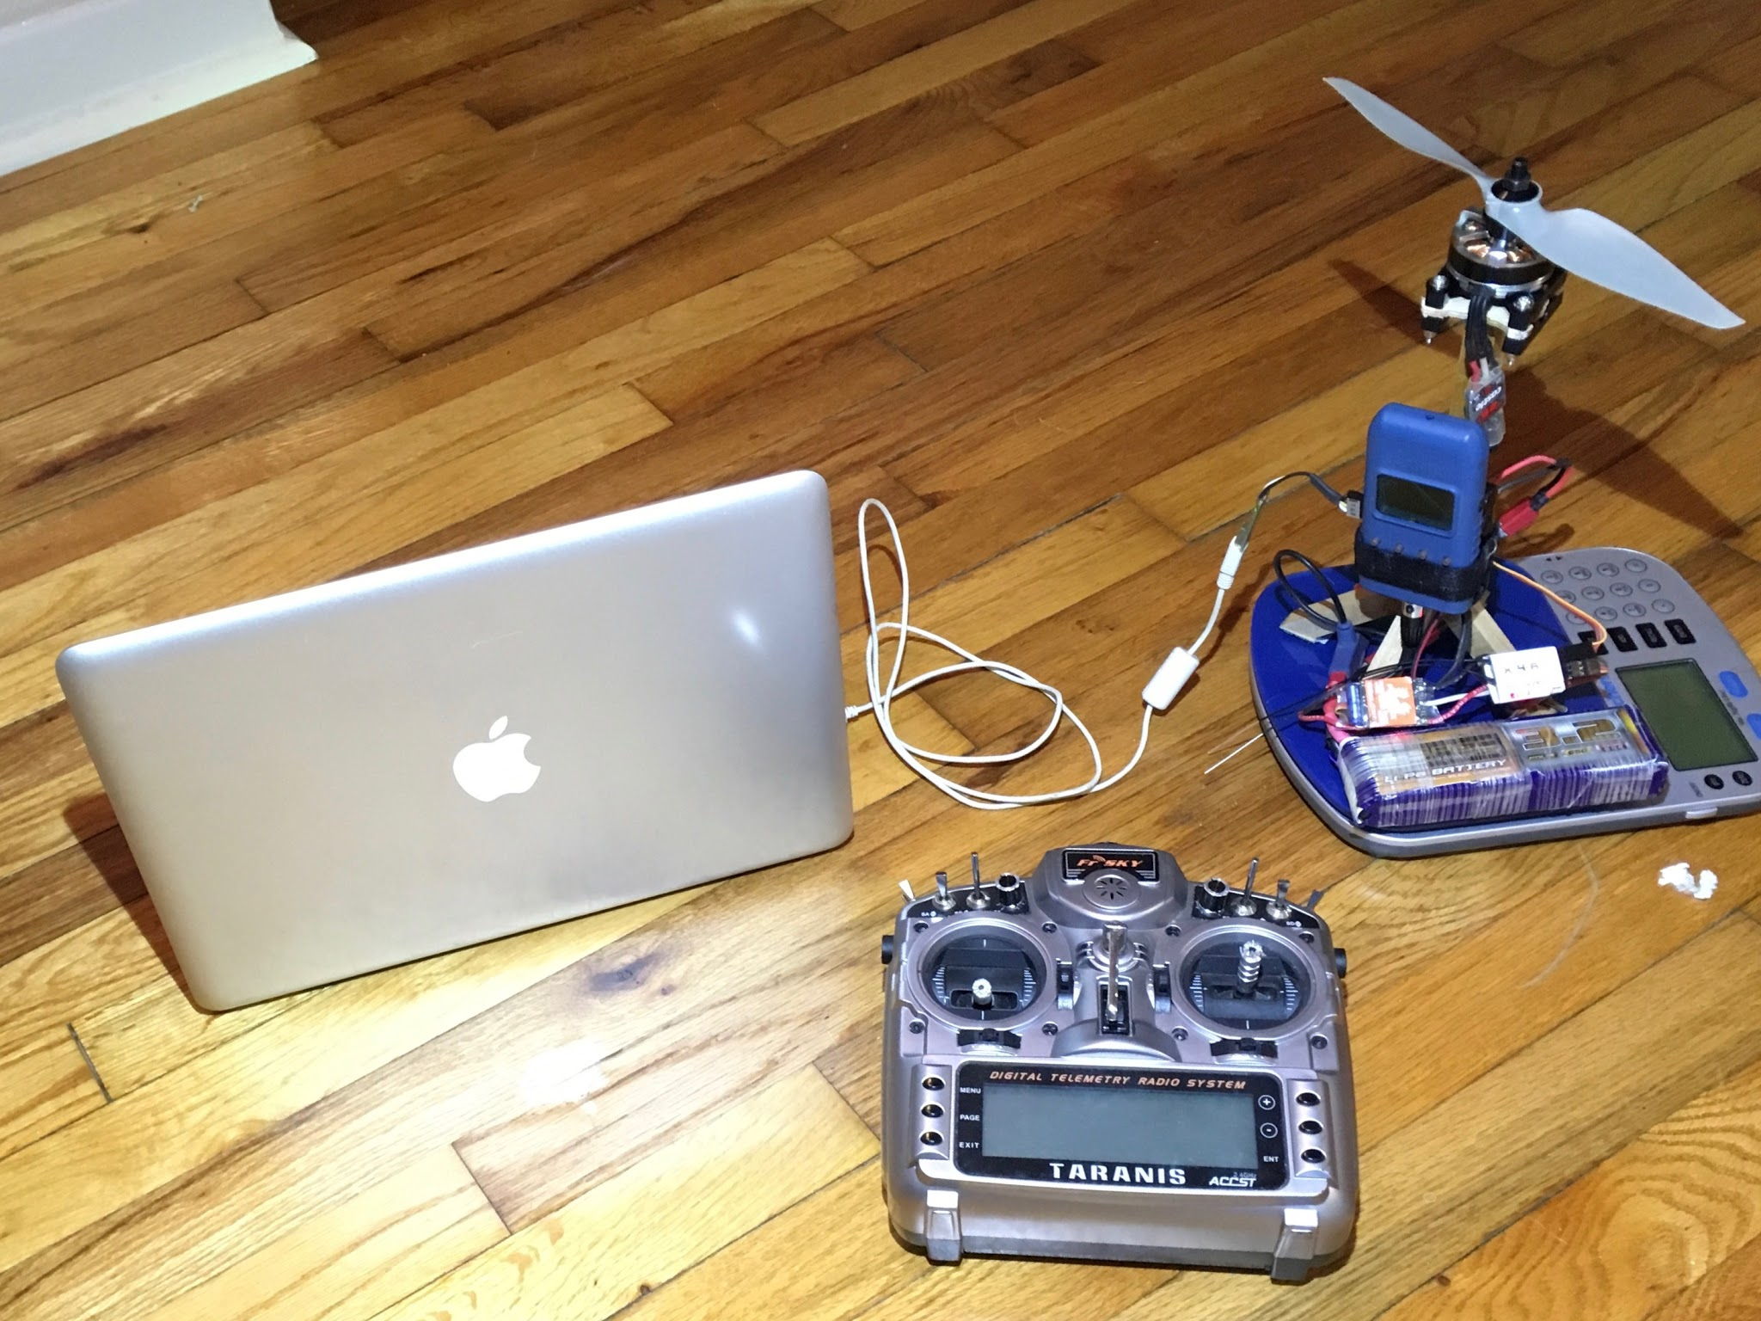
Recap → Flight Control → Processor → Object Detection → WiFi / USNG → Propeller Testing
What was Tested
Voltage
Amperage
RPM
Thrust

Slide 27
Recap → Flight Control →Processor → Object Detection → WiFi / USNG → Propeller Testing
Propeller Testing Arrangement
ESC
Motor and Propeller
Manual
Data
Record
RC Receiver
BEC
Optical RPM Sensor
Scale
Automated Data Record
Voltage and Current
Sensor
RC Transmitter
Control
Power
Main Battery
Signal
Data

Slide 28
Results and Conclusions
Sarah Hood

Slide 29
Recap → Flight Control → Processor → Object Detection → WiFi / USNG → Propeller Testing
Peak Thrust Assessment
Battery Tested | 4 Rotor | Y6 - 6 Rotors
3 Cell | 2776 g | 4164 g
4 Cell | 4148 g | 6222 g
Needed Peak Thrust* | 3746 g | 4218 g
*Based on the predicted weight of the aircraft and on board technology, not including the weight of the battery.

Slide 30
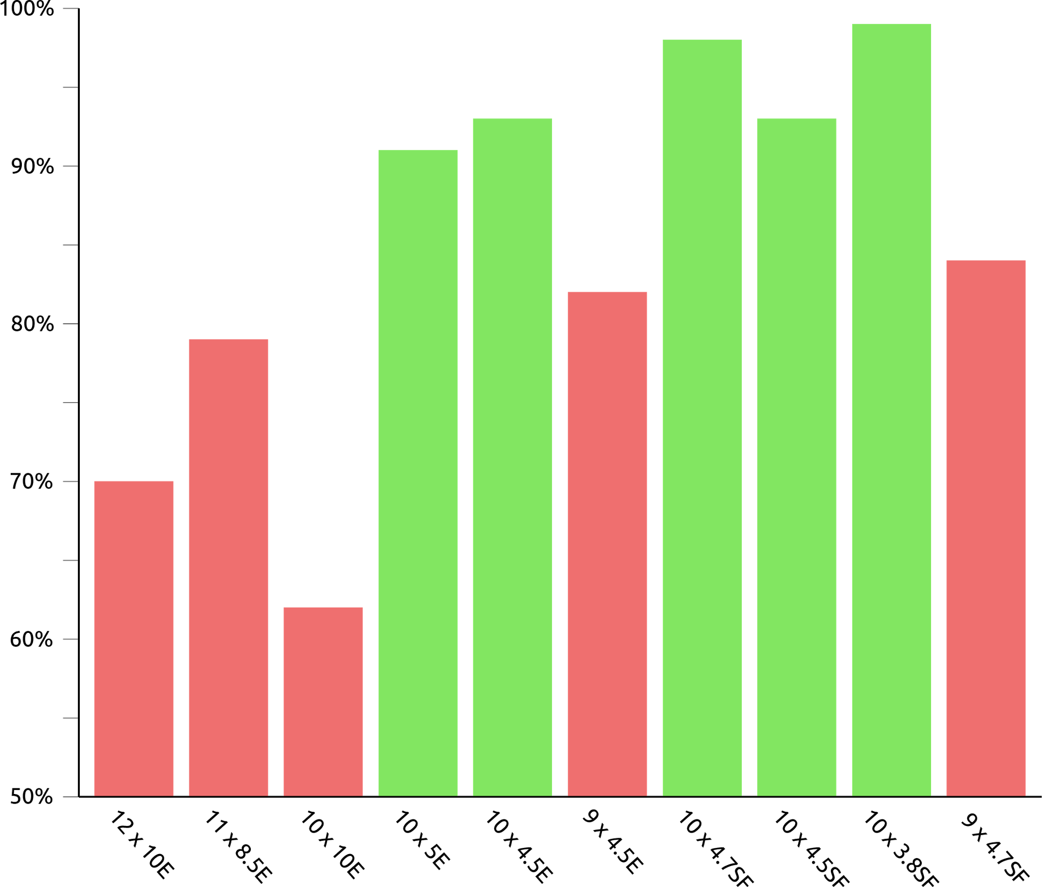
Recap → Flight Control →Processor → Object Detection → WiFi / USNG → Propeller Testing
Normalized 4 cell Thrust and
Efficiency
Best Propellers
10 x 3.8SF
10 x 4.7SF
10 x 4.5SF
10 x 4.5E
10 x 5E
Notes:
{[(mid-eff prop)/(mid-eff max)+(peak-thrust prop)/(peak-thrust max)]/2}*100%
Combines peak thrust and mid-eff in one value

Slide 31
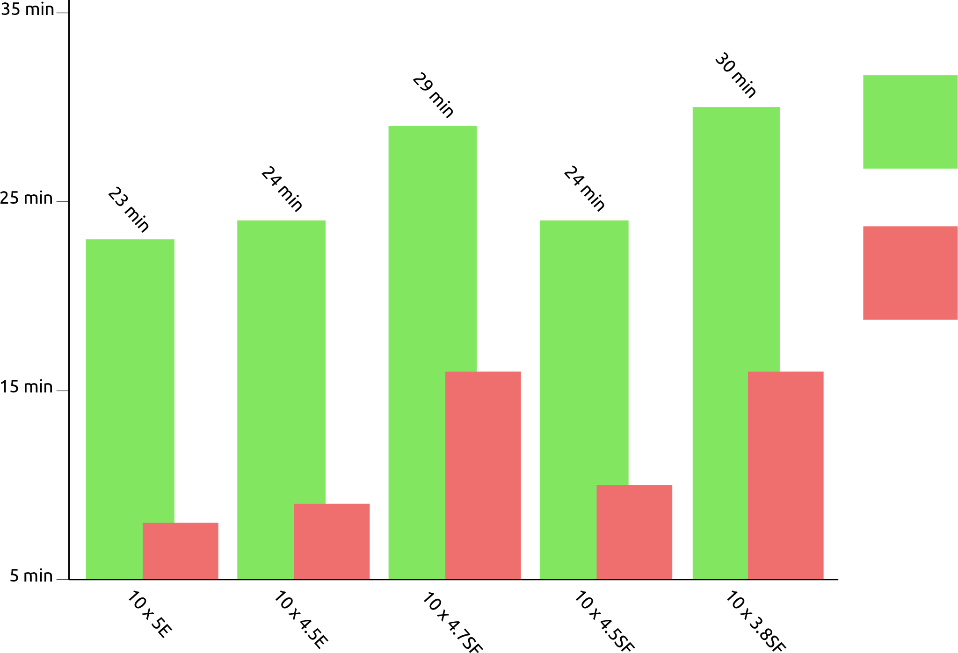
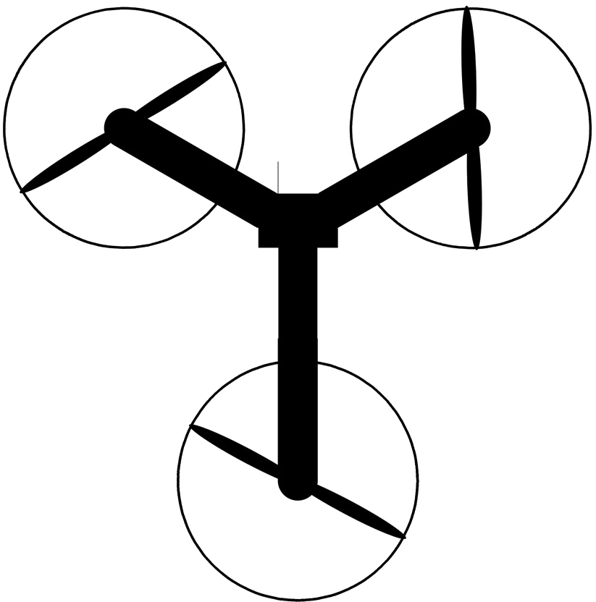
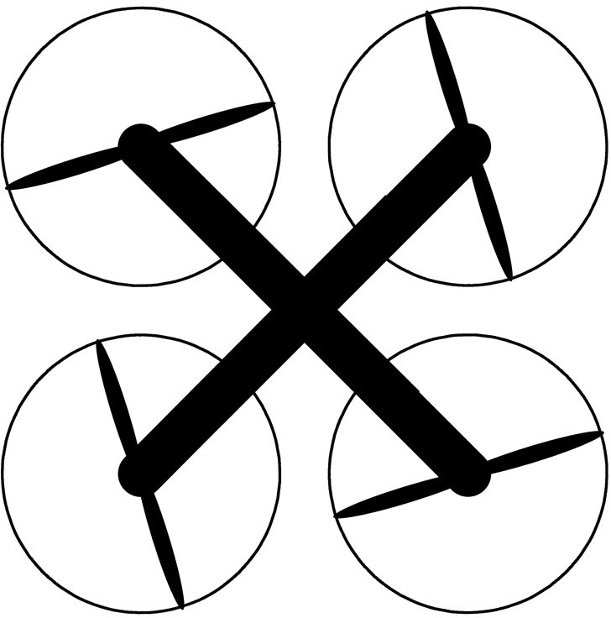
Recap → Flight Control →Processor → Object Detection → WiFi / USNG → Propeller Testing
Estimated Flight
Duration
Best Propellers
10 x 3.8SF
10 x 4.7SF
10 x 4.5SF
10 x 4.5E
10 x 5E
Y6
X4
Notes:
Confirms prop ranking from previous slide
g/watt from midrange average eff
Vehicle weight form (peak thrust)/2
Air frame est at 1.5kg
Battery weight from (vehicle weight) - 1.5kg
Energy density of battery from lipo 0.148 watt*hours/gram
Flight duration ={ [(Battery weight)*(energy density)]/[(vehicle weight)/(mid-range eff)]}*60 min

Slide 32
Summary
Halil Yonter

Slide 34
Acknowledgements to
Mr. Merrick
Dr. Hooker
Dr. Roberts
Dr. Foo
Dr. Harvey
Thank You
Questions?
Questions?

Slide 35
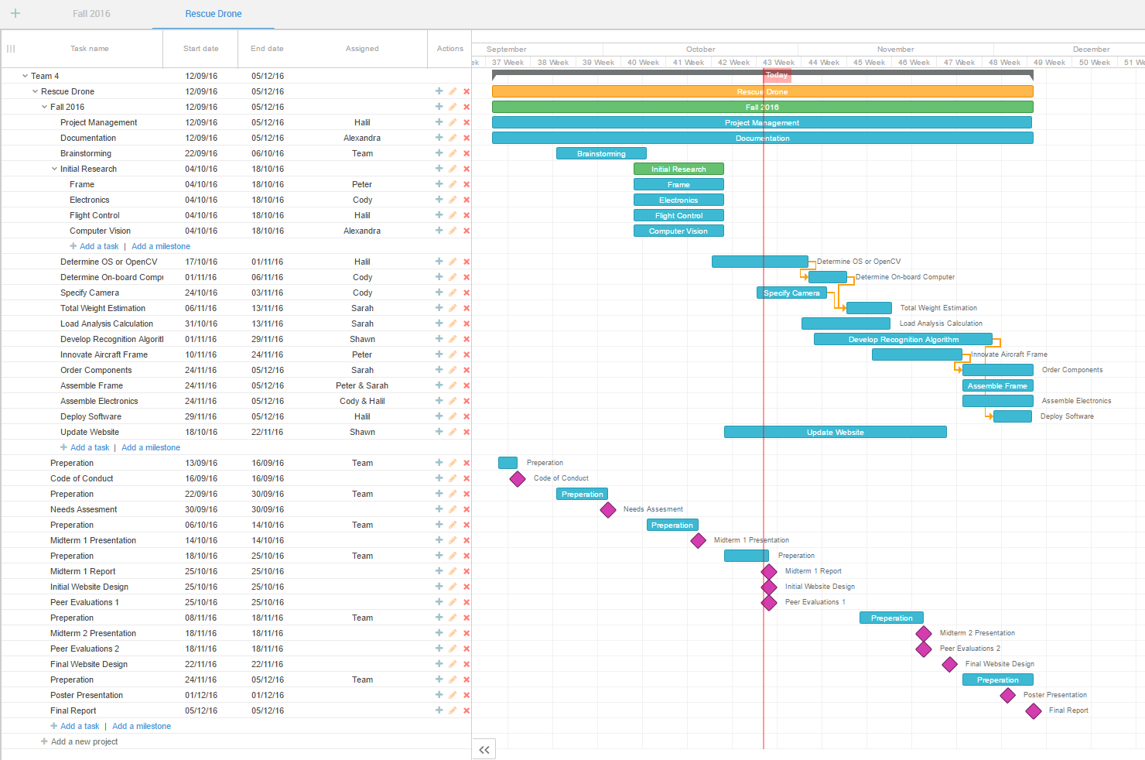

Slide 37
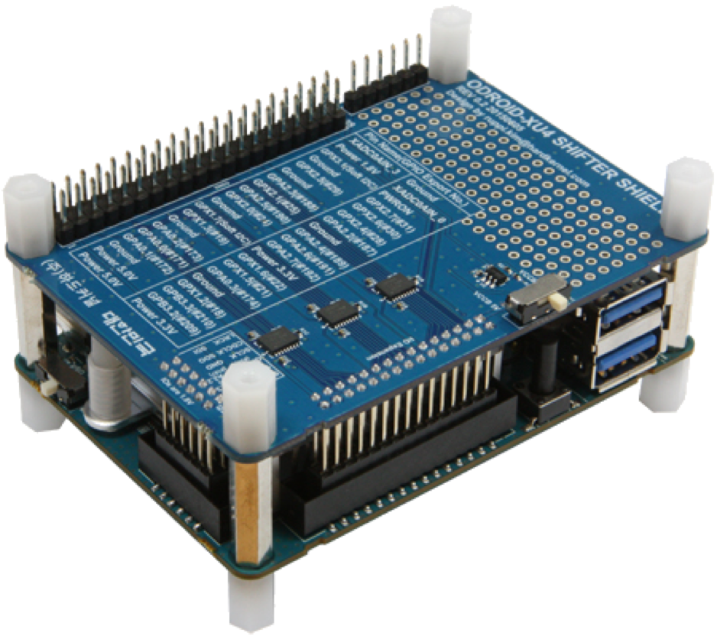
Recap → Flight Control → Processor → Object Detection → Wifi / USNG → Propeller Testing
The Hardware: ODROID XU4
Compatibility
Pixhawk → 5V logic
ODROID → 1.8V logic
Notes:
The two boards are not compatible out

Slide 38
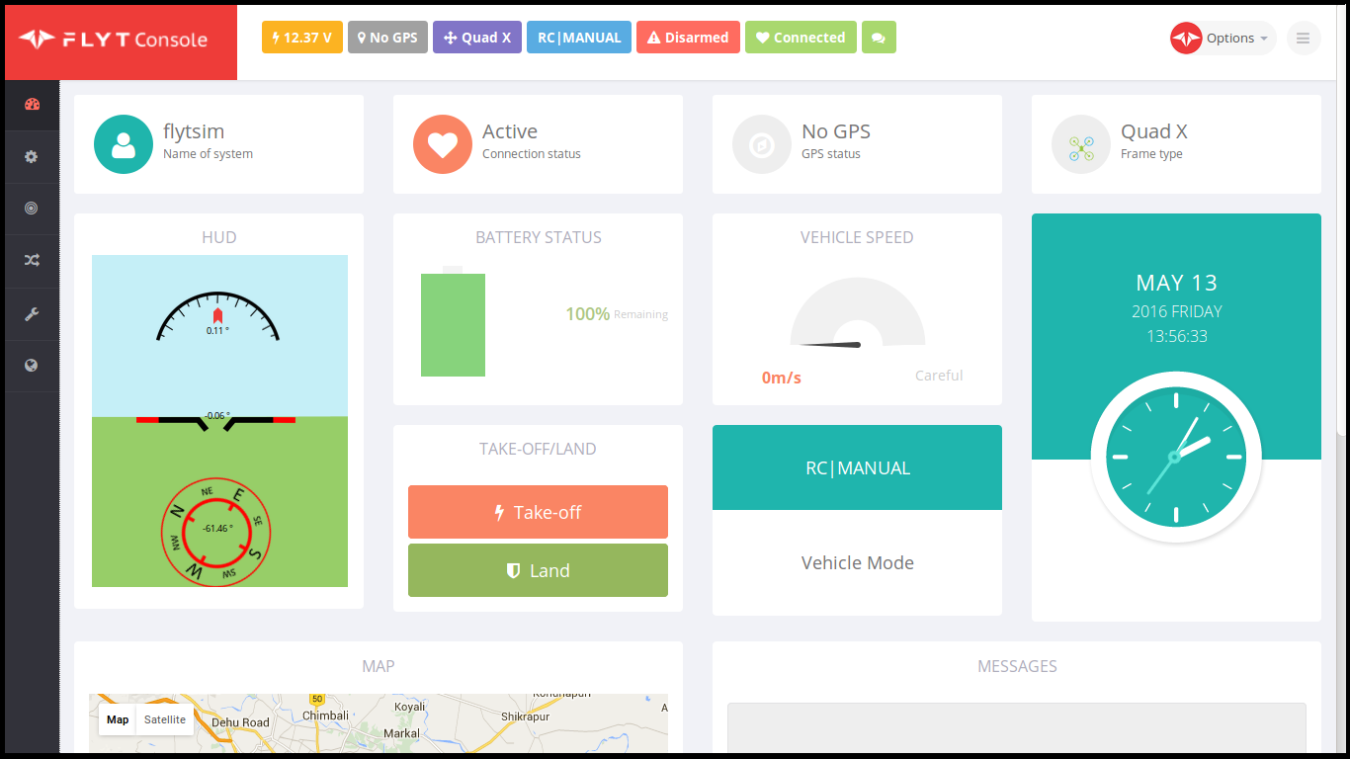
Recap → Flight Control → Processor → Object Detection → WiFi / USNG → Propeller Testing
USNG System Implementation
USNG
Implement Conversion Algorithm
Display USNG through GUI in FlytOS

Slide 39
Recap → Flight Control → Processor → Object Detection → WiFi / USNG → Propeller Testing
IEEE 802.11 AC @ 2.4 GHz
2.4 GHz
  has lower frequency and greater range
  is more stable
5 GHz
  is power hungry
  subject to transmission interruption

Slide 40
Recap → Flight Control → Processor → Object Detection → WiFi / USNG → Propeller Testing
Equipment Selection
USB WiFi Adapter
802.11 Standard | Max Speed of One Channel (Mbps) | Bandwidth of Channel (MHz) | Max Number of Channels | Operating Frequency (GHz)
a | 54 | 20 | 1 | 3.7/5
b | 11 | 22 | 1 | 2.4
g | 54 | 20 | 1 | 2.4
n | 150 | 20/40 | 4 | 2.4/5
ac | 866 | 20/40/80/160 | 8 | 2.4/5

Slide 41
Item | weight (g) | qty x4 | sub weight (g) x4 | qty Y6 | sub weight (g) Y6
Pixhawk | 38 | 1 | 38 | 1 | 38 | weighed
Pixhawk accessories | 60 | 1 | 60 | 1 | 60 | weighed
Pixhawk Telemetry Tx/Rx | 17 | 1 | 17 | 1 | 17 | weighed
Motor/Prop/ESC each | 118 | 4 | 472 | 6 | 708 | weighed
Controller Reciever | 22 | 1 | 22 | 1 | 22 | weighed
Gimbal | 214 | 1 | 214 | 1 | 214 | weighed
camera | 150 | 1 | 150 | 1 | 150 | est on mfgr spec
Nvidia TX1 | 120 | 1 | 120 | 1 | 120 | mfgr spec
total weight |  |  | 1093 |  | 1329
Goal Weight (dry)(g) |  |  | 1593 |  | 1829
companion power 20 watts

