Slide 1
Rescue Drone
Senior Design - ECE Team #4
Notes:
why and how we are doing what we are doing.
give audience enough time to digest on what we are doing.
Jumping past the problem
Not expecting us to have everything planned out already.
Prove what we are doing is the right thing to do for the process.
don’t have to have a decision.
just talk about how we plan to evaluate these.
will be interested in the decision making process. want to see that we are making them out of logic/sense not feeling.
decision matrix for report not presentation.

Slide 2



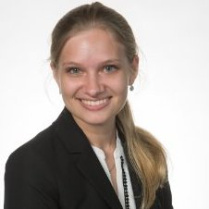

Meet The Team: ECE Department
Alexandra Borgesen
Computer Engineering
UAV hardware, sensors, motors, aerial imagery and control systems
Cody Campbell
Hardware Engineering
Microelectronics, radio communication, and embedded systems
Shawn Cho
Software Engineering
Web development, flight navigation and user tracking software
Halil Yonter
Team Leader
Validation, sensor data, and interdisciplinary cross-implementation
Notes:
Hello: Name: Engineer

Slide 3
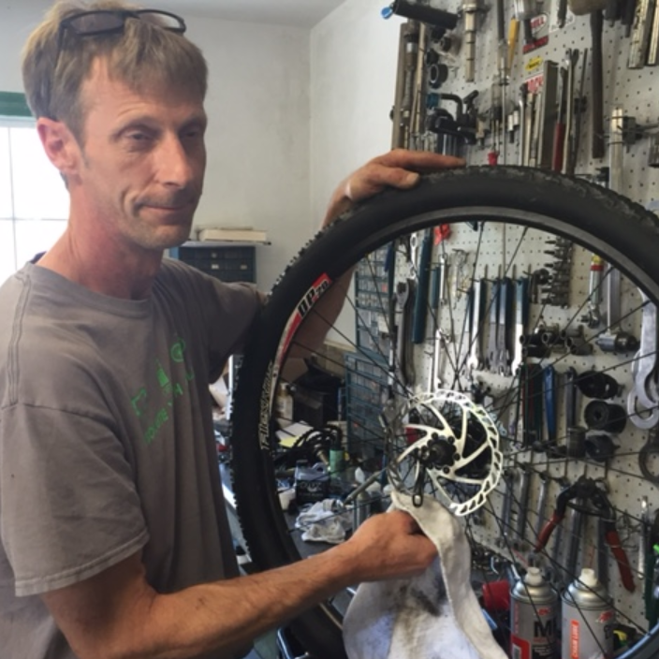
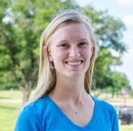
Meet The Team: ME Department
Peter Burchell
Airframe and Mechanics Engineer
Electromechanic integration
and product testing
Sarah Hood
Dynamic Systems Engineer
Communications, finance, dynamic systems, and project management
Notes:
Hello: Name: Engineer

Slide 4
Agenda
Introduction
Background
Needs Assessment
Research
Notes:
we will disuss the introduction which give give information about the evolution of drones and their widspan of applications.
Background into what our research is specifically
Share what the needs are for this project as well as some listed goals.
Then share what our challenges are and the

Slide 5
Progression of the Unmanned Aerial Vehicle
Introduction
Notes:
What are drones… overarching concept

Slide 6
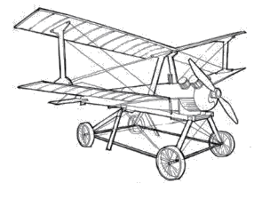
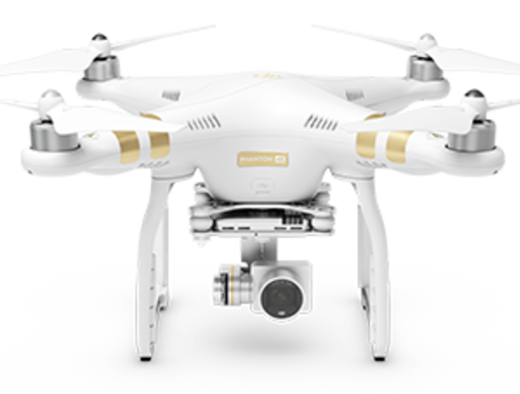

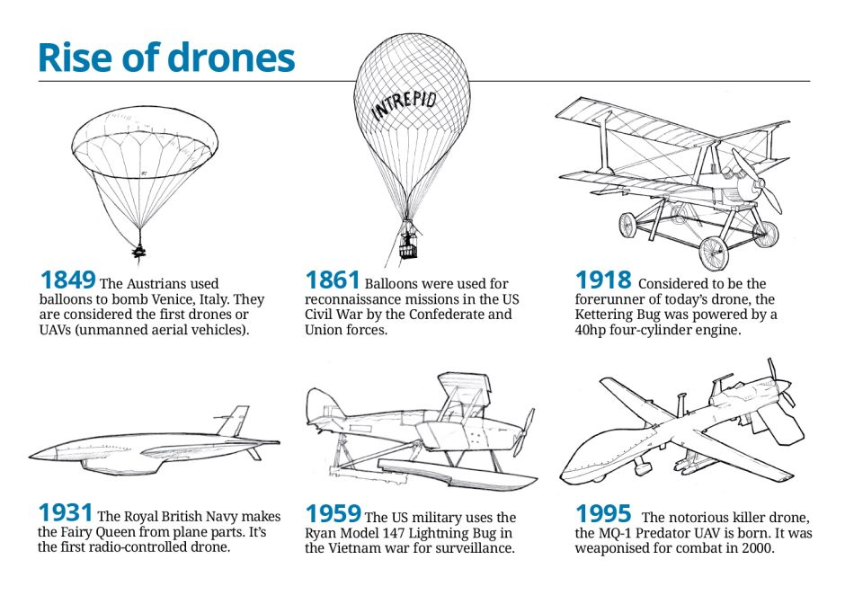
Fairy Queen
The Royal British Navy makes its first radio-controlled drone from plane parts.
MQ-1 Predator
The notorious killer drone is born. It was weaponized for combat in 2000.
1918
1959
2016
The Kettering Bug
The forerunner of today’s drone, the Kettering Bug was powered by a 40 hp four-cylinder engine.
Lightning Bug
The US military uses the Ryan Model 147 Lightning Bug in the Vietnam War for surveillance.
DJI Phantom
Reaching beyond professional use, drones are now available in most department stores.
1931
1995
Notes:
What are drones… overarching concept

Slide 7
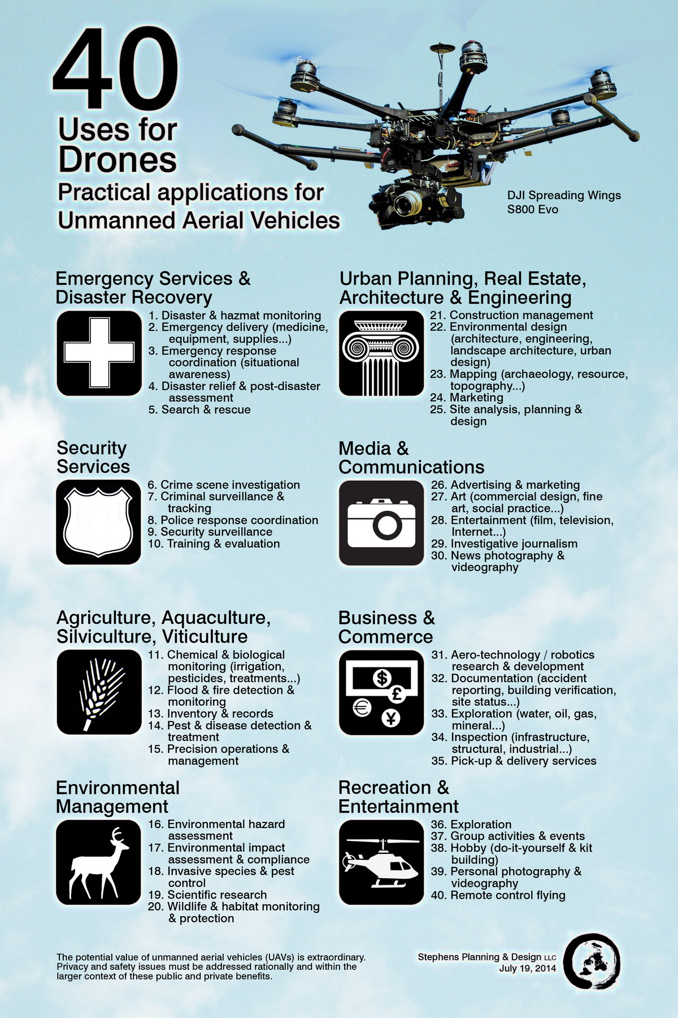
Application of Drones
 | Topographic mapping | Wildlife and habitat monitoring
 | Pick-up and delivery | Advertising and broadcasting
 | Inspection and exploration | Emergency search and rescue
Notes:
Emergency Search and Rescue

Slide 8
Background
Notes:
what are we wanting to do to with drones. background on our project

Slide 9
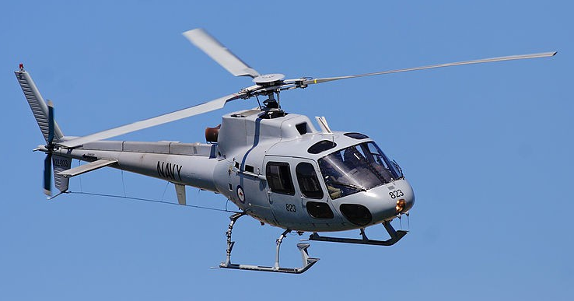
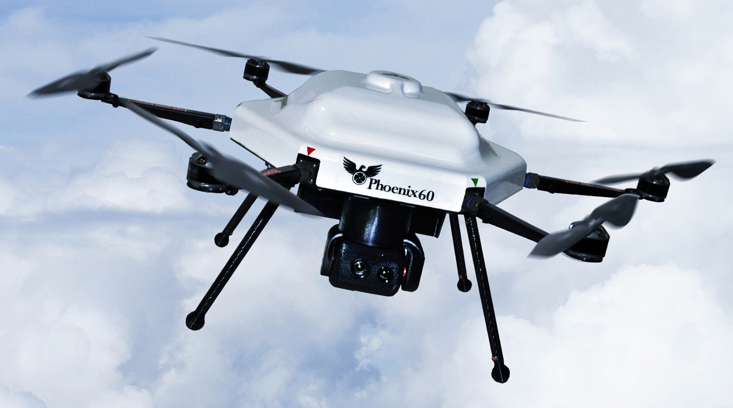
Rescue Aircraft
Manned Helicopters
Unmanned Aircraft Vehicle (UAV)
Large in Size
Limited Maneuverability
Loud Noise Footprint
Require Large Landing Pad
Expensive
Smaller Size
High Maneuverability
Lower Noise Footprint
Low Cost
Notes:
UAVs provide a safer and faster way to incorporate aerial assistance in
SAR operations for a fraction of the cost and resources

Slide 10

Project Rescue Drone
Florida State University’s
Emergency Management and Homeland Security Program
Objective
Develop a UAV for SAR missions
Longer Flight Time
Reliable Image Recognition
IP Communication
Notes:
what merrick does

Slide 11
Needs Assessment
Notes:
what are we wanting to do to with drones. background on our project

Slide 12
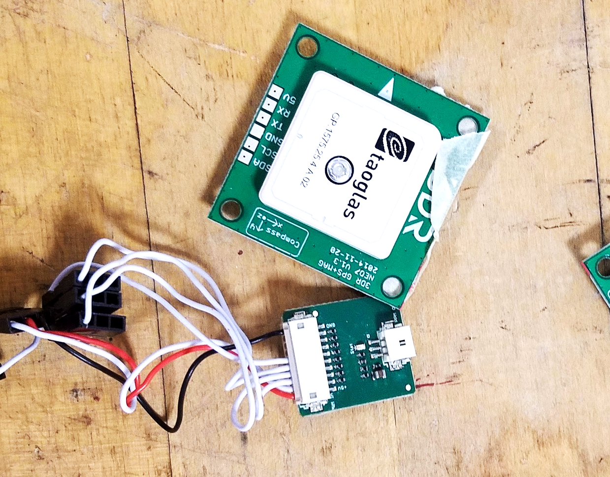
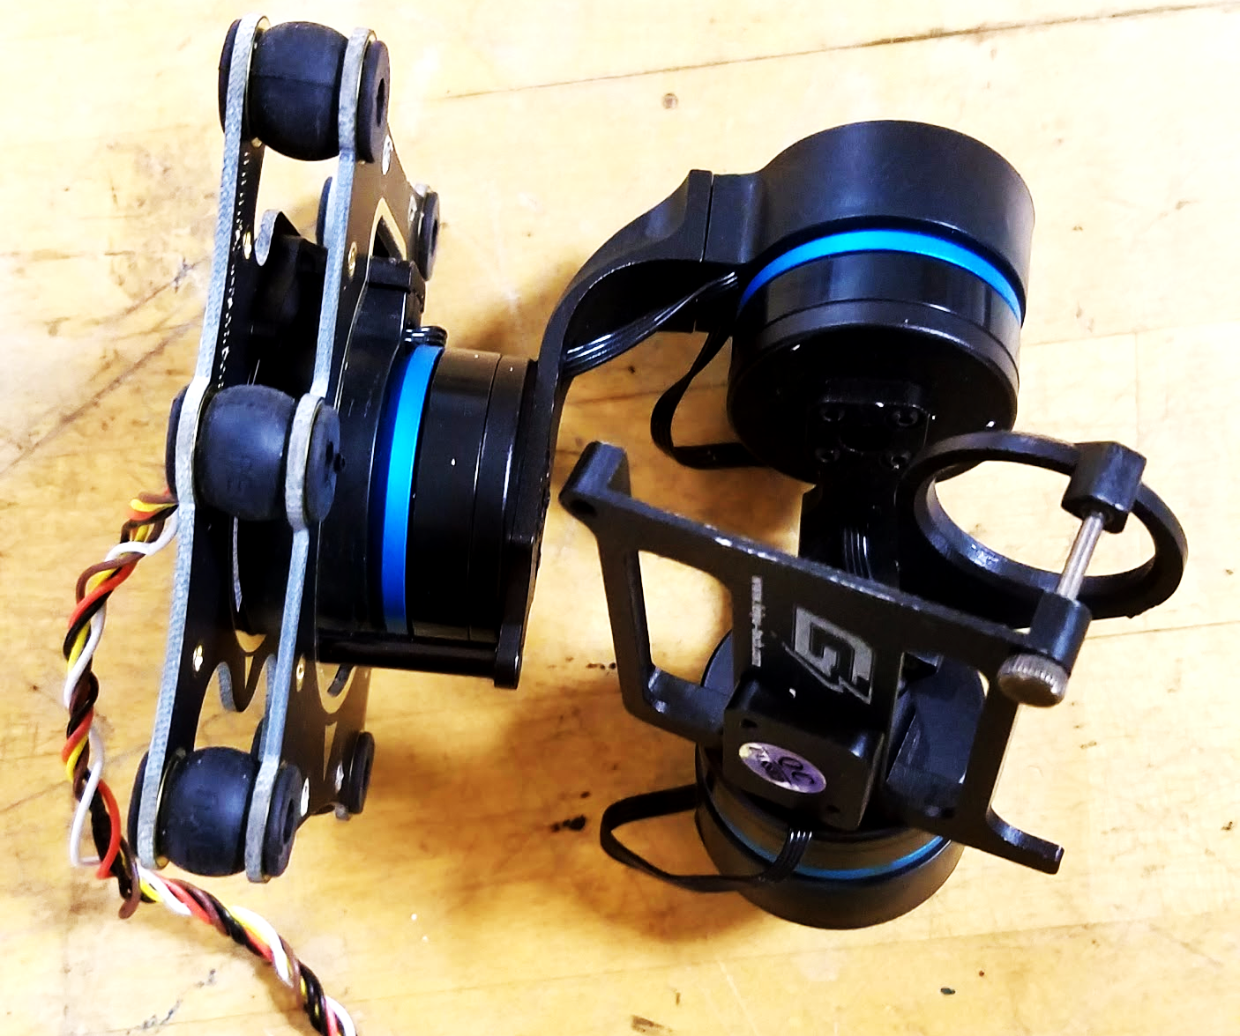
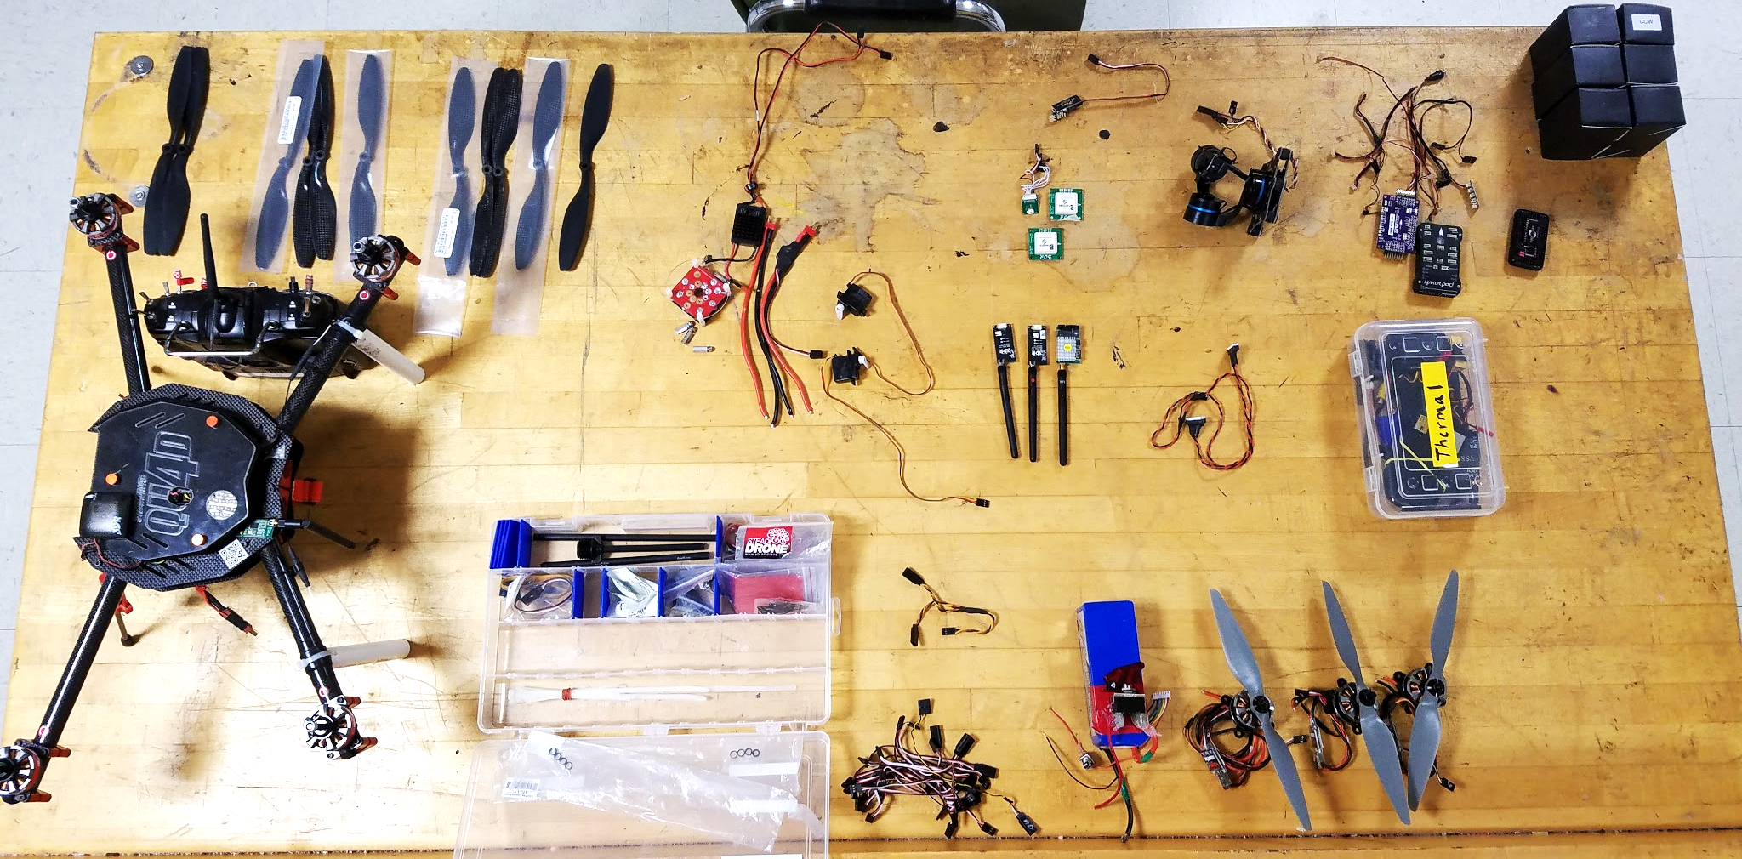
Needs and Requirements
Multirotor aircraft
Maximum size: 24” x 20” x 14”
18 minute flight time
Photometrics and sensors
Three axis gimbal
Radio communication
USNG coordinates
User manual
Reproducible design
Notes:
Multirotor aircraft capable of autonomous flight
Size, want it to fit in suitcase
Sensors for object detection
Radio communication with ground station
Location data transferred using USNG coordinates
User manual

Slide 13
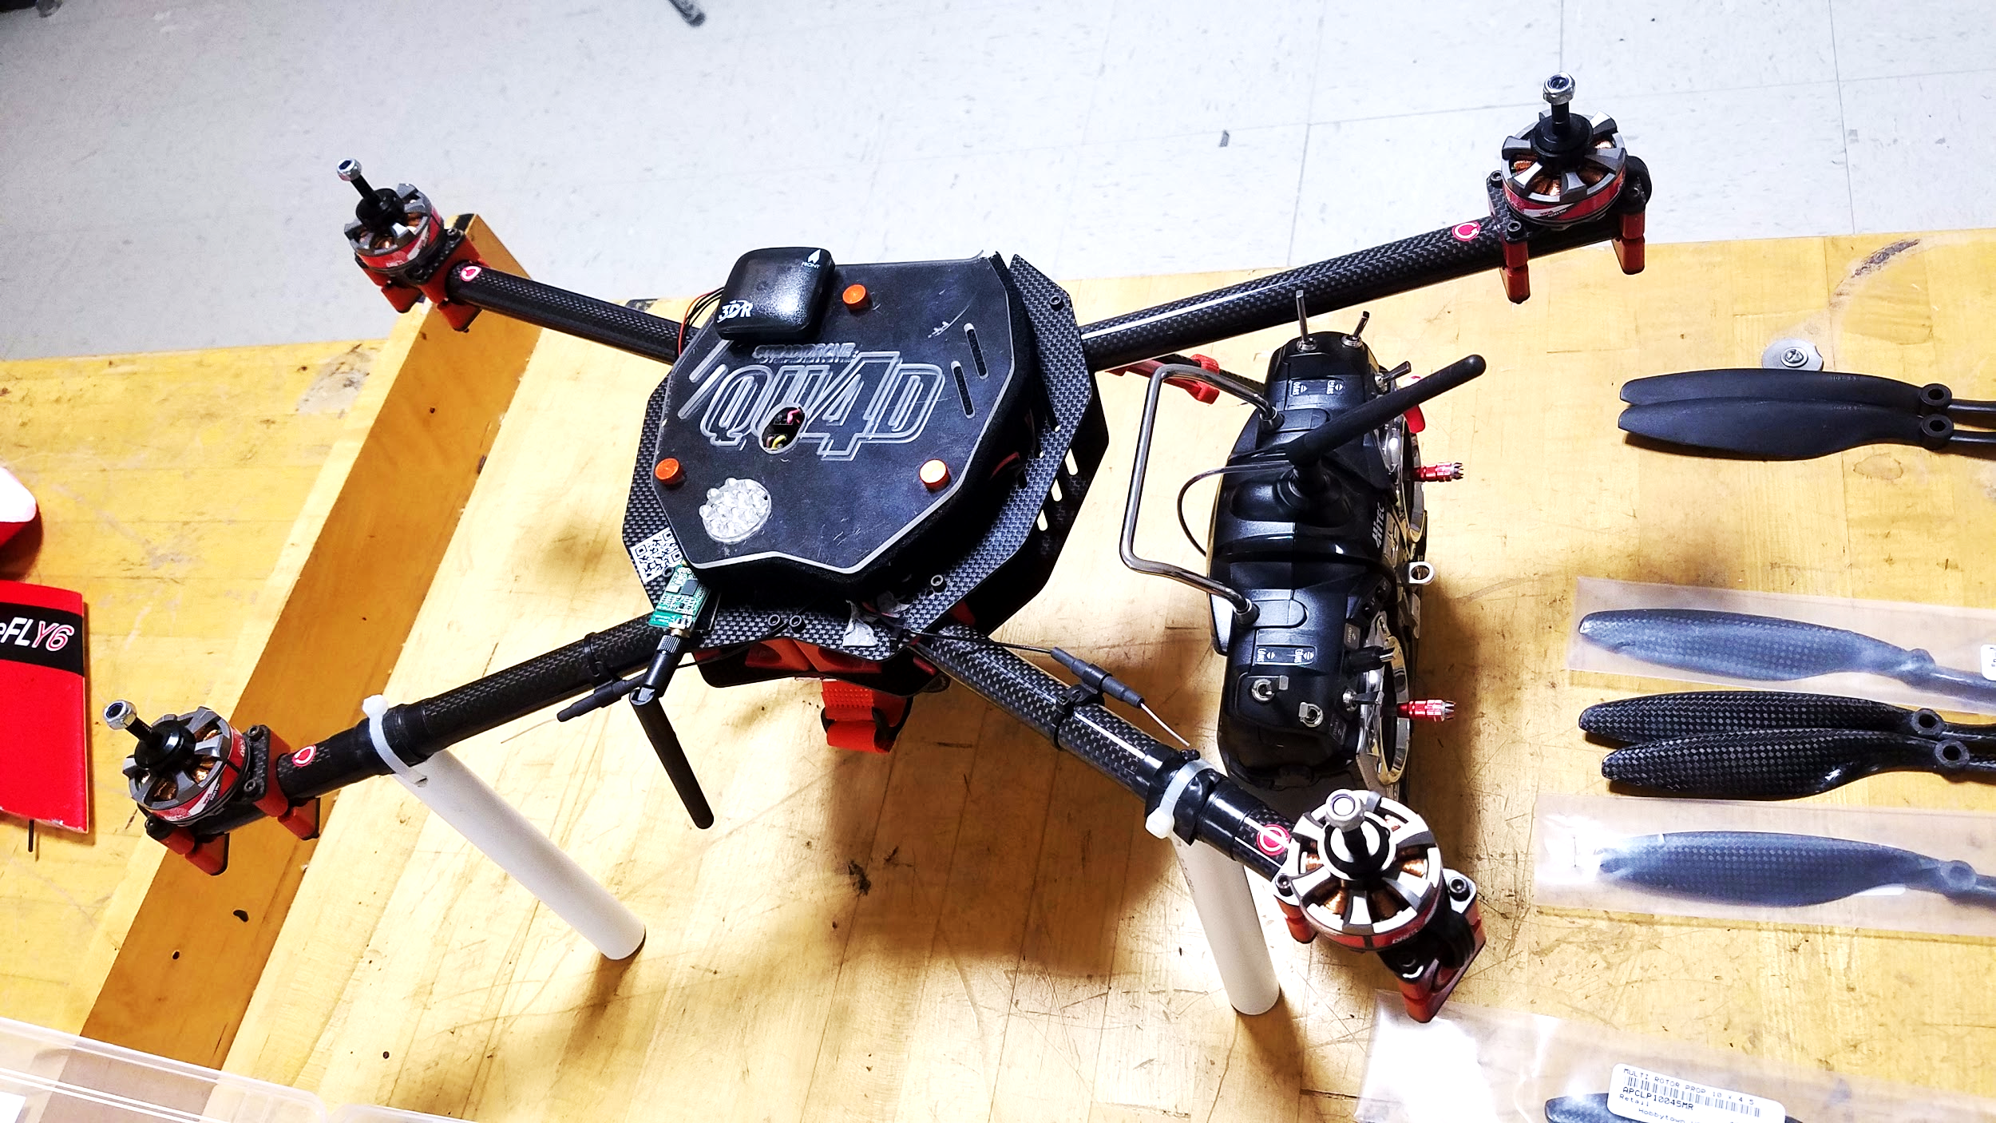
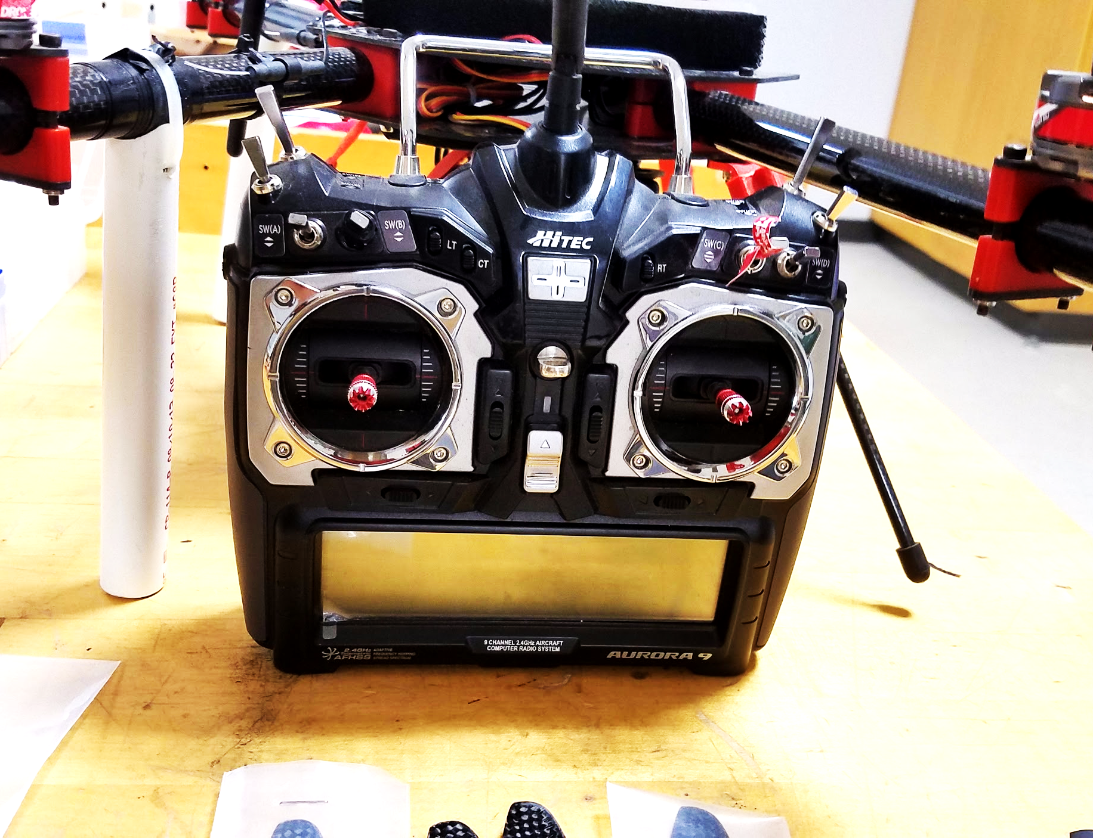
Additional Features
Flight time closer to 30 minutes
Fits in a backpack
IP network used for data communication
Autonomous collection of stand-out data
Location logging of stand-out-data

Slide 14
Research
Notes:
what are we wanting to do to with drones. background on our project

Slide 15
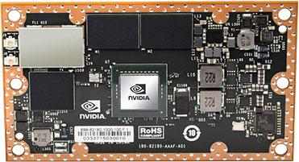
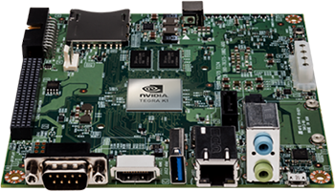
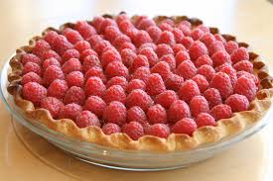
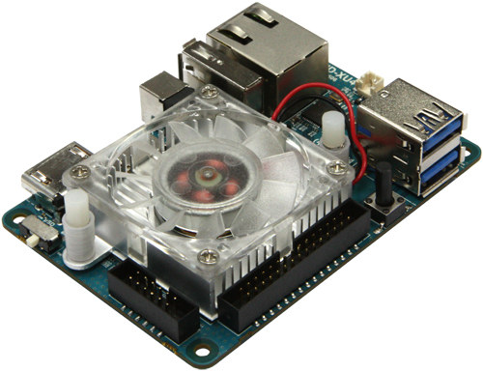
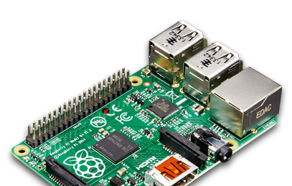
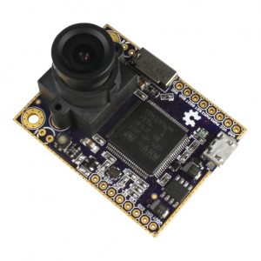
Research - Hardware Options
NVIDIA TX1
NVIDIA TK1
Raspberry Pi
Odroid XU4
OpenMV
Notes:
the pie should be fine.

Slide 16





Research - Software Options
FLYTOS
OpenCV
MAVlink
robotOS
Cuda
Notes:
FLYTOS
new operating system specifically for drone.
includes ip communication protocol built in .
has video identification.
works in since with pixhawk, the flight controller
OpenCV
open computer vision.
ton of resource online.
has a big resource base.
MAVlink -
communication protocol for pixhawk,
works with the apm flight controllers.
if decide not to use operating system, this will allow communication with flight controller
robotOS
operating system specifically for mobile robotics
Cuda
programming software specifically for nvidia cards.

Slide 17
The Process
Account for Available Inventory
Functional Prototype
Statewide Hurricane Exercise
Determine Equipment
Redesign
Modify
Finalize
Implement software
Optimize
Ground Testing
Plan
September
Organize
October
Build/Test
November/December
Complete Prototype
Spring

Slide 18
Acknowledgements to
Mr. Merrick
Dr. Hooker
Dr. Roberts
Dr. Foo
Dr. Harvey
Thank You
Questions?

