Slide 1




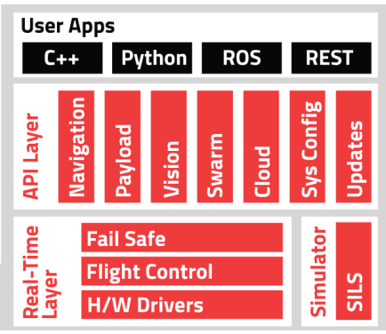
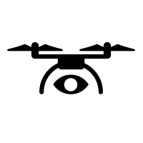
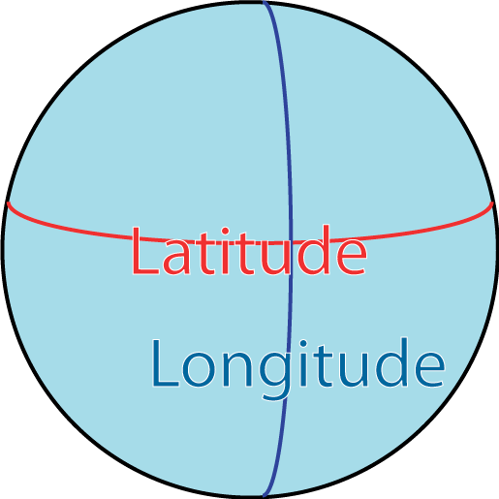


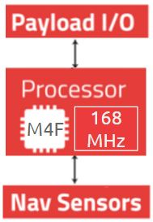



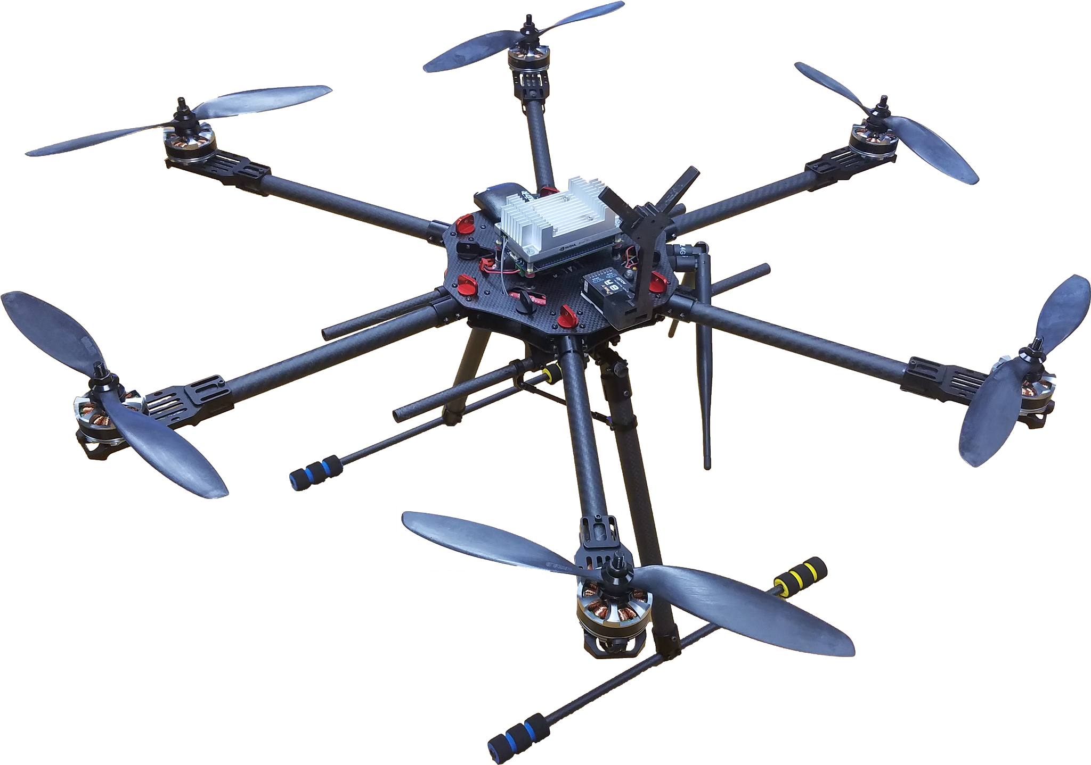
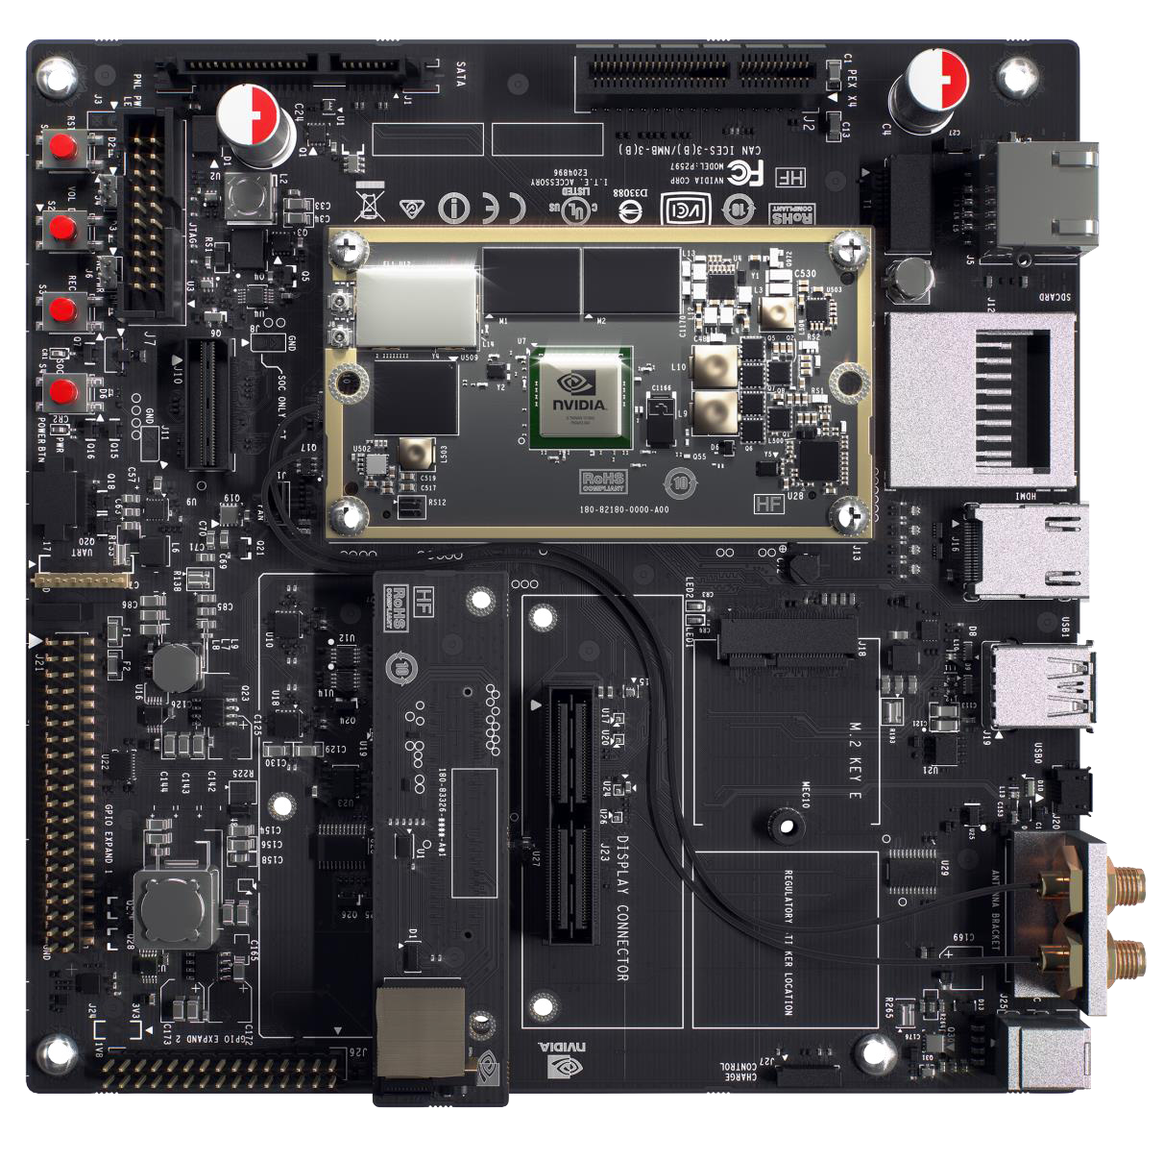
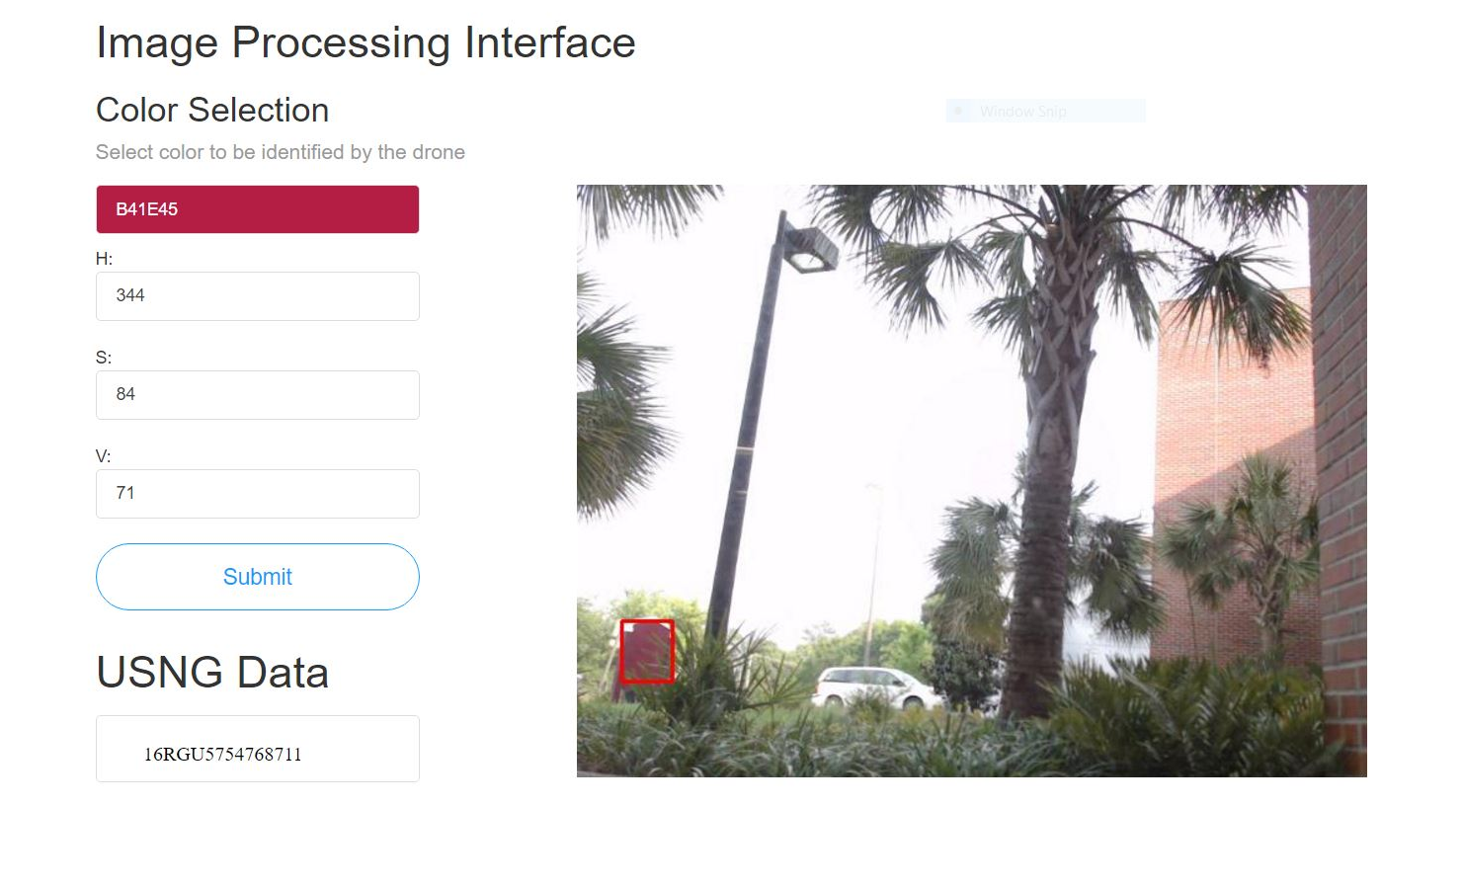
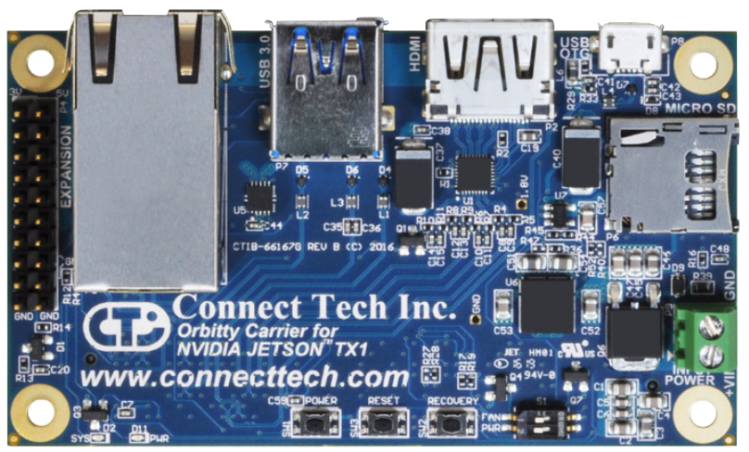
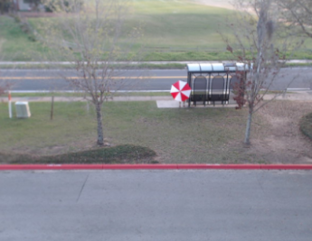

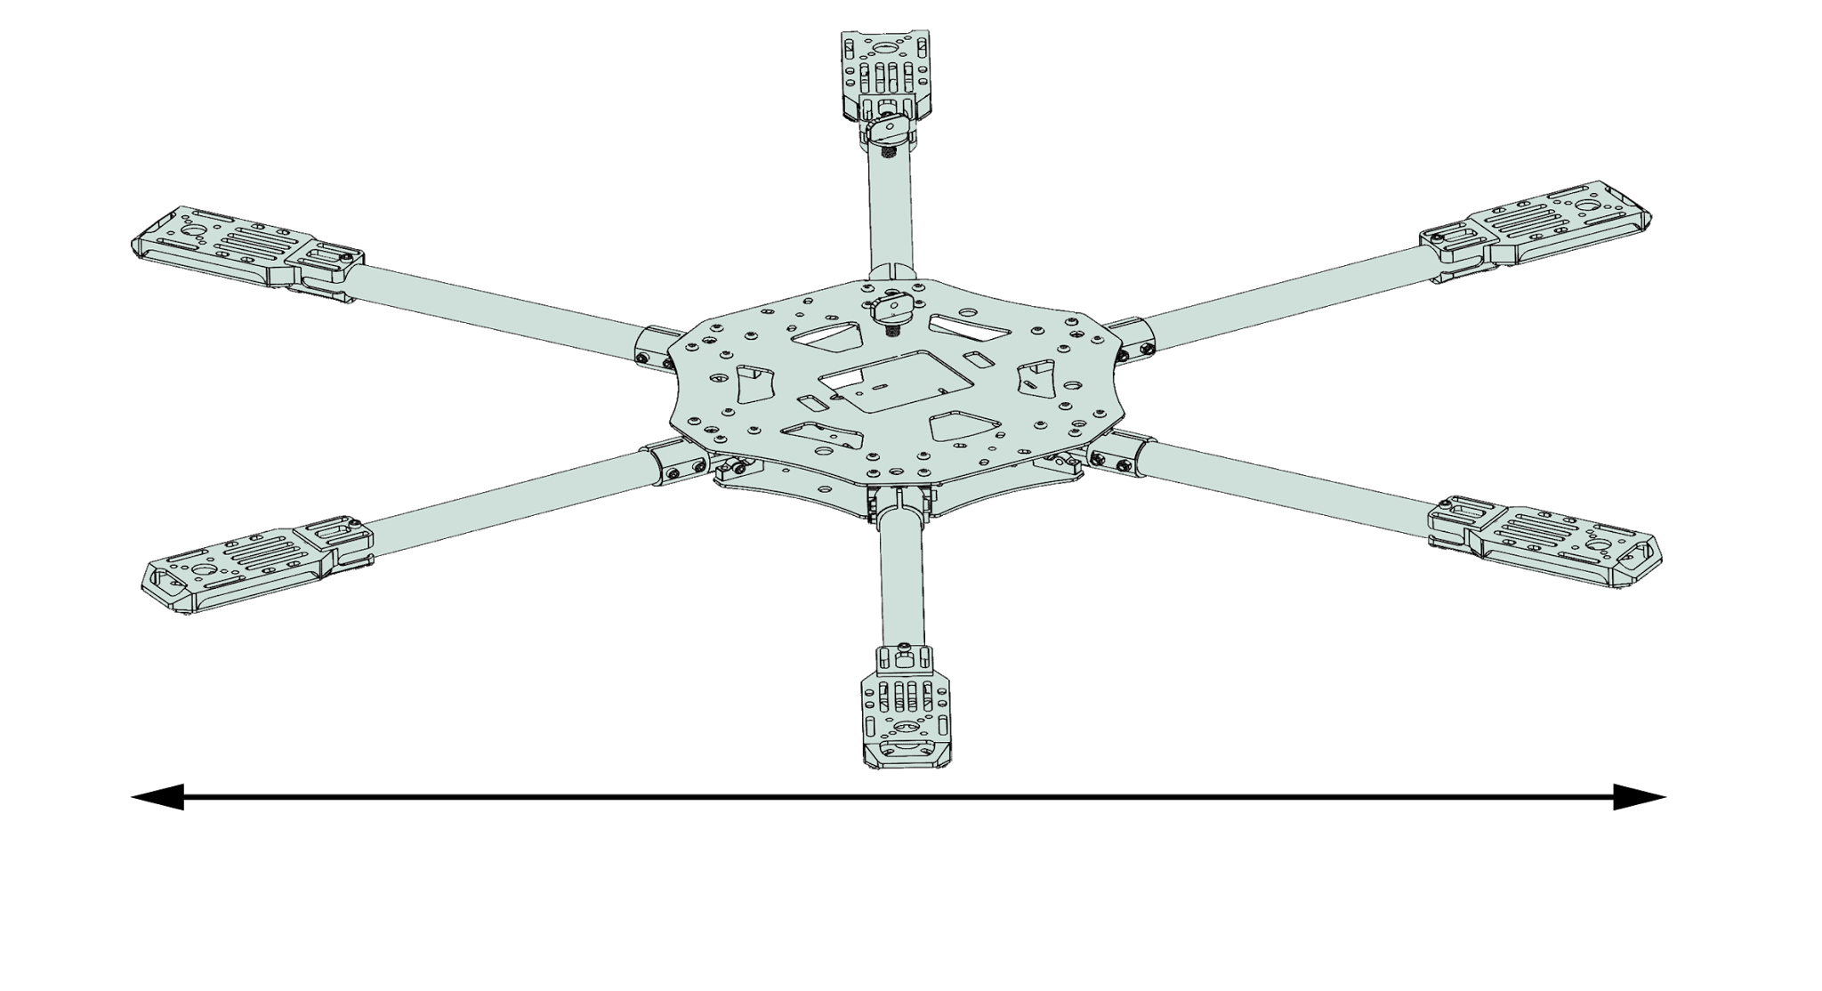
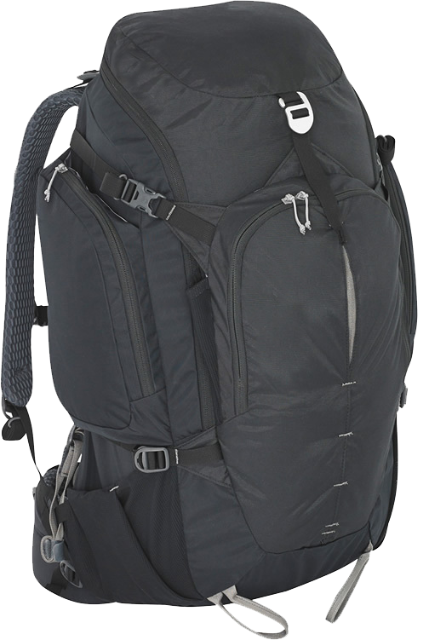
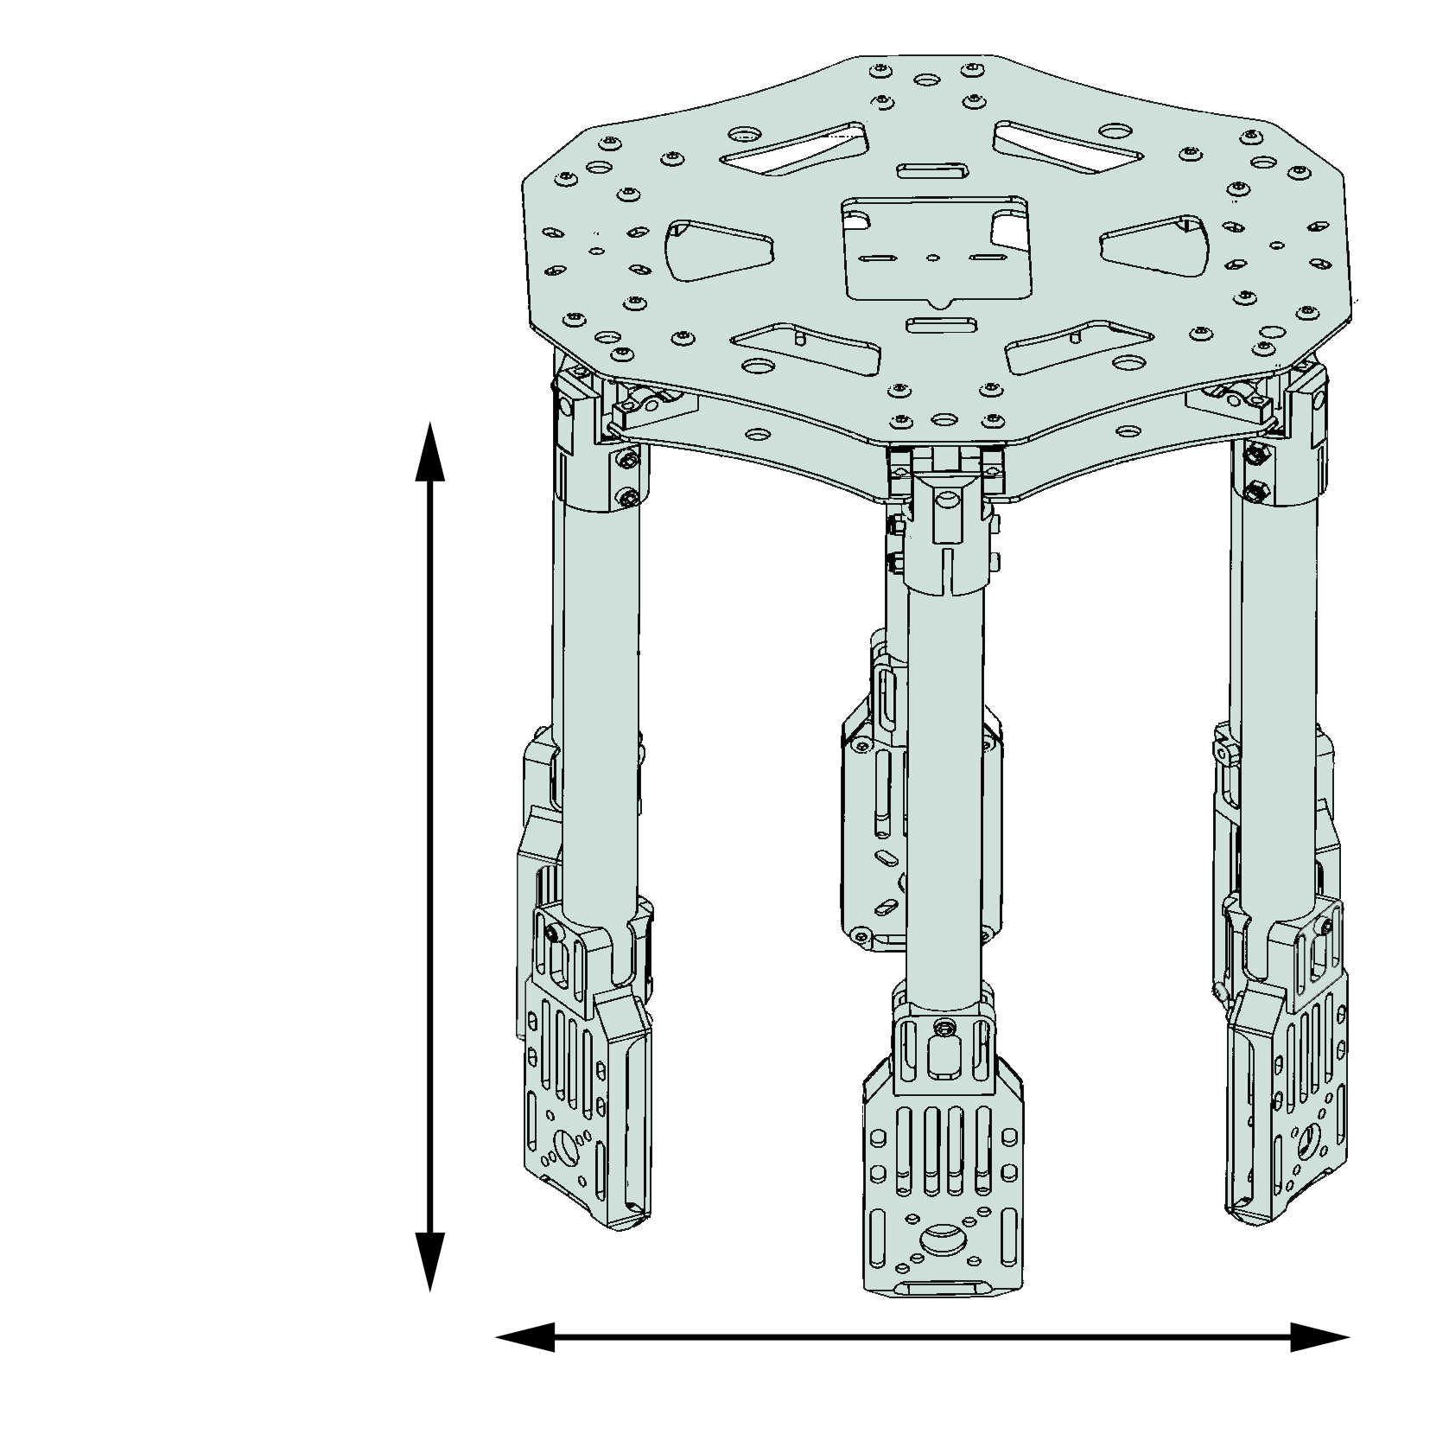
Rescue Drone: Increasing Autonomy
and Implementing Computer Vision
Halil Yonter, Cody Campbell, Alexandra Borgesen, Shawn Cho, Peter Burchell, Sarah Hood
Flight Control
Introduction
Communication & Location
Software
Current methods employed by FSU’s EMHS do not support the desired duration of flight or data transmission method. The shortcomings become apparent when handling images transmitted by drones currently in use, as these images need to be manually evaluated and important details risk being overlooked. A more advanced and capable drone is necessary to simplify the process.
Flytos
M4F
IP Network
M4F
168 MHz
168 MHz
Pixhawk
Hardware
Ground Station
Shawn Cho ‹#›
Onboard Computer
User Interface
The TX1 has been removed from the development board and inserted into the Orbitty Carrier Board. This board contains the needed ports to reduce the weight, size, and power consumption of the processor.
Object Detection
Summary
This project will increase the ability to conduct successful and efficient search and rescue missions. The drone will feature object detection through continuous image data processing. By highlighting unique objects in a monitored video feed, the necessary human effort involved is greatly reduced.
Acknowledgements
David Merrick, Dr. Hooker, Dr. Foo, Dr. Harvey, Dr. Roberts
Airframe
Quanum 680UC
Fits in 50 L backpack
Payload protection
Standard materials
Modular construction
680 mm
A color filtering algorithm relies on a range of HSV values to filter out pixels of interest. These localized regions are highlighted in the output.
280 mm
260 mm

Slide 2
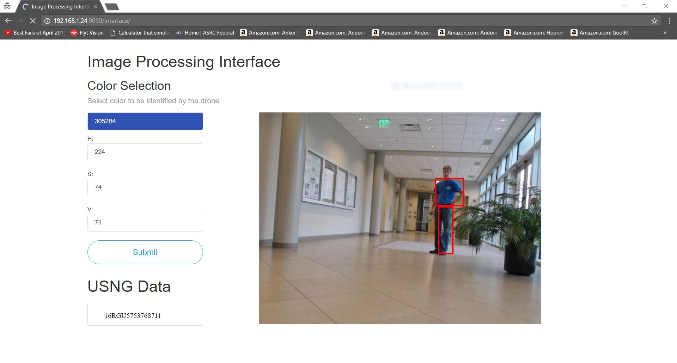
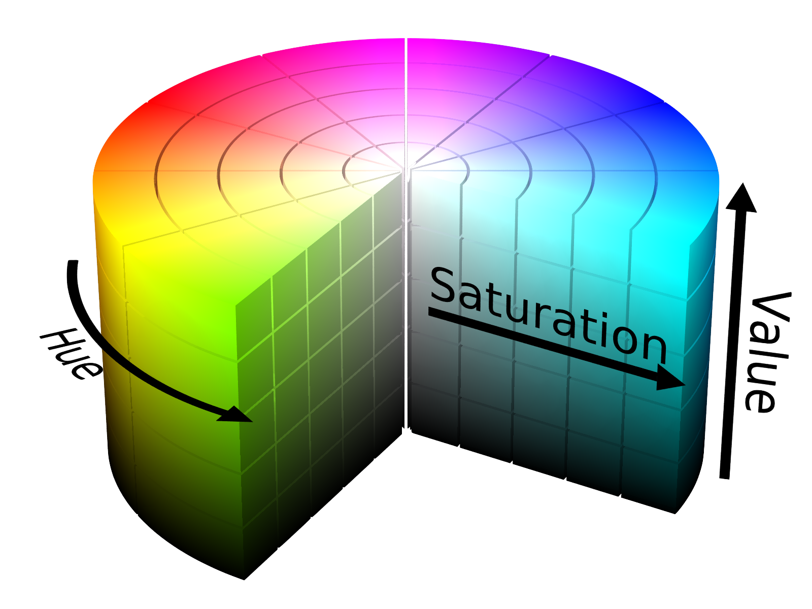
Rescue Drone: Increasing Autonomy
and Implementing Computer Vision
Halil Yonter, Cody Campbell, Alexandra Borgesen, Shawn Cho, Peter Burchell, Sarah Hood
Introduction
Flight Control
User Interface
Current methods employed by FSU’s EMHS do not support the desired duration of flight or data transmission method. The shortcomings become apparent in the image processing phase, as these images need to be manually evaluated and important details risk being overlooked. A more advanced and capable drone is necessary to simplify the process.
Software
Flytos
M4F
168 MHz
M4F
168 MHz
Pixhawk
Hardware
Onboard Computer
The TX1 has been removed from the development board and inserted into the Orbitty Carrier Board. This board contains the needed ports to reduce the weight, size, and power consumption of the processor.
Airframe
Quanum 680UC
Fits in 50 L backpack
Payload protection
Standard materials
Modular construction
680 mm
280 mm
260 mm
Object Detection
Communication & Location
Summary
This project will increase the ability to conduct successful and efficient search and rescue missions. By highlighting unique objects in a monitored video feed, the necessary human effort involved is greatly reduced.
Acknowledgements
Mr Merrick, Dr. Hooker, Dr. Foo, Dr. Harvey, Dr. Roberts
IP Network
A color filtering algorithm relies on a range of HSV values to filter out pixels of interest. These localized regions are highlighted in the output.
Ground Station
Shawn Cho ‹#›

