Slide 1
Rescue Drone:
Increasing Autonomy and Implementing Computer Vision
ECE Team 4

Slide 2
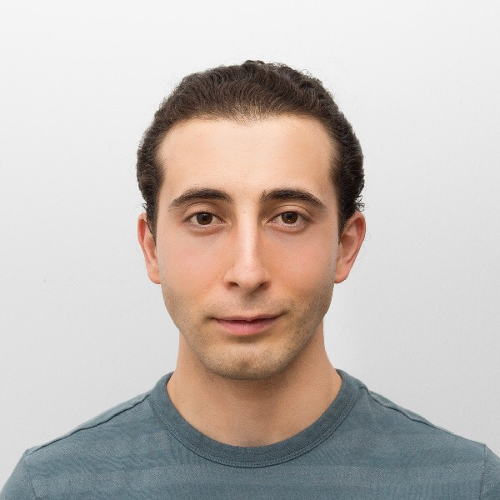
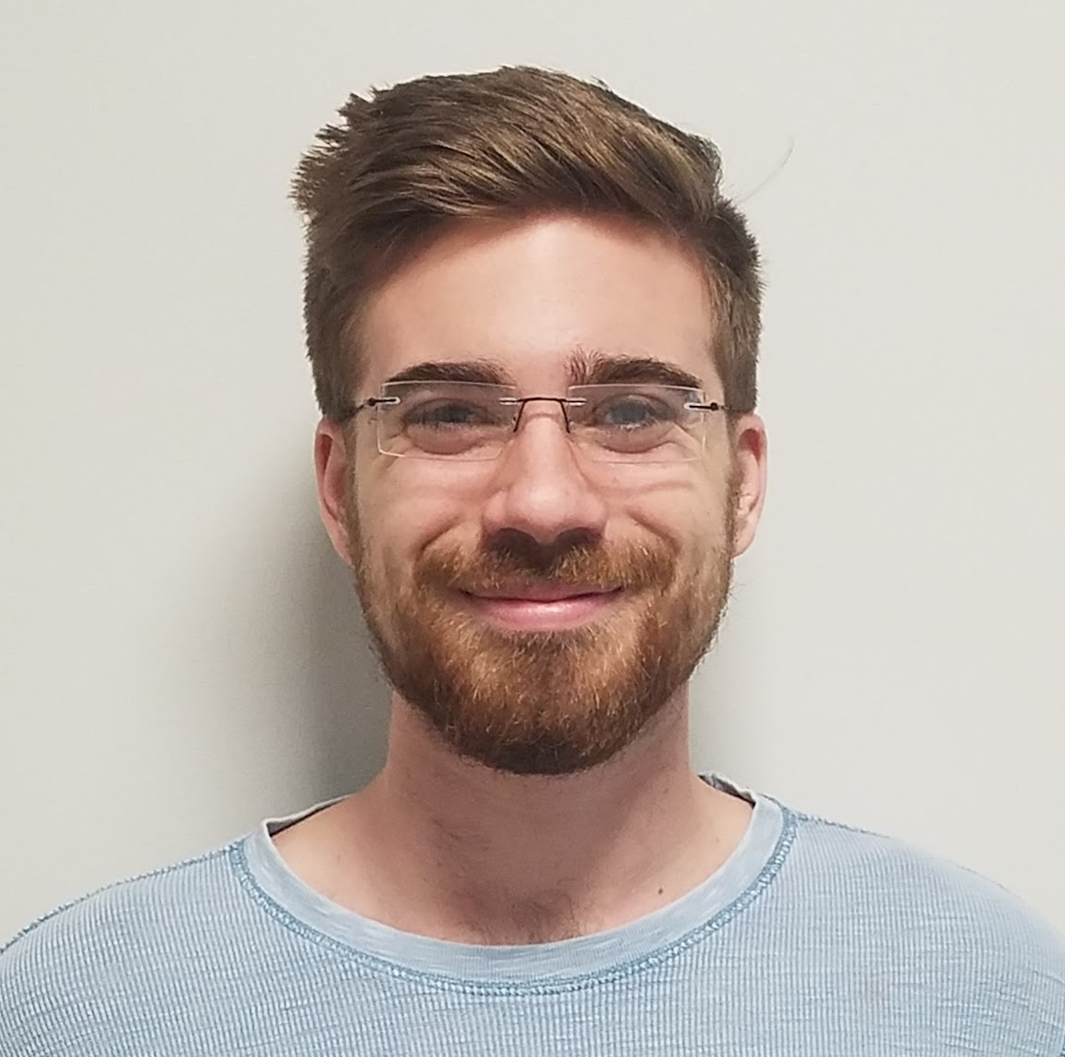
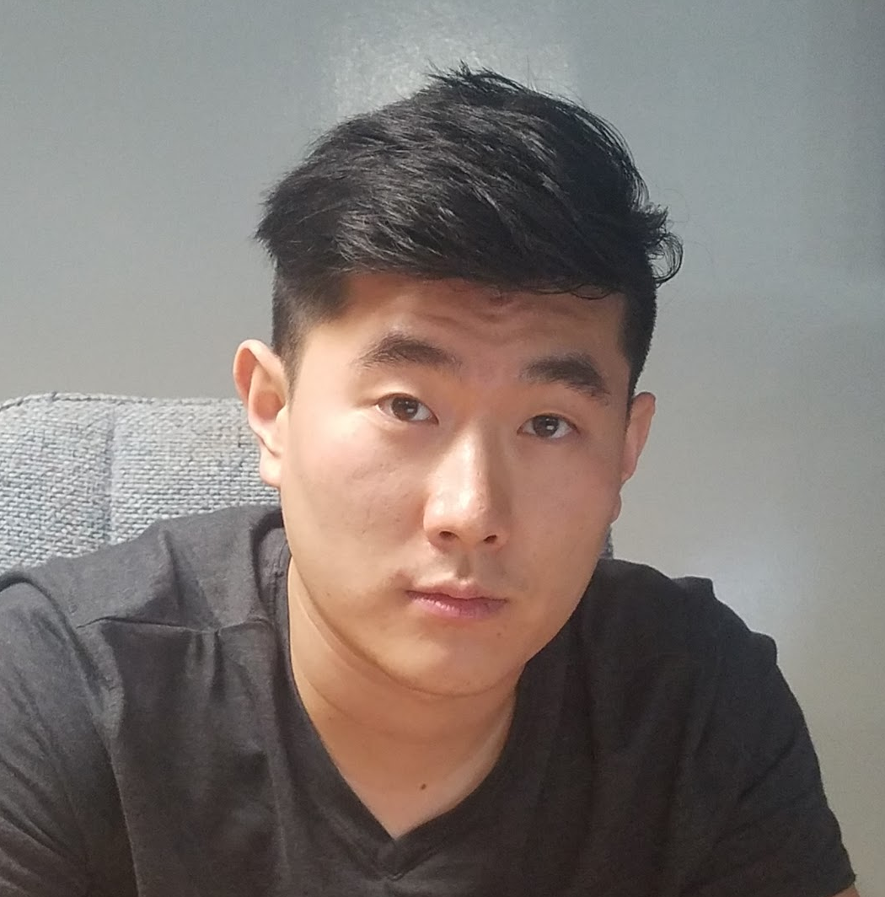
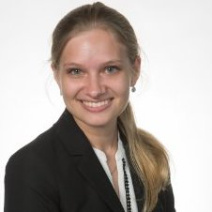

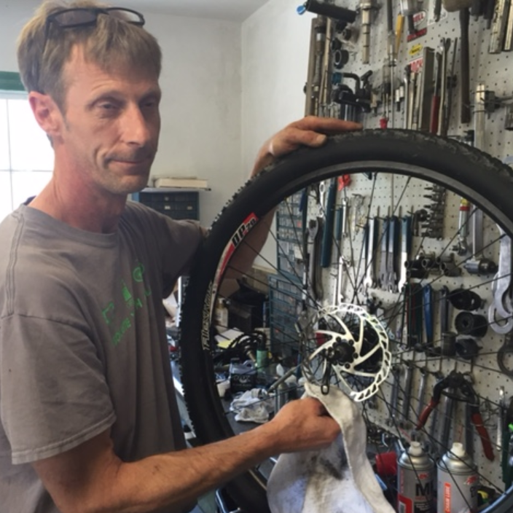
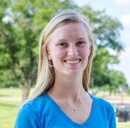
Halil Yonter
Team Leader
Flight Control
Cody Campbell
Hardware Engineer
Onboard Electronics
Shawn Cho
Software Engineer
Communication & Location
Alexandra Borgesen
Computer Engineer
Image Processing
Peter Burchell
Mechanical Engineer
Mechanical Coordinator
Sarah Hood
Dynamic Systems Engineer
Airframe & Performance

Slide 3






Recap → Flight Control → Processor → Object Detection → WiFi / USNG → Propeller Testing

Slide 4

Recap → Flight Control → Image Processing → WiFi / USNG → Airframe & Performance → Demo
World Class Education
Disaster Recovery
Search and Rescue
Applied Research

Slide 5
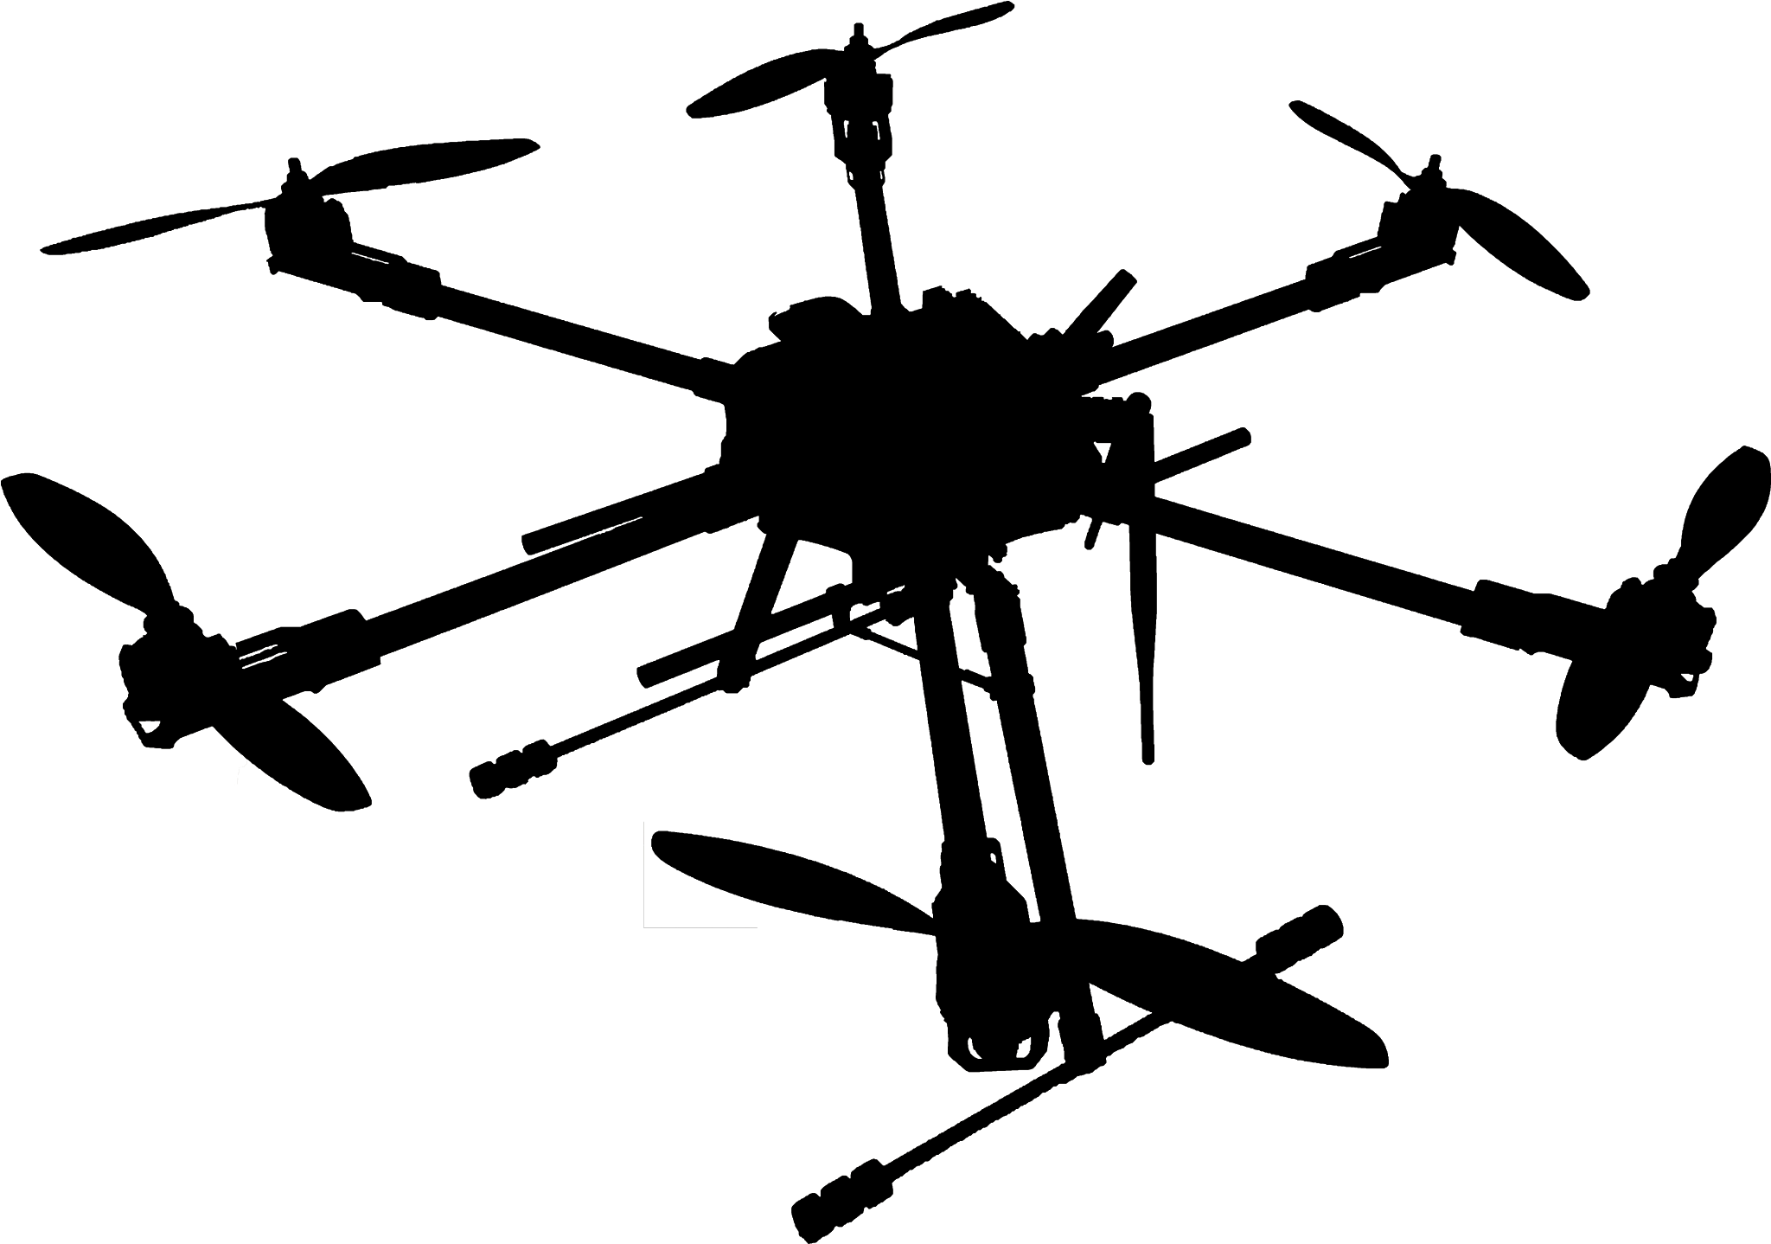
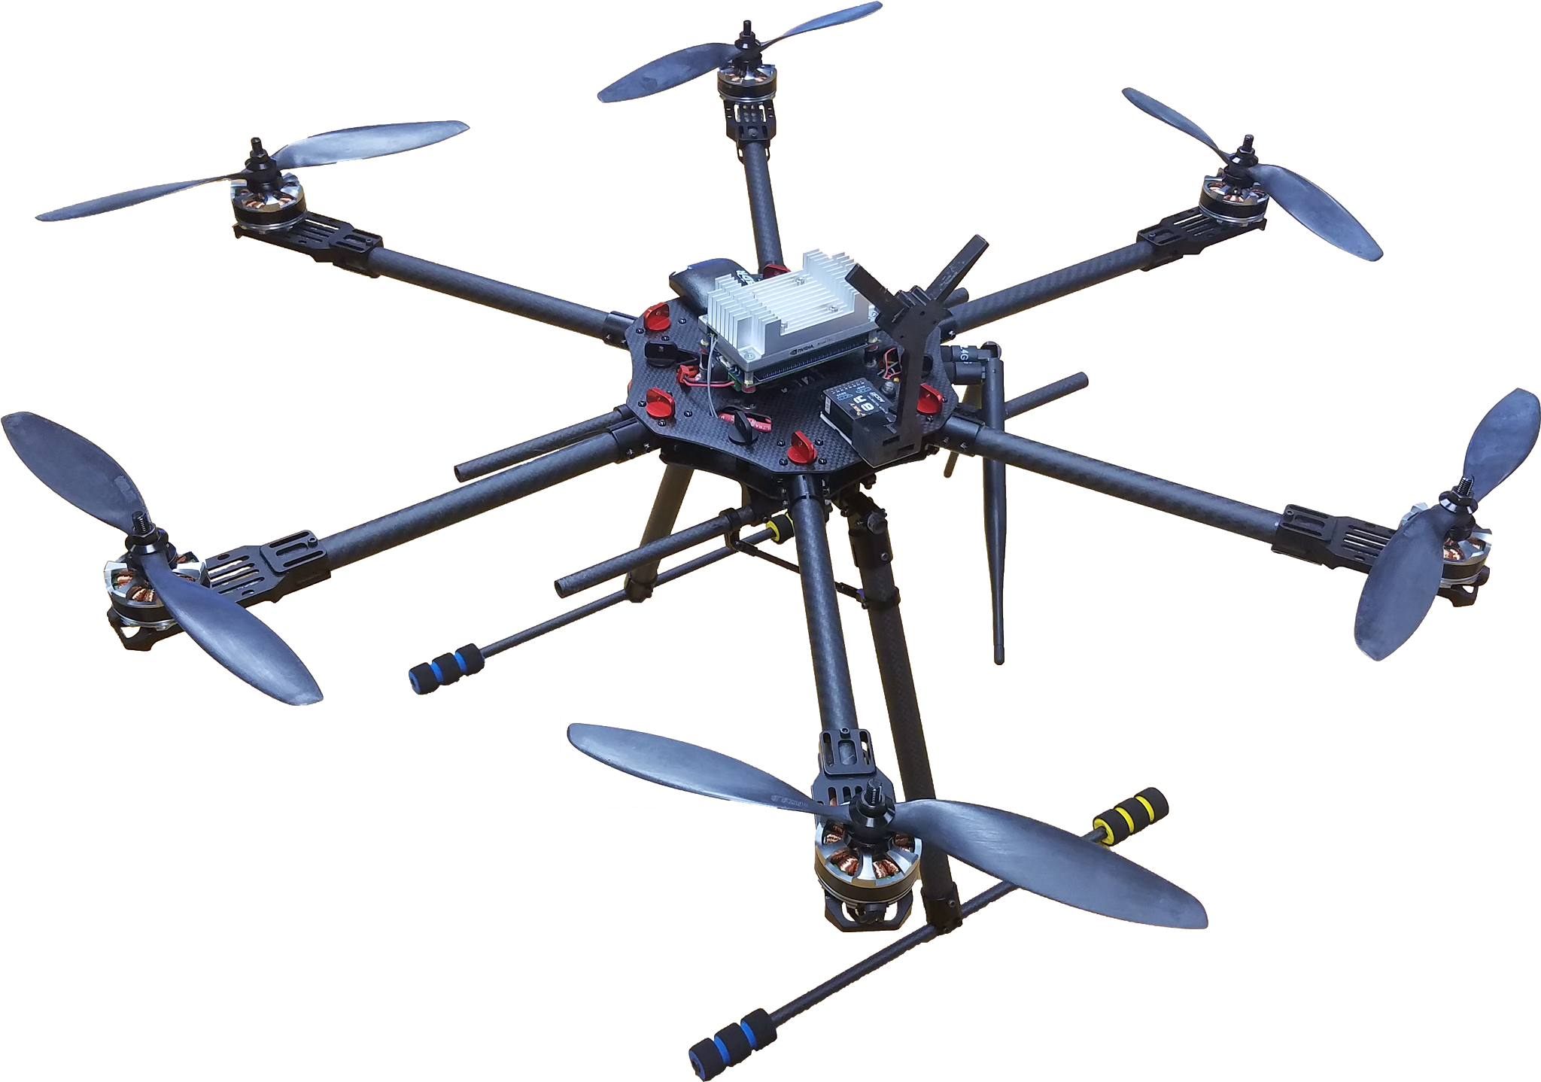
Recap → Flight Control → Image Processing → WiFi / USNG → Airframe & Performance → Demo
Saurus
Autonomous Object Detection
Convenient Coordinate Conversion
Versatile Communication
Collapsable Design
Extended Flight Time

Slide 6
Flight Control and Onboard Electronics
Cody Campbell

Slide 7
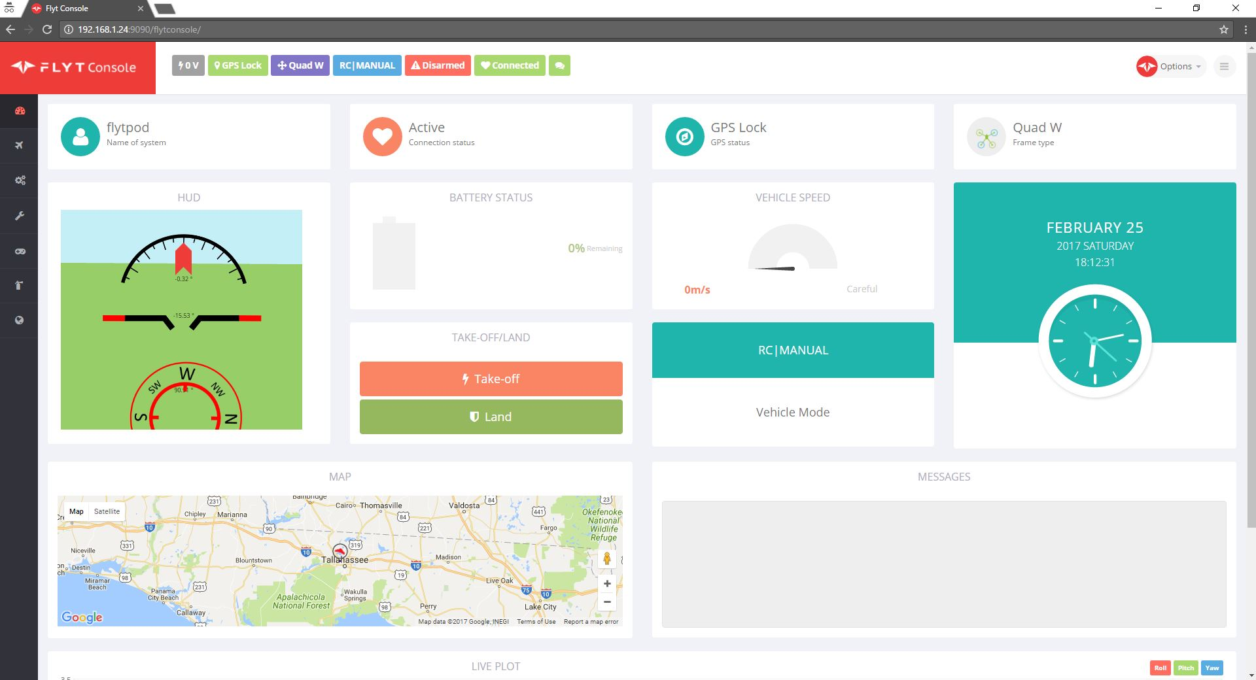
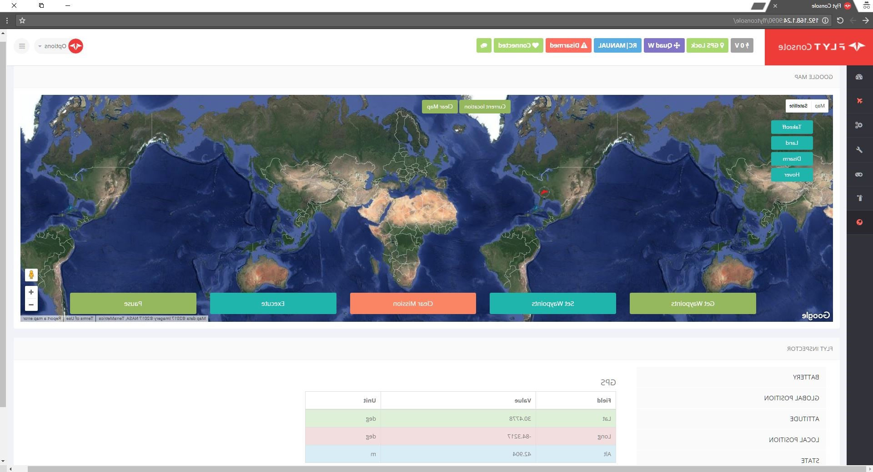

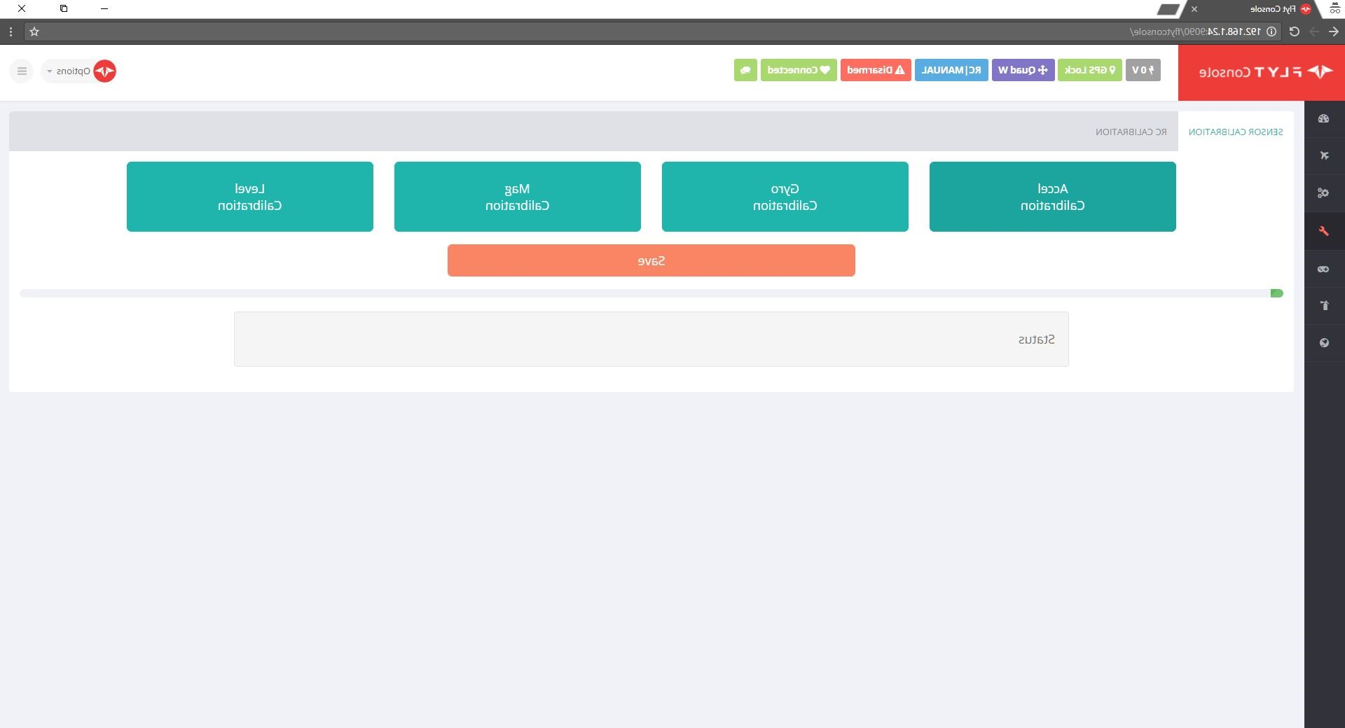
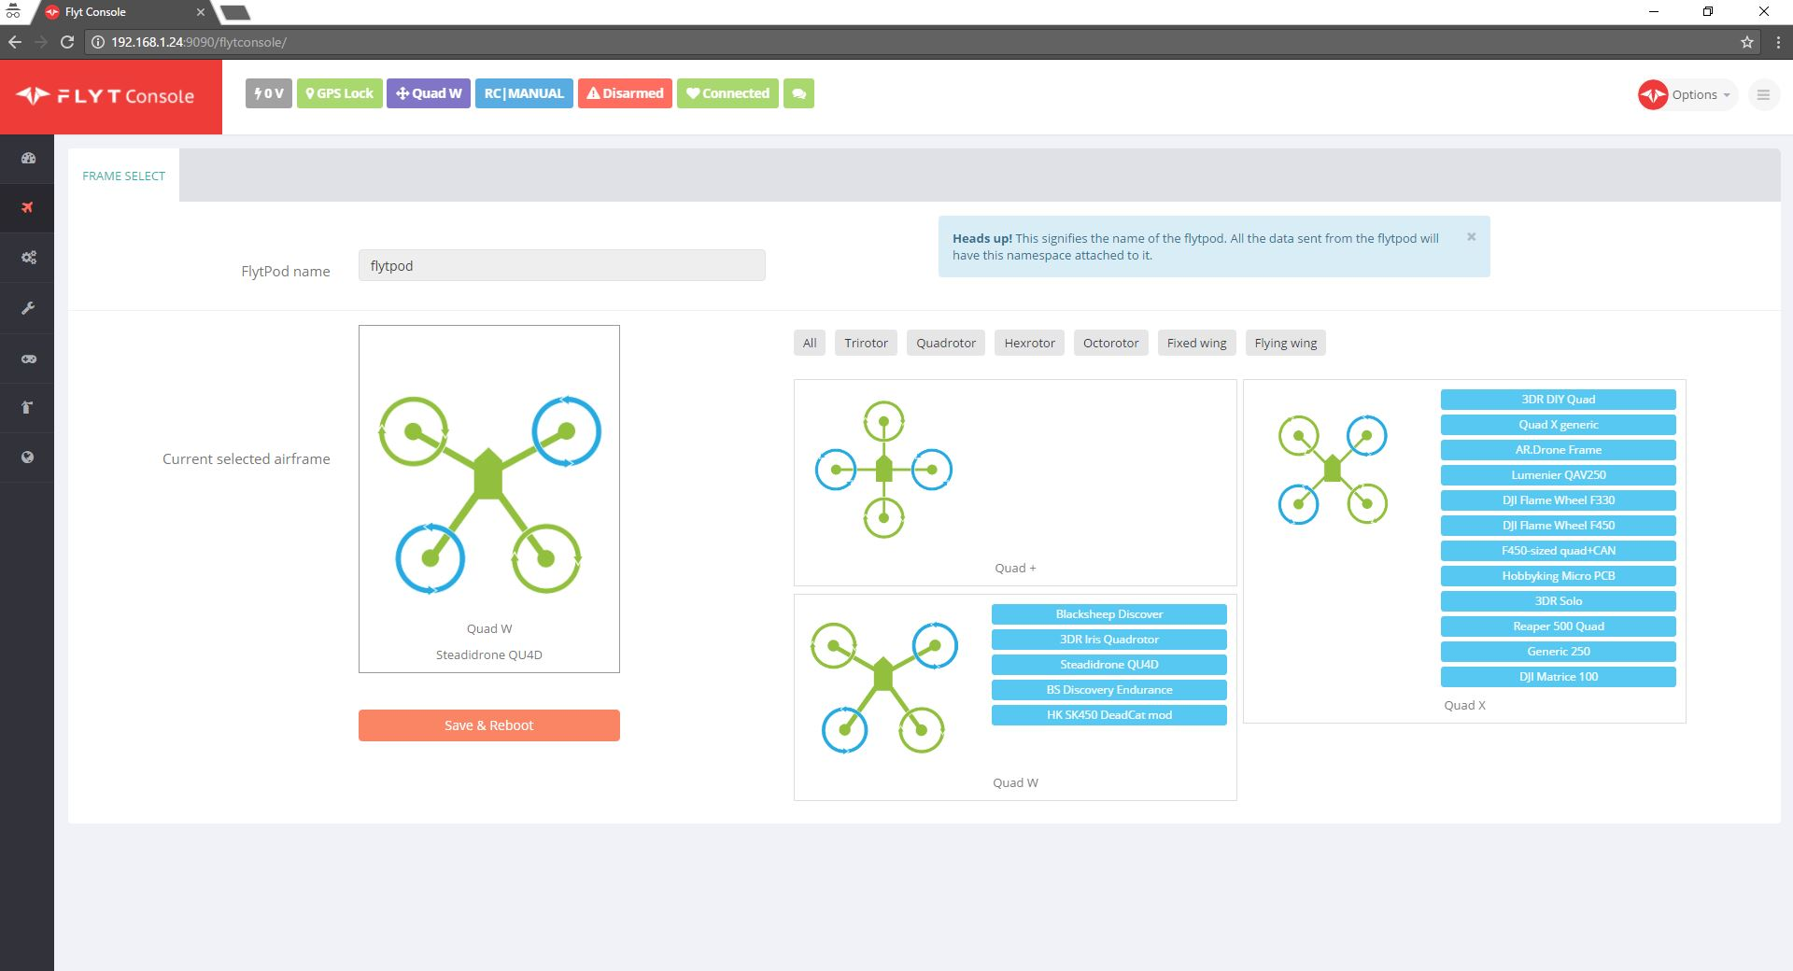

Recap → Flight Control → Image Processing → WiFi / USNG → Airframe & Performance → Demo
Notes:
For our flight control architecture, we collaborated with Navstik labs in India, the developers of FlytOS. We were not only using the FlytOS software, but assisting in its development. This resulted in a flight control system capable of running autonomous missions, calibrating flight control hardware and providing convenient apis to access telemetry data. All within the clean and intuitive interface seen here.

Slide 8


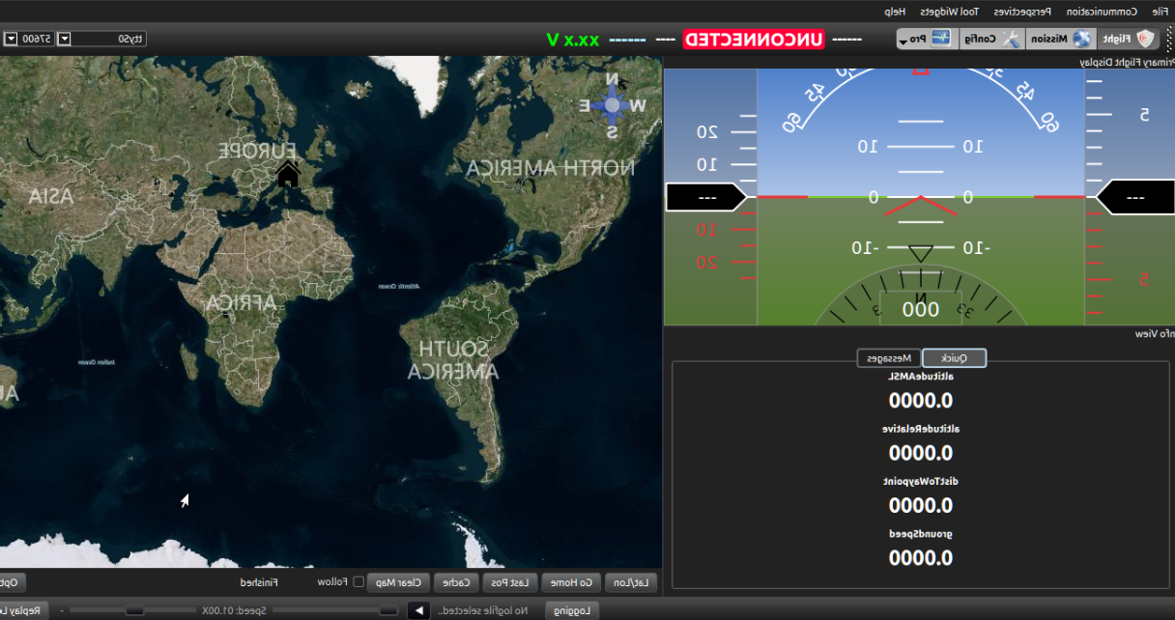
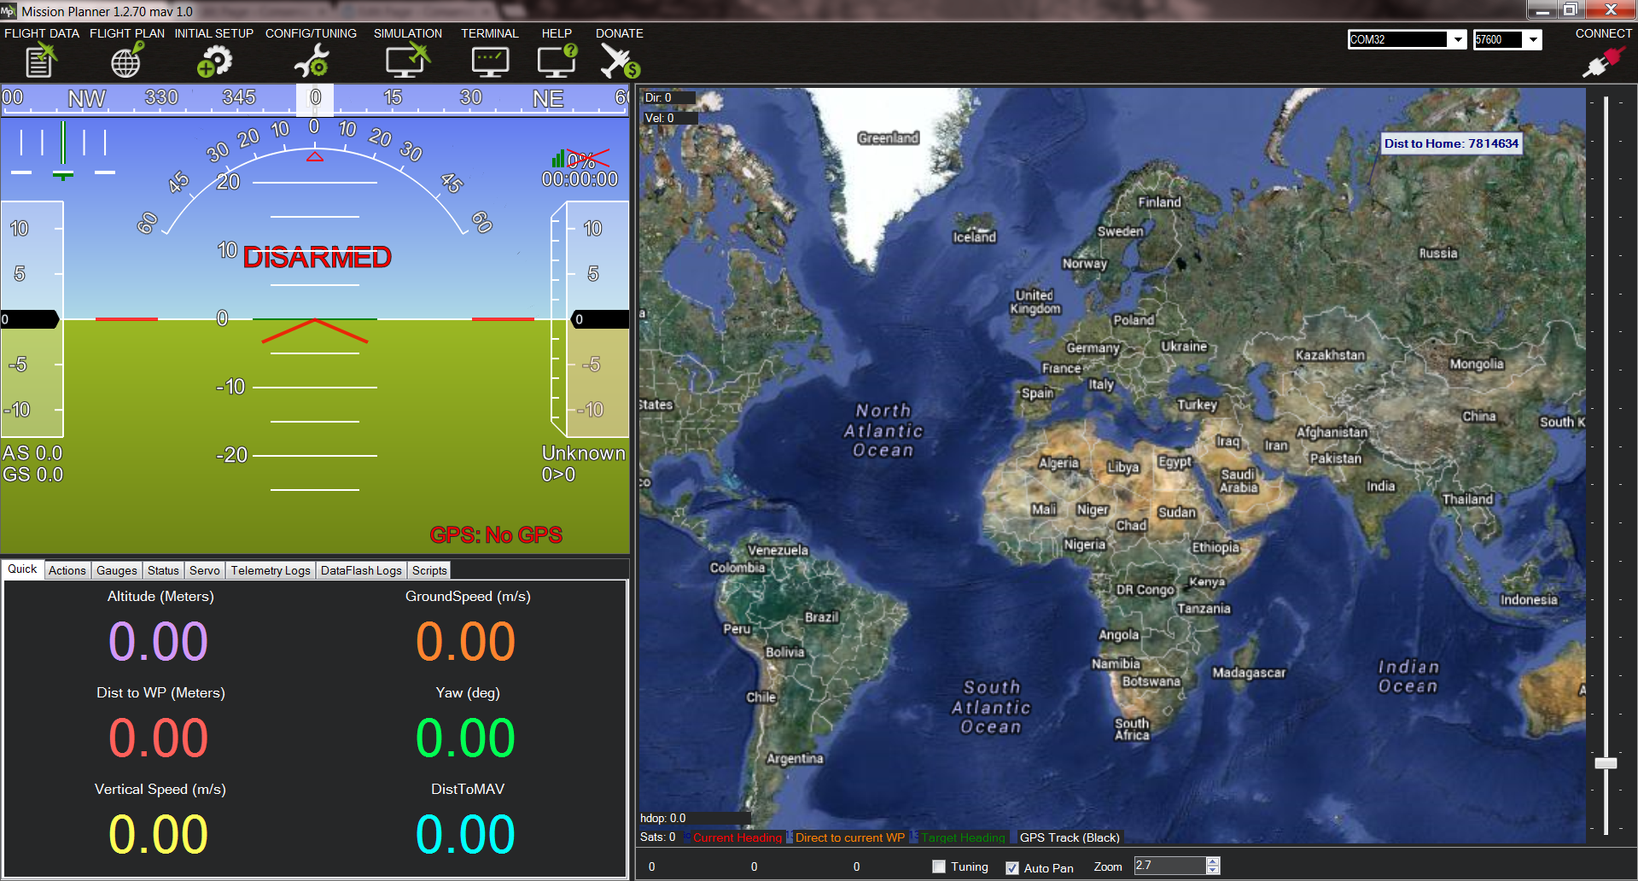
Recap → Flight Control → Image Processing → WiFi / USNG → Airframe & Performance → Demo
Notes:
FlytOS architecture is essential to our design and will run in the background at all times however we left the choice of mission control software to the end users discretion for greater versatility. We implemented a udp bridge on our network and that opened the floor up for endless possibilities. Now, not only our drone supports advanced flight functions but also works with many well known mission control software.
Udp bridge => serial communication through computers

Slide 9
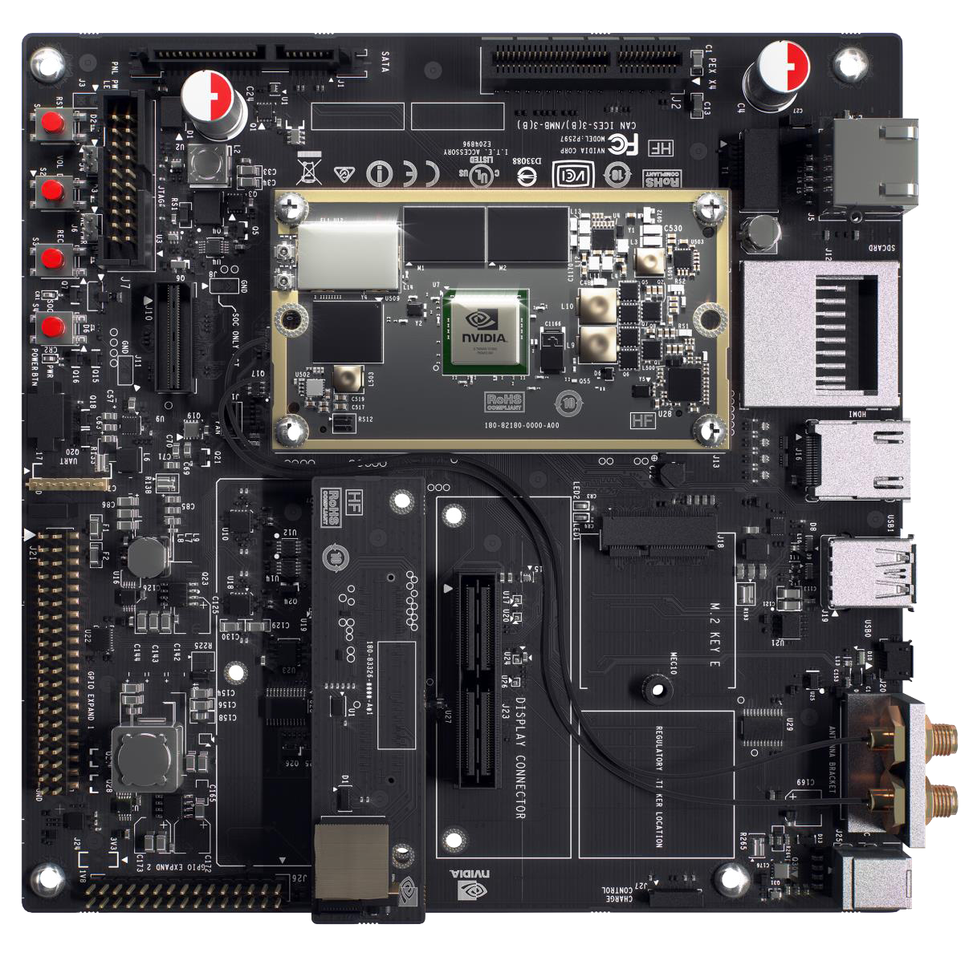
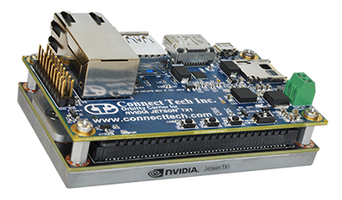
Recap → Flight Control → Image Processing → WiFi / USNG → Airframe & Performance → Demo
NVIDIA Jetson TX1 and Orbitty Carrier Board
TX1
Low power consumption
Integrated WiFi
64-bit ARM A57 CPUs
4 GB LPDDR4 Memory
Cuda Cores
Orbitty Carrier
USB Port
Micro SD Port
UART port
Notes:
The TX1 came with a development board, which allows you to interface with the TX1 in many different ways. We were able to successfully fly the drone with the development board, but the power draw and weight were too much to provide the minimum flight time of 20 minutes. To fix this, we purchased a much smaller carrier board that maintains all of the needed functionality, with an expected power consumption of just 9 Watts. We’ll be using the USB port for our camera, the Micro SD port for storage, and the UART port to communicate with the Pixhawk and other on board controllers.

Slide 10
Image Processing
Alexandra Borgesen

Slide 11
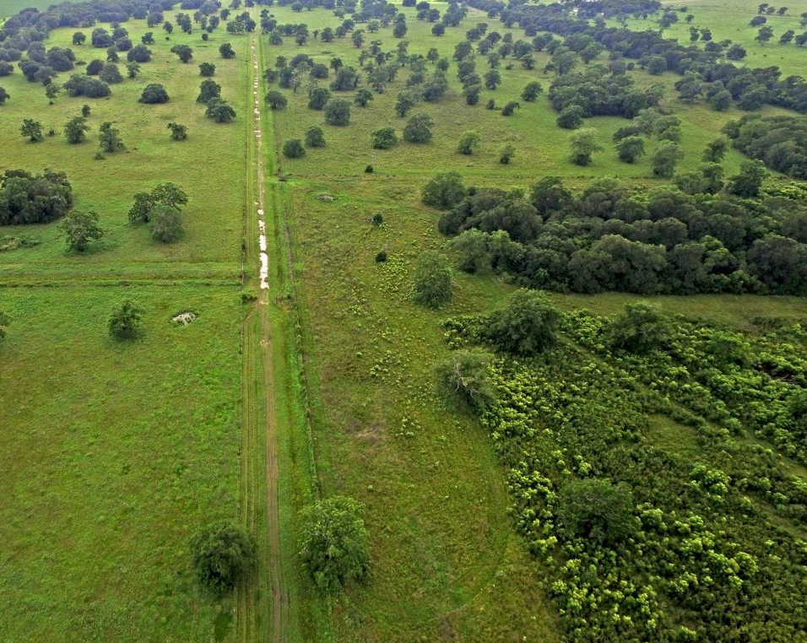
Recap → Flight Control → Image Processing → WiFi / USNG → Airframe & Performance → Demo
Object Detection
Goal: Detect an object of interest
Logitech C920
Estimated altitude: 200 ft
Limited visibility
Complex and detailed backgrounds
Let algorithms handle image processing
Color Filtering

Slide 12
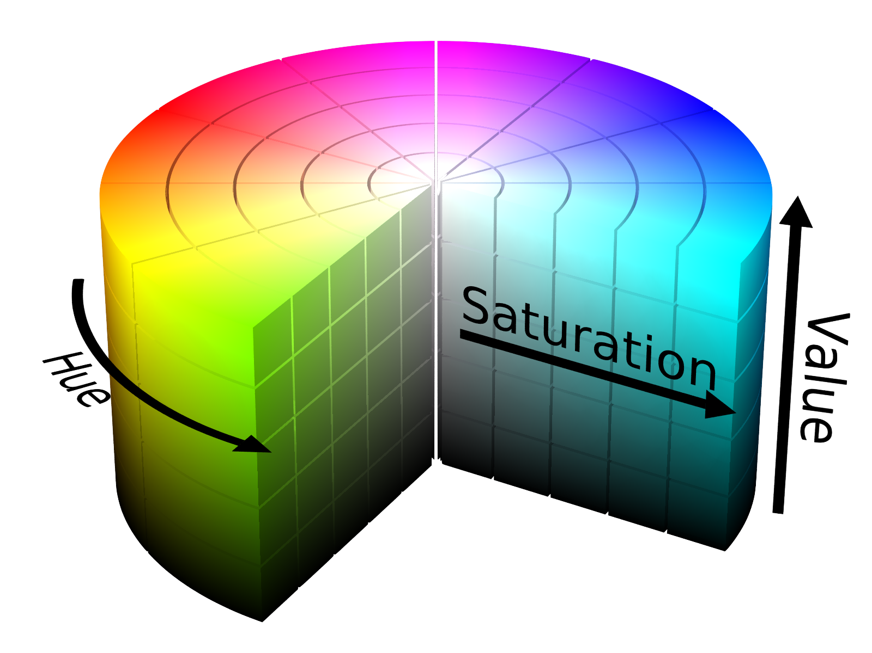
Recap → Flight Control → Image Processing → WiFi / USNG → Airframe & Performance → Demo
Color Filtering
Converting colors to HSV
Hue: Color
Saturation: Intensity
Value: Brightness
# Select HSV range for color “red”
lower_red = np.array([30,150,50]) upper_red = np.array([255,255,255]) # Converts frames to HSV,
# ... if the frame’s HSV is within the given range
# ... the mask will return “true” for that frame mask = cv2.inRange(hsv, lower_red, upper_red) # Restores image frames only where mask is true
res = cv2.bitwise_and(frame,frame, mask = mask)

Slide 13
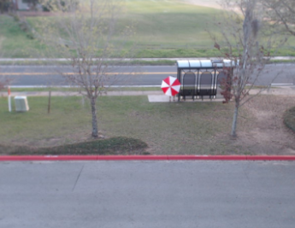

Recap → Flight Control → Image Processing → WiFi / USNG → Airframe & Performance → Demo

Slide 14
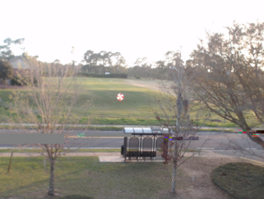
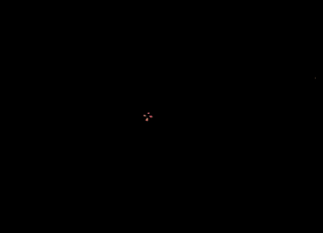
Recap → Flight Control → Image Processing → WiFi / USNG → Airframe & Performance → Demo

Slide 15
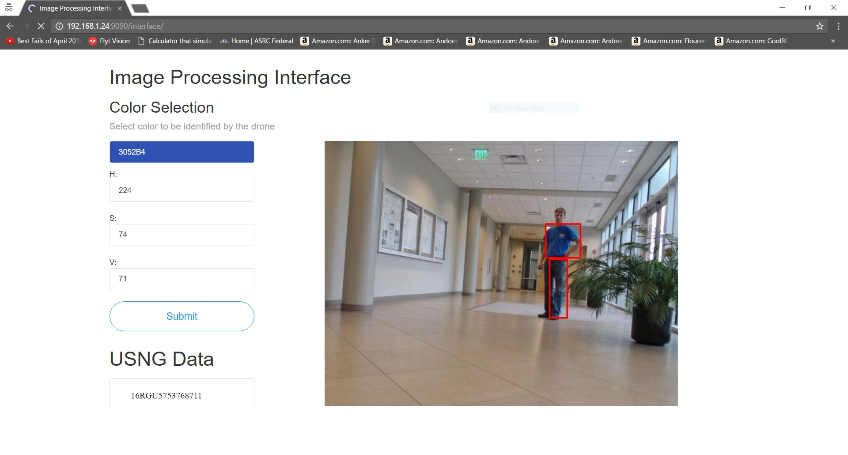
Recap → Flight Control → Image Processing → WiFi / USNG → Airframe & Performance → Demo

Slide 16
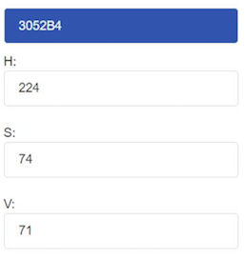
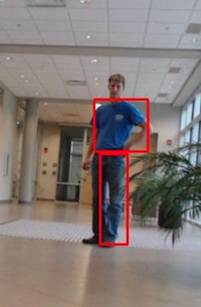
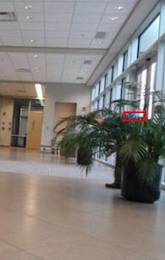
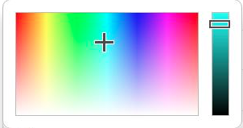
Recap → Flight Control → Image Processing → WiFi / USNG → Airframe & Performance → Demo

Slide 17
Communication and Location
Shawn Cho

Slide 18

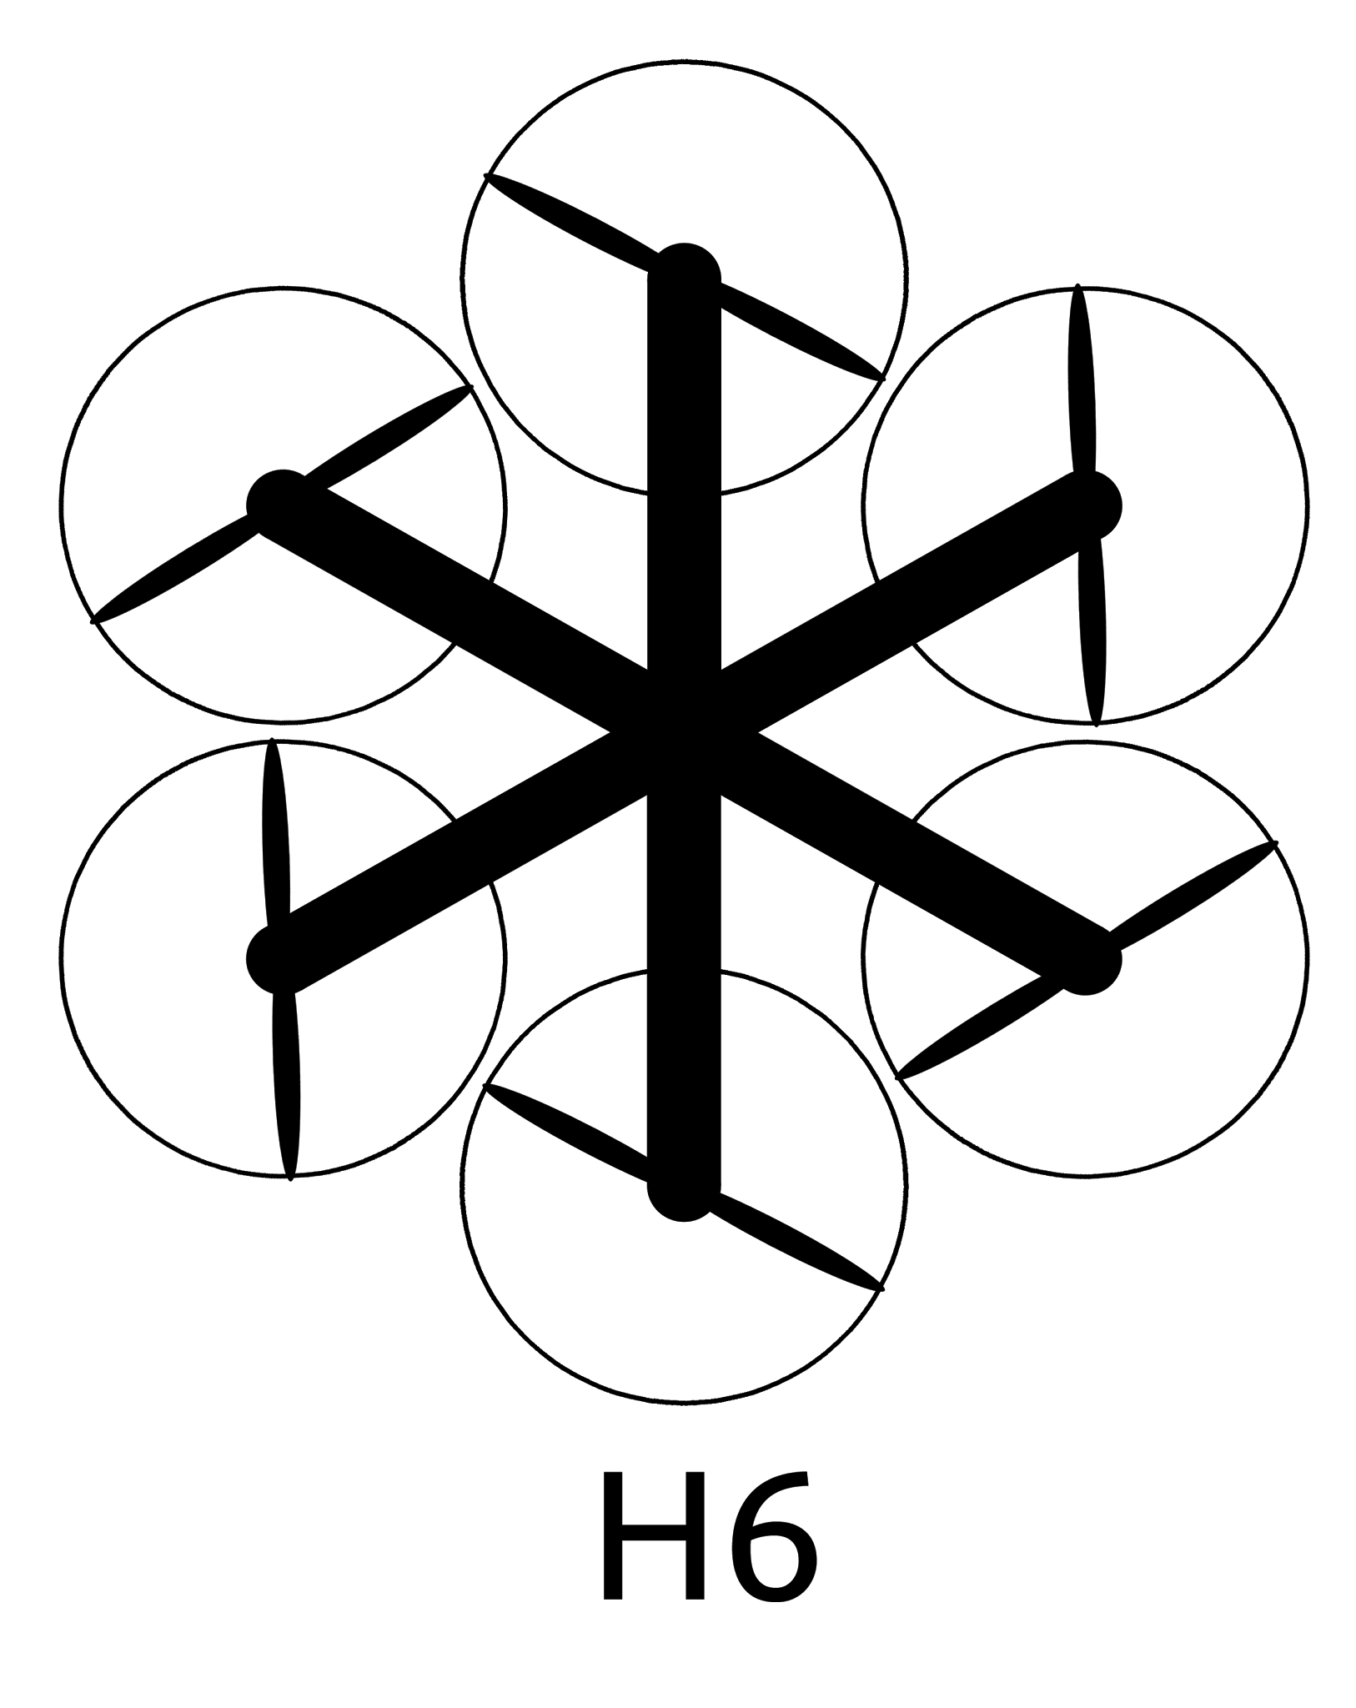
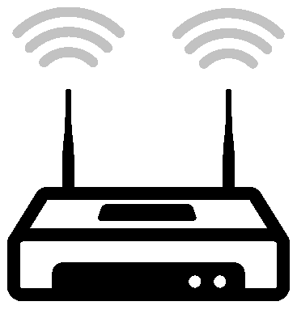



Recap → Flight Control → Image Processing → WiFi / USNG → Airframe & Performance → Demo
Implementation
ISP
4G LTE

Slide 19
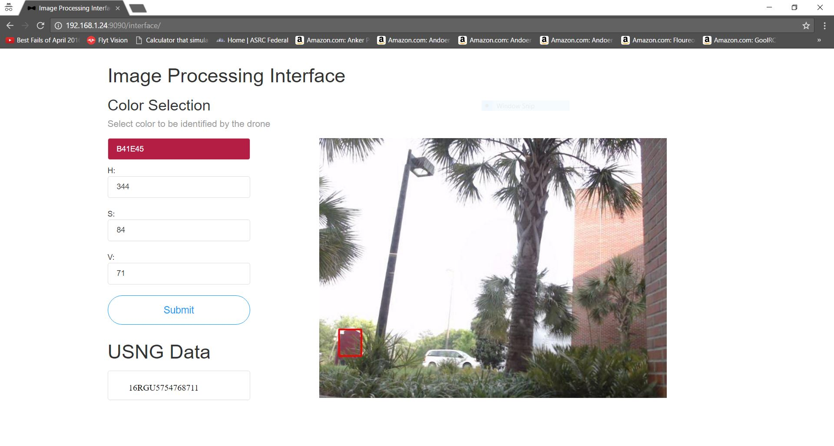
Recap → Flight Control → Image Processing → WiFi / USNG → Airframe & Performance → Demo
USNG Conversion Interface

Slide 20
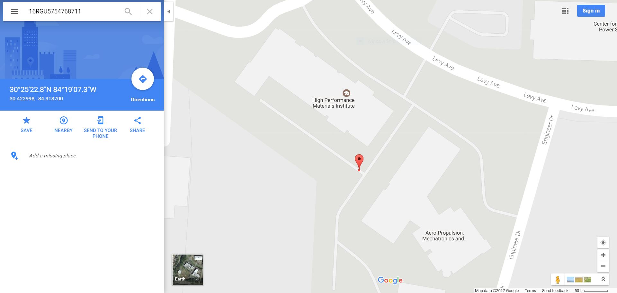
Recap → Flight Control → Image Processing → WiFi / USNG → Airframe & Performance → Demo
USNG in Google Maps

Slide 21
Airframe and Performance
Sarah Hood

Slide 22
Recap → Flight Control → Image Processing → WiFi / USNG → Airframe/Performance → Demo
Peak Thrust Assessment
Battery Tested | 4 Rotor | 6 Rotor
3 Cell | 2776 g | 4164 g
4 Cell | 4148 g | 6222 g
Needed Peak Thrust* | 3746 g | 4218 g
*Based on the predicted weight of the aircraft and on board technology, not including the weight of the battery.

Slide 23
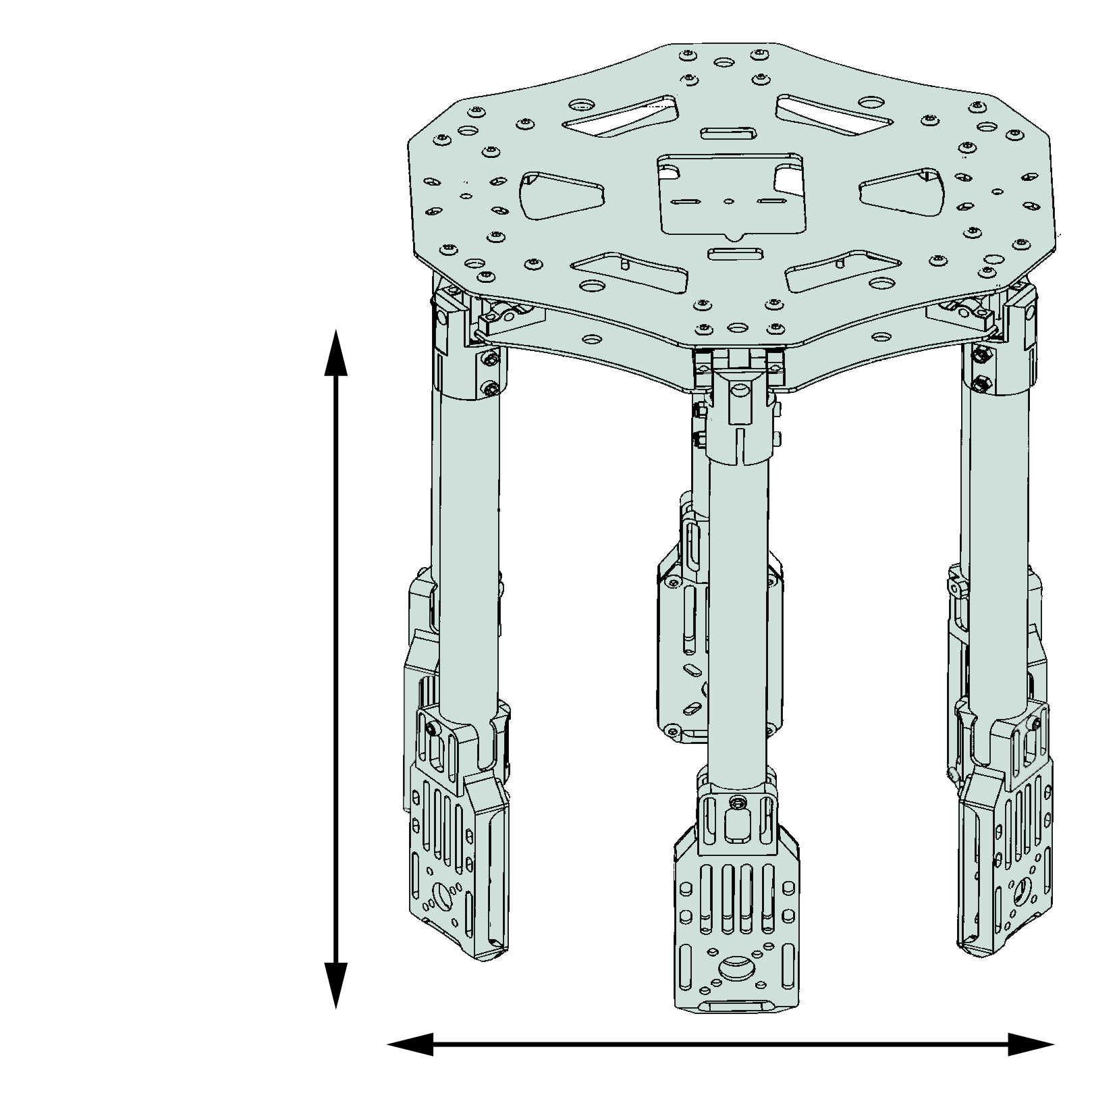
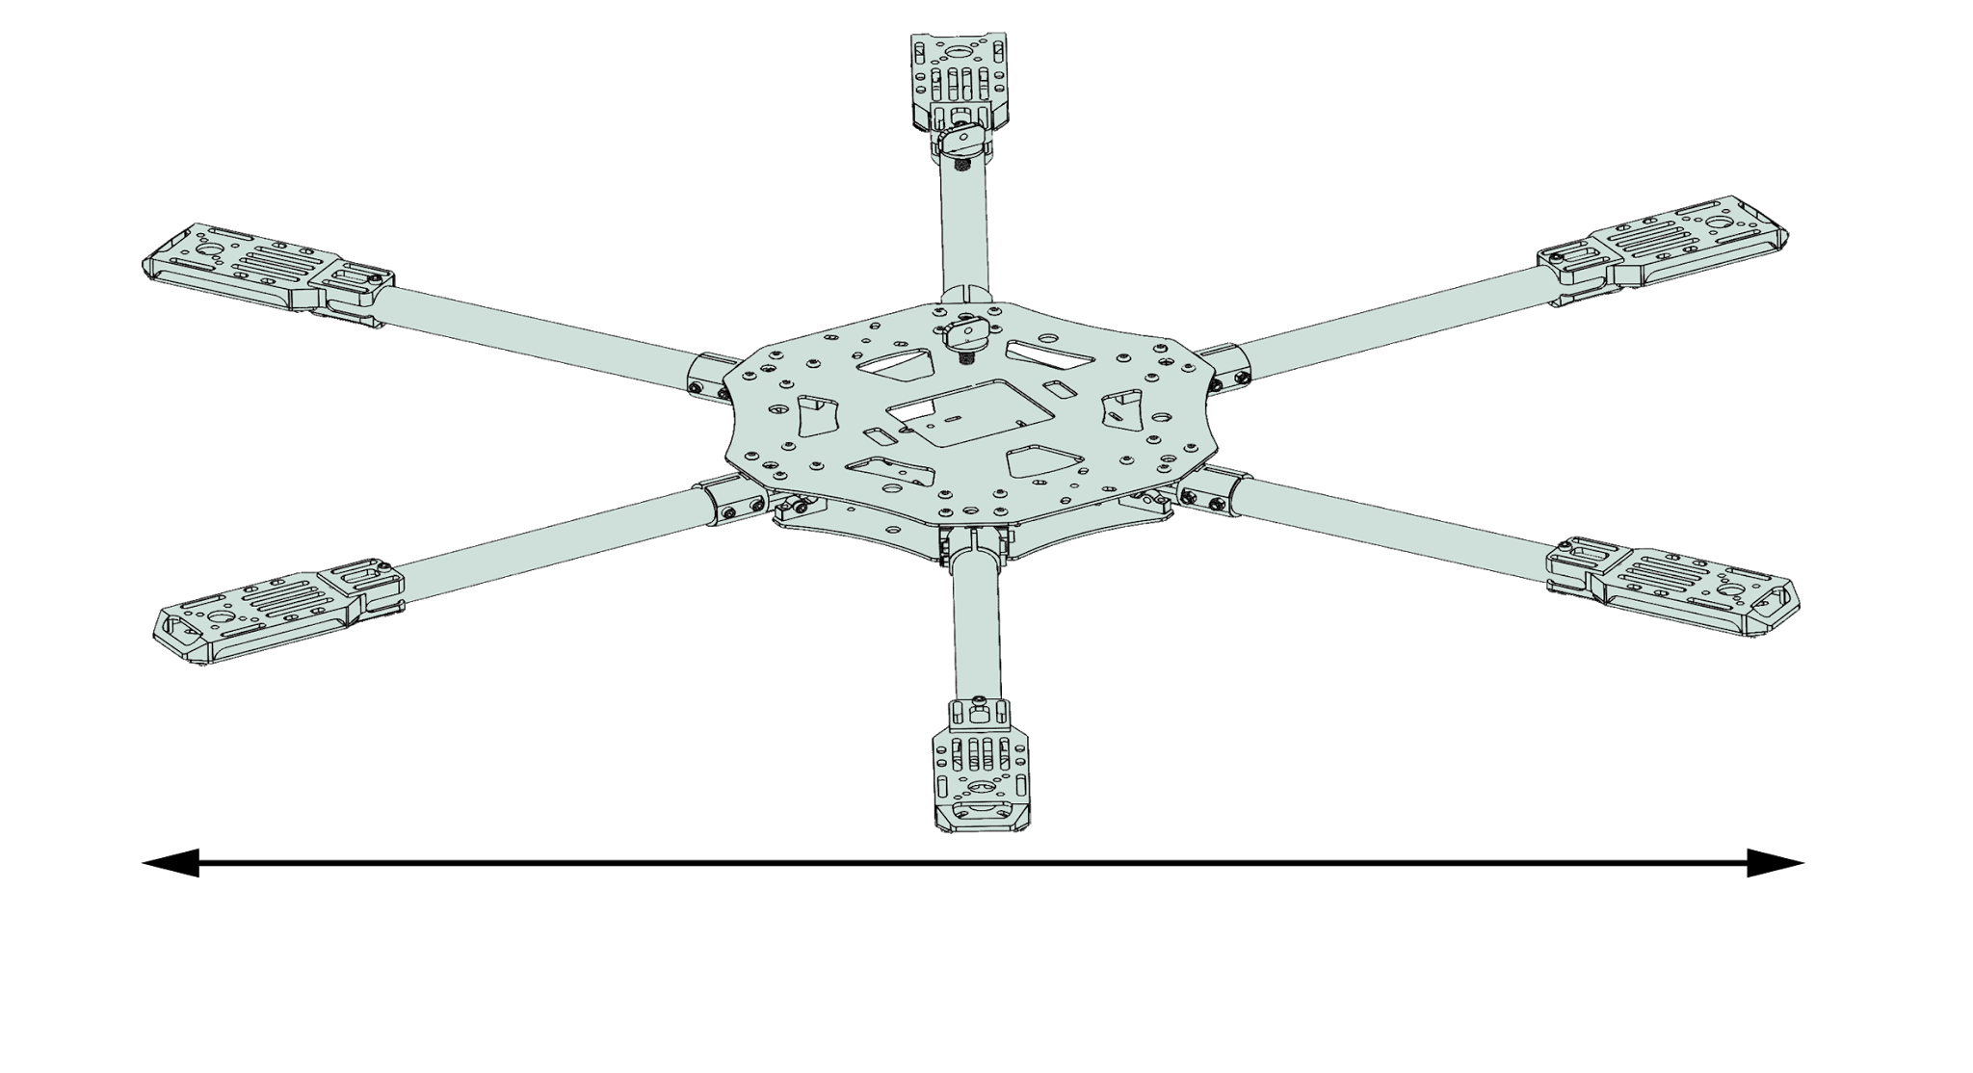
Recap → Flight Control → Image Processing → WiFi / USNG → Airframe/Performance → Demo
Quanum 680UC - 740 g
280 mm
260 mm
680 mm

Slide 24
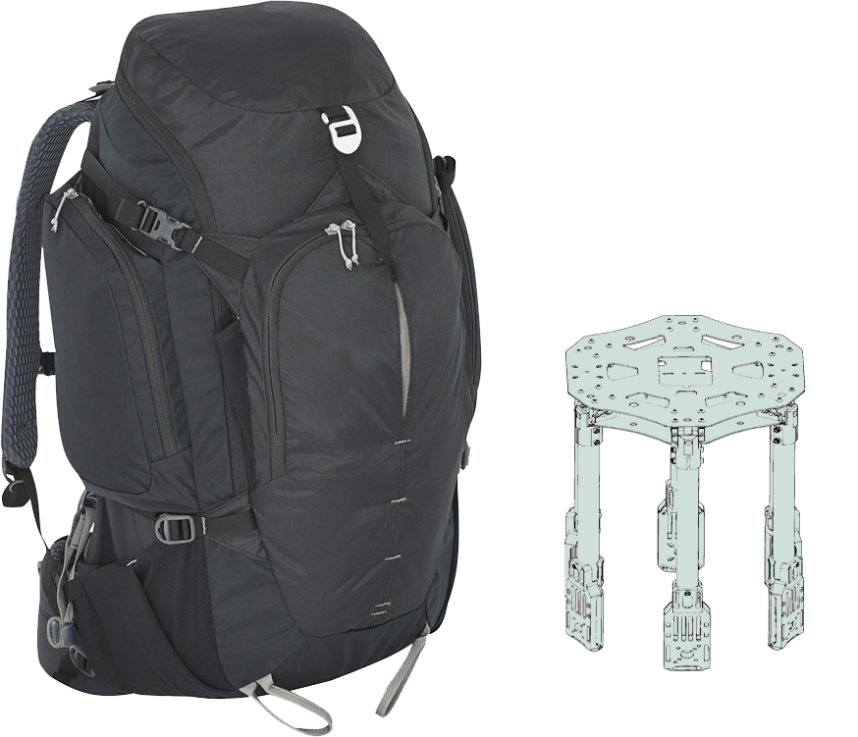
Recap → Flight Control → Image Processing → WiFi / USNG → Airframe/Performance → Demo
Quanum 680UC
Quanum 680UC
Fits in 50 L backpack
Payload protection
Standard materials
Modular construction

Slide 25
Recap → Flight Control → Image Processing → WiFi / USNG → Airframe/Performance → Demo
Current Weight
Flight duration
20 minutes
Pixhawk | 1 | 38 g
Pixhawk accessories | 1 | 60 g
Motor/Prop/ESC each | 6 | 118 g
Controller receiver | 1 | 22 g
Gimbal | 1 | 214 g
Camera | 1 | 150 g
Nvidia TX1 | 1 | 144 g
Airframe | 1 | 740 g
Battery | 2 | 500 g
Total weight | 3076 g
3076 g

Slide 26
Demonstration
Peter Burchell

Slide 27
Recap → Flight Control → Image Processing → WiFi / USNG → Airframe/Performance → Demo
Demonstration
Vehicle Overview
Flight Management
User Interface
USNG
Object Detection

Slide 28
Summary
Halil Yonter

Slide 29





Slide 30
Acknowledgements to
Mr. Merrick
Dr. Hooker
Dr. Roberts
Dr. Foo
Dr. Harvey
Thank You
Questions?
Questions?

Slide 31
Cost Analysis
Ground Station Router | $340.00
Jetson NVIDIA TX1 | $325.00
Gimbal | $208.00
Carrier Board for TX1 | $200.00
Hexacopter Frame | $175.00
Camera | $65.00
Carbon Fiber Sheets | $55.00
Carbon Fiber Tubes | $47.00
Drone Antenna | $40.00
Prop 12 x 3.8 SF | $47.00
Prop 10 x 3.8 SF | $35.00
Prop 12 x 4 SF | $15.00
Ground Station Antenna | $13.00
UBEC | $4.00
Total | $1569.00

Slide 32
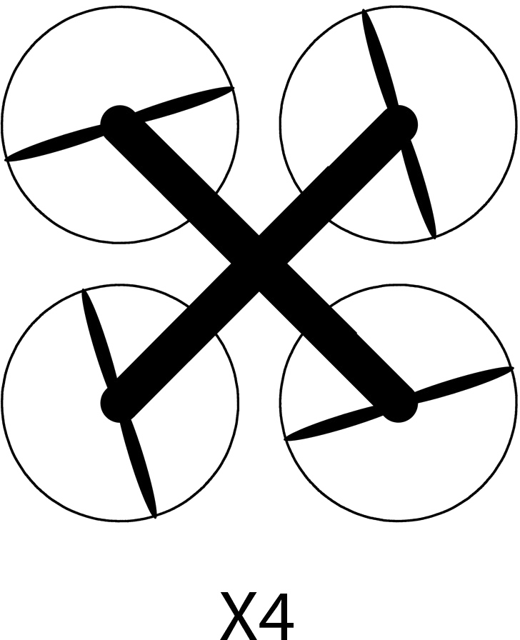
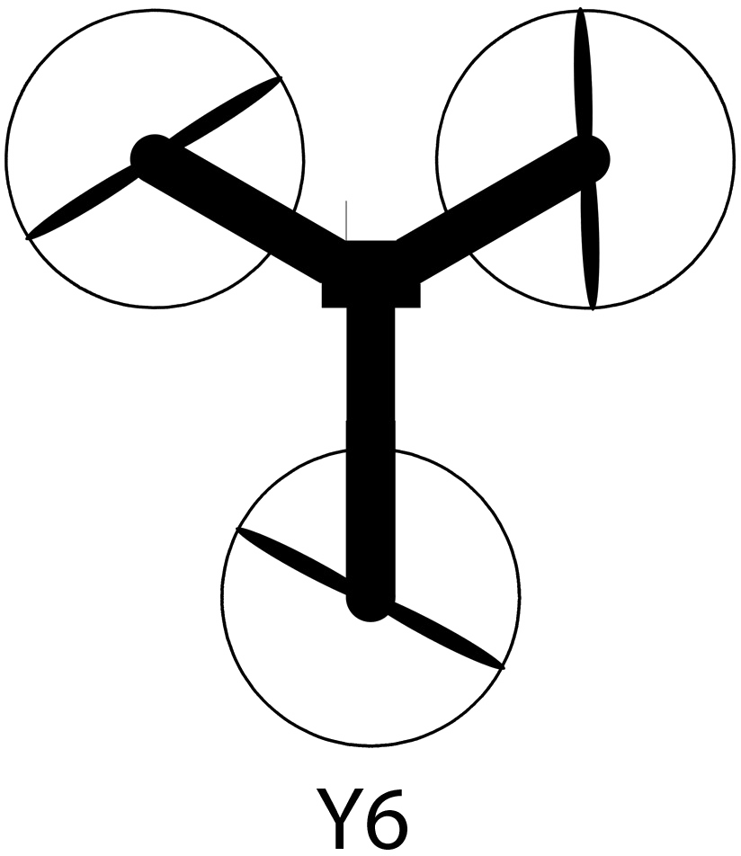
Recap → Flight Control → Image Processing → WiFi / USNG → Airframe/Performance → Demo
Quad
Tri
Hexa

Slide 33
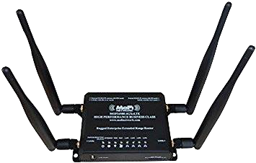
Recap → Flight Control → Image Processing → WiFi / USNG → Airframe & Performance → Demo
MOFI-4500 4G/LTE Router
WiFi and Cellular Dual Router
2 x 9 dBi External Antennas for WiFi
2 x 5 dBi External Antennas for Cellular
Transmit Power: 21 +/- 1 dBm

Slide 34
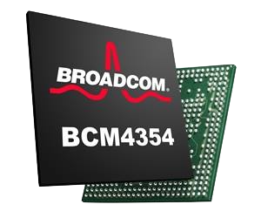
Recap → Flight Control → Image Processing → WiFi / USNG → Airframe & Performance → Demo
Broadcom BCM4354
WiFi Chipset used in TX1
Receiver sensitivity of -95 dB
Antenna gain of 5 x 2 dB

Slide 35
Recap → Flight Control → Image Processing → WiFi / USNG → Airframe & Performance → Demo
Range Calculation

Slide 36
Recap → Flight Control → Image Processing → WiFi / USNG → Airframe & Performance → Demo
Range Calculation

Slide 37
Recap → Flight Control → Image Processing → WiFi / USNG → Airframe & Performance → Demo
Range Calculation
Factors to consider in Empirical Calculation
Transmit Power
Path Loss
Fade Margin
Receiver Sensitivity
Transmit Antenna Gain
Receiver Antenna Gain
d ≈ 1.5 km

Slide 38
Recap → Flight Control → Image Processing → WiFi / USNG → Airframe & Performance → Demo
Range Calculation

Slide 39
Recap → Flight Control → Image Processing → WiFi / USNG → Airframe & Performance → Demo
Range Calculation

Slide 40
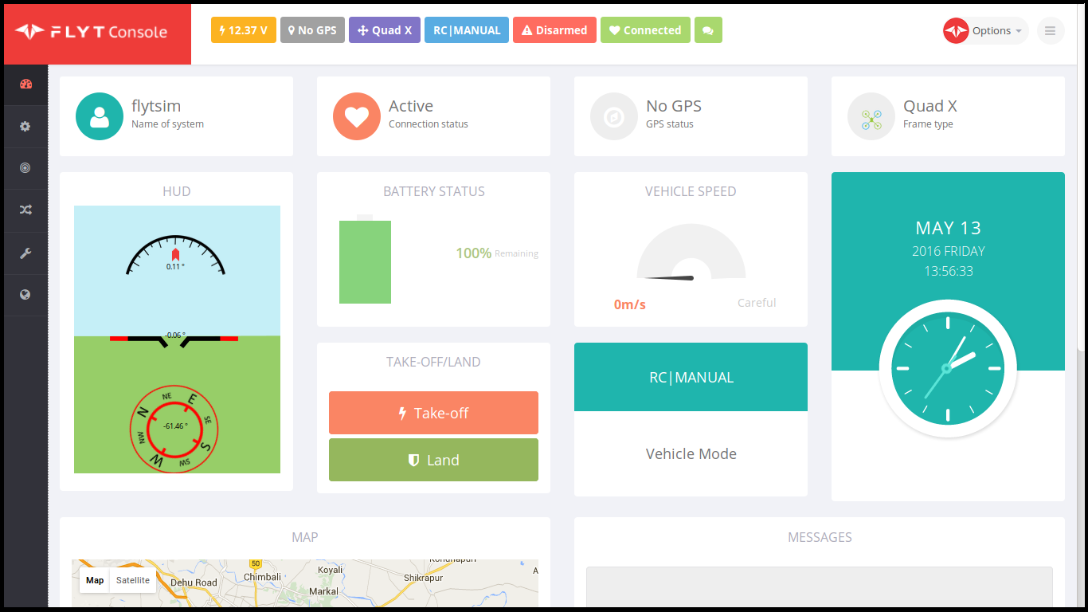
USNG System Implementation
USNG
Implement Conversion Algorithm
Display USNG through GUI in FlytOS

Slide 41
IEEE 802.11 AC @ 2.4 GHz
2.4 GHz
has lower frequency and greater range
is more stable
5 GHz
is power hungry
subject to transmission interruption

Slide 42
Equipment Selection
USB WiFi Adapter
802.11 Standard | Max Speed of One Channel (Mbps) | Bandwidth of Channel (MHz) | Max Number of Channels | Operating Frequency (GHz)
a | 54 | 20 | 1 | 3.7/5
b | 11 | 22 | 1 | 2.4
g | 54 | 20 | 1 | 2.4
n | 150 | 20/40 | 4 | 2.4/5
ac | 866 | 20/40/80/160 | 8 | 2.4/5

