Slide 1
Rescue Drone:
Increasing Autonomy and Implementing Computer Vision
Team 4

Slide 2
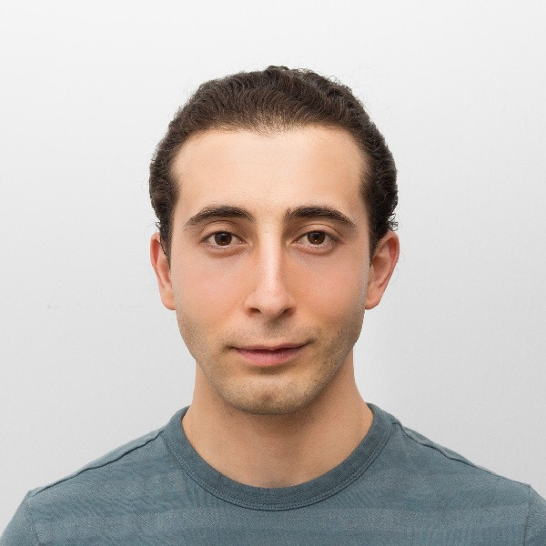
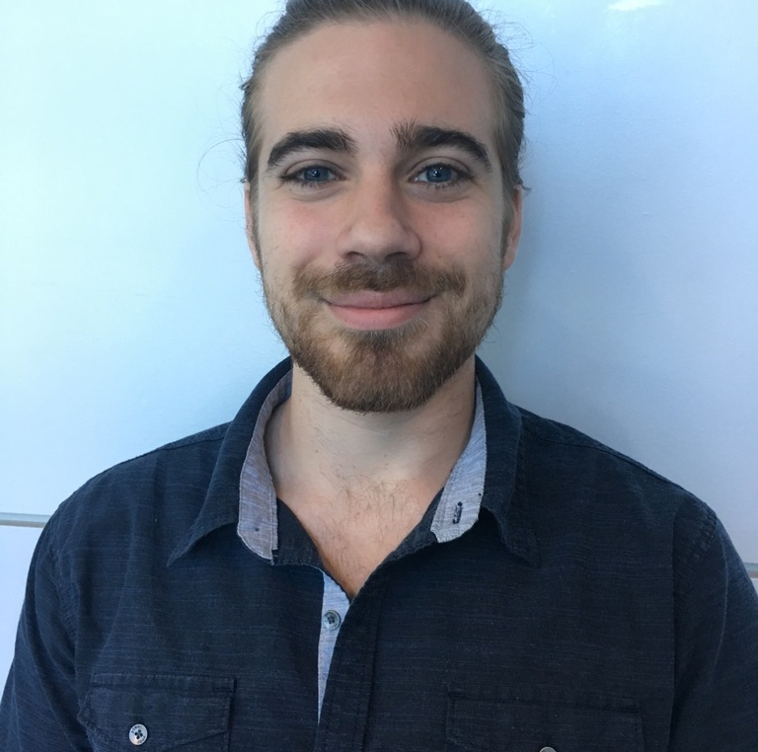



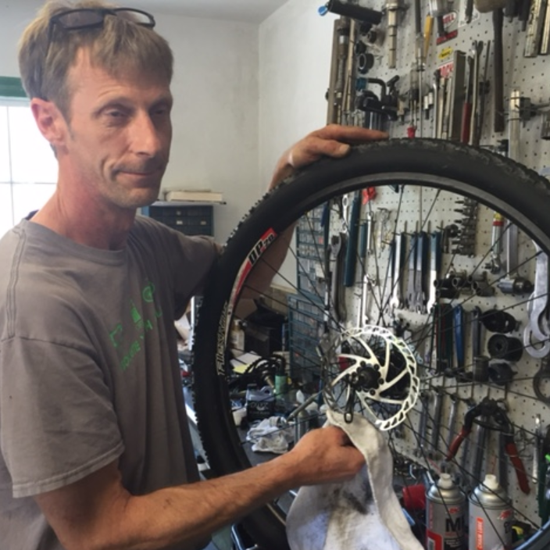
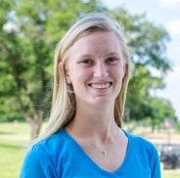
Halil Yonter
Team Leader
Flight Control
Cody Campbell
Hardware Engineer
Onboard Electronics
Shawn Cho
Software Engineer
WiFi/USNG
Alexandra Borgesen
Computer Engineer
Image Processing
Peter Burchell
Mechanical Engineer
Demonstration
Sarah Hood
Dynamic Systems Engineer
Airframe & Performance

Slide 3

Recap → Flight Control → Image Processing → WiFi / USNG → Airframe & Performance → Demo
World Class Education
Disaster Recovery
Search and Rescue
Applied Research

Slide 4
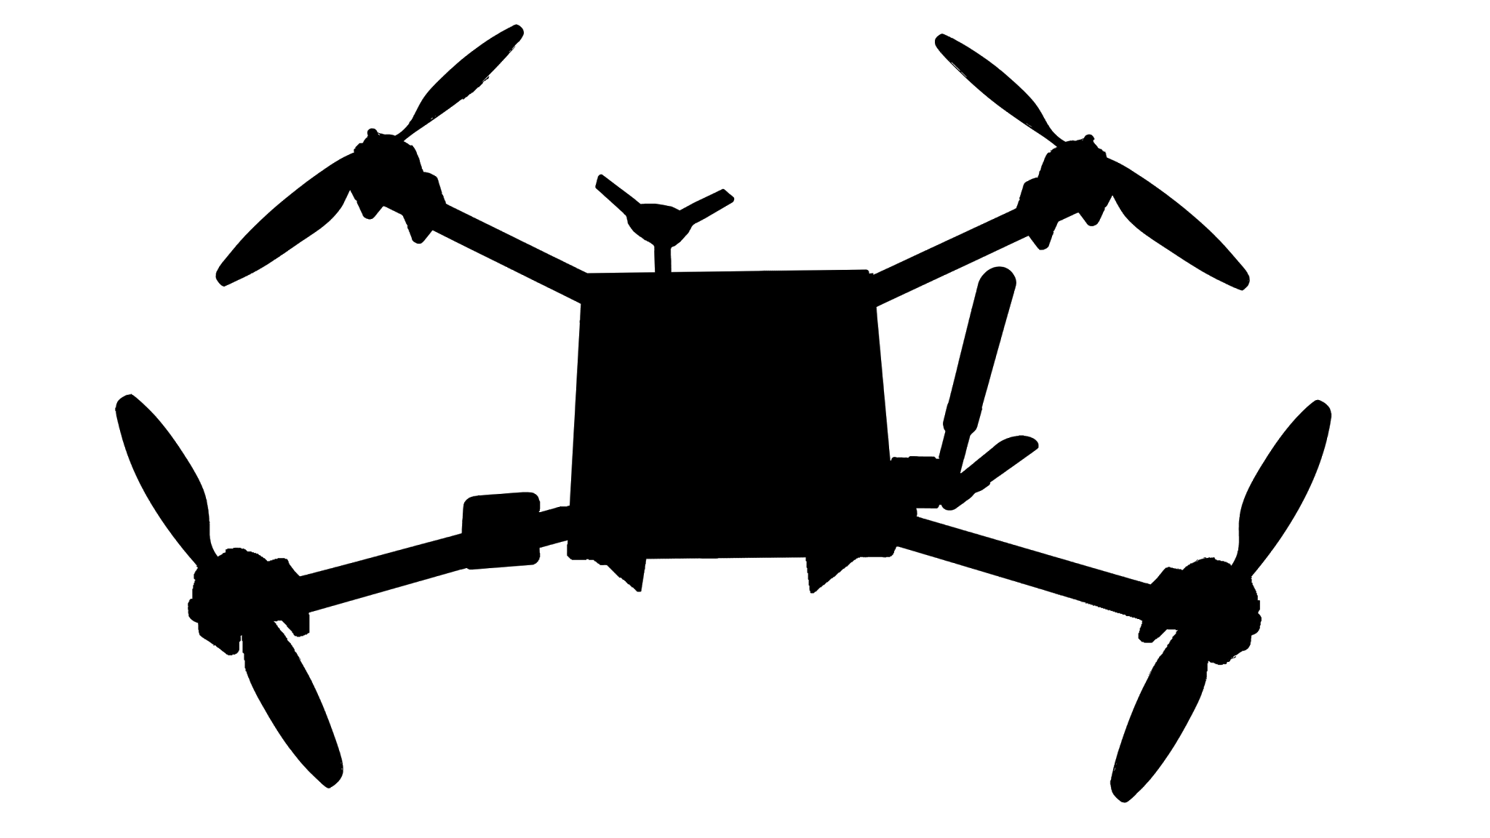
Recap → Flight Control → Image Processing → WiFi / USNG → Airframe & Performance → Demo
Autonomous Object Detection
Convenient Coordinate Conversion
Versatile Communication
Collapsable Design
Extended Flight Time

Slide 5
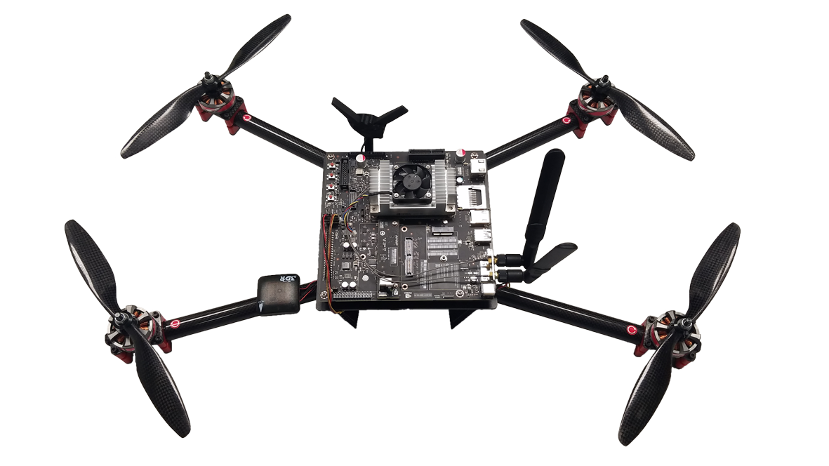
Recap → Flight Control → Image Processing → WiFi / USNG → Airframe & Performance → Demo
Innovative Flight Control
Powerful Onboard Computer
Adaptable Object Detection
Advanced USNG Output
Internet Protocol Network
Estimated 30% Increased Flight Time

Slide 6
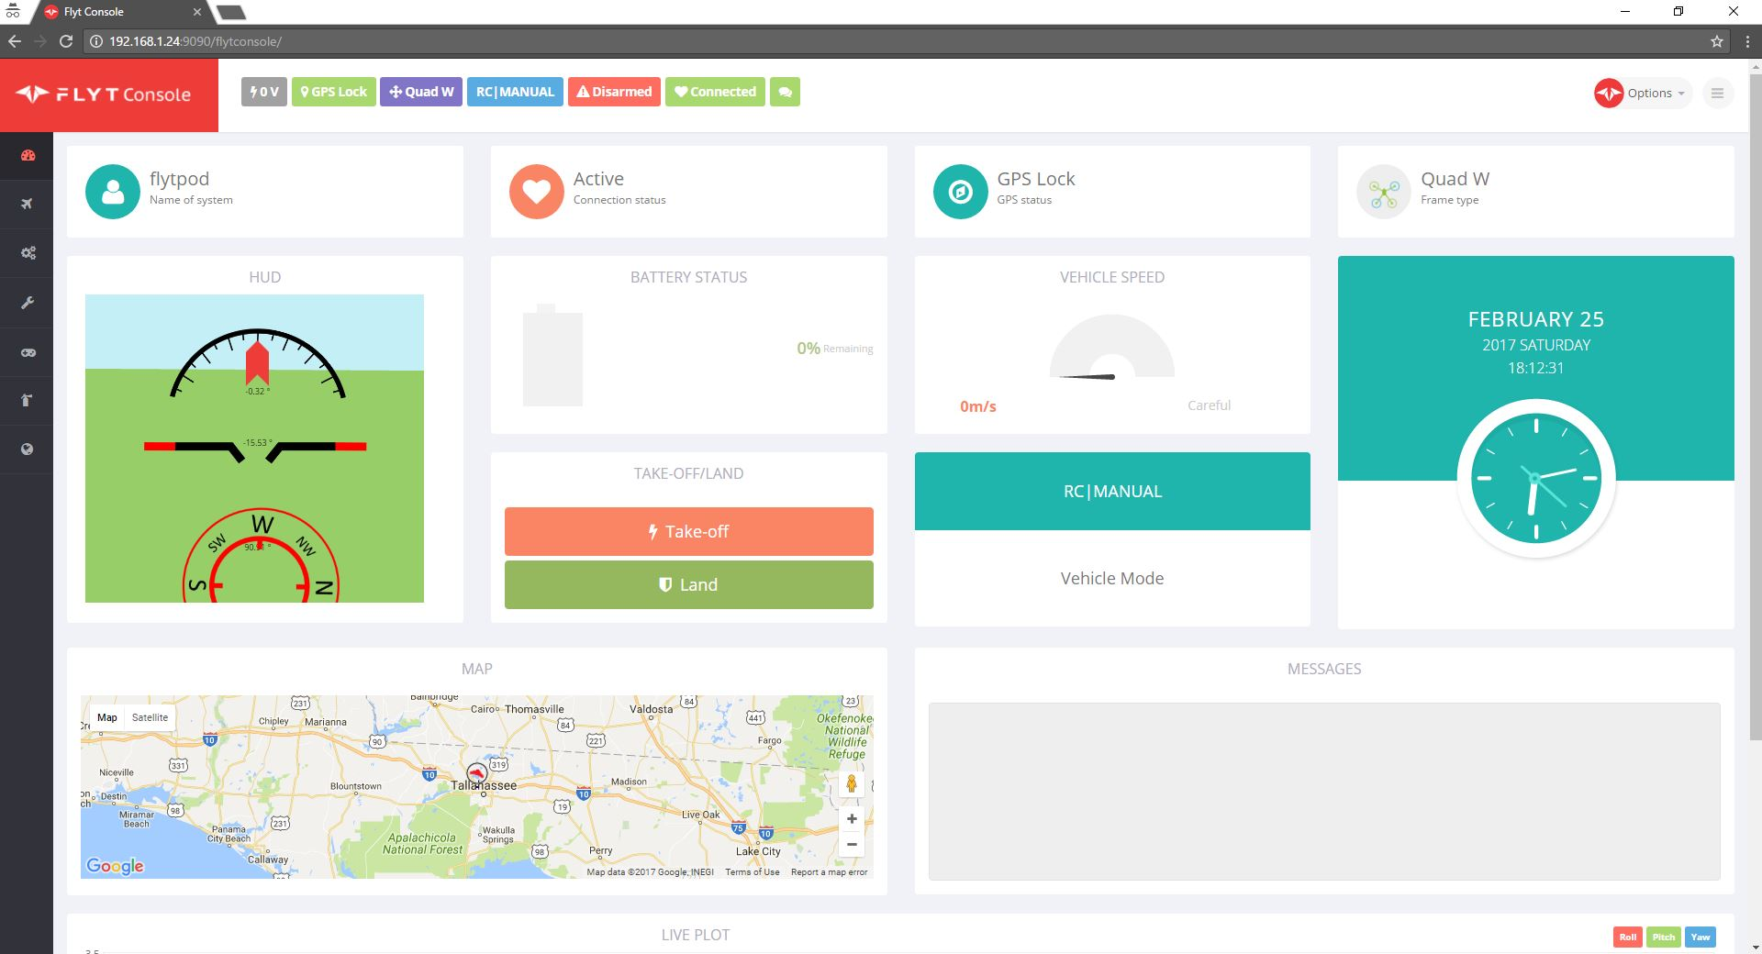
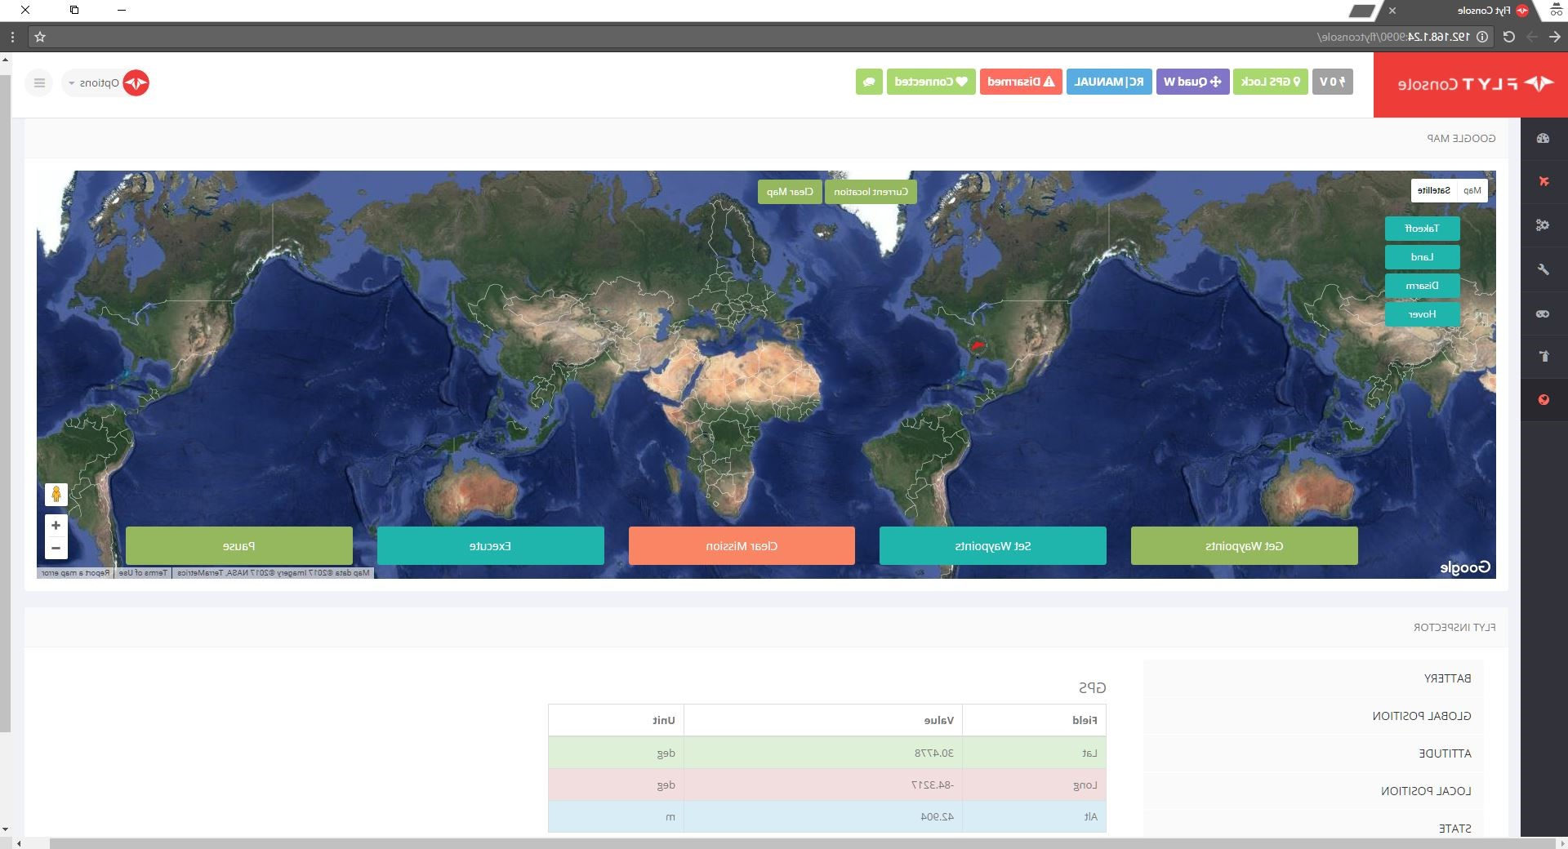

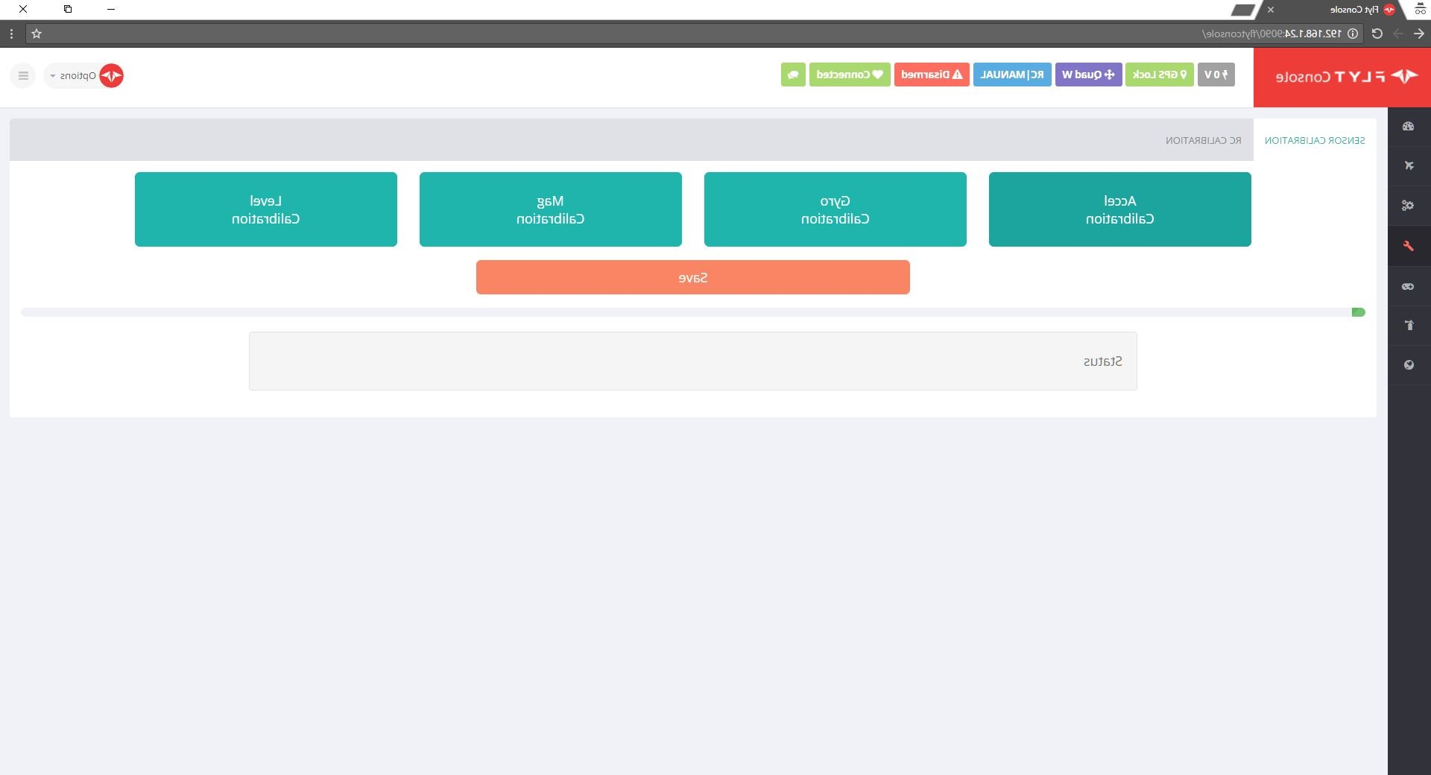
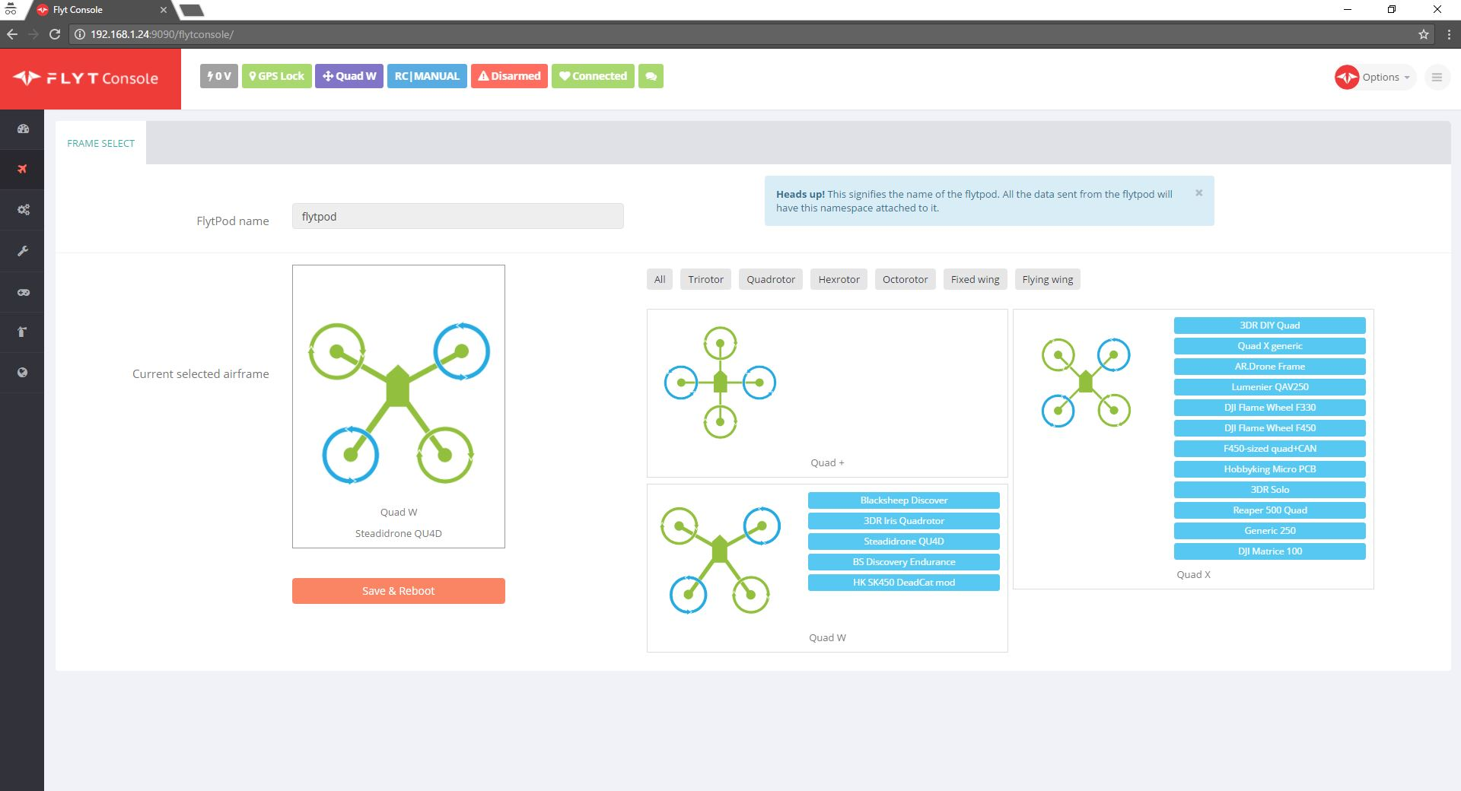

Recap → Flight Control → Image Processing → WiFi / USNG → Airframe & Performance → Demo

Slide 7


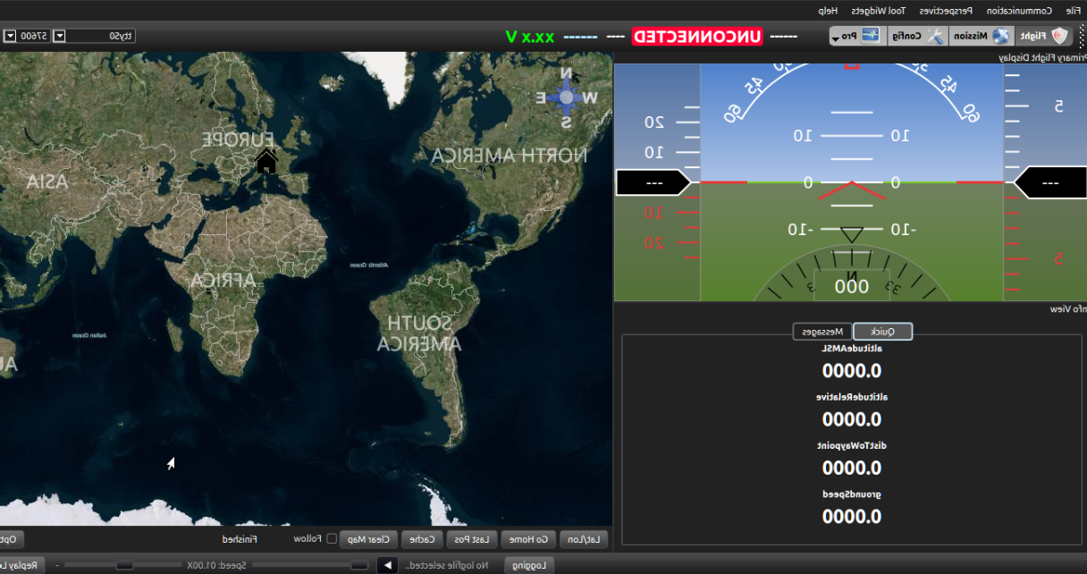
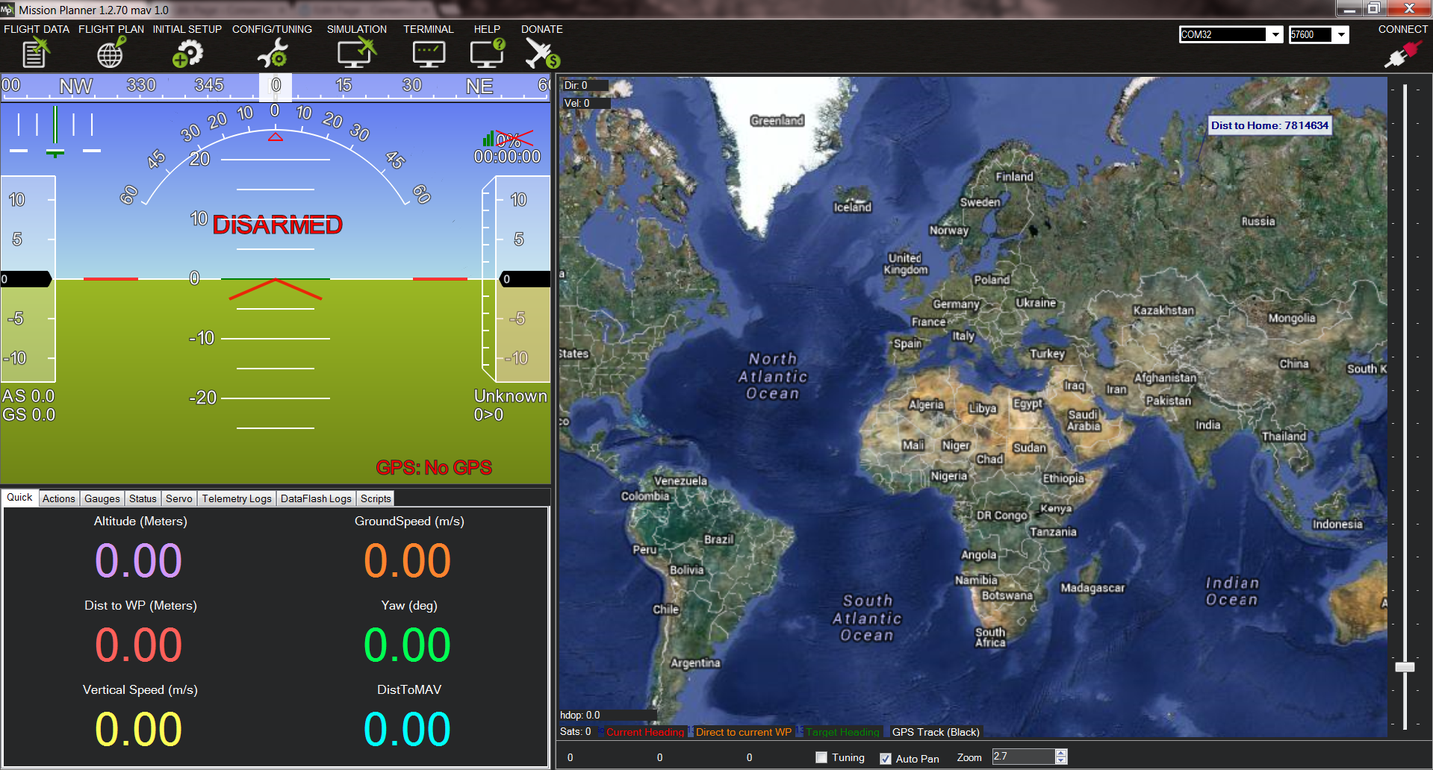
Recap → Flight Control → Image Processing → WiFi / USNG → Airframe & Performance → Demo

Slide 8
Image Processing
Cody Campbell and Alexandra Borgesen

Slide 9
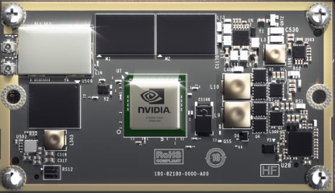
Recap → Flight Control → Image Processing → WiFi / USNG → Airframe & Performance → Demo
NVIDIA Jetson TX1
Low power consumption
Integrated WiFi
Designed specifically for
  Video Processing
  Image Recognition
  Deep Learning
Specifications:
64-bit ARM A57 CPUs
4 GB LPDDR4 Memory
Notes:
As discussed before, we’ve implemented the NVIDIA TX1 as our processor. We chose this for its low power consumption, on board WiFi, and its internal architecture which was designed specifically for Image processing and deep learning. We have since purchased the TX1, and successfully tested it with the software we will be using.

Slide 10
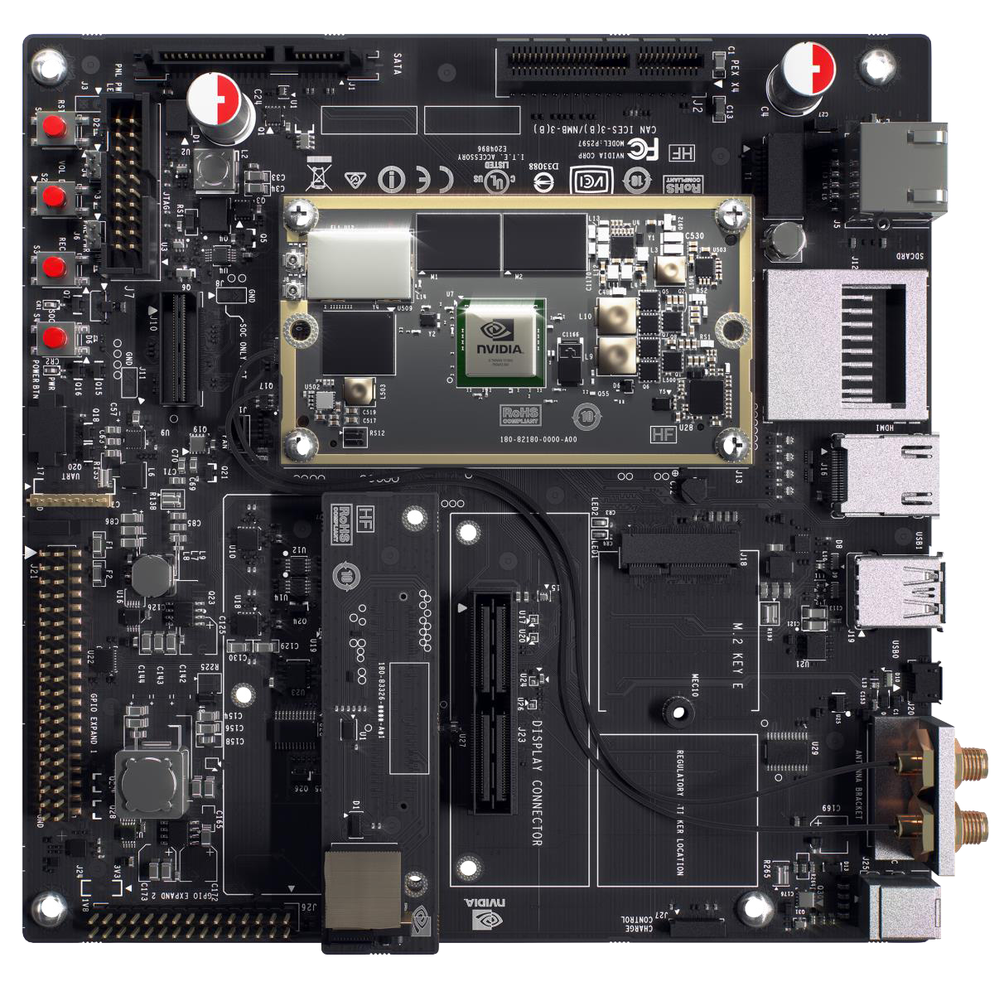
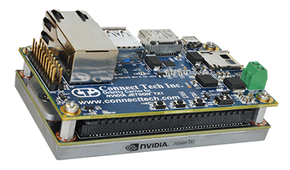
Recap → Flight Control → Image Processing → WiFi / USNG → Airframe & Performance → Demo
Connect Tech Orbitty Carrier Board
Expected power consumption of 9 W
USB Port
Micro SD Port
UART port
Notes:
The TX1 came with a development board, which allows you to interface with the TX1 in many different ways. We were able to successfully fly the drone with the development board, but the power draw and weight were too much to provide the minimum flight time of 20 minutes. To fix this, we purchased a much smaller carrier board that maintains all of the needed functionality, with an expected power consumption of just 9 Watts. We’ll be using the USB port for our camera, the Micro SD port for storage, and the UART port to communicate with the Pixhawk and other on board controllers.

Slide 11
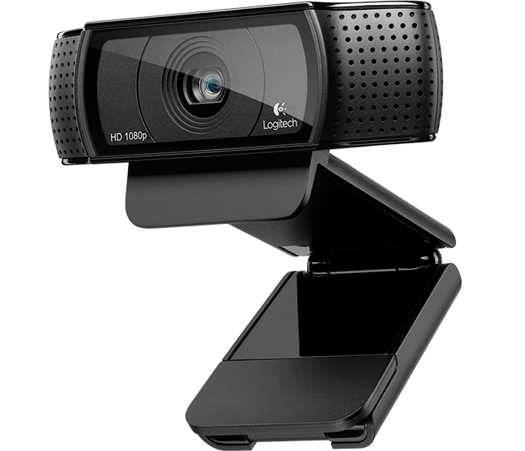
Recap → Flight Control → Image Processing → WiFi / USNG → Airframe & Performance → Demo
Camera
GoPro Hero 3
High quality and small form factor
Live streaming over WiFi
Live streaming with analog video
Logitech C920
Streams over USB
Great color reproduction
High contrast
Can be replaced by any USB camera
Notes:
Our original camera was a gopro, because of its quality, and small form factor. The only way to stream live, high quality video from the GoPro is over a WiFi connection, using the GoPro as a hotspot. This won’t work with our setup not only because of the interference in the 2.4GHz spectrum, but also because we need to connect to the ground station over WiFi. The TX1 cannot connect to both the ground station and the GoPro as two WiFi hotspots. The gopro can also stream analog video, but the available analog to digital converters are either too big for our purpose, or provide video at a quality lower than the camera we are currently using.

Slide 12
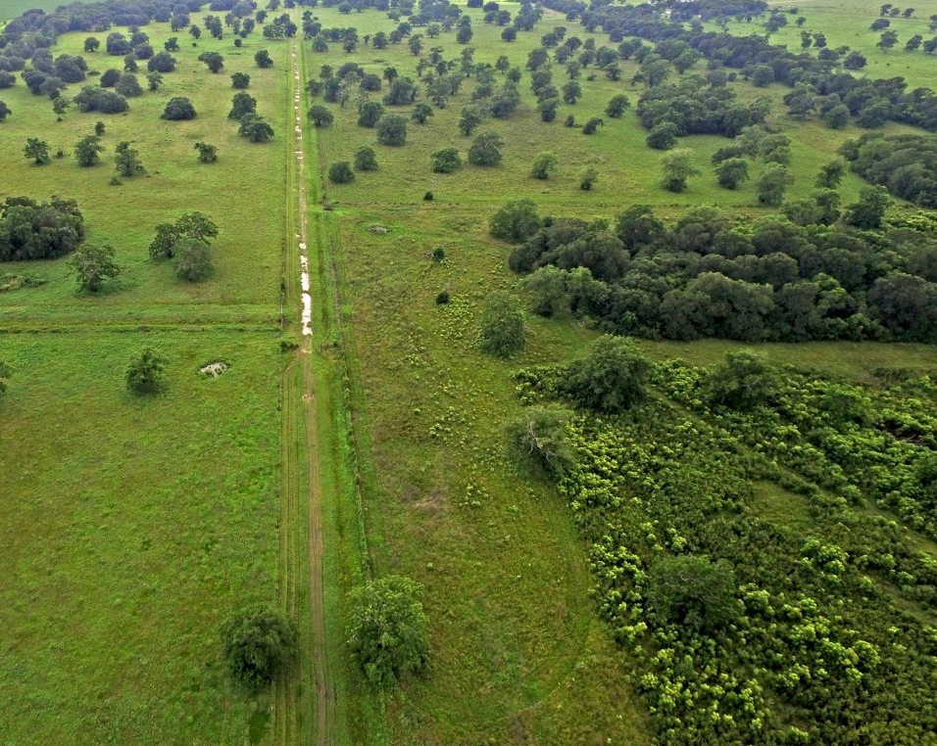
Recap → Flight Control → Image Processing → WiFi / USNG → Airframe & Performance → Demo
Object Detection
Goal: Detect an object of interest
Estimated altitude: 200 ft
  Limited visibility
  Complex and detailed backgrounds
Let algorithms handle image processing
  Pedestrian Tracking
  Color Filtering
Notes:
Now, onto the object detection. Our goal is to detect an object of interest on the ground, and bring attention to it by automatically highlighting it.

Slide 13
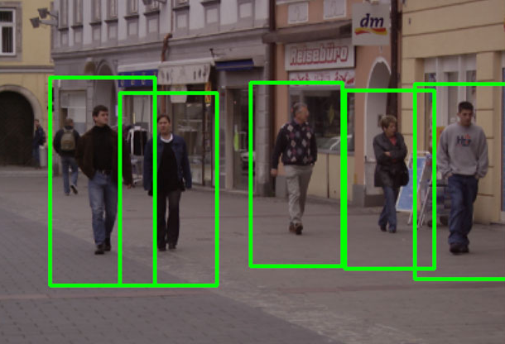
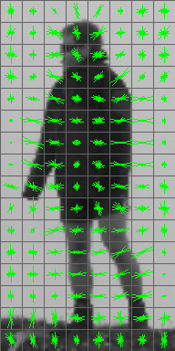
Recap → Flight Control → Image Processing → WiFi / USNG → Airframe & Performance → Demo
Pedestrian Tracking
The tracking looks for anything that resembles a head, two arms, two legs, and a torso.
  HOG - feature descriptor
  SVM - binary classifier
Notes:
As Cody said, we are looking for an object of interest. There is no clear definition of what this object may be, so we have played around with two different methods that are both excellent for object detection. For the pedestrian tracking, it works by looking for anything that resembles a head, two arms, two legs, and a torso. It identifies these using a feature descriptor, and pairs this output with a binary classifier for the decision making.

Slide 14
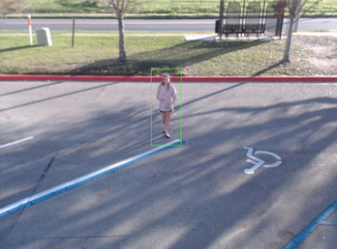
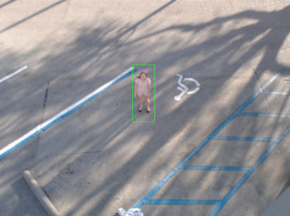
Recap → Flight Control → Image Processing → WiFi / USNG → Airframe & Performance → Demo
Notes:
In this image, the pedestrian tracking algorithm successfully detected me in the parking lot. We tried this from two separate angles, where the image to the right is more likely to resemble the angle we can expect from the drone overhead.

Slide 15
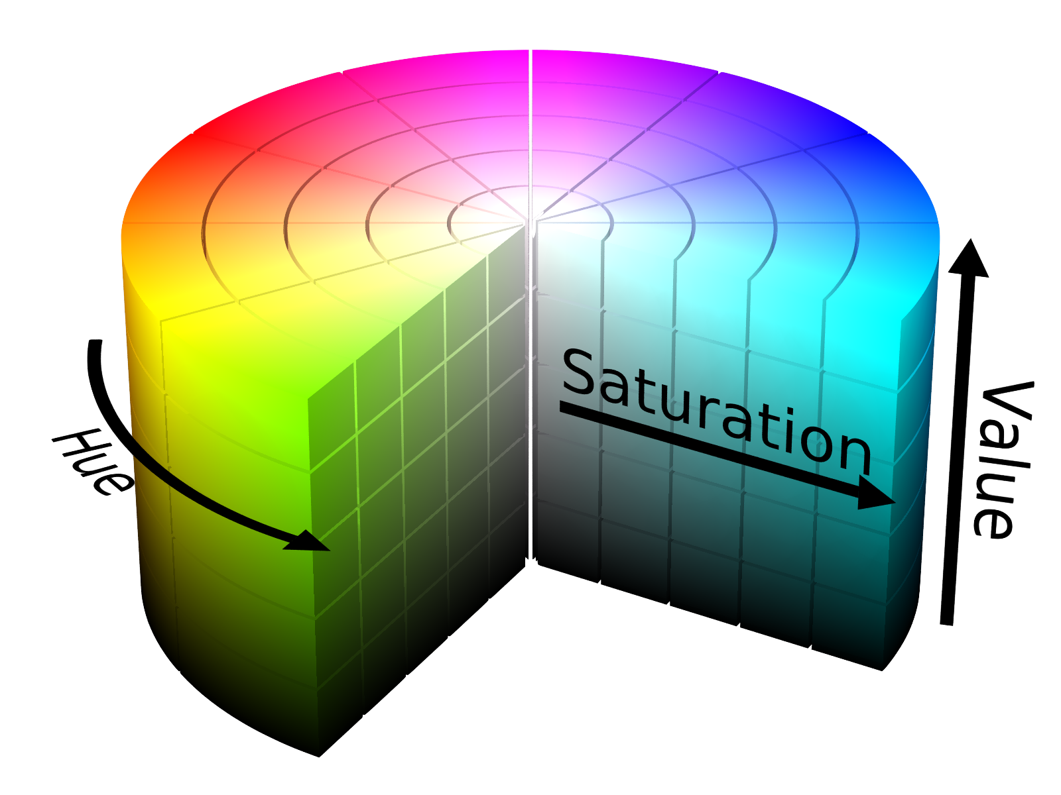
Recap → Flight Control → Image Processing → WiFi / USNG → Airframe & Performance → Demo
Color Filtering
Converting colors to HSV
  Hue: Color
  Saturation: Intensity
  Value: Brightness
# Select HSV range for color “red”
lower_red = np.array([30,150,50])
upper_red = np.array([255,255,180])
# Converts frames to HSV,
# ... if the frame’s HSV is within the given range
# ... the mask will return “true” for that frame
mask = cv2.inRange(hsv, lower_red, upper_red)
# Restores image frames only where mask is true
res = cv2.bitwise_and(frame,frame, mask = mask)

Slide 16
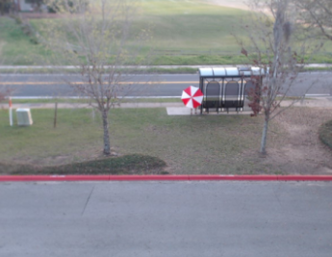

Recap → Flight Control → Image Processing → WiFi / USNG → Airframe & Performance → Demo

Slide 17
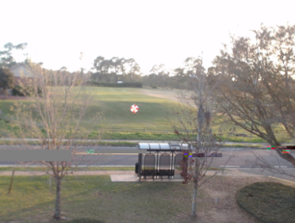
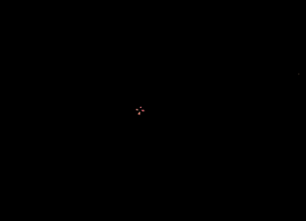
Recap → Flight Control → Image Processing → WiFi / USNG → Airframe & Performance → Demo

Slide 18
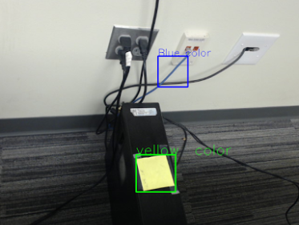
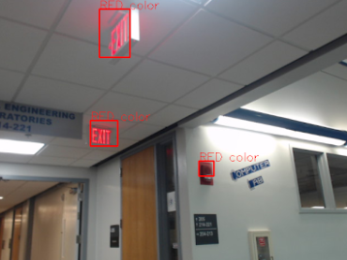
Recap → Flight Control → Image Processing → WiFi / USNG → Airframe & Performance → Demo

Slide 19
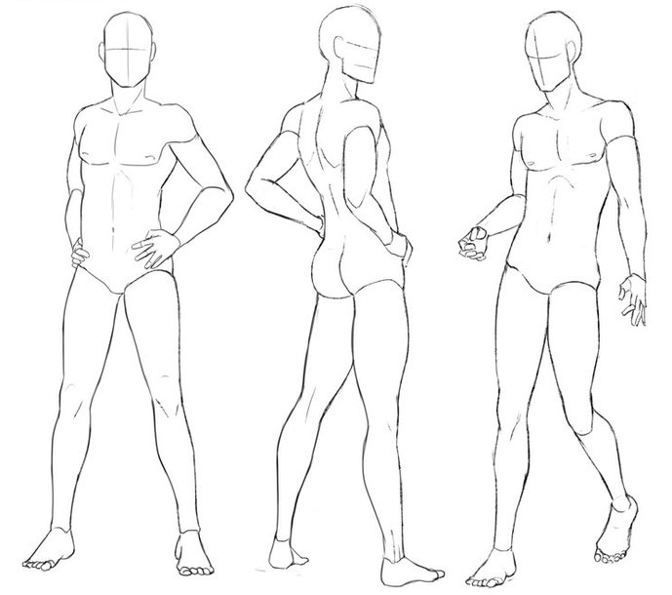
Recap → Flight Control → Image Processing → WiFi / USNG → Airframe & Performance → Demo
Observations
Pedestrian tracking
  Tested range: 40 ft
  Live stream has a 2 second delay
  Struggles with certain poses
Color filtering
  Tested range: 200 ft
  Live stream “instantaneous”
  Risk overfiltering

Slide 20
Communication and Location
Shawn Cho

Slide 21

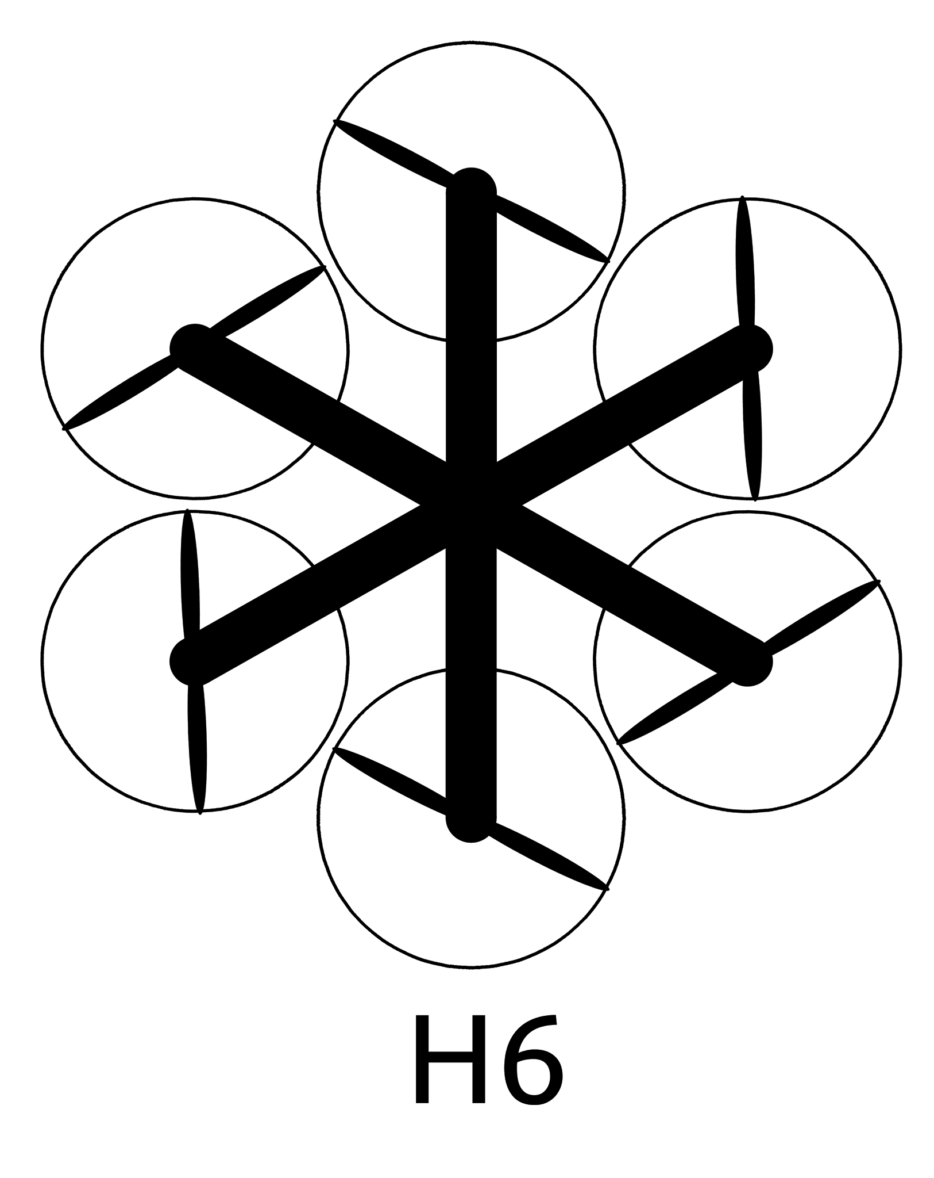
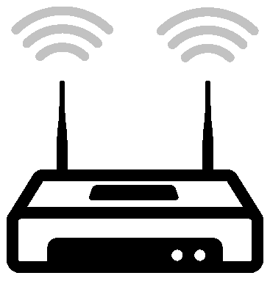



Recap → Flight Control → Image Processing → WiFi / USNG → Airframe & Performance → Demo
Implementation
ISP
4G LTE

Slide 22
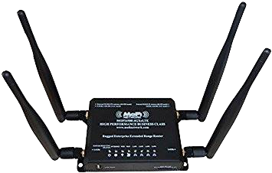
Recap → Flight Control → Image Processing → WiFi / USNG → Airframe & Performance → Demo
MOFI-4500 4G/LTE Router
WiFi and Cellular Dual Router
2 x 5 dBi External Antennas for WiFi
2 x 5 dBi External Antennas for Cellular
Transmit Power: 21 +/- 1 dBm

Slide 23
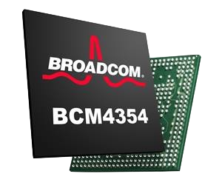
Recap → Flight Control → Image Processing → WiFi / USNG → Airframe & Performance → Demo
Broadcom BCM4354
WiFi Chipset used in TX1
Receiver sensitivity of -85 dB
Antenna Gain of 6 dB

Slide 24
Recap → Flight Control → Image Processing → WiFi / USNG → Airframe & Performance → Demo
Range Calculation

Slide 25
Recap → Flight Control → Image Processing → WiFi / USNG → Airframe & Performance → Demo
Range Calculation
Factors to consider in Empirical Calculation
Transmit Power
Path Loss
Fade Margin
Receiver Sensitivity
Transmit Antenna Gain
Receiver Antenna Gain
d ≈ .800 km

Slide 26
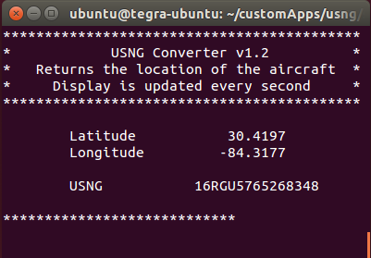
Recap → Flight Control → Image Processing → WiFi / USNG → Airframe & Performance → Demo
USNG Conversion
Implemented in multiple programming languages by MIT GeographicsLib
C++ implementation
Successfully converts latitude and longitude to USNG from hardware coordinates

Slide 27
Airframe and Performance
Sarah Hood

Slide 28
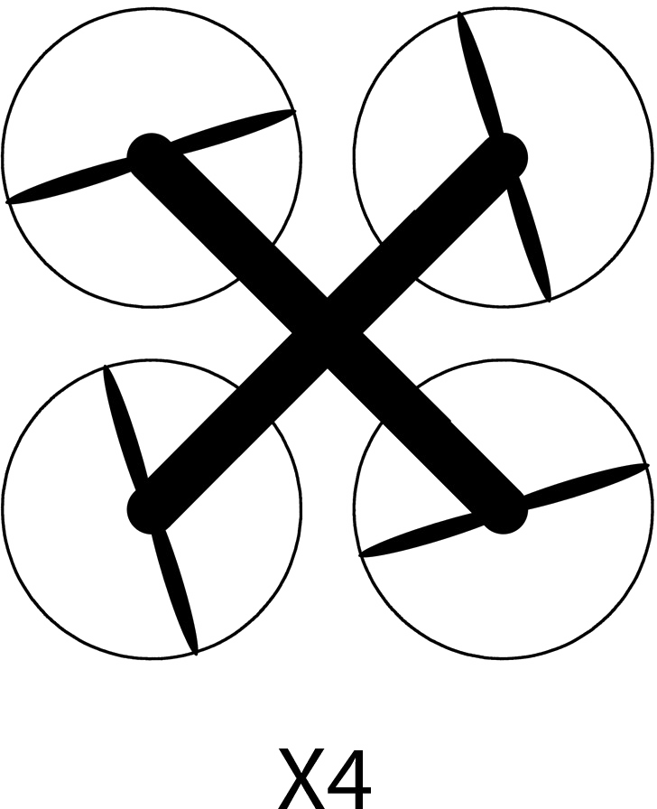
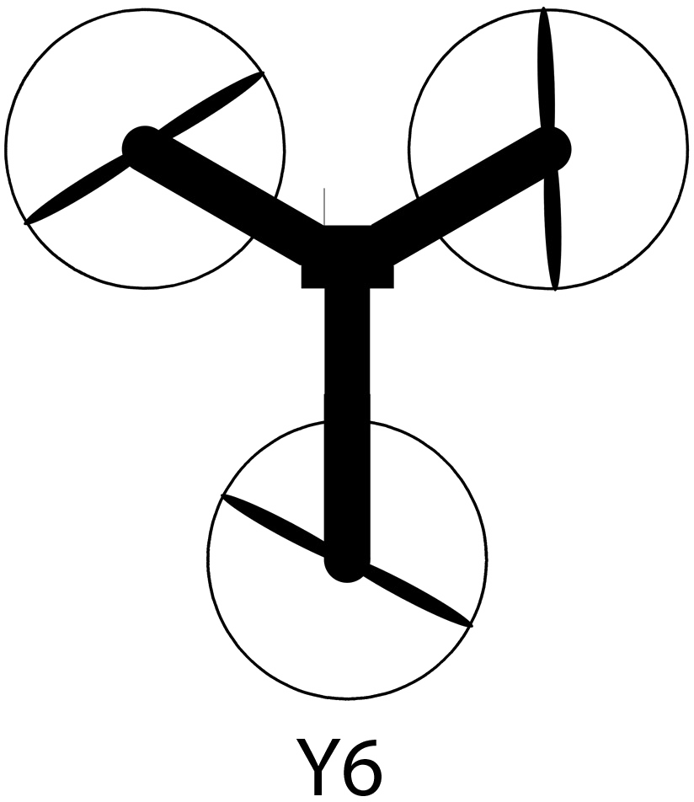
Recap → Flight Control → Image Processing → WiFi / USNG → Airframe/Performance → Demo
Quad
Tri
Hexa

Slide 29
Recap → Flight Control → Image Processing → WiFi / USNG → Airframe/Performance → Demo
Hexacopter
Custom SteadiDrone
  Poor availability
Tarot 680PRO
  780 g
  685 mm storeage dimension
Quanum 680UC
  740 g
  280 mm storeage dimension

Slide 30
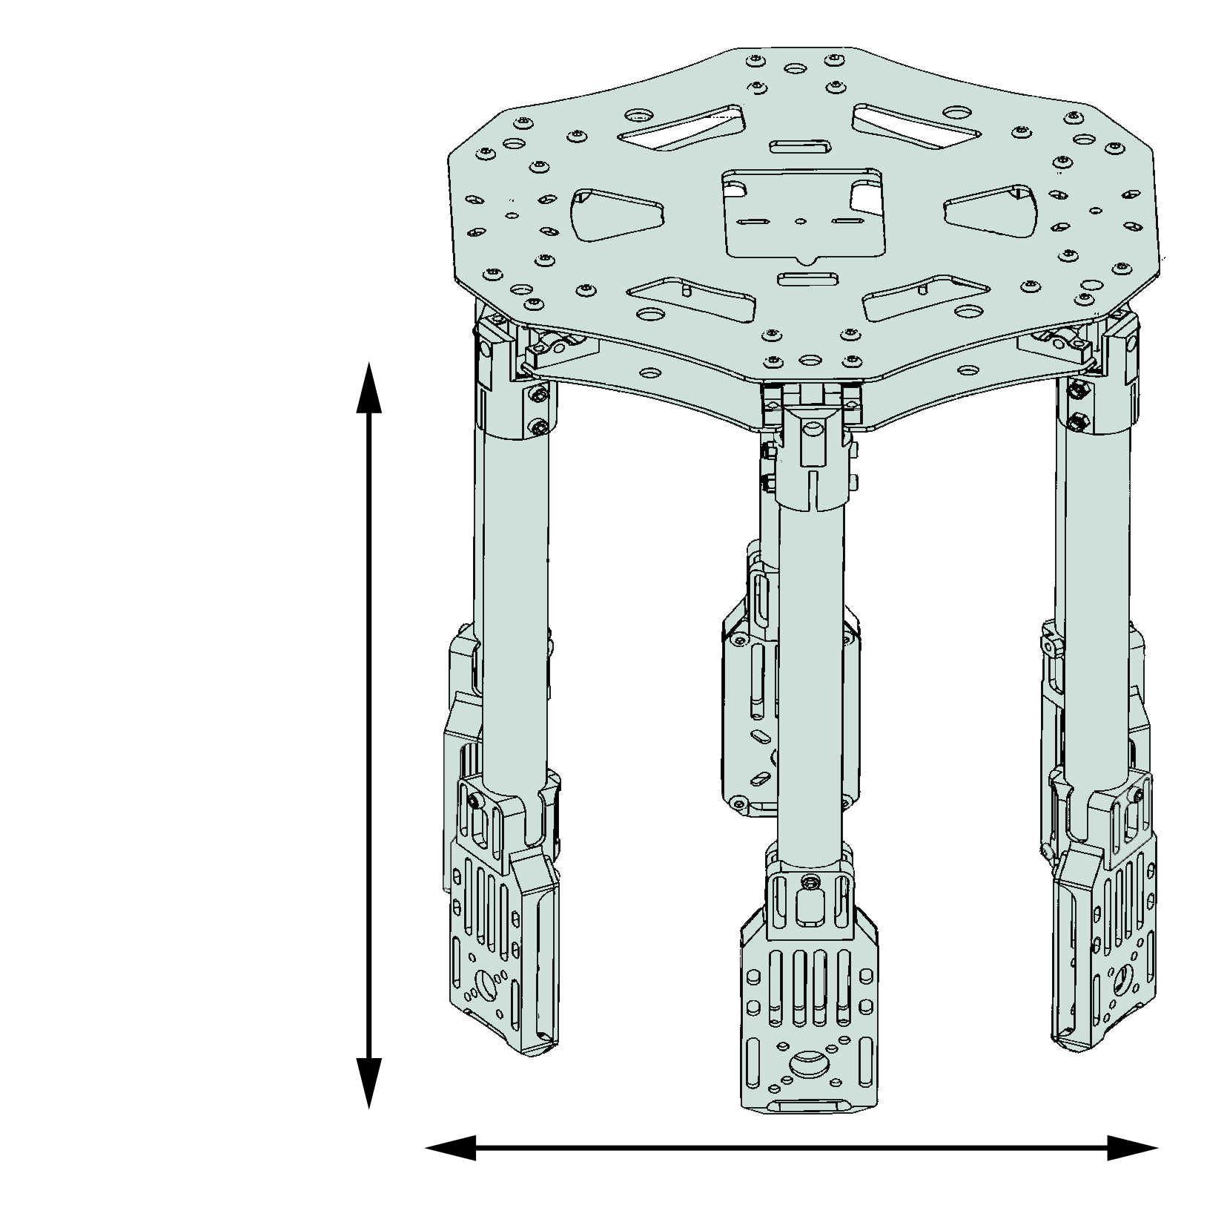
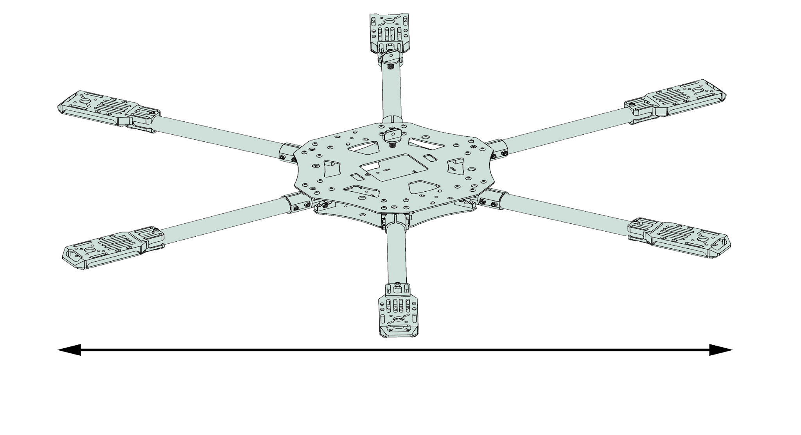
Recap → Flight Control → Image Processing → WiFi / USNG → Airframe/Performance → Demo
Quanum 680UC
280 mm
680 mm
260 mm

Slide 31
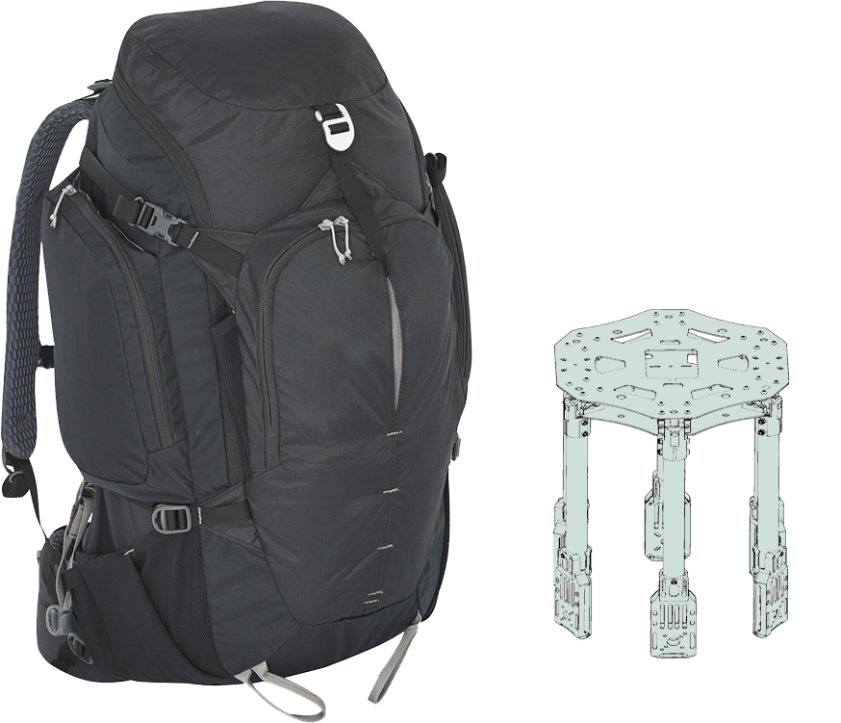
Recap → Flight Control → Image Processing → WiFi / USNG → Airframe/Performance → Demo
Quanum 680UC
Quanum 680UC
  Fits in 50 L backpack
  Payload protection
  Standard materials
  Modular construction

Slide 32
Recap → Flight Control → Image Processing → WiFi / USNG → Airframe/Performance → Demo
Peak Thrust Assessment
Battery Tested | 4 Rotor | 6 Rotor
3 Cell | 2776 g | 4164 g
4 Cell | 4148 g | 6222 g
Needed Peak Thrust* | 3746 g | 4218 g
*Based on the predicted weight of the aircraft and on board technology, not including the weight of the battery.

Slide 33
Recap → Flight Control → Image Processing → WiFi / USNG → Airframe/Performance → Demo
Predicted Weight
Flight duration
30 minutes → 24 minutes
Pixhawk | 1 | 38 g
Pixhawk accessories | 1 | 60 g
Motor/Prop/ESC each | 6 | 118 g
Controller receiver | 1 | 22 g
Gimbal | 1 | 214 g
Camera | 1 | 150 g
Nvidia TX1 | 1 | 144 g
Airframe | 1 | 740 g
Total weight | 2076 g
Previous Weight vs Current Weight
1829 g → 2076 g

Slide 34
Demonstration
Peter Burchell

Slide 35
Recap → Flight Control → Image Processing → WiFi / USNG → Airframe/Performance → Demo
Demonstration
Vehicle Interface
USNG
Object Detection

Slide 36
Summary
Halil Yonter

Slide 37





Slide 38
Acknowledgements to
Mr. Merrick
Dr. Hooker
Dr. Roberts
Dr. Foo
Dr. Harvey
Thank You
Questions?
Questions?

Slide 39
Recap → Flight Control → Image Processing → WiFi / USNG → Airframe & Performance → Demo
Range Calculation

Slide 40
Recap → Flight Control → Image Processing → WiFi / USNG → Airframe & Performance → Demo
Range Calculation

Slide 41
Recap → Flight Control → Image Processing → WiFi / USNG → Airframe & Performance → Demo
Range Calculation

Slide 42
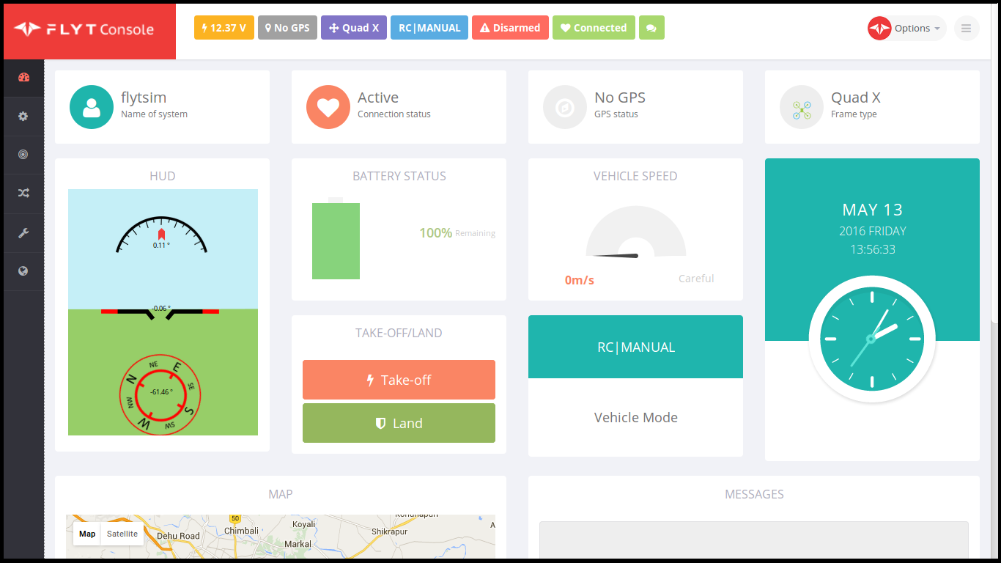
USNG System Implementation
USNG
Implement Conversion Algorithm
Display USNG through GUI in FlytOS

Slide 43
IEEE 802.11 AC @ 2.4 GHz
2.4 GHz
  has lower frequency and greater range
  is more stable
5 GHz
  is power hungry
  subject to transmission interruption

Slide 44
Equipment Selection
USB WiFi Adapter
802.11 Standard | Max Speed of One Channel (Mbps) | Bandwidth of Channel (MHz) | Max Number of Channels | Operating Frequency (GHz)
a | 54 | 20 | 1 | 3.7/5
b | 11 | 22 | 1 | 2.4
g | 54 | 20 | 1 | 2.4
n | 150 | 20/40 | 4 | 2.4/5
ac | 866 | 20/40/80/160 | 8 | 2.4/5

