Slide 1
Reversible Computing:
A Cross-Disciplinary Introduction
Invited talk presented Mar. 10th, 2014 to the Beyond Moore Research Challenge group at Sandia National Laboratories, Albuquerque, NM
Michael P. Frank
Associate in Engineering, Department of Electrical & Computer Engineering, FAMU-FSU College of Engineering

Slide 2
Outline of Talk
Limits of traditional CMOS scaling
  And of all irreversible digital technologies
Brief history of reversible computing research
  Review of some major developments
An example reversible logic scheme: 2LAL
RevComp’s alternate path for power scaling
  Potential to sidestep limits of standard roadmap
  Requires cooperation, with a new mindset, among:
    Device physicists
    Process engineers
    Logic family designers / tool developers
    Circuit/interconnect designers
    Computer architects

Slide 3
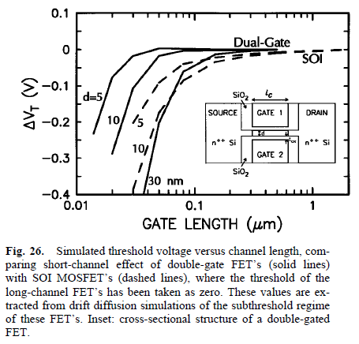
Problems with continued
CMOS power-performance scaling
We have been aware these were coming for a long time!
  E.g., Proc. IEEE paper by David Frank & colleagues, 1997 →
Short-channel effects related to electron diffusion length
  Low thresholds → hard to turn device off
Even more fundamental limits on subthreshold slope of log(I)-log(V_{GS}) curve
  ~60 mV/decade at best
  Limits I_{on}/I_{off} for given logic swing V_{dd}

Slide 4
Even More Fundamental Problems with Energy Efficiency Scaling
Boltzmann’s Distribution tells us that any system experiences energy fluctuations of order ~kT
  Thus, reliably suppressing undesired transitions requires energy barriers/differences of 10s of kT
    If you dissipate say ~40 kT at any temperature T when switching, implies ~1 eV system dissip. into room-T env.
  Boltz. Dist. is derived by a totally general thermodynamic argument that is unaffected by the specific physical structure of the system in question
    Novel device physics cannot help (CNTs, optics, quantum)
    Fancy error correction codes cannot help
      Total energy/reliability of encoded bit still subject to argument!

Slide 5
An Absolute Requirement for Ongoing Power-Performance Scaling
Given that we must, therefore, dissipate ~1 eV for each (irreversible, terrestrial) bit operation,
  We can only do at most ~6×10¹⁸ bit operations
  (6 Eops) per Joule of system energy dissipation
    Convert to FLOPS/W with your favorite conversion
If we hope to ever do significantly better than this, we absolutely MUST start learning how to:
Avoid Dissipating the Entire Bit
Energy When Manipulating Bits!
There literally is
no other choice.

Slide 6
Brief History of Reversible Computing Research
Rolf Landauer, 1961
  Only irreversible (many-to-one) logical operations appear to require a fundamental minimum energy dissipation
Charles Bennett, 1973
  Irreversible operations are not required for universal computation
Fredkin & Toffoli, late ‘70s
  Construct reversible computations by composing reversible logic primitives
  First proposal for an electronic reversible logic
Seitz et al., Kollar & Athas, etc., 1980s
  Earliest development of quasi-adiabatic circuits in CMOS
Younis & Knight & colleagues, 1990s
  First fully adiabatic sequential logic (early versions were still buggy)
Bennett (1988), Lange et al. (1997), Frank & Ammer (1997)
  Exploring computational complexity overheads of reversible computing
Frank & colleagues, 2000-2004
  Development & simulation of a simple truly, fully adiabatic logic scheme (2LAL)

Slide 7
Von Neumann – Landauer (VNL)
Principle
One correct statement of the principle:
  On average, oblivious erasure of a known logical bit must increase total entropy by at least k ln 2.
    Assuming 0 and 1 states arise equally often
Can be proven true via a trivial argument:
  Fundamental physics is believed to be reversible
    Unitary quantum evolution is consistent with all data
  A many-to-one transformation of the logical state ∴ implies a one-to-many transformation of the detailed physical state. → Increased entropy

Slide 8
Bennett’s Insight
Landauer: We can embed any irreversible (many-to-one) logical transformation into a larger reversible (one-to-one) transformation.
  However, this in general generates extra unwanted “garbage” bits – what to do with them?
Bennett: Just save the unwanted bits, reversibly copy the result, then undo the computation, de-computing the garbage.
  Frees up space for reuse in later computation.
Space-inefficient, but later work greatly improved on this.

Slide 9
Adiabatic Logic using FETs:
Basic Principle
Basic recipe to transition a logic level with negligible dissipation (“adiabatically”):
  Match levels between input node I
  and storage node S (with known data).
  Switch voltage on transistor gate G to turn it on
    Can be done using same method, in staggered fashion.
  Ramp voltage on input node I gradually to new logic level over some time t ≫ RC (R = eff. on-resistance)
    Dissipation ~CV²RC/t can be as small as desired
    Series/parallel combinations of devices can do logic
    CMOS can be used for full-swing transitions
  Switch gate voltage on transistor to turn it off.
G
I
S
R
C

Slide 10
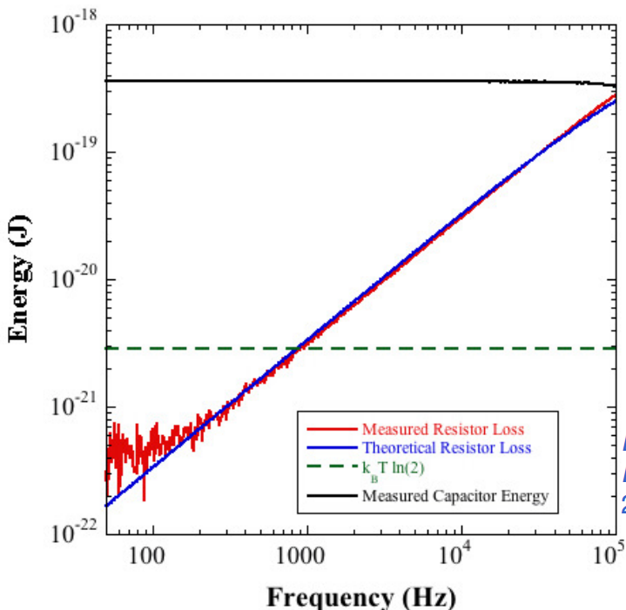
Is there a fundamental lower limit to energy dissipation of adiabatic charging?
No!
C.f., Boechler et al. (APL 97:103502, 2010) measured dissipation for charging a capacitor through a resistor adiabatically
  Min. dissipation was much less than (kT ln 2), and was limited only by measurement uncertainty

Slide 11
2LAL: 2-level Adiabatic Logic
A pipelined fully-adiabatic logic invented at UF (Spring 2000),
implementable using ordinary CMOS transistors.
T_{N}
T
2
Use simplified T-gate symbol:
Basic buffer element:
  cross-coupled T-gates:
    need 8 transistors to
    buffer 1 dual-rail signal
Only 4 timing signals φ₀₋₃ are
needed. Only 4 ticks per cycle:
  φ_{i} rises during ticks t≡i (mod 4)
  φ_{i} falls during ticks t≡i+2 (mod 4)
:≡
φ₁
(implicit
dual-rail
encoding
everywhere)
in
T_{P}
out
φ₀
Animation:
Tick #
0 1 2 3 …
φ₀
φ₁
φ₂
φ₃
Notes:
Anyway here is a simple adiabatic logic scheme, here demonstrated using ordinary CMOS transistors, that is based on a new operation paradigm we discovered in Spring of 2000 (called input-barrier, clocked-bias latching). For convenience, we use Hall’s electroid (switch) symbol, which can be implemented in CMOS with a parallel nFET/pFET pair (transmission gate).
There is a basic clocked buffer element consisting of a pair of cross-coupled switches.
This logic scheme is more economic than many previous ones because it requires only 4 global timing signals, really just 4 different phases of a single waveform. These are shown in the timing diagram. The top and bottom portions must be flat for at least a full tick. The shape of the transitions is arbitrary (though the slope should be finite everywhere and should scale down with increasing tick length).

Slide 12
More Complex Logic Functions
Non-inverting multi-input Boolean functions:
One way to do inverting functions in pipelined logic is to use a quad-rail logic encoding:
  To invert, just
  swap the rails!
    Zero-transistor
    “inverters.”
φ₀
AND gate
(plus delayed A)
OR gate
A₀
φ
A₀
B₀
A₁
B₀
(A∨B)₁
(AB)₁
A = 0
A = 1
A_{N}
A_{P}
A_{N}
A_{P}
Notes:
How about more complex functions? Again, series/parallel combinations of input-controlled switches will do the job. (Forward parts shown.) However, one must remember that information on internal nodes (such as the A output of the left circuit) must also be retracted by subsequent gates. Inputs that are not echoed in the output (e.g. B in both these examples) must be retracted seperately by some other circuit.
The easiest way to do inverting functions is to use a dual-rail encoding: a pulse on one wire represents 0, while a pulse on another represents 1. (Quad-rail encoding is shown since this is needed if switches are implemented using CMOS transmission gates.) Then a NOT gate is just a renaming of rails. Dual-rail has the further advantage of allowing the total magnitude of back-reactions on the resonant driver to be data-independent.

Slide 13
Shift Register Simulation Results (Cadence/Spectre)
Graph shows power dissipation vs. frequency
  in 8-stage shift register.
At moderate frequencies
(1 MHz),
  Reversible uses
  < 1/100th the power of irreversible!
At ultra-low power
(1 pW/transistor)
  Reversible is 100× faster than irreversible!
Minimum energy dissip. per nFET is < 1 eV!
  500× lower than best irreversible!
    500× higher computational energy efficiency!
Energy transferred is still ~10 fJ (~100 keV)
  So, energy recovery efficiency is 99.999%!
    Not including losses in power supply, though
2LAL = Two-level adiabatic logic (invented at UF, ‘00)
1 nJ
100 pJ
10 aJ
Standard
CMOS
10 pJ
1 aJ
1 pJ
1 eV
Energy dissipated per nFET per cycle
100 zJ
2LAL 1.8-2V
2V
100 fJ
1V
10 zJ
0.5V
10 fJ
kT ln 2
0.25V
1 fJ
1 zJ
100 yJ
100 aJ

Slide 14
Θ(log n)-time Recursive Adiabatic
Wired-OR Carry-Skip Adder
(8 bit segment shown)
With this recursive structure,
we can do a 2^{n}-bit add in 2(n+1)
logic levels.
Hardware
overhead is
< 2× regular
ripple-carry!
C_{in}
S A B
S A B
S A B
S A B
S A B
S A B
S A B
S A B
G C_{in}
GC_{out}C_{in}
G C_{in}
GC_{out}C_{in}
G C_{in}
GC_{out}C_{in}
G C_{in}
GC_{out}C_{in}
P
P
P
P
P
P
P
P
P_{ms} G_{ls} P_{ls}
P_{ms} G_{ls} P_{ls}
P_{ms} G_{ls} P_{ls}
P_{ms} G_{ls} P_{ls}
G
MS
GC_{out}
LS
C_{in}
G
MS
GC_{out}
LS
C_{in}
P
P
P
P
P_{ms} G_{ls} P_{ls}
P_{ms} G_{ls} P_{ls}
G
MS
GC_{out}
LS
C_{in}
P
P
P_{ms} G_{ls} P_{ls}
GC_{out}
LS
C_{in}
P

Slide 15
32-bit Adder Simulation Results
Further improvements may be attainable through more pipelining, carry-save adders, etc.
1V CMOS
1V CMOS
0.5V CMOS
0.5V CMOS
2V 2LAL, V_{sb}=1V
2V 2LAL, V_{sb}=1V
20x better perf.
@ 3 nW/adder
(Results are normalized to a
throughput level of 1 add/cycle)

Slide 16
What’s needed to create a viable path to pursue such ideas further?
Requires large numbers of engineers, across multiple disciplines, to cooperate in pursuing this approach, while each adopting a very different new mindset:
  Device physicists
  Process engineers
  Logic family designers / tool developers
  Circuit/interconnect designers
  Computer architects
All these people need to learn that the optimal design points for reversible operation differ greatly from the optimal design points assuming irreversible operation.

Slide 17
A New Perspective for Physicists
Exploring New Device Technologies
The important figures of merit determining power-performance of digital technologies operated reversibly in terrestrial environments are things like:
  For switching devices: Minimize the entropy coefficient c_{S} = Et/T, where:
    Device dissipates energy E over an adiabatic transition time t at operating temperature T.
      Determines how system-level dissipation trades off against speed, while accounting for minimum cryogenic cooling overheads
  For storage technologies (static nodes, memory cells): Minimize the entropy rate r_{S} = (E/t)/T, where:
    Device dissipates energy E per unit time t at temp. T just to reliably preserve a desired data value.
      Determines limits on system energy efficiency due to power leakage from storage, again while accounting for minimum cooling overheads.

Slide 18
A New Perspective for
Fabrication Process Engineers
The best technology for maximizing system power-performance given the availability for reversible design is not the same as the best technology given traditional design practices!
  E.g. leading-edge CMOS is highly suboptimal for reversible design b/c leakage currents are so high
    It makes the wrong tradeoff if you don’t have to pay CV² costs!
  Older-generation CMOS processes can actually achieve better overall energy efficiency when fully adiabatic design techniques are used! (Due to lower leakage)
    System cost-performance is worse, but will improve over time
  Looking forward, continuing to optimize processes for reversibility will lead to very different choices among the various potential post-CMOS device technologies.

Slide 19
A New Perspective for Logic Designers
The constraint of reversibility leads to very different abstractions being required at all levels in logic design. Designs must be rethought and re-optimized at every level.
  New logic families
  New standard cell libraries
  New hardware description languages
  New design tools
  New functional unit architectures

Slide 20
A New Perspective for
Integrated Circuits & Systems Design
New chip-level IC technologies
  Integrated high-L helical inductors would be useful
New clocking and power-supply networks
  Resonant delivery of trapezoidal clock-power signals
New circuit-level constraints on logic layouts
  Load balancing becomes even more important
New interconnect design methodologies
  Controlled-impedance signal paths become even more important
  High-Q transmission lines (integrated coax?)

Slide 21
A New Perspective for Computer Architecture
Which functions best lend themselves to implementation with efficient reversible hardware algorithms?
  Low computational complexity overheads from the use of reversibility
Which reversible logic design technique is best for implementing a given functional unit?
At what level in the system architecture should the reversibility constraint be broken?
  As low-level device characteristics improve, we can expect the reversible/irreversible boundary to be pushed to higher and higher levels

Slide 22
Conclusion
The digital technology industry is racing headlong towards a thermodynamic brick wall, due to irreversible logic practices
  NO post-CMOS technology concept that ignores the requirement for reversibility can possibly get us very far beyond end-of-line CMOS
But, I believe there’s a potential for the industry to transition over to a new track focused on development of reversible technologies
  This approach has the potential to take us far beyond the limits of irreversible technology’s power-performance
However, it will require a major shift in how things are done, which will be very disruptive to the industry
  It requires rethinking design goals and constraints at every level from basic research in nanodevice physics up to microarchitecture (at least)
I believe that massive investment in this approach needs to begin very soon if we want to avoid an extended flatline in power-performance delivered to end-user applications

