Slide 1
Digital Cash, Bitcoin, and the Distributed Consensus Revolution
ECE Graduate Seminar
Tuesday, January 14th, 2014
Dr. Michael Frank
Associate in Engineering
FAMU-FSU College of Engineering
v1.2

Slide 2


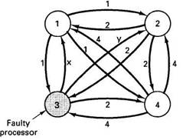
Abstract of Talk (Summarized)
A classic CS problem for digital cash:
  The “Double-Spending Problem”
Essentially solved in 2009 by Bitcoin
  A distributed, P2P digital currency protocol
  Has grown rapidly, worth >$10B today
But, the solution has other applications!
  Bitcoin’s distributed consensus
  mechanism addresses an even more
  general CS problem of “Byzantine
  Agreement” among distributed parties
    Many applications: Name registration,
    electronic voting, digital fundraising/stakeholding,
    distributed autonomous corporations, digital law, etc.
      A new organizing principle for civilization?

Slide 3


Talk Outline
Distributed Digital Cash systems
  Motivation
  Some early history
  Emergence of Bitcoin
How Bitcoin works
  Cryptographic tools used
  Peer-to-peer protocol
The Byzantine Agreement problem
  Distributed Consensus as a general solution
  Survey of (far-ranging!) applications

Slide 4


Some Motivations for Digital Cash
Cash money (vs. e.g. checks/debit+credit
cards/EFT) offers the following features:
  Anonymously transferrable, hard to trace
  Can be accepted with confidence, w. limited
  need to trust/consult a centralized authority
  Transactions are irreversible
Certain kinds of cash money (e.g., gold
coins) have the additional advantage
that their supply is fairly well limited
  Reliable as a long-term store of value
Some ways digital cash > physical cash:
  Instant long-distance transactions, encrypted storage, backup copies, (in some systems) nonrepudiability.

Slide 5
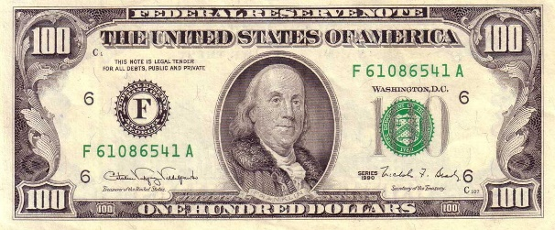


Fiat Currencies
Almost all sovereign (gov’t-issued) money today is what’s known as fiat currency.
  Not backed by gold or any other limited resource.
    True in U.S. since “Nixon shock” in 1971.
  Can be issued at will by government/central bank.
The problem with this is that the money supply can increase without limit over time…
  Long-term supply inflation → declining value
  Fiat is not a good long-term store of value!

Slide 6
Example: History of U.S. Dollar
Value, Based on Consumer Price Index
Data source: measuringworth.com

Slide 7
History of Digital Cash Research
Some notable prior efforts:
  David Chaum’s Ecash (seminal papers in 1982 & 1988)
    Patented approach based on his “blind signatures” invention
    Founded DigiCash co., Netherlands in 1990 to commercialize idea
      Company went bankrupt in 1998! -- Lots of management problems
    Depended on a trusted central clearinghouse for transactions
  Adam Back’s Hashcash (proposed in 1997)
    Computationally expensive “stamps” to prevent email spamming
  Wei Dai’s B-money (proposed in 1998)
    Incorporated Hashcash together with a distributed ledger
  Hal Finney’s Reusable Proofs-of-Work (RPOW)
    Under development in period 2004-2009.
  Nick Szabo’s Bitgold (1998-2005)
    Introduced chains of proofs-of-work (similar to Bitcoin)
    Still vulnerable to Sybil attacks (a.k.a. sockpuppets)

Slide 8
Why Distributed Digital Cash is used to be difficult to achieve
The classic “double-spending problem:”
  What prevents me from sending (copies of) my digital cash to different parties, and thereby effectively spending it twice (or more times)?
    If recipients have to check back with a central authority to determine whether the cash was spent yet, that tends to ruin the anonymity property of the cash.
      Also, the central authority then becomes a single “point of failure” that needs to be trusted to do the right thing.
        Chaum’s Ecash scheme dealt with some of these problems, but not all.

Slide 9
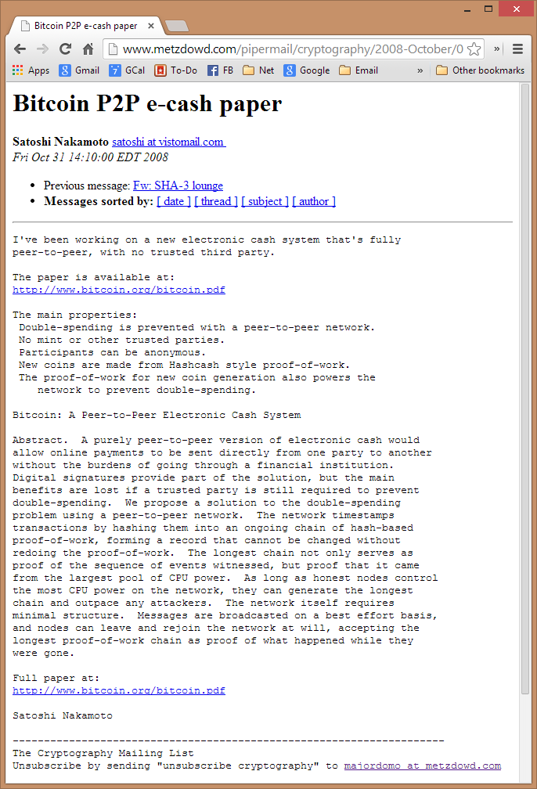
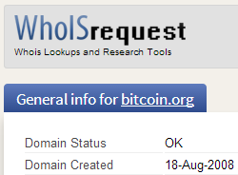
Introduction of Bitcoin
Aug. 18, 2008:
  bitcoin.org
  domain registered
Oct. 31, 2008:
  “Satoshi Nakamoto” <satoshi@vistomail.com> announces Bitcoin to the cryptography@metzdowd.com mailing list.
    A lively discussion ensues!
Jan. 3, 2009:
  Satoshi releases first (0.1) public version of Bitcoin client source

Slide 10
Some Properties of Bitcoin
Anonymous (or at least, pseudonymous)
  Yet, transactions are non-repudiable (unlike with cash)
No centralized authority (instead: distributed network)
Anyone can create new Bitcoins (by ‘mining’)
  In this process, miners also perform the service of timestamping valid transactions
But, total supply of Bitcoins is finite! (~21M)
  New Bitcoins are produced at a rate that asymptotically approaches zero over many years
Transactions are (almost always) irreversible
  They get exponentially more difficult to reverse with age
Double-spending is (very nearly) impossible

Slide 11
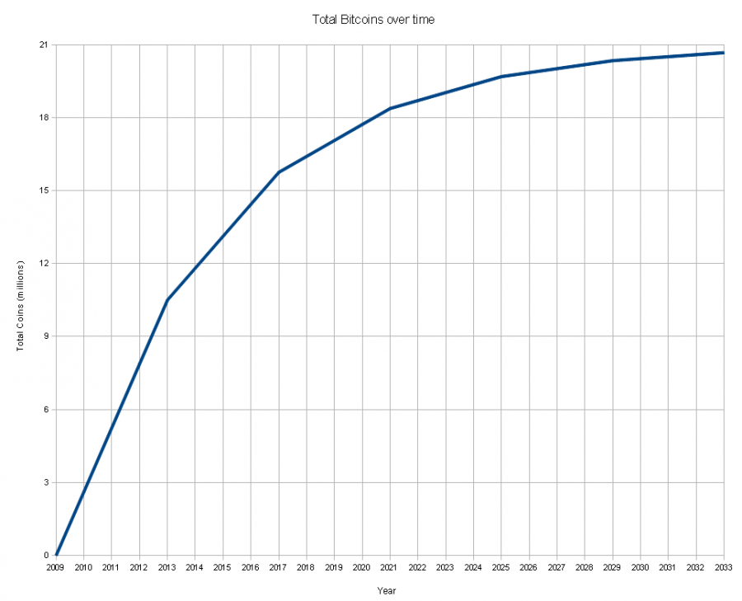
Bitcoin Supply Over Time
(Inset: U.S. dollar supply over time)

Slide 12
Bitcoin Price Growth
Data source: bitcoincharts.com
Trendline is:
+0.6% / day
+ 20% / month
+795% / year

Slide 13
Bitcoin Market Capitalization vs.
Base U.S. currency in circulation
U.S. data source: Federal Reserve Bank of St. Louis
Bitcoin data source: blockchain.info
Trendline is:
+1,014%/year
(11.14×/year)

Slide 14
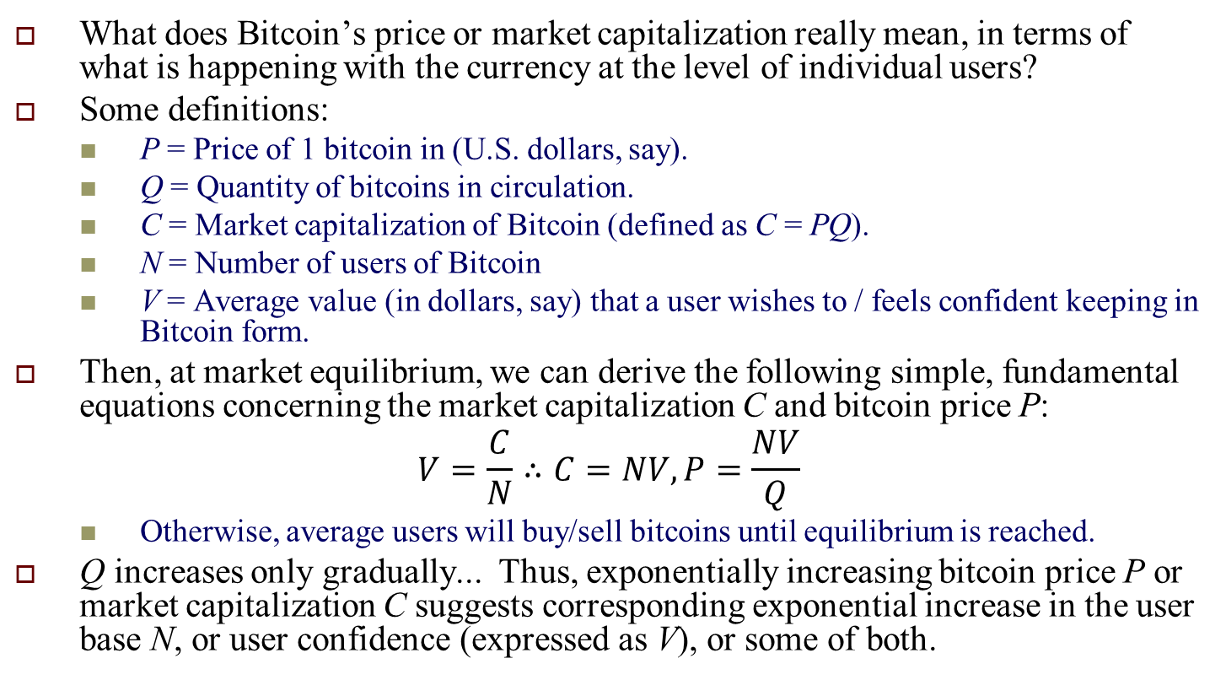
Market Cap Equation
What does Bitcoin’s price or market capitalization really mean, in terms of what is happening with the currency at the level of individual users?
Some definitions:
  P = Price of 1 bitcoin in (U.S. dollars, say).
  Q = Quantity of bitcoins in circulation.
  C = Market capitalization of Bitcoin (defined as C = PQ).
  N = Number of users of Bitcoin
  V = Average value (in dollars, say) that a user wishes to / feels confident keeping in Bitcoin form.
Then, at market equilibrium, we can derive the following simple, fundamental equations concerning the market capitalization C and bitcoin price P:
$$V=\frac{C}{N}∴C=NV, P=\frac{NV}{Q}$$
  Otherwise, average users will buy/sell bitcoins until equilibrium is reached.
Q increases only gradually... Thus, exponentially increasing bitcoin price P or market capitalization C suggests corresponding exponential increase in the user base N, or user confidence (expressed as V), or some of both.

Slide 15













Some Merchants Accepting Bitcoin
(Plus 10,000s of Others)

Slide 16
Some of the Key Ingredients of Bitcoin’s Core Technology
Basic cryptographic primitives:
  One-way cryptographic hash functions:
    Specifically: SHA-256, RIPEMD-160
  Public-key (asymmetric) digital signature systems:
    Namely: Elliptic Curve Digital Signature Algorithm (ECDSA)
      more specifically, using the secp256k1 curve
Various higher-level functions built on those elements:
  E.g., Merkle hash trees, Hashcash proof-of-work, distributed timestamp service
Other important aspects of Bitcoin:
  Peer-to-Peer (P2P) networking – no central server!
    A lá Bittorrent, gnutella, etc.
  Open Source development process
    https://github.com/bitcoin/bitcoin

Slide 17

Cryptographic Hashes &
Public-Key Digital Signature Systems
One-way cryptographic hash functions:
Public-key digital signature systems:
Arbitarily-large data
to be hashed
Easy!
Hash code, e.g.
fb3e8b10a62f
Hard (to find any info)
Signer’s private domain
Verifier
Private
key
Public
Key
RNG
Signa-
ture
verifi-
cation
Data to
Sign
Signed
Data
Signature generation

Slide 18
How Bitcoin Works
(Basic Outline)
Anonymous accounts are associated with ECSDA public keys, identified by public addresses (hashed from public key)
  Each account has a current balance (denominated in bitcoins).
In a typical Bitcoin transaction, the owner of some account(s) signs a transaction order,
  Thereby deeding coins (received in previous transactions) from his accounts to a set of destination addresses.
Full nodes (running the core Bitcoin client) keep track of the distributed account ledger called the blockchain.
  Each block contains a set of newly confirmed transactions, a timestamp, and a proof of work (based on Hashcash).
    The POW prevents new blocks from being created too quickly.
Miners (running an extended client) create new blocks, and receive a predetermined reward (plus optional transaction fees).
  Newly created blocks build on (link back to) previous ones.

Slide 19
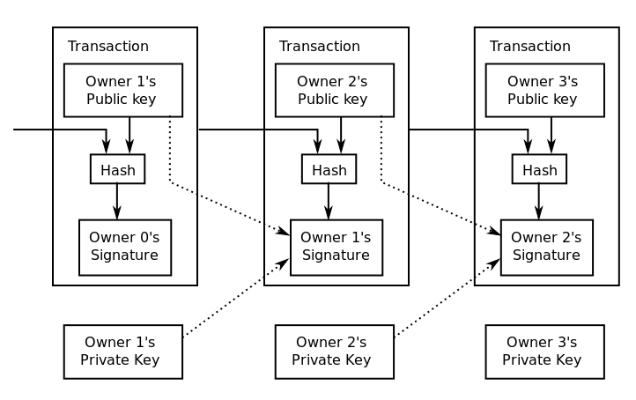
Bitcoin Transaction – Basic Structure

Slide 20
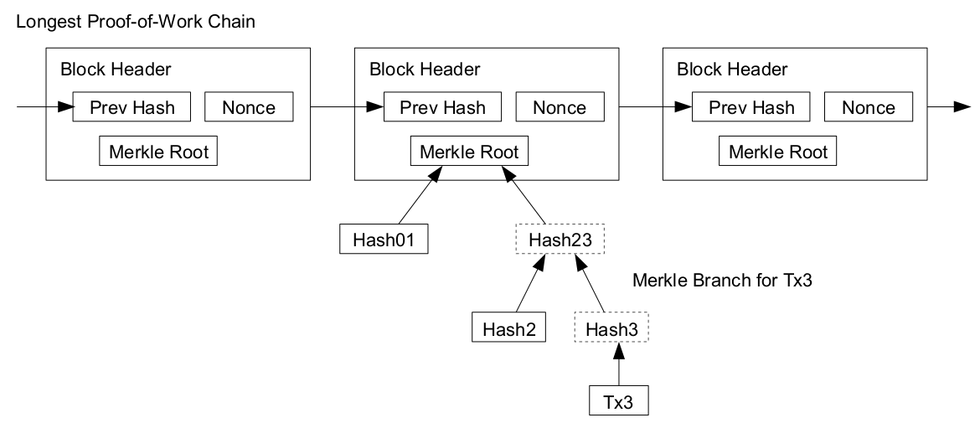
Bitcoin Blockchain – Basic Structure

Slide 21
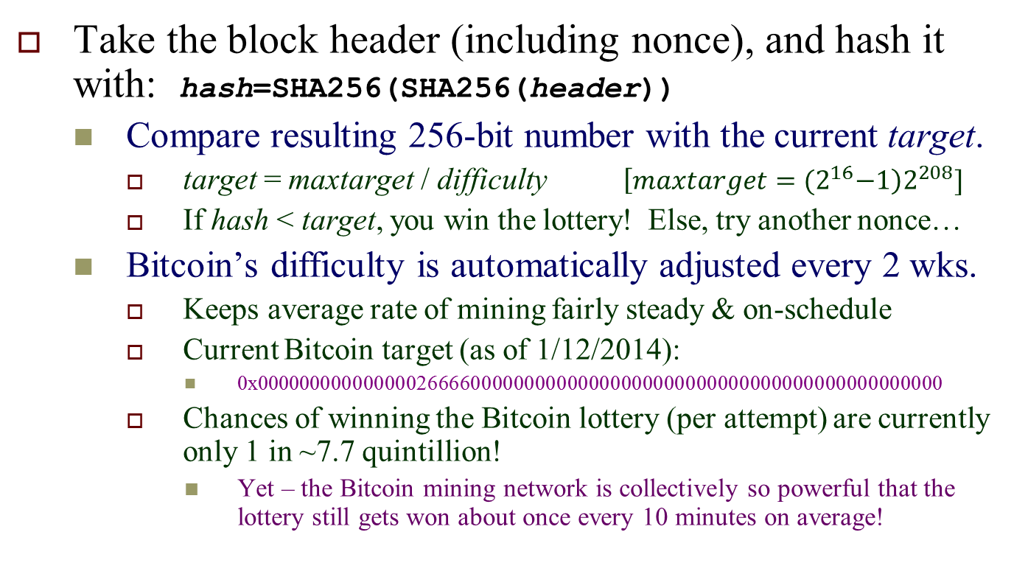
Hashcash Proof-of-Work Function
(as used in Bitcoin)
Take the block header (including nonce), and hash it with: hash=SHA256(SHA256(header))
  Compare resulting 256-bit number with the current target.
    target = maxtarget / difficulty $\left[maxtarget={(2}^{16}−1\right)2^{208}]$
    If hash < target, you win the lottery! Else, try another nonce…
  Bitcoin’s difficulty is automatically adjusted every 2 wks.
    Keeps average rate of mining fairly steady & on-schedule
    Current Bitcoin target (as of 1/12/2014):
      0x0000000000000002666600000000000000000000000000000000000000000000
    Chances of winning the Bitcoin lottery (per attempt) are currently only 1 in ~7.7 quintillion!
      Yet – the Bitcoin mining network is collectively so powerful that the lottery still gets won about once every 10 minutes on average!

Slide 22
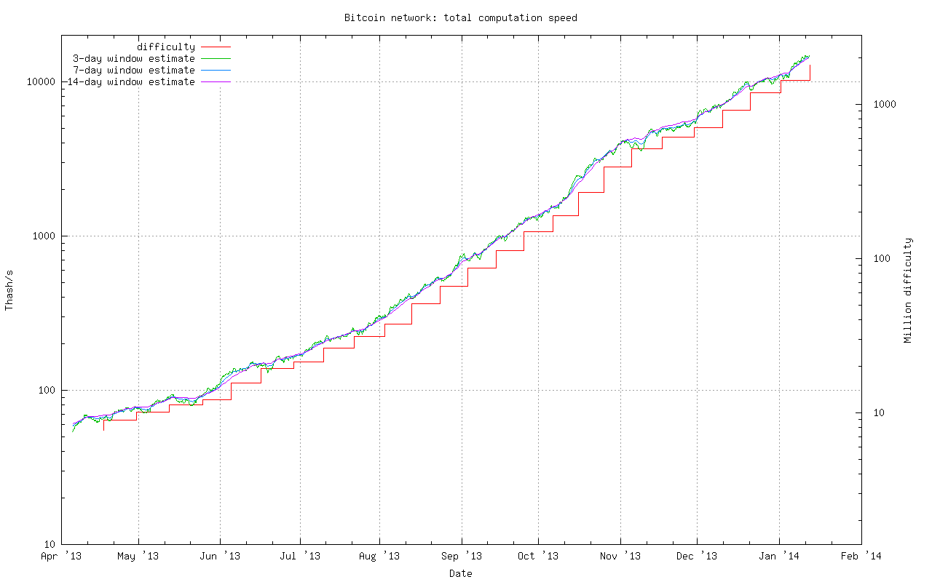
Bitcoin Network – Aggregate Speed
And POW Difficulty – Last 10 mo.

Slide 23
Bitcoin’s Core Innovation
Can view the main job of Bitcoin network as implementing a distributed timestamping function, which effectively serializes Bitcoin transactions
  I.e., puts them in a definite sequential order
The reason to serialize transactions is to decide, in case someone tried to spend the same coins twice (or more), which of those attempts was first.
  This effectively prevents double-spending!
    2nd (and later) attempts to spend the same coins are simply ignored
Distributed timestamping is an example of distributed consensus.
  A set of widely-separated entities arriving at unanimous (or near-unanimous) agreement on some decision(s).
In Bitcoin, any dispute re: transaction order is automatically resolved via a very simple arbitration mechanism:
  Whichever full node happens to find the proof-of-work solution first, is the one that gets to decide which of any conflicting transactions to accept!
In other words, computational power → decision-making authority.
  We’ll talk more later about other applications of this principle…

Slide 24
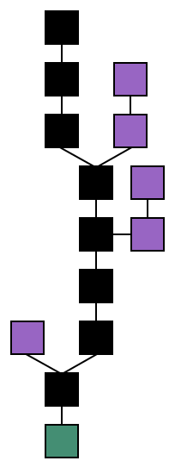
Some more details of how distributed consensus is achieved
Suppose two mining nodes (A and B) happen to announce a new block at about the same time – who wins in that case?
  Some set of mining nodes will build on A’s
  block, and some set will build on B’s block.
    However, one set of nodes will be faster than
    the other, and will produce new blocks faster.
  Important: All nodes on the network are
  programmed to work on the longest chain!
    Eventually one chain becomes clearly longer than
    the other, and as all nodes shift to work on that one, consensus is thereby achieved.
A
B
A
B

Slide 25
Importance of Distributed Consensus
In Bitcoin, nodes achieve distributed consensus as to one decision: What is the sequence of valid transactions making up the Bitcoin blockchain?
  However, the same protocol could be use to attain consensus about anything – so long as the decision made is included/encoded into the block data.
A distributed consensus mechanism such as Bitcoin’s can be used to solve the very general classic CS problem of Byzantine agreement:
  How can N distributed notes reliably come to an agreement if communications between them could be arbitrarily interrupted/corrupted by attackers?

Slide 26
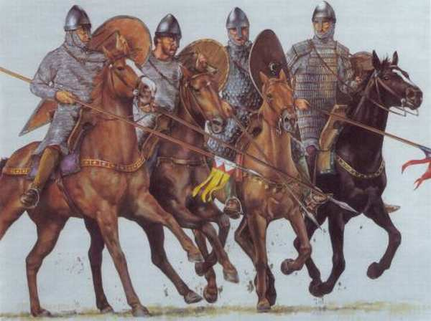
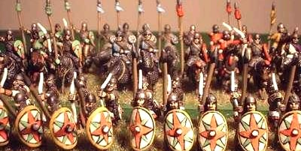


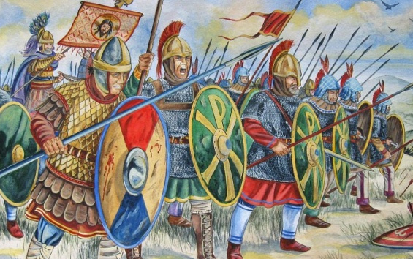

“Byzantine Generals” problem
Generals must coordinate armies for attack
Messages may be intercepted/forged
Some generals could be turncoats!

Slide 27
Alternative Applications of Byzantine Agreement / Distributed Consensus
Distributed unique-name registration
  E.g., Namecoin, distributed replacement for DNS
Reliable P2P delivery of encrypted messages
  E.g., Bitmessage application
Distributed electronic markets (e.g. Ripple)
Secure electronic voting!
  Record candidate selections in Txns/blocks
    Mining pools function like political parties
  Caveat: Not really “1-person/1-vote”
    More like “1 Ghash/1 vote” or “1 BTC/1 vote”

Slide 28
Some Other Intriguing Applications
Issuing Stock w/o Underwriters or Banks
  Just create a cryptocoin representing your shares
    E.g., Invictus Innovation Incorporated’s ProtoShares
Digital Autonomous Corporations (III’s idea)
  Bitcoin can be viewed as the first example of these
  A DAC reliably executes the “corporate charter” that’s encoded in its open-source codebase
    Its algorithm is the CEO, human ops are like employee-owners, and are paid in ‘shares of stock’ (the DAC’s coin)
Secure pseudonymous digital identities
  E.g., III’s Keyhotee proposal

Slide 29
Reinventing the fundamental organizing principles of human civilization?
E.g. could we make a distributed-consensus-based legal system?
  The system’s “laws” are encoded into the open-source code-base of a blockchain network. Initial code-base = the system’s constitution.
  All participants in the system can (via messages embedded in transactions/blocks) propose changes to the law and “vote” on them.
    Changes to the law are represented in the form of patches to the open-source codebase, in some pre-defined patch language.
  As is runs, the node software modifies itself to automatically incorporate changes that have been previously proposed, voted on by the community, and then accepted by blockchain consensus.
Our old-fashioned, flawed, fallible human systems for politics, law, and governance could become obsolete!
  The new system is incorruptible – all changes to the law that occur are by definition legitimate, as per the original constitution and the automatically-arbitrated community consensus.

Slide 30

Top-10 Largest Cryptocurrencies
(as of Jan. 11, 2014)

Slide 31
Conclusion
To say (as some have) that Bitcoin is “just another payment system” is like saying the Internet is “just another communication medium”
  Rather, Bitcoin’s core technology is a fundamentally new kind of platform which opens the door to a vast new space of applications, based on Bitcoin’s revolutionary technological innovation of distributed consensus.
    Similarly to how the Internet is a new platform, based on its revolutionary technological innovation of its network stack separating applications from low-level data-transport plumbing
The Bitcoin community is growing exponentially (~10×/year) and its adoption, applications, and diverse spin-offs are flourishing.
  I think, in Bitcoin, we are seeing the early stages of the most transformative revolution in technology & society of our time.

