Slide 1
Simon Y. Foo
Michael P. Frank, Associate Teaching Faculty
presenting on behalf of
Professor and Chair
Electrical & Computer Engineering
simon.foo@famu.edu
sfoo@fsu.edu
Located on 3rd Floor, Building A

Slide 2


Electrical & Computer Engineering
Overview
ECE Department Website: www.eng.fsu.edu/ece
Faculty: 19 (tenure-track) + 3 (FSU-PC)
Offers: BS Electrical Engineering (ABET Accredited)
BS Computer Engineering (ABET Accredited)
4+1 MS Program, Electrical Engineering
Federal University of Technology at Akure (FUTA)-FAMU
special graduate program
Tianjin University of Technology (TUT)-FSU
3+1+1 BS/MS EE special program
MS, PhD Electrical Engineering
Undergraduate Enrollment (2013): ~350
Graduate Enrollment (2013): ~80

Slide 3
Electrical Engineering
the study and applications of electricity, electronics, and electromagnetism
covers a range of subtopics including power, electronics, control systems, robotics, signal processing, instrumentation, and telecommunications
Related disciplines:
  Mechatronics: microelectromechanical systems (MEMS)
  Biomedical Engineering:
    Magnetic resonance imaging (MRI)
    Implants
    Pacemakers, etc.

Slide 4
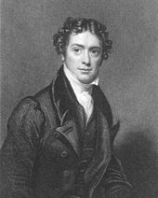
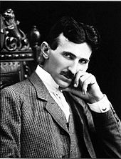
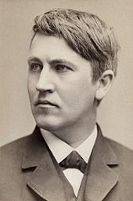
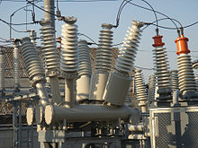
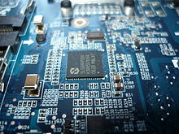
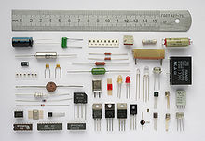
Pioneers in Electrical Engineering (from Wikipedia)
Michael Faraday
– electric motor development
Nikola Tesla
Inventor of AC current
Thomas Edison
- Large scale electric power network
Power systems
Electronic circuits

Slide 5
Computer Engineering
Integrates several fields of electrical engineering and computer science required to develop computer systems. Computer engineers are involved in many hardware and software aspects of computing, from the design of individual microprocessors, personal computers, and supercomputers, to circuit design.
Usual tasks include writing software and firmware for embedded microcontrollers, designing VLSI chips, designing analog sensors, designing mixed signal circuit boards, and designing operating systems. Computer engineers are also suited for robotics research, which relies heavily on using digital systems to control and monitor electrical systems like motors, communications, and sensors.

Slide 6
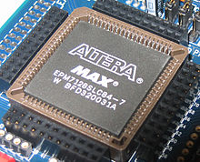

Computer Engineering (contd.)
Specialty Areas
Coding, Cryptography, and Information Protection
Communications and Wireless Networks
  Smart Grids
Compilers and Operating Systems
Computational Science and Engineering
Computer Networks, Mobile Computing, and Distributed Systems
Computer Systems: Architecture, Parallel Processing, and Dependability
Computer Vision and Robotics
Embedded Systems
Integrated Circuits, VLSI Design, Testing, and CAD
Signal, Image, and Speech Processing
Embedded Systems

Slide 7
Who hires our EE/CpE graduates?
Defense contractors – Boeing Company, Lockheed Martin, Northtrop Grumman, Raytheon, etc.
Government labs – Navy, Air Force, Army, NSA, etc.
Industry – GM, Ford, Chrysler, BMW, Dell, Harris, FPL, local engineering companies
Academia (Ga Southern, Memphis State, Vanderbilt, etc.)

Slide 8
Technical Societies related to EE and CpE
Society memberships enable you stay current within your chosen technology profession, keep in touch with your peers, and invest in your career.
Institute of Electrical and Electronics Engineers (IEEE)
  A total of 38 societies including
    Power and Energy Society (PES)
    IEEE Consumer Electronics Society
    IEEE Robotics and Automation Society
Association for Computing Machinery
American Society for Engineering Education
Audio Engineering Society
National Society of Black Engineers (NSBE)
National Society of Professional Engineers
Society of Hispanic Professional Engineers (SHPE)
Society of Women Engineers (SWE)
Tau Beta Pi Engineering Honor Society
Eta Kappa Nu

Slide 9
Technical/Specialty Areas
6 Specialty Areas:
Electronics (audio/video, sensors, MEMs, etc)
Electromagnetics (antennas, radar, etc)
Controls (robotic kinematics, intelligent systems)
Communications (wireless communication, etc)
Power (power systems, power electronics, etc)
Computer (mobile devices, embedded systems, etc)

Slide 10
ECE Research Areas
  Renewable energy (photovoltaics, wind power, etc.)
  Energy storage and conversion (lithium ion batteries, supercapacitors, fuel cells, etc.)
  Advanced power systems (smart grids, etc.)
  Hybrid electric vehicles (plug-in hybrid electric vehicles)
  Antennas, RF and microwave devices, wireless communications
  Digital signal and image processing
  Robotics
  Embedded systems
  Intelligent systems

Slide 11
State of the Art or Emerging Technologies
Carbon Nanotube-based Fuel cells
Very high efficiency multi-junction solar cells
Hybrid electric vehicles (cars, planes, etc)
Integration of Renewables into Smart grids
Nanotechnology
Cybersecurity
Unmanned Aerial Vehicle (UAV), or drone
Autonomous Underwater Vehicle (AUV)
3-D printing, etc.

Slide 12
ECE Achievements 2011-2012
1st Place Award, Hardware Competition, IEEE Southeastcon, March 17, 2012, Orlando, FL
http://news.fsu.edu/More-FSU-News/Engineering-students-win-robotic-competition
http://www.youtube.com/watch?v=cE50tWmVT_U
      FSU-PC TEAM OSCEOLA Wins 2nd Place in NASA UNIVERSITY Launch Initiative (G. Brooks)
ECE Dept Assessment Process voted as “Exemplary” by FAMU, March 21, 2012
“Outstanding Chapter Award, 2010-11” to our Eta Kappa Nu Lambda Delta Chapter
      Successful QER/GPC review of ECE Department, Fall 2011
      ABET accreditation of both EE and CpE programs extended to Sept 30, 2016 (next ABET visit in Nov 2015)

Slide 13
ECE Achievements 2013
Dr. Jim Zheng, Sprint Eminent Scholar Chair in Electrical and Computer Engineering
IEEE Southeastcon 2013 Hardware Competition, 3rd Place win
  http://www.youtube.com/watch?v=Lkg19G002Sg
1st Entrepreneurship Workshop held on April 20 at Challenger Center
Wanjun Cao, PhD student, top 10 finalist, 2013 MegaWatt Ventures competition
Indranil Bhattacharya, ECE PhD student, won 2nd Place, Statewide Graduate Student Research Symposium, STEM Engineering Division
Samuel Rustan and team members, Nathan Crock and Olmo Zavala, won the local 2013 International Space Apps Challenge held the weekend of April 20th-21st in Tallahassee, FL. Their team will continue on to the international level of the competition.
Kyle A. Miller and the Robosub team won "Best in Show: Innovative Undergrad" project at DIGITECH held on March 29, 2013. Project was featured in an article in the FSView issue (April 1, 2013) in the Arts & Life section.
Tianjin University of Technology (TUT)-FSU 3+1+1 BS/MS EE special program, signed May 27, 2013

Slide 14
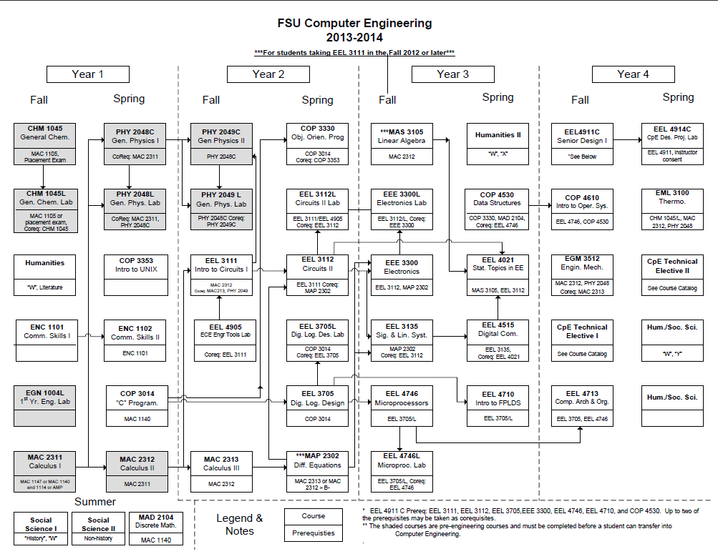

Slide 15
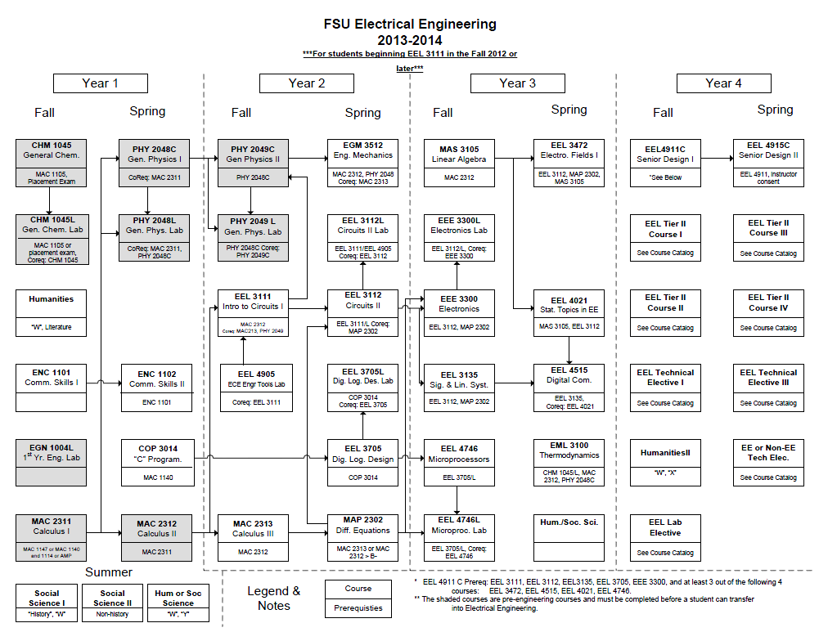

Slide 16
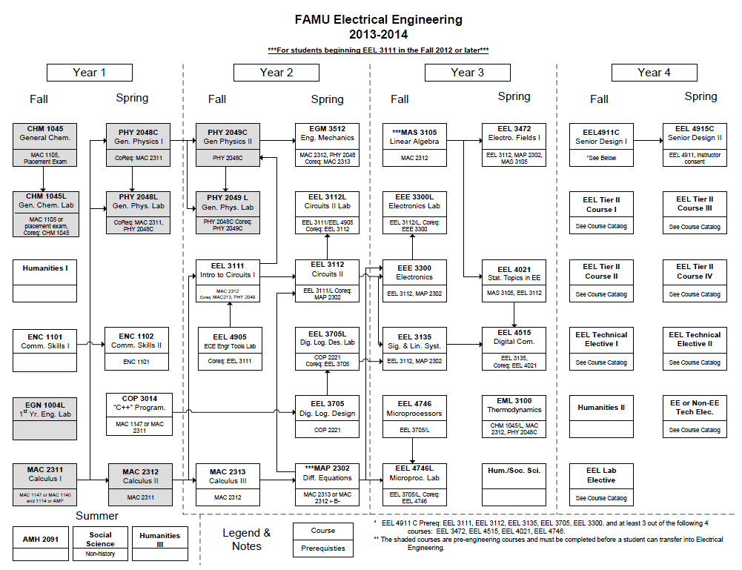

Slide 17
