Slide 1
ECE Senior Design Projects
2014-2015
EEL 491(1/4/5)C
Senior Design Project I & II
Fall 2014-Spring 2015
Instructor: Dr. Michael Frank
v0.4

Slide 2
ECE-involved Projects for 2013-14, p. 1 (of 2):
Projects Led by the ECE Department
# | Project Name / Description | Led by | Includes | Project Type
E1 | SoutheastCon Robotics (2-3 teams) | ECE | ME | Competition
E2 | Solar Sausage / PV + Sterilization, EWB? | ECE | ME, CEE/IE? | Entrepreneurial/Charitable
E3 | EOAS/GFDI - Oil Spill Radar | ECE |  | Scientific Instrumentation
E4 | RoboSub AUV | ECE | CS? | Competition
E5 | DAQ System for SAE Baja Vehicle | ECE |  | Competition
E6 | EOAS/GFDI – Stokes Drifters | ECE |  | Scientific Instrumentation
E7 | Efficient Systems’ Electric Bike Sharing | ECE | ME? | Entrepreneurial System
E8 | Simple offline electronic bitcoin wallet | ECE | CS? | Entrepreneurial Product
E9 | Voice-Controlled Quadcopters | ECE |  | Research
E10 | 3D Scanning of Rare Artifacts | ECE |  | Research
E11 | Northrop-Grumman / SAR Imager | ECE | ME/CS/IE? | Commercial development
E12 | Energy Management System | ECE |  | Research / Univ. Facilities

Slide 3
ECE-involved Projects for 2013-14, p. 2 (of 2):
Projects Not Led by ECE Department
# | Project Name / Description | Led by | Includes | Project Type
E13 | FIPSE/AUVSI SUAS AAV/UAV (Drone) | ME | ECE | Competition
E14 | Friction Cone Penetrometer | ME | ECE, CS | Scientific Instrumentation
E15 | ASME / Robot for Relief | ME | ECE | Competition
E16 | Robo-Harvester/Weeding Organic Farms | ME | ECE/CS | Commercial Product Dev.
E17 | Siemens Solar Wireless IR Monitoring Sys. | ME | ECE/CS | Commercial development
E18 | General Capacitors / Coating Machine | ME | ECE | Commercial development
E19 | Tall Timber Res. Sta./Robotic Tortoise Scope | ME | ECE | Research Instrumentation
E20 | CISCOR/Cons. Energ./Wheel Torque Sensor | ME | ECE/SBI | Commercial development
E21 | Pedibus? | ME | ECE, IE | Commercial development
E22 | Palm Fruit Harvesting Equipment | IME | ME, ECE | Commercial development
E23 | Reactive materials for quadrotor airframes | IME | ME, EE | Research

Slide 4
Suggested Work Allocation for
ECE Faculty on Senior Design
Name | # Main Adv. (2 units) | # Ext. Advisor (1 unit) | # Rev. (1 unit) | Total Work Units
Andrei | 0 | 2 | 2 | 4
Arora | 0 | 1 | 2 | 3
Bernadin | 0 | 1 | 1 | 2
DeBr., L. | 0 | 1 | 1 | 2
DeBr., V. | 0 | 0 | 2 | 2
Edrington | 1 | 0 | 0 | 2
Foo | 1 | 0 | 0 | 2
Frank | 4 | 0 | 0 | 8
Name | # Main Adv. (2 units) | # Ext. Adv. (1 unit) | # Rev. (1 unit) | Total Work Units
Harvey | 3 | 0 | 0 | 6
Kwan | 0 | 2 | 2 | 4
Li | 2 | 1 | 0 | 3
Meyer-B. | 0 | 1 | 3 | 4
Moss | 0 | 1 | 3 | 4
Weathers. | 0 | 1 | 1 | 2
Yu | 0 | 3 | 1 | 4
Zheng | 2 | 0 | 0 | 4
TOTAL: | 13/13 | 14/14 | 16/16 | 58
We currently need, at minimum, roughly
56 work units (13 main advising, 14 external/co-advising, 16 reviewing ECE-led projs.)

Slide 5
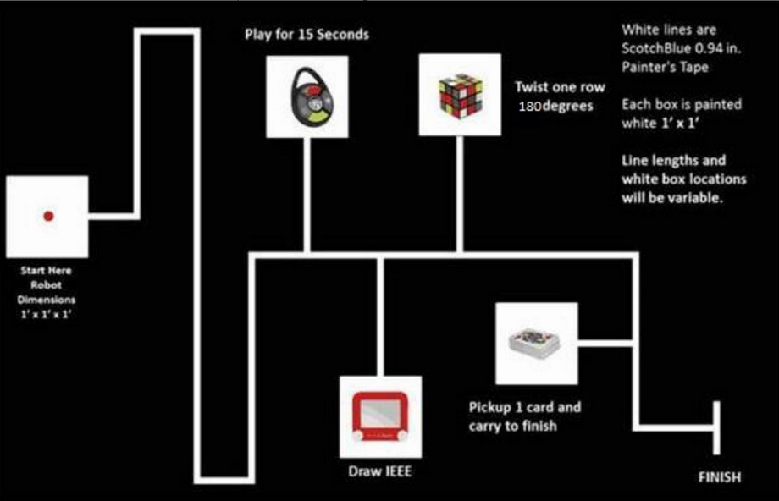
IEEE SoutheastCon 2015
Student Hardware Competition
ECE-led
m/d
Project
E#1 (of 23)
Advisor:
Dr. Harvey
Autonomous robots
  Play “road trip games”
    Simon / Etch-a-Sketch /
    Rubik’s Cube / Cards
Local competition:
  2-4 teams
  Winner → regionals
Rules, FAQ & link
to Facebook group
  http://ta.gd/SEcon15
(2-3 teams, 4-5 ECE
studs ./team + 0-2 others)

Slide 6
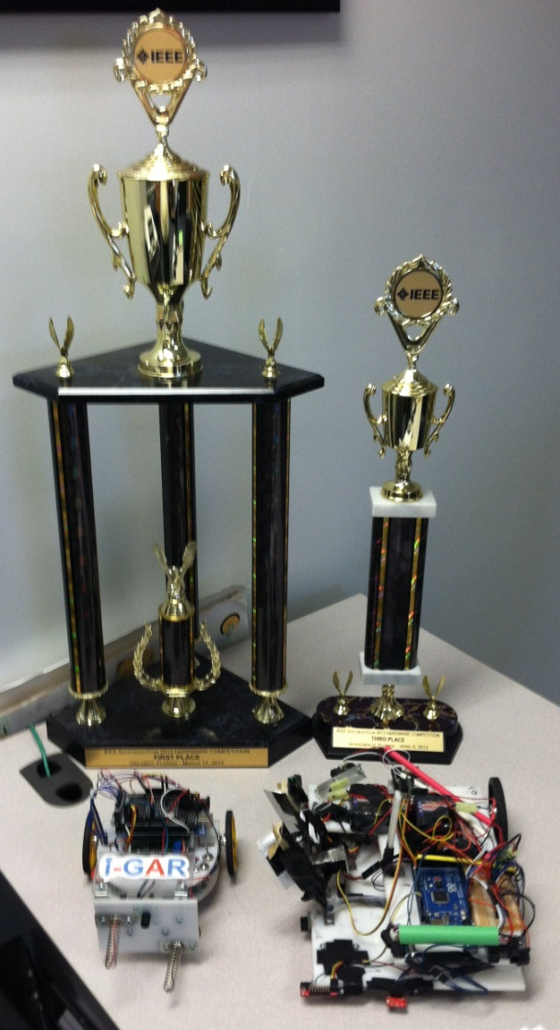
FAMU-FSU COE at SoutheastCon:
A Winning Tradition!
Our college placed regionally in 2 out of the last 3 years!
  2011-12 – 1st place!
  2012-13 – 3rd place!
Both years, we beat all of the big, highly-ranked engineering schools in the Southeast…
  Ga. Tech., UF, Auburn, UCF…
Let’s do it again!

Slide 7
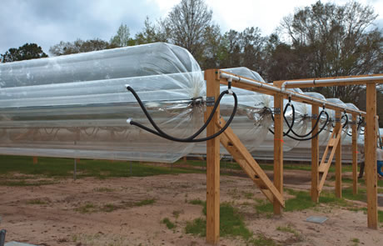
Solar Sausage (Proj. ‘B’)
ECE-led m/d
Project advisor: Dr. Edrington (ME advisor: Ordonez)
Project
#E2 (of 23)
(3 ECE, 2 ME,
1-2 CEE/IE?)
Commercial IP, property of
FSU / SunnyLand Solar
  Inexpensive framework for
  solar power collection
  Has been under development
  for a few years now
Two related Senior Design Projects this year (A&B)
  Proj. A doesn’t involve ECE – ME-only (thermal desal.)
Project B: Provide PV & sterile water to off-grid areas
  Student orgs such as EWB or SES are also encouraged to get involved

Slide 8
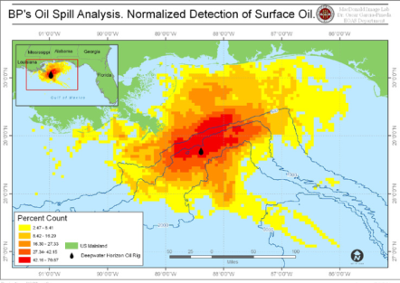
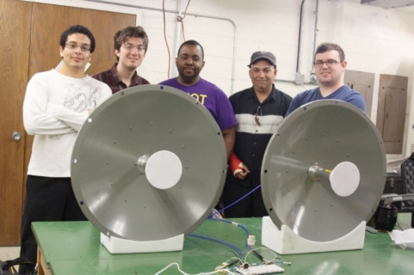
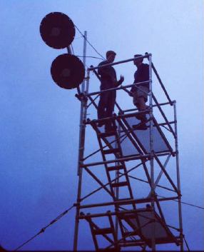
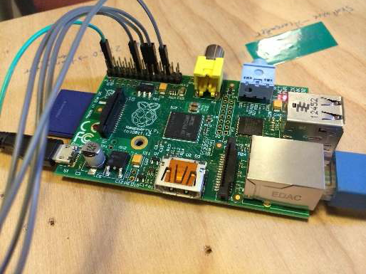
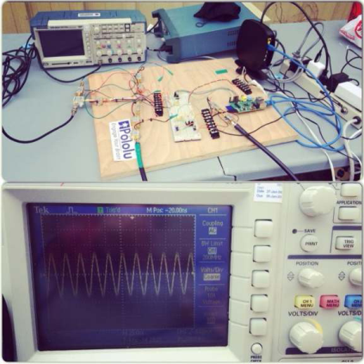
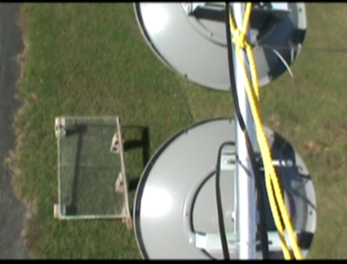
Radar System for Oil Spill Analysis
Advisors: Oscar Garcia (GFDI),
M. Frank (ECE)
ECE-led m/d
(3 ECE, 1 CS?)
Proj. E#3
(of 23)
Sponsored by FSU Dept. of Earth, Ocean & Atmos. Sciences (EOAS)
& Geophys. Fluid Dyn. Inst. (GFDI)
  Third year of ongoing project
Background: Satellites use synthetic aperture radar (SAR) to image spills
  Proj. goal: Develop a portable radar testbed to help characterize radar response to oil slicks under varying conditions
  1st year - Working radar system built
  2nd year - Progress on mech. HW
  This year, needs fine-tuning, GUI, mechatronic control

Slide 9
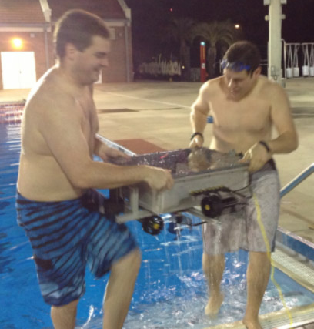
RoboSub (AUV)
ECE-led m/d
Project Advisors: M. Frank
Project
E#4 (of 23)
(3 ECE, 1 CS?)
AUVSI int’l competition
  http://ta.gd/robosub
Fourth year of ongoing effort:
  Year 1: Original chassis
  Year 2: Chassis redesign
  Year 3: Navigate thru gate
  Now – Complete more tasks
    Much coding/testing still needed to prepare robot for competition
    Competition in mid/late summer

Slide 10
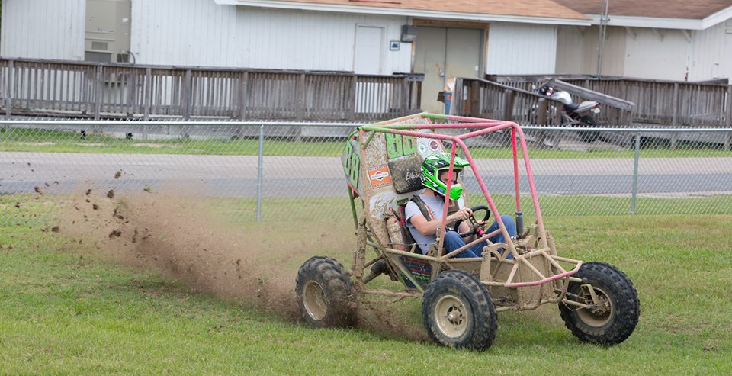
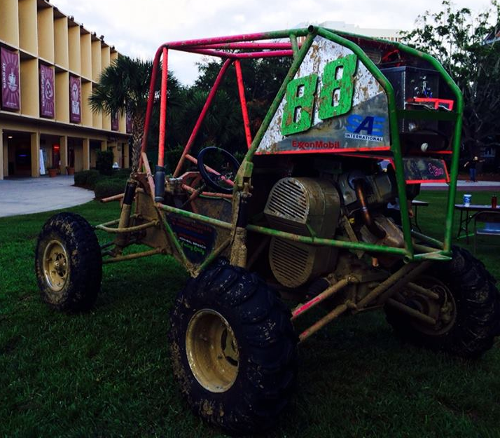
DAQ System for SAE Baja Car
ECE proj.
Faculty Advisor: TBD
Project
E#5
(4 ECE)
Society of Automotive Engineers (SAE) Baja Series competition
  Small dune-buggy type vehicle
SAE student chapter built a vehicle last year for this competition →
  New one under construction for this year
A Data Acquisition (DAQ) system deeds to be developed
  Accelerometers/cameras
  Record/transmit/display data

Slide 11
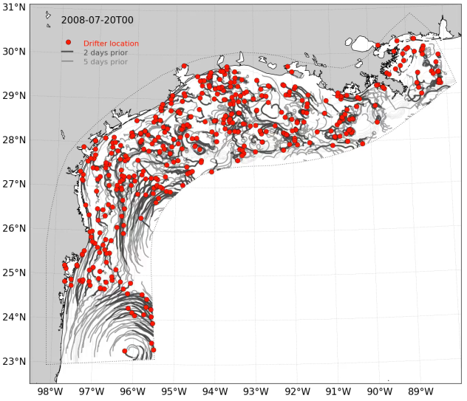
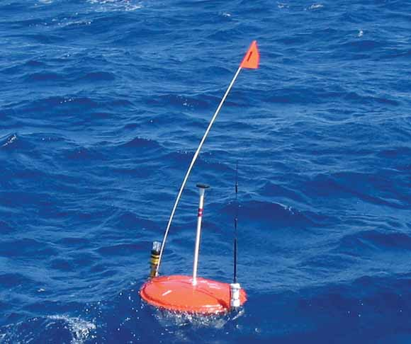
Stokes Drifters
ECE proj.
Faculty Advisor: Nick Wienders (EOAS/GFDI)
& TBD (ECE)
Project
E#6
(5 ECE)
Sponsored by EOAS/GFDI
  New project this year
  Relates to: Deep-C.org research consortium
Background: Stokes Drift is a
fundamental wave-driven process
  Never measured precisely
Project goal: Develop a slim drifter w. satellite radio
  Field testing at sea
TracPy simulation

Slide 12
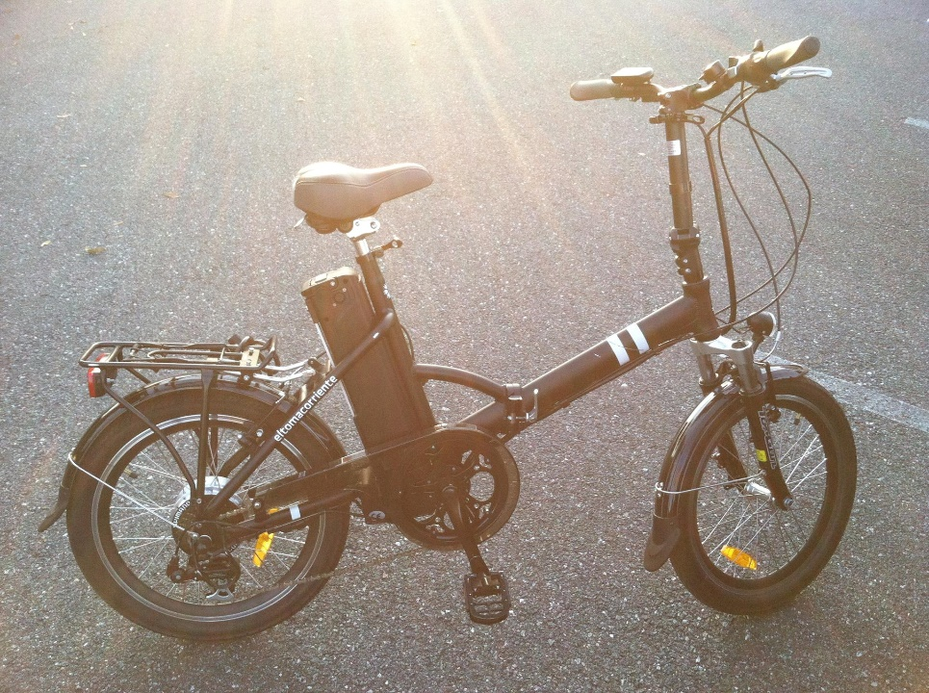
Charging Station for
Electric Bike Sharing
ECE proj.
Faculty
Advisor:
TBD
Project
E#7
(4 ECE)
Local venture Efficient
Systems, LLC
  Wants to set up an
  E-Bike Sharing
  system in Tallahassee
Bikes already exist →
  Need to develop a docking system/charging station
  Also maybe: LED Display for spokes, for nighttime visibility / eye-catching appearance

Slide 13

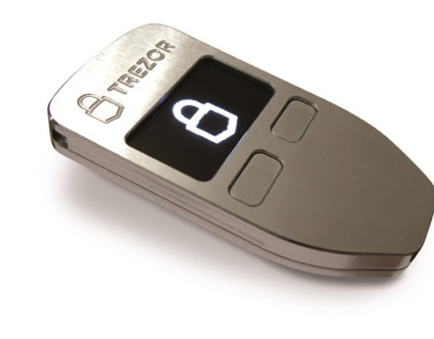
Simple Offline
Electronic Bitcoin Wallet
ECE proj.
Faculty
Advisor: Frank
Project
E#8
(4 ECE)
Bitcoin is the revolutionary peer-to-peer digital cash system introduced in 2009.
  Issues: Hard to use, incurs risks of theft/loss.
  We’d like to make it easier to use, yet also extremely secure from hackers.
Project goal: Create a simple,
inexpensive, easy-to-use, open-source electronic device that allows users to store their Bitcoins securely offline, yet easily spend them when needed.
  Similar products like Trezor already exist, but we’d like a cheaper, more full-featured and transparent solution.

Slide 14
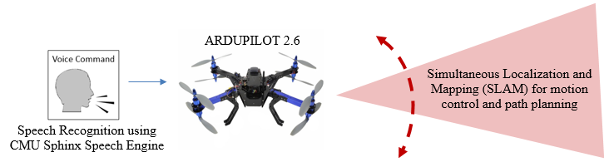
Intelligent Autonomous Quadcopters
ECE proj.
(1 EE, 2 CpE,
1 CS?)
Faculty Advisor: Bernadin
Project
E#9
Sponsored by Speech Processing And Data Analysis Laboratory (SPADAL)
Goal: Design & build a quadcopter system with voice-control and vision-based navigation capabilities.

Slide 15
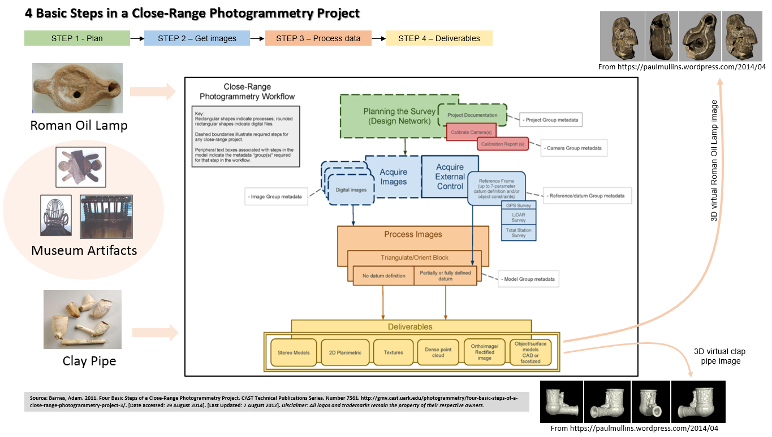
3D Image Reconstruction of Cultural Artifacts
ECE
proj.
Advisor::
Bernadin
Project
E#10
(1 EE, 1 CpE, 2 CS?)
Another SPADAL project
Make 3D scans of historical artifacts from a collection at FAMU
  Create fly-throughs
  Do 3D prints
Figure 1- Overview of CRP project

Slide 16
Electronic Synthetic
Active Aperture Array Imager
ECE-led
m/d
Sponsor:
Northrop-
Grumman
Project
E#11
Radar-based imaging system for weapons detection applications:
  “Design a simple multi-element aperture with open-ended waveguides fed by COTs X/Ku band transmit/receive componentry that is configured to collect short-range transmit/receive radar data in I/Q format so that a SAR image can be generated. Test equipment used would be capital.”
See more info in posted documents

Slide 17
Energy Management System
ECE proj.
Faculty Advisor: Faruque
Sponsor: FSU Utilities
Project
E#12
Abstract:
  “This project will focus on the management of home appliances/load by managing, connecting or disconnecting them based on the demand of energy on the grid and its price variability. The objective is to optimize energy consumption so that the consumer minimizes its cost without compromising the use of energy. Students need to develop algorithm for the optimized energy management at home and then implement that on a controller with controllable physical loads. A prototype scale management system with controller and loads would be demonstrated at the end.”

Slide 18
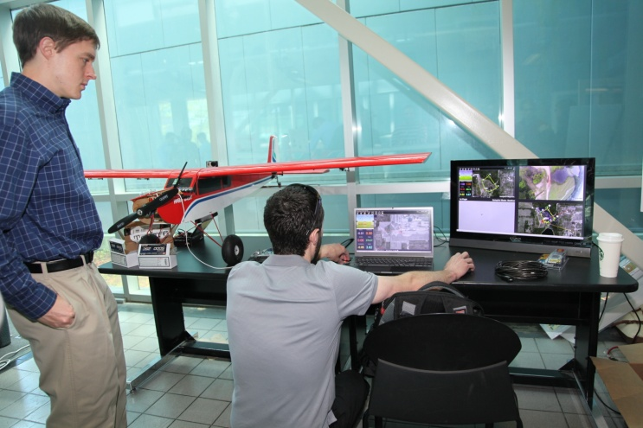
SUAS UAV (Drone)
ME-led
Advisor: Dr. ?? (ME)
Project
#13 (of 24)
2 ECE, 1 CS, 3 ME
AUVSI 2015 Student UAS (Drone) Competition
Working w. U.S.-Brazil Student Exchange Pgm.
  Sustainable Energy & Aeronautical Engineering
    http://www.eng.fsu.edu/FIPSE-SEAEP/
This is the 4th year of
an ongoing effort

Slide 19
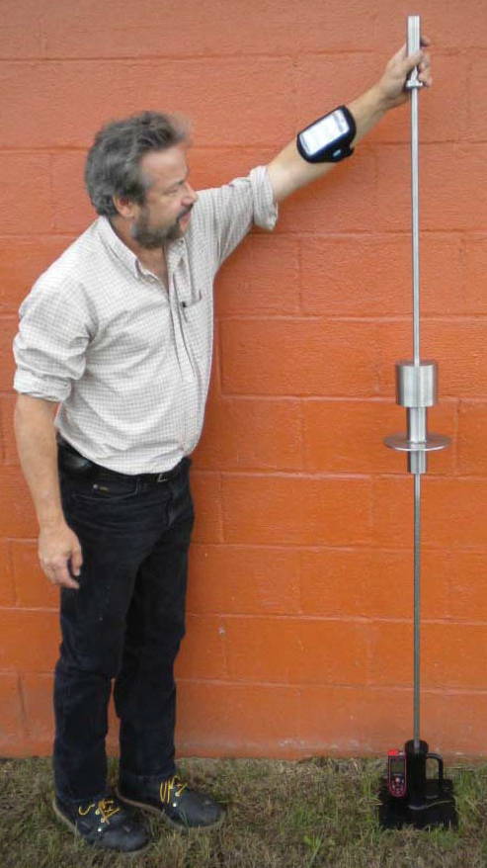
Friction Cone Penetrometer
ME-led
2 ME, 2 ECE, 1 CS
Project
#16 (of 21)
Sponsored by National Park Service
Cone Penetrometers (CPs) are tools used in archaeology, construction, etc. to measure soil compaction
  Goal: Develop a portable CP with added friction sleeve to measure an additional parameter: soil cohesion
ECE/CS roles would involve:
  Data acquisition, embedded wireless, mobile app/GUI for data display

Slide 20
Projects #E15-E21
These are all new (for ECE at least) ME-led projects that I have not had time to make slides for yet.
Please see however the materials for them posted on Blackboard.

Slide 21
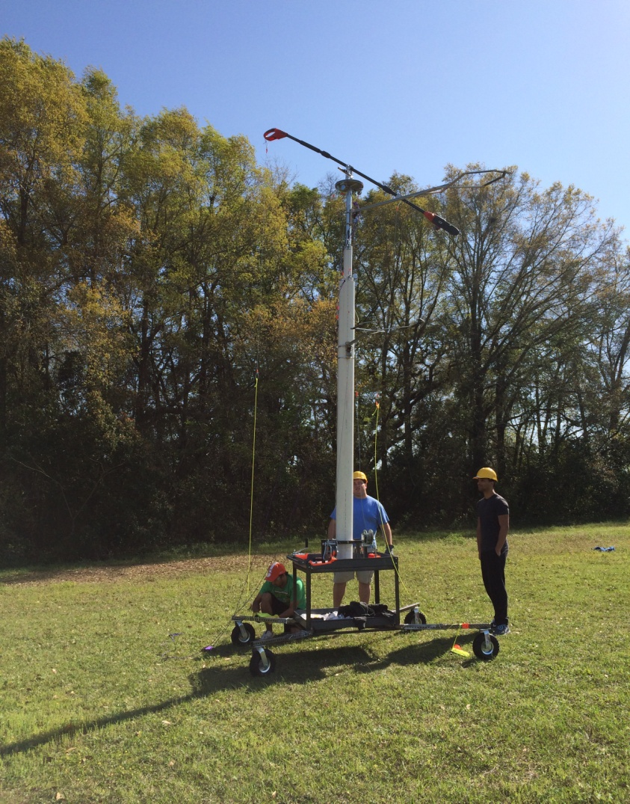
Palm Harvester
IE-led
Advisor: Dr. Okoli
(2 IE, 3 ME,
1 ECE?)
Project
E#22
Oil palms are cultivated to produce palm oil, used in many applications
  Harvesting these is currently labor-intensive
Goal: Design an efficient mechanical harvester
  An early prototype exists, but needs improvements

Slide 22
Reactive Materials for
Quadrotor Airframes
Project
E#23
New IME-led project
See description on Blackboard

Slide 23
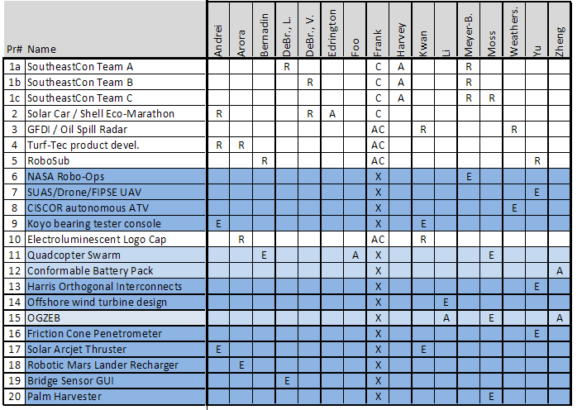
Tentative ECE Faculty Advisor/Reviewer Assignments
Not yet finalized

