Slide 1
Home Energy Management
EML 4911C-Senior Design- Fall 2015 Initial Design Presentation

Slide 2
Our Goal
With the implementation of our Home Energy Management System and the advantage of Real-Time Pricing (RTP) provided by electric utility companies, consumers have the ability to adjust their energy usage in order to reduce their electricity bill.
Sponsored by FEEDER – Foundation for Engineering Education for Distributed Energy Resource
Who are we?
Dillon Wiggins – EE – Project Manager
Pablo Aguirre – EE – Financial Analyst
Juan Ospina – CE & EE – Hardware Engineer
Ivan Remete – EE – Electrical Engineer
Michael Garcia-Rivas – CE – Software Engineer
Notes:
Dillon

Slide 3
Background
According to Brattle Group, a leading consulting firm, during the power crisis in the Western U.S. in 2000/01, a demand response program would have helped contain the energy crisis in California.
If real‐time pricing had been offered to large commercial and industrial customers, peak demand would have fallen by 2.5 percent, resulting in a drop of 18 percent in wholesale market prices.
SOURCE: BENEFITS OF DEMAND RESPONSE IN ELECTRICITY MARKETS AND RECOMMENDATIONS FOR ACHIEVING THEM
Notes:
http://energy.gov/sites/prod/files/oeprod/DocumentsandMedia/DOE_Benefits_of_Demand_Response_in_Electricity_Markets_and_Recommendations_for_Achieving_Them_Report_to_Congress.pdf
Pablo

Slide 4
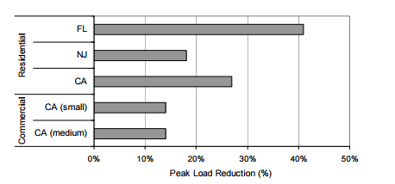
Background cont.
Load Response from Critical Peak Pricing and Demand Response Enabling Technologies
Figure 1
SOURCE: BENEFITS OF DEMAND RESPONSE IN ELECTRICITY MARKETS AND RECOMMENDATIONS FOR ACHIEVING THEM
Notes:
http://energy.gov/sites/prod/files/oeprod/DocumentsandMedia/DOE_Benefits_of_Demand_Response_in_Electricity_Markets_and_Recommendations_for_Achieving_Them_Report_to_Congress.pdf
Pablo

Slide 5
Background cont.
Real-time pricing (RTP) enables customers to pay for electricity at the wholesale price during a predetermined period of time, paying for energy at a rate that is linked to the hourly market price for electricity.
This is often viewed as the purest form of price-based demand response, as the much smaller price-responsive interval periods lead to a closely linked cost/price ratio.
Result
The cost of generating electricity does not always match the price the end user pays for electricity, RTP allows customers to base their energy usage on the energy market price.
Renewable energy can become a viable source through a normalized demand curve
Notes:
Source: Faruques PDF
Pablo

Slide 6
Projected residential loads per kW
Figure 2 displays the power you need when all appliances have started and are running. Loads are based on the U.S average. Assuming total house continuous rating is 47.860 kW
Figure 2
Reference: CentralMaineDiesel
Notes:
Ivan

Slide 7
Continuous Load Rating Per Average Household
Unit | Continuous Rating (W)
Electric Vehicle | 10000
Central Air (40k BTU)-for a 1,500sqft home | 6000
Electric Water Heater | 4000
Refrigerator (1/4 HP) | 500
Freezer (1/4 HP) | 600
Dehumidifier | 650
Computer System: CPU, Monitor, Laser Printer | 1500
UPS System | 2000
CD Player | 100
Radio | 100
Television | 300
Microwave | 800
Blender | 300
Coffee Maker | 1500
Electric Range (1 element) | 1500
Toaster (2-slice) | 1000
Dishwasher (Hot Dry) | 1500
Electric Oven | 3410
Reference: CentralMaineDiesel
Notes:
IVAN

Slide 8
Continuous Load Rating Per Average Household Cont.
Unit | Continuous Rating (W)
Washing Machine | 1150
Electric Clothes Dryer | 5400
Security System | 500
Hair Dryer | 1200
Garage Door Opener (1/3 HP) | 750
Iron | 1200
Total Load (W)
47,860
Reference: CentralMaineDiesel
Notes:
IVAN

Slide 9
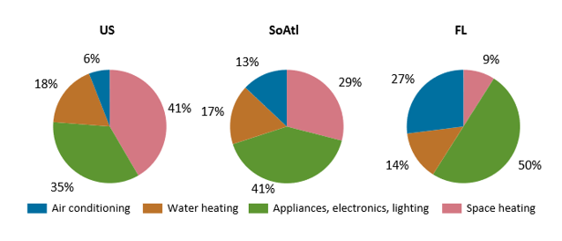
Average Energy Consumed (Residential)
Figure 3
More than a quarter (27%) of the energy consumed in Florida homes is for air conditioning, which is more than four times the national average. Half of energy consumed by Florida households is for appliances, electronics, and lighting.
Source: U.S Energy information Administration
Notes:
Ivan

Slide 10
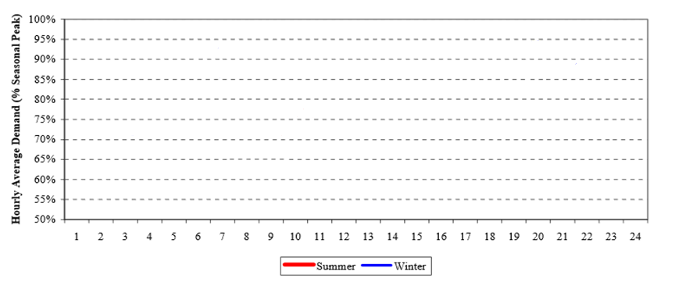
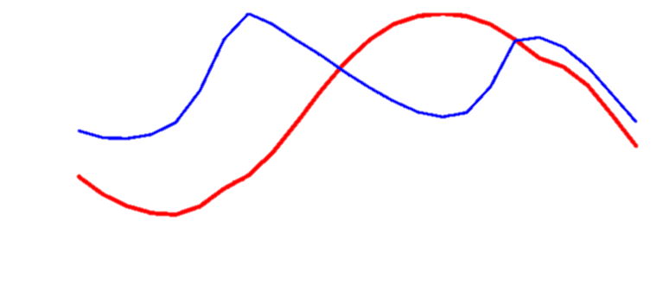
TYSP(Ten Year Site Plan) Utilities: Example Daily Load Curve (FL)
Figure 4
Source: Florida Public Service Commission, Dec.2012
PV: Pecan Street Research Institute (Not to scale)
Notes:
Ivan

Slide 11
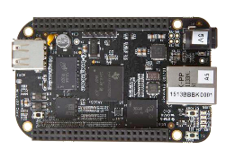
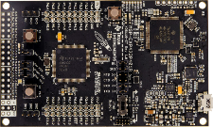
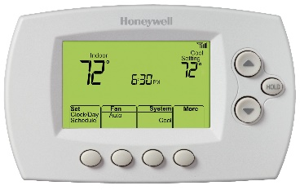
Design
Internet
Web Application
Web Server
Router
Main Controller
Load Controller
Load Controller
Load Controller
Electric
Vehicle
Water Heater
Thermostat
Notes:
Dillon

Slide 12
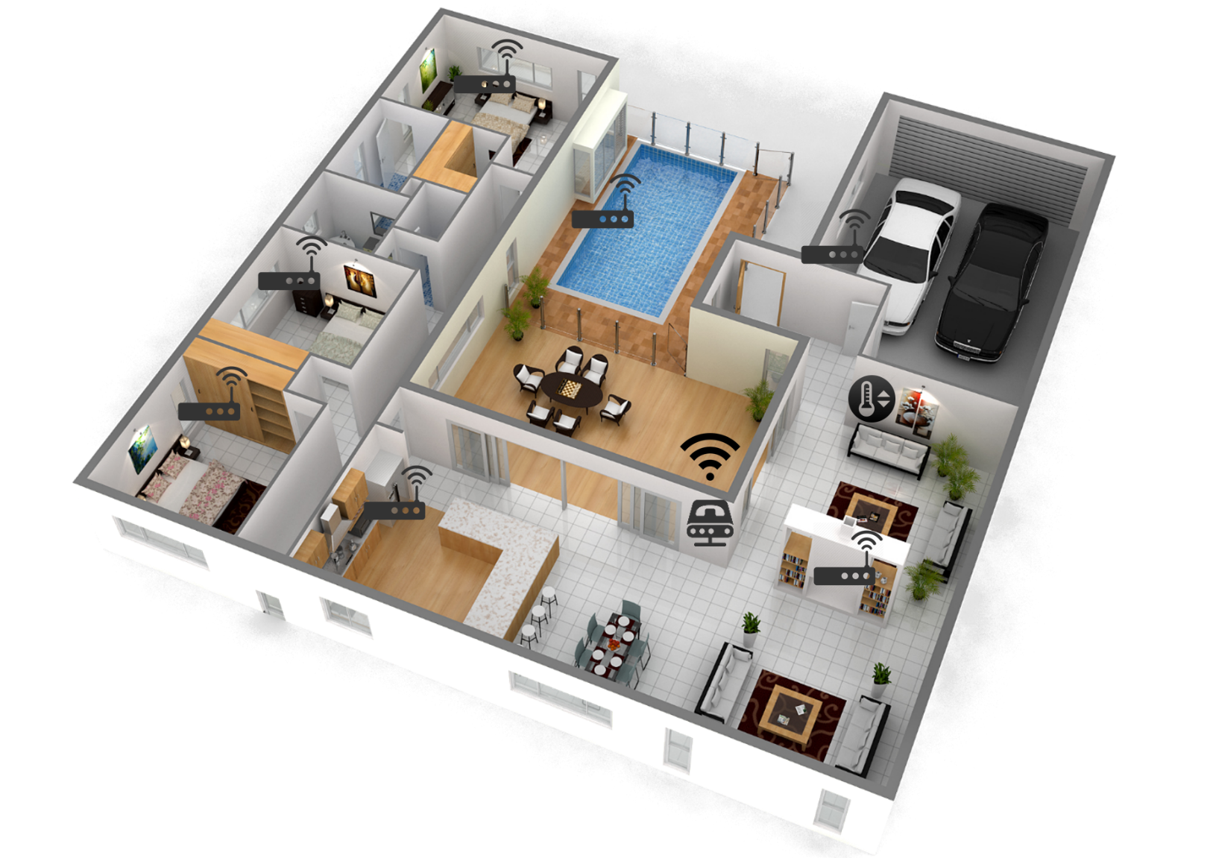
House Design
Notes:
Dillon

Slide 13
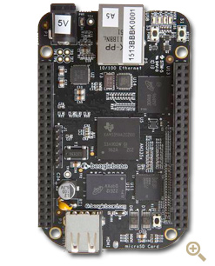
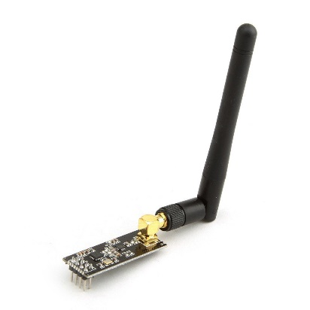
Controller Section
Beagle Bone Black (Main Controller)
Connected to Internet using Ethernet Connection.
NRF24L01+ Transceiver
Characteristics | Specification
Processor | AM335x 1GHz ARM® Cortex-A8
RAM | 512MB DDR3 RAM
Storage | 4GB 8-bit eMMC on-board flash
Connectivity | Specification
 | Ethernet
 | SPI (Serial Peripheral Interface)
 | HDMI
 | GPIO
Characteristics | Specification
RF Technology | 2.4 GHz ISM Band Operation
Modulation | 1 or 2 MHz Bandwidth
Information | Dynamic Payload 1 to 32 bytes
Notes:
Michael

Slide 14
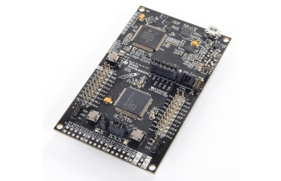
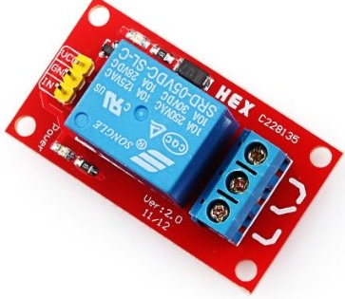
Load Section
MSP432P401R
Direct communication with main controller using a NRF24L01+ Transceiver.
NRF24L01+ Transceiver
5[V] Relay – Rated 10[A] 250 [V] AC
Characteristics | Specification
MCU | 48 MHz 32-bit ARM Cortex M4F
Power | 95 [uA]/MHz Active Operation
 | 850 [nA] Standby Operation
Memory
Flash | 256 KB
RAM | 64 KB
Notes:
Michael
10 Amp relay

Slide 15
Why Choose NRF24L01+ ?
Comparison Table (Antenna versions)
 | NRF24L01+ | XBEE (Zigbee)
Frequency Band | 2.4 GHz ISM | 2.4 GHz ISM
Protocol | Proprietary | IEEE 802.15.04
Range | 1100[meters] | 1000 [meters]
Data Rate Max. | 2 Mbps | 250 Kbps
Price | 12.00 | 42.00
Data rates Baud for data transfer is higher on the NRF24L01+, i.e. more data can be transferred to the loads controller per second.
The price difference between both modules could be a important factor for big projects and business scalability.
Example: Costs of Load Controllers
Costs per Box
 | Load Controller (NRF24L01+) | Load Controller (XBEE)
Box | 5 | 5
Relays | 6 | 6
Cables | 4 | 4
PCB Circuits | 7 | 7
MCU | 13 | 13
Transceiver | 12 | 42
TOTAL | 47 | 77
x1000 Boxes | 47000 | 77000
Price Difference | 30000
Notes:
Michael

Slide 16
Prototype Box Design
Notes:
Juanito

Slide 17
Communication Protocols
Beagle bone Black ←→ MSP432
Technology:
2.4 GHz ISM (Industrial Scientific and Medical) radio frequency band.
SPI (Serial Peripheral Interface)
Communication Design:
2 Bytes Code at Data Rate of 1 MBPS
3 Modes for Communication:
Turn ON/OFF – Code: A1/A2.
Ask if Load is ON/OFF – Code: B5.
Ask for Temperature Information – Code: C1
Notes:
Juanito

Slide 18
Address: The address for each load is going to be assigned via web application.
Recommendations followed for Assigning Addresses:
Avoid addresses that start with 0x00 0x55 0xAA 0xFF
40-Bit (5 Bytes) Long.
Avoid addresses made by 5, 4 or 3 equal bytes (0x00 and 0xFF not recommended)
Load1 : 0D 0C 0B 0A 01
Load 2: 0D 0C 0B 0A 02
….
Load 10: 0D 0C 0B 0A 0A
Load 11: 0D 0C 0B 0A 0B
….
Load 16: 0D 0C 0B 0A 10
Load 17: 0D 0C 0B 0A 12
Notes:
Juan

Slide 19
User Input Data
Load Data
Type: washer, water heater, etc.
Priority
1-10, 1 will be turned off first 10 will be turned off last
Specs
operating watt usage, current, voltage
Air Conditioning
Set temp schedule
Set max deviation
Example: ±5º from current setting
Set priority of AC schedule deviation
Notes:
Dillon

Slide 20
Algorithm
Start
User Input?
NO
YES
NO
NO
OFF
Load On/Off?
Time > 5min?
Price change?
YES
YES
ON
Current price
Deactivate load
Activate load
Time=0
Less than threshold
Greater than threshold
Reduce load
Notes:
Dillon

Slide 21
Gantt Chart
 | Dates
Task Name | 08/31/15 | 09/07/15 | 09/14/15 | 09/21/15 | 09/28/15 | 10/05/15 | 10/12/15 | 10/19/15 | 10/26/15 | 11/02/15 | 11/09/15 | 11/16/15 | 11/23/15 | 11/30/15
Research load data and real time pricing
Needs Assessment
Web site design
Order necessary hardware
Develop algorithm for application
Midterm Presentation I preparation
Assemble prototype
Midterm Presentation II preparation
Test and debug application
Prepare final design for demonstration
 | Deliverables
 | Project Work
 | Others
Notes:
Dillon

Slide 22
Notes:
Dillon
Dillon
Dillon
Dillon
Dillon
Dillon
Dillon
Dillon
Dillon
Dillon
Dillon
Dillon
Dillon
Dillon
Dillon

Slide 23
Questions?
Notes:
Dillon
Dillon
Dillon
Dillon
Dillon
Dillon
Dillon

Slide 24
Thank you for your time!
Notes:
Dillon
Dillon
Dillon
Dillon
Dillon

