Slide 1
Home Energy Management
EML 4911C-Senior Design- Fall 2015
Presentation II: Interim Design Review

Slide 2

Our Goal
With the implementation of our Home Energy Management System and the advantage of Real-Time Pricing (RTP) provided by electric utility companies, consumers have the ability to adjust their energy usage in order to reduce their electricity bill.
Sponsored by FEEDER – Foundation for Engineering Education for Distributed Energy Resource
Who are we?
Dillon Wiggins – EE – Project Manager
Pablo Aguirre – EE – Systems Engineer
Juan Ospina – CE & EE – Hardware Engineer
Michael Garcia-Rivas – CE – Software Engineer
Ivan Remete – EE – Electrical Engineer

Slide 3
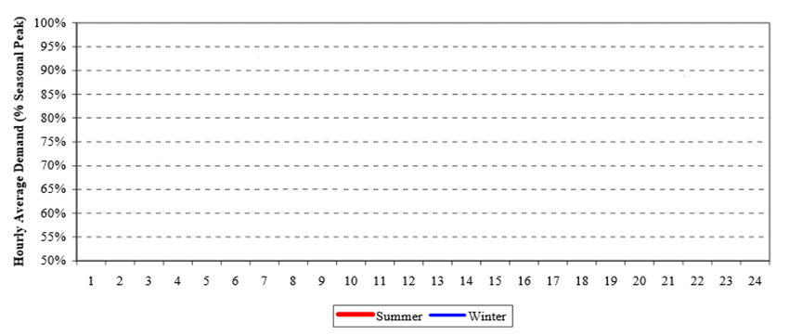
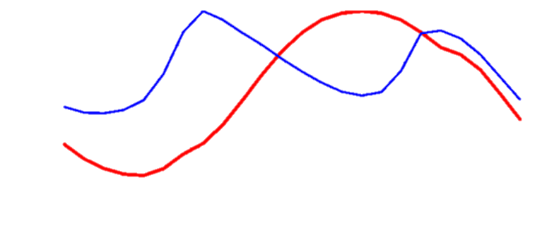

TYSP(Ten Year Site Plan) Utilities: Example Daily Load Curve (FL)
Figure 4
Source: Florida Public Service Commission, Dec.2012
PV: Pecan Street Research Institute (Not to scale)

Slide 4
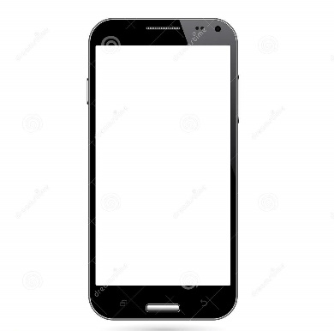


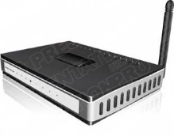
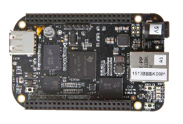
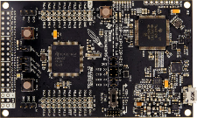

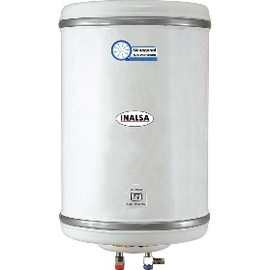
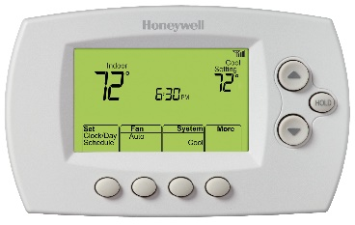


Design
Internet
Web Application
Web Server
Router
Main Controller
Load Controller
Load Controller
Load Controller
Electric
Vehicle
Water Heater
Thermostat

Slide 5
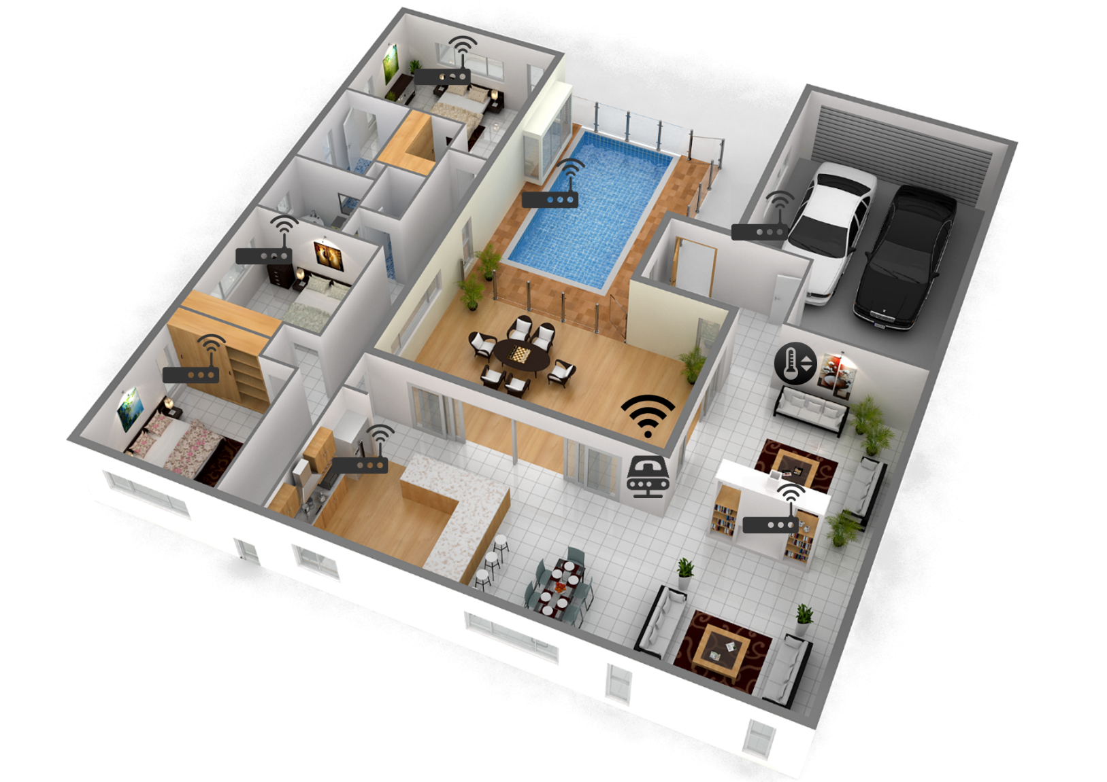
House Design

Slide 6
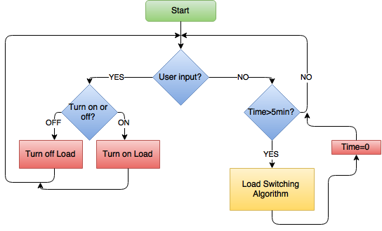
Algorithm

Slide 7

Algorithm

Slide 8
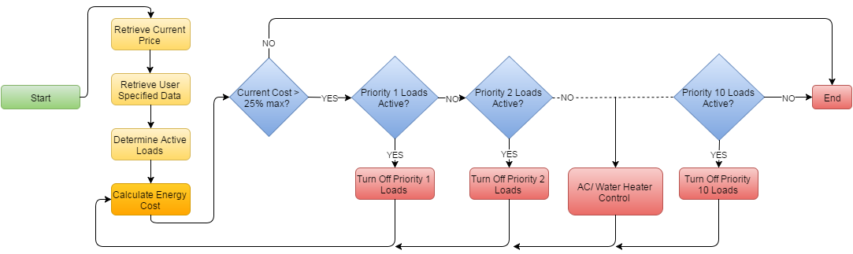
Algorithm

Slide 9
Algorithm
25% of yesterday’s price or 25% of maximum cost specified by user
  Priority 1-4
  Adjust AC
  Water Heater off while user is away
    Depends on size
50% of yesterday’s price or 50% of maximum cost specified by user
  Priority 5-7
75% of yesterday’s price or 75% of maximum cost specified by user
  Priority 8-10
  AC adjusted to maximum deviation

Slide 10
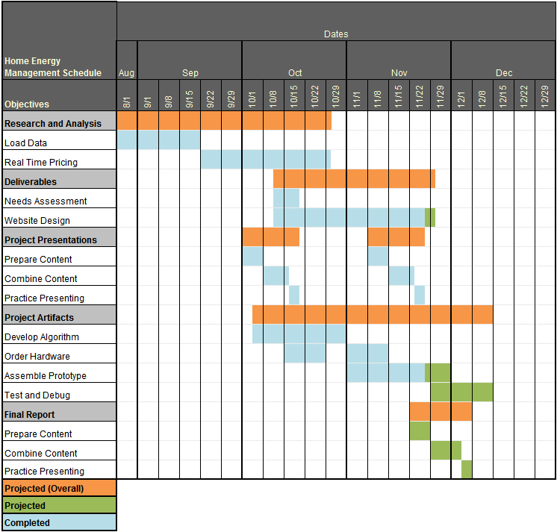
Objectives
Needs Assessment
Project Plans and Specs
Research Load Data
Midterm Presentation I
Order Hardware
Team Website
Algorithm
Assemble Prototype
  Communication between Main Controller and Load Controller

Slide 11
PLC: Power Line Communication
PLC is a method of communication protocol that uses electrical wiring (AC or DC) to carry both electrical power and data. PLC is used in electrical transmission, distribution, home networking, and automotive uses.
Home networking: Broadband over Power Line (BPL) allows for high-speed internet access through existing power lines. Extensive infrastructure already present offers a great benefit to using BPL.
Pros:
Data speed up from 90Mbps to 200Mbps.
Since it communicates with the power line of the home, it will have no trouble in communicating through the entirety of the home (i.e. through thick walls).
Infrastructure already present
Cons:
It is more costly (average of $50 per a kit of two).
Do not work when plugged into a surge protector, power strip, and Arc-fault circuit interrupts (AFCI’s required in some homes)
Dependent of electrical wiring in the house itself (If the house is improperly wired, the system can fail or even trip breakers).
Performance can be degraded by noise created by certain appliances as well as ON/OFF switching.

Slide 12
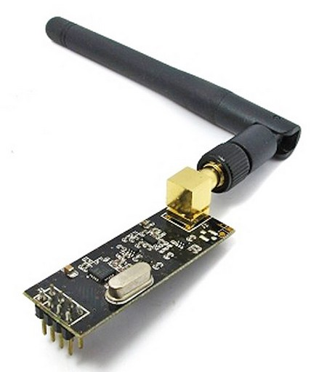
Transmitting Data with the nRF24L01+
Enhanced ShockBurstTM is a packet based data link layer that features
  1 to 32 bytes dynamic payload length
  Automatic packet handling
  Automatic packet transaction handling
    Auto Acknowledgement with payload
    Auto retransmit
  6 data pipe MultiCeiver for 1:6 star networks
The automatic packet transaction works as follows:
  Begin by transmitting a data packet from the transceiver(PTX) to the receiver (PRX).
  The PTX is then set to receive mode to wait for acknowledgement packet (ACK packet)
  If the data packet is received by the PRX, the PRX sends the ACK packet to the PTX and returns back to receive mode.
  If the ACK packet isn’t received by the PTX immediately, the data packet is sent again after a programmable delay.
Source: nRF24L01+ Product Specification

Slide 13
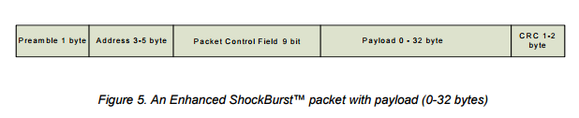
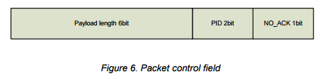
The Preamble is a bit sequence used to synchronize the receivers demodulator to the incoming bit stream.
The Address is the address for the receiver.
The Packet Control Field is shown in Figure 6 and is made up of a 6 bit payload length field, a 2 bit PID field, and a 1 bit NO_ACK flag.
The Payload is our data we are sending from load controller to main controller.
The CRC (Cyclic Redundancy Check) is a mandatory error detection mechanism in the packet.
Source: nRF24L01+ Product Specification

Slide 14
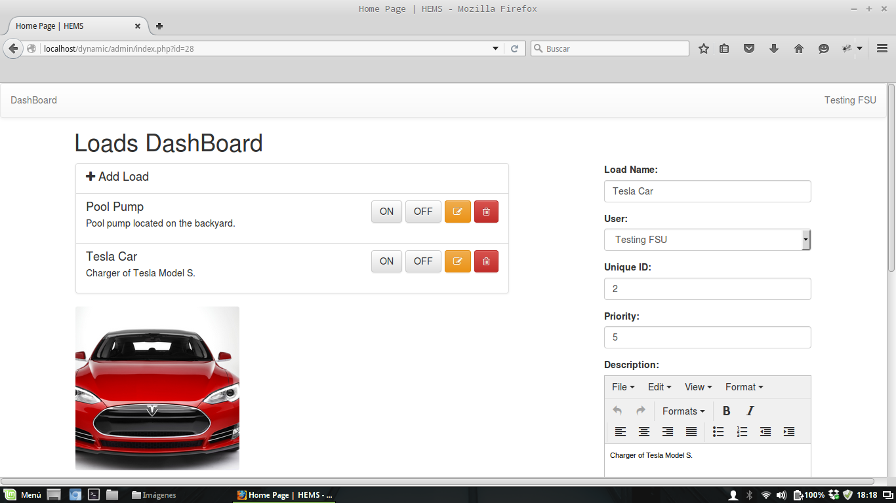

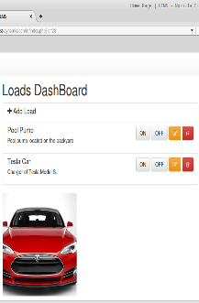
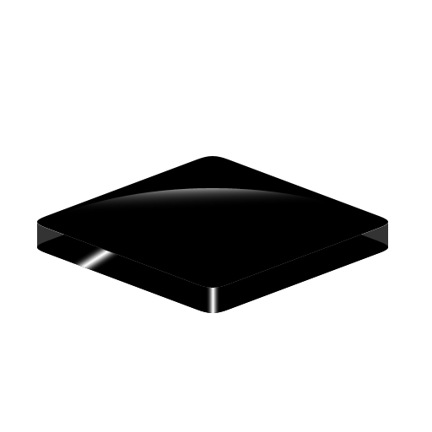

Demo: Web-Application ← → Main Controller
WebPage Hosted on IP: 192.168.0.119
Socket Connection
Via nRF24L01
Load Controllers
Main Controller
IP: 192.168.0.125

Slide 15
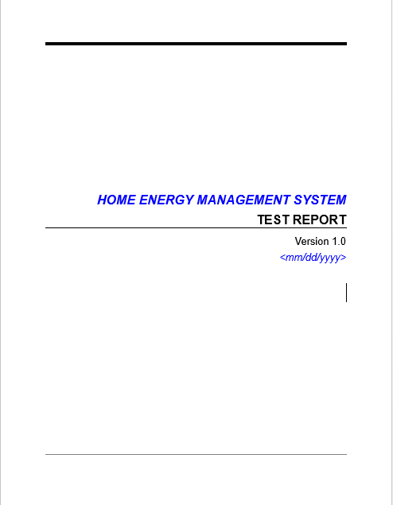
Testing Protocols
Test Report: Document with a detailed description of all the tests performed on the system.
Primary sections to be tested:
Inner Mesh: Main Controller ←→ Load Controllers
Line of Sight/Open Air Test
Indoor Test
Hypothesis:
Smaller payload = increase in range.
Lower Data Rate = increase in sensitivity.
2. Network/Socket Connection: Web/Server Application ←→ Main Controller

Slide 16
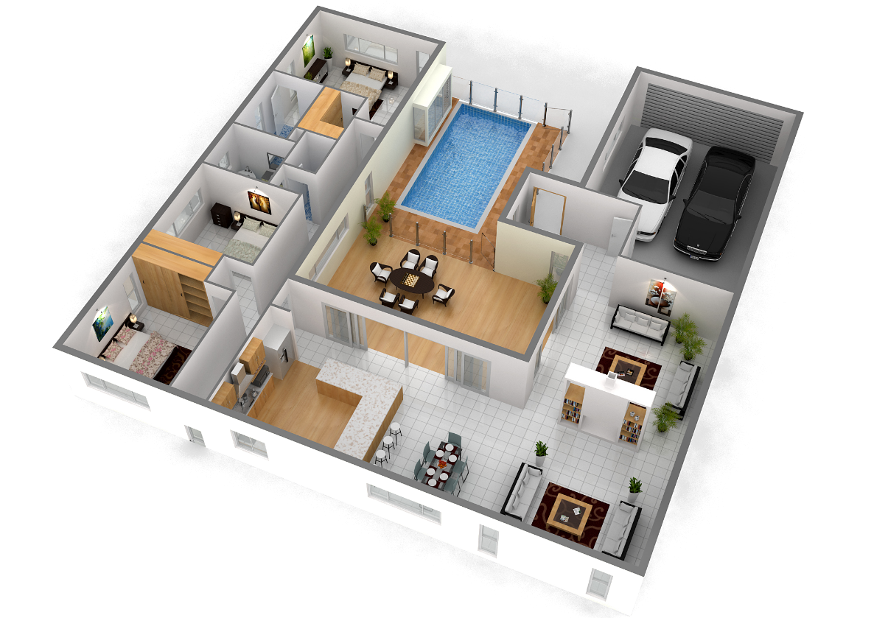
Inner Mesh:
1. Line of Sight/Open Air Test
2. Indoor Test
Indoor Range Test:
Location of Main Controller
Good Reception:
Few Packet Loss:
No Reception:

Slide 17


LAN (Local Area Network)
Network Connection Tests:
Socket Connection
Real-Time Control of Loads
Real-Time Price Change on Server
Algorithm Response
AC Temperature Control
Website Performance
IP: 192.168.0.119
IP: 192.168.0.125
3. WebServer
2. Router
The Network Tests will be performed in a LAN due to:
Possible Severe Security Problems.
Full Control of a Router with access to Public IP to perform Port Forwarding.
Main Controller
4. CellPhone
Items on Graph:
Main Controller
Router = Internet
Server = Webserver where website will be hosted. (A computer will be used to simulate as server).
Cellphone used to access the Webserver.

Slide 19
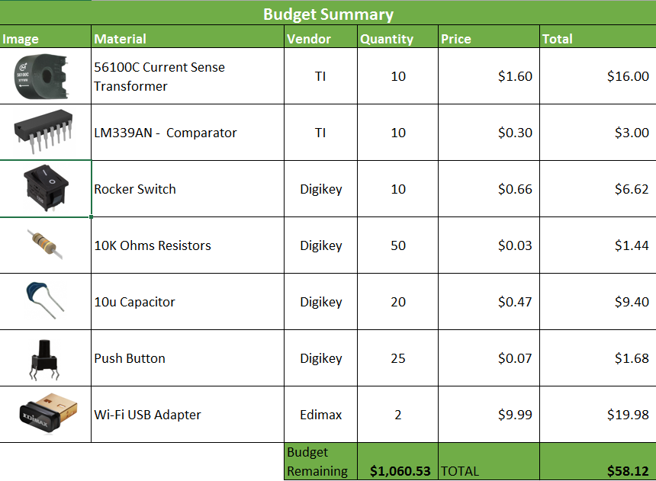
Budget Cont.

Slide 20
Questions?

Slide 21
Thank you for your time!

