Slide 1
Home Energy Management
Senior Design Final Presentation

Slide 2

Our Goal
With the implementation of our Home Energy Management System and the advantage of Real-Time Pricing (RTP) provided by electric utility companies, consumers have the ability to adjust their energy usage in order to reduce their electricity bill.
Sponsored by FEEDER – Foundation for Engineering Education for Distributed Energy Resource
Who are we?
Dillon Wiggins – EE – Project Manager
Pablo Aguirre – EE – Systems Engineer
Juan Ospina – CE & EE – Hardware Engineer
Michael Garcia-Rivas – CE – Software Engineer
Ivan Remete – EE – Electrical Engineer

Slide 3
Background
According to Brattle Group, a leading consulting firm, during the power crisis in the Western U.S. in 2000/01, a demand response program would have helped contain the energy crisis in California.
If real‐time pricing had been offered to large commercial and industrial customers, peak demand would have fallen by 2.5 percent, resulting in a drop of 18 percent in wholesale market prices.
SOURCE: BENEFITS OF DEMAND RESPONSE IN ELECTRICITY MARKETS AND RECOMMENDATIONS FOR ACHIEVING THEM
Notes:
http://energy.gov/sites/prod/files/oeprod/DocumentsandMedia/DOE_Benefits_of_Demand_Response_in_Electricity_Markets_and_Recommendations_for_Achieving_Them_Report_to_Congress.pdf
THESE 7 SLIDES SHOULD BE COMPRESSED INTO, AT MOST, 3
TOO WORDY
Pablo

Slide 4
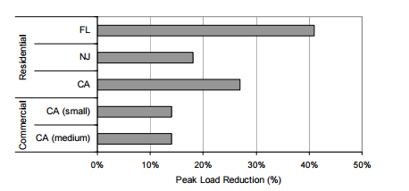
Background cont.
Load Response from Critical Peak Pricing and Demand Response Enabling Technologies
Figure 1
SOURCE: BENEFITS OF DEMAND RESPONSE IN ELECTRICITY MARKETS AND RECOMMENDATIONS FOR ACHIEVING THEM
Notes:
http://energy.gov/sites/prod/files/oeprod/DocumentsandMedia/DOE_Benefits_of_Demand_Response_in_Electricity_Markets_and_Recommendations_for_Achieving_Them_Report_to_Congress.pdf
THESE 7 SLIDES SHOULD BE COMPRESSED INTO, AT MOST, 3
Pablo

Slide 5
Background cont.
Real-time pricing (RTP) enables customers to pay for electricity at the wholesale price during a predetermined period of time, paying for energy at a rate that is linked to the hourly market price for electricity.
This is often viewed as the purest form of price-based demand response, as the much smaller price-responsive interval periods lead to a closely linked cost/price ratio.
Result
The cost of generating electricity does not always match the price the end user pays for electricity, RTP allows customers to base their energy usage on the energy market price.
Renewable energy can become a viable source through a normalized demand curve
Notes:
Source: Faruques PDF
THESE 7 SLIDES SHOULD BE COMPRESSED INTO, AT MOST, 3
TOO WORDY
Pablo

Slide 6
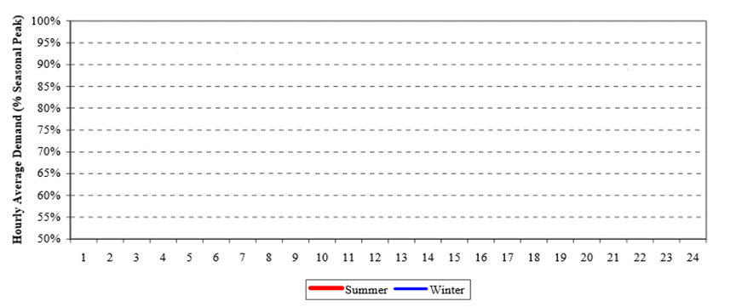
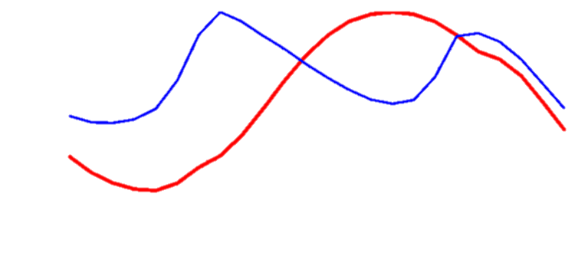

TYSP(Ten Year Site Plan) Utilities: Example Daily Load Curve (FL)
Figure 4
Source: Florida Public Service Commission, Dec.2012
PV: Pecan Street Research Institute (Not to scale)
Ivan Remete
Notes:
IVAN

Slide 7
Source: Power Smart Pricing, Ameren Illinois
Ivan Remete
Notes:
IVAN

Slide 8
Source: Power Smart Pricing, Ameren Illinois
Average monthly utility: $87 for Illinois, $123 for FL. <Electricity Local>
Ivan Remete
Notes:
IVAN

Slide 9
Projected residential loads per kW
Figure 2 displays the power you need when all appliances have started and are running. Loads are based on the U.S average. Assuming total house continuous rating is 47.860 kW
Figure 2
Reference: CentralMaineDiesel
Notes:
Ivan
THESE 7 SLIDES SHOULD BE COMPRESSED INTO, AT MOST, 3
Mention Tesla

Slide 10
Continuous Load Rating Per Average Household
Unit | Continuous Rating (W)
Electric Vehicle | 10000
Central Air (40k BTU)-for a 1,500sqft home | 6000
Electric Water Heater | 4000
Refrigerator (1/4 HP) | 500
Freezer (1/4 HP) | 600
Dehumidifier | 650
Computer System: CPU, Monitor, Laser Printer | 1500
UPS System | 2000
CD Player | 100
Radio | 100
Television | 300
Microwave | 800
Blender | 300
Coffee Maker | 1500
Electric Range (1 element) | 1500
Toaster (2-slice) | 1000
Dishwasher (Hot Dry) | 1500
Electric Oven | 3410
Reference: CentralMaineDiesel
Notes:
IVAN
THESE 7 SLIDES SHOULD BE COMPRESSED INTO, AT MOST, 3

Slide 11
Continuous Load Rating Per Average Household Cont.
Unit | Continuous Rating (W)
Washing Machine | 1150
Electric Clothes Dryer | 5400
Security System | 500
Hair Dryer | 1200
Garage Door Opener (1/3 HP) | 750
Iron | 1200
Total Load (W)
47,860
Reference: CentralMaineDiesel
Notes:
IVAN
THESE 7 SLIDES SHOULD BE COMPRESSED INTO, AT MOST, 3

Slide 12
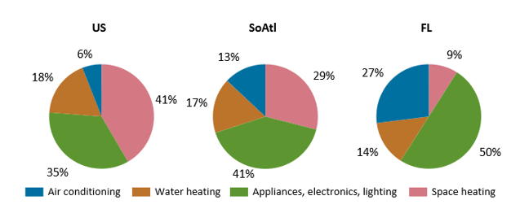
Average Energy Consumed (Residential)
Figure 3
More than a quarter (27%) of the energy consumed in Florida homes is for air conditioning, which is more than four times the national average. Half of energy consumed by Florida households is for appliances, electronics, and lighting.
Source: U.S Energy information Administration
Notes:
Ivan
THESE 7 SLIDES SHOULD BE COMPRESSED INTO, AT MOST, 3

Slide 13









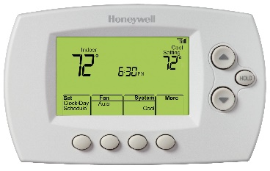

Design
Internet
Web Application
Web Server
Router
Main Controller
Load Controller
Load Controller
Load Controller
Thermostat
Electric
Vehicle
Water Heater

Slide 14
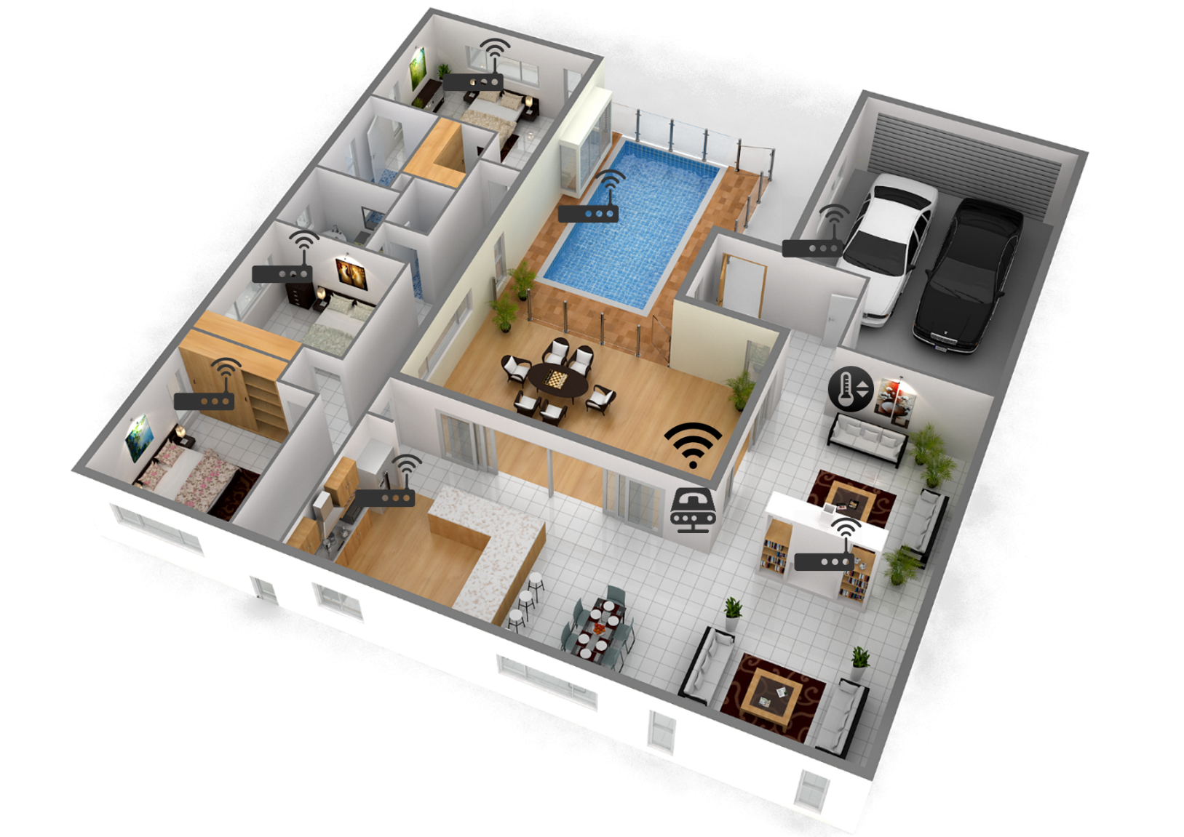
House Design

Slide 15


Main Controller Section
Beagle Bone Black (Main Controller)
Connected to Internet using Ethernet Connection.
NRF24L01+ Transceiver
Characteristics | Specification
Processor | AM335x 1GHz ARM® Cortex-A8
RAM | 512MB DDR3 RAM
Storage | 4GB 8-bit eMMC on-board flash
Connectivity | Specification
 | Ethernet
 | SPI (Serial Peripheral Interface)
 | HDMI
 | GPIO
Characteristics | Specification
RF Technology | 2.4 GHz ISM Band Operation
Modulation | 1 or 2 MHz Bandwidth
Information | Dynamic Payload 1 to 32 bytes
Notes:
Michael

Slide 16

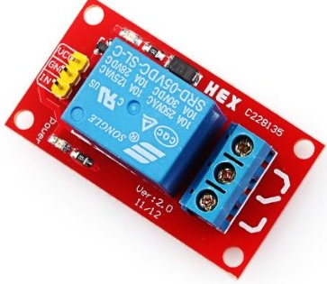
Load Section
MSP432P401R
Direct communication with main controller using a NRF24L01+ Transceiver.
NRF24L01+ Transceiver
5[V] Relay – Rated 10[A] 250 [V] AC
Characteristics | Specification
MCU | 48 MHz 32-bit ARM Cortex M4F
Power | 95 [uA]/MHz Active Operation
 | 850 [nA] Standby Operation
Memory
Flash | 256 KB
RAM | 64 KB
Notes:
Michael
10 Amp relay

Slide 17
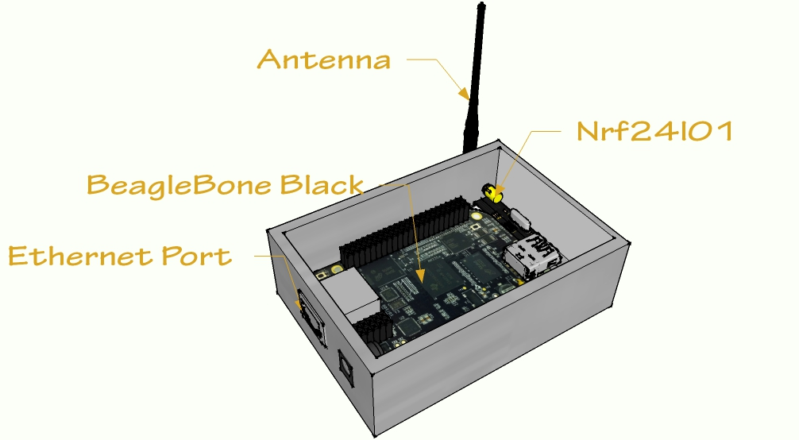
Main Controller

Slide 18
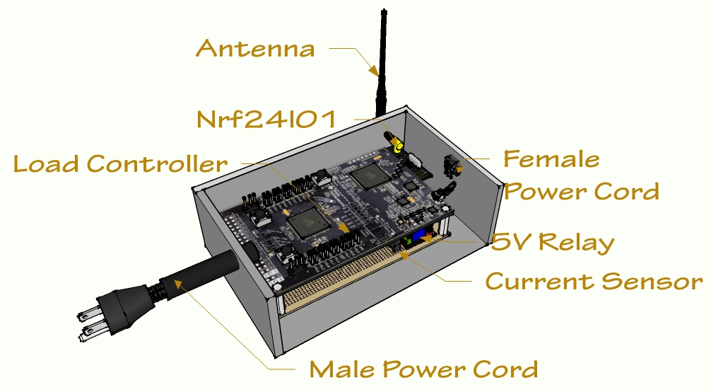
Load Controller

Slide 19
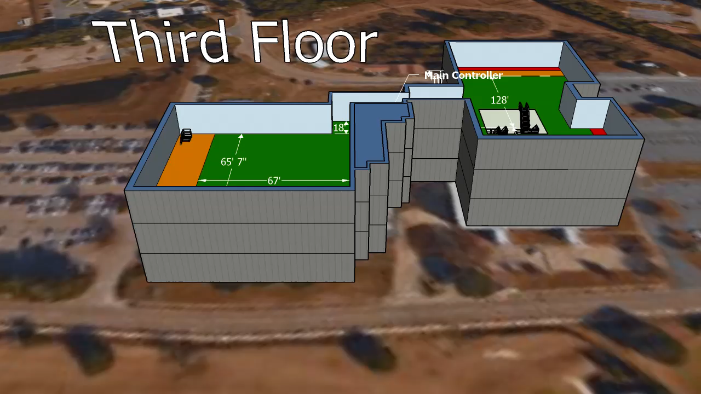
Combination of Collected Data
The Main Controller was on the third floor therefore the direct distance on other floors had to be calculated using the height.
There is about 25ft between floors
Building B has 4 large rooms
Building A has more open space

Slide 20
System Testing
Testing Results
Command | Component
 | Main Controller | Load Controller | Main Controller
 | Task
 | Sent | Received | Returned
Decrease Temperature | Pass | Pass | N/A
Increase Temperature | Pass | Pass | N/A
Turn Loads Off | Pass | N/A | N/A
Turn Loads On | Pass | N/A | N/A
RefreshTemp | Pass | Pass | Pass
CheckStatus | Pass | Pass | Pass
UpdateLoads | Pass | Pass | Pass
UpdateTemps | Pass | Pass | Pass
holdOrSched | Pass | Pass | Pass
Max Price Set | Pass | Pass | Pass
Testing Price | Pass | Pass | Pass
Loads(Deletion) | Pass | Pass | Pass

Slide 21
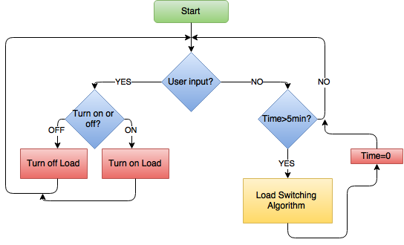
Algorithm

Slide 22

Algorithm

Slide 23
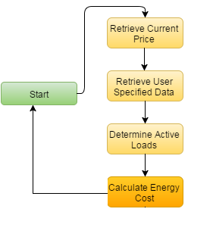
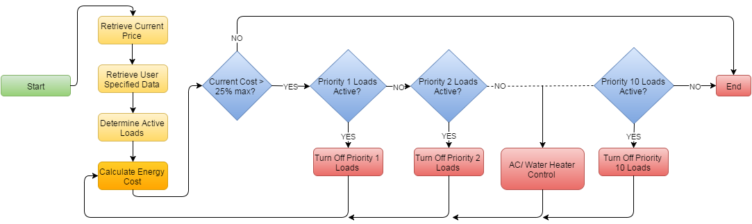
Algorithm

Slide 24
Algorithm

Slide 25
Start
Algorithm
No
Time > x min ?
Yes
OFF
Check status of Load
ON
Load 1
Load 2
Load N
Calculate Cost [₵]
Calculate Cost [₵]
Calculate Cost [₵]
…
Consumption Cost [₵]= RTP [₵/Wmin] * Load Rating [W] * Elapsed Time [min]
Σ Total Cost Load 1
Σ Total Cost Load 2
Σ Total Cost Load N
Σ Total Cost
(Consumption)

Slide 26
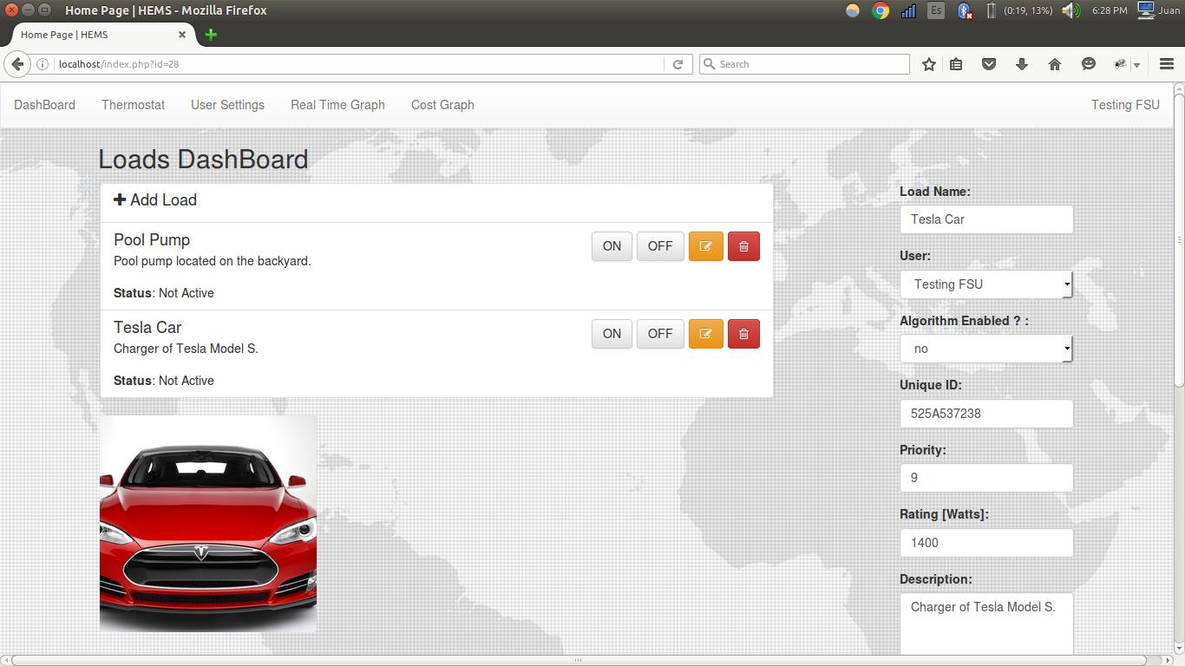



Web-Application ← → Main Controller
Socket Connection
Main Controller
IP: 192.168.1.3
Information Exchange:
ON/OFF Event
Check Status of the loads (if they are active)
Update each load’s information or save new load
Set Temperature Event
Set hold or schedule option
Check thermostat temperature reading
Update temperature schedule
Set User preferred monthly maximum price
(During testing) Send current Real Time Price
Via nRF24L01+
Load Controller
Notes:
MGR

Slide 27
Simulation

Slide 28

Future Development
Later versions of this project could have the following features
  Metering
  Renewable Energy Generation
    Priority on solar
  Algorithm Machine Learning (AI)
  Security

Slide 30
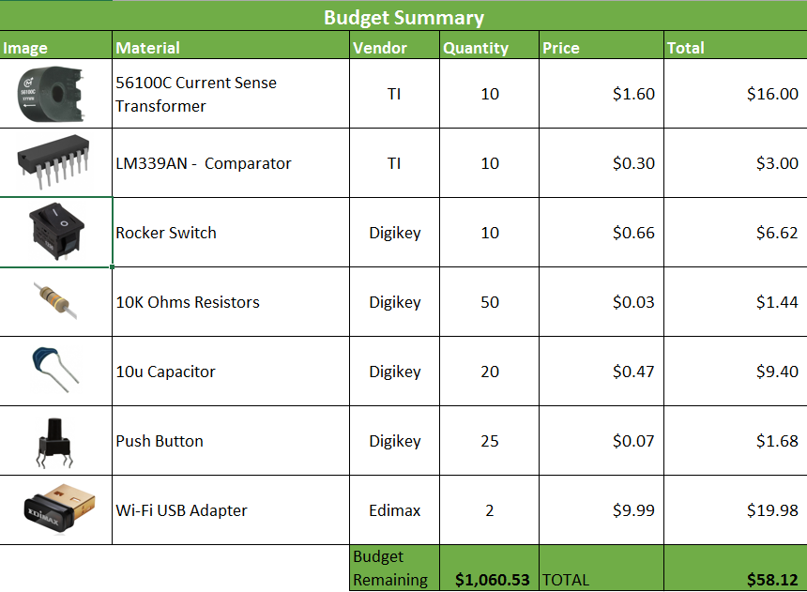
Budget Cont.

Slide 31
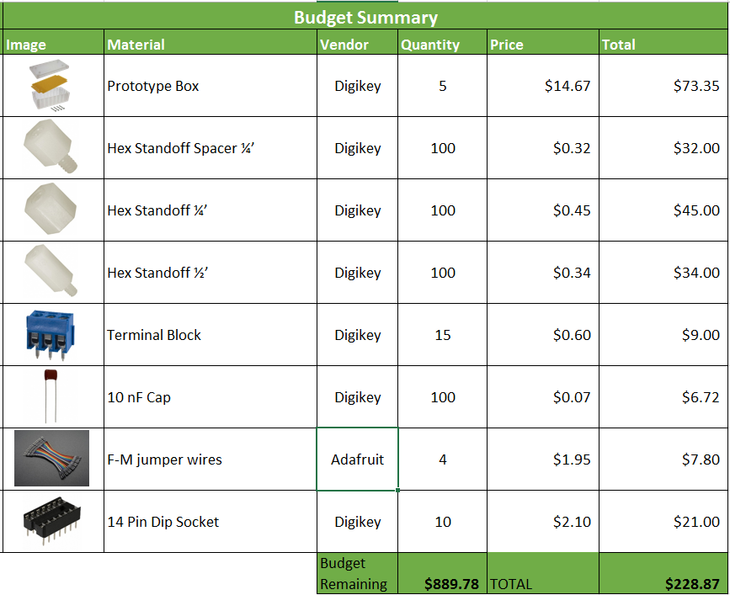
Budget Cont.

Slide 32
Thank you for your time!

Slide 33
For more information please visit: www.eng.fsu.edu/~ospinju/

Slide 34
Reference Slides

Slide 35
Testing Results

Slide 36
Testing Results

Slide 37
Testing Results

