Slide 1
Home Energy Management
EML 4911C-Senior Design- Spring 2016 Presentation I

Slide 2

Our Goal
With the implementation of our Home Energy Management System and the advantage of Real-Time Pricing (RTP) provided by electric utility companies, consumers have the ability to adjust their energy usage in order to reduce their electricity bill.
Sponsored by FEEDER – Foundation for Engineering Education for Distributed Energy Resource
Who are we?
Dillon Wiggins – EE – Project Manager
Pablo Aguirre – EE – Systems Engineer
Juan Ospina – CE & EE – Hardware Engineer
Michael Garcia-Rivas – CE – Software Engineer
Ivan Remete – EE – Electrical Engineer

Slide 3




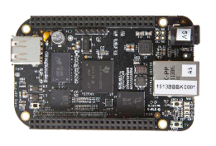
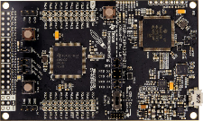


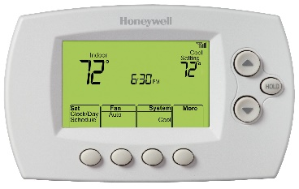


Design
Internet
Web Application
Web Server
Router
Main Controller
Load Controller
Load Controller
Load Controller
Electric
Vehicle
Water Heater
Thermostat

Slide 4
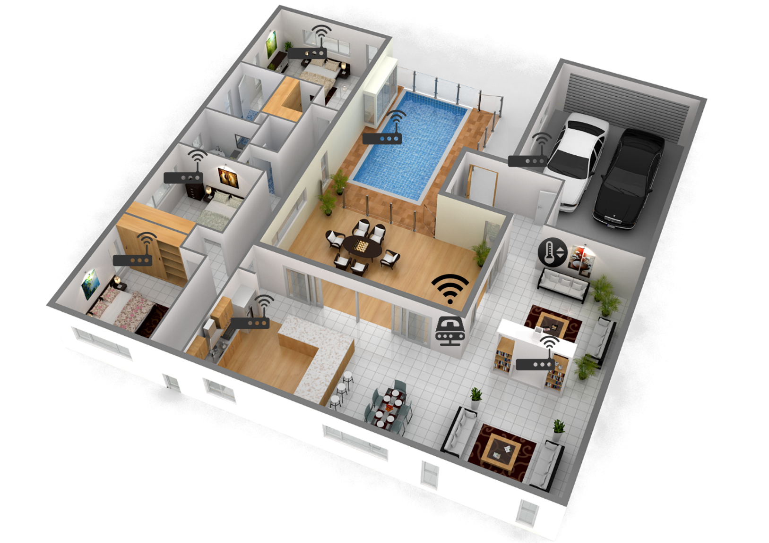
House Design

Slide 5
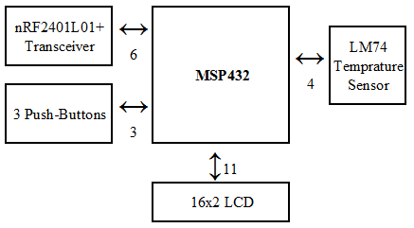
Thermostat
LM74 Temperature Sensor
SPI
0.0625°C Temperature Resolution
−55°C to +150°C (-66°F to 302°F)
Accuracy: −10°C to 65°C, ±1.25°C (max)

Slide 6
Current Detector
Detecting Active Loads Zero Cross Detect Utilizing LM139 Comparator
Current sensor turns: 100

Slide 7
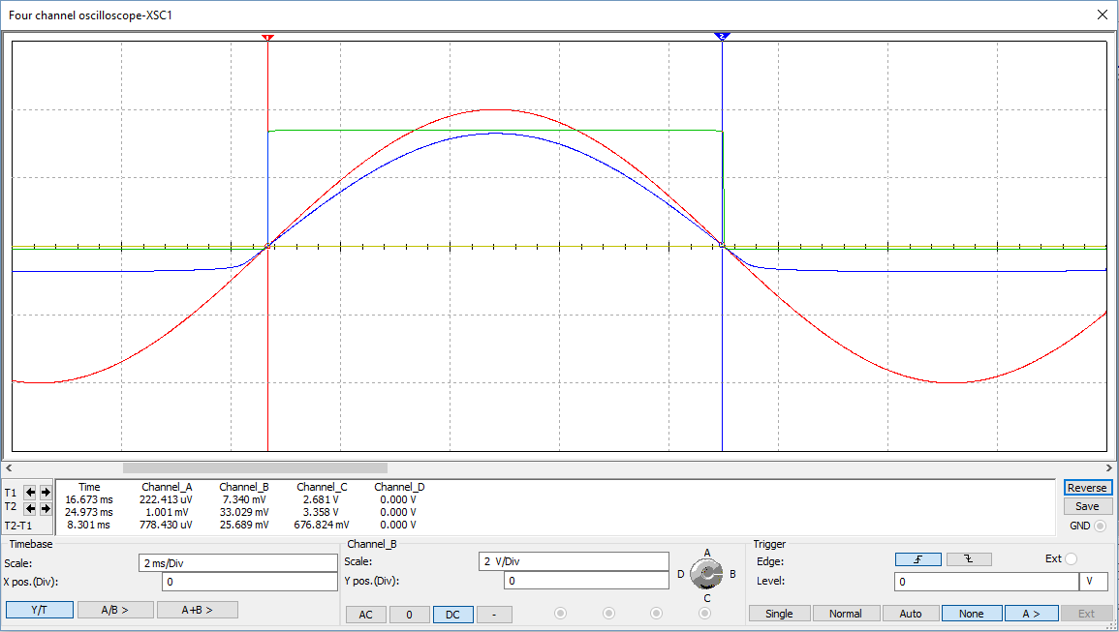
Current Detector: Zero Cross Detect Waveform
Scale (V/div)
2
2
50m (A)
2

Slide 8
Current Detector: Adjusting Reference Voltage
Current sensor turns: 100

Slide 9
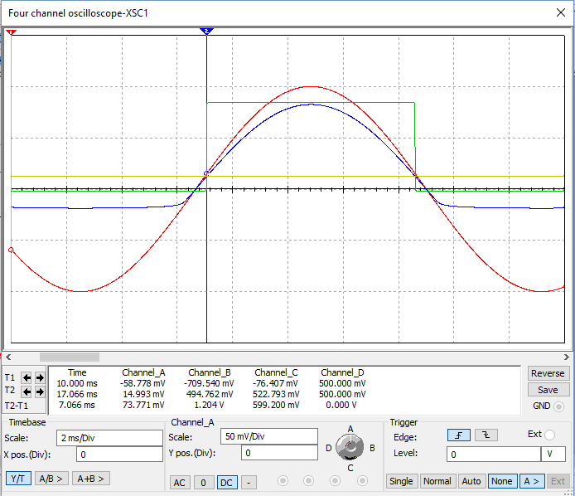
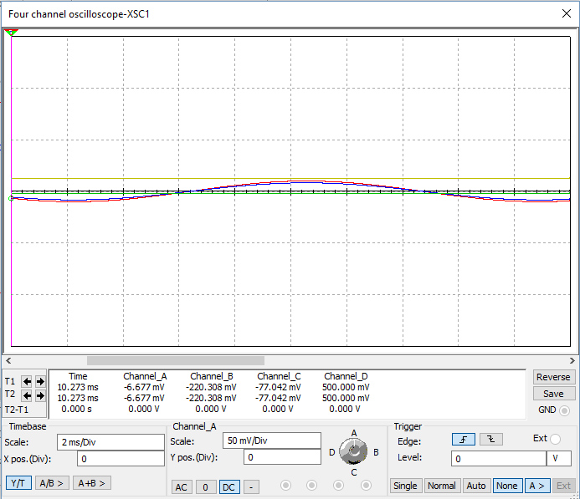
Current Detector: Adjusting Reference Voltage Negative Reference = 500mV
Sensor Current = 100mA
Sensor Current = 10mA

Slide 10
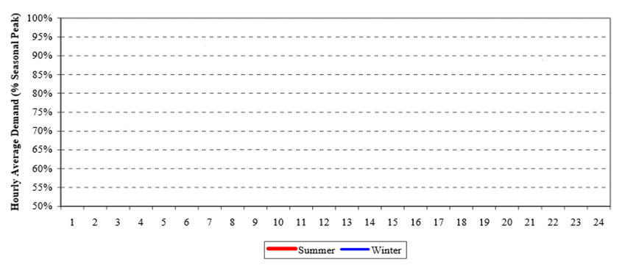
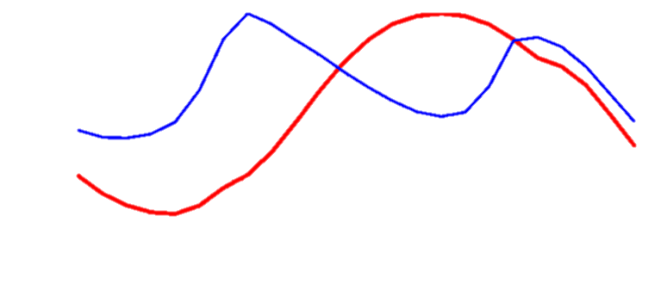

TYSP(Ten Year Site Plan) Utilities: Example Daily Load Curve (FL)
Figure 4
Source: Florida Public Service Commission, Dec.2012
PV: Pecan Street Research Institute (Not to scale)
Ivan Remete

Slide 11
Source: Power Smart Pricing, Ameren Illinois
Ivan Remete

Slide 12
Source: Power Smart Pricing, Ameren Illinois
Average monthly utility: $87 for Illinois, $123 for FL. <Electricity Local>
Ivan Remete

Slide 13
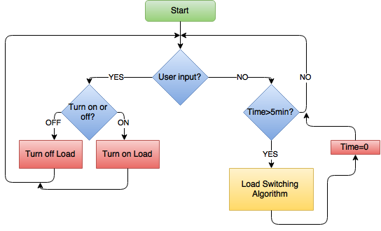
Algorithm
Ivan Remete

Slide 14

Algorithm
Ivan Remete

Slide 15
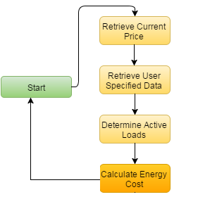
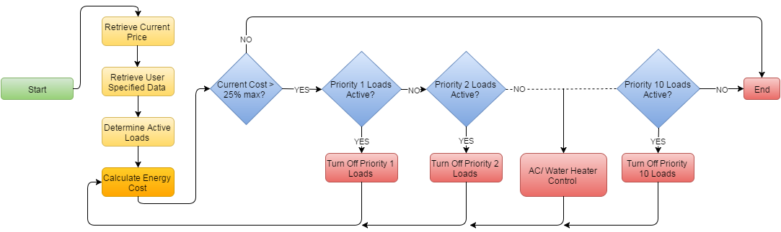
Algorithm
Ivan Remete

Slide 16
Algorithm
Ivan Remete

Slide 17
Start
Algorithm
No
Time > 1 min ?
Yes
OFF
Check status of Load
ON
Load 1
Load 2
Load N
Calculate Cost [Cents]
Calculate Cost [Cents]
Calculate Cost [Cents]
…
Σ Total Cost Load 1
Σ Total Cost Load 2
Σ Total Cost Load N
Σ Final Cost (Running Sum for that Month)
Ivan Remete

Slide 18
Priority 1-4 : Turn off loads at 45% of the maximum price set by the user
Priority 5-7 : 75% of the maximum price set
Priority 8-10: 95% of the maximum price set
Ivan Remete

Slide 19
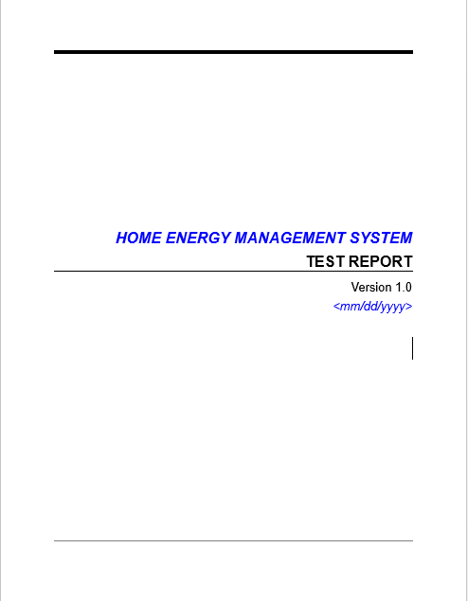
Testing Protocols
Test Completed:
1. Inner Mesh: Main Controller ←→ Load Controllers
Line of Sight/Open Air Test
Outside the Center of Advanced Power (CAPS) building
Indoor Test
Inside the College of Engineering
2. Network/Socket Connection: Web/Server Application ←→ Main Controller

Slide 20
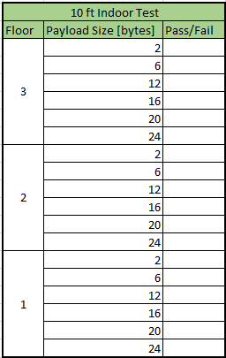
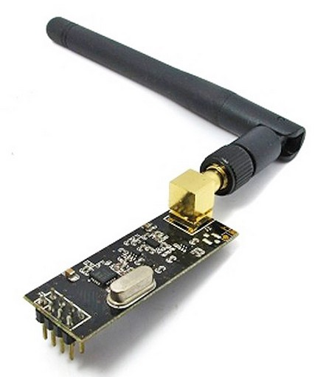
Testing Protocols
Inner Mesh: Main Controller ←→ Load Controllers
Line of Sight/Open Air Test
Outside the Center of Advanced Power (CAPS) building over 2,000 ft
Indoor Test
Testing was done in the Atrium of the 3rd floor of the COE
Main controller was connected to a power source while the Load Controller was connected to a computer and taken to different testing points across all three floors of the COE
A set of bytes was continuously sent from Main Controller to Load Controller
Main Controller
Load Controller
Via nRF24L01

Slide 21
Testing Results

Slide 22
Testing Results

Slide 23
Testing Results

Slide 24
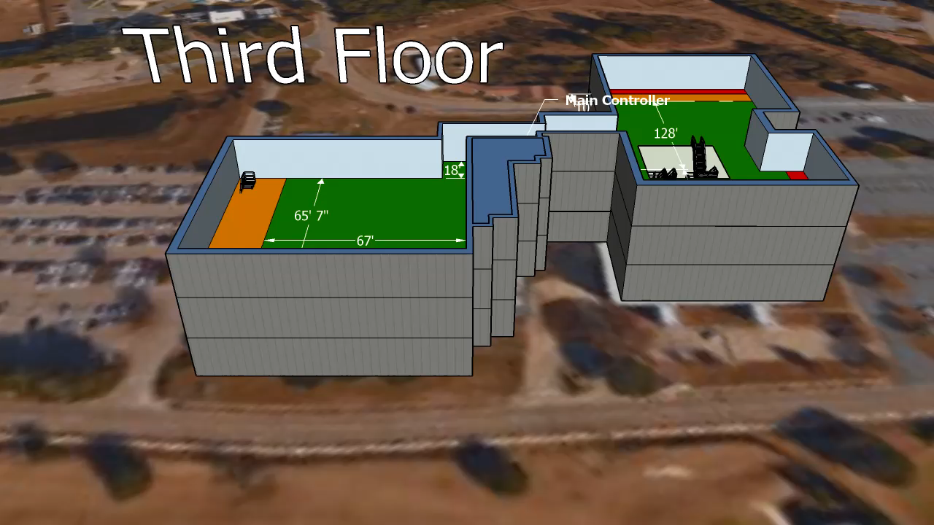
Combination of Collected Data
The Main Controller was on the third floor therefore the direct distance on other floors had to be calculated using the height.
There is about 25ft between floors
Building B has 4 large rooms
Building A has more open space

Slide 25




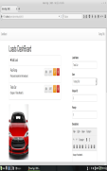

Network Connection Tests
LAN (Local Area Network)
Socket Connection
Real-Time Control of Loads
Real-Time Price Change on Server
Algorithm Response
AC Temperature Control
Website Performance
IP: 192.168.0.119
IP: 192.168.0.125
3. Server – Web App
2. Router
Main Controller
4. CellPhone
Items on Graph:
Main Controller
Router = Internet
Server = Webserver where website will be hosted. (A computer will be used to simulate as server).
Cellphone used to access the Web server.
Load Controllers
5. Load Controllers

Slide 26
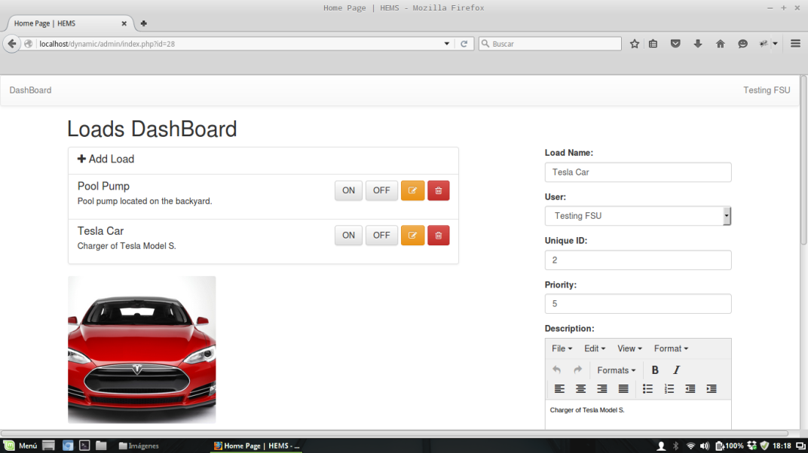
Demo: Web-Application ← → Main Controller
Socket Connection
Main Controller
IP: 192.168.0.125
Information Exchange:
1. ON/OFF Event
2. Set Temperature Event
3. Set User preferred monthly maximum price
4. Send current Real Time Price

Slide 27
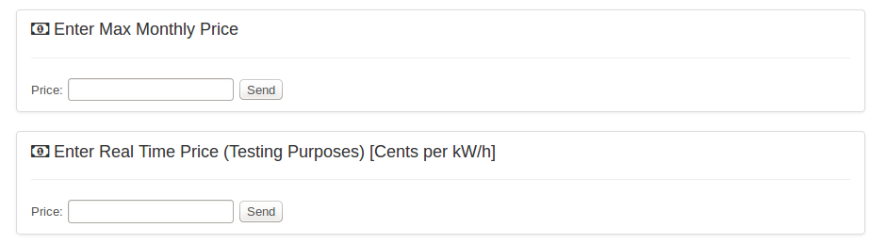
Real Time Price Example
Max. Monthly Price = $ 100.00
Max. kW/h Price = $ (100.00/30 days)/24 Hours = 0.138 = $13.8 Cents per kWh
Algorithm:
45 % of Max. kWh Price - Turn OFF Loads w/ Priority 1-4 = 0.062 = $6.2 Cents per kWh
75 % of Max. kWh Price - Turn OFF Loads w/ Priority 5-7 = 0.103 = $10.3 Cents per kWh
95 % of Max. kWh Price - Turn OFF Loads w/ Priority 8-10 = 0.131 = $13.1 Cents per kWh
Pool Pump Priority = 1
Tesla Car Priority = 9

Slide 28
Objectives

Slide 29
Objectives

Slide 30
Current and Future Development
Algorithm Development
Priority settings are currently grouped into only three (3) categories with little resolution
Testing for current and comparing real-time pricing
Threshold Calculation
What percentage of the max price amount should turn off certain loads?
Storing a weeks worth of data on the device to calculate the day’s value
Hardware cases and pricing custom acrylic
Pricing custom acrylic
Developing CAD files
Notes:
priority settings:
--This does not take advantage of the 1-10 priority setting
--Little resolution when deciding which loads to cut off
Testing for current:
--Used to compare current load usage with real-time pricing
--Current sensor information will tel us which loads are being used. After calculating the power each load is drawing, the algorithm should determine which loads should be off.
Threshold calculation:
--Keeping the constant value of 45% of max price is simple but does not take full advantage of the system

Slide 32
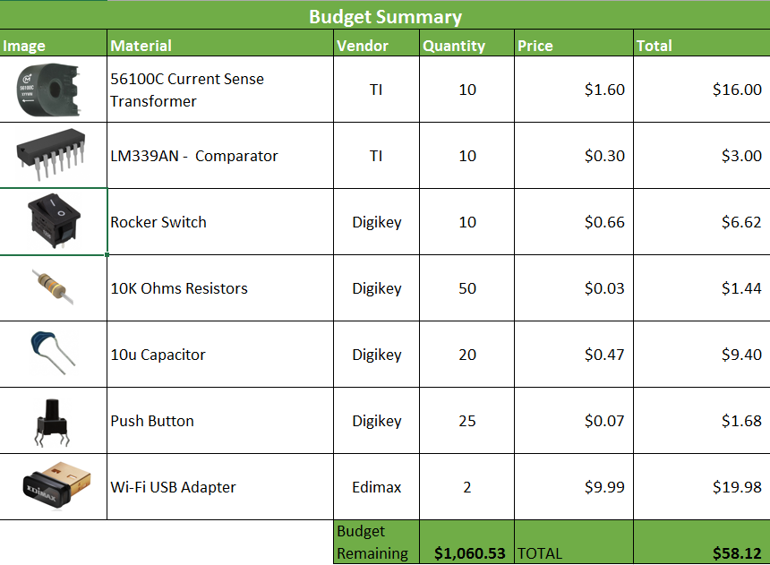
Budget Cont.

Slide 33
Questions?

Slide 34
Thank you for your time!

