Slide 1
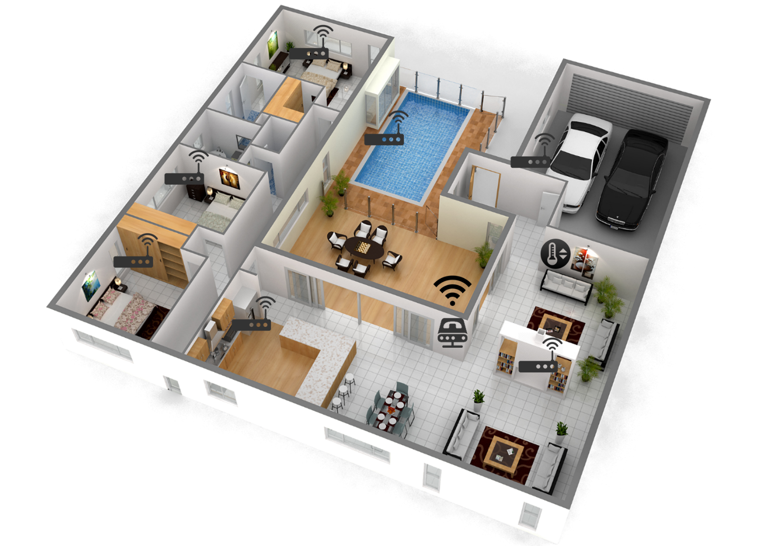
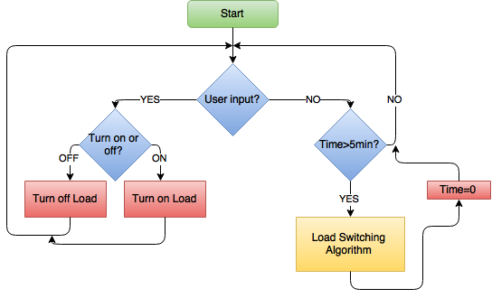
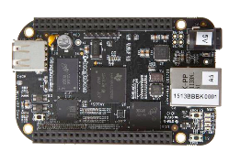
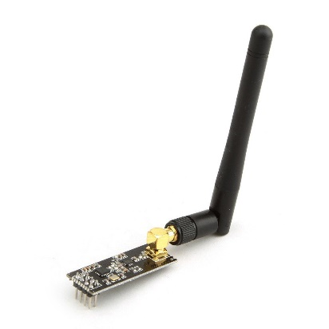
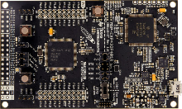
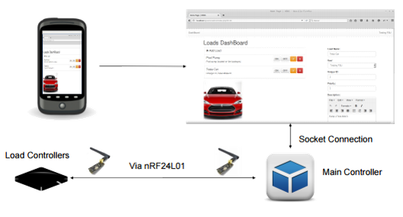
Home Energy Management
Team No: 10
Dillon Wiggins, Pablo Aguirre, Juan Jose Ospina,
Ivan Remete, Michael Garcia-Rivas
Aim: Develop a system that gives residential consumers the ability to autonomously adjust their energy usage in order to
reduce their monthly electrical bill.
Introduction/Background
The energy industry is rapidly approaching a significant bottleneck in the supply of energy causing a possible energy crisis in the world within the next few years. The Home Energy Management (HEM) system is designed to resolve this potential problem by taking advantage of Real-Time Pricing (RTP) and giving users total control over their electrical consumption.
Objectives
Our objective is to develop a system that will allow the real-time control and autonomous adjustments of energy usage based on predefined settings provided by the user, thus allowing HEM’s algorithm to determine the load usage based on the data gathered from the utility RTP.
Design
BeagleBone Black
nRF24L01
MSP432P401R
Model Home
Technical Approach
Web Application Provides real-time user interaction with loads and energy consumption information.
Main Controller Performs the HEM Algorithm. Communication directly with web application and load controllers.
Load Controller Determines if load is active and sends back the information to the main controller. Turns On/Off loads via relay.
HME Algorithm Automates the control of all the loads according to the RTP provided by the utility company.
Figure 1. Algorithm
Future Work
Improve metering system in order to calculate, more accurately, the energy usage of the home
Improve security to prevent data breaches
Add artificial intelligence capabilities to the HEM Algorithm
Figure 2. System Schematics

