Slide 1
EML4550 – Engineering Design Methods (2007)
Introduction to Design
ME Integrated Design Experience

Slide 2
ABET Outcome Criteria
Engineering programs must demonstrate that their students attain abilities to:
(a) apply knowledge of mathematics, science, and engineering
(b) design and conduct experiments, as well as to analyze and interpret data
(e) identify, formulate, and solve engineering problems
(k) use the techniques, skills, and modern engineering tools necessary for engineering practice.
-- These are more traditional engineering science subjects

Slide 3
ABET Outcome Criteria (cont.)
Engineering programs must demonstrate that their students attain abilities to:
(c) design a system, component, or process to meet desired needs within realistic constraints such as economic, environmental, social, political, ethical, health and safety, manufacturability, and sustainability
(d) function on multi-disciplinary teams
(g) communicate effectively
-- These are design-emphasis curriculum

Slide 4
ABET Outcome Criteria (cont.)
Engineering programs must demonstrate that their students attain abilities to:
(f) understanding of professional and ethical responsibility
(h) the broad education necessary to understand the impact of engineering solutions in a global, economic, environmental, and societal context
(i) recognize of the need for, and an ability to engage in life-long learning
(j) a knowledge of contemporary issues
-- These are broad-based educational components

Slide 5
Professional Components
(a) one year of a combination of college level mathematics and basic sciences (some with experimental experience)
(b) one and one-half years of engineering topics, consisting of engineering sciences and engineering design, providing a bridge between mathematics and basic sciences on the one hand and engineering practice on the other.
(c) a general education component that complements the technical content of the curriculum and is consistent with the program and institution objectives.
Students must be prepared for engineering practice through the curriculum culminating in a major design experience based on the knowledge and skills acquired in earlier course work and incorporating appropriate engineering standards and multiple realistic constraints. (--Capstone Experience)

Slide 6
Engineering Design (ABET)
Design is the process of devising a system, component, or process to meet desired needs. It is a decision-making process (oftentimes iterative) in which mathematics, the basic sciences, and the engineering sciences, are applied to convert resources optimally to meet a certain objective.
Among the fundamental elements of the design process are the establishment of objectives and criteria, synthesis, analysis, construction, testing, and evaluation
For Mechanical Engineering - Attain the ability to work professionally in both thermal and mechanical systems areas including the design and realization of such systems.

Slide 7
Engineering Design - Key Words
Systematic – “orderly”, “with planning” and “methodical”
Process – not an isolated action but ongoing activity
Generation and evaluation - Trade-offs, optimization
Specifications - What will it do, how it will do it, drawings, manufacturing methods, etc.
Artifacts - Physical objects
Form and function - “Shape” and “Operation” (form follows function? Function follows form?)
Stated objectives - Specified needs or problem
Constraints - Budget, environment, etc.

Slide 8
Other aspects of the design process
Formal process - yes
Informal (social) process - yes
Design takes place in social setting. emotions, negotiations, personal dynamics, are all part of the process and affect the outcome as much as the formal components
Management and teamwork are an integral part of every design effort
Alternate Definition of Design (Luongo, 2001) : A form of art (creativity) in which the scientific disciplines (tools) are used to arrive at an optimal solution (painting) on a pre-specified problem (canvas) brought up by a customer (viewer)

Slide 9
Phases of the design process
Concept development
Identify customer needs, gather information on competition or possible alternatives, generate and evaluate alternate concepts, select concept, define form and function of the artifact.
System-level design
Determine system architecture (configuration) as well as all sub-systems and respective interfaces, produce system layout and specifications for the system and each sub-system
Cost planned
Cost Effective
Cost spend
Production development process
1 2 3 4 5

Slide 10
Phases of the design process (cont’d)
Detailed design
Complete and final specification of the system, including geometry, materials, tolerances, etc. (drawings), complete and final manufacturing process specification.
Testing and refinement
Review design, build prototype (if appropriate), alpha and beta prototype.
Production ramp-up and delivery
Production line checked and refined (CI), product ‘launch’

Slide 11
FAMU-FSU ME
Integrated Design Curriculum

Slide 12
Evolution of Capstone Design Curriculum
Embedded Model (1999-2003)
4+4 units (Fall/Spring of senior year)
Combined lectures, Engineering Design Methods (EDM) and concurrent year-long projects
Problems: Lecture material too late for project, project delay, combined grading encouraged students to concentrate on coursework in detriment of projects
Just-in-time model (2003-date)
3+3+3 units (Fall/Fall/Spring of senior year)
Separate Engineering Design Method (EDM) class from the Capstone project class
Problems: Lecture material still too late for projects; students not practicing formal design process in core courses
Intro. to
ME
Capstone-1
EDM
Capstone-2
EDM
Intro. to
ME
Capstone-1
EDM
Capstone-2
Proposed new model

Slide 13
Proposed New Model – Design Integration
First exposure of engineering processes
ME as a profession
Design process
CAD, tool sets, machine shop practice
Product design cycle
Engineering economics
Statistics, reliability, optimization
Implementation “design practice” in junior-level core courses
two-semester capstone project design/realization
Freshman
Sophomore
Junior
Senior
1st Year Engineering Lab
ME Tools
Introduction to ME
Engineering Design Methods
EDM
Capstone-1
Capstone-2

Slide 14
Proposed Modules in EDM (Spring, Junior-year)
Design Process:
Product design cycle
Project management
Design for “X” (DFX):
Manufacturing/assembly
Reliability (statistics)
Engineering Economy
Economic principle
Cost analysis
Modeling & Optimization:
System engineering
Design trade space
System optimization
Other components: legal, ethical, environmental, societal issues, team work, communication
Guest lectures by MEAC members and other engineering professionals
Coordinate with junior-level core courses to implement formal design practice in project realization

Slide 15
An Overview of Capstone Course
Expose students to project-based engineering design (two-semesters) under conditions closely resembling industrial practice
Teamwork
Project management and controls
Technical communications (reports, reviews, meetings)
Fulfill selective ABET outcome assessments
Annual project presentation, open house/poster session, and ME advisory council (MEAC) assessment/feedback meeting

Slide 16
Increase in Class Size and Industrial Sponsorships
Academic Year | Student Enrollment | Number of Projects | Avg. Number of Students per Team | Fraction of Industry-Sponsored Projects
99-00 | 56 | 17 | 3.3 | 12% (2/17)
00-01 | 40 | 12 | 3.3 | 25% (3/12)
01-02 | 56 | 18 | 3.1 | 44% (8/18)
02-03 | 46 | 13 | 3.5 | 54% (7/13)
03-04 | 47 | 13 | 3.6 | 54% (7/13)
04-05 | 60 | 15 | 4.0 | 80% (12/15)
05-06 | 65 | 16 | 4.1 | 88% (14/16)
06-07 | 52 | 14 | 3.7 | 86% (12/14)
07-08 | 92 | 22 | 4+ | 91% (20/22)
08-09 | 72 | 18 | 4 | 78% (14/18)

Slide 17
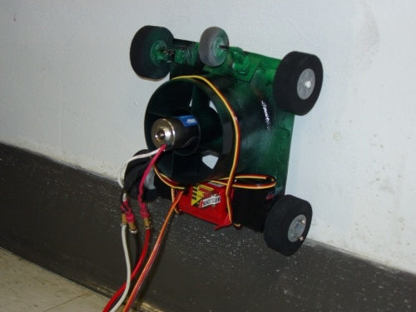
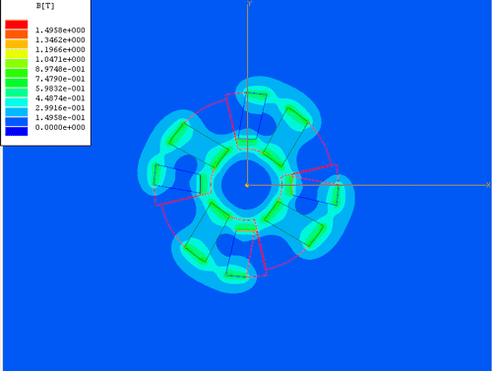
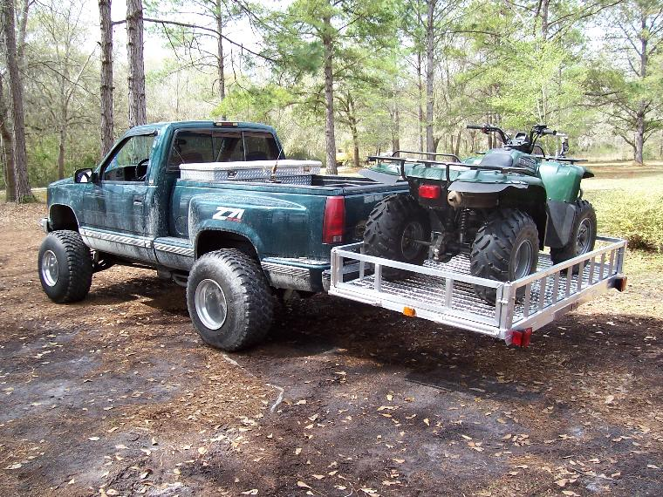
Project Descriptions
A wide variety of student projects spanning the entire spectrum of mechanical engineering practice
(shared in design reviews for class exposure)
Materials selection and testing
Thermal and fluid systems
Mechanisms and automotive
Controls and robotics
System integration, instrumentation, and electromechanical devices (mechatronics)
ASME and SAE competitions
Service-learning projects (if appropriate)
Feasibility studies (recently, and only if very relevant/interesting)

Slide 18
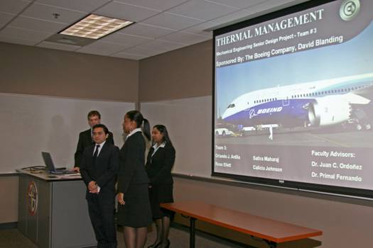
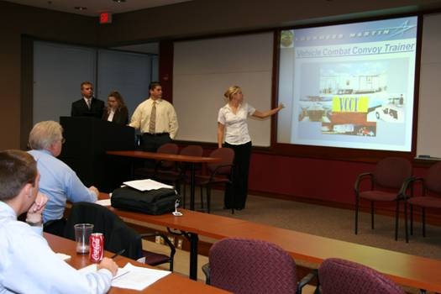
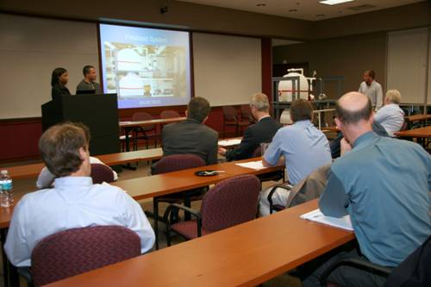
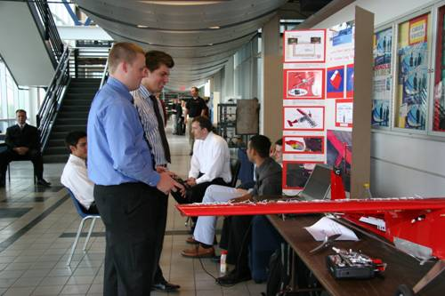
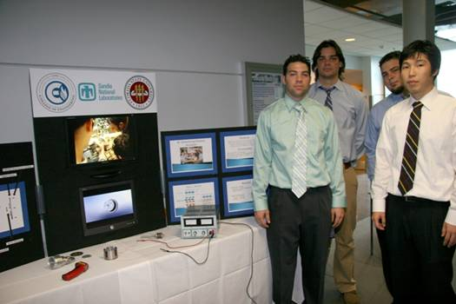
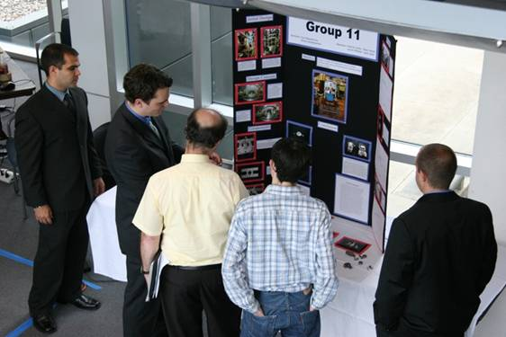
Presentation/Open House, April 16, 2009

Slide 19
Conclusions
A solid capstone design experience
9 years running, strong industrial participation, including high rate of returning customers
Transition to more integrated design experience
Industry participation is an important part of making capstone experience “realistic”
ME Advisory Council has been instrumental in increasing industrial participation in capstone projects and help us close an annual ABET review cycle that includes the senior project open house
It will be one of the most rewarding experience for your academic career

