Slide 1
CHAPTER 3 IME: Design and Analysis
Engineers and the Real World?

Slide 2
Objectives
Examine Society’s View of Engineering
Engineering Ethics (an added section)
Learn about the Role of Failure in Engineering Design
Discuss Classic Design Failures as Case Studies
Sections
3.1 Society’s view of Engineering
3.2 How Engineers Learn From Mistakes
3.3 The Role of Failure in Engineering Design: Case Studies
3.4 Preparing for Failures in Your Own Design

Slide 3
3.1 Society’s View of Engineering?
Public image
>60% are not very well or at all informed about engineering
Relatively high prestige compared to many professions
Scientists versus engineers
Discovery of new knowledge vs. invention of useful products (research, development & design)
Engineering recognition
Technological advancements
Engineering disasters
As Engineers, we need to hold ourselves to high standards in expanding the quality of life and maintain
Moral and Ethical Standard
Clear many popular scientific/engineering misconceptions.

Slide 4
Engineering Ethics & Responsibilities
The study of understanding moral values, resolving moral issues and justifying moral decisions in engineering practice.
Also can be considered beliefs and acceptable practices  codes of ethics
Finally, it is also the obligation, justification and principles to be endorsed.

Slide 5
ASME Codes of Ethics -The 3 Fundamental Principles (plus 10 Canons)
Engineers uphold and advance the integrity, honor, and dignity of the Engineering profession by:
using their knowledge and skill for the enhancement of human welfare;
being honest and impartial, and serving with fidelity the public, their employers and clients; and
striving to increase the competence and prestige of the engineering profession.

Slide 6
Learning Objectives
Enhance the ability to deal with difficult ethical decisions
Strengthen moral autonomy (self-determination) – the habit of thinking rationally about ethical issues following appropriate moral principles  improve practical skills such as
Recognize and understanding ethical situations
Critical thinking skill on assessing opposing sides of ethical issues
Tolerate uncertainty and respect different perspectives in decision making
Maintain moral integrity by integrating personal convictions and professional practices (sweat the small stuff)
Be articulate by learning common ethical language (to support or oppose viewpoints)

Slide 7
Methodologies for Case Studies
State of the art in engineering ethics – an article by Charles Harris (Texas A&M) dedicated on methodologies to resolve engineering ethical issues through the use of case studies and other schemes
Methods of Analysis and Problem Resolution
Studied Cases: micro-cases, macro-cases, and exemplary cases.
Microethics (ex: health and safety, integrity, bribes/gifts, etc..), macroethics (less emphasis, ex: sustainability, nanotechnology, cloning, etc..) defined by Joseph R. Herkert (2003)

Slide 8
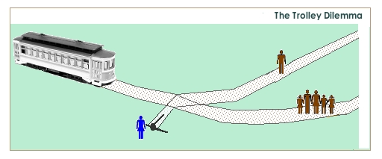
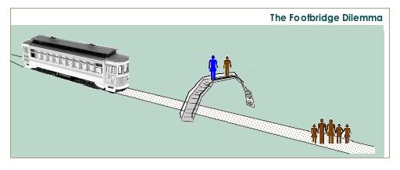
A Classical Ethical Dilemma
Trolley problem or lifeboat problem
Adopted from http://web.lemoyne.edu/~hevern/psy340/lectures/psy340.12.1.emotions.html

Slide 9
Some Ethics References
Online Ethics Center-sample assignments for student
Help on ethical decisions
Numerical and design problems with ethical content
Write case studies based on senior design projects
Key concepts to teach engineering ethics

Slide 10
3.2 How Engineers Learn from Mistakes?
Only he/she who does nothing makes no mistake (French proverb)
Failure is delay, but not defeat. It is a temporary detour but not a dead-end street. (William Ward)
The fellow who never makes mistakes takes order from the one who does (Herbert Prochnow)
To make no mistake is not in the power of man; but from their errors and mistakes the wise and good learn wisdom for the future (Plutarch)
A famous quote

Slide 11
3.2 Welcome to reality!
“If anything can go wrong, it will”- Murphy’s Law
Are all great discoveries made by mistake?
More appropriately, a discovery is said to be an accident meeting a prepared mind. Ex: Fleming and the discovery of Penicillin
An expert is one who knows more and more about less and less until he knows absolutely everything about nothing
Experienced engineers know that design never works the first time and are never discouraged by initial failures
Design is an iterative process
It is better for a defect to surface during the design and testing, rather than in the field or during mass production.
More cost effective
The best way to avoid field failure is to test, re-test and do some more re-testing.

Slide 12
3.2 Case Studies of Engineering Disasters!
Despite great attempts by engineers to weed out design mistakes, they eventually show up and result in catastrophes.
Mistakes are made by engineers who do their best but fail due to lack of prior experience or/and lack of engineering judgment.
Of course, it is easy to pick the flaw in hind sight
Spotting a flaw becomes difficult as the complexity of the system increases.
A good engineer becomes a great engineer when he/she can spot flaws before the production or operation.

Slide 13
3.2 Succeed by Averting Failures!
The study of failure is an important part of the engineering design process –
Studying failures which occur during product testing helps to discover hidden flaws which were not foreseen during the initial design and prototype process
Subsequent redesign and adjustment will help to prevent similar failures from occurring once the product has been released to the public
Classic engineering failures, Wikipedia
Well documented cases where inadequate design or testing resulted in catastrophic failure: both loss of life and/or major loss of property
The study of these failures helps us to avoid the mistakes of the past (not necessarily the exact causes/effects but usually the philosophy of engineering practices)

Slide 14
3.2 Tacoma Narrows Bridge!
- Design Blind Spot
Tacoma Narrows Bridge
Built across Puget Sound in Tacoma, WA, in 1940
Longest suspension bridge of its day
Engineers copied designs used for shorter bridges, and simply lengthened them, without testing for structural integrity
Bridge collapsed after less than one year, due to high winds which the structure could not withstand (aerodynamic loads)
Notes:
Figure on left: This photograph shows the twisting motion of the center span just prior to failure
Figure in the middle: A few minutes after the first piece of concrete fell, this 600 foot section broke out of the suspension span, turning upside down as it crashed in Puget Sound. Note how the floor assembly and the solid girders have been twisted and warped. The square object in mid air (near the centre of the photograph) is a 25 foot (7.6m) section of concrete pavement. Notice the car in the top right corner
Figure on the right: This photograph shows the sag in the east span after the failure. With the centre span gone there was nothing to counter balance the weight of the side spans. The sag was 45 feet (13.7m). Also the immense size of the anchorages is illustrated.

Slide 15
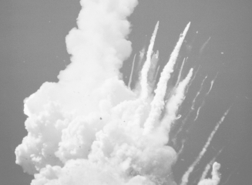
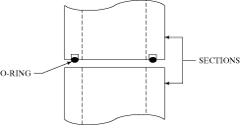
3.2 Space Shuttle Challenger!
- Whistleblowing
Space Shuttle Challenger
Exploded in 1986 about two minutes after it was launched
One of the O-rings used to seal the solid rocket booster failed after it became brittle due to low (below freezing) temperatures on the day of the launch
This low temperature failure was unforeseen because the O-ring was never tested at sub-freezing temperatures

Slide 16
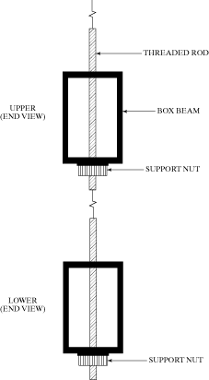
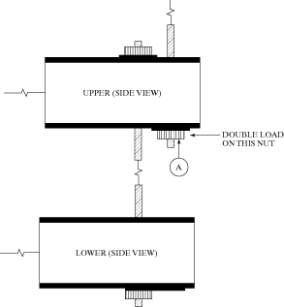
3.2 Hyatt Skywalk Collapse!
- Cut Corner
Hanging, two-layer, open-air pedestrian walkway designed to span a lobby atrium
The original design required a set of support shafts which could not easily be fabricated
Construction engineers modified the original shaft design. While this modification allowed the walkways to be built, it reduced the maximum load that could be supported
The reduced capacity of the walkways did not come to light until their collapse during a party, which resulted in over 100 fatalities

Slide 17
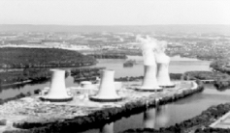
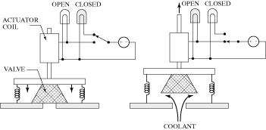
3.2 Three Mile Island Power Plant!
- Flawed Safety Design
Three-Mile Island Power Plant
Second-worst nuclear accident (Chernobyl was the worst)
Flaw in reactor design: an indicator light showed that power had been delivered to a pressure relief valve actuator coil, but could not verify that the valve had actually opened. This is an example of a poor man-machine interface

