Slide 1
EML4550 - Engineering Design Methods
The Design Process
Phases of the design process, work breakdown structure, design in teams, organizational structures
Hyman: Chapters 1 and 2
Smith: Chapter 1 + Chapter 6 (first section)
Ulrich and Eppinger: Chapters 1 and 2
Dym and Little: Chapters 1 and 2
MF Ashby, Materials Selection in Mechanical Design, Chp. 1&2

Slide 2
Design (ABET definition)
Engineering design is the process of devising a system, component, or process to meet desired needs. It is a decision-making process (often iterative), in which the basic sciences and mathematics, and engineering sciences are applied to convert resources optimally to meet a stated objective. Among the fundamental elements of the design process are the establishment of objectives and criteria, synthesis, analysis, construction, testing, and evaluation (Note: a design project)

Slide 3
What is Design?
Design is …
“…the process of translating a new idea or a market need into detailed information from which a product can be manufactures.”
MF Ashby, Materials Selection in Mechanical Design, pg. 1
Invention
Design
Innovation

Slide 4
Market Pull vs. Technology push
Mechanical Design
Industrial Design
Market Need
R&D
Production
Marketing
Market Pull
e.g. Cellular phones, high capacity hard drives
R&D
Production
Marketing
Need?
Technology Push
e.g. carbon nanotubes, quasi-crystals

Slide 5
Types of Design
Original Design
New idea or working principle
e.g. CD vs Tape
Adaptive or Development Design
Takes existing product and seeks an incremental advance in performance through a refinement in working principle.
e.g. beverage cans, automobiles,…
Variant Design
Change in scale/dimension without change of function
e.g. desktop to laptop computer

Slide 6
What is a Process?
Input 1
Output
Process
Input 2
Input 3
Process: Sequence of steps transforming a set of inputs
into a desired output

Slide 7
Engineering design as a process
Engineering design implies a ‘methodology’ (sequence of steps)
Desired Characteristics:
Creativity
Quality assurance
Coordination
Planning
Management
Improvement (CI)

Slide 8
The Design Process
Design problems are open ended – no single correct answer
Design is an iterative process
In Design, a product is a technical system composed of sub-assemblies and components
Starting point: A Market need or New idea
Formulate a need statement
Define the need precisely – “a device is requested to perform task X”
Solution neutral

Slide 9
The Design Process (step by step model)
Step 1: Recognizing the need
Listen to the customer’s needs. Dissatisfaction with an existing situation/product? Needs to accomplish new functionality? What is the ultimate purpose of the project?
Step 2: Defining the problem
Translate needs to a problem statement:
Goal – An ideal response to the needs statement
Objectives – A quantifiable set of performance expectations
Constraints – Limits to the performance, design parameters, or project resources

Slide 10
The Design Process (step by step model)
Step 3: Planning the project
How do we do it? How do we organize ourselves? How do we get from here to there?
Alphabet soup: DCD, WBS, and CPM
Project management and controls
SYSTEM DESIGN
PROJECT MANAGEMENT & CONTROL
COMMUNICATIONS
Six steps of any engineering design:
Enthusiasm
Disillusionment
Panic
Search for the guilty
Punishment of the innocent
Praise and honor for the non-participants

Slide 11
The Design Process (step by step model)
Step 4: Gathering information
Solutions to similar problems?
Background research? Patents?
This could be an empty set for some problems
Step 5: Conceptualizing alternative approaches
“Concept generation”
Generate wide range of design options
Suspend judgment, anything goes, let creativity run wild
Step 6: Evaluating the alternatives
Use analysis to quantify expected performance of design options
Predict cost of each alternative

Slide 12
The Design Process (step by step model)
Step 7: Selecting the best alternative
Develop criteria to select “best” alternative (must match customer’s needs and input)
Create a formal selection process (decision matrix)
Step 8: Communicating the design
Step 9: Implementing the preferred design
Final (detailed) design
Construction and test
SYSTEM DESIGN
PROJECT MANAGEMENT & CONTROL
COMMUNICATIONS

Slide 13
“Phases” of the design process (alternative view)
Concept development
Identify customer needs, gather information on competition or possible alternatives, generate and evaluate alternate concepts, select concept, define form and function of the artifact. (Steps 1-7)
System-level design
Determine system architecture (configuration) as well as all sub-systems and respective interfaces, produce system layout and specifications for the system and each sub-system (Step 9a)

Slide 14
Phases of the design process (cont’d)
Detailed design
Complete and final specification of the system, including geometry, materials, tolerances, etc. (drawings), complete and final manufacturing process specification. (Step 9b)
Testing and refinement
Review design, build prototype (if appropriate), alpha and beta prototype. (Step 9c)
Production ramp-up and delivery
Production line checked and refined (CI), product ‘launch’

Slide 15
Phases of the design process (skill set)
Concept development
The Engineer as Artist and Inventor
System-level design
The Engineer as Architect
Detailed design
The Engineer as Engineer
Testing and refinement
The Engineer as Tinkerer
Production ramp-up and delivery
The Engineer as Builder and Marketer

Slide 16
Simple 5-step linear description of the design process
Client Statement
(Needs)
Problem Definition
Conceptual Design
Preliminary Design
Detailed Design
Final Design
Fabrication Specs.
Documentation
Design Communication

Slide 17
The Design Process

Slide 18
The Design Process

Slide 19
Design can only be accomplished by teams

Slide 20
The Design Process is a Team Activity
Almost all engineering systems of interest today are too complex to be designed by an individual
High degree of interdisciplinary content
Engineers must conduct design in a team setting
Team organization and dynamics become a major part of engineering design

Slide 21
Team-based design: Roles
Coordinator (Manager)
Creator
Resource-Investigator
Shaper
Monitor-Evaluator
Team Worker (Consensus Builder)
Implementer
Record Keeper
Completer-Finisher
Notes:
- Personal biography (Uruguay, Stanford, Bechtel, etc.)
- Prsent researcj at NHMFL, s/c magnet design
- Pass students list (so groups can be assigned)
- REAL WORLD: Like in the military, this is the ‘last drill’, as real as possible, bullets will fly, introduce element of surprise, introduce ‘fear’, need to show that YOU can put together what you learned in the previous 3 years.
- YOU need to show that you CAN be an ENGINEER before you are allowed to hang your diploma on the wall

Slide 22
Team based design: Guidelines
Keep the Team Productive
All members understand the purpose
All members feel the project is exciting
The goals are clear, simple, realistic, and measurable
The approach is clear and agreed upon
Achieve balance of skills in team roles
Establish clear rules of behavior
Set a few immediate performance-oriented goals and tasks (one-day-at-a-time)
COMMUNICATE! SPEND TIME TOGETHER!

Slide 23
Design Project: What is a Project?
Dictionary: A combination of human and non-human resources pulled together in a temporary organization to achieve a specified purpose
A non-routine series of tasks directed towards a goal
Characteristics:
Definable purpose and established goals
Cost, schedule, and performance requirements
Multiple resources across organizational lines
One-time activity, and temporary (beginning and end)
Element of risk (some uncertainty as of the outcome)
Process of phases, a life-cycle

Slide 24
Managing Design Projects
All design activities are done in teams
All design activities are done within a project
Managing a project:
Management is the process of achieving organizational goals by engaging in the four major functions of planning, organizing, leading, and controlling

Slide 25
Project Management
Planning
Process of setting goals and deciding how best to achieve them. Transform goals into strategic and tactical plans for the organization
Organizing
Process of arranging human and non-human resources so that the plans can be carried out successfully
Leading
Process of influencing others to engage in behaviors that are necessary to achieve the organizational goals
Controlling
Process of monitoring and regulating the organization’s progress towards achieving goals

Slide 26
The Design Process (step by step model)
Step 3: Planning the project
How do we do it? How do we organize ourselves? How do we get from here to there?
Alphabet soup: DCD, WBS, and CPM
Project management and controls
Step 4: Gathering information
Solutions to similar problems?
Background research? Patents?
This could be an empty set for some problems
A VERY concise introduction to systems engineering and project management

Slide 27
Systems Engineering
Complex systems are better understood and managed if broken down into pieces.
Principle behind “systems engineering”:
Break it Down!
Break system down into sub-systems so that design activities and tracking become manageable.

Slide 29
Work Breakdown Structure (WBS)
A “System” (and the design activities that go with it) is “broken down” into sub-systems.
The breakdown is arbitrary, yet it must follow some logic when it comes to the design activities
The general criterion is to select sub-systems with clearly defined interfaces (tracking concern – most problems come from “unmatched” interface issues)
The resulting set of sub-systems define a set of design activities or “Work Breakdown Structure” (WBS)

Slide 30
WBS: Properties
Must be clear and simple (tree structure)
Must follow the structure of major sub-systems in a logical way
Once created it cannot change for the duration of the project (yet it needs some flexibility to accommodate the unexpected)

Slide 31
WBS Example: Task-Oriented
Level 1 “Prepare and eat a meal”
Level 2 Break it down
Preparation
Boil soup
Boil rice
Boil peas
Brown chicken
Prepare sauce
Bake chicken, rice and sauce
Open wine and let it breathe
Eating
Eat soup
Eat entrée
Level 3 Incorporate into a schedule (timing element)
Sequence is not important at this level

Slide 32
WBS: Example: Process/Sub-system oriented

Slide 33
WBS: Example (sub-system oriented)
WBS 1000
Management
WBS 2000
Subsystem 1
WBS 3000
Subsystem 2
WBS 4000
Subsystem 3
WBS 1100
Purchasing
WBS 1100
Services
WBS 1200
Scheduling
WBS 1300
Cost Controls
WBS 1120
Hardware

Slide 34
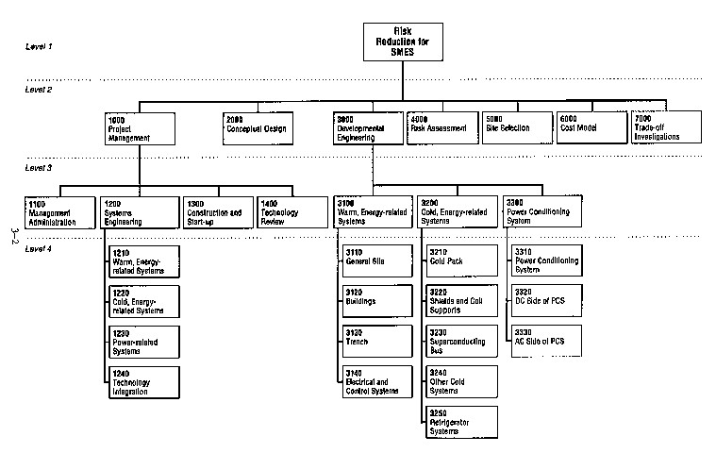
WBS: Example

Slide 35
WBS: Why is it important?
Framework for tracking design progress
Effort and costs
Schedule (first step: WBS → Tasks → Schedule)
Framework for assigning tasks
“Work packages”, calculations, etc.
Planning
Framework for reporting
“Design packages”, sets of drawings
Framework for communication
Define and monitor “interfaces”

Slide 36
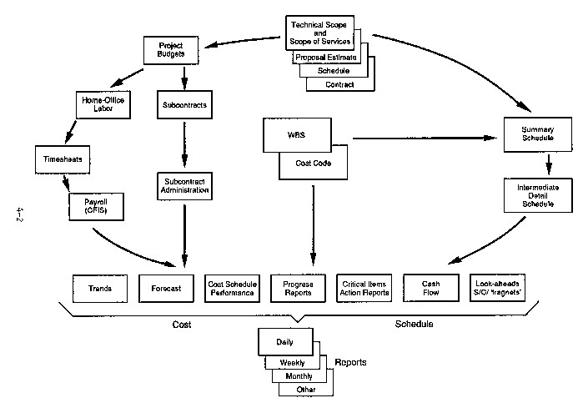
WBS: Why? At the center of project controls

Slide 37
What is an Interface?
Any piece of data that needs to go from one sub-system to another in order to proceed with a proper design defines an interface

Slide 38
Systems Integration
The art and science of keeping track of interfaces during the design process
In a large design project system integration is a major part of the effort
“Complexity” of a project is proportional to the number and extent of interfaces
Most “problems” in a design originate in system integration and not in individual work packages (i.e., when work packages are not properly coordinated)

Slide 39
Management: Organizations
Success of any project rests on the adequacy of the organization that supports it
Companies spend a great deal of effort to device efficient (‘lean and mean’) organizations
Projects:
Reside within organization
Accountable
Independent
Goal-driven
Transient in nature

Slide 40
Matrix Organization
Each person has ‘two bosses’
Each person ‘wears two hats’
Success hinges on rapid deployment of ‘project teams’ (reconfiguration)
Success hinges on flexibility
Success hinges on worker’s ability to ‘juggle’ multiple projects (prioritize, plan, manage time)

Slide 41
Matrix Organization
Functional Org
Fosters specialization and development
Repository of ‘skills’
‘Placement’ of workers
Bureaucracy
Project Org
Optimal allocation of resources
Objective-driven, fast-paced (Client-driven)
Quick evaluation of concepts, trade-offs
Difficulty of people staying ‘sharp’
Difficulty in capturing ‘lessons-learned’ (memory)

Slide 42
Implications to Design Project
Understand the design process to implement in your own project
Team formation (team building to come)
Engage in management of your own project: planning, organizing, leading, controlling
Prepare WBS
Prepare schedule
Stick to WBS and schedule on all reporting!
Understand system interfaces on your design

