Slide 1
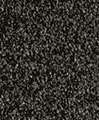
Soil Classification
Systems

Slide 2
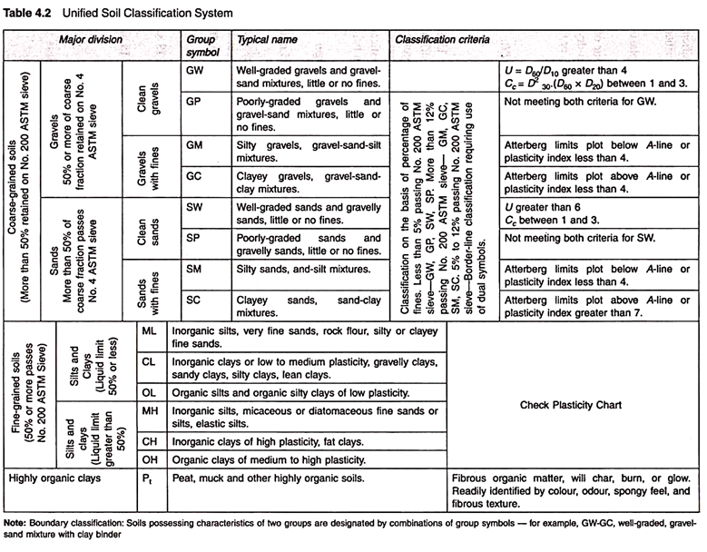
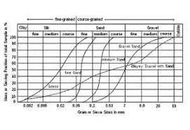
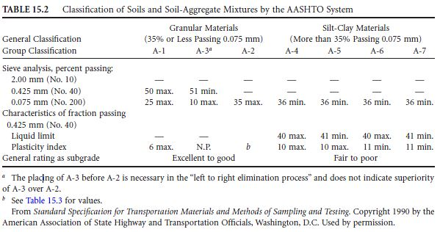
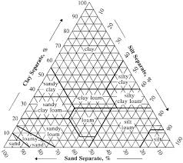
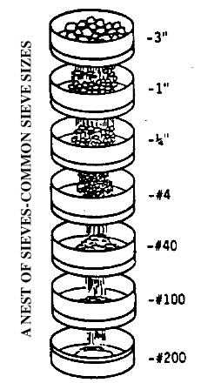
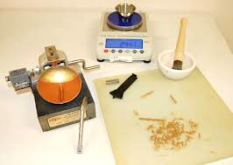
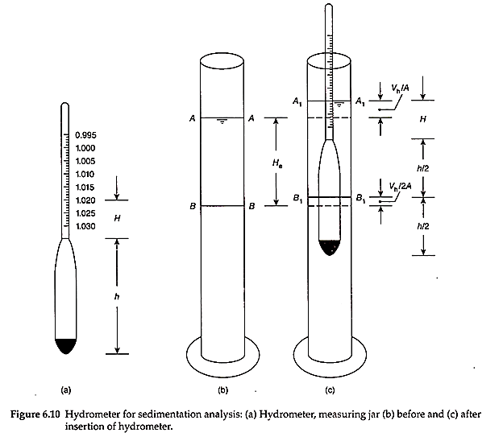
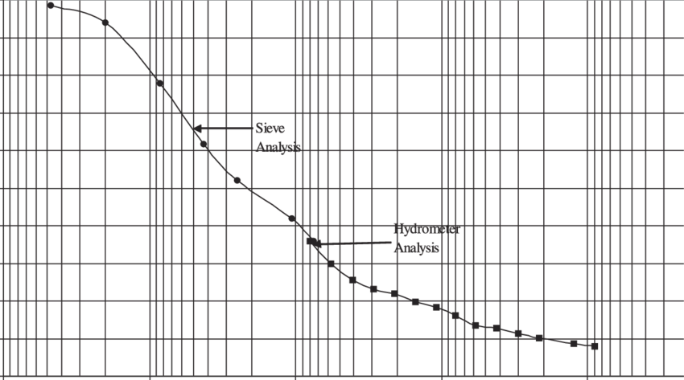
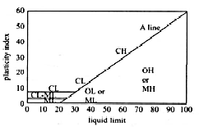
Soil Classification
Unified Soil Classification System
Grain Size Distribution
The separation of soil into classes or groups each having similar characteristics and potentially similar behaviour
AASHTO
USDA Soil Textural Classification System
Few simple (routine) tests are used to classify soils.
  Gradation …… Sieve Analysis
  Atterberg Limits ……..
  Hydrometer Analysis …
Casagrande Chart
Liquid Limit
Plastic Limit
Plasticity Index

Slide 3
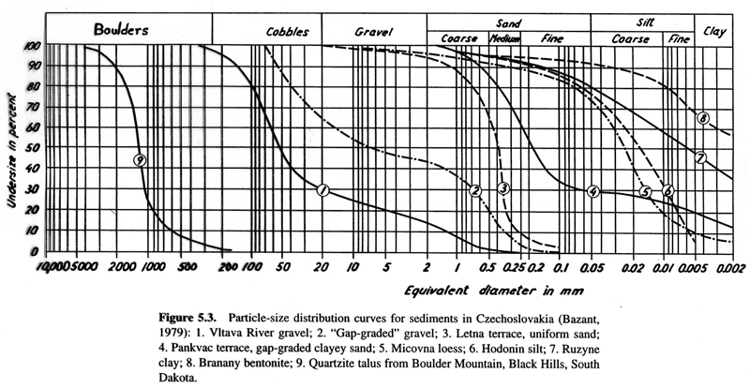

Slide 4
Computing CU and CC
Coefficient of Uniformity
High Values Indicate Well-Graded Soil
Coefficient of Curvature
Values Between 1-3 Indicate Well-Graded Soil

Slide 5
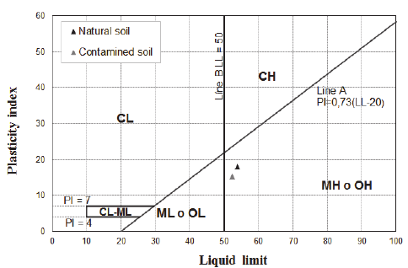
Casagrande Chart

Slide 6
Soil Classification Systems
USCS……………………
AASHTO…………………
USDA……………………..
FAA………………………..
MIT
ASTM

Slide 7
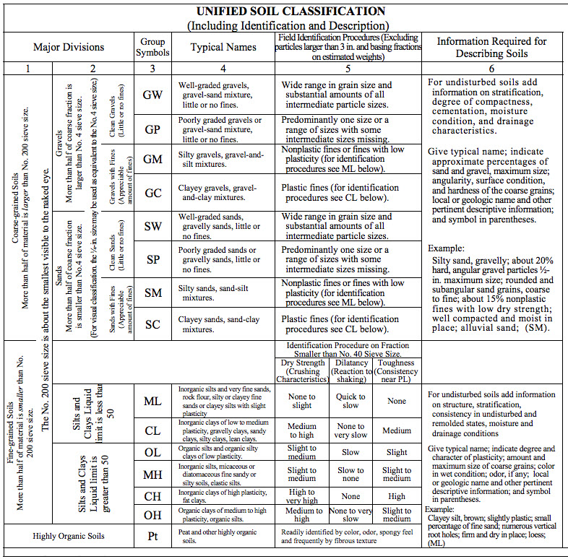

Slide 8
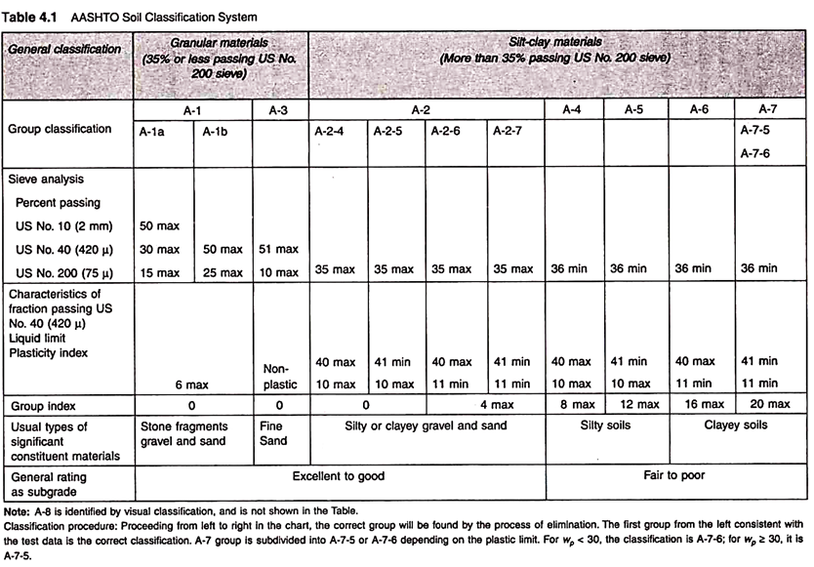

Slide 9
