Slide 1
Stresses in Soil
Geostatic Stresses
&
Applied Stresses
By
Kamal Tawfiq, Ph.D., P.E.
Fall 2024

Slide 2
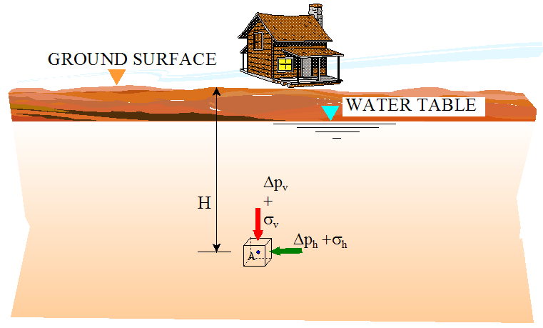
There are two types of lateral stresses in soil.
Added Stress
Due to the
weight of the
house
Geostatic Stress
Total Stress
Effective Stress
Pore Water Pressure

Slide 3
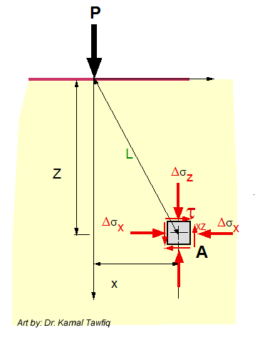
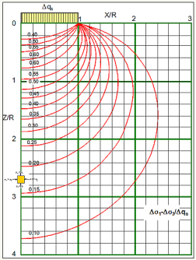
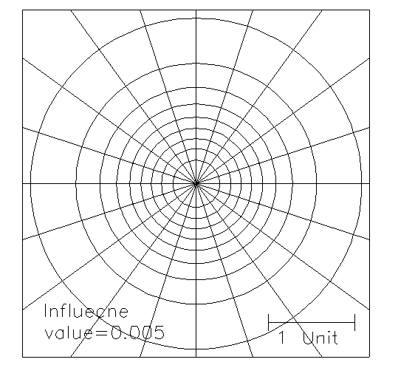
Added
Stress
By: Kamal Tawfiq, Ph.D., P.E
Stress Distribution in Soils
Geostatic
Stress
Geostatic Stresses
Added Stresses (Point, line, strip, triangular, circular, rectangular)
Total Stress
Effective Stress
Pore Water Pressure
Westergaard’s Method
(For Pavement)
Bossinisque Equations
Point Load
Line Load
Strip Load
Triangular Load
Circular Load
Rectangular Load
σ_{y}
σ_{x}
τ_{xy}
Approximate Method
1:2 Method
Total Stress= Effective Stress+ Pore Water Pressure
σ_{total} = σ_{eff} + u
Stress Bulbs
Newmark Charts
Influence Charts
A

Slide 4
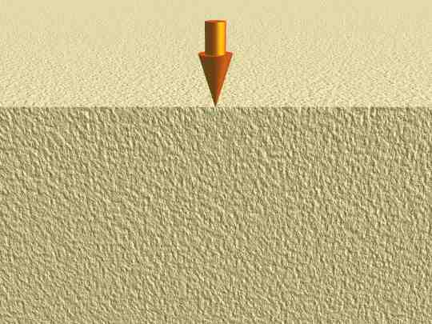
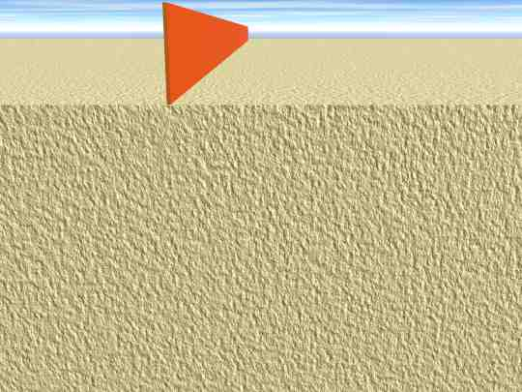
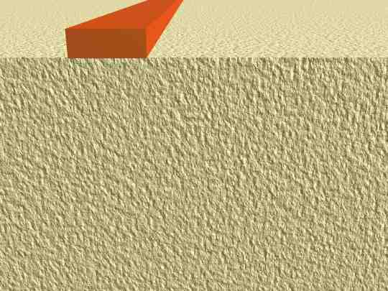
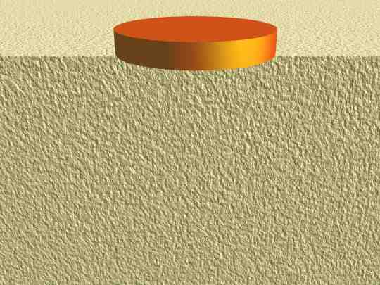
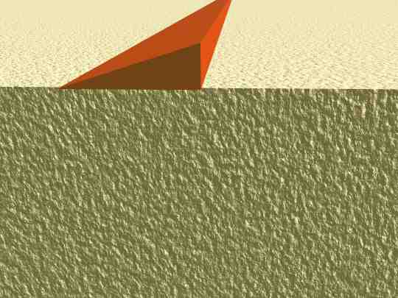
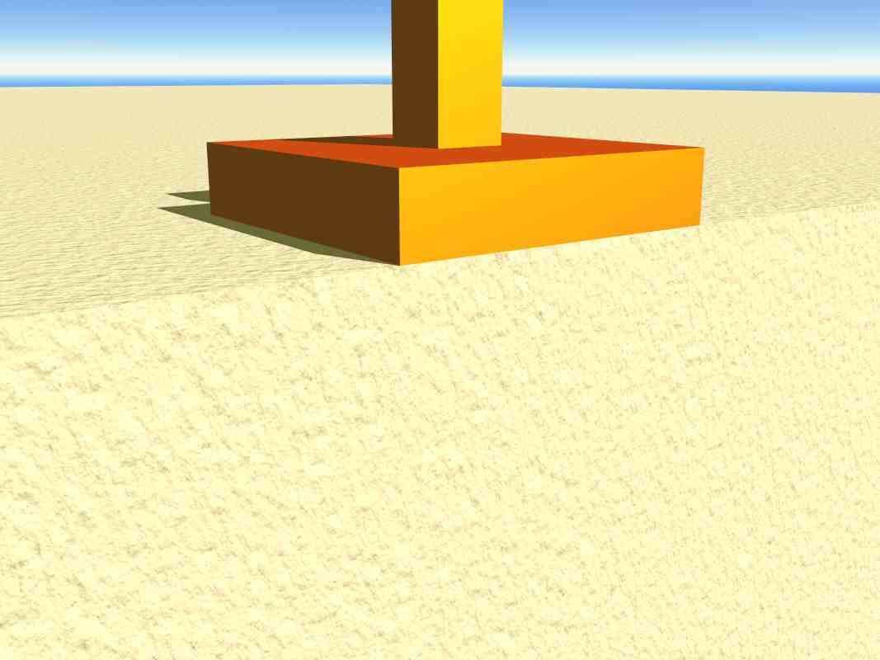
Types of Loads
Point Load
Line Load
Strip Load
Circular Load
Triangular Load
Rectangular Load

Slide 5
z

Slide 6
z

Slide 7
z
z
ΔP_{z}
ΔP_{z}

Slide 8
z
ΔP_{z}
z

Slide 10
Stress Bulbs
q_{s}
Circular Load
1
X/R
2
3
0
R
Δq_{s}
0.95
0.90
X
0.80
Z
0.70
1
0.60
0.50
σ_{z}
0.40
σ₁
σ₂
Z/R
τ_{xy}
0.30
σ_{x}
σ_{x}
2
σ_{z} = σ₁
σ₁
σ_{z}
τ_{xy}
σ₂
σ_{x} = σ₂
σx = σ₂
0.20
σ_{x}
σ_{x}
σ_{z}
σ_{z} = σ₁
σ_{z}
θ
σ_{z} = σ₁
σ_{x} = σ₂
σx = σ₂
σ_{z} = σ₁
0.15
3
q_{s}
Δσ₁/q_{s}
A
3 ft
0.10
9 ft
4
Circular Load: (Major Principal Stress)/(Surface Stress)

Slide 11
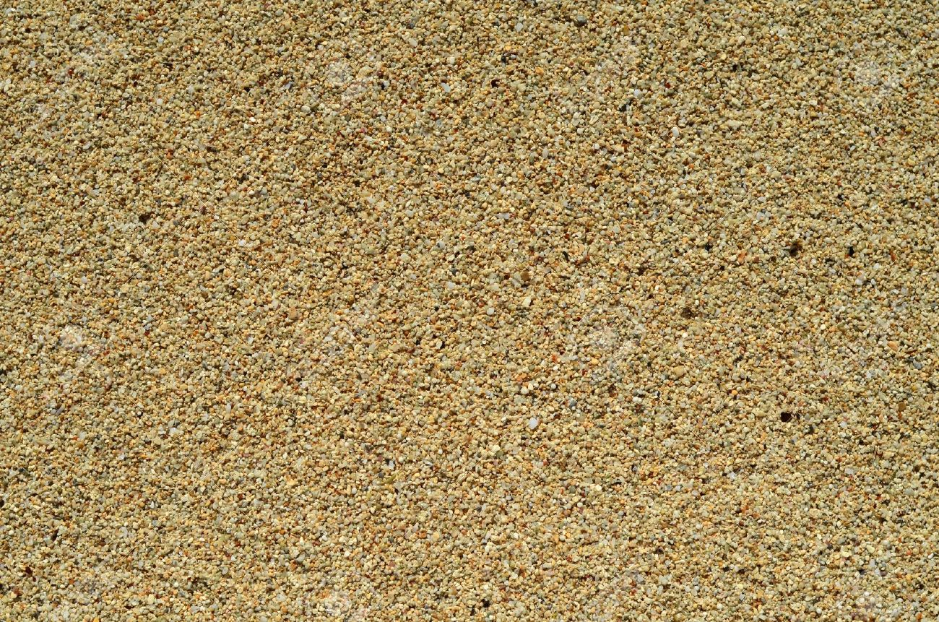
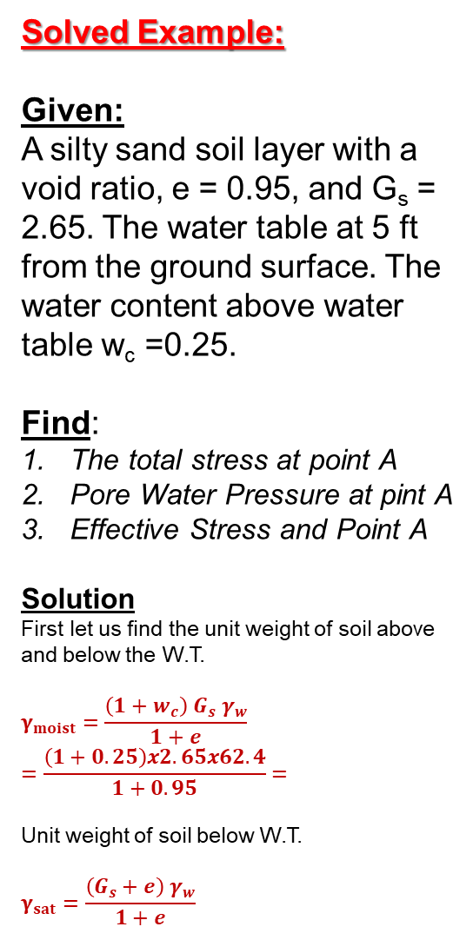
Solved Example:
Given:
A silty sand soil layer with a void ratio, e = 0.95, and G_{s} = 2.65. The water table at 5 ft from the ground surface. The water content above water table w_{c} =0.25.
Find:
The total stress at point A
Pore Water Pressure at pint A
Effective Stress and Point A
Solution
First let us find the unit weight of soil above and below the W.T.
$$γ_{moist}=\frac{\left(1+w_{c}\right){ G}_{s} γ_{w}}{1+e}=\frac{\left(1+0.25\right)x2.65x62.4}{1+0.95}=$$
Unit weight of soil below W.T.
$$γ_{sat}=\frac{\left(G_{s}+e\right) γ_{w}}{1+e}$$
G. S.
5 ft
W_{c} = 0.25
G_{s} =2.65
e = 0.95
W. T.
Silty Sand
12 ft
σ_{v}
e = 0.95
G_{s} =2.65
A

Slide 12
Geostatic Stresses
&
Stress Distribution in Soils
Self-weight of the soil
Or
Geostatic Stress
2
1
Stresses from the house
2: 1 Approximate Method

Slide 13
Solved Problems

Slide 14

Static Water
σ_{total} = σ_{eff} + Δu
G.S.
1
u₁
σ’₁
σ₁
γ₁= 112 lb/ft³
7 ft
u₂
σ’₂
σ₂
2
γ₂= 110 lb/ft³
+
=
W.T.
6 ft
3
u₃
σ’₃
σ₃
e = 0.76
G_{s}= 2.7
12 ft
u₄
σ’₄
σ₄
4
Δu
σ’
σ
$$γ_{sat}=\frac{\left(G_{s}+e\right) γ_{w}}{1+e}=\frac{\left(2.7+0.76\right)62.4}{1+0.76}=122.7pcf$$
Pore Water Pressure
Effective Stress
Total Stress
Point | u (psf) | σ’ (psf) | σ (psf)
1 | 0 | 0 | 0
2 | 0 | 7x112 = 784 | 7x112 = 784
3 | 0 | 7x112+6x110= 1444 | 7x112+6x110=1444
4 | 12x62.4= 748.8 | 7x112+6x110+12(122.7-62.4) =2167.6 | 7x112+6x110+12x122.7=2916.4

Slide 15
Static Water
Determine σ_{total}, σ_{effective}, and Δu for the following cases
σ_{total} = σ_{eff} + Δu
G.S.
1
σ’₁
σ₁
γ_{soil}= 112 lb/ft³
7 ft
σ’₂
σ₂
2
+
=
6 ft
3
σ’₃
σ₃
12 ft
σ’₄
σ₄
4
σ’
σ
Δu
Pore Water Pressure
Effective Stress
Total Stress
Point | u (psf) | σ’ (psf) | σ (psf)
1 | 0 | 0 | 0
2 | 0 | 7 x 112 = 784 | 7x112=784
3 | 0 | 13x112=1344 | 13x112=1344
4 | 0 | 25x112=2800 | 25x112=2800

Slide 16
Static Water
Determine σ_{total}, σ_{effective}, and Δu for the following cases
σ_{total} = σ_{eff} + Δu
G.S.
W.T.
1
σ’₁
u₁
γ_{soil}= 112 lb/ft³
7 ft
u₂
σ’₂
σ₂
2
+
=
6 ft
3
u₃
σ’₃
σ₃
12 ft
u₄
σ’₄
σ₄
4
Δu
σ’
σ
Pore Water Pressure
Effective Stress
Total Stress
Point | u (psf) | σ’ (psf) | σ (psf)
1 | 0 | 0 | 0
2 | 7x62.4= 436.8 | 7x(112-62.4) =347.2 | 7x112=784
3 | 13x62.4= 811.2 | 13x(112-62.4)=644.8 | 13x112=1456
4 | 25x62.4=1560 | 25x(112-62.4)=1240 | 25x112=2800

Slide 17
Static Water
σ_{total} = σ_{eff} + Δu
W.T.
G.S.
3 ft
1
u₁
σ’₁
σ₁
γ_{soil}= 112 lb/ft³
7 ft
u₂
σ’₂
σ₂
2
+
=
6 ft
3
u₃
σ’₃
σ₃
12 ft
u₄
σ’₄
σ₄
4
Δu
σ’
σ
Pore Water Pressure
Effective Stress
Total Stress
Point | u (psf) | σ’ (psf) | σ (psf)
1 | 3x62.4=187.2 | 0 | 0 +187.2=187.2
2 | 10x62.4= 624 | 7x(112-62.4) =347.2 | 971.2
3 | 16x62.4= 998.4 | 13x(112-62.4)=644.8 | 1643.2
4 | 28x62.4=1747.2 | 25x(112-62.4)=1240 | 2987.2

Slide 18
Static Water
σ_{total} = σ_{eff} + Δu
G.S.
1
u₁
σ’₁
σ₁
γ_{soil}= 112 lb/ft³
7 ft
u₂
σ’₂
σ₂
2
+
=
6 ft
W.T.
3
u₃
σ’₃
σ₃
12 ft
u₄
σ’₄
σ₄
4
Δu
σ’
σ
Pore Water Pressure
Effective Stress
Total Stress
Point | u (psf) | σ’ (psf) | σ (psf)
1 | 0 | 0 | 0
2 | 0 | 7x112 = 784 | (7x112) = 784
3 | 0 | 13x112=1456 | 13x112=1456
4 | 12x62.4= 748.8 | 13x112 + 12 (112-62.4) =2051.2 | 25x112=2800

Slide 19
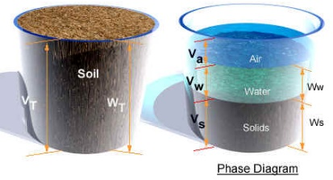
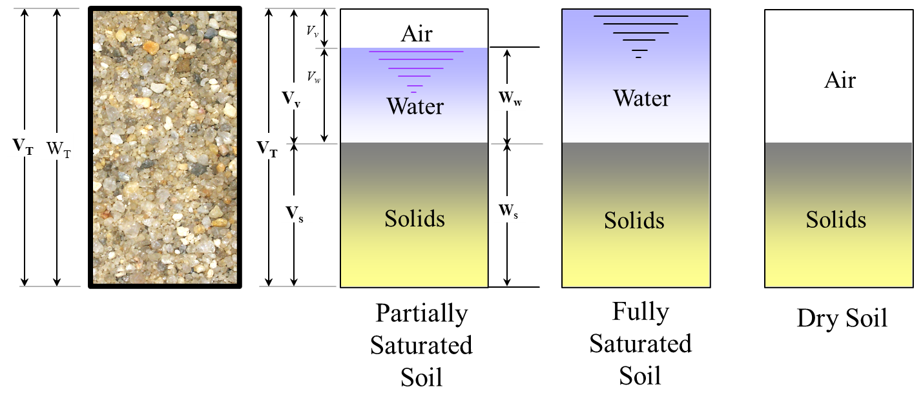
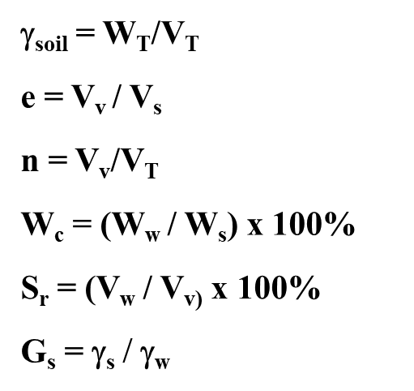
Degree of Saturation S_{r} = 1
Soil Phases Relationships

Slide 20
Static Water
σ_{total} = σ_{eff} + Δu
G.S.
1
u₁
σ’₁
σ₁
γ₁= 112 lb/ft³
7 ft
u₂
σ’₂
σ₂
2
γ₂= 110 lb/ft³
+
=
W.T.
6 ft
3
u₃
σ’₃
σ₃
γ₃= 120 lb/ft³
12 ft
u₄
σ’₄
σ₄
4
Δu
σ’
σ
Pore Water Pressure
Effective Stress
Total Stress
Point | u (psf) | σ’ (psf) | σ (psf)
1 | 0 | 0 | 0
2 | 0 | 7x112 = 784 | 7x112 = 784
3 | 0 | 7x112+6x110= 1444 | 7x112+6x110=1444
4 | 12x62.4= 748.8 | 7x112+6x110+12(120-62.4) =2135.2 | 7x112+6x110+12x120=2884

Slide 21


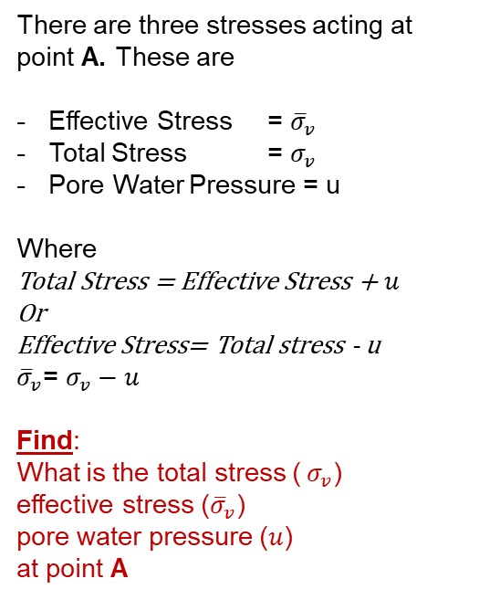

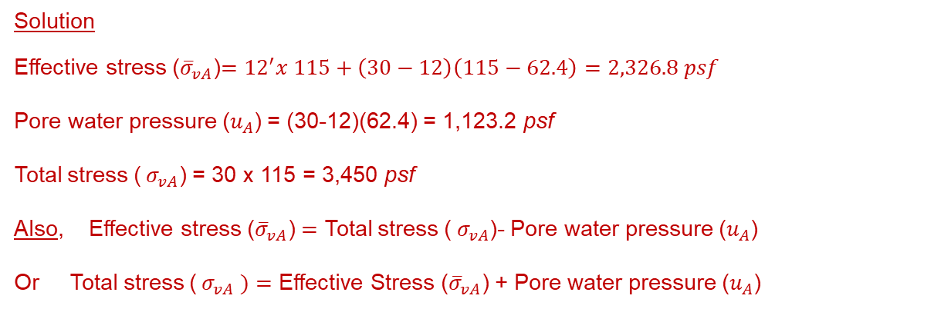

Geoststic Stresses
Figure 6
G.S.
There are three stresses acting at point A. These are
Effective Stress = ${\overline{σ}}_{v}$
Total Stress = $σ_{v}$
Pore Water Pressure = u
Where
Total Stress = Effective Stress + $u$
Or
Effective Stress= Total stress - u
${\overline{σ}}_{v}$= $σ_{v}−u$
Find:
What is the total stress (${ σ}_{v}$)
effective stress (${\overline{σ}}_{v}$)
pore water pressure ($u$)
at point A
d_{w}=12’
$$γ_{soil}=115\frac{lb}{{ft}^{3}}$$
W.T.
Z = 30’
$${\overline{σ}}_{v}, σ_{v}, u$$
A
This is if you have γ_{sat} for the soil below water table. If not
$$γ_{sub}$$
Solution
Effective stress (${\overline{σ}}_{vA}$)$={12}^{′}x 115+\left(30−12\right)\left(115−62.4\right)=2,326.8 psf$
Pore water pressure ($u_{A}$) = (30-12)(62.4) = 1,123.2 psf
Total stress (${ σ}_{vA}$) = 30 x 115 = 3,450 psf
Also, Effective stress (${\overline{σ}}_{vA}$) $=$ Total stress (${ σ}_{vA}$)- Pore water pressure ($u_{A}$)
Or Total stress (${ σ}_{vA} )=$ Effective Stress (${\overline{σ}}_{vA}\text{)}$ + Pore water pressure ($u_{A}$)
$γ_{submerged }= γ_{sat}−γ_{water}$
Or
$$γ_{submerged }= γ_{soil}−γ_{water}$$
or
This is if you don’t have γ_{sat} for the soil below water table, then use γ_{soil} above the water table

Slide 22


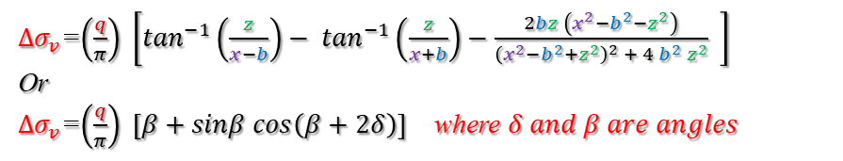



Boussinesq's Equations.
3- Strip Load of Infinite Length
4- Triangular Load of Infinite Length
$$∞$$
Triangular Load of Infinite Length
q
Strip Load of Infinite Length
q
$$∞$$
x
x
z
2b
B = 2b
δ
R₂
z
β
$${∆σ}_{v}$$
R₁
δ
x
α
$${∆σ}_{v}$$
Z
To use this equation see next page
Z
${∆σ}_{v}$=$\left(\frac{q}{π}\right) \left[\tan^{−1}\left(\frac{z}{x−b}\right)− \tan^{−1}\left(\frac{z}{x+b}\right)−\frac{2bz \left(x^{2}−b^{2}−z^{2}\right)}{{\left(x^{2}−b^{2}+z^{2}\right)}^{2} + 4{ b}^{2}{ z}^{2}} \right]$
Or
${∆σ}_{v}$=$\left(\frac{q}{π}\right) \left[β+sinβ cos\left(β+2δ\right)\right]$ where $δ and β are angles$
${∆σ}_{v}$=$\left(\frac{q}{2π}\right)\left(1+cos2δ − \frac{Z}{b}α\right)$
Figure 3
Figure 4

Slide 23
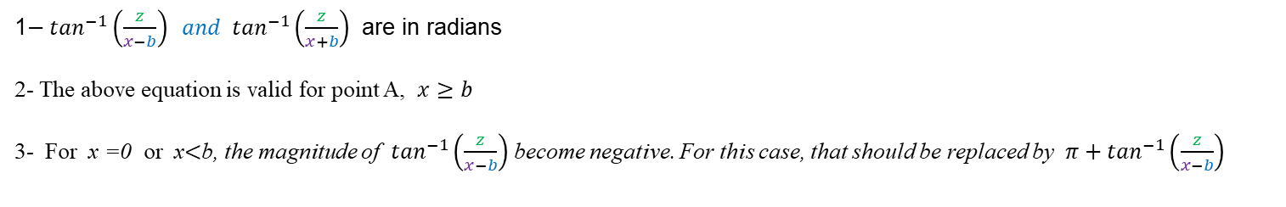

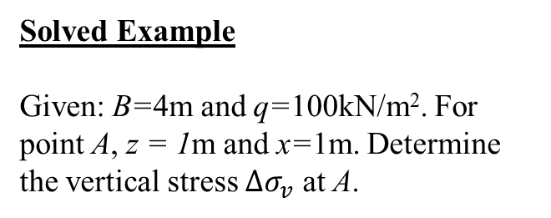
3- Strip Load of Infinite Length
${∆σ}_{v}$=$\left(\frac{q}{π}\right) \left[\tan^{−1}\left(\frac{z}{x−b}\right)− \tan^{−1}\left(\frac{z}{x+b}\right)−\frac{2bz \left(x^{2}−b^{2}−z^{2}\right)}{{\left(x^{2}−b^{2}+z^{2}\right)}^{2} + 4{ b}^{2}{ z}^{2}} \right]$
Note:
1$− \tan^{−1}\left(\frac{z}{x−b}\right) and \tan^{−1}\left(\frac{z}{x+b}\right)$ are in radians
2- The above equation is valid for point A, $x≥b$
3- For x =0 or x$<$b, the magnitude of $\tan^{−1}\left(\frac{z}{x−b}\right)$ become negative. For this case, that should be replaced by $π+\tan^{−1}\left(\frac{z}{x−b}\right)$
$$∞$$
Solved Example
Given: B=4m and q=100kN/m². For point A, z = 1m and x=1m. Determine the vertical stress $∆σ_{v}$ at A.
B = 2b
Strip Load of Infinite Length
q=100kN/m²
x
Z = 1m
A
X=1m
Z

Slide 24
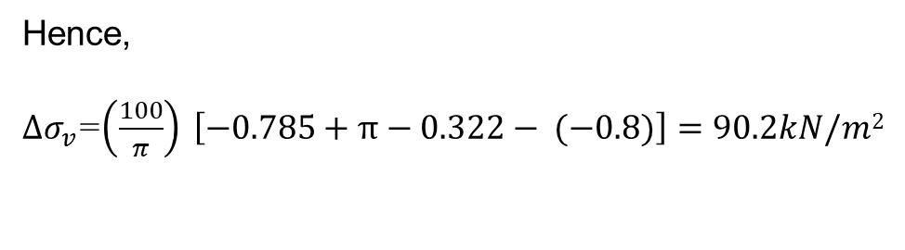
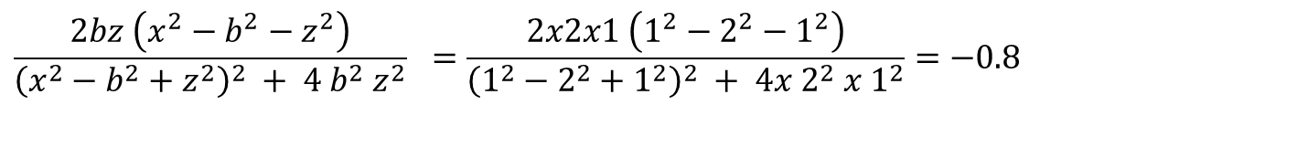
Solution
Since x=1m < b =2m
${∆σ}_{v}$=$\left(\frac{q}{π}\right) \left[\tan^{−1}\left(\frac{z}{x−b}\right)+π− \tan^{−1}\left(\frac{z}{x+b}\right)−\frac{2bz \left(x^{2}−b^{2}−z^{2}\right)}{{\left(x^{2}−b^{2}+z^{2}\right)}^{2} + 4{ b}^{2}{ z}^{2}} \right]$
$\tan^{−1}\left(\frac{z}{x−b} \right)= \tan^{−1}\left(\frac{1}{1−2}\right)=−{45}^{0}=−0.785 rad$
$$\tan^{−1}\left(\frac{z}{x−b}\right)=\tan^{−1}\left(\frac{1}{1+2}\right)={18.43}^{0}=0.322 rad$$
$$\frac{2bz \left(x^{2}−b^{2}−z^{2}\right)}{{\left(x^{2}−b^{2}+z^{2}\right)}^{2} + 4{ b}^{2}{ z}^{2}} =\frac{2x2x1 \left(1^{2}−2^{2}−1^{2}\right)}{{\left(1^{2}−2^{2}+1^{2}\right)}^{2} + 4{x 2}^{2}{ x 1}^{2}}=−0.8$$
Hence,
${∆σ}_{v}$=$\left(\frac{100}{π}\right) \left[−0.785+π−0.322−\text{ (−0.8)}\right]=90.2kN/m2$

Slide 25


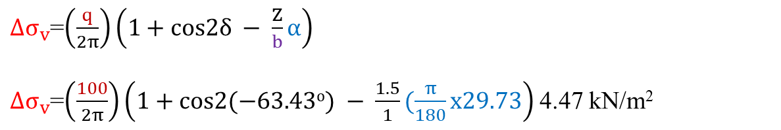
Solved Example
Foe linearly increasing vertical loading on an infinite Strip,
Given:
B = 2m; q = 100kN/m².
Find:
the vertical stress Δσ_{v} at A (x = -1m, z =1.5m)
Solution:
1- Find δ and α
δ = − 63.43^{ο}
α = 29.73^{ο}
$$∞$$
q=100 kN/m²
X=-1m
x
$${∆σ}_{v}$$
R₁
B=2b
Z= 1.5m
δ
α
R₂
A(-1, 1.5)
z
${∆σ}_{v}$=$\left(\frac{q}{2π}\right)\left(1+cos2δ − \frac{Z}{b}α\right)$
${∆σ}_{v}$=$\left(\frac{100}{2π}\right)\left(1+cos2(−63.43o) − \frac{1.5}{1}(\frac{π}{180}x29.73\right)$ 4.47 kN/m²

