Slide 1
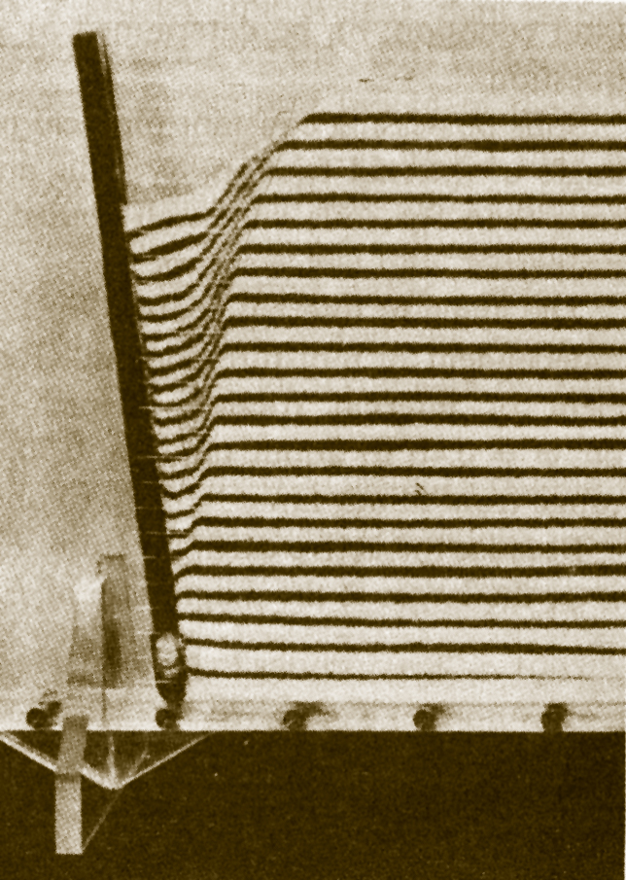
Geotechnical Design
CEG 4801
Fall 2010
By: Dr. Kamal Tawfiq
Earth Pressure Behind Retaining Wall

Slide 2
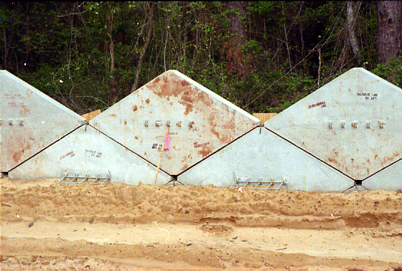
Geotechnical Design
CEG 4801
Fall 2004
By: Dr. Kamal Tawfiq
Mechanically Stabilized Earth Wall (MSE Wall)

Slide 3
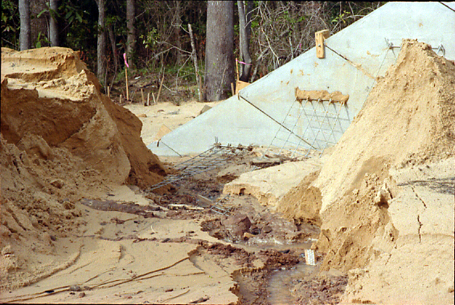
Mechanically Stabilized Earth Wall (MSE Wall)

Slide 4
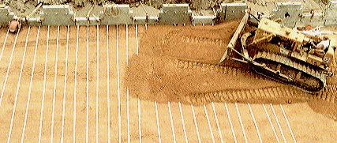
Mechanically Stabilized Earth Wall (MSE Wall)

Slide 5
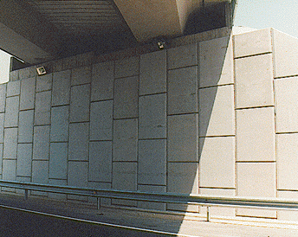
Mechanically Stabilized Earth Wall (MSE Wall)

Slide 6
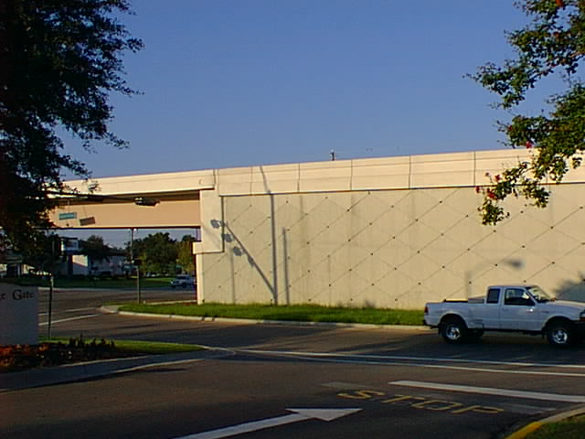
Mechanically Stabilized Earth Wall (MSE Wall)

Slide 7
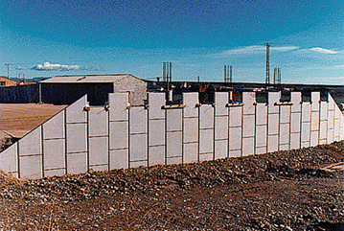
Mechanically Stabilized Earth Wall (MSE Wall)

